Slide 1
Software developments (close to federated infrastructures)
Liliana Teodorescu
Mohammad Al-Turany
Guenter Duckeck
Tommaso Boccali

Slide 2
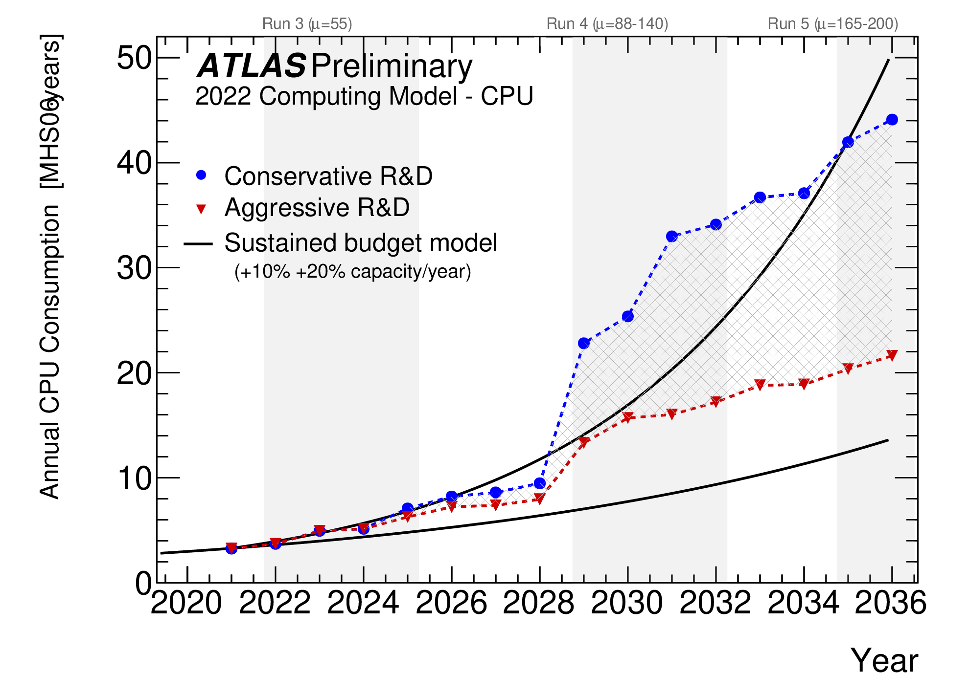
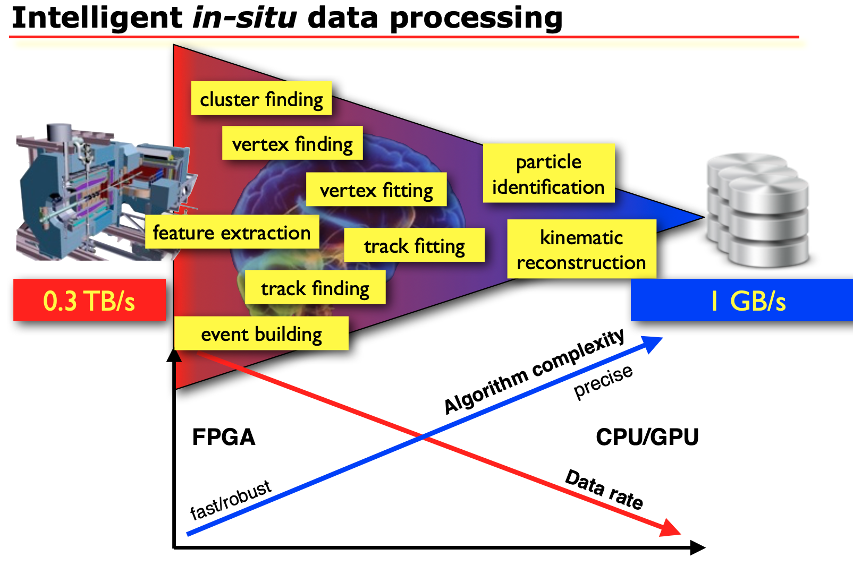
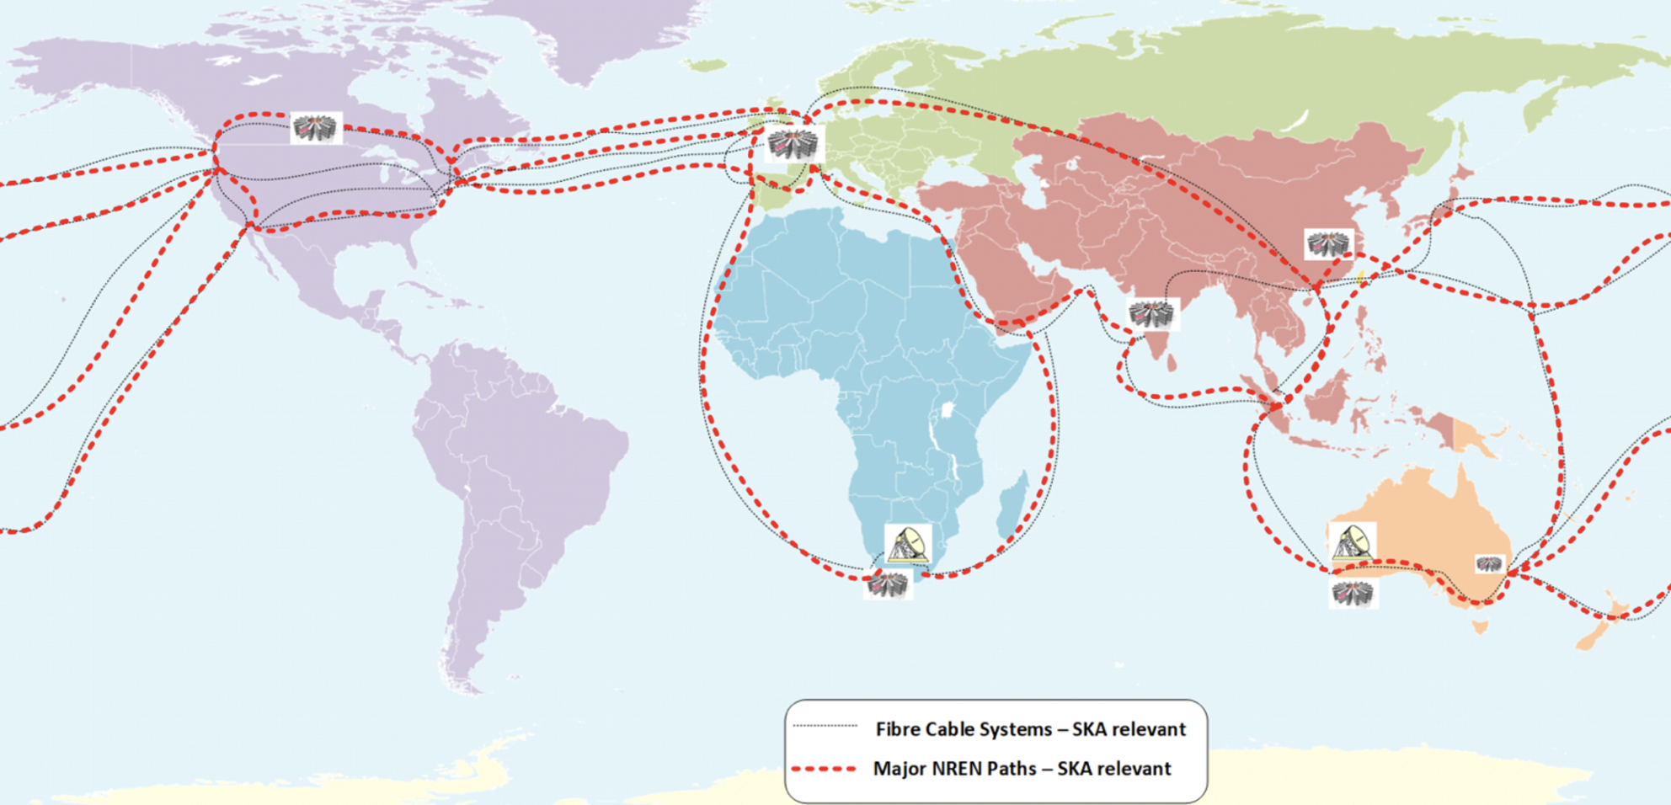
Introduction
We saw yesterday the computing challenges of current/next-generation experiments in the domains of ENA - including sw aspects
We saw solutions being developed, deployed and tested in the various experiments
Can the “J” in JENA have a role?

Slide 3
Aspects relevant for ”Software developments (close to federated infrastructures)”
Common SW tools
Docker, GitHub, …
AAI, Accounting, ticketing, …
Data Management, Workload Management, sw distribution, …
ROOT, Geant, Corsika, MC Generation codes, …
Choice of programming languages / programming frameworks
C++ as workhorse, Python for users?
R? Julia?
...
Role of ML/DL
Approach to heterogeneous computing in sw
Scaling to the Exascale
Sustainability
(Long Term) Data & Environment preservation
Opendata
Governance
Interoperability
Training
… ???

Slide 4
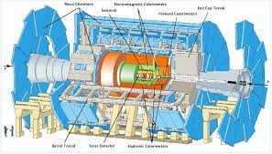
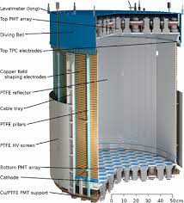
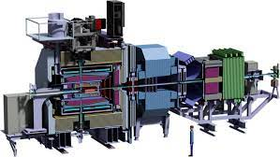
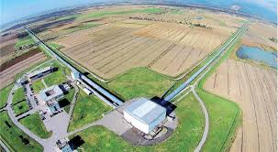
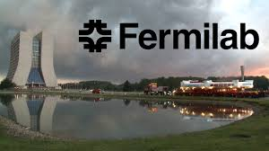
Who are the major actors today?
Experiments: each and every one has “the best” solution; based on some open or not toolset
Large Labs as stakeholders of general solutions (remember Scientific Linux CERN?) or initiatives which have become wider (WLCG)
EU/US/national/… projects propose(d) solutions valid for specific domains
Indigo-DataCloud, IRIS-HEP, Excalibur, ICSC, SWIFT-Hep, ESCAPE, …
Bodies like HSF

Slide 5
What we propose for today
Go point by point, and collect opinions from the panel and more importantly from the domain experts in the public
Find commonalities / differences in ENA domains
(some of these points can be suggested for a working group?)

Slide 6
List of topics to be removed at the end
Services (DM, WM, ….)
Scaling to O(1e6) nodes
Software distribution
(long term) data & environment preservation / Tommaso
opendata?
Common software tools
Processing Frameworks
Heterogeneous computing / Tommaso
Sustainability / Tommaso
Programming languages
Machine learning / Tommaso
Interoperability
Fault Tolerance and Resilience
Governance and Collaboration

Slide 7
Heterogeneous computing
In the timeframe of < 10 years, we expect to see systems based on different solutions wrt Intel-x86 to be available to our processing (access to HPC, Cloud, or simply because every CPU will have embedded GPUs, neural engines, FPGA, etc)
Can we afford writing specialized code for multiple architectures?
Is there a better solution? Do we want to try a domain level approach?
What should we do to be prepared?
How can we do a proper matchmaking code → resource in a vastly diverse system landscape?

Slide 8
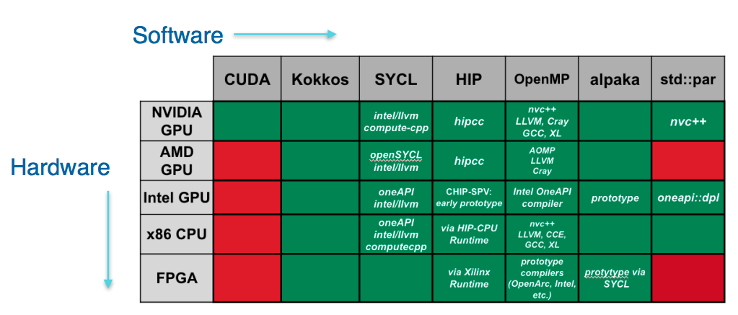
Heterogeneous computing #2
Possible solutions
“We” continue developing for one reference architecture, and we port to a second (a third …) only when there is an advantage (value of resources > cost of the porting)
“We” try to embrace per experiment a forward looking solution which “ensures” the capability to execute on multiple platforms
“We” as an enlarged domain try to select one / a few relevant technologies which “ensures” the capability to execute on multiple platforms
Legget et al, CHEP 2023

Slide 9
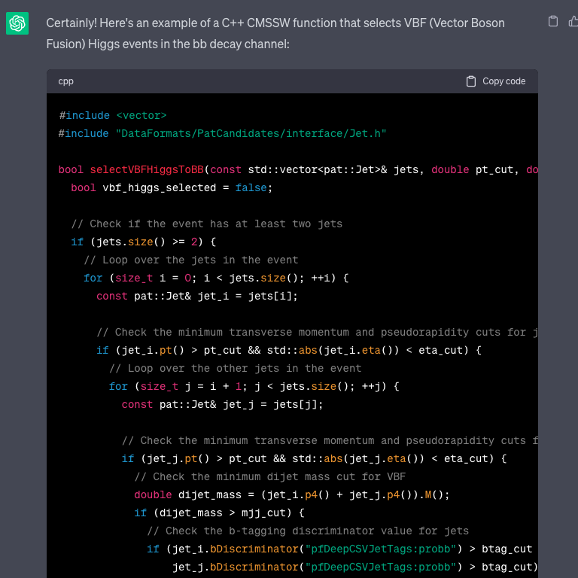
Programming languages
Tension between “mission critical codes” (C++/CUDA/…?) and “user friendliness” (Python/R/…?).
Are we bound to have 2 (more or less integrated) ecosystems?
Who will write the mission critical parts if users only know the latter?
Trained by whom?
Is this kind of problem going to become moot with ChatGPT?

Slide 10
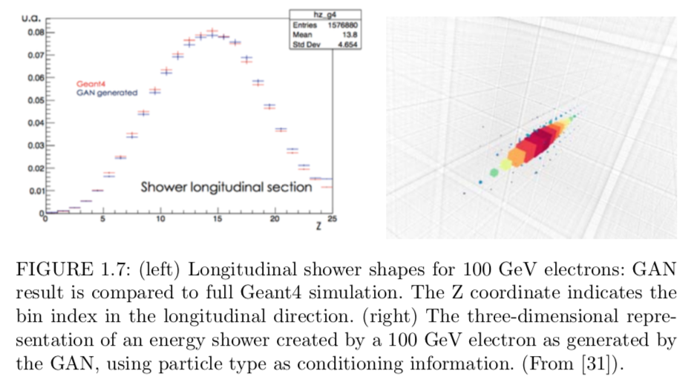
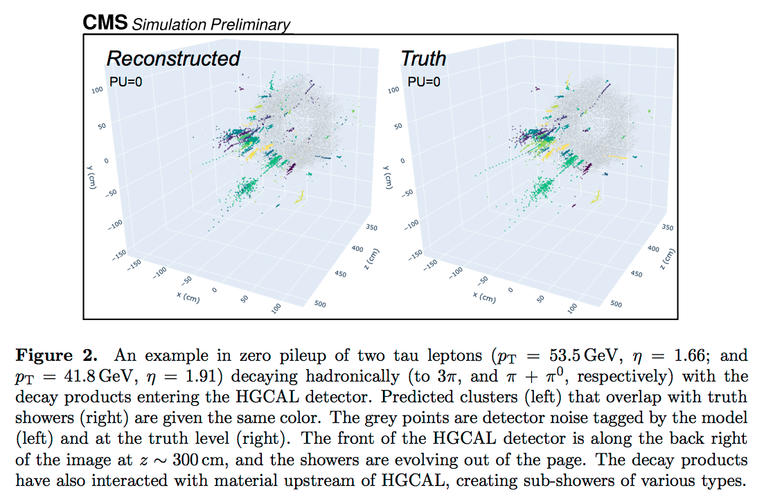
Machine Learning / Deep Learning
Carminati et al, 2018
We do not know yet the extent of ML/DL utilization in 10 years from now.
Can be ~now (a few algorithms explicit coding → ML) or far more (end-to-end approach from RAW data to Analysis data, GANs used for most realistic-like simulation).
How ready are “we” for the transition?
Personnel, knowledge, trust, …
How to handle ML training?
Do we have the technology to handle large distribute training? In which facilities?
We depend on sw stacks not in our control (Tensorflow, Pytorch, Keras)... is this a problem?
Bhattacharya et al, 2021

Slide 11
Possible solutions
ML utilization
Programmatically try and build an ML-twin of every (time consuming) algorithm?
How to perform validation? Is explainability in our radar?
ML needs in most cases a proper training set: we still need to keep maintaining standard codes; we cannot always compare with data!
We need foundational studies → party with CS friends (one example below …)
Training
Use HPCs for large scale training
Grants? Multi-year allocation through FAs?
Training facilities per experiment / per domain?
Remote access to GPUs?
(not really a sw issue, but sw needs to cope with this)
Training can be very CPU intensive
Can we share pre-trained models?

Slide 12
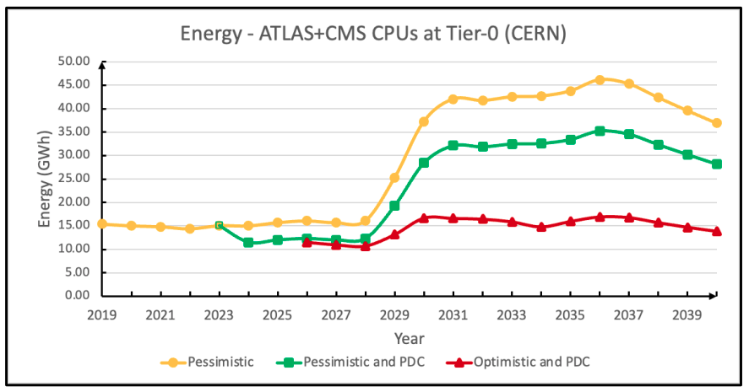
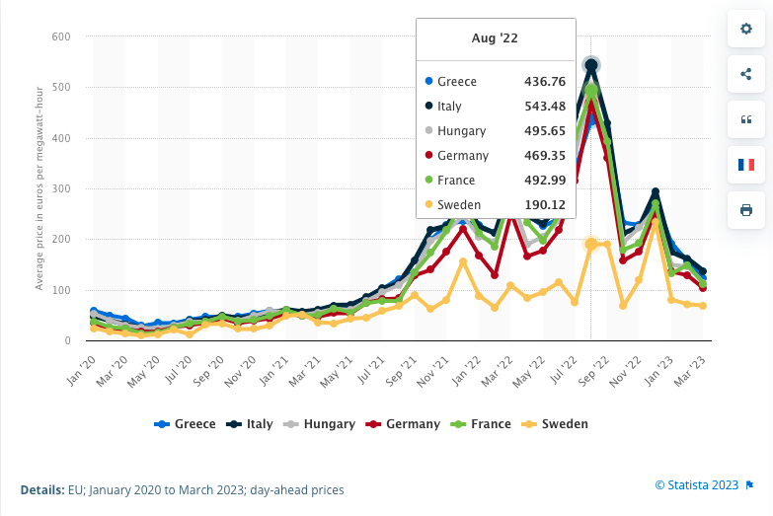
(enviromental) Sustainability
S. Campana, CHEP 2023
Let’s be frank, we (our computing) are huge offenders when speaking about footprint and consumption. Three directions can be chased:
Build better datacenters (better PUE; reuse of heat, …)
Optimize the processing (for example produce fewer simulated events, or perform fewer reprocessings, or use less precise algorithms)
Use fewer J/event (arch, language, …)
statista.com
Notes:
https://indico.jlab.org/event/459/contributions/11499/attachments/9236/14205/WLCGEnergyNeedsCHEP2023.pdf

Slide 13
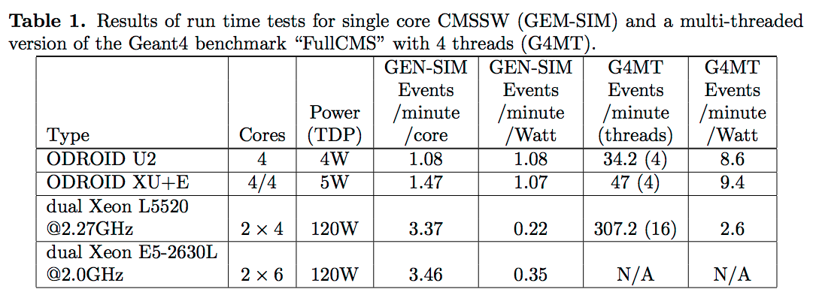
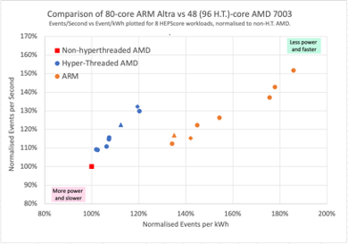
Use fewer J/event
Are we ready to port our code to lower power architectures? (back to the heterogeneous discussion…)
Are we ready to explicitly use power efficiency as a target when writing selecting algorithms? (for example: Python vs C++ vs Julia, ML vs code, AVX512 yes/no, FPGA yes/no, GPU yes/no)?
And if yes, do we have the tools to assess it?
How can this be exposed to FAs, in addition to “I need XXXX kHS06?”
Abdurachmanov et al, 2014
Britton et al, 2023

Slide 14
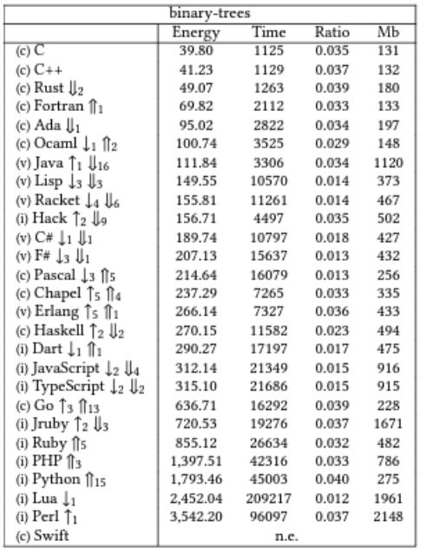
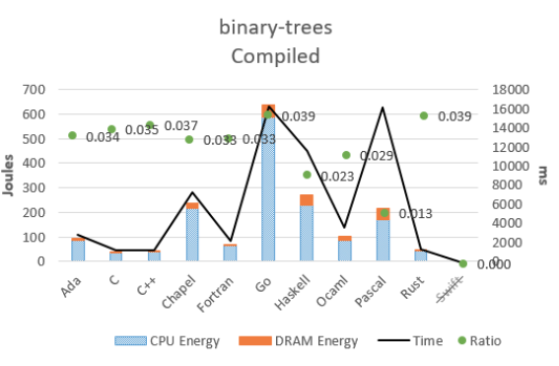
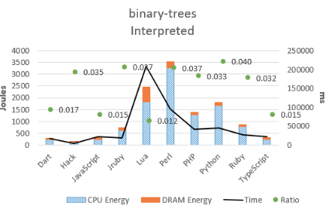
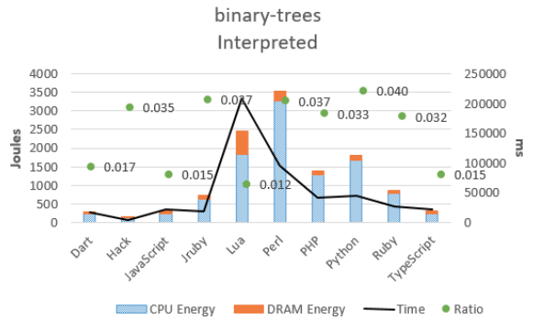
Joule sec Watt
Energy consumption per language

Slide 15
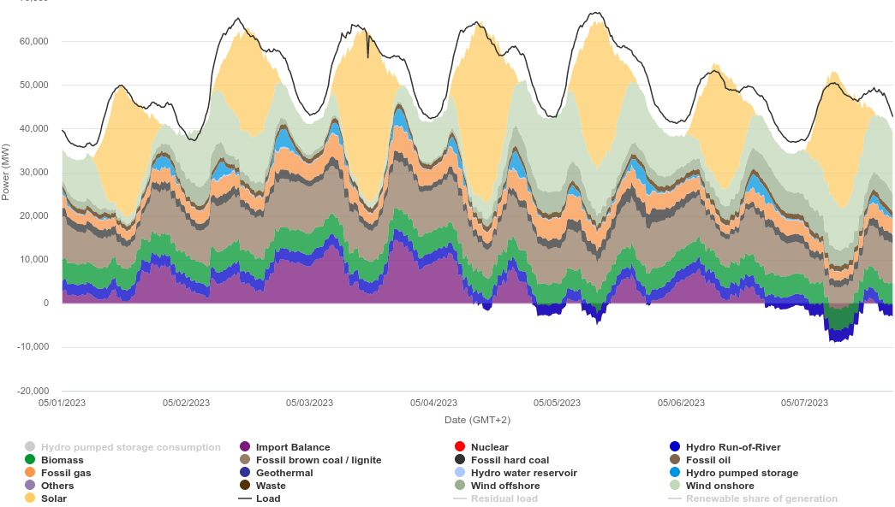
Env Sustainability - dynamic resource usage
There are promising concepts to synchronize data center operation with renewable energy availability or even co-locate data centers with renewable power stations
Most ENA workflows not time-critical – Tasks take days or weeks (unlike media streaming or social media)
CPU cycle adjustments most simple way to throttle power usage → effect limited
Options to stop and resume jobs (after ~hours) desirable
Currently such features largely lacking
“Checkpointing” fairly standard in HPC world
Would also help for pre-empt mode for opportunistic HPC usage
DE electricity mix and demand
https://www.energy-charts.info/
statista.com
Notes:
https://indico.jlab.org/event/459/contributions/11499/attachments/9236/14205/WLCGEnergyNeedsCHEP2023.pdf

Slide 16
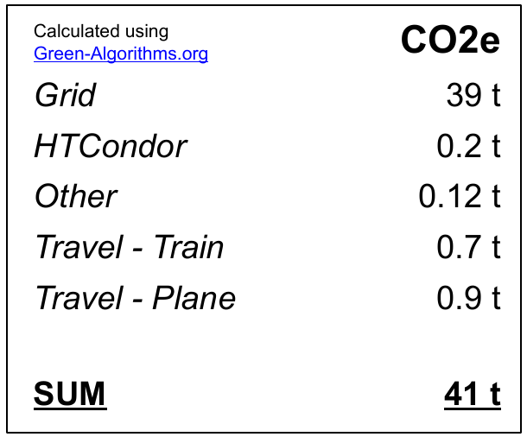
Env Sustainability - raise awareness
It is fairly standard to check energy consumption/CO2e footprint for all kind of activities (traveling, cars, heating, nutrition, …). For our S&C we largely lack easy-to-get information
Users should get estimates of power consumption/CO2e of jobs (data transfers?)
Same for production managers & physics coordinators
What is the footprint to start this 10 M event simulation task or the 2022 reprocessing, etc
Example from PhD student estimating footprint of PhD thesis
Notes:
https://indico.jlab.org/event/459/contributions/11499/attachments/9236/14205/WLCGEnergyNeedsCHEP2023.pdf

Slide 17
(Long term) data & analysis preservation
Our experiments’ value is in the data we collect. We need to make sure not only that it remains available for long (== we do not lose the bits), but that we can find it, access it, reuse it for repeated / novel analyses (FAiR).
This includes hardware (possibly virtualized), OSs, software, knowledge.
Is tape still the best solution long-term for bit preservation?
Are we confident that technically containers/VM + possibly low level virtualization can respond to all the technical needs?
Do we have realistic solutions for knowledge preservation?
What budget preservation costs comes from?

Slide 18
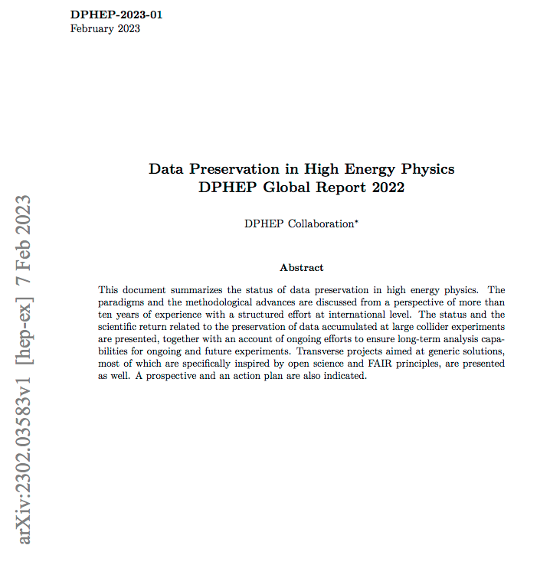
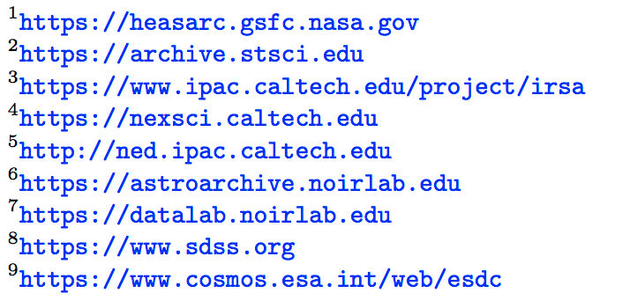
(Long term) data & analysis preservation #2
https://arxiv.org/pdf/2302.03583.pdf
The HEP community just released a report covering all the experiments in the last 40 years
Astro community is probably the most advanced
CERN has been offering a preservation service since some time
DP and Open Data as close siblings
Notes:
https://kcdc.ikp.kit.edu/ ???

Slide 19
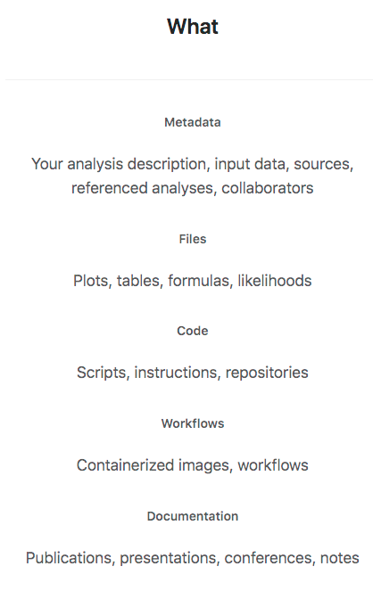
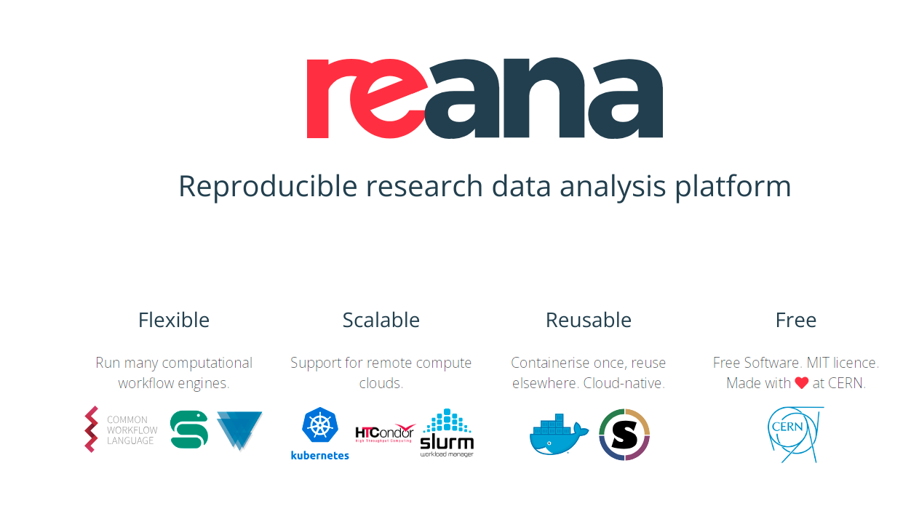
https://analysispreservation.cern.ch

Slide 20
Interoperability
Federated infrastructures typically involve different systems, platforms and technologies; How to ensure seamless integration and communication between various components?
Would “Open standards and protocols” help?
Tension between “our” standards (ROOT, GRID stack, …) and “industrial standards” (webdav, OpenStack, …) … are we ready to embrace the latter?

Slide 21
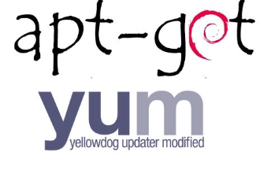
SW distribution
We depend on frequent and capillary distribution of software packages. In the past we moved from manual installations, to installation via jobs, via managed repositories (apt, yum, …), to bit-torrent. Now at least the largest collaborations seem to have found a stable solution with CVMFS
Do we have a solution which scales at the Exascale?
Are containers going to replace the need for software installation?
How to operate it in limited-network systems?

Slide 22
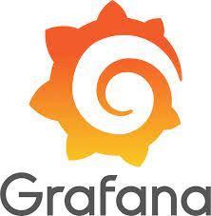
Common Software tools #1 - infra level
Some tools provide frameworks, libraries, and utilities that simplify the development process and address the unique challenges of working with distributed systems:
Containerization and Orchestration (e.g: Docker and Kubernetes)
Monitoring and Logging (Prometheus, Grafana and Kibana)
Security and Identity Management (Keycloak, Okta or Auth0)
Collaboration and Version control (Github and GitLab)
…
How can we be sure these evolve as we need?

Slide 23
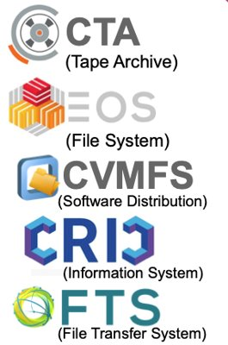
Common Software tools #2 - still close to infra but “from research”
AAI stacks, ticketing, accounting systems
Data Management and Workload Management
…
These are “from” our domains. Can we have them converge at the ENA level?
ESCAPE is a good example of such convergence. We should not lose momentum!

Slide 24
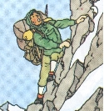
Common software #3 - closer to Physics
These include tools we “own”
ROOT, Geant4, Corsika, ..
MC generators, …
…
And tools we depend on
Tensorflow, Keras, ONNX, …
TBB, CUDA, …
…
Can we guarantee the support to the former? Are they evolving at the rate we need (GPU, new architectures, …)?
For the latter, which is the strategy?

Slide 25
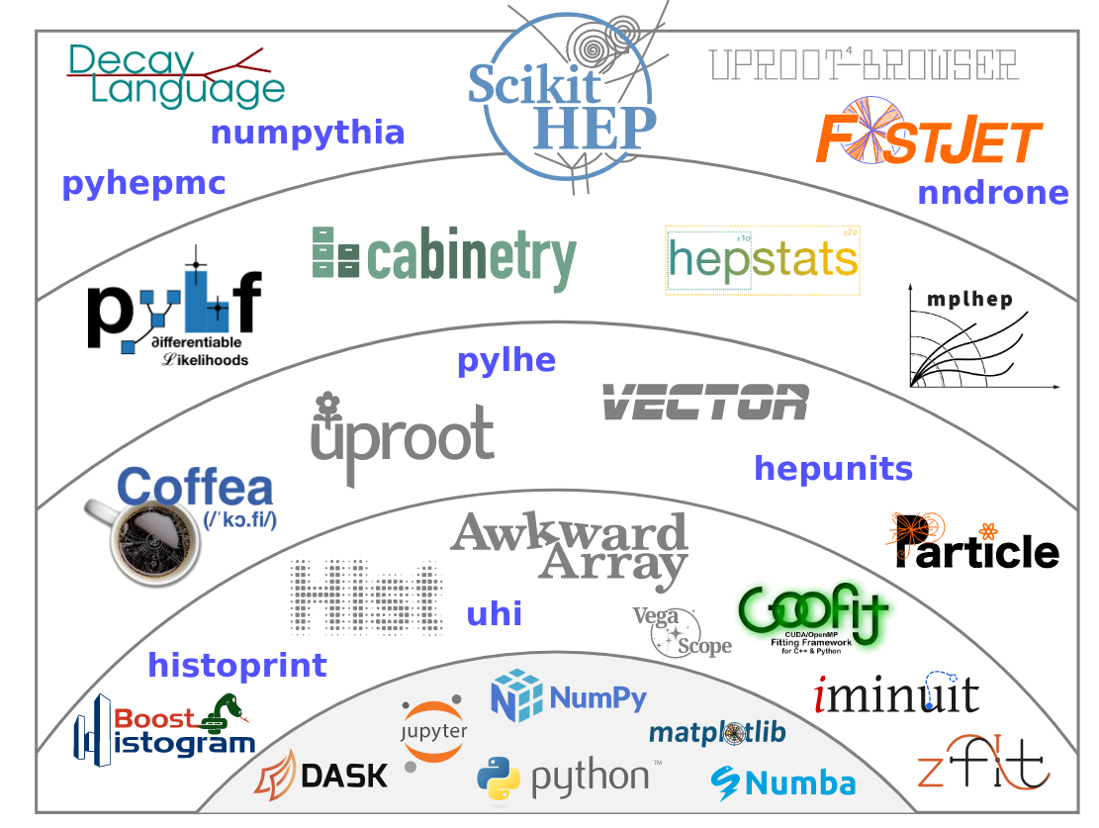
Common software #4 - Python eco system
eg Scikit-HEP, gammapy
Analysis tools and frameworks based on standard Python data science packages
Also basis for many ML packages
Clear advantage in teaching and training
communalities between communities?
Risks with long-term support?

Slide 26
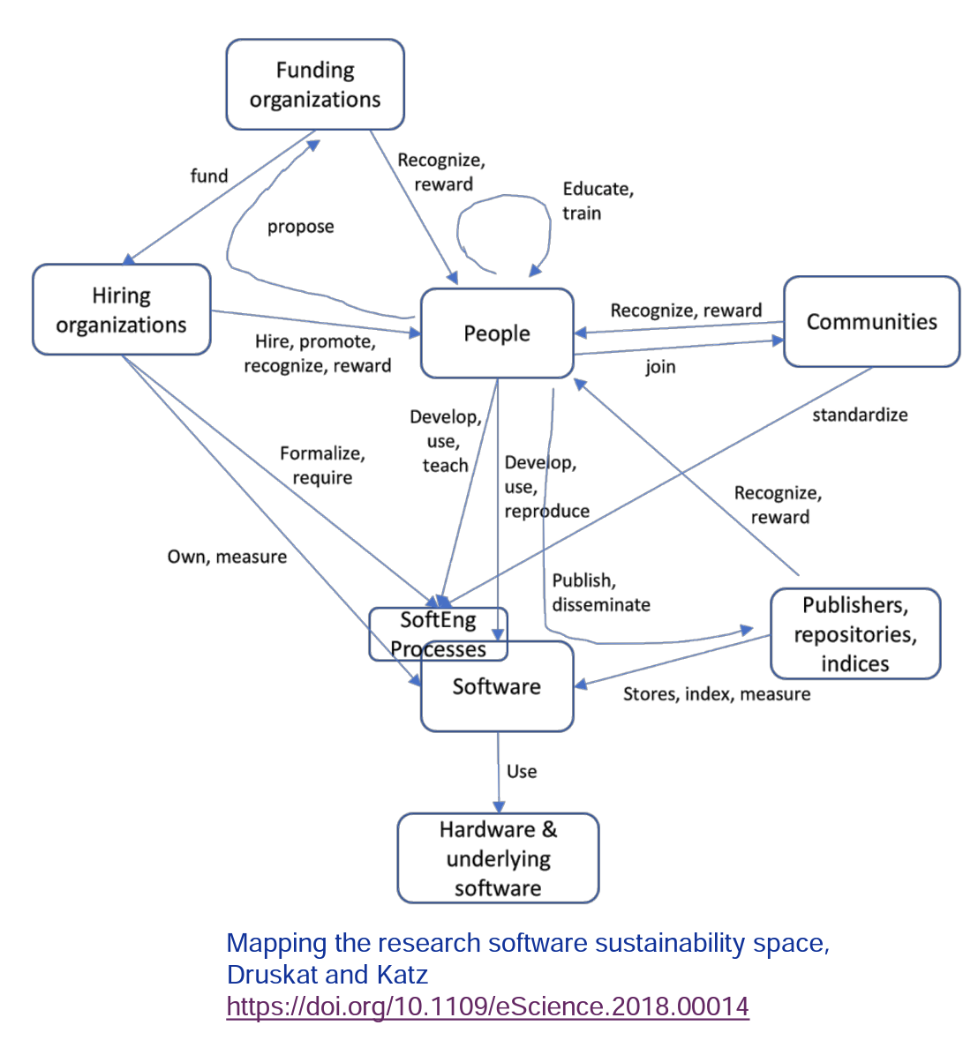
(sw) Sustainability
Stewart, JENAS 2022

Slide 27
Fault Tolerance and Resilience
Distributed systems are prone to failures and network disruptions, the infrastructure level software has to be Fault-tolerant and resilience by:
Incorporating redundancy, replication and error handling mechanisms
Implement strategies such as data replication, caching and load balancing
All should be at the infrastructure level (even at the NREN level?)
Do we have such tools? Is the “datalake” concept going to solve all of this?

Slide 28
Governance and Collaboration
How to establish a clear governance model and collaboration mechanisms that ensure effective coordination, decision-making and communication among all parties
E.g: Define roles, responsibilities and protocols for managing the infrastructure and resolving conflicts
Is WLCG a starting point? Do we want to scale at ENA level?
It is sort of already happening in some cases: see Virgo, DUNE, JUNO, Belle-2, … and MoU with SKA
What for small(er) experiments?

