Slide 1
Small experiments perspectives Nuclear Physics example

Slide 2
Acknowledgements
Information based on Adrien Matta’s (LPC Caen) presentation at
ACAT (Advance Computing and Analysis Techniques in Physics) 2021
“Outlook on software framework in nuclear physics”
https://indico.cern.ch/event/855454/contributions/4623822/

Slide 3
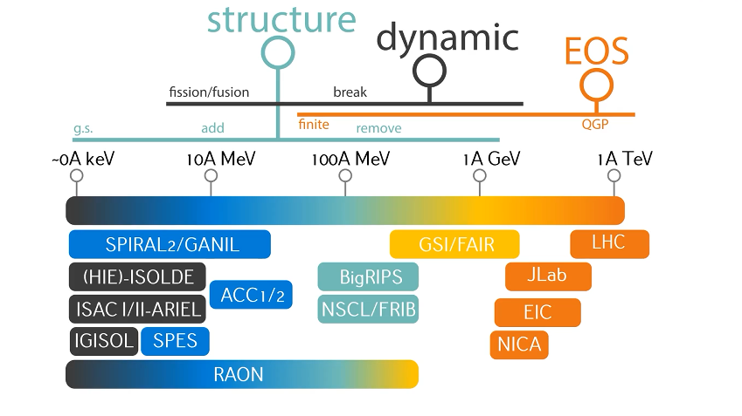
Nuclear Physics questions and facilities

Slide 4
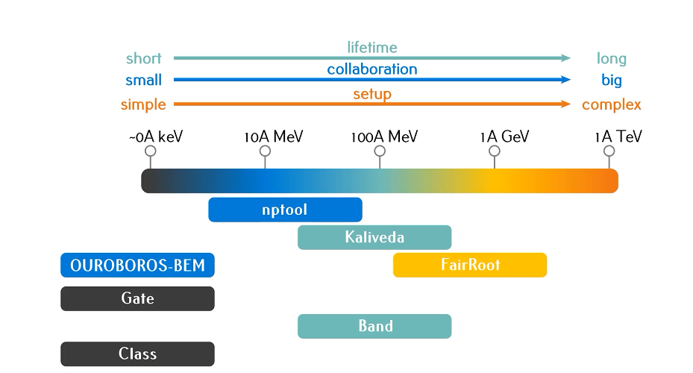
Experiments and software frameworks

Slide 5
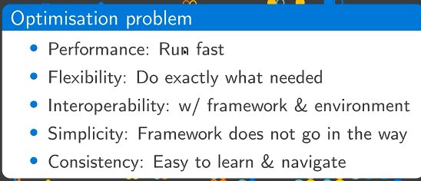
Requirements for software frameworks
Relative priority of what is
optimised is different for
different experiments =>
different frameworks
Experiment with 3 collaborations coming together
One big experiment => optimsed

Slide 6
Examples SW frameworks
Kalivera – for multifragmentation experiments
- entirely based on ROOT
- modular analysis
- performance, consistency, simplicity - essential
Nptool – for low energy NP experiments
- open source;
- modular design: detectors and event generators as plugin; tool box for tracking, nuclear data etc
- interoperability and simplicity - essential

Slide 7
Challenges
Diversity of communities – have to accommodate different needs
Open Science requirements
- need a change in working culture
- technical challenges
– how to keep the software to analyse past
data
- how to prepare the current data for future
use

Slide 8
Synergies with high energy experiments
- Common software as ROOT, GEANT
- Software preparation for new hardware platforms
(e.g GPU needed for some parts of analysis even for small experiments)
- Preparation for open science/data
- common data formats – are they possible?

