Slide 1
Federation
JENA Workshop
Bologna
13th June 2023
David Britton GridPP Project Leader
University of Glasgow

Slide 2
Questions
What does Federation mean?
What can we Federate?
Why would we Federate?
How can we Federate?

Slide 3
What is a Federated Architecture?
Wikipedia: Federated architecture […] allows interoperability and information sharing between semi-autonomous de-centrally organized lines of business, information technology systems and applications.
From a business perspective, data is increasingly subject to constraints on geographic location and access, so the compute is increasingly moved to the data: “Federated computing”.
The business benefits of federation are expressed as: ”Being as independent as possible from a global authority such as a central computer system, central organisation, central management system”, because it enables:
Lifecycle independence: no complex coordination needed for product evolution.
Operational independence: components can be fixed without relying on others.
Platform independence: Freedom to optimise individual components.
WLCG would recognise much of this.

Slide 4
Federation
vs Consolidation
Federation: The act of uniting smaller or more localized entities to create a larger entity for mutual benefit, with an agreed mixture of common policies and local autonomy.
Consolidation: The act of reducing the number of entities by dissolution of existing ones and creation of a single larger entity.
Some of the steps towards Federation and Consolidation are the same (unification actions), but some of the end results are diametrically opposite.

Slide 5
Why Federation and not Consolidation ?
Federation allows composition of new solutions out of existing investment (but you can only rearrange the building blocks if you still have the building blocks).
Federation enables decision making to be devolved “down” the hierarchy to where it best sits, improving choices and protecting against domination of one community or voice to the detriment of the rest.
Federation can empower communities in a way that consolidation does not. All these elements become particularly important as the scale grows.
Federation encourages diversity, of ideas, solutions, and people. It can protect against “group think” and stagnation, and can provide resilience against single points of failure – both geographical and technological.
Federation enables low risk evaluation and testing of “future” technologies, in particular where they are driven by specific well motivated communities that would otherwise be overlooked or dismissed by a large scale operation with a consolidated approach.
Federation allows smaller operations to benefit from the full scale of the federation. E.g., security, identity management, accounting and allocation; but also in the building of larger communities to share ideas and solutions.
Federation allows leveraging of local resources that otherwise would not be available.

Slide 6
What can we Federate?
Storage
WLCG: federates data within a domain (experiment) to reduce number of copies (saves cost and energy).
Astronomy: perhaps also across domains for multi-messenger studies.
Nuclear: federated data is part of the FAIR principle.
Escape data lake: Federates data (within a domain) globally.
Can also share the storage hardware and service, independent of the data that it is used to store… as long as the QOS is appropriate.
Compute
WLCG: Within and across many HEP (and some other) domain.
BUT do impose common requirements (e.g 2GB/core).
For large users groups, dedicated compute that is optimised for a specific set of tasks, may be better if it will be kept fully used.

Slide 7
What can we Federate?
Federated Software and Services
Agree policies, interfaces, common tools, common services.
Security; AAI; Accounting; Data management & transfer; Software distribution; etc.
Networking
This already is a combination of shared (eg LHCOPN) and federated infrastructure (NRENS).

Slide 8
Federation Benefits (1)?
Cost benefits?
Ensure hardware is fully used? Not really an issue for big projects like WLCG and, eventually, SKA. Perhaps for collections of smaller projects?
Reduced operational costs? Certainly from federating services and software.
Reduces costs of developing and deploying new domain-specific, but similar, infrastructures where there is close alignment of requirements.
Leverage! Federation enables contributions from many sources.

Slide 9
Federation Benefits (2)?
Quality benefits?
Clearly can be benefits if federating software and services results in well-supported “best-of-breed” products (e.g. Security infrastructure).
Access benefits?
Broaden access and reduce barriers to entry with a consistent and streamlined user experience;
Support structures; Ability to scale easily.
Hearts and Minds!
With appropriate guiding structures, an infrastructure owned by its users can be more effective and agile. Users take more ownership. It changes “this isn’t good enough” into “how can we improve this?”

Slide 10
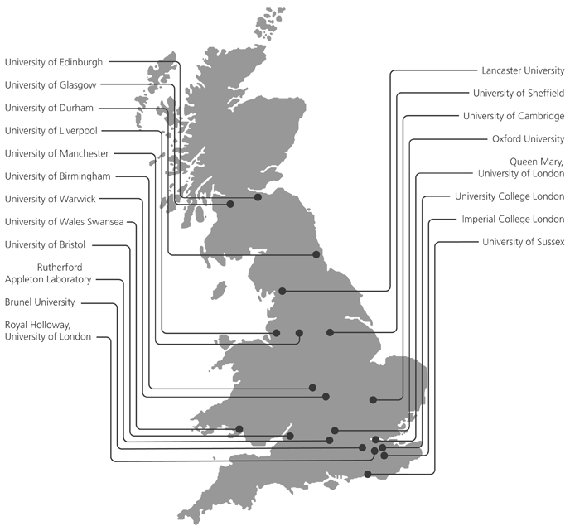
UK PPAN* e-Infrastructure
*PPAN = Particle Physics, Astronomy and Nuclear
GridPP (UK Computing for HEP+): Federates the RAL Tier-1 and 16 Tier-2 sites as part of the Worldwide LHC Computing Grid global federated infrastructure.
IRIS (UK Computing for non-HEP PPAN science):
IRIS does NOT run infrastructure but provides funding for, and coordinates access (gives allocations) across, hardware infrastructures run by:
GridPP (Grid computing)
DiRAC (various types of HPC systems for STFC Theory communities)
The STFC Scientific Computing Department (Cloud and Software services).
IRIS was built on the concept of “federation, where it makes sense to do so.”
ScotGrid
NorthGrid
London
SouthGrid

Slide 11
(A) Federation Vision
Recognise that communities need gateway projects that worry about the (evolving) complexity for them.
Other PPAN IRIS
Share software and services where it makes sense to do so (minimises costs; maximises quality)
Community specific Gateways
SKA
?
Theory DiRAC
HEP GridPP
APEL??
Federated Services
RUCIO/FTS
AAI?
Network monitor?
?
SOC
?
Physical Infrastructure
DiRAC HPC
SCD Cloud etc
GridPP
HTC
SKA
Optimise hardware for the tasks (minimises costs and energy use)
Federated Data and Compute
Federated access and accounting

