Slide 1
ESCAPE in the EU frameworks: advancing Open Science to the next level
Giovanni Lamanna
LAPP, Laboratoire d’Annecy de Physique des Particules, CNRS-IN2P3
JENA workshop - 12th June 2023

Slide 2
Outline
The European Commission’s outlook on the future of the European Open Science Cloud (EOSC) ^{(*)}
The “Science Cluster” synergy
The domain-based plans: the ESCAPE Open Collaboration
Views about “the next level” of Open Science in Europe.
(*) Content adapted from EC DG R&I communications and from EOSC Future programme
Giovanni Lamanna

Slide 3
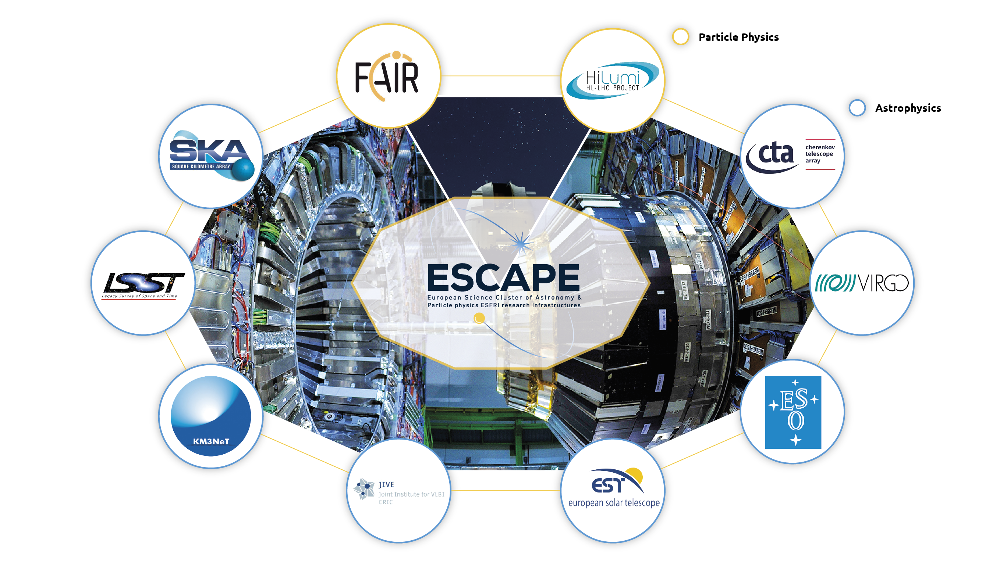
ESCAPE (ESFRI and other world-class) RIs
/ Nuclear Physics
/ Astroparticle Physics
Giovanni Lamanna

Slide 5
European Research Data Landscape
EC-funded study ‘European Research Data Landscape’ Undertaken from June 2021 to July 2022
Research data depositing
40% of researchers occasionally store data in research data repositories; 22% respondents did that during the current/latest research activity
Researchers usually (60%) store data in personal physical data storage or institutional local data storage
FAIR aligned practices
>2/3s develop DMPs but other FAIR-aligned practices are less common
Allocating PIDs to data is the least common practice
Barriers to sharing research data
Time, effort & financial costs required for RDM and data sharing
Data protection and legal restrictions
Lack of recognition
Geographical coverage: EU Member States, Horizon 2020 Associated Countries, and the UK
All fields of science

Slide 6
EOSC support by the European Commission
Keeping the policy momentum
‘Open Science including EOSC’ fully embedded in the ERA Policy Agenda
EOSC as a sectoral data space of the European Strategy for Data
Support through the Horizon Europe programme
Implementation of Research Infrastructure Calls: direct EU investment in EOSC developments of up to €490 million
Including also procurement of EOSC managed services by the EC
Studies commissioned by the EC, e.g. the European Research Data Landscape study
Continued support to:
The EOSC governance: EOSC Steering Board, EOSC Partnership Board
EOSC engagement and coordination with ESFRI and eIRG
EOSC thematic demonstrators, e.g. the European Covid-19 Data Platform, the Blue Cloud, the ‘science clusters’
The monitoring of the uptake of Open Science and ‘EOSC readiness’

Slide 7
Enabling open science including through EOSC …
ERA Policy Action 1: “Enable the open sharing of knowledge and the re-use of research outputs, including through the development of the EOSC”
Deploy Open Science principles and identify Open Science best practices
Mainstreaming OS across national programmes, catalogue of OS practices, tools and services, data scientists and data stewards, national EOSC tripartite events …
Deploy the core components and services of EOSC and federate existing data infrastructures in Europe, working towards the interoperability of research data
Horizon Europe support to EOSC Partnership, connection of national/regional research infrastructures to EOSC federation, community frameworks for interoperability & quality control …
Establish a monitoring mechanism to collect data on investments, policies, digital research outputs, open science skills and infrastructure capacities related to EOSC
Co-development of EOSC national surveys, roll-out of key layers of monitoring mechanism …

Slide 8
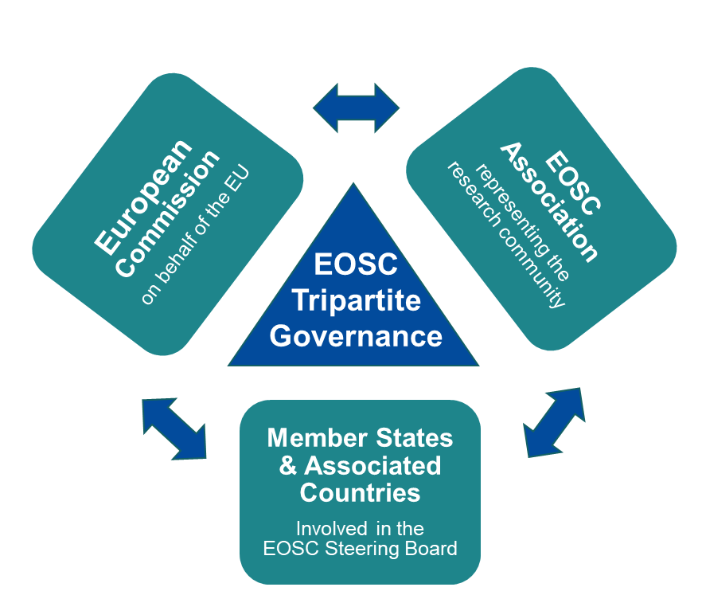
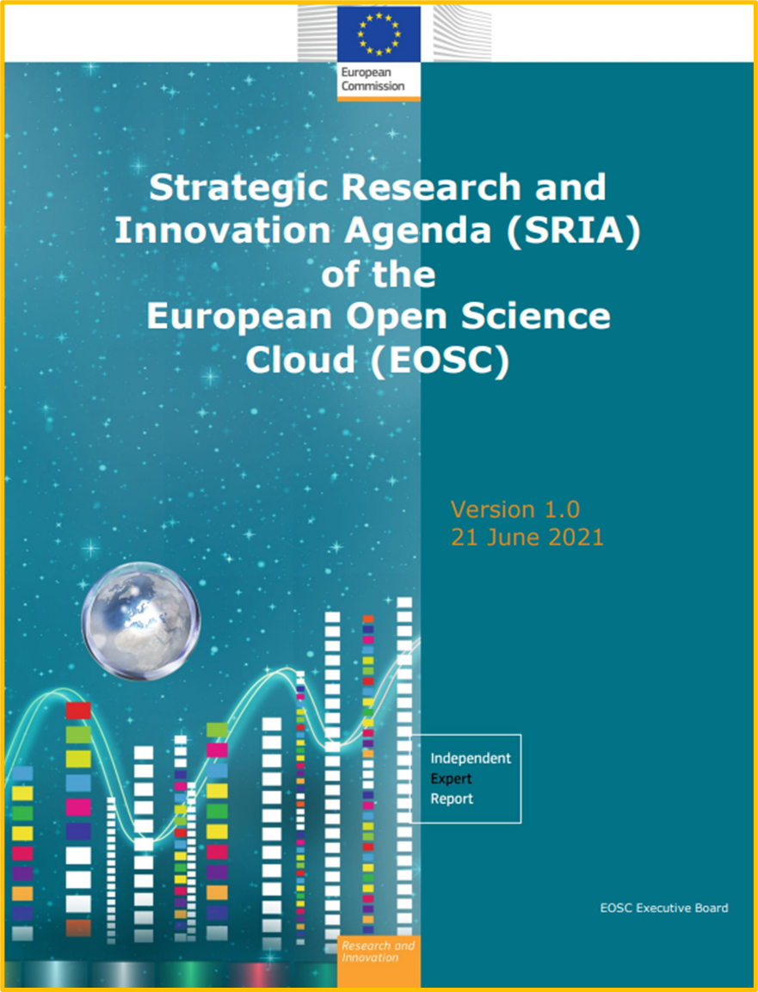
… Enabling open science including through EOSC
A community-driven process (commitments by EU Member States, Associated Countries, research stakeholders)
Gradual implementation based on mutual alignment and pooling of resources at European, national and institutional levels. Move from prototyping to operations
With direct support by:
EOSC European Co-programmed Partnership to pool commitments and resources along priorities set in the EOSC Strategic Research and Innovation Agenda
EOSC tripartite governance to ensure dialogue and strategic coordination between EC, EU Member States and Associated Countries, and EOSC Association

Slide 9
Open Science next steps: EOSC architecture
Towards a sustainable EOSC legal entity
A tripartite configuration
A data and service federation (operating “EOSC Core and Exchange”)
A System of Systems
Institutional resources.
National and regional bodies.
European (@ EC) authority and administration of horizontal services.
Science Clusters as the domain-based bodies -> operating vertical resources (… and ENA institutes taking over some community services for ESCAPE).

Slide 10
Broader synergies with other research clusters
https://science-clusters.eu/
Five thematic
Science Clusters
created under
INFRAEOSC-04-2018
(80% of ESFRI RIs)
https://www.projectescape.eu/sites/default/files/Escape_position_statement_web.pdf
https://zenodo.org/record/3675081 - .X2R2PJNLhTY
https://indico.in2p3.fr/event/24327/
https://zenodo.org/record/4889503
Giovanni Lamanna

Slide 11
ESCAPE and the other Science Clusters in Europe
Acknowledged as a successful approach in “Making Science Happen”,
“Consolidation of The European RI Landscape” as well as an example of scheme for new coordinated focus by ESFRI.
Giovanni Lamanna

Slide 12
“Embracing open science” by EC (and ESCAPE)
Improving the practice
Providing full and immediate open access to scientific publications, research data, models, algorithms, software, protocols, notebooks, workflows, and all other research outputs
Research output management - publications, data, and other outputs - in line with FAIR principles
Early and open sharing of research, e.g.
Pre-registration, registered reports, data deposition in shared repositories, pre-prints
Ensuring verifiability and reproducibility of research outputs
Open collaboration within science and with other knowledge producers/users, incl. citizens, civil society and end users
Developing the enablers
Incentives and rewards to adopt open science practices, e.g. initiative for Reforming Research Assessment
Legislative and regulatory framework for practicing open science
An EU data, copyright and digital legislative framework fit for research
Horizon Europe provisions on Open Access and Open Science practices
Open research infrastructures and skills e.g.
European Open Science Cloud (EOSC) virtual research environment
Open Research Europe (ORE) open access publishing service
Support for skills and education for practicing open science & data-intensive research

Slide 13
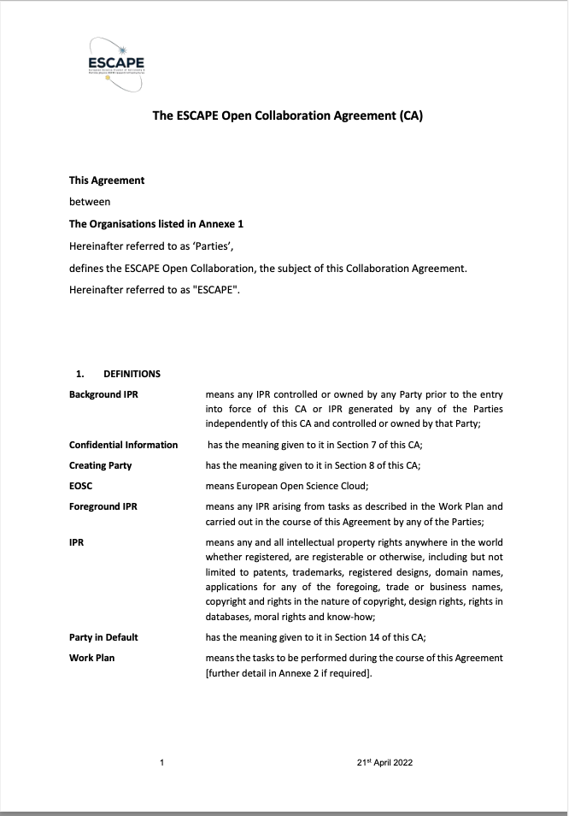
Outlook for Science Clusters
The 5 Science Cluster projects are ending
However, synergies between them have been significant, and collaborative activity is increasing
Recently, all of the 5 have put in place long-term structures – through MoU or Collaboration Agreement
E.g. ESCAPE has Collaboration Agreement signed by Directors of all the partner RIs
→ ESCAPE Open Collaboration
The Clusters have a common position and agree: they want to have effective mechanisms to enable cross cluster/cross-domain collaborations
but not an additional layer of governance
Giovanni Lamanna

Slide 14
What will partners work on?
On topics that they would anyway work on, but now as a collaborative activity
Better and more use cases → robustness, bigger user community, testing, support, …
Don't invent new tasks - unless there is a clear overall benefit to the community
Share and build expertise
Pool resources for developments, training, support, etc.
Software artefacts should follow normal open source model,
collaborative and open, no particular support implications
Don’t expect all RIs to run services for each other,
perhaps AAI, OSSR could be community services, otherwise most likely separate instances.
Use common tools, but not same instance of services
Giovanni Lamanna

Slide 15
A work plan for the future of the Science Clusters
There is a prompt need and opportunity to support the Science Clusters further (in 2022-2025) within Horizon Europe framework
H2020 and potential Horizon Europe funded actions (aligned with the EOSC-SRIA Stage2 -to- Stage3)
General Objectives (GO):
- consolidation of thematic data infrastructures (cluster VREs, platforms and a “few core services”) as parts of a federation.
Specific Objectives (SO):
- relevant scientific results from clusters;
- increased number of RIs;
- enhance researchers uptake of OS and widening dimension.
Operational Objectives (OO):
- sustainable operation of the deployed cluster as a “platform infrastructure”;
- continuous promotion, extension and hosting of inter-domain FAIR Science Projects (new Open Science Objectives).
Science Cluster GO
H2020 Cluster projects
EOSC-Future
Science Cluster SO
Science Cluster OO
2021
2022
2023
2024
2025
2026
2027
EOSC-SRIA Stage2 Stage3

Slide 16
Broader synergies with other research clusters
A common work programme that the five Science Clusters together shared and published in June 2021, structured according to two pillars:
Pillar A – Consolidate clusters and strengthen inter-cluster common data services co-development.
Some of the most successful achievements of the Science Cluster projects are the key data services within EOSC for “data provision, discovery, and exploitation”, e.g., catalogues, analysis platforms, FAIR data archiving, solving research communities/themes challenges. There is a clear need to support the community-based consolidation of individual cluster services, as well as fulfilling the reference role of the Science Clusters at pan-European level, to foster inter-cluster projects.
Pillar B - Delivering content to EOSC and demonstrating its impact on science.
The five Science Clusters, while consolidating their thematic data infrastructures, commit to target and pursue some specific scientific objectives producing Open Science results. This will happen by increasing the number of involved RIs in each cluster, enhancing the researchers’ uptake of Open Science, and mentoring new impactful trans-RI science projects. This approach is also inspired by the success achieved with Test Science Projects within EOSC Future.
New proposals within Horizon Europe aim at supporting both pillars …

Slide 17
Consolidating role of Science Clusters
Leverage successful training schemes developed by Science Clusters to target new cross-domain approaches.
Start complementary Community-based Competence Centres (CCC) focusing on pre-existing and established data-stewardship practices, as well as domain-based expertise.
The ESCAPE data-lake service will be extended to further RIs and other science clusters.
The “data management” will be one major “competence” to be leveraged in a dedicated community-based competence centre and will be made available in an interdisciplinary manner.

Slide 18
Consolidating role of Science Clusters
The catalogue of software will continue to be populated with new collaborative cross-border software, workflows and methods and for the benefit of the community at large.
Development of community-based approaches for ensuring and improving quality of scientific software and code
Framework for community curation across disciplines
Limited scope for innovation or development
But highly relevant to all clusters: examples of previous work HSF, SIDIS, software carpentries, training materials and schools, career development of young scientists specialising in software and computing

Slide 19
Consolidating role of Science Clusters
Together with services for data analysis, the Science Clusters will foster the composability of services explored by ESCAPE with the deployed ESFRI RI-specific “analysis platforms”, as well as a prototype integrated Virtual Research Environment (VRE), currently under construction in EOSC Future and conceived to host dedicated Test Science Projects.

Slide 20
Enhancing EOSC scientific content
According to Pillar B, the Science Clusters together would manage financial support (with cascading grants) to third parties with a primary aim of enabling cross-RI and/or cross-domain Open Science Projects and Services (OSPS).
All funded OSPS are expected to “build on the science cluster approach to ensure the uptake of EOSC”. Therefore, they are expected to participate in the consolidation of FAIR services of the five Science Clusters and, more broadly, to perform excellent science and pursue societal benefits by leveraging an Open Research approach.

Slide 21
ESCAPE for a thematic coverage for new goals
Preparation of common strategies for future development of RI technologies and services within broad RI communities. Namely,
Analysis of technology needs and service gaps in European research infrastructures at strategic level;
Common long-term strategies for development of technologies and services in pan-European Research Infrastructures;
ESCAPE would totally rely on ENAA roadmaps.
ESCAPE to facilitate the actions, ensure appropriate thematic coverage of the RI landscape, foster a coordinated development of common roadmaps, reducing the risk of overlaps between future services, and improve the division of tasks among research infrastructures.

Slide 22
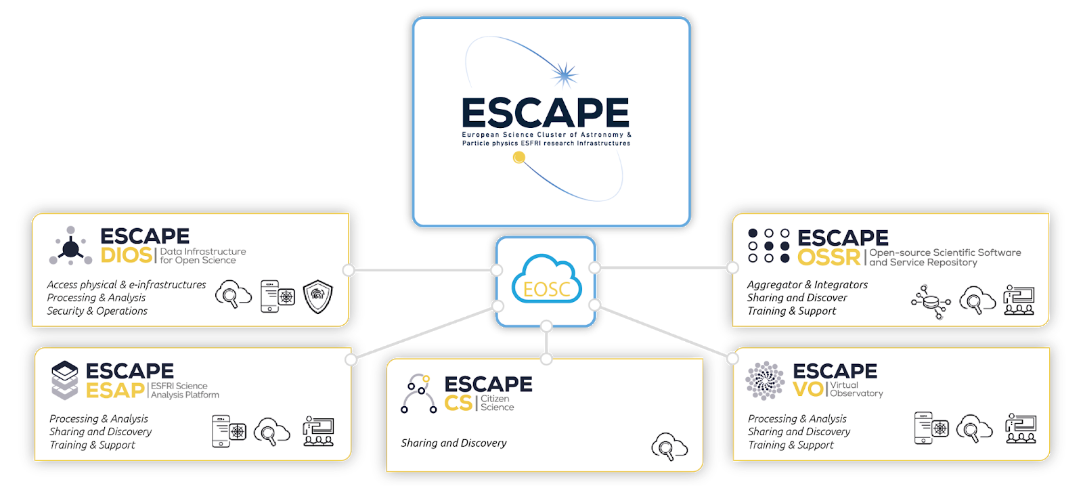
The new ESCAPE Collaboration work programme
Entities
CC
Operating the community-based “Competence Center” for EOSC-alignment, train and support, extended outreach, financial model for services and networking with other SCL-CCs
EVSI
R&I for an “European Virtual Institute for Research Software” for advanced technologies
VRE services
Programmes
COSO
Challenging “Open Science Objectives” by RI commitments in Open Science Projects (OSP) as well as Cross-Cluster Open Science Projects (COSP)
TECH
Bring the FAIRness within technology, R&D and innovation projects as well as explore new “close-to-sensors” low-latency open-data science
CARS
Career development and rewarding for researcher committing in Open Science. Planning, tracking, and assessing scientific knowledge production
SDSS
Building synergies on “Sector Data Spaces” for Society: Green deal, Health, Manufacturing, Education and Skills
Giovanni Lamanna

Slide 23
Conclusions
EOSC deployment is progressing in parallel with policy and governance development
Science Clusters together and associated infrastructure projects
Essential that science RIs and organisations engage and ensure the direction is appropriate and useful
Experience shows that science must be the driver and infrastructure must be able to respond to changing needs
EOSC is a complex landscape, but the benefits can be significant
A community-based commitment through ESCAPE and adopting JENA+A as a privileged forum for defining our strategy […]
Horizon Europe opportunities in 2024 with consolidation, software and cascading grants actions.
More to come through the EOSC tripartite governance during the next years. It is up to us as a community to set priorities and achieve the expected results.
ESCAPE 1st Open Collaboration meeting 7/07/23 (open to all)
https://indico.in2p3.fr/event/30249/

Slide 24
Thank you
Giovanni Lamanna

Slide 25
Open Science & Research Infrastructures
ERA would demand: prioritisation, coordination and direction of R&I investments.
An ESCAPE focus on the FAIRness of TECH-data to be explored (digitalisation of instrumentation, services and results):
Low-latency processing and edge computing (e.g. FAIR virtual access to detectors/telescopes)
R&D and technology data of Big-Science projects during their feasibility studies (e.g. collaborative simulation platforms)
Technological, industrial and applicative FAIR data platforms (e.g. nuclear physics facilities)
EOSC as the “data space for science” :
From “open data” to “open software & hardware”.
From “Open Science” to “Open Research” meant as “FAIRness of Capacity Building” with targeted topics.
GL ideas:
Ex. 1) EC “boost actions” for ESFRIs:
FAIR-technology R&D (for RI’s upgrade and/or ex-novo ‘design-preparatory-implementation’ phase cycles)
R&I programmes for a “forward-looking approach development plan” to be adopted by all RIs to respond to the EU labour market and other expectations (in coherence with national plans … ).
Ex. 2) National institutes (from ENA) could host/operate/have a leading role in:
“domain-based competence centres” at EU-level.
“networks of hubs/virtual institutes” for the benefit of Open Research and EOSC.

Slide 26
Competence centres
The CC is not becoming one more pan-European e-infrastructure. While e-infrastructures are in charge of providing some services in a user marketplace, a CC provides solutions built on and by scientists, which are developed and adopted within ESCAPE by a series of ESFRIs for the benefit of their science goals and that are the effective responses and choices of the concerned scientists/users.
The CC keeps together competences, cross-disciplinary/cross-RI collaborative development schemes, gathers ESFRIs and community requirements and operates for interoperability among RIs. CC is scientist- and ESFRI-centric, therefore, it can commit in the sustainability of common operative functionalities.
This approach avoids the support of repetitive functionalities per each ESFRI, saves single RI funding, avoid single RI’s budget shortfalls for software/data/archive and innovation (as the most vulnerable items out of the list of expenditures and running costs) in the event of budget constraints. Consequently, such a perspective of operationalization of the CC would imply:
I) economy of scale (saving budget on a longer term);
II) incentive to a global and continuous innovation in Open Science targeted to and brought by the scientific community at large that acts as a global “open science foundation”;
III) a boost for EU member state institutes and research agencies (participating in the CC and that finally pay for implementing and exploiting the ESCAPE ESFRIs).

