Slide 1
INFN Computing
Diego Bettoni

Slide 2
700 kHS06 CPU
60 PB disk space
200 PB tape library
500 kHS06 CPU
40 PB disk space

Slide 8

Italian Center for SuperComputing - ICSC
ICSC is one of the 5 «Champions» on Key Technologies
5 National Centres PNRR
ICSC Working model
Hub & Spoke model
ICSC: HPC, Big Data and
Quantum Computing
  Governance structure: Hub and Spokes
  Hub purpose: management and coordination
  Spokes purpose: CN activities execution (research, development, infrastructures and research material hosting, etc.).
  Spoke Leader/Co-Leader: lead the scientific activities coordination. The initial set of Spoke Leader e Co-leader will remain in charge for 4 years and each person could be nominated again only once
1
2
Agricultural Technology
(Agritech)
3
Sustainable mobility
4
Drugs development with RNA technology and gene therapy
5
Bio-diversity
1,6 B€ from PNRR
(approx. 320M€ for ICSC)
Networks of universities, research institutions, public and private entities aggregated in consortia in «HUB&SPOKE» mode
Kick off: 1/9/2022

Slide 16
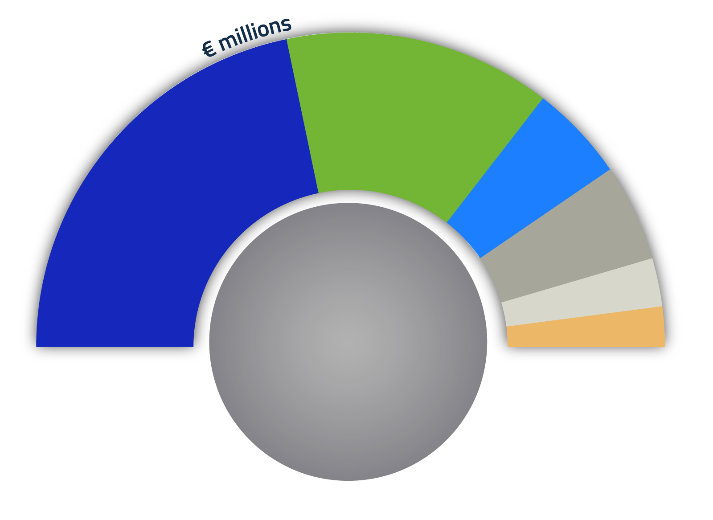
ICSC Budget
INFRASTRUCTURES
STAFF
OTHER
OPEN CALL
PHD
INDIRECT COSTS
88
139.1
31.8
32
320
Meuro
41% to the South
15.9
13.2
Budget in M€ to be spent in the period 2022-25

Slide 17
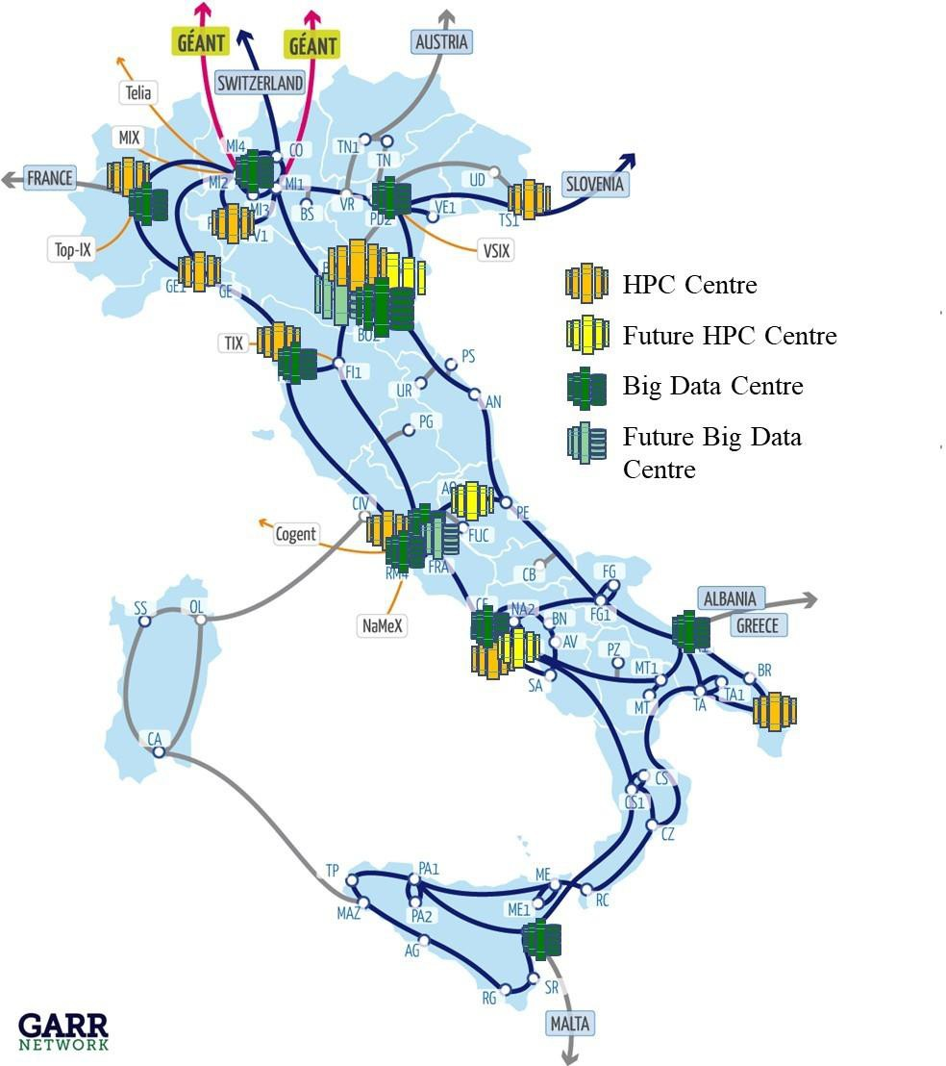
ICSC Infrastructure
117 M€ in spoke 0
  CINECA, INFN, GARR
22 M€ more in other spokes
15 M€ for personnel dedicated to the management of the infrastructure

Slide 18
Objectives
The project has been designed to be complementary to ICSC. It is meant to network, integrate and upgrade the GARR-X, PRACE-Italy and HPC-BD-AI Research Infrastructures with three main objectives:
Enable the offer of uniform Terabit-per-second data transfer rates and advanced telecommunication services on a geographical scale across the national territory, specifically focusing on under-connected regions in Southern and Insular Italy.
Innovate the structure of the central HPC node of PRACE-Italy, updating to the new Tier-1 level.
Innovate the set of HPC services available to researchers, going beyond the centralized computing system model.

Slide 19
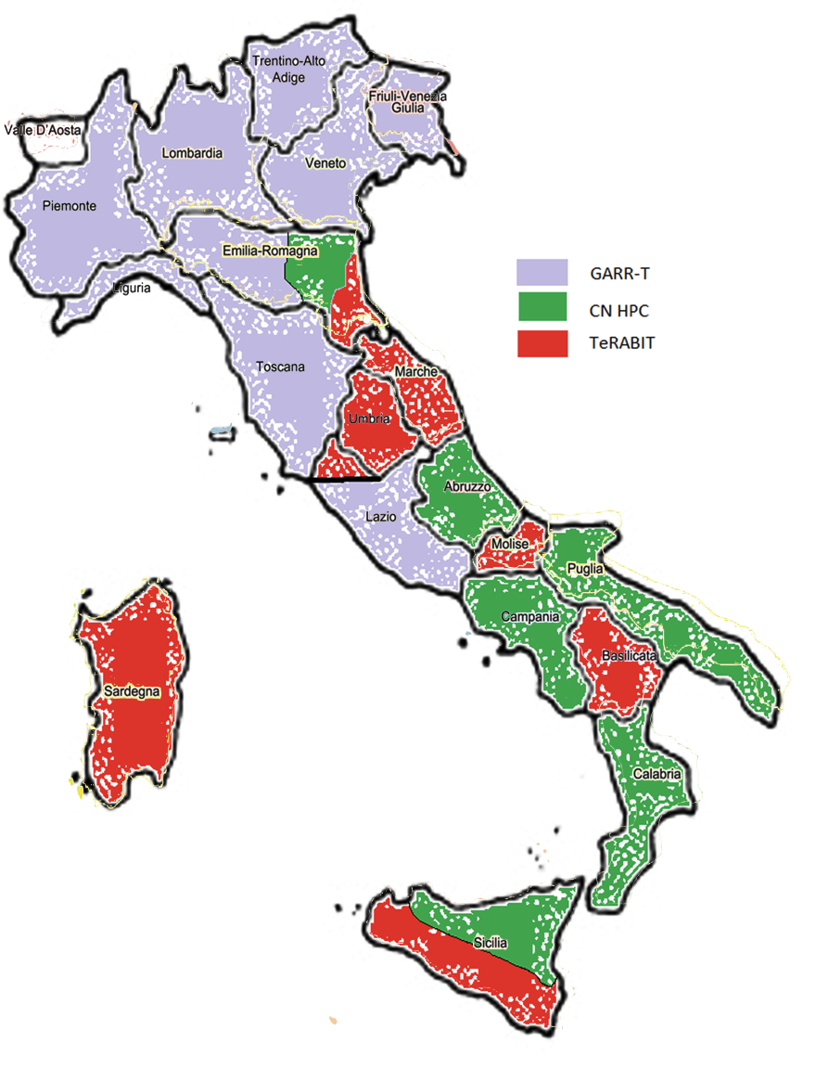
TeRABIT
Proponents : INFN and OGS
Coord. scientifico:
Mauro Campanella INFN/GARR
P.I. OGS : Stefano Salon
GARR e CINECA non sono partner perché non sono organi vigilati MUR, ma esecutori unici per rete e Tier-1 HPC)
Finanziamento totale 41ME
21.1 PM per 30 mesi INFN a termine
20.9 PM per 30 mesi OGS a termine
Data Inizio: 1 gennaio 2023
Durata: 30 mesi
OGS Trieste
INFN-CNAF (Bologna)
INFN Sez. Bari
INFN Sez. Cagliari

Slide 20
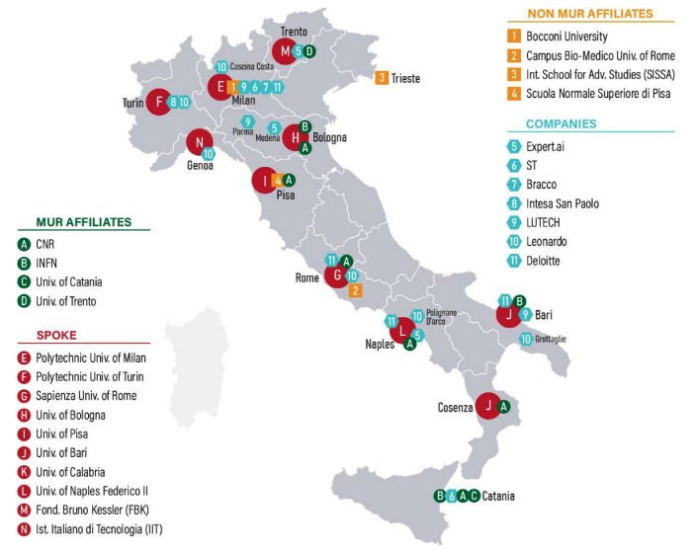

PE 1: “Artificial Intelligence: foundational aspects”
INFN in FAIR
Spoke 6 (lead UniBA): AI for BigData, reference use cases HEP data analysis
  Elia (BA), Antonacci (BA), Doria (NAP), Battaglieri (GE)
Spoke 8 (lead UniBO): xplainability in biomedical physics
  Retico (PI), Chincarini (GE)
Spoke 10 (lead UniCT): brain inspired systems, (connection with Human Brain Project)
  Vicini (RM1), Paolucci (RM1)
Total Budget 115 MEur (1,62 MEur for INFN)
PNRR
Diego Bettoni
20

Slide 21
Thank you

