Slide 1
Spectral characterization with a Bonner Sphere Spectrometer of the Neutron Irradiation area for radiation hardness studies at the EPOS facility
16 Workshop on Shielding aspects of Accelerators, Targets and Irradiation Facilities
Author: Federico Chiarelli
Contact: federico.chiarelli@lnf.infn.it
Frascati National Labs (INFN-LNF)

Slide 2
Content
Introduction to the ELBE facility
Bonner sphere spectrometry and unfolding methods
Neutron characterization at the pELBE facility
Unfolding methods adopted
Experimental / unfolded data comparison
Conclusion
Spectral characterization with a Bonner Sphere Spectrometer of the Neutron Irradiation area for radiation hardness studies at the EPOS facility Federico Chiarelli – INFN -LNF
2/18

Slide 3
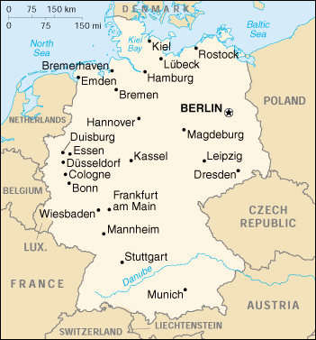
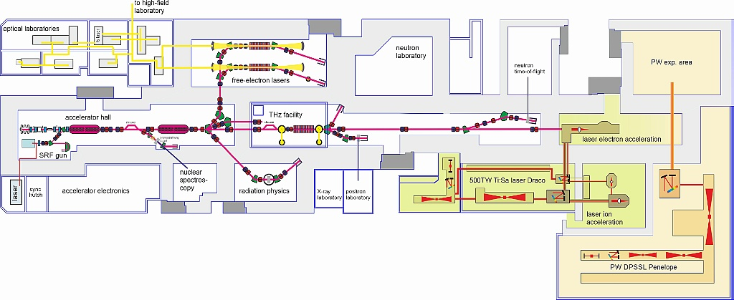
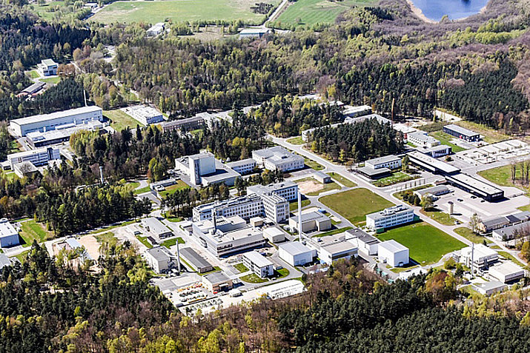
Introduction to the ELBE facility
The radiation source ELBE (Electron Linear Accelerator for Beams of High Brilliance and Low Emittance) is used to produce various types of secondary beams - both electromagnetic radiation and particles. The properties of this radiation make ELBE an excellent research tool both for external users and for scientists at the Helmholtz-Zentrum Dresden-Rossendorf.
Spectral characterization with a Bonner Sphere Spectrometer of the Neutron Irradiation area for radiation hardness studies at the EPOS facility Federico Chiarelli – INFN -LNF
3/18

Slide 4
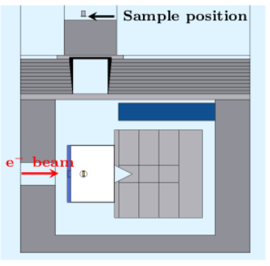
Introduction to the ELBE facility
At pELBE the electron beam hits a 1 cm thick water-cooled W target and produces positrons through Bremsstrahlung and following pair production. Positrons are transported in a dedicated area for positron annihilation spectroscopy studies. In the tungsten target, the electron beam induces neutron photo-production, allowing the definition of an optimal neutron irradiation area. The high neutron fluence rate - up to about 10⁷ n/cm2/s - and a negligible photon contamination
The aim of the experiment performed was to obtain a complete neutron characterization of the area near the W target, in particular on the lead roof.
Spectral characterization with a Bonner Sphere Spectrometer of the Neutron Irradiation area for radiation hardness studies at the EPOS facility Federico Chiarelli – INFN -LNF
4/18

Slide 5
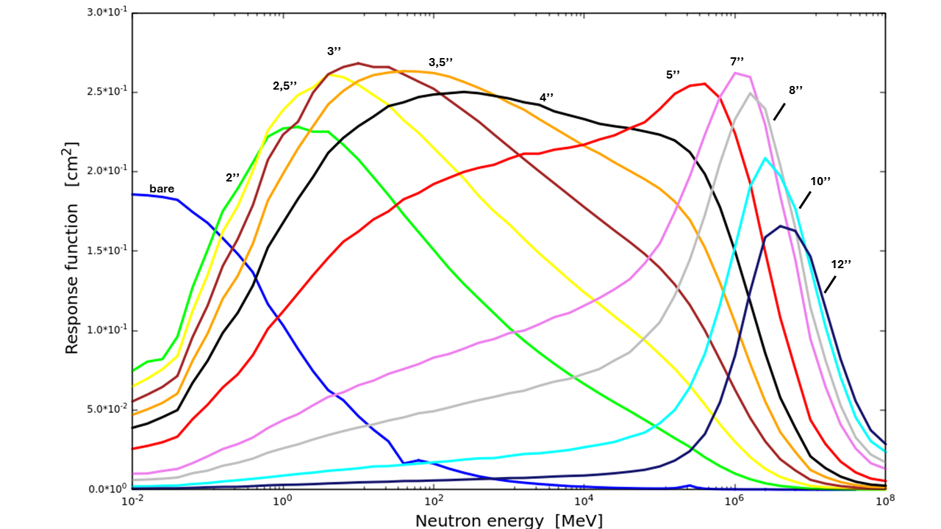
Bonner sphere spectrometry and unfolding methods
The Bonner Sphere Spectrometer (BSS) is a multisphere system based on:
the use of thermal neutron detectors surrounded by moderating spheres of different diameters (usually polyethylene);
an unfolding method used for the spectrum reconstruction.
$$C_{i}=\sum_{j}{R_{ij}Φ_{j}}$$
$$C=RΦ$$
$C_{i}$ → counts obtained from the i-th sphere Φ_{𝑗} → neutron fluence component of j-th energy R_{ij} → response matrix
j>>i → not a unique solution!
Spectral characterization with a Bonner Sphere Spectrometer of the Neutron Irradiation area for radiation hardness studies at the EPOS facility Federico Chiarelli – INFN -LNF
5/18

Slide 6
Bonner sphere spectrometry and unfolding methods
Once obtained the counts for the entire set and exploiting the knowledge of the response matrix, the unknown neutron field is estimated using a guess spectrum $Φ$_{guess} and then applyng the unfolding code.
Some unfolding code:
MAXED
GRAVEL
i → i-th energy bin
$Φ_{i}$ → spectrum value at the i-th energy bin
$Φ_{i}^{guess}$ → guess spectrum value at the i-th energy bin
These codes need to a priori information, given through a guess spectrum
$$S=−\sum_{i}{\left\{Φ_{i} \ln\left(\frac{Φ_{i}}{Φ_{i}^{guess}}\right)+Φ_{i}^{guess} − Φ_{i}\right\} }$$
j/j’ → j/j’-th energy bin
k→ iteration number
$C_{i}$→ count of the i-th bonner sphere
$$Φ^{guess}=a_{1}∙Φ_{th}+a_{2}Φ_{int}+a_{3}Φ_{fp}+a_{4}Φ_{he}$$
$$Φ_{j}^{k+1}=Φ_{j}^{k}\exp\left(\frac{\sum_{i}{W_{ij}^{k}\ln\left(\frac{C_{i}}{\sum_{j′}{R_{ij^{′}}Φ_{j′}^{k}}}\right)}}{\sum_{i}{W_{ij}^{k}}}\right)$$
$Φ_{i}$ → parametrized component
$$W_{ij}^{k}=\frac{R_{ij}Φ_{j}^{k}}{\sum_{j′}{R_{ij^{′}}Φ_{j′}^{k}}}∙\frac{C_{i}^{2}}{σ_{i}^{2}}$$
$a_{i}$ → weighting factor
Spectral characterization with a Bonner Sphere Spectrometer of the Neutron Irradiation area for radiation hardness studies at the EPOS facility Federico Chiarelli – INFN -LNF
6/18

Slide 7
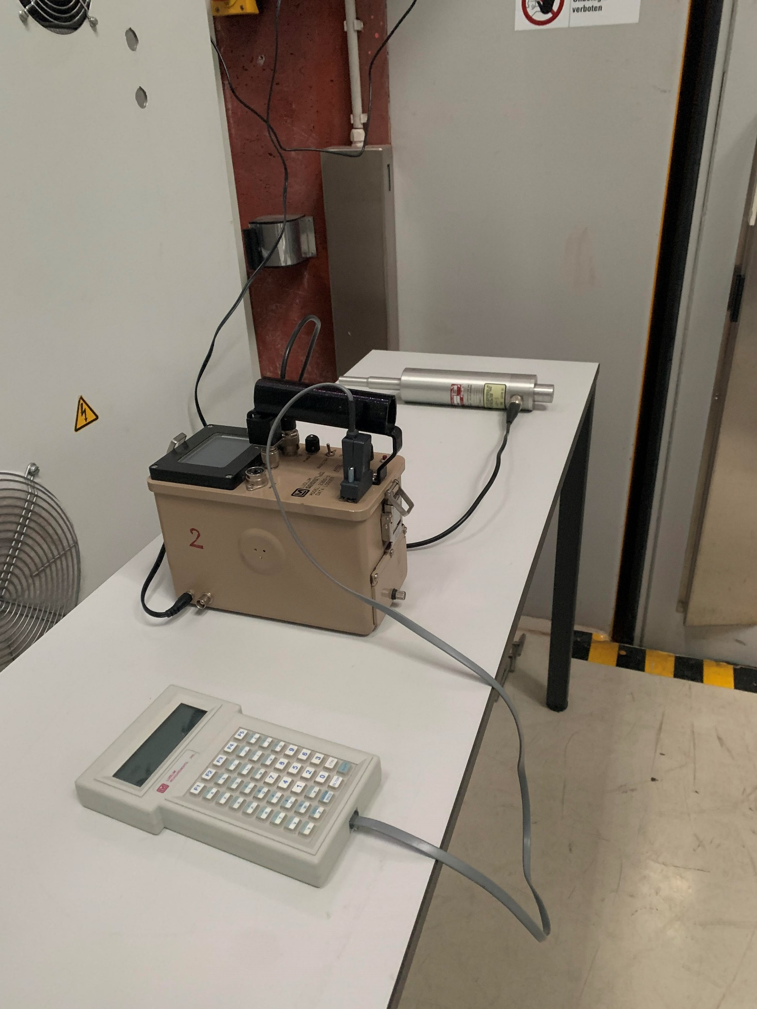
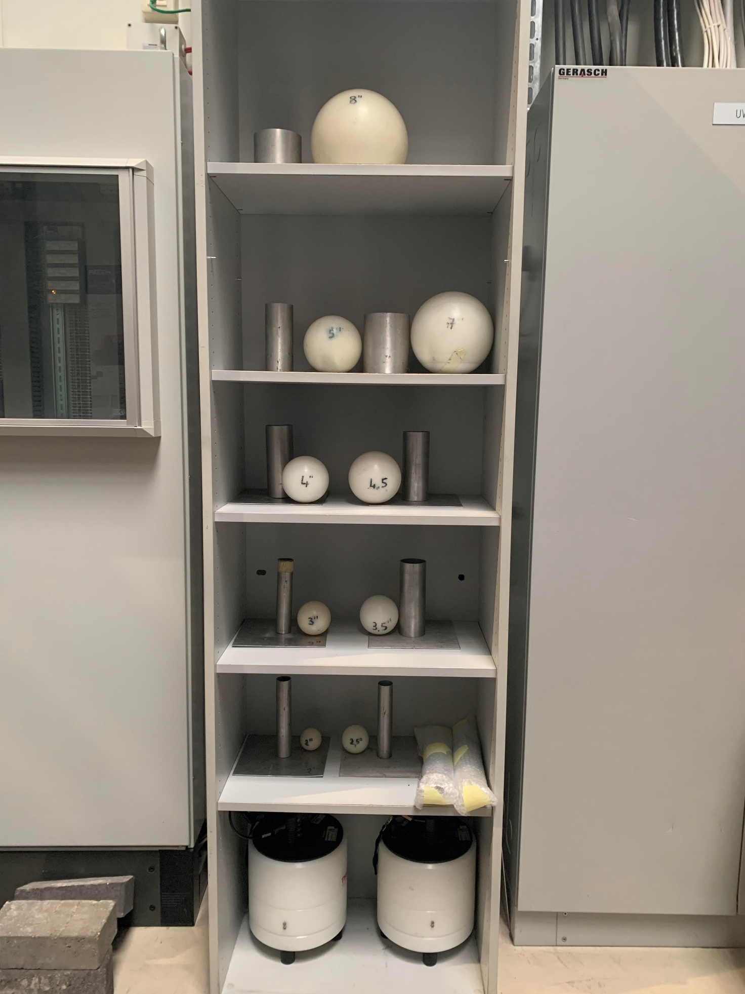
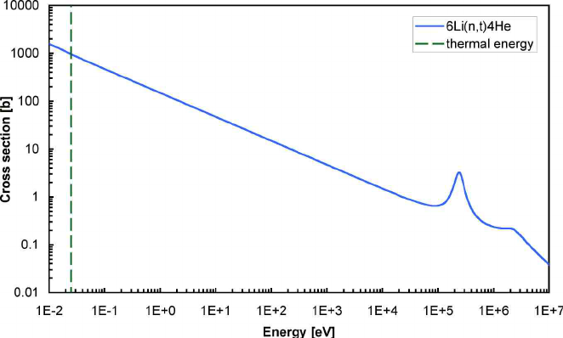
Neutron characterization at the pELBE facility
The complete characterization was performed for three different points placed on the pELBE lead roof under the same irradiation conditions, using the BSS of INFN Frascati National Laboratories. It consists of a set of 13 polyethylene spheres and 4 x 4 mm² cylindrical Li-6I(Eu) scintillators placed inside it. Since the neutron spectrum under investigation is a typical photo-neutron spectrum, a sub-set of 9 polyethylene spheres with diameter ranging from 2 to 8” has been chosen, in order to cover the appropriate energy range.
Spectral characterization with a Bonner Sphere Spectrometer of the Neutron Irradiation area for radiation hardness studies at the EPOS facility Federico Chiarelli – INFN -LNF
7/18

Slide 8
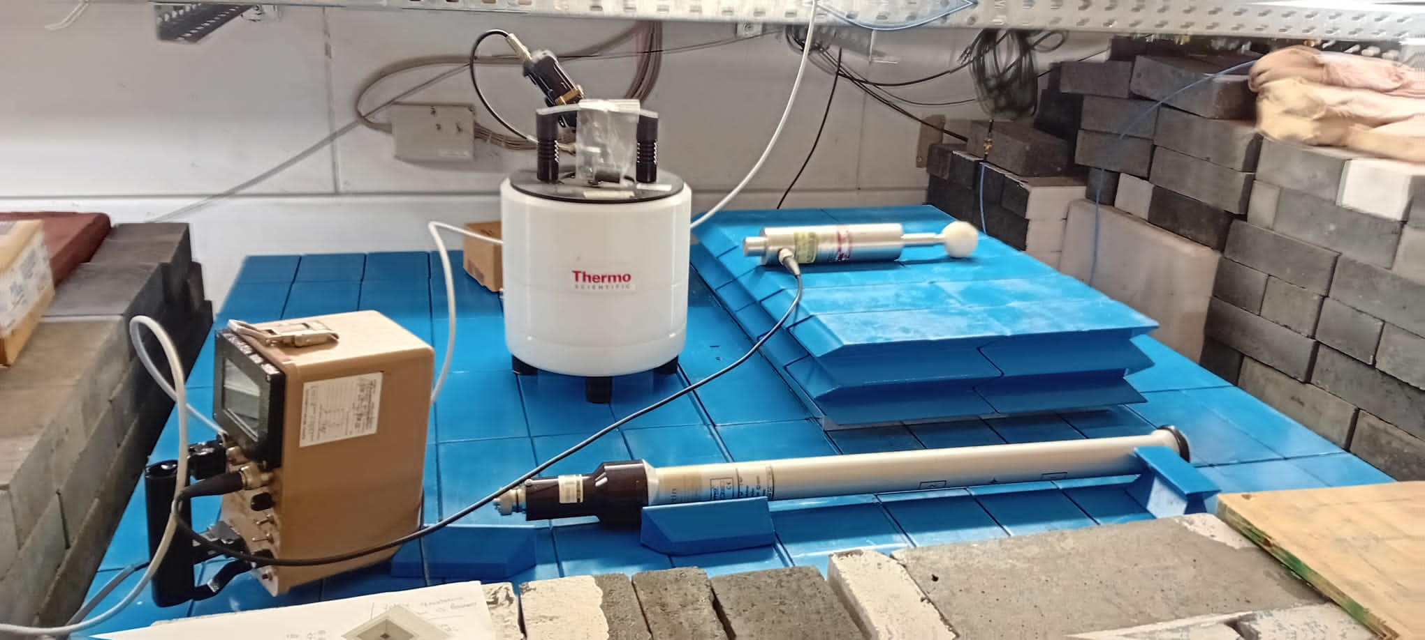
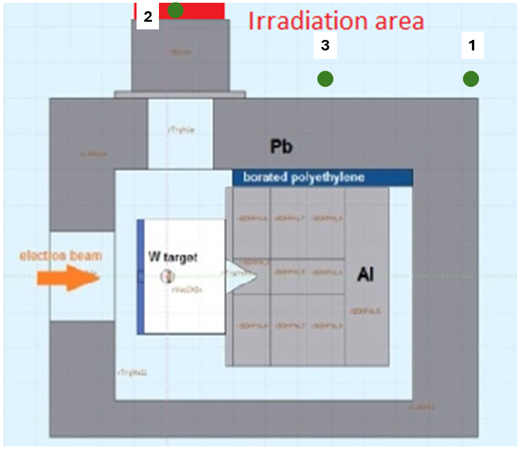
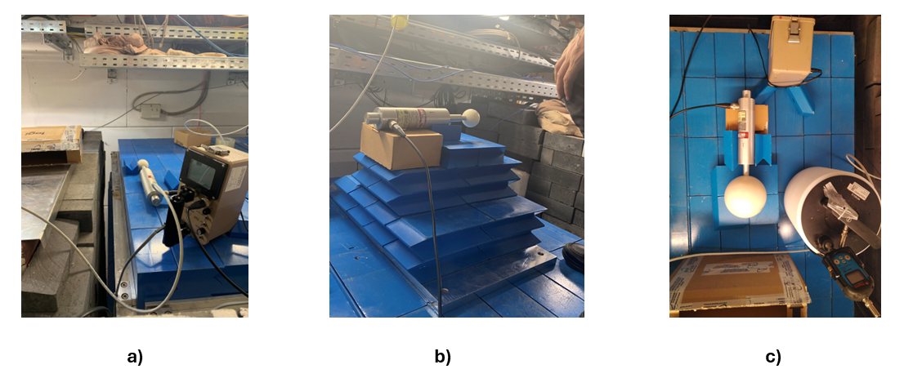
Neutron characterization at the pELBE facility
The complete characterization was performed for three different points placed on the pELBE lead roof under the same irradiation conditions, using the BSS of INFN Frascati National Laboratories.
1
2
3
Spectral characterization with a Bonner Sphere Spectrometer of the Neutron Irradiation area for radiation hardness studies at the EPOS facility Federico Chiarelli – INFN -LNF
8/18

Slide 9
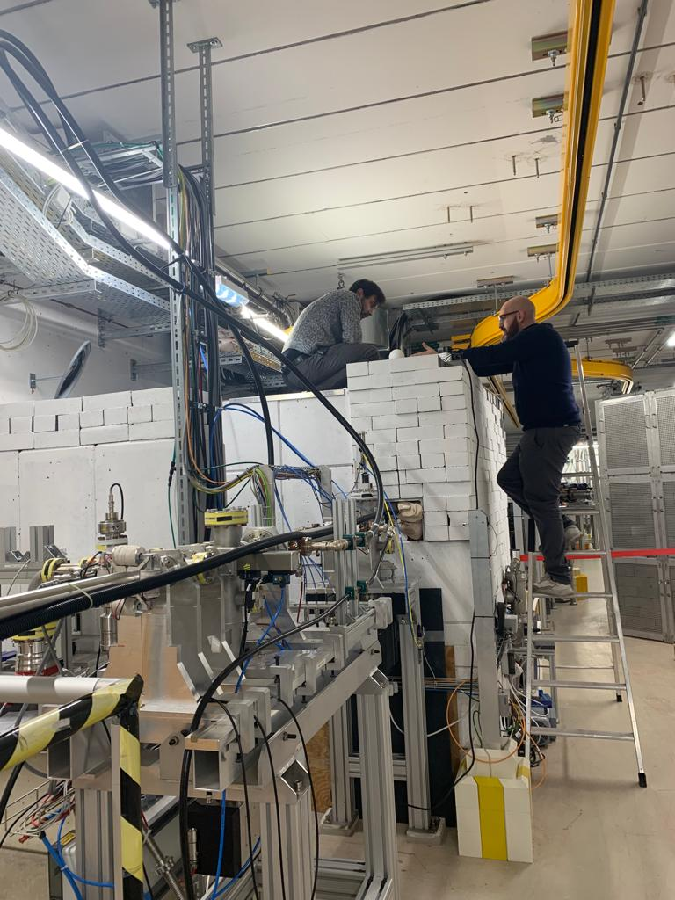
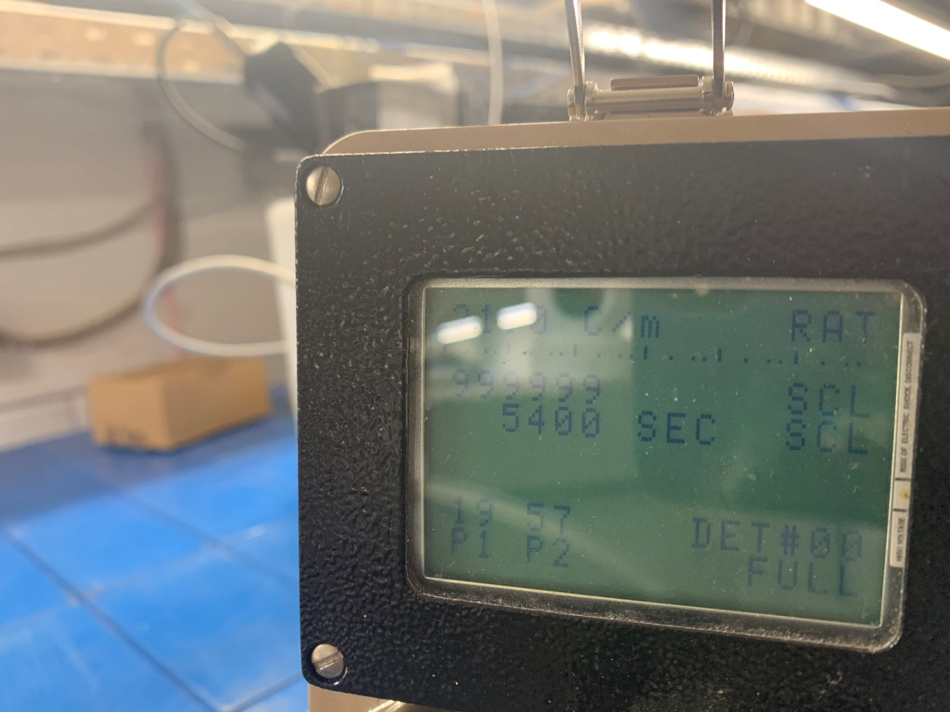
Neutron characterization at the pELBE facility
The irradiation time considered for each setup range from 40 and 60 seconds, in order to avoid the detector saturation and to diminish the waiting time due to the air activation.
The counts reported are normalized to 60 second of irradiation time, in order to:
Perform a correct comparison between the counts of the different spheres;
Perform a correct unfolding approach for the neutron spectrum reconstruction.
Irradiation conditions
Energy [MeV] | 34
Mean current [nA] | 2
Neutron Flux [n/ cm² /s] | 3 x 10⁵
Irradiation time [s] | 40-60
Spectral characterization with a Bonner Sphere Spectrometer of the Neutron Irradiation area for radiation hardness studies at the EPOS facility Federico Chiarelli – INFN -LNF
9/18

Slide 10
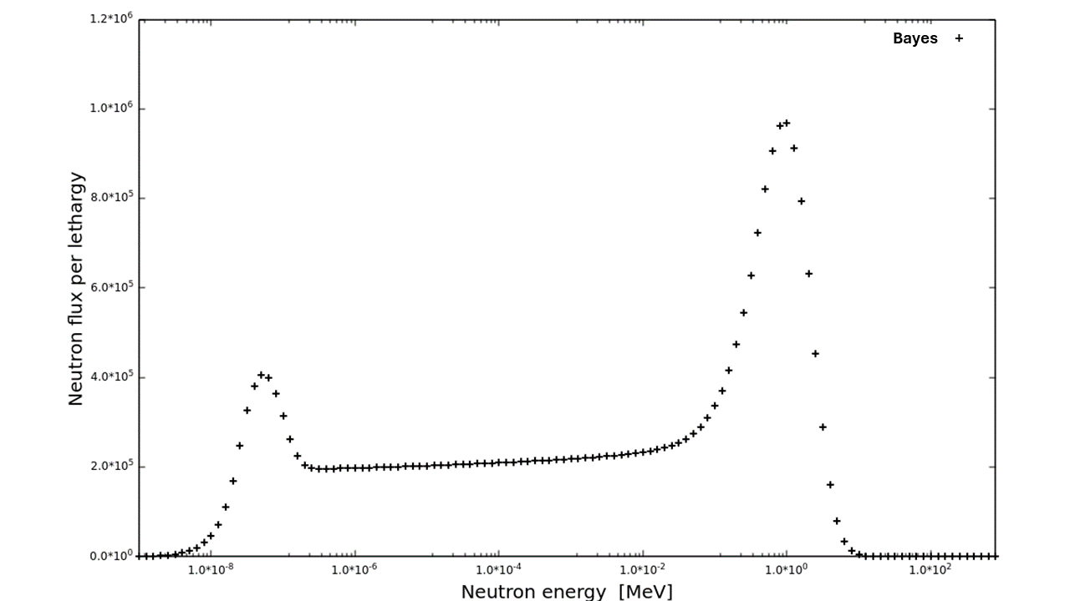
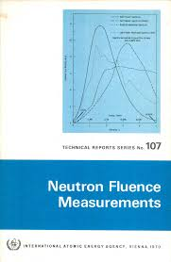
Unfolding methods adopted
In order to generate the guess spectrum, the software package WinBUGS, designed for Bayesian analysis, was used. Ad hoc scripts were created, focused on the parameterization of the neutron components that make up the spectrum: thermal + intermediate + fission peak.
Functional forms based on those in “neutron fluence measurements” IAEA Technical Reports Series No. 107.
$$φ_{fp}∝\left(E/{T_{ev}^{2}}\right)∙exp(−E/{T_{ev}})$$
Starting from the response matrix and the counts knowledge, through ad hoc script created, the WinBUGS package can generate the guess spectrum.
$$φ_{th}∝\left(E/{kT_{th}^{2}}\right)∙exp(−E/{kT_{th}})$$
$$φ_{in}∝1/E$$
Spectral characterization with a Bonner Sphere Spectrometer of the Neutron Irradiation area for radiation hardness studies at the EPOS facility Federico Chiarelli – INFN -LNF
10/18

Slide 11
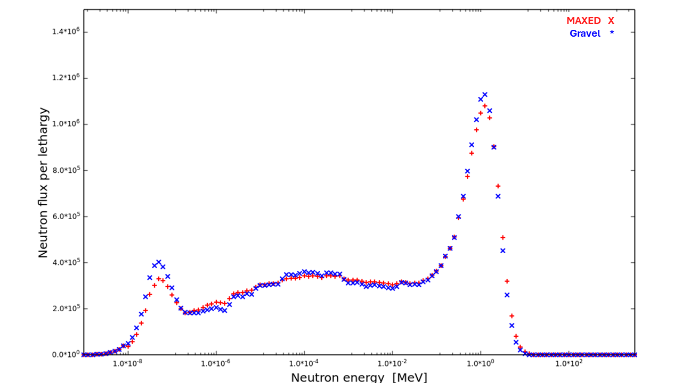
Unfolding methods adopted
UMG (Unfolding with MAXED and GRAVEL) is a package of seven programs written for the analysis of data measured with spectrometers that require the use of unfolding techniques.
The package reads, through external files, the response matrix and the counts obtained from the different spheres during the exposure. Using this information, by selecting the desired unfolding process and the chi-square, it is possible to proceed with the reconstruction of the spectrum.
MAXED
GRAVEL
i → i-th energy bin
$Φ_{i}$ → spectrum value at the i-th energy bin
$Φ_{i}^{guess}$ → guess spectrum value at the i-th energy bin
$$S=−\sum_{i}{\left\{Φ_{i} \ln\left(\frac{Φ_{i}}{Φ_{i}^{guess}}\right)+Φ_{i}^{guess} − Φ_{i}\right\} }$$
$$Φ_{i}=Φ_{i}^{guess}\exp\left(\sum_{k}{λ_{k }∙R_{ki}}\right)$$
j/j’ → j/j’-th energy bin
k→ iteration number
$C_{i}$→ count of the i-th bonner sphere
$$Φ_{j}^{k+1}=Φ_{j}^{k}\exp\left(\frac{\sum_{i}{W_{ij}^{k}\ln\left(\frac{C_{i}}{\sum_{j′}{R_{ij^{′}}Φ_{j′}^{k}}}\right)}}{\sum_{i}{W_{ij}^{k}}}\right)$$
Spectral characterization with a Bonner Sphere Spectrometer of the Neutron Irradiation area for radiation hardness studies at the EPOS facility Federico Chiarelli – INFN -LNF
11/18

Slide 12
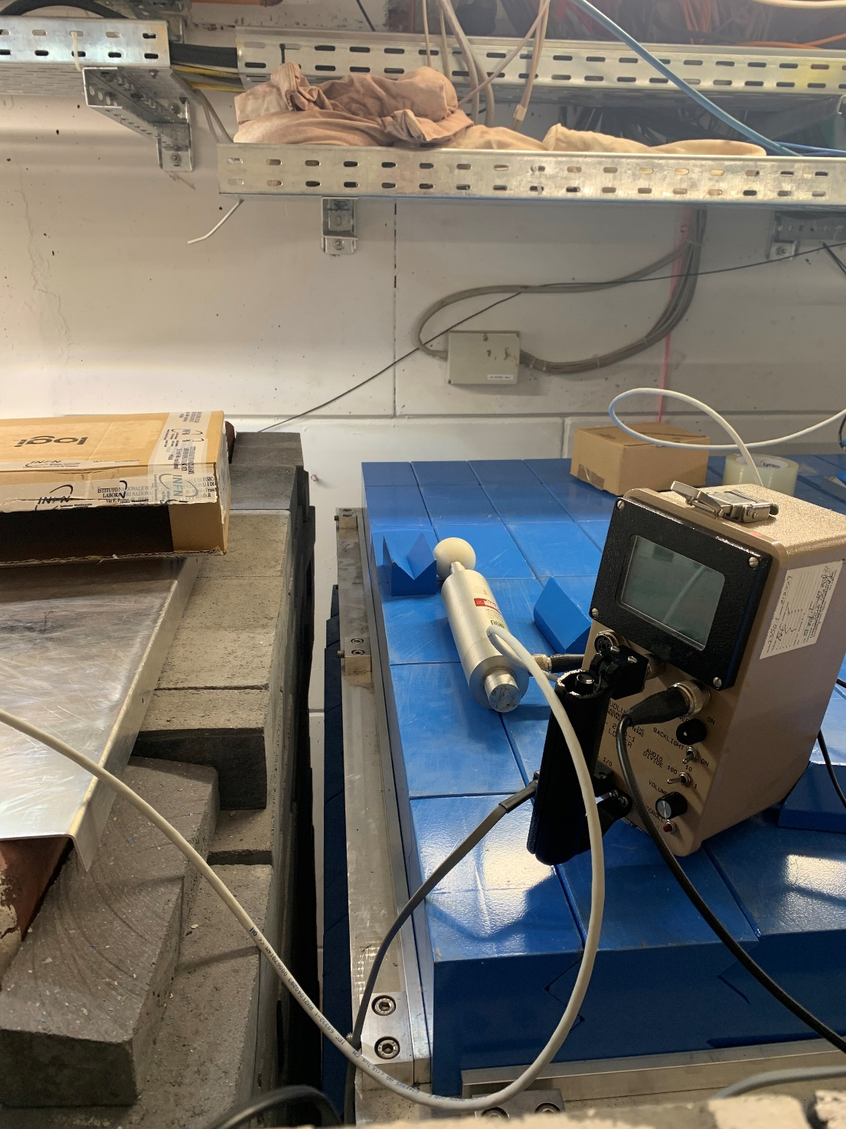
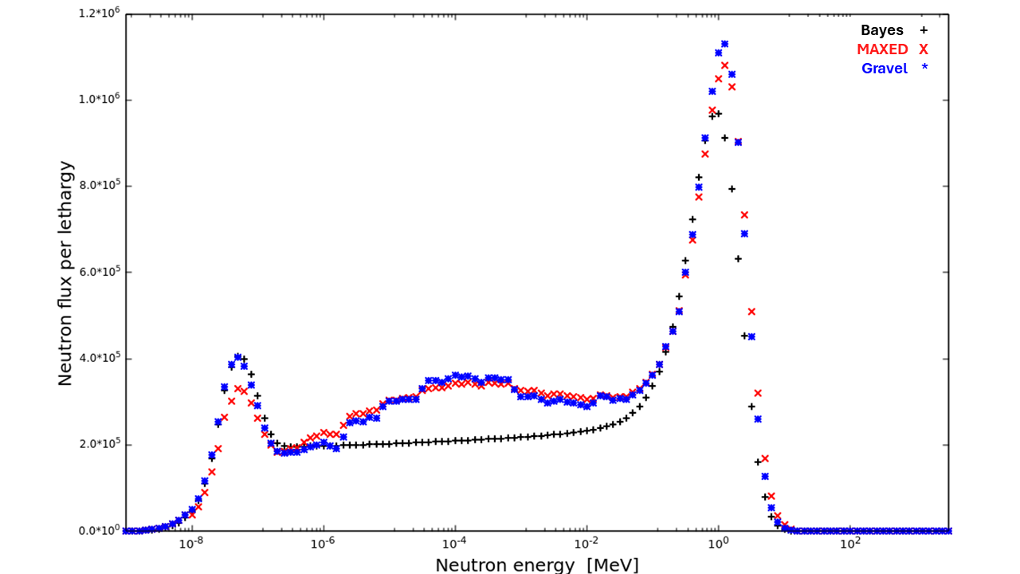
Unfolding methods adopted
Point 1
Sphere | Point 1 [cnt]
2'' | (5.184 ± 0.007) x 10⁵
2,5'' | (7.087 ± 0.008) x 10⁵
3'' | (9.048 ± 0.009) x 10⁵
3,5'' | (1.022 ± 0.001) x 10⁶
4'' | (1.035 ± 0.001) x 10⁶
4,5'' | (1.054 ± 0.001) x 10⁶
5'' | (1.061 ± 0.001) x 10⁶
7'' | (8.786 ± 0.009) x 10⁵
8'' | (6.168 ± 0.008) x 10⁵
Spectral characterization with a Bonner Sphere Spectrometer of the Neutron Irradiation area for radiation hardness studies at the EPOS facility Federico Chiarelli – INFN -LNF
12/18

Slide 13
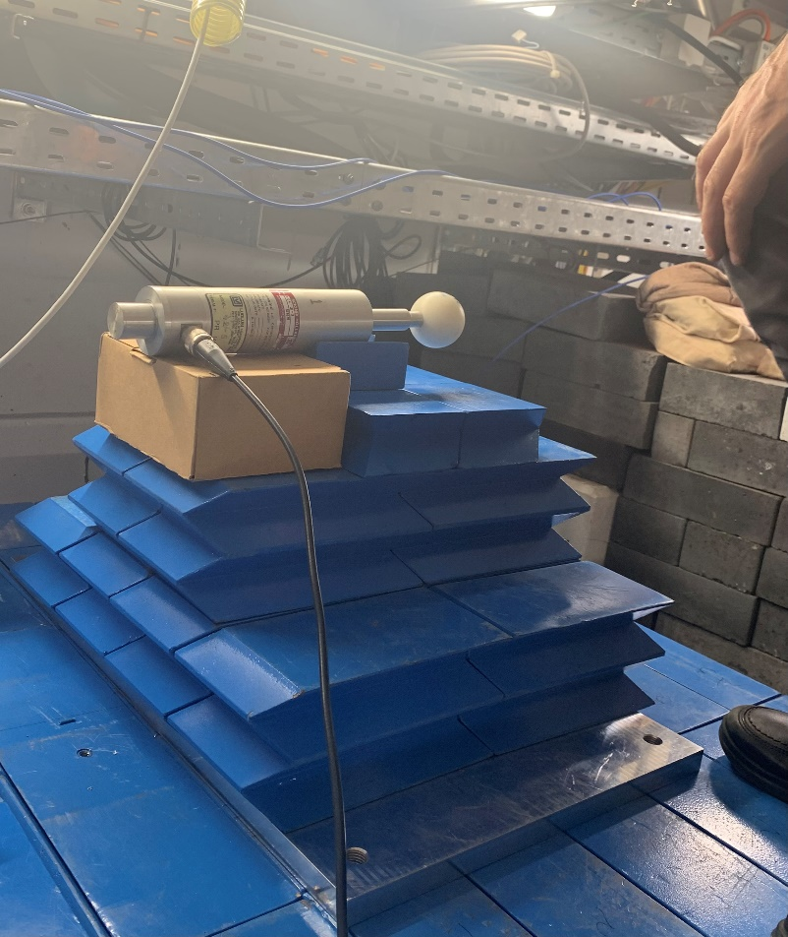
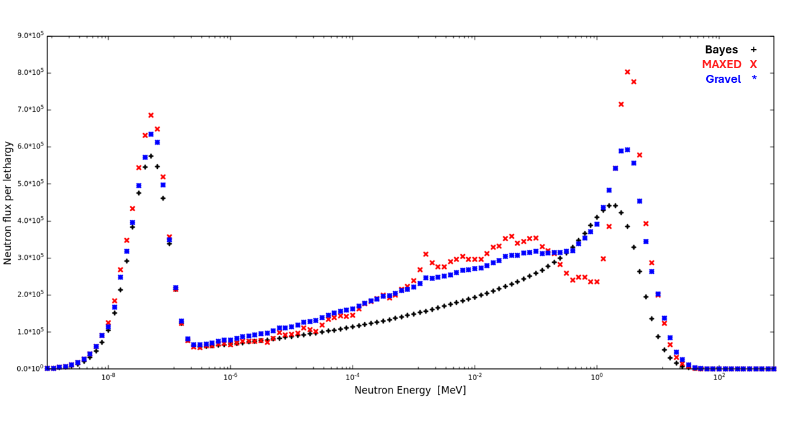
Unfolding methods adopted
Point 2
DAddddddddddddTI
Sphere | Point 2 [cnt]
2'' | (2.222 ± 0.004) x 10⁵
2,5'' | (4.499 ± 0.007) x 10⁵
3'' | (5.291 ± 0.008) x 10⁵
3,5'' | (6.269 ± 0.009) x 10⁵
4'' | (6.746 ± 0.008) x 10⁵
4,5'' | (7.036 ± 0.008) x 10⁵
5'' | (6.849 ± 0.008) x 10⁵
7'' | (4.983 ± 0.007) x 10⁵
8'' | (4.171 ± 0.006) x 10⁵
Spectral characterization with a Bonner Sphere Spectrometer of the Neutron Irradiation area for radiation hardness studies at the EPOS facility Federico Chiarelli – INFN -LNF
13/18

Slide 14
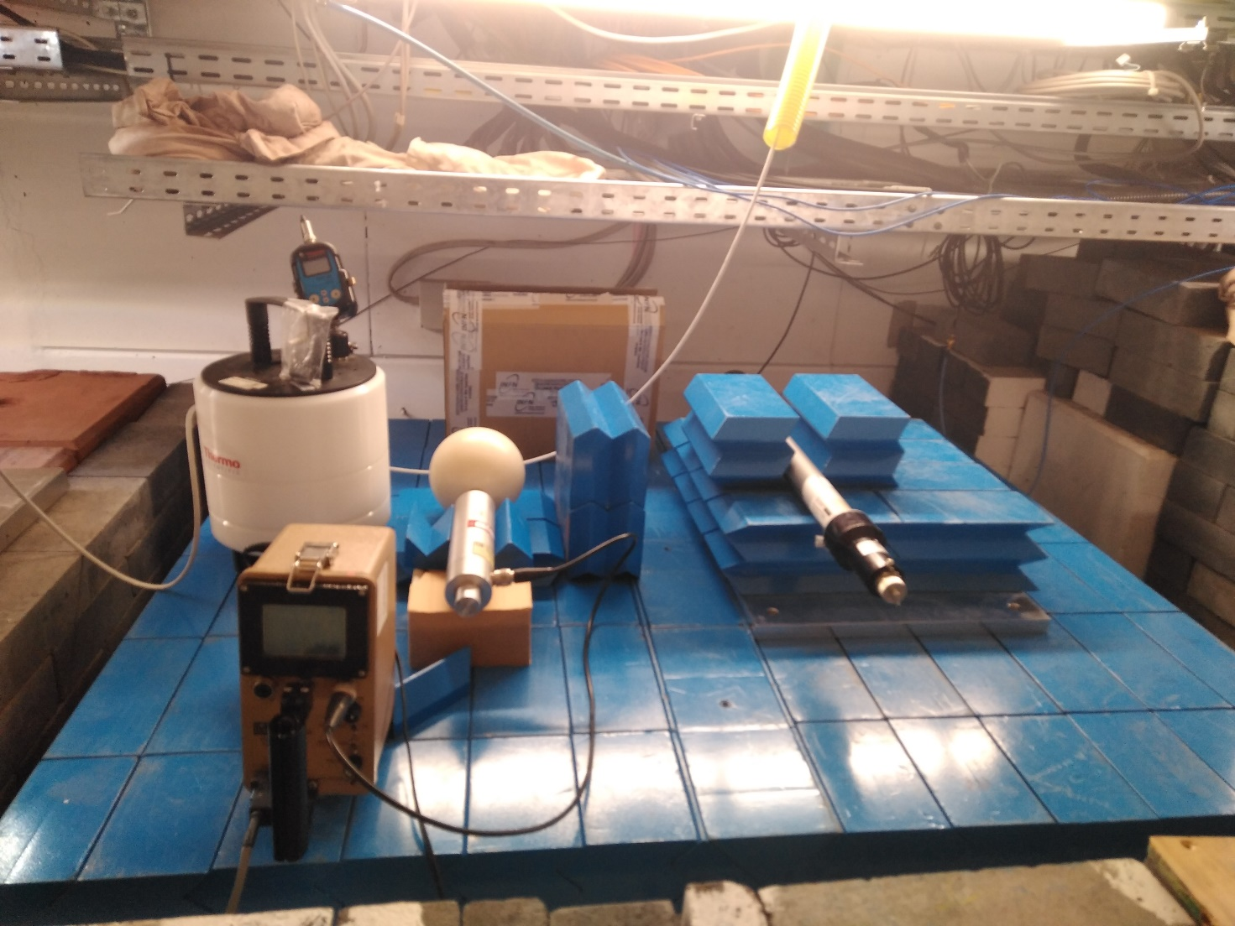
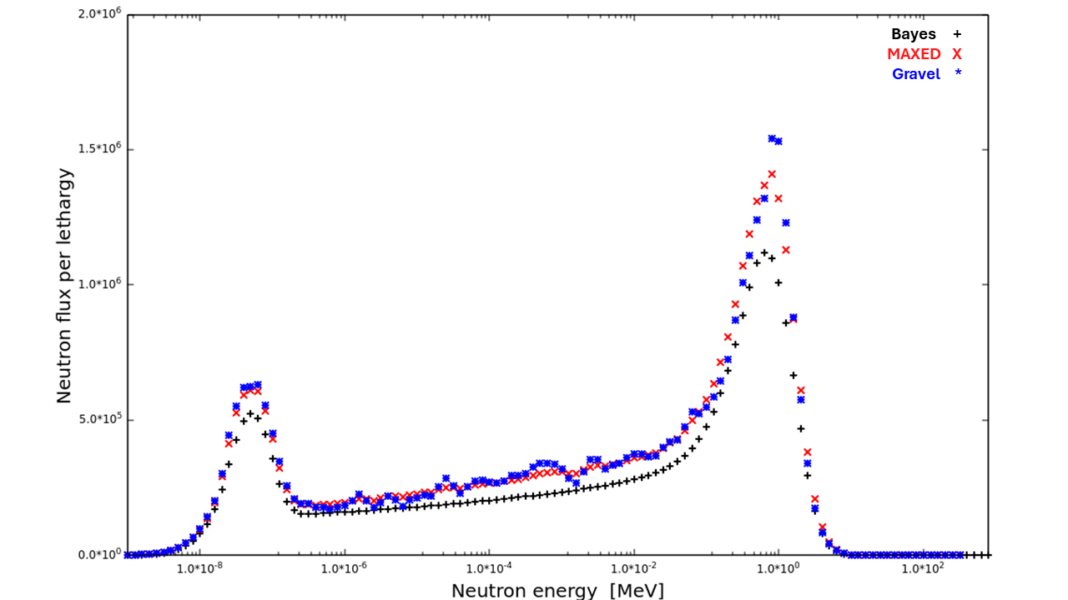
Unfolding methods adopted
Point 3
Sphere | Point 3 [cnt]
2'' | (5.319 ± 0.007) x 10⁵
2,5'' | Not used
3'' | (9.309 ± 0.009) x 10⁵
3,5'' | Not used
4'' | (1.221 ± 0.001) x 10⁶
4,5'' | Not used
5'' | (1.191 ± 0.001) x 10⁶
7'' | (9.108 ± 0.009) x 10⁵
8'' | (6.891 ± 0.008) x 10⁵
Spectral characterization with a Bonner Sphere Spectrometer of the Neutron Irradiation area for radiation hardness studies at the EPOS facility Federico Chiarelli – INFN -LNF
14/18

Slide 15
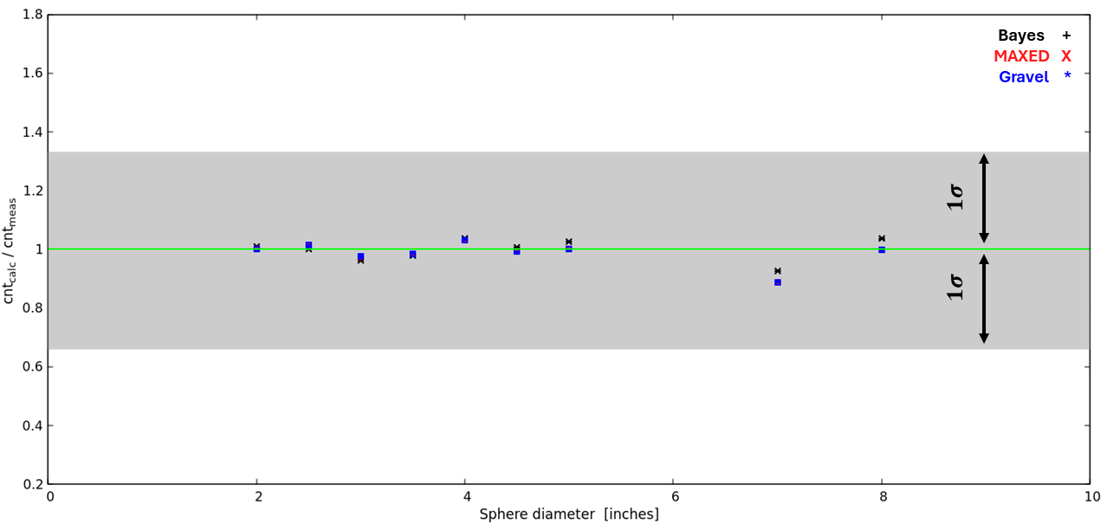
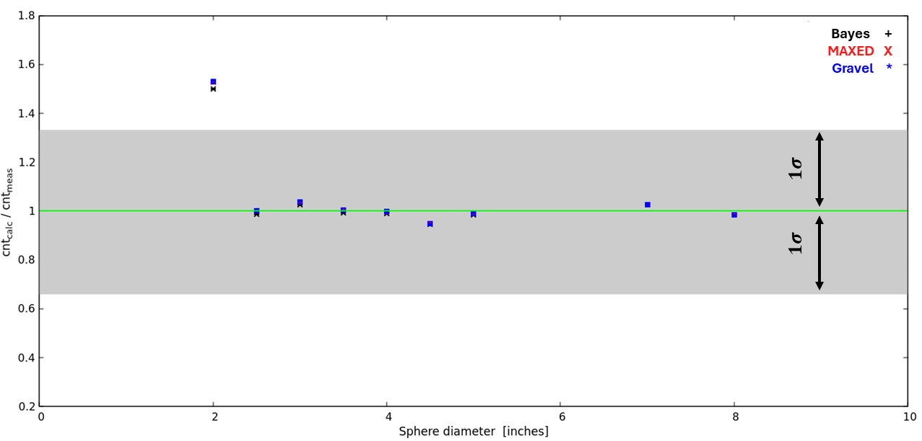
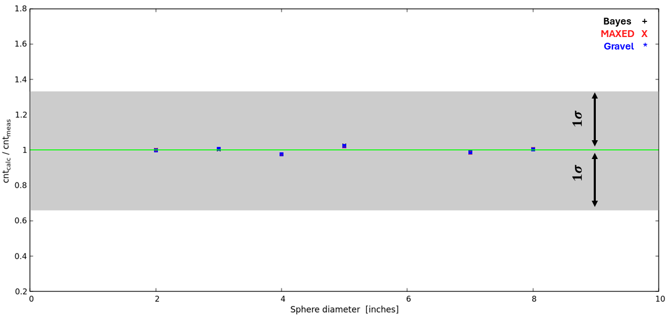
Experimental / unfolded data comparison
The comparison between the calculated and measured counts shows excellent agreement, particularly the maximum deviation from the measured value is:
within 12% for point 1;
within 6% for point 2 (except for the 2" sphere count);
within 3% for point 3.
1
2
3
Spectral characterization with a Bonner Sphere Spectrometer of the Neutron Irradiation area for radiation hardness studies at the EPOS facility Federico Chiarelli – INFN -LNF
15/18

Slide 16
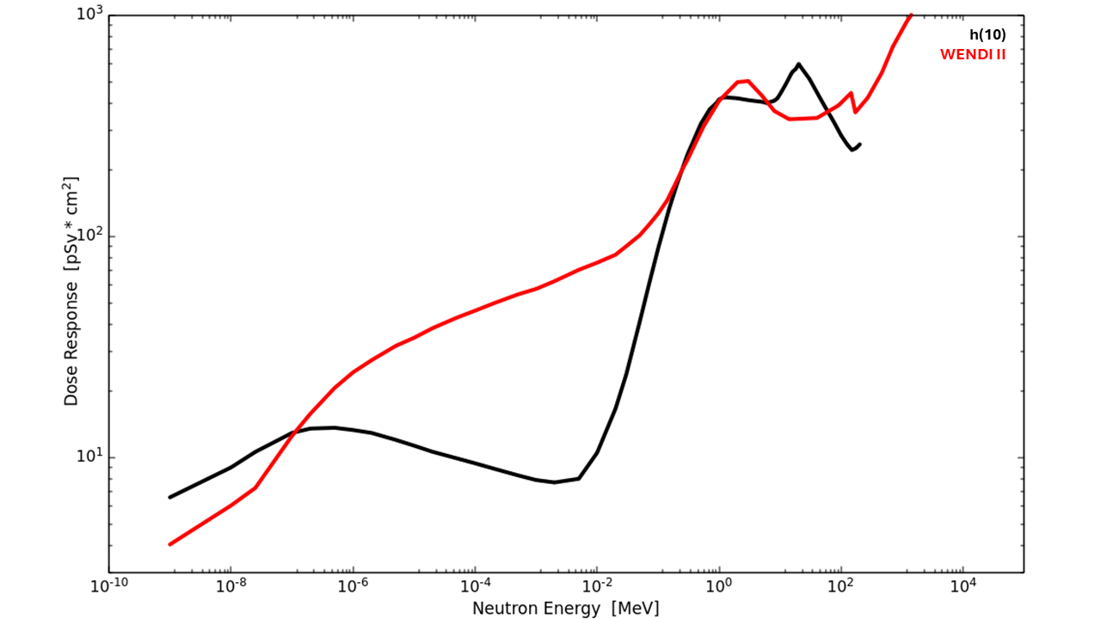
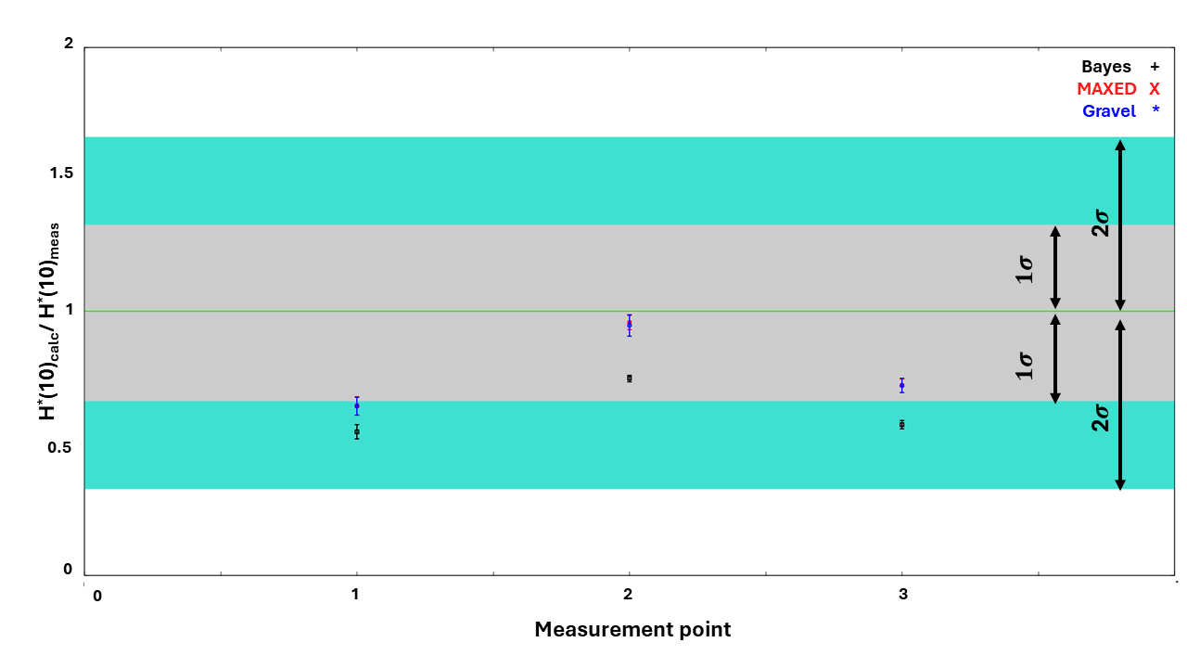
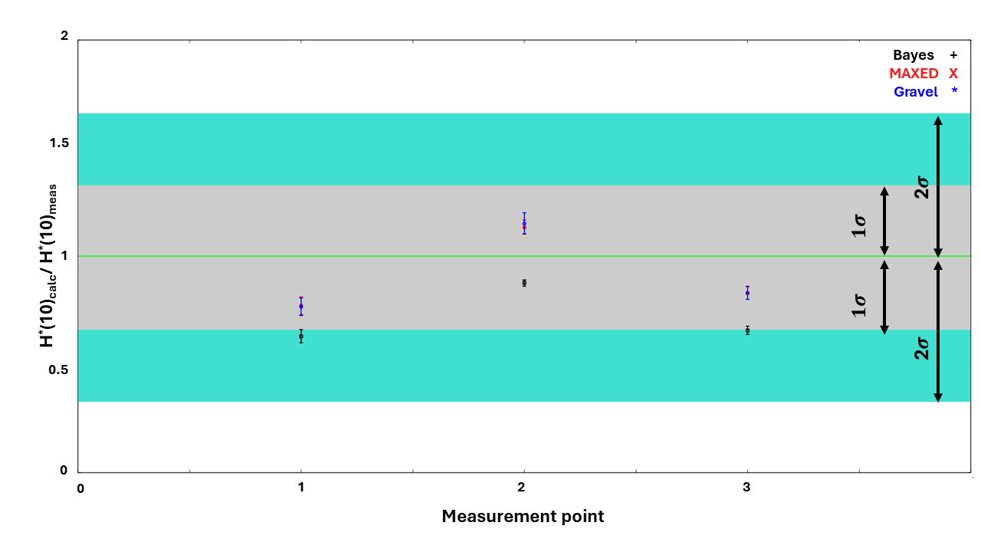
Experimental / unfolded data comparison
For the comparison between the measured and calculated neutron ambient dose equivalent two approaches were followed:
The application of h(10) conversion factor to the unfolded spectrum;
The application of the WENDI II dose response to the unfolded spectrum.
First approach (h(10))
Second approach (WENDI II)
Spectral characterization with a Bonner Sphere Spectrometer of the Neutron Irradiation area for radiation hardness studies at the EPOS facility Federico Chiarelli – INFN -LNF
16/18

Slide 17
Conclusion
A complete neutron characterization of the EPOS roof was performed, using the Bonner sphere system of the Frascati National Labs (INFN);
The UMG package, with a Bayesian approach, was used to evaluate the neutron spectrum produced during the normal working conditions at the pELBE;
The reliability of the unfolded spectra obtained was shown through a some comparison, in terms of sphere counts obtained and ambient dose equivalent measurement.
Next challange: complete the benchmark with a dedicated Monte Carlo simulation.
Spectral characterization with a Bonner Sphere Spectrometer of the Neutron Irradiation area for radiation hardness studies at the EPOS facility Federico Chiarelli – INFN -LNF
17/18

Slide 18
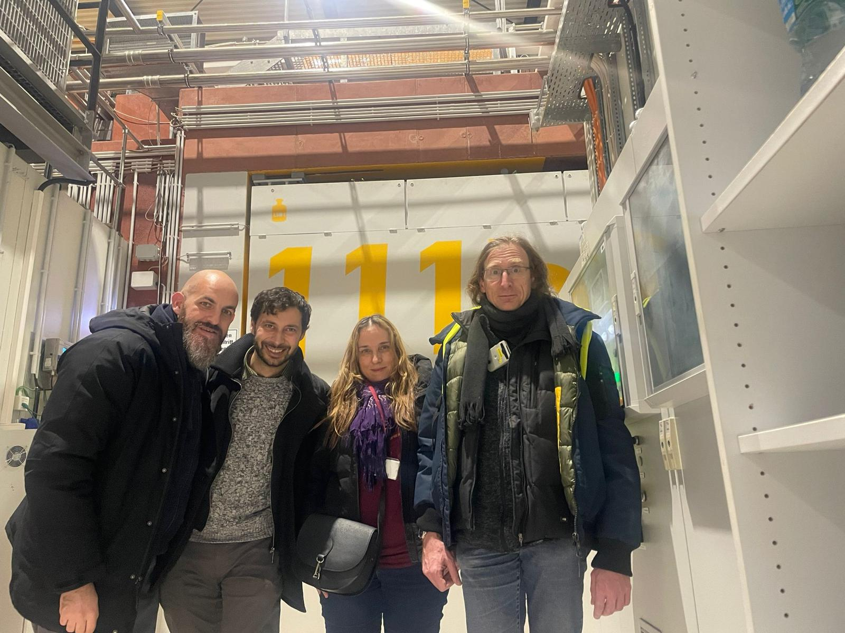
Thanks for the attention
Author: Federico Chiarelli
Contact: federico.chiarelli@lnf.infn.it
Frascati National Labs (INFN-LNF)
Spectral characterization with a Bonner Sphere Spectrometer of the Neutron Irradiation area for radiation hardness studies at the EPOS facility Federico Chiarelli – INFN -LNF

