Slide 1
The Frascati Neutron Generator (FNG): capabilities and applications for radiation testing on electronic devices
Frascati, INFN - LNF 31/05/2024
Andrea Colangeli – ENEA Nuclear Department, Fusion Energy Division

Slide 2
Contributors list
Fabrizio Andreoli¹, Paola Batistoni¹, Alessandro Calamida¹, Marta Damiano^{1,2}, Davide Flammini¹, Nicola Fonnesu¹, Stefano Loreti¹, Michele Lungaroni¹, Simone Noce¹, Fabio Moro¹, Guglielmo Pagano¹, Antonino Pietropaolo¹, Alberto Previti¹, Rosaria Villari¹
¹ENEA, NUC Department, Via E. Fermi 45, 00044 Frascati, Rome, Italy
²Department of Industrial Engineering, University of Rome “Tor Vergata”, Via del Politecnico 1, 00133, Rome, Italy

Slide 3
Summary
The Frascati Neutron Generator
Activities at the Frascati Neutron Generator
Radiation Effects on electronics
RADNEXT project
ASIF program
GENeuSIS project
Conclusions

Slide 4
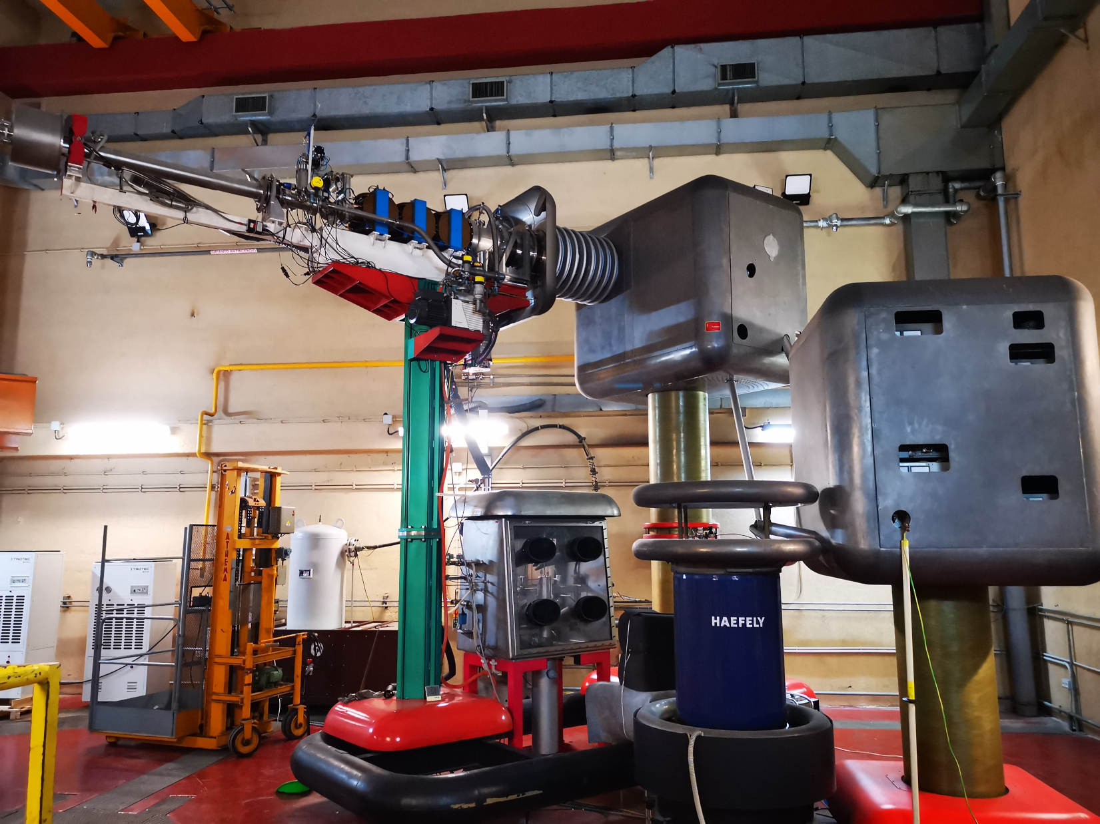
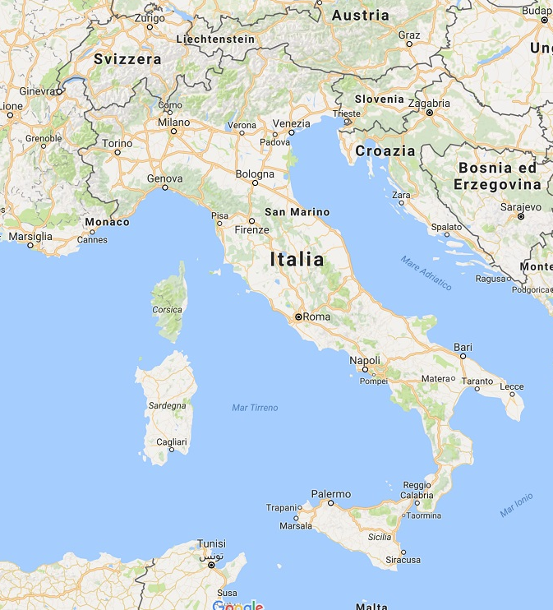
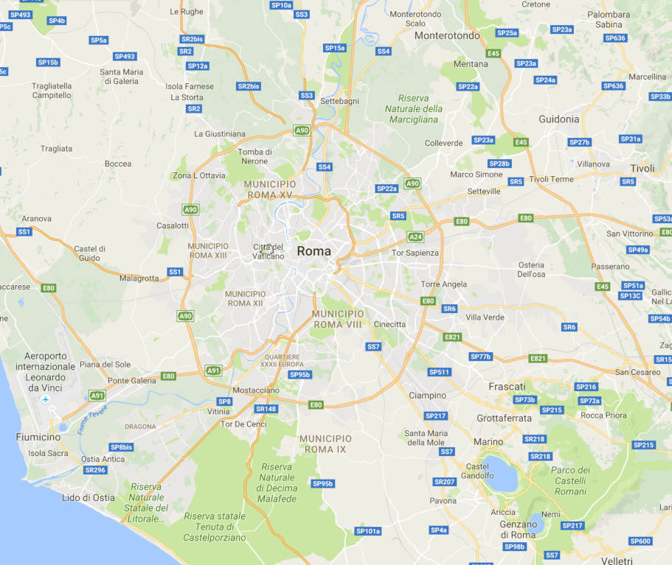
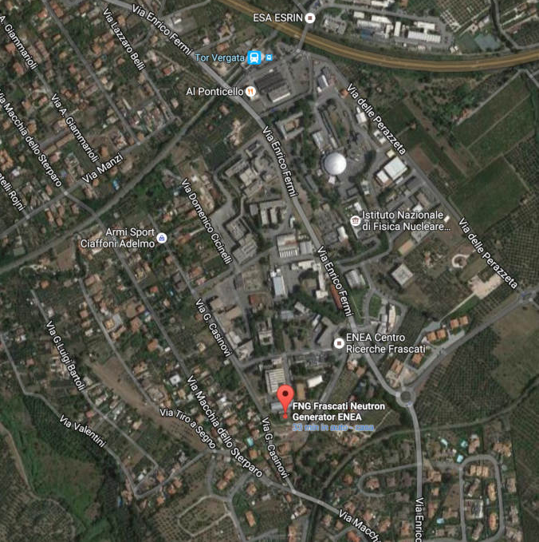
The Frascati Neutron Generator
The Frascati Neutron Generator (FNG) is a medium intensity neutron source designed to perform neutronics experiment in support of the EU Fusion community
It started its operations in 1992 and has been continuously improved and upgraded in time
Numerous experiments have been performed during the last 30 years: neutronincs benchmark experiments, nuclear data validation, irradiation of electronic devices, materials activation experiments
FNG is located in Frascati (Rome) within the ENEA Frascati research centre

Slide 5
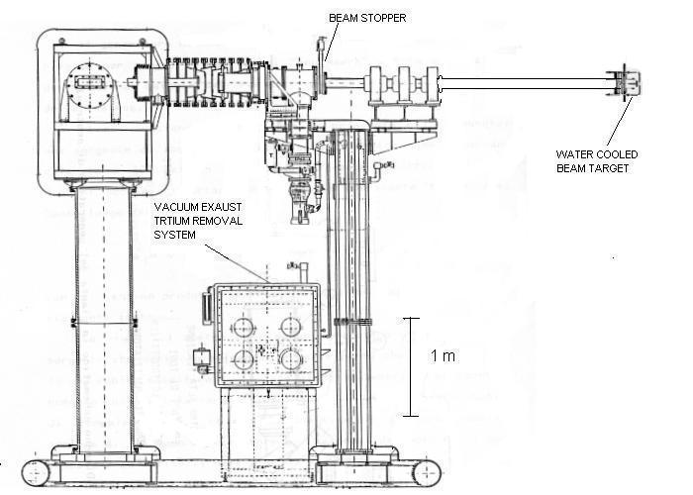
The Frascati neutron generator: main characteristics
 | D- T Mode | D – D Mode | D – D Mode
Max neutron yield | 1x10¹¹ n/s | 1x10⁹ n/s | 1x10⁹ n/s
Max neutron flux → volume | 5x10⁹ n/cm²/s – 1 cm³ | 5x10⁷ n/cm²/s – 1 cm³ | 5x10⁷ n/cm²/s – 1 cm³
Max irradiation volume → flux | ~1 cm³ | A few cm³ | ~1 cm³
Max irradiation time - targets | 50 hours (1 target) | Continuous | Continuous
Average utilization (year) | > 150 hours/years
Free time available for irradiation | 200 hours/years
Maximum achievable fluence | 5x10¹⁵ on a 1 cm³ sample | 5x10¹³ on a 1 cm³ sample
FNG is a linear electrostatic accelerator with 270 keV and up to 1 mA D+ ions are accelerated to hit:
tritiated target, producing 14 MeV neutrons via the nuclear fusion reaction D(T,n)α
deuterated target, producing 2.45 MeV neutrons, via the nuclear fusion reactions D(D,n) ³He (D self-implantation)
The maximum available neutron flux on small samples placed close to the target is 5x10⁹ n/(cm²s) (D-T), 5x10⁷ n/(cm²s) (D-D)
The spatial distribution of neutrons emitted by the target is almost isotropic

Slide 6
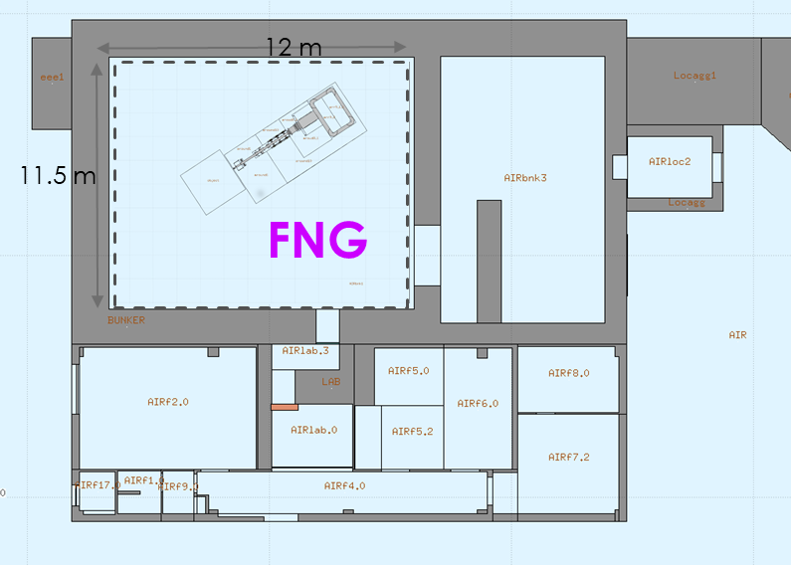
The Frascati Neutron Generator: bunker hall
FNG is housed in a large shielded hall (11.5 x 12 m² wide and 9 m high)
The target is more than 4 m far from walls, floor and ceiling.
The large hall reduces to a very low level the background of moderated/thermalized neutrons due to the reflection from the walls
Target holder is designed to reduce spectrum contamination due to neutron scattering

Slide 7
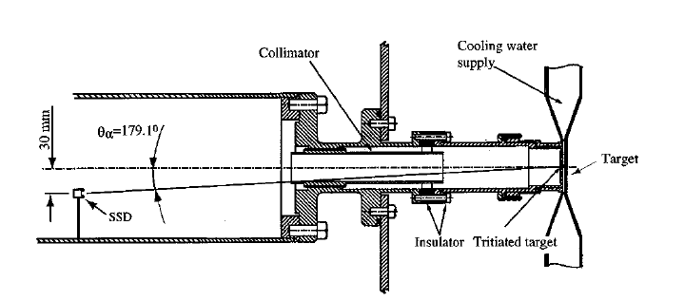
14 MeV Neutron flux measurement at FNG
Precise, real-time flux measurement is mandatory to perform cross section measurements (physical and SEEs), detector characterization and Monte Carlo benchmark experiments
On-line monitoring exploits associated α-particle detection by a Silicon Surface barrier Detector (SSD) placed in the vacuum pipe
ISO 9001 certified calibration

Slide 8
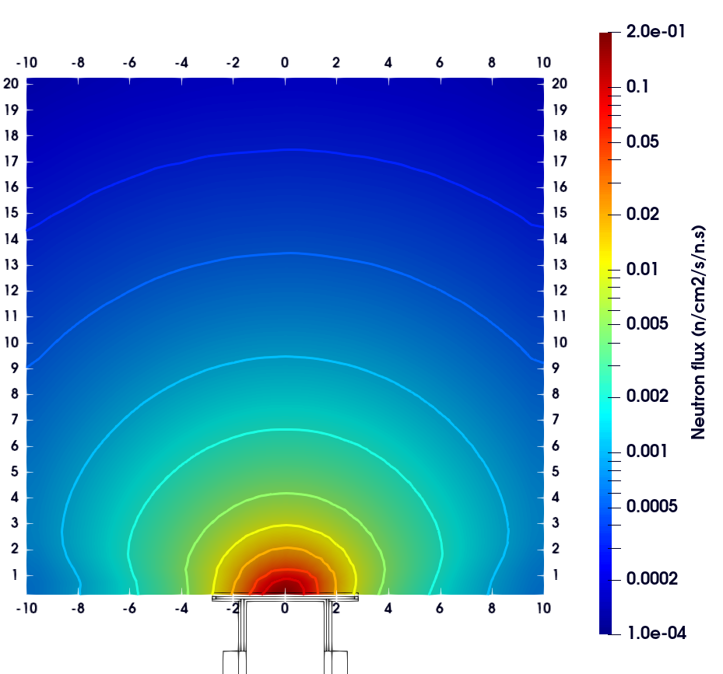
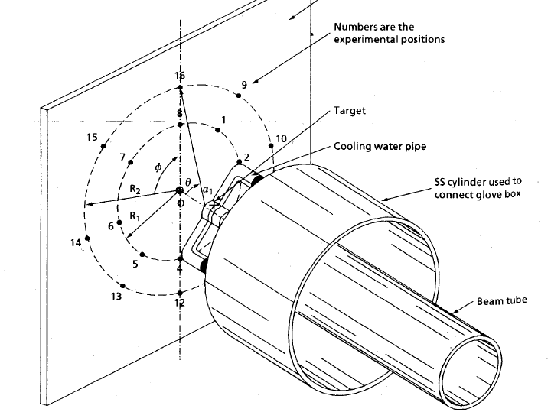
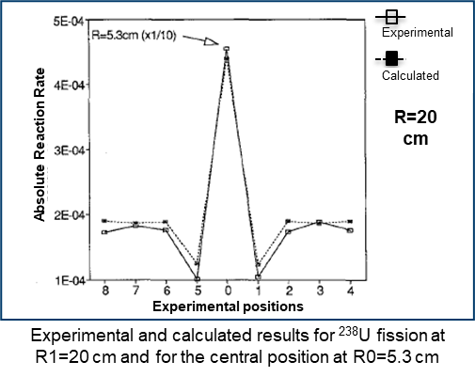
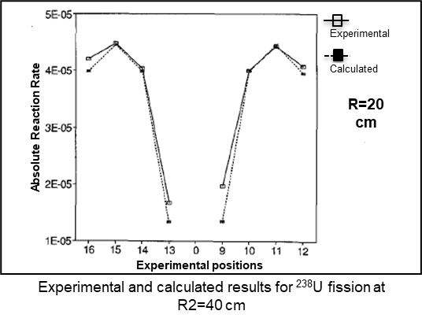
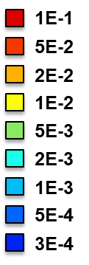
MCNP Model of FNG target and neutron source
A Monte Carlo model of the FNG target, including bunker hall, has been developed using MCNP
The neutron source has also been developed to completely describe the neutron emission
Characterization campaigns were performed to check the reliability of the MCNP DT neutron source routine in 1992-1993, and repeated in 2005 in collaboration with JAERI (now QST)
Fission Chambers have been used to characterize the neutron emission around the source, and collected data have been compared with the MCNP model

Slide 9
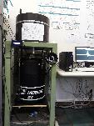
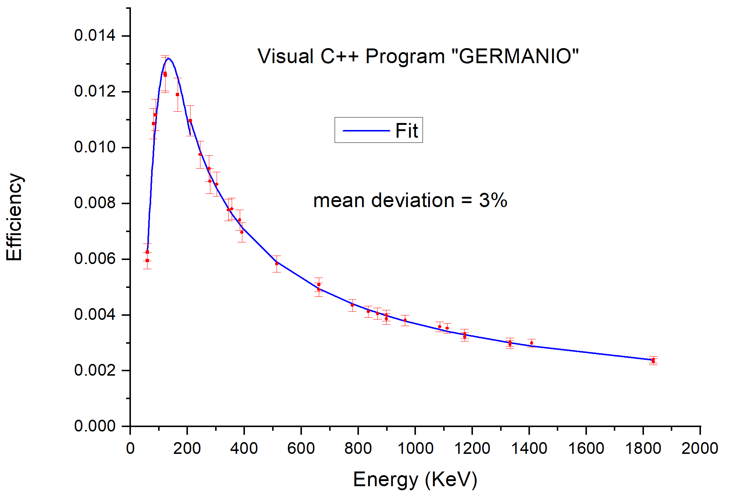
FNG Quality assurance process
Administrative and Experimental Activities recorded in a Relational database (MariaDB) and elaborated by a home-made software (Diogene) installed in a secure NAS system
List of individual user accesses
List of users, typology, total access days, total dose
Records of all the administrative steps
Every FNG Shot is recorded in the database through an experiment id, progressive shot number, Start, Stop, neutron yield
Reference Metrological Chain for FNG calibration
ENEA INMRI
U=2.7%
Calibration of HPGE detector
Total Uncertainty
(neutron yield)
3.1%
U < 1%
Certificated point sources
U < 3%
Use of acrtivation foils for FNG calibration
U=3%

Slide 10
Activities at the Frascati Neutron Generator
Benchmark experiments for validation of neutronics codes and nuclear data​
Development of new detectors ​(e.g. optical fiber detectors, GS20)
Detectors calibration ​
Radiation induced effects on electronics
Efficiency of dosimeters ​
Irradiation of biological samples (for dosimetry and radiation effects in hostile environments for living organisms as space)

Slide 11
Activities at the Frascati Neutron Generator
Benchmark experiments for validation of neutronics codes and nuclear data​
Development of new detectors ​(e.g. optical fiber detectors, GS20)
Detectors calibration ​
Radiation induced effects on electronics
Efficiency of dosimeters ​
Irradiation of biological samples (for dosimetry and radiation effects in hostile environments for living organisms as space)

Slide 12
Radiation effects on electronics in a nutshell
Total Ionizing Dose (TID)
Degradation of electronics parameters with passing of the time
Cumulative effects
Depend only on dose, not on particles
Displacement Damage (DD)
Displacement of lattice atoms
SEU
Soft Effect
SET
A single ionizing particle hits the sensitive area of a powered device compromising its functionality.
Single Event Effects (SEE)
SEFI
SEL
Depend on type and energy of the radiations
Hard Effect
SEBO
SEGR

Slide 13
FNG for radiation testing of electronic components
Considering characteristics of the generator it represents a unique facility to test electronic devices under neutron irradiation. Wide range of application can be tested at FNG:
Nuclear instrumentation
Avionics
Fusion research
Aerospace
Particles accelerators
Presently FNG is involved several projects regarding the investigation of radiation effects on electronic devices:
RADNEXT (RADiation facility Network for the EXploration of effects for indusTry and research)
ASIF (ASI supported radiation facility program)
GENeuSIS ENEA project (General Experimental Neutron System Irradiation Station)

Slide 14
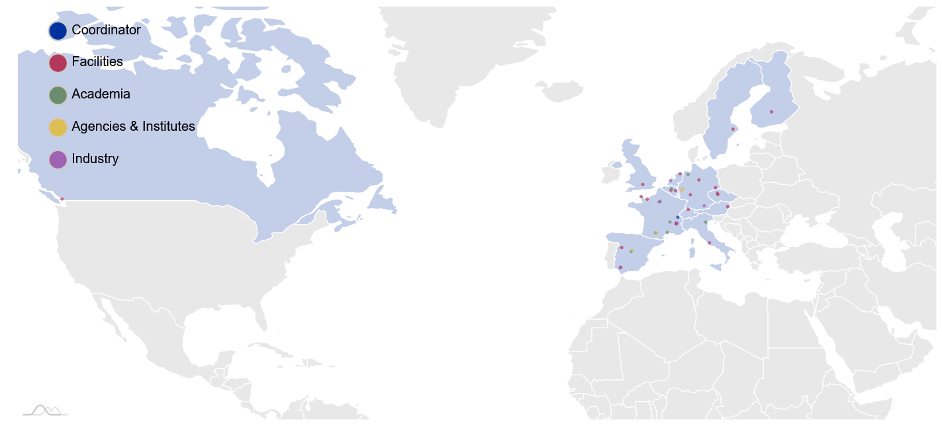
The RADNEXT project
RADiation facility Network for the EXploration of effects for indusTry and research
RADNEXT is an H2020 INFRAIA-02-2020 infrastructure project, led by CERN, with the objective of creating a network of facilities and related irradiation methodology for responding to the emerging needs of electronics component and system irradiation; as well as combining different irradiation and simulation techniques for optimizing the radiation hardness assurance for systems, focusing on the related risk assessment.
22 irradiation facilities
8 Academia centers
4 agencies
5 industries
Partner and associates
6 irradiation facilities
9 Academia centers
3 agencies
24 industries
Supporters
Reference to the project
R. G. Alía et al., "Heavy Ion Energy Deposition and SEE intercomparison within the RADNEXT irradiation facility network", in IEEE Transactions on Nuclear Science, doi: 10.1109/TNS.2023.3260309 .

Slide 15
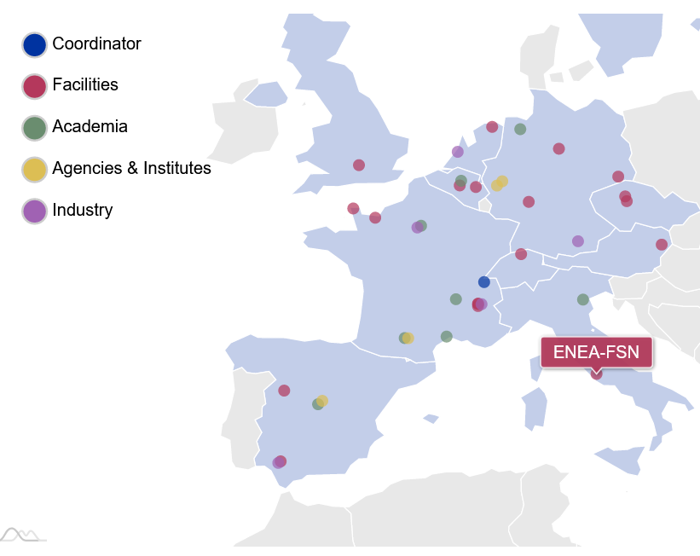
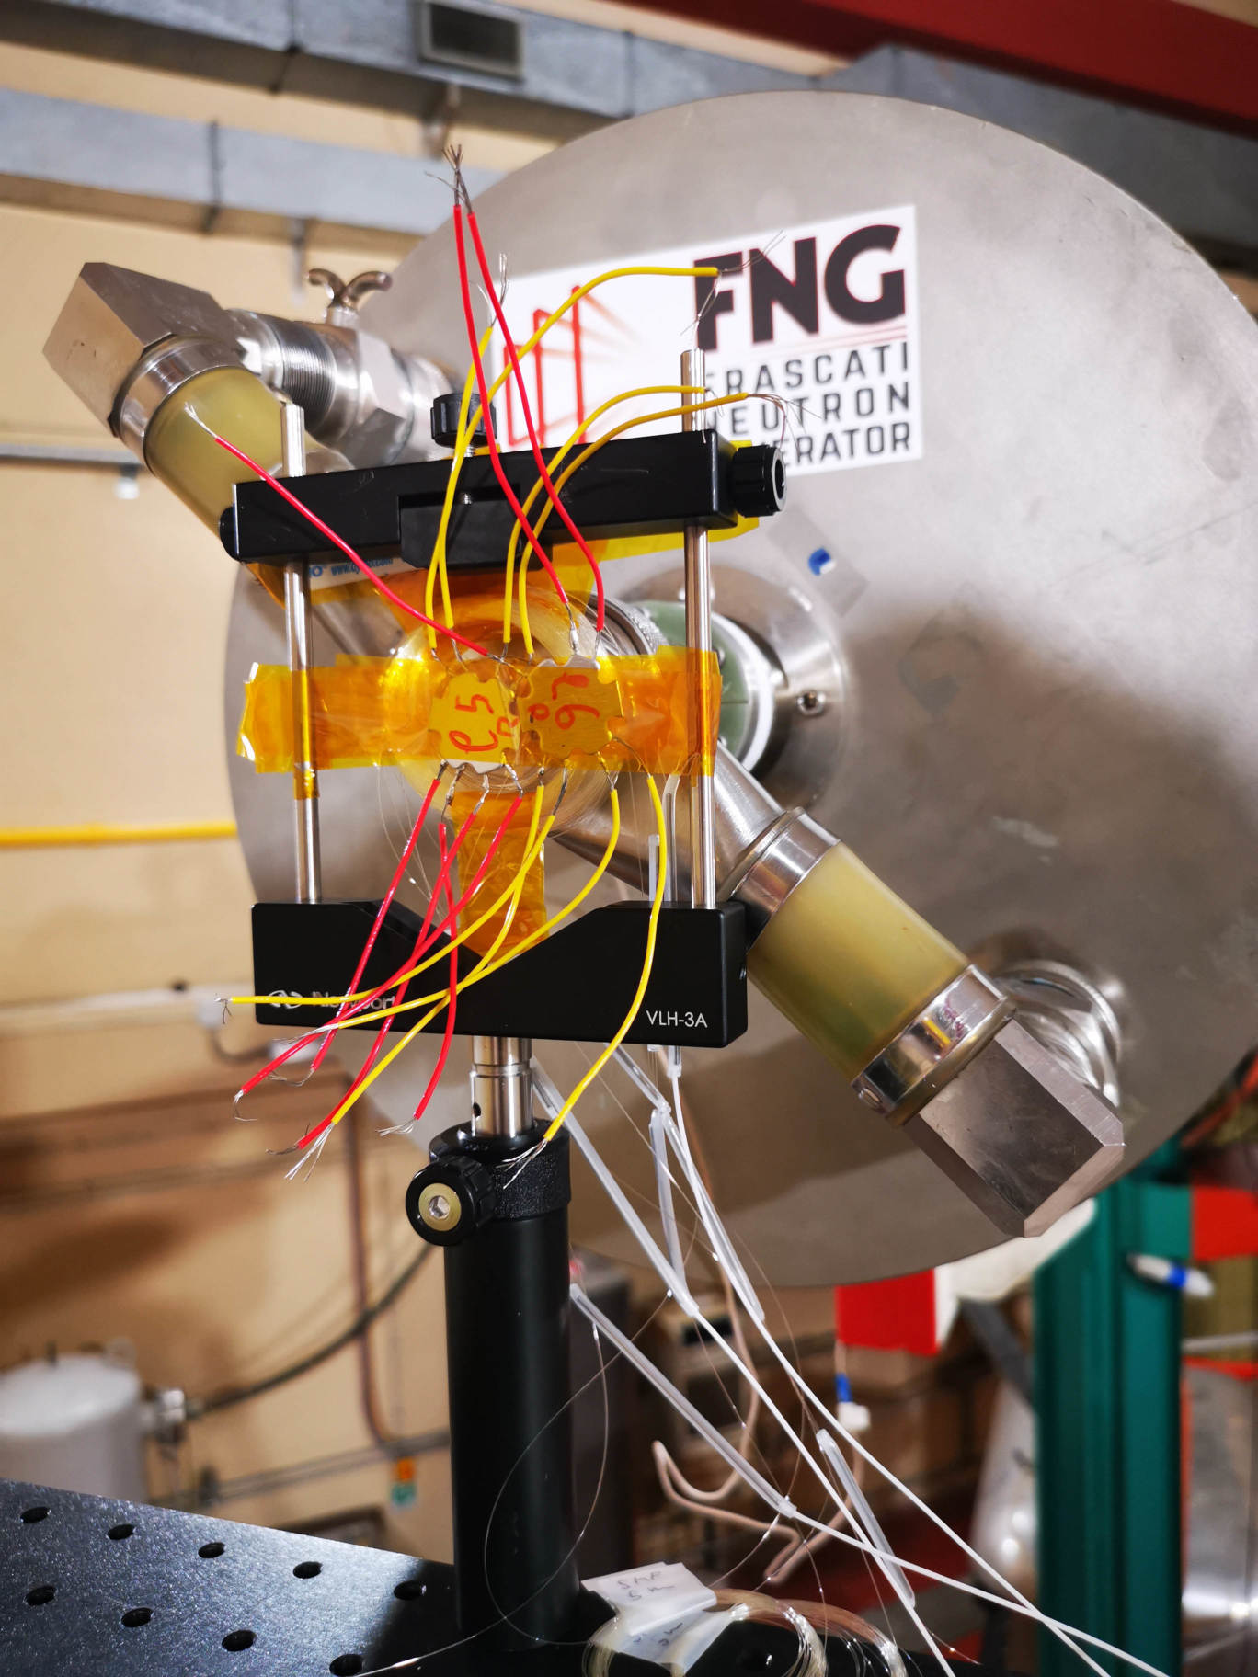
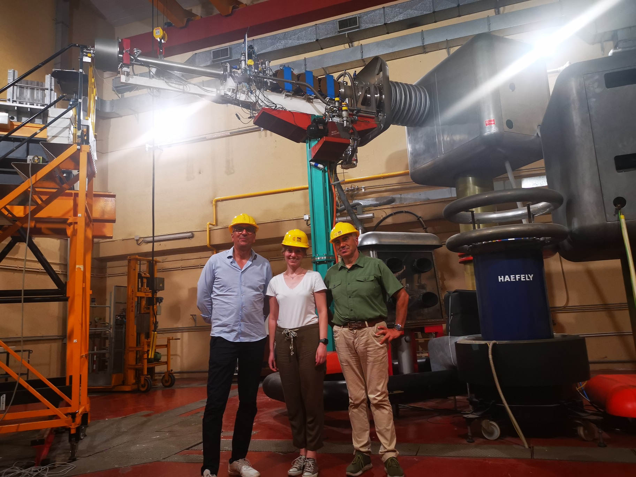
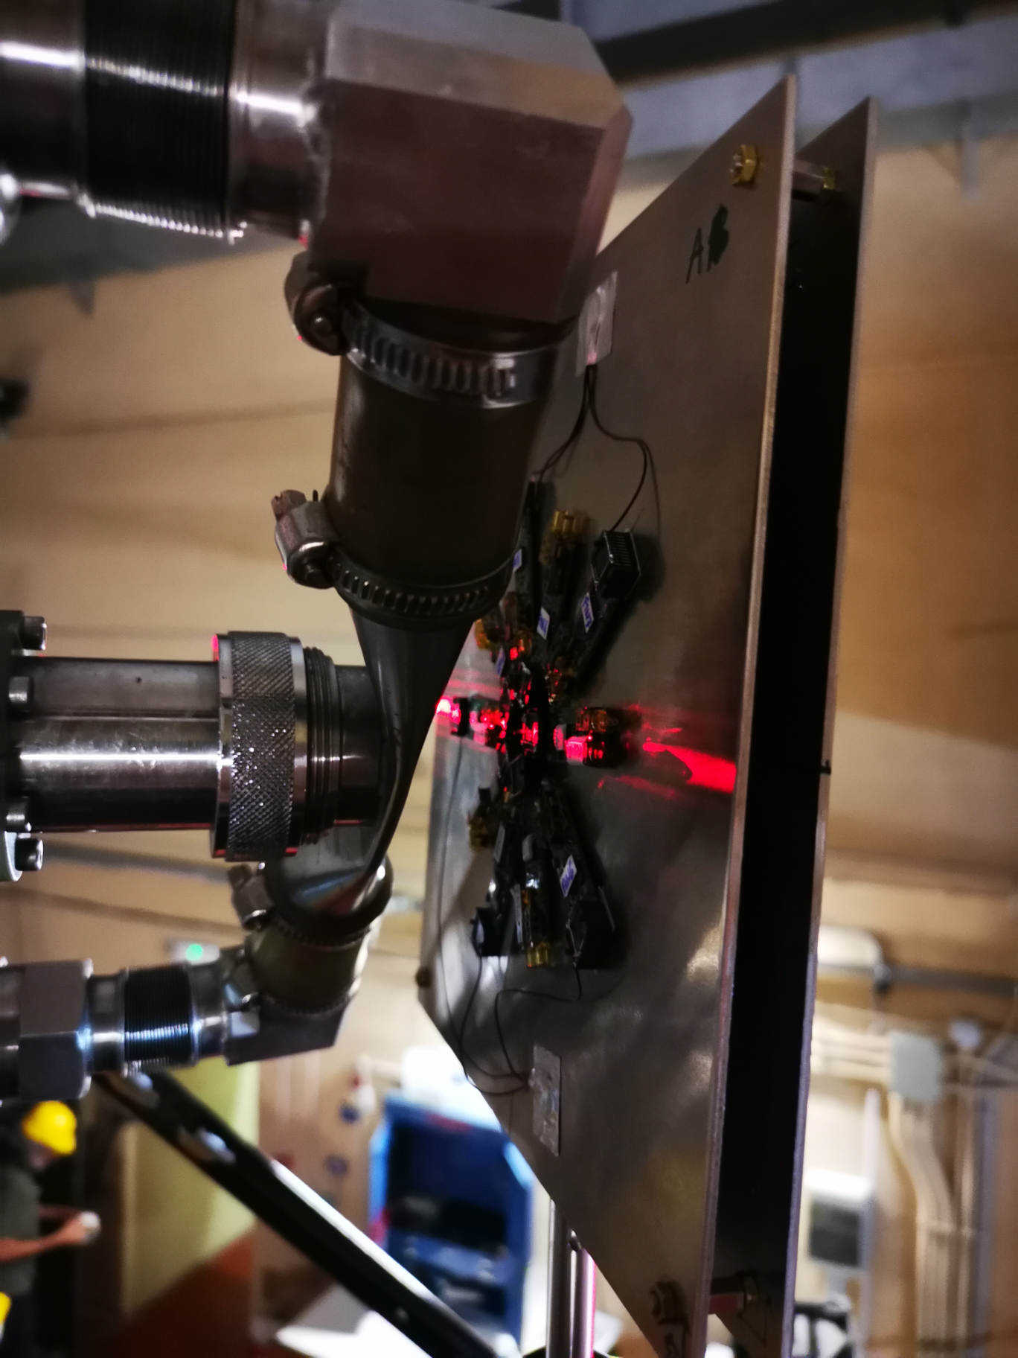
FNG in RADNEXT
In the frame of RADNEXT, ENEA is involved in the Transnational Access program with FNG facility for testing electronic devices under 14 and 2.45 MeV neutron irradiation.
FNG is involved in the project since the beginning (2021) and, presently, results as one of the best irradiation facility for completed experiments, availability and reliability.
More than 250 hours of experiments, including beam delivered, experimental setups and experiment preparation have been spent at FNG.
Examples of RADNEXT test done at FNG
Neutron test for photosensors for Crilin experiment
Study of Displacement damage effects on octocouplers
Study of neutron irradiation on active implanted medical devices
14 MeV neutron calibration of Fiber Optic Dosimeters
DVS and Environment Sensitivity Evaluation for Radiation Vulnerability of COTS SRAMs

Slide 16
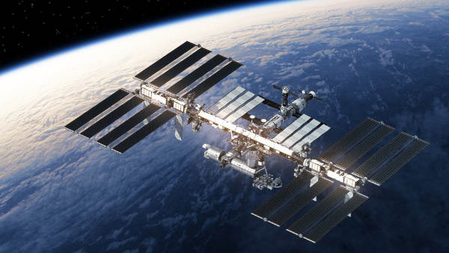
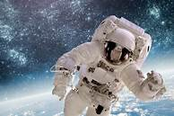
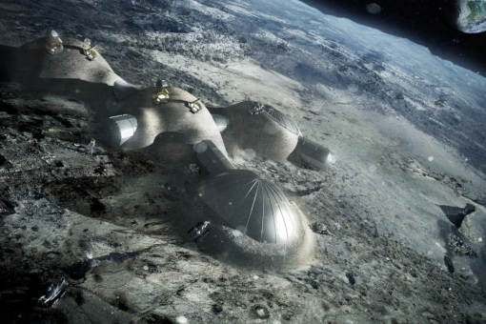
The ASIF program: space radiation conditions
Radiation sources
Primary particles
Shielding
Secondary radiation
87% protons
12% Helium
1% Heavy nuclei
100 MeV – 100 GeV
Galactic cosmic rays
Neutrons
Protons
Electrons
X-rays
Gamma rays
Recoil heavy nuclei
92% protons
6% Helium
2% Heavy nuclei
keV – 100 MeV
Solar particle events
Electrons & Protons
1 MeV – 100 MeV
Earth radiation belt
Curtesy of A. Cemmi

Slide 17
The ASIF Program: ASI supported Irradiation facilities
The ASIF program aims to establish a coordinated network of the Italian irradiation facilities (ENEA, INFN)
to grow the knowledge of the space radiation environment (radiation damage, simulation and modelling tools, EEE supply chain)
Private Companies
Public users
Standard ESA-ESCC qualification
Phase I (2017-2019)
Phase II (2022-2025)
Selection of facilities
Standardization of the facilities and operating procedures
Dosimetry
Increase the number of facilities
Standardization, dosimetry
Interactive portal implementation (ASIF gateway)
Many activities for testing electronics in space environment have been performed at FNG within the ASIF program

Slide 18
The GENeuSIS project
GENeuSIS
A Novel concept of neutron test bed facility
Assembly to be located in front of DT neutron generator to reproduce in a proper irradiation region the neutron and gamma energy spectra (with embedded gamma sources) expected in the positions in which the components/systems of interest will be installed in ITER.
General
Experimental
Neutron
Systems
Irradiation
Station
Neutron diagnostics calibration
Test for critical diagnostics/ systems with low radiation tolerance
Single Event Effects study on electronics
Recent studies focused to reproduce some ITER relevant neutron energy spectra using the 14 MeV neutrons produced at the FNG
Curtesy of R. Villari

Slide 19
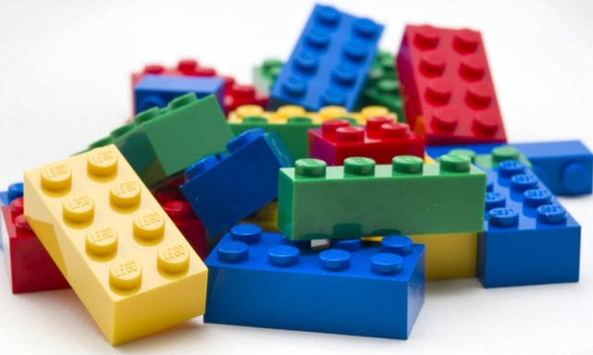
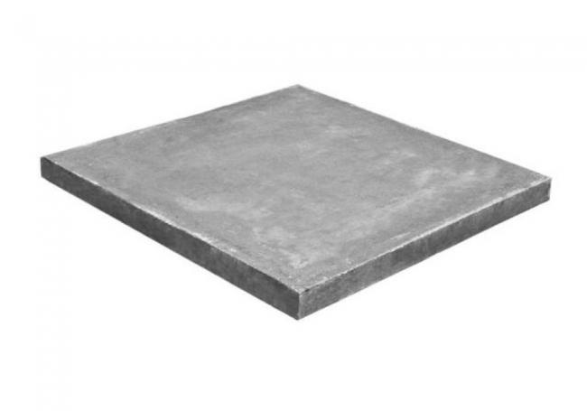
The GENeuSIS project: Design requirements & features
Modular
Bricks + sheets assemby
Combination of common materials
SS316L, Perpex, Borated polyethilene, Lead, Tungsten, Copper, Teflon, Cd, Boron Carbide, etc...
Trasportable
Easy mounting/dismounting to be used also in other similar neutron facilities.
Flexible
The replacement/substitution of bricks/layers to reproduce various neutron spectra. Housing for gamma sources to reproduce various gamma spectra
Customizable
Experimental cavity (ies) adjustable and customizable to the system/component under test
Curtesy of R. Villari

Slide 20
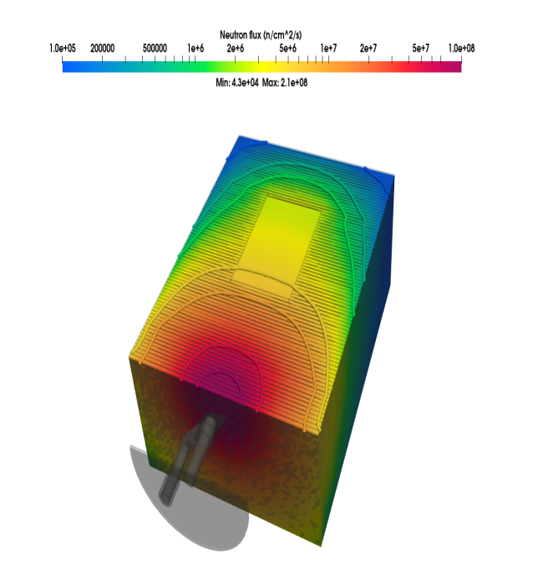
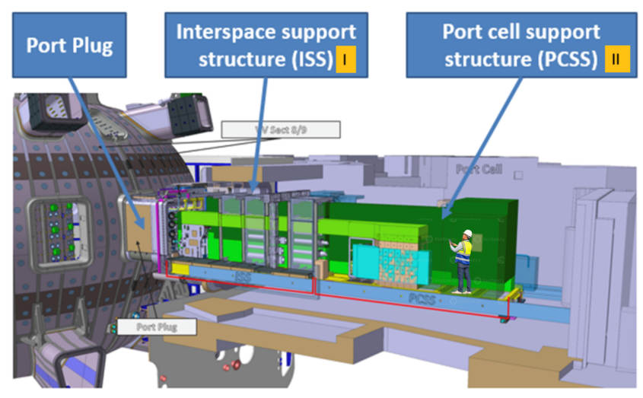
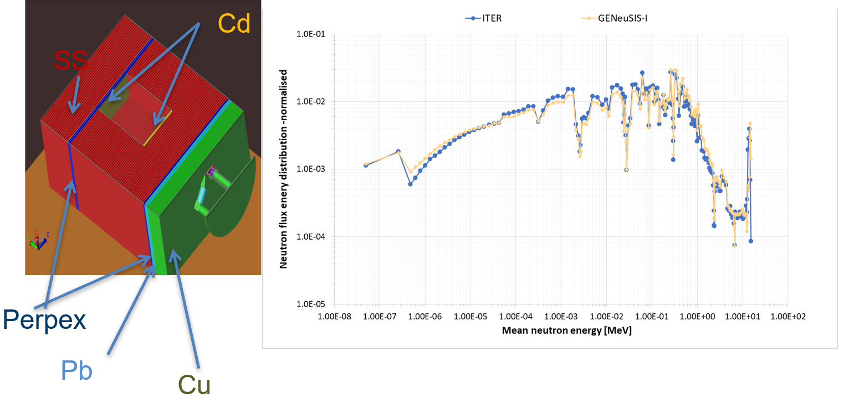
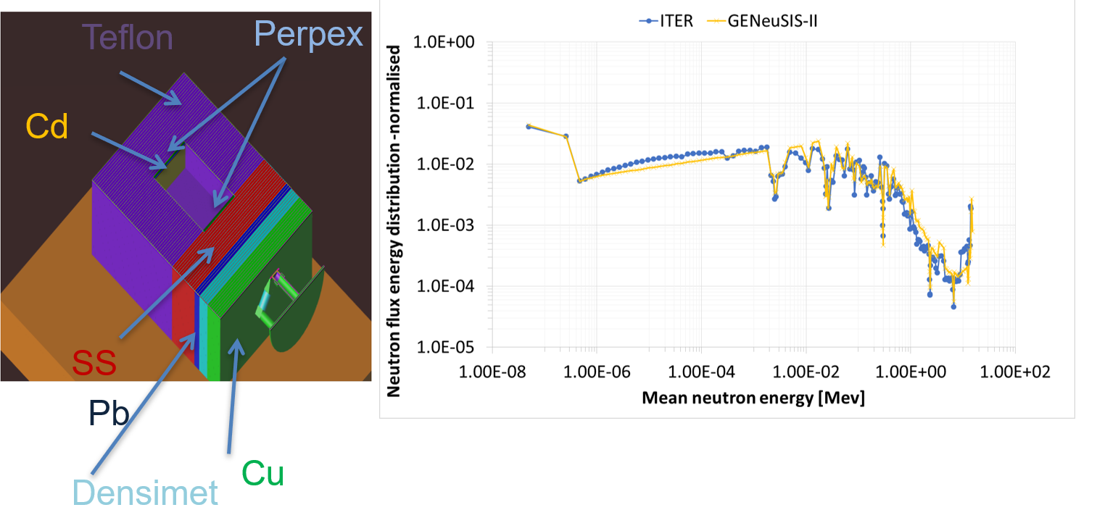
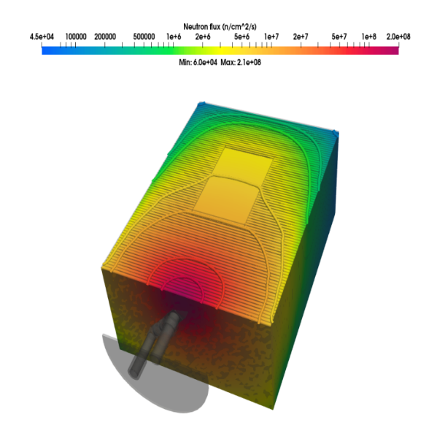
The Geneusis project
The goal is to perform at FNG specific tests aimed at studying the response and performance of active diagnostic systems, electronics and shielding optimization under ITER relevant conditions.
GENeuSIS-I
E.g., assemblies to replicate at FNG the neutron flux energy spectrum expected in a Diag Eq. Port:
Port Interspace (GENeuSIS-I)
Port Cell (GENeuSIS-II)
GENeuSIS-II

Slide 21
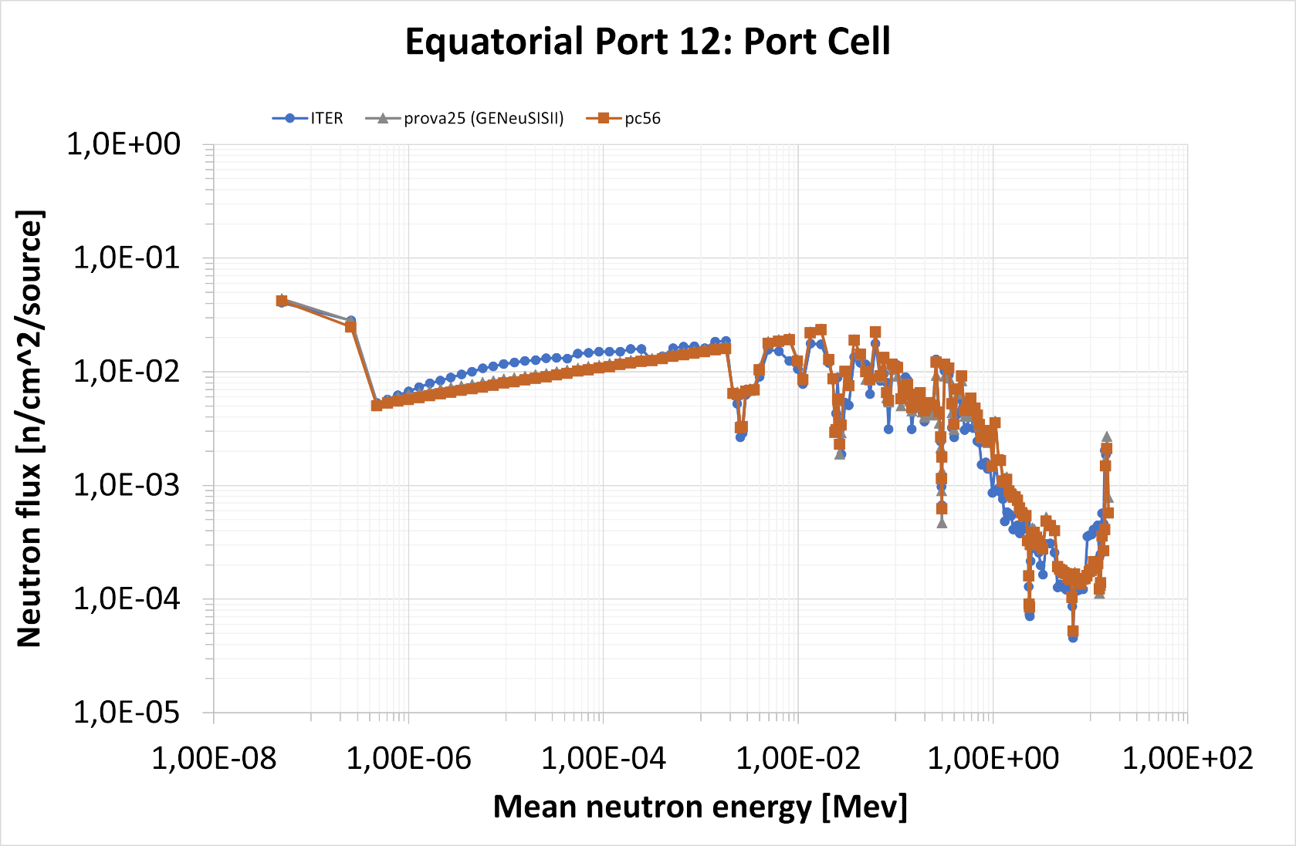
The Geneusis project
Further improvement

Slide 22
Conclusions
The Frascati Neutron Generator has started in the last few years an intense activity on testing neutron induced effects on electronic devices
These activities cover a wide range of application: Nuclear Fusion, Accelerators, Spatial Manners, Nuclear Fission, Avionics, Medical applications
FNG is involved in many international project such as RADNEXT and ASIF
A novel and innovative project called GENeuSIS has started last year to build a modular irradiation station for testing electronics under neutron and gamma radiation
FNG staff is continuously improving its knowledge and equipment on these projects by delivering hundreds of hours of beam time and collaborating with many institutions

Slide 23
Conclusions
The Frascati Neutron Generator has started in the last few years an intense activity on testing neutron induced effects on electronic devices
These activities cover a wide range of application: Nuclear Fusion, Accelerators, Spatial Manners, Nuclear Fission, Avionics, Medical applications
FNG is involved in many international project such as RADNEXT and ASIF
A novel and innovative project called GENeuSIS has started last year to build a modular irradiation station for testing electronics under neutron and gamma radiation
FNG staff is continuously improving its knowledge and equipment on these projects by delivering hundreds of hours of beam time and collaborating with many institutions
We look forward to facing new collaborations and exciting challenges!

Slide 24
Andrea Colangeli
andrea.colangeli@enea.it
Thank you!

