Slide 1


Exploring the Durability of thin carbon-backed lithium fluoride targets bombarded by 68 MeV ¹⁷O beams:
A Theoretical and Experimental Analysis
The 16th workshop on Shielding aspects of Accelerators, Targets and Irradiation Facilities, May 28-31, INFN-LNF, Italy
Yong Hyun Kim^{1,2}, Hee-Seock Lee¹, Mahdi Bakhtiari¹, Barry Davids ³
¹ Pohang Accelerator Laboratory (PAL), South Korea
² Hanyang university, South Korea
³ TRIUMF, Canada
May 31, 2024

Slide 2

Table of Contents
1. Introduction
2. Analysis on the target degradation
a) Thermal evaporation (Sublimation)
b) Sputtering
c) Radiation damage
3. Result & discussion
4. Conclusion

Slide 3
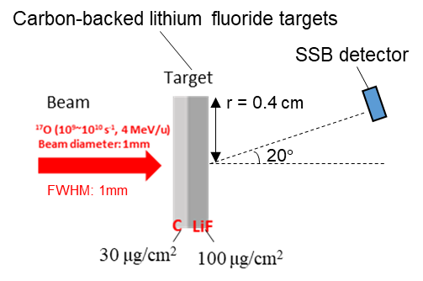
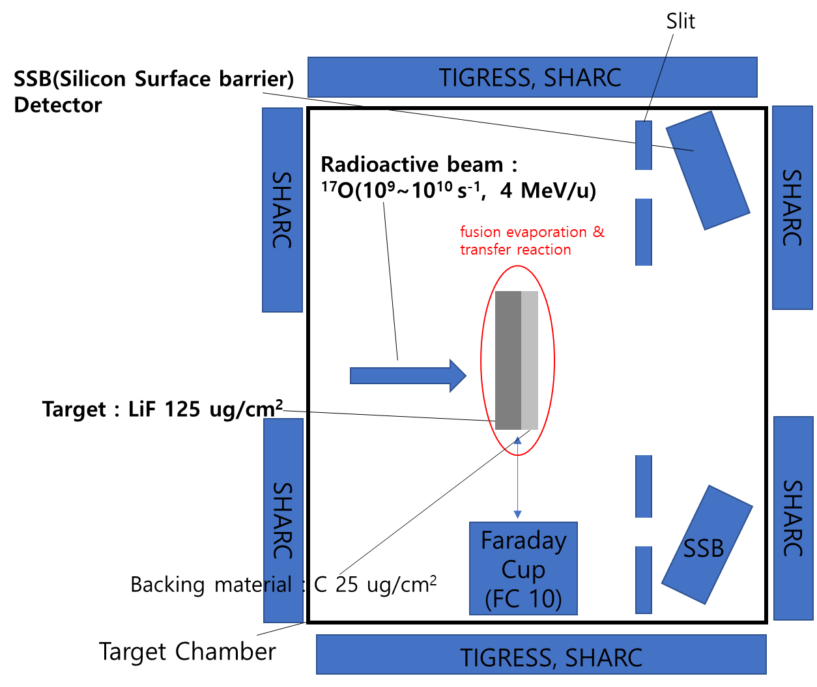
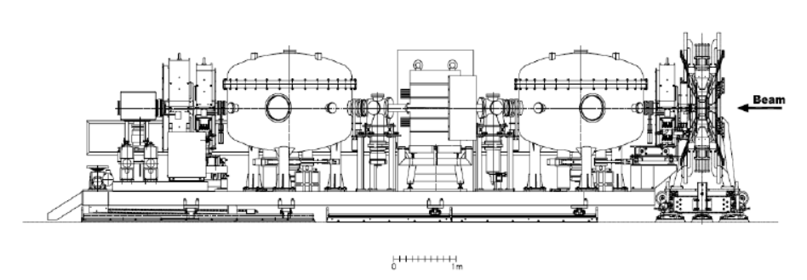
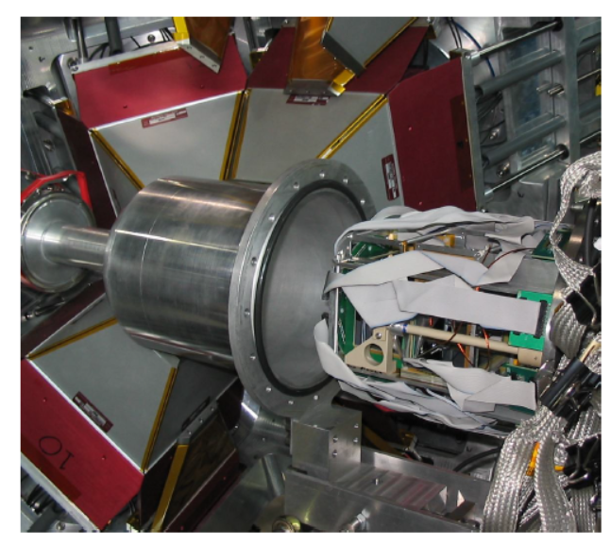
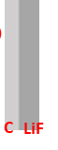
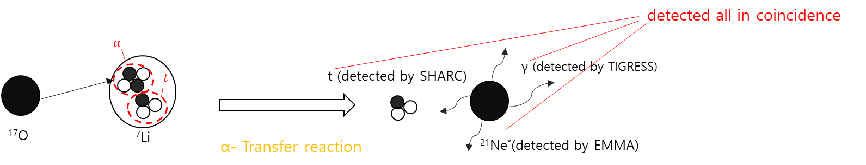
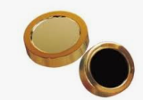

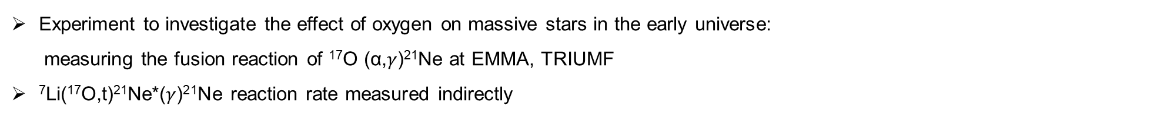


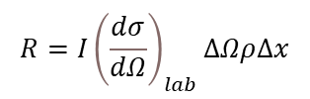
01
Introduction
Experiment to investigate the effect of oxygen on massive stars in the early universe:
measuring the fusion reaction of ¹⁷O (α,$γ$)²¹Ne at EMMA, TRIUMF
⁷Li(¹⁷O,t)²¹Ne*($γ$)²¹Ne reaction rate measured indirectly
TIGRESS & SHARC
EMMA
¹⁷O
Target
⁷LiF 100ug/cm²
+ C 30ug/cm²
Electromagnetic recoil mass spectrometer
Target chamber
SSB detector (particle rate in detector)
- Detecting elastically scattered beam and target ions to monitor the beam flux and target content degradation
⁷Li(¹⁷O,t)²¹Ne*($γ$)²¹Ne reaction
$$R=I{\left(\frac{dσ}{dΩ}\right)}_{lab}∆Ωρ∆x$$
R : count rate
I : beam intensity
${\left(\frac{dσ}{dΩ}\right)}_{lab}$ : differential elastic scattering cross section,
ΔΩ : solid angle
: target mass density
Δx : target thickness
R/I ∝ $ρ∆x$(areal mass density of target)

Slide 4
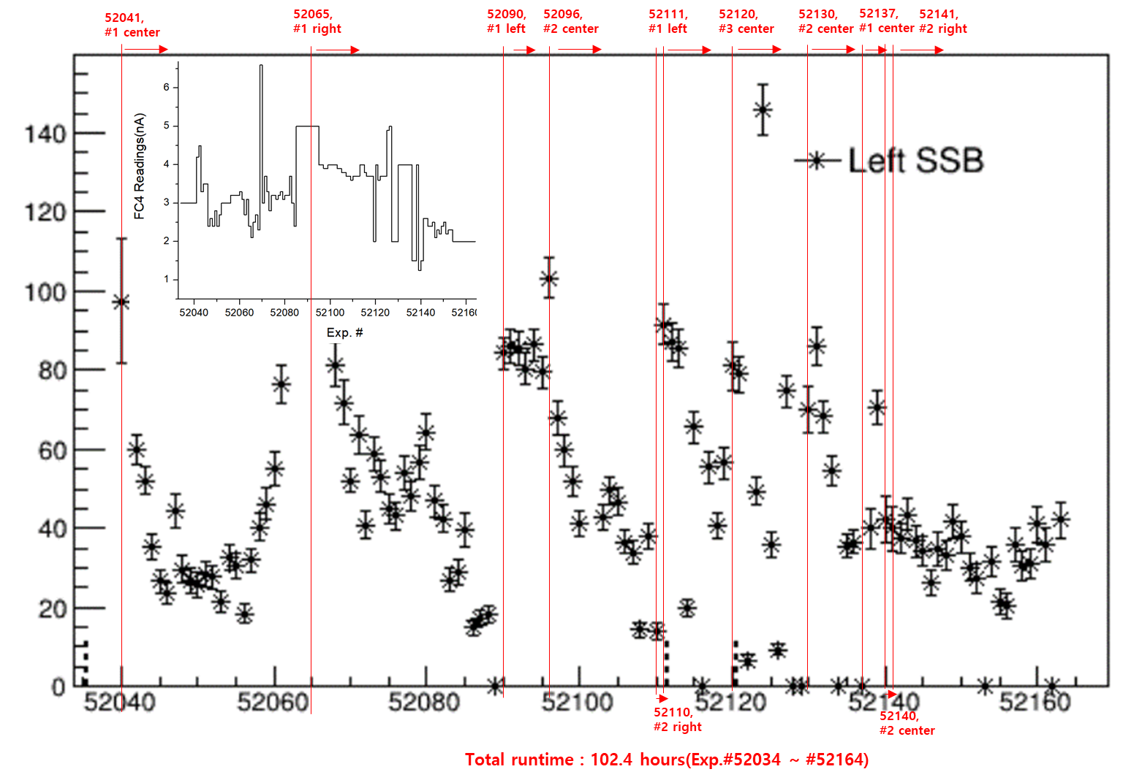

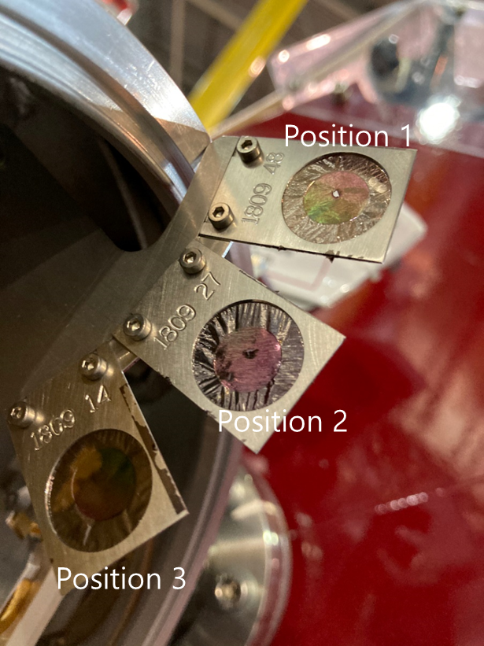
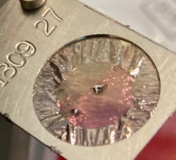
01
Introduction
Three identical targets were prepared in case of targets destruction
For each target, three areas could be selectively irradiated.
Running HISTORY about SSB(14th/12/2019~ 19th/12/2019)
center
right
left
Target #1
Target #2
Target #3
Count rate from SSB, R
During 6-day experiment, areas where beam hit were changed 10 times due to target degradation, which limited data acquisition
Target #3
Running number (each run ~ 1 hour)
Target #2
Target #1
After experiment
Experiment was postponed around 1 year due to target destruction
Time consuming & Costly
-> Each targets were rejected after 5~20 hours irradiation
Notes:
This is the plot about count rate history for each run from SSB detector during the measurement.

Slide 5
01
Introduction
Started to figure out the cause of target destruction (hole)
Approach
To analyze the cause of the destruction of the target bombarded with ¹⁷O beam,
a) Thermal evaporation (sublimation),
b) Sputtering (erosion rate), and
c) Radiation lattice damage
were explored.
Target lifetime was theoretically calculated by these three factors and was compared with the experimental target lifetime
5

Slide 6
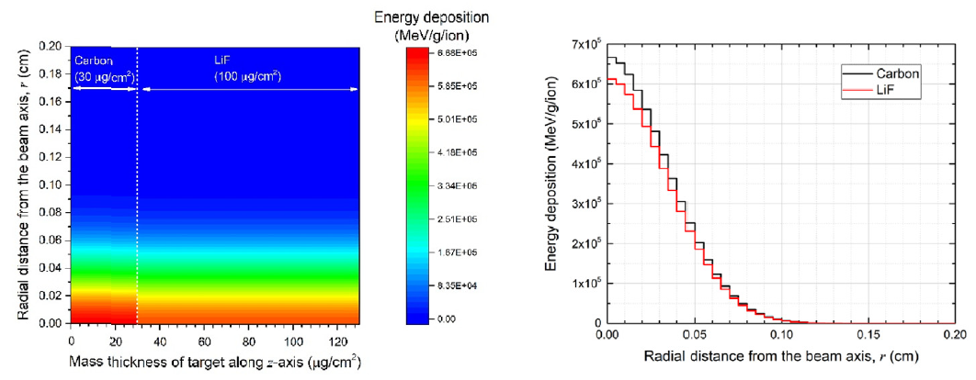
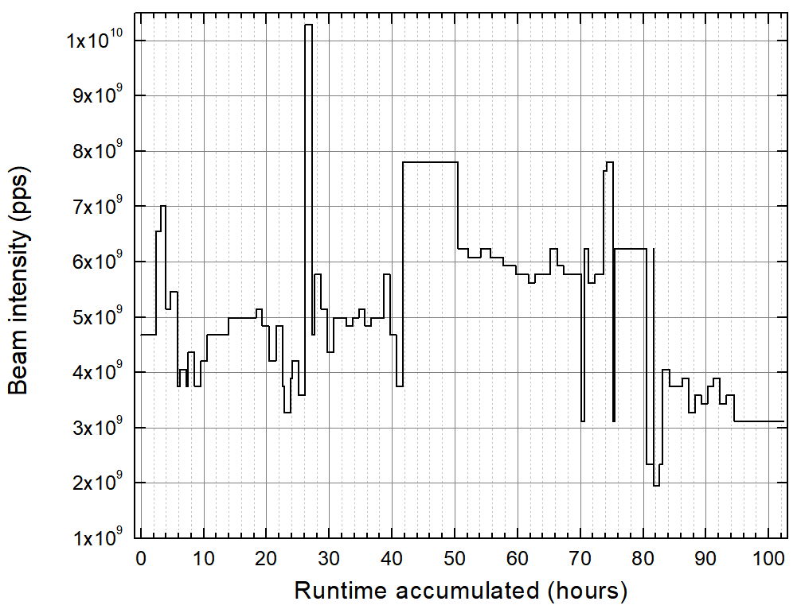
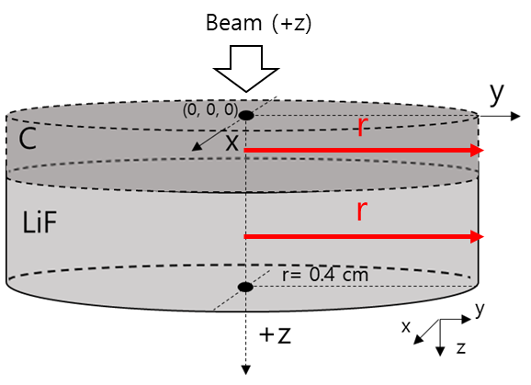
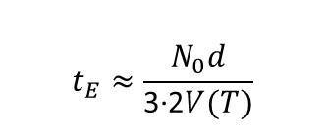
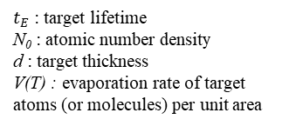
02
Analysis on the target degradation
a) Thermal evaporation (sublimation)
Thermal evaporation was calculated to estimate target lifetime
Analysis flow
Energy deposition –> Temperature -> Evaporation(sublimation)
Evaporation lifetime
By F. Nickel (1978)
(Tool: FLUKA)
(Tool: ANSYS)
$$t_{E}≈\frac{N_{0}d}{\text{3∙2}V(T)}$$
$t_{E}$: target lifetime
N₀ : atomic number density
d : target thickness
V(T) : evaporation rate of target atoms (or molecules) per unit area
Thin target lifetime $t_{E}$with respect to evaporation can be expressed as:
Energy deposition
(By FLUKA)
Energy deposition 2D map
Energy deposition v.s. radius
Beam intensity profile during exp.
¹⁷O⁴⁺ 2~7 nA
in: 68 MeV
out: 67.42 MeV
Assumption: beam intensity = 1.0 $×{10}^{10}$ ions/s
the largest value used in the experiment
6

Slide 7
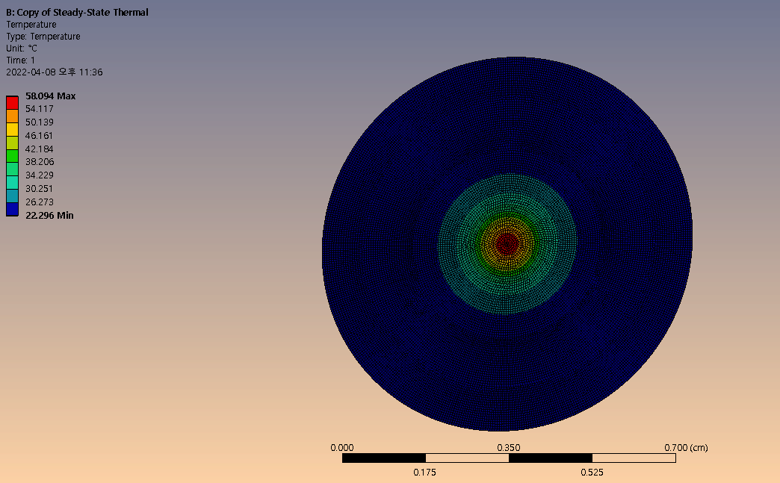


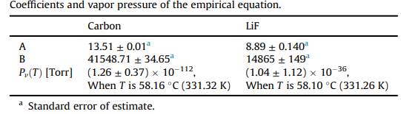
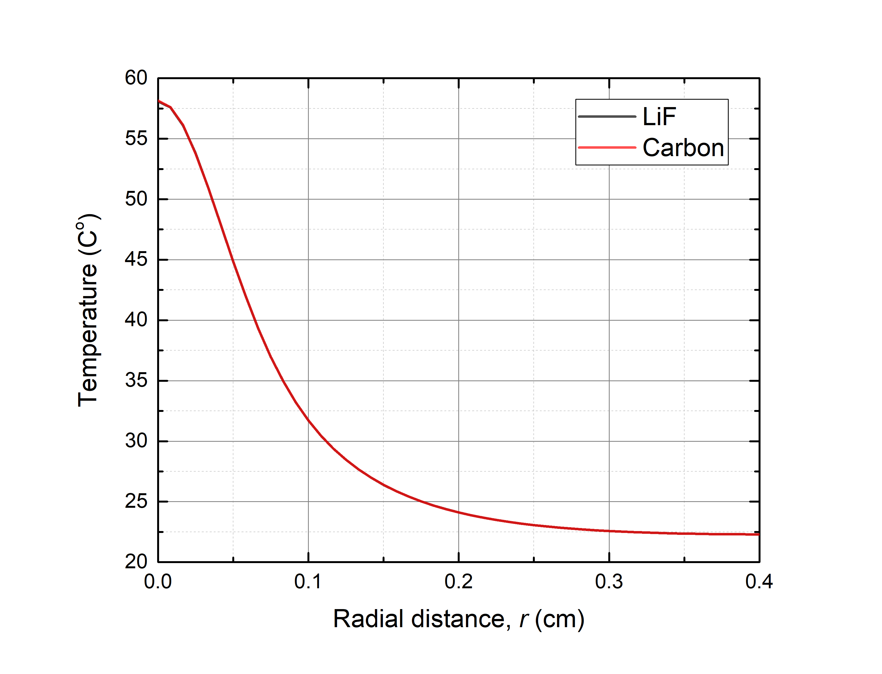
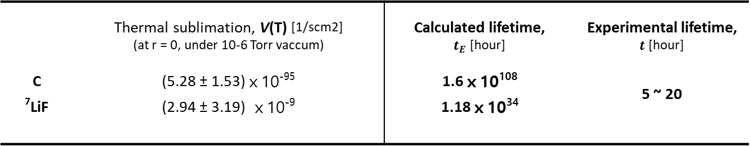
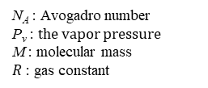

02
Analysis on the target degradation
a) Thermal evaporation (sublimation)
Sublimation can occur in vacuum at temperature below melting point
Temperature
Thermal sublimation (evaporation) flux, V(T)
steady-state thermal analysis
- Hertz-Knudsen Equation
Vapor pressure
N_{A} : Avogadro number
P_{v} : the vapor pressure
M : molecular mass
$R$: gas constant
R=0.4 cm
[1/s·cm²]
By ANSYS
Calculated lifetime $t_{E}$ determined by sublimation
 | Thermal sublimation, V(T) [1/scm2] (at r = 0, under 10-6 Torr vaccum) | Calculated lifetime, $t_{E}$ [hour] | Experimental lifetime, $t$ [hour]
C | (5.28 ± 1.53)ⅹ10⁻⁹⁵ | 1.6ⅹ10¹⁰⁸ | 5 ~ 20
⁷LiF | (2.94 ± 3.19) ⅹ10⁻⁹ | 1.18ⅹ10³⁴
Center (r =0) of C : 58.16 ºC
Center (r =0) of ⁷LiF : 58.10 ºC
Assumption: beam intensity = 1.0 $×{10}^{10}$ ions/s
Beam intensity= ${10}^{9} \sim {10}^{10}$ ions/s
Background Temp. : 22 ͦC
-> No effect on target degradation and target lifetime
7

Slide 8
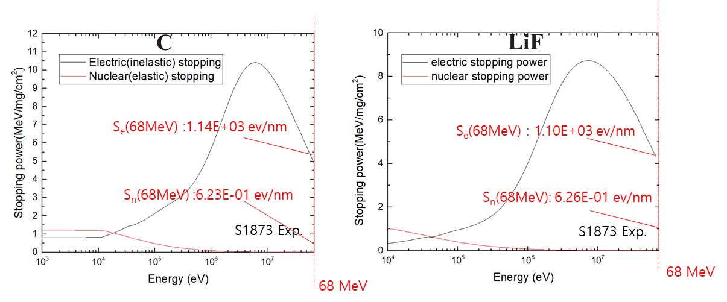
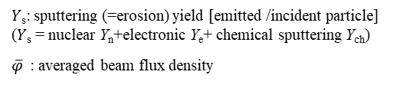

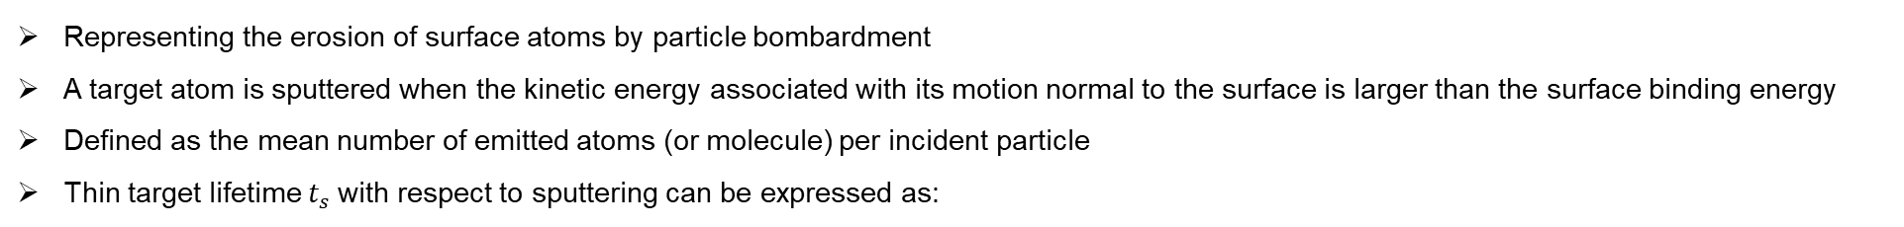
02
Analysis on the target degradation
b) Sputtering
Representing the erosion of surface atoms by particle bombardment
A target atom is sputtered when the kinetic energy associated with its motion normal to the surface is larger than the surface binding energy
Defined as the mean number of emitted atoms (or molecule) per incident particle
Thin target lifetime $t_{s}$with respect to sputtering can be expressed as:
Sputtering lifetime
By J. Yntema, F. Nickel (1978)
$$t_{S}≈\frac{N_{0}d}{\text{3∙}Ys\overline{φ}}$$
$Y$_{s}: sputtering (=erosion) yield [emitted /incident particle]
($Y$_{s} = nuclear Y_{n}+electronic Y_{e}+ chemical sputtering Y_{ch})
$\overline{φ}$ : averaged beam flux density
Sputtering consists of three types: Electronic, Nuclear, and chemical sputtering
Total sputtering is calculated as the sum of these types
Nuclear S_{n} & electronic Stopping power S_{e} at target
(By SRIM[1] stopping range table)
Sputtering
Electronic
sputtering
Nuclear
sputtering
Chemical
sputtering
→ governed by S_{e}
→ governed by S_{n}
→ governed by chemical reaction
Beam energy
-> Electronic stopping power in C and LiF was predominant at 68MeV
8
[1]J.F. Ziegler, The Stopping and Range of Ions in Solids, SRIM Co. (2008).

Slide 9
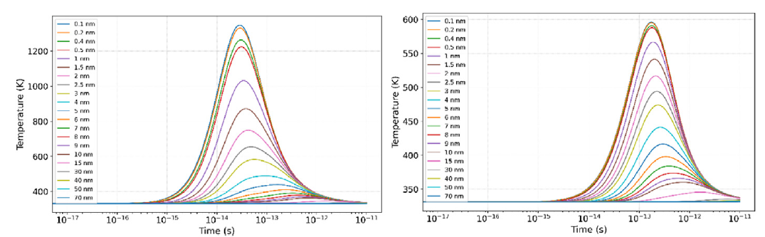
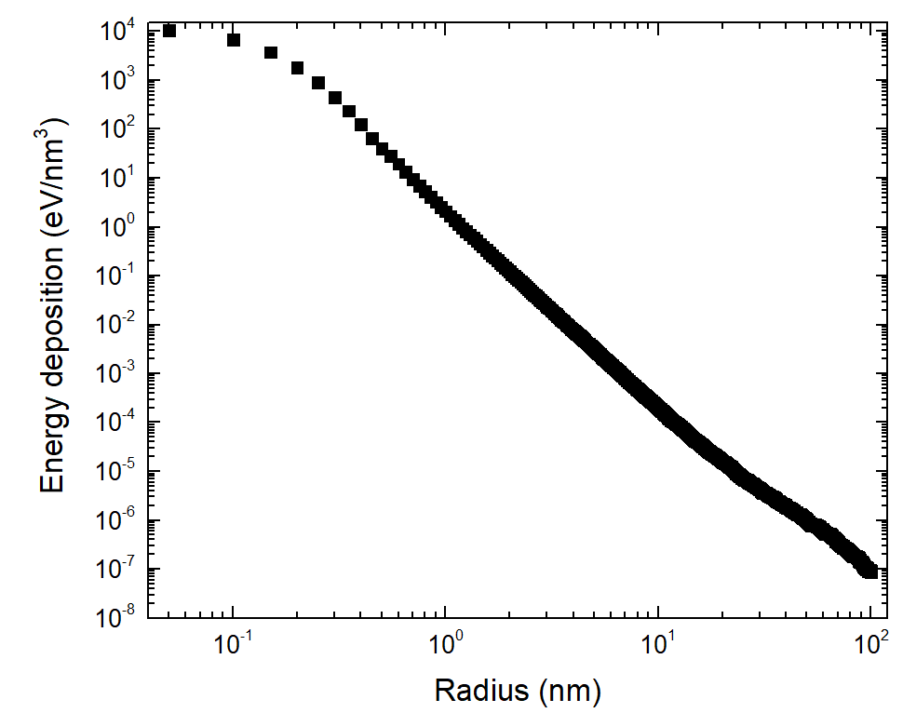


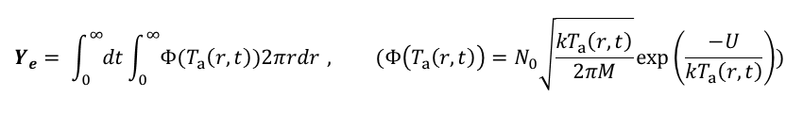


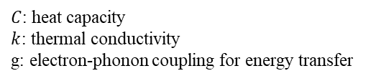

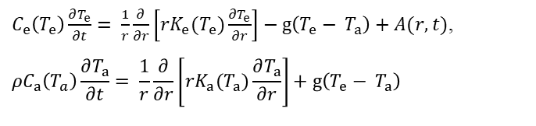
02
Analysis on the target degradation
b) Sputtering
Electronic sputtering
Electronic sputtering Y_{e}: energy deposition from high-energy ions (>1 A MeV) through ionization and electronic excitations leads to surface evaproation
i-TS model used to calculate electronic sputtering yield (i-TS model : best explains observed electronic sputtering yields quantitatively)
- Heat diffusion in the electron & lattice subsystems by two coupled differential equations:
Temperature $T_{a}$ as a function of time at different radial distances from ion in nm.
$C_{e}\left(T_{e}\right)\frac{∂T_{e}}{∂t}= \frac{1}{r}\frac{∂}{∂r}\left[rK_{e}(T_{e})\frac{∂T_{e}}{∂r}\right]−g\left(T_{e}− T_{a}\right)+A(r,t)$,
$$ρC_{a}\left(T_{a}\right)\frac{∂T_{a}}{∂t}= \frac{1}{r}\frac{∂}{∂r}\left[rK_{a}(T_{a})\frac{∂T_{a}}{∂r}\right]+g\left(T_{e}− T_{a}\right)$$
$T_{a}$ for C
$T_{a}$ for ⁷LiF
Numerically solved using an explicit method
$C$: heat capacity
$k$: thermal conductivity
g: electron-phonon coupling for energy transfer
$$A(r,t)$$
Initial energy on electron
(Heat source by inelastic collision (i-TS model))
$$Y_{e}= \int_{0}^{∞}{dt}\int_{0}^{∞}{Φ(T_{a}\left(r,t\right))2πrdr} , (Φ\left(T_{a}\left(r,t\right)\right)=N_{0}\sqrt{\frac{kT_{a}\left(r,t\right)}{2πM}}\exp\left(\frac{−U}{{kT}_{a}\left(r,t\right)}\right))$$
electronic sputtering
lattice subsystem
$Φ$: local evaporation rate
T_{a}
Calculated electronic sputtering yield
Carbon film
-> Y_{e_c} = 9.74e-4 [emitted /incident particle]
⁷LiF film
-> Y_{e_LiF} = 4.8e-7 [emitted /incident particle]
$$By handcalculation$$
energy
Ref.: M. R. P. Waligorski(1986)
T_{e}
electron subsystem
- Deposited energy per ion v.s. radial distance to the ion path
incident ion
9

Slide 10
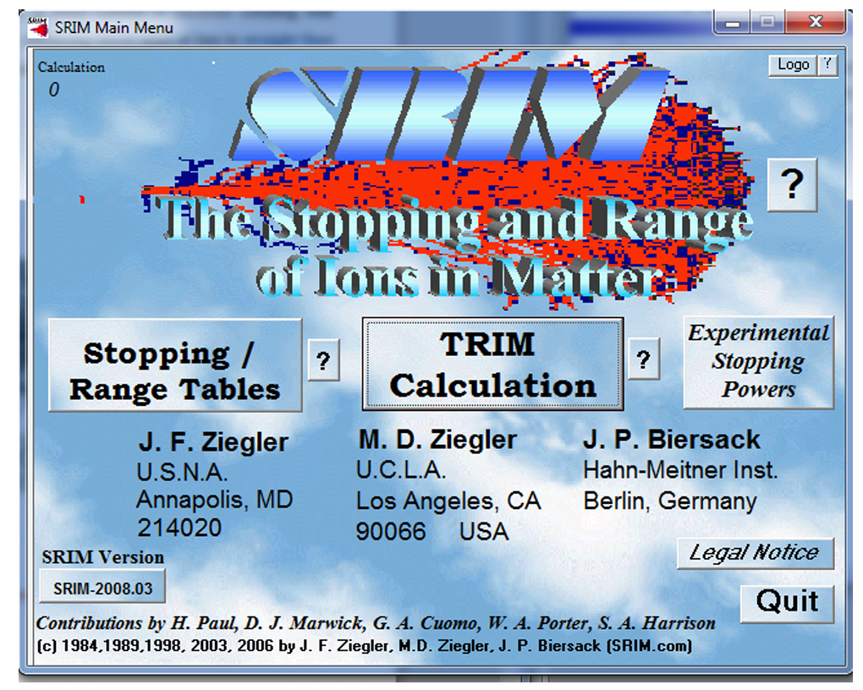
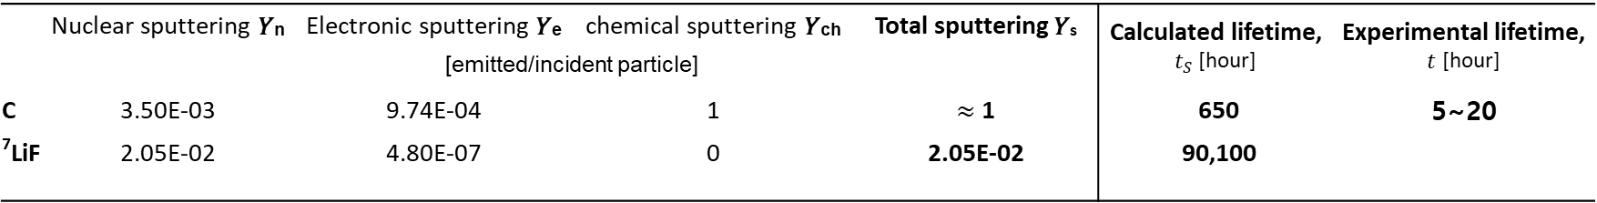

02
Analysis on the target degradation
b) Sputtering
Nuclear sputtering
Chemical sputtering
Caused by atomic collision cascades between the incoming particles and the atoms in the surface layers of a solid
Chemical reaction only between ¹⁷O beam and carbon film :
¹⁷O + C -> CO or CO₂
-> Chemical erosion in the form of volatile CO and CO₂
Total yield from both reactions is approximately 1, independent of the oxygen beam energy
heavy ions in the MeV energy region, the transmission sputtering and back sputtering occur
Ref.: A. Guentherschulze, Vacuum. 3 (1953) 360–374
Calculated nuclear sputtering yield
Carbon film
Y_{n_c} = 3.5e-3 [emitted /incident particle]
⁷LiF film
Y_{n_LiF} = 2.05e-2 [emitted /incident particle]
Reported chemical sputtering yield
Carbon film
Y_{ch_C} = 1 [emitted /incident particle]
⁷LiF film
Y_{ch_LiF} = 0 [emitted /incident particle]
(by TRIM MC Simulation)
Calculated lifetime $t_{S}$ determined by sputtering (𝑌_{s} = nuclear 𝑌_{n} + electronic 𝑌_{e} + chemical sputtering 𝑌_{ch})
 | Nuclear sputtering 𝑌_{n} | Electronic sputtering 𝑌_{e} | chemical sputtering 𝑌_{ch} | Total sputtering 𝑌_{s} | Calculated lifetime, $t_{S}$ [hour] | Experimental lifetime, $t$ [hour]
 | [emitted/incident particle]
C | 3.50E-03 | 9.74E-04 | 1 | $≈$ 1 | 650 | 5~20
⁷LiF | 2.05E-02 | 4.80E-07 | 0 | 2.05E-02 | 90,100
beam intensity range: ${10}^{9} \sim {10}^{10}$ ions/s
Assumption: beam intensity = 1.0 $×{10}^{10}$ ions/s (the largest value used in the experiment)
-> No meaningful effect on the degradation or longevity of the target
10

Slide 11
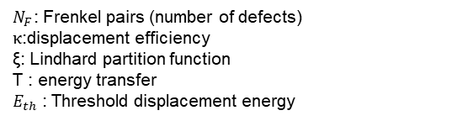

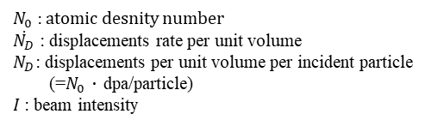

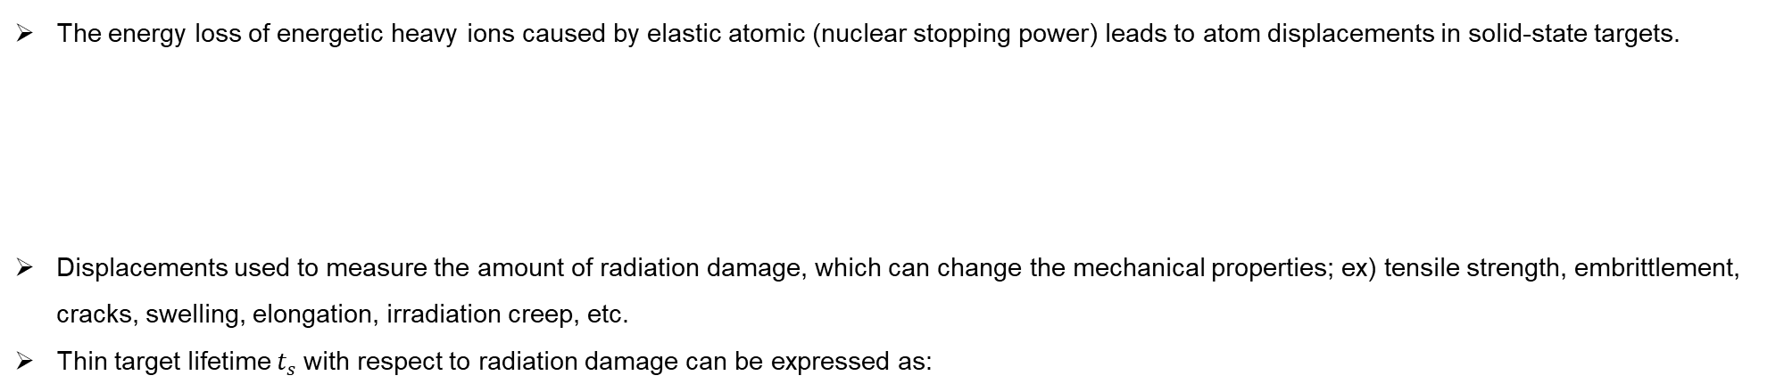
02
Analysis on the target degradation
c) Radiation damage
The energy loss of energetic heavy ions caused by elastic atomic (nuclear stopping power) leads to atom displacements in solid-state targets.
Displacements used to measure the amount of radiation damage, which can change the mechanical properties; ex) tensile strength, embrittlement, cracks, swelling, elongation, irradiation creep, etc.
Thin target lifetime $t_{s}$with respect to radiation damage can be expressed as:
Displacements : The number of interstitial atoms and vacancies in the lattice
- Number of displacement (NRT model)
$$N_{F}=κ\frac{\text{ξ}\text{(}T\text{)}T}{2E_{th}}$$
$N_{F}$: Frenkel pairs (number of defects)
$κ$:displacement efficiency
$\text{ξ}$: Lindhard partition function
T : energy transfer
$E_{th}$ : Threshold displacement energy
limitation of target lifetime
Radiation damage lifetime
By F. Nickel (1978)
$t_{D}≈\frac{N_{0}}{\text{2}\text{∙}\dot{N_{D}}}$= $\frac{N_{0}}{\text{2}\text{∙}N_{D}\text{∙}I}$
$N_{0}$ : atomic desnity number
$\dot{N_{D}}$ : displacements rate per unit volume
$N_{D}$: displacements per unit volume per incident particle
(=$N_{0}$ ∙ dpa/particle)
$I$ : beam intensity
Displacements of target were calculated using TRIM, FLUKA[1,2], PHITS[3] codes for estimation of target lifetime.
Different radiation damage models used for each simulation. In case of TRIM, threshold displacement energy $E_{th}$ could not be adjusted by the user
 | Used model for radiation damage | Threshold displacement Energy, E_{d} (eV)
 |  | C | ⁷LiF
TRIM | Full damage cascade (Binary collision approximation, BCA simulation) | 21^{[4]} | 1.40^{[5]}
FLUKA 4-4.0 | NRT using restricted loss | 21^{[4]} | 1.40^{[5]}
PHITS-3.34.1 | NRT | 31 | 22
 |  | (built hard-coded variable)
[1] C. Ahdida et al, Frontiers in Physics 9, 788253 (2022).
[2] G. Battistoni et al, Annals of Nuclear Energy 82, 10-18 (2015).
[3]T. Sato et al, J. Nucl. Sci. Technol. 61, 127-135 (2024)
[4] F. Vuković, J.M. Leyssale, P. Aurel, N.A. Marks, Evolution of Threshold Displacement Energy in Irradiated Graphite, Phys. Rev. Appl. 10 (2018) 1–12.
[5] F. Herrmann, P. Pinard, Y. Farge, About the displacement of the lithium ion in lithium fluoride by accelerated electrons, J. Phys. C Solid State Phys. 7 (1974).
11
[2]T. Sato et al, J. Nucl. Sci. Technol. 61, 127-135 (2024)

Slide 12
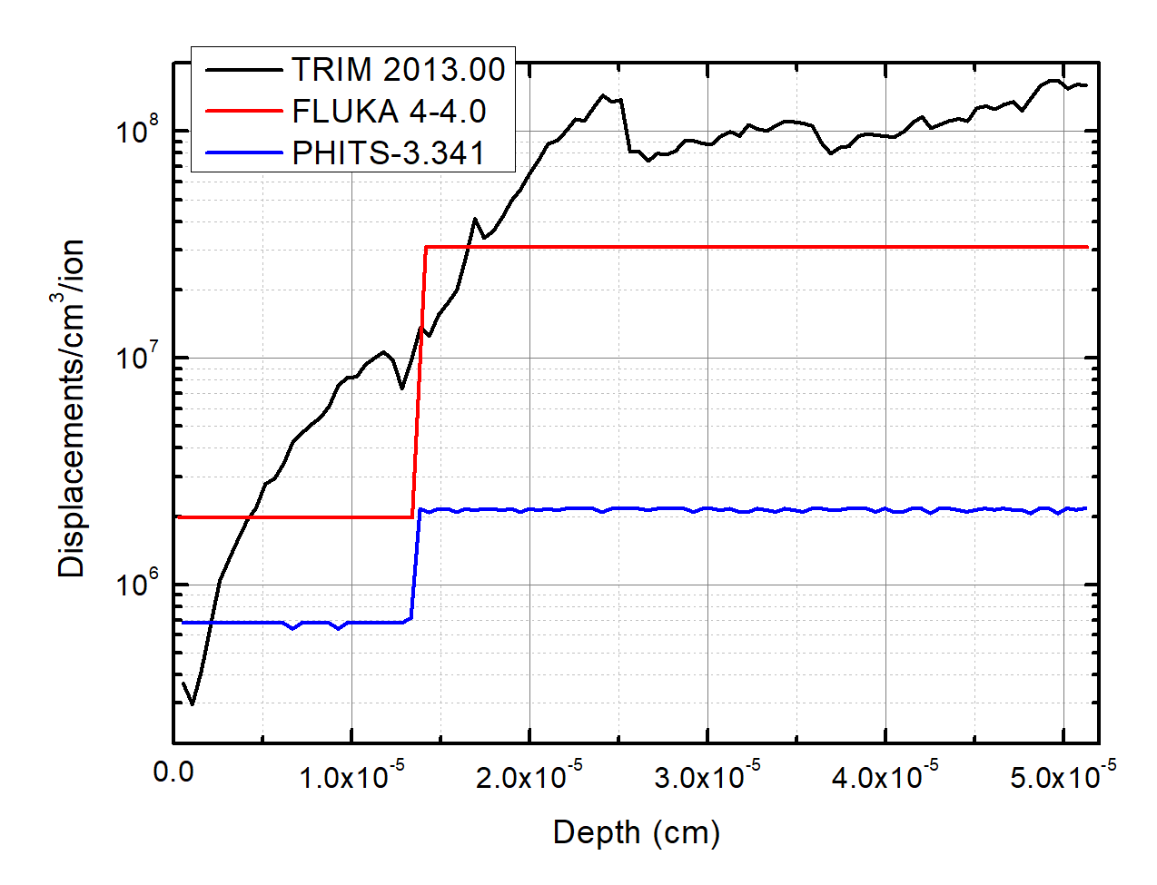
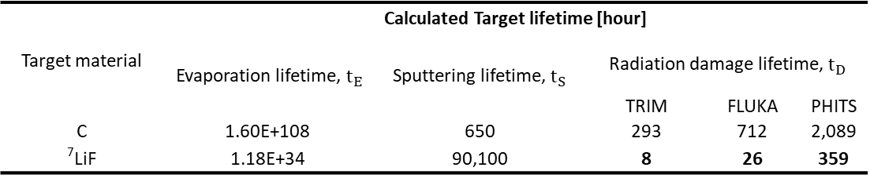
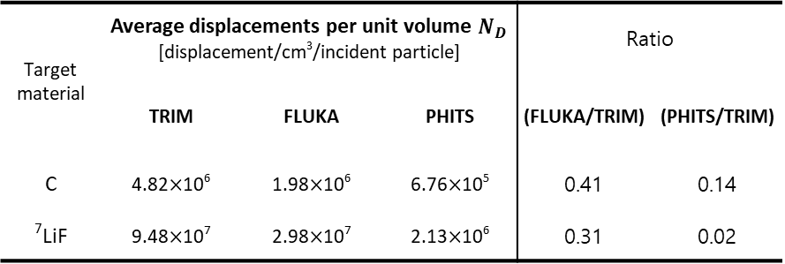



03
Result & Discussion
Radiation damage
Average displacements results of TRIM were 2 to 3 times higher than FLUKA results and 10 to 100 times higher than PHITS results.
Displacements per unit volume $N_{D}$ for each simulation
$$N_{D}$$
Target material | Average displacements per unit volume $N_{D}$ [displacement/cm³/incident particle] |  |  | Ratio
 | TRIM | FLUKA | PHITS | (FLUKA/TRIM) | (PHITS/TRIM)
C | 4.82$×$10⁶ | 1.98$×$10⁶ | 6.76$×$10⁵ | 0.41 | 0.14
⁷LiF | 9.48$×$10⁷ | 2.98$×$10⁷ | 2.13$×$10⁶ | 0.31 | 0.02
C
LiF
Based on the calculations, LiF film seems to be degraded due to lattice damage, and the moment the LiF film is perforated or torn, the carbon film which was intact may also be torn. Lifetime of the target was determined by radiation lattice damage to the ⁷LiF film
Target material | Calculated Target lifetime [hour]
 | Evaporation lifetime, $t_{E}$ | Sputtering lifetime, $t_{S}$ | Radiation damage lifetime, $t_{D}$
 |  |  | TRIM | FLUKA | PHITS
C | 1.60E+108 | 650 | 293 | 712 | 2,089
⁷LiF | 1.18E+34 | 90,100 | 8 | 26 | 359
Experimental lifetime,$t$ [hour]
5 ~ 20
beam intensity range: ${10}^{9} \sim {10}^{10}$ ions/s
Assumption: beam intensity = 1.0 $×{10}^{10}$ ions/s (the largest value used in the experiment)
11

Slide 13
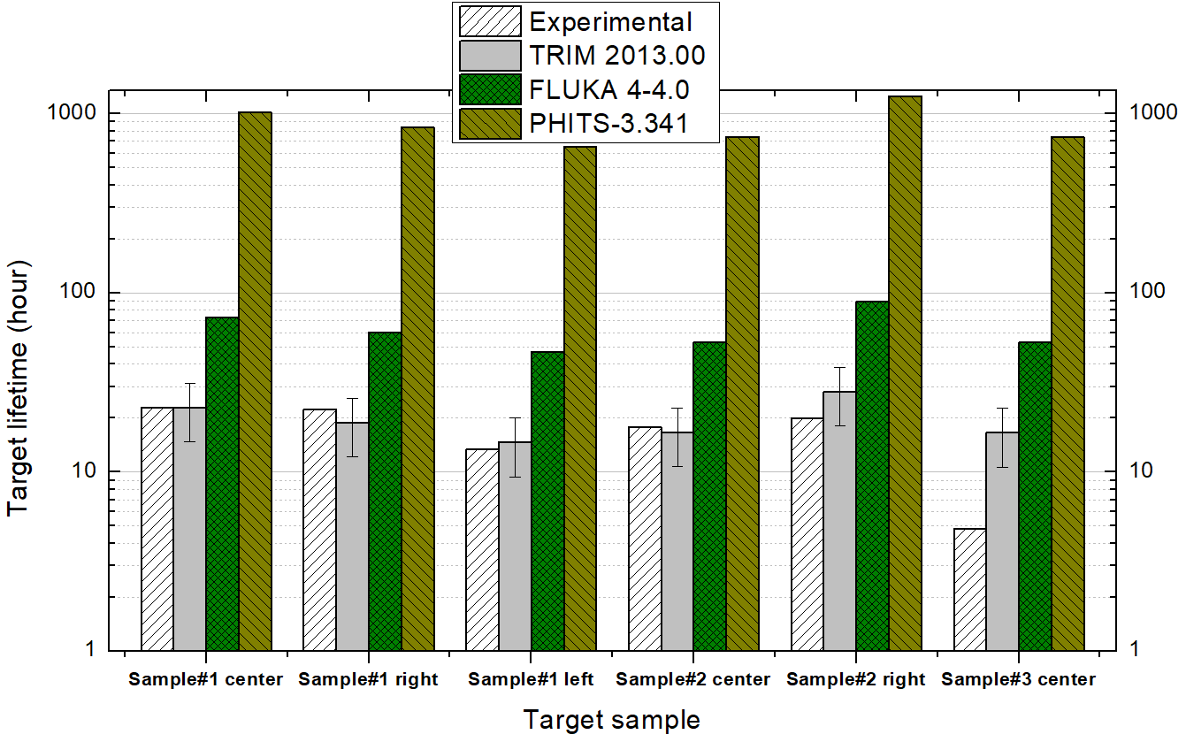
03
Result & Discussion
The theoretically calculated lifetime of the target was compared to the experimental lifetime which was the period of use before disposal.
Experimental and calculated lifetime for thin LiF targets on carbon backings
Comparison between the calculated lifetime at the beam spot and the experimental time
 | Sample#1 center | Sample#1 right | Sample#1 left | Sample#2 center | Sample#2 right | Sample#3 center
Average intensity [ions/s] | 3.90E+09 | 4.72E+09 | 6.07E+09 | 5.35E+09 | 3.18E+09 | 5.39E+09
Fluence [ions/cm²] | 4.09E+16 | 4.82E+16 | 3.73E+16 | 4.34E+16 | 2.90E+16 | 1.19E+16
Calculated DPA by TRIM [Displacements/atom] | 5.55E-01 ±2.04E-01 | 6.54E-01 ±2.23E-01 | 5.06E-01 ±1.82E-01 | 5.89E-01 ±2.12E-01 | 3.93E-01 ±1.41E-01 | 1.61E-01 ±5.80E-02
Experimental time to rejection [hours]* | 22.8 | 22.3 | 13.4 | 17.7 | 19.9 | 4.8
Calculated lifetime [hours] | 22.9±8.2 | 18.9±6.8 | 14.7±5.3 | 16.7±6.0 | 28.1±10.1 | 16.6±6.0
* Experimental time to rejection is the time it takes for the SSB count to reach 0, after which the target is replaced.
In this study, the lifetime calculated with TRIM agreed well with the observed target lifetime during the experiment.
Discrepancy in displacements occurred in different radiation damage models.
FLUKA and PHITS provide an average estimate of atomic displacements, but they do not detail the complex chain of successive collisions as TRIM's radiation damage model does. TRIM keeps track of all displaced atoms and counts them.
In the case of PHITS, the simulation results differed significantly from the other two simulations due to the use of an inherent higher threshold displacement energy.
11

Slide 14
04
Conclusion
The cause of the destruction of thin, carbon-backed lithium fluoride targets during a measurement of the fusion of ⁷Li and ¹⁷O were analyzed.
The lifetimes of carbon and LiF films due to thermal evaporation, sputtering, and lattice damage were estimated and compared with the lifetime observed in the experiment.
Thermal evaporation and sputtering did not affect the target degradation
The lifetime of LiF film is calculated for the first time using the radiation lattice damage model suggested by Nickel et al.
It was confirmed that the radiation damage and target life estimation using TRIM closely matched the experimental results, compared to those using FLUKA and PHITS.
Radiation damage calculation varied according to the model used and the threshold displacement energy set by user.
This study suggested methods for predicting the lifetimes of thin LiF films, which are used to induce nuclear reactions, allowing for increased experimental efficiency.
Details in the published paper
Kim, Yong Hyun, et al. Nuclear Engineering and Technology 55.3 (2023): 919-926.
14

Slide 15
Thank you for attention
Yong Hyun Kim
E-mail: kimyh0411@postech.ac.kr

Slide 16

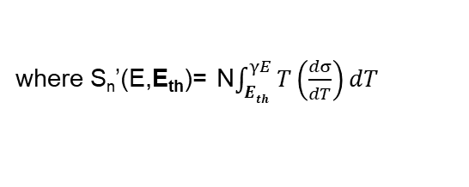
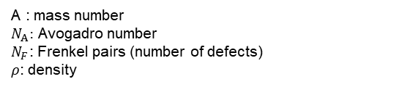




Support
FLUKA : NRT model using restricted loss (stopping power)*
$$dpa=\frac{A}{2N_{A}ρ}N_{F}$$
A : mass number
$N_{A}:$ Avogadro number
$N_{F}$: Frenkel pairs (number of defects)
$ρ$: density
where $N_{F}=κ\frac{\text{ξ}\text{(}T\text{)}T}{2E_{th}}$
$N_{NRT}$: number of defects by Norgert, Robinson and Torrens (NRT)
$κ$:displacement efficiency
$\text{ξ}$: Lindhard partition function
Sn’ : restricted nuclear stopping power(energy loss)
N : atomic density
T : energy transfer
$dσ /dT$: differential scattering cross section
E_{th} : displacement damage threshold
where $\text{ξ}\text{(}T\text{)}$=Sn’/S,
where S_{n}’(E,E_{th})= N$\int_{Eth}^{γE}{T\left(\frac{dσ}{dT}\right)dT}$
restricted loss (stopping power)
adjustable
*Ref: Fasso, Alberto, et al., Progress in Nuclear Science and Technology 2 (2011): 769-775.
TRIM(Full Cascade calculation) : Binary collision approximation (BCA) simulation model
$$N_{F}=κ\frac{\text{ξ}\text{(}T\text{)}T}{2E_{th}}$$

Slide 17
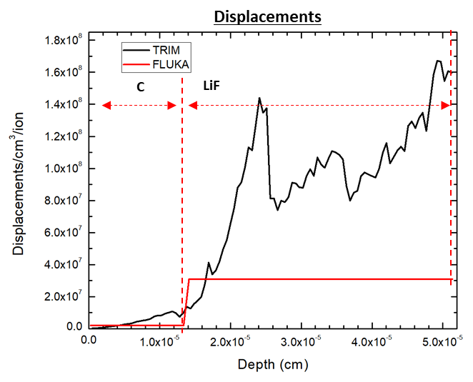
Support
Two peaks comes from?
Displacement and ion(17O)&recoil(Li,F) distributions according to depth were examined for each particle. And, simulations were performed according to the thickness of LiF. As a result, the bonding force between Li and F on the surface is rather weak compared to that one in the bulk, so it is estimated that vacancy and replacement increased near the boundaries by recoil of Li and F from the surface.

Slide 18

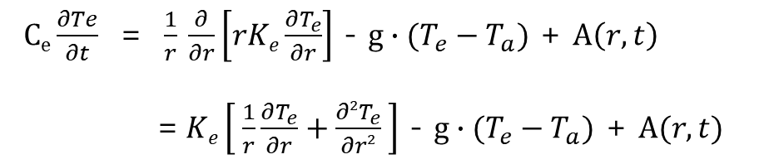

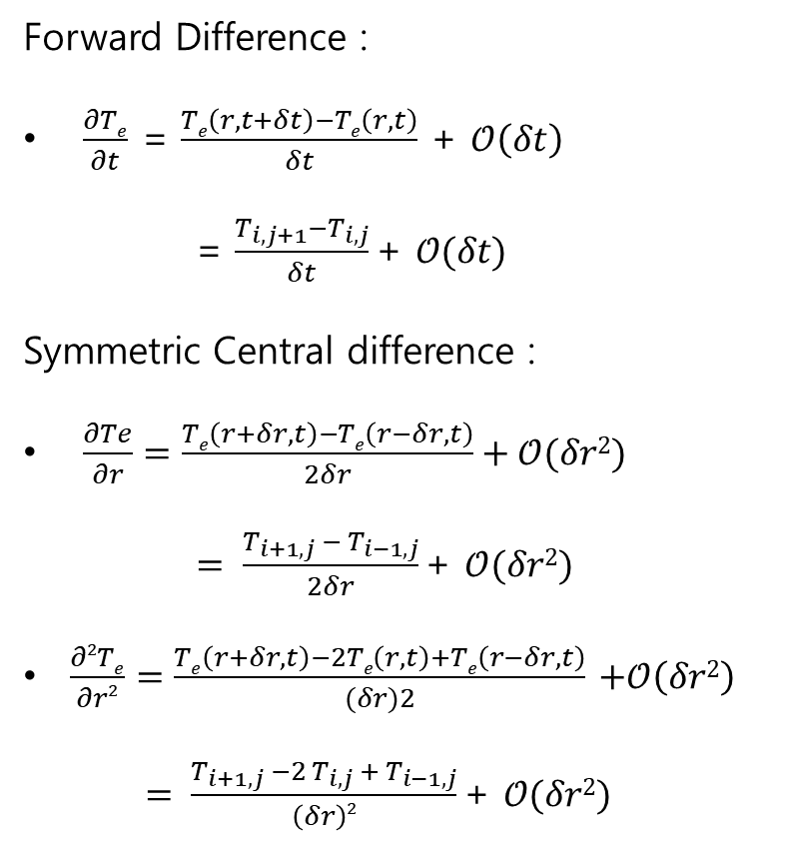




FDA-Explicit scheme (electronic system)
$Ce\frac{∂Te}{∂t}$ = $\frac{1}{r}$ $\frac{∂}{∂r}\left[rKe\frac{∂T_{e}}{∂r}\right]$ - $g∙(T_{e}−T_{a})$ + $A\left(r,t\right)$
=$Ke\left[ \frac{1}{r}\frac{∂T_{e}}{∂r}+\frac{∂2T_{e}}{∂r2} \right]$ - $g∙(T_{e}−T_{a})$ + $A(r,t)$
Boundary Conditions
Convergence Conditions
the classical equations of heat flow according to Fick’s law
$Te\left(r,0\right)$ = $Ta\left(r,0\right)$ = T₀
2D_{e} $δt$ / ($δr$)² < 1
$Te\left(rmax,t\right)$ = $Ta\left(rmax,t\right)$ = T₀
${\text{(}\frac{∂Te}{∂r}\text{)}}_{r=rmin}$, ${\text{(}\frac{∂Ta}{∂r}\text{)}}_{r=rmin}$ = 0
$δr$= 0.1 nm
$δt$ = 2.0 x10⁻¹⁷ s
Forward Difference :
$\frac{∂Te}{∂t}$ = $\frac{Te\left(r,t+δt\right)−Te\left(r,t\right)}{δt}$ + $𝒪\left(δt\right)$
= $\frac{T_{i,j+1}−T_{i,j}}{δt}\text{+ }𝒪(δt)$
Symmetric Central difference :
$\frac{∂Te}{∂r}=\frac{Te\left(r+δr,t\right)−Te\left(r−δr,t\right)}{2δr}+𝒪(δr2)$
$= \frac{T_{i+1,j} −{ T}_{i−1,j}}{2δr}\text{+ }𝒪(δr2)$
$\frac{∂2Te}{∂r2}=\frac{Te\left(r+δr,t\right)−2Te\left(r,t\right)+Te\left(r−δr,t\right)}{(δr)2}$ $+𝒪\left(δr2\right)$
$= \frac{T_{i+1, j} −2{ T}_{i, j} + T_{i−1,j}}{\left(δr\right)2}\text{+ }𝒪(δr2)$
(r_{min}=0.1 nm, r_{max}=100 nm)
0.1< r <100 nm
2.0x10⁻¹⁷< t < 2.0x10⁻¹¹ s
$Ce \frac{T_{i,j+1}−T_{i,j}}{δt}$= $Ke\left[ \frac{1}{ri}(\frac{T_{i+1,j} −{ T}_{i−1,j}}{2δr})+\frac{T_{i+1, j} −2{ T}_{i, j} + T_{i−1,j}}{\left(δr\right)2}\right]$- $g∙({ T}_{i, j}−{ T′}_{i, j})$ +${ A}_{i, j}$+ $𝒪\left(δt+δr2\right)$
$T_{i,j+1}$= $\frac{dt}{C }$ [
${+ T}_{i−1,j}\left(\frac{−K}{2 dr{ r}_{i}}+\frac{K}{{\left(dr\right)}^{2}}\right)$
$+{ T}_{i,j}\left(−\frac{2 K}{{\left(dr\right)}^{2}}−g+\frac{C}{dt}\right)$
${+ T}_{i+1,j}\left(\frac{K}{2 dr r_{i}}+\frac{K}{{\left(dr\right)}^{2}}\right)$
${+ T^{′}}_{i,j} g+{ A}_{i, j}$ ]
Ref: [1]Thermal spike model interpretation of sputtering yield data for Bi thin films irradiated by MeV 84Kr15+ ions [2] Transient thermal process after a high-energy heavy-ion irradiation of amorphous metals and semiconductors[3] Bell, R. O., M. Toulemonde, and P. Siffert. "Calculated temperature distribution during laser annealing in silicon and cadmium telluride." Applied physics 19.3 (1979): 313-319.[3] THERMAL SPIKE MODEL OF TRACK FORMATION IN YBa2Cu3O7−x

Slide 19


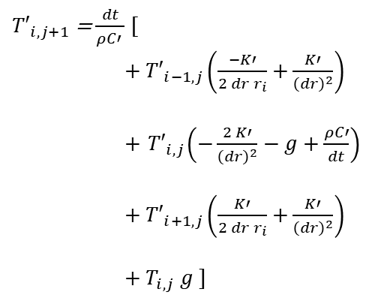






FDA-Explicit scheme (lattice system)
$ρCa\frac{∂Ta}{∂t}$ = $\frac{1}{r}$ $\frac{∂}{∂r}\left[rKa\frac{∂T_{a}}{∂r}\right]$ + $g∙(T_{e}−T_{a})$
=$Ka\left[ \frac{1}{r}\frac{∂T_{a}}{∂r}+\frac{∂2T_{a}}{∂r2} \right]$ + $g∙(T_{e}−T_{a})$
Boundary Conditions
Convergence Conditions
the classical equations of heat flow according to Fick’s law
$Te\left(r,0\right)$ = $Ta\left(r,0\right)$ = T₀
2D_{e} $δt$ / ($δr$)² < 1
$Te\left(rmax,t\right)$ = $Ta\left(rmax,t\right)$ = T₀
${\text{(}\frac{∂Te}{∂t}\text{)}}_{r=rmin}$, ${\text{(}\frac{∂Ta}{∂t}\text{)}}_{r=rmin}$ = 0
$δr$= 0.1 nm
$δt$ = 2.0 x10⁻¹⁷ s
Forward Difference :
$\frac{∂Ta}{∂t}$ = $\frac{Ta\left(r,t+δt\right)−Ta\left(r,t\right)}{δt}$ + $𝒪\left(δt\right)$
= $\frac{{T′}_{i,j+1}−{T′}_{i,j}}{δt}\text{+ }𝒪(δt)$
Symmetric Central difference :
$\frac{∂Ta}{∂r}=\frac{Ta\left(r+δr,t\right)−Ta\left(r−δr,t\right)}{2δr}+𝒪(δr2)$
$= \frac{{T′}_{i+1,j} −{ T′}_{i−1,j}}{2δr}\text{+ }𝒪(δr2)$
$\frac{∂2Ta}{∂r2}=\frac{Ta\left(r+δr,t\right)−2Ta\left(r,t\right)+Ta\left(r−δr,t\right)}{(δr)2}$ $+𝒪\left(δr2\right)$
$= \frac{{T′}_{i+1, j} −2{ T′}_{i, j} + {T′}_{i−1,j}}{\left(δr\right)2}\text{+ }𝒪(δr2)$
(r_{min}=0.1 nm, r_{max}=100 nm)
0.1< r <100 nm
2.0x10⁻¹⁷< t < 2.0x10⁻¹¹ s
$ρ Ca\frac{{T′}_{i,j+1}−{T′}_{i,j}}{δt}$= $Ka\left[ \frac{1}{ri} (\frac{{T′}_{i+1,j} −{ T′}_{i−1,j}}{2δr})+\frac{{T′}_{i+1, j} −2{ T′}_{i, j} + {T′}_{i−1,j}}{\left(δr\right)2}\right]$+ $g∙({ T}_{i, j}−{ T′}_{i, j})$ $+ 𝒪\left(δt+δr2\right)$
Sol.1
Sol.2
$g∙({ T}_{i, j}−{ T′}_{i, j})$ = N(r,t)
${T′}_{i,j+1}$= $\frac{dt}{ρC′ }$ [
${+ T′}_{i−1,j}\left(\frac{−K′}{2 dr{ r}_{i}}+\frac{K′}{{\left(dr\right)}^{2}}\right)$
$+{ T′}_{i,j}\left(−\frac{2 K′}{{\left(dr\right)}^{2}}−g+\frac{ρC′}{dt}\right)$
${+ T′}_{i+1,j}\left(\frac{K′}{2 dr r_{i}}+\frac{K′}{{\left(dr\right)}^{2}}\right)$
${+ T}_{i,j} g$ ]
$$L=Half width of radial distribution of the enrgy deposition$$
L = 0.15 nm (z= end of target)
De = 2 cm²/s
dE/dx = 1.1E+10 ev/cm
$τ$_{a :} electron-lattice
relaxation time(1E-12s )
${T′}_{i,j+1}$= $\frac{dt}{ρC′ }$ [${ T′}_{i−1,j}\left(\frac{−K′}{2 dr{ r}_{i}}+\frac{K′}{{\left(dr\right)}^{2}}\right)+{ T′}_{i,j}\left(−\frac{2 K′}{{\left(dr\right)}^{2}}+\frac{ρC′}{dt}\right)$
${+ T′}_{i+1,j}\left(\frac{K′}{2 dr r_{i}}+\frac{K′}{{\left(dr\right)}^{2}}\right)$ +$S_{e}\frac{1}{τ_{a}}exp⁡(−\frac{t}{τ_{a}})\frac{1}{4πσ2}exp⁡(−\frac{r2}{4σ2})$

Slide 20













FDA-Explicit scheme (calculation)
Boundary Conditions
$Te\left(rmax,t\right)$ = $Ta\left(rmax,t\right)$ = T₀ = 320 K
= $Te\left(r=100 nm ,t\right)$ = $Ta\left(r=100 nm,t\right)$ = T₀=320 K
${\text{(}\frac{∂Te}{∂r}\text{)}}_{r=rmin}$, ${\text{(}\frac{∂Ta}{∂r}\text{)}}_{r=rmin}$ = 0
= ${\text{(}\frac{∂Te}{∂r}\text{)}}_{r=0nm}$ , ${\text{(}\frac{∂Ta}{∂r}\text{)}}_{r=0nm}$ = 0
$Te\left(r,0\right)$ = $Ta\left(r,0\right)$ = T₀=320 K
1. $g∙({ T}_{i, j}−{ T′}_{i, j})$ = N(r,t)
$Ce \frac{T_{i,j+1}−T_{i,j}}{δt}$= $Ke\left[ \frac{1}{ri}(\frac{T_{i+1,j} −{ T}_{i−1,j}}{2δr})+\frac{T_{i+1, j} −2{ T}_{i, j} + T_{i−1,j}}{\left(δr\right)2}\right]$- $g∙({ T}_{i, j}−{ T′}_{i, j})$ +${ A}_{i, j}$
$ρCa\frac{{T′}_{i,j+1}−{T′}_{i,j}}{δt}$ = $Ka\left[ \frac{1}{ri} (\frac{{T′}_{i+1,j} −{ T′}_{i−1,j}}{2δr})+\frac{{T′}_{i+1, j} −2{ T′}_{i, j} + {T′}_{i−1,j}}{\left(δr\right)2}\right]$+ $g∙({ T}_{i, j}−{ T′}_{i, j})$
$Ce \frac{T_{i,j+1}−T_{i,j}}{δt}$ = 0 $\text{− }g∙({ T}_{i, j}−{ T′}_{i, j})\text{ +}{ A}_{i, j}$
$T_{i,j+1}$ = $\text{−}δt∙g∙({ T}_{i, j}−{ T^{′}}_{i, j})/Ce\text{+}{δt∙A}_{i, j}$/ $Ce$ + $T_{i,j}$
${T′}_{i,j+1}$= $\frac{dt}{ρC′ }$ [${ T′}_{i−1,j}\left(\frac{−K′}{2 dr{ r}_{i}}+\frac{K′}{{\left(dr\right)}^{2}}\right)+{ T′}_{i,j}\left(−\frac{2 K′}{{\left(dr\right)}^{2}}+\frac{ρC′}{dt}\right)$
${+ T′}_{i+1,j}\left(\frac{K′}{2 dr r_{i}}+\frac{K′}{{\left(dr\right)}^{2}}\right)$ +$S_{e}\frac{1}{τ_{a}}exp⁡(−\frac{t}{τ_{a}})\frac{1}{4πσ2}exp⁡(−\frac{r2}{4σ2})]$
$T_{i,j+1}$ = + $T_{i,j}$(1-$\frac{δt∙g}{Ce}$) + ${ T^{′}}_{i, j} (\frac{δt∙g}{Ce}$) + ${ A}_{i, j}(\frac{δt}{Ce}$)
2. ${\text{(}\frac{∂Ta}{∂r}\text{)}}_{r=0nm}$ = 0
${ T}_{i−1, j}−{ T^{′}}_{i+1, j}=0$
$$r−1=−0.1 nm$$
$$r0=0 nm$$
$$r1=0. 1nm$$
$$dr=0. 1nm$$
${T′}_{i,j+1}$= $\frac{dt}{ρC′ }$ $[{ T′}_{i+1,j}\left(\frac{2K′}{{\left(dr\right)}^{2}}\right)+{ T′}_{i,j}\left(−\frac{2 K′}{{\left(dr\right)}^{2}}+\frac{ρC′}{dt}\right)$ +$S_{e}\frac{1}{τ_{a}}exp⁡(−\frac{t}{τ_{a}})\frac{1}{4πσ2}exp⁡(−\frac{r2}{4σ2})]$
$$L=Half width of radial distribution of the enrgy deposition$$
L = 0.15 nm (z= end of target)
De = 2 cm²/s
dE/dx = 1.1E+10 ev/cm
${T′}_{0,j+1}$= $\frac{dt}{ρC′ }$ $[{ T′}_{1,j}\left(\frac{2K′}{{\left(dr\right)}^{2}}\right)+{ T′}_{0,j}\left(−\frac{2 K′}{{\left(dr\right)}^{2}}+\frac{ρC′}{dt}\right)$+$S_{e}\frac{1}{τ_{a}}exp⁡(−\frac{t}{τ_{a}})\frac{1}{4πσ2}exp⁡(−\frac{(\left(0\right)∗dr)2}{4σ2})]$

