Slide 1
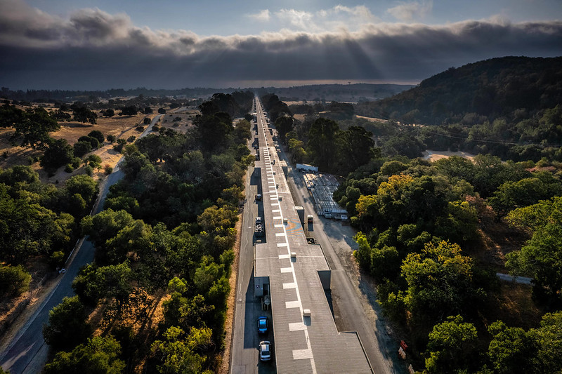
RP Commissioning of the LCLS-II LINAC at low power
Thomas FROSIO, Mario SANTANA, Jan BLAHA, Johannes BAUER

Slide 2
Content
LCLS-II description
Field emission and models
Monitoring of field emissions
Survey with low power beams on collimators
Conclusions

Slide 3
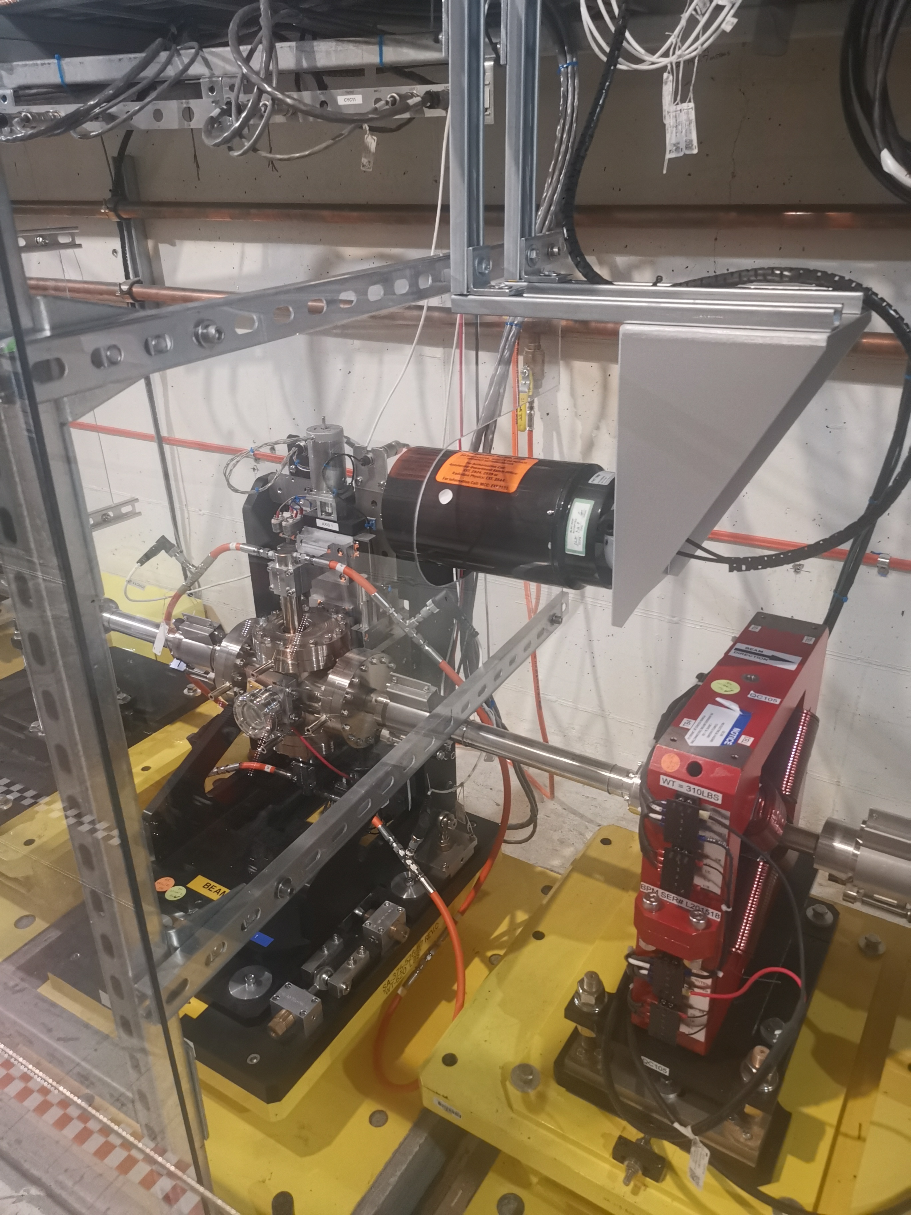
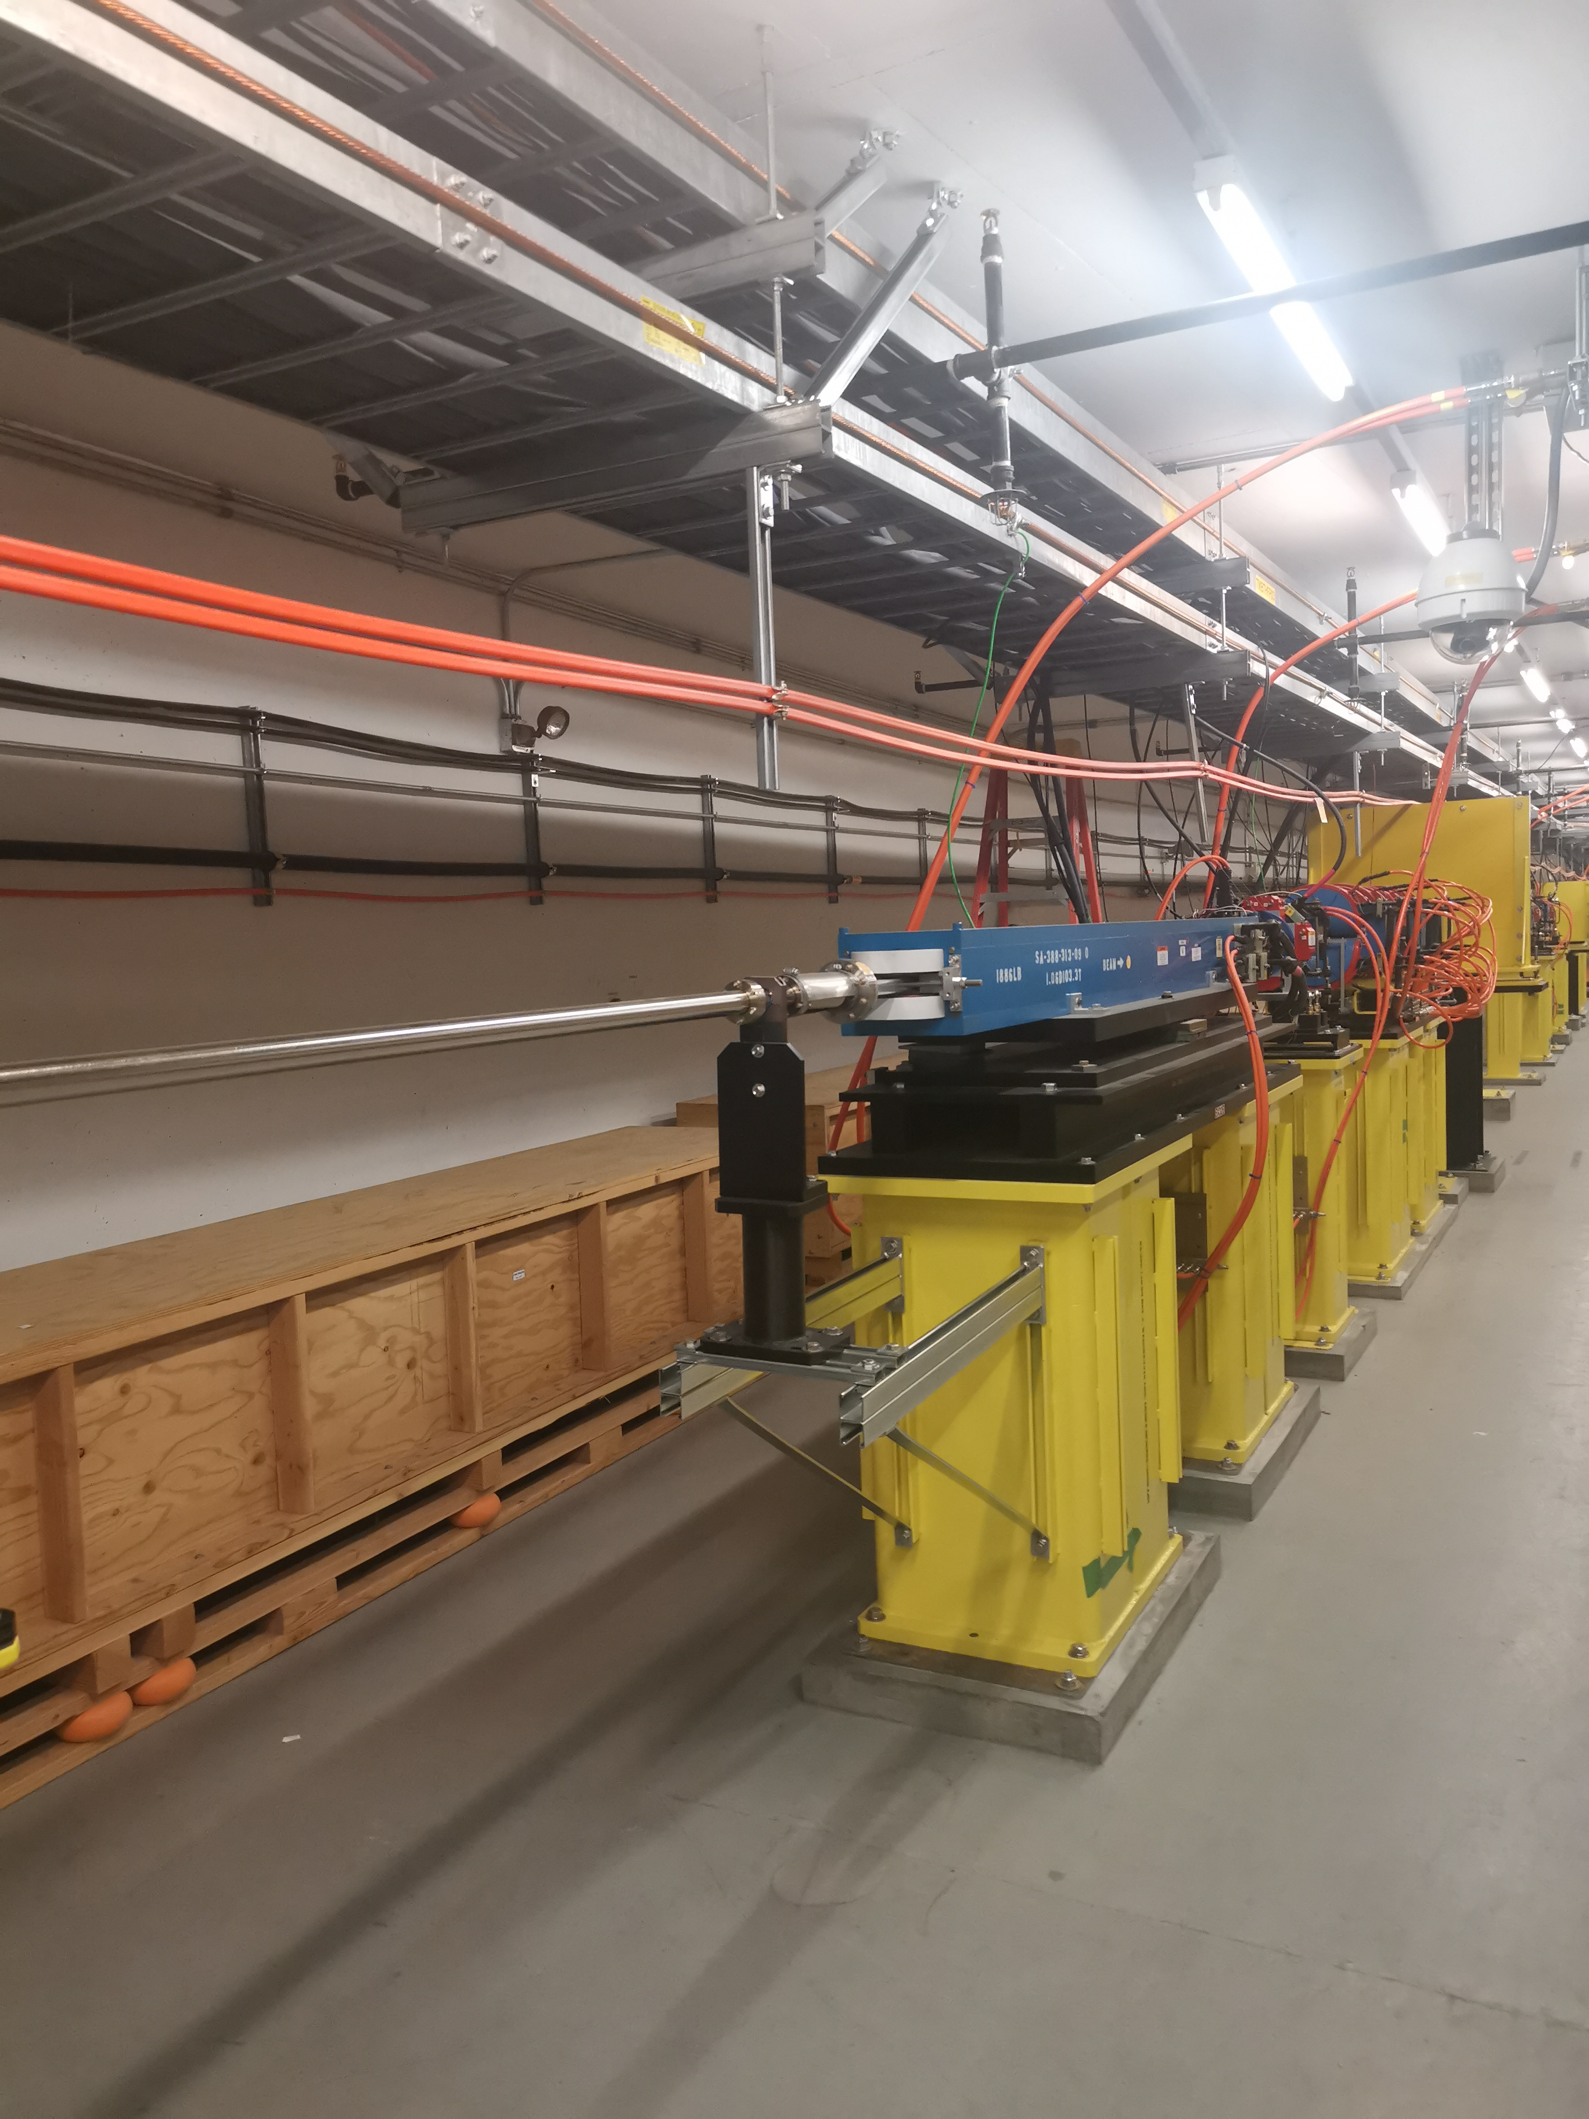
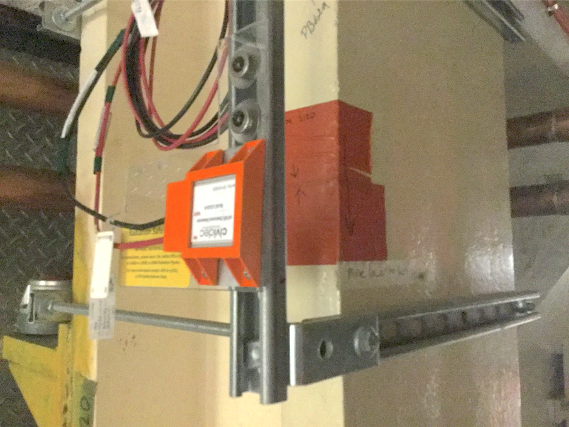
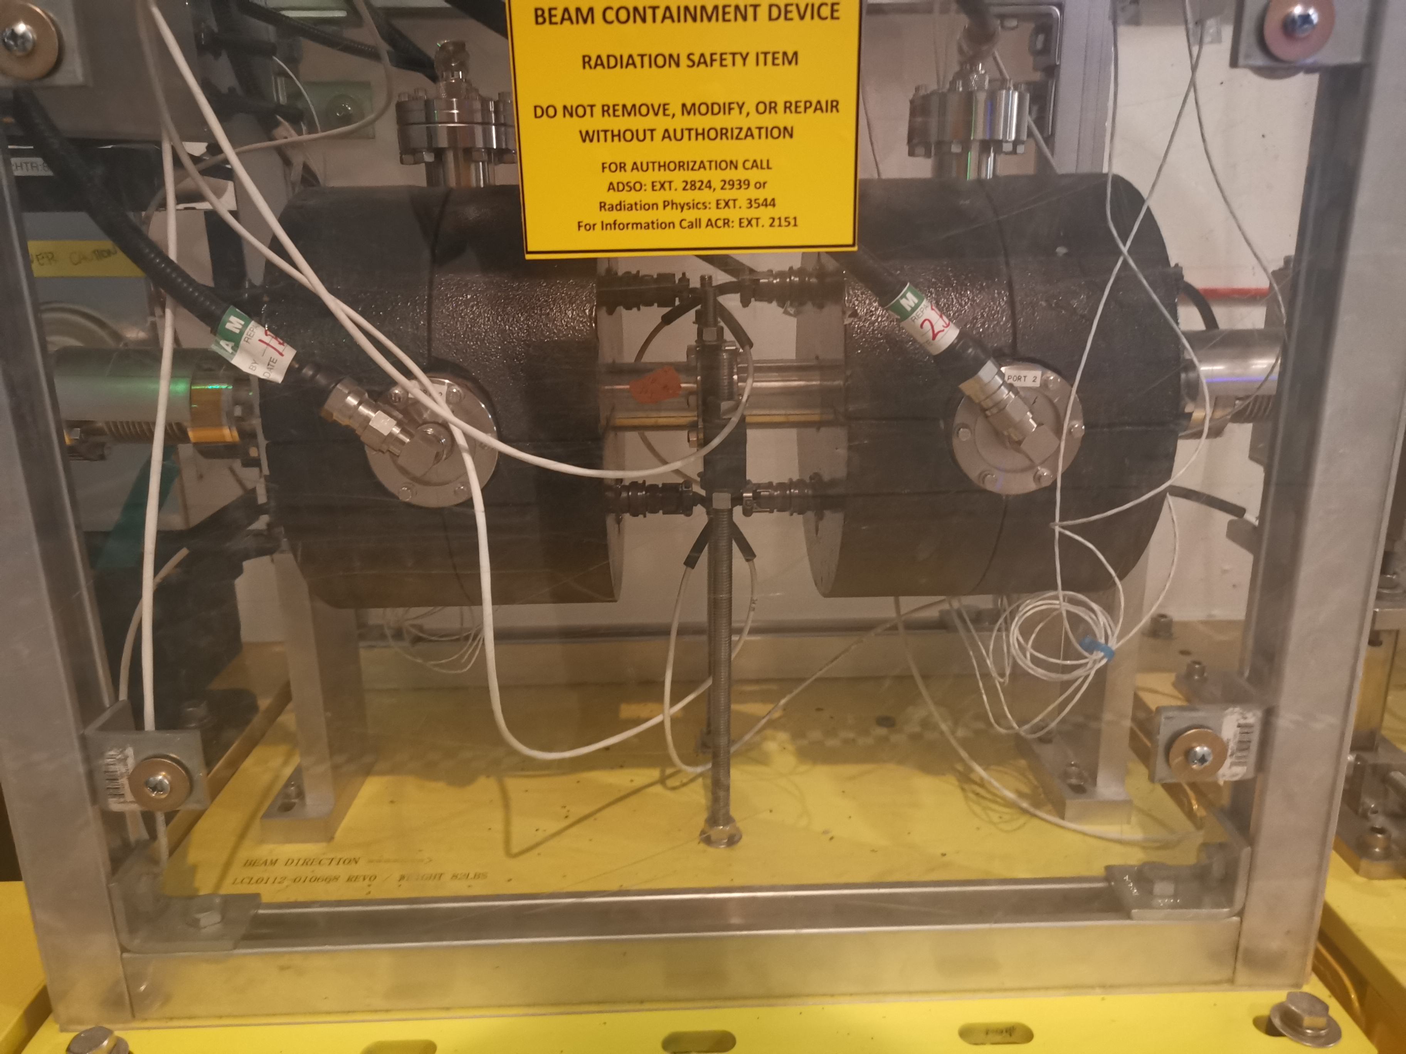
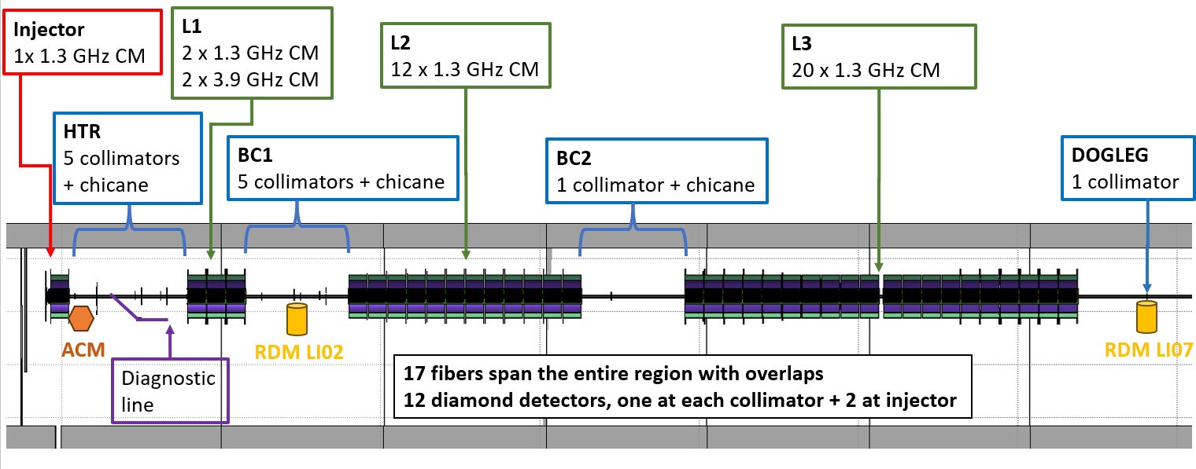
LCLS-II layout and monitoring devices
Cherenkov fiber
 | Nominal | Range | Currently | Next month
Electron energy | 4 GeV | 2 - 4.5 GeV | ~4 GeV | ~4 GeV
Electron bunch charge | 100 pC | 10 - 300 pC | ~ 50 pC | ~50 pC
Electron bunch repetition rate | 620 kHz | 0 - 1 MHz | ~1.1 kHz | ~10 kHz
Electron beam power | 240 kW | 0 - 1.2 MW | ~200 W | ~4 kW
Residual dose rate monitor
Average Current Monitor
ACM
CIVIDEC diamond detector
35+2(1/2) Cryomodules for acceleration made of eight TESLA type 1.3 GHz cavities

Slide 4
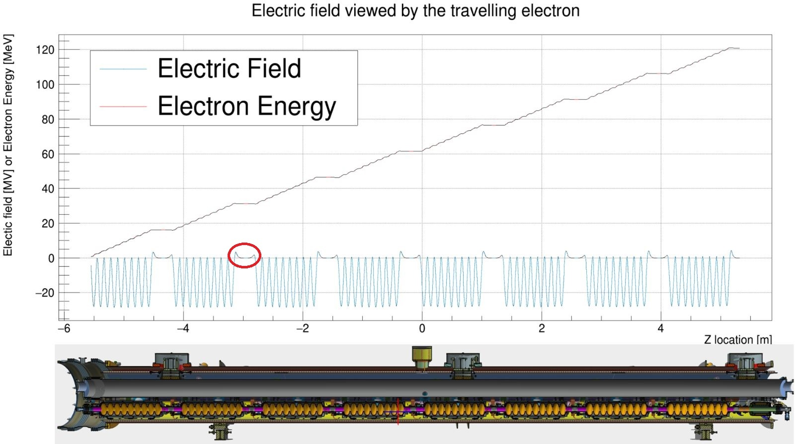
Superconducting cavity for LCLS-II
Electric field
Magnetic field

Slide 5
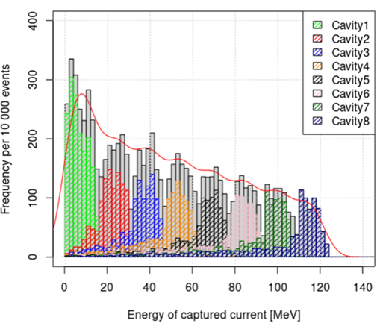
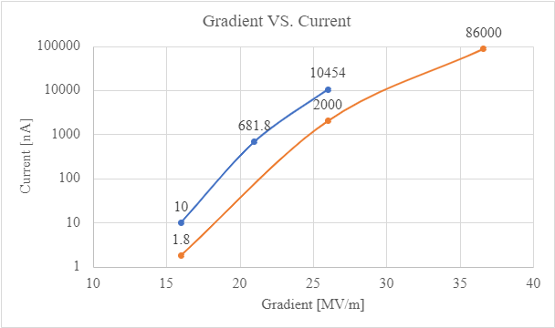
Superconducting cavity for LCLS-II
Energy distribution of captured electrons at 16 MV/m gradient
Captured current as a function of cavity gradient
Field emission
All cavities synchronized @ 16 MV/m
Field emission
All cavities unsynchronized @ 16 MV/m

Slide 6
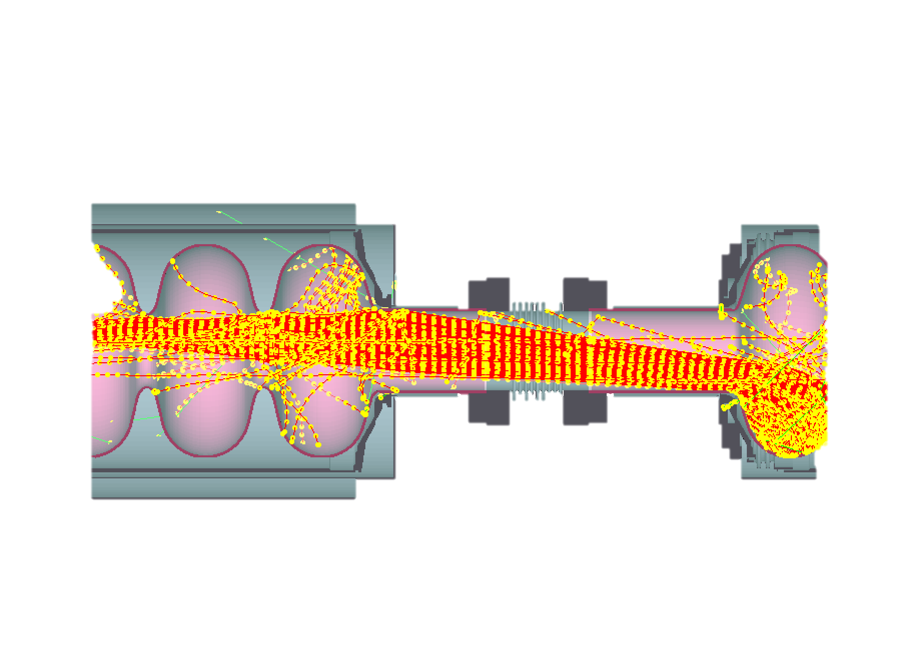
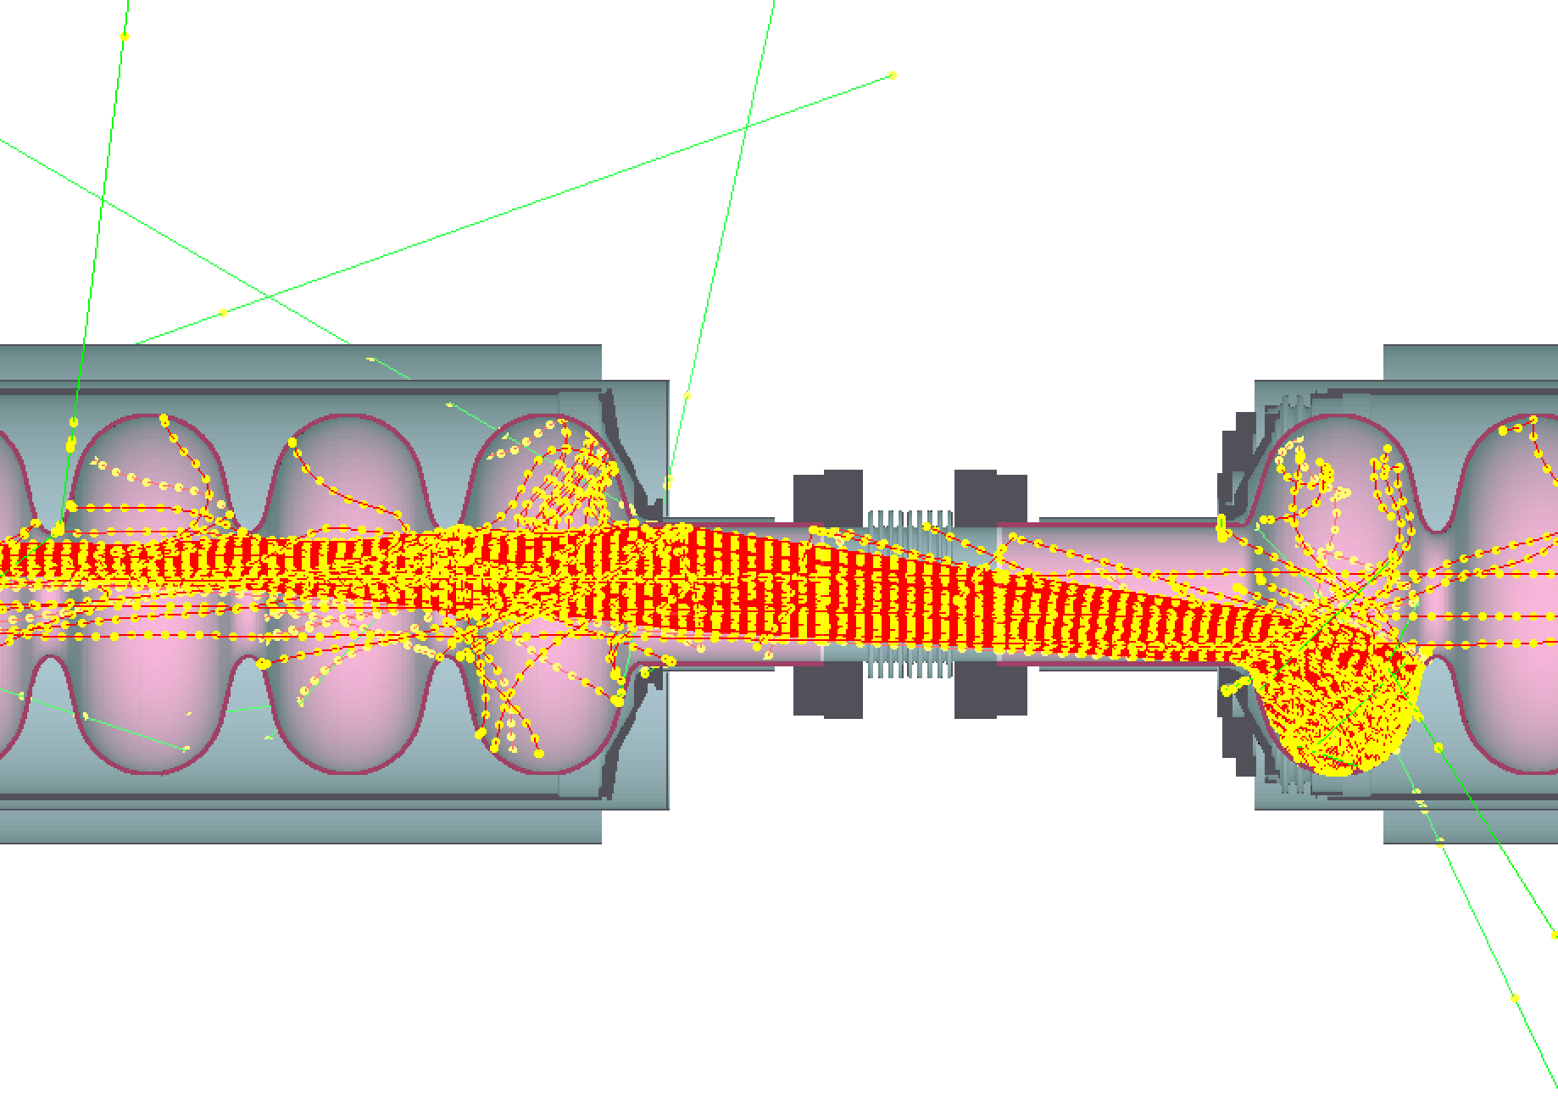
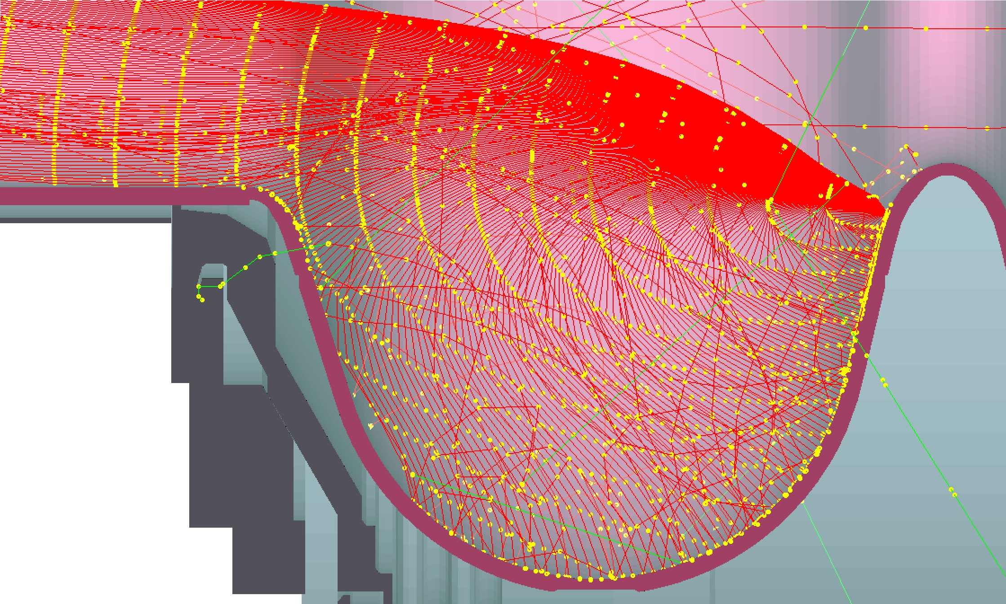
Field emission and Monte-Carlo models (see M. Santana’s presentation)
FLUKA Model of a cryomodule

Slide 7
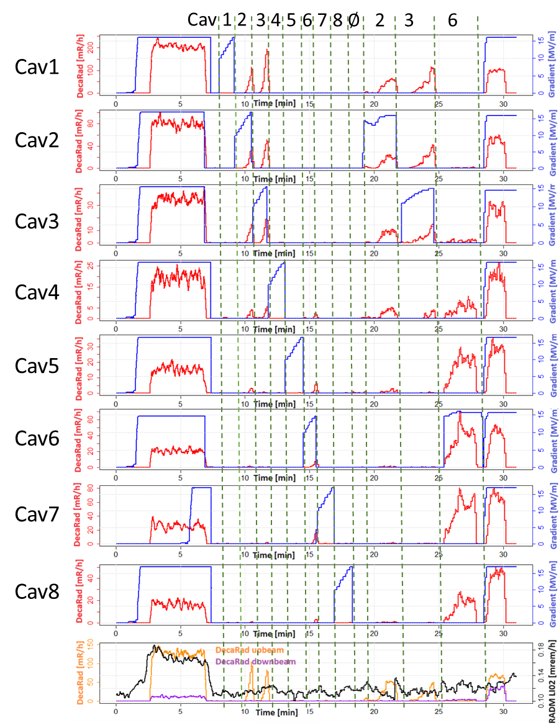
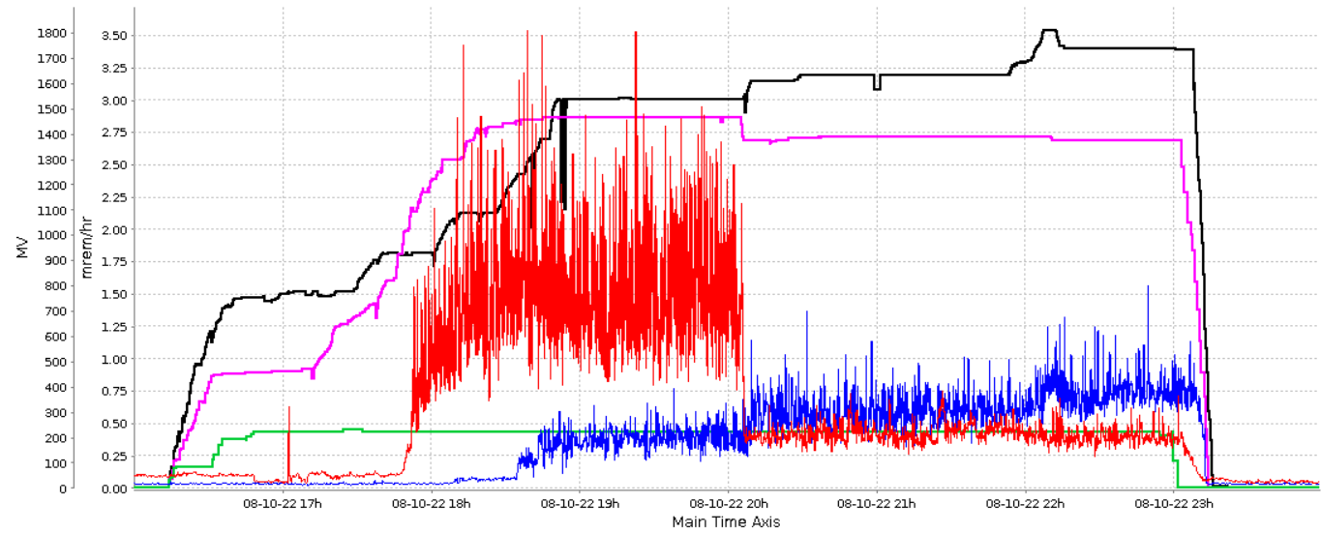
Estimation of field emission produced by the cryomodules
CM # | Cavity # | Rad measured at | Direction
1 | 2 | > 15 MV | Backward
 | 3 | > 10 MV | Forward
 | 5 | > 10 MV | Forward
 | 8 | > 15 MV | Forward
5 | 4 | > 14 MV | Backward / Forward
8 | 2 | > 13 MV | Backward
 | 3 | > 13 MV | Backward
 | 6 | > 14 MV | Backward
33 | 6 | > 8 MV | Forward
35 | 4 | > 8 MV | Backward
 | 8 | > 12 MV | Backward / Forward
RDM LI02
RDM LI07
Gradient in L1
Gradient in L2
Gradient in L3
~1 mrem/h when considering the design target of 1 nA captured current per CM when not synchronized in 2022. Compatible with dose in the RDM
~500 mrem/h when considering the design target of 1 nA captured current per CM when synchronized in 2024
Not compatible with RDM of 5000 mrem/h => degradation

Slide 8
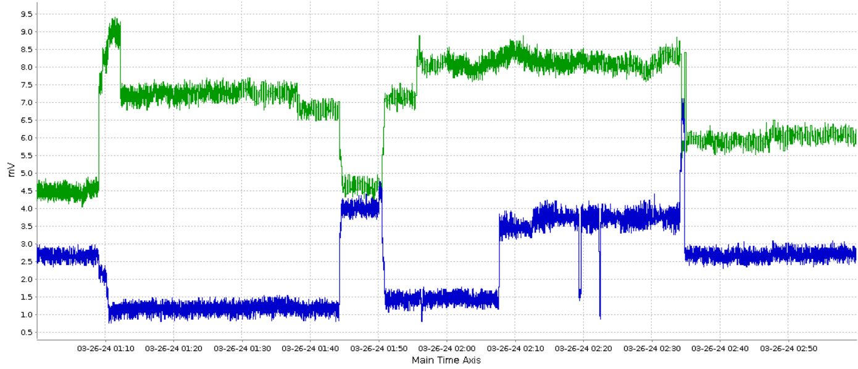
Transmitted dark current from the gun through the beam line
Previous measurements (M. Bai, S. Littleton) showed 7 nA dark current from the gun transmitted through the beamline
A collimator aperture after the gun was reduced from 20 to 16 mm
Dark current from gun gives 0.3 mV in diamond
250 mW gives 2 mV in diamond
Scaling shows 0.15 nA dark current from the gun transmitted through the beamline
CYC11 / CYC13 / CXC13 closed
CXC13 close
CYC11 opened
CXC13 opened
#2 Diamond ~4 mV
Backward captured current
#4 Diamond ~3.5 mV
forward captured current
#1 Diamond background ~1.2 mV
#3 Diamond ~1.5 mV
forward captured current
250 mW / 250 MeV beam

Slide 9
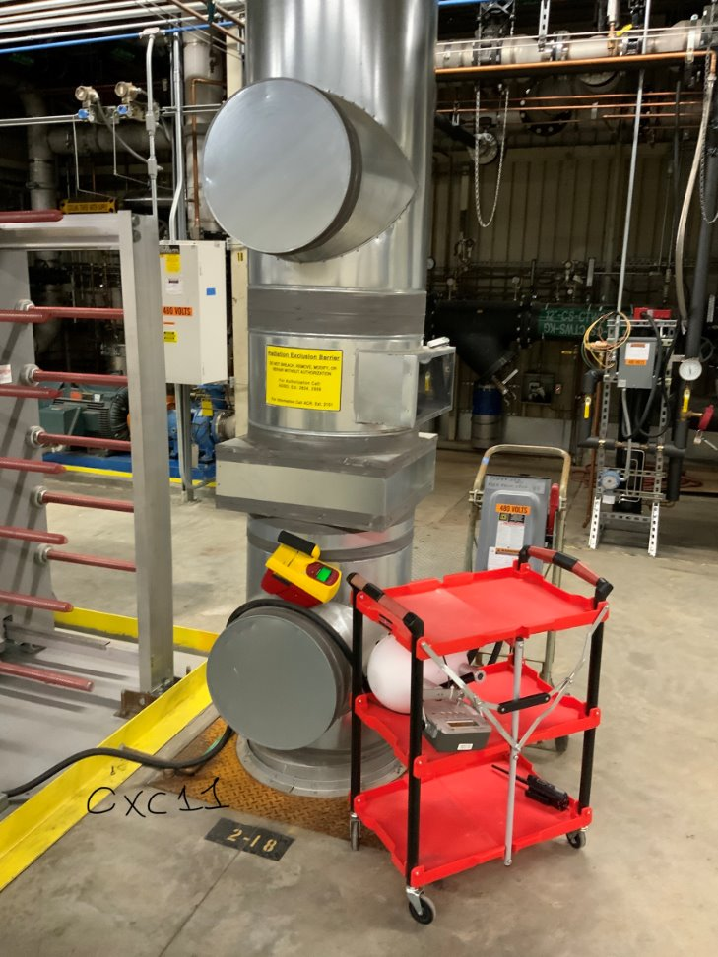
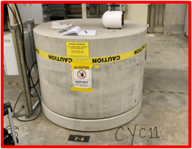
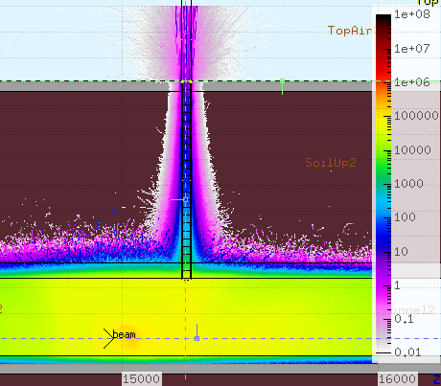
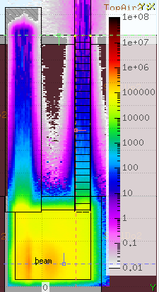
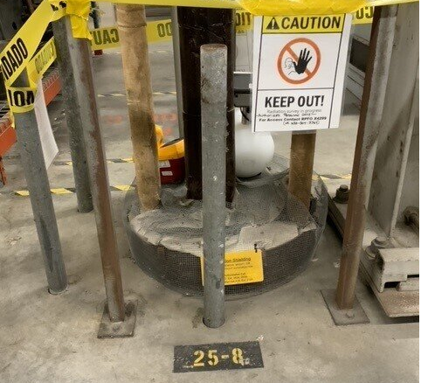
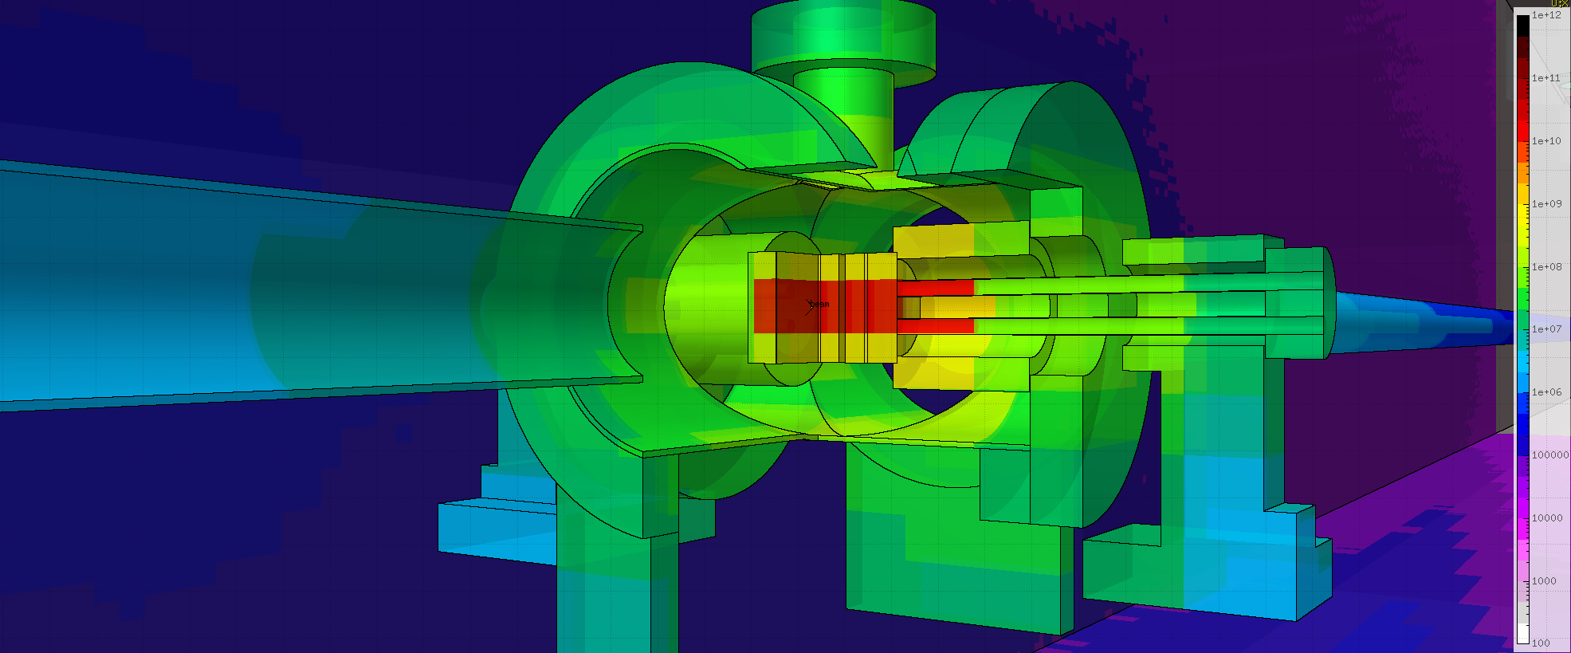
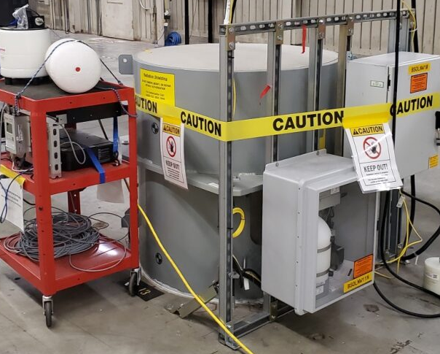
Beam on collimators
Beam location | Location | Dose rate 𝛾 | Dose rate n | Location | Dose rate 𝛾 | Dose rate n
 |  | [𝜇rem/h] | [𝜇rem/h] |  | [𝜇rem/h] | [𝜇rem/h]
CEBC1 50 W / 200 MeV | P2-5 | 0 | 11.6 | P2-4 | 8 | 8
CYC11 50 W / 200 MeV | P2-7 | 0 | 4 | P2-8 | 4 | 0.8
CXC11 50 W / 200 MeV | P2-18 | 220 | 89.2 | P2-10 | 4 | 0.8
 | P2-9 | 0 | 3.6 | P2-8 | 0 | 0
CYC13 50 W/ 200 MeV | P2-11 | 0 | 0.8 | P2-10 | 4 | 1.6
0.2 mrem/h
Penetrations for equipment ~each 5 m

Slide 10
Conclusions
SLAC is doing tests by parking the beam at different locations in the beamline, for different beam parameters and ramping up the power
We have collected a huge amount of data and we started to analyze it: more results to come
This presentation focuses on some dark current results obtained from the gun and the cryomodules
Dark current are of high interest to:
Keep a good beam quality
Reduce the dose in the vicinity of the machines
Avoid damages to the superconducting cavities
We have tools to simulate (see M. Santana’s presentation this afternoon):
Cryomodule operations including field emission
All SLAC’s RP detectors and monitors (Cerenkov fibers, diamond detectors)
Starting today, beam power is being double each day until Friday to reach 4 kW. New surveys planed when coming back to SLAC

Slide 11
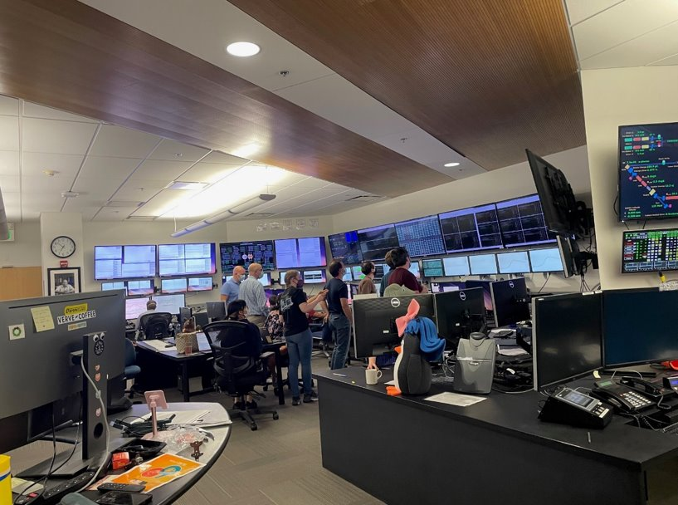
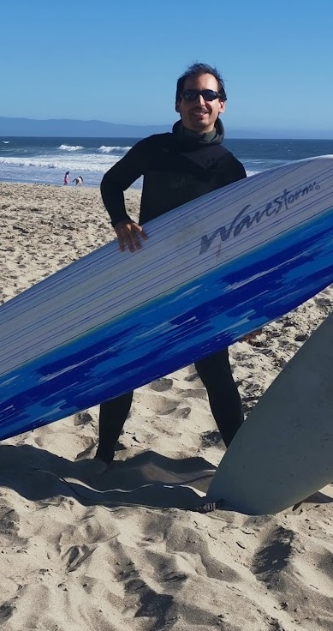
QUESTIONS ?
Next commissioning phase with ~4 kW beam starts in June 2024

Slide 12
