Slide 1
Evaluation of Radiation Heating and Damage for the Preliminary Design of Second Target Station Monolith Inserts
Thomas M Miller, Min-Tsung Kao, Tucker McClanahan, Vitaly Pronskikh
STS Neutronics Group
SATIF-16, INFN-LNF, Frascati, Italy
May 28-31, 2024

Slide 2
Outline
Orientation to Second Target Station (STS), the target monolith, and monolith insert
Hybrid CSG model of the target monolith & unstructured mesh model of the monolith insert
Radiation heating
Maximum operating temperature
Radiation damage
DPA

Slide 3
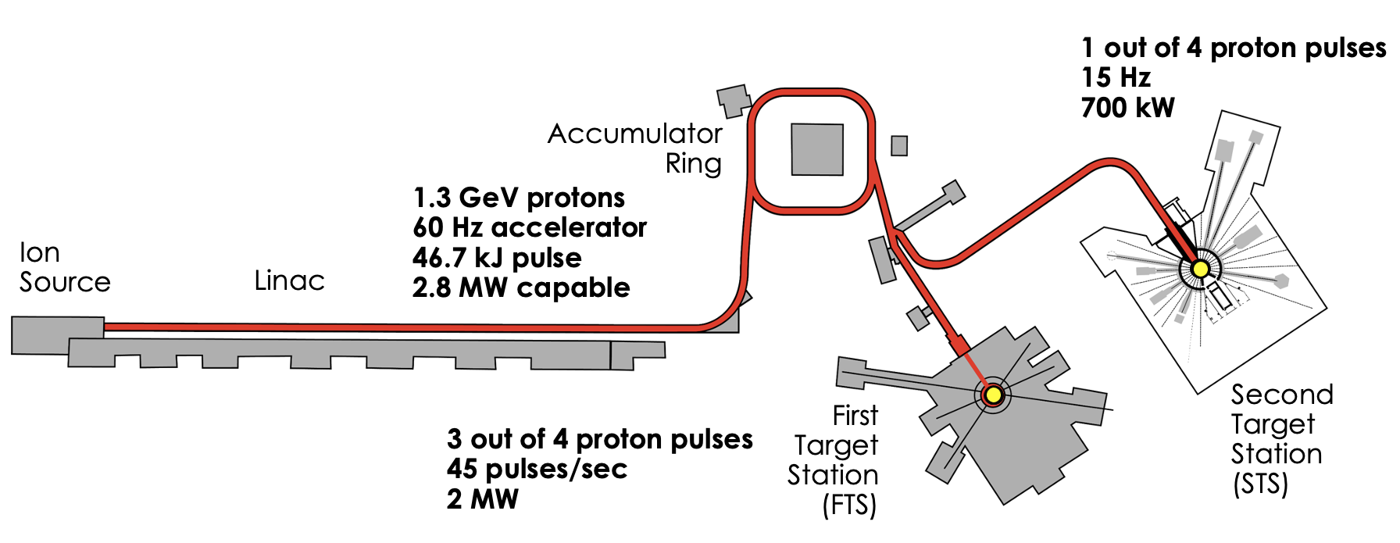
Orientation to STS, the target monolith, and monolith insert
STS will start with 700 kW of 1.3 GeV protons on a rotating tungsten target and will have 2 cold moderators optimized for peak brightness
Igor, Franz, and Irina introduced more details about STS and SNS
This cartoon provides an overview of the layout of SNS: the proton accelerator, first target station (FTS), and STS

Slide 4
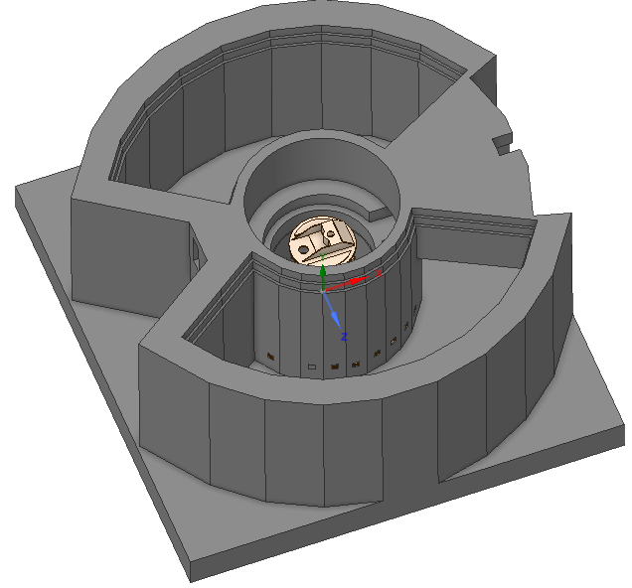
Orientation to STS, the target monolith, and monolith insert
STS will start with 700 kW of 1.3 GeV protons on a rotating tungsten target and will have 2 cold moderators optimized for peak brightness
Igor, Franz, and Irina introduced more details about STS and SNS
This cartoon provides an overview of the layout of SNS: the proton accelerator, first target station (FTS), and STS
The STS target monolith is the bulk shielding surrounding the target and moderator
The monolith contains penetrations for the neutron beamlines, so neutrons can exit the monolith, traverse the instrument bunker, to the instrument hall
Outside of monolith
Protons
Outside of bunker

Slide 5
Orientation to STS, the target monolith, and monolith insert
Removing the bunker and outer shielding layers of the target monolith reveals the core vessel, nozzle extensions, and monolith inserts
Core vessel
Protons
Protons
Nozzle extension
Monolith inserts fit inside the nozzle extensions

Slide 6
CSG model of the STS Target Monolith
Y
All the radiation heating and damage simulations of the monolith inserts start with the proton beam on target
This requires a model that includes the target and moderators
This model is “simplified” because
It is primarily based on CSG with simplifications of components
It uses a reflective boundary condition along the proton beamline (model half the monolith)
However, the monolith insert models are not simple, they are represented via the unstructured mesh capability of MCNP6 produced via direct conversion from CAD
X
M O N O L I T H
Important Conservatism:
The lower portion of the target shaft is void. This model was prepared before the existing design was settled
Protons
Core vessel

Slide 7
CSG model of the STS Target Monolith
X
Z
Tube moderator: ST10, ST14, ST18
Cylindrical moderator: ST11-13, ST15-17
ST10
Geometry to Bound Heating and DPA
The neutron extraction ports are empty / void (white)
For the tube moderator, a narrow neutron extraction port was used (77 mm diameter cylinder)
Analysis of ST10 provides a conservative estimate for the narrow extraction ports
For the cylindrical moderator, a wide-open neutron extraction port was used
Analysis of ST11 provides a conservative estimate for the wide extraction ports
These are plots of a full CSG model, which is also used with ADVANTG to generate space and energy dependent weight windows
ST11
ST12
ST13
M O N O L I T H
ST14
M O N O L I T H
Reflected Boundary Condition
Reflected Boundary Condition
ST15
ST16
ST17
ST18
Protons
Protons

Slide 8
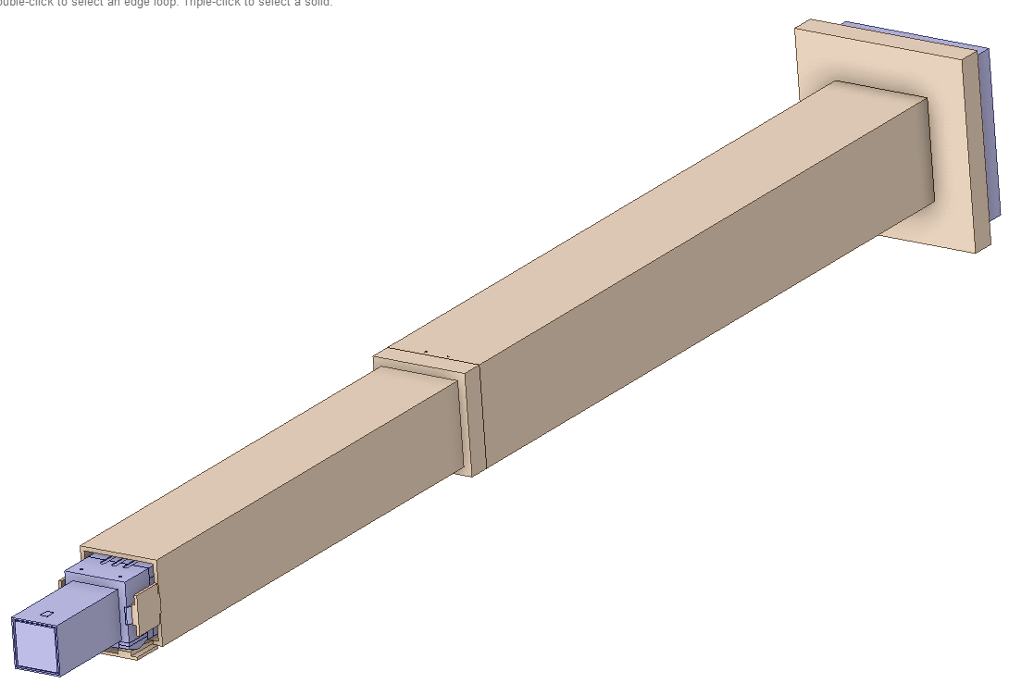
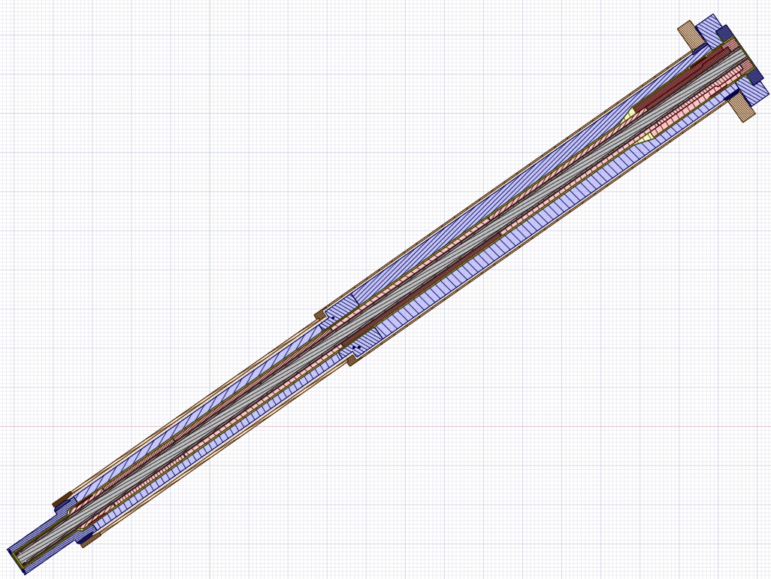
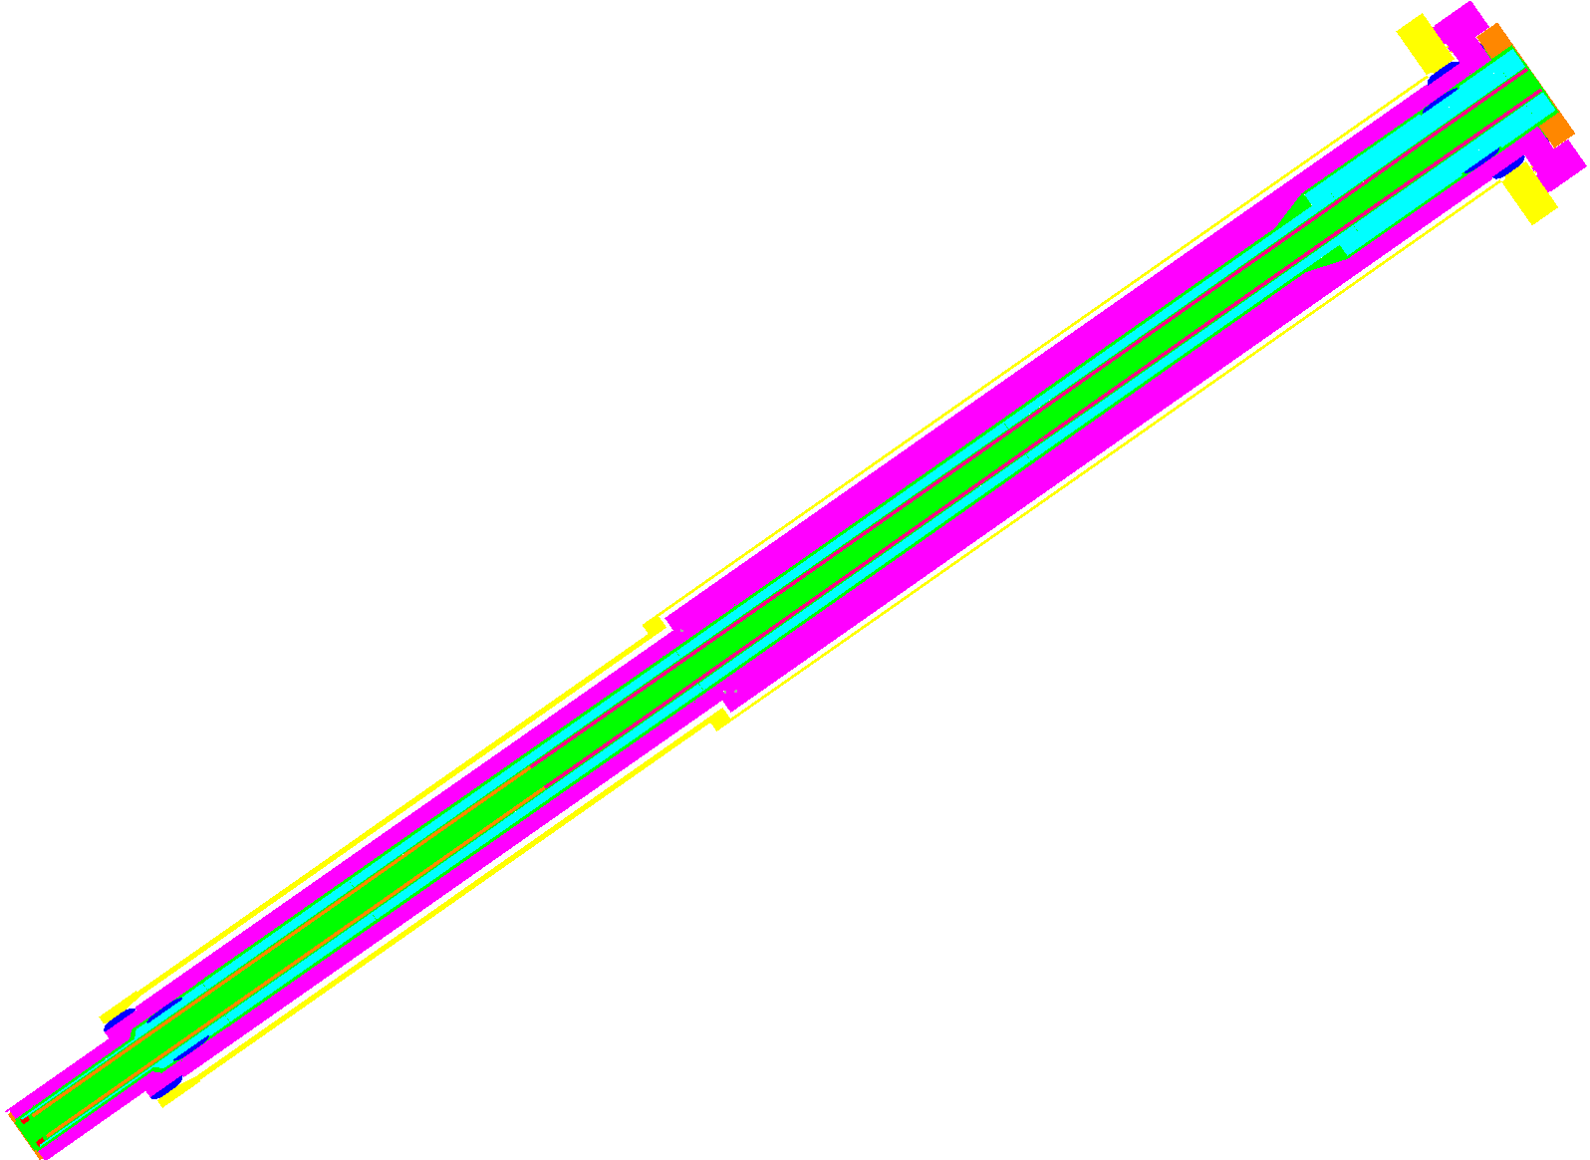
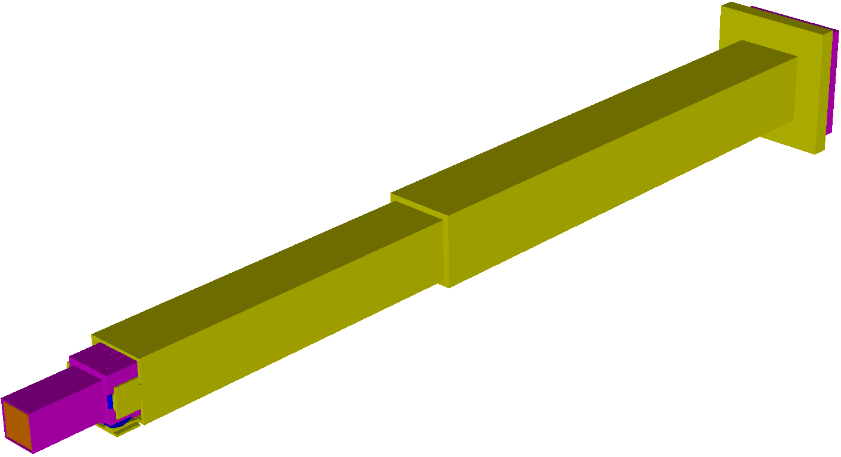
Images of ST10 CAD (top) and MCNP6 Unstructured Mesh (bottom)
Nozzle extension
Monolith insert inside nozzle extension
Creo → SpaceClaim → Attila4MC → MCNP6

Slide 9
Neutron (left) and proton (right) flux in the ST11 front Al window

Slide 10
ST10 energy deposition results
W/cm³
Start with ST10 because it is one of the neutron beamlines in the forward direction
The highest energy particles have high forward momentum and tend to continue in the forward / proton beam direction
Maximum total energy deposition is 89.9 mW/cm³
Void

Slide 11
Rule of thumb in target systems: areas with more than 1 mW/cm³ heating need cooling
W/cm³
Notice the outline of the cylindrical neutron extraction port
60 cm

Slide 12
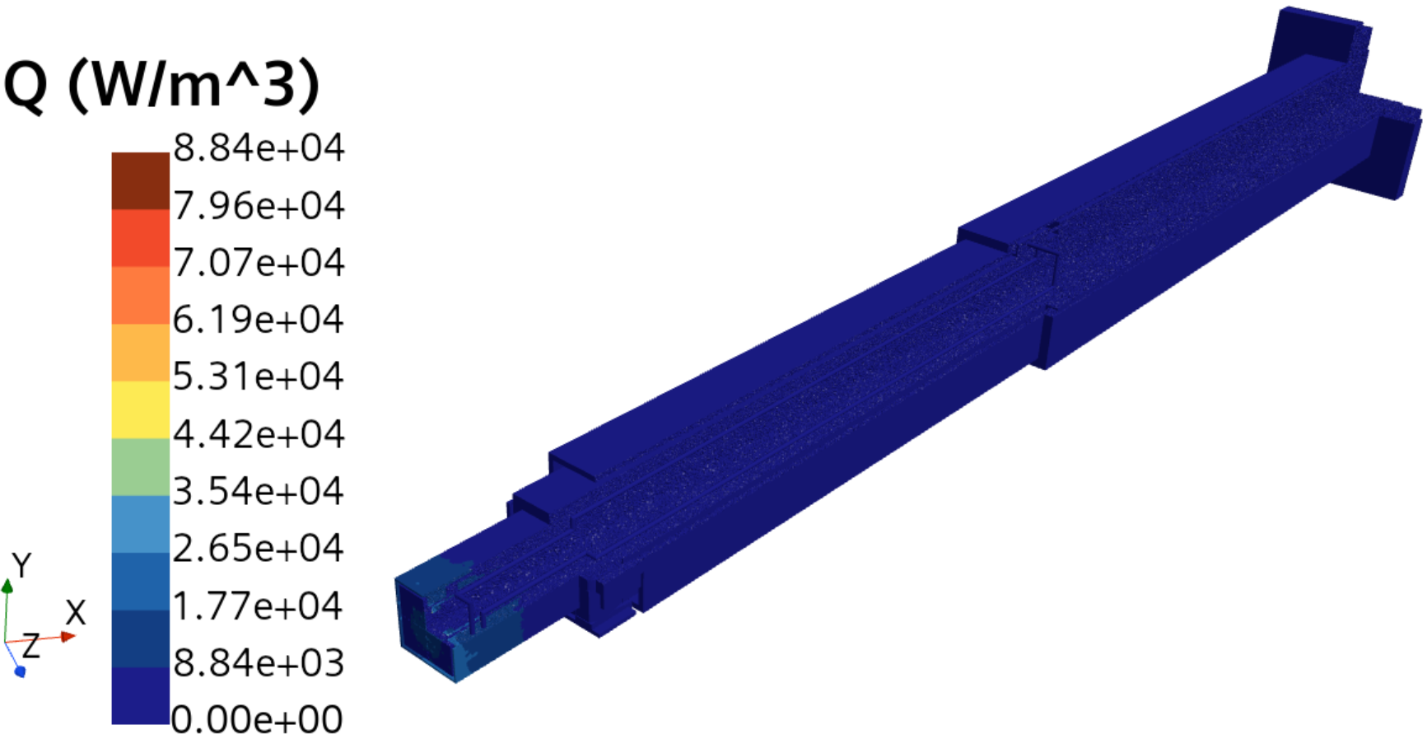
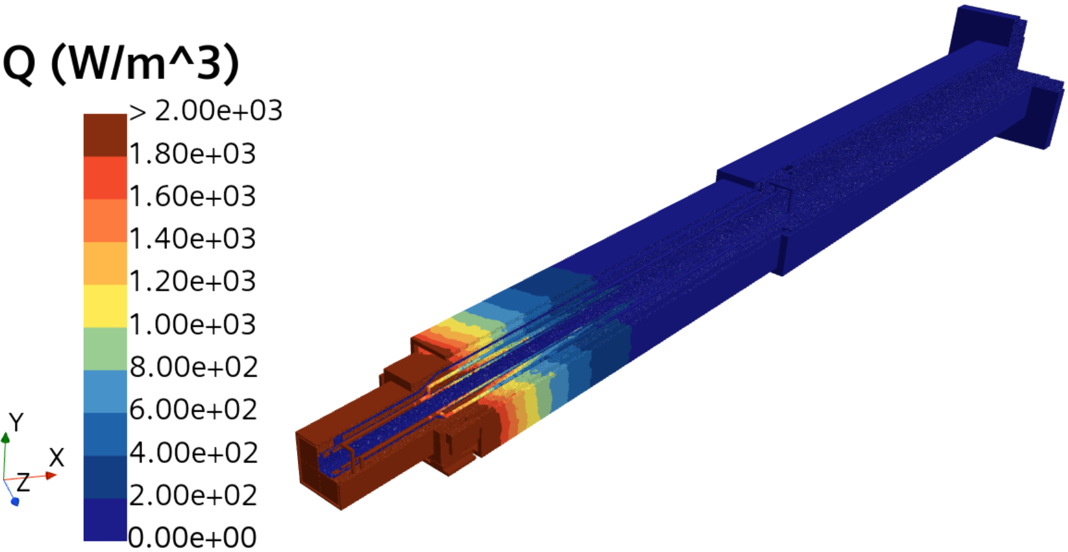
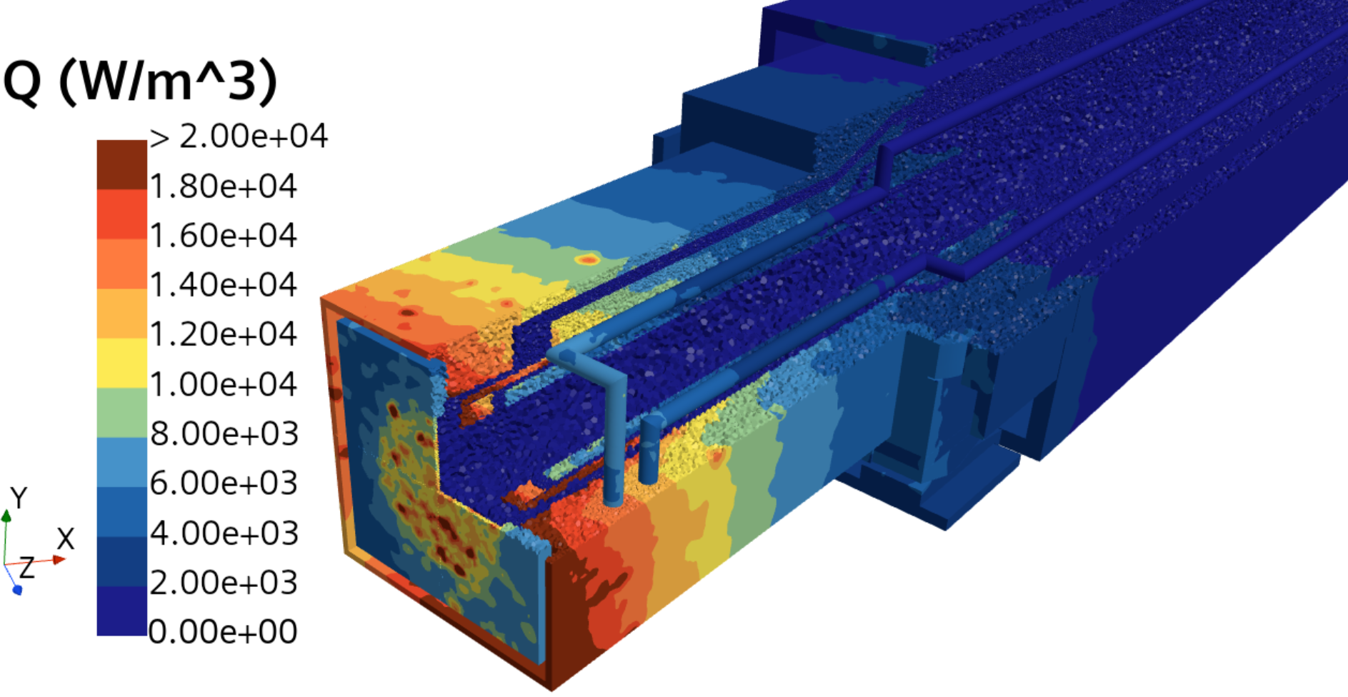
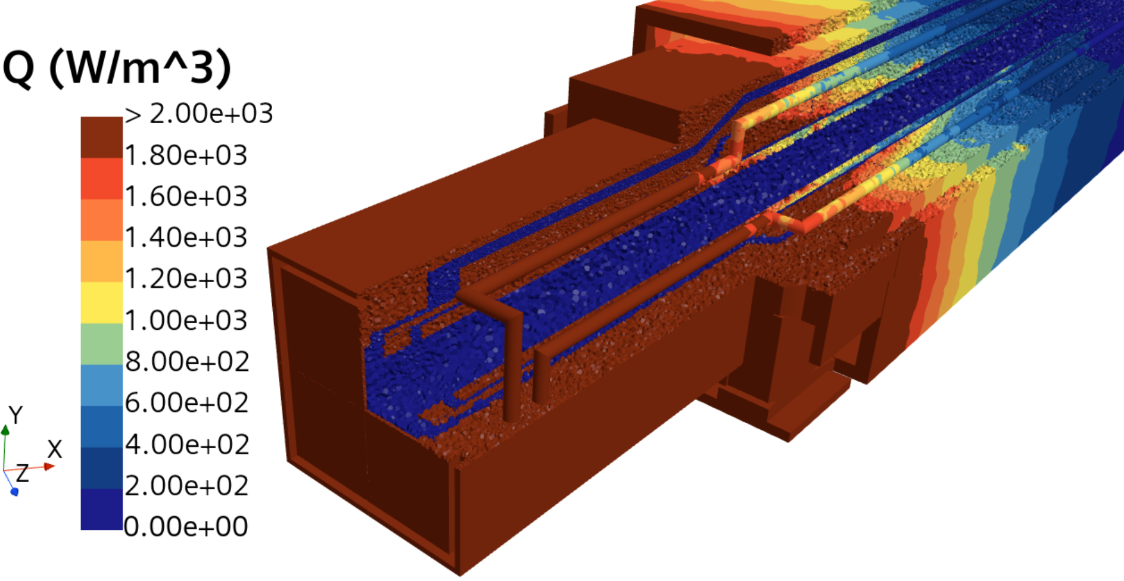
Steady State Heat Transfer Analysis for ST10 Monolith Insert, Heat Source
This is the same data plotted with different color scales
Total Heat = 82 W
Note that the heating in the rear portion is small but not zero.
Macor

Slide 13
Steady State Heat Transfer Analysis for Monolith Insert, Heat Source
Monolith Insert ST10
Material | Component | Total Heat (W) | %
Al6061 | Upstream & Downstream Windows, and Guide Substrate | 4.1 | 5.0
Cu | Downstream Seal, Rollers, and Shims | 0.8 | 0.9
Float Glass | Guide Substrate | 0.1 | 0.1
Macor | Guide Shield | 1.0 | 1.2
SS304 | Optics Module | 10.9 | 13.3
SS304L | Monolith Insert | 55.8 | 67.9
SS316L | Nozzle Extension, Seals, and Rollers | 8.5 | 10.3
He | Helium | 0.00289 | 0.0035
H₂O | Water | 0.9 | 1.1
Total |  | 82.1 | 100
Assumptions of thermal hydraulics simulation
Inlet water and initial temperature of helium (stagnant) is 35$°$C
Water flow rate 0.063 kg/s (1.0 gal/min)
Heat removal paths from the monolith insert
Monolith insert actively cooled (forced convection) by the cooling water
Heat conduction to Helium and through the contacts surfaces between the monolith insert and nozzle extension
Adiabatic boundary condition for all outer surfaces

Slide 14
Summary
Monolith Insert ST10
Material | Component | Peak Temperature (°C)
Al6061 | Upstream & Downstream Windows, and Guide Substrate | 38.7
Cu | Downstream Seal, Rollers, and Shims | 37.5
Float Glass | Guide Substrate | 35.4
Macor | Guide Shield | 41.2
SS304 | Optics Module | 40.6
SS304L | Monolith Insert | 37.5
SS316L | Nozzle Extension, Seals, and Rollers | 52.7
He | Helium | 41.2
H₂O | Water | 36.0
Temperature sensitive components in blue (limit 70$°$C)
Highest temperature components in red
Largest bulk monolith insert component is bold

Slide 15
ST11 energy deposition results
Maximum total energy deposition is 445 mW/cm³
W/cm³
W/cm³
Void

Slide 16
ST15 energy deposition results
Maximum total energy deposition is 161 mW/cm³
W/cm³
W/cm³
Void

Slide 17
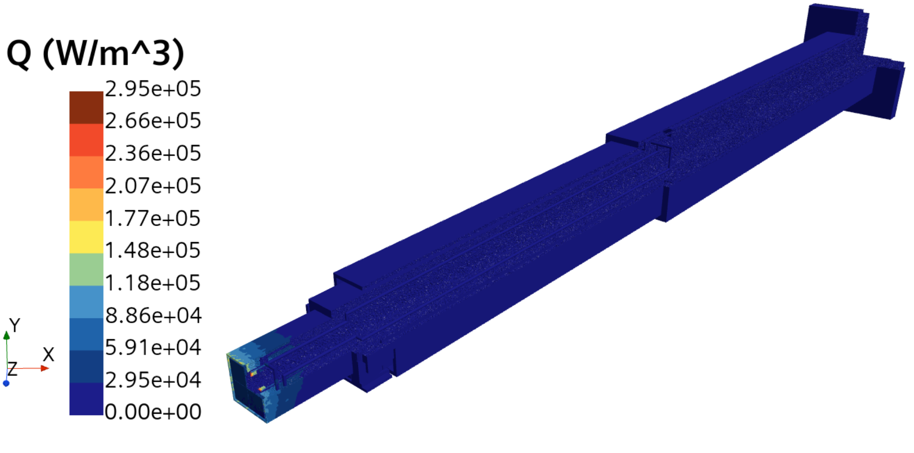
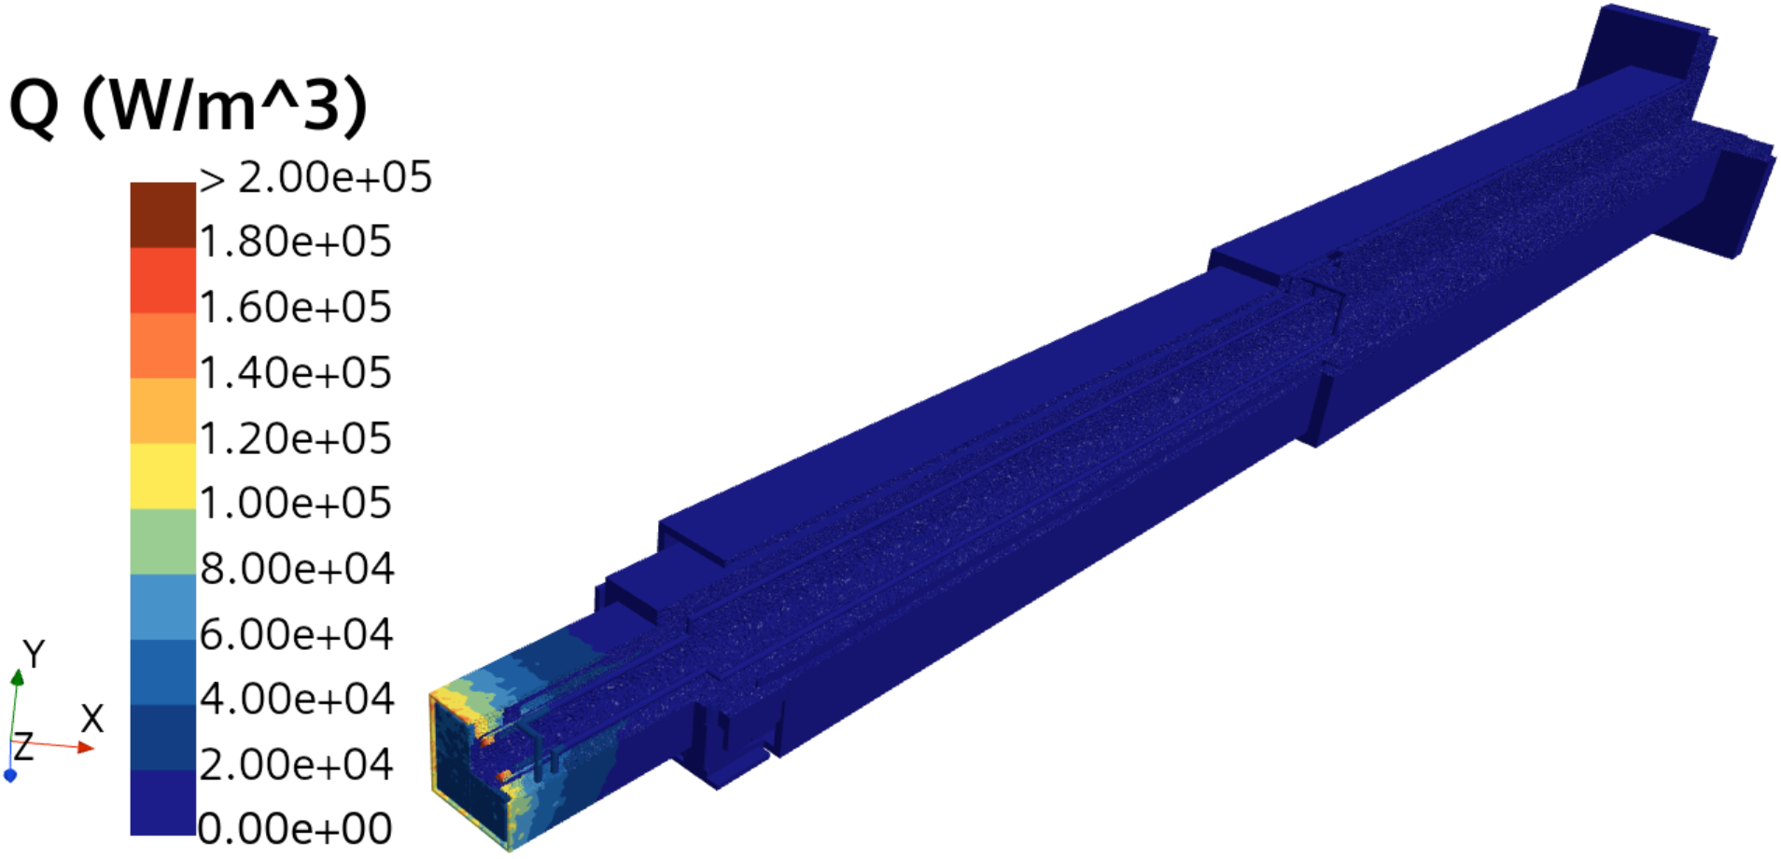
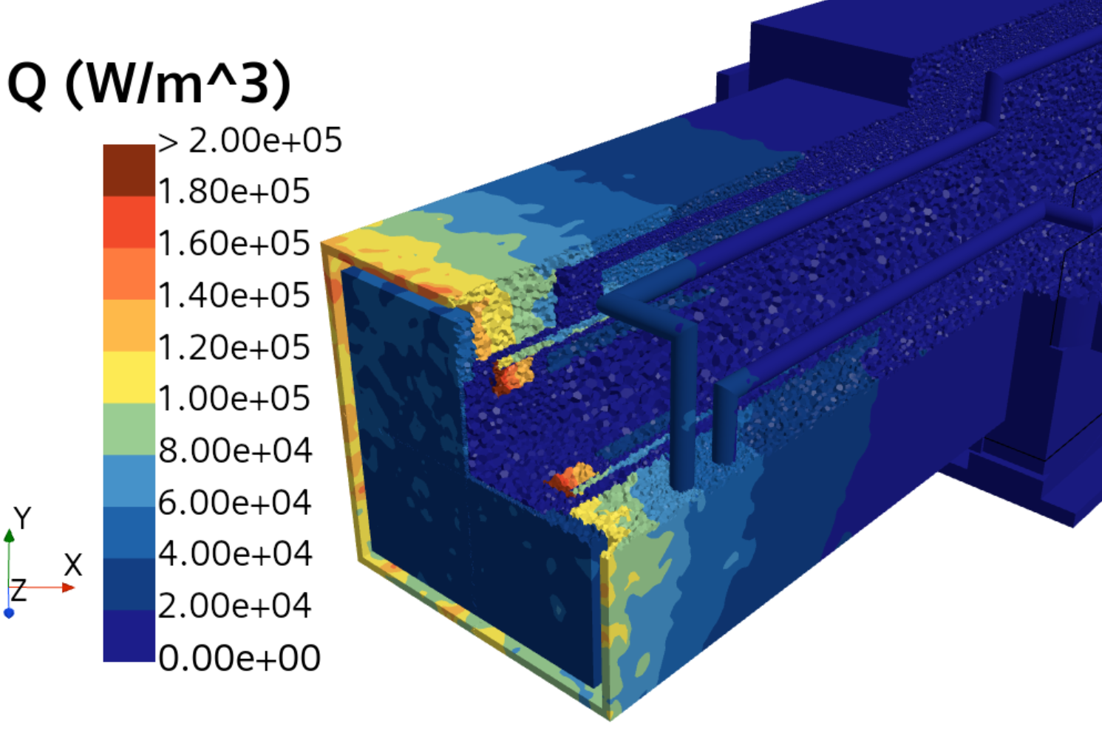
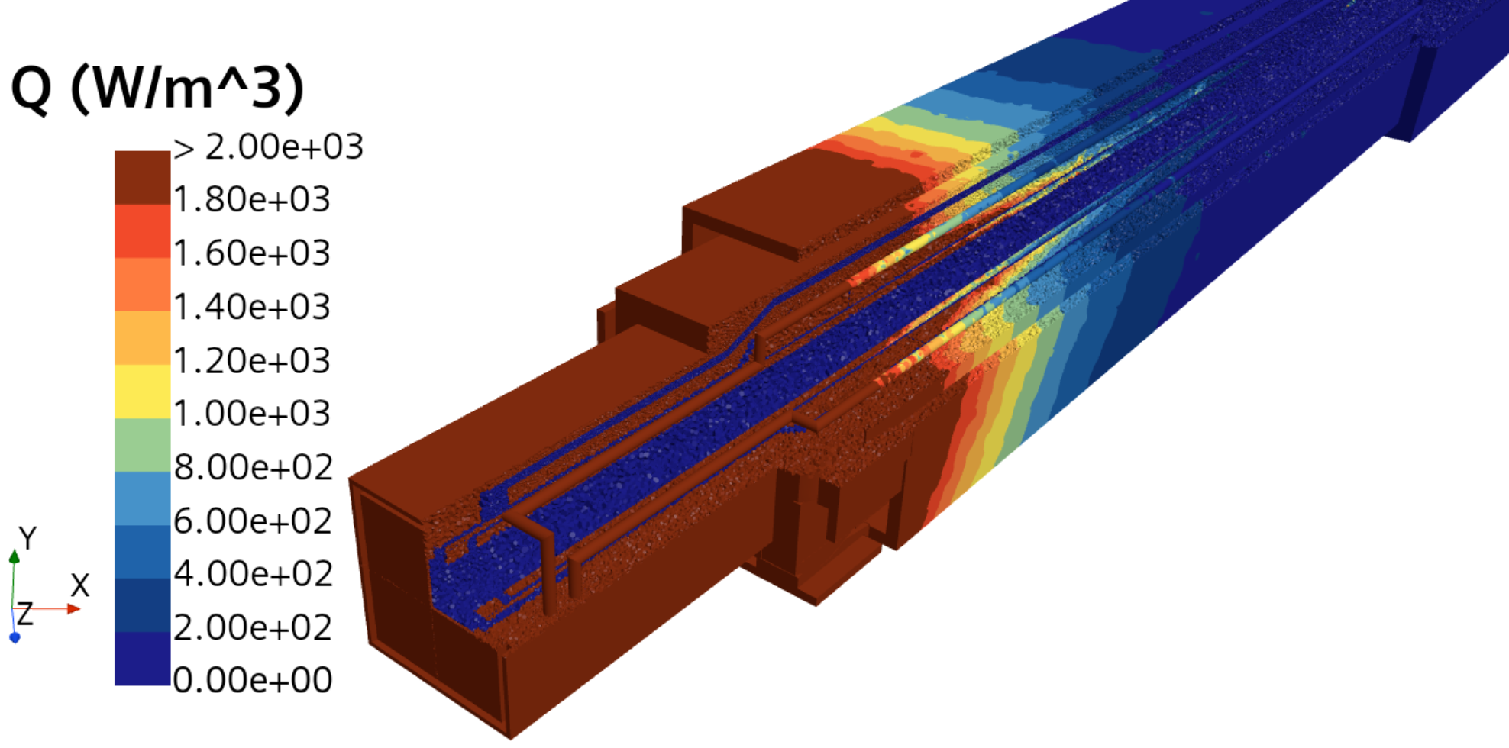
Steady State Heat Transfer Analysis for ST11 Monolith Insert, Heat Source
This is the same data plotted with different color scales
Total Heat = 240.3 W
Note that the heating in the rear portion is small but not zero.
Macor

Slide 18
Steady State Heat Transfer Analysis for Monolith Insert, Heat Source
Monolith Insert ST11
Material | Component | Total Heat (W) | %
Al6061 | Upstream & Downstream Windows, and Guide Substrate | 13.0 | 5.4
Cu | Downstream Seal, Rollers, and Shims | 1.4 | 0.6
Float Glass | Guide Substrate | 0.1 | 0.04
Macor | Guide Shield | 9.0 | 3.8
SS304 | Optics Module | 26.7 | 11.1
SS304L | Monolith Insert | 174.6 | 72.7
SS316L | Nozzle Extension, Seals, and Rollers | 12.6 | 5.2
He | Helium | 0.0083 | 0.0035
H₂O | Water | 2.8 | 1.2
Total |  | 240.3 | 100
Assumptions of thermal hydraulics simulation
Inlet water and initial temperature of helium (stagnant) is 35$°$C
Water flow rate 0.063 kg/s (1.0 gal/min)
Heat removal paths from the monolith insert
Monolith insert actively cooled (forced convection) by the cooling water
Heat conduction to Helium and through the contacts surfaces between the monolith insert and nozzle extension
Adiabatic boundary condition for all outer surfaces

Slide 19
Summary
Monolith Insert ST11
Material | Component | Peak Temperature (°C)
Al6061 | Upstream & Downstream Windows, and Guide Substrate | 48.2
Cu | Downstream Seal, Rollers, and Shims | 39.6
Float Glass | Guide Substrate | 35.8
Macor | Guide Shield | 68.6
SS304 | Optics Module | 62.4
SS304L | Monolith Insert | 48.6
SS316L | Nozzle Extension, Seals, and Rollers | 60.7
He | Helium | 68.4
H₂O | Water | 40.4
Temperature sensitive components in blue (limit 70$°$C)
Highest temperature components in red
Largest bulk monolith insert component is bold

Slide 20
Summary of Radiation Heating Analysis
Conservative “features” of the model that bound the final design
The bottom 2m of the target shaft is void – the design has settled on this region being filled with steel
Tube moderator extraction port is 77mm diameter cylinder & the cylindrical moderator extraction port is “wide open” – the design is moving towards a ~90mm diameter neutron extraction port for all beamlines
All monolith insert configurations analyzed can be adequately cooled
ST10 82 W, maximum temperature 41.2$°$C (52.7$°$C in the nozzle extension)
ST11 240 W, maximum temperature 68.6$°$C
Final design will be between these two configurations, but closer to ST10

Slide 21
Monolith Insert Radiation Damage
The expectation before this analysis began was that DPA will not be an issue
The results on the next 2 slides verify this
Gas production (H and He) is due to high energy particles – this was not analyzed because we are confident this is not a concern
These simulations used the same MCNP models as the radiation heating analysis (CSG + UM for monolith inserts)
DPA cross sections produced via the NRT model and published by Konobeyev, et. al. were used
Nuclear Instruments and Methods B, 431, pp. 55-58 (2018)

Slide 22
ST10 DPA results
Maximum total is 1.61E-3 dpa/yr
Assuming STS operates 5000 hr/yr
Notice the outline of the cylindrical neutron extraction port

Slide 23
ST11 DPA results
Maximum total is 7.80E-3 dpa/yr
Assuming STS operates 5000 hr/yr
This 3D plot uses the same color scale as the 3D plot on the previous slide, so you can easily see the difference in DPA rate

Slide 24
Comparison of FTS and STS simulations of heating and radiation damage
Table 3.2 from SNS-106100200-DA0098-R00 gives calculated heating density and DPA rate for a few core vessel inserts from FTS (MCNPX 2.7)
The distance from moderator to these inserts is approximately the same as STS
Scaling the maximum FTS results for a 2 MW, 1.3 GeV proton beam to 700 kW
Heating density ranges from 2.96E-2 to 3.50E-2 W/cm³
DPA rate ranges from 3.37E-3 to 6.18E-3 dpa/yr
The maximum STS monolith insert calculations presented here
Heating density ranges from 8.99E-2 to 4.45E-1 W/cm³
DPA rate ranges from 1.61E-3 to 7.80E-3 dpa/yr
The FTS calculated heating and radiation damage are comparable to the STS calculations and do not present problems for the design

