Slide 1
The Shielding Integral Benchmark Archive Database (SINBAD) Task Force
Reinvigorating SINBAD by Crowdsourcing
Oliver BUSS, Evren DOGAN OECD NEA, Division of Nuclear Science & Education, WPRS Secretariat
Thomas MILLER Chair of SINBAD Task Force Oakridge National Laboratory, USA
SATIF-16, Frascati, Italy, 28 May 2024

Slide 2
Outline
Update on SINBAD Developments
SINBAD Migration to GitLab

Slide 3
SINBAD - Shielding Integral Benchmark Archive and Database
International archive for complex shielding benchmarks
102 reactor, fusion neutronics, and accelerator shielding experiments
Work jointly carried out by the United States’ Radiation Safety Information Computational Center (RSICC) and the NEA.
Started in 1992 by OECD/NEA Databank and ORNL/RSICC by E. Sartori, B. Kirk, I. Kodeli, and others
https://oe.cd/nea-sinbad
Figure: Sinbad entries per application domain
Figure: Sinbad entries per physical phenomenon

Slide 4
SINBAD: Motivation for Change
102 reactor, fusion neutronics, and accelerator shielding experiments
BUT: only 9 updates since 2016 and only 4 new experiments added in the last 10 years
Initiated NEW EGPRS Task Force on SINBAD in 2022
Targets:
Modernize the database building upon previous work
Implement new software tools for database maintenance based on new NEA Data Bank infrastructure
(Re-)Build community of database developers
Adopt standardized format agreed in 2019 for SINBAD
Improve the quality of the existing database entries
Provide new database entries

Slide 5
Status SINBAD Task Force
01/2022: Kick-Off
25/03/2022: Update procedures, workflows, and GitLab hand-Over
23/02/2023: Status Report WPRS
04/03/2022: Prioritize development & define subgroups dealing with specific entries
22/02/2024: Status Report WPRS

Slide 6
Status SINBAD Task Force
01/2022: Kick-Off
25/03/2022: Update procedures, workflows, and GitLab hand-Over
02/2023: Status Report WPRS
04/03/2022: Prioritize development & define subgroups dealing with specific entries
03/2026: Final Evaluation of Task Force Efficiency by EGPRS ➔ TRG or Stop
Development Phase: Independent subgroups for different entries and periodic Task Force reviews
04/2023: Technical Review Meeting
02/2024: Status Report WPRS
04/2024: Technical Review Meeting

Slide 7
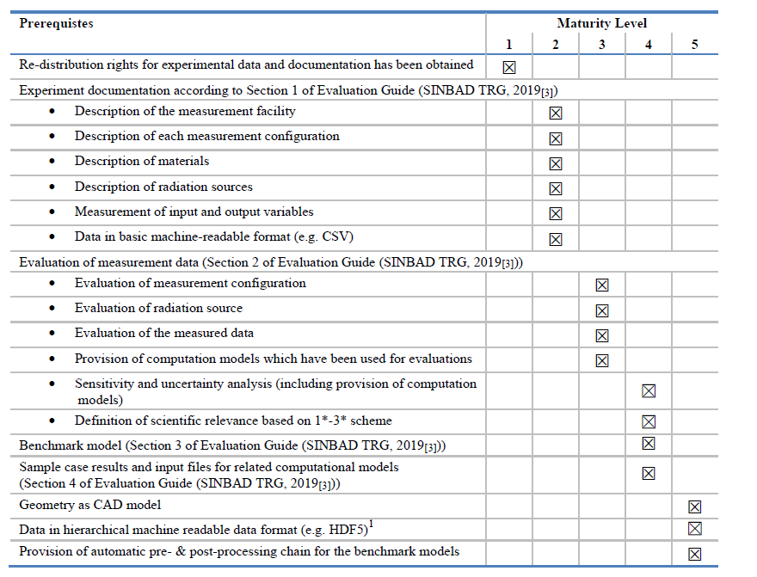
NEW: SINBAD Maturity Level Scheme
5 Maturity Levels
Level 4 corresponds roughly to ICSBEP requirements
Iterative maintenance efforts to reach specific maturity levels and/or prerequisites

Slide 8
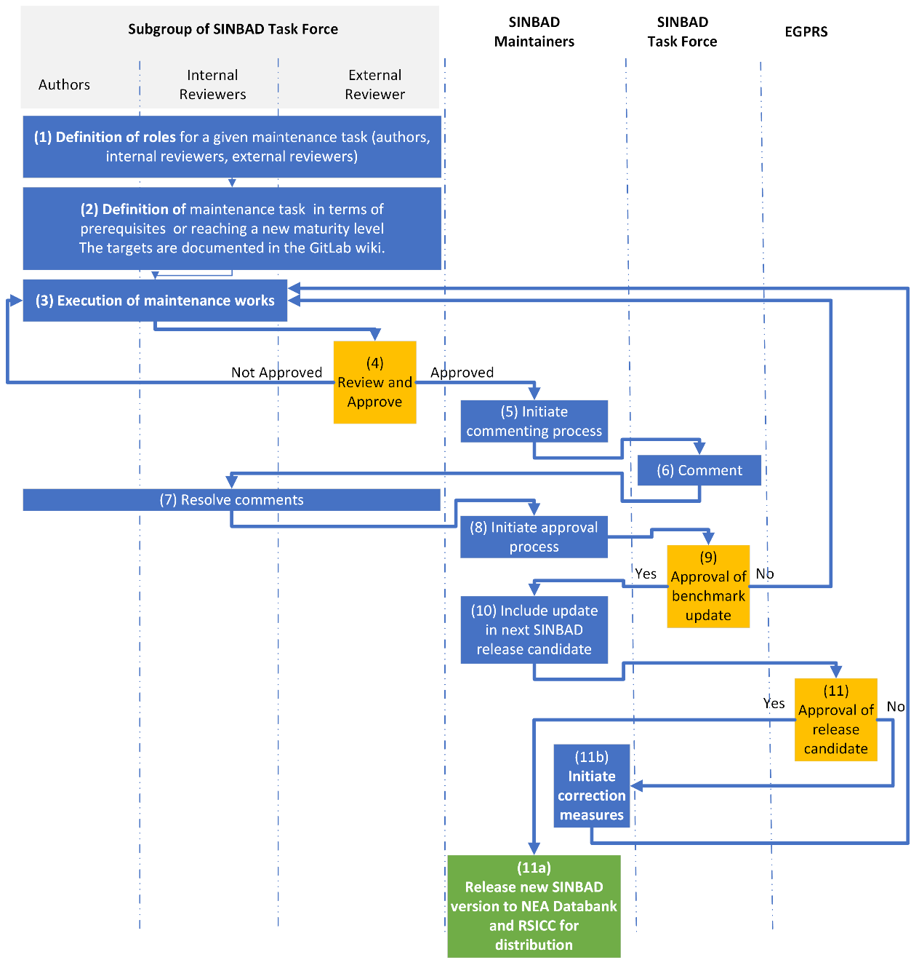
Other Process Updates
Report templates follow ICSBEP standard (based on TRG 2019 recommendations)
Standardized hierarchical directory structures
Word and Latex Templates
Two processes:
Maintenance effort driven by subgroup
Simplified merge request workflow for small changes (Maintainers consult former subgroups)

Slide 9
Active TF Subgroups
Subgroup Title | Coordinator | Application Domain
Vessel fluence | A. Alpan (USA) | V&V for RPV aging studies
LLNL pulsed spheres | A. Tamashiro (USA) | Attenuation of 14MeV neutrons
FNG Copper | I. Kodeli (UK) | Attenuation of 14MeV neutrons in Cu
KFK – n gamma | S. Simakov (GER) O. Buss (NEA) | Neutron and gamma attenuation in Fe and the associated (n,$γ$) reactions
FNG HCLL | P. Ortego (SPN) | Tritium breeding in He cooled Pb-Li
Broomstick ¹⁶O | S. Simakov (GER) O. Buss (NEA) | Attenuation of fission neutrons in ¹⁶O
CERN-EU high-energy Reference Field (CERF) | R. Froeschl (CERN) | Accelerator activation and residual dose rate + neutron shielding at CERN with a hadron beam
Health Physics Research Reactor (HPRR) | M. Dupont (USA) | Neutron fluence, neutron dose, and gamma dose from a HEU fast burst reactor
ASPIS Cranked Duct | D. HANLON (UK) | Neutron streaming in a configurable duct
NEW
NEW

Slide 10
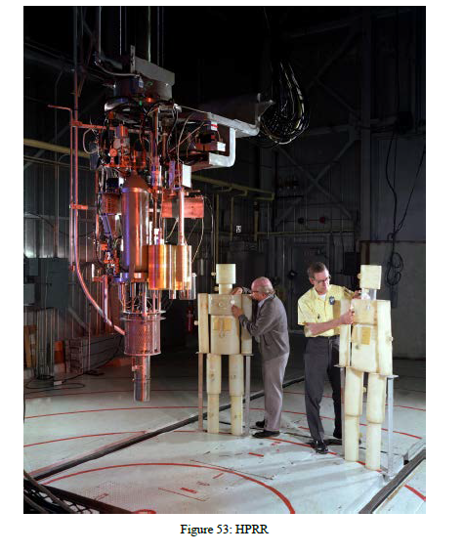
Health Physics Research Reactor (HPRR)
Evaluation work focused only on experimental data from ORNL-6240, the latest report available with the newest reactor configuration
SINBAD evaluation will contain benchmarks from four 4 experiment categories:
Total neutron fluence from a steady-state operation of the HPRR measured by Bonner sphere spectrometry, shielded and unshielded
Derived neutron kerma results
Sulfur pellet activation at different distances from an HPRR pulse, shielded and unshielded
Gamma dose from an HPRR pulse measured by G-M counter and TLD

Slide 11
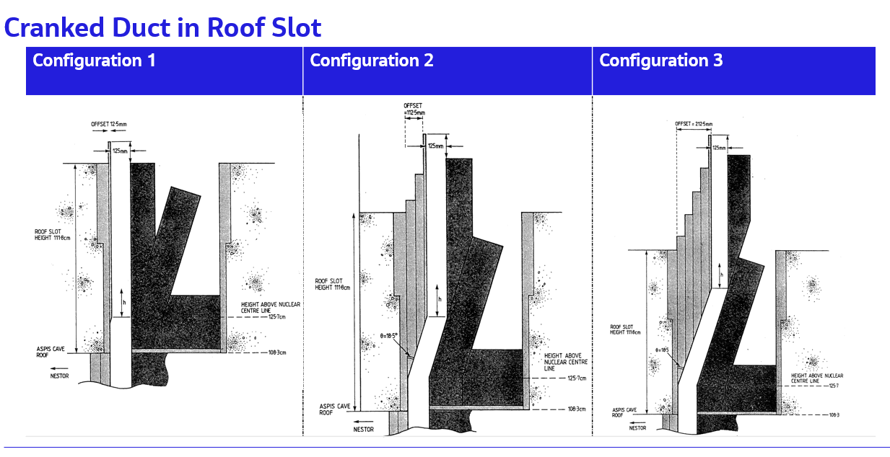
ASPIS Cranked Duct
NESTOR = Argonaut type reactor with caves in which shielding experiments could be performed.
One of the caves is referred to as the ASPIS cave, in which experiments of the NESTOR Shielding and Dosimetry Improvement Programme (NESDIP) were performed by inserting a trolley containing different arrangements of materials.
These source fission neutrons then penetrate a configurable neutron shield and entered a polythene backed cavity from where they could stream up through a roof slot into a three-legged “cranked” (kinked) duct.
Neutron measurements were performed in the final leg of the duct with both BF3 and SP2 Hydrogen gas counters

Slide 12
SINBAD Migration to GitLab

Slide 13
SINBAD Migration to NEA GitLab
Migration of SINBAD content to GitLab Version Control System
Conversion of HTML content to Markdown
Categorization and renaming of all entries based on SINBAD naming scheme
Custom config of GitLab projects
Reformat-ting
WHY?
Provide platform for simple user feedback
Quick & traceable change workflows
Enable users to upload proposed corrections and additional data
Full version control and control of main version by the SINBAD Task Force

Slide 14
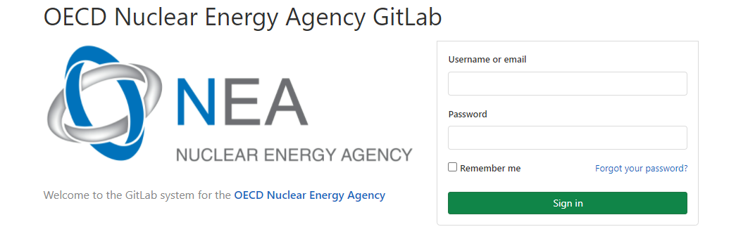
SINBAD Platform
SINBAD hosted on NEA GitLab by OECD NEA Data Bank (on-premises)
GitLab access for all licensees
Subgroups work in branches & issue merge requests to maintainers (NEA & Task Force Chair)
New evaluations added as new projects ➔ modular
Issue Tracking:
Transparent issue tracking for development within GitLab
Users are asked to report issues directly on GitLab
Future SINBAD distribution only via NEA GitLab
GitLab Group/Project Structure:
SINBAD (GitLab Group)
Templates & Guidance (P)
Sinbad.v1 (LEGACY)
Evaluation A
Evaluation B
Sinbad.v2
(GitLab Group)
SINBAD Wiki
Evaluation X

Slide 15
SINBAD Versions
2 versions of SINBAD on GitLab
Sinbad.V1:containing the original entries (updated to GitLab)
Sinbad.v2:current version, designed for maintenance, allowing contributors to work on this version

Slide 16
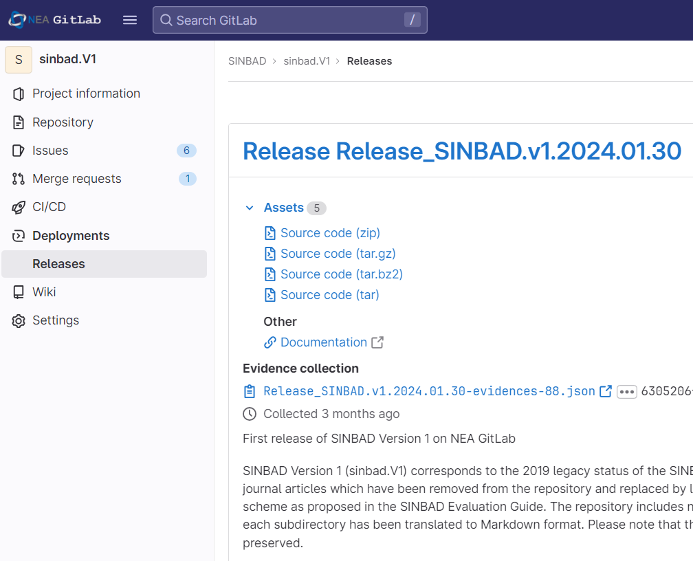
SINBAD Distribution Process
Users request licenses at NEA-DB or RSICC
All licensed users (also RSICC licensees) are given access to the NEA GitLab system by NEA DB
Licensees will also have access to all future revisions of a SINBAD Version
Users have always access to most up-to-date information

Slide 17
Outlook and Conclusions
Successful migration of SINBAD to NEA GitLab
GitLab system supports crowdsourcing to drive the future SINBAD development: users can easily provide feedback and get involved in development process
Transparent maintenance & development process
Ready to acquire experimental data in “Maturity Level 1”
SINBAD licensing by RSICC and NEA DB
SINBAD distribution in future only via NEA GitLab
RTS 2024: need for unified results format, need exchange of numerical benchmark results, exchange input decks, identify synergies in geometry converter projects

Slide 18
For more information please contact: wprs@oecd-nea.org

Slide 19
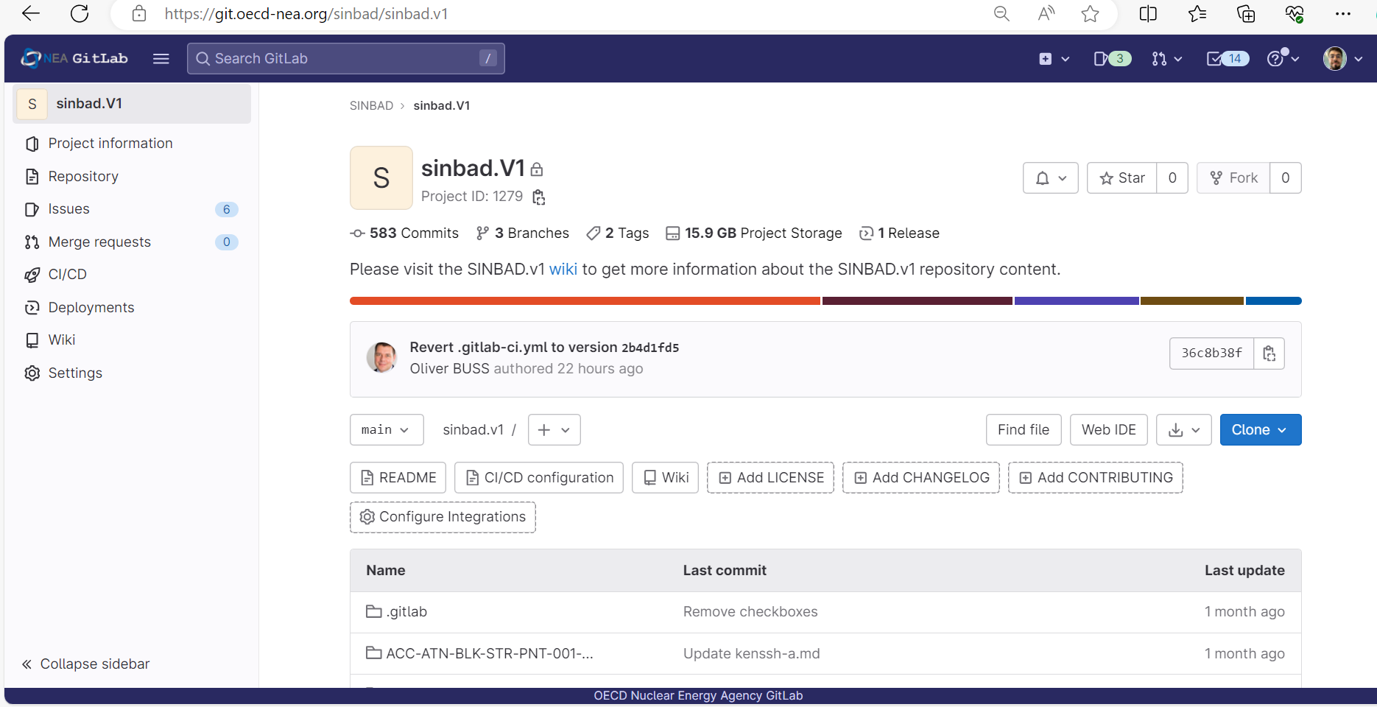
Issue System
GitLab's issue system efficiently tracks tasks in one central location.

Slide 20
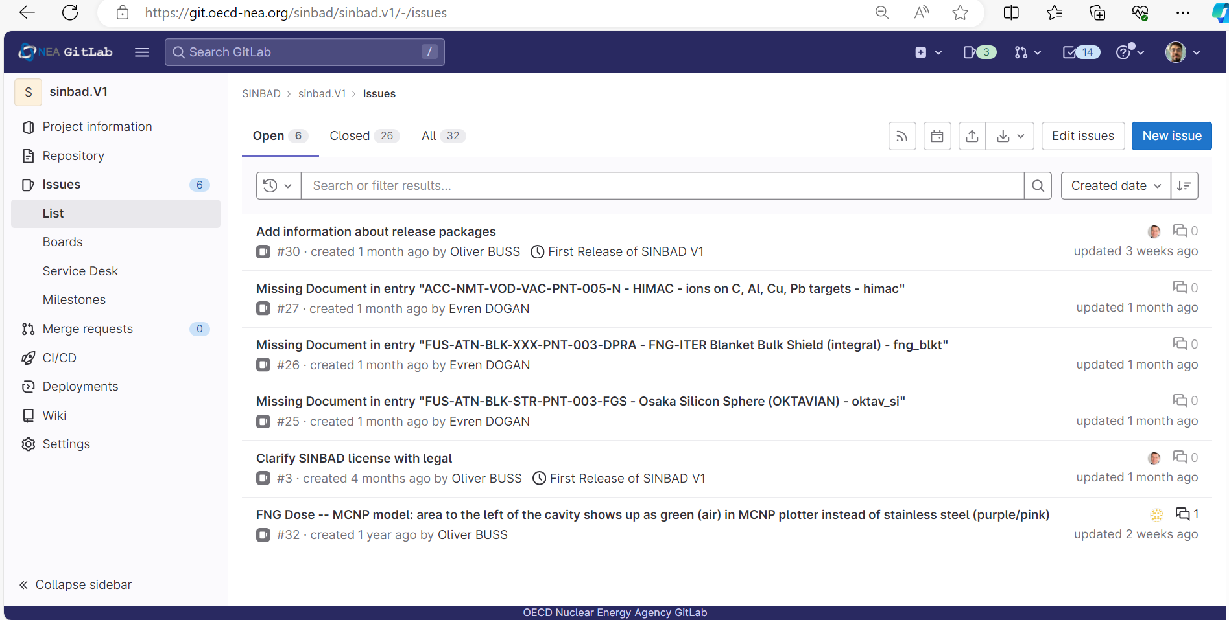
Issue System
Creating New Issue

Slide 21
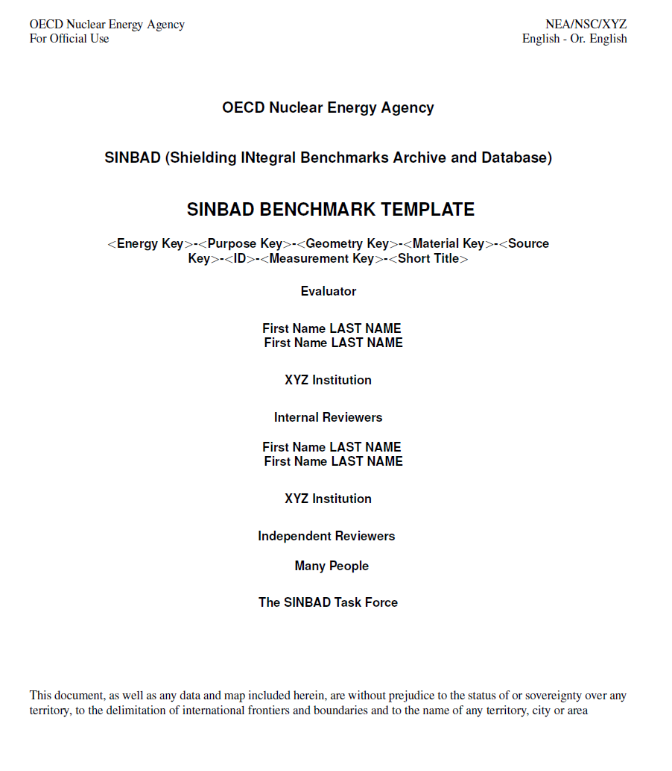
Updates to Templates
Word Template:
Added scientific relevance rating, updated maturity level table
New LATEX templates based on ICSBEP templates proposed by Alex McSpaden, Kelsey Amundson, Jesson Hutchinson, Geordie McKenzie, Kristin Stolte, Nicholas Thompson, and Robert Weldon.
https://git.oecd-nea.org/sinbad/templates-and-guidance

Slide 22
New Licences for SINBAD v1 and v2
See PDFs
SINBAD v1: https://mynea.oecd-nea.org/sites/WPRS/EGPRS/SINBAD/Meetings/SINBAD%20Task%20Force%20Meeting%2C%2018%20April%202024%2004-18-2024%2009h00/Meeting%20material/10_License%20SINBAD%20V1.pdf
SINBAD v2: https://mynea.oecd-nea.org/sites/WPRS/EGPRS/SINBAD/Meetings/SINBAD%20Task%20Force%20Meeting%2C%2018%20April%202024%2004-18-2024%2009h00/Meeting%20material/10_Licence%20SINBAD%20%20V2.pdf
Owner A
Owner A
Owner C
Owner D
Owner B
Owner E

Slide 23
BACK-UP

Slide 24
Naming Scheme
<Energy Key>-<Purpose Key>-<Geometry Key>-<Material Key>-<Source Key>-<ID>-<Measurement Key>-<Short Title>
• FIS: experiments relevant for the fission energy range, including spontaneous fission and neutron sources based on (α,n) reaction.
• FUS: the FUS identifier shall be used for experiment in the Fusion energy range, and should be used with DT reactions. This key also applies to DD reactions if they are mixed with DT reactions, otherwise DD reactions should be classified as fission.
• ACC: Accelerator experiments are those with energy close to the nucleus binding energy and much higher and are frequently far off being properly a shielding experiment, therefore most of the subsequent identifiers are not applicable.

Slide 25
Naming Scheme
<Energy Key>-<Purpose Key>-<Geometry Key>-<Material Key>-<Source Key>-<ID>-<Measurement Key>-<Short Title>
The following purpose keys are defined:
• ATN: Attenuation of neutron flux, gamma flux and their doses
• ACT: Activation of samples of materials for measuring activity and residual heat
• HOT: Heating rate during the irradiation process
• SDR: Residual or shutdown dose rate originated in a part of the shielding
• TBR: Tritium breeding or production of tritium in breeding materials
• RES: Production of residual nuclides
• SEC: Production of secondary particles in number, energy or angle
• NMT: Production of multiple neutrons by high energy particles (spallation)

Slide 26
Naming Scheme
<Energy Key>-<Purpose Key>-<Geometry Key>-<Material Key>-<Source Key>-<ID>-<Measurement Key>-<Short Title>
The following geometries are categorized:
• BLK: The geometry of most of shielding blocks is a solid parallelepiped made of a single material or of a set of plates of different materials including water in a closed container or simulated by plastics. This case is defined as BLK.
• GAP: In other cases, the main purpose is to measure the streaming of neutrons and gammas along a narrow gap between close bulky elements or along a human size labyrinth in a concrete building. These cases are defined as GAP.
• VOD: In many cases there is no shielding at all because the purpose is to detect and measure secondary particles, measure cross sections or produce residuals by high energy particles generated in an accelerator, so the shield part is void and is identified as VOD.
• SKY: The special case where the objective is to measure the scattering of particles in the air located over the facility, i.e. the skyshine radiation. This is defined as SKY.

Slide 27
Naming Scheme
<Energy Key>-<Purpose Key>-<Geometry Key>-<Material Key>-<Source Key>-<ID>-<Measurement Key>-<Short Title>
Concerning the material of the shielding the following groups are defined:
• STR: Structural materials as steel, iron, concrete, etc.
• MOD: Materials with capability to moderate neutrons such as water, polymers, light materials in general. Lead is included because of function similarity if this is its main purpose (fission energy range).
• BRE: Breeder materials such as lithium.
• MUL: Neutron multiplier materials such as Berylium and Lead when this is its main purpose (fusion energy range).
• VAC: In all those cases with accelerators where only vacuum is present in the space between target and detectors.
• XXX: Various material groups.

Slide 28
Naming Scheme
<Energy Key>-<Purpose Key>-<Geometry Key>-<Material Key>-<Source Key>-<ID>-<Measurement Key>-<Short Title>
The following types of radiation sources are defined:
• PNT: Point source
• LIN: Linear source
• SUR: Surface source
• VOL: Volume source

Slide 29
Naming Scheme
<Energy Key>-<Purpose Key>-<Geometry Key>-<Material Key>-<Source Key>-<ID>-<Measurement Key>-<Short Title>
The <ID> is an integer identifier. It is an integer identifier if the first 5 identifiers are the same.

Slide 30
Naming Scheme
<Energy Key>-<Purpose Key>-<Geometry Key>-<Material Key>-<Source Key>-<ID>-<Measurement Key>-<Short Title>
The identifier letters for the different measuring techniques are the following:
• N: Total neutron flux and neutron flux spectrum
• G: Total gamma flux and gamma flux spectrum
• R: Reaction rate in activation foils
• A: Activity
• F: Time of neutron flight if directly available, otherwise as spectrum would be N
• D: Neutron dose
• P: Photon dose
• T: Tritium activity in a breeder material or in a TLD
• B: Bonner sphere signal if directly available, otherwise D or P
• L: Linear transfer dose if directly available, otherwise D or P
• S: Scintillator light pulses if directly available, otherwise D or P

Slide 31
Naming Scheme
<Energy Key>-<Purpose Key>-<Geometry Key>-<Material Key>-<Source Key>-<ID>-<Measurement Key>-<Short Title>
This part should contain short title of the entry and the legacy directory name if the entry was already distributed before the implementation of this naming scheme (e.g. “KEK-KENS-p-500-MeV-with-4m-Concrete-kens500” or “FNG-ITER-Blanket-Bulk-Shield-integral-fng_blkt” ).

