Slide 1

Radiation Shielding Analysis for Synchrotron Radiation Beamlines of 4th Generation Storage Ring in Korea
The 16th workshop on Shielding aspects of Accelerators, Targets and Irradiation Facilities (SATIF-16)-INFN-LNF-Italy
Mahdi Bakhtiari, Nam-Suk Jung, Hee Seock Lee
Pohang Accelerator Laboratory (PAL), POSTECH
2024.05.29

Slide 2
Contents
Introduction
4thGSR (4th Generation Storage Ring) construction project in Korea
Radiation safety control policy
Shielding design to determine tunnel structure
Beamlines radiation safety issues
  Front-end safety magnet design
  Safety shutter
  Optics hutch
  Experimental hutch
  Ray tracing
Monte Carlo calculation results
Safety magnet design using FLUKA 4-4.0 and PHITS-3.34.1 codes
Dose calculations from gas Bremsstrahlung (GB) using FLUKA 4-4.0
Safety shutter design using semi-empirical formula and FLUKA 4-4.0
Dose calculations from synchrotron radiation (SR) using FLUKA 4-4.0
Summary and conclusions

Slide 3


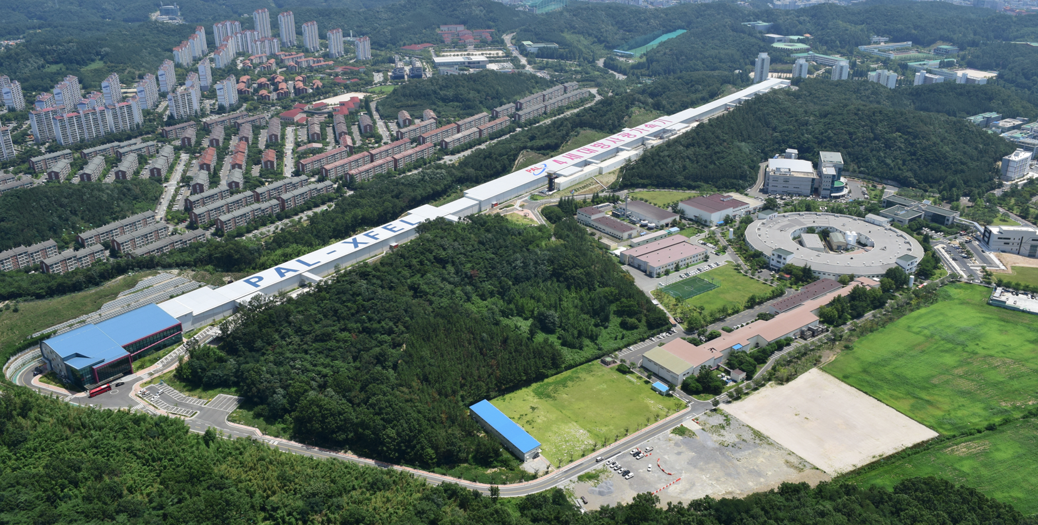

Introduction: 4thGSR project in Korea
History
2019. 10 : Start a Conceptual Design of 4thGSR by PAL/KBSI/KAERI collaboration
2020. 5 : Determine a construction site as ‘Cheongju’
2020. 6 : Publish a Conceptual Design Report (CDR)^{[1]}
2021. 7 : Determine a institution to conduct construction project
as KBSI (Korea Basic Science Institute)
2021. 7 (~ 2027. 6) : Start a construction project, ‘Multipurpose Synchrotron
Radiation Construction Project’
Counterpart in the construction project
KBSI : Building & Infrastructure
PAL : Accelerator & Beamline
(+ Radiation Shielding, Radiation Protection System)
PAL-XFEL
4th GSR
PLS-II
[1] Pohang Accelerator Laboratory, “Conceptual Design Report of 4GSR”, PAL-PUB-2000-004, 2000.

Slide 4
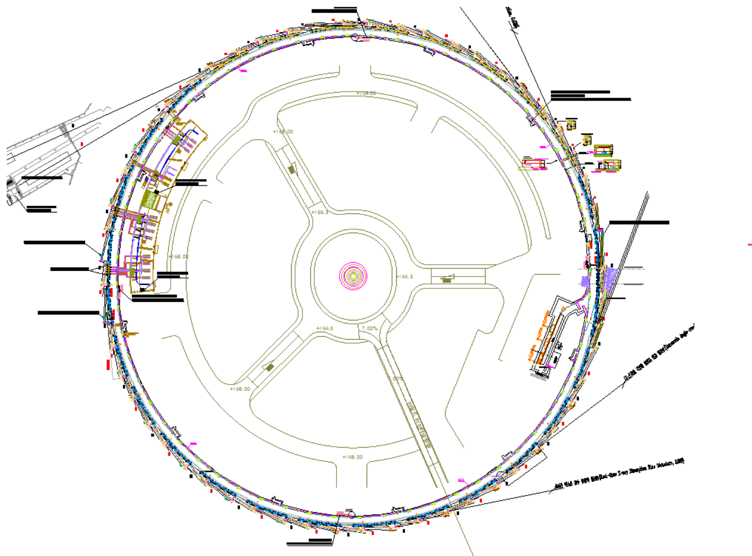
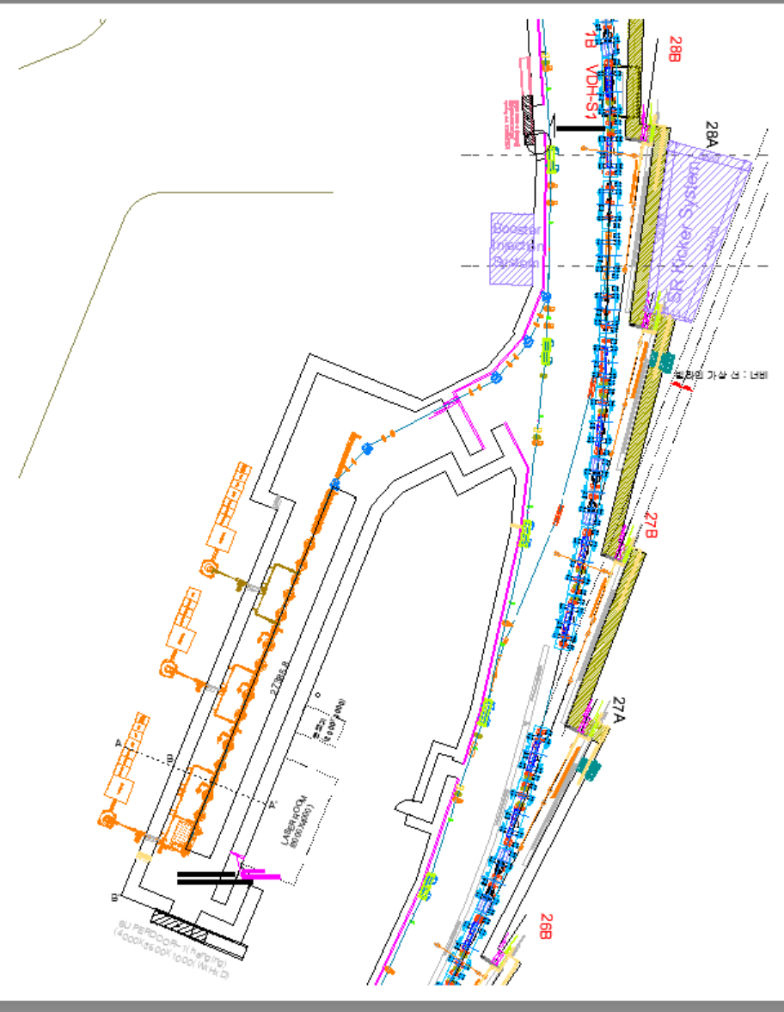
Introduction: Specification and layout of 4thGSR in Korea
 | Parameter | Value in TDR [1]
Storage Ring (SR) | Beam Energy | 4 GeV
 | Stored Current | 400 mA
 | Ring Circumference | 799.297 m
 | Symmetry | 28
 | Straight Section No. | 28
 | Straight Section length | 6.06 m
 | Emittance | 62 pm rad
Booster | Energy | 0.2 GeV to 4 GeV
 | Circumference | 772.893 m
Linac | Energy | 200 MeV
 | Reputation rate | 2 Hz
 | Pulse charge | 1 to 3 nC (Multi-bunch) 0.01 to 1 nC (Single-bunch)
 | Pulse length | ≈128 ns (Multi-bunch) 6~8 ps FWHM (Single-bunch)
Booster ring & storage ring in the same tunnel
10 beamlines will be constructed at the end of the first construction phase.
Beam direction: Counter-clockwise
Plan view
Linac to Booster Injection
Booster to SR Injection
e beam
Linac: 200 MeV
Booster: 0.2 to 4 GeV
SR: 4 GeV, 400 mA
4
[1] Multipurpose synchrotron radiation accelerator (Korea-4GSR) detailed design report (2023)-In Korean

Slide 5
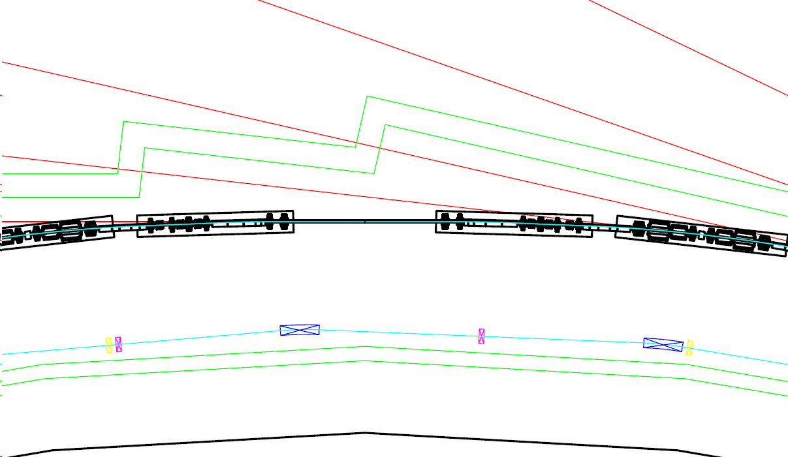
Radiation safety control policy
Dose criteria
Same safety control policy to PAL
Dose Limit (based on Korean Regulation) | Dose
Radiation Workers (RW) | 20 mSv/y
Frequent Visitors | 6 mSv/y
Public (including User) | 1 mSv/y
Site Boundary | 0.25 mSv/y
Shielding Criteria | Dose | Note
RW accessible area | 10 mSv/y, (5 µSv/h) ½ of dose limit based on ALARA | Normal operation
User accessible area | 1 mSv/y (0.5 µSv/h) | Normal operation
(In Accident) | 1 mSv within 1 h for single event
Area (Zone) Classification | Dose
Restricted Area | 0.25 mSv/y ≤ Dose < 1 mSv/y
Generally-Controlled Area | 1 mSv/y ≤ Dose < 20 mSv/y
Radiologically-Controlled Area | 20 mSv/y ≤ Dose < 1 mSv/h
High Radiation Area | Dose ≥ 1 mSv/h (No Access)
Beamline, User Accessible, 1 mSv/y
SR
Booster
Infield, RW Accessible, 10 mSv/y

Slide 6
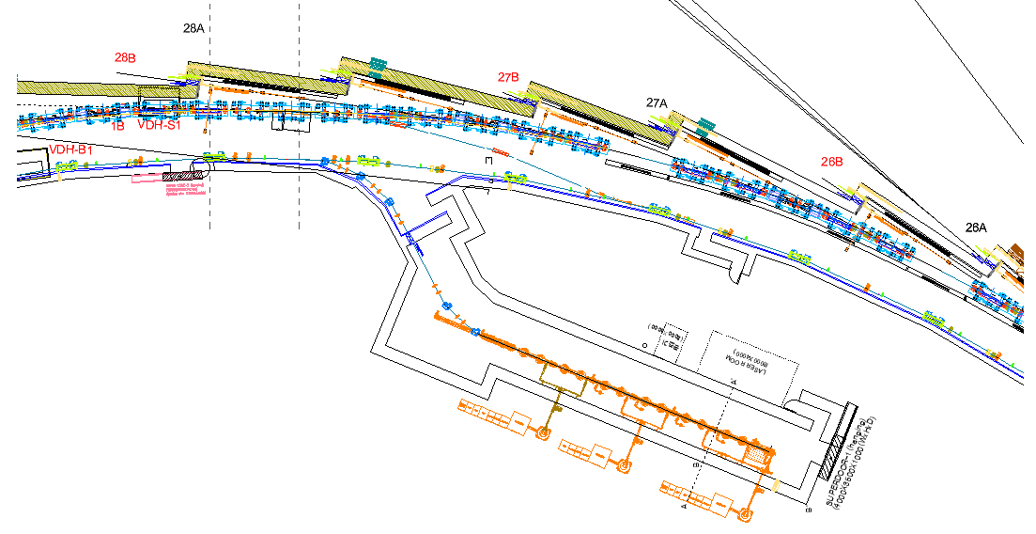
Shielding design to determine tunnel structure
According to the radiation safety control policy:
  The required walls thickness were calculated using SHIELD 11 [1] (1st step).
  The required shielding thickness were more precisely determined using FLUKA 4-4.0 (CERN branch) [2,3] Monte Carlo code calculations [next slide].
Position | Wall thickness (cm)
Outer Sidewall | Non injection area: 80 cm concrete
 | Injection area: 100 cm concrete
Inner Sidewall | Non injection area: 50 cm concrete
 | Injection area: 70 cm concrete
End wall | ID* beamline: 130 cm concrete + 4 cm Pb with 2.5 cm Fe
 | BM** beamline: 180 cm concrete
Ceiling | 50 cm
Injection area
Outer sidewall
Non Injection area
Inner sidewall
ID*: Insertion device (undulator or wiggler)
BM**: Bending magnet
[1] W.R. Nelson and T.M. Jenkins, SLAC-R-737, 2005
[2] C. Ahdida et al, Frontiers in Physics 9, 788253 (2022).
[3] G. Battistoni et al, Annals of Nuclear Energy 82, 10-18 (2015).

Slide 7
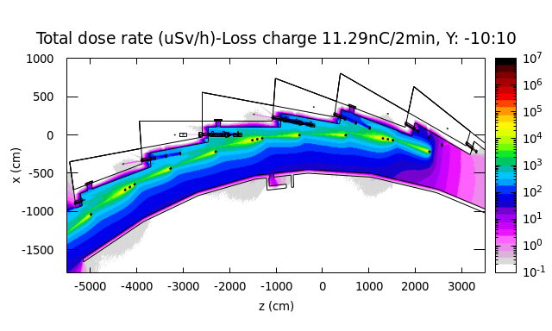
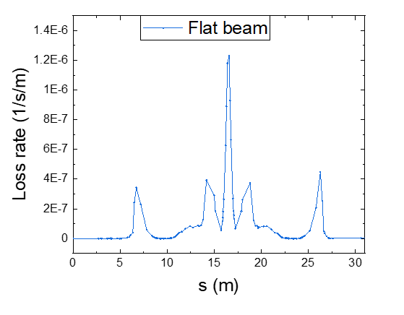
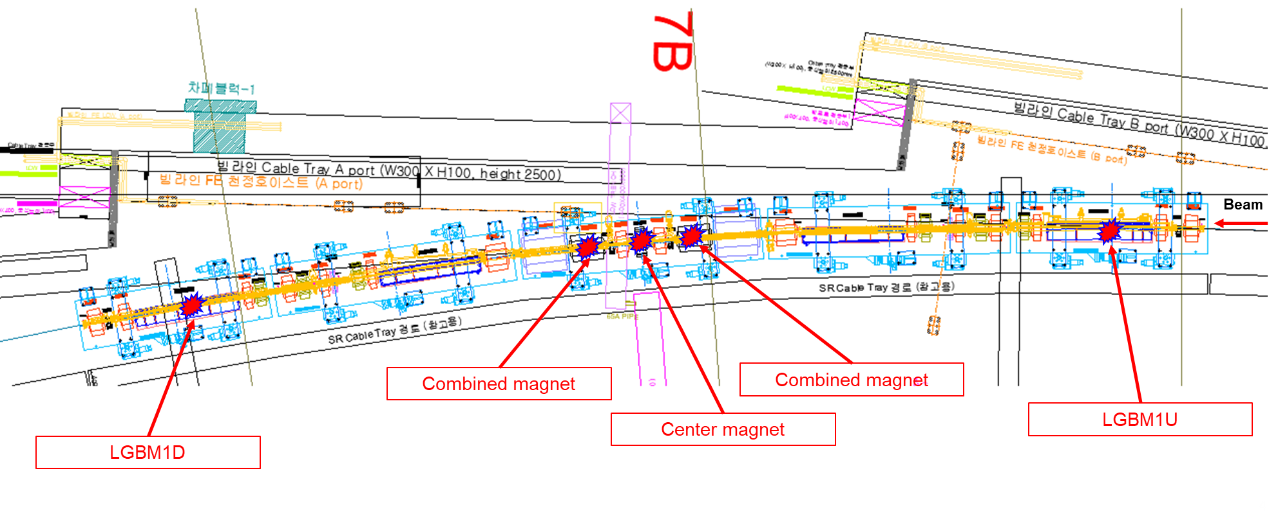
Shielding design to determine tunnel structure
Beam loss
Total dose distribution (µSv/h), 5.88E10 e/s
  Normal operation with a uniformly distributed beam loss was assumed in FLUKA simulations for determining the tunnel structure.
  5 beam loss positions were considered each one cell.
Optics hutch
BM
beamline
ID
beamline
Center magnet
White areas < 0.2 µSv/h
Combined magnets
LGBM1U
LGBM1D
beam loss position
Beam loss positions at one cell of the storage ring.
LGBM: Longitudinal Gradient Magnet

Slide 8
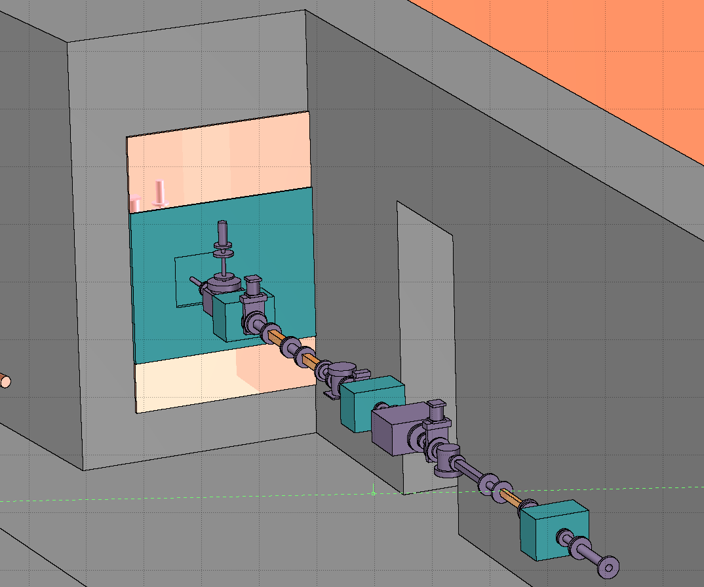
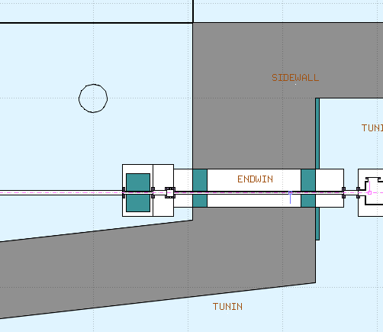
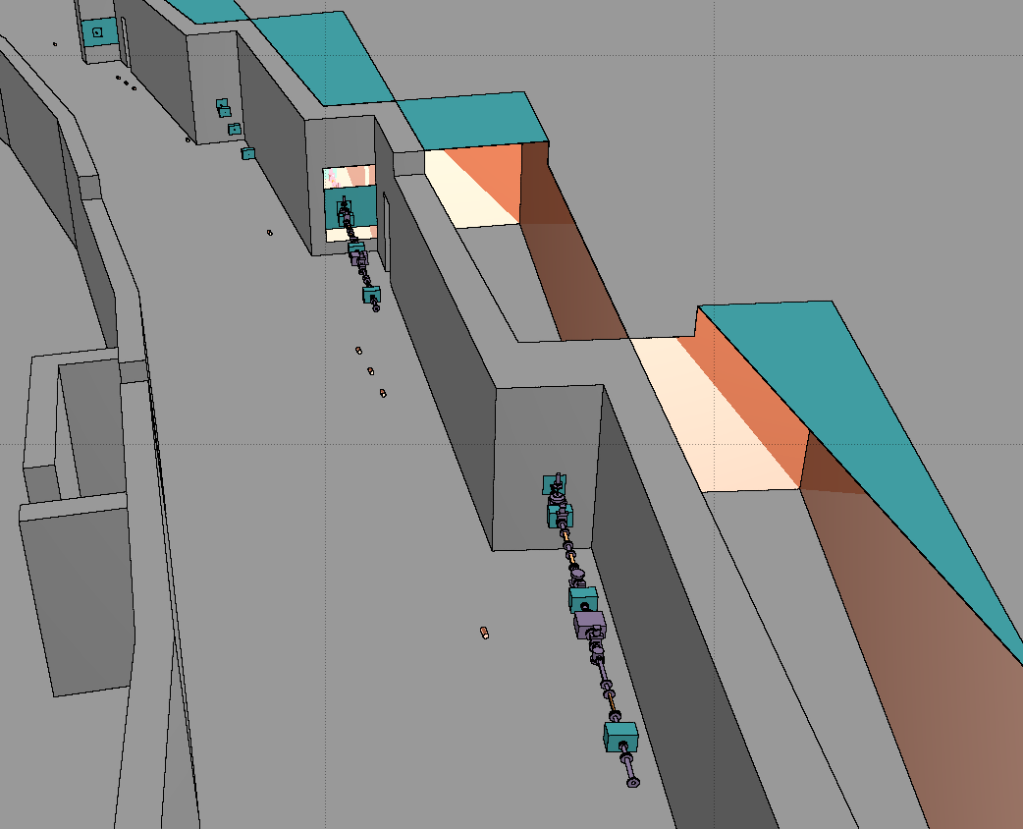
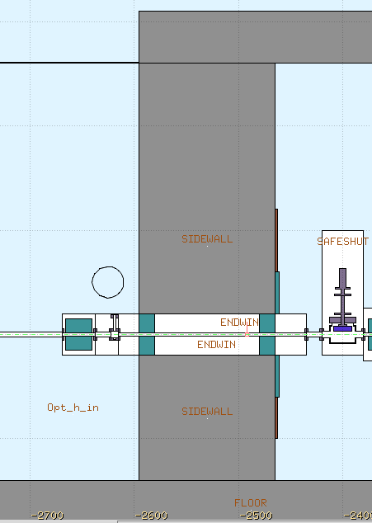
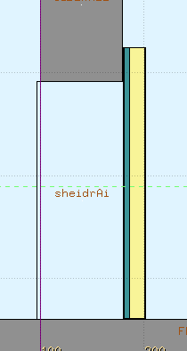
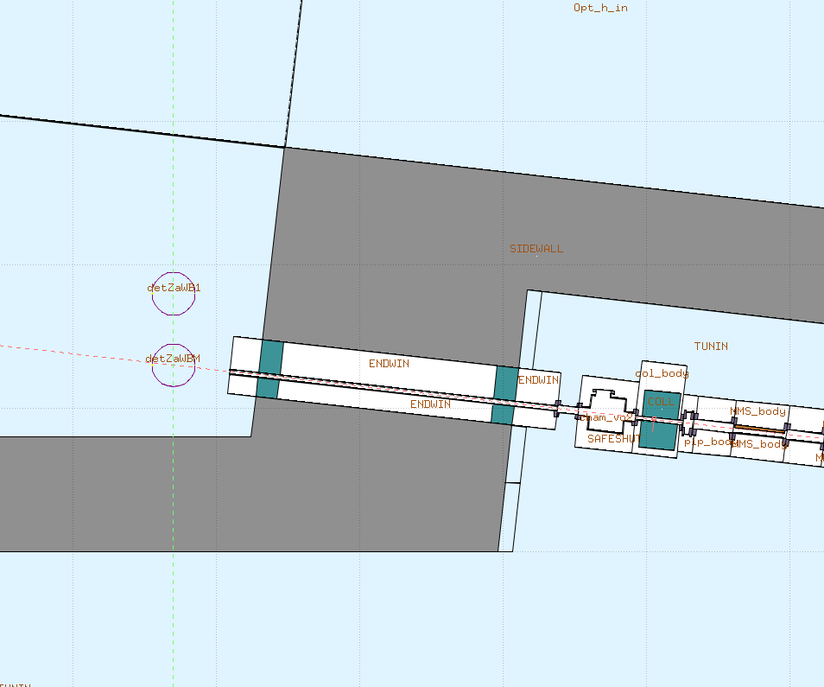
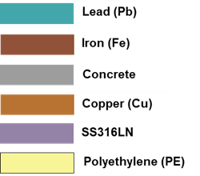
Shielding design to determine tunnel structure
Geometry
Top view
  Monte Carlo calculations were performed to precisely determine the tunnel structure.
150 cm
Fe: 2.5 cm thick
130 cm
Pb: 4 cm thick
60 cm
Pb: 4 cm thick
Beam
120 cm
Beampipe size:
Outer D: 3.4 cm
Inner D: 2.76 cm
ID
beamline
40 cm
Optics hutch
Fe: 2.5 cm thick
Shielding door:
1 cm Fe+ 5 cm Pb + 15 cm PE +1 cm Fe
Vertical view
BM
beamline
Infield
32.5 cm
130 cm
Tunnel
BM beamline top view
264 cm
Fe: 2.5 cm thick
180 cm
Gap size: 0.5 cm
Pb: 15 cm thick

Slide 9
Radiation sources considered for beamline shielding design
Source of radiation:
  Normal operation:
      Gas Bremsstrahlung (GB) is produced by stored electrons interacting with residual gas in a vacuum chamber.
      Synchrotron radiation (SR) is generated when electrons travel through a bending magnet, wiggler, or an undulator.
      High energy Bremsstrahlung as a result of stored electron interaction with the storage ring components.
      Accidental case:
        Electron beam accidentally strikes the storage ring components, intense Bremsstrahlung radiation is generated, passing through the beamline.
      These radiations needs to be suitably shielded.

Slide 10
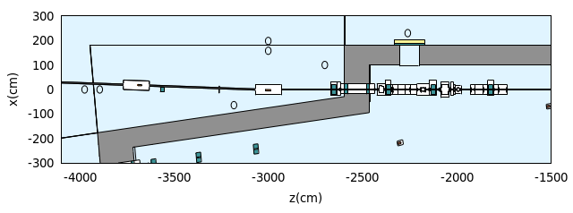
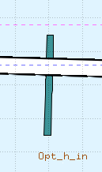
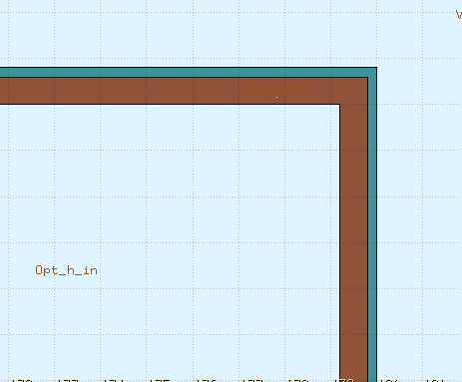
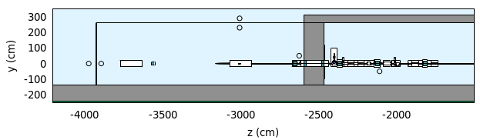

Beamlines radiation safety issues
Important components and regions in beamline shielding design:
Optics hutch
Top view
Front-end components
  Safety magnet
  Collimators
  Safety shutters
Optics hutch
  Mirrors
  Stopper
  Collimators
Photon transport line (PTL)
Experimental hutch
Ray tracing
PTL to experimental hutch
Safety magnet
Optics components
180 cm
Front end
Beam
Stopper, Pb: 20 cm thick
Collimator
Pb: 2 cm thick
Safety shutter
Collimators
Pb: 25 cm thick
Pb (2 mm)
Vertical view
1320 cm
Fe (6 mm)
Optics hutch
Beam
400 cm
140 cm

Slide 11
Considered beamlines radiation safety issues
Front-end safety magnet design
In PLS-II, The Bending Magnets (BM) are powered in series → No need for safety magnet
In 4thGSR, each BM is equipped with its own dedicated power supply
  → A permanent magnet is considered for 4thGSR beamlines to remove the primary electron beam in case of magnet power loss (Accident case) → Called a safety magnet
The safety magnet specifications:
  Length: 50 cm
  Magnetic field: 0.5 T
  Gap size: 4 cm
  Simulations were performed using:
    FLUKA 4-4.0 with the JEFF-3.3 [1] neutron library.
    PHITS-3.34.1 [2] with EGS5 mode and the JENDL-4.0 [3] neutron library.
    Same materials, geometries, mesh size, threshold energies were used in both codes.
Safety shutter
Safety shutters provide protection in the forward direction from gas Bremsstrahlung, white beam, and radiation from beam losses in the storage ring.
  Optics hutch (OH)
Optics hutch shields the secondary radiations generated from Bremsstrahlung radiation interaction with optics components.
[1] A.J.M. Plompen, et al, European Physical Journal A, 56, 181 (2020).
[2] T. Sato et al, J. Nucl. Sci. Technol. 61, 127-135 (2024)
[3] K. Shibata et al, J. Nucl. Sci. Technol. 48, 1-3 (2011).

Slide 12
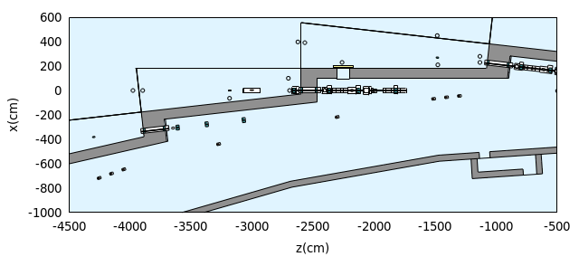
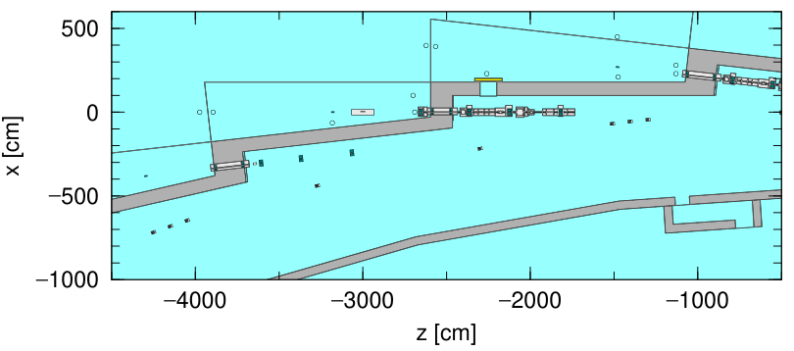
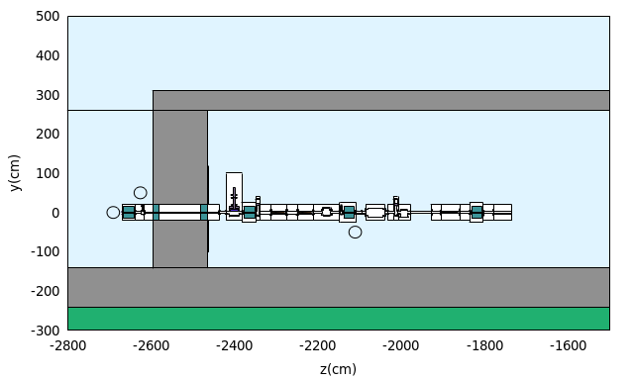
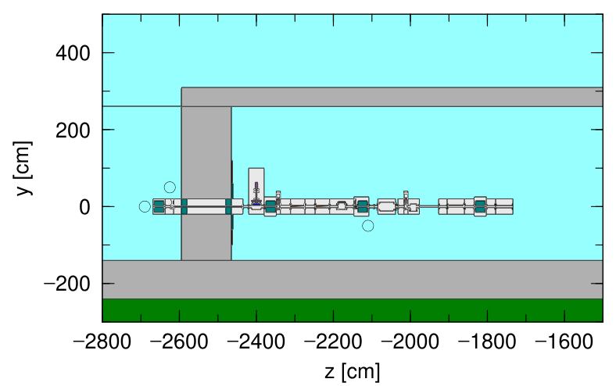
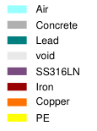
Shielding calculations results: Safety magnet design
Geometry
The FLUKA geometry was converted into PHITS geometry to compare the results.
Detailed geometry of the front end was modeled in FLUKA
Top view
FLUKA geometry
Top view
PHITS geometry
BM
beamline
BM
beamline
ID
beamline
ID
beamline
Vertical view
Vertical view
Safety shutter
Safety shutter
Safety magnet
Safety magnet
172 cm
172 cm
Beam
Beam
Collimators
Collimators
Soil

Slide 13
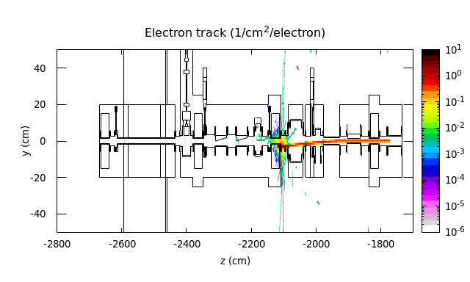
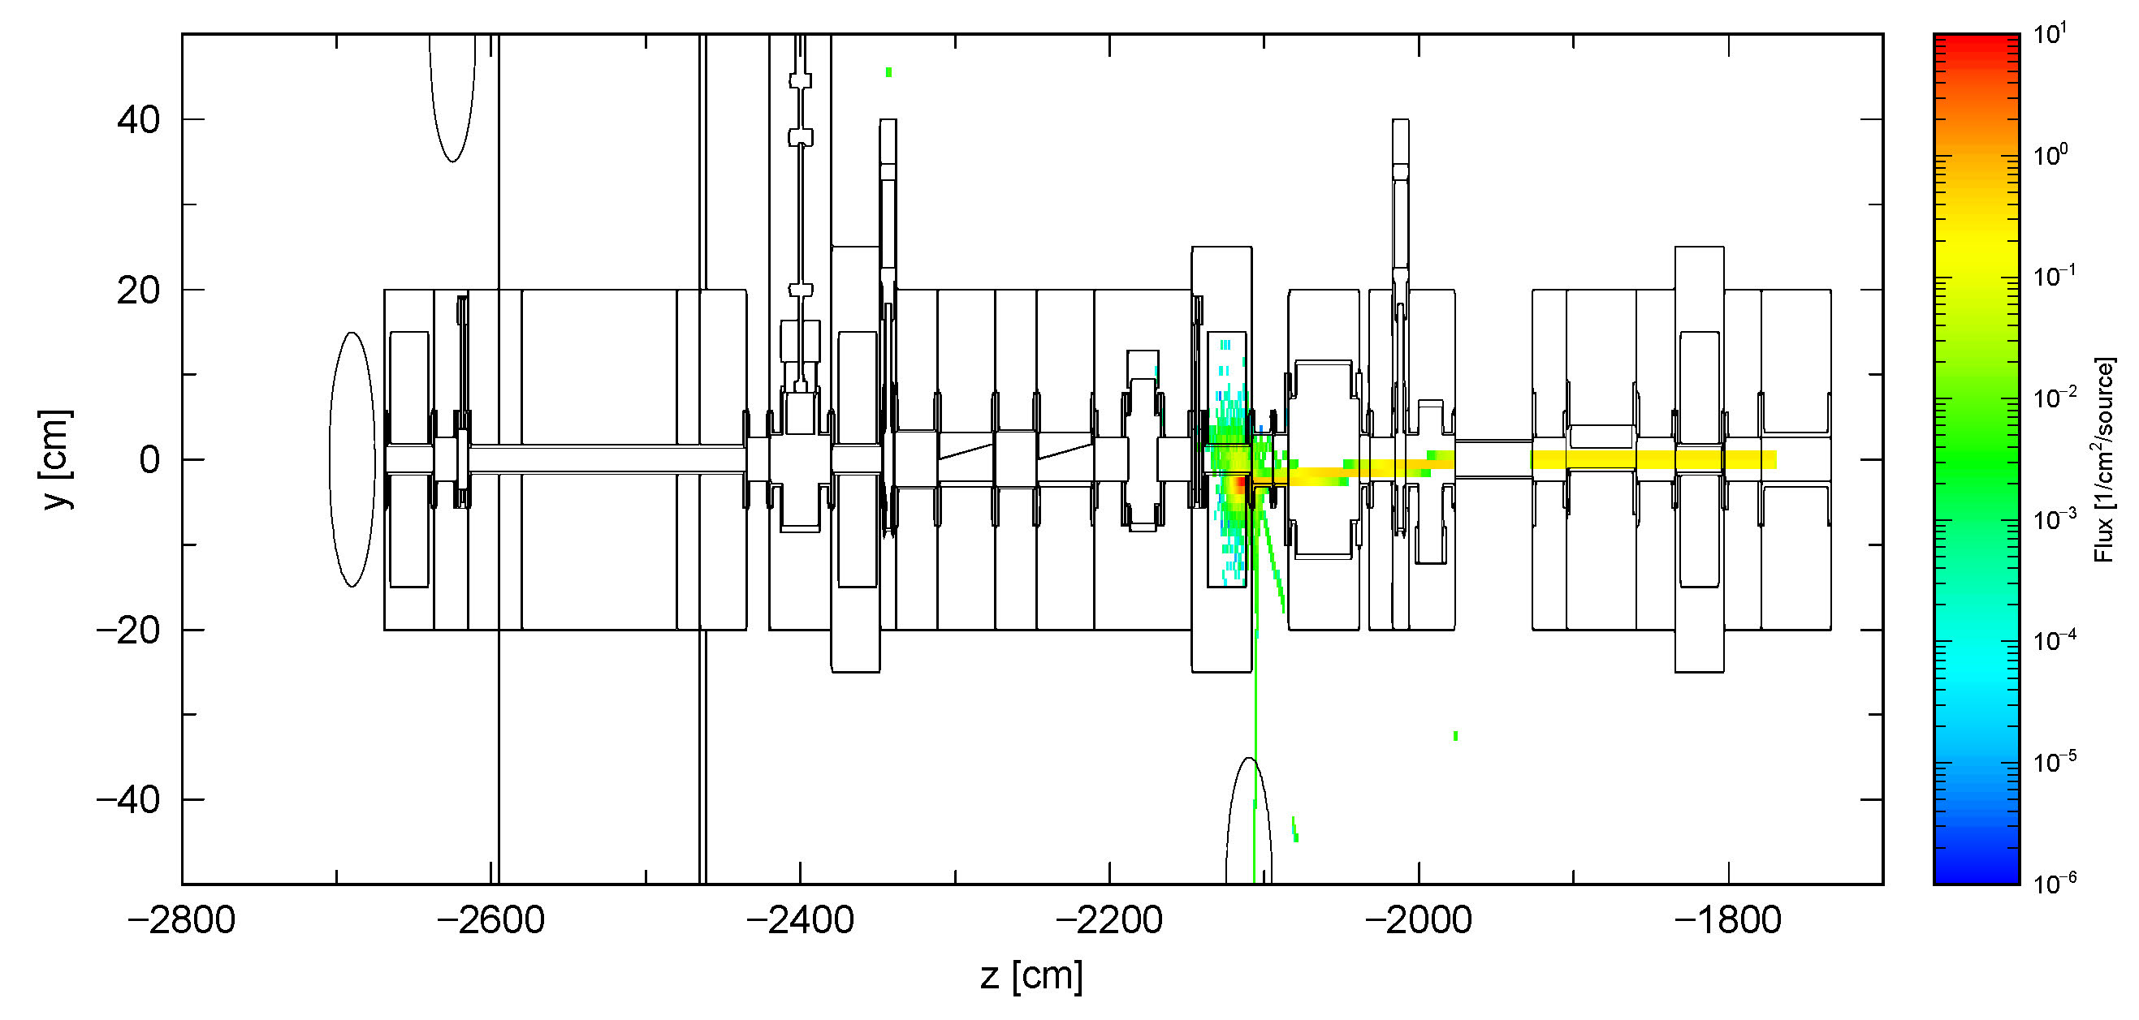
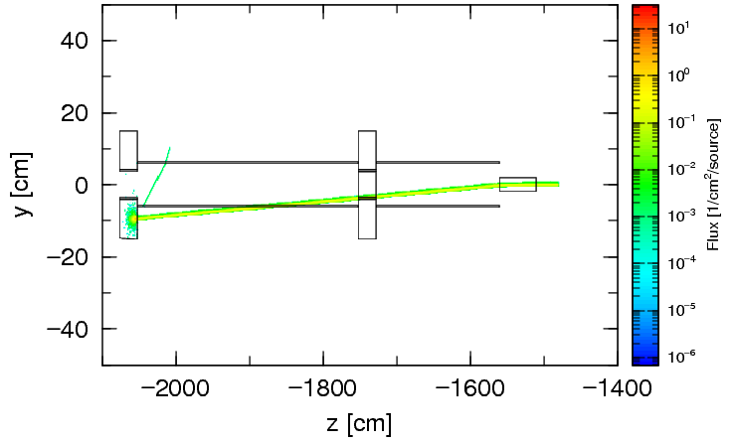
Shielding calculations results: Safety magnet design
Electron beam track
The distance between the collimator and the safety magnet is important to suppress the radiation. In this case, it is 172 cm.
Except for the current components, no other components should be added between the safety magnet and the downstream collimator.
FLUKA and PHITS show the same electron beam track after passing in the magnetic field.
Vertical view
FLUKA 4-4.0
Safety magnet
Electron beam hits the collimator
An error of electron transport in the magnetic field simulation in the old version of PHITS-3.32 was found and reported. → Fixed in the new version PHITS-3.34.1.
PHITS-3.32
PHITS-3.34.1
Safety magnet
Magnet region
0.5 T
Electron beam hits the collimator
No interaction

Slide 14
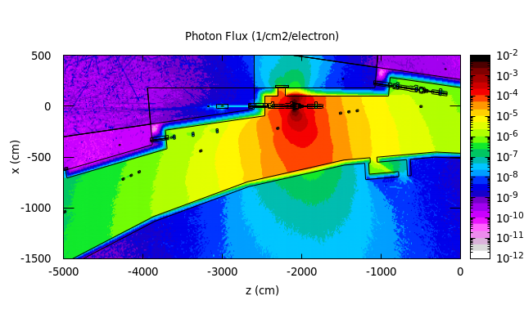
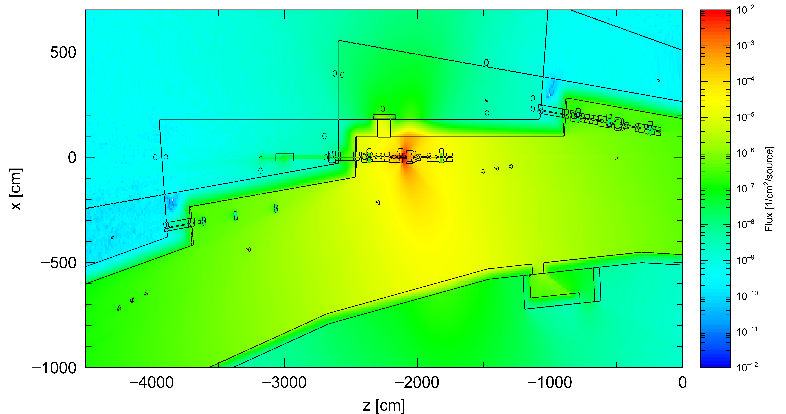
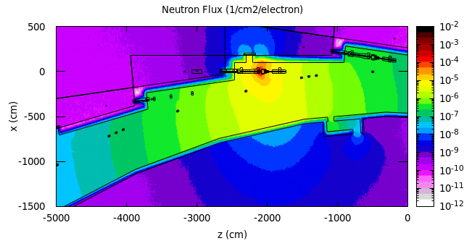
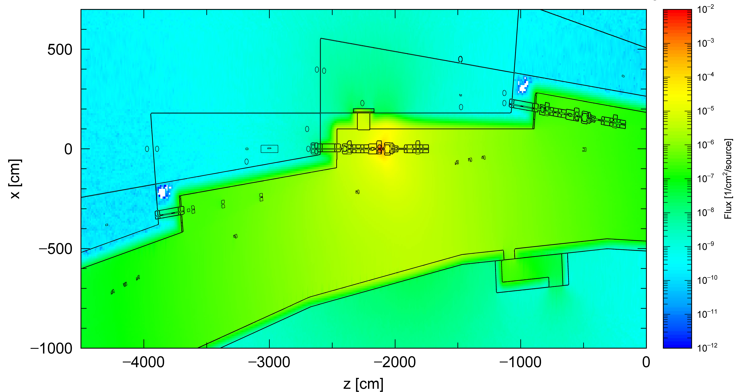
Shielding calculations results: Safety magnet design
Radiation distributions (Top view)
Deflection of the electron beam by the safety magnet onto the collimator produces significant radiation.
FLUKA 4-4.0
PHITS-3.34.1
Photon
Electron beam hits the collimator
Electron beam hits the collimator
Neutron

Slide 15
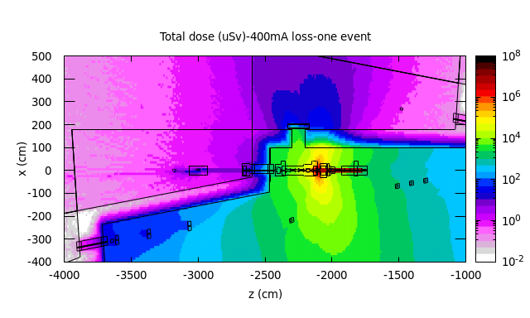
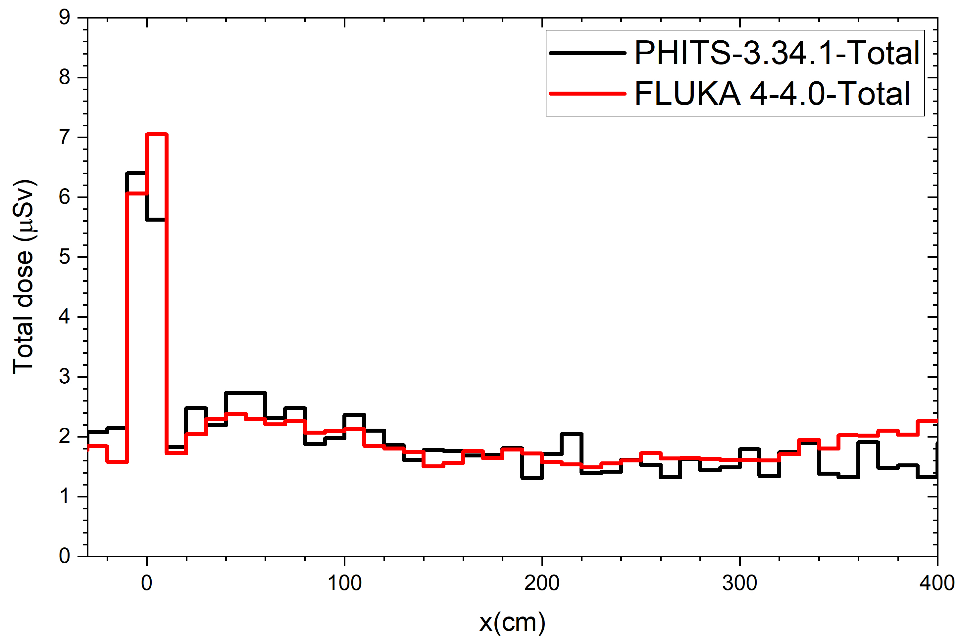
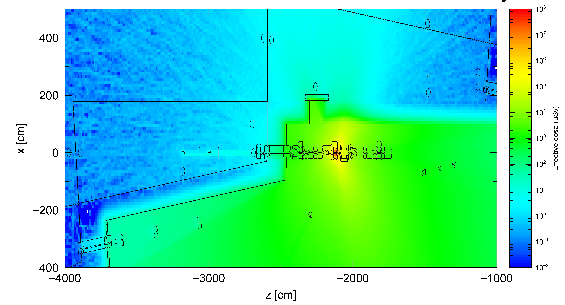
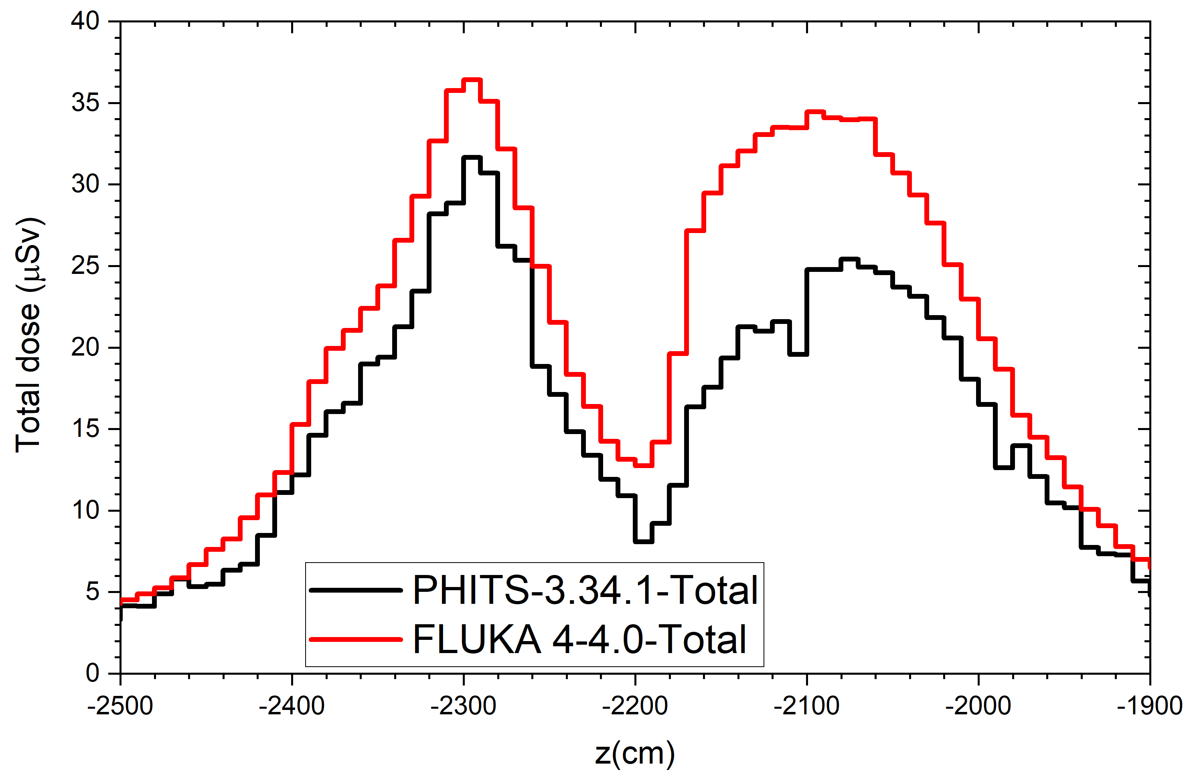
Shielding calculations results: Safety magnet design
Dose distribution
Dose is far below 1 mSv (1000 µSv) after the wall and optical hutch for this accident case.
FLUKA 4-4.0
Cut-1
Cut-1
Cut-2
Beamline hole
ID beamline
ICRP 116 (anterior–posterior) was used in FLUKA and PHITS for comparison.
  PHITS and FLUKA are consistent at Cut-1.
Shielding door:
1 cm Fe+ 5 cm Pb + 15 cm PE +1 cm Fe
PHITS-3.34.1
Cut-2
  PHITS shows a lower dose than FLUKA at Cut-2.
  Further study is ongoing to compare FLUKA and PHITS in more details.
Cut-1
Cut-2
ID beamline
Beam
Beamline hole

Slide 16
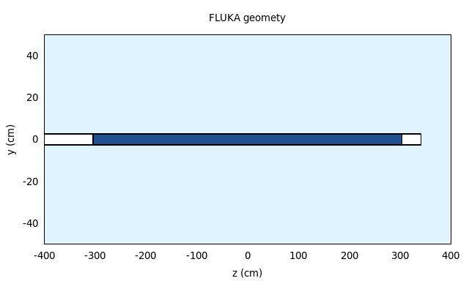
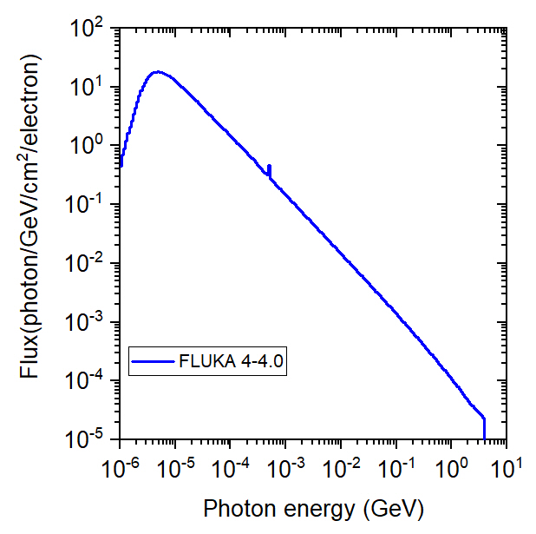
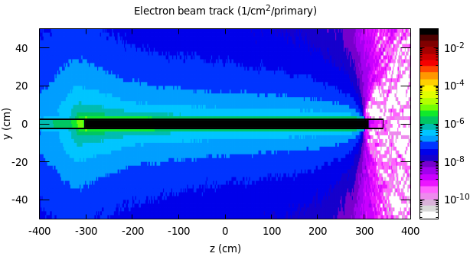
Shielding calculations results: Gas Bremsstrahlung
Parameters setting
Beam: Electron 4 GeV
Target: Residual gas inside a 6.01 m length straight section (Shown in table)
Average pressure in the straight section: 1.0 × 10⁻⁹ mbar. Calculations performed at atmospheric pressure (1 atm) and then scaled at design value
Multiple scattering of electrons is suppressed [1]: Multiple scattering broadens the bremsstrahlung beam, thus making it less forward peaked→ scored dose is lower if MS is turned on.
Moller scattering is suppressed: Delta rays are generated in the air target and can deflect the primary electron beam→ Scored dose is lower if Moller scattering is on
GB target at 1 atm
Beam
6.01 m
GB spectrum
Residual gas [2] | Partial Pressure ratio
H₂ | 90%
H₂O | 1%
CH₄ | 3%
CO | 5%
CO₂ | 1%
Electron Beam killed
The primary beam should be killed at the end of the target→ Using cut-offs
[1] Ipe et al, NIMA, 351 (1994).
[2] J. Y. PARK et al. J. Korean Phys. Soc. 47, 5, 788 (2005).

Slide 17
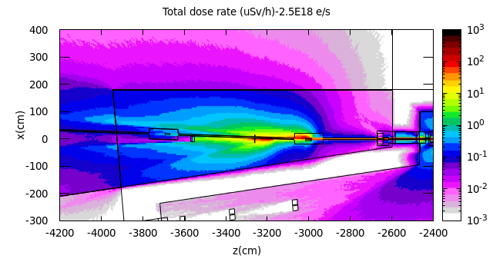
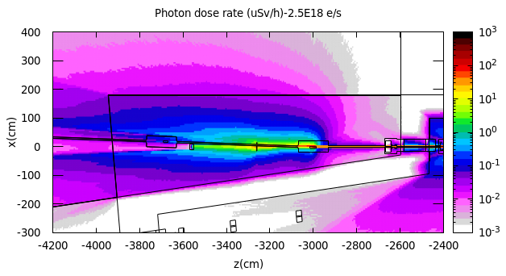
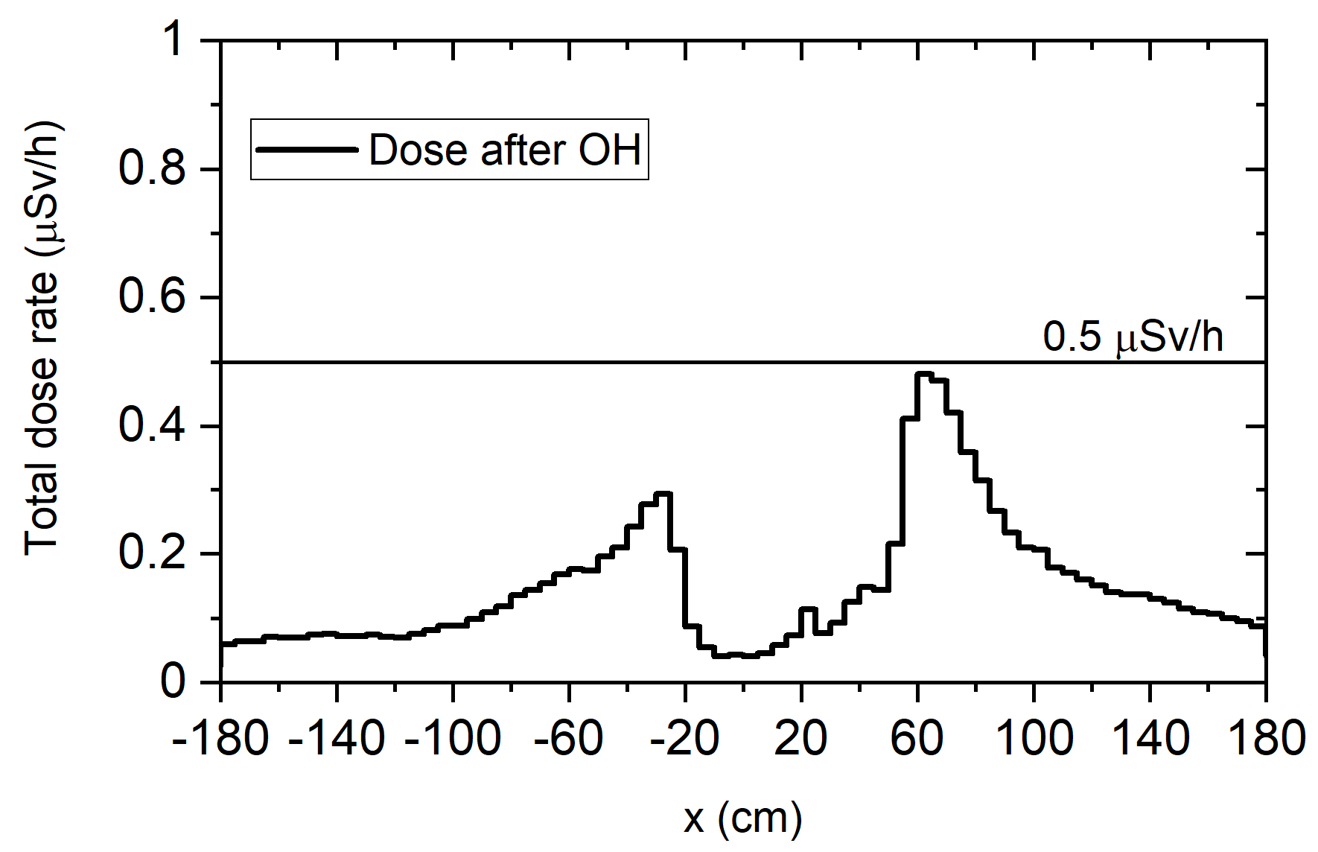
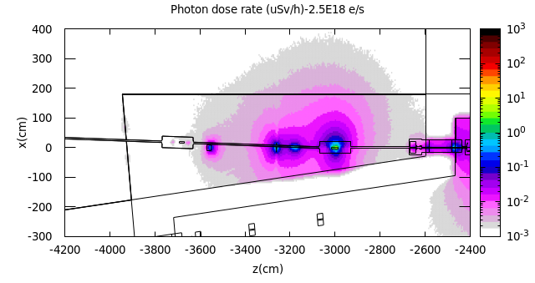
Shielding calculations results: Gas Bremsstrahlung
Dose distribution (ID beamline): Top view
The dose rate is below 0.5 µSv/h outside of OH with 6 mm Fe + 2 mm Pb .
The dimension and position of the collimator will be reconsidered by ray tracing.
The stopper dimension can also be adjusted instead of using a collimator.
Stopper
Optics hutch
Cut
Collimator

Slide 18
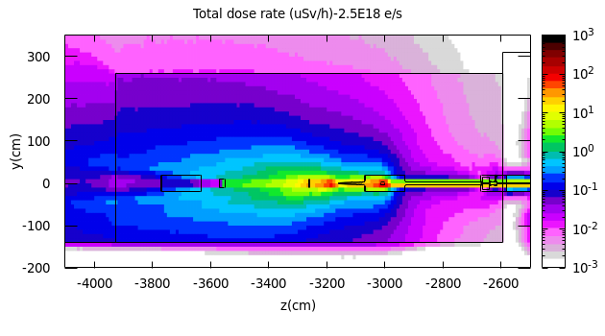
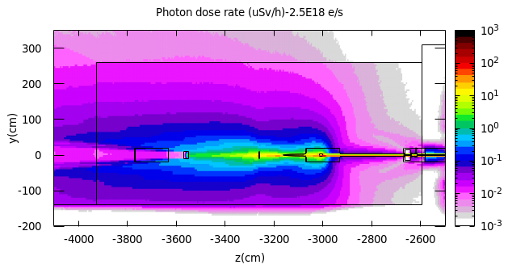
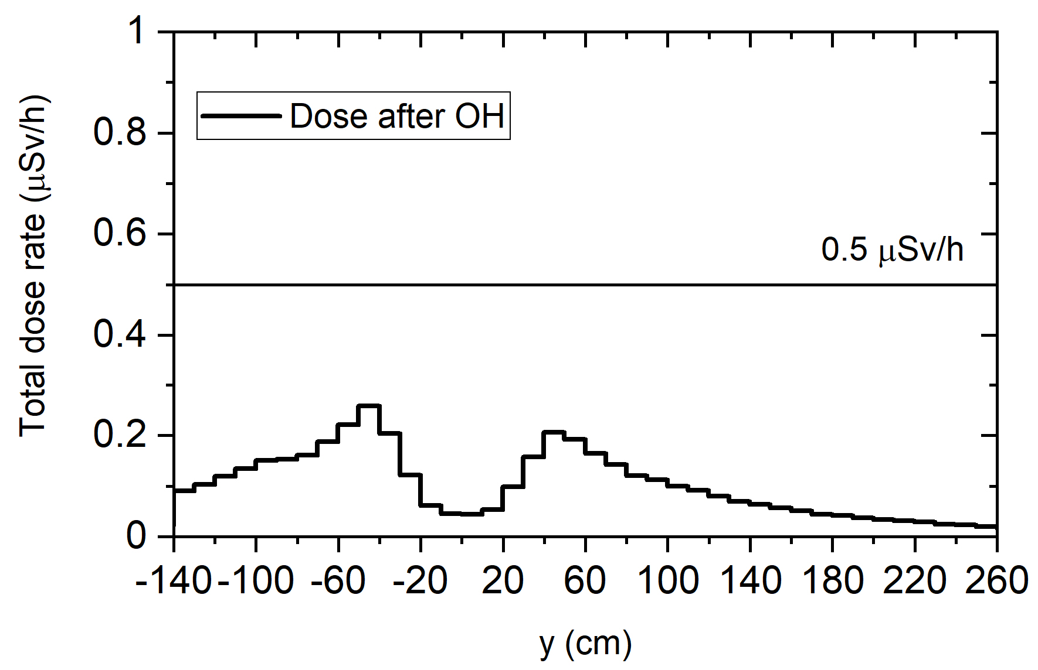
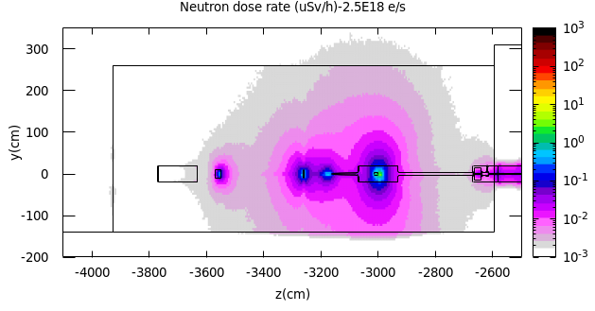
Shielding calculations results: Gas Bremsstrahlung
Dose distribution (ID beamline): Vertical view
The dose rate is below 0.5 µSv/h outside of OH with 6 mm Fe + 2 mm Pb .
The neutron dose rate is significantly lower than that of photon.
Optics hutch
Cut

Slide 19
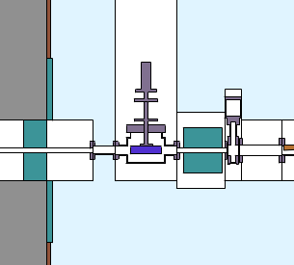
Shielding calculations results: Safety shutter
Safety shutter thickness:
The thickness of safety shutter was calculated using semi-empirical formula [1.2] and confirmed by Monte Carlo calculations.
 | Straight section (Undulator)
Length of air path, L [m] | 6.01
Distance from dose point to air path, d [m] | 20.9
Bremsstrahlung dose rate [Sv/h] | 0.62 (Tromba’s Eq.) 1.23 (Ferrari’s Eq.)
Required lead* thickness to reach 0.5 [µSv/h] | 32.4 (Ferrari’s Eq.)
The safety shutter should block:
  The gas Bremsstrahlung.
  All secondary radiation generated from electron loss in storage ring.
* 20 cm-thick Tungsten has the same shielding effect.
Radiation
Safety Shutter closed
[1] G. Tromba and A. Rindi, Nucl. Instrum. Meth. A 292, 700 (1990)
[2] A. Ferrari et al., Nucl. Instrum. Meth. B 83, 518 (1993)

Slide 20
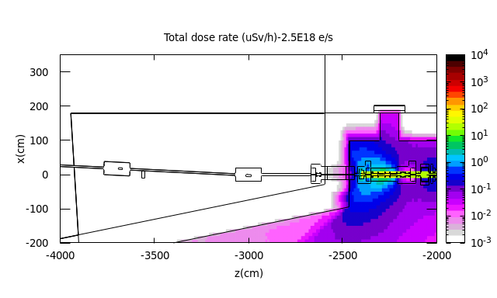
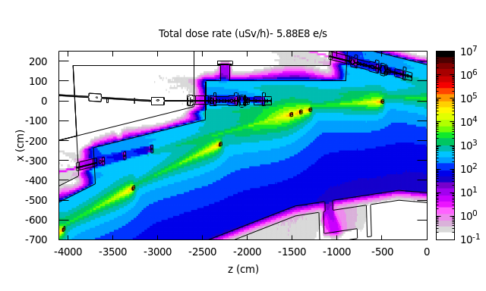
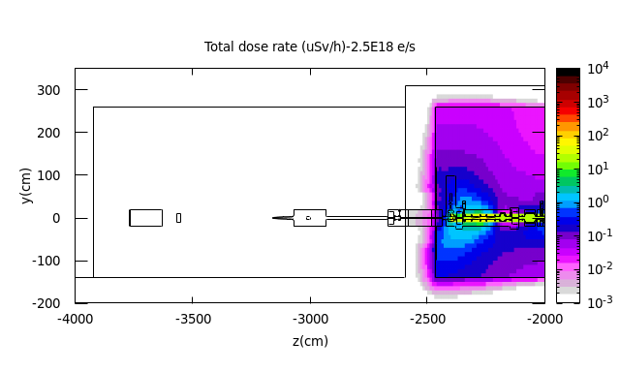

Shielding calculations results: Safety shutter
Safety shutter closed:
Dose from Gas Bremsstrahlung
Dose from Bremsstrahlung photons generated from stored electrons
Safety Shutter: 20 cm-thick tungsten is sufficient to block the GB.
Top view
A uniform beam loss is assumed in the storage ring (2 mA/min) and injection efficiency of 90%.
20 cm-thick tungsten effectively blocks the forward-peaking bremsstrahlung photons generated from from electron loss in storage ring.
Optics hutch
ID beamline
Optics hutch
A
A'
Stored electron beam loss positions
Vertical view
A
A'
ID beamline
Optics hutch
Optics hutch

Slide 21

Shielding calculations results: Synchrotron radiation (SR)
Synchrotron radiation (SR) source
  In Korea 4thGSR, there will be 9 ID beamlines and one BM beamline at the end of the first phase.
  In this work, the synchrotron radiation shielding results are preliminarily presented for only one ID beamline with In-Vacuum Undulator (IVU24).

Slide 22


Shielding calculations results: Synchrotron radiation (SR)
SR spectrum:
SR from an In-Vacuum Undulator (IVU24) was calculated using SPECTRA 11.1.2 code [1].
The SR spectrum was used as a photon source in FLUKA with biased sampling.
The input source spectrum is sampled correctly in FLUKA.
To FLUKA
[1] T. Tanaka, J. Synchrotron Radiation 28, 1267 (2021).

Slide 23


Shielding calculations results: Synchrotron radiation (SR)
Dose distribution (ID beamline):
The dose rate outside of the optics hutch is less than 0.1 µSv/h which is far below the dose limit of 0.5 µSv/h.
The optics hutch with 6 mm Fe +2 mm Pb is adequate to block the SR radiation generated from IVU24 (ID beamline).
Top view
Vertical view
Optics hutch
Optics hutch
ID beamline

Slide 24
Summary and conclusions
Beamline radiation shielding analysis of 4th generation storage ring in Korea were performed to design the safety magnet, the safety shutter and the optics hutch.
The position of the safety magnet and downstream collimator were carefully selected to ensure the dose level remains below 1mSv in the beamline.
The safety shutter made of tungsten and 20 cm thickness would be adequate to block GB and other Bremsstrahlung radiations.
The OH with 6 mm Fe + 2 mm Pb properly shielded the GB and all other secondary radiations.
The synchrotron radiation from the In-Vacuum Undulator (IVU24) was shielded properly by designed OH.
A comparison between FLUKA and PHITS calculated dose (for the safety magnet) showed discrepancies between them.
More comparisons between FLUKA and PHITS codes is ongoing to study the reason of discrepancy.
STAC8 [1] code will be also used determined the optics hutch and experimental hutch for each beamline and compare with FLUKA.
[1] Y.Asano and N.Sasamoto, Radia. Phys. Chem. Vol.44 p133 (1994)

Slide 25

Thank You for Your Attention
bakhtiari@postech.ac.kr

