Slide 1
Monte Carlo calculation code applications for the shielding design of a transportable positron generator
Inès DUARTE – Nicolas MARY – Cédric DOSSAT – Nathalie CHATRY (TRAD Tests & Radiations)
Jean-Michel REY (POSITHÔT)
May 29th 2024
SATIF-16 – Frascati, Italy

Slide 2
Who are we ?
The positron generator
The objectives
The radiation assessments
Conclusion

Slide 3
1
Who are we ?

Slide 4
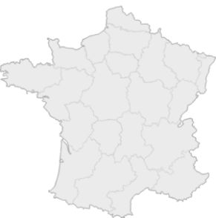
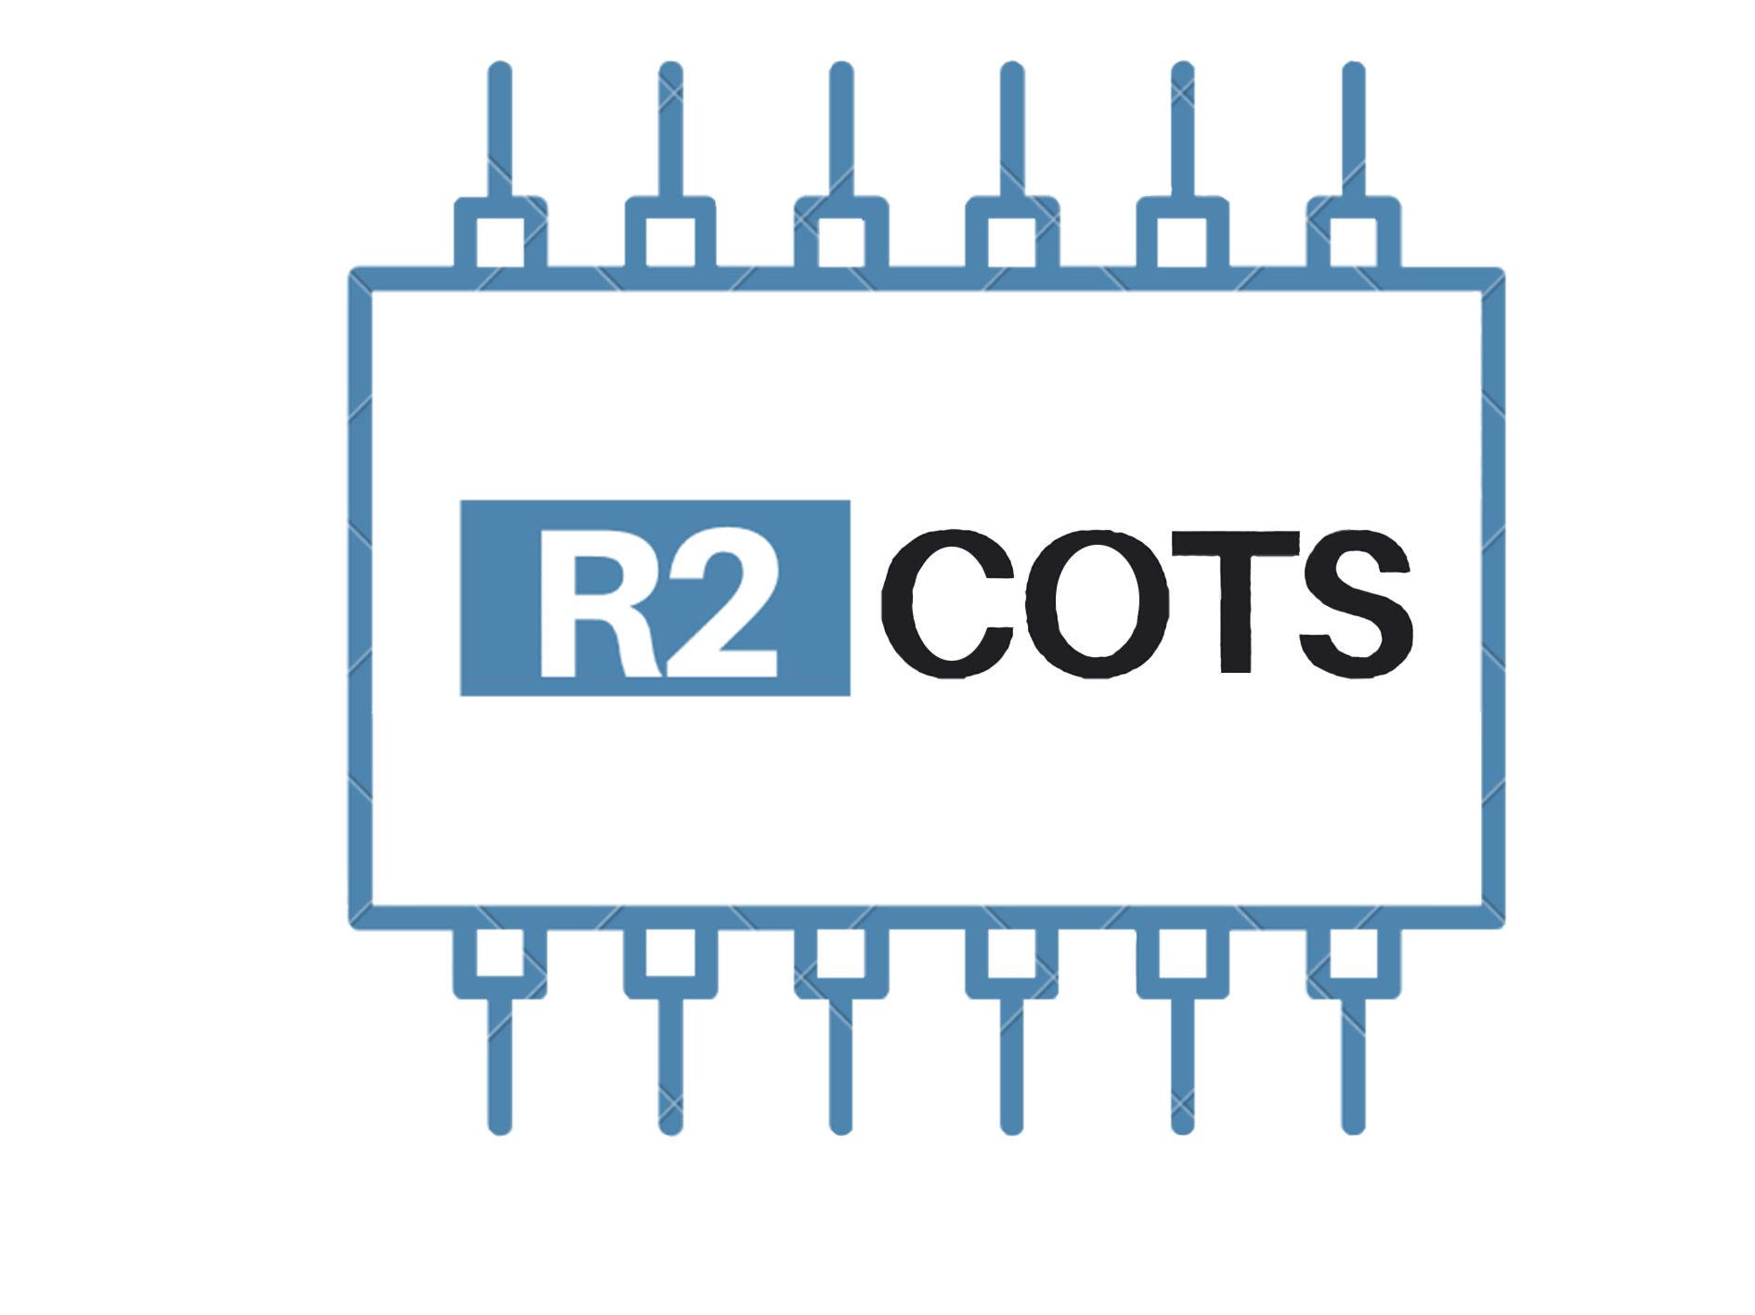
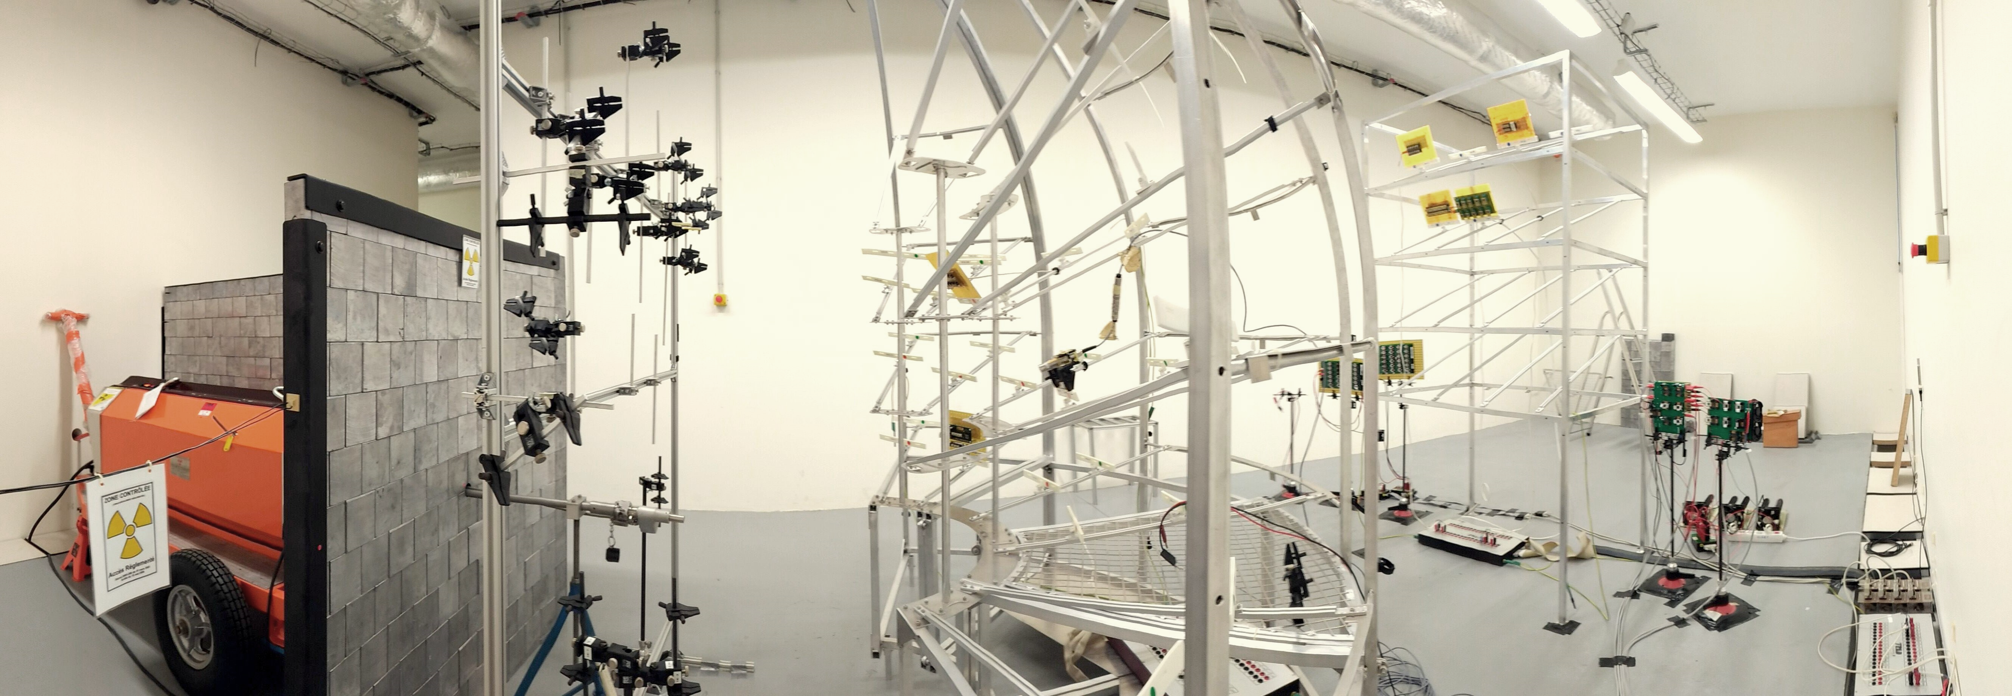
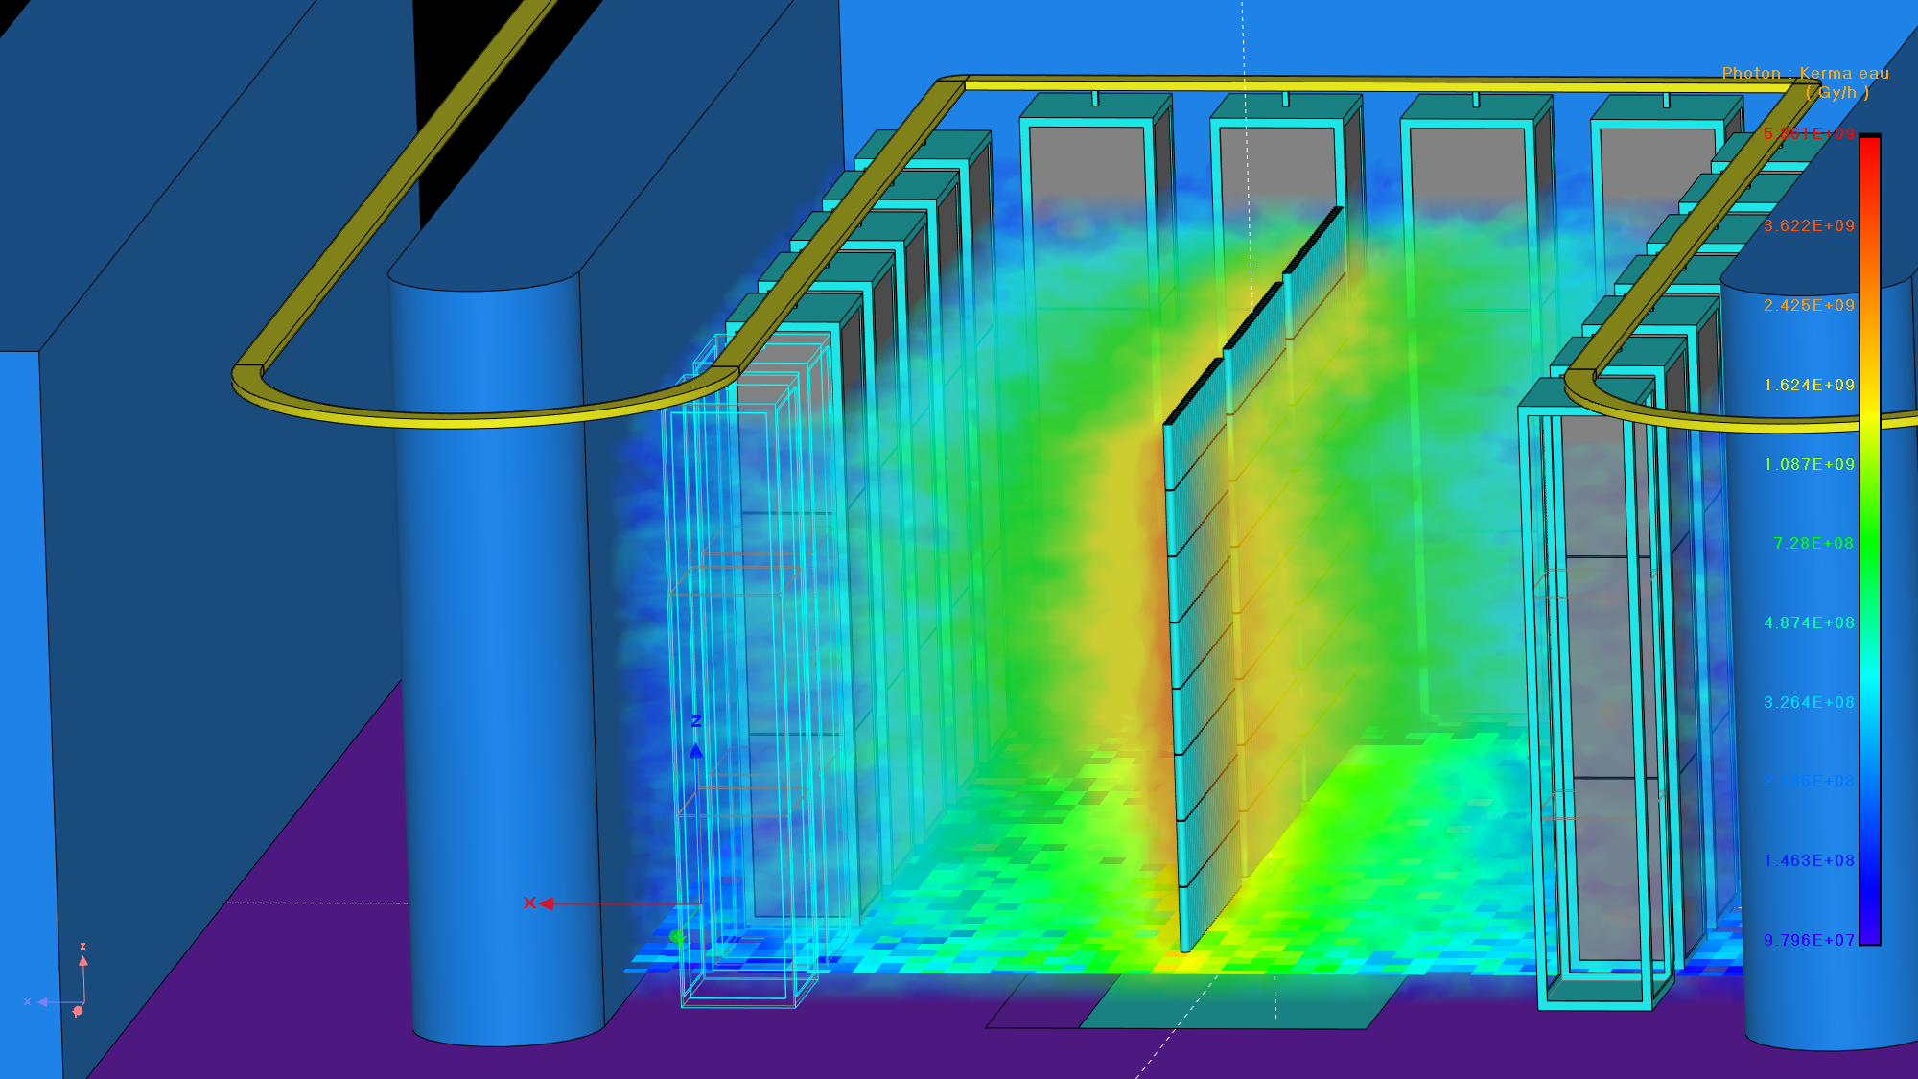
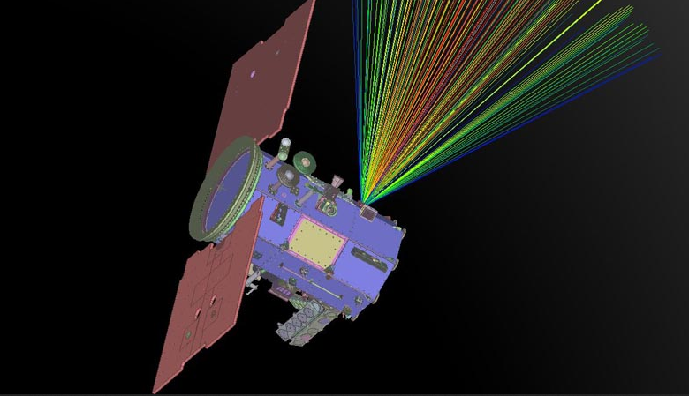
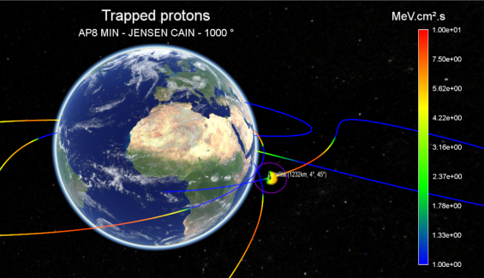
TRAD Tests & Radiations
Company founded in 1994 and based in France
TRAD
RADIATION RESISTANCE TESTS
SOFTWARES EDITORS
& ENGINEERING
ELECTRONIC COMPONENTS
For more information :
rayxpert.com
trad.fr
r2cots.com
fastrad.net
Notes:
-Parler du bunker avec source de Co60 + préciser que les composants électriques qu’on vend ont été qualifiés en dose
-Préciser les applications des autres codes de calcul

Slide 5
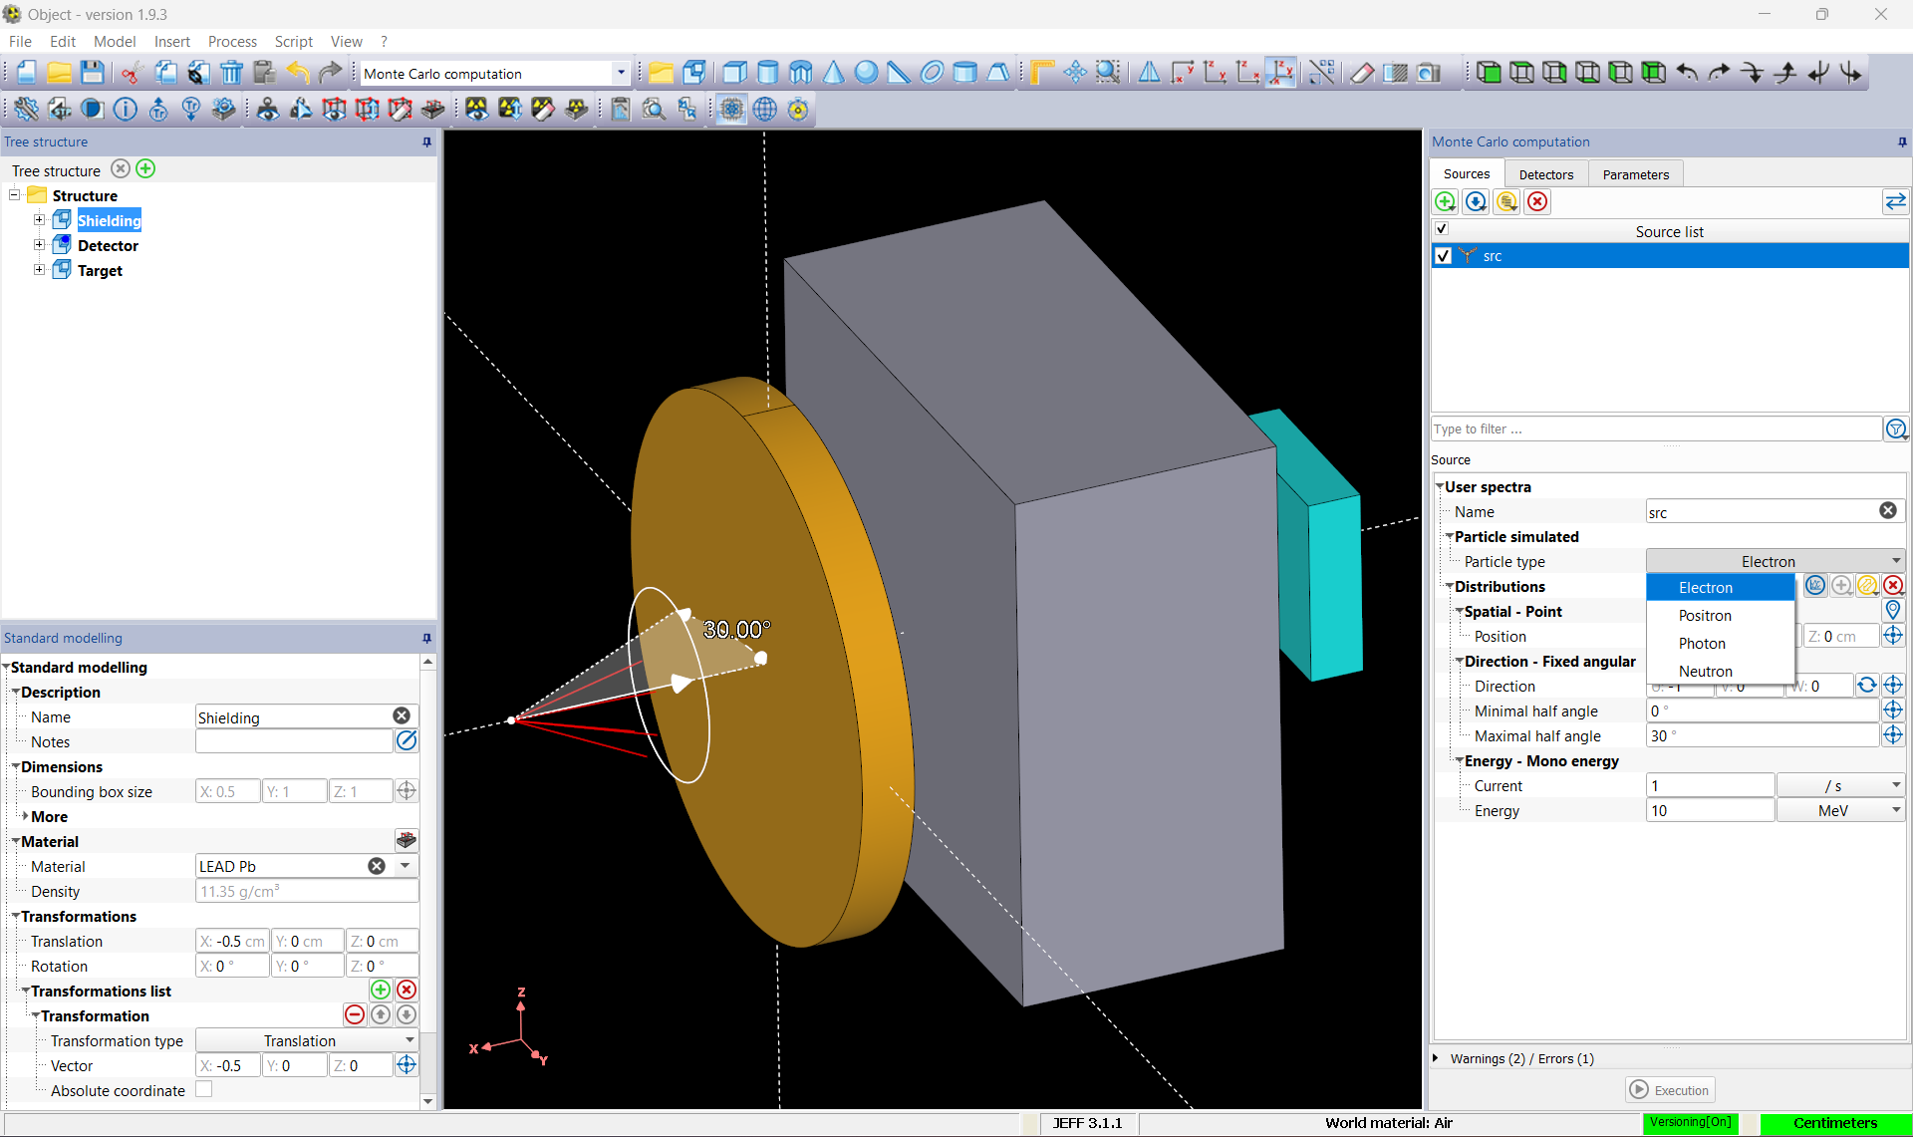
RayXpert v1.9.3
Figure 1: RayXpert® interface
Notes:
Monte Carlo calculation code launched in 2013
CAD modeling tools and import step file + beam /decay source + volume mapping / sensitive elements

Slide 6
RayXpert v1.9.3
Particles | Interaction process | Energy ranges |  | Nuclear Decay Database | Cross section
 |  | $$E_{min}$$ | $$E_{max}$$
Electron | Bremsstrahlung, Ionisation, Multiple diffusion, Lewis theory | 1 keV | 1 TeV | JEFF 3.1.1 & EAF2010 | Based on GEANT4
Positron | Bremsstrahlung, Ionisation, Multiple diffusion, Lewis theory | 1 keV | 1 TeV
 | Annihilation | 1.022 MeV | 100 GeV
Photon | Compton diffusion, Photoelectric Effect | 1 keV | 100 GeV
 | Pair production | 1.022 MeV | 100 GeV
Neutron | Elastic and Inelastic scattering, Radiative capture, Induced fission | ${10}^{−11}$ MeV* | 20 MeV* | - | ENDF/B-VII.1
Table 1: Description of the Physics simulated in the last version of RayXpert®
*depending on the isotope
They trust us :
Notes:
- French Atomic Energy and Alternative Energies Commission
French company Specialised in nuclear fuel cycle
International atomic energy agency
French Radioprotection and nuclear safety institute

Slide 7
POSITHÔT
Founded in 2015 by Jean-Michel REY and issued from the fundamental physics institute of the CEA
First transportable positron generator created in 2018
Offers materials analysis using positron annihilation spectrometry
Allows to detect the defects in the matter without generating radioactive waste
For more information :
posithot.com
Figure 2: https://www.posithot.com/about/

Slide 8
2
The positron generator

Slide 9
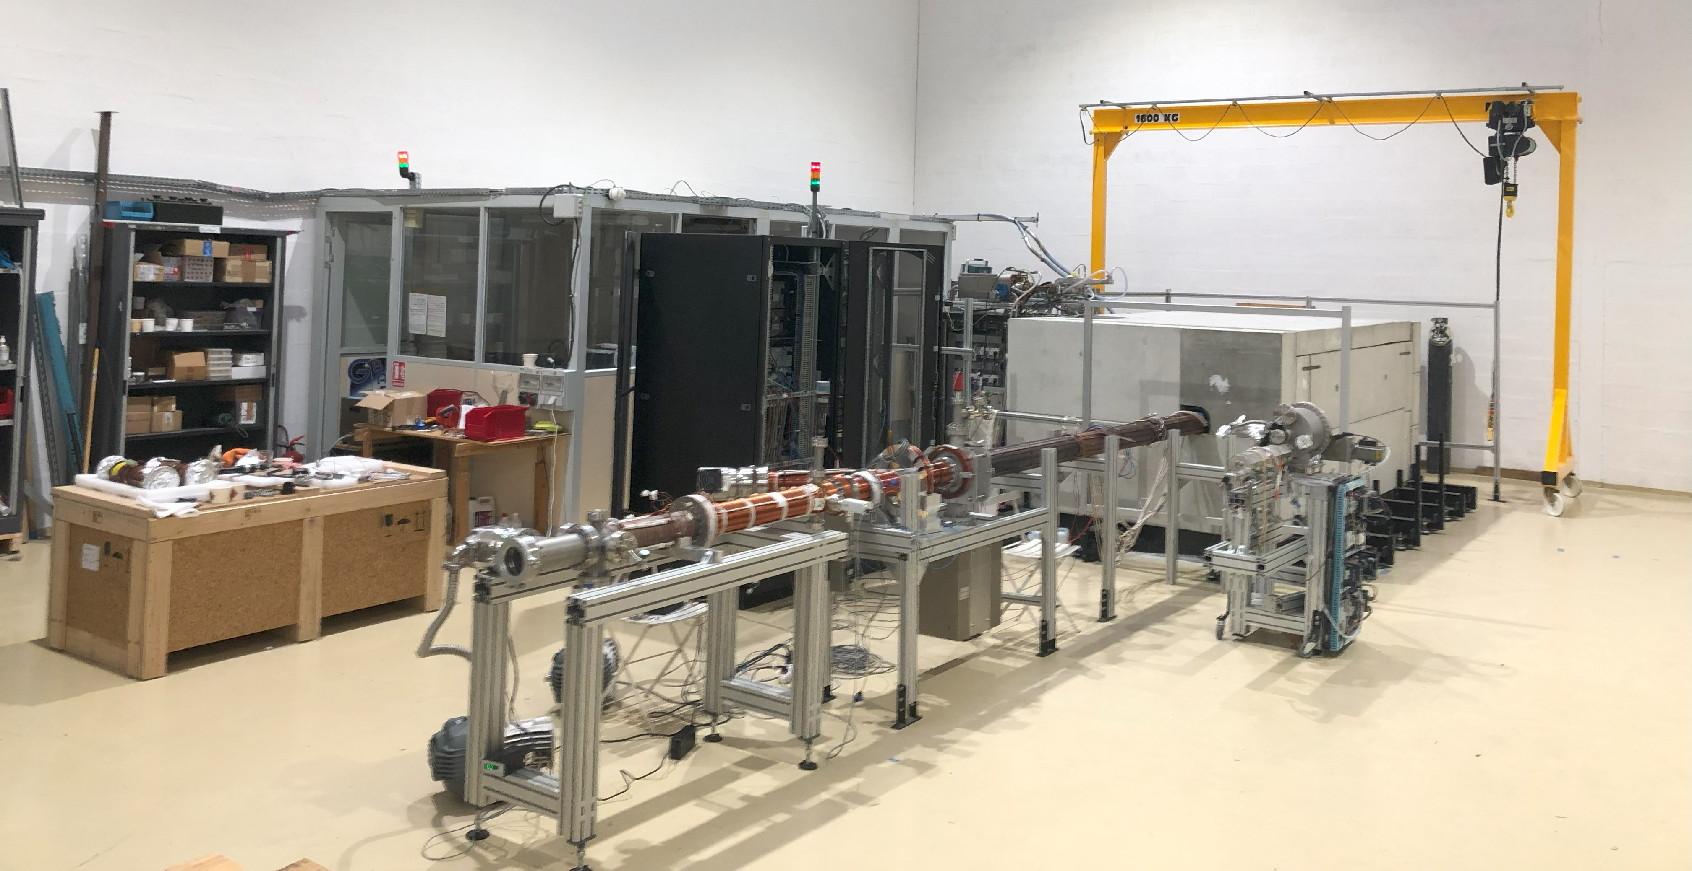
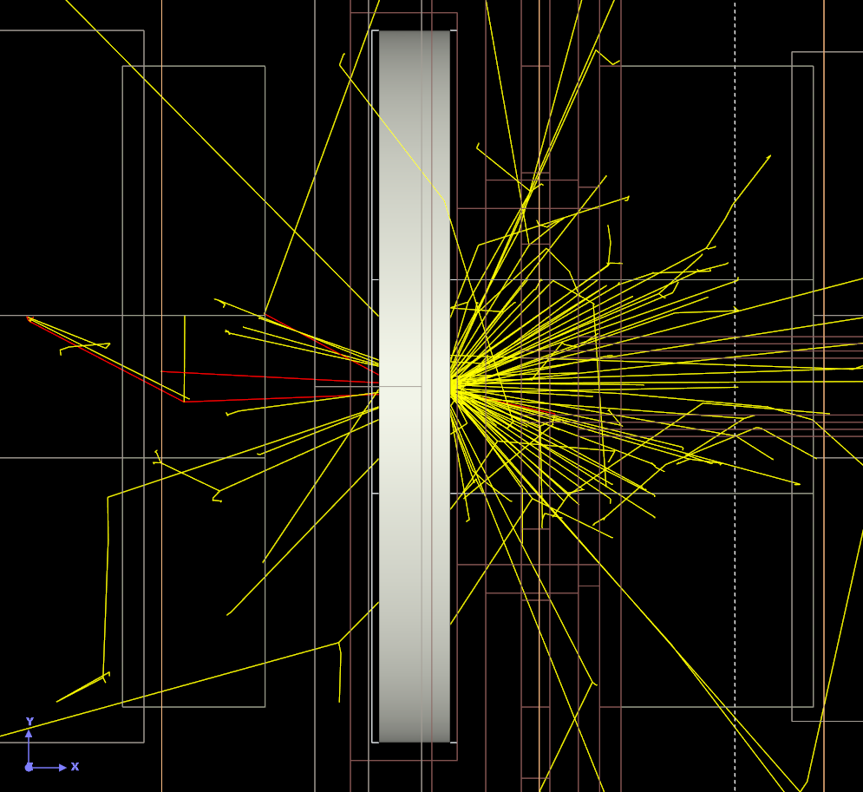
The positron generator
Target
Figure 4: Visualization of the photon secondaries created from the target in RayXpert®
Figure 3: Image of the POSITHÔT generator
Notes:
Pas le droit de parler de la techno par soucis de confidentialité
Problématique de rayonnements photoniques de la cible + du beam dump

Slide 10
3
The objectives

Slide 11
The objectives
→ Sizing of the positron generator shielding complying with the regulations on ionizing radiation sources and transportable limitations
I. Dose rate outside the generator ≤ 7.5 μSv/h = 1.25 mSv/month
II. A total weight < 45 tons for the equipment portability
Areas accepted
Public area < 80 μSv/month
Supervised area < 1.25 mSv/month
Monitored area < 4 mSv/month
Monitored area < 2 mSv/h
Monitored area < 100 mSv/h
Monitored area > 100 mSv/h
Figure 5: French Nuclear Safety Authority (ASN) equivalences for radiation zoning

Slide 12
4
The radiation assessments

Slide 13
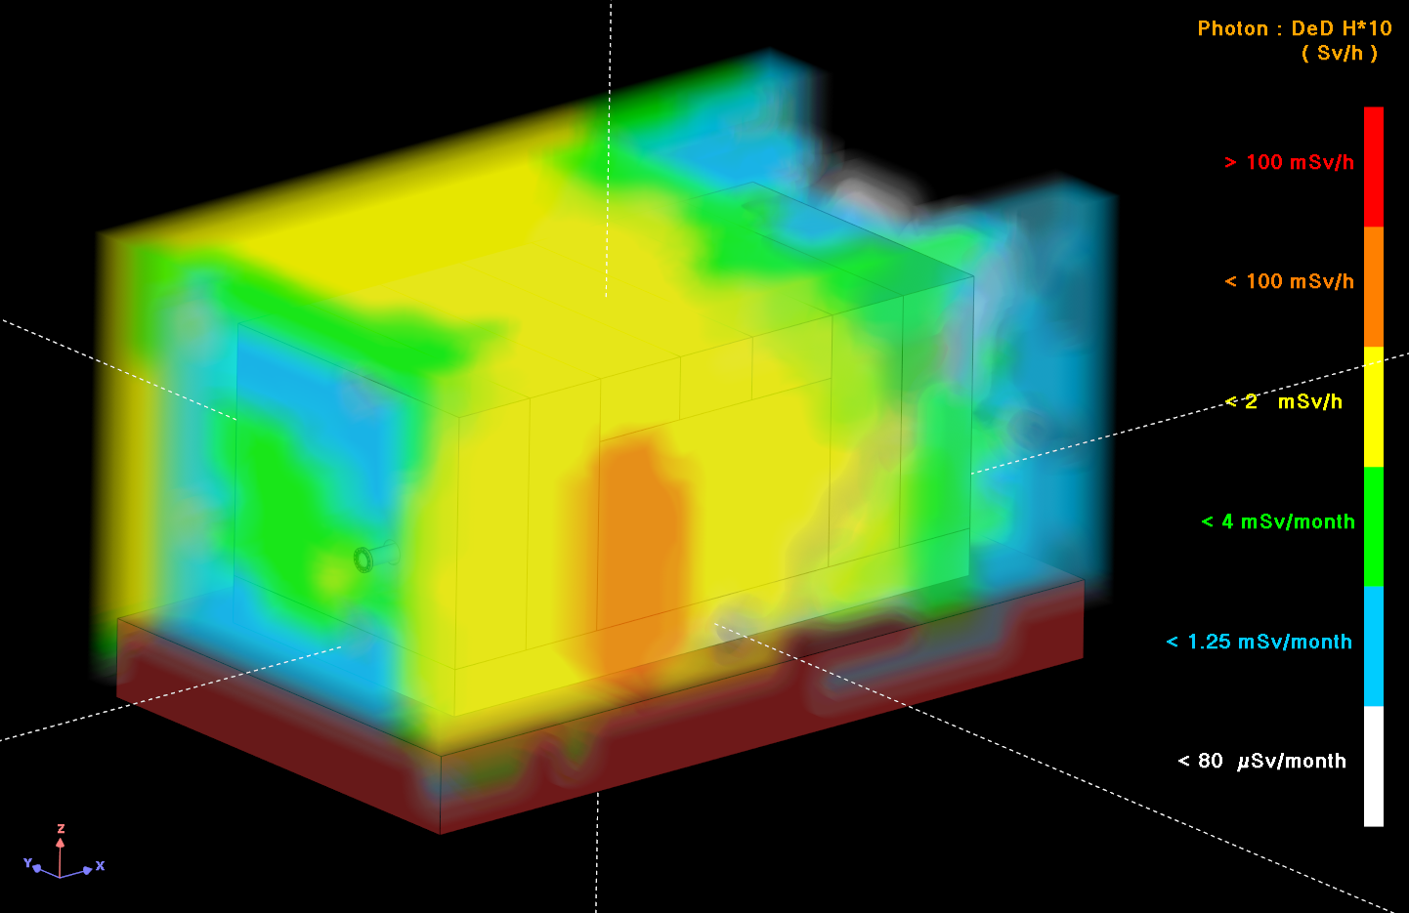
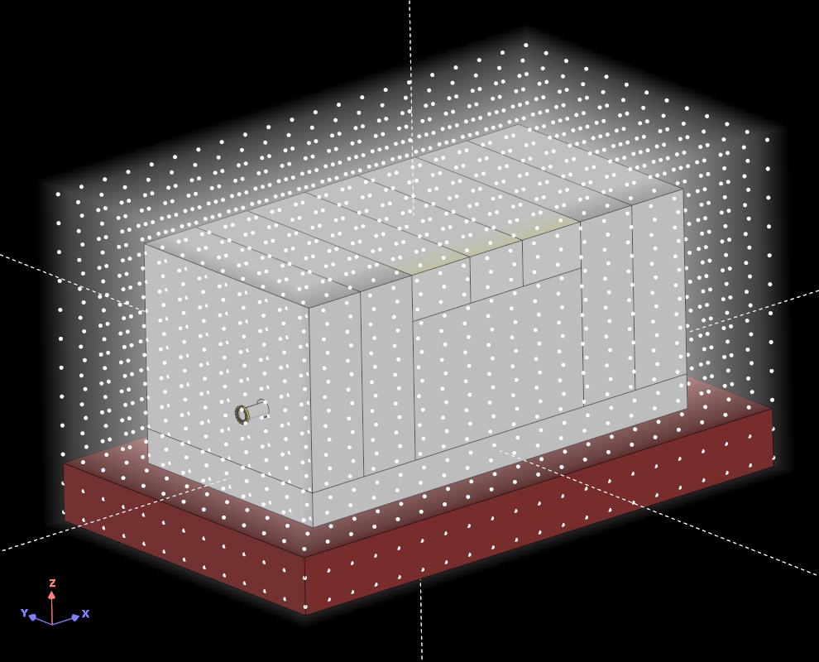
The radiation assessments
The initial radiation zoning
Public area < 80 μSv/month
Supervised area < 1.25 mSv/month
Monitored area < 4 mSv/month
Monitored area < 2 mSv/h
Monitored area < 100 mSv/h
Monitored area > 100 mSv/h
Figure 5: French Nuclear Safety Authority (ASN) equivalences for radiation zoning
Quantity calculated:
Photon H*(10)
Virtual mesh resolution:
25 x 25 x 25 cm³
Maximum about 20 mSv/h
Figure 6: Dose mapping definition in RayXpert®
Figure 7: Initial zoning assessment in RayXpert®, errors < 30%
Notes:
- Import step
- Définition de cartographie

Slide 14
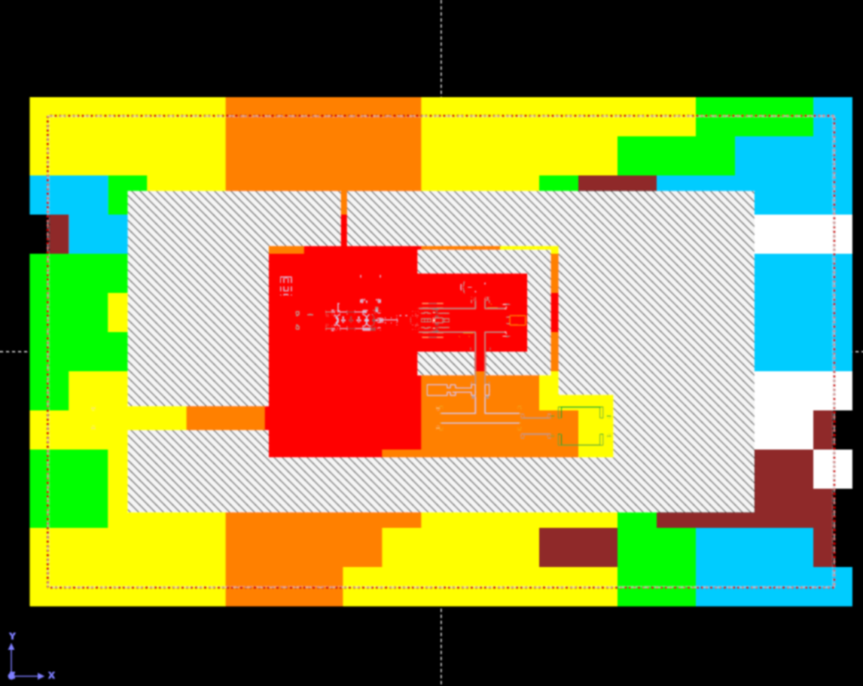
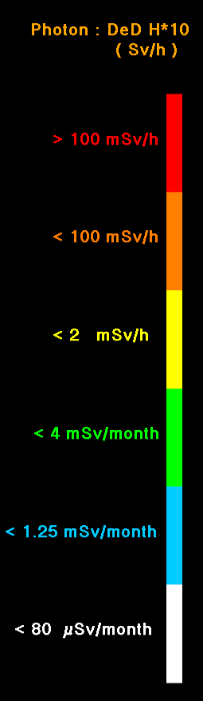
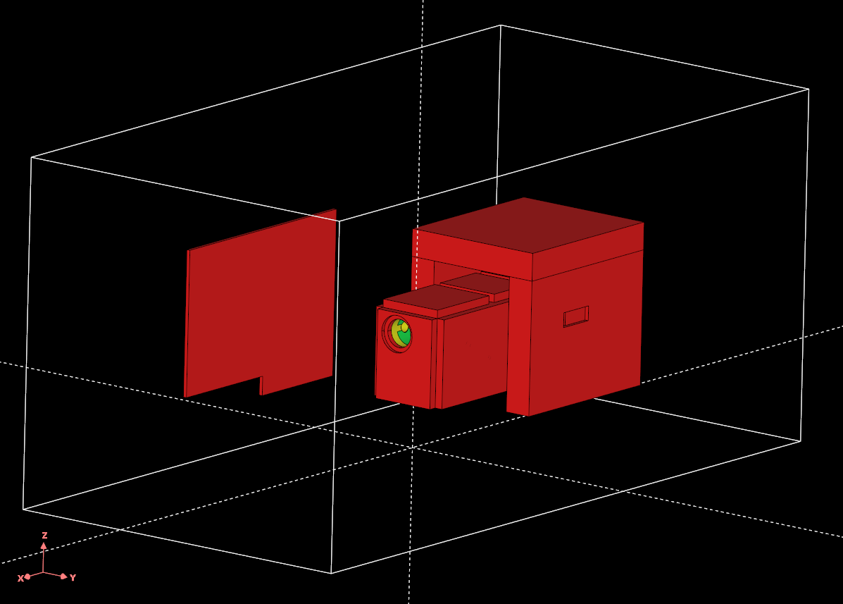
The radiation assessments
The shielding definition
Public area < 80 μSv/month
Supervised area < 1.25 mSv/month
Monitored area < 4 mSv/month
Monitored area < 2 mSv/h
Monitored area < 100 mSv/h
Monitored area > 100 mSv/h
Figure 5: French Nuclear Safety Authority (ASN) equivalences for radiation zoning
Figure 9: Additional shielding in RayXpert®
Addition of 5.5 tons
→ 41 tons in total
Figure 8: Identification of the leakage areas in RayXpert®, errors < 30%

Slide 15
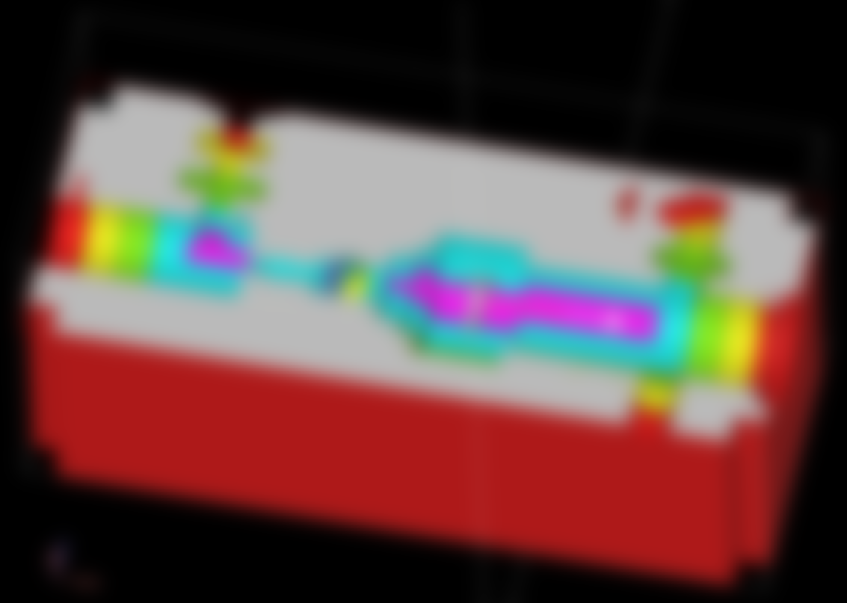
The radiation assessments
The shielding definition
Public area < 80 μSv/month
Supervised area < 1.25 mSv/month
Monitored area < 4 mSv/month
Monitored area < 2 mSv/h
Monitored area < 100 mSv/h
Monitored area > 100 mSv/h
Figure 5: French Nuclear Safety Authority (ASN) equivalences for radiation zoning
Figure 9: Additional shielding in RayXpert®
Lead shot for:
Limiting the weight (ρ = 7 g.cm⁻³)
Providing a simple access for maintenance
Figure 10: Lead shot shielding in RayXpert®

Slide 16
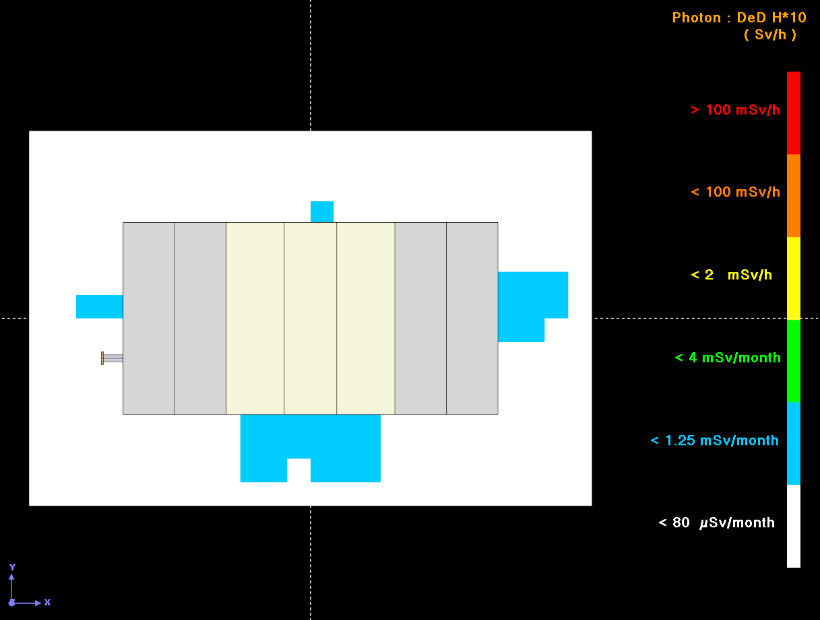
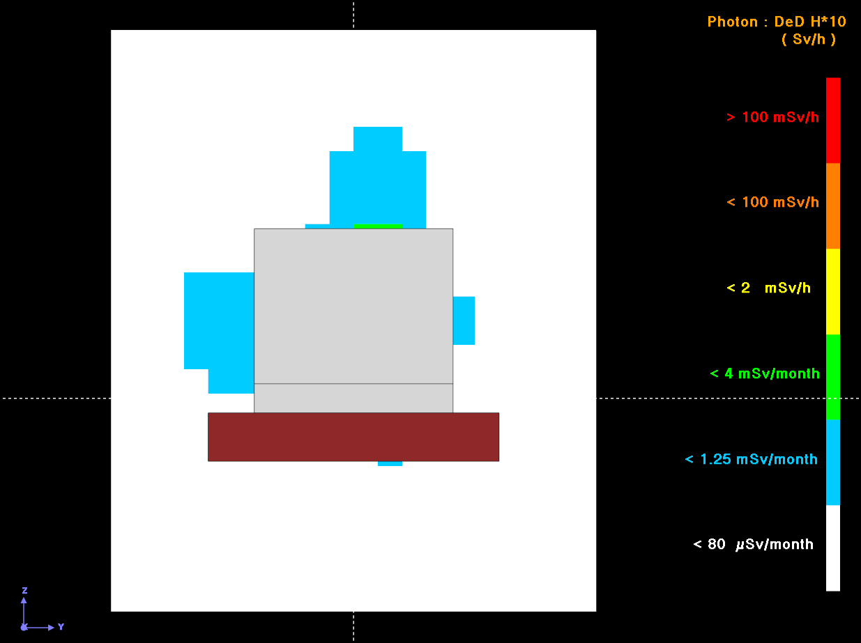
The radiation assessments
The final radiation zoning
Public area < 80 μSv/month
Supervised area < 1.25 mSv/month
Monitored area < 4 mSv/month
Monitored area < 2 mSv/h
Monitored area < 100 mSv/h
Monitored area > 100 mSv/h
Figure 5: French Nuclear Safety Authority (ASN) equivalences for radiation zoning
110 cm
100 cm
80 cm
60 cm
100 cm
Maximum about 2 μSv/h
Figure 12: Final zoning assessment in RayXpert®, view from the side, errors < 30%
Reducing the dose rate outside the generator by a factor of 11,000 and by a factor of 25,000 for the most problematic direction
Figure 11: Final zoning assessment in RayXpert®, view from the top, errors < 30%

Slide 17
5
Conclusion

Slide 18
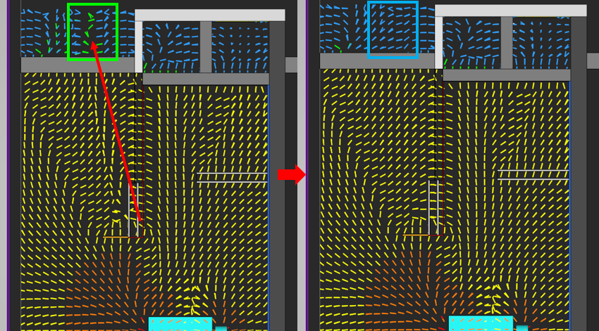
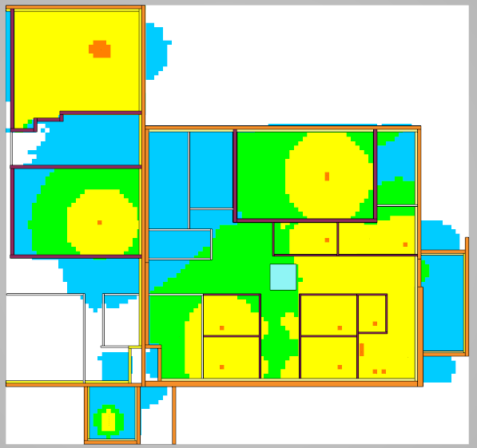
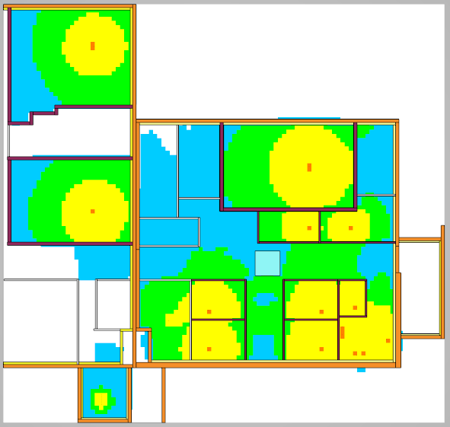
Conclusion
Import of STEP files for complex infrastructure geometry
Monte Carlo calculation for shielding design
CAD interface and dose mapping for shielding optimization
Figure 14: Determination of the origin of dose contribution thanks to the gradient mode of the dose mapping display feature in RayXpert®
Figure 13: Zoning assessments in RayXpert® for a healthcare facility

Slide 19
Thank you
For your attention
907 voie l’Occitane
31670 Labège
ines.duarte@trad.fr
www.rayxpert.com

