Slide 1
Investigation of residual nuclide inventory of the storage ring of the Swiss Light Source (SLS)
Roman Galeev, Sophie Harzmann, Eike Hohmann, Lisa Pedrazzi, Sabine Mayer Department of Radiation Safety and Security :: Paul Scherrer Institute (PSI), Switzerland
SATIF-16, May 2024, INFN
Frascati, Italy

Slide 2
Swiss Light Source
Bird's-eye view of PSI
Electron energy: 2.4 GeV
16 operational experimental beamlines
In operation since December 2000
Upgrade since October 2023
Circumference: 288 m
Over 500 beamline components in storage ring
Aim:
Study of nuclide inventory is necessary for clearance process -> first results are presented
https://www.psi.ch
SLS tunnel
Booster
Storage ring
https://www.synchrotron-analysis.ch

Slide 3
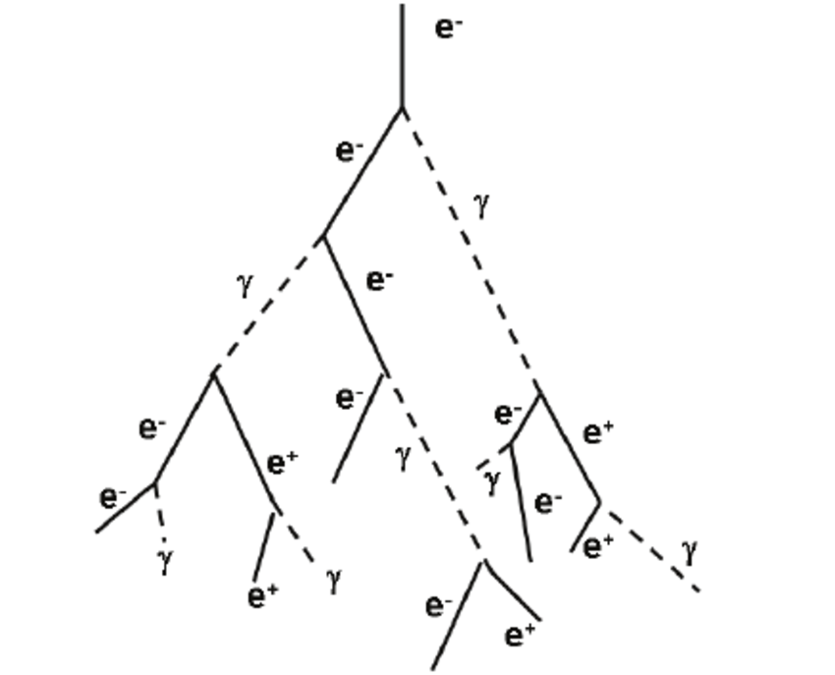
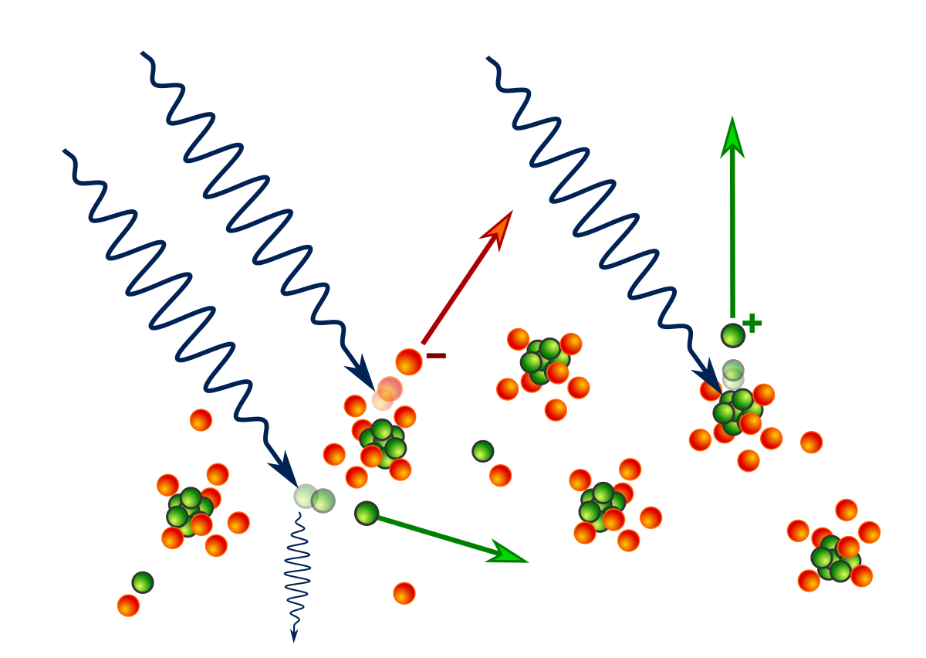
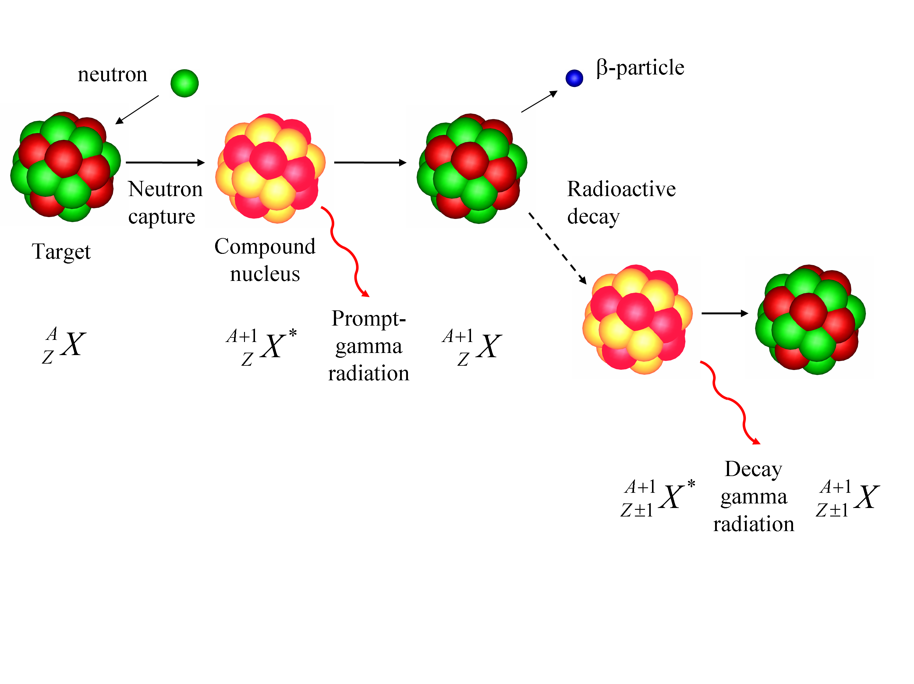
Activation of materials at electron accelerators
Electromagnetic shower
Photonuclear reactions
Neutron capture
Activation mechanisms at high energy electron accelerator
Considering material composition and previous studies, expected inventory includes:
Isotopes of Co, Mn, Ni, Fe, V, Cr, Sc, Na
High activation gradient expected in vicinity of beam loss location
Different activation processes for different materials

Slide 4
Studies of nuclide inventory
Study is done in 2 main stages:
During operation:
Pre-study. Dose rate survey (“Hot Spots”)
In-situ gamma spectrometry (relative)
Material sampling (absolute)
After shutdown, 6 months of cooling time:
In-situ gamma spectrometry (relative)
Material sampling (absolute)

Slide 5
Studies of nuclide inventory
Study is done in 2 main stages:
During operation:
Pre-study. Dose rate survey (“Hot Spots”)
In-situ gamma spectrometry
Material sampling
After shutdown, 6 months of cooling time:
In-situ gamma spectrometry
Material sampling

Slide 6
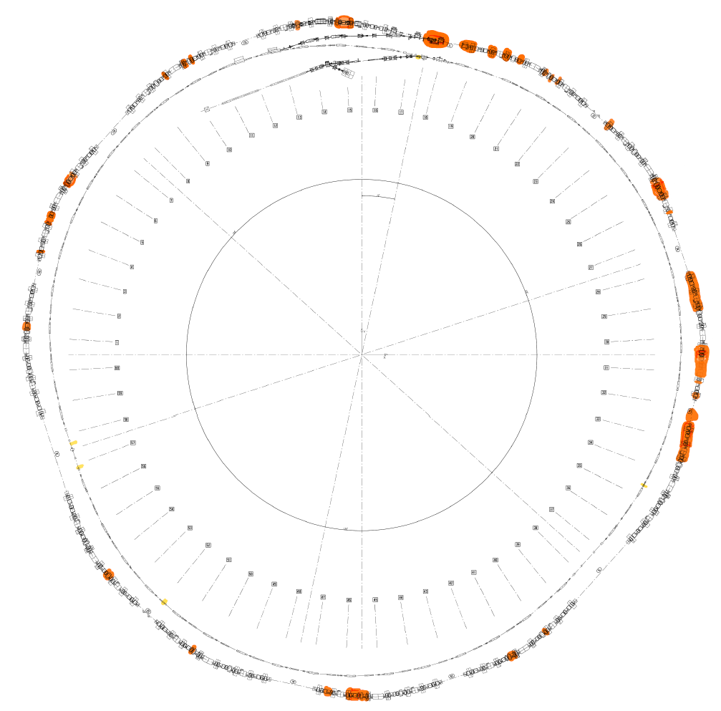
Dose rate survey. Hot Spots search
Repeated measurements for 8 years for more than 350 positions
Measured in contact with beam pipe
Background is about 70 nSv/h
Hot spot: dose rate above 100 nSv/h
Hot spot locations are constant
>100 nSv/h after 1 hour
Scheme of SLS

Slide 7
Studies of nuclide inventory
Study is done in 2 main stages:
During operation:
Dose rate survey (“Hot Spots”)
In-situ gamma spectrometry
Material sampling
After shutdown, 6 months of cooling time:
In-situ gamma spectrometry
Material sampling

Slide 8
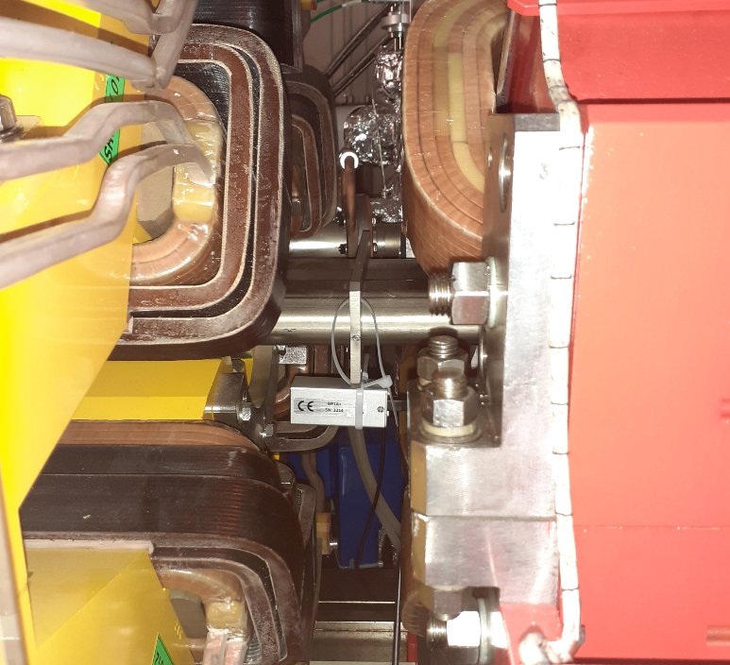
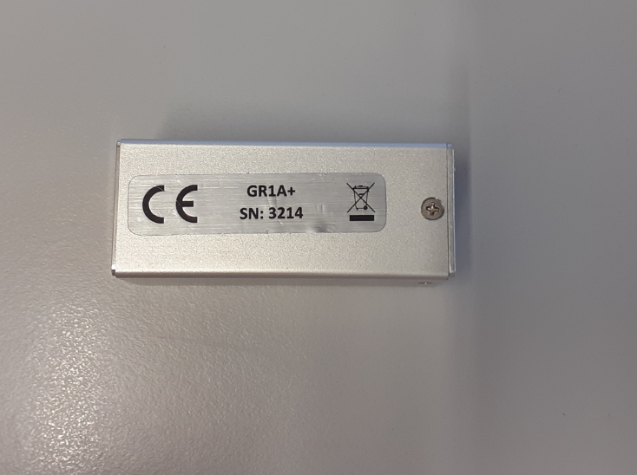
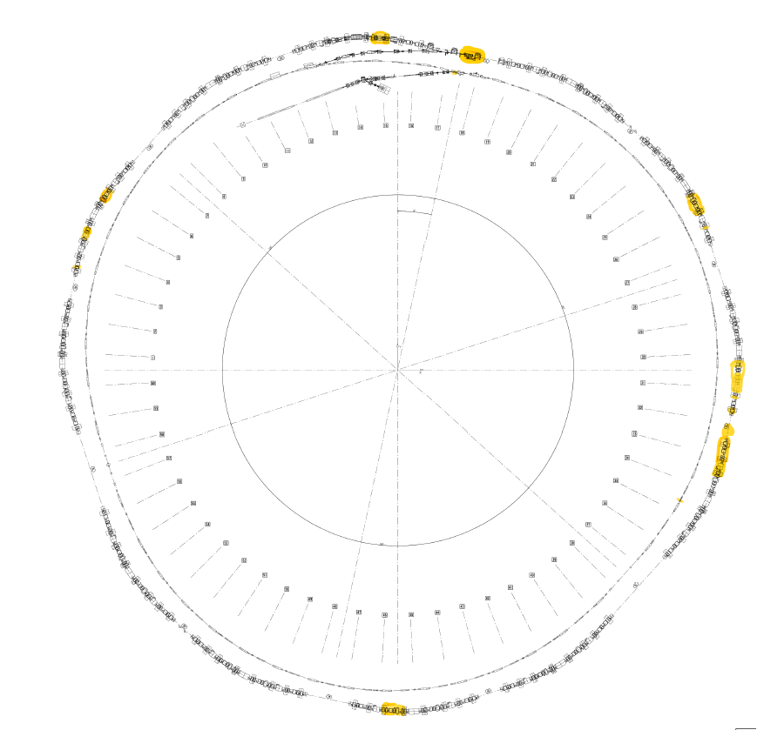
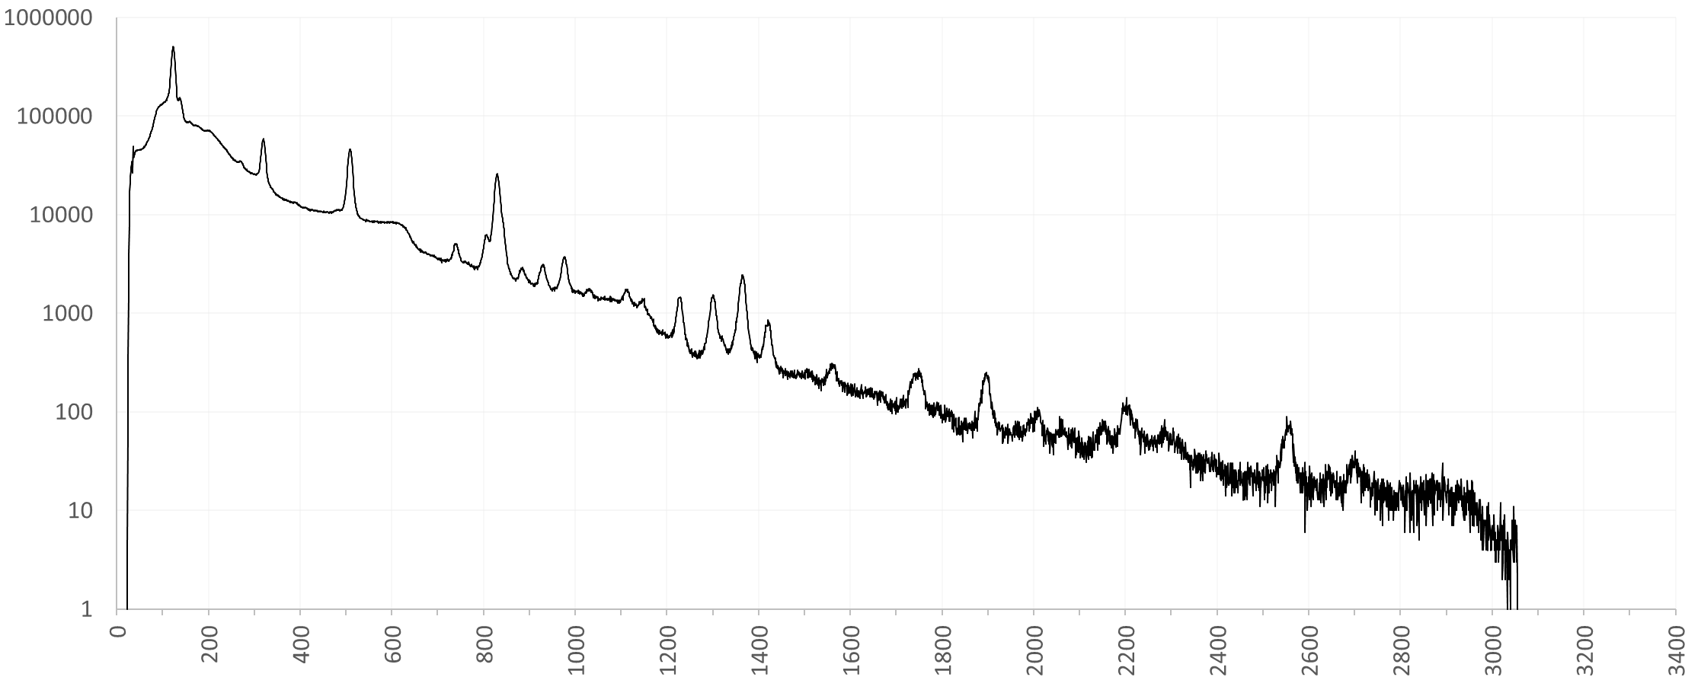
In-situ spectrometry at hot spot, 1 hour after shutdown
Spectrometer at measurement position
Used spectrometer
6 cm
https://www.kromek.com/product/gr1/
Counts
Energy [keV]

Slide 9
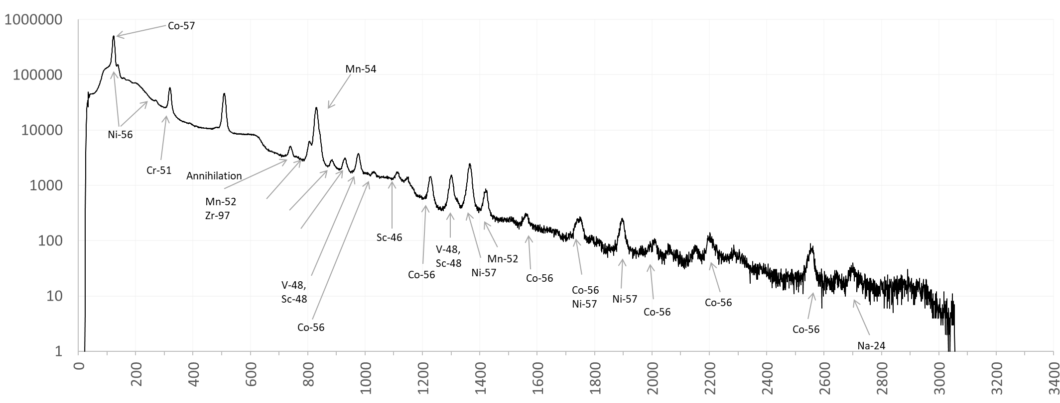
In-situ spectrometry at hot spot, 1 hour after shutdown
Spectrometer at measurement position
Used spectrometer
6 cm
https://www.kromek.com/product/gr1/
Counts
Energy [keV]

Slide 10
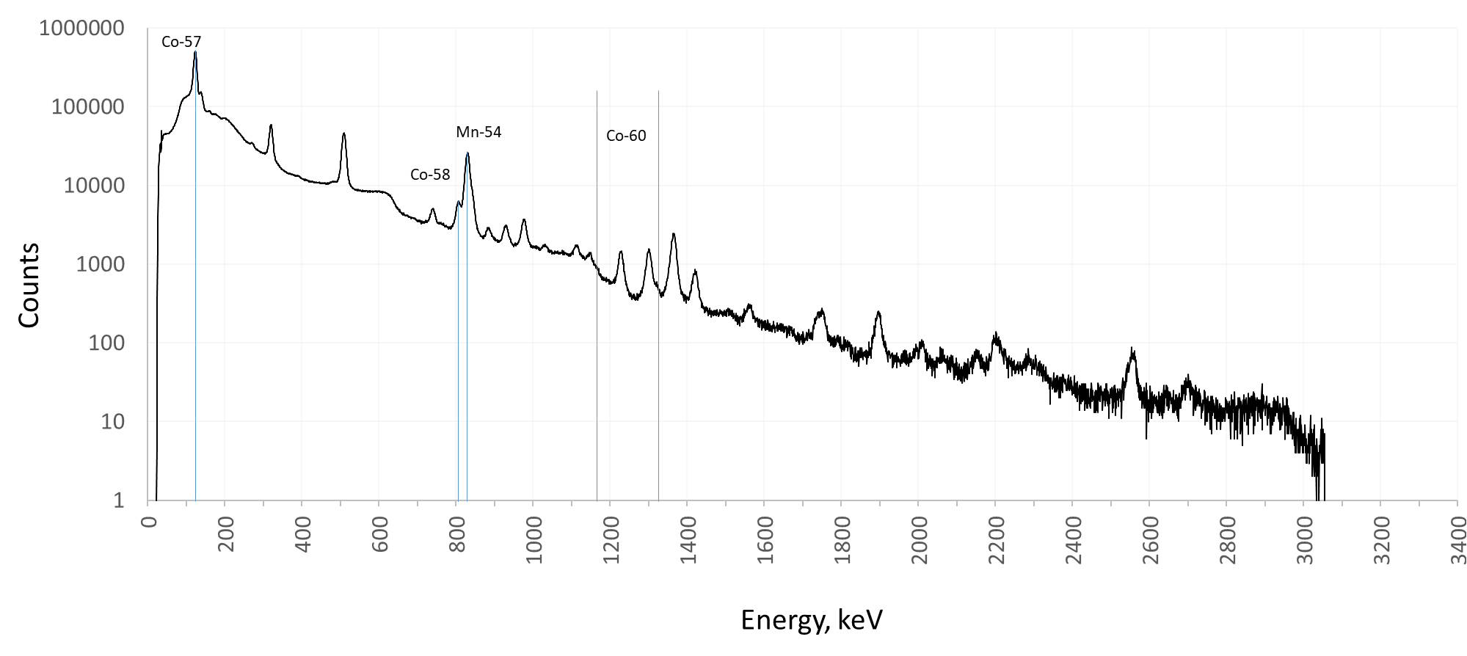
In-situ spectrometry at hot spot, 1 hour after shutdown
Spectrometer at measurement position
Used spectrometer
6 cm
https://www.kromek.com/product/gr1/
Relevant nuclides:
Mn-54
Co-57
Co-58
Co-60
Counts
Energy [keV]

Slide 11
Studies of nuclide inventory
Study is done in 2 main stages:
During operation:
Dose rate survey (“Hot Spots”)
In-situ gamma spectrometry
Material sampling
After shutdown, 6 months of cooling time:
In-situ gamma spectrometry
Material sampling

Slide 12
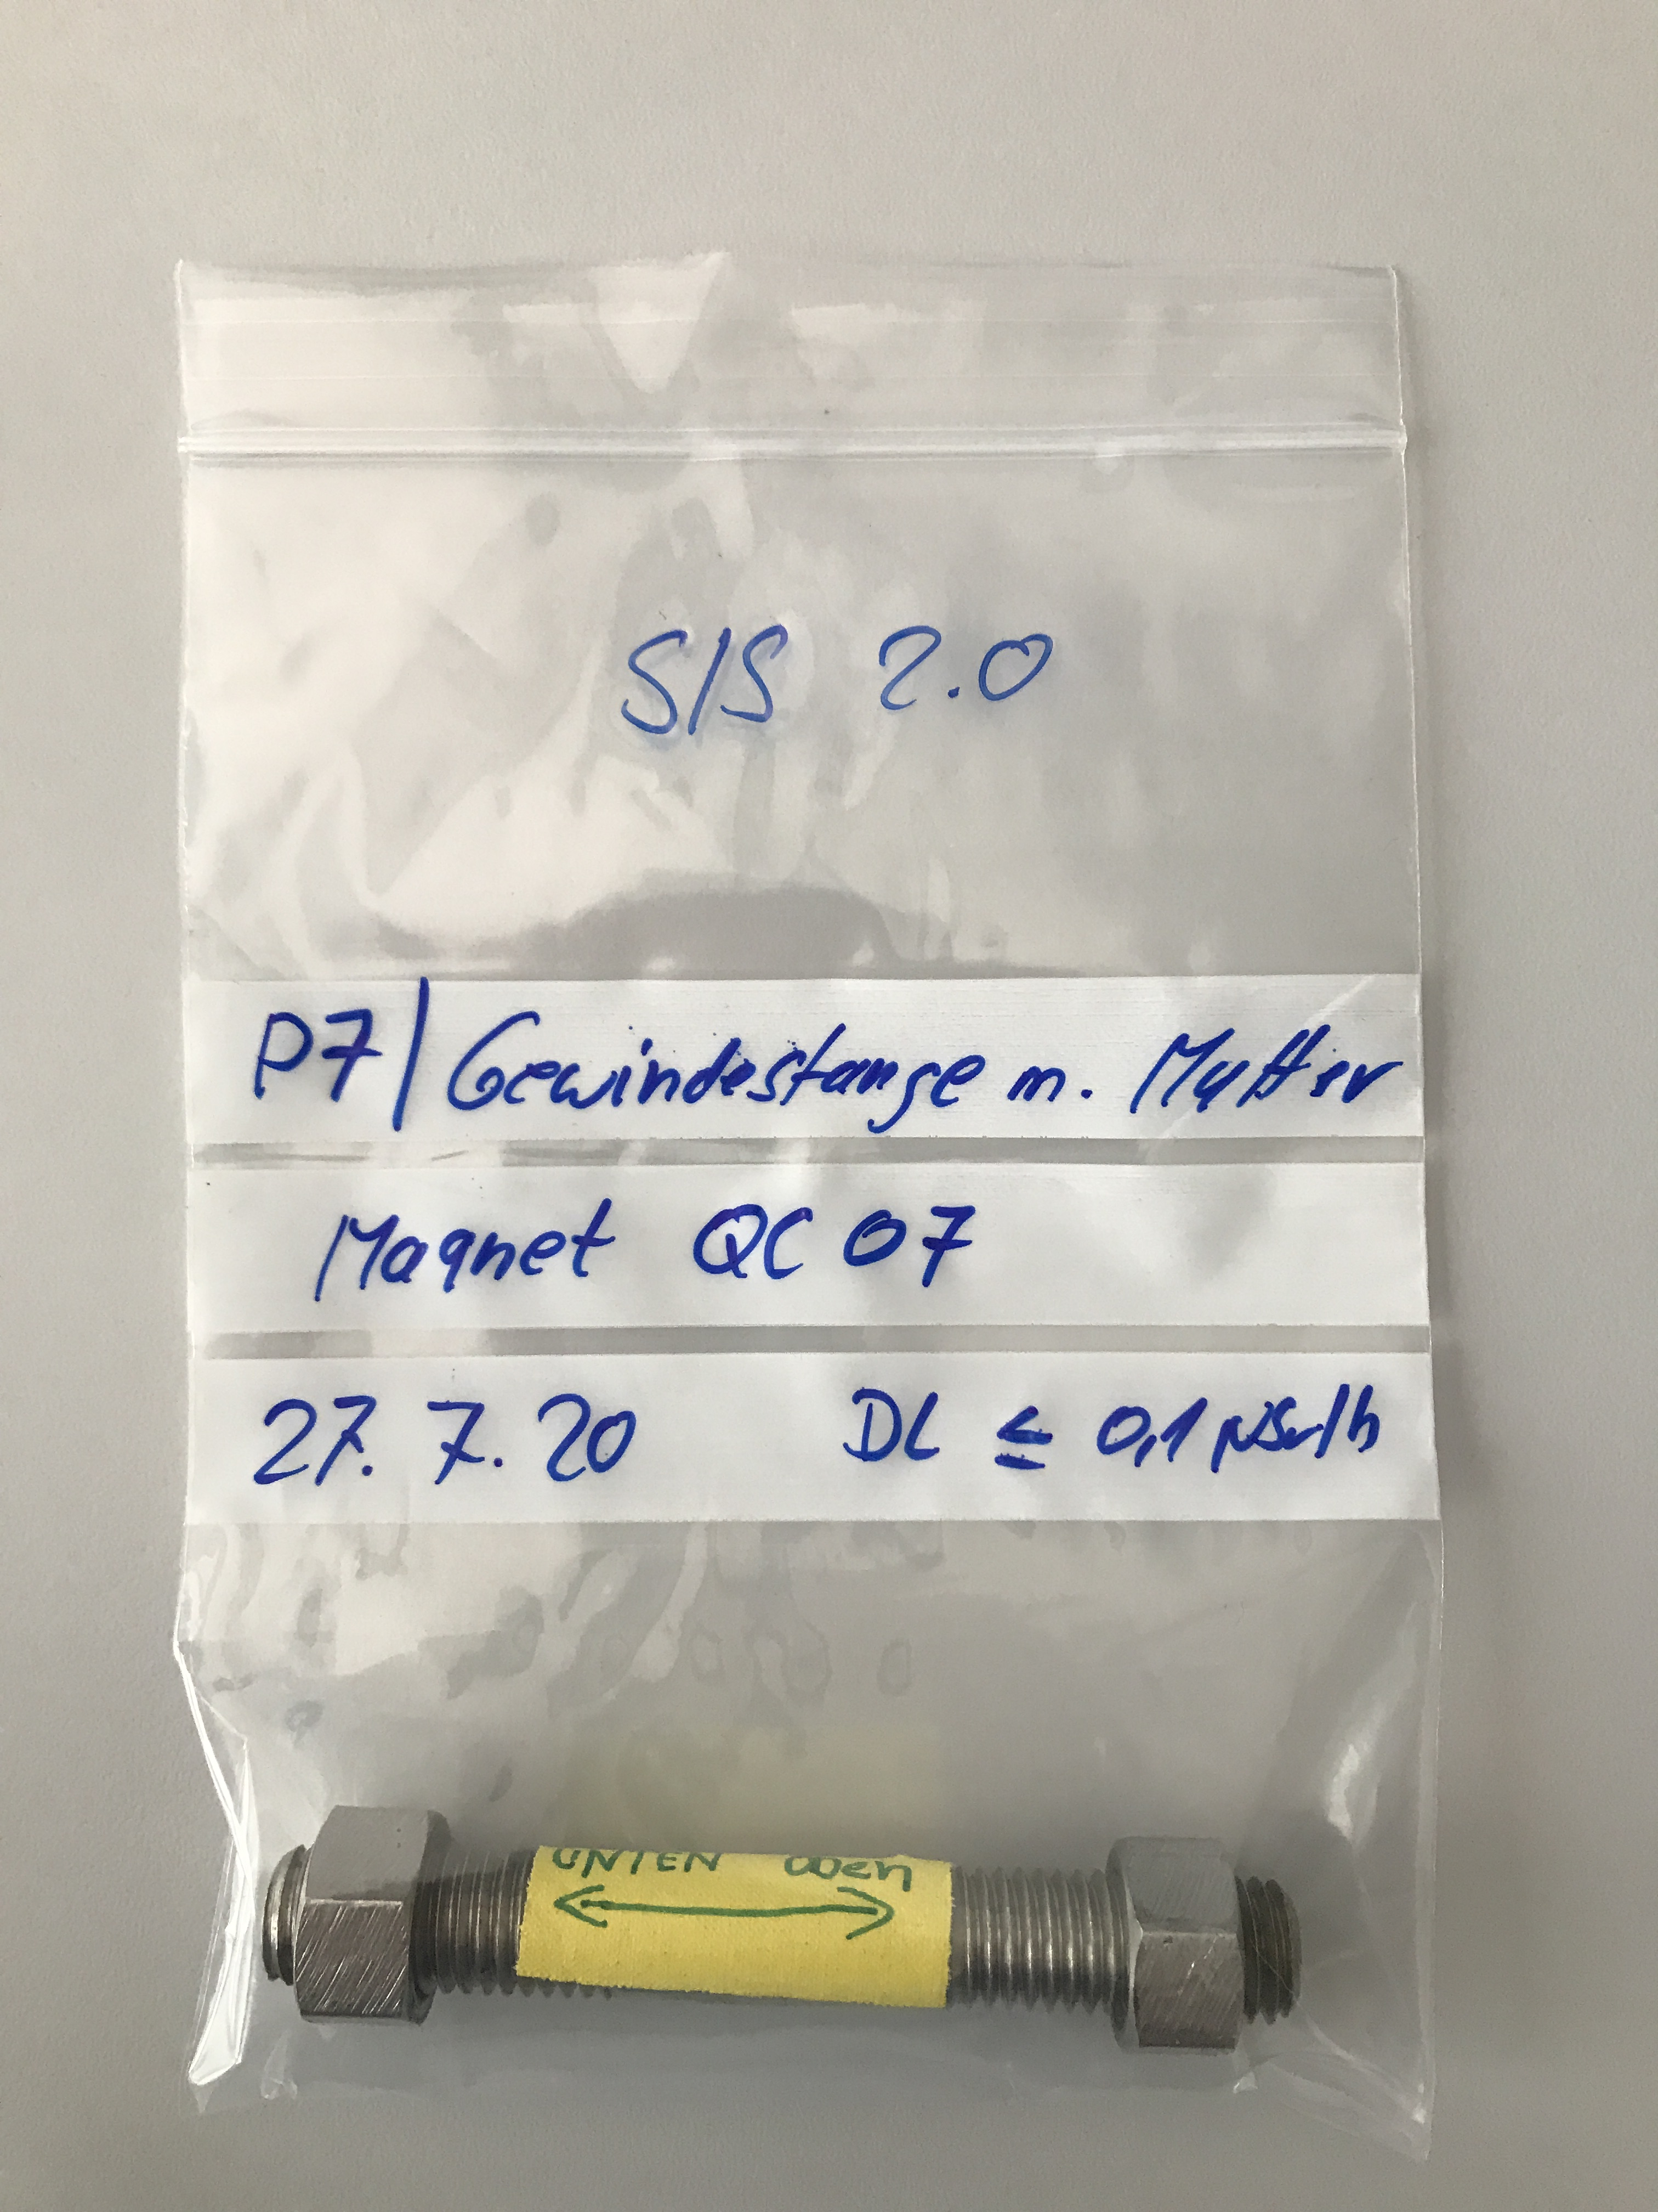
Material sampling during accelerator operation
Beam direction
Hot spot

Slide 13
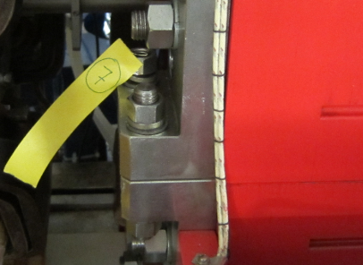
Samples from magnets: screws
9 stainless steel samples from same magnet
Measurements were done with high purity Germanium detector (HPGe)
Measurements results:

Slide 14
Studies of nuclide inventory
Study is done in 2 main stages:
During operation:
Dose rate survey (“Hot Spots”)
In-situ gamma spectrometry
Material sampling
After shutdown, 6 months of cooling time:
In-situ gamma spectrometry
Material sampling

Slide 15
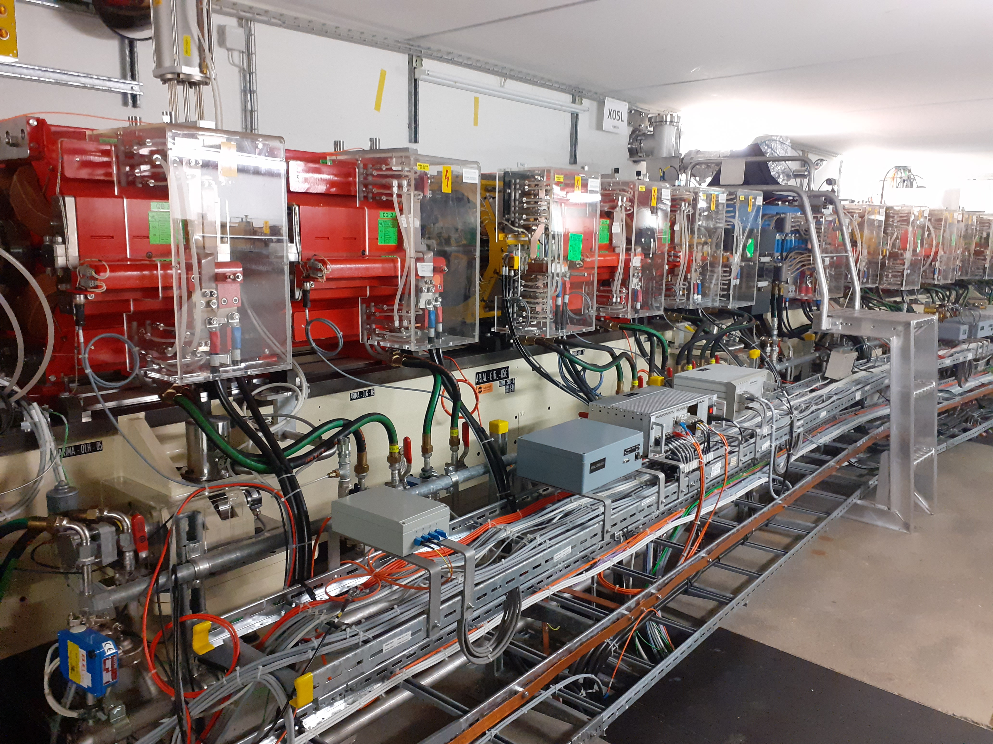
Features for measurements after shutdown
Measurable activation only in few locations
Limited accessibility
Destructive methods possible
>100 nSv/h after 1 hour

Slide 16
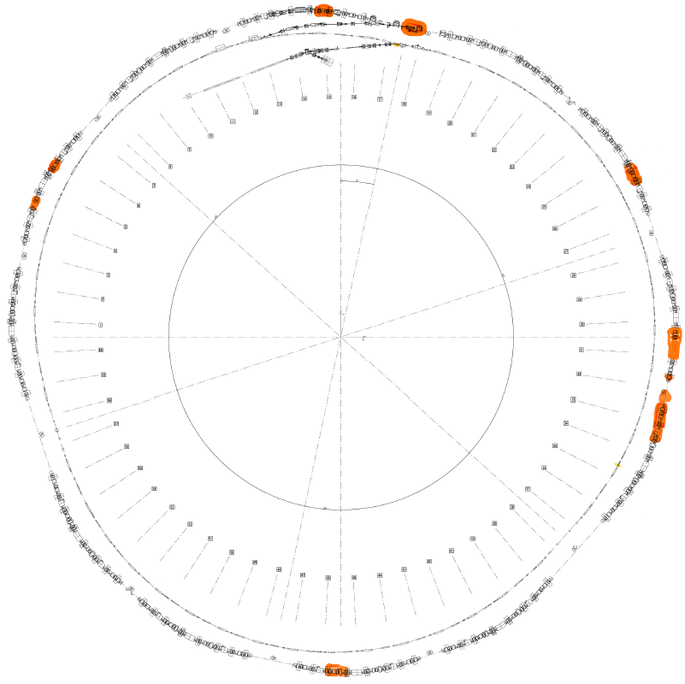
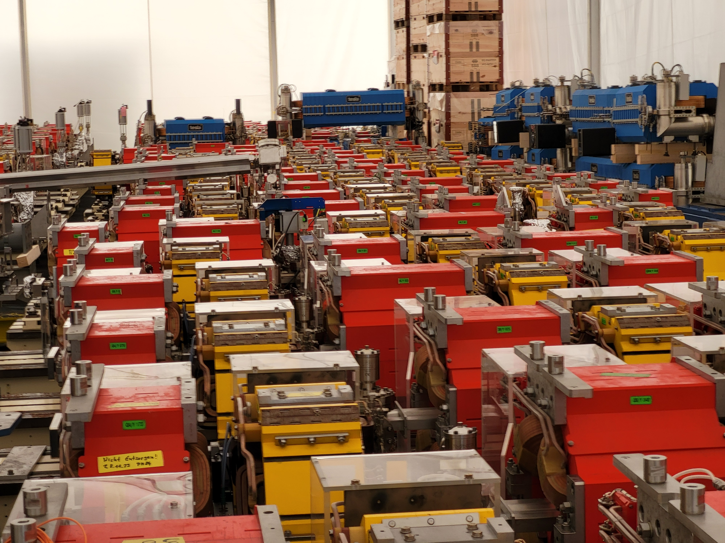
Features for measurements after shutdown
Measurable activation only in few locations
Limited accessibility
Destructive methods possible
>100 nSv/h after 1 month

Slide 17
Studies of nuclide inventory
Study is done in 2 main stages:
During operation:
Dose rate survey (“Hot Spots”)
In-situ gamma spectrometry
Material sampling
After shutdown, 6 months of cooling time:
In-situ gamma spectrometry
Material sampling

Slide 18
In-situ spectrometry, 6 months after shutdown
Measurements are done in 5 reachable hot spots
Short living nuclides already decayed
Co-57
Mn-54
Counts

Slide 19
In-situ spectrometry, 6 months after shutdown
Comparison of normalized spectra
Channel counts/total counts

Slide 20
In-situ spectrometry, 6 months after shutdown
Comparison of normalized spectra
Channel counts/total counts

Slide 21
In-situ spectrometry, 6 months after shutdown
Comparison of normalized spectra
Channel counts/total counts

Slide 22
In-situ spectrometry, 6 months after shutdown
Comparison of normalized spectra
Channel counts/total counts

Slide 23
In-situ spectrometry, 6 months after shutdown
Comparison of normalized spectra
Co-57
Mn-54
Channel counts/total counts

Slide 24
Studies of nuclide inventory
Study is done in 2 main stages:
During operation:
Dose rate survey (“Hot Spots”)
In-situ gamma spectrometry
Material sampling
After shutdown, 6 months of cooling time:
In-situ gamma spectrometry
Material sampling

Slide 25
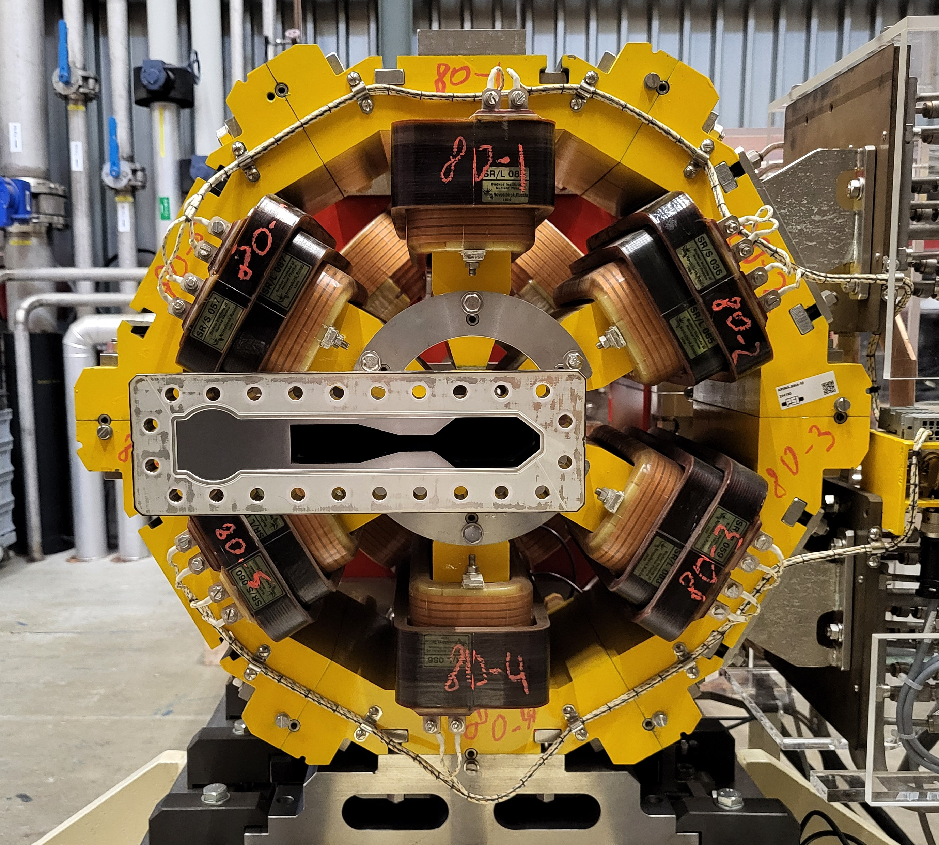
Sampling of materials. 6 months of cooling
Magnet yokes:
Ferromagnetic steel

Slide 26
Sampling of materials. 6 months of cooling
Vacuum chamber:
Stainless steel 316LN
Magnet yokes:
Ferromagnetic steel
Magnet coils:
Copper

Slide 27
Vacuum chamber. Indicated nuclides
Nuclide | Co-57 | Mn-54 | Co-60

Slide 28
Vacuum chamber. Identified nuclides
Nuclide | Co-57 | Mn-54 | Co-60
Hot spot 1 | ✓ | ✓ | ✓

Slide 29
Vacuum chamber. Identified nuclides
Nuclide | Co-57 | Mn-54 | Co-60
Hot spot 1 | ✓ | ✓ | ✓
Hot spot 2 | ✓ | ✓ | x
- below minimal detectable activity
*Minimal Detectable Activity

Slide 30
Vacuum chamber. Identified nuclides
Nuclide | Co-57 | Mn-54 | Co-60
Hot spot 1 | ✓ | ✓ | ✓
Hot spot 2 | ✓ | ✓ | x
Hot spot 3 | ✓ | ✓ | x
- below minimal detectable activity

Slide 31
Vacuum chamber. Identified nuclides
Nuclide | Co-57 | Mn-54 | Co-60
Hot spot 1 | ✓ | ✓ | ✓
Hot spot 2 | ✓ | ✓ | x
Hot spot 3 | ✓ | ✓ | x
Hot spot 4 | ✓ | ✓ | x
- below minimal detectable activity

Slide 32
Vacuum chamber. Identified nuclides
Nuclide | Co-57 | Mn-54 | Co-60
Hot spot 1 | ✓ | ✓ | ✓
Hot spot 2 | ✓ | ✓ | x
Hot spot 3 | ✓ | ✓ | x
Hot spot 4 | ✓ | ✓ | x
Hot spot 5 | ✓ | ✓ | x
- below minimal detectable activity

Slide 33
Vacuum chamber. Identified nuclides
Predominant nuclide
Nuclide | Co-57 | Mn-54 | Co-60
Hot spot 1 | ✓ | ✓ | ✓
Hot spot 2 | ✓ | ✓ | x
Hot spot 3 | ✓ | ✓ | x
Hot spot 4 | ✓ | ✓ | x
Hot spot 5 | ✓ | ✓ | x
Hot spot 6 | ✓ | x | x
- below minimal detectable activity

Slide 34
Vacuum chamber. Activity ratios
Nuclide | Co-57 | Mn-54 | Co-60
Hot spot 1 | ✓ | ✓ | ✓
Hot spot 2 | ✓ | ✓ | x
Hot spot 3 | ✓ | ✓ | x
Hot spot 4 | ✓ | ✓ | x
Hot spot 5 | ✓ | ✓ | x
Hot spot 6 | ✓ | x | x
- below minimal detectable activity

Slide 35
Vacuum chamber. Activity ratios
Nuclide | Co-57 | Mn-54 | Co-60
Hot spot 1 | ✓ | ✓ | ✓
Hot spot 2 | ✓ | ✓ | x
Hot spot 3 | ✓ | ✓ | x
Hot spot 4 | ✓ | ✓ | x
Hot spot 5 | ✓ | ✓ | x
Hot spot 6 | ✓ | x | x
- below minimal detectable activity

Slide 36
Magnet yoke. Identified nuclide
Identified nuclide: Mn-54

Slide 37
Magnet coils. Identified nuclides
Predominant nuclide
Sample | Co-57 | Mn-54 | Co-60
Hot spot 1 | ✓ | ✓ | ✓
Hot spot 2 | ✓ | x | ✓
Hot spot 3 | x | x | ✓
Hot spot 4 | x | x | x
Hot spot 5 | x | x | x
- below minimal detectable activity

Slide 38
Copper coils. Activity ratios
Sample | Co-57 | Mn-54 | Co-60
Hot spot 1 | ✓ | ✓ | ✓
Hot spot 2 | ✓ | x | ✓
Hot spot 3 | x | x | ✓
Hot spot 4 | x | x | x
Hot spot 5 | x | x | x
- below minimal detectable activity

Slide 39
Copper coils. Activity ratios
Sample | Co-57 | Mn-54 | Co-60
Hot spot 1 | ✓ | ✓ | ✓
Hot spot 2 | ✓ | x | ✓
Hot spot 3 | x | x | ✓
Hot spot 4 | x | x | x
Hot spot 5 | x | x | x
- below minimal detectable activity

Slide 40
Summary and conclusions
Studies of nuclide inventory are done in two steps with two approaches
Predominant nuclides are identified for most used materials of storage ring. Namely, they are:
For vacuum chamber: Co-57
For magnet yoke: Mn-54
For magnet coil: Co-60
Nuclide inventories obtained in different locations are comparable
First results need to be confirmed by further investigation

Slide 41
Wir schaffen Sicherheit– heute für morgen
Thank you
Dr. Roman Galeev
Department of Radiation Safety and Security (ASI), PSI
roman.galeev@psi.ch

