Slide 1
Overview of recent activation benchmarks at the CERN High Energy Accelerator Mixed Field (CHARM) facility and the CERN Shielding Benchmark Facility (CSBF)
D. Bozzato¹, A. Devienne², P. Dyrcz¹, R. Froeschl¹, A. Infantino¹, T. Lorenzon¹, M. Tisi¹,
S. Roesler¹, M. Brugger¹, N. Nakao³, T. Kajimoto⁴, E. Lee⁵, T. Sanami⁵
1 European Organization for Nuclear Research (CERN)
2 Fusion for Energy (F4E)
3 Institute of Technology, Shimizu Corporation
4 Hiroshima University
5 High Energy Accelerator Research Organization (KEK)
SATIF-16
Shielding aspects of Accelerators, Targets and Irradiation Facilities
May 28-31, 2024
Frascati
Laboratori Nazionali dell’INFN
EDMS 3087048

Slide 2
Introduction

Slide 3
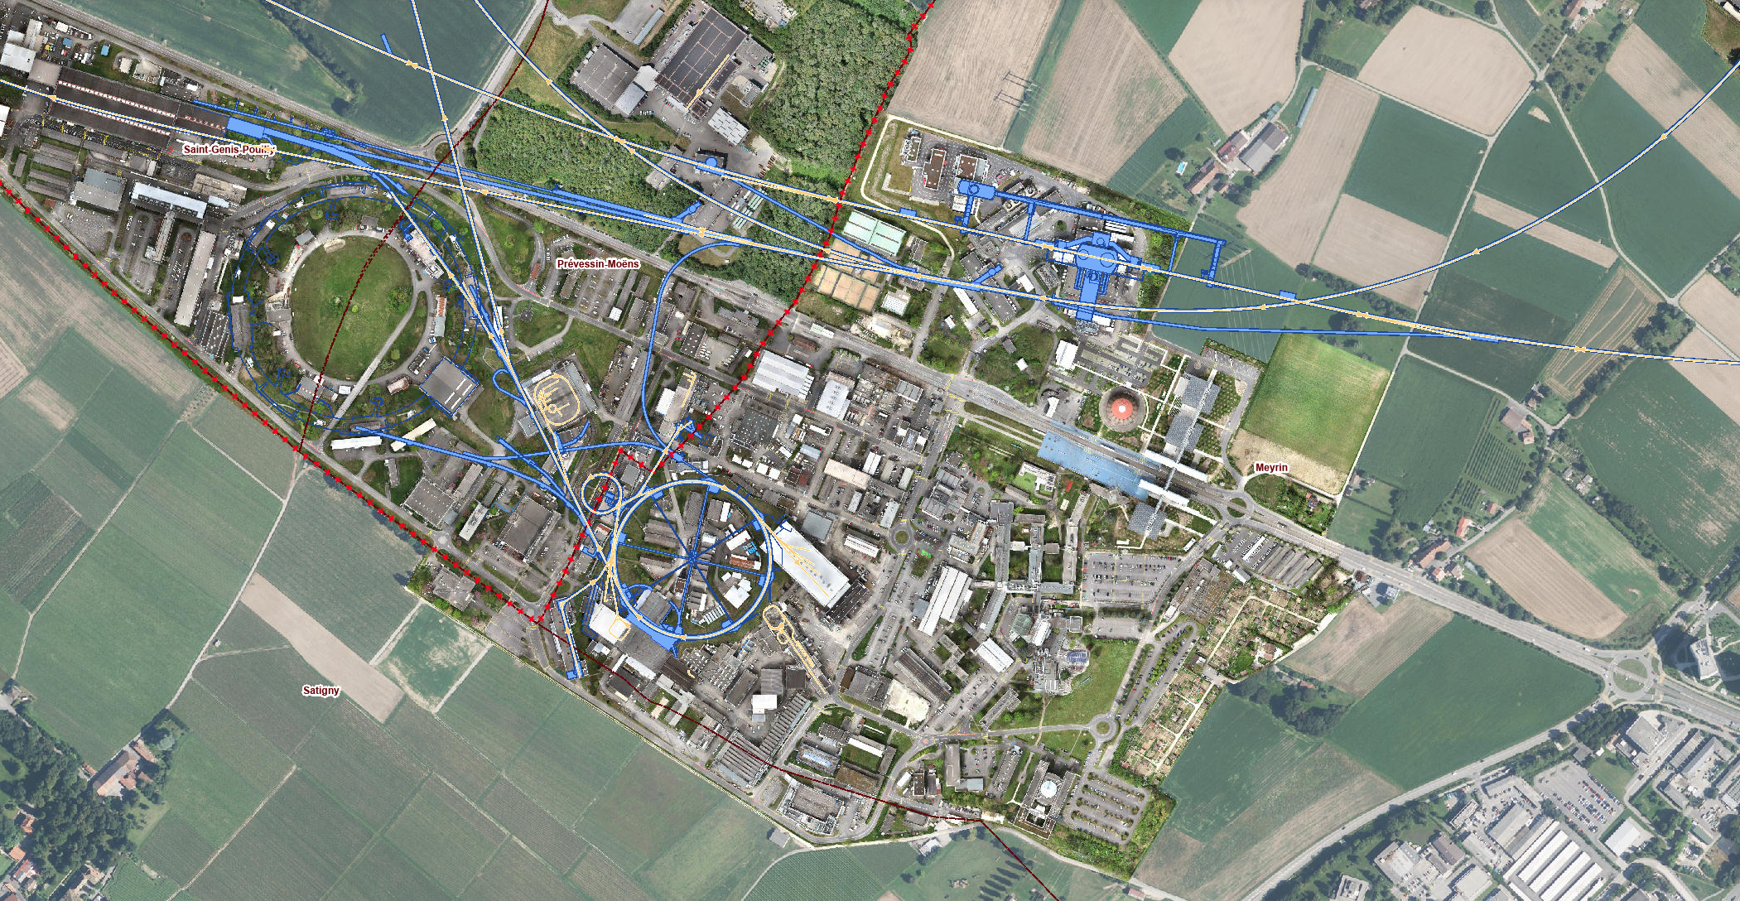
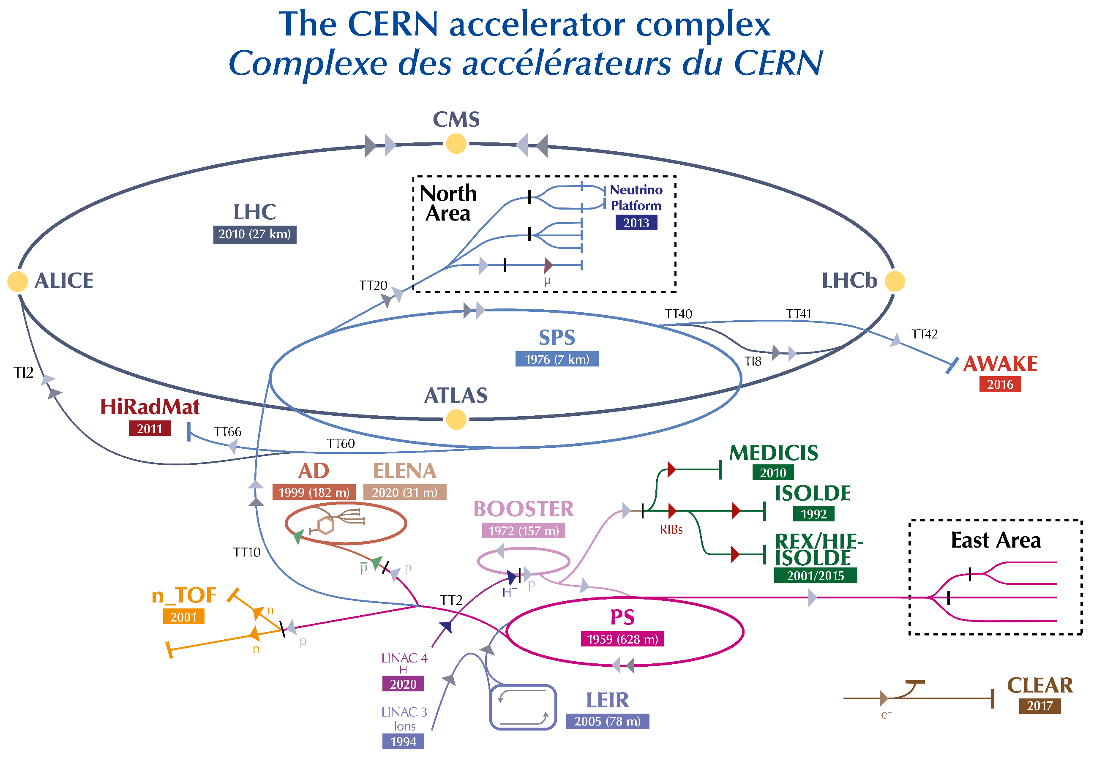
The CERN East Experimental Area
SPS
SPS
n_TOF
ATLAS
AD
LHC
ELENA
ISOLDE
MEDICIS
CERN Globe and
Science Gateway
PS Booster
EAST AREA
PS
LINAC 4
100 m

Slide 4
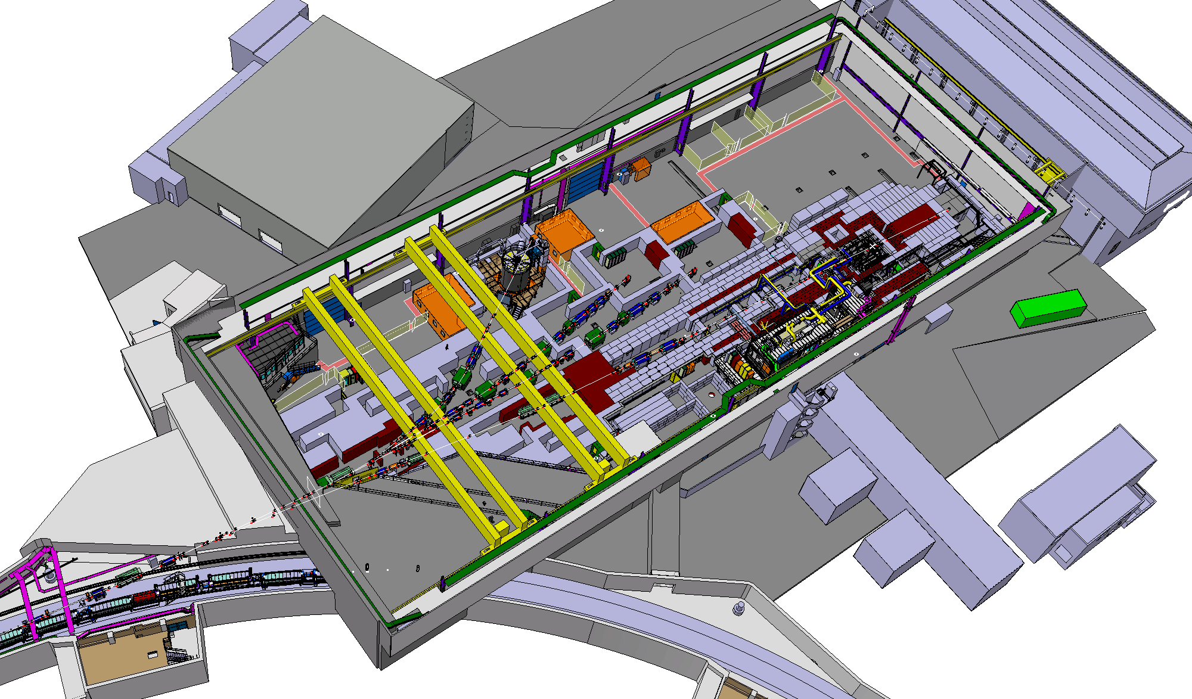
CHARM and CSBF in the CERN East Experimental Area
CHARM
and CSBF
IRRAD
T08 beam line
PS ring

Slide 5
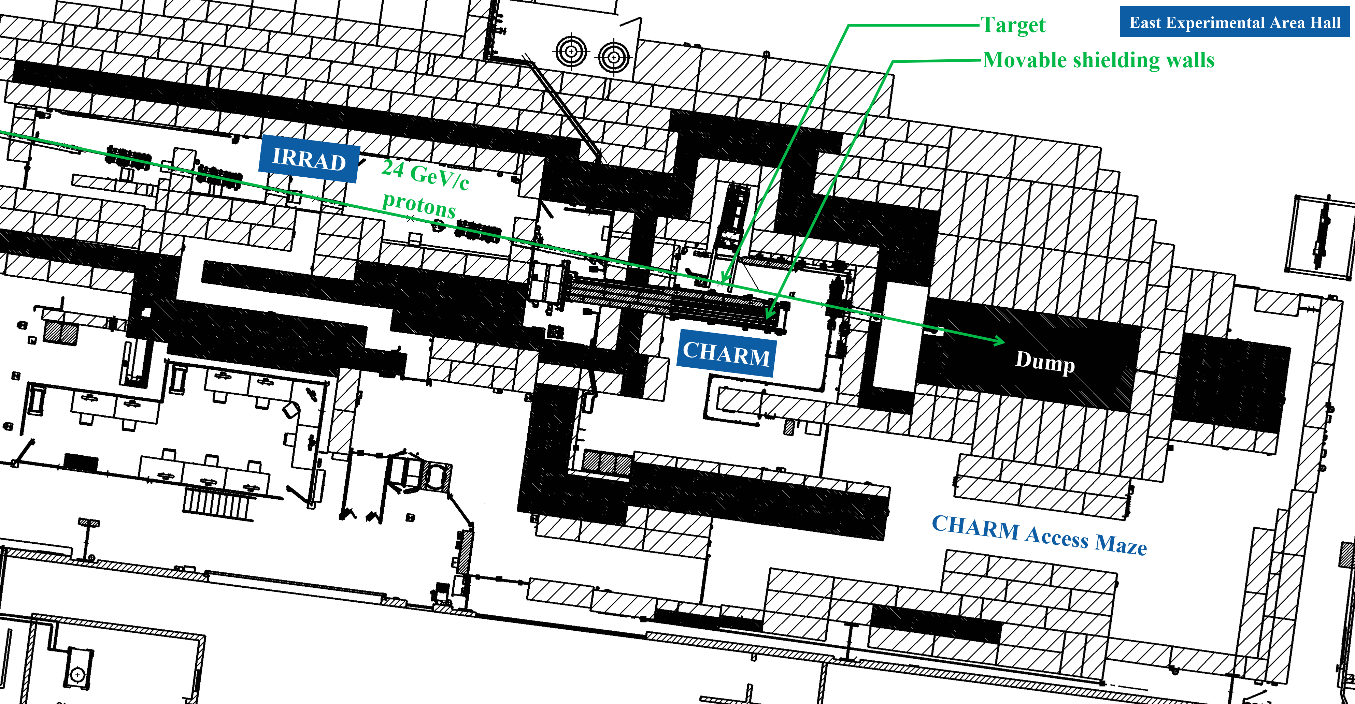
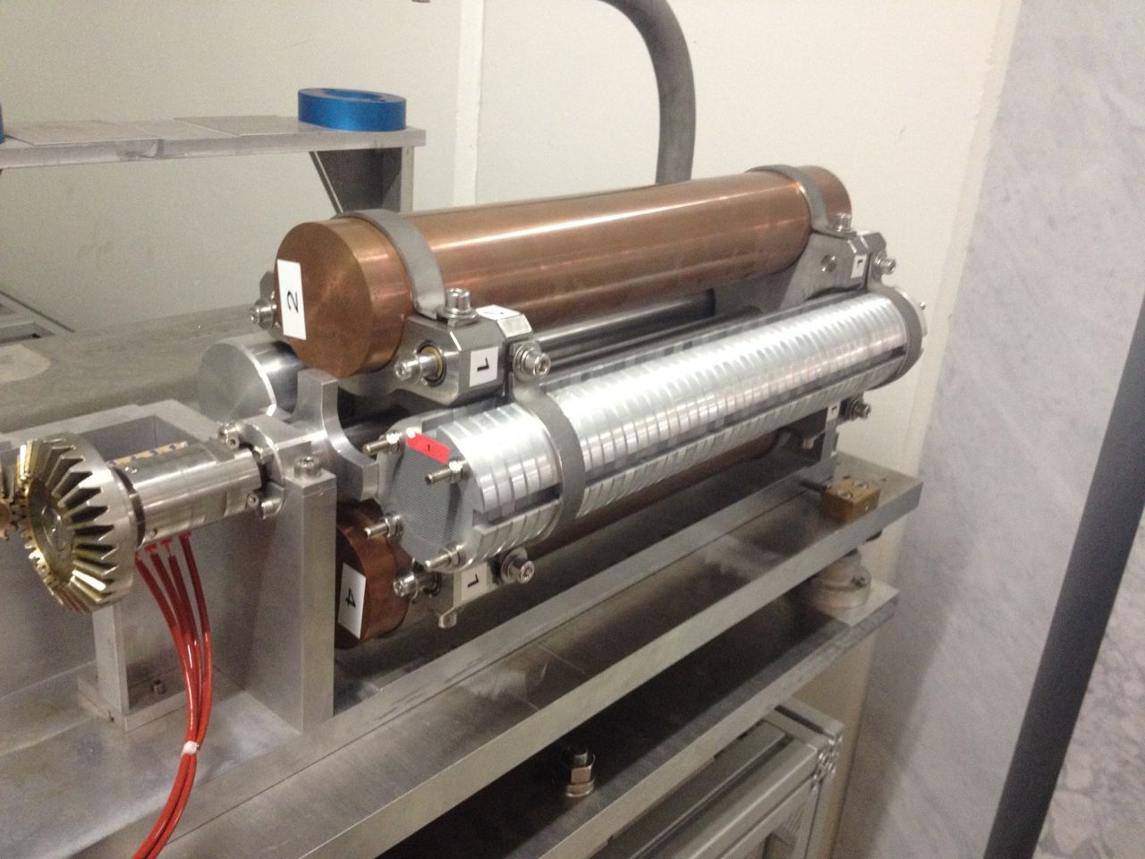
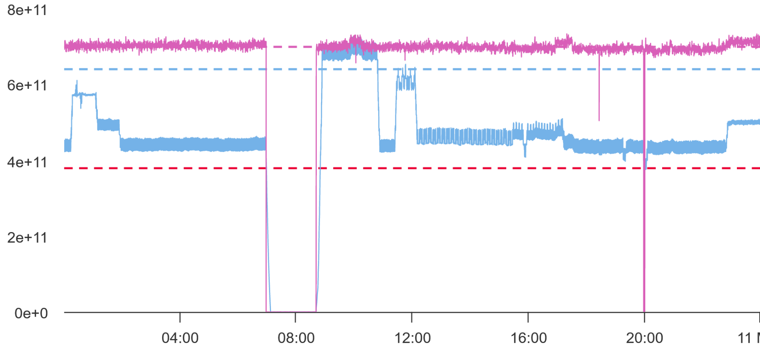
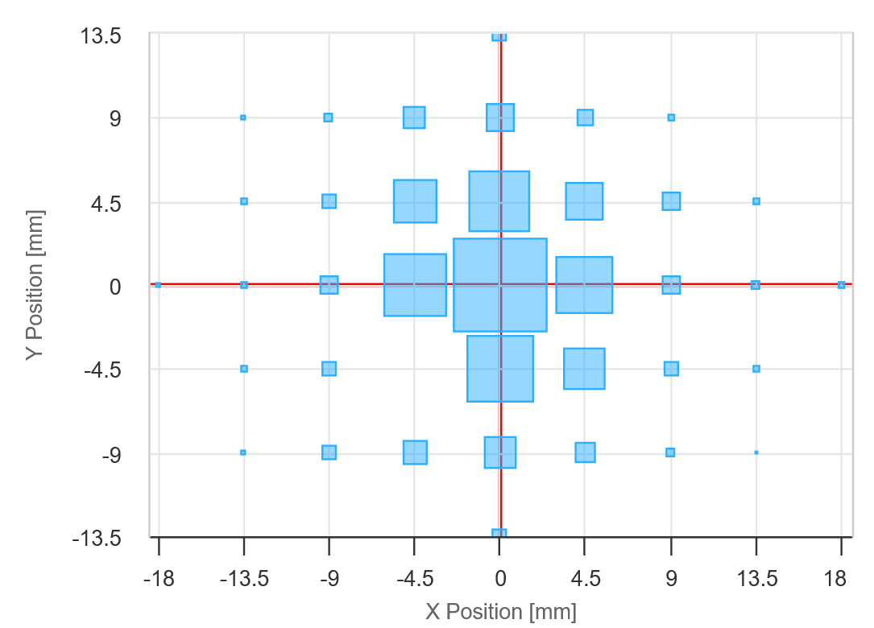
Beam properties
Primary protons from the PS:
momentum: 24 GeV/c;
intensity: 8.0E11 p/spill (nominal), tuneable down to 3.0E09 p/spill, measured with Secondary Emission Chamber (SEC);
typical spill length: 350 ms;
max. average intensity (over PS cycle): 6.6E10 p/s;
beam profile: Gaussian, typically with a 1.2 cm FWHM, measured with Beam Position Monitors (BPMs);
Three types of targets:
copper, aluminium, aluminium with slits to achieve an effective density of 0.9 g/cm³;
50 cm length, 8 cm diameter.

Slide 6
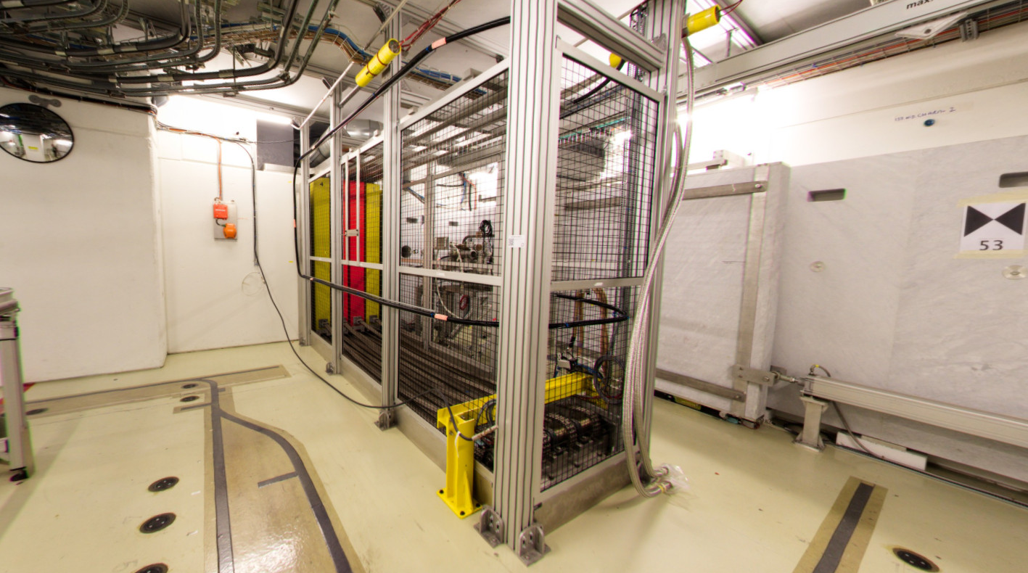
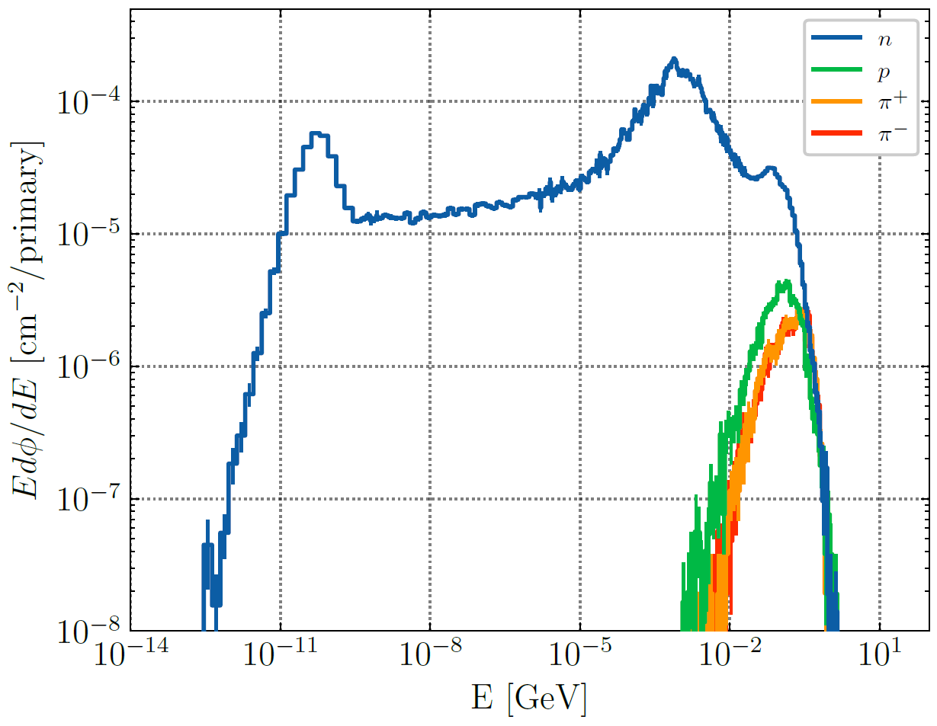
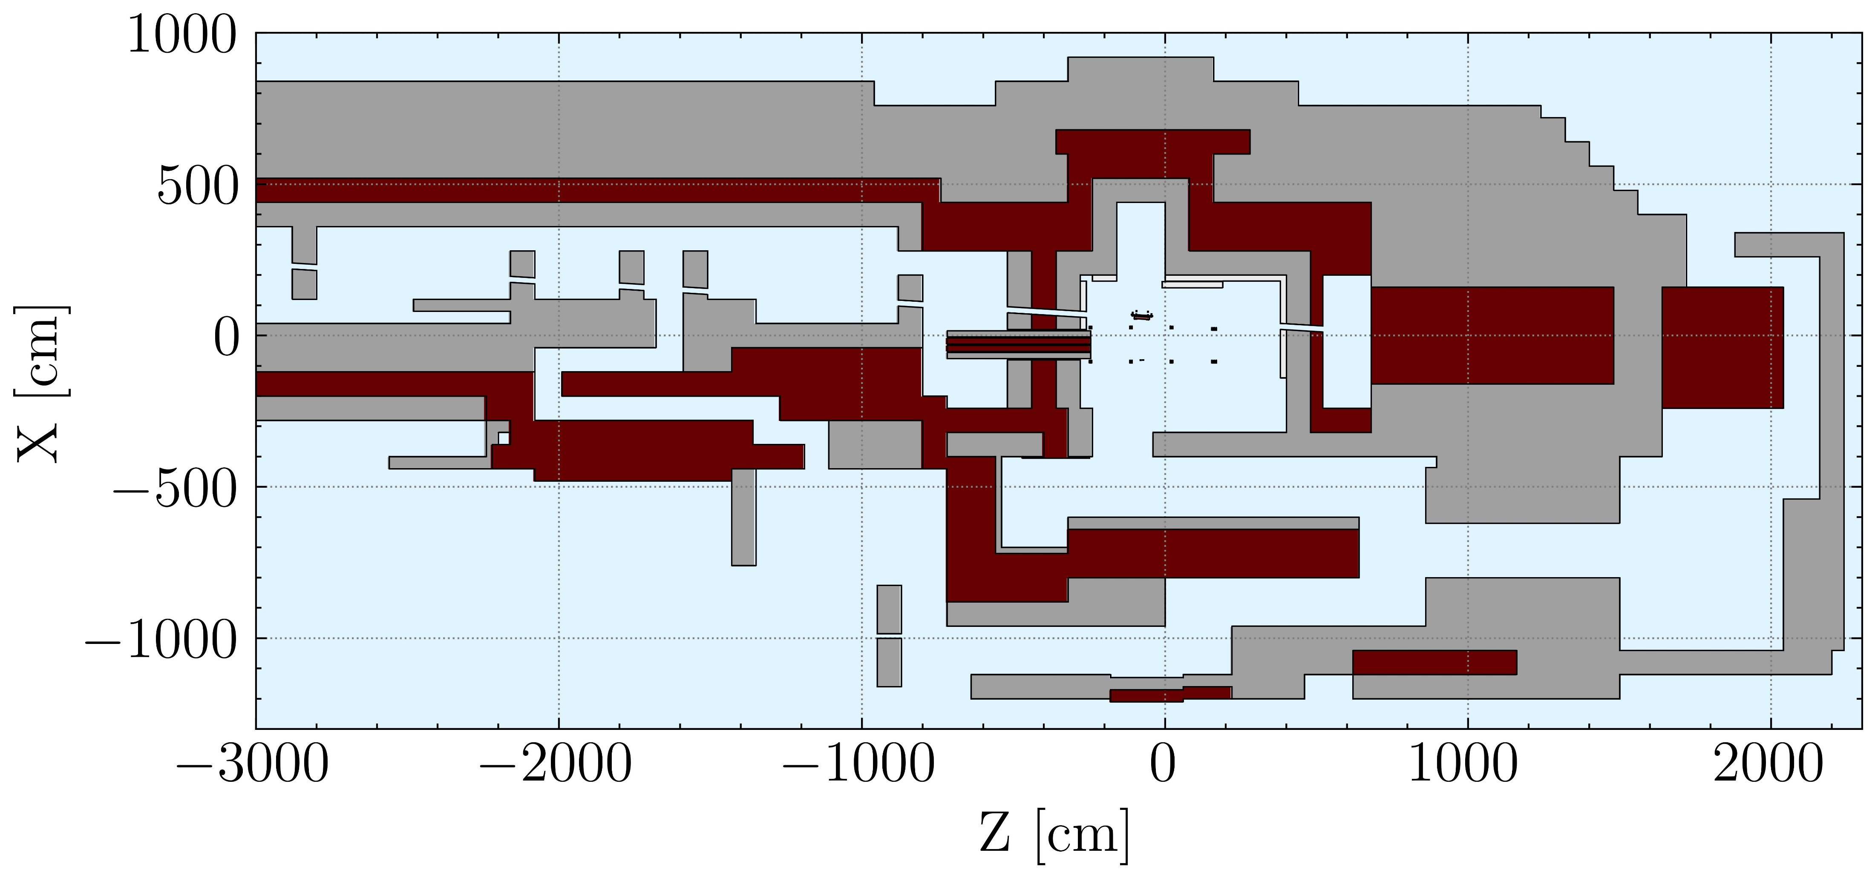
CHARM
CERN High-energy AcceleRator Mixed field
Facility designed to reproduce the radiation environment of particle accelerators and space conditions for electronics testing.
Variation of the radiation field by:
selecting target and beam intensity;
selecting among dedicated test positions;
acting on 4 movable shielding layers
Movable shielding layers:
20 cm each
Concrete (outermost)
Iron (innermost)
Typical spectra at 90°
IRRAD
CHARM

Slide 7
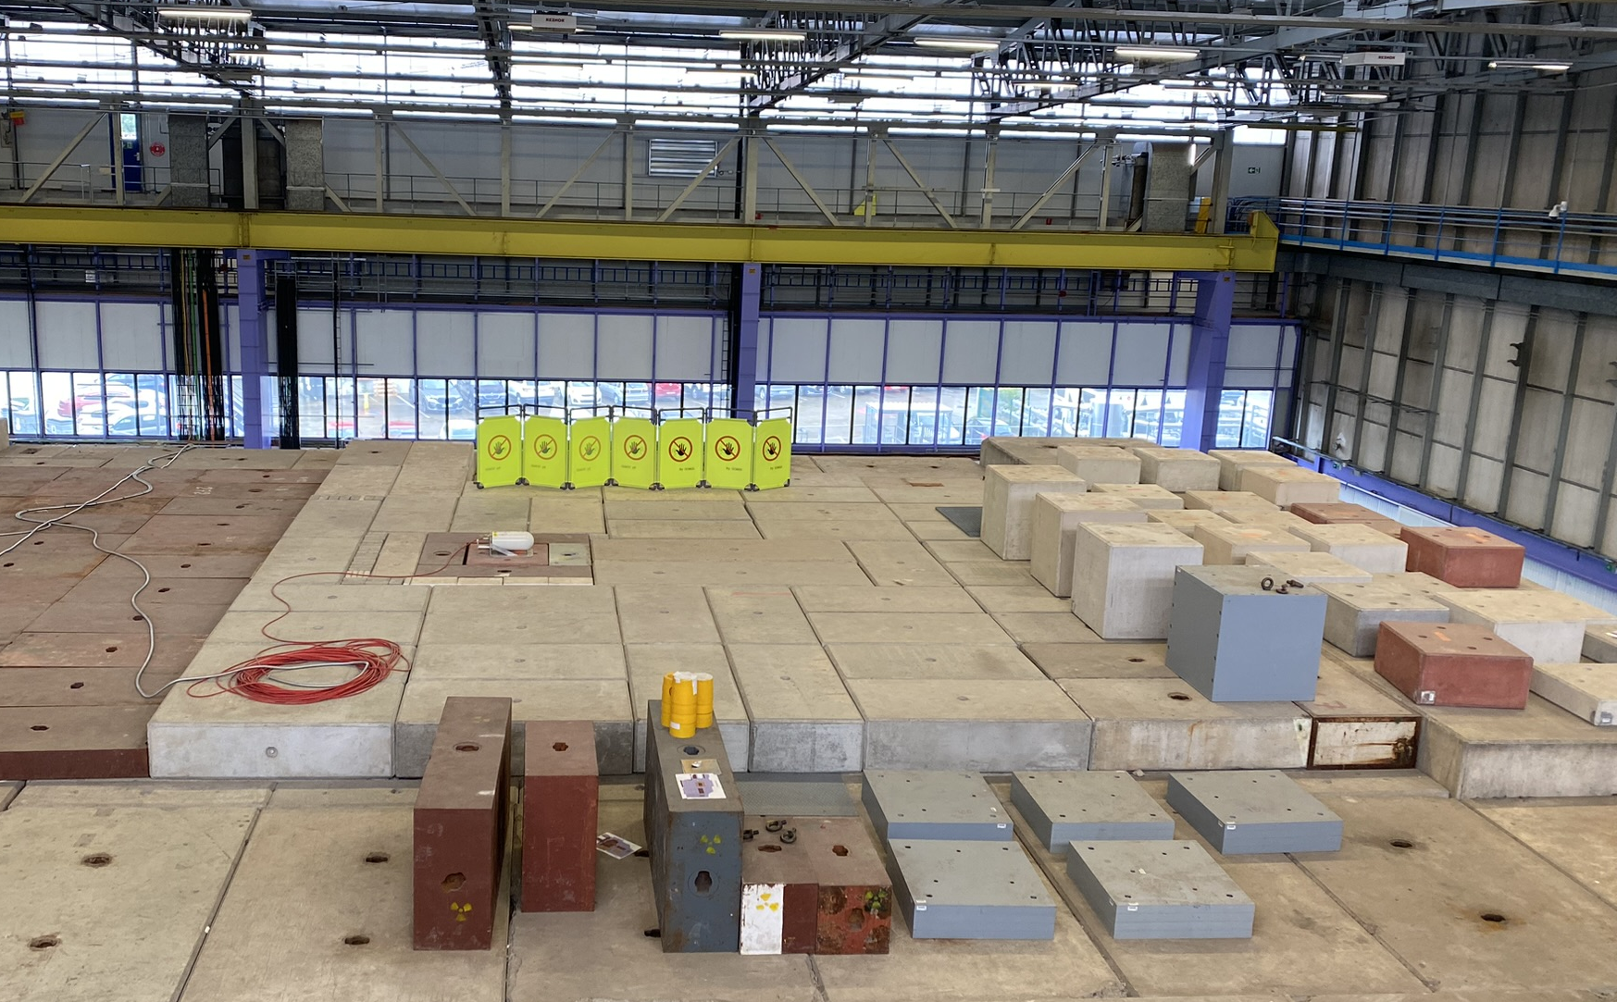
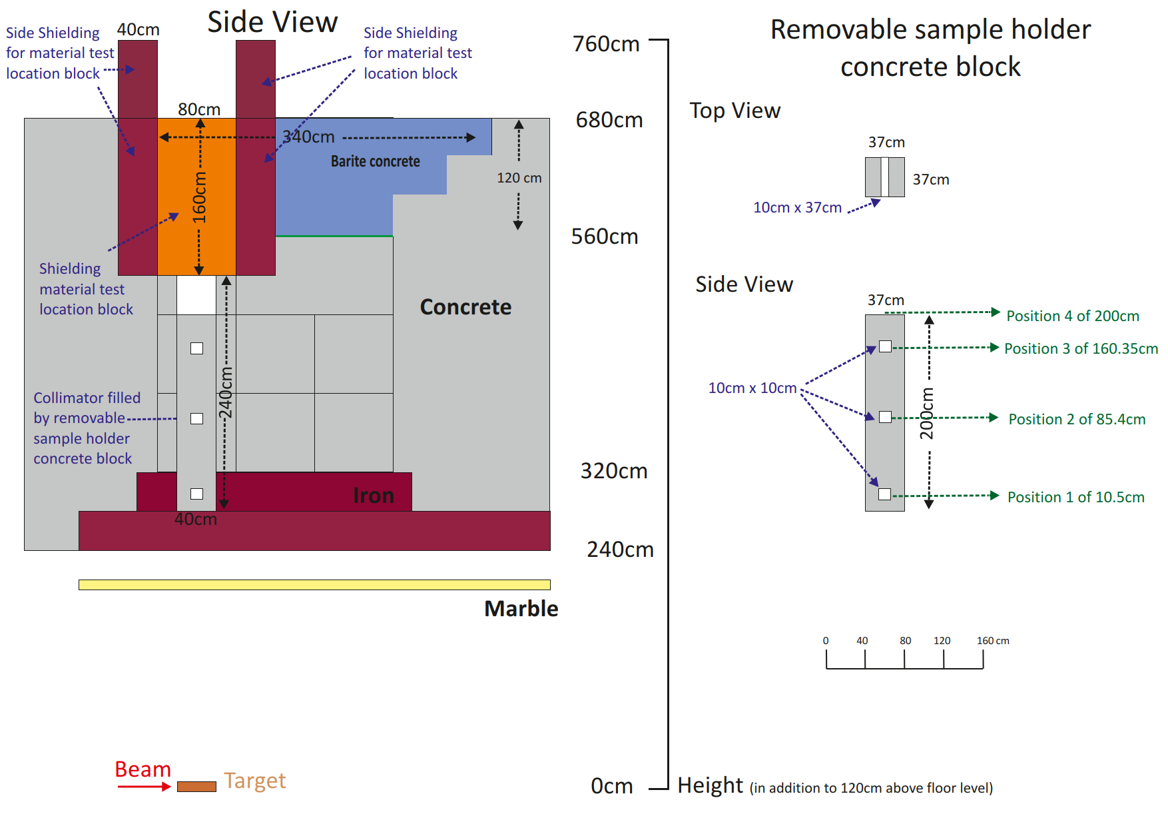
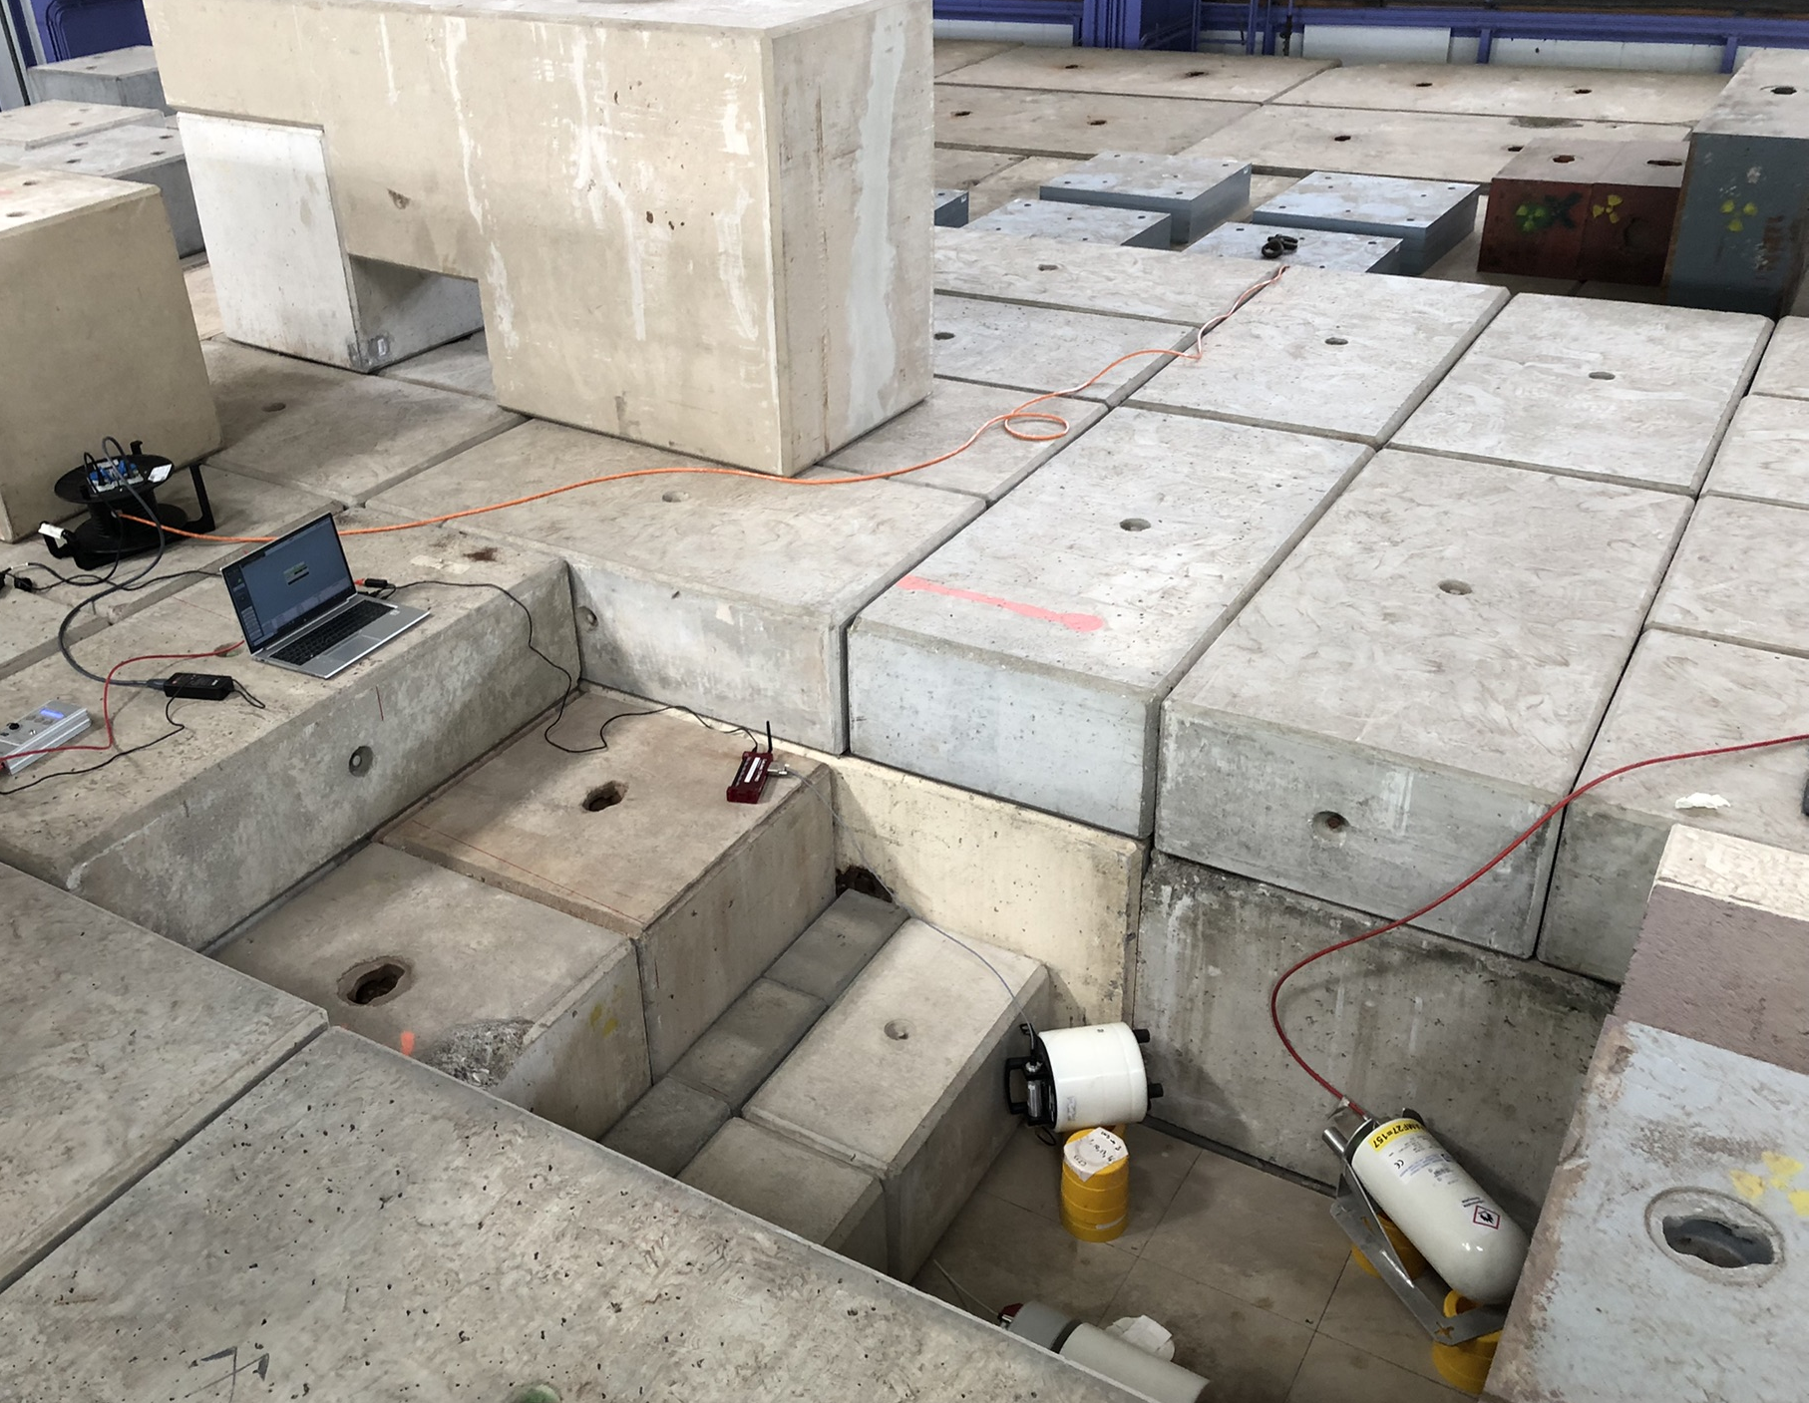
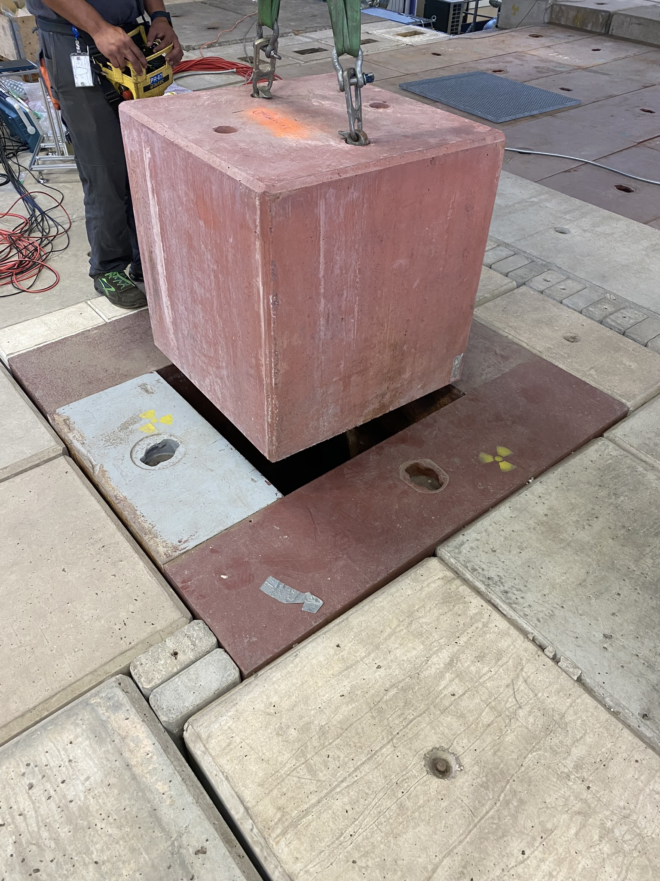
CSBF
CERN Shielding Benchmark Facility
90° above target
Located within CHARM, 90° above the target;
Collimated high-energy neutron field modulated by inserting/extracting shielding blocks;
A versatile facility: shielding studies, passive/active detectors testing, MC benchmarks.
CSBF Platform
Material Test Location

Slide 8
Benchmarking needs
Ensuring the safe and reliable operation of particle accelerator facilities necessitates prediction of prompt and residual radiation levels.
Prompt radiation:
shielding material;
shielding thickness;
radiation streaming (design of access paths).
Residual radiation and induced radioactivity:
selection of materials in design phase of components;
prediction of residual dose rates for planned exposure situations;
prediction of nuclide for clearance/decommissioning.

Slide 9
Benchmarks inside CHARM

Slide 10
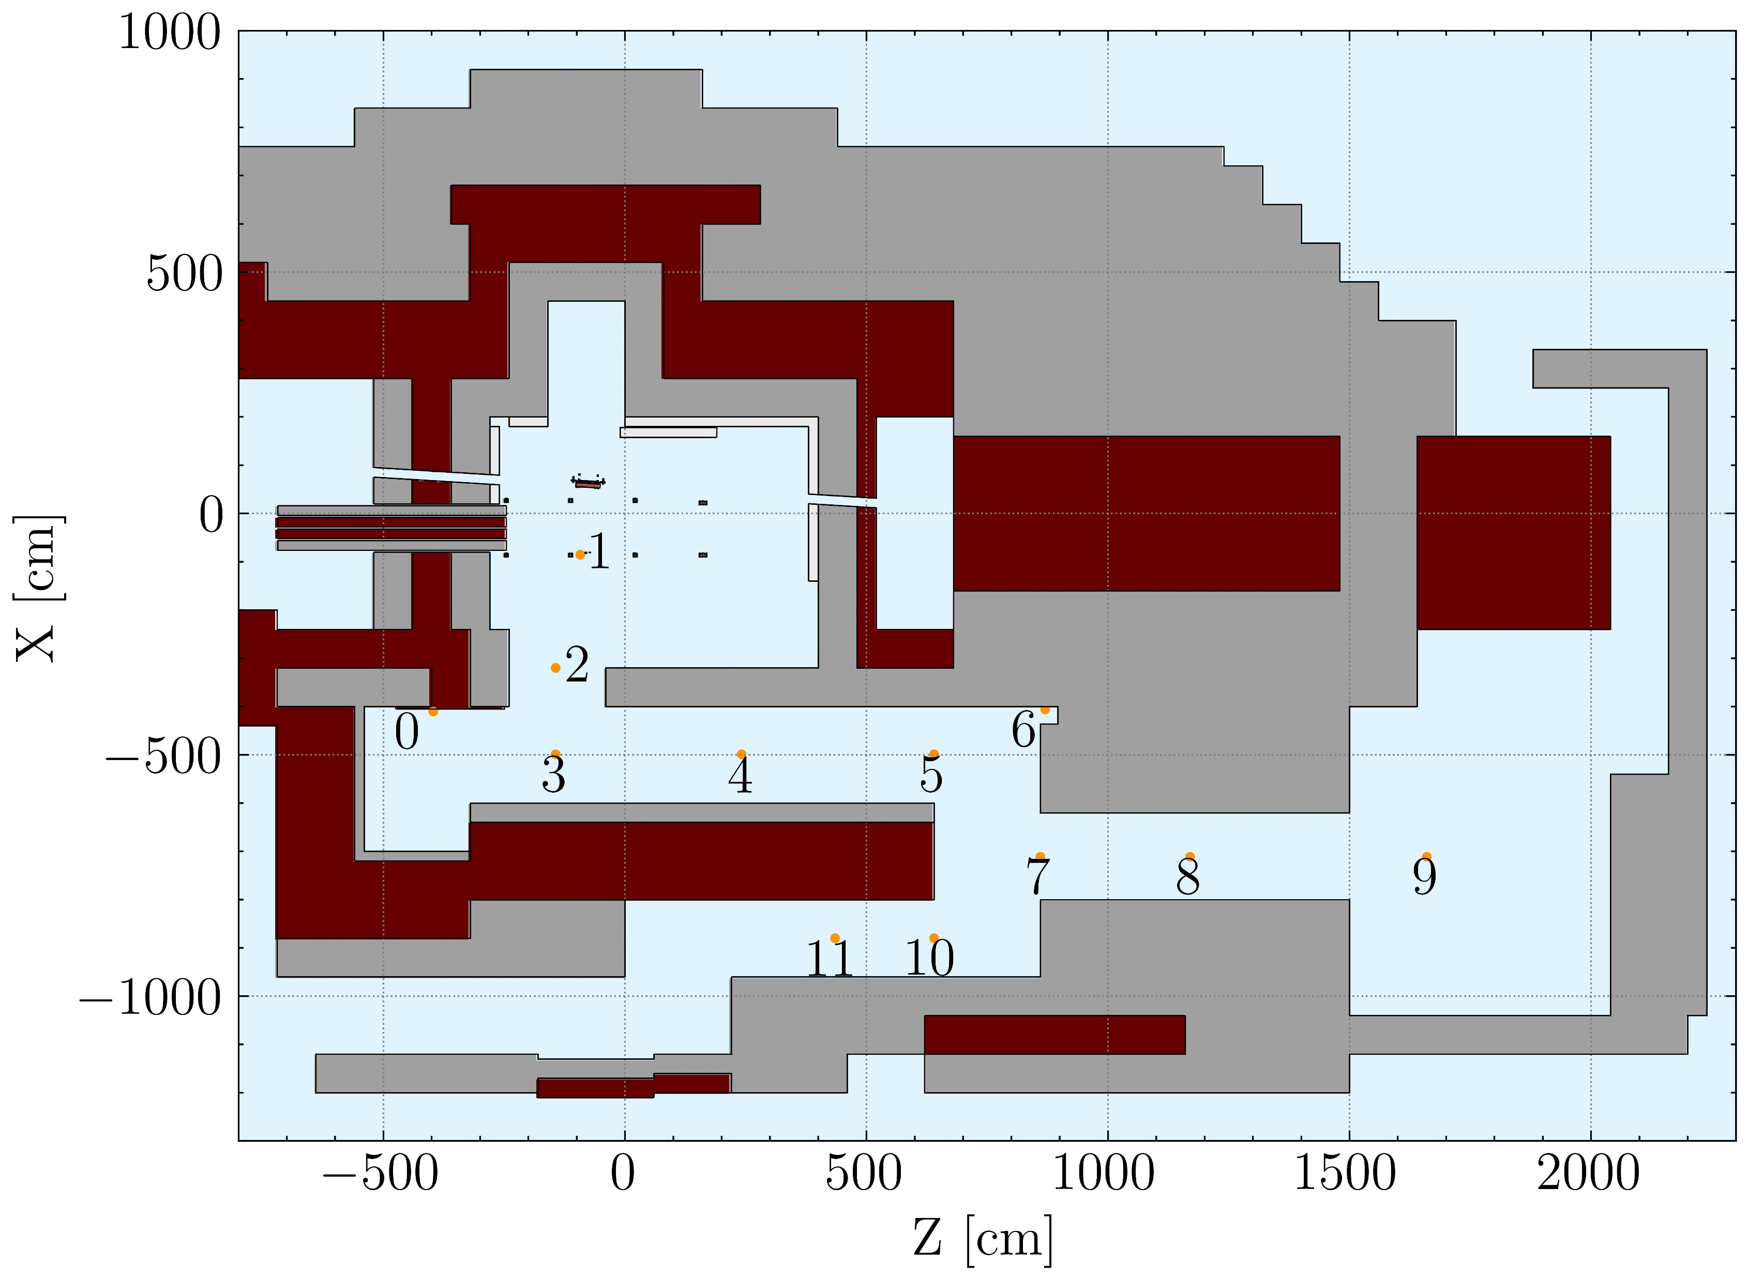
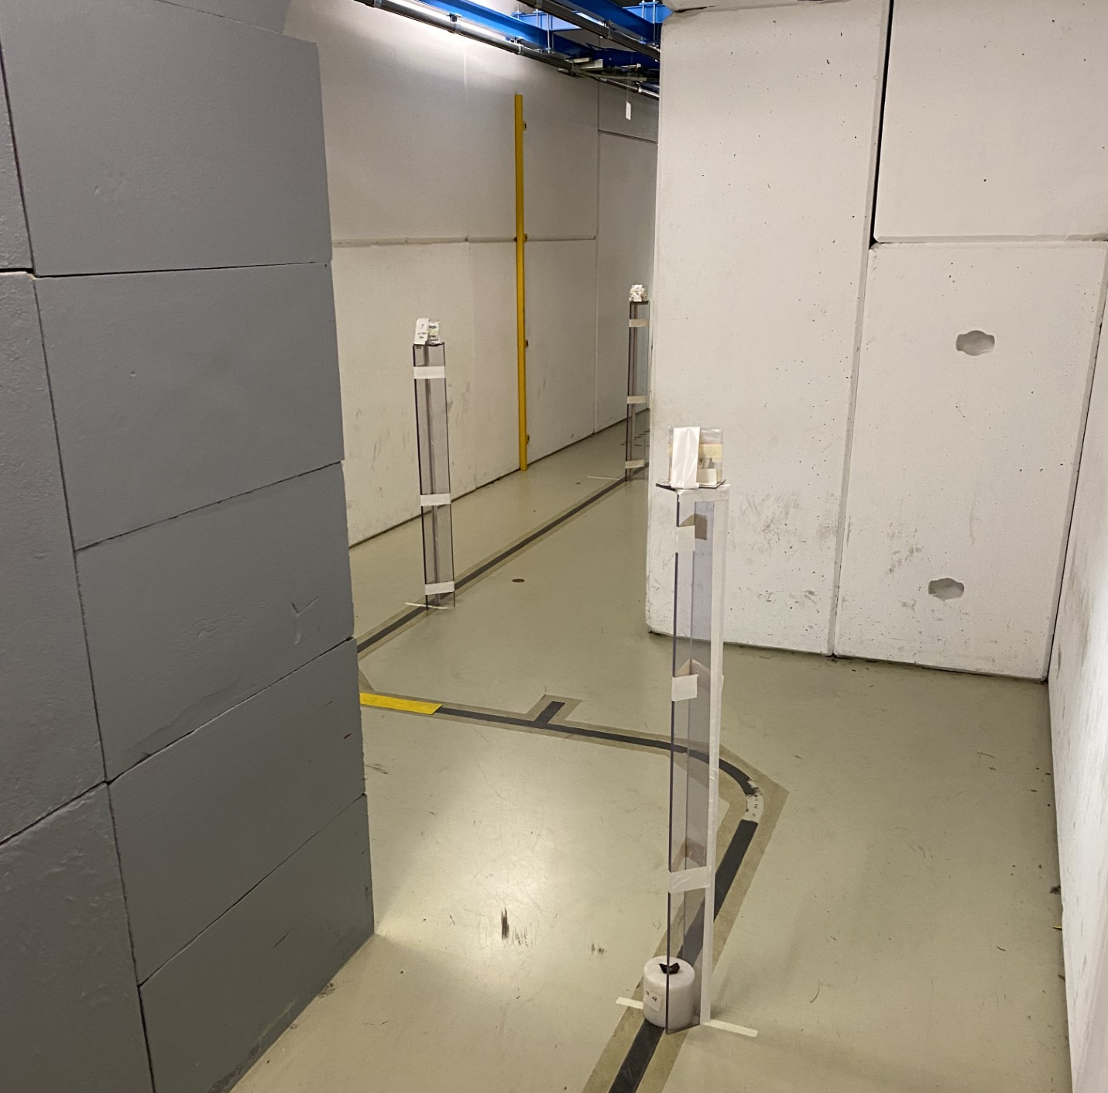
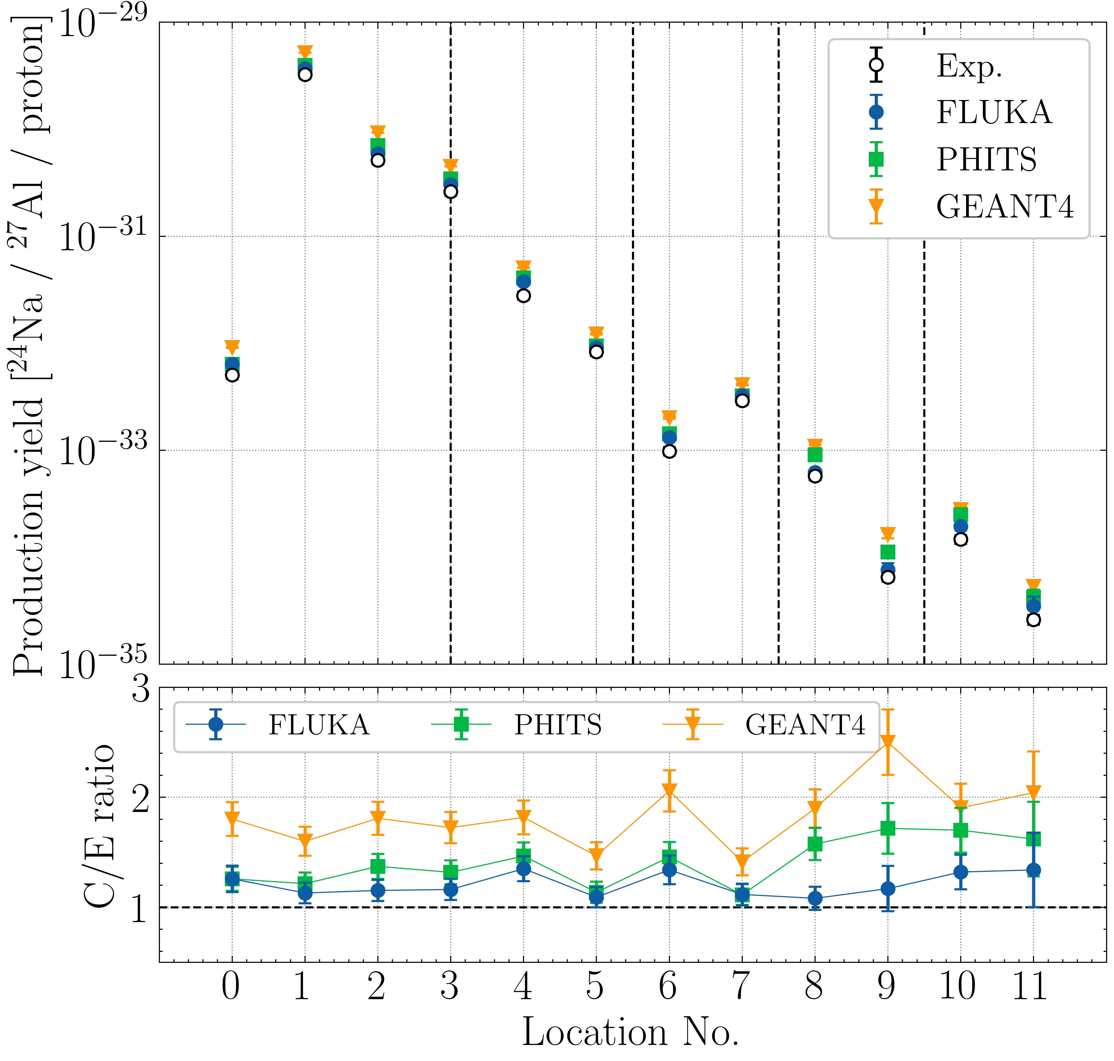
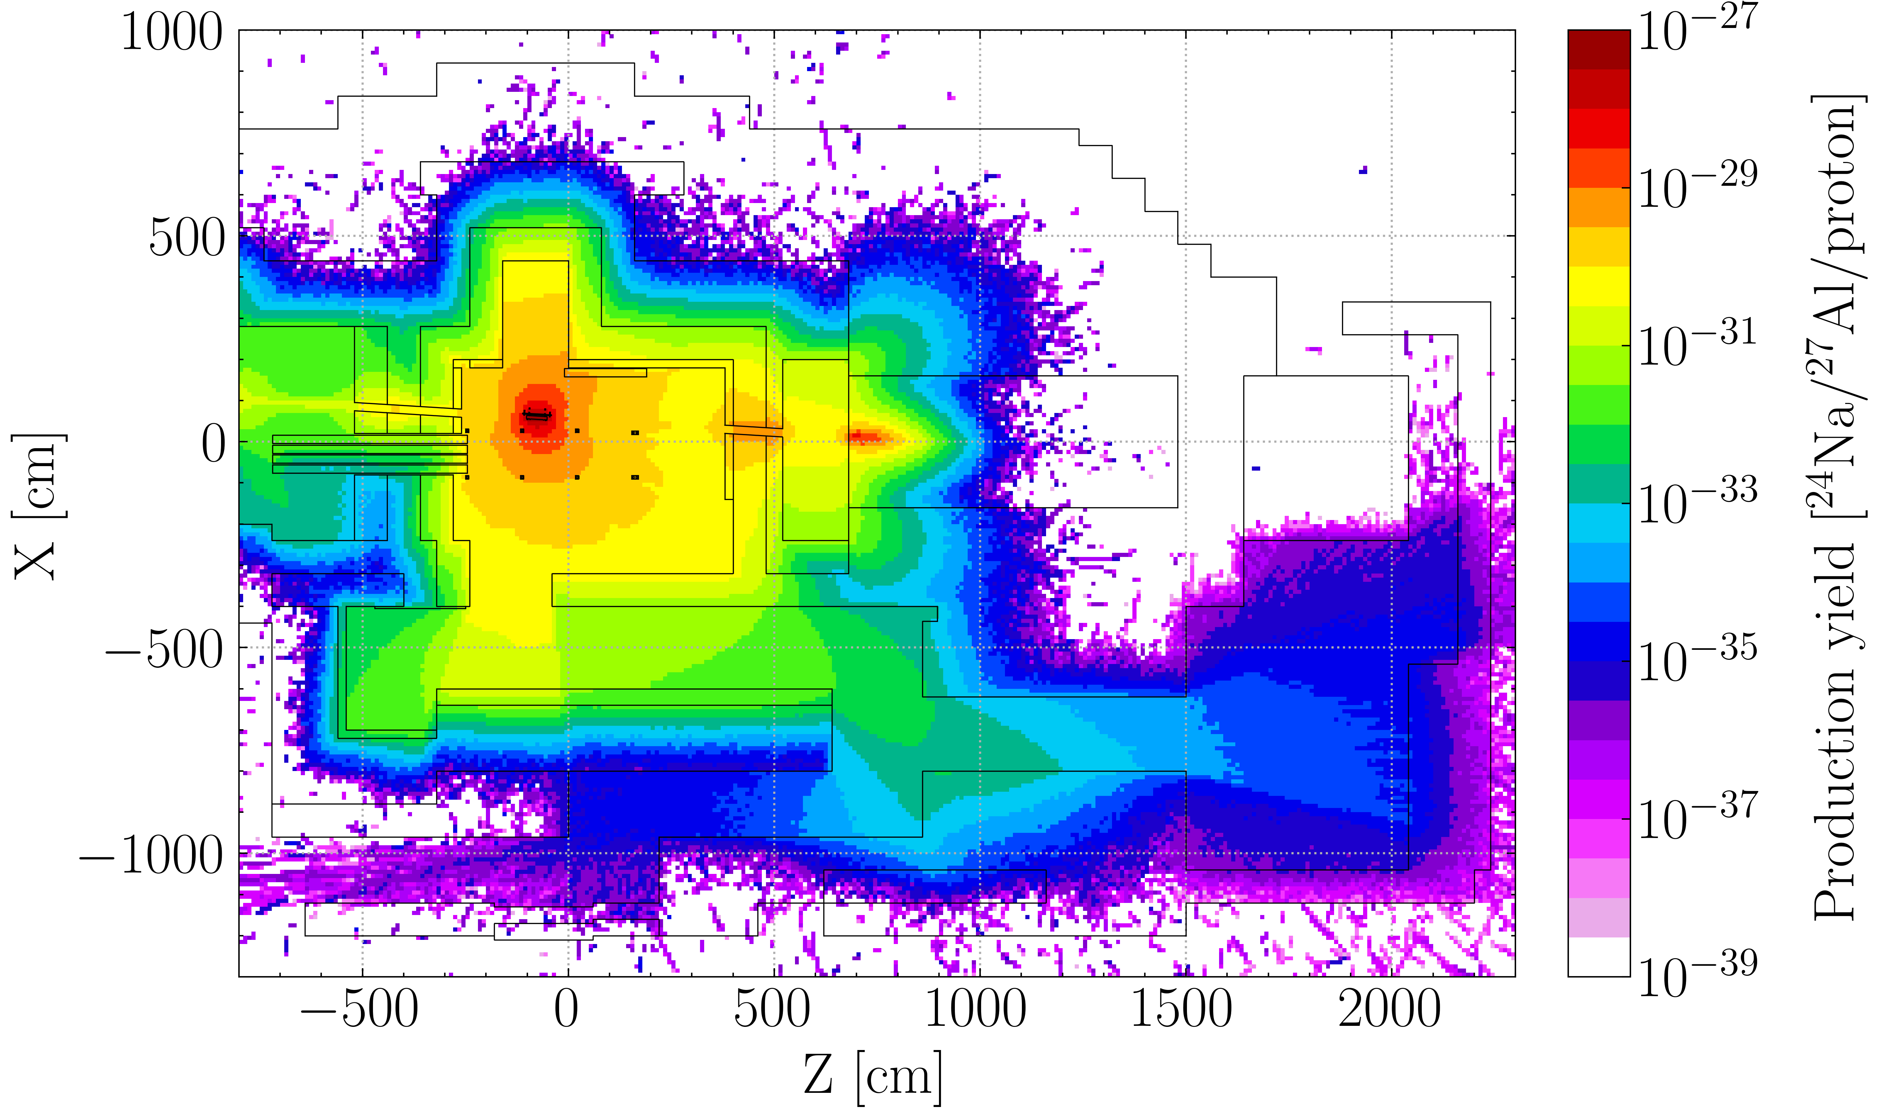
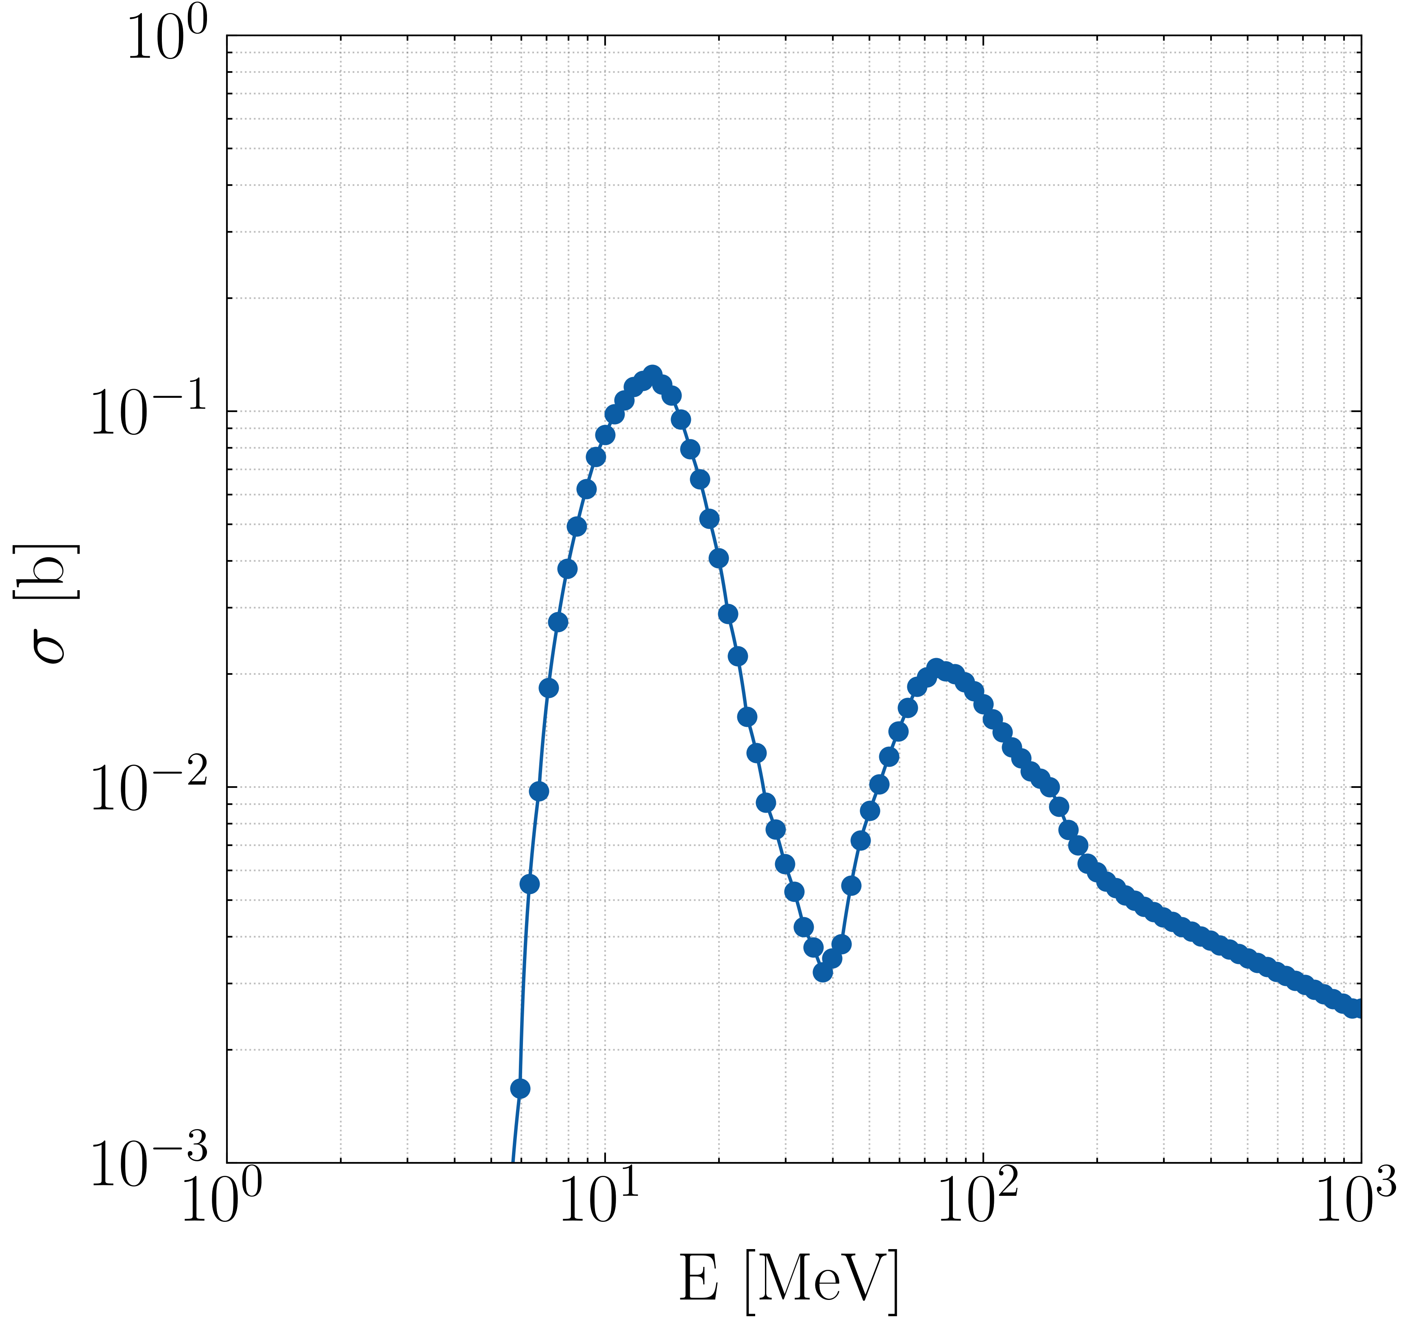
Neutron streaming in the CHARM access maze
FLUKA 4-3.3
PHITS 3.30
GEANT 4.11.1
D. Bozzato et al., Monte Carlo intercomparison and benchmark of the neutron streaming in the ramified access maze of the CERN High-energy AcceleRator Mixed field (CHARM) facility at CERN (submitted to NIMA)
Measurement of the ²⁴Na production yield in aluminium disks (2022)
Meakawa et al. (2001)

Slide 11
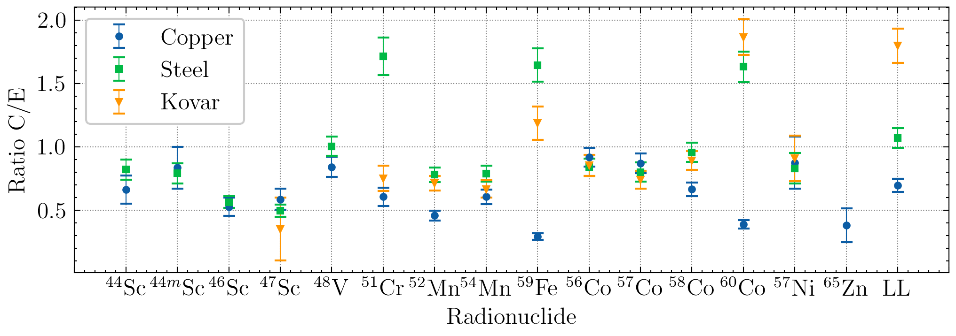
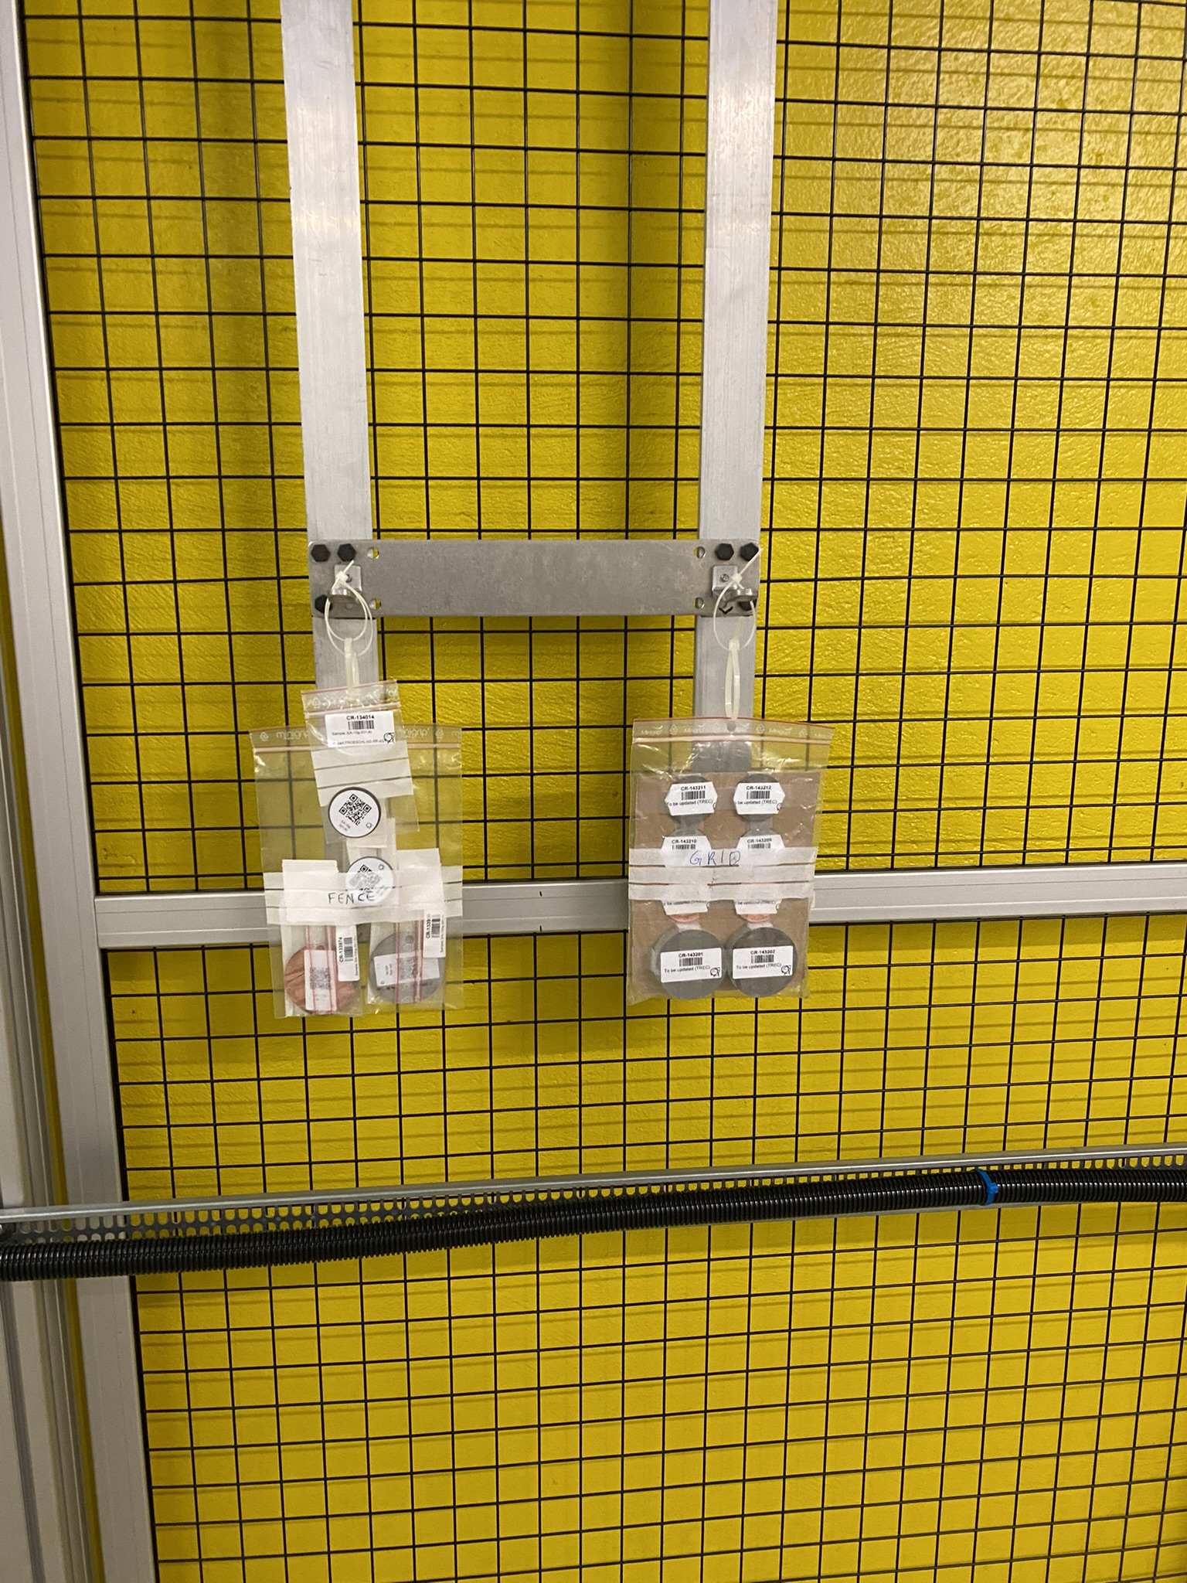
Activation in copper and steel - I
FLUKA 4-3.0
D. Bozzato et al., Measurements and FLUKA Monte Carlo simulations of steel and copper activation at CHARM and CSBF, CERN Technical Note, EDMS 3017707 (2024)
Activation of commonly used materials in accelerator elements and high-energy physics (HEP) detector components:
copper, steel 304L, kovar;
radiation field similar to certain LHC experiments conditions;
2 days irradiation (2022): emphasis on medium-lived radionuclides;
fairly satisfactory comparison (Calculation/Experiment ratio);

Slide 12
Benchmarks at CSBF

Slide 13
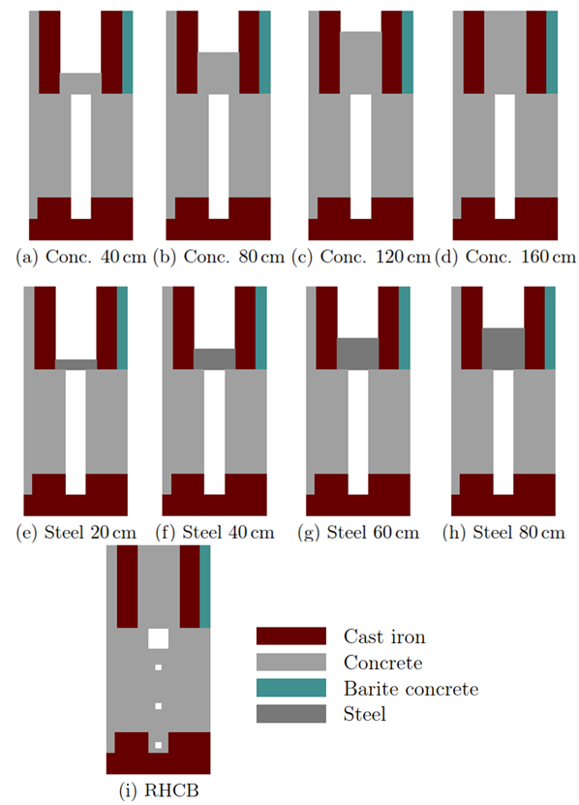
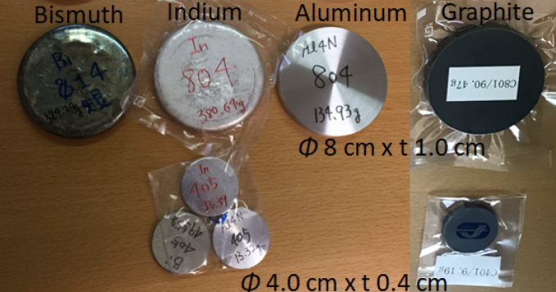
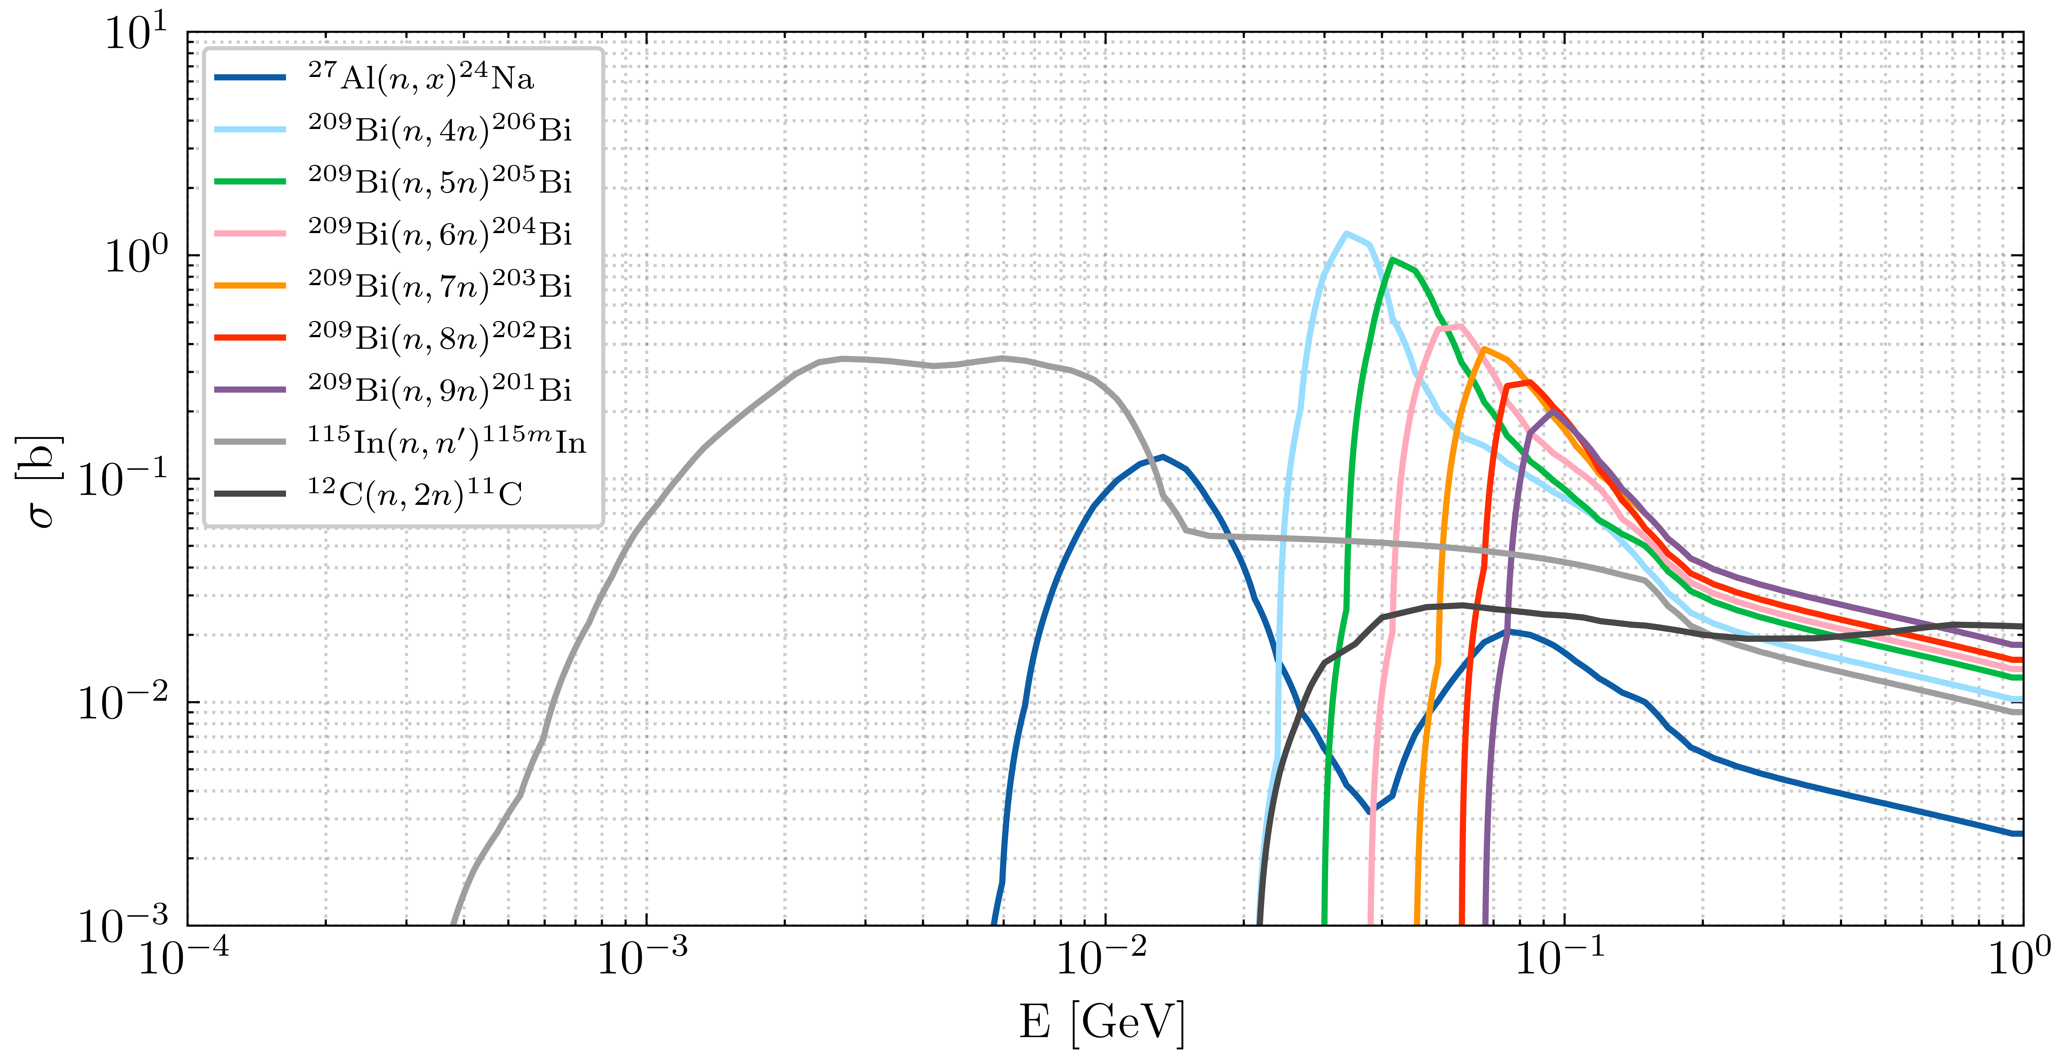
Neutron attenuation in concrete and steel
FLUKA 4-2.2
PHITS 3.24
GEANT 4.10.07
N. Nakao et al., Measurement and simulations of high-energy neutrons through a various thickness of concrete and steel shields using activation detectors at CHARM and CSBF, JNST (2023) DOI: 10.1080/00223131.2023.2239243
Analogous attenuation curves for steel shield and removable holder concrete block (RHCB)
Experiments performed over several years with different configurations
Meakawa et al. (2001)

Slide 14
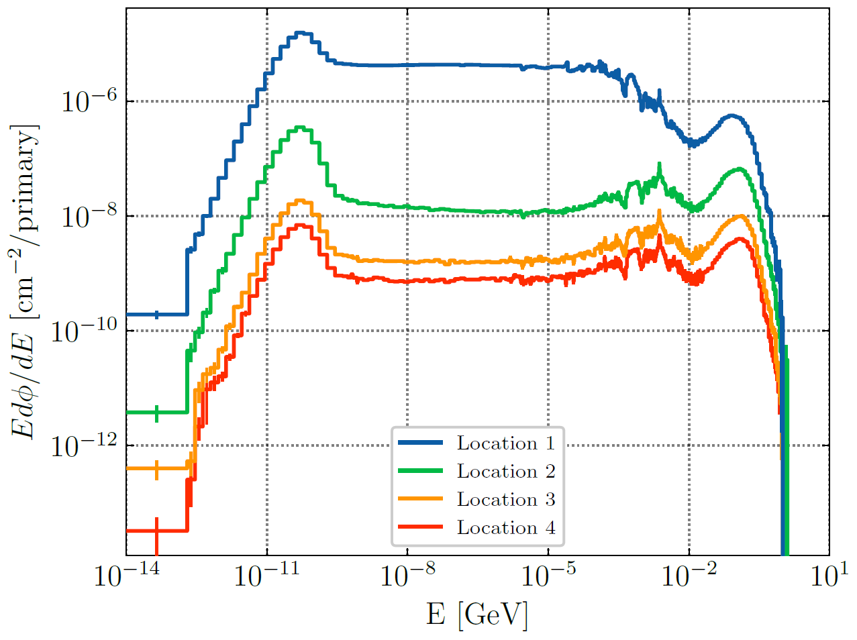
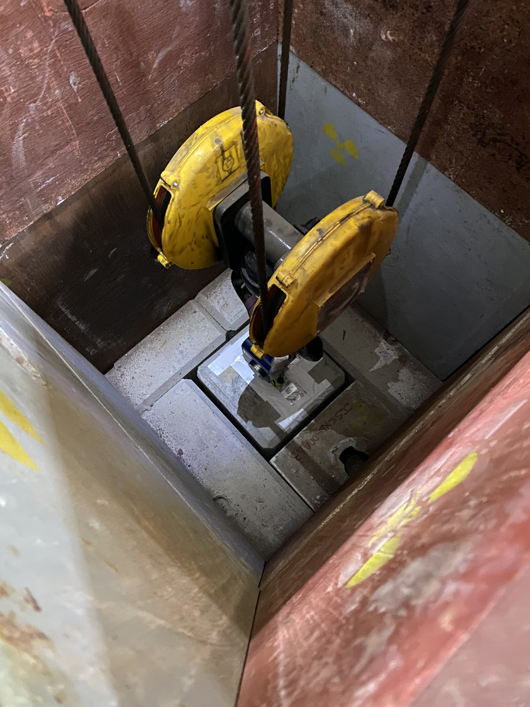
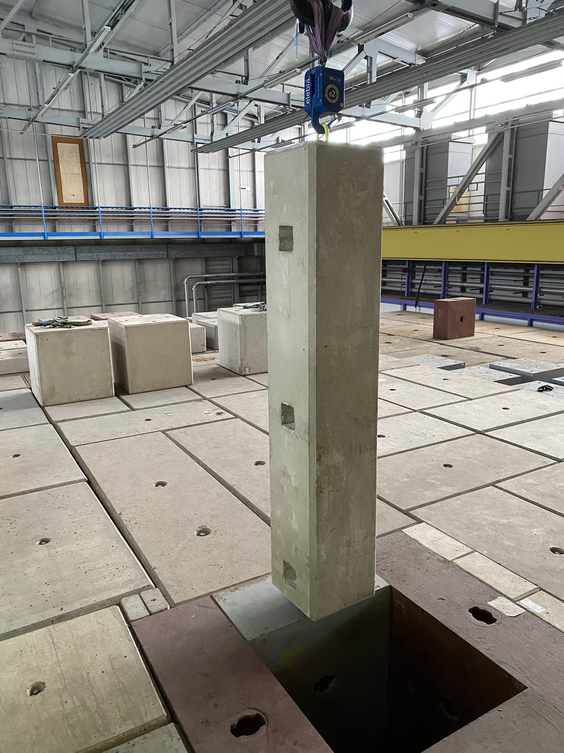
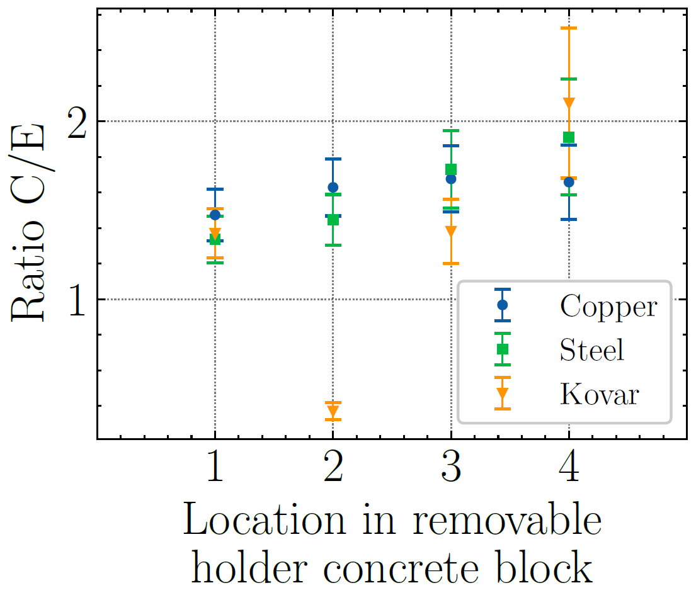
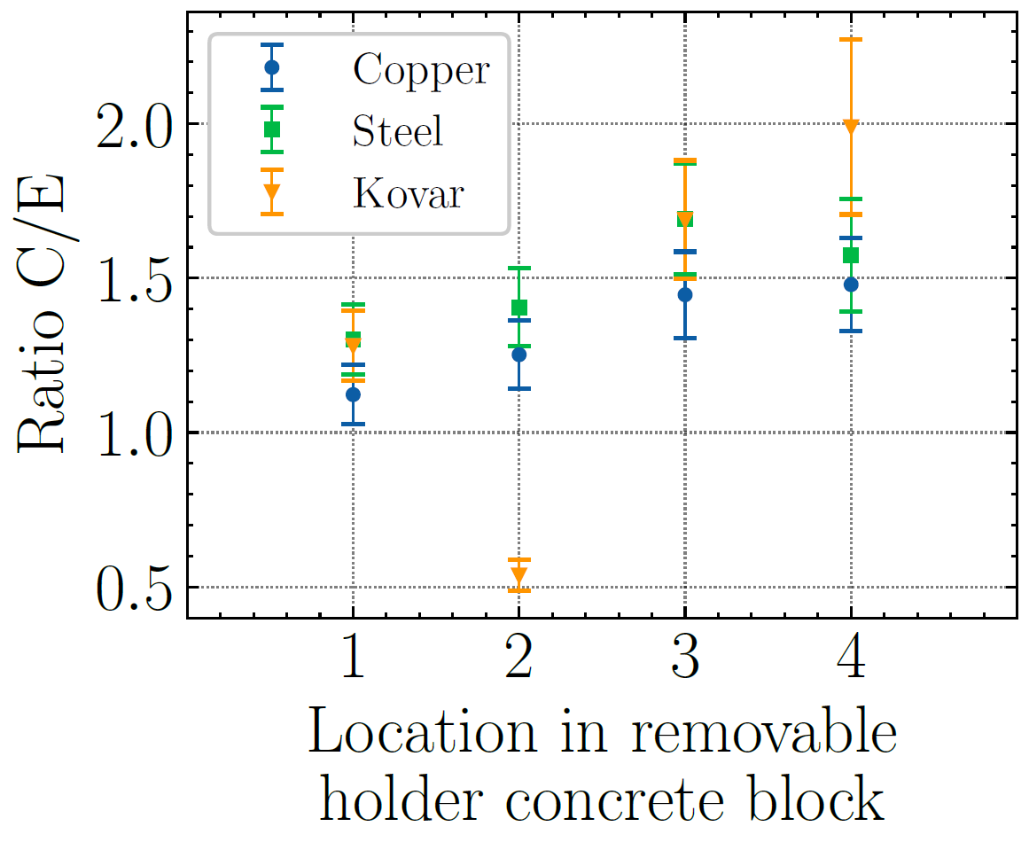
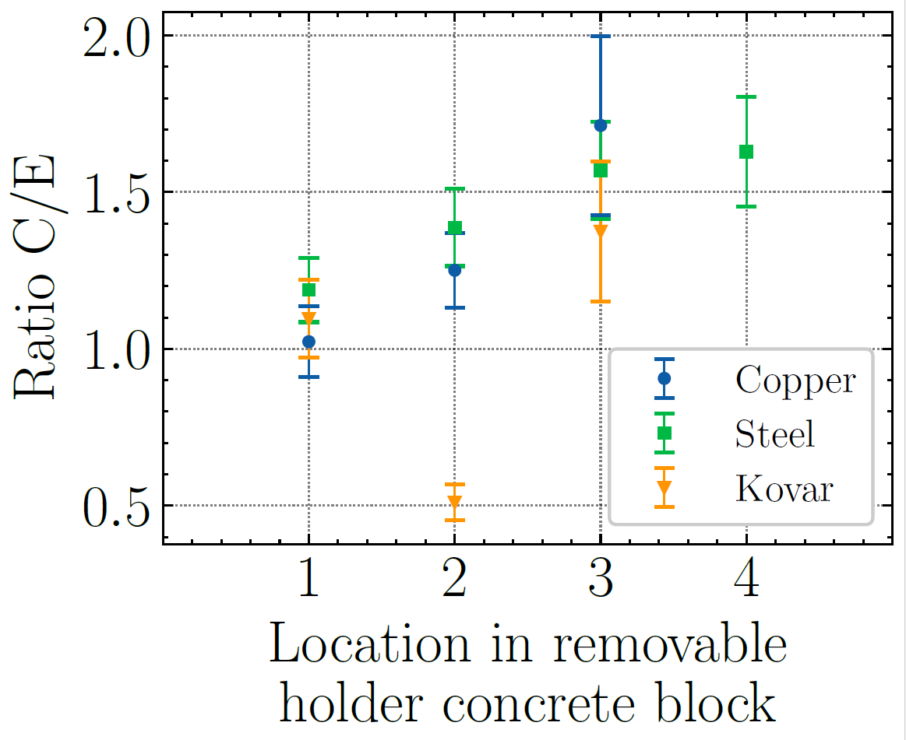
Activation in copper and steel - II
FLUKA 4-3.0
D. Bozzato et al., Measurements and FLUKA Monte Carlo simulations of steel and copper activation at CHARM and CSBF, CERN Technical Note, EDMS 3017707 (2024)
Extension of the CHARM benchmark:
copper, steel 304L, kovar;
radiation field for well shielded locations;
1 month irradiation (2022): emphasis on medium-lived radionuclides;
fairly satisfactory comparison (Calculation/Experiment ratio);
⁵⁷Co
⁵⁸Co
⁵⁴Mn

Slide 15
Prospects and Summary

Slide 16
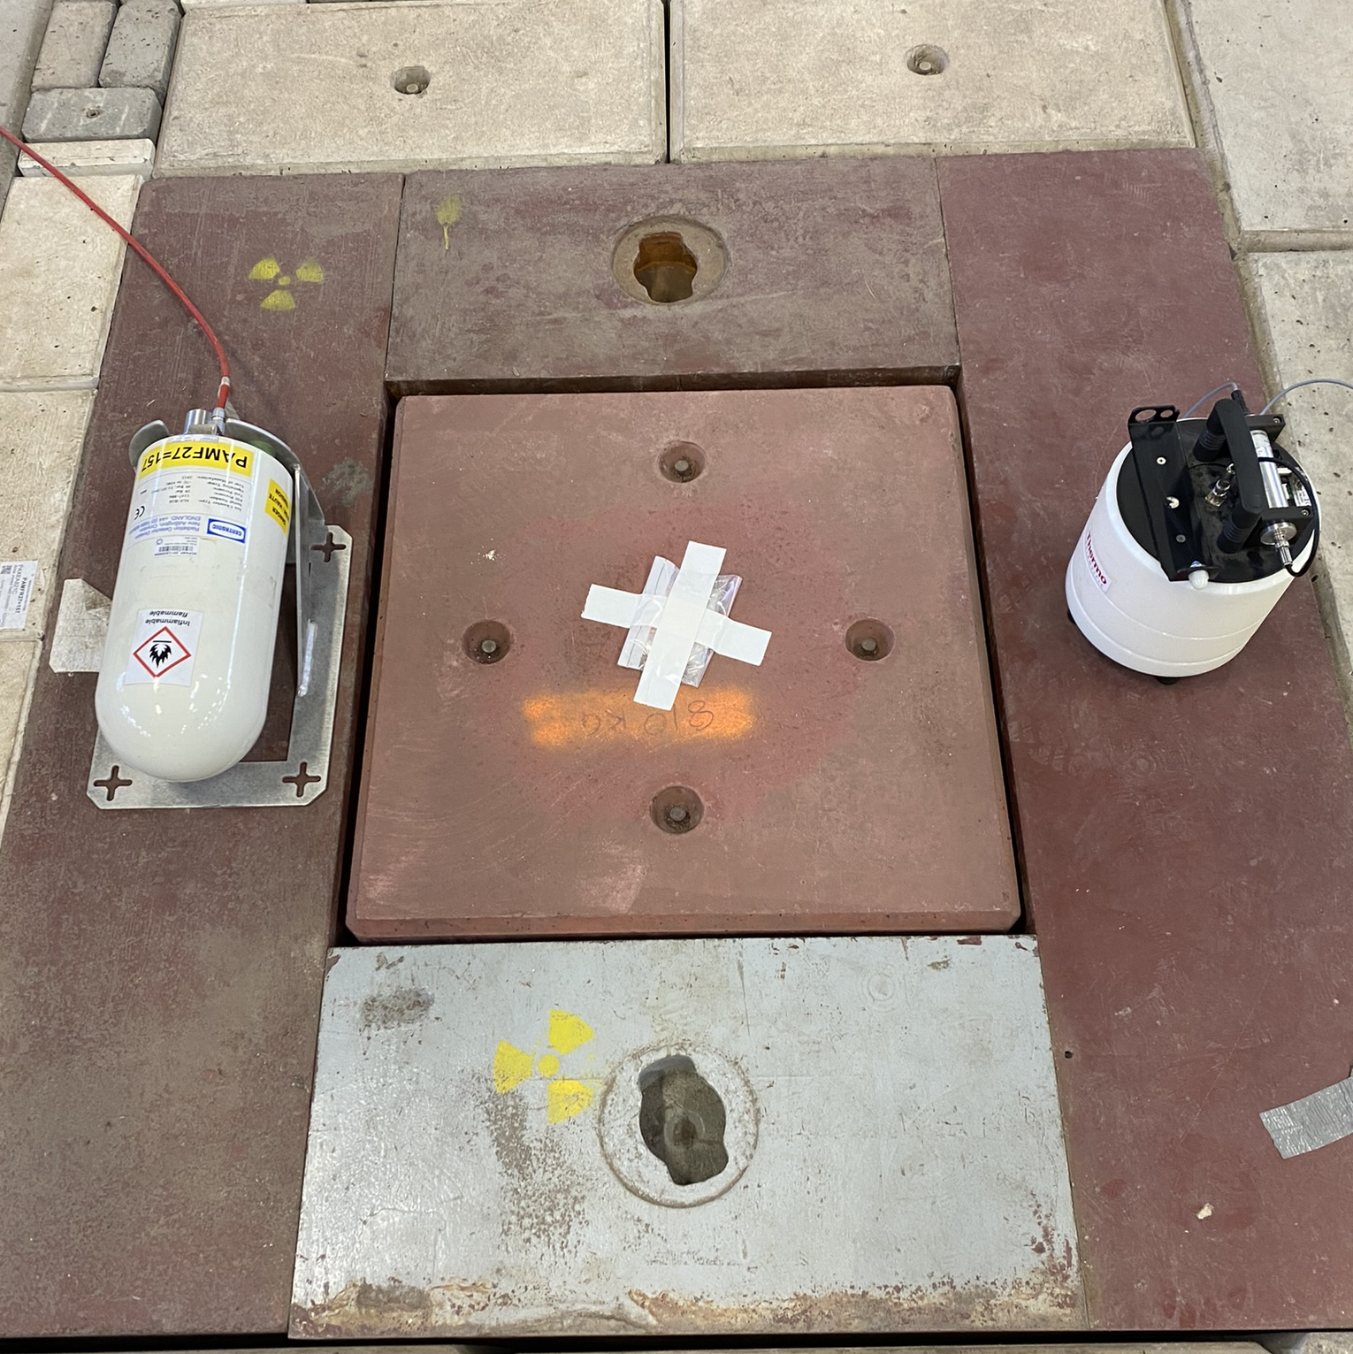
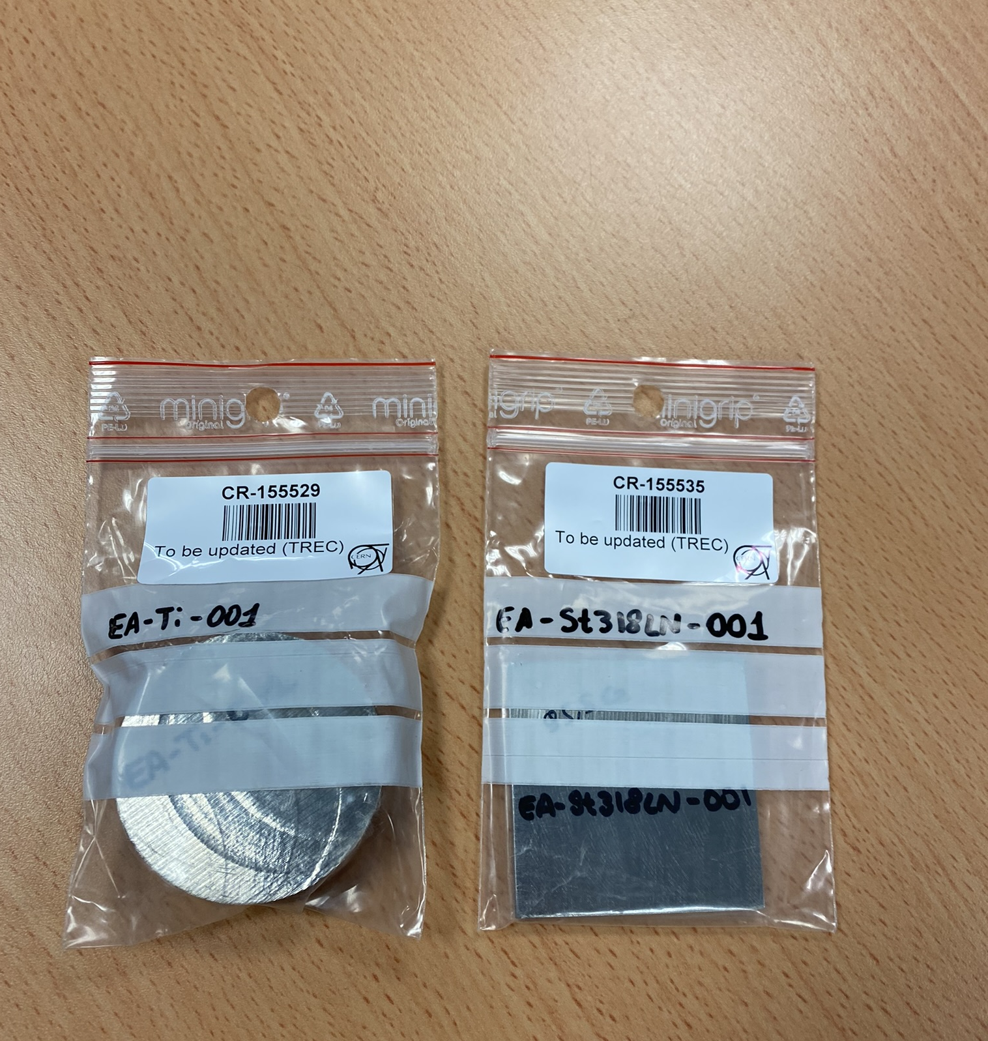
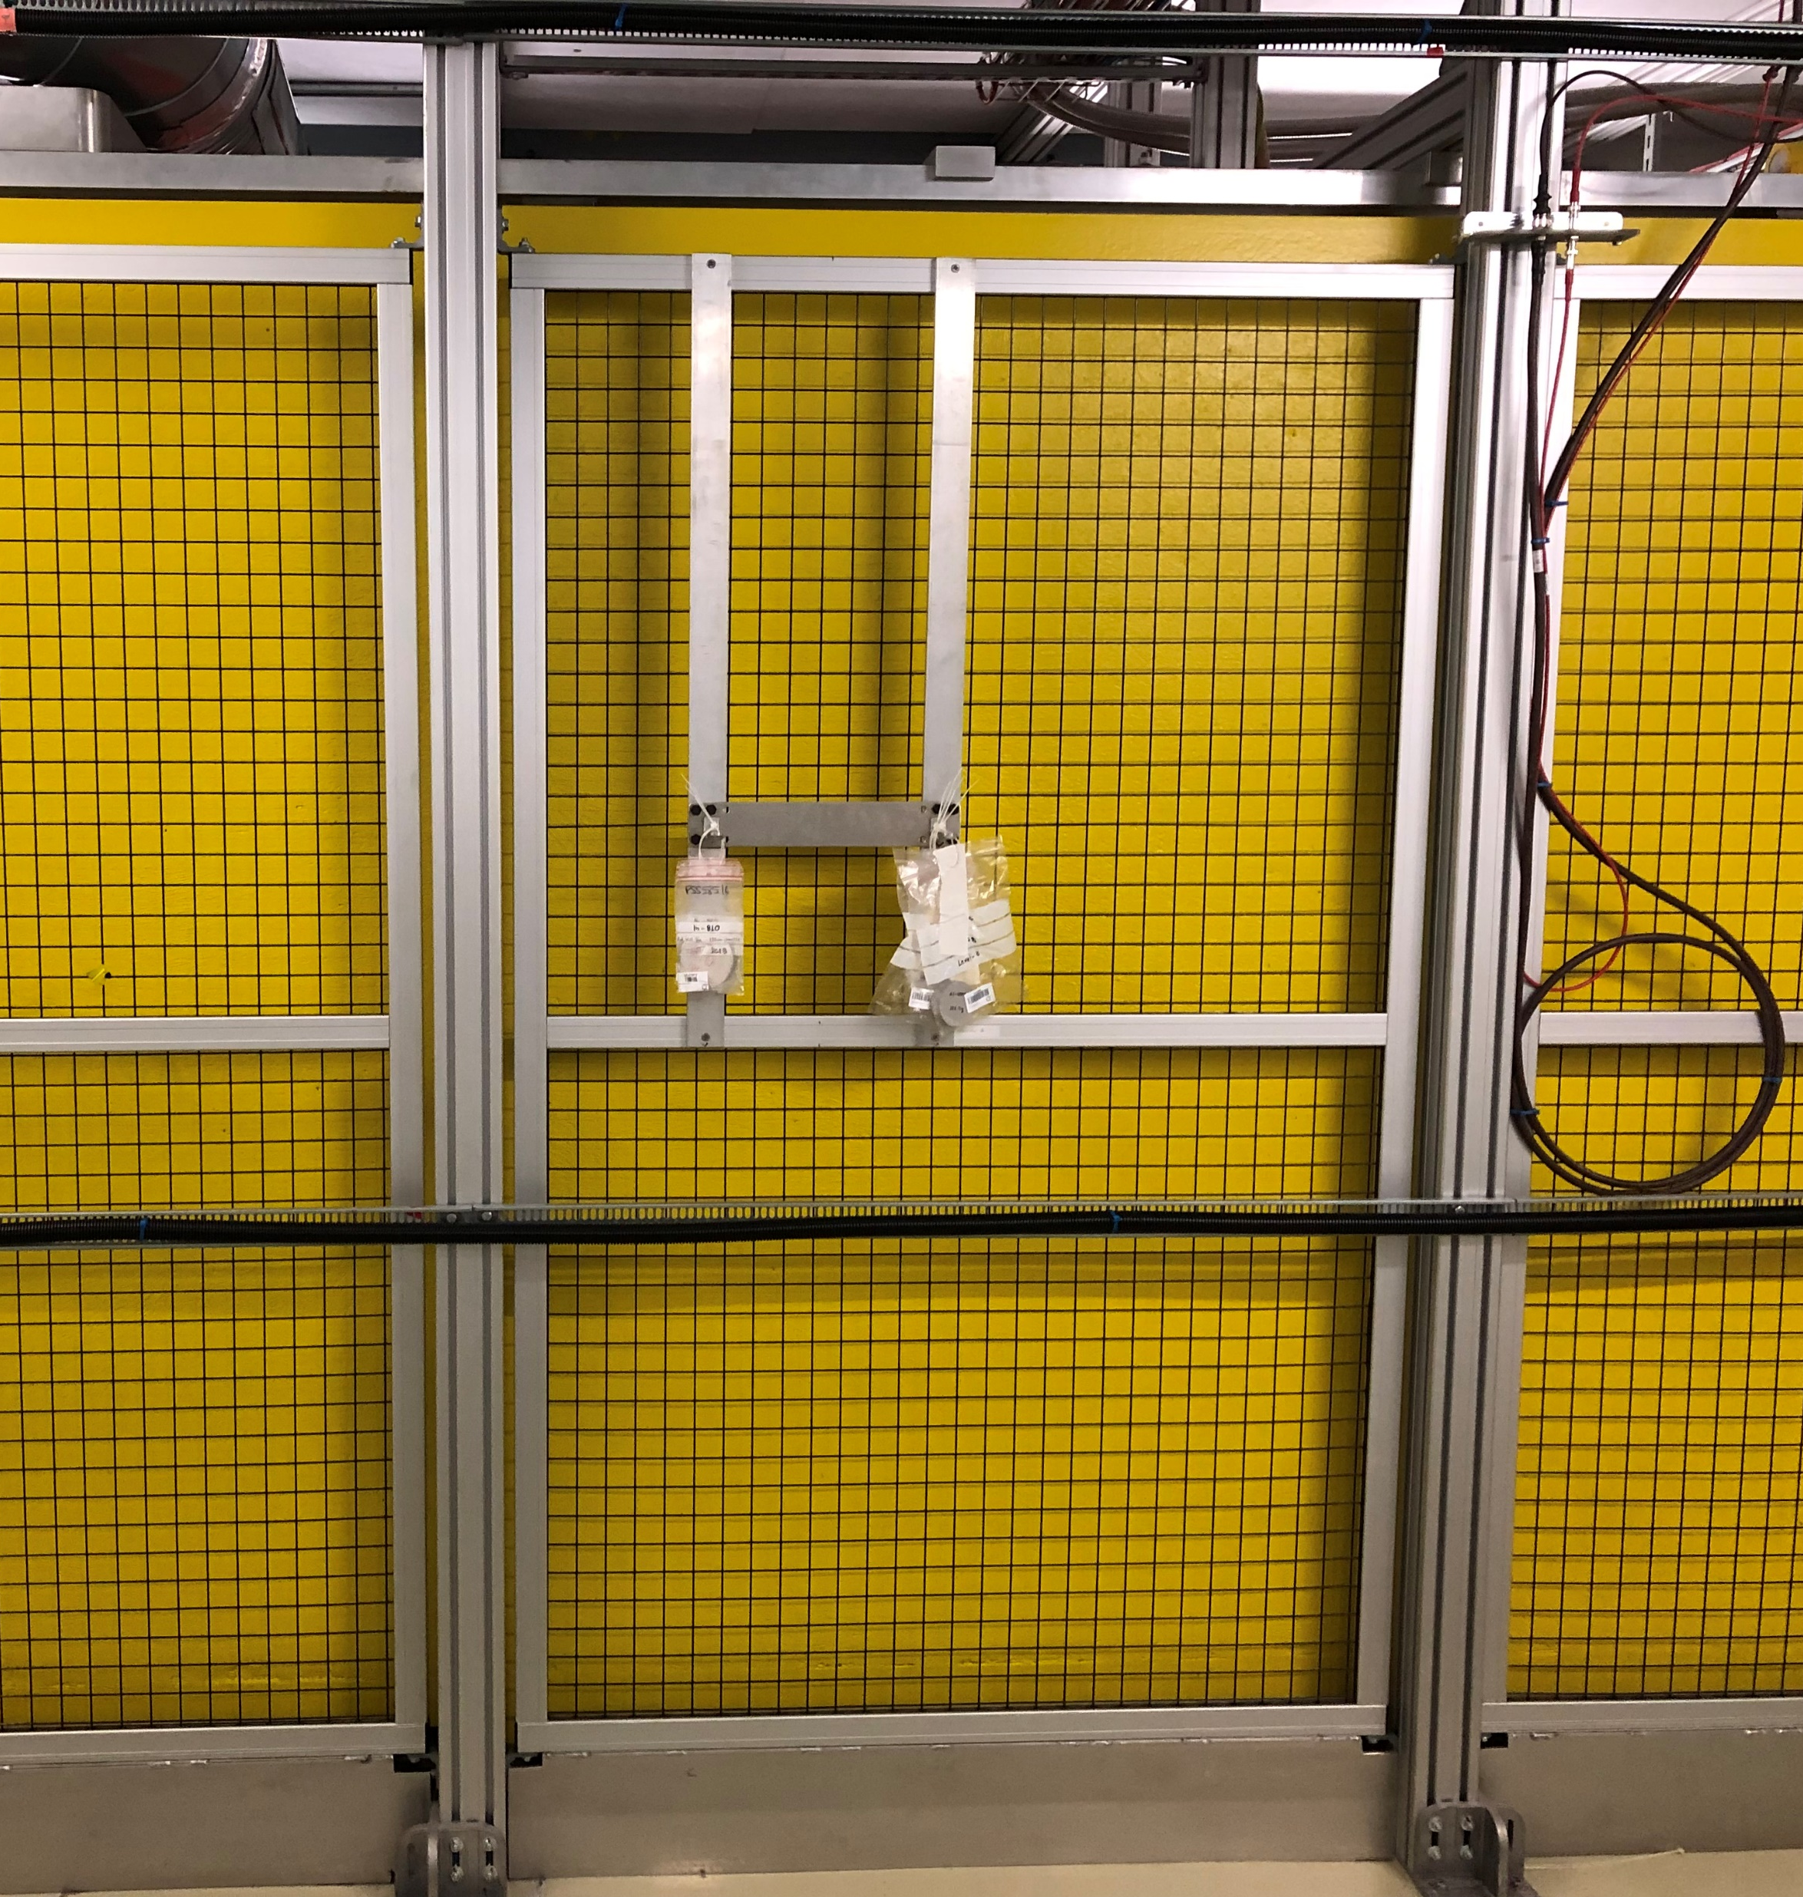
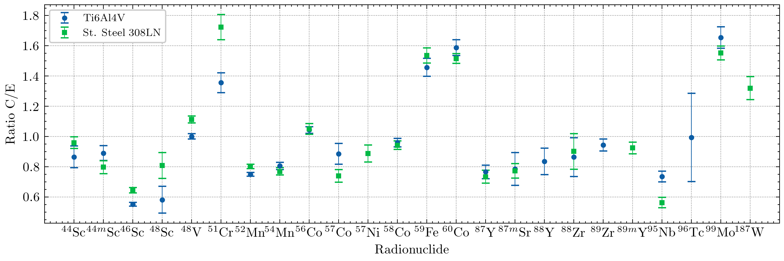
Ongoing assessments and future prospects
FLUKA 4-3.4
The 2023 run saw several other activation experiments whose assessment is ongoing:
neutron attenuation in hematite concrete (3.3 g/cm³) and barite concrete (3.2 g/cm³) at the Material Test Location (CSBF): two thicknesses covered;
activation at CHARM reference location of special alloys foreseen for LHC applications (Ti-6Al-4V and St. Steel 308 LN): preliminary simulations indicate very good agreement

Slide 17
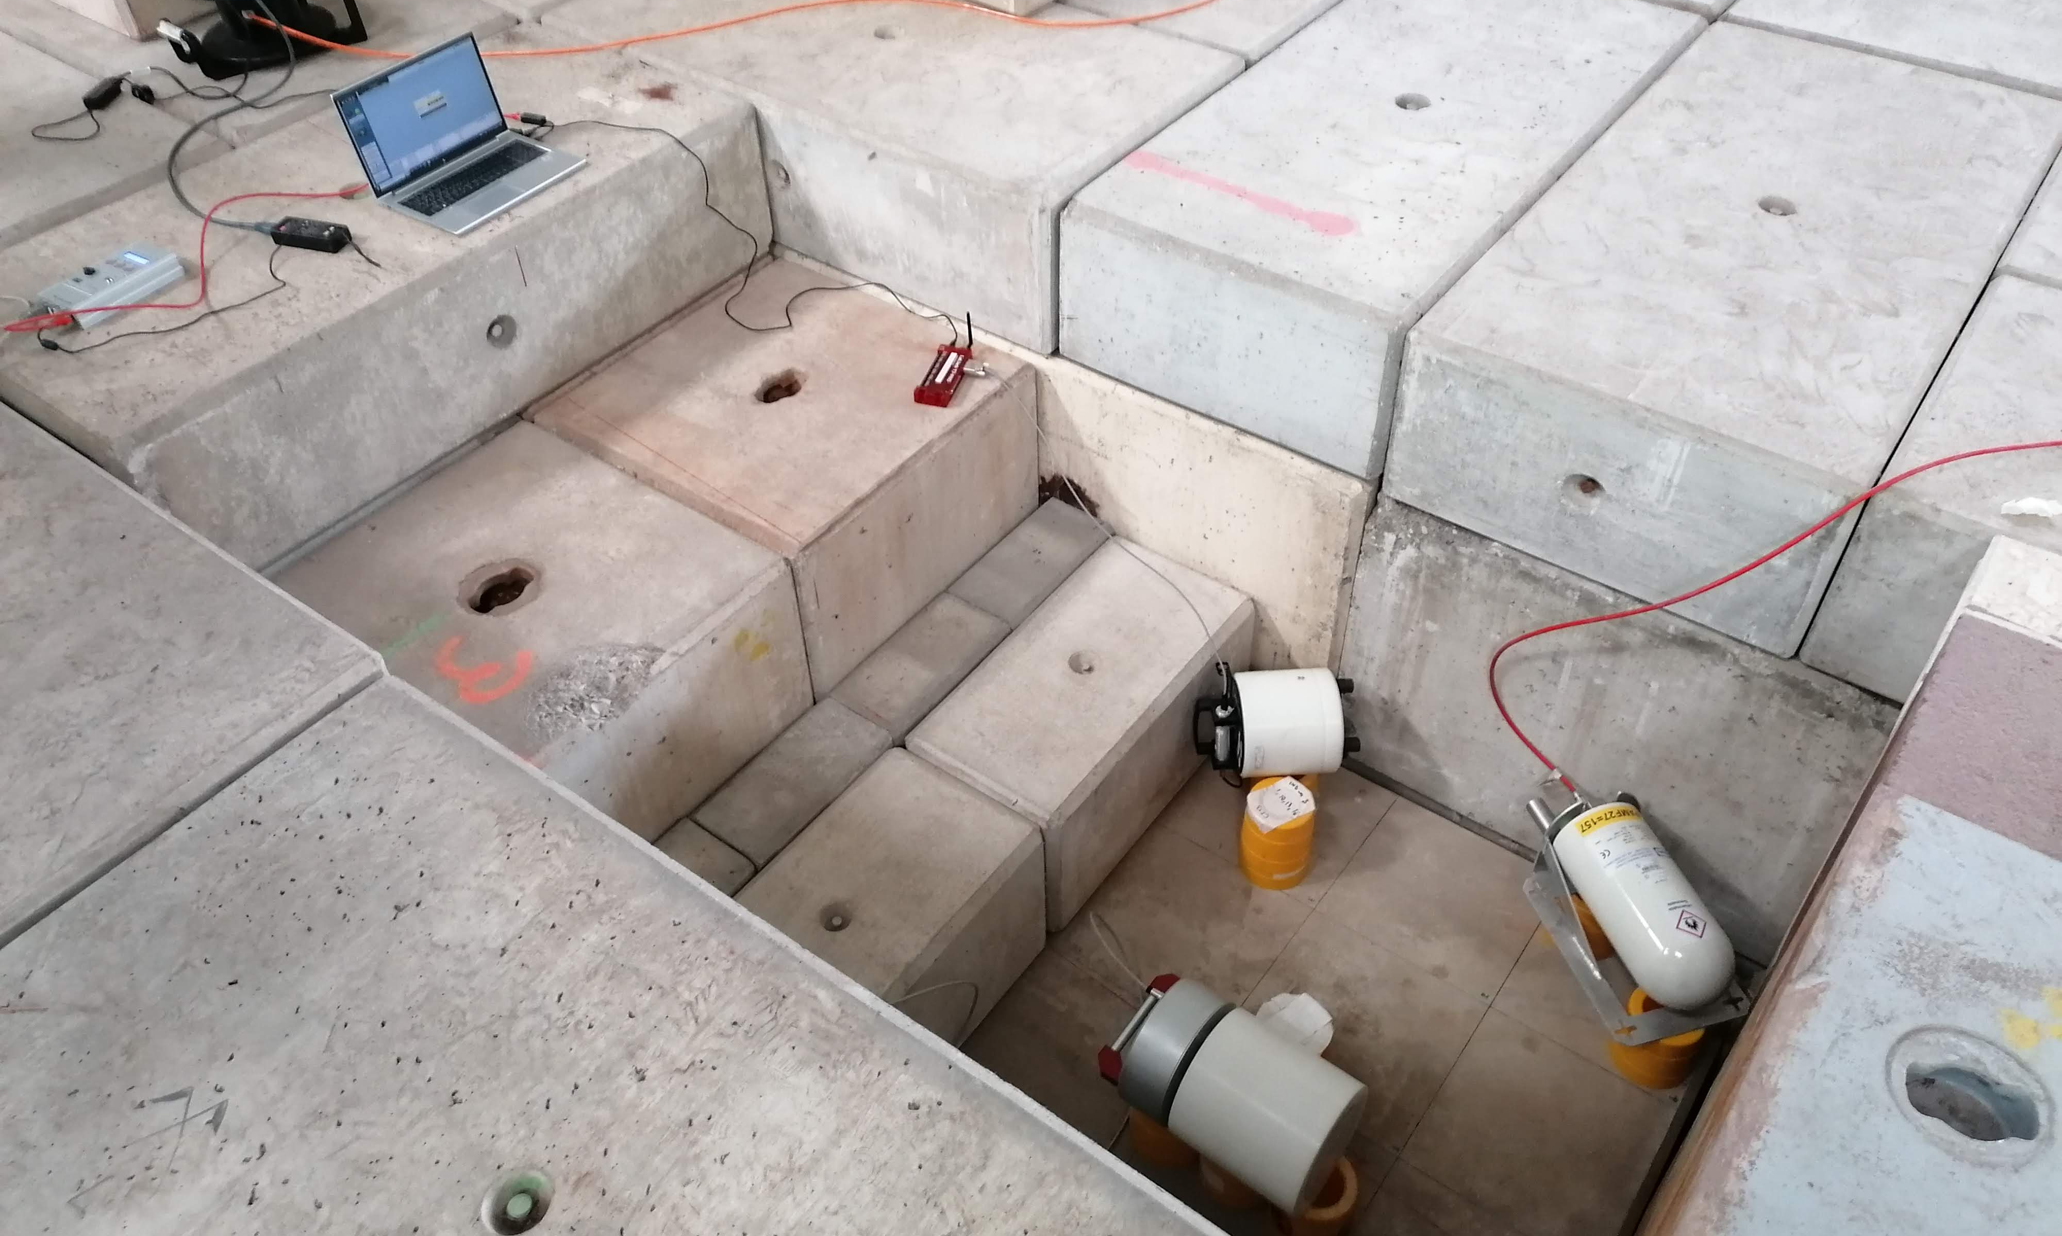
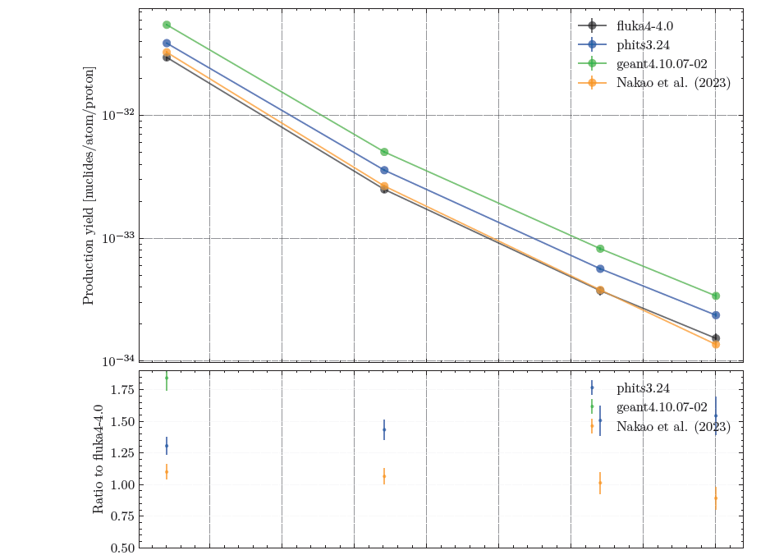
Summary
CHARM and CSBF are well established and quite versatile benchmarking facilities.
This talk focused on activation benchmarks, but several active measurements have been performed as well (PMI, Bonner Spheres, REM counters, IG5-H20)
Exploitation will continue in the next years:
extension and completion of the measurements with special concretes;
possible forward activation experiment;
Long term conservation of benchmarks:
addition of benchmarks into the FLUKA VALidation framework FLUKAVAL: see R. Froeschl (NEA satellite workshop) and F. Salvat talks.
desire to contribute to SINBAD with the integration of at least one benchmark.

Slide 18
On behalf of the CSBF team, thank you for your attention
Davide Bozzato

