Slide 2
Benchmarking of FLUKA residual simulations for Radiation Protection at CERN’s Large Hadron Collider
Vasco Mendes, Patrycja Dyrcz, Marco Tisi, Angelo Infantino, Safouane El-Idrissi, Christophe Tromel, Heinz Vincke
HSE-RP-AS
29/05/2024

Slide 3
Table of Contents
1.
Introduction to the LHC
2.
FLUKA models of the LHC sections here discussed
3.
Residual Studies
Long Straight Sections 1, 5, 8, 7
4.
Radiation Measurements:
Radiation monitors (PMIs)
Surveys (AD6)
5.
Cross-validation of FLUKA with the measurements
6.
Conclusion
29/05/2024

Slide 4
Motivation
Context
The LHC has a complex operation and duty cycle
Intervention in highly activated areas must be optimized (ALARA) from the radiological perspective
Capability to project radiation levels crucial for Radiation Protection purposes
FLUKA residual dose rate maps at the LHC complex are used to produce preliminary estimates of the individual/collective dose during future interventions (in CERN jargon “Work and Dose Plan” or WDP).
Aim of the work:
To cross-validate FLUKA simulations (and operational parameters) with online and offline radiation surveys to be able to predict projected radiation level during LHC Technical Stops and major upgrade phases (e.g. LS3 & HL-LHC upgrade)
“Validation” mainly from the Operational RP perspective, i.e. no intent to validate at nuclear model level (regular RP surveys not meant for this purpose)
29/05/2024

Slide 5
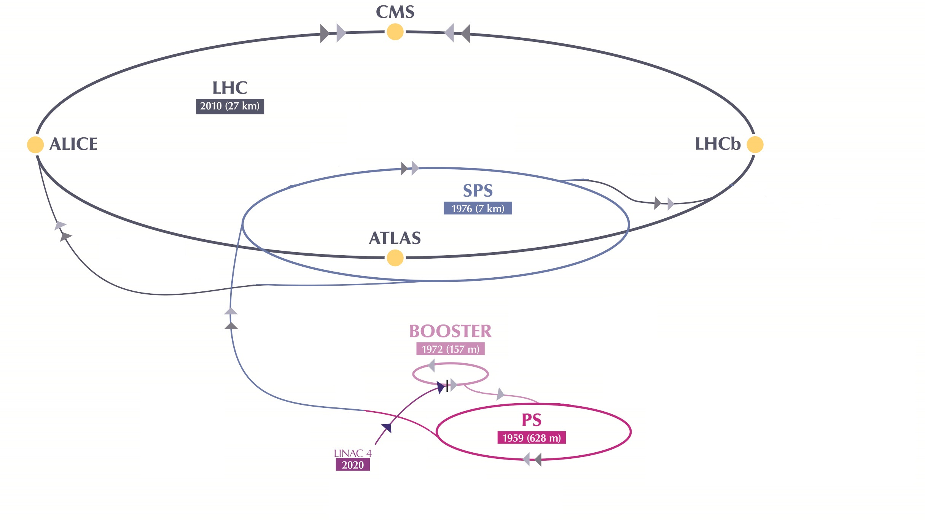
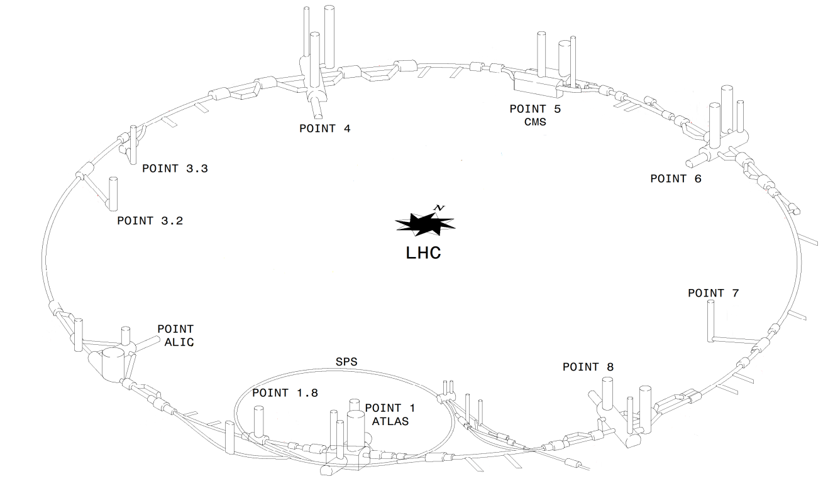
The Large Hadron Collider (LHC)
RF system
Momentum cleaning
Beam dump
Betatron cleaning
29/05/2024
Notes:
Explain 8 Points. But then we’ve focused in only 4:
Experiments - ATLAS, CMS, LHCb
Betatron cleaning – beam collimation point

Slide 6
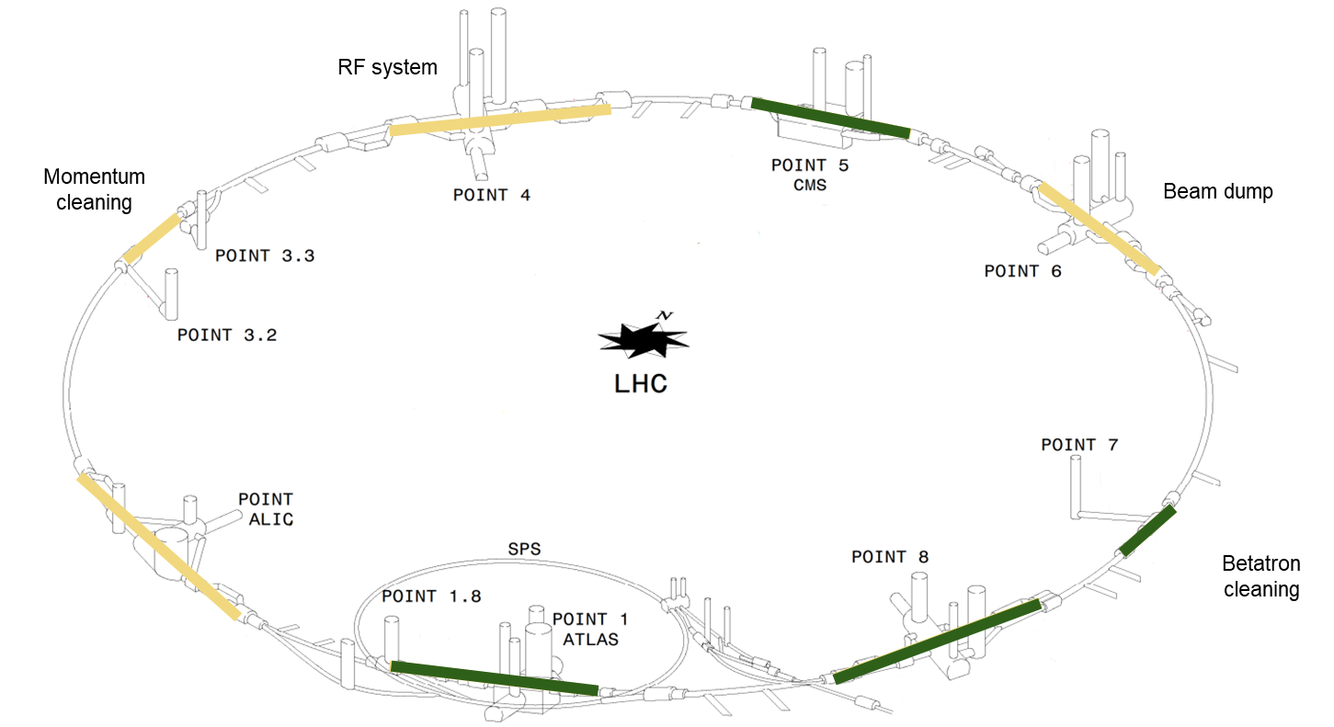
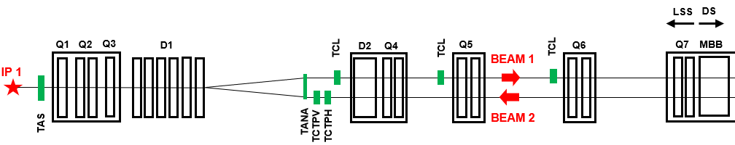
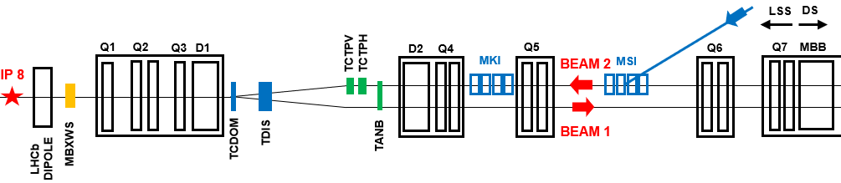
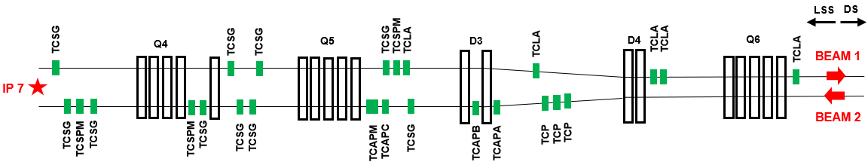
Layouts of the Long Straight Sections
LSS 1 and 5 (ATLAS and CMS)
LSS 8 (LHCb)
LSS 7 (Betatron cleaning insertion)
Figures represent only Right side of the insertion due to symmetry
29/05/2024
Notes:
Shortly explain the elements present
LSS1+5
Beam elements (Dipoles, Quadrupoles, Collimators, Absorbers
2 Beamlines that converge into one, collision in the IP
LSS8 – Injection line –kicker (MKI) and septum (MSI) magnets –dipoles that insert the beam from TI to the LHC
LSS7 – insertion fully dedicated to collimation – higher radiation levels due to the interaction with the collimatos. Specacular

Slide 7
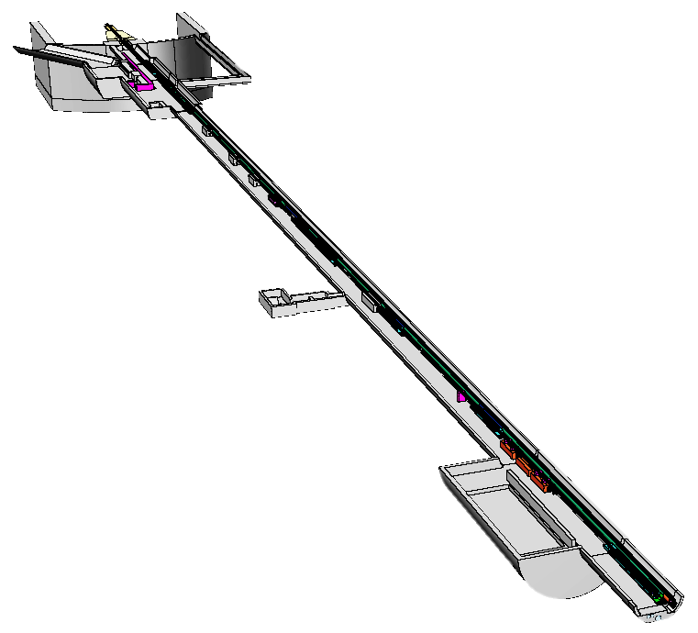
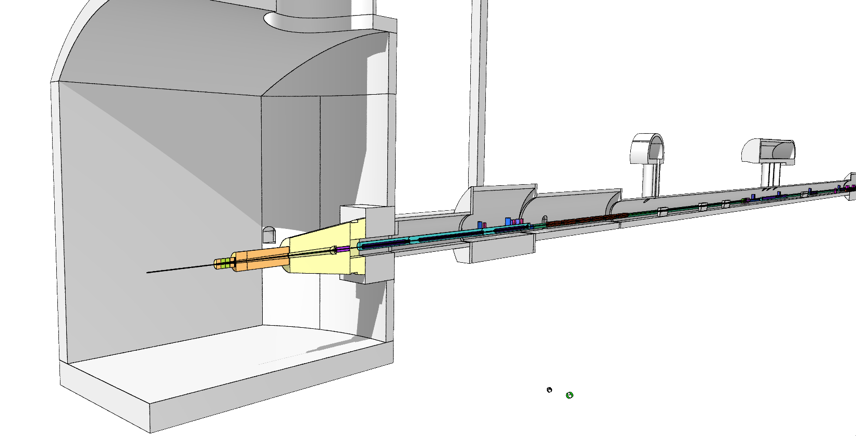
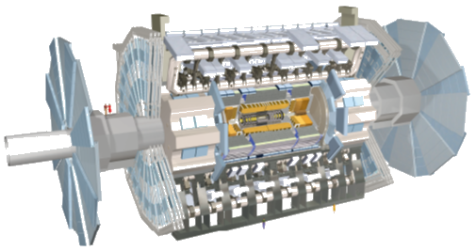
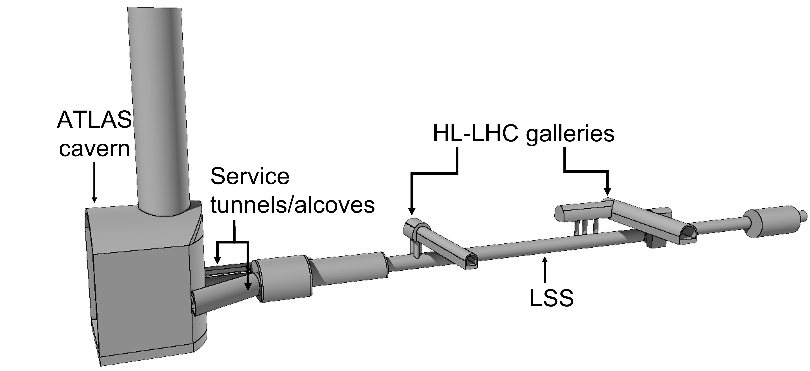
FLUKA Models: Geometry of the LSS 1
Model developed using FLUKA 4 (lately v.4-4)
Highly complex model with all the LHC’ beam elements
29/05/2024
Notes:
FLUKA model refers to geometry, physics, transport settings, not nuclear models
Source: Collision at the Interaction Point
ONLY RIGHT side
No experiment model – we’re interested only in the forward prticles that arrive to the LSS
Other studies performed only for the experimental caverns

Slide 8
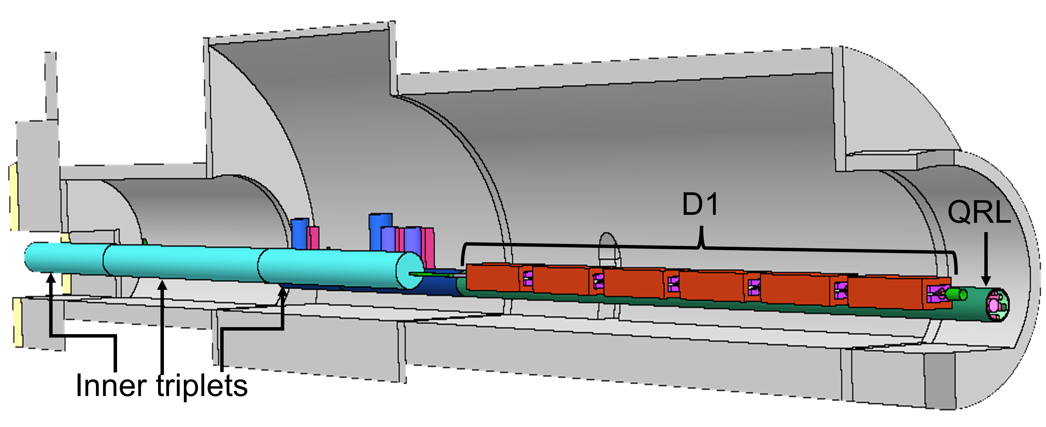
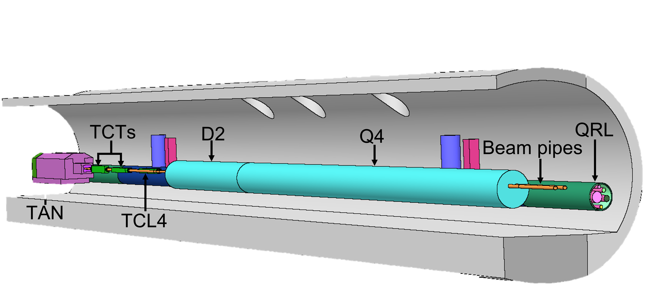
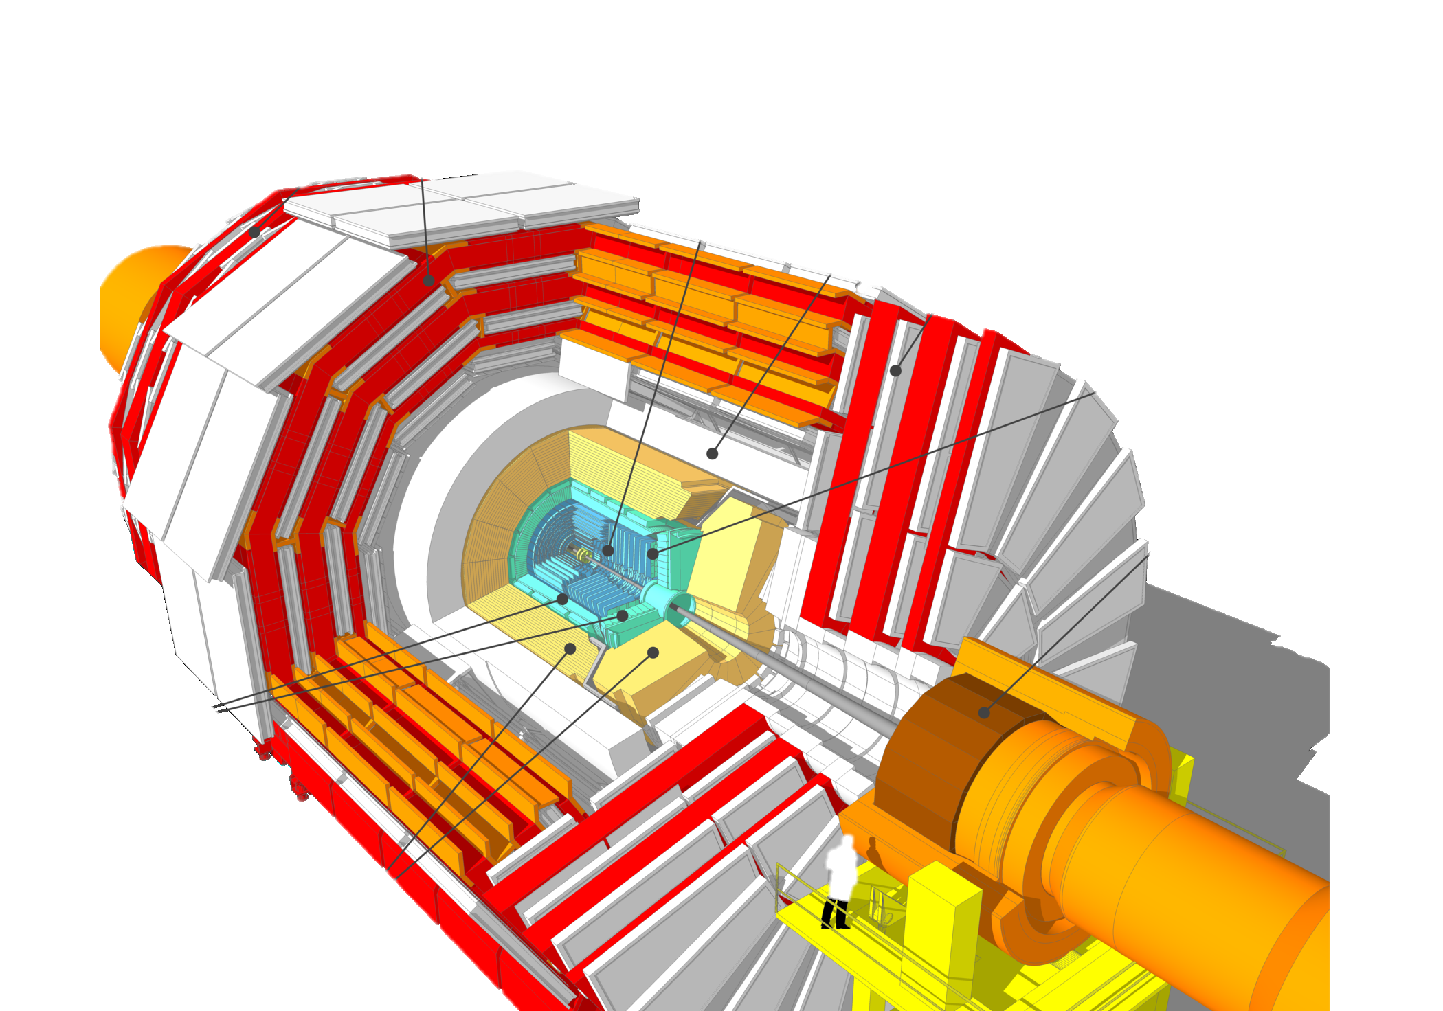
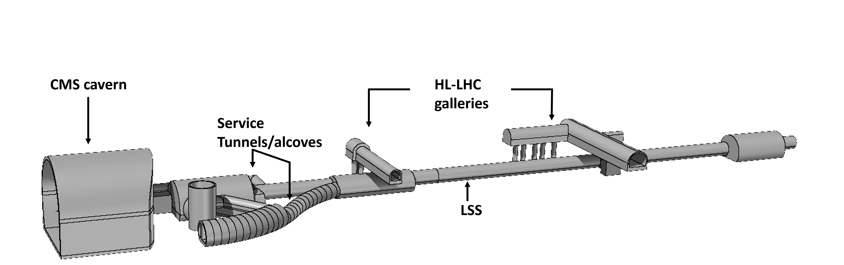
FLUKA Models: Geometry of the LSS 5
Model developed using FLUKA 4 (lately v.4-4)
Highly complex model with all the LHC’ beam elements
29/05/2024
Notes:
Inner triplet (right) as we have in our Layout – link between scheme and FLUKA model

Slide 9
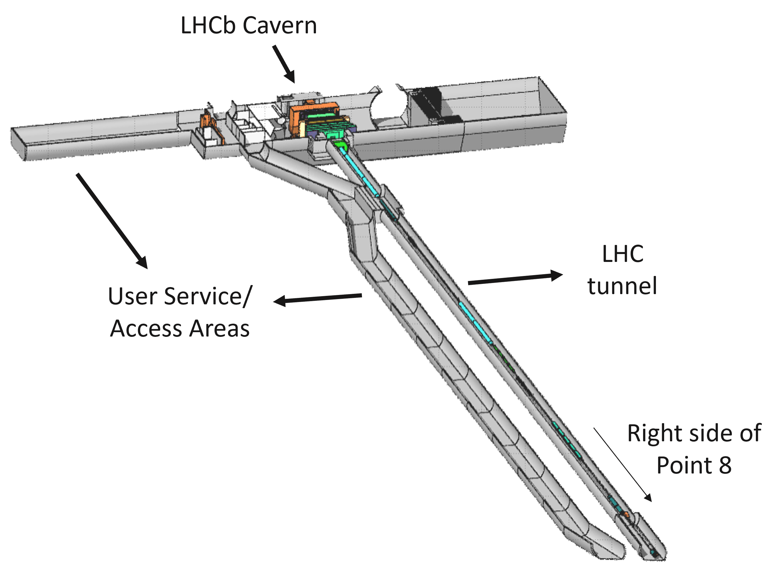
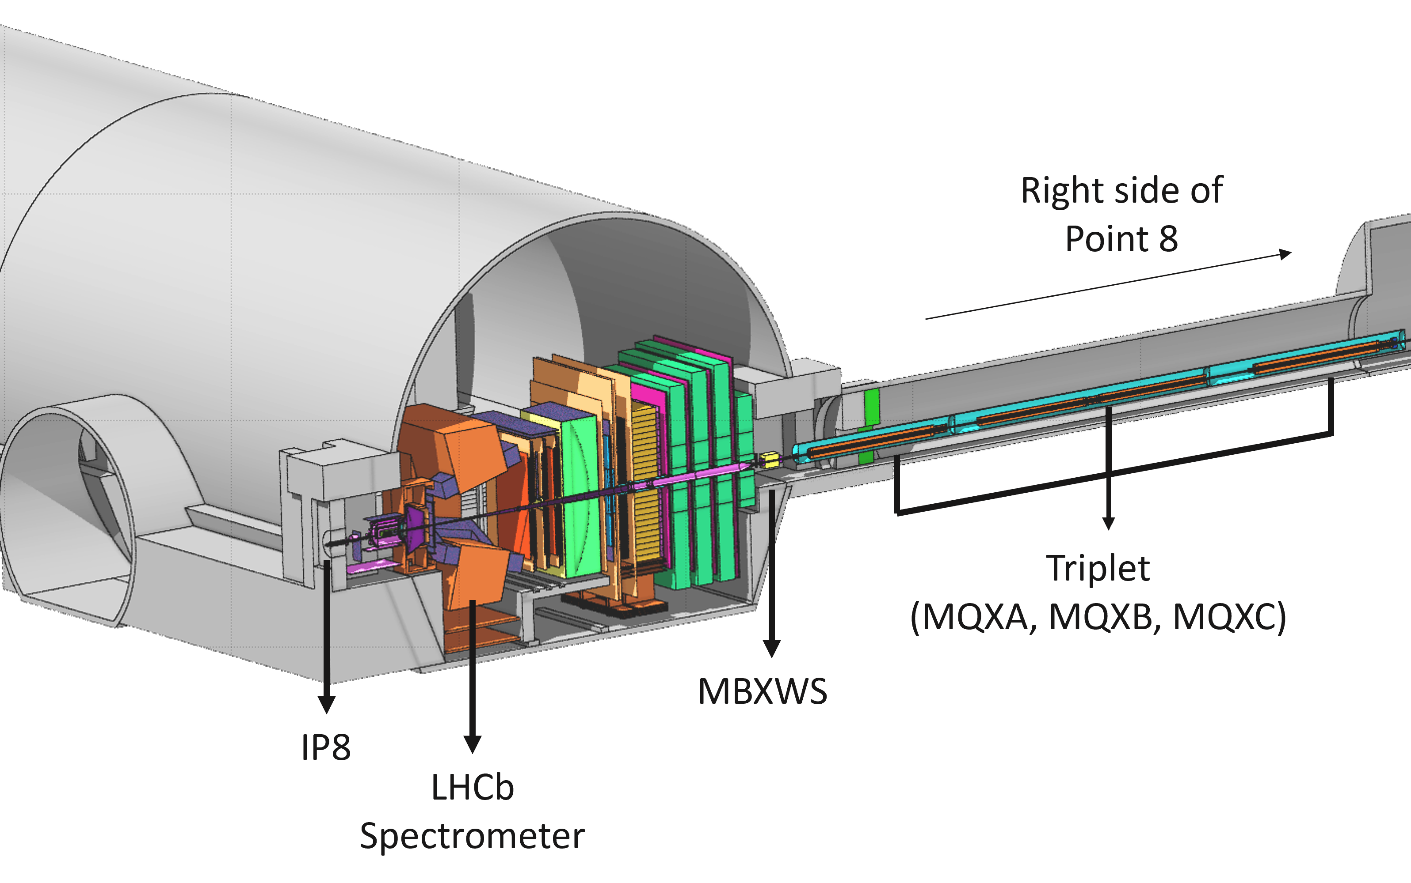
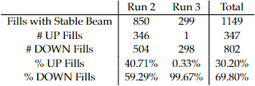
FLUKA Model: Geometry of the LSS 8
Polarity of the LHCb spectrometer (UP and DOWN) taken into account
29/05/2024
Notes:
Here we have the LHCb model bc the experiment is assymetric
Polarity of the spectrometr: UP and DOWN

Slide 10
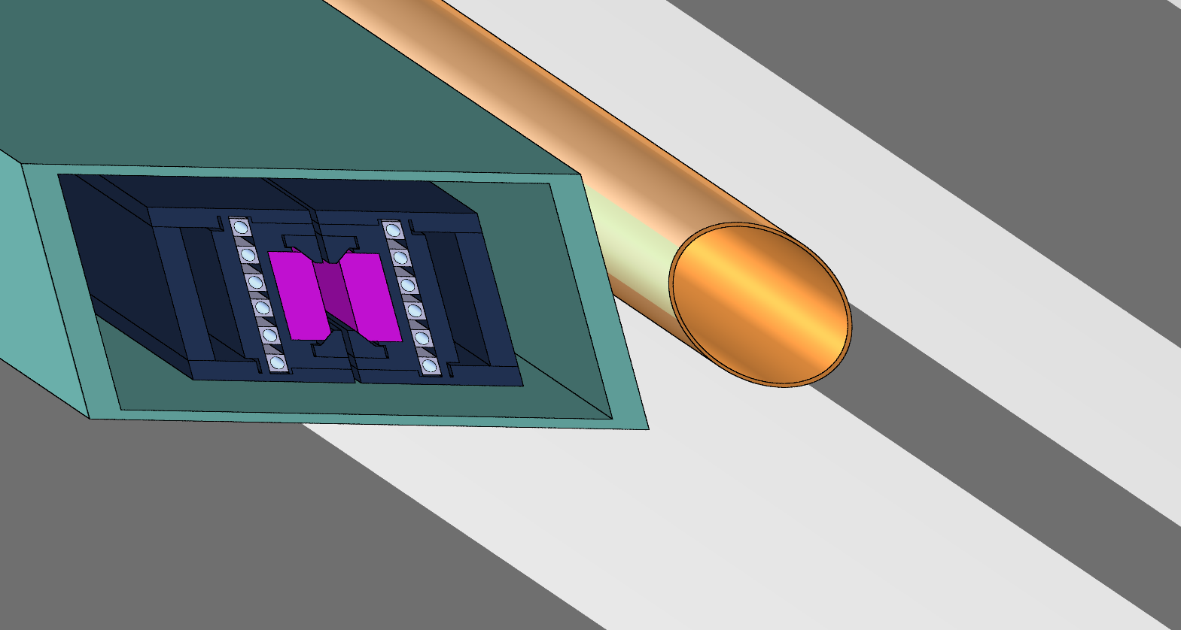
FLUKA model: Source for the LSS 7 Simulations
Two contributions: losses from Beam 1 and losses from Beam 2
BEAM 2
BEAM 1
29/05/2024
Notes:
Protons loss in the jaws of the collimators

Slide 11
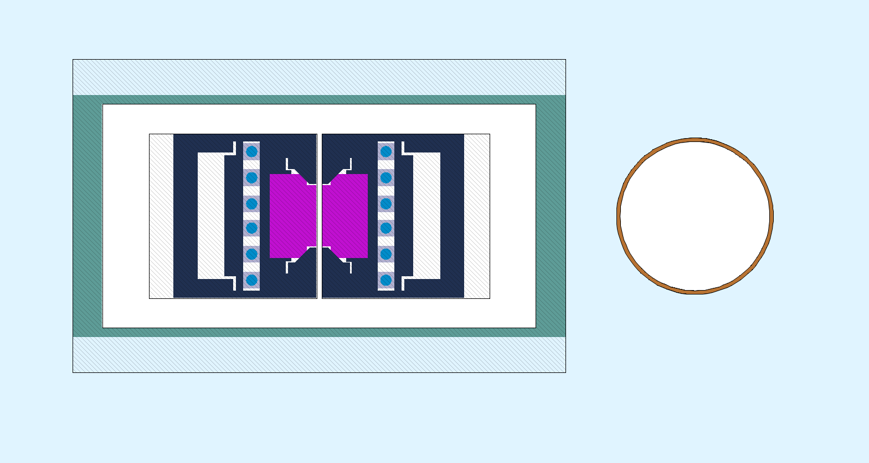
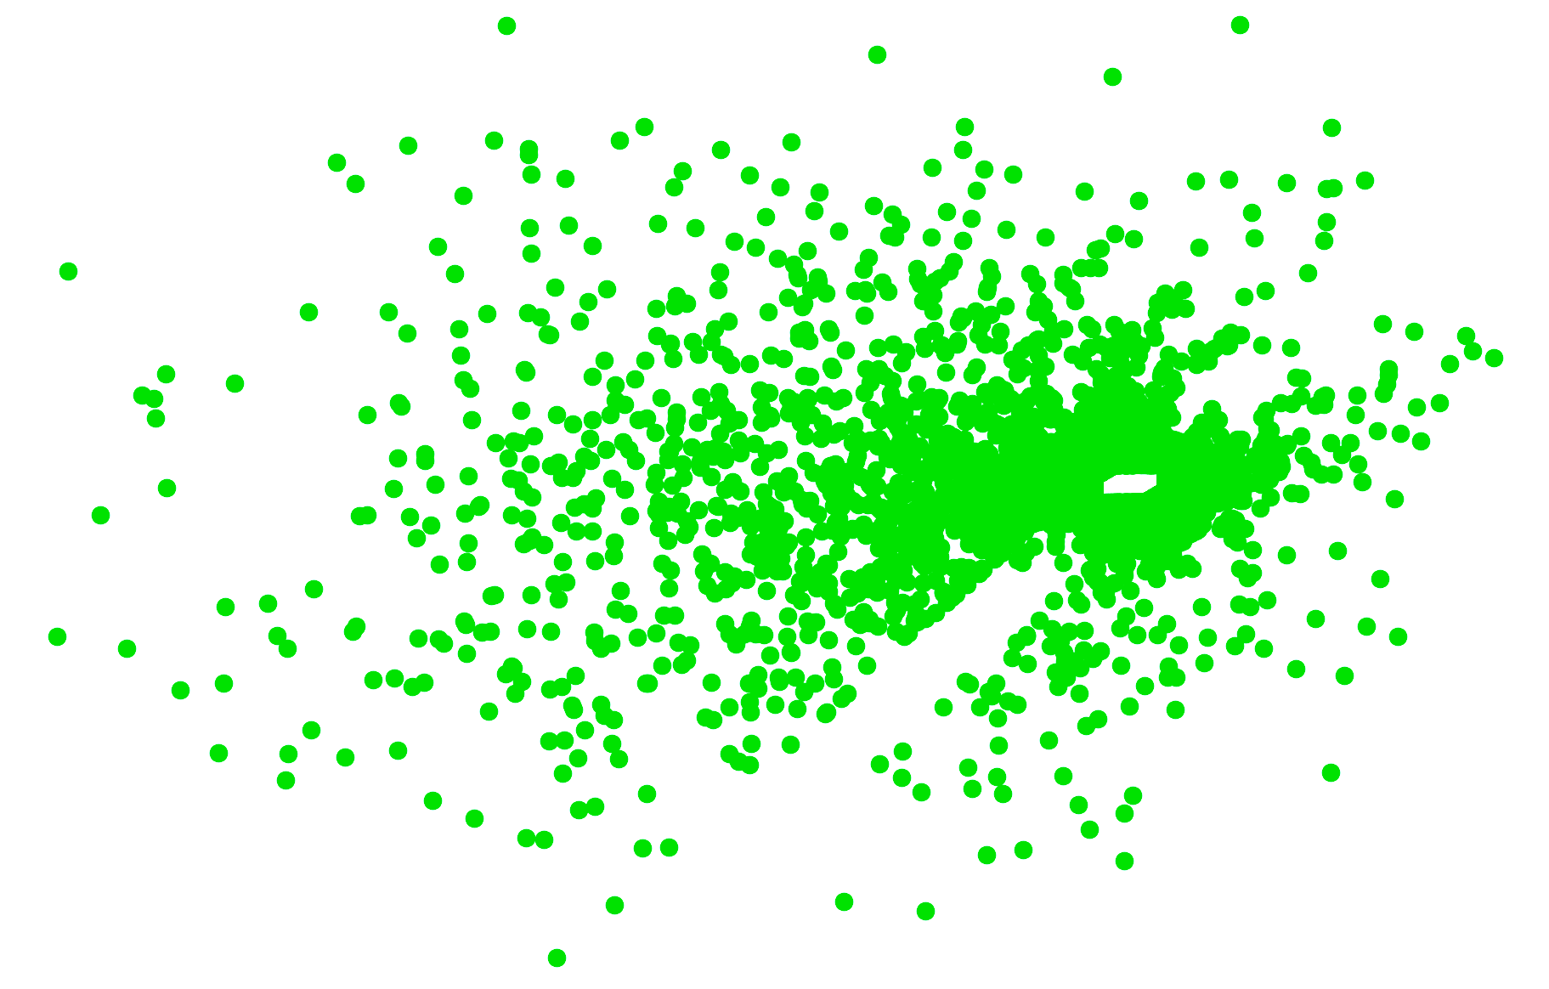
FLUKA model: Source for the LSS 7 Simulations
29/05/2024

Slide 12
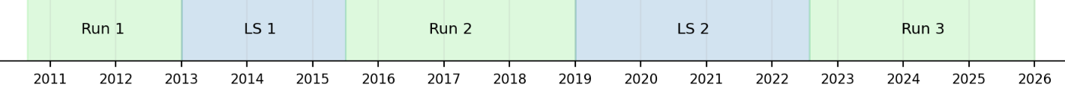
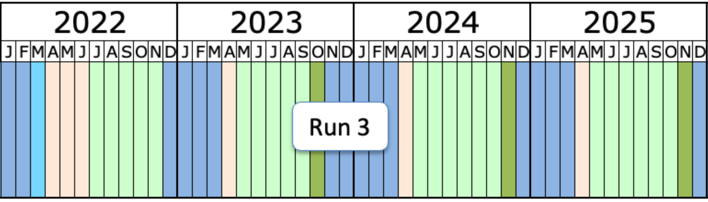
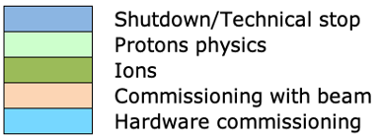
LHC Operation Timeline
Complex LHC operation over a typical operation year and over a “Run”
29/05/2024
Notes:
Complex Operational cycle (to be simulated)
Duty cycle over a run: Commisioning, p-p, ion run, Technical stop

Slide 13
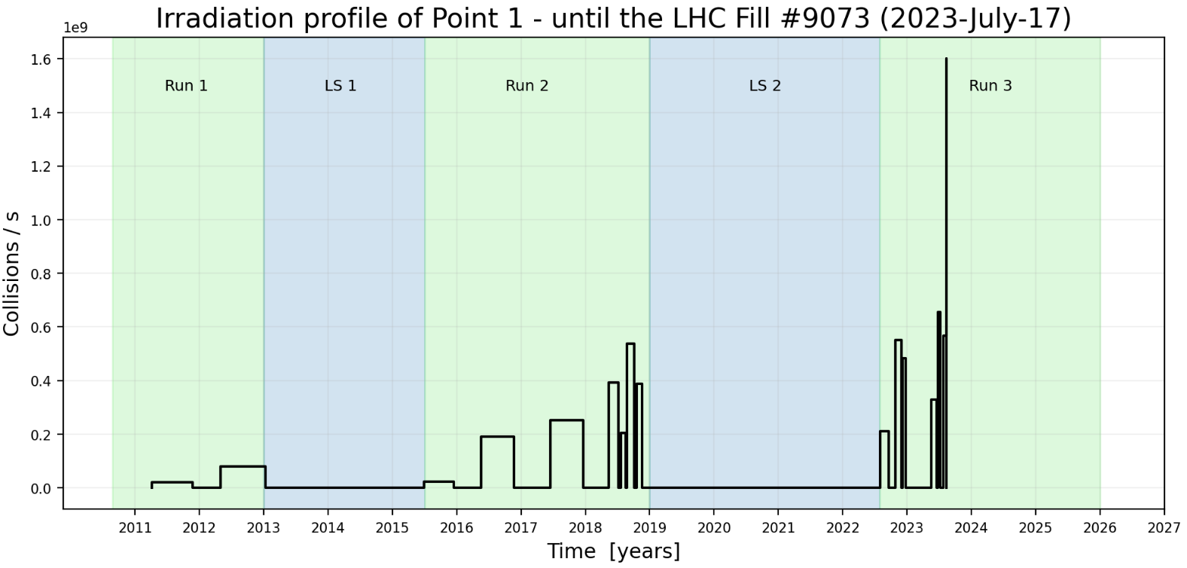
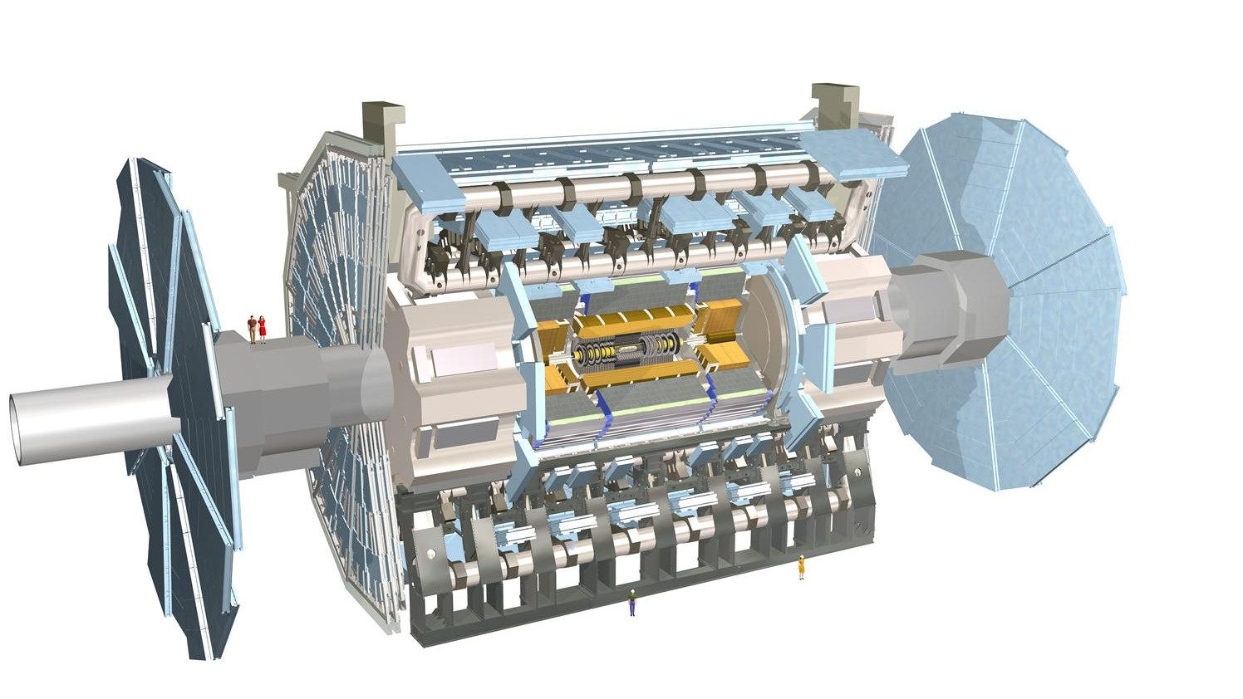
FLUKA model: Irradiation profile for LSS 1
Irradiation profiles encode the LHC operation and they are designed based on real-data (e.g. luminosity delivered to ATLAS/CMS)
*EDMS 2694263 v2
29/05/2024
Notes:
Explain in detail!
Way to encrypt LHC complex operation, based on real-data of Luminosity
Collision/s at IP
Until 17 July 2023 , explained next slide
12h Boost

Slide 14
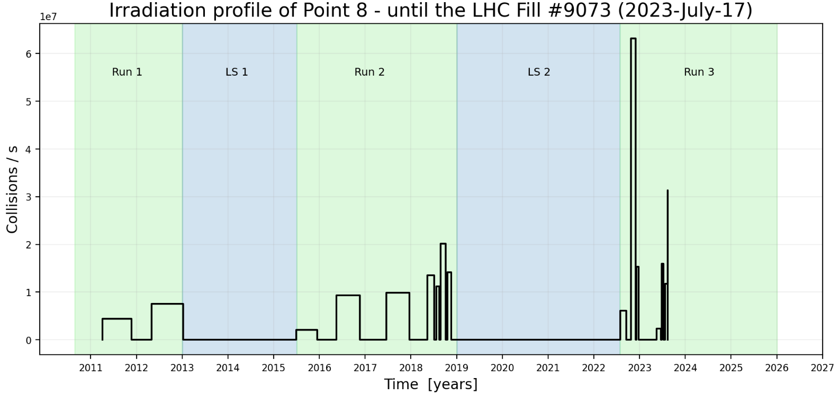
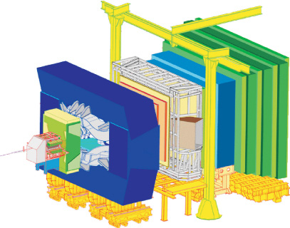
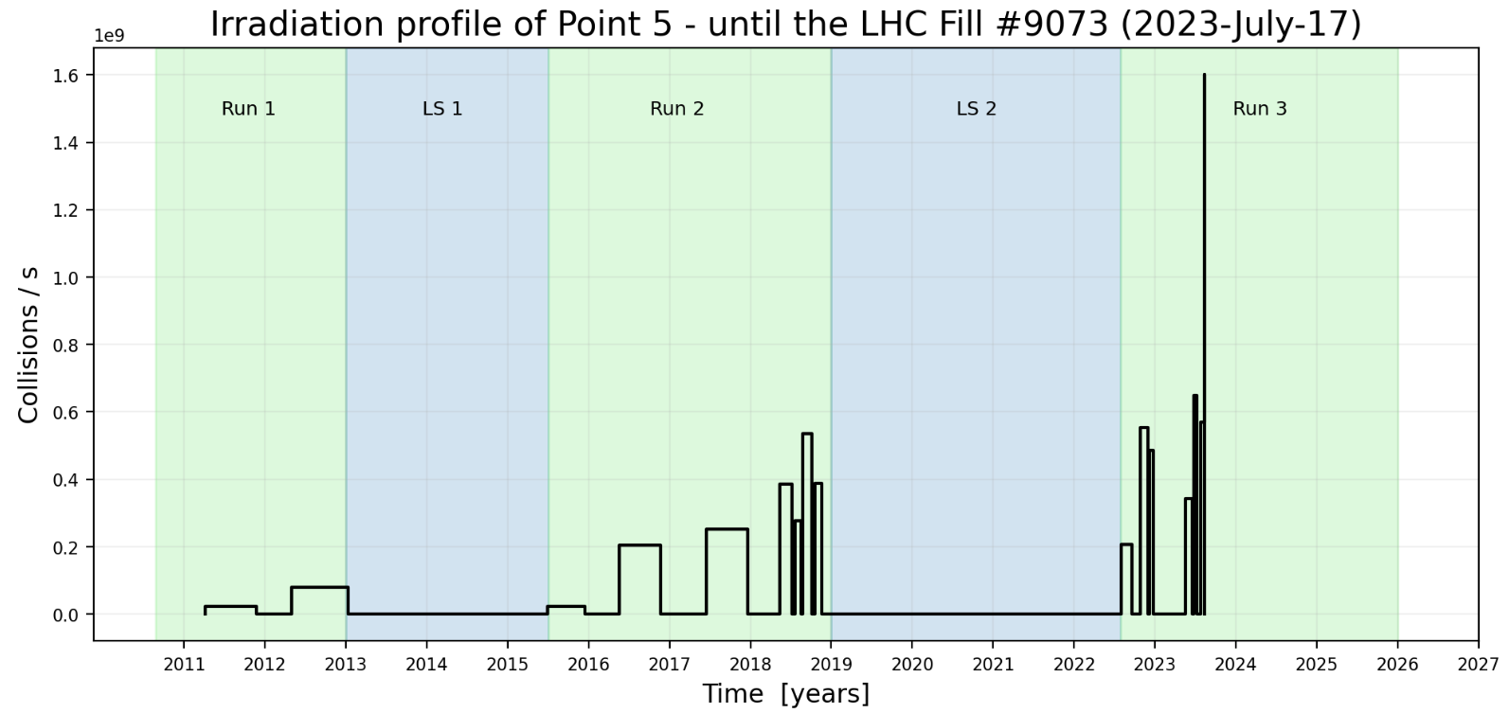
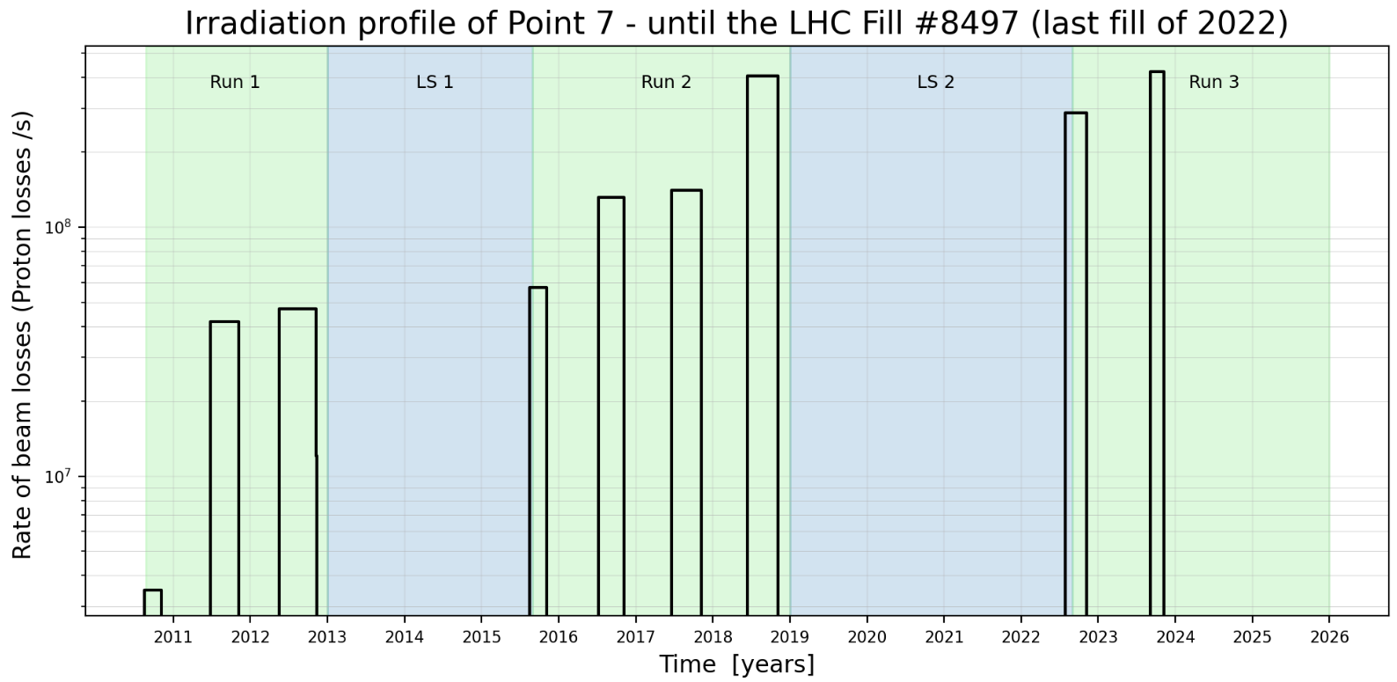
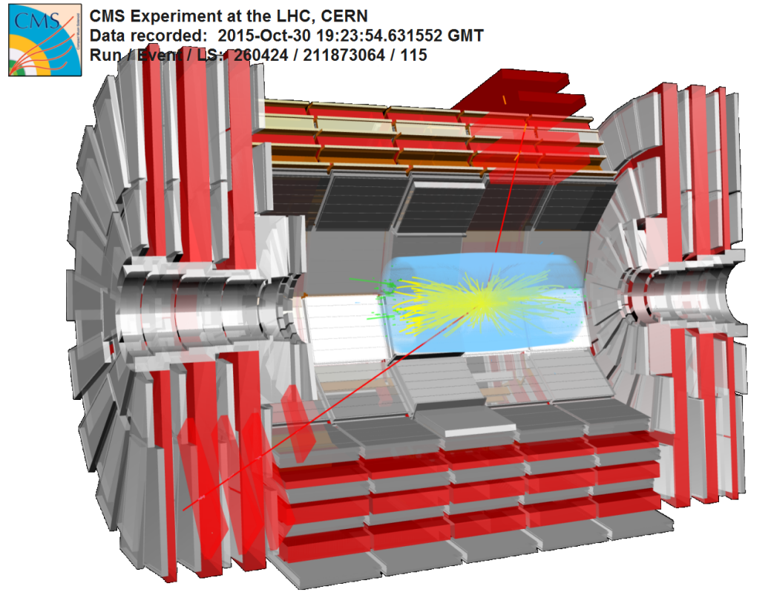
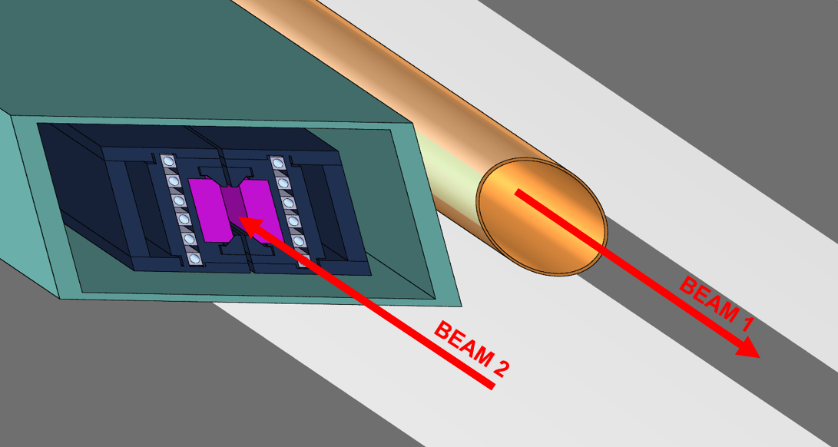
FLUKA model: Irradiation profiles
Irradiation profiles encode the LHC Operation and they are designed based on real-data
Sources:
  LSS with Experimental areas – p-p collision at the IP (at 13.6 TeV)
  LSS for beam cleaning – Beam loss map in the primary collimator (TCP)
Point 1
Point 8
Point 5
Point 7
*EDMS 2694263 v2
29/05/2024
Notes:
Explain in detail!
Points 1,5,8 – Based on real-data of luminosity of each experiment
Point 7 – We cannot directly measure losses. They are measured from an iterative process of matching BLM data with FLUKA data scored in BLMs
Simulations until 17 July 2023, explained next slide

Slide 15
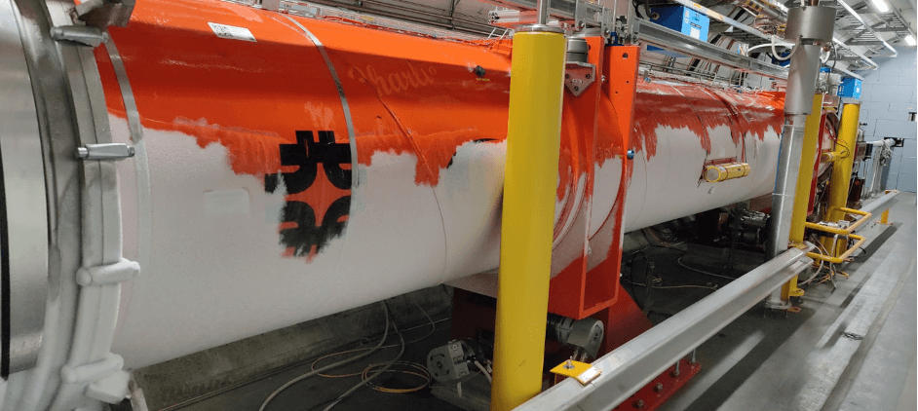
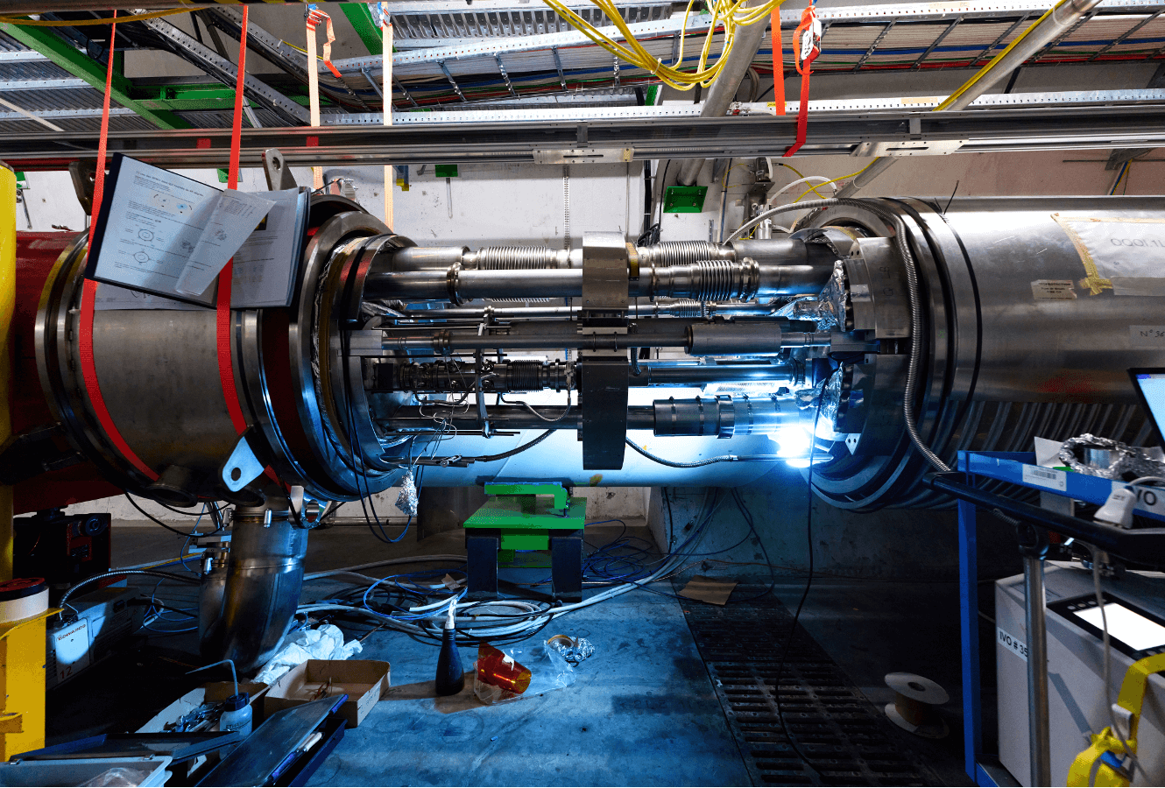
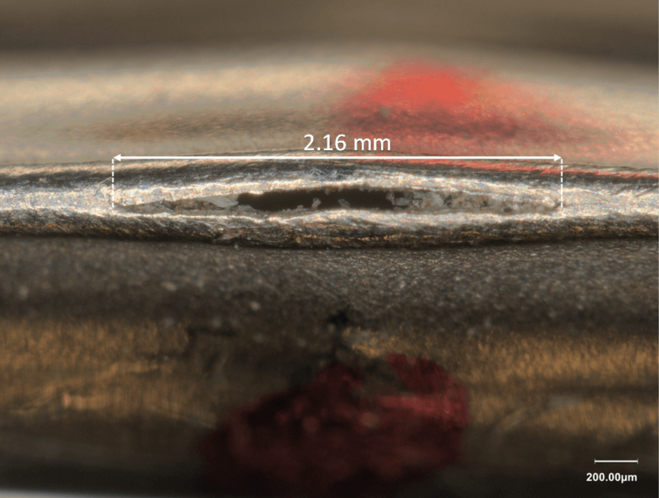
17 July 2023 Incident
17th July
2023-July-17 00:00:12
The inner triplet superconducting magnets at Point 8 quenched (i.e. they lost its superconducting state)
Caused an helium leakage in the interconnection of these magnets
as a result, the LHC stopped its operation for several weeks
This date was chosen for the analysis/comparison with PMI data, as we had a long cool down, i.e. no operation with beam, after a proton physics run.
Credit: https://home.cern/news/news/accelerators/lhc-leak-repair-short-photostory
29/05/2024
Notes:
We had the stop but in October the ion operation continued
That’s why our irradiation profiles finish on the 17th July
LHC stopped its operation for a period longer than 1 month.
Fallen tree in Vaud (55km away from CERN) that disturbed the electrical glitch

Slide 16
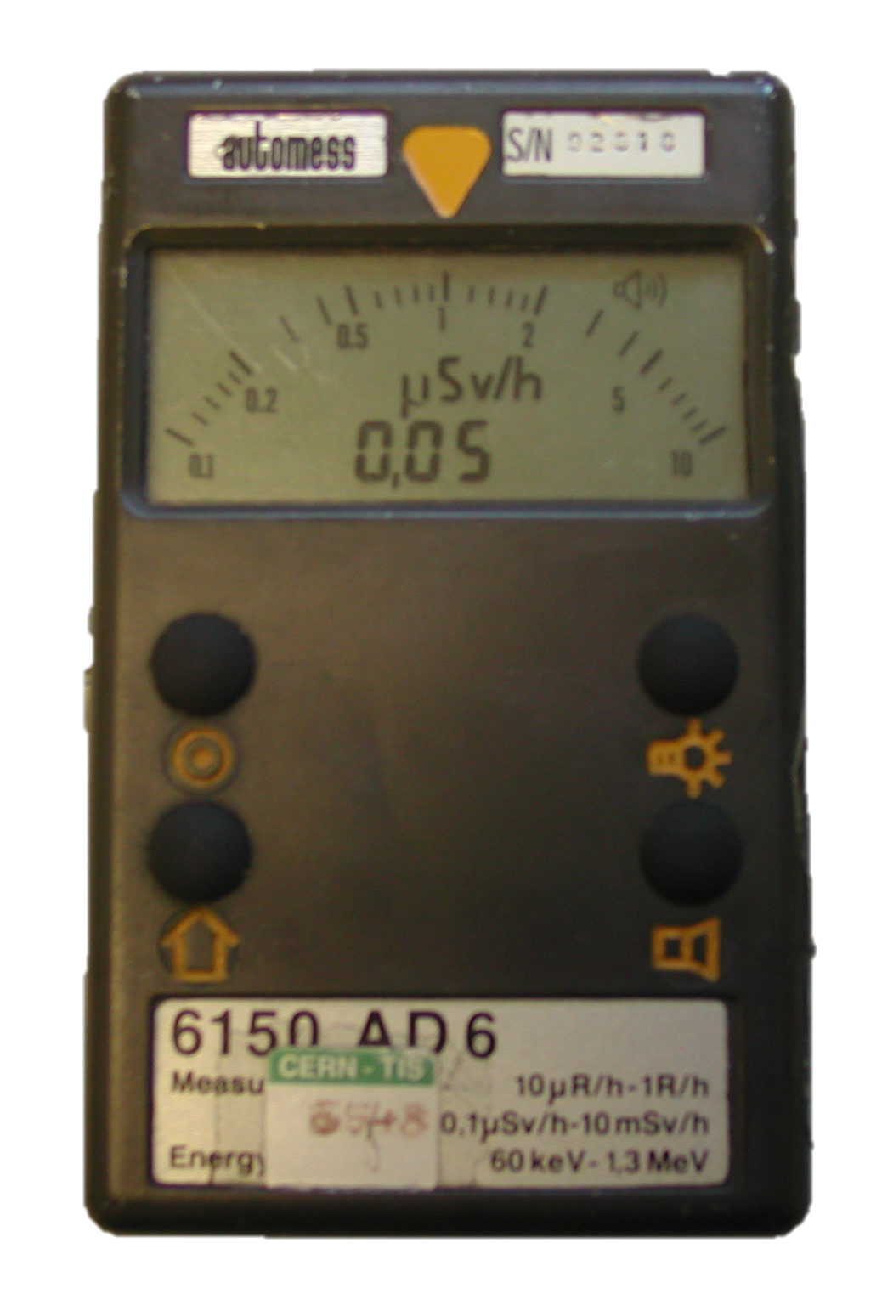
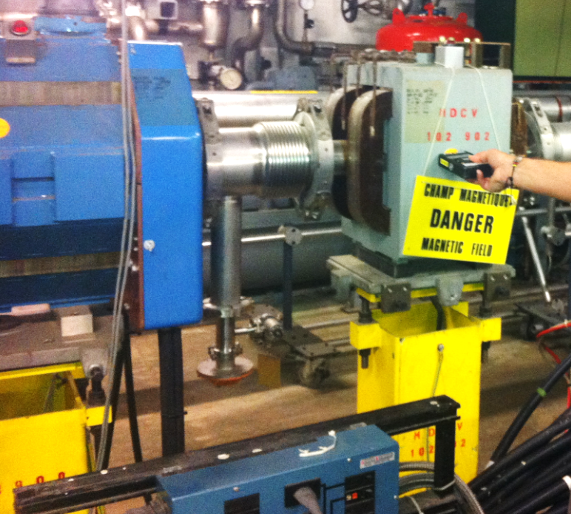
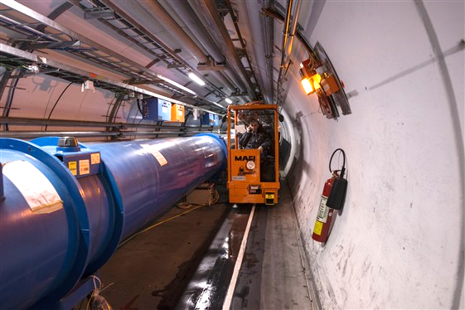
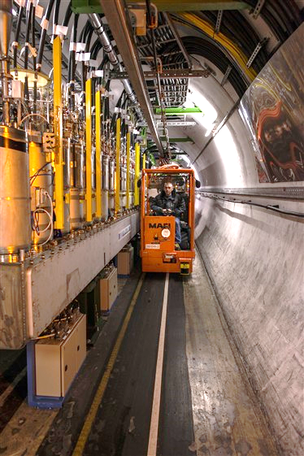
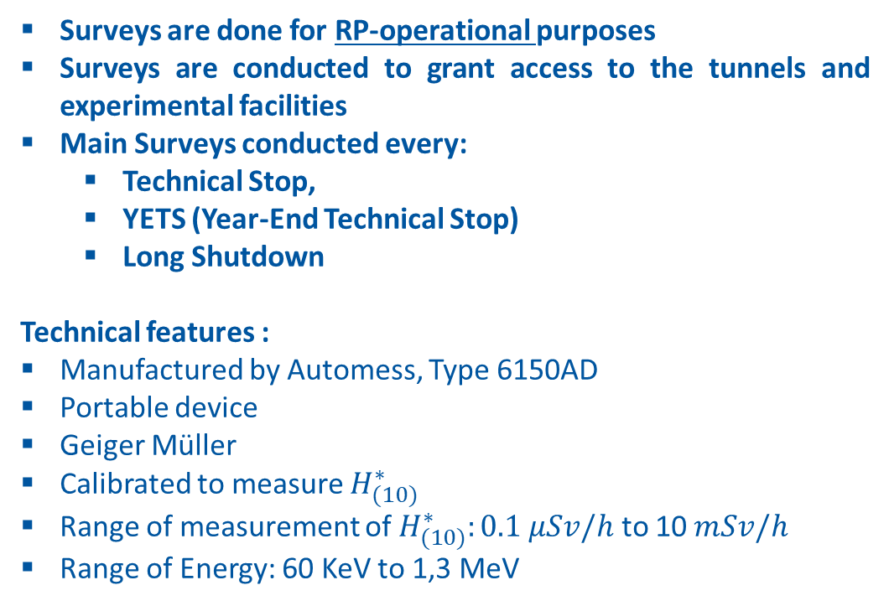
RP Measurements at the LHC – Surveys with AD-6
Surveys are done for RP-operational purposes
Surveys are conducted to grant access to the tunnels and experimental facilities
Main Surveys conducted every:
  Technical Stop,
  YETS (Year-End Technical Stop)
  Long Shutdown
Technical features :
Manufactured by Automess, Type 6150AD
Portable device
Geiger Müller
Calibrated to measure $H_{(10)}^{∗}$
Range of measurement of $H_{(10)}^{∗}:0.1 μSv/h$ to 10$mSv/h$
Range of Energy: 60 KeV to 1,3 MeV
29/05/2024
Notes:
Surveys are done to provide and access and for zoning. They are not done for benchmarking
They are not the most suitable instrments for benchmarkig nuclar models
Cross validation not benchmark because the measurements are not done for that they are for Operational validation
From an operation RP point of view, we are interested in obtaining a ‘FLUKA-to-measurement’ ratio and then to update the model in order to reduce that factor
Surveys are done 2 or mores times a year: TS, YETS
AD = Analog and Digital display
The built-in counter is used to measure photon radiation (X-ray and gamma radiation
Measures DR DRmax and DRaccumulated – access to these values at any time
Uncertainty: 30% (Angular and Energy response and linearity)
Range of Energy is the one for which the instrument is qualified for

Slide 17
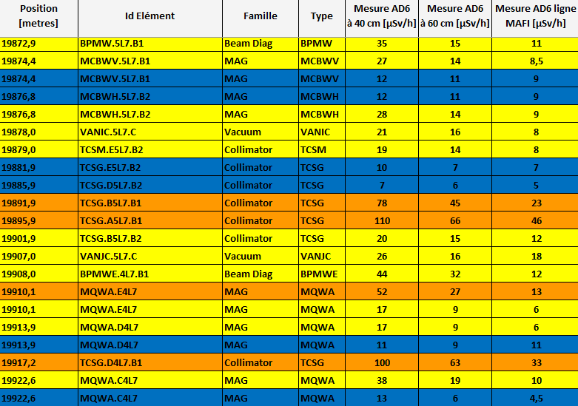
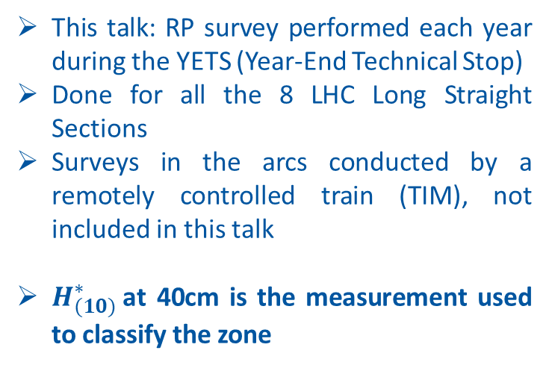
RP Measurements at the LHC – Surveys with AD-6
This talk: RP survey performed each year during the YETS (Year-End Technical Stop)
Done for all the 8 LHC Long Straight Sections
Surveys in the arcs conducted by a remotely controlled train (TIM), not included in this talk
$H_{(10)}^{∗}$at 40cm is the measurement used to classify the zone
29/05/2024

Slide 18
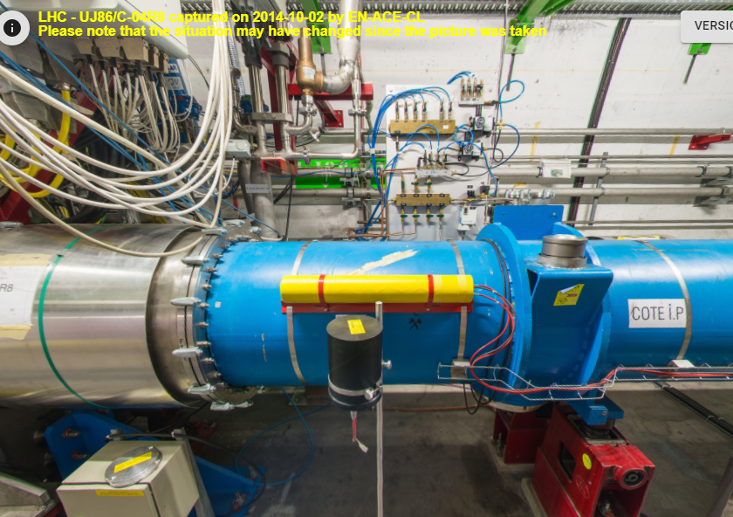
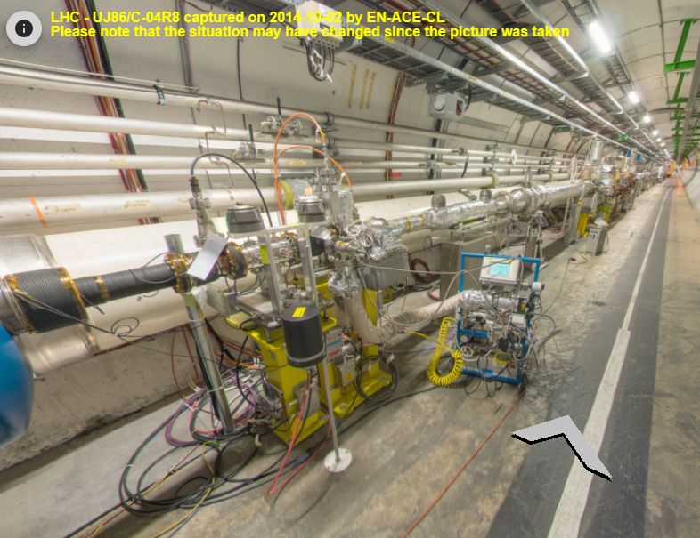
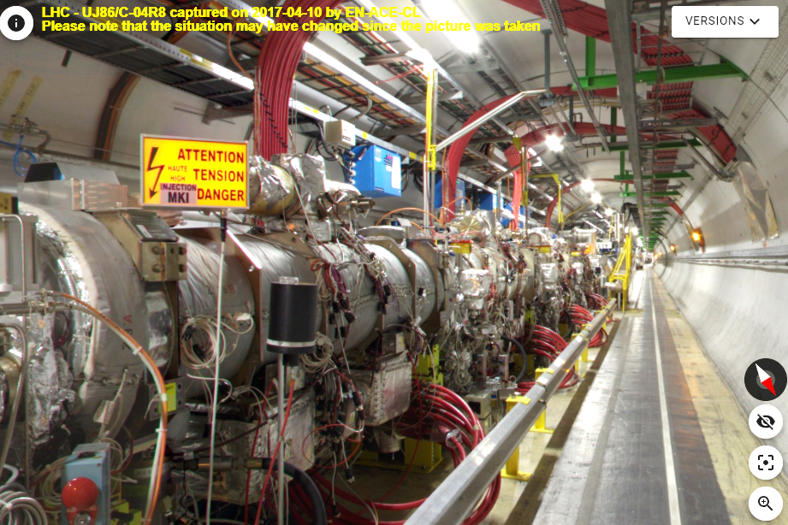
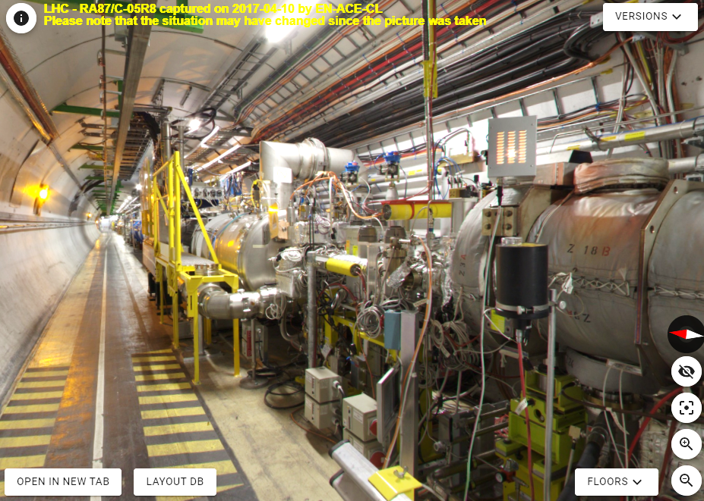
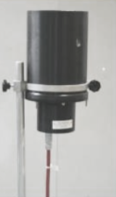
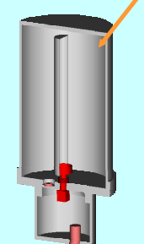
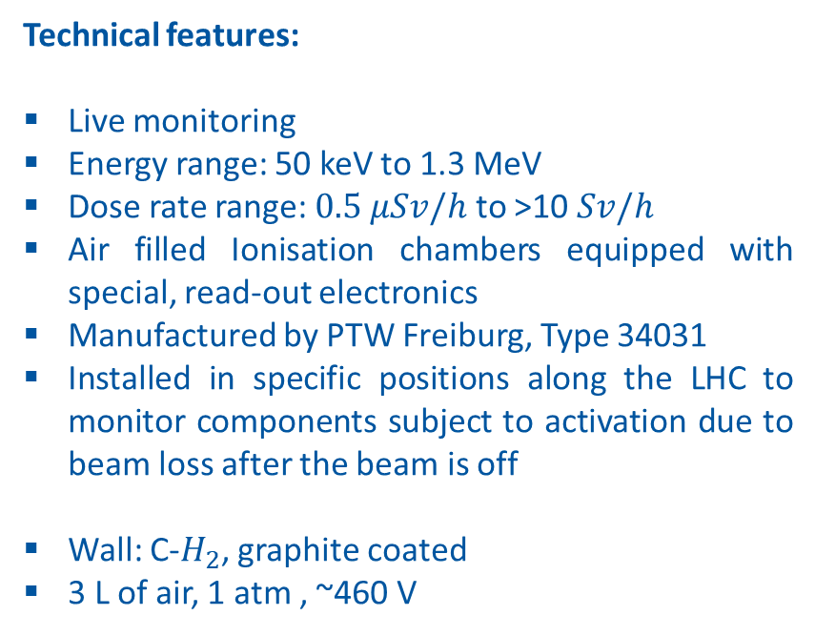
RP Measurements at the LHC – PMIs
Technical features:
Live monitoring
Energy range: 50 keV to 1.3 MeV
Dose rate range: $0.5 μSv/h$ to >10$Sv/h$
Air filled Ionisation chambers equipped with special, read-out electronics
Manufactured by PTW Freiburg, Type 34031
Installed in specific positions along the LHC to monitor components subject to activation due to beam loss after the beam is off
Wall: C-$H_{2}$, graphite coated
3 L of air, 1 atm , ~460 V
PMIL8612
PMIL8711
PMIL8713
PMIL8714
Images from: https://gis.cern.ch/gisportal/Radioprotection.htm
29/05/2024
Notes:
Calibrated to measure Cs-137
3 Liter Radiation Monitoring Chamber Type 34031 (data from PTW Catalogue)

Slide 19

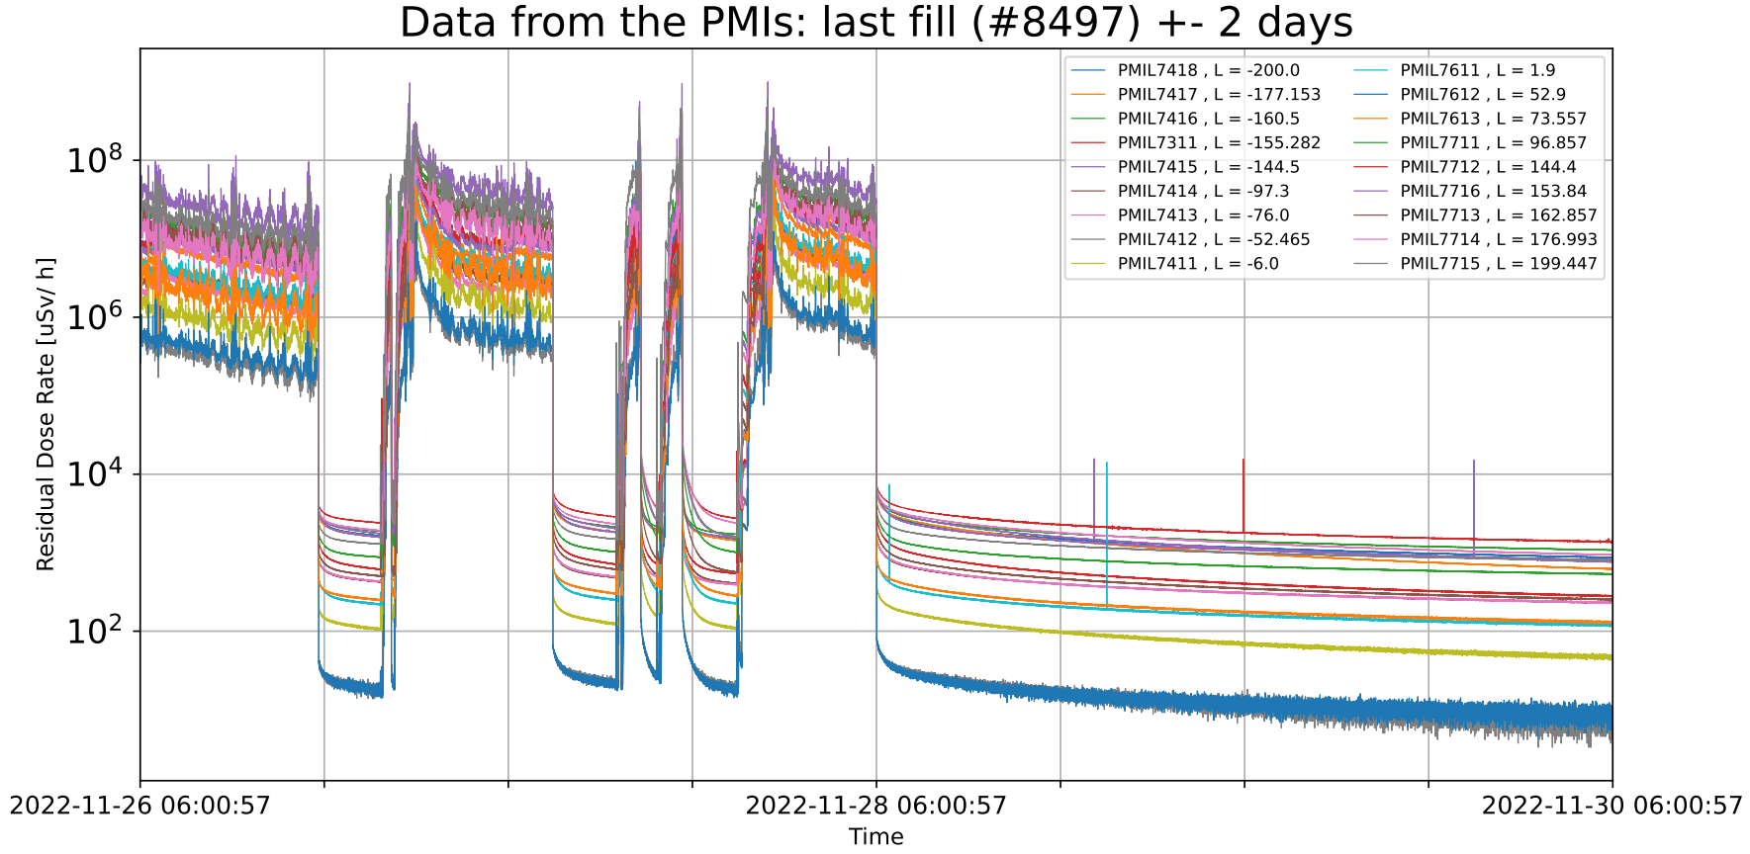
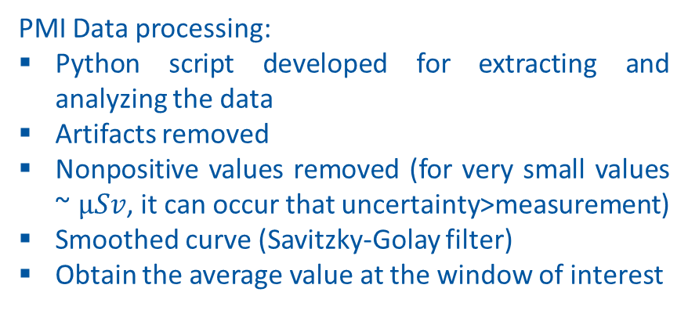

RP Measurements at the LHC – PMIs
PMI data extracted from:
CERN logging database
PMI Data processing:
Python script developed for extracting and analyzing the data
Artifacts removed
Nonpositive values removed (for very small values ~ $μSv$, it can occur that uncertainty>measurement)
Smoothed curve (Savitzky-Golay filter)
Obtain the average value at the window of interest
Figures are representative for the processing of PMI data
29/05/2024
Notes:
Data is fetched to Timber and extracted for analysis using NXCALS

Slide 20




Residual dose rate
Cool-down time: 1 month
Relevant for access at the beginning of a (E)YETS
LHC LSS 1 Right side – 1 month after the end of Run 3 pp operation
LHC LSS 8 - RIGHT – 30%UP 70%DOWN POLARITIES - Residual radiation levels 1 m after the end of Run 3 pp operation
LHC LSS 5 Right side – 1 month after the end of Run 3 pp operation
LHC LSS 7 – Sum of Beam 1 and Beam 2 - Residual radiation levels 1 month after the end of Run 3 pp operation
29/05/2024
Notes:
Typical maps obtained for each Points
These are the FLUKA maps we use to extract quantitative data to confront with measurements
Radiation levels expected
ATLAS and CMS – higher radiation, due to higher Lumi
7 – Beam losses in collimators –Z Activated region

Slide 21





FLUKA VS Measurements – LSS 1
PMI 1612 : Located near the DFB, which model is not presently included in the simulations
PMI 1713 : Located close to TCL5, collimator which is either fully open or fully closed over different years -> complex operation to represent in FLUKA
Ratio PMI to FLUKA = 1,09 $±$ 0,03
Ratio Survey to FLUKA = 1,06 $±$ 0,32
Averaged ratios computed without considering the outliers described
29/05/2024
Notes:
Positive message – The great outcomes , improvements:
Survey data uncertainty:
Uncertainty on the exact position where the surveys were made
PMI data uncertainty:
not all are positioned at 40cm,
some are tilted
They may be displaced
FLUKA data uncertainty:
The collimators width-gap aperture is a fixed value in the model but it changes during the LHC operation
Simpler model for: interconnections, Collimator structures, TAN
Ion runs considered as cool-down time
Weighted Average for the Ratio
Values of < 10 uSv/h where discarded for comparison purposes due to their high relative uncertainties in this range
DFB (the electric sources for the superconducting triplet)

Slide 22




FLUKA VS Measurements – LSS 5
Outliers:
PMI 5612 : Located near the DFB, which model is not presently included in the simulations
Ratio PMIs to FLUKA = 1,11 $±$ 0,23
Ratio Survey to FLUKA = 1,39 $±$ 0,42
Averaged ratios computed without considering the outliers described
29/05/2024
Notes:
Same comments as for LSS1

Slide 23





FLUKA VS Measurements – LSS 8
PMI 8612 : Measurement has the same order of magnitude of the uncertainty (very low dose rate in the order of ~1 uSv/h or less)
Ratio PMIs to FLUKA = 0,87 $±$ 0,40
Ratio Survey to FLUKA = 1,30 $±$ 0,41
29/05/2024
Notes:
LHCb is a low-Lumi experiment -> Lumi will increase during next run, increasing the Value-to-Noise ratio
Surveys – Uncertainty on the exact position where the measurements were done

Slide 24




FLUKA VS Measurements – LSS 7
PMI 7716 and 7713 : PMIs were displaced during LS2 (only noticed during analysis)
Ratio PMIs to FLUKA = 1,42 $±$ 0,34
Ratio Survey to FLUKA = 2,10 $±$ 0,73
Averaged ratios computed without considering the outliers described
29/05/2024
Notes:
Loss map of protons used as source for Point 7

Slide 25
Summary
RP-FLUKA simulations performed to compare the residual radiation environment in the LHC, after the end of 2023 proton operation, with measurements (RP surveys and PMI).
Main goal to validate simulations parameters to be used to produce accurate residual radiation maps at the LHC complex: these maps are used to produce preliminary estimates of the individual/collective dose during future interventions (a.k.a. Work and Dose Plan or WDP).
Focus on validation of operational RP “parameters” rather than nuclear models (regular RP surveys not meant for this purpose). Dedicated “benchmark” studies already published by CERN HSE-RP group (e.g. at CHARM facility).
Overall good agreement between FLUKA simulations and measurements, considering possible sources of systematic uncertainty (such as modelling, material composition, beam losses, and more) which might be difficult to assess in some cases.
Know discrepancies were analyzed and discussed
Analysis on-going – including more timestamps, detailed uncertainty analysis
Continuous improvement
FLUKA simulations already used today for planning LS3 interventions at the LHC complex
29/05/2024
Notes:
- RP Operational interest, not model validation. Cross validation not benchmarking. The measurements are not even done for validation
- This work used to estimate doses for LS3, estimate dose on people during interventions and provide access
- Continuous process to update these RP factors
Great outcomes , the details to fix/ space for improvement, the importance of the work
Uncertainties not only associated with physics, but also with the operation of the LHC
We don’t care of obtaining 1. We are not validating nuclear model (like we could do at CHARM, by R. Froeschl)
Other techniques to estimate the error? What would be the advantage, since we already have some errors difficult to fix
PT 7 -> # loss protons
PT 8 -> Injection line
FLUKA Statistical Error (MC) < ~1%
FLUKA Systematic Error (model errors which we cant fix), ex: PT7 # loss protons
AD-6 : ~30% (Conservative based on our experience) – Response in Energy, Angular, etc.
To it properly: In each position where surveys are done, we’ll have a diff mixed fields
PMI : Uncertainties not an instrument error -> Statistical fluctuation from the measured value
Impossible to estimate systematic error

Slide 26

Vasco Mendes
HSE-RP-AS
vasco.mendes@cern.ch
29/05/2024

Slide 28

CERN Accelerator Complex
29/05/2024

Slide 29
The Large Hadron Collider (LHC)
29/05/2024

Slide 30


The Large Hadron Collider (LHC)
Compact Muon Solenoid
A Large Ion Collider Experiment
LHC beauty
A Toroidal LHC ApparatuS
29/05/2024

Slide 31

LHC long term schedule
29/05/2024
Notes:
Run 3 – first 2 years are real data, the other 2 are projection
Hi-Lumi – Irrad profile projection

Slide 32





FLUKA model: Physics and Transport settings
Thresholds for Residual radiation studies are shown bellow
Other particles
$e^{+}/$ $e^{−}$
γ
n
…
${10}^{−12}$ GeV = 1 meV
${10}^{−3}$ GeV = 1 MeV
${10}^{0}$ GeV
${10}^{3}$ GeV = 1 TeV
29/05/2024
Notes:
Run 3 – first 2 years are real data, the other 2 are projection
Hi-Lumi – Irrad profile projection

Slide 33

PMI Data Cleaning - Savitzky-Golay filter
from scipy.signal import savgol_filter
Smoothed_curve = savgol_filter (data_array, window_length , polyn_order)
29/05/2024

Slide 34



Collimators in the LHC
29/05/2024

Slide 35

Layout of the Long Straight Sections
LSS 1 and 5 (Right side)
LSS
DS
Q1
Q2
Q3
D1
D2
Q4
Q5
Q6
Q7
MBB
TCL
TCL
BEAM 1
TCL
IP 1
TAS
TANA
BEAM 2
TCTPV
TCTPH
LSS 7
LSS
DS
TCSPM
TCLA
TCSG
TCSG
TCLA
Q6
Q4
TCSG
TCSG
Q5
TCLA
D3
TCLA
D4
TCLA
BEAM 1
IP 7
BEAM 2
TCP
TCSG
TCSG
TCP
TCSG
TCSG
TCP
TCSPM
TCSPM
TCSG
TCSG
TCAPC
TCAPM
TCAPB
TCAPA
LSS 8
DS
LSS
LSS
DS
Q4
Q1
Q2
Q3
Q5
Q6
Q7
MBB
D2
D1
TCTPH
MBB
Q7
Q6
Q5
TCTPV
D1
Q3
Q2
Q1
TCTPV
D2
Q4
BEAM 1
TCTPH
MKI
BEAM 2
MSI
IP 8
BEAM 2
TDIS
TANB
BEAM 1
TCLIM
TANB
TCLIA
MBXWS
MBXWS
TCDOM
TCLIB
MBXWH
LHCb DIPOLE
29/05/2024

Slide 36
29/05/2024
Notes:
Shortly explain the elements present
LSS1+5
- Beam elements (Dipoles, Quadrupoles, Collimators, Absorbers
- 2 Beamlines that converge into one, collision in the IP
LSS8 – Injection line –kicker (MKI) and septum (MSI) magnets –dipoles that insert the beam from TI to the LHC
LSS7 – insertion fully dedicated to collimation – higher radiation levels due to the interaction with the collimatos. Specacular

Slide 37
Figures represent only Right side of the insertion due to symmetry
29/05/2024
Notes:
Shortly explain the elements present
LSS1+5
- Beam elements (Dipoles, Quadrupoles, Collimators, Absorbers
- 2 Beamlines that converge into one, collision in the IP
LSS8 – Injection line –kicker (MKI) and septum (MSI) magnets –dipoles that insert the beam from TI to the LHC
LSS7 – insertion fully dedicated to collimation – higher radiation levels due to the interaction with the collimatos. Specacular

Slide 38



FLUKA-4
FLUKA is one of the main tools at CERN used for Radiation Protection studies
FLUKA (FLUktuierende KAskade) is a general purpose Monte Carlo code
Interaction and transport of hadrons, leptons, and photons from in any material
Currently developed in-house at CERN, organized by Working Groups
Every time a radioisotope is created, FLUKA flags it
Radioisotope databases containing the possible decays and half-life (τ) for each isotope population
Solving the Bateman equations we can obtain the populations of each radioisotope at each time of interest
29/05/2024

Slide 39







LHC Beam elements
Dipoles
Quadrupoles
Multipoles
Collimators
Particle Absorbers
29/05/2024

Slide 40


Radiation Protection activities at CERN
Design
Support the design of accelerator elements (ex: positioning, material choice)
Shielding
Operation
Innervations in the tunnel and experimental cavern
Estimate of collective and personal dose during maintenance of the LHC
Area classification based on Radiation levels
Assessing air contamination
Monitoring
Radiological surveys of work places
Radiation Monitoring System for the Environment and Safety for LHC (RAMSES)
Dosimetry for CERN personnel
Waste
Characterization of the future radioactive waste
ALARA (As Low As Reasonably Achievable)
29/05/2024

Slide 41



FLUKA model: Irradiation profile – Points 1 and 5
Designed based on real data of the LHC operation (EDMS 2694263 v2)
Irradiation profiles encode the LHC Operation, in terms of collisions’ rate at the IP
3 Bins due to the 3 ‘bumps’ of Int-Lumi during 2023 operation
12h Boost at the end to stimulate short-lived radionucleides
29/05/2024
Notes:
Run 3 – first 2 years are real data, the other 2 are projection
Hi-Lumi – Irrad profile projection

Slide 42



FLUKA model: Irradiation profile of Point 7
Designed based on real data of the LHC operation (EDMS 2694263 v2)
Loss Maps (SixTrack Touches) of particles deposited in the 2nd Primary Collimator of the LSS 7: TCP.C6R7.B2
Provided a list: [ Energy X Y Z $p_{x}$ $p_{y}$ ]
The beam loss map for beam 2 is provided by the SY-STI group, which initially developed it for quench test studies and is considered as well representative of the beam loss profile during normal operation in Run 2 and Run 3
Same logic applied for Beam 1: TCP.C6L7.B1, the 2nd Primary Collimator
NAME | $$β_{x}$$ | $$β_{y}$$ | $σ_{x}$ [mm] | $σ_{y}$ [mm] | FLUKA Half-gap [mm] | $β^{∗}$ ATLAS [m] | Position Averaged [mm] | HG/ SIGMA | Ratio of HG FLUKA/Real
TCP.D6L7.B1 | 147,291 | 72,070 | 0,3938 | 0,2754 | 0,929065 | 1,2 | 0,9298 | 2,361 | 0,09%
 |  |  |  |  |  | 19,2 | 0,9275 | 2,355
TCP.C6L7.B1 | 139,829 | 76,050 | 0,3837 | 0,2830 | 1,30424 | 1,2 | 1,3025 | 3,395 | 0,13%
 |  |  |  |  |  | 19,2 | 1,305 | 3,401
TCP.B6L7.B1 | 132,617 | 80,246 | 0,3736 | 0,2907 | 1,09676 | 1,2 | 1,0925 | 2,924 | 0,39%
 |  |  |  |  |  | 19,2 | 1,095 | 2,931
TCP.B6R7.B2 | 134,754 | 78,964 | 0,3766 | 0,2883 | 1,09697 | 1,2 | 1,095 | 2,907 | 0,18%
 |  |  |  |  |  | 19,2 | 1,0975 | 2,914
TCP.C6R7.B2 | 142,041 | 74,834 | 0,3867 | 0,2807 | 1,30446 | 1,2 | 1,30489 | 3,374 | 0,03%
 |  |  |  |  |  | 19,2 | 1,3025 | 3,368
TCP.D6R7.B2 | 149,578 | 70,918 | 0,3968 | 0,2732 | 0,929266 | 1,2 | 0,9275 | 2,337 | 0,19%
 |  |  |  |  |  | 19,2 | 0,93 | 2,344
29/05/2024
Notes:
Run 3 – first 2 years are real data, the other 2 are projection
Hi-Lumi – Irrad profile projection

