Slide 1
Data access and Storage
Some new directions
From the xrootd and Scalla perspective
Fabrizio Furano
CERN IT/GS
02-June-08
Elba SuperB meeting
http://savannah.cern.ch/projects/xrootd
http://xrootd.slac.stanford.edu

Slide 2
Outline
So many new directions
Designers and users unleashed fantasy
  What is Scalla
  The “many” storage element paradigm
  Direct WAN data access
  Clusters globalization
  Virtual Mass Storage System and 3rd party fetches
  Xrootd File System + a flavor of SRM integration
  Conclusion

Slide 3
What is Scalla?
The evolution of the BaBar-initiated xrootd project
Data access with HEP requirements in mind
  But a very generic platform, however
Structured Cluster Architecture for Low Latency Access
  Low Latency Access to data via xrootd servers
    POSIX-style byte-level random access
      By default, arbitrary data organized as files
      Hierarchical directory-like name space
    Protocol includes high performance features
  Structured Clustering provided by cmsd servers (formerly olbd)
    Exponentially scalable and self organizing
  Tools and methods to cluster, harmonize, connect, …

Slide 4
Scalla Design Points
High speed access to experimental data
  Small block sparse random access (e.g., root files)
  High transaction rate with rapid request dispersement (fast concurrent opens)
Wide usability
  Generic Mass Storage System Interface (HPSS, RALMSS, Castor, etc)
  Full POSIX access
  Server clustering (up to 200Kper site) for linear scalability
Low setup cost
  High efficiency data server (low CPU/byte overhead, small memory footprint)
  Very simple configuration requirements
  No 3rd party software needed (avoids messy dependencies)
Low administration cost
  Robustness
  Non-Assisted fault-tolerance (the jobs recover failures - no crashes! – any factor of redundancy possible on the srv side)
  Self-organizing servers remove need for configuration changes
  No database requirements (high performance, no backup/recovery issues)

Slide 5
Single point performance
Very carefully crafted, heavily multithreaded
  Server side: promote speed and scalability
    High level of internal parallelism + stateless
    Exploits OS features (e.g. async i/o, polling, selecting)
    Many many speed+scalability oriented features
    Supports thousands of client connections per server
  Client: Handles the state of the communication
      Reconstructs everything to present it as a simple interface
    Fast data path
    Network pipeline coordination + latency hiding
    Supports connection multiplexing + intelligent server cluster crawling
Server and client exploit multi core CPUs natively

Slide 6
Fault tolerance
Server side
  If servers go, the overall functionality can be fully preserved
    Redundancy, MSS staging of replicas, …
    Can means that weird deployments can give it up
      E.g. storing in a DB the physical endpoint addresses for each file. Generally a bad idea.
Client side (+protocol)
  The application never notices errors
    Totally transparent, until they become fatal
      i.e. when it becomes really impossible to get to a working endpoint to resume the activity
  Typical tests (try it!)
    Disconnect/reconnect network cables
    Kill/restart servers

Slide 7
Authentication
Flexible, multi-protocol system
  Abstract protocol interface: XrdSecInterface
    Protocols implemented as dynamic plug-ins
    Architecturally self-contained
      NO weird code/libs dependencies (requires only openssl)
      High quality highly optimized code, great work by Gerri Ganis
Embedded protocol negotiation
  Servers define the list, clients make the choice
  Servers lists may depend on host / domain
One handshake per process-server connection
  Reduced overhead:
  # of handshakes ≤ # of servers contacted
    Exploits multiplexed connections
    no matter the number of file opens per process-server
Courtesy of Gerardo Ganis (CERN PH-SFT)

Slide 8
Available protocols
Password-based (pwd)‏
  Either system or dedicated password file
    User account not needed
GSI (gsi)‏
  Handle GSI proxy certificates
  VOMS support should be OK now (Andreas, Gerri)
  No need of Globus libraries (and super-fast!)
Kerberos IV, V (krb4, krb5)
  Ticket forwarding supported for krb5
  Fast ID (unix, host) to be used w/ authorization
ALICE security tokens
  Emphasis on ease of setup and performance
Courtesy of Gerardo Ganis (CERN PH-SFT)

Slide 9
The “many” paradigm
Creating big clusters scales linearly
  The throughput and the size, keeping latency very low
We like the idea of disk-based cache
  The bigger (and faster), the better
So, why not to use the disk of every WN ?
  In a dedicated farm
  500GB * 1000WN → 500TB
  The additional cpu usage is anyway quite low
Can be used to set up a huge cache in front of a MSS
      No need to buy a bigger MSS, just lower the miss rate !
Adopted at BNL for STAR (up to 6-7PB online)
      See Pavel Jakl’s (excellent) thesis work
      They also optimize MSS access to nearly double the staging performance
  Quite similar to the PROOF approach to storage
      Only storage. PROOF is very different for the computing part.

Slide 10
The “many” paradigm
This big disk cache
  Shares the computing power of the WNs
  Shares the network of the WNs pool
    i.e. No SAN-like bottlenecks (… reduced costs)
    Exploits a complete graph of connections (not 1-2)
      Handled by the farm’s network switch
  The performance boost varies, depending on:
    Total disk cache size
    Total “working set” size
      It is very well known that most accesses are to a fraction of the repo at a time.
      In HEP the data locality principle is valid. Caches work!
    Throughput of a single application
      Can have many types of jobs/apps

Slide 11
WAN direct access – Motivation
We want to make WAN data analysis convenient
  A process does not always read every byte in a file
    Even if it does… no problem
  The typical way in which HEP data is processed is (or can be) often known in advance
    TTreeCache does an amazing job for this
  xrootd: fast and scalable server side
    Makes things run quite smooth
    Gives room for improvement at the client side
      About WHEN transferring the data
      There might be better moments to trigger a chunk xfer
        with respect to the moment it is needed
      The app has not to wait while it receives data… in parallel

Slide 12
WAN direct access – hiding latency
Pre-xfer
data
“locally”
Remote
access
Remote
access+
Data
Processing
Data access
Overhead
Need for
potentially
useless replicas
And a huge
Bookkeeping!
Latency
Wasted CPU
cycles
But easy
to understand
Interesting!
Efficient
practical

Slide 13
Multiple streams‏
Clients still see
One Physical connection per
server
Application
Client1
Server
TCP (control)‏
Client2
TCP(data)‏
Client3
Async data
gets
automatically
splitted

Slide 14
Multiple streams‏
It is not a copy-only tool to move data
  Can be used to speed up access to remote repos
  Transparent to apps making use of *_async reqs
      The app computes WHILE getting data
xrdcp uses it (-S option)‏
  results comparable to other cp-like tools
For now only reads fully exploit it
  Writes (by default) use it at a lower degree
    Not easy to keep the client side fault tolerance with writes
Automatic agreement of the TCP windowsize
  You set servers in order to support the WAN mode
    If requested… fully automatic.

Slide 15
Dumb WAN Access*
Setup: client at CERN, data at SLAC
  164ms RTT time, available bandwidth < 100Mb/s
Smart features switched OFF
  Test 1: Read a large ROOT Tree
    (~300MB, 200k interactions)
      Expected time: 38000s (latency)+750s (data)+CPU➙10 hrs!
      No time to waste to precisely measure this!
  Test 2: Draw a histogram from that tree data
    (~6k interactions)
      Measured time 20min
      Using xrootd with WAN optimizations disabled
*Federico Carminati, The ALICE Computing Status and Readiness, LHCC, November 2007

Slide 16
Smart WAN Access*
Smart features switched ON
ROOT TTreeCache + XrdClient Async mode + 15*multistreaming
  Test 1 actual time: 60-70 seconds
    Compared to 30 seconds using a Gb LAN
    Very favorable for sparsely used files
      … at the end, even much better than certain always-overloaded SEs…..
  Test 2 actual time: 7-8 seconds
    Comparable to LAN performance (5-6 secs)
    100x improvement over dumb WAN access (was 20 minutes)
*Federico Carminati, The ALICE Computing Status and Readiness, LHCC, November 2007

Slide 17
Cluster globalization
Up to now, xrootd clusters could be populated
  With xrdcp from an external machine
  Writing to the backend store (e.g. CASTOR/DPM/HPSS etc.)
E.g. FTD in ALICE now uses the first. It “works”…
    Load and resources problems
    All the external traffic of the site goes through one machine
      Close to the dest cluster
If a file is missing or lost
  For disk and/or catalog screwup
  Job failure
    ... manual intervention needed
    With 10⁷ online files finding the source of a trouble can be VERY tricky

Slide 18
Virtual MSS
Purpose:
  A request for a missing file comes at cluster X,
  X assumes that the file ought to be there
      And tries to get it from the collaborating clusters, from the fastest one
Note that X itself is part of the game
  And it’s composed by many servers
The idea is that
  Each cluster considers the set of ALL the others like a very big online MSS
  This is much easier than what it seems
    And the tests around report high robustness…
      Very promising, still in alpha test, but not for much more.

Slide 19
Many pieces
Global redirector acts as a WAN xrootd meta-manager
Local clusters subscribe to it
  And declare the path prefixes they export
  Local clusters (without local MSS) treat the globality as a very big MSS
  Coordinated by the Global redirector
    Load balancing, negligible load
    Priority to files which are online somewhere
    Priority to fast, least-loaded sites
    Fast file location
True, robust, realtime collaboration between storage elements!
  Very attractive for tier-2s

Slide 20

Cluster Globalization… an example
ALICE global redirector (alirdr)
root://alirdr.cern.ch/
Includes
CERN, GSI, and others
xroot clusters
all.role meta manager
all.manager meta alirdr.cern.ch:1312
xrootd
cmsd
Meta Managers can be
geographically replicated
Can have several in different places for region-aware load balancing
xrootd
xrootd
xrootd
Prague
NIHAM
… any other
cmsd
cmsd
cmsd
GSI
CERN
all.manager meta alirdr.cern.ch:1312
all.role manager
all.manager meta alirdr.cern.ch:1312
all.role manager
all.role manager
all.manager meta alirdr.cern.ch:1312

Slide 21
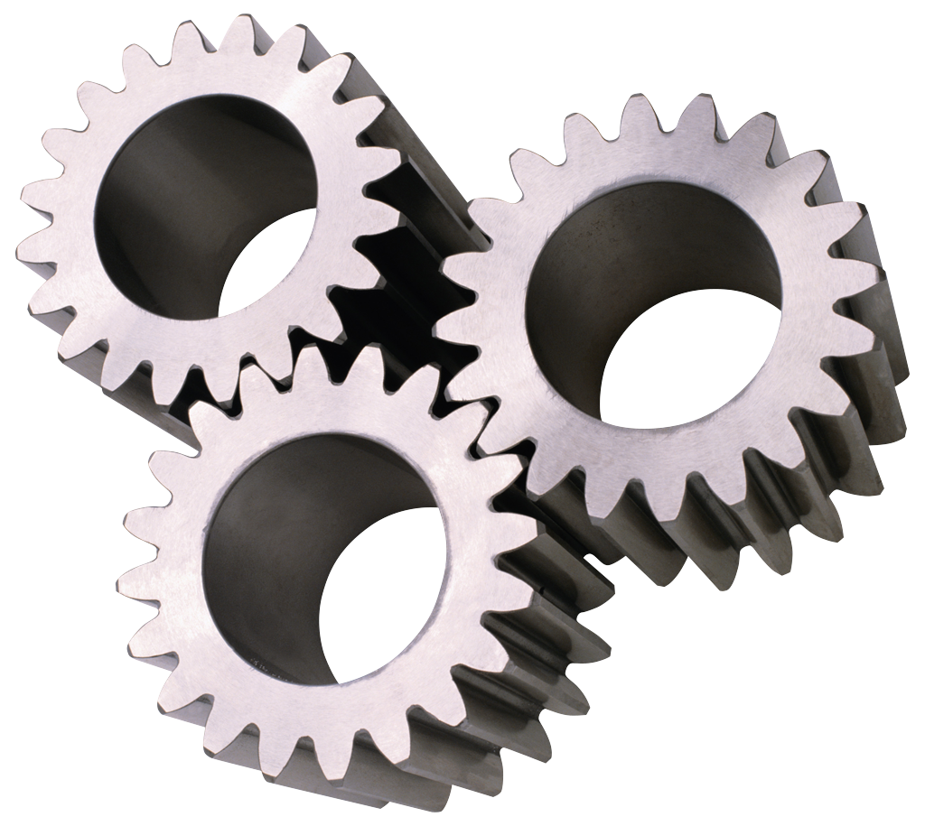
The Virtual MSS Realized
ALICE global redirector
xrootd
all.role meta manager
all.manager meta alirdr.cern.ch:1312
cmsd
But missing a file?
Ask to the global metamgr
Get it from any other
collaborating cluster
Note:
the security hats could require
you use xrootd
native proxy support
xrootd
xrootd
xrootd
Prague
NIHAM
… any other
cmsd
Local clients work
normally
cmsd
cmsd
GSI
CERN
all.manager meta alirdr.cern.ch:1312
all.role manager
all.manager meta alirdr.cern.ch:1312
all.role manager
all.manager meta alirdr.cern.ch:1312
all.role manager

Slide 22
Virtual MSS – The vision
Powerful mechanism to increase reliability
  Data replication load is widely distributed
  Multiple sites are available for recovery
Allows virtually unattended operation
  Automatic restore due to server failure
    Missing files in one cluster fetched from another
      Typically the fastest one which has the file really online
      No costly out of time DB lookups
  File (pre)fetching on demand
    Can be transformed into a 3rd-party GET (by asking for a specific source)
  Practically no need to track file location
    But does not stop the need for metadata repositories

Slide 23
Problems? Not yet.
There should be no architectural problems
    Striving to keep code quality at maximum level
    Awesome collaboration (CERN, SLAC, GSI)
BUT...
    The architecture can prove itself to be ultra-bandwidth-efficient
      Or greedy, as you prefer
  Need of a way to coordinate the remote connections
    In and Out
    We designed the Xrootd BWM and the Scalla DSS

Slide 24
The Scalla DSS and the BWM
Directed Support Services Architecture (DSS)
  Clean way to associate external xrootd-based services
    Via ‘artificial’, meaningful pathnames
A simple way for a client to ask for a service
  Like an intelligent queueing service for WAN xfers!
  Which we called BWM
    Just an xrootd server with a queueing plugin
  Can be used to queue incoming and outgoing traffic
    In a cooperative and symmetrical manner
    So, clients ask to be queued for xfers
  Work in progress!

Slide 25
Virtual MSS
The mechanism is there, once it is correctly boxed
  Work in progress…
A (good) side effect:
  Pointing an app to the “area” global redirector gives complete, load-balanced, low latency view of all the repo
  An app using the “smart” mode can just run
    Probably now a full scale production won’t
      But what about an interactive small analysis on a laptop?
      After all, HEP sometimes just copies everything, useful and not
    I cannot say that in some years we will not have a more powerful WAN infrastructure
      And using it to copy more useless data looks just ugly
      If a web browser can do it, why not a HEP app? Looks just a little more difficult.
Better if used with a clear design in mind

Slide 26
Data System vs File System
Scalla is a data access system
  Some users/applications want file system semantics
    More transparent but much less scalable (transactional namespace)
For years users have asked ….
  Can Scalla create a file system experience?
The answer is ….
  It can to a degree that may be good enough
We relied on FUSE to show how
Users shall rely on themselves to decide
  If they actually need a huge multi-PB unique filesystem
      Probably there is something else which is “strange”

Slide 27
What is FUSE
Filesystem in Userspace
Used to implement a file system in a user space program
  Linux 2.4 and 2.6 only
  Refer to http://fuse.sourceforge.net/
Can use FUSE to provide xrootd access
    Looks like a mounted file system
Several people have xrootd-based versions of this
  Wei Yang at SLAC
      Tested and fully functional (used to provide SRM access for ATLAS)

Slide 28
XrootdFS (Linux/FUSE/Xrootd)
User Space
Client
Host
POSIX File System
Interface
FUSE
Kernel
Appl
FUSE/Xroot Interface
opendir
xrootd POSIX Client
create
mkdir
mv
rm
rmdir
Redirector
xrootd:1094
Name Space
xrootd:2094
Redirector
Host
Should run cnsd on servers
to capture non-FUSE events
And keep the FS namespace!

Slide 29
Why XrootdFS?
Makes some things much simpler
  Most SRM implementations run transparently
  Avoid pre-load library worries
But impacts other things
  Performance is limited
    Kernel-FUSE interactions are not cheap
    The implementation is OK but quite simple-minded
    Rapid file creation (e.g., tar) is limited
      Remember that the comparison is with a plain xrootd cluster
  FUSE must be administratively installed to be used
    Difficult if involves many machines (e.g., batch workers)
    Easier if it involves an SE node (i.e., SRM gateway)
So, it’s good for the SRM-side of a repo
  But not for the job side

Slide 30
Conclusion
Many new ideas are reality or coming
Typically dealing with
  True realtime data storage distribution
  Interoperability (Grid, SRMs, file systems, WANs…)
  Enabling interactivity (and storage is not the only part of it)
The next close-to-completion big step is setup encapsulation
  Will proceed by degrees
    Trying to avoid common mistakes
      Both manual and automated setups are honorful and to be honoured!

Slide 31
Acknowledgements
Old and new software Collaborators
  Andy Hanushevsky, Fabrizio Furano (client-side), Alvise Dorigo
  Root: Fons Rademakers, Gerri Ganis (security), Bertrand Bellenot (windows porting)
  Alice: Derek Feichtinger, Andreas Peters, Guenter Kickinger
  STAR/BNL: Pavel Jackl, Jerome Lauret
  GSI: Kilian Schwartz
  Cornell: Gregory Sharp
  SLAC: Jacek Becla, Tofigh Azemoon, Wilko Kroeger, Bill Weeks
  Peter Elmer
Operational collaborators
  BNL, CERN, CNAF, FZK, INFN, IN2P3, RAL, SLAC

