Slide 1
WP – 4- activity “From BriXSinO to HB²TF the new updated Beam Line”
Respect BriXSinO here we have :
  Adoption of the Flat-cathode JLAB-like DC gun profile
  (Carlos: “if this profile works properly there is no necessity to test the Pierce-Geometry”)
  Real Bunchers (650 MHz) profile : β ≈ 0.7 & β ≈ 0.9
  The Solenoid-Gun as received from Carlos (peak-field at z = 27cm under check with JLab)
  The Solenoids of the BeamLine reshaped with a larger bore that passes the pipe flanges
Main Goals:
  Reproduce the results of BriXSinO (i.e. 100 pC bunch and DC-gun at 250 keV)
  A new working point with 50 pC and DC-gun at 300 keV
Milestone 2023 – 30 June: Machine Optimized layout – Prog. Sistemi dinamica di fascio

Slide 2
WP4 – The Beam Physics
@ Feb. 2023 not yet involved in the WP 4 activities up to day

Slide 3
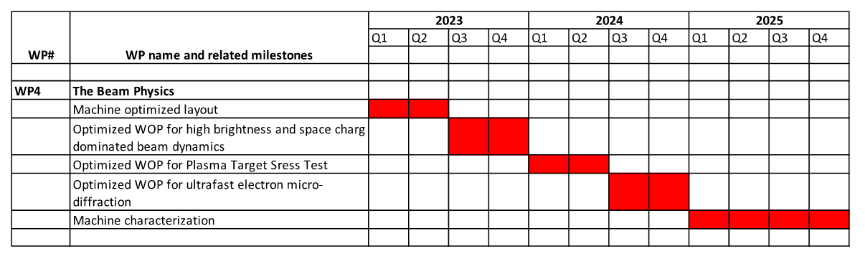
This presentation 8th of February 2023

Slide 4
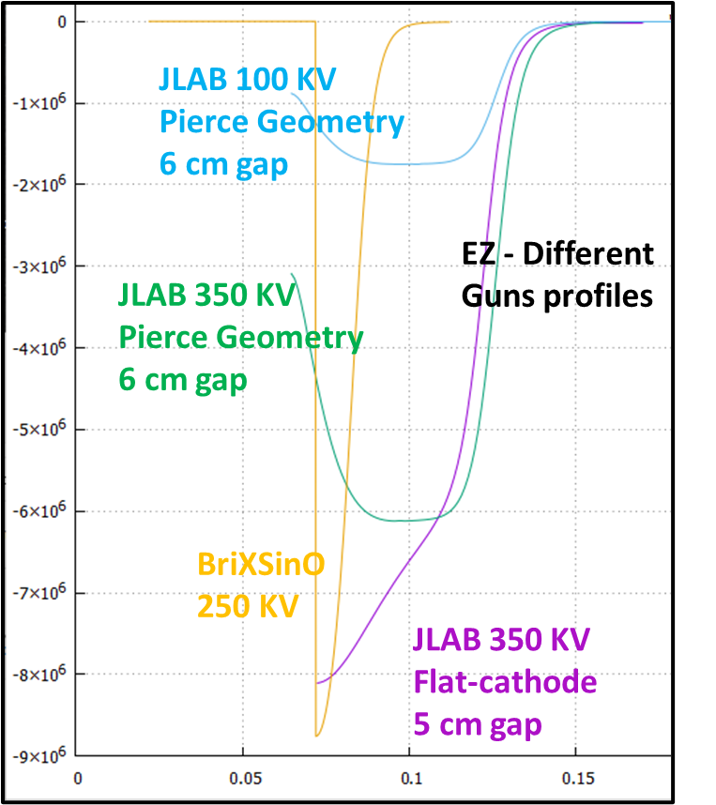
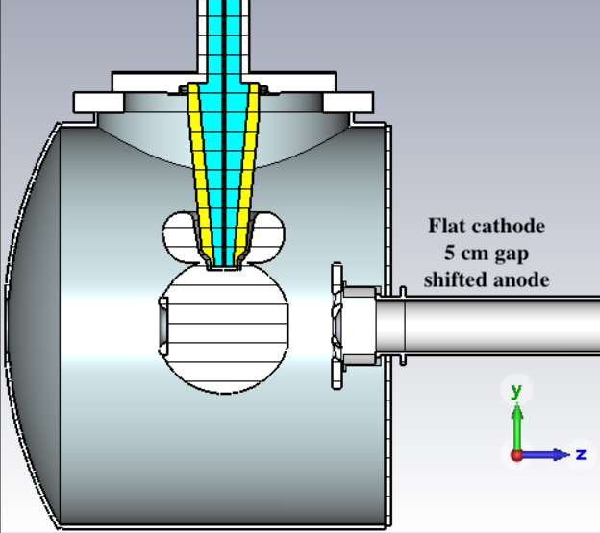
Adoption of the Flat-cathode JLab DC-gun profile
The Flat-cathode Ez profile works very well.
We tested some different cases:
ΔV = 250 kV (as BriXSinO gain case)
ΔV = 350 kV (DC maximum gain case)
ΔV = 300 kV (DC most reasonable operative gain case) The one we are going to use as reference value
Flat-cathode

Slide 5
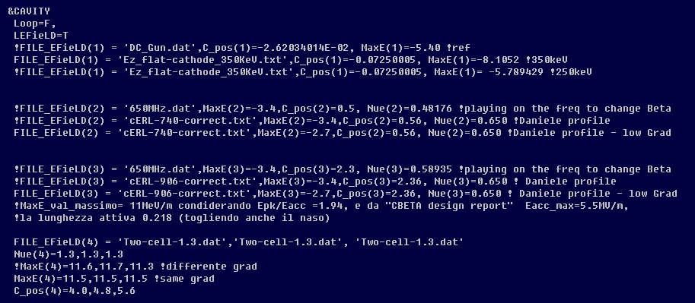
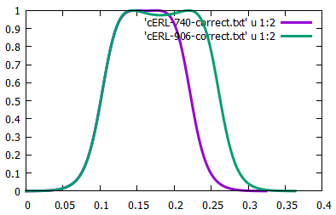
Real Bunchers (650 MHz) profile : β ≈ 0.7 & β ≈ 0.9
BriXSinO Case –old buncher --- to change β we changed the cavity freq.; in true not a realistic method if β is lower than 0.9
Now a real cavity field map from SuperFish
HB2TF Buncher-1
Ez
normalized
β ≈ 0.7
β ≈ 0.9
HB2TF Buncher-1
Vs
Buncher-2
Ez maps
HB2TF Buncher-2
Also a new map from SuperFish
Z [m]

Slide 6
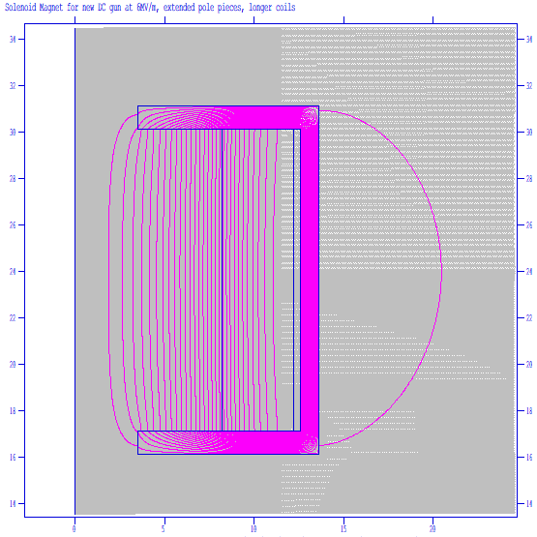
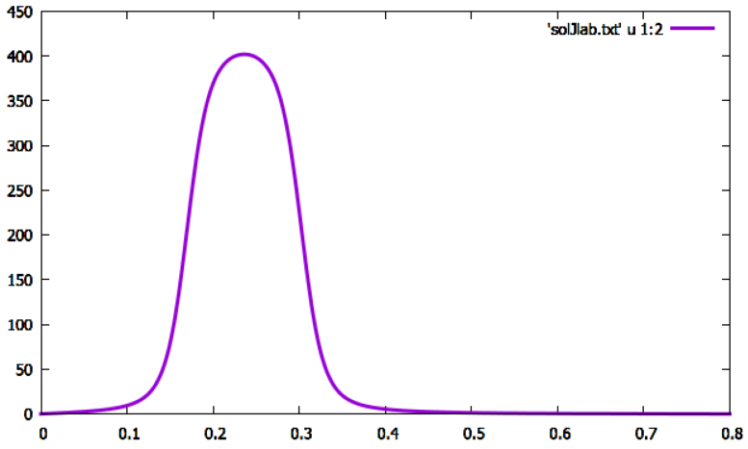
The Solenoid-Gun as received in December 22 from Carlos
(peak-field at z = 27cm)
Solenoid Gun as received from Carlos.
Peak Center at 27 cm from gun-cathode, position as in BriXSinO (i.e. as for Jaea 250 keV DC-Gun used for BriXSinO)
B_{z} [G]
Check compatibility with pipes and flanges
(@ feb-2023 it is compatible using movable discs)
Z [m]

Slide 7
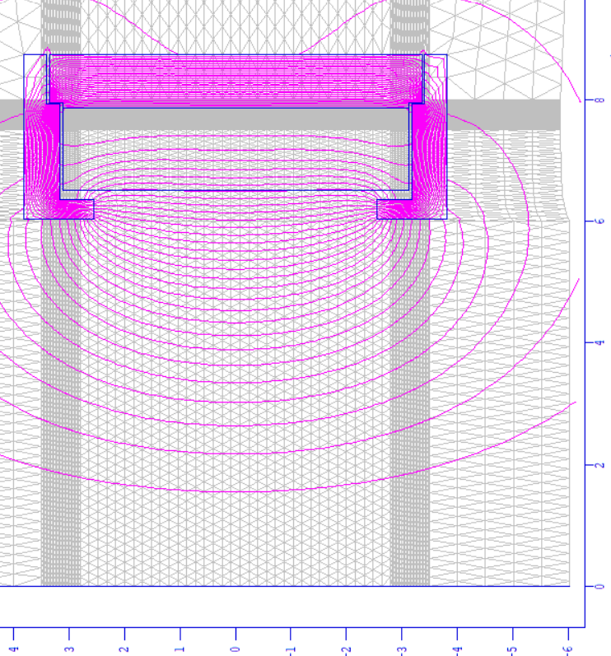
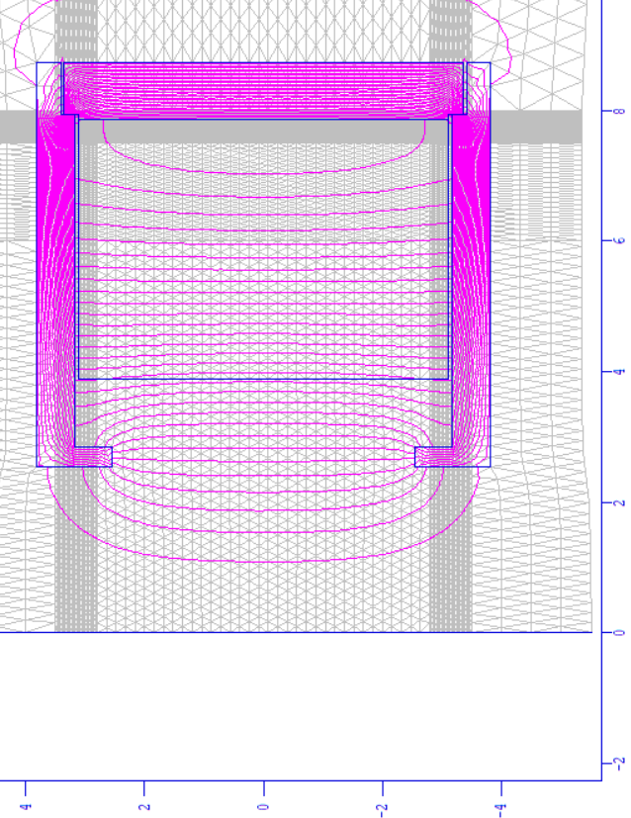
The Solenoids of the BeamLine reshaped with a larger bore that passes pipe’s flanges
BriXSinO
HB₂TF
6 cm
Orbit

Slide 8
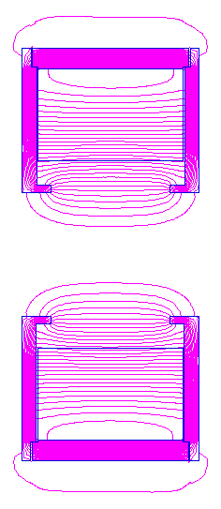
27 cm
120 cm
210 cm
300 cm
421 cm
501 cm
581 cm
27 cm
254 cm
Cathode
@ z=0
0.5
1
2
3
4
5
6
7
m
650 MHz
650 MHz
line
Solenoids
@slide 7
Gun
Solenoid
@slide 6
45 cm
50 cm
40 cm
40 cm
40 cm
The cryostat
Buncher-I @ 650 MHz
β=0.7
Buncher-II @ 650 MHz
β=0.9
Two Cells 1.3 GHz cavity

Slide 9
Initial Beam-line optimizations: 4 test cases @ 100 pC:
Pay attention:
we use 100 pC (HB2TF @ 50 pC) to compare with BriXSinO, understanding the real performance of the new layout.
The 4 cases:
BriXSinO-like case (Gun 250 keV; buncher @ E_{max}= 3.4 MV/m)
BriXSinO-like case 2 (Gun 250 keV; buncher @ E_{max}= 3.4 MV/m) --- A further Optimization on emit & Energy_spread
case 3 (Gun 350 keV; buncher @ E_{max}= 3.4 MV/m) --- “ “ “
case 4 (Gun 350 keV; buncher @ E_{max}= 2.7 MV/m) --- “ “ “
Parameters results @ 100 pC
case | Sig_X [mm] | Emit_nx [mm-mrad] | Sig_z [mm] | ΔE [keV] | Energy [MeV]
1 - BriXSinO | 1.20 | 1.2 | 1.24 | 10 | 4.6
2 –Jlab-250 | 1.25 | 1.06 | 1.48 | 5.6 | 4.5
3 –Jlab-350 | 1.2 | 0.82 | 1.25 | 2.4 | 4.2
4 – bunc-2.7 | 1.2 | 0.86 | 1.20 | 2.8 | 4.2

Slide 10
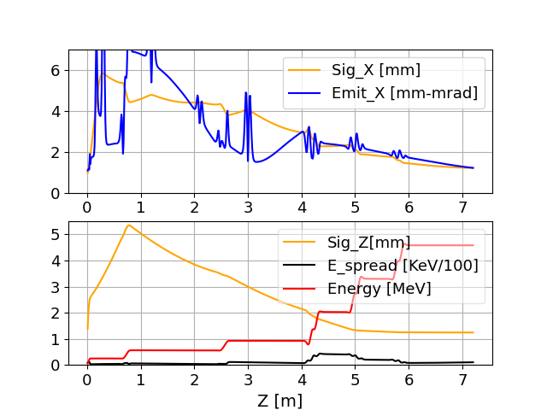
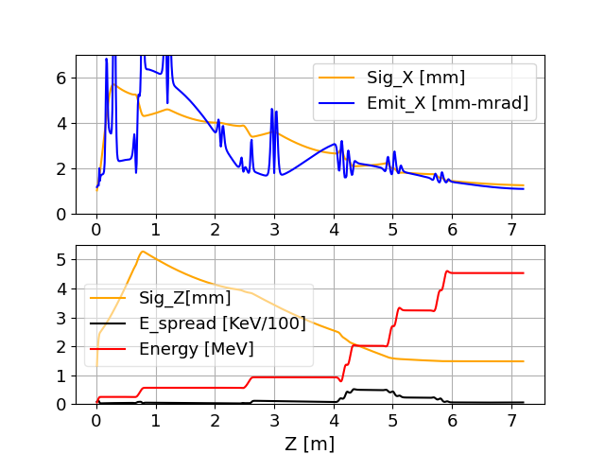
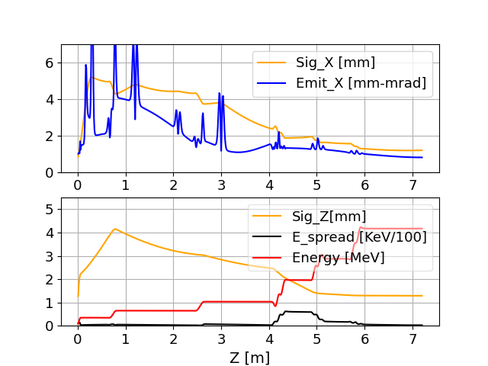
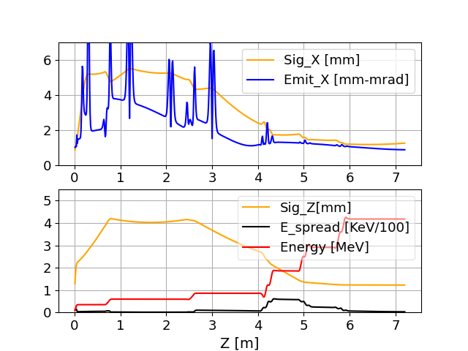
1 - BriXSinO
Beam Dynamics main plots
@ 100 pC
All these cases represent very well optimize ERL injectors at low energy.
We submitted a relative paper:
“A new scheme for low emittance in ERL injectors” (sub. January 23 at prst-ab)
2 – Jlab-250kV
3 – Jlab-350kV
4 – Buncher-2.7 & gun @ 350 kV
The Goal of reproducing BriXSinO parameters with Jlab -gun, new Solenoids and new Bunchers is achieved
This is the 100 pC case from which we switched to the HB2TF setting (next slide); i.e.
50 pC and 300kV in

Slide 11
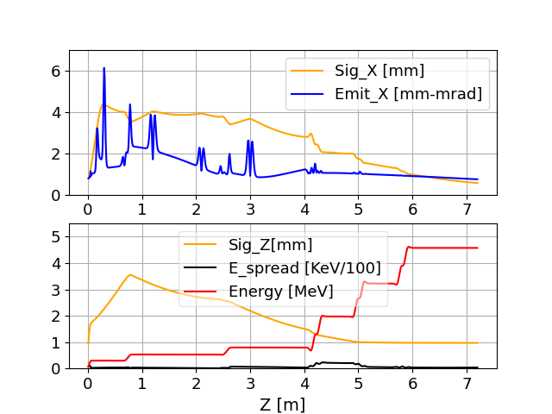
4 – Buncher-2.7 & gun @ 350 kV
A possible HB²TF working point
N. 5 – Buncher-2.7 – Gun 300 keV – charge 50 pC
Charge | case | Sig_ X [mm] | Emit_nx [mm-mrad] | Sig_z [mm] | ΔE [keV] | Energy [MeV]
100 pC – 350 keV | 4 | 1.2 | 0.86 | 1.20 | 2.8 | 4.2
50 pC – 300 keV | 5- HB²TF | 0.56 | 0.74 | 0.97 | 3.5 | 4.56
Emit & Energy (as low as possible) are more important parameters. The bunch length can be shortened exploiting the R₅₆ of any ERL DBA line

Slide 12
Insight into the HB2TF working point N.5
Main data:
50 pC Bunch charge
DC-gun @300keV
New line solen. respect
New Bunchers profiles
Bunchers with E_{peak} = 2.7 MV/m
Region of the cryogenic booster needed to rise the beam energy before entering the typical dispersion line that inject any ERL
Charge | case | Sig_ X [mm] | Emit_nx [mm-mrad] | Sig_z [mm] | ΔE [keV] | Energy [MeV]
100 pC – 350 keV | 4 | 1.2 | 0.86 | 1.20 | 2.8 | 4.2
50 pC – 300 keV | 5 the new | 0.56 | 0.74 | 0.97 | 3.5 | 4.56

Slide 13
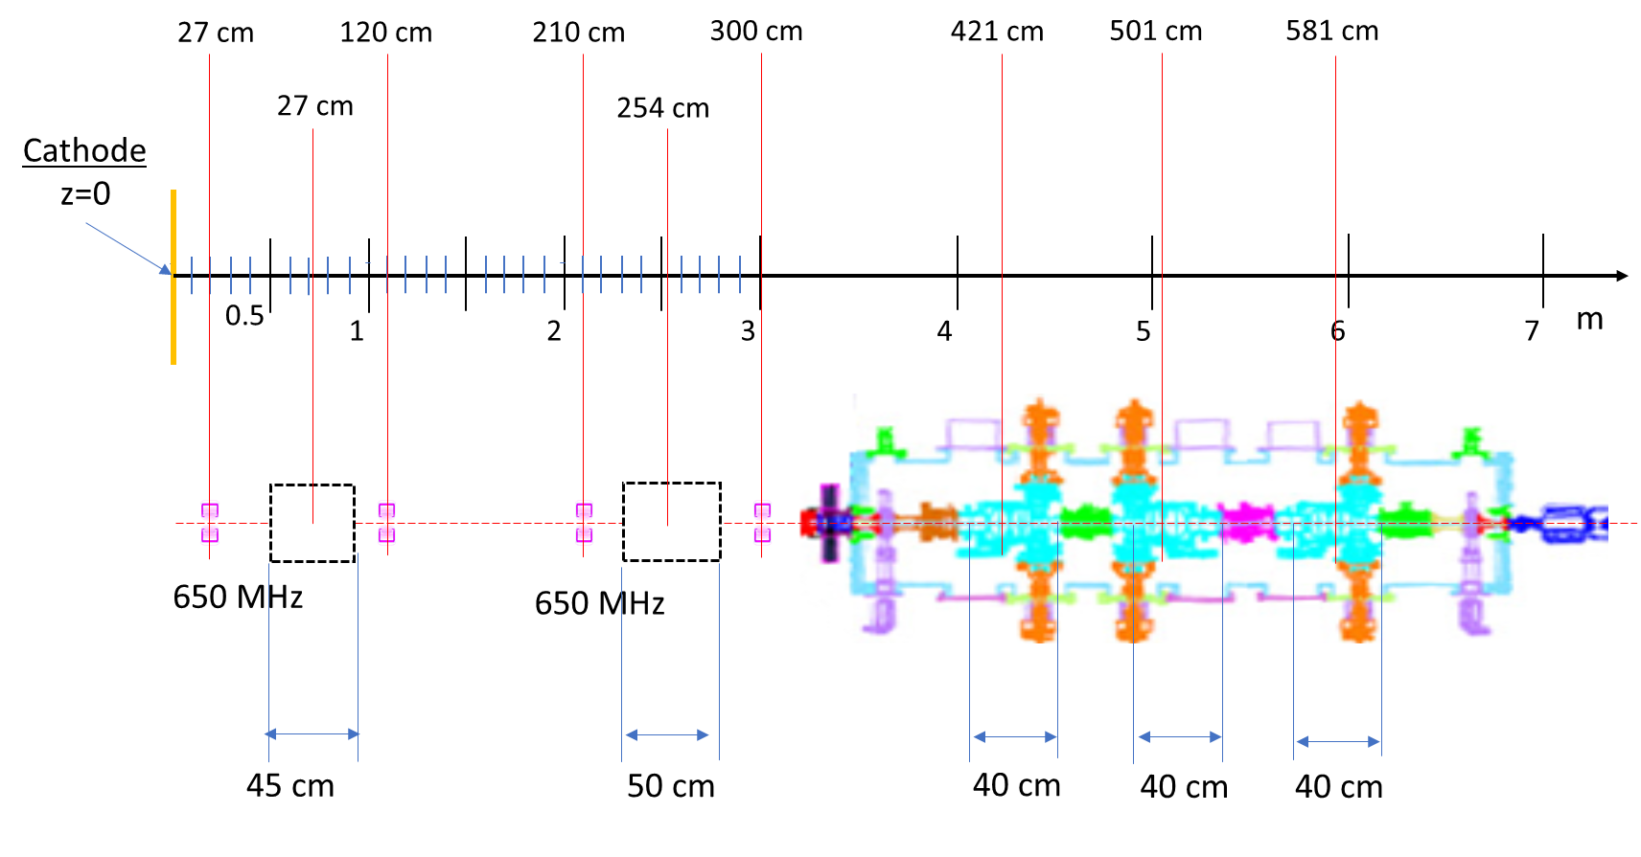
Preliminary hypothesis about an emittance measurement
Pepper-pot/slits position for emittance measurement. Position before the solenoid; the measure
has be done out of the B_{z} field tails
If the emit is measured before the solenoid can be turned off.
The slits can be hosted also downstream the solenoid but in this case it has to be turned on, to be checked the Bz tails.
This measure is still under discussion
Screen position from 50-120 cm seems a reasonable range

Slide 14
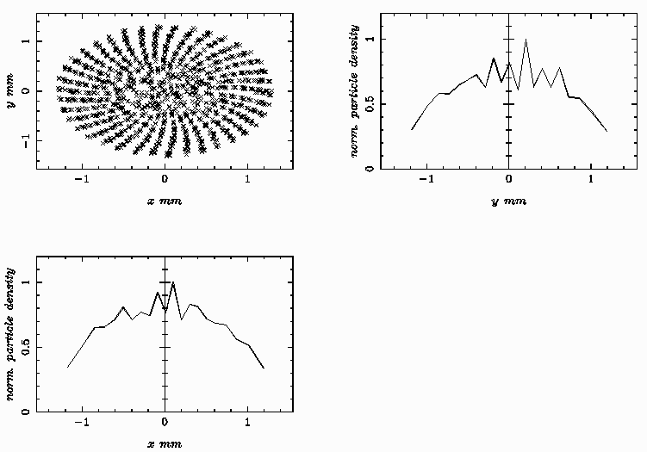
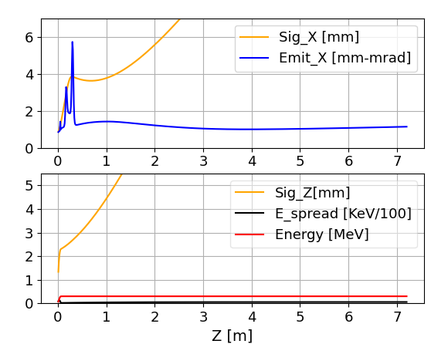
Considering only the GUN (300 kV),
Laser pulse shaping:
Laser_t= 18 ps
L-Sig_x= 0.650 um
Pepper-pot/slits position and relative measure position

