Slide 1
Technology update as of 24-may-2023
Andrea Chierici

Slide 2
Terms and definitions
HBM: High Bandwidth Memory
MCR DIMM: Multipexer Combined Ranks DIMM
GPU: Graphic Processing Unit
CPU: Central Processing Unit
APU: Accelerated Processing Unit
SoC: System on Chip
TSMC: Taiwan Semiconductor Manufacturing Company

Slide 3

Focus
Focus only on major chip makers
Leaving to another update storage
Everything on this presentation is publicly available
  Nothing is under NDA

Slide 4
General aspects and common technologies

Slide 5
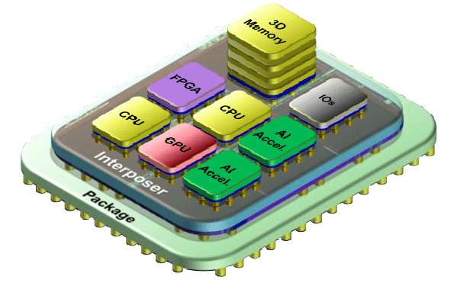

Introducing the “chiplet” (a.k.a. tile)
Chiplets are small, modular chips that can be combined to form a complete system-on-chip (SoC).
  designed to be used in a chiplet-based architecture, in which multiple chiplets are connected to create a single, complex integrated circuit.
  offer several benefits over traditional monolithic SoCs, including improved performance, reduced power consumption, and increased design flexibility.
Universal Chiplet Interconnect Express (UCIe)
  Promoters include Intel, AMD, ARM, e Samsung
  Trying to define standards to allow integration of chiplets from different manufacturers within the same chip.
A modern CPU like AMD EPYC gen3, is composed of separated modules containing core, memory controller, PCIe bus.
  All built with different fabrication technology

Slide 6
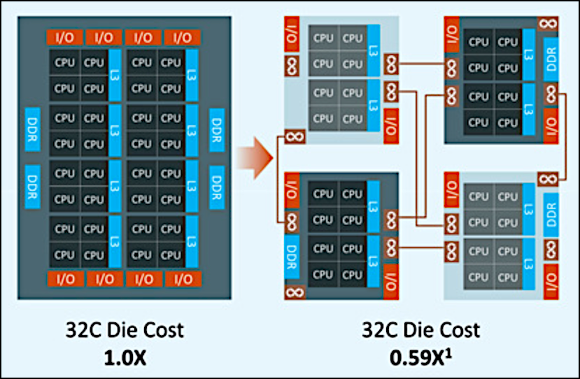
Chiplet: example (1)

Slide 7
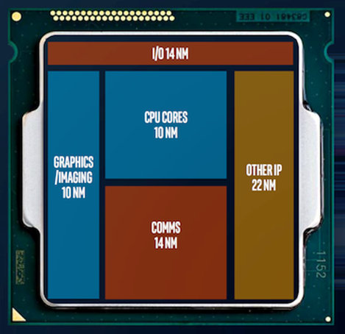
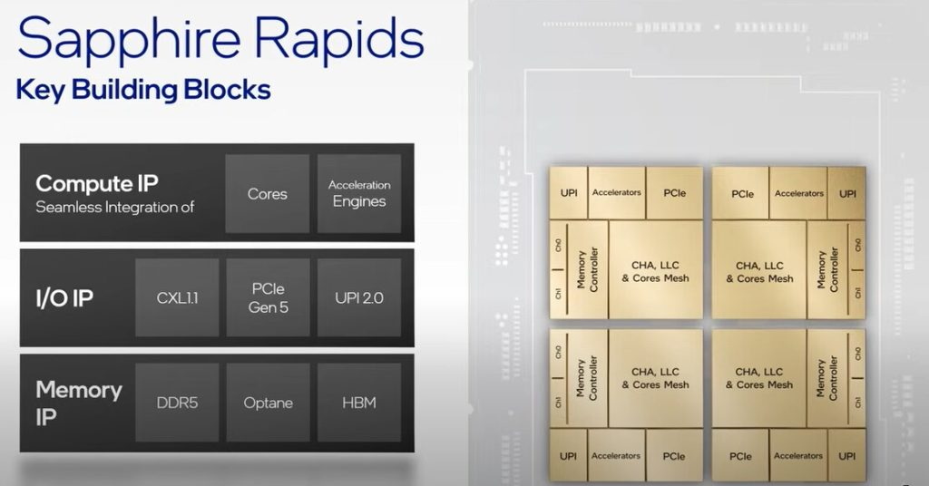
Chiplet: example (2)

Slide 8
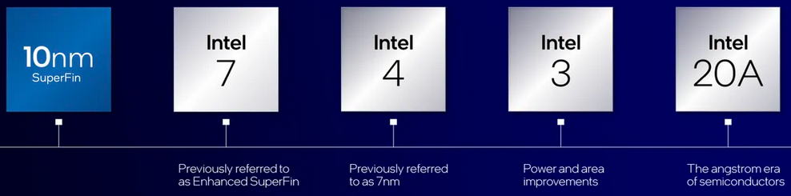
Fabrication technology
In a CPU, nm is used to measure the size of the transistors that make up a processor.
In technological terms, a processor's nm is also referred to as a process node or technology process, or just node.
  It is the manufacturing process and design of a CPU made through lithography.
Lower nm is better for your machine due to the following reasons
  More power efficient
  Less cooling required
  Transistors are faster
  Transistor density is higher
14nm, 10nm, 7nm… today the terms are used primarily as marketing terms to refer to new or improved generation of chips

Slide 9
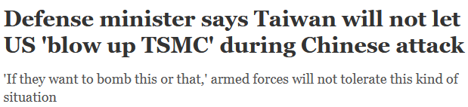

Major foundries are in Asia
Top 5 semiconductor companies
  TSMC 55% Taiwan, Samsung 13% Korea,
  Globalfoundries 7% USA, UMC 6% Taiwan, SMIC 5% China
On 8 February 2022, the European Commission proposed the Chips Act, a comprehensive set of measures to confront semiconductor shortages and strengthen Europe’s technological leadership
  And yet ASML, the largest supplier for the semiconductor industry and the sole supplier in the world of extreme ultraviolet lithography, is Dutch.
Notes:
Tutto, in realtà, è nato da una dichiarazione di un membro del Congresso, Seth Moulton, secondo il quale gli Stati Uniti dovrebbero avvertire la Cina di essere pronti a far "esplodere" TSMC se attaccasse Taiwan.

Slide 10
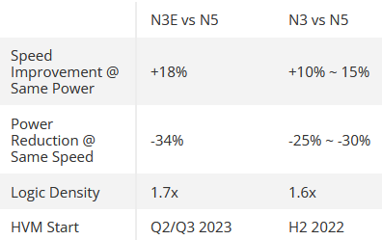
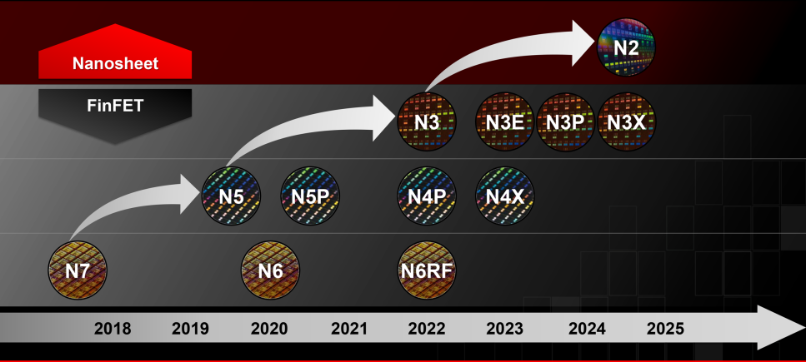
TSMC Roadmap

Slide 11
Compute Express Link (CXL)
The CXL spec is an open industry standard that provides a cache coherent interconnect between CPUs and accelerators, like GPUs, smart I/O devices, like DPUs, and various flavors of DDR4/DDR5 and persistent memories.
The interconnect allows the CPU to work on the same memory regions as the connected devices, thus improving performance and power efficiency while reducing software complexity and data movement.
All major chipmakers have embraced the spec: AMD, Intel, Nvidia, Arm, followed by memory makers, hyperscalers, and OEMs

Slide 12


Slide 13
CPU roadmap

Slide 14
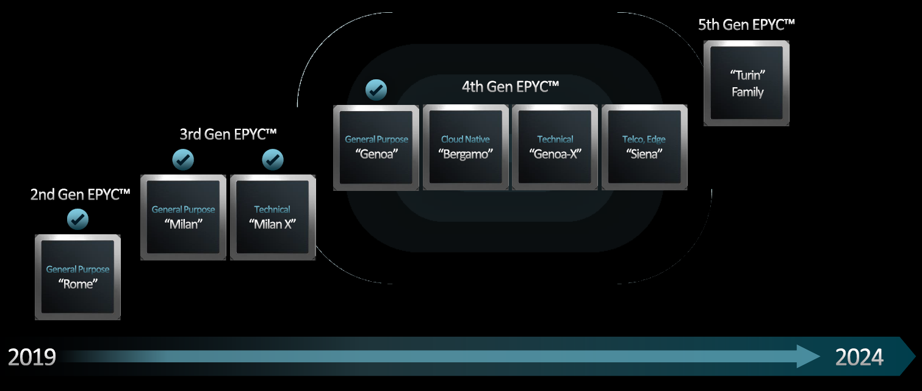
EPYC family
Sticking to regular cadence and flawless execution
Carved the datacenter up into four segments:
  General purpose - socket level performance
  Technical – core level performance
  Cloud-native – maximum core and
  thread density
  Telco/Edge – lower-cost platform

Slide 15
5th gen EPYC (Turin)
Based on Zen 5 architecture, 4nm
Expected end 2024
4nm node
Four variants: plain, with 3D V-Cache, Zen 5c, AI
  Plain should have 128 cores, up to 500W TDP
  3D V-Cache is a packaging technology that stacks additional layers of cache on top of a CPU
  Zen 5c is the version with high core count, up to 192 (rumored 3nm)
  AI version should include a Zen 5c plus an AI chiplet
1 socket could be enough in many situations
  Cheaper platform
  Still high core count

Slide 16
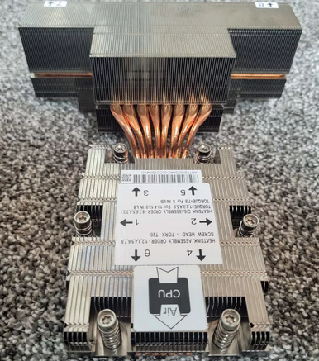
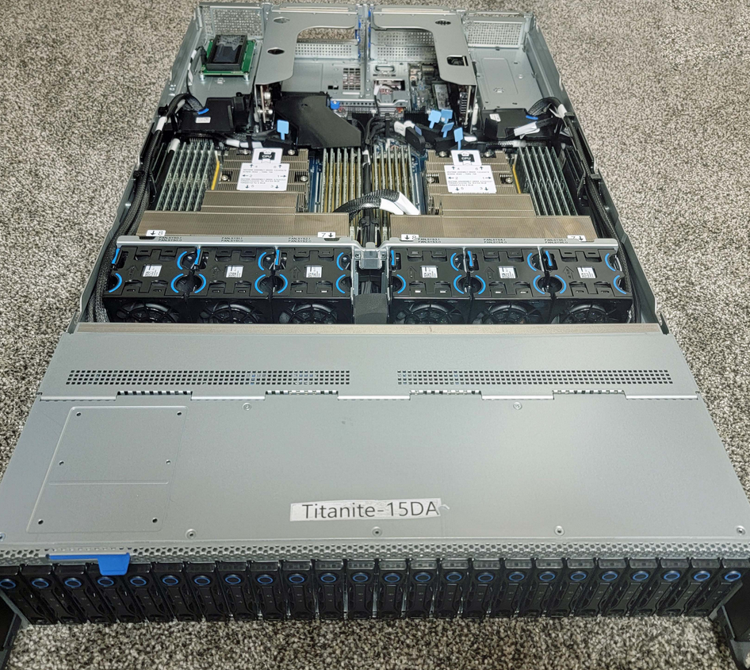


Cooling
128 cores Turin has a default TDP of 500W
  In 2P configuration 1KW only for CPUs! 2U servers!

Slide 17
GPU roadmap

Slide 18
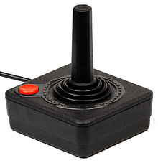
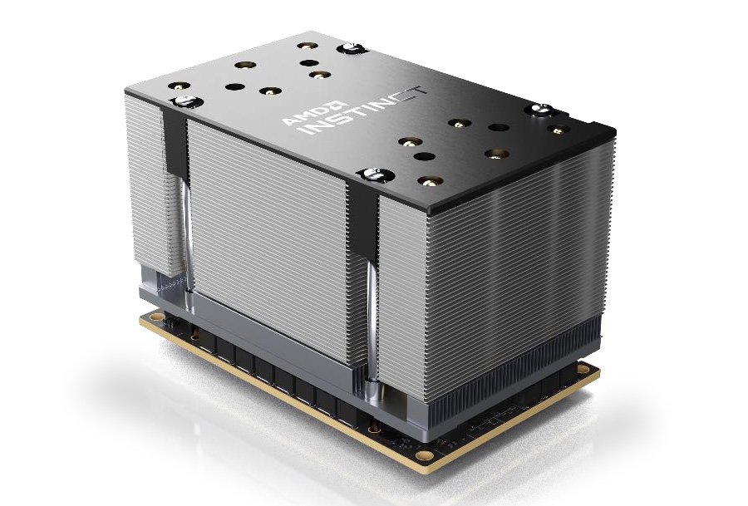

AMD GPUs in Data Center
GPU architecture for Data Center is called CDNA - RDNA is for
Current “Instinct” MI200 family is based on CDNA 2
Thanks to IF links, can achieve coherent memory space between CPU and GPU (advantages for the right workloads)
For the MI250x the form factor is the OCP Accelerator Module (OAM)
  Can reach 700W for a single card
  Can potentially offer interoperability
  with other OAM hardware
Frontier supercomputer is based on it

Slide 19
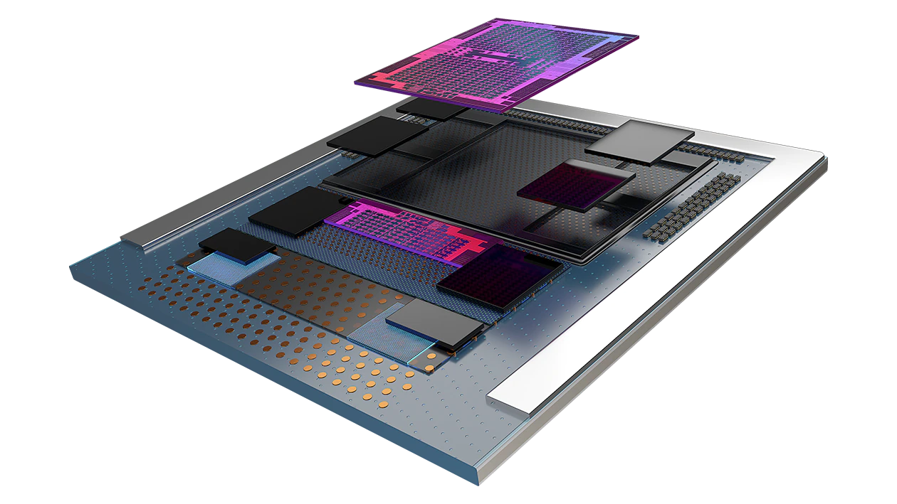
Next gen: MI300 Data Processing Unit
Combining AMD CPU and GPU technologies
  multiple chiplets built on 5nm process
  3D die stacking over a base die
  paired with on-package HBM memory to maximize bandwidth
Specs
  146B transistors
  24 Zen4 CPU cores
  CDNA 3 CU
  128GB HBM3 memory

Slide 20
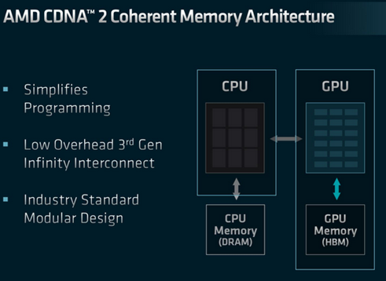
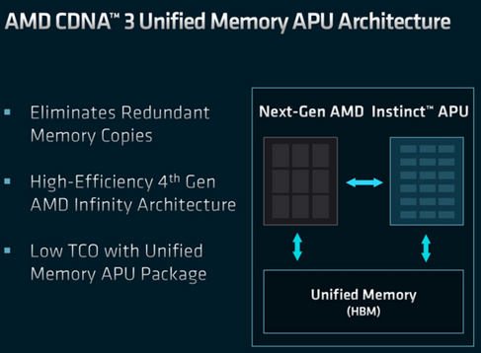
Unified memory
Unified memory PROS
  Performance increased by eliminating redundant memory copies
  CPU no longer needs to copy data over to the dedicated memory pool
  No additional memory (DRAM) is required
  No static memory allocation between CPU and RAM
Unified memory CONS
  Memory on chip can’t be increased

Slide 21

Figures and results
According to AMD
  >5x improvement in AI performance-per-watt versus the MI250X (Frontier GPU)
  overall >8x improvement in AI training performance
  simplify HPC programming at a socket level by giving both processor types direct access to the same memory pool
    not just a unified virtual memory space with copies to hide the physical differences
    A truly shared and physically unified memory space

Slide 22


Slide 23
CPU roadmap

Slide 24
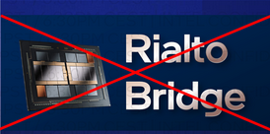
In short
Intel declares to be finally turning a corner in their critical data center business segment
2 CPU generations coming in few months (4th and 5th)
  Sapphire rapids (4th, first chiplet-based - tiles, initial launch delayed)
  Emerald rapids (5th)
  Sharing same socket
Cancelation of “Rialto Bridge”, the new
Data Center GPU product

Slide 25
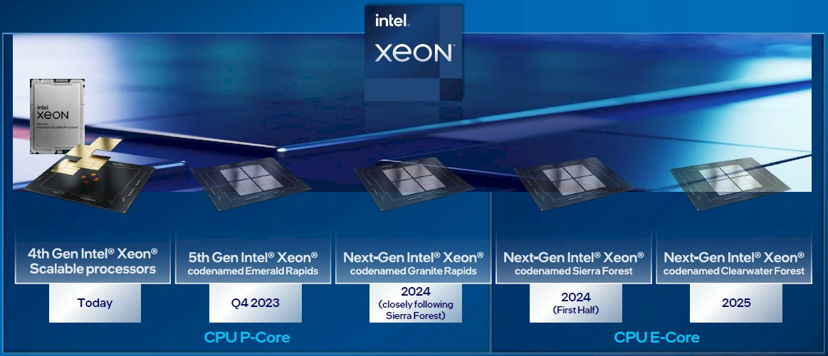
Xeon Roadmap

Slide 26
Xeon Roadmap - details
Xeon Scalable Generations
Date | AnandTech | Codename | Abbr. | Max Cores | Node | Socket
Q3 2017 | 1st | Skylake | SKL | 28 | 14nm | LGA 3647
Q2 2019 | 2nd | Cascade Lake | CXL | 28 | 14nm | LGA 3647
Q2 2020 | 3rd | Cooper Lake | CPL | 28 | 14nm | LGA 4189
Q2 2021 |  | Ice Lake | ICL | 40 | 10nm | LGA 4189
Q1 2023 | 4th | Sapphire Rapids | SPR | 60 P | Intel 7 | LGA 4677
Q4 2023 | 5th | Emerald Rapids | EMR | >60 P | Intel 7 | LGA 4677
H1'2024 | 6th? | Sierra Forest | SRF | 144 E | Intel 3 | ?
2024 |  | Granite Rapids | GNR | ? P | Intel 3
2025 | 7th? | Clearwater Forest | CWF | ? E | Intel 18A | ?
? |  | Next-Gen P | ? | ? P | ?

Slide 27
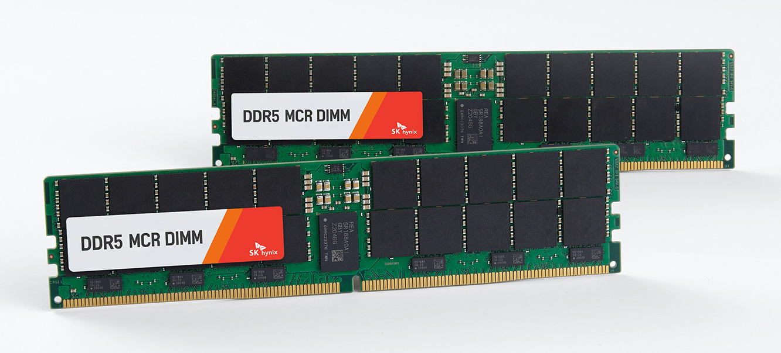
Granite Rapids
Granite Rapids is a tile-based architecture, with separate compute and I/O tiles – an evolution from Sapphire Rapids,
Tiles are being built on the Intel 3 process
Will also come with a notable new memory feature: MCR DIMM support.
  Multiplexer Combined Ranks (MCR) DIMMs
  essentially gang up two sets/ranks of memory chips
  in order to double the effective bandwidth to
  and from the DIMM.
  Aiming to get data rates equivalent to
  DDR5-8800 (or higher) speeds
  Preliminary tests show 1.5TB/s on a dual
  socket system, 12 channels

Slide 28
Introducing E-cores and P-cores
x86 CPUs used core layouts comprised of cores that are, for the most part, identical to one another.
  Each core has the same processing capacity and clock speed
British semiconductor developer Arm decided to switch things up with what's known as a big.LITTLE architecture.
  ARM architectures effectively have two sets of cores doing different tasks.
    The bigger, performance-focused cores handle the heavier tasks
    the smaller, efficiency-oriented cores take up background tasks while consuming way less energy.
Intel first introduced this approach in Alder Lake chips (for clients) two sets of CPU cores: E-cores and P-cores.

Slide 29
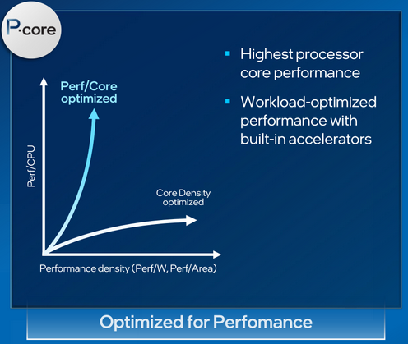
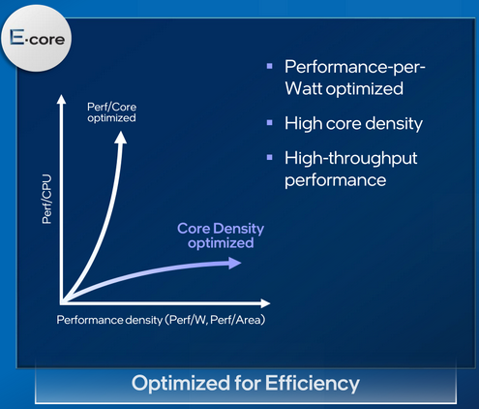
Sierra Forest (H1-2024)
First E-core Xeon
Using only optimized “efficiency cores”
Up to 144 processor cores
Built for cloud-optimized workloads
Sharing the same platform as Granite rapids
  Also, same I/O tiles
P-core and E-core Xeons are remaining distinct product lines.

Slide 30
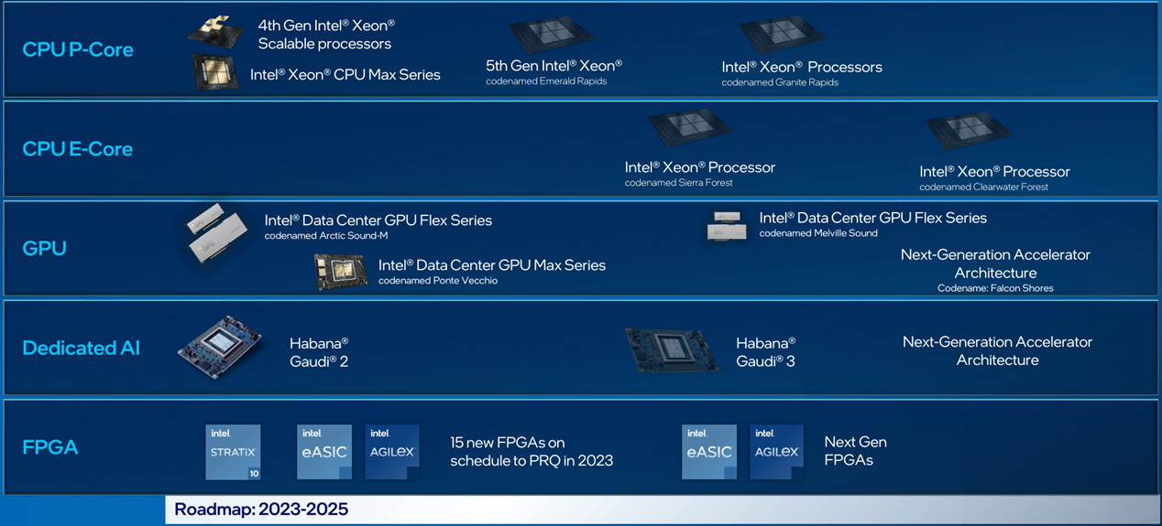
DCAI Architecture evolution

Slide 31
GPU roadmap

Slide 32

A bit of a bombshell
Intel cancelled multiple server GPU products that were planned
  No more HPC-class Rialto Bridge GPU this year
Falcon shores delayed until 2025
Previous roadmap was too tight
  Two-year product release cadence for server GPUs.
Announce given at 5pm on a Friday, just when stock exchange was closing…

Slide 33
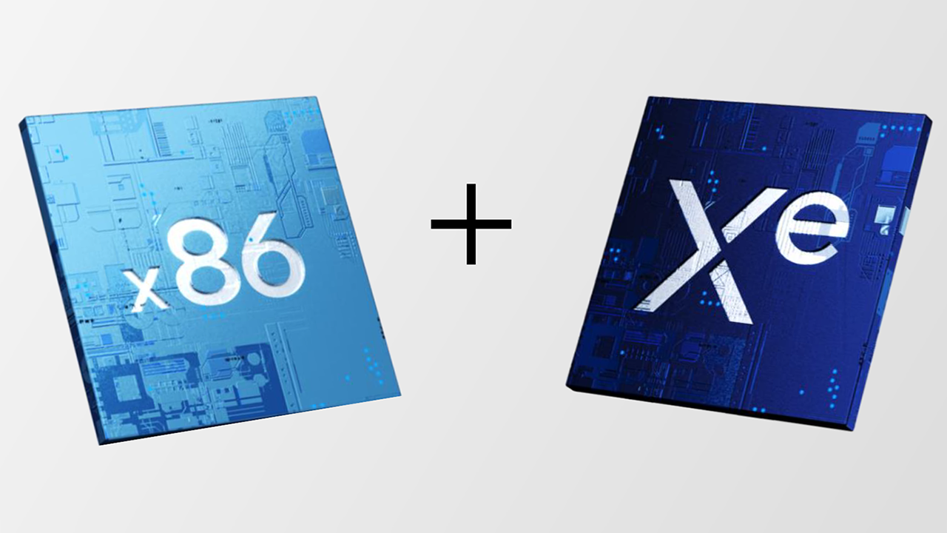

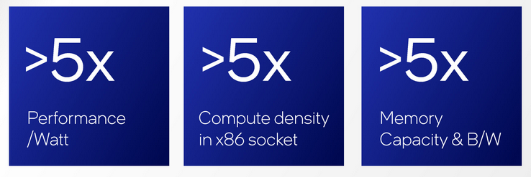
Falcon Shores
XPU concept
  The “X” in “XPU” stands for any compute architecture that
  best fits the need of your application.
  X can be CPU, GPU, FPGA
oneAPI software stack is designed to abstract away many of the hardware differences to allow easier multi-architecture development..
Targeting the market for HPC users with absolutely massive datasets
  the kind that can’t easily fit into the relatively limited memory capacity of a discrete GPU
offering multiple SKUs with different numbers of cores
    likely enabled by varying the number of x86 and Xe titles
Refactored

Slide 34

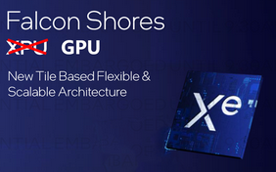
From a XPU in 2024 to a GPU in 2025
This is the future of Falcon Shores
A bit of a problem here for intel:
  Ponte Vecchio is already an old design today
  The delay to 2025 for the new product is a concern
    No real competition from intel in GPU market in the near future
  Intel will not be able to compete with
  AMD MI300 and Nvidia Grace Hopper up
  until 2026

Slide 35


Slide 36
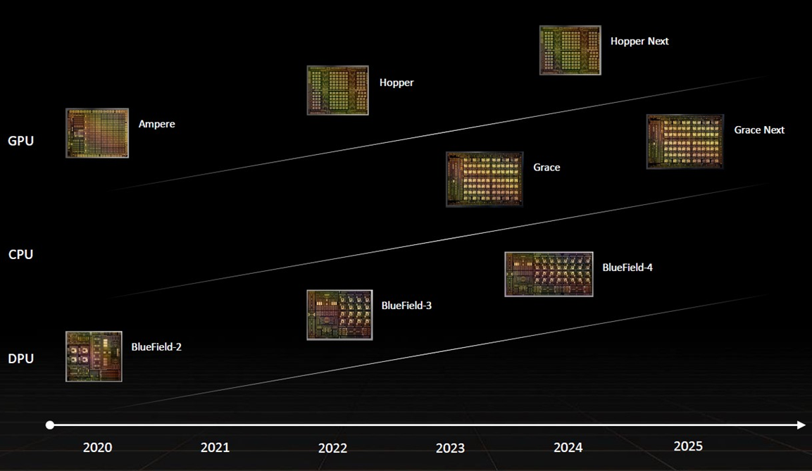
Data Center roadmap
Notes:
NVIDIA BlueField® data processing units (DPUs) ignite unprecedented innovation for modern data centers and supercomputing clusters. By offloading, accelerating, and isolating a broad range of advanced networking, storage, and security services, BlueField DPUs provide a secure and accelerated infrastructure for any workload, in any environment, from cloud to data center to edge.

Slide 37
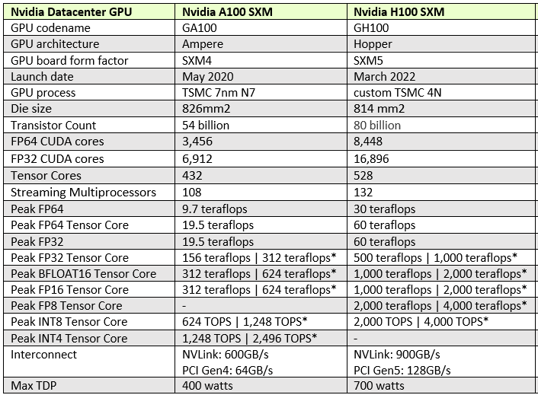
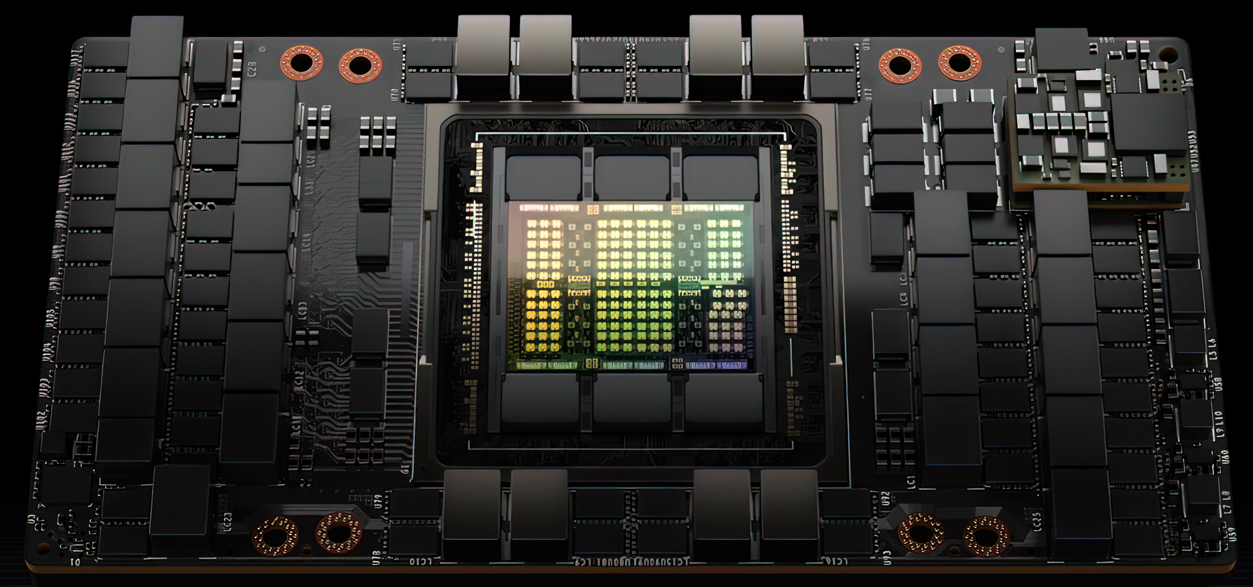
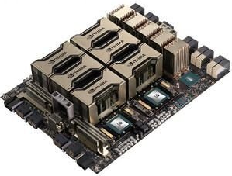
NVIDIA H100

Slide 38
Grace CPU specs
CPU for AI and HPC infrastructure
144 Neoverse V2 ARM Cores
  2 CPUs, 72 core each
LPDDR5x with ECC 1TB/s bandwidth
500W total power consumption, including memory

Slide 39
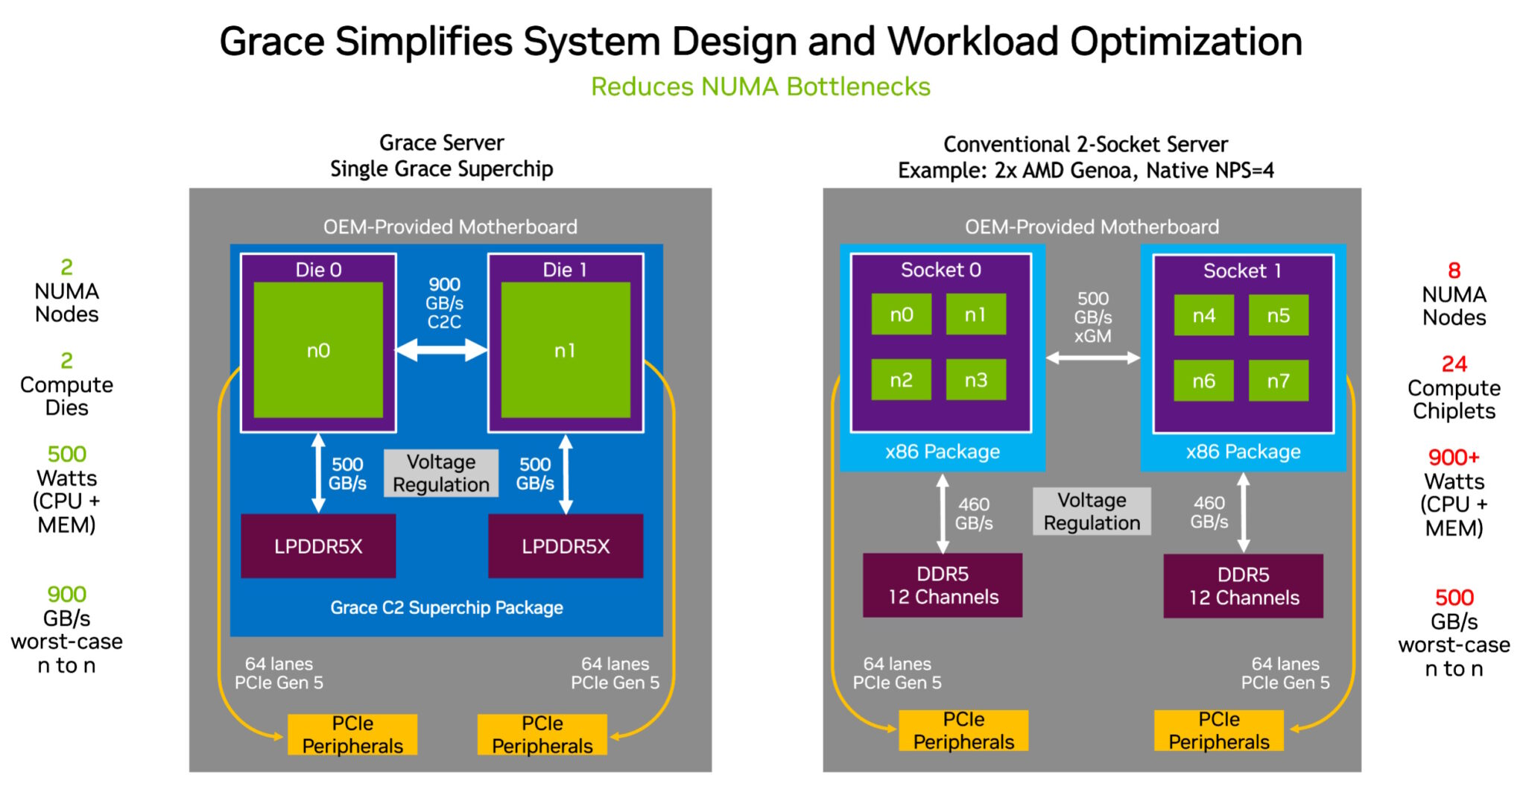
Architecture

Slide 40
Some figures
NVIDIA declares Grace 1.2 times faster than an “average x86 next-gen CPU”
Requires just 60% of the power
  Can fit into passively-cooled modules
1.7 times more servers in limited power DC
Not targeted to general purpose server market
  Optimized for AI and cloud

Slide 41
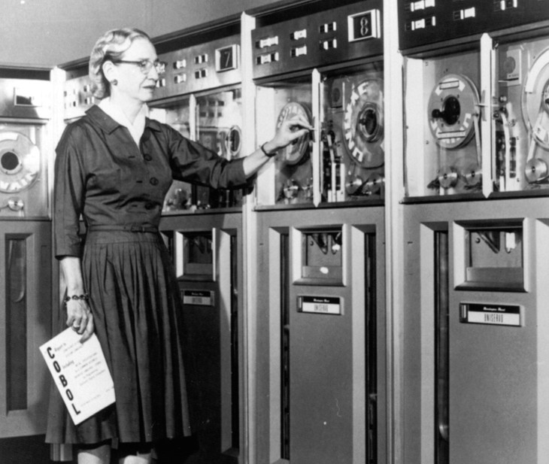
Grace Hopper
Grace CPU plus Hopper GPU
600GB mem available to GPU
LPDDR5x and HBM3
15x higher system memory bandwidth to GPU
  Via NVLink-c2c

Slide 42
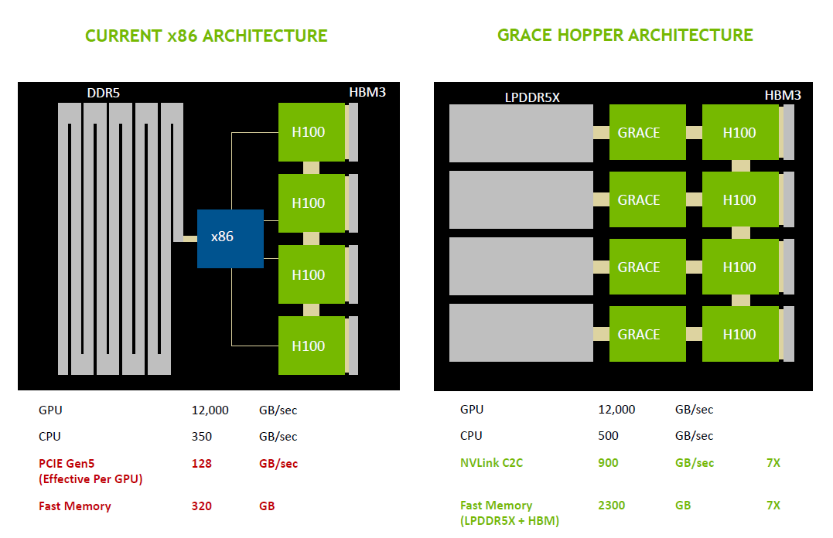
Architecture
NVIDIA declares this approach to allow CPU and GPU to share information held in memory at unrivalled speed

Slide 43
Final words on “superchips”
Combined CPU+GPU products
  NVIDIA with Grace Hopper (Grace + H100)
  Intel with Falcon Shores XPUs (mix & match CPU + GPU)
  AMD MI300 with its use of both CPU and GPU chiplets on a single package.
These technologies are aimed at combining the best of CPUs with the best of GPUs for workloads that are not purely bound by either
Different design approaches and programming interfaces
  Fast access to memory is the key factor
Cancelled

