Slide 1


The MRPC-based ALICE Time-Of-Flight detector: status and performance
Andrea Alici
on behalf of the ALICE TOF Group
Museo Storico della Fisica e Centro Studi e Ricerche Enrico Fermi, Rome
INFN, Bologna
TRDs for the third Millennium
4th Workshop on Advanced Transition Radiation Detectors for Accelerator and Space Application
Bari, Italy, September 14 – 16, 2011

Slide 2
Outlook
Overview of the TOF detector at the LHC ALICE experiment
The core of the ALICE TOF detector: the Multigap Resistive Plate Chambers (MRPCs)
Status and performance of the TOF detector

Slide 3
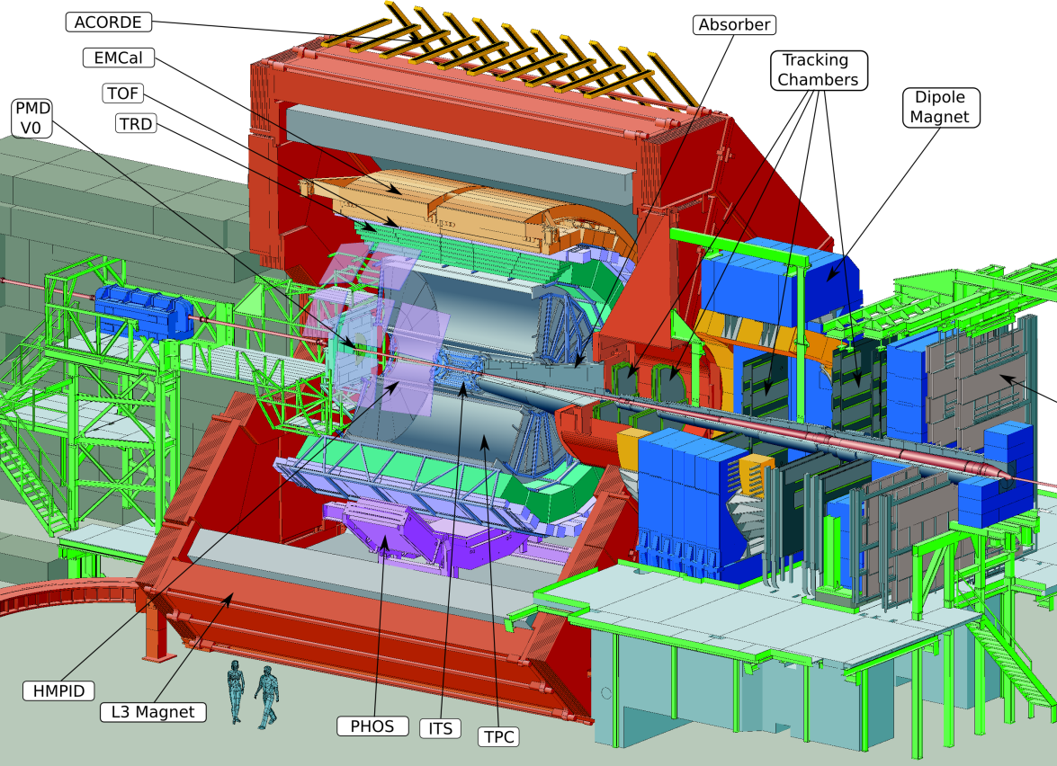
ALICE experiment
ALICE is the heavy-ion dedicated experiment at LHC, designed and optimized for Pb-Pb collisions @ 5.5 TeV/NN. A large Time-Of-Flight array is devoted to charged hadron identification in the mid-rapidity region.
TOF

Slide 4
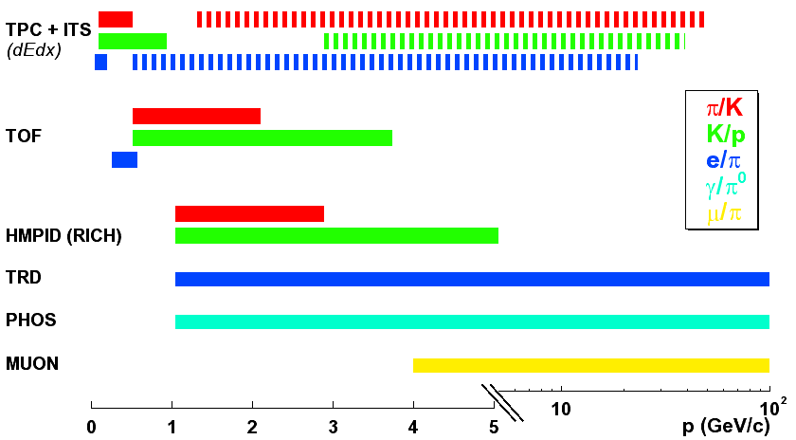
The ALICE Time-Of-Flight detector
The ALICE TOF detector aims at charged hadron identification up to a few GeV/c (3σ π/K and K/p separation up to 2.5 GeV/c and 4 GeV/c respectively).
Design values assuming a TOF global time resolution of 80 ps
Separation:
@ 3σ
@ 2σ

Slide 5
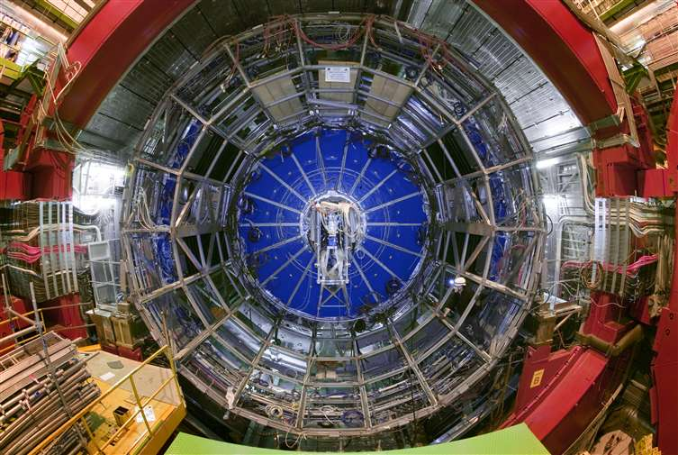
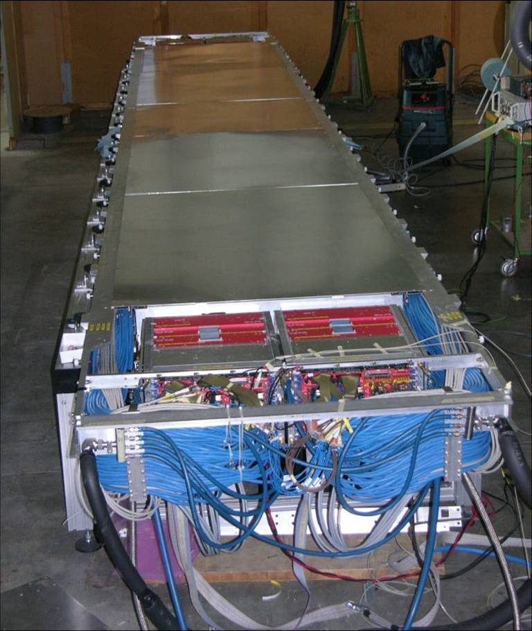
The ALICE Time-Of-Flight detector
Cylindrical surface of ~ 150 m² of area with an inner radius of 3.7 m;
Full azimuthal acceptance;
Polar acceptance |η| ≤ 0.9;
Φ segmentation : 18 – fold (sectors or SuperModules);
91 MRPCs for SuperModule for a total of 1593 MRPCs;
96 readout channels of ~ 10 cm² of area for MRPC for a total of 152928 channels.
R=3.7m
The largest element of the TOF: a SuperModule 9.3 m long and 1.4 ton heavy

Slide 6
The MRPC
NIM A374 (1996) 132
HV
Resistive plates are physics barriers to stop the avalanche growing too big, but they are invisible for fast signals; the readout signal is the sum of the signals induced in each gap.
cathode
resistive
plate
anode
HV
Readout pads
High resistive electrodes allow to apply very intensive electric fields avoiding sparks inside the gas gap.
Dead time depends on the relaxation time τ=ρε₀ε_{r} and on the amount of charge in the avalanche; since this charge depends on the distance travelled by the avalanche as n(x+d)=n(x)*exp(α_{eff}d), to ensure a good rate capability small gaps are needed.
A serie of many gas gaps guarantees a high efficiency.

Slide 7
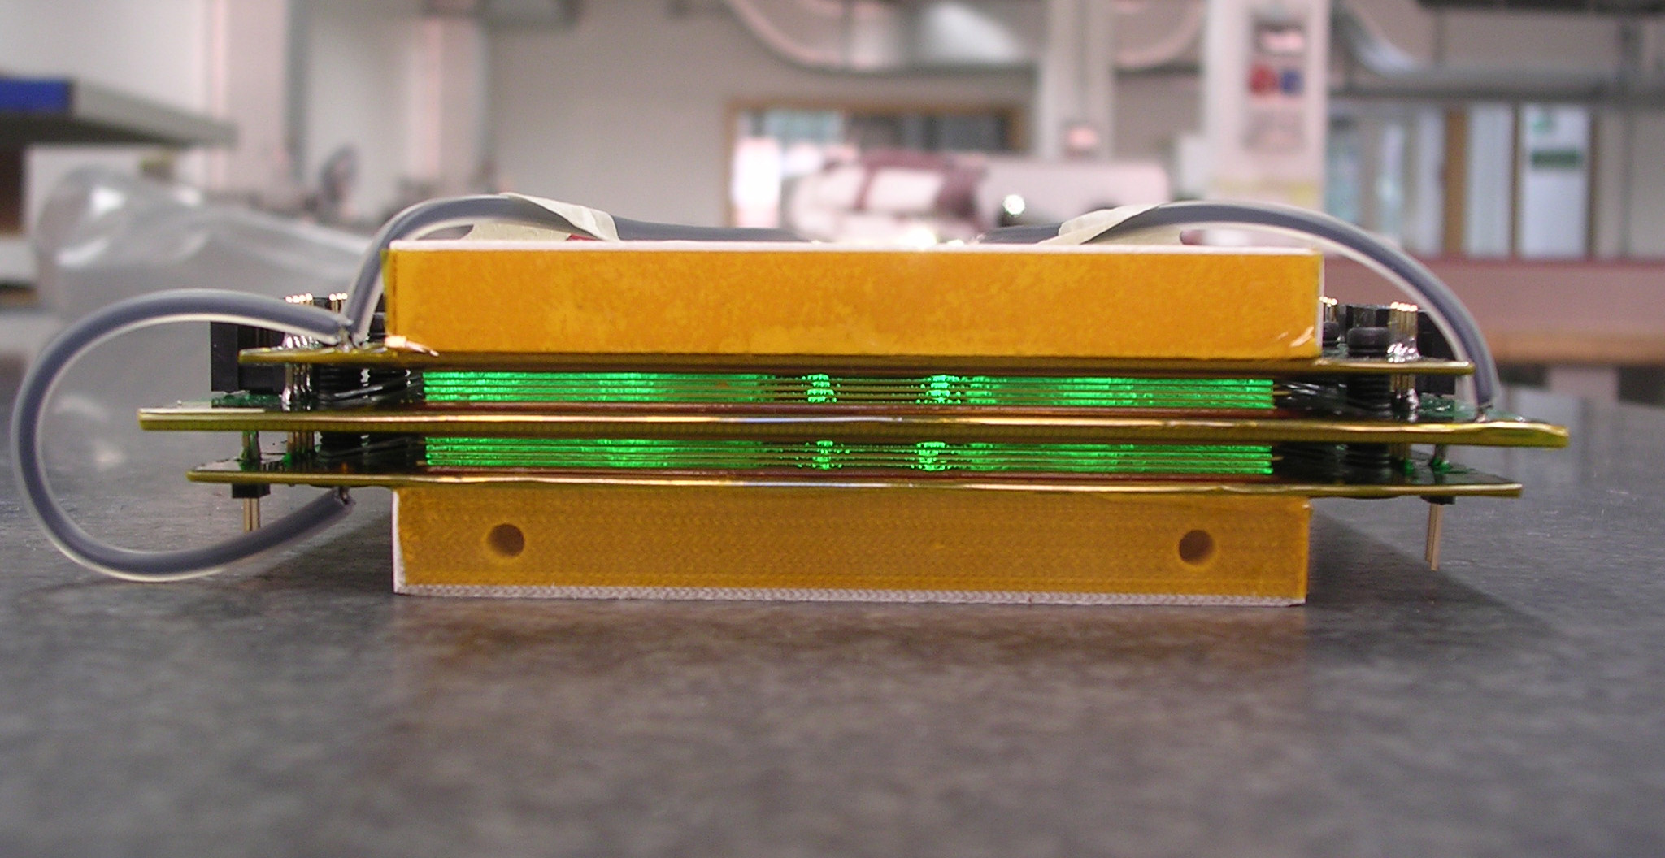
The MRPC as timing detector
cathode
Typical parameter for ALICE MRPCs are, assuming ΔV ≈ 13kV and standard gas mixture →
E ≈ 100 kV/cm
α_{eff} ≈ 100 mm⁻¹
v_{D} ≈ 200 μm/ns
anode
1cm
cathode
The key to obtain MRPCs with time resolution of few tens of ps is to have gas gaps with submillimetric size.
Time resolution is determined mainly by the avalanche statistic σ ≈ 1/(α_{eff} v_{D}).
In this regime (E ≈ 100kV/cm, very high Townsend coefficient α_{eff} ≈ 100 mm⁻¹) the development of the avalanche is strongly dominated by space-charge effect. Space-charge field inside the avalanche reaches the same magnitude as the applied electric field, stopping the exponential develop of the avalanche → avalanche mode even at very high fields.

Slide 8
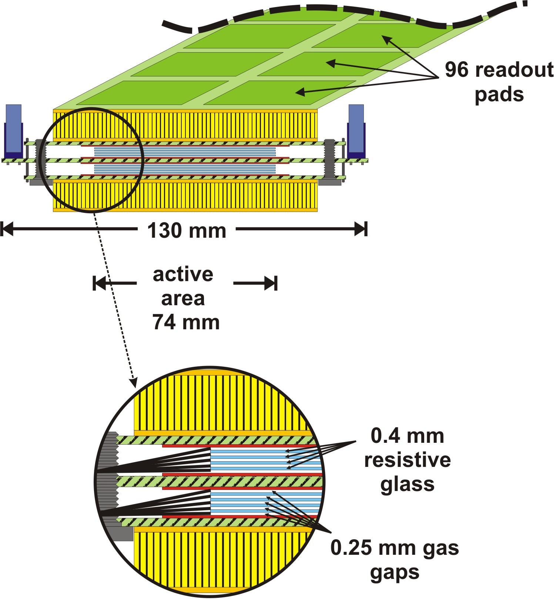
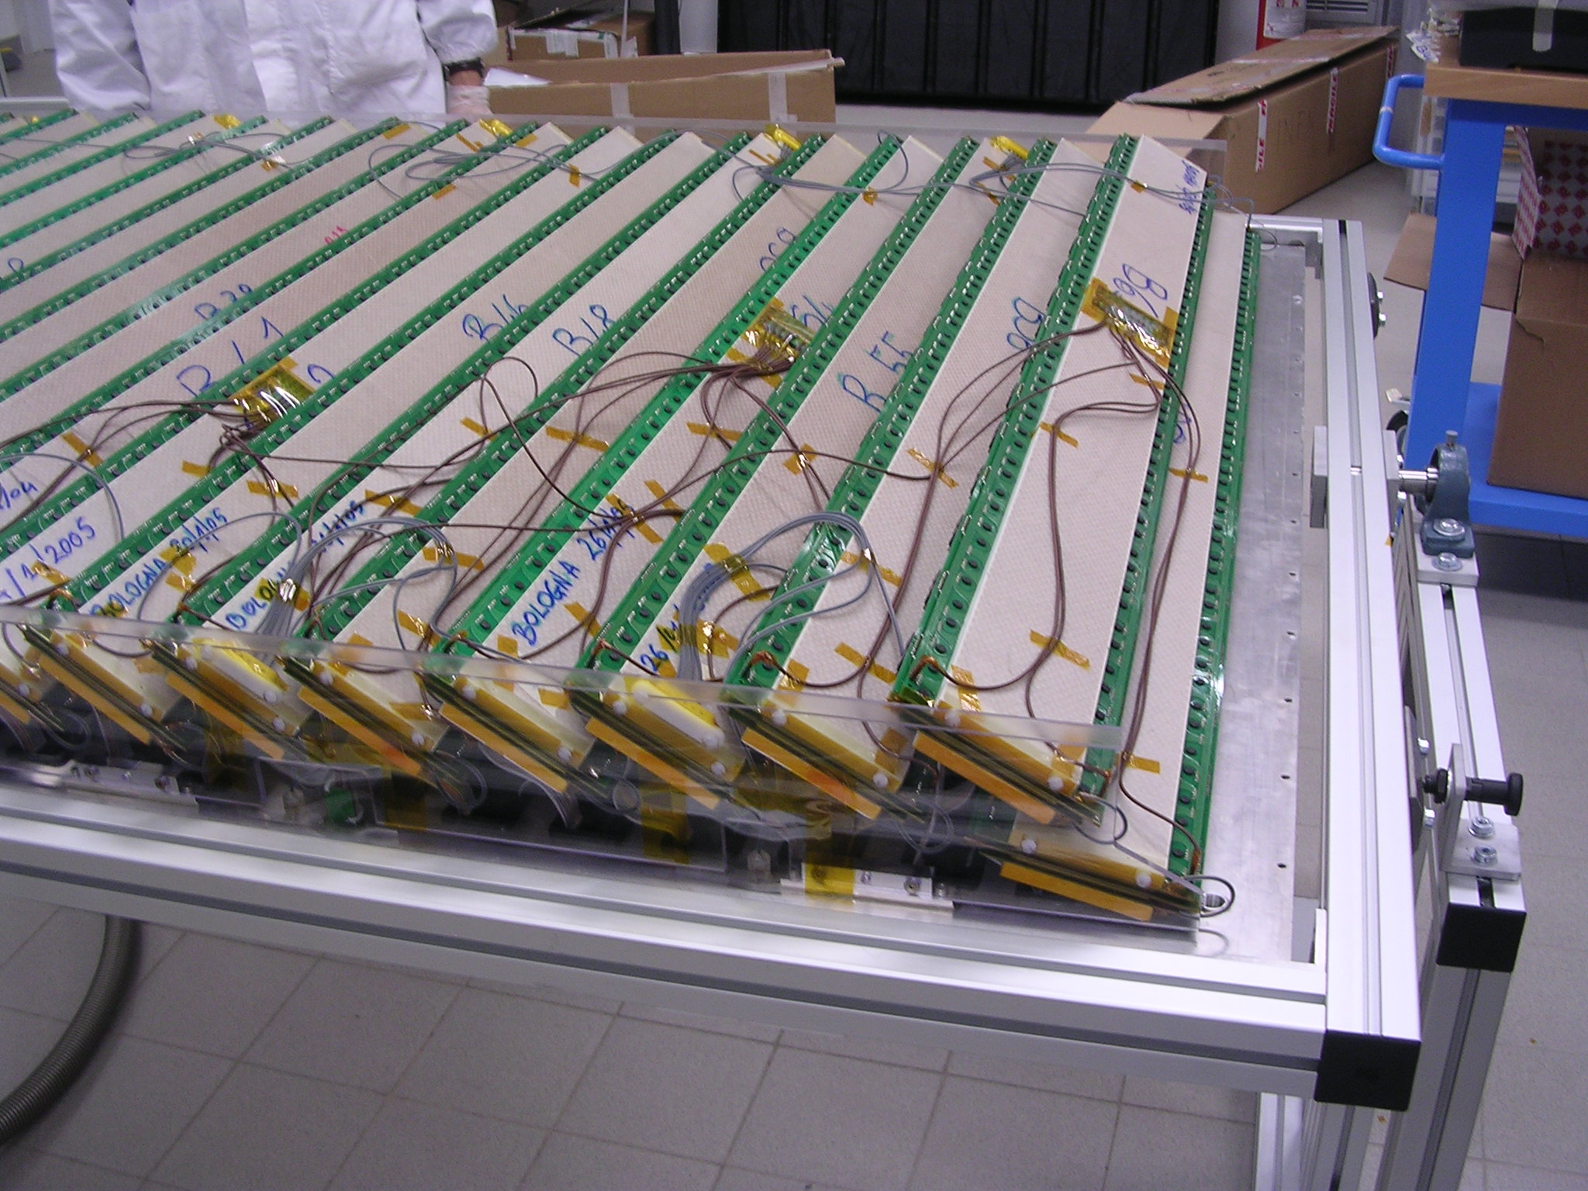
The ALICE-TOF MRPCs
many advantages compared to standard RPC with melamine-phenolic plastic materials:
higher smoothness and uniformity of the surface
higher stability for long-term behavior
The ALICE TOF MRPCs are designed as strips of 7.4 x 120 cm² active area.
Ten 250 μm width gas gaps grouped into two stacks placed on both sides around a central anode.
Resistive plates are made of 400 μm tick soda – lime glass with a bulk resistivity of ≈ 10¹³ Ωcm.
External electrodes are obtained from 550 μm tick glasses with a specially developed acrylic paint loaded with metal oxydes giving an average surface resistivity between 2 and 25 MΩ/☐.
The surface resistivity limits the transversal size of induced signal: readout elements placed outside the external plates can be finely segmented (readout pads of 2.5 x 3.5 cm²)

Slide 9
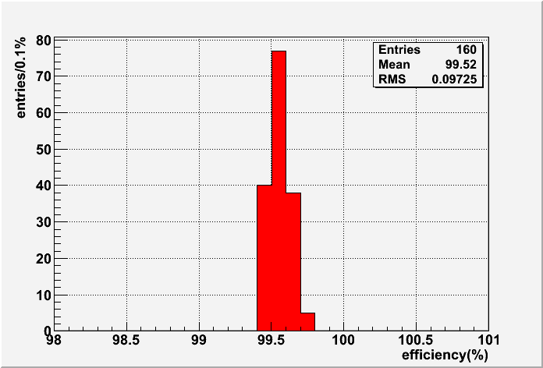
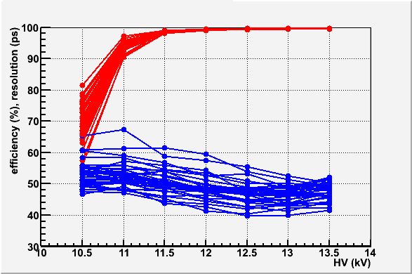
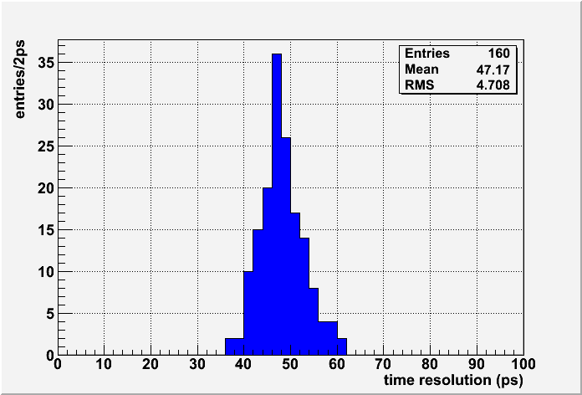
The MRPC: performance @ test beam
Results of a test with a beam of charged particles @ CERN PS during autumn 2006 over a MRPC mass production sample
long efficiency plateau
efficiency > 99%
Working point @ ALICE
very uniform performance
gas mixture: 90% C₂H₂F₄ 5% C₄H₁₀ 5% SF₆
resolution < 50ps

Slide 10
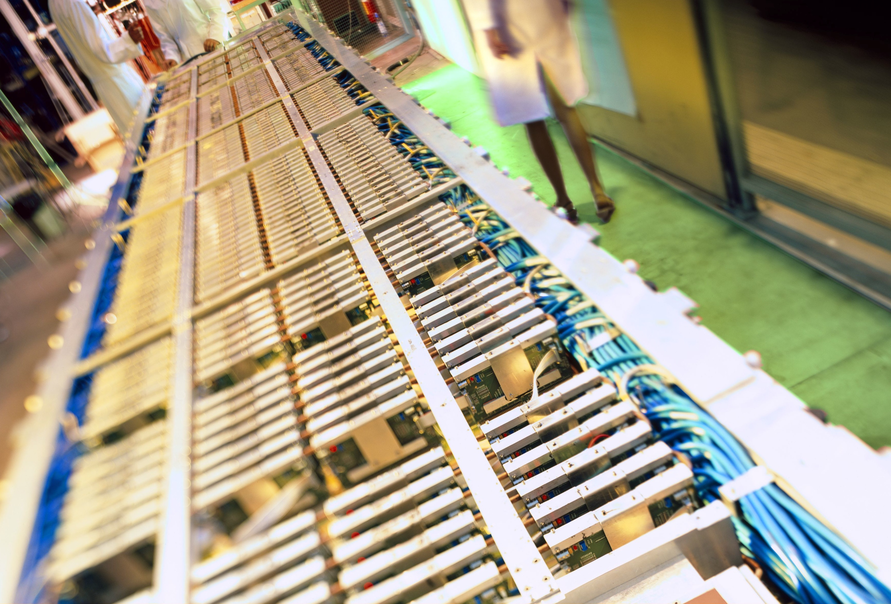
TOF Performance
in ALICE

Slide 11
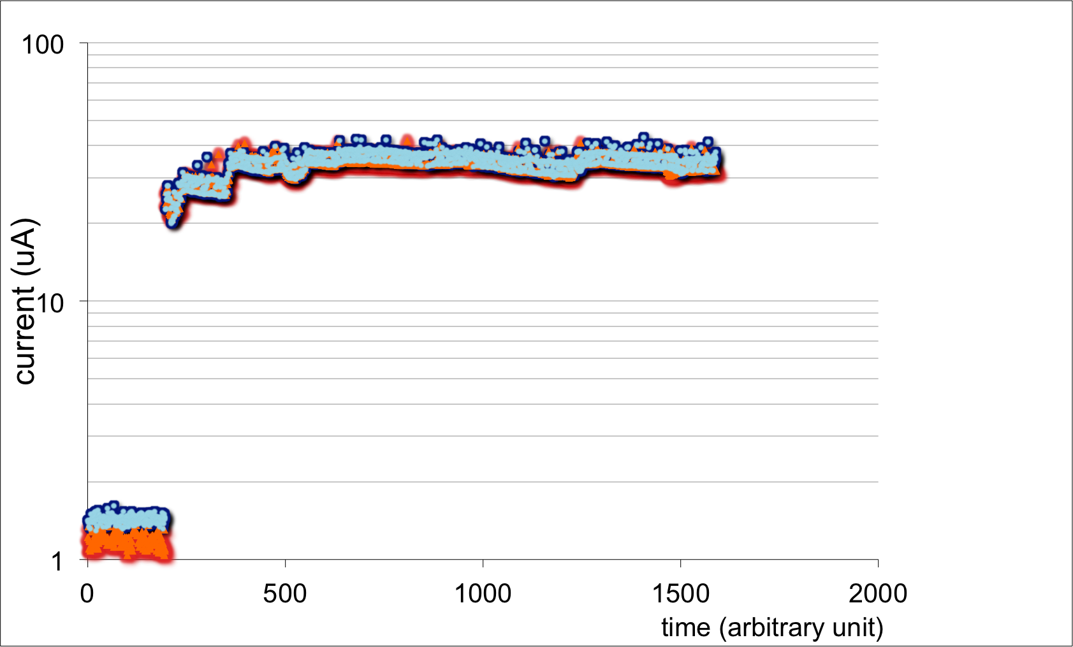
The MRPC: dark current and aging
Average current drawn by full TOF @ 13 kV during Summer 2011
for L = 2*10³⁰ s⁻¹ cm⁻² , I ≈ 35μA for 1593 MRPCs → less than 25nA per MRPC on average
negative
positive
TOF cosmics trigger rate is ≈ 10 Hz for pure back-to-back topology, with 50% of purity, using same HV and threshold settings for all MRPCs
cosmics runs (no charged particle flux) I ≈ 1μA for 1593 MRPCs → less than 1nA per MRPC on average
Very small current draw by ALICE TOF MRPCs implies:
→ less aging effects (no aging ever seen with prototypes tested for years)
→ very low noise (TOF trigger is the preferred choice for cosmics runs in ALICE)

Slide 12
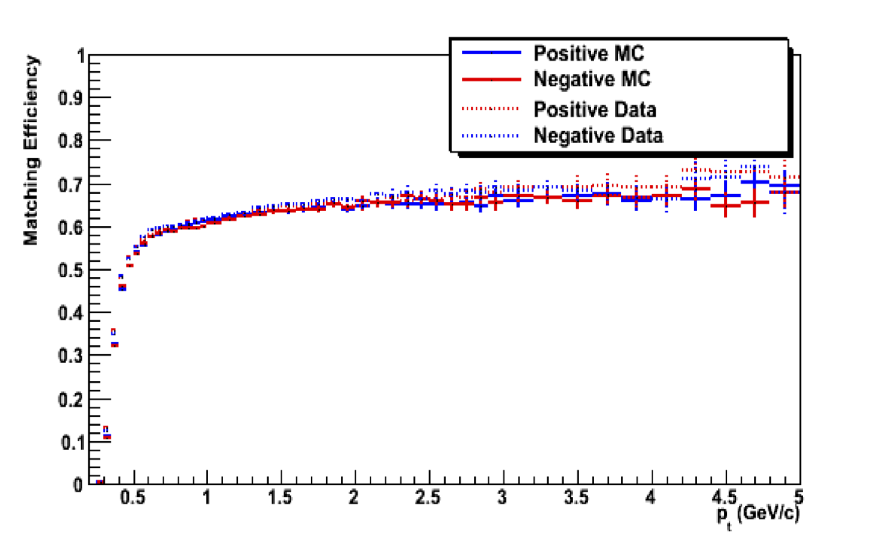
TOF performance - efficiency
Matching efficiency includes:
TOF efficiency
Dead space
Decays
Interaction with materials
Algorithmic inefficiency
Efficiency of the TOF matching (ε = N_{TPC_tracks} /N_{TPC_tracks_with_TOF_signal} ) is compared for positive and negative particles in MC sample and in data for different p_{t} values.
TOF detection efficiency is close to the ones declared in MC (98%)

Slide 13
TOF Performance – time resolution
A time-of-flight measurement always consist of two measurements: time_{hit} – timeZero.
timeZero is the time of the interaction, measured in ALICE by means of:
dedicated Cherenkov detector (T0)
TOF detector itself (if a certain amount of tracks is available)
the average t₀ of LHC fill σ_{Z}/c (finite length of colliding bunches of particles)

Slide 14
T0 with TOF detector
we divide selected primary tracks matched with TOF in sets C(m₁,…m_{N}) (max N=10 tracks per set);
for each track of the set we consider the 3^{N-1} possible mass configurations (track is assumed to be only π, k or proton) using the other N-1 tracks;
for each mass configuration of the set we define the N-1 t⁰_{i} and the ChiSquare using the weighted mean over all N-1 t⁰_{i}.
We define the best t⁰(C) as the one with
minimum ChiSquare.
resolution scales with number of used tracks as 1/√N
thanks to B. Guerzoni

Slide 15
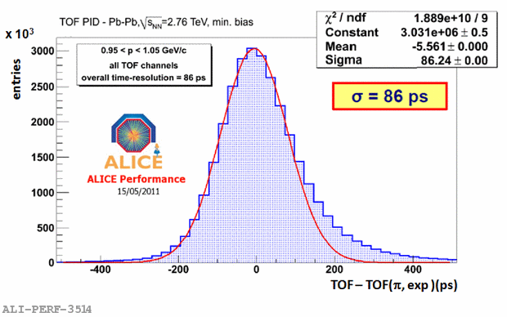
TOF Performance – time resolution
In Pb+Pb:
σ _{t-Zero} ≈ 10 ps (obtained with TOF itself)
σ _{t-Track} ≈ 20 ps
σ_{TOF} ≈ 80 ps, as from Design Value
Calibration can be still improved by:
single channel time-slewing corrections (finite rise time of the amplifying electronics)
time-walk corrections (signal propagation delays on the pick-up pad)

Slide 16
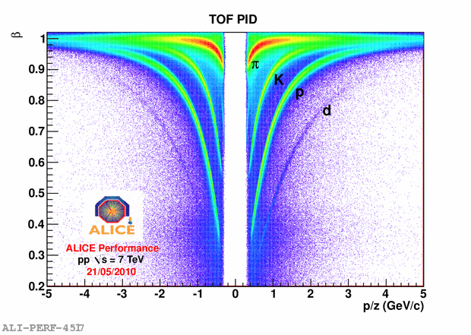
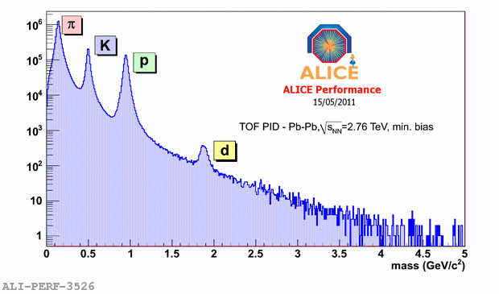
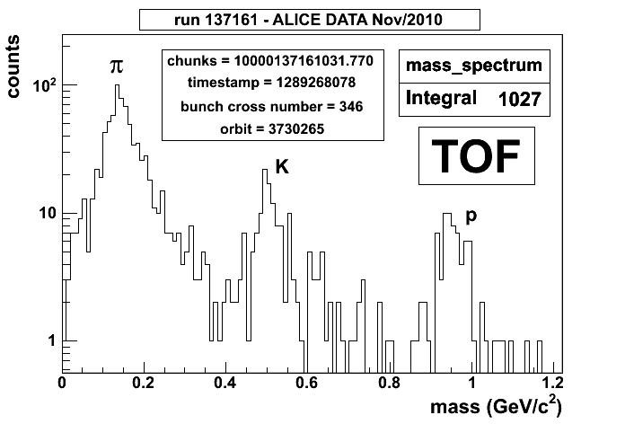
TOF Performance - PID
pp collisions
TOF measured particle β vs. signed momentum in pp collisions @ 7TeV
Different species are clearly visible
Mass distribution in one single PbPb collision!
PbPb collisions
Mass spectra from TOF in Pb-Pb collisions @ 2.76 TeV

Slide 17
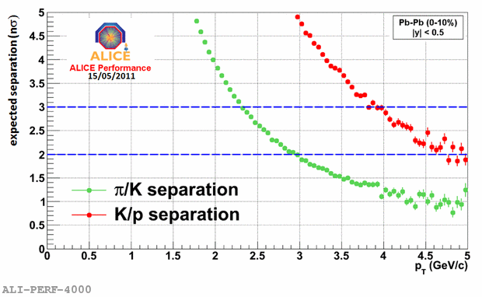
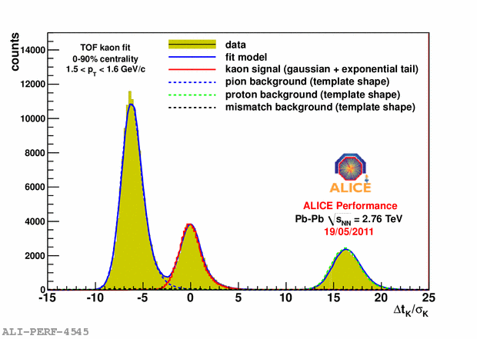
TOF Performance – separation power
Expected separation for π/K and p vs transverse momentum; the plot is based on expected integrated times at TOF smeared according experimental resolution achieved in PbPb central collisions.
A 2σ separation is achieved up to 3 GeV for π/K and up to 5 GeV for K/p

Slide 18
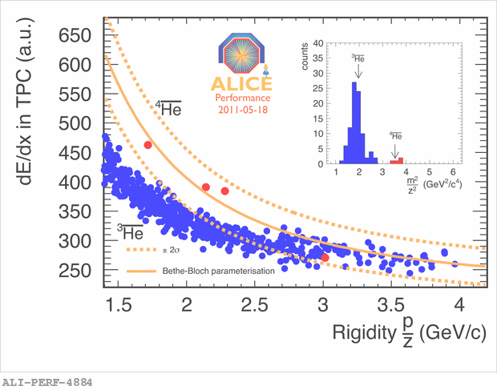
TOF Performance – combined PID
Anti-Alpha candidates confirmed by TOF
Anti matter search in ALICE
Above R=2.3GeV/c the <dE/dx> bands from (anti)³He and (anti)⁴He are overlapping and the mass calculated with the TOF is needed to separate these two species.

Slide 19
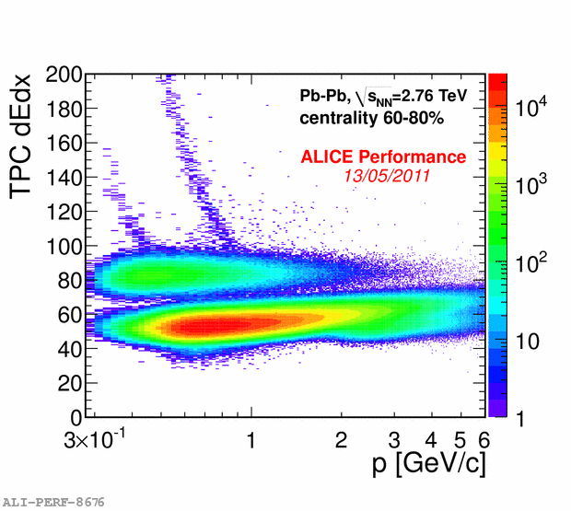
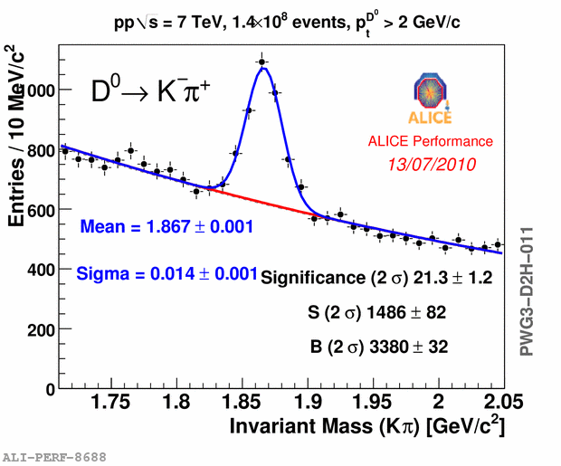
TOF Performance – combined PID
TPC dE/dx vs. momentum after TOF electron hypothesis 3σ cut → the slower hadrons (for a given momentum) can be eliminated with a cut on the particle velocity.
Example of resonance studies with TOF and TPC PID

Slide 20
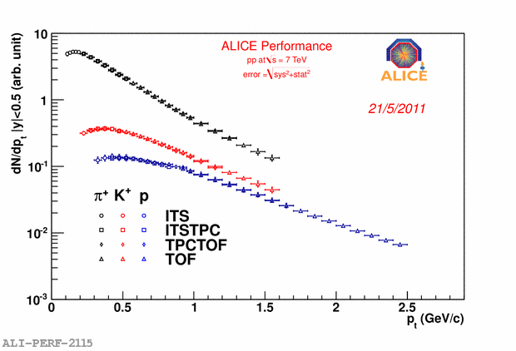
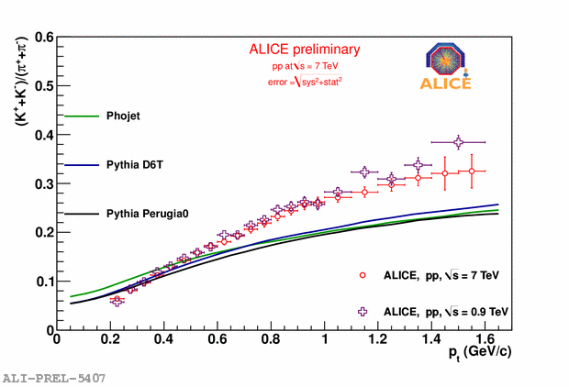
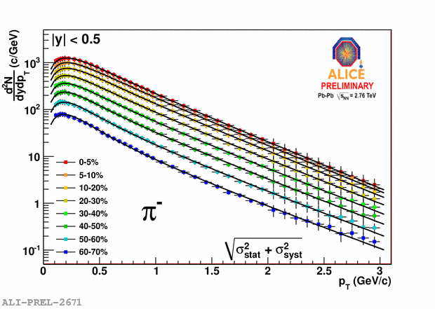
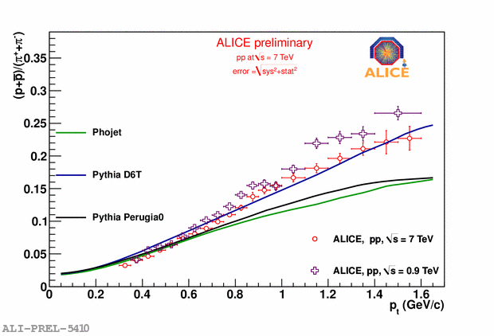
TOF Performance – spectra
Spectra of identified hadrons from combined analysis.
particle ratio as a function of p_{t} plus MC models.

Slide 21
Conclusions
The ALICE TOF detector is efficiently taking data since the first pp collisions recorder in ALICE in December 2009.
The performance are getting closer to the ones obtained so far at the test beam; the TOF is already able to extend the PID capabilities of the other central full-acceptance detectors (ITS and TPC) toward higher momenta.
The information provided by the TOF detector are widely used in many analysis inside the ALICE Collaboration.

Slide 22
backups

Slide 23
Time-of-Flight technique
Time-of-Flight measurements yield the velocity of a charged particle by measuring the particle flight time t over a given distance along the track trajectory L.
Error affecting the mass resolution:
Since in most cases γ>>1, the mass resolution is predominantly affected by the accuracies in time and length measurements.
For L=3.5m, a 3σ separation for π/K up to 2.5 GeV/c requires a global time resolution of 80 ps.

Slide 24
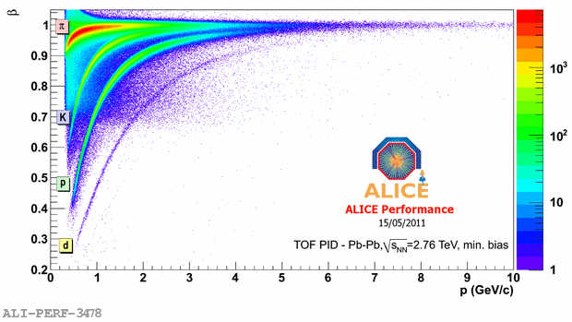
TOF Performance - PID
TOF measured particle β vs. signed momentum in PbPb collisions @ 2.76 TeV
Different species are clearly visible

Slide 25
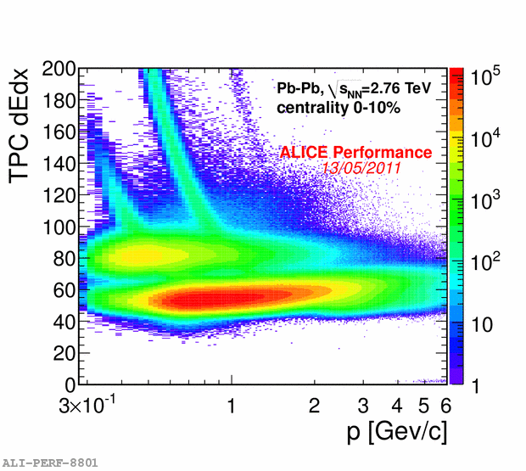
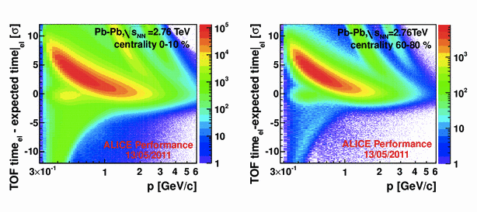
TOF Performance – combined PID
TPC dE/dx as a function of momentum in central and peripheral collisions after TOF electron hypothesis cut (3sigma).
Electrons: TOF nsigma for central and peripheral events

