Slide 1
WP2 Task 2.3
TA to Research Infrastructures delivering Neutron Beams
alberto.mengoni@cern.ch

Slide 2


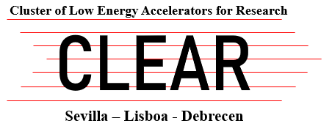


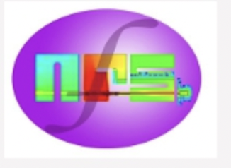


WP2 - Task 2.3: TA to Research Infrastructures delivering Neutron Beams. This task brings together state-of-the-art European laboratories in which neutron beams are produced by a wide range of generators, such as high-energy proton synchrotrons as well as by small Van de Graaff accelerators, in an extremely wide range of neutron kinetic energies (from sub-meV up to GeV), for measurements of high-resolution neutron-induced reactions Neutron beams are especially required, among others, for the investigations of processes taking place in astrophysical scenarios and for applications in advanced nuclear technology developments (nuclear fusion and emerging fields of medicine).
Task co-ordinator: CERN/n_TOF
Partners: GANIL/NFS, IJCLab/ALTO-LICORNE, INFN/LNL-LNS, CLEAR (Seville)

Slide 3
TA objectives [keywords]
The complementarity of the neutron beam characteristics at the different facilities allow for establishing a wide range of interests and objectives. A few keywords for the expected projects’ activities are:
Nuclear astrophysics (nucleosynthesis of the heavy elements, s-process), advanced nuclear technologies (nuclear data for accelerator driven systems, safety of nuclear facilities), basic nuclear science (neutron induced nuclear reaction process, neutron-nucleus interactions, nuclear reaction dynamics)
Fundamental research and applications in fields related to nuclear medicine and radiation damage studies
Neutron capture cross section measurements on stable and radioactive nuclei, neutron induced fission, (n,xn) and (n,lcp) reaction studies

Slide 4
Summary
Facility | Activities | Access units [hr] | Budget [%]
HiSPANoS, Sevilla | neutron beam commissioning | 64/640 | 3.5
LENOS, INFN | neutron beam commissioning | - | -
ALTO, ICJLAB | ²³⁸U(n,f) experiment | 2184/1860 | 44.7
NFS, GANIL | Ion Production Studies Gas production In Chromium Deuteron activation of ^{nat}Mo Pygmy dipole resonance in ¹⁴⁰Ce | (see report) | (see report)
n_TOF, CERN | ⁶⁴Ni(n,𝛾) Capture cross sections of Er Neutron-induce fission on ²⁴³Am | 225/504 | 49.2

Slide 6

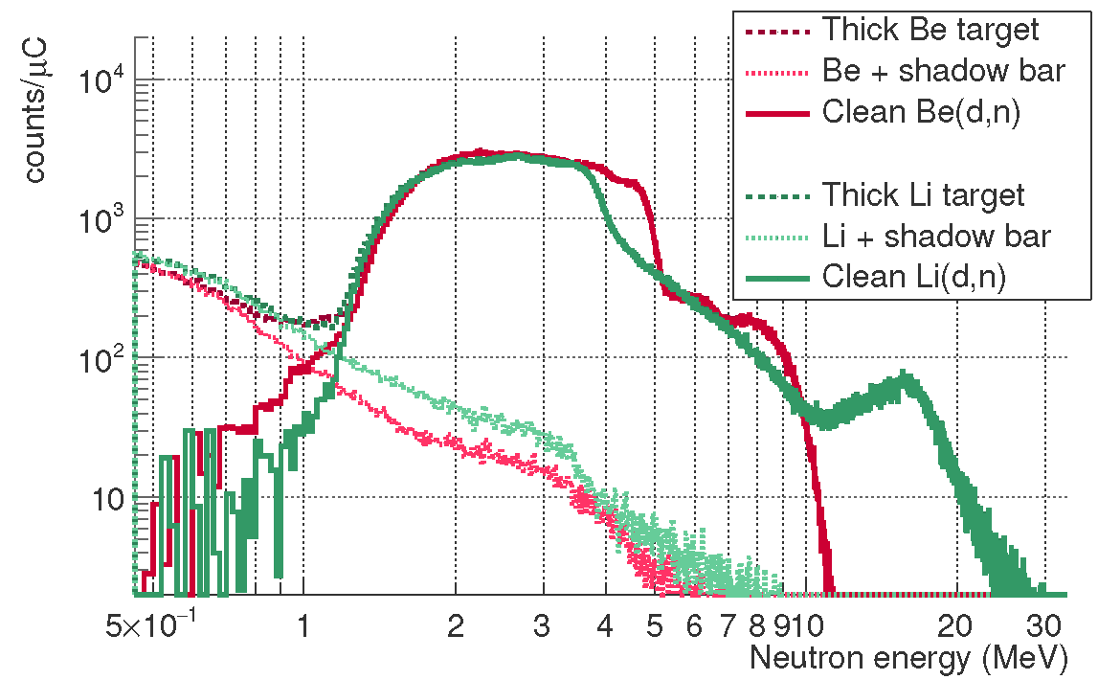
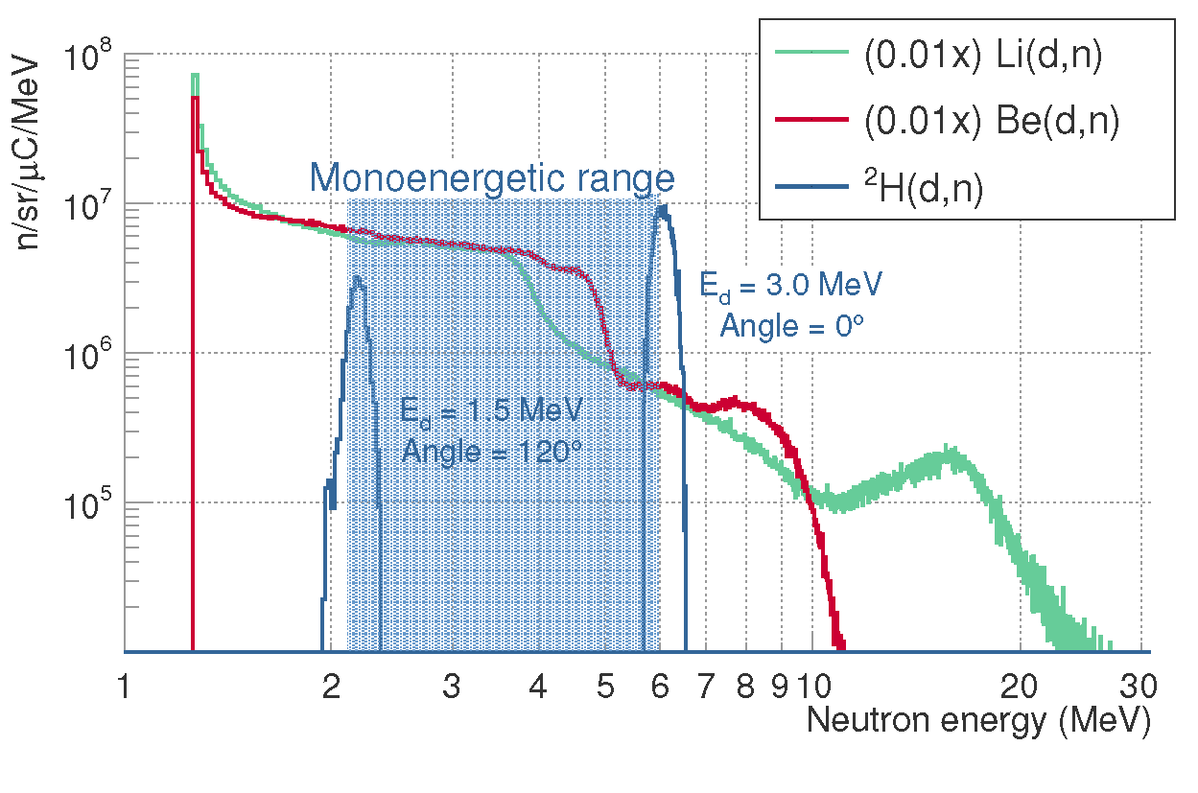


Commissioning of Fast Neutron Beams at HiSPANoS
Pulsed & Continuous beams
Fast neutron energy ranges:
- Monoenergetic: 2 to 6 MeV
- Broad beams: up to 10/15 MeV
Fast neutron fluxes:
- Monoenergetic: 10⁶ n/sr/μC
- Broad beams: 10¹⁰ n/sr/μC
Energy resolution R(L_{ToF}):
- 4% at 4 m flight path
11% at 1 m flight path
M. A. Millán-Callado et al., “Continuous and pulsed fast neutron beams at the CNA HiSPANoS facility”, Rad. Phys. and Chem. (accepted)

Slide 8
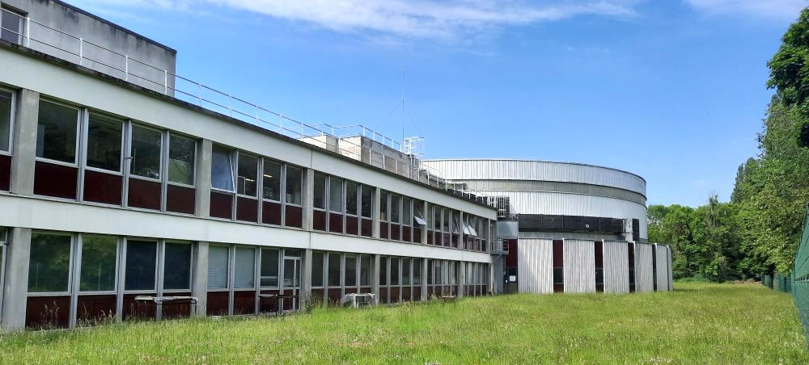

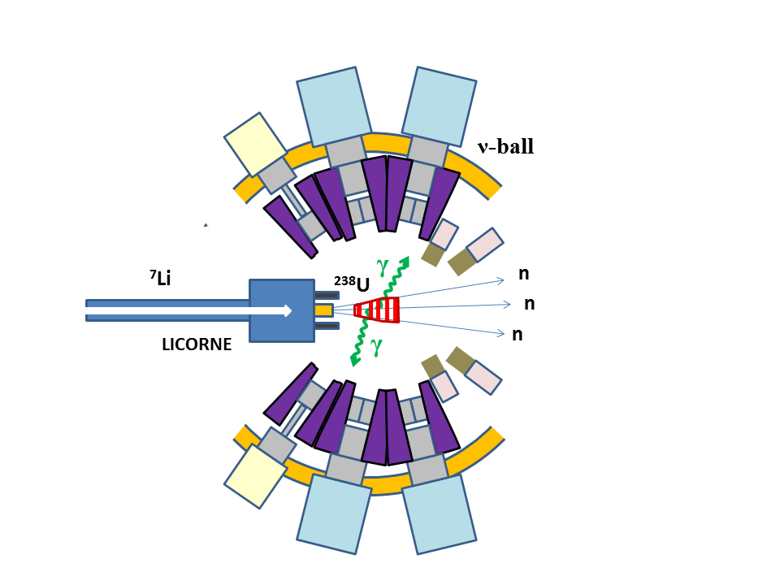
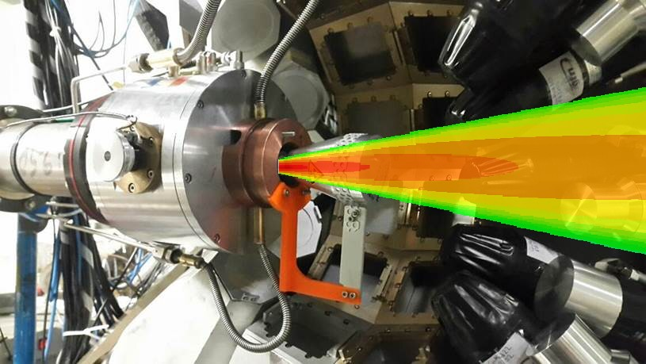
https://alto.ijclab.in2p3.fr/
LICORNE: The unique inverse kinematics neutron source of the ALTO facility
2022/2023 highlights
Coupling with the nu-Ball2 hybrid spectrometer as the flagship experiment of the nu-Ball2 experimental campaign
Primary beam (400ns – pulsed)
2 x 10¹¹ /s
Samples
Secondary beam
2 x 10⁷ /s
Gas target
up to 10⁵ fissions/s
⁷Li (16 MeV)
H₂
1.5 MeV neutrons
²³⁸U
²³²Th
~100 g
200 nA
3 x 10²⁰ atoms/cm²

Slide 9

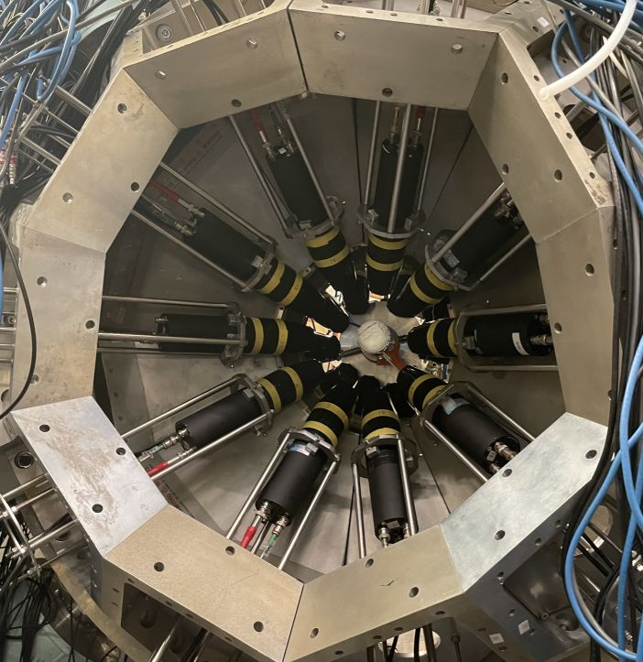
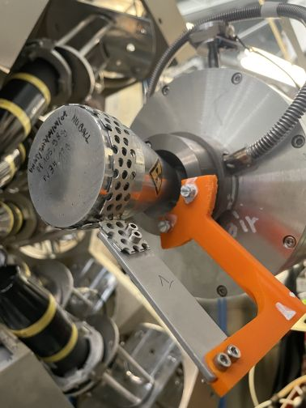
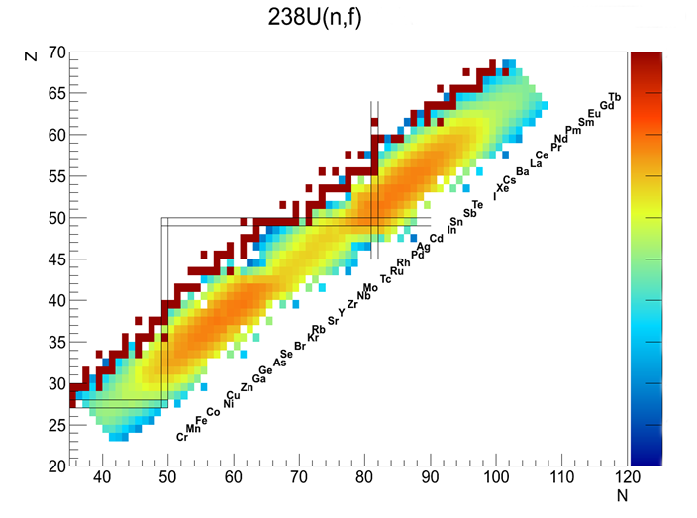
Supported experiment
24 Clover Ge + BGO
20 FATIMA LaBr3 in close packed configuration
https://alto.ijclab.in2p3.fr/
Thanks to S. Pascu and the FATIMA collaboration
²³⁸U(n,f) @ 2 MeV
Flagship experiment N-SI-120 completed
Fast-timing lifetime measurements in neutron rich fission fragments
3 weeks of beam time
Pulsed neutron beam from LICORNE (400 ns)
2.3 x 10¹⁰ events
Improvement over nu-Ball1
Significantly reduced backgrounds
× 6.5 more events
× 8 more Ge-Ge coincidences from fission
× 50 more LaBr3-LaBr3-Ge coincidences
(June and October 2022)
University of Surrey
TU Darmstadt
University of Cologne
University Madrid
University of Warsaw
(> 70 International users)

Slide 11
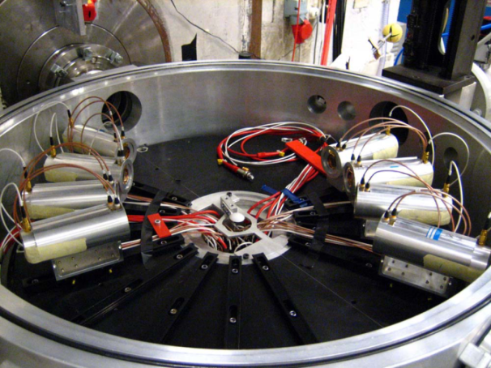
Ion Production Studies with Medley at the NFS facility
E800: Ion Production Studies with Medley at the NFS facility
E802: GARIC - Gas production In Chromium by neutrons
Spokesperson : D. Tarrio, Uppsala University
Neutron-Induced Light charged particles
  8 Si-Si-CsI telescopes
  Double-differential cross sections :
  Cancer therapy and dosimetry (H,C,O, Ca...)
  Radiation effects in microelectronics (Si, O)
  Energy applications: Gen-IV or fusion reactors (building materials, fuel, coolants, etc)
Identification E-∆E technique

Slide 12
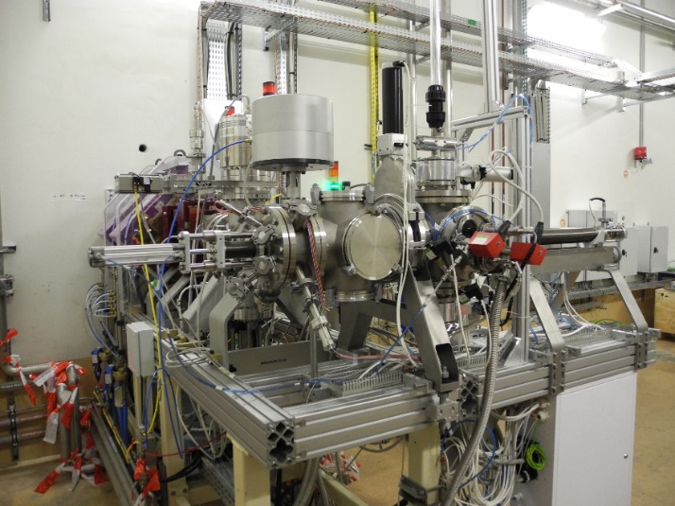
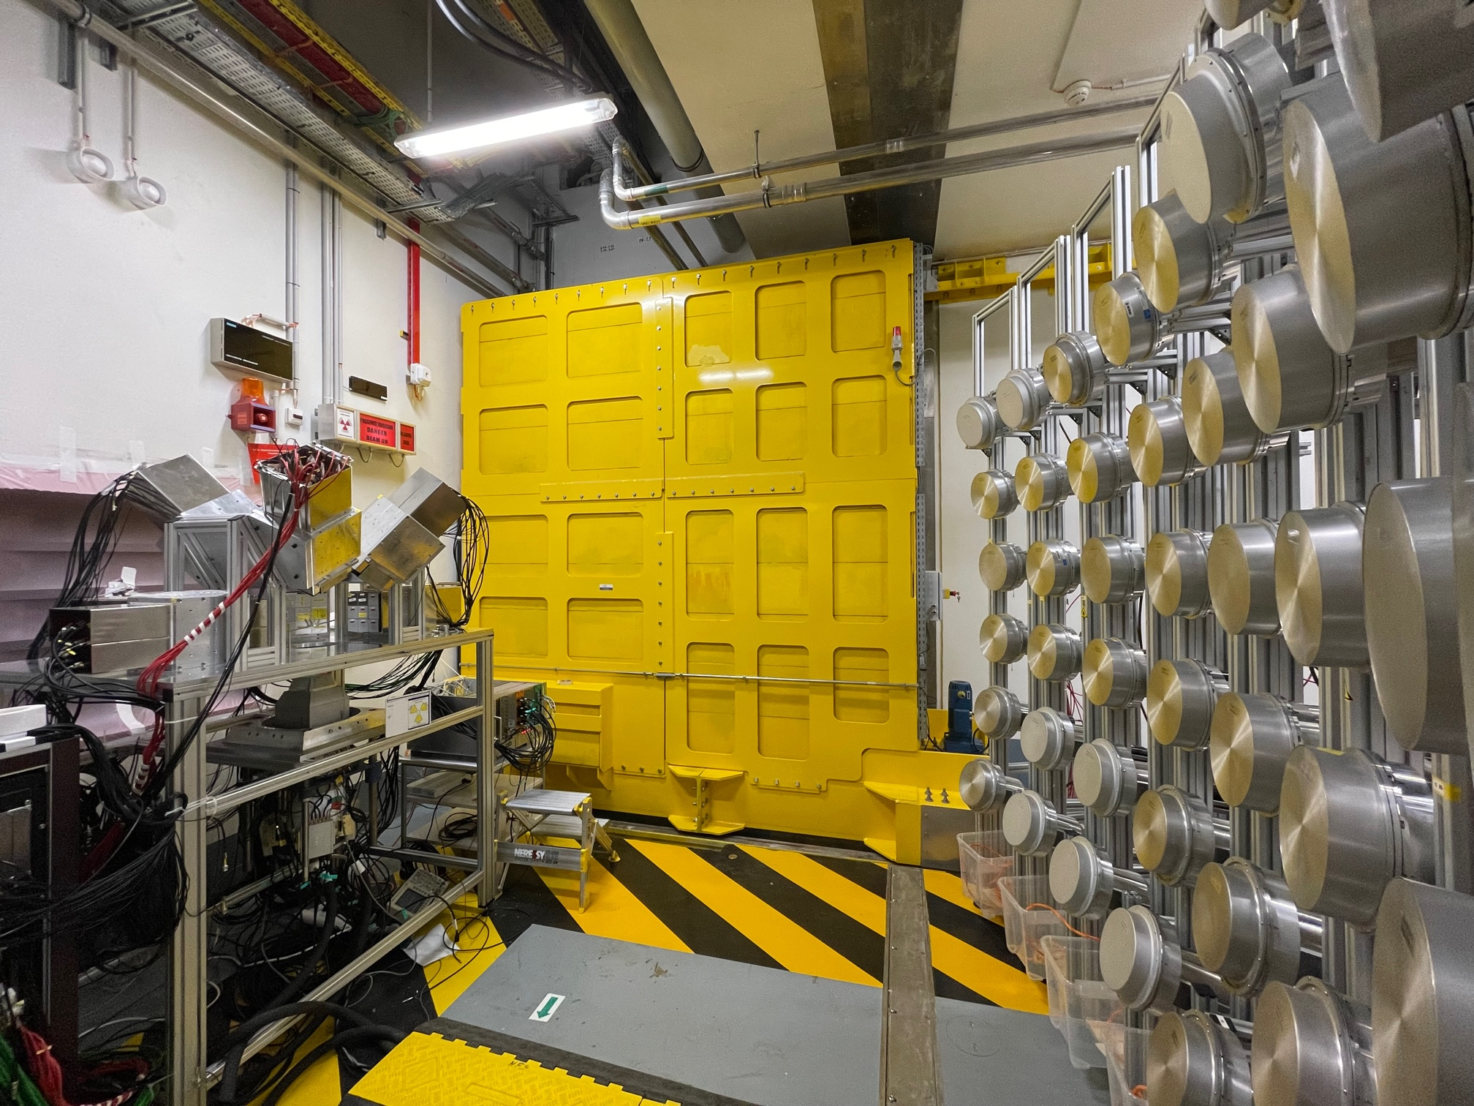
E832: Deuteron activation of ^{nat}Mo - focus on short-lived products
Spokesperson : E. Simeckova, NPI, Rez
Measurement of reaction cross-sections by activation technique :
  data for Nuclear technology
  improvement of reaction model
  Access to short-lived nuclei thanks to the pneumatic-transfer system
E832: Pygmy dipole resonance in ¹⁴⁰Ce using the (n,n’γ) reaction at SPIRAL2-NFS
Spokespersons: Marine VANDEBROUCK (CEA Saclay Irfu/DPhN) and Iolanda MATEA (IJCLab)
The use of different reactions to excite the PDR showed different responses, not always compatible with the neutron skin picture
New probes are necessary to resolve the complexity of the PDR structure
We propose to use neutron inelastic scattering reaction at SPIRAL2-NFS as a new probe
MONSTER + PARIS detectors

Slide 13
EURO-LABS at NFS in 2022/2023
Numbers of days funded : 152
Total amount : 18,9 k€
Travel expenses 5,5 k€
Stays 13,4 k€
Funded Experiments:
E800: Ion Production Studies with Medley at the NFS facility
E802: GARIC - Gas production In Chromium by neutrons
E832: Deuteron activation of ^{nat}Mo - focus on short-lived products
E833: Pygmy dipole resonance in ¹⁴⁰Ce using the (n,n’𝛾) reaction at NFS

Slide 15


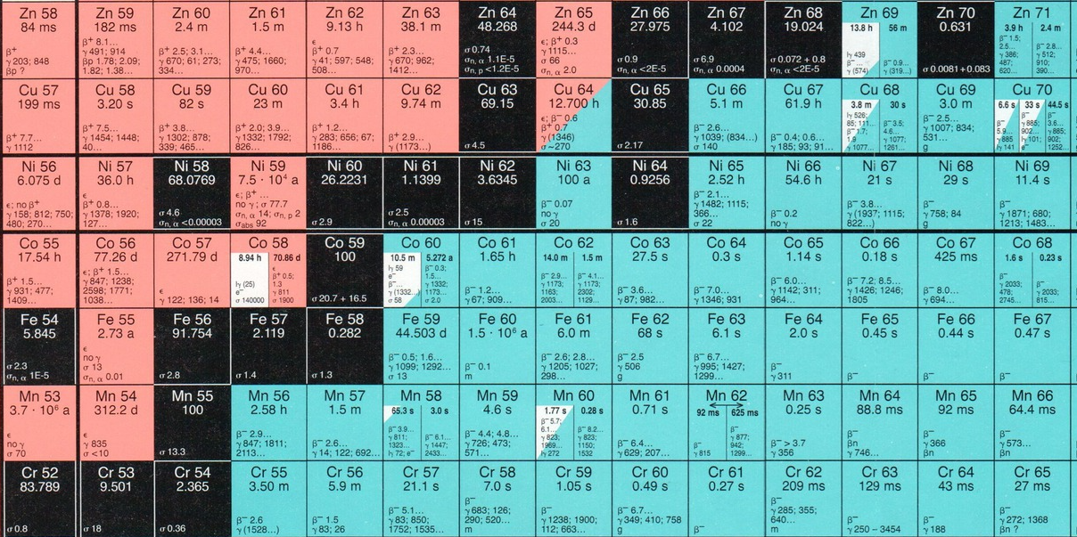

EURO-LABS-2023-nTOF INTC-P-208-ADD-1
Measurement of the neutron capture cross section of ⁶⁴Ni
⁶⁴Ni capture cross section measurement

Slide 16
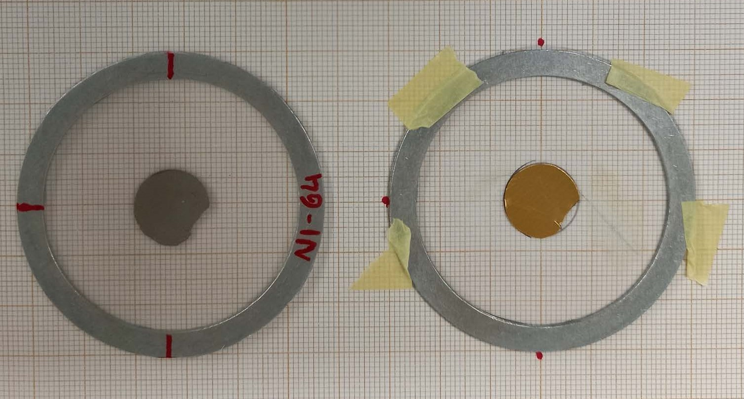
EURO-LABS-2023-nTOF INTC-P-208-ADD-1
Measurement of the neutron capture cross section of ⁶⁴Ni
⁶⁴Ni capture cross section measurement
Samples used
⁶⁴Ni ¹⁹⁷Au
STED
+C, Pb (background investigation)
neutrons
C₆D₆

Slide 17
Very preliminary results
Comparison with literature and evaluations
Not observed any (strong) resonance
@ 9.52 keV

Slide 20
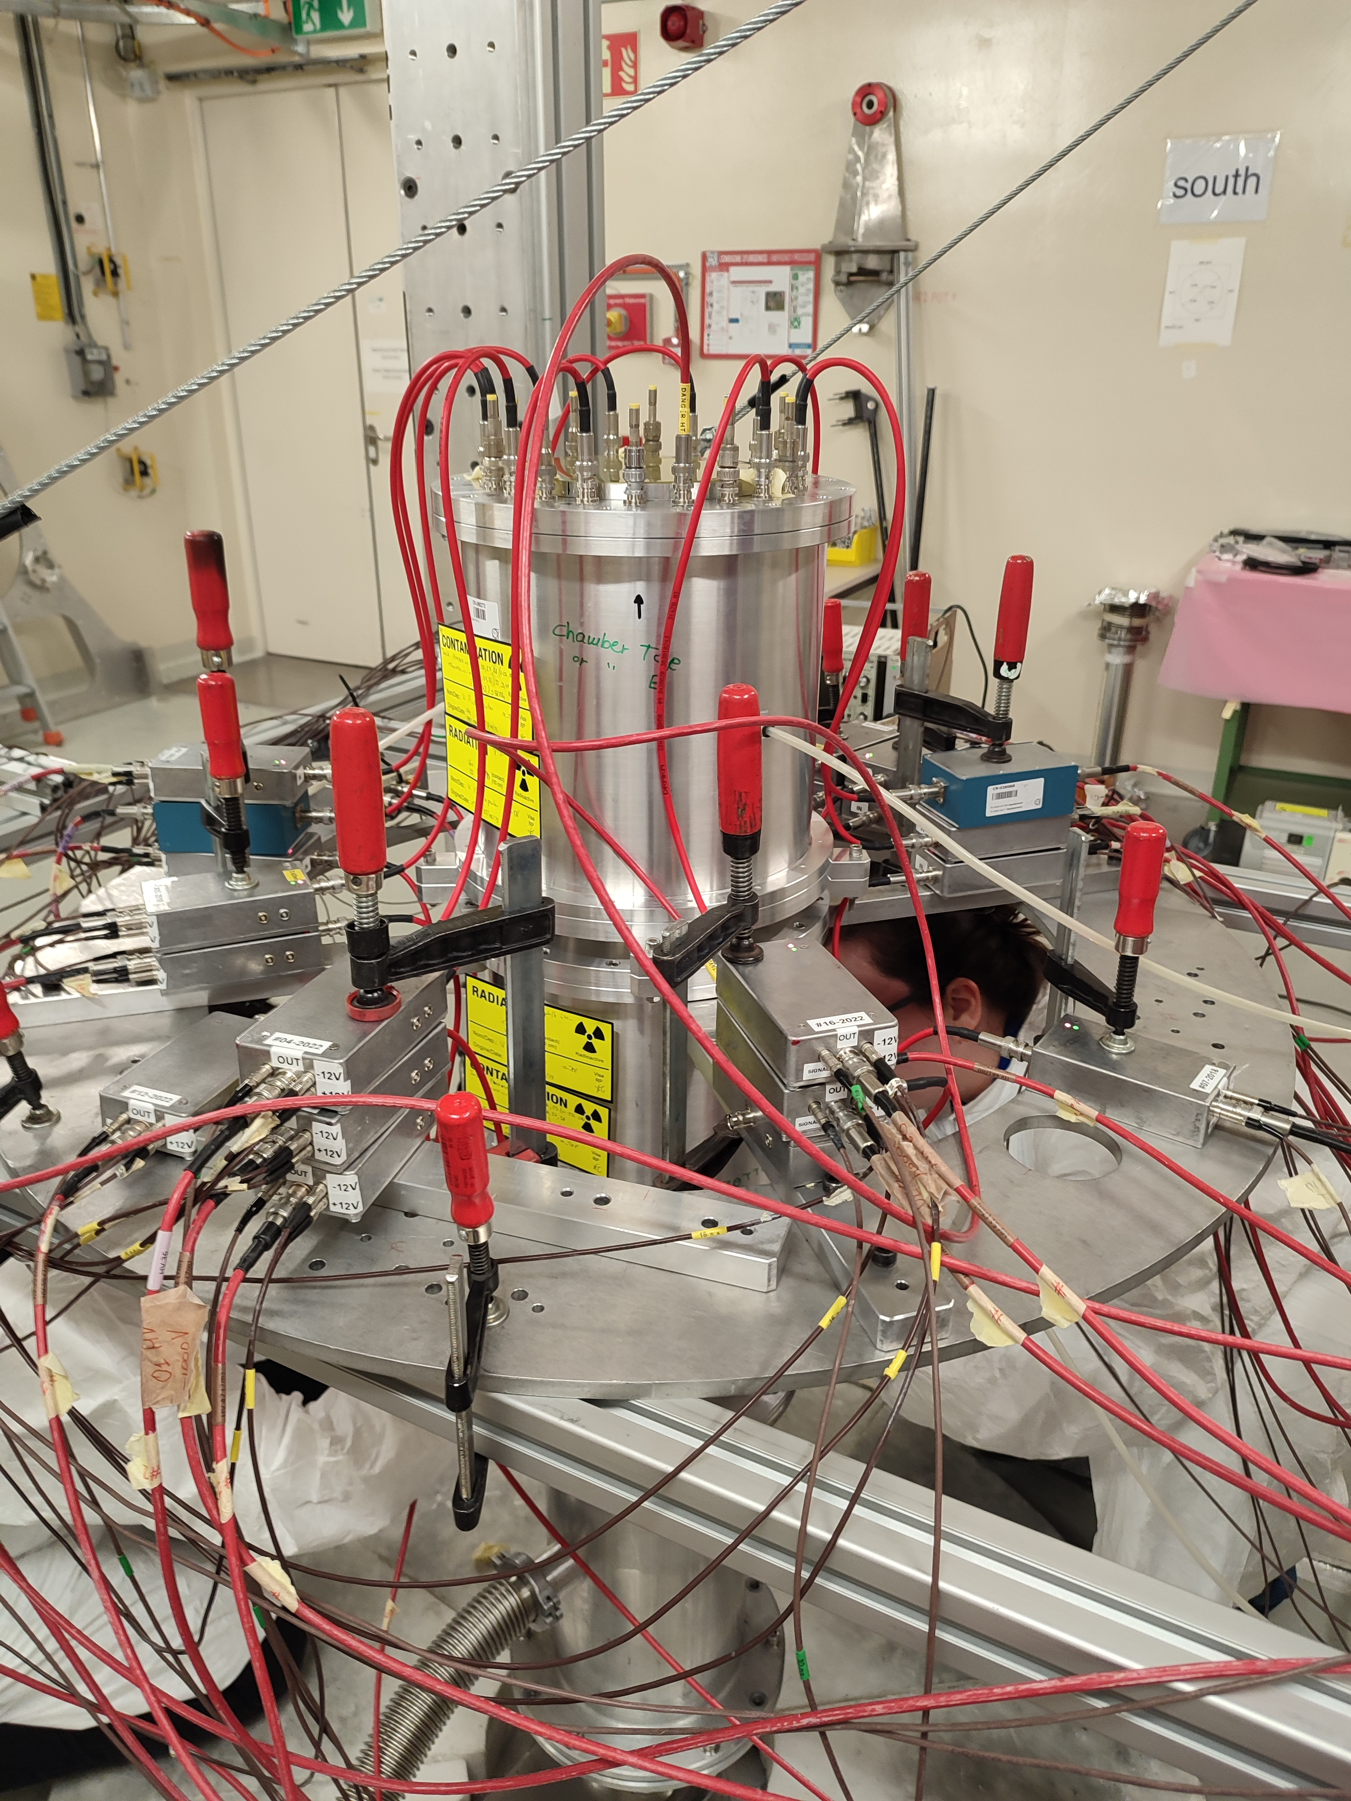
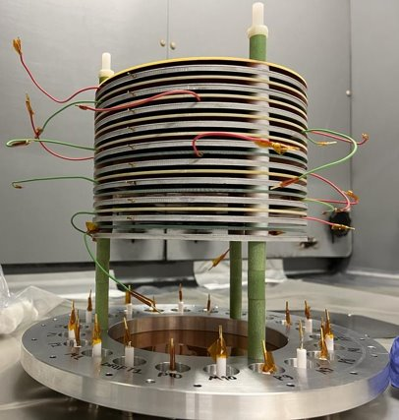
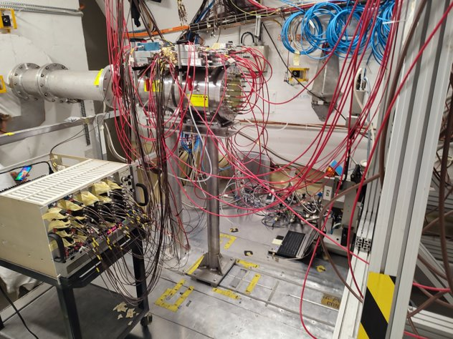
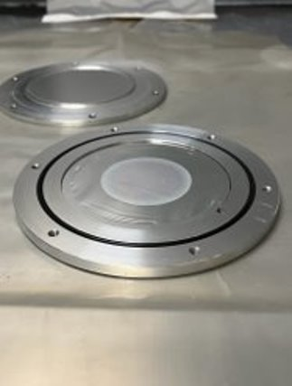
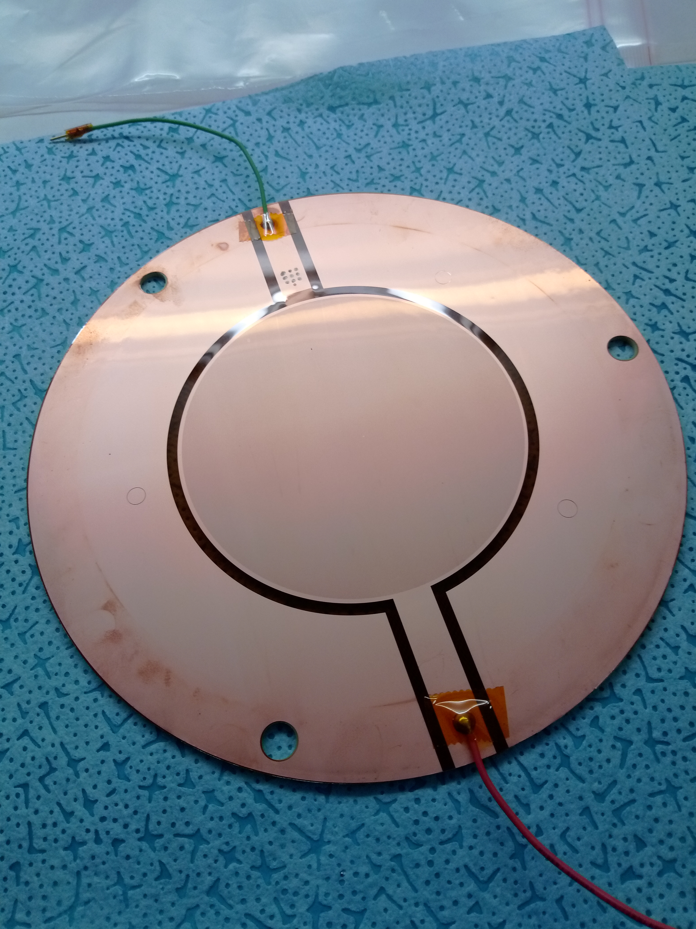
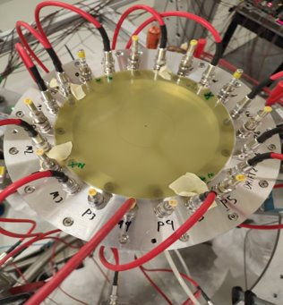
Measurement of the neutron-induced fission cross section of Am-243
²⁴³Am (T_{1/2} = 7364y) contributes to the radiotoxicity of nuclear waste via ²³⁹Pu production through decays
Important candidate for use as burnable actinide in future reactors
NEA Nuclear Data High Priority Request List (https://www.oecd-nea.org/dbdata/hprl/search.pl?vsec=on)
Lack of good quality data sets. High discrepancies and poor resolution + Inconsistencies between evaluated libraries
Aim of this work: To provide a single high-quality dataset from thermal up to 100s MeV for the first time.
Experimental measurements of the ²⁴³Am(n,f) reaction cross section were carried out in both experimental areas EAR-2 (from June 7th – July 11th) and EAR-1 (from July 19th - August 22nd)
Subject of the PhD thesis of Nikolaos Kyritsis (NTUA)
High purity ²⁴³Am samples, have been prepared at JRC-Geel, along with the reference samples ²³⁵U, ²³⁸U and ¹⁰B. Six thick (~150μg/cm² per sample) and five thin (~3μg/cm² per sample) ²⁴³Am samples in order to avoid pile-up issues, maintain high counting rates in all energy regions and protect detectors from potential radiation damage.
Total of 20 Micromegas detectors were used, housed in 2 Chambers

Slide 21
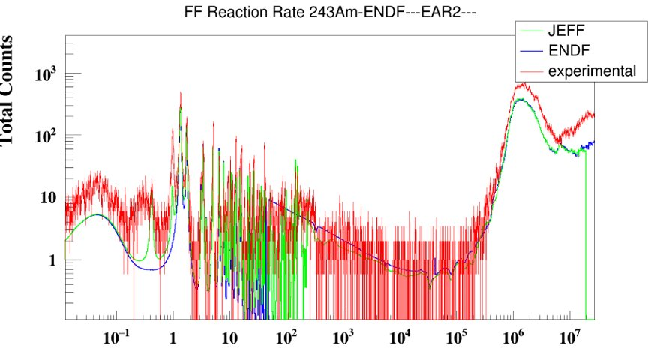
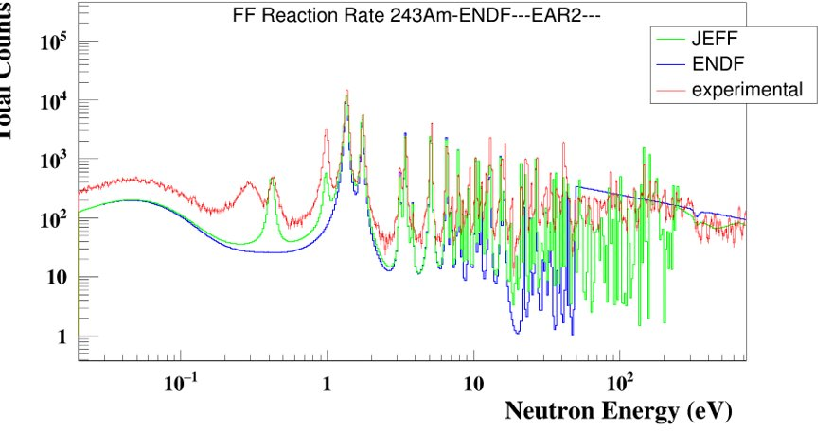
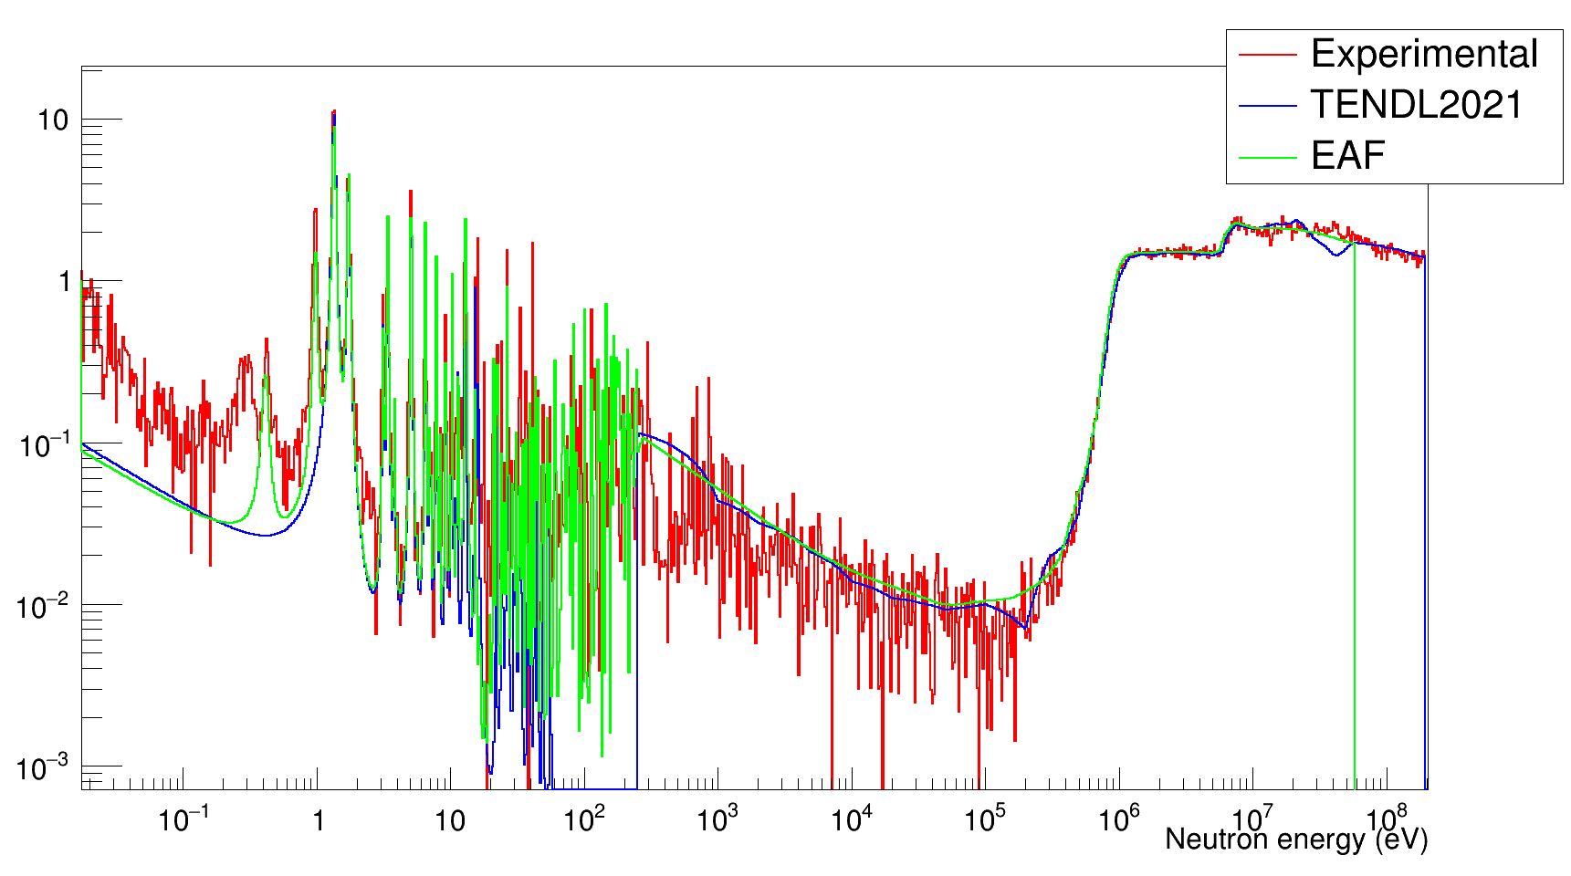
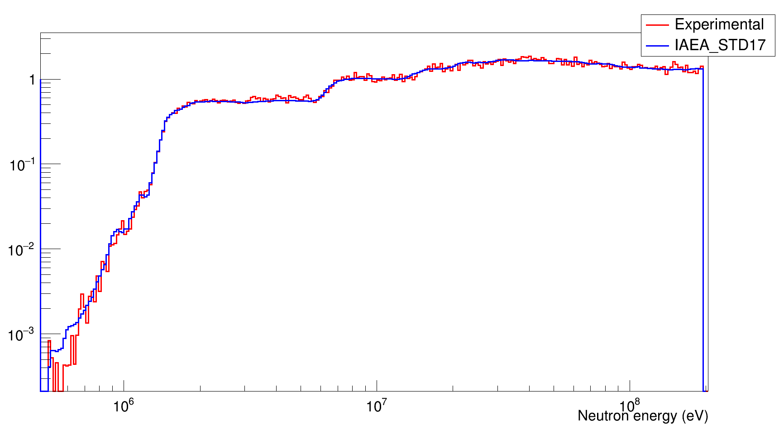
First look at the experimental data
EAR2: ²⁴³Am thick samples
EAR2: ²⁴³Am thin samples
²³⁹Pu
²⁴³Am cross section using ²³⁵U as reference
²³⁸U cross section using ²³⁵U as reference
Cross section (barn)
Cross section (barn)

Slide 22
Summary
Facility | Activities | Access units [hr] | Budget [%]
HiSPANoS, Sevilla | neutron beam commissioning | 64/640 | 3.5
LENOS, INFN | neutron beam commissioning | - | -
ALTO, ICJLAB | ²³⁸U(n,f) experiment | 2184/1860 | 44.7
NFS, GANIL | Ion Production Studies Gas production In Chromium Deuteron activation of ^{nat}Mo Pygmy dipole resonance in ¹⁴⁰Ce | (see report) | (see report)
n_TOF, CERN | ⁶⁴Ni(n,𝛾) Capture cross sections of Er Neutron-induce fission on ²⁴³Am | 225/504 | 49.2

Slide 23
The End

