Slide 1
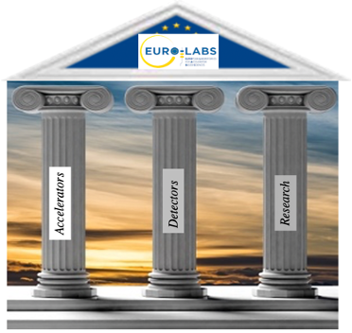

SAM, Kraków
10/10/2023
EURO-LABS Project Office
Paolo Giacomelli
INFN Bologna
Project Coordinator
Project Office Manager

Slide 2
Layout
Project Office people
Monitoring of the project
Transnational Access issues
EURO-LABS website
Use of resources
Steering Committee meetings
Conclusions

Slide 3

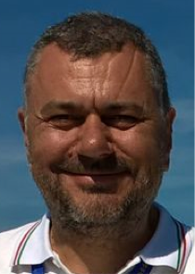
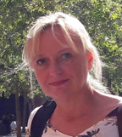

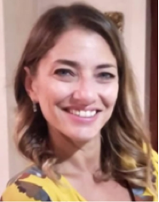
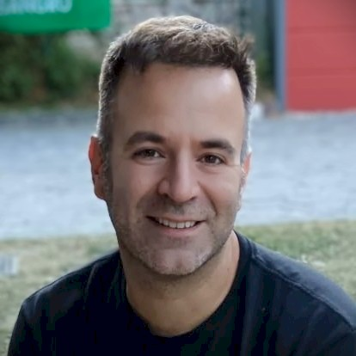
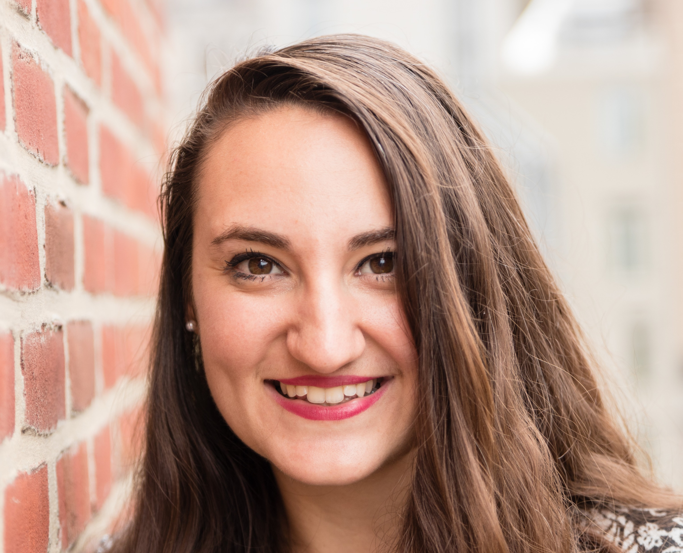
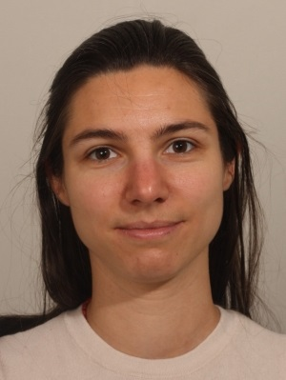
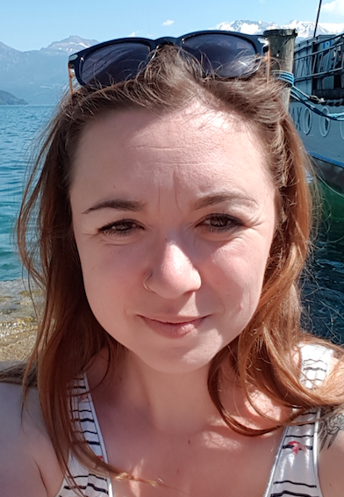
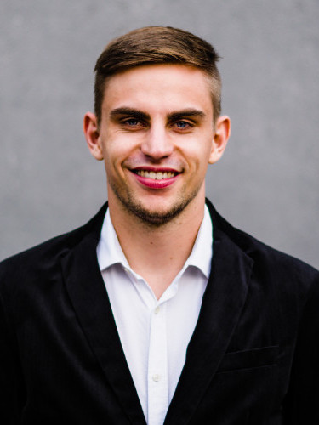
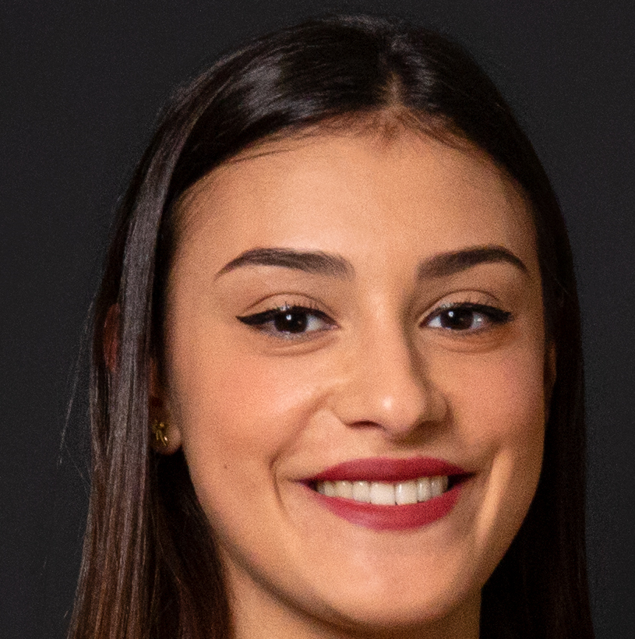
Project Office people
Project Office Manager
Financial Officer
Project Management
Support Office
Financial Management
Support Office
With the support of WARRANT HUB consultants:
Tiziano Ferro
INFN Frascati
Barbara Pezzotta
INFN Bologna
Chiara Mondaini
INFN Frascati
Sara Silvi
INFN Frascati
Marco Traini
INFN Frascati
Stefania Melandri
WARRANT HUB
In cooperation with CERN - The EU Projects Office team (IPT-EU)
Cloé Levointurier-Vajda
CERN-IPT-EU
Sabrina El Yacoubi
CERN-IPT-EU
Pablo Lopez
CERN-IPT-EU
Giulia Mora
WARRANT HUB
29 June 2023

Slide 4
Monitoring the status of the project
To monitor the status of the project we have EMDESK
  We would like to ask all beneficiaries to update the financial status every 3 months
    This allows the PO to know the financial status of the project at regular intervals
  Upload as well any important document
The P1 report has to be uploaded on the EU portal by the end of this month
  If anything is still missing or needs to be completed, we still have two weeks, but time is quickly running out

Slide 5
Monitoring the status of the project
It's important to keep regularly updated the file EURO-LABS TA-VA-Report1-facility and upload it on EMDESK
  Possibly every 3 months, to match what I indicated in the previous slide

Slide 6
TA doubts
Transnational Access (TA) has three modalities:
  Normal TA
    Experimental group goes physically to the facility
  Remote TA
    Experimental group sends device to the facility to be tested
  Virtual TA
    Access, typically through a network connection to a computer facility
Eligibility criteria
  More than 50% of the members of the experimental group have to be employed by an Institute of a different country

Slide 7
TA doubts
Experimental groups are divided into 2 categories:
  EU experimental groups
    More than 50% of the people of the group are employed by a European institute
  Non-EU experimental groups
    More than 50% of the people of the group are employed by a Non-EU institute
      In this case TA can be allowed up to 20% of the total amount of access units provided by the project
        Important to monitor regularly in time the resources offered

Slide 8
TA reimbursements
The TA reimbursements are handled by the respective facility coordinators (FCs)
  FCs explain the modalities of reimbursement to the new users
  FCs have to ensure that the reimbursements are handled properly and quickly
    We are aware of some issues at a few infrastructures
      We have to make sure to resolve these issues and guarantee a swift reimbursement to the users
  FCs have to keep track of all the accesses and users
  FCs have to keep track of the users information (affiliation, gender, etc.)

Slide 9
Website
The EURO-LABS is intended to be a "living object"
  We will keep it updated
    Download the latest (and updated) templates
  Used to disseminate information
    Job offers
    Events
    Publications
    AOB

Slide 10
Use of resources (PMs)
BENEFICIARY | PLANNED | ACTUAL M1-M12 | ACTUAL/ PLANNED
INFN | 162,50 | 14,46 | 9%
GANIL | 36,00 | 0,00 | 0%
CERN | 122,50 | 6,38 | 5%
JSI | 18,00 | 7,18 | 40%
IFJ PAN | 83,00 | 14,15 | 17%
DESY | 16,00 | 0,79 | 5%
UCL | 3,00 | 0,00 | 0%
RBI | 8,00 | 5,30 | 66%
CNRS | 41,00 | 0,19 | 0%
FBK | 0,00 | 0,00 | 0%
ITAONNOVA | 17,00 | 2,96 | 17%
UNIWARSAW | 24,00 | 6,00 | 25%
GSI | 97,00 | 14,94 | 15%
IFIN-HH | 4,00 | 0,00 | 0%
USE | 52,80 | 10,88 | 21%
IST | 0,00 | 0,00 | 0%
ATOMKI | 8,00 | 1,58 | 20%
JYU | 12,50 | 0,00 | 0%
UU | 20,00 | 3,40 | 17%
CEA | 32,50 | 1,42 | 4%
KIT | 0,00 | 0,00 | 0%
UMCG | 12,00 | 0,00 | 0%
INCT | 16,00 | 1,79 | 11%
CSIC | 2,50 | 0,00 | 0%
UMIL | 40,80 | 6,00 | 15%
TOTAL | 829,10 | 97,42 | 12%
Person months (PMs) usage
WP | PLANNED | ACTUAL M1-M12 | ACTUAL/ PLANNED
WP1 | 72,00 | 14,35 | 20%
WP2 | 336,60 | 47,61 | 14%
WP3 | 106,50 | 8,42 | 8%
WP4 | 203,00 | 19,10 | 9%
WP5 | 111,00 | 7,94 | 7%
WP6 | 0,00 | 0,00 | 0%
TOTAL | 829,1 | 97,42 | 59%

Slide 11
Use of resources (budget)
BENEFICIARY | PLANNED | ACTUAL M1-M12 | ACTUAL/PLANNED
INFN | 2.574.442,50 | 84.425,44 | 3%
GANIL | 779.611,75 | 235.210,28 | 30%
CERN | 3.033.942,00 | 616.264,89 | 20%
JSI | 399.375,00 | 68.739,00 | 17%
IFJ PAN | 598.200,00 | 55.044,55 | 9%
DESY | 356.820,00 | 34.285,69 | 10%
UCL | 200.562,50 | 0,00 | 0%
RBI | 126.170,00 | 38.405,75 | 30%
CNRS | 794.500,00 | 212.476,96 | 27%
FBK | 272.000,00 | 37.717,48 | 14%
ITAONNOVA | 159.750,00 | 18.661,05 | 12%
UNIWARSAW | 264.375,00 | 186.884,08 | 71%
GSI | 1.437.081,25 | 121.205,25 | 8%
IFIN-HH | 512.417,50 | 104.696,60 | 20%
USE | 357.506,25 | 88.756,06 | 25%
IST | 65.000,00 | 2.040,09 | 3%
ATOMKI | 93.125,00 | 8.588,19 | 9%
JYU | 635.625,00 | 0,00 | 0%
UU | 399.925,00 | 70.077,01 | 18%
CEA | 441.765,25 | 42.549,94 | 10%
KIT | 570.067,56 | 94.641,64 | 17%
UMCG | 112.905,00 | 2.279,53 | 2%
INCT | 150.000,00 | 5.802,15 | 4%
CSIC | 180.000,00 | 0,00 | 0%
UMIL | 189.000,00 | 22.434,90 | 12%
TOTAL | 14.704.166,56 | 2.151.186,51 | 15%

Slide 12
Use of resources
% PMs used
% Budget used
Flat use
of resources

Slide 13
Use of resources
Other Direct Costs: if Materials/Personnel costs >15% then you need a proper justification

Slide 14
Steering committee
Steering Committee is composed of the Management Team plus the WP coordinators
Steering Committee meetings are held every 2 months
All the important executive decisions are taken by the SC

Slide 15
PO contact
Contacts:
euro-labs@lists.infn.it
Thank you for your time and cooperation

Slide 16
Conclusions
The EURO-LABS project is well on its way
  The P1 report is an important milestone of the project
    We have to do it right!
    Next 2 weeks are crucial to ensure that we can submit a nice P1 report in time
  A few beneficiaries are way beyond the expected use of resources in the first year
    Will follow them closely
  We would like to have a continuous monitoring of the project
    Let's try to follow the "rule" of a 3 month update from all beneficiaries regarding their financial information
The PO is always available to help! Do not hesitate to contact us.

