Slide 1
WP4: Access to Research Infrastructures
for Detectors
Marko Mikuž
University of Ljubljana and Jožef Stefan Institute, Ljubljana, Slovenia

Slide 2
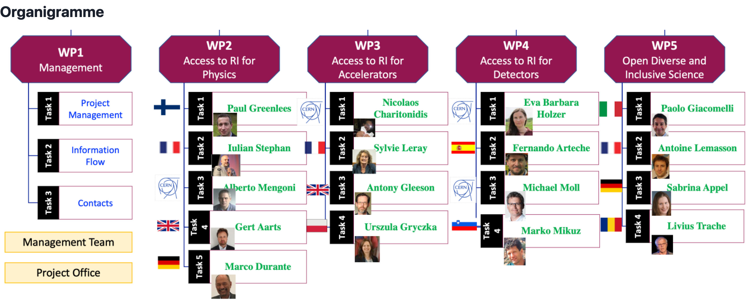
WP4:Access to RI for Detectors in EURO-LABS

Slide 3

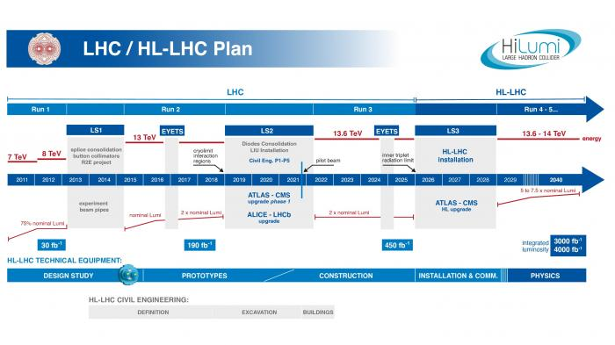
Placing of WP4 in European HEP (present)
Core HEP Detectors endeavour today - construction of upgraded detectors for operation at the HL-LHC
  In line with the stipulations of the 2013 European Strategy for Particle Physics (ESPP) report and their secondment in the 2020 ESPP update – “The successful completion of the high-luminosity upgrade of the machine and detectors should remain the focal point of European particle physics, together with continued innovation in experimental techniques.”
  Associated detector R&D almost entirely finished, large orders placed, construction activities are well under way
  Expected load on WP4 - few remaining parts of late R&D, like LGAD and SiPM for the timing layers
    Main load driven by sensor QA activities to monitor production quality – not serviced by EURO-LABS
    Production Readiness Review adopted as the dividing line – allow QA of preproduction (~5 %)
  Exception to the grand picture - inner tracker part of ATLAS and CMS
    No solution found to survive the entire HL-LHC lifetime
    Replace the inner pixel detector at mid-point after ~2/ab of integrated luminosity
    Existing detector solution could serve as a viable replacement, but R&D for technologically more advanced detectors are being pursued vigorously
  LHCb - major upgrade in LS4
    Radiation load to detectors - close to the inner parts of ATLAS&CMS trackers; their R&D in obvious need of EURO-LABS WP4 RI’s.

Slide 4
Placing of WP4 in European HEP (future)
The 2020 ESPP establishes two project initiatives as high-priority
  “the highest-priority next collider”: “an electron-positron Higgs factory”
  for the longer term: “a proton-proton collider at the highest achievable energy”, dubbed as the FCC-hh project.
Detector R&D for these two goals: supported by AIDAinnova EC project
  Other focal points: CERN DRD collaborations, developments within (big) experiments
Development cycle towards the use of a new technology in detectors spans over 10 to 20 years.
  prospective detector R&D (“Blue Sky” research) – TRL 1
  guided detector R&D, according to known needs of future projects – TRL 2-5
  focussed detector R&D of approved experiments – TRL 5-7
These detector development phases - supplemented by providing access to the RI’s of EURO-LABS WP4

Slide 5

Placing of WP4 in European HEP (future)
Major support of EURO-LABS WP4 for Higgs factory detectors
  Test Beams (WP4.1) and Detector Characterization (WP4.2) tasks
  Radiation load is relatively small
    Still testing at low levels of radiation & checking for single event effects
Detector studies aimed at FCC-hh
  Detectors at FCC-hh - highest radiation levels (after 30/ab)
    forward calorimeters : 5000 MGy and 5x10¹⁸ n_{eq}/cm²
    innermost layer of the barrel vertex detectors ~1x10¹⁸ n_{eq}/cm²
  Need fluences in excess of at least 1x10¹⁷ n_{eq}/cm²
    benchmark for a yearly exchange of inner layers
EURO-LABS WP4 intends to provide access to these conditions, even up to 1x10¹⁸ n_{eq}/cm²
  RI’s in the Irradiations task WP4.3
End of 2021 the ECFA Detector R&D Roadmap was approved by the CERN Council
  Long term HEP Detector R&D goals defined
  Implementation strategy approved in September 2022

Slide 6
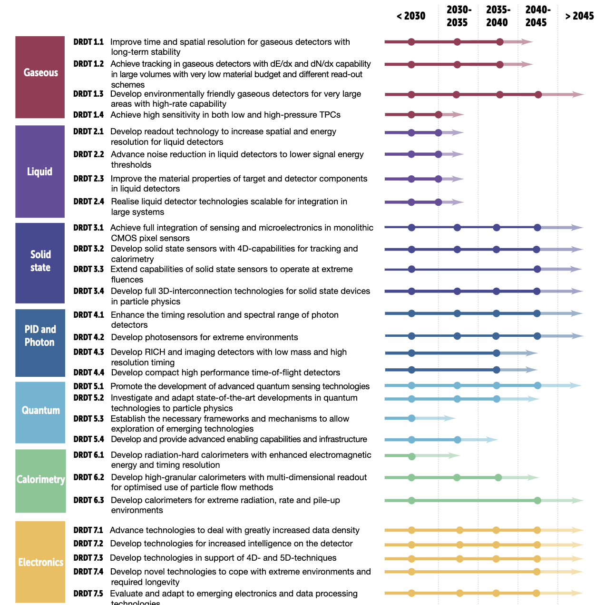
ECFA Detector Roadmap Implementation
Detector R&D Themes to be tackled by DRD Collaborations being formed now
  DRD1 Gaseous Detectors
  DRD2 Liquid Detectors
  DRD3 Solid State Detectors
  DRD4 Particle ID and Photon Detectors
  DRD5 Quantum and Emerging Technologies
  DRD6 Calorimetry
  DRD7 Electronics
Process overseen by CERN’s DRD Committee
  Evaluating submitted proposals
Collaborations start on Jan 1st 2024
More by
DRDC Chair Thomas Bergauer
on Wednesday morning

Slide 7
WP4 Budget
EC allocation 2.6 MEUR
  Supplemented by CH and UK contributions from their national funds
About 40 % more TA funding than in AIDA2020

Slide 8
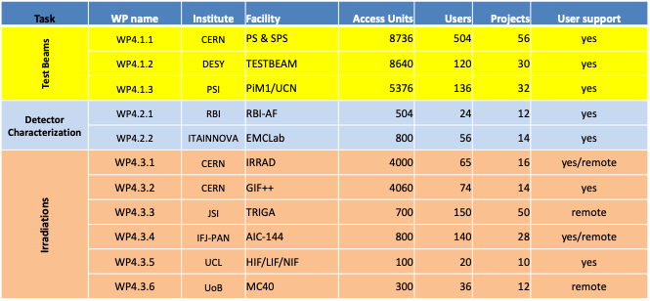
WP4.1-3 Deliverables
Each RI delivers Access Units (~beam hours) to Projects with Users
Two access modalities: physical/remote access
  Physical: users at RI (user support)
  Remote: users send samples to RI (handling, shipment)
Dedicated talk
on each of the the
tasks tomorrow !

Slide 9
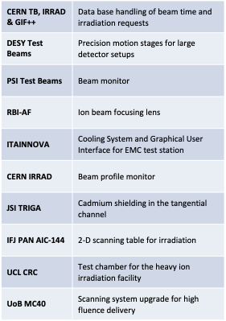
WP4.4 Service Improvements
Aimed at improving access to RI for EURO-LABS
  Each RI proposed improvements to maximize impact on user access
  Improvements have to be ready in Y2 of the project
    First three milestones delivered
    Two more follow end October
  EC contributions are matched by RI’s own funding, typically exceeding EC
    Budget adjustment of EC part: equipment -> consumables, manpower
Dedicated talk on Service Improvements tomorrow !

Slide 10
Proccessing of WP4 Applications
Single entry point through the EURO-LABS web page
Generic review procedure in WP4:
  The scientific RI coordinator (“Facility Coordinator”) checks the technical requirements and eligibility of applications. Then the EURO-LABS WP4 User Selection Panel gets notified of the application and decides on the allocation of resources.
USP composition: WP4 & WP4.1-3 leaders (4) & representatives of LHC experiments and DRD 1,3,7 (4), awaiting assignment from DRD6
Some facilities require pre-approval by their Scientific Committees (CERN, PSI…)
USP receives the proposal from the FC, any member can request discussion within two weeks, otherwise the project can go ahead
WP4 USP
DRD1 (Gas): Eraldo Oliveri (CERN)
DRD3 (Solid): Gianluigi Casse (Univ. Liverpool)
DRD6(Calorimetry): to be nominated
DRD7 (Electronics): Mohsine MENOUNI (CPPM Marseille)
LHC experiments: Anna Macchiolo (Univ. Zurich)
WP4.1: Eva Barbara Holzer (CERN)
WP4.2: Fernando Arteche (Itainnova)
WP4.3: Michael Moll (CERN)
WP4: Marko Mikuz (Univ. Ljubljana & JSI) (Chair)

Slide 11
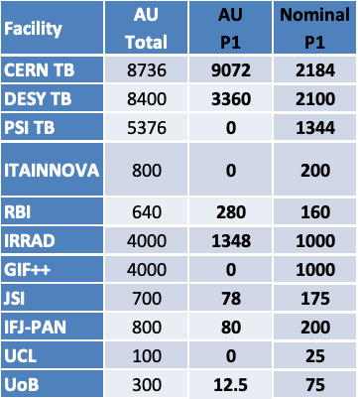
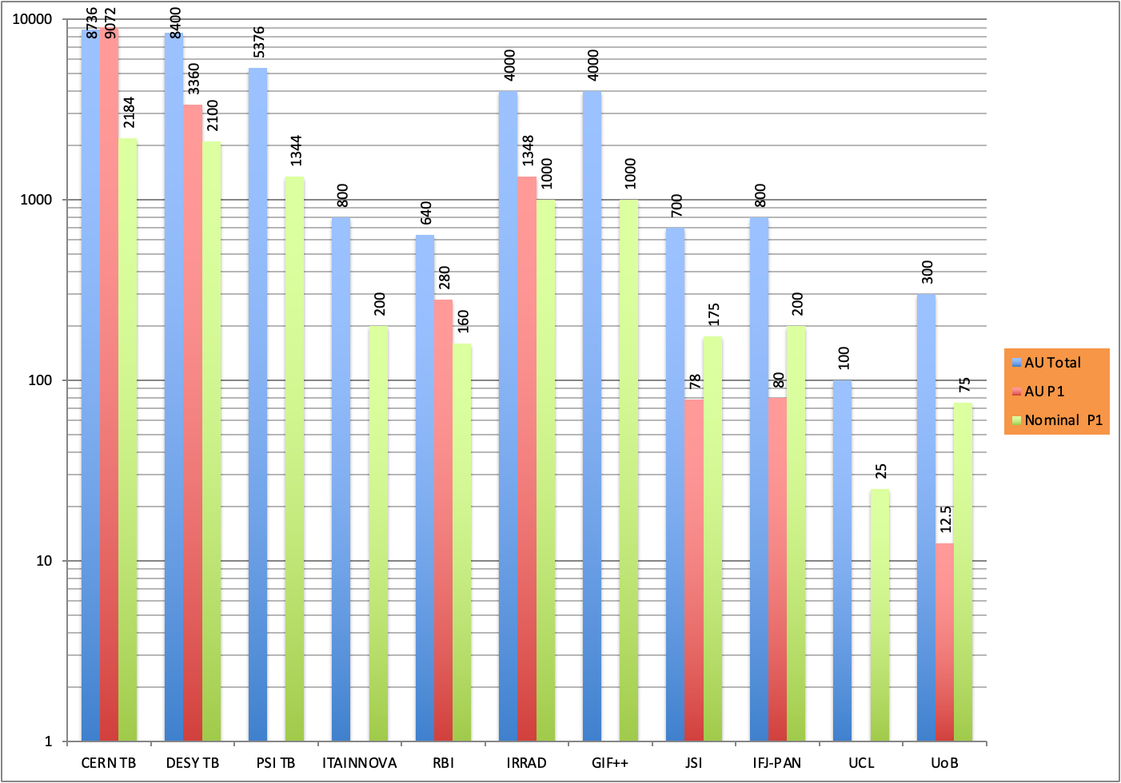
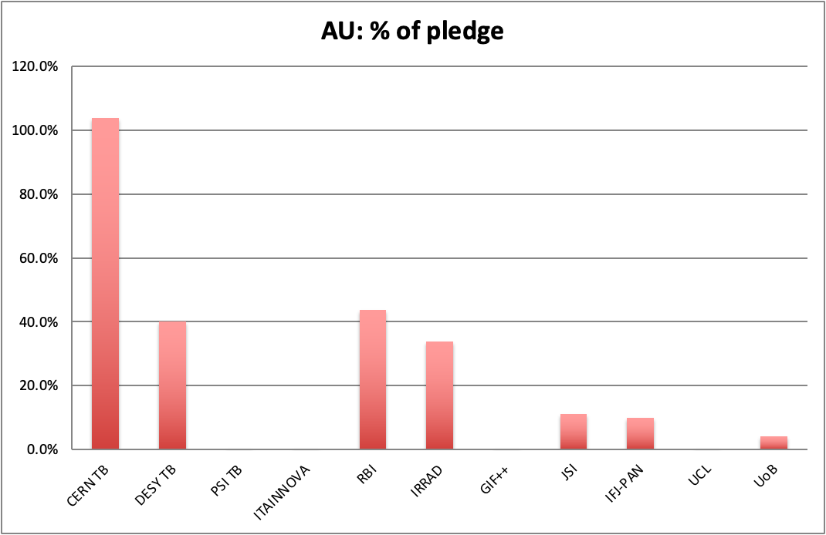
WP4 Performance in P1
Taking overall number of AU (the only deliverable!) granted to users in P1 WP4 is doing very well with 42% of total delivered
In fact, performance must be improved
  Overall figure dominated by CERN (and DESY)
    Even troublesome, if no extra resources found for user support
      No CERN beams in 2026 though
  Four Ris with no AU delivered at all
Nominal 25%

Slide 12
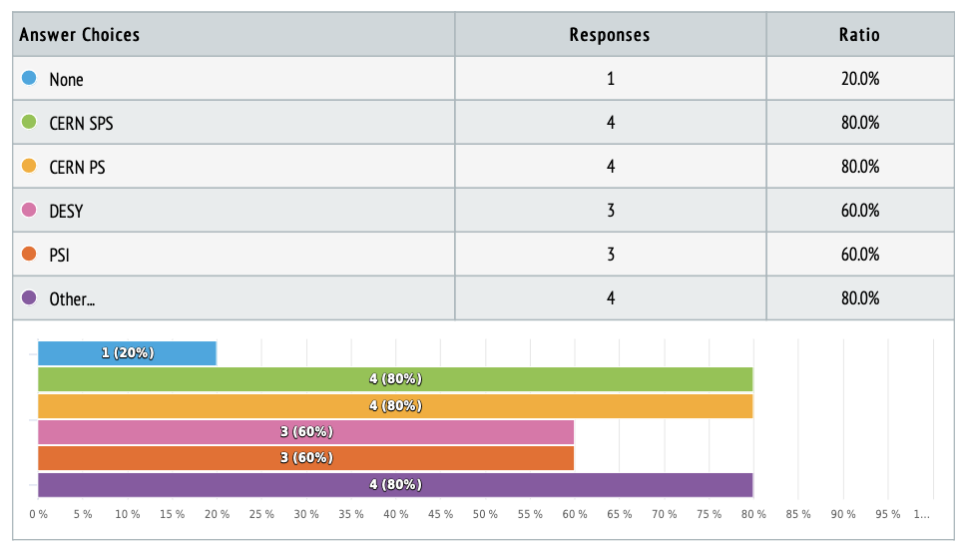
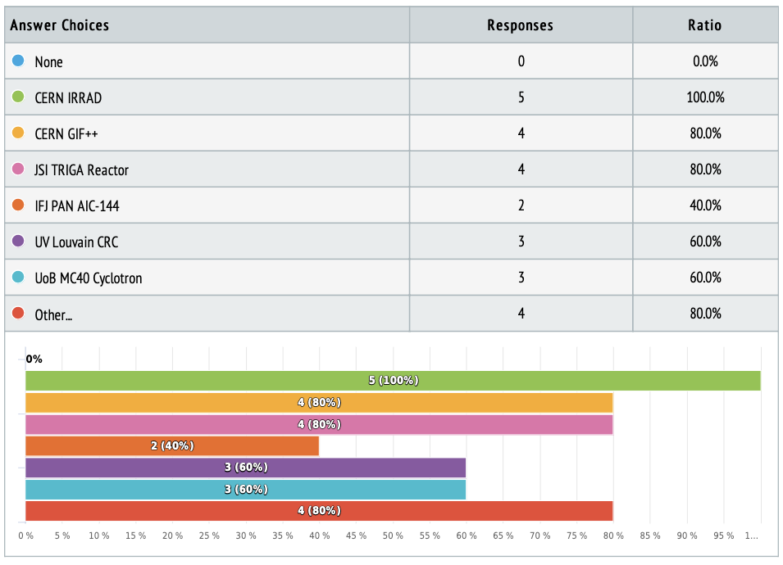
Have we miscalculated ?
ECFA and LDG have conducted a survey among DRD collaborations of their need of resources for the coming years and beyond
All WP4 facilities in high demand including the ones with no AU in P1
Possible reasons for under-performance
  Period of 12 months to short to draw (hard) conclusions
  Formation of DRD collaborations poses heavy load on the users
  Facilities with few expected projects – large fluctuations
  Is excluding all HL-LHC production QA to be revised?
Expect more comments in task leader talks tomorrow
Certainly, development needs to be followed up closely, efforts made to actively solicit users, eventually also move resources

Slide 13
WP4 Summary
With WP4 EURO-LABS is providing transnational access to top level European Research Infrastructures for R&D on HEP detectors
  TA complement to AIDAinnova
Acess to RI’s free of charge
  Tailored to detector R&D where dedicated funding is often a problem
Covers 3 types of research infrastructures, grouped into tasks
  Test Beams (3 facilities)
  Detector Characterization (2 facilities)
  Irradiations (6 facilities)
Service Improvements at each RI to improve access
Large fluctuations between RIs observed in P1 – to be watched
EURO-LABS WP4 RIs in high demand for future DRD collaborations

