Slide 1
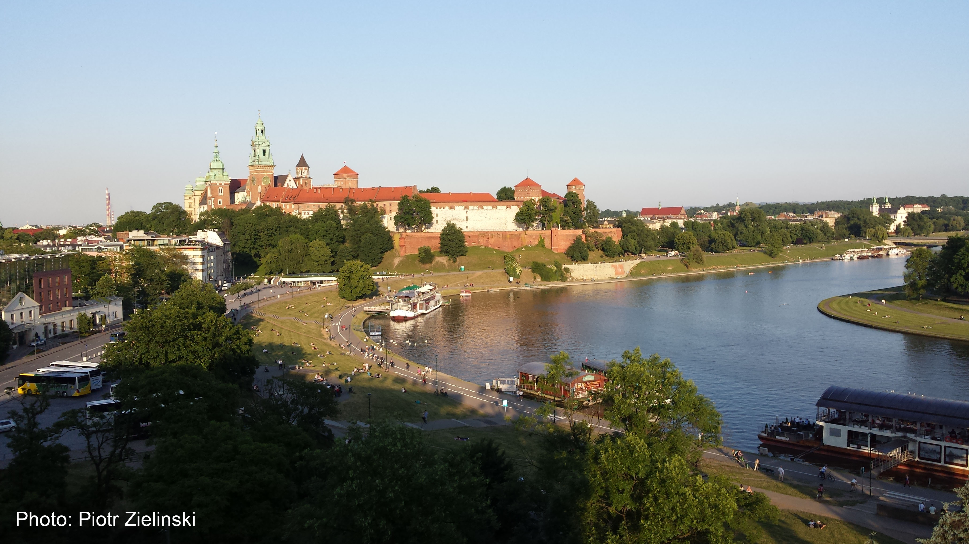
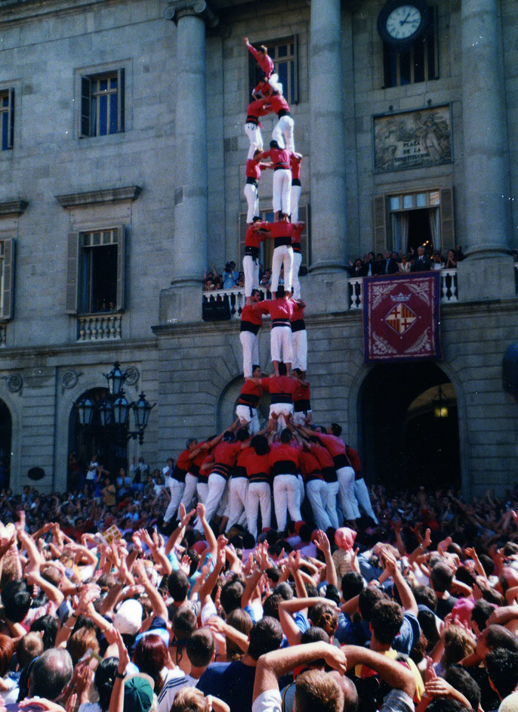
WP3 – Access to Research Infrastructures for Accelerator R&D
HORIZON-INFRA-SERV-07-01
I. Efthymiopoulos – for the WP3 many thanks to all FC for the work done !!

Slide 2
WP3 - Goals
Include the leading facilities involved in Accelerator R&D in Europe
Maintain and further strengthen the collaboration, exchange of information, and knowledge between the facilities and the User Community
Support the User Groups in their Research
provide expert help, exploit the full capabilities and extract the maximum scientific outcome from the facilities
With targeted service improvements, enrich the possibilities of the facilities to the profit of the Users
Fertilize synergies between the research communities and applications
Support ongoing R&D efforts in the Present and Future Accelerators
Targeted Outreach & Training activities to attract new (or to be) Researchers in the Field of Accelerators

Slide 3
WP3 & Accelerator R&D
EURO-LABS in I-FAST Meeting, May 2022
AMICI-I-FAST WP13 Workshop on Facilities for Beam test of accelerator components
I-FAST
Innovation Fostering in Accelerator Science and Technology
Detector R&D tests @ HIRadMat
AIDAinnova
EURO-LABS
WP3
TIARA
Support the Implementation of Accelerator R&D Activities,
Trans-field activities also beyond PP,
Roadmaps/Priorities iof various muncities
Reports in TIARA Meetings
EUPRAXIA
Compact European Plasma Acceleration with Superior Beam Quality
EuPRAXIA@SPARCLAB
Presentation by Angelo Biagioni on Wednesday

Slide 4
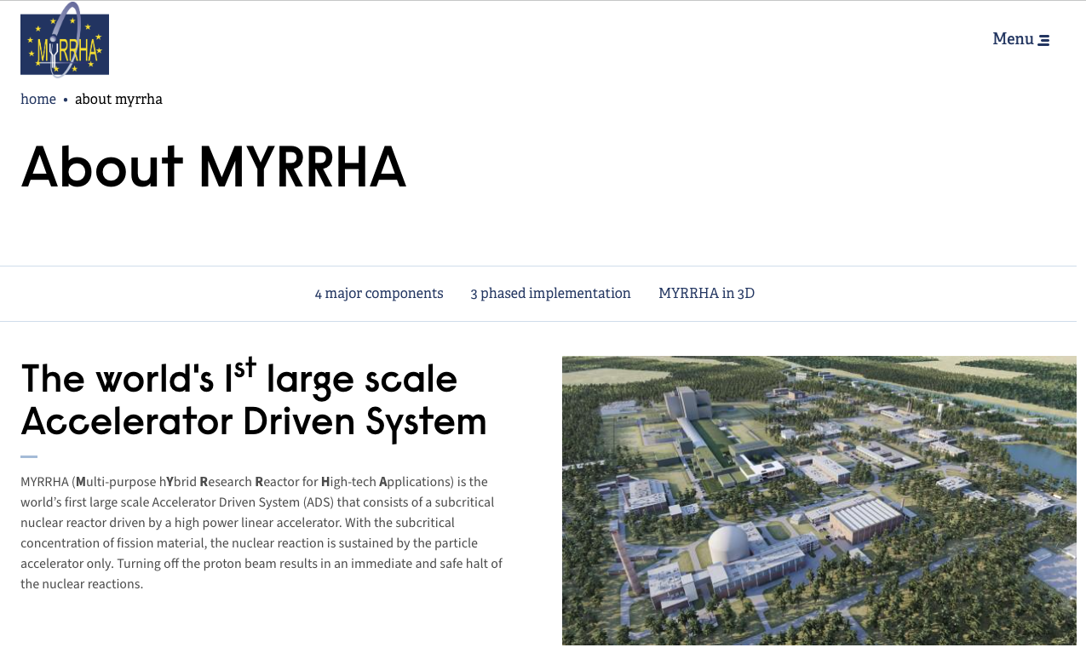
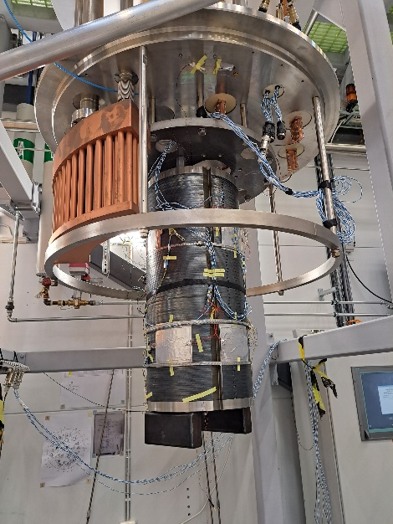
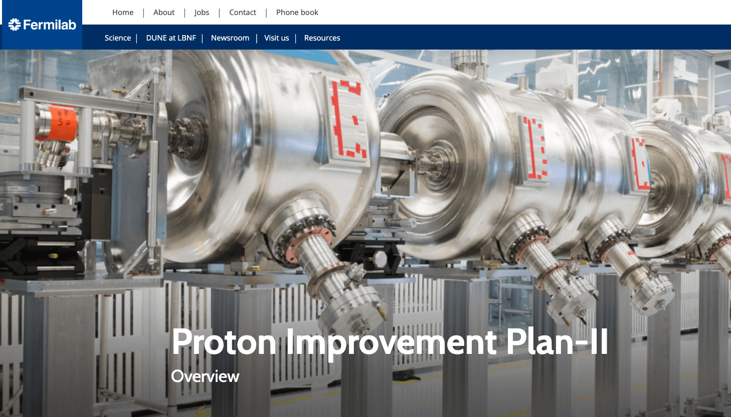
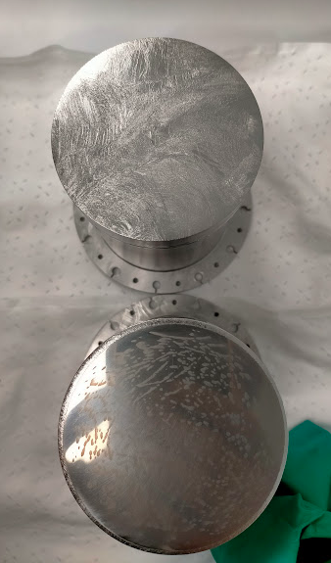
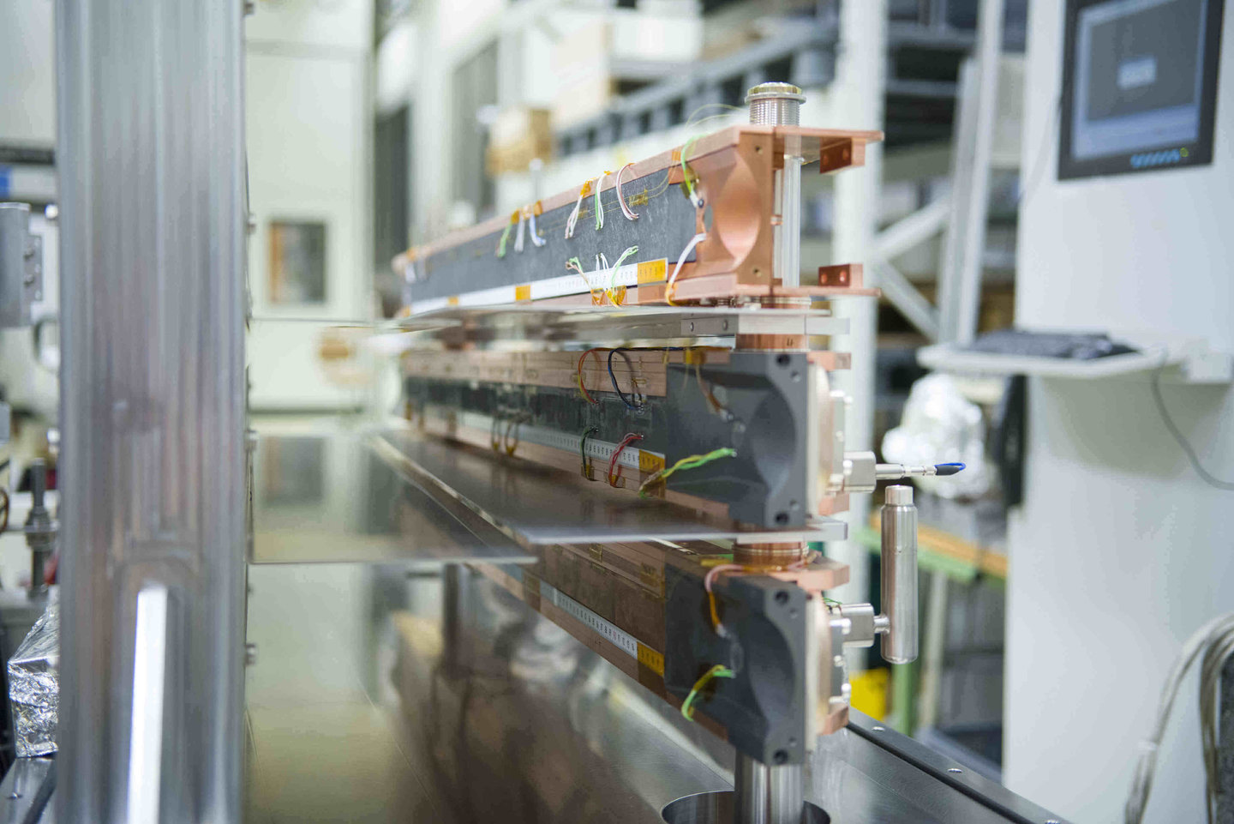
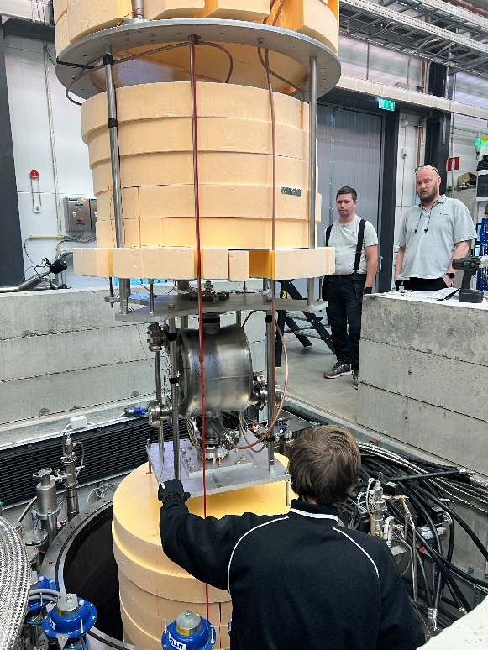
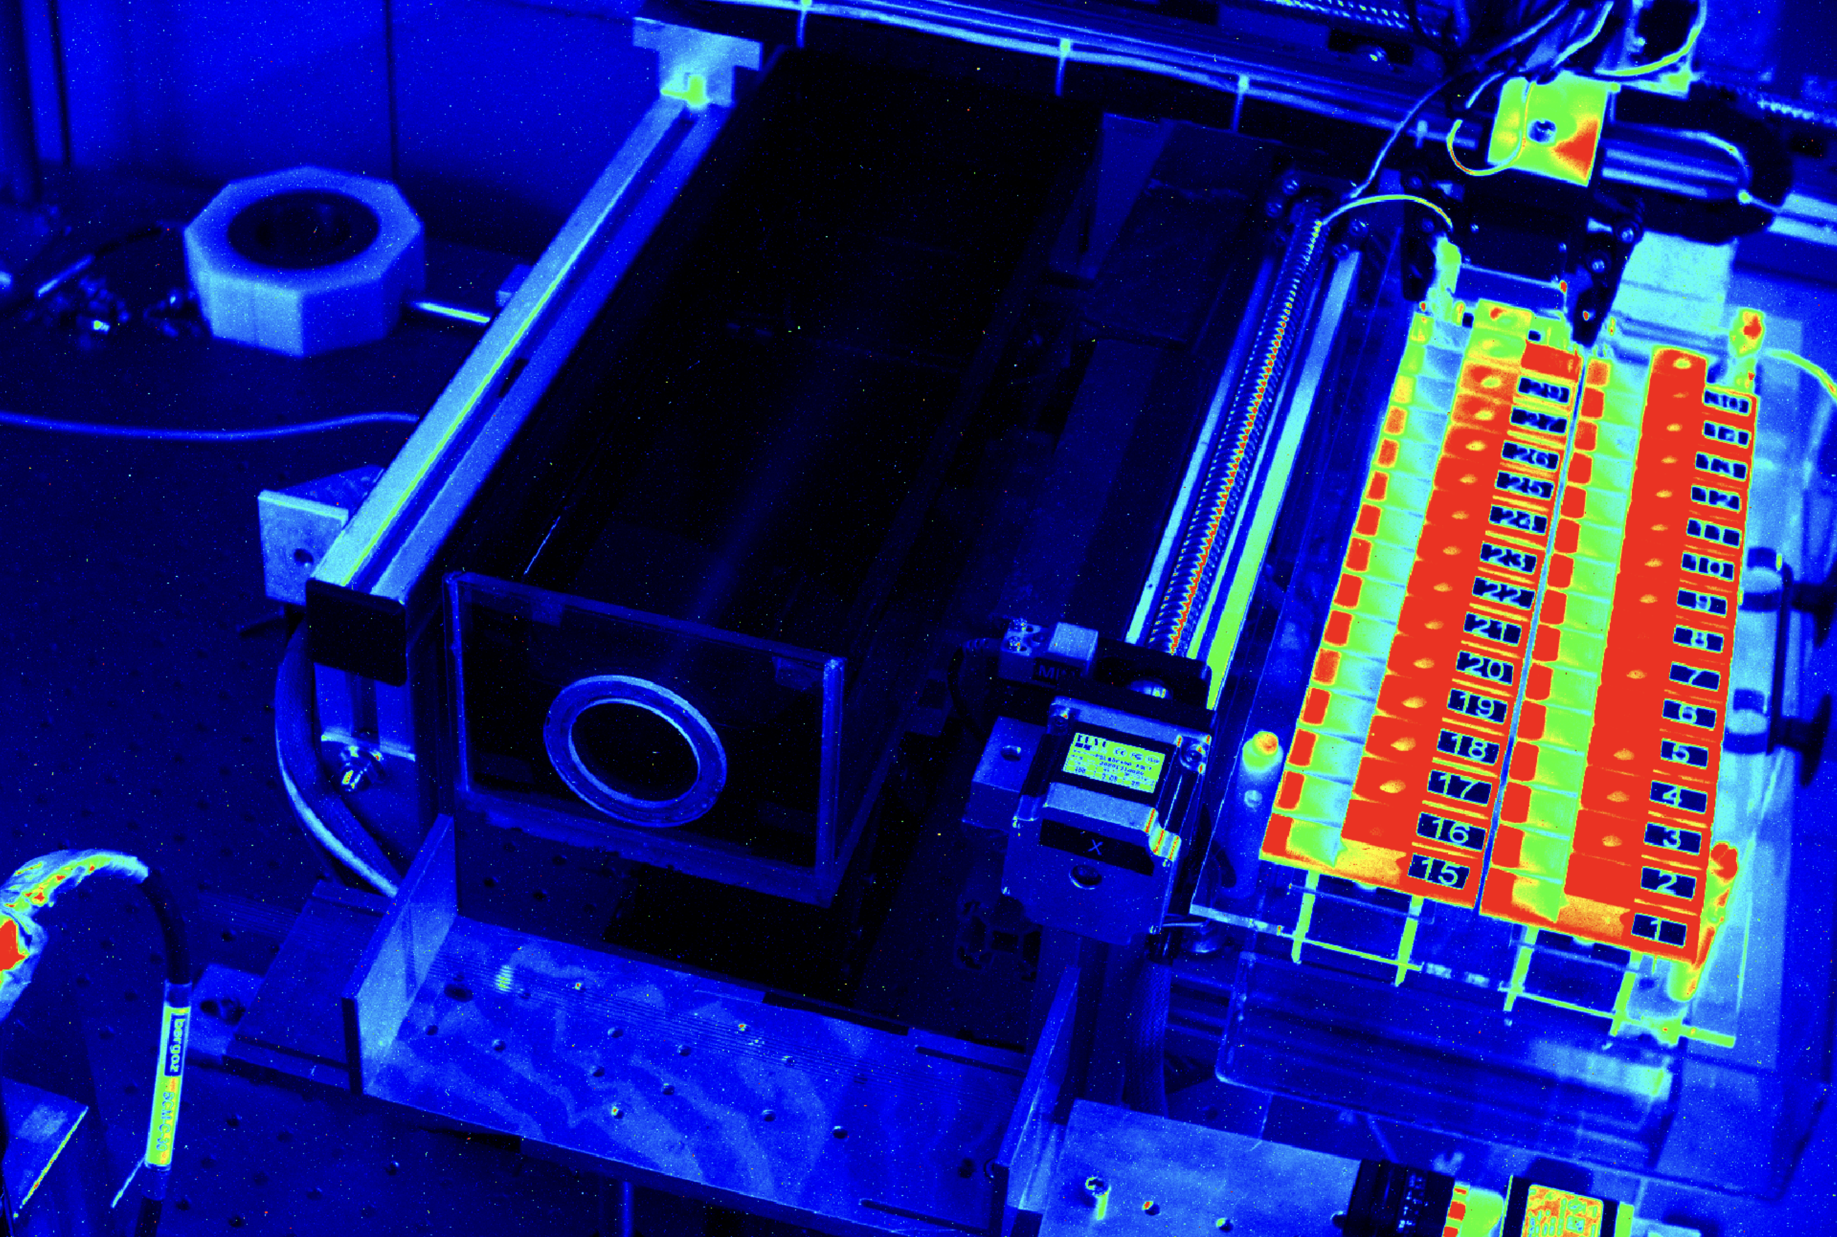
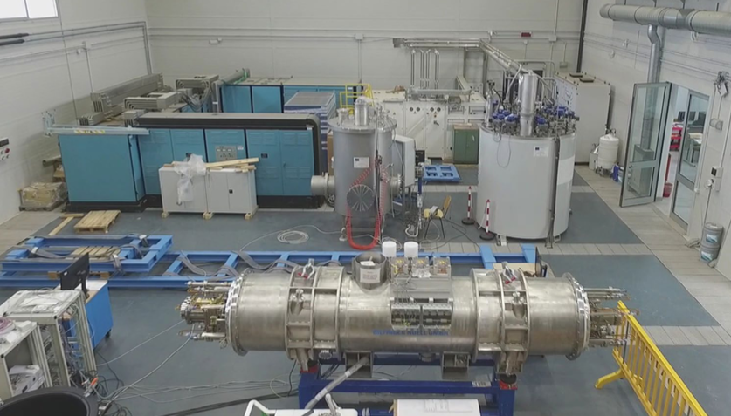
WP3 & Accelerator R&D
Facilities
Future projects - FCC
World-wide R&D
Sushi septum test @ FREIA
SRF production cavity test @ FREIA
Vacuum technology @ KARA
PIP-II Cavity validation @ SUPRATECH
HL-LHC
WP3-RIs
HL-LHC collimators @ HIRadMat
Technology
QPR sample conditioning and testing for HZB @ SUPRATECH
Applications
IRIS – applied Superconductivity
INFN-THOR
Crab cavity test @ FREIA
INFN-LASA
Fibre-optic fabric for UHDR real-time dosimetry for FLASH radiotherapy @ CLEAR-CERN
Notes:
QPR = quadrupolar resonator to measure surface resistance in RF cavity material
HZB = Helmholtz Zentrum Berlin
IRIS = Innovative Research Infrastructure on applied Superconductivity

Slide 5
WP3 - Organization
Work-package structure
User Selection Panels
Meetings
Activities in P1

Slide 6
WP3 - Structure
WP3
Access to RI for Accelerators
WP Coordinator: I. Efthymiopoulos
Task 1 N. Charitonidis - CERN
Material Testing Facilities
HiRadMat@SPS^{(*)}
Task 2 Sylvie Leray - CEA
Technology Infrastructures
FREIA^{(*)} (Univ. Uppsala)
INFN –LASA ^{(*)} (Milano)
INFN-THOR^{(*)} (Univ Salerno)
IJCLAB SUPRATECH
CEA Irfu-Synergium^{(*)}
XBOX CERN
Task 3 Anthony Gleeson - UKRI
Electron Beam Facilities
KIT-ALFA (ANKA+FLUTE)^{(*)}
VELA/CLARA (Univ. Daresbury)
INFN – BTF Frascati
INFN – SPARC Frascati
CEA LIDYL LPA-UHI100^{(*)}
Task 4 Urszula Gryczka - INTC
Applications
INTC –RAPID (Warsaw)
CLEAR CERN
(*) budget for service improvements assigned
new in TA program

Slide 7
WP3 - Organization
Work-package structure
User Selection Panels
TA application forms _{from project web (doc & excel)} and procedures defined and working
Meetings
Activities in P1

Slide 8
WP3 - USP
WP3
Access to RI for Accelerators
WP Coordinator: I. Efthymiopoulos
Task 1 N. Charitonidis - CERN
Material Testing Facilities
Nikolaos Charitonidis (CERN) Alice Goillot(CERN) David Sprouster (SUNY Stony Brook, BNL) Bernie Riemer (ORNL, chair) Ilias Efthymiopoulos (CERN)
Task 2 Sylvie Leray - CEA
Technology Infrastructures
Sylvie Leray (CEA, chair) Thomas Proslier (CEA) Roberto Corsini (CERN), David Longuevergne (CNRS) Dario Giove (INFN) Rocío Santiago Kern (UU) Jose Manuel Perez (CIEMAT) Marc Wenskat (DESY) Robert Zierold (Hamburg University) Bernard Auchmann, (PSI) Robert Laxdall (TRIUMF) Ilias Efthymiopoulos (CERN)
Task 3 Anthony Gleeson - UKRI
Electron Beam Facilities
Anthony Gleeson (STFC, chair) Sandrine Dobosz Dufrenoy (CEA) Robert Ruprecht (KIT) Riccardo Pompili (INFN-LNF) Roberto Corsini (CERN) Florian Burkart (DESY) Leonida Gizzi (CNR-INO) Shaukat Khan (Dortmund) Markus Ries (HZB) Ilias Efthymiopoulos (CERN)
Task 4 Urszula Gryczka - INTC
Applications
Urszula Gryczka (INCT, TL, chair) Roberto Corsini (CERN) Angeles Faus-Golfe (CNRS/IN2P3) Rob Edgecock (HUD) Ilias Efthymiopoulos (CERN)
Most of the USP meetings are organized on zoom (remote)
Yearly meetings or ad-hoc, depending on applications received
external members

Slide 9
WP3 - Organization
Work-package structure
User Selection Panels
TA application forms _{from project web (doc & excel)} and procedures defined and working
Meetings
Work-package _{all facility coordinators} : 3(+1) meetings in P1
Task Leader : 2 meetings in P1
Activities in P1

Slide 10
WP3 - Organization
Work-package structure
User Selection Panels
TA application forms _{from project web (doc & excel)} and procedures defined and working
Meetings
Work-package _{all facility coordinators} : 3(+1) meetings in P1
Task Leader : 2 meetings in P1
Activities in P1

Slide 11
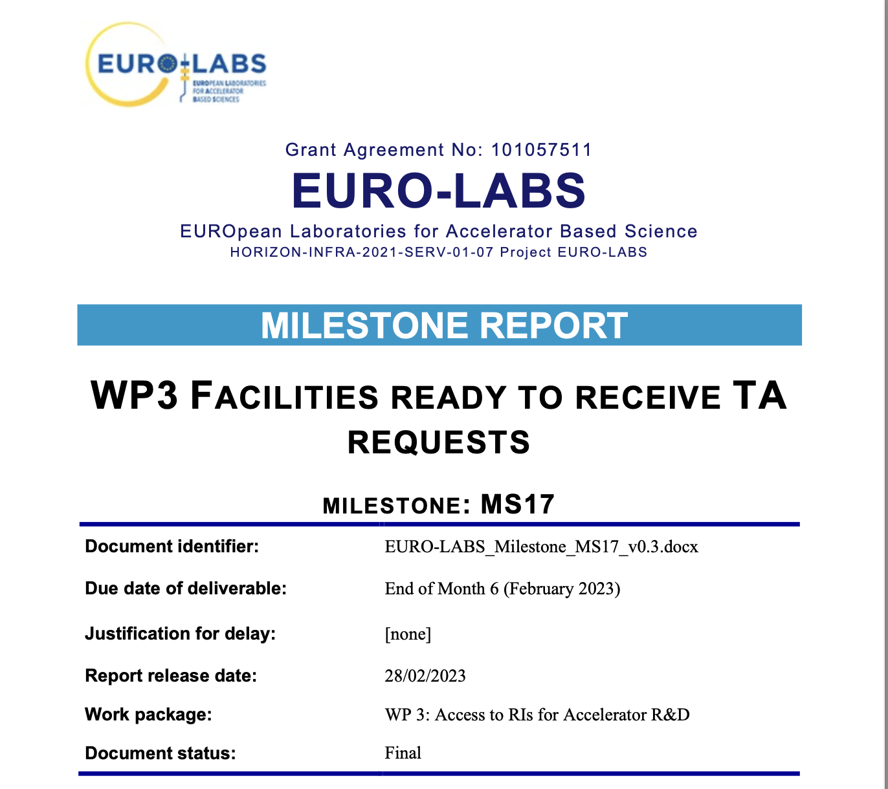
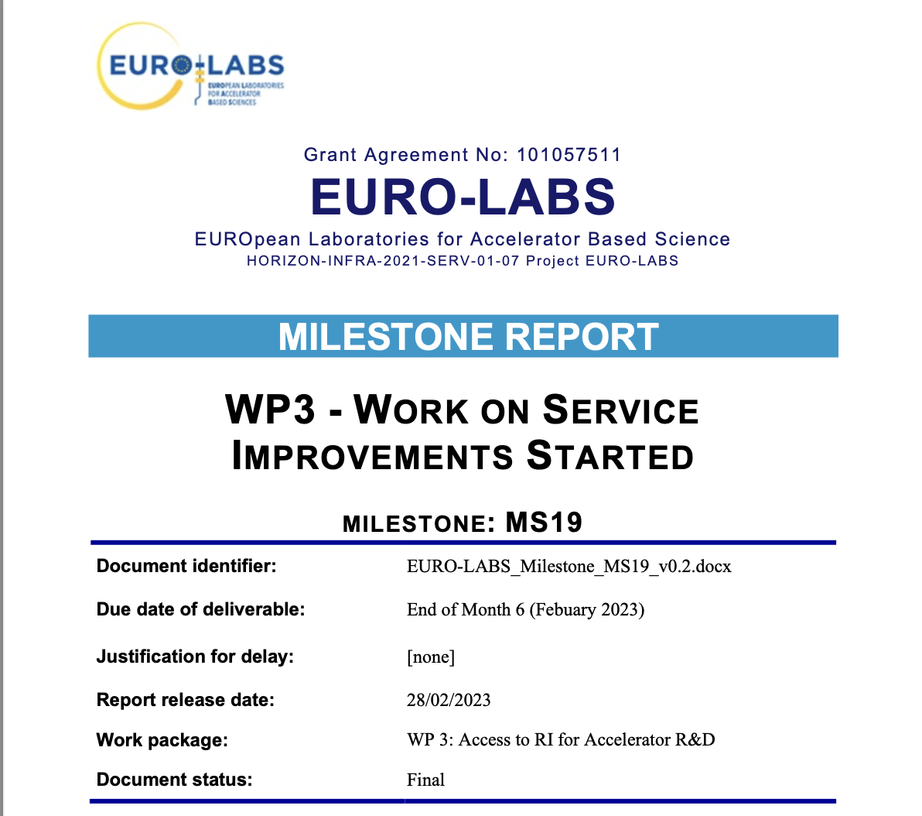
Milestones/Deliverables
First milestones: MS17 and MS19 completed (February 2023)
Most of the facilities in operation and ready to receive TA projects
Service improvements plan, budget and timeline defined
… details in the WP3-Task presentations tomorrow

Slide 12
TA in P1 - Status
First TA projects completed
slower startup in some facilities – will catch up in the next period
(*)
(**)
(*) 25% of total AU in the project
(**) projects in the pipeline not included
… details in the WP3-Task presentations tomorrow

Slide 13
Activities in P1
Data Management Plan (DMP) : organised at facility level
Discussions with WP5 team – implementation of a minimal DMP for Open Access under FAIR (Findability, Accessibility, Interoperability, and Reuse of digital assets)
Training - Outreach
Hands-on training on large Accelerators @ CERN
Combined effort with WP2 – ISOLDE and WP3 - PS booster, CLEAR coordinated by WP5
Yearly (?) sessions for the duration of the project, starting >March 2024
Training in INCT-RAPID for Applications

Slide 14
In the news
EURO-LABS article on kick-off meeting in CERN Courier
Issue January/February 2023
Further articles to follow on highlights of TA projects
Facility videos coordinated by WP1
… details in the WP3-Task presentations tomorrow

Slide 15
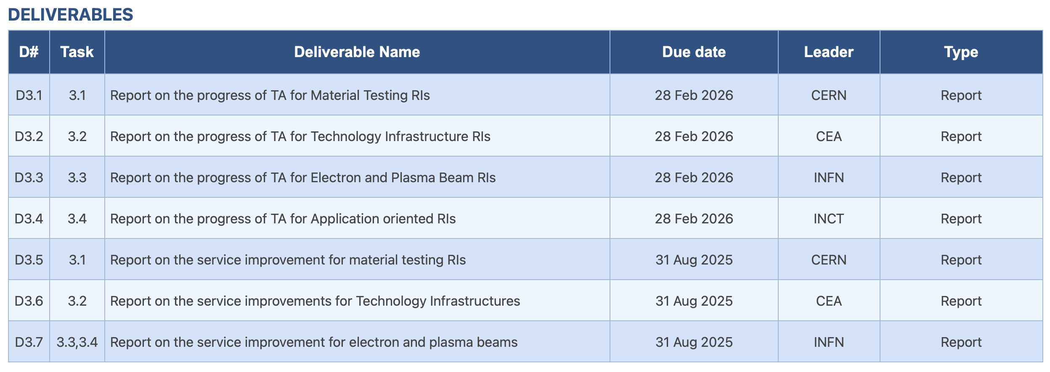
Next Steps
Work to finalize our part on the Period-1 Report
Achieve cruising speed on TAs and implement Service Improvements
MS18: Majority of TAs attributed,
MS20 : Services improvements implemented for August’25
Deliverables ahead

Slide 16
Note:
Success is a marathon, not a sprint;
START
…and we all know well how the story ends!

