Slide 1
Planning INFN contribution to computing

Slide 2
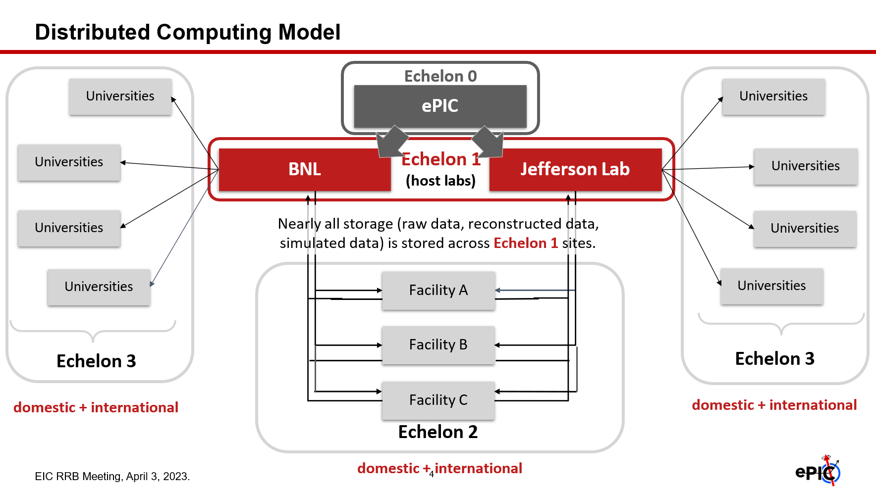
Present Computing Model of ePIC

Slide 3
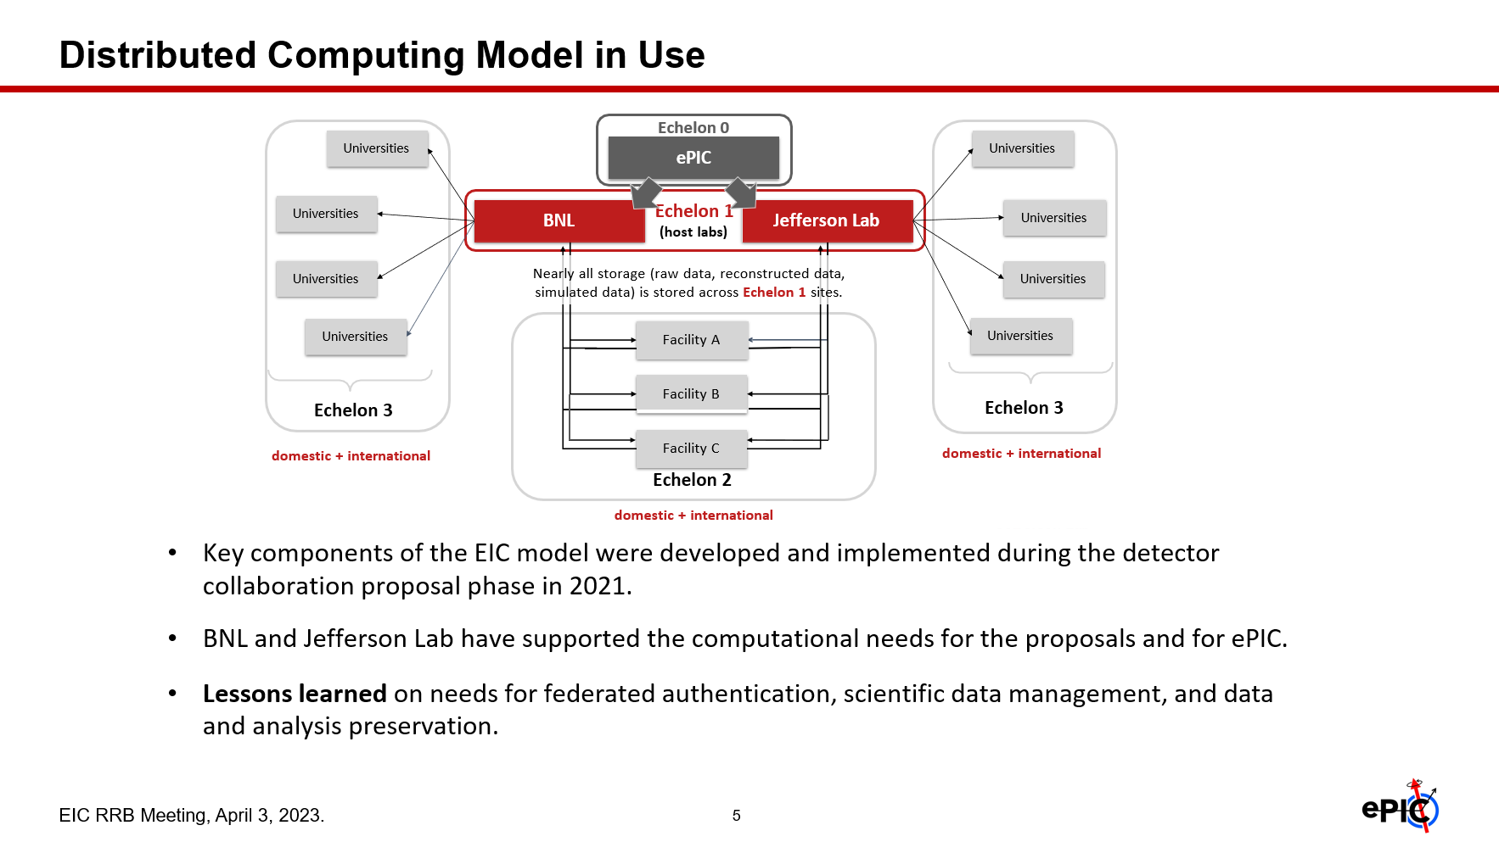
Accompanying Comments

Slide 4
Comments
The computing model is in a very primordial stage
Developed inside the S&C working group. I don’t know if it was discussed with the ePIC management
No cost and/or cost sharing attached to it
Not discussed with the international community
Nonetheless it was shown at the RRB

Slide 5
Trigger and actions
At RRB INFN representative were asking question about possible pledge sharing.
We will need to detail the financial plan for the next years, and it is a good time start to include computing
For this reasons, Pietro and me (Domenico was not able to join, unfortunately) contacted Markus to be updated on the ePIC computing model
Since the two labs have appointed two contacts persons to support the (at that time) proto collaboration for the simulations, we contacted also Jerome Lauret (BNL, by Eric Lancon) and Graham Heyes (Jlab, by Amber Boehnlein) to have also an insight to the Labs point of view.

Slide 6
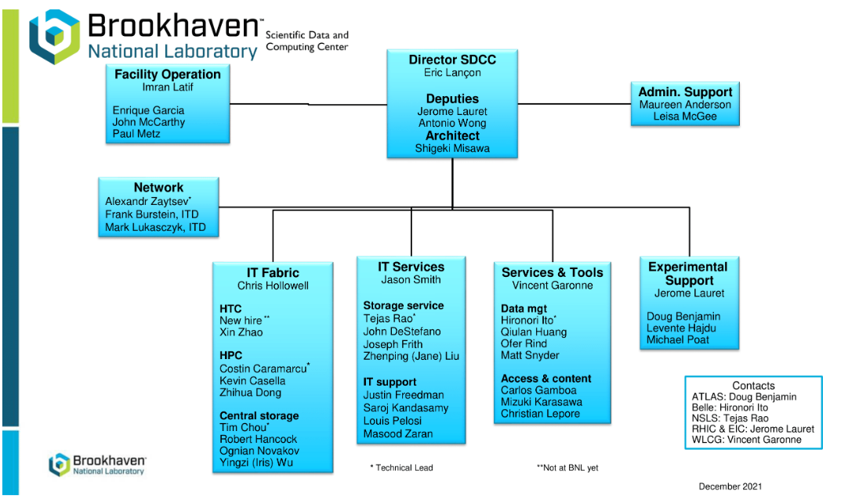
BNL Computing

Slide 7
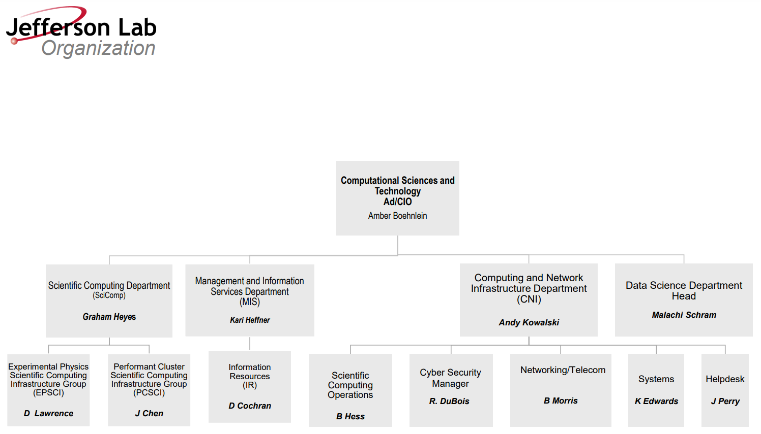
JLab Computing

Slide 8
Outcome:
Gotten information:
  Eric and Amber are setting up a new institute for computing to support the EIC
  Both BNL and Jlab put forward a request to DOE for a 2.5 M/year each for EIC computing. This request if for iron (i.e. no extra money for personnel or running costs included). Both Eric and Amber were doubling the initial estimation of Jerome and Graham
  Collaboration fees will include/cover computing costs for the collaboration
  The brits discussing to have a echelon 1 (or 2)
Comments
  Neither Marcus for ePIC or Jerome and Graham have plans or ideas for international commitment
  Fair sharing of cost not foreseen
  Approach was more of the type: good that you plan to contribute with national resources, just tell us how much you will be able to list as inkind contribution (?)

Slide 9
Further comment
The decision making process to me is very unclear
  Money will come to the labs from DOE and I’m quite sure that the DOE will step in if not happy with the computing model
  Labs have the tasks to support EIC computing and will install the needed tools and hardware. Also in this second case, I’m pretty sure that they will step in if not happy
  Experiments (now ePIC but in the future eventually also the second experiment) have been task to develop their computing models.
  MoU for Computing?

Slide 10
Conclusion
If our wish it to plan for a INFN contribution to EIC computing:
We need from our side to define an envelope for our participation to computing that can be accepted by INFN
We need to push for a fair share of computing between both national (share may be higher) and international communities.
We need to match the international share with our target
We need to do this in order to arrived with an agreed scheme for the next RRB
This is also the message we passed to both Markus, Jerome and Graham. To Graham and Jerome we also asked to pass the message up.

