Slide 1
Artificial Intelligence in Medicine
High pathological grade prediction in prostate cancer patients undergoing 18F-PSMA PET/CT using matRadiomics
Giovanni Pasini
giovanni.pasini@uniroma1.it

Slide 2
Who Am I
Graduated in Biomedical Engineering, I’m currently a
PhD student in Industrial and Management Engineering at the Department of Mechanical and Aerospace Engineering (DIMA), located at «La Sapienza» University of Rome, and a research collaborator at the Institute of Molecular Bioimaging and Physiology (IBFM-CNR) in Cefalù, Sicily.
Research activity: Personalized medicine for the diagnosis and prognosis of oncological and neurodegenerative diseases: Radiomics and Artificial Intelligence to support clinical decision-making

Slide 3
Team
Richiusa Selene
IBFM-CNR, Cefalù,Sicily
Giorgio Russo
Chief IBFM-CNR, Cefalù
Alessandro Stefano Researcher IBFM-CNR, Cefalù
Giovanni Pasini
PhD student, DIMA,IBFM
Albert Comelli
Senior Scientist, Ri.Med Foundation
Massimo Ippolito
Director U.O.C Nuclear Medicine and PET
Cosentino Sebastiano
Doctor of Medicine
Maria Gabriella Sabini
Head of medical Physics Unit
Fabiano Bini
Associate professor in Bioengineering, DIMA, «Sapienza»
Franco Marinozzi
Full professor Biomedical Instrumentation, DIMA, «Sapienza»

Slide 4
Study Illustration
1
2
3
Aim
Our approach
Expected Results
Radiomics models based on Prostatic
Specific Membrane antigen ([18F]-PSMA) positron emission tomography (PET) images for the prediction of
high pathological grade (Gleason score > 7)
Classical radiomics pipeline
Build a model able to predict high risk prostate tumor
Show the potentiality of radiomics biomarkers
matRadiomics as a comprehensive tool
for radiomics analysis
Image acquisition
Dataset: 86 or more

Slide 5
Image acquisition, dataset
Devices
Dataset
PET/CT
Siemens Horizon Biograph
GE Discovery 690
GS Score | Siemens | GE
6 | 22 | 13
7 | 14 | 14
8-10 | 17 | 6
tot | 53 | 33
86 patients or more,
Only cancer staging

Slide 6
What is matRadiomics
matRadiomics is a freeware that allows the user to carry out the whole radiomics framework:
1
import medical images
segmentation
feature extraction
feature selection
model building
prediction.
2
3
4
5
6
Journal of Imaging
https://doi.org/10.3390/jimaging8080221

Slide 7
Architecture
User
GUI
Model
Dicom Module
1
Image processing
1
Pyradiomics Module
2
2
Statistical &
ML
Classification Module
3

Slide 8
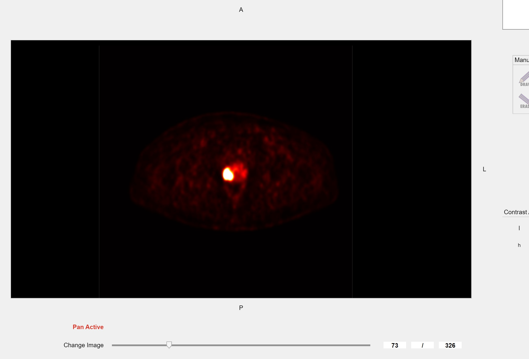
Our approach through matRadiomics: Import Medical Images
1
2
3
Supported Image format: DICOM, CT, PET, MRI, DBT
Visualize: Slices, Scroll mouse wheel
Contrast Adjustment
Dataset
ex. ANON37910

Slide 9
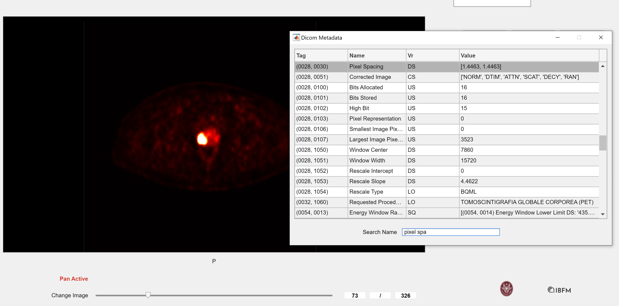
Our approach through matRadiomics: DICOM metadata
Visualize DICOM attributes: Patient Position, Pixel Spacing, etc…
Check for homogeneity of attributes
such as pixel spacing, slice thickness, kvp

Slide 10
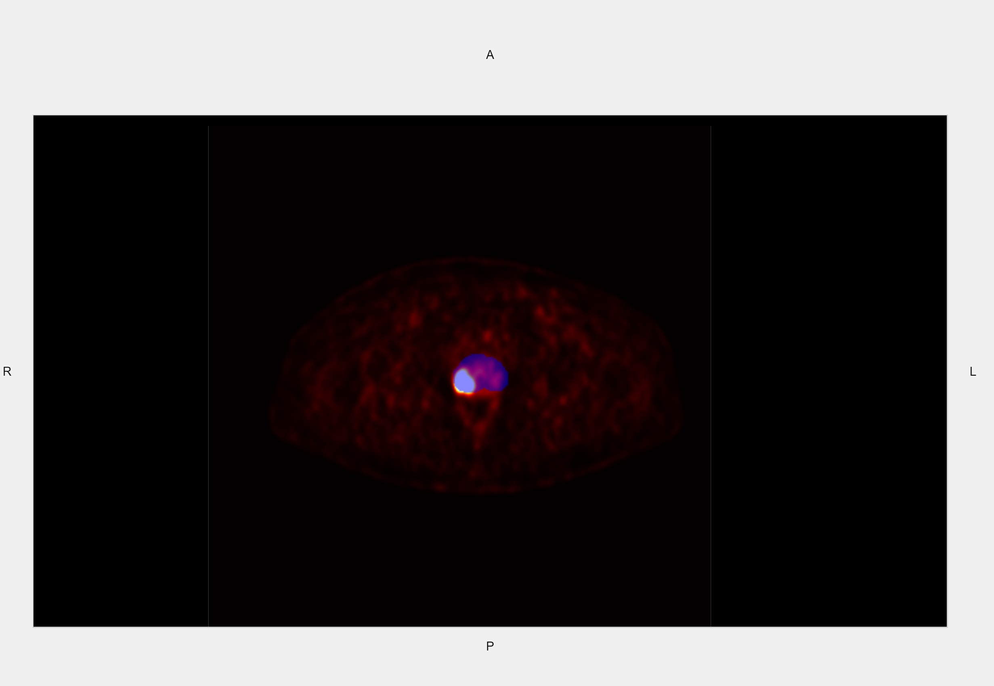
Our approach through matRadiomics: Segmentation
1
2
3
Import segmentations:
Dicom and DicomRT
Change mask opacity and colour
And switch between segmentations
Segmentation algorithms:
manual, thresholding, active contours,
Automatic (?)
Identify the best segmentation method

Slide 11
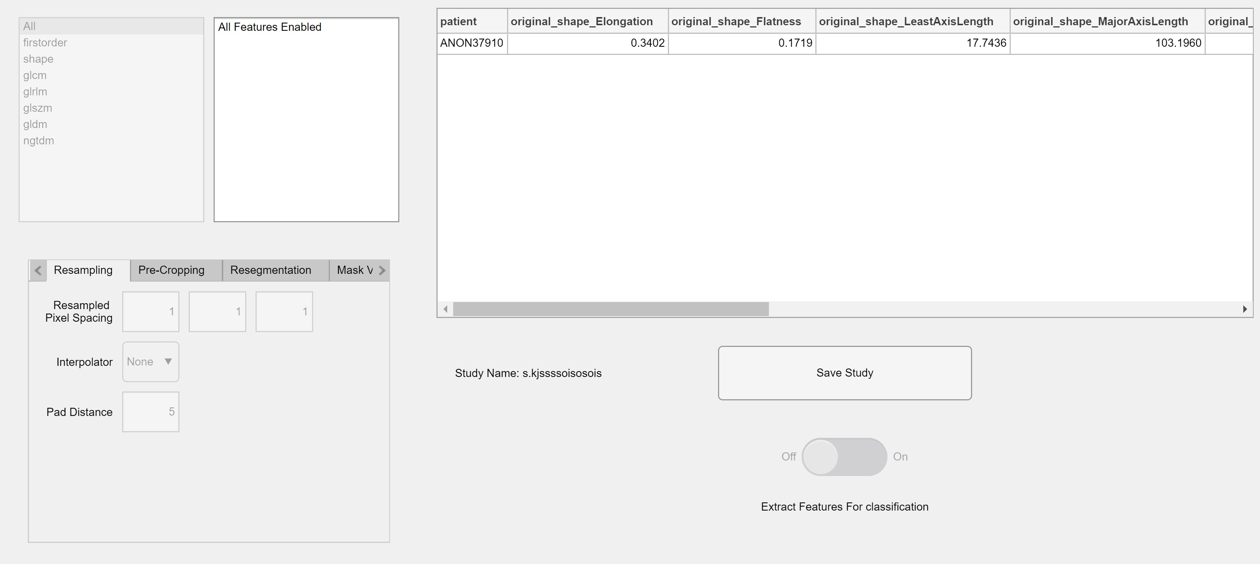
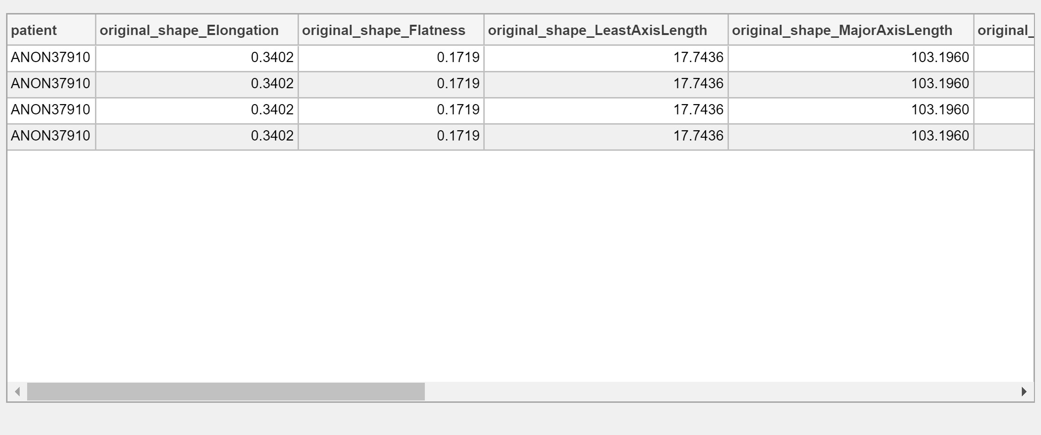
Our approach through matRadiomics: Feature Extraction
Image and mask
Feature Extractor:
Pyradiomics integrated in matRadiomics

Slide 12
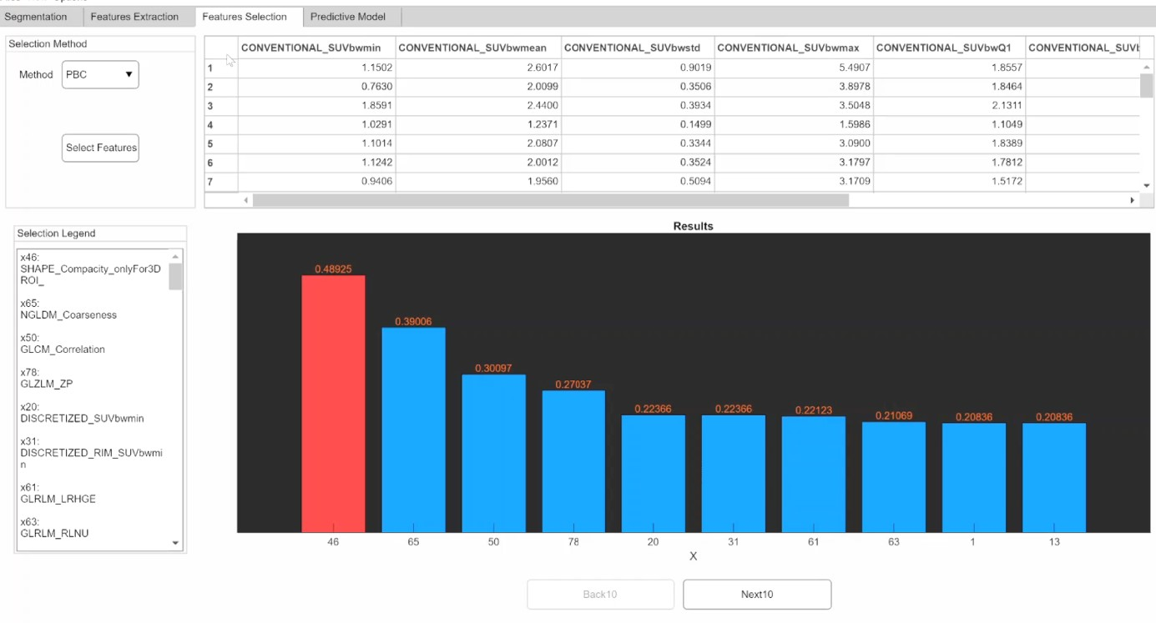
Our approach through matRadiomics: Feature Selection
Feature Selection: Hybrid descriptive-inferential method, LASSO, Relieff
Feature Weighting
Ordering
Logistic Regression Deviance Test
Feature Selection
PBC
Built iteratively
P-value check each cycle
Selected features

Slide 13
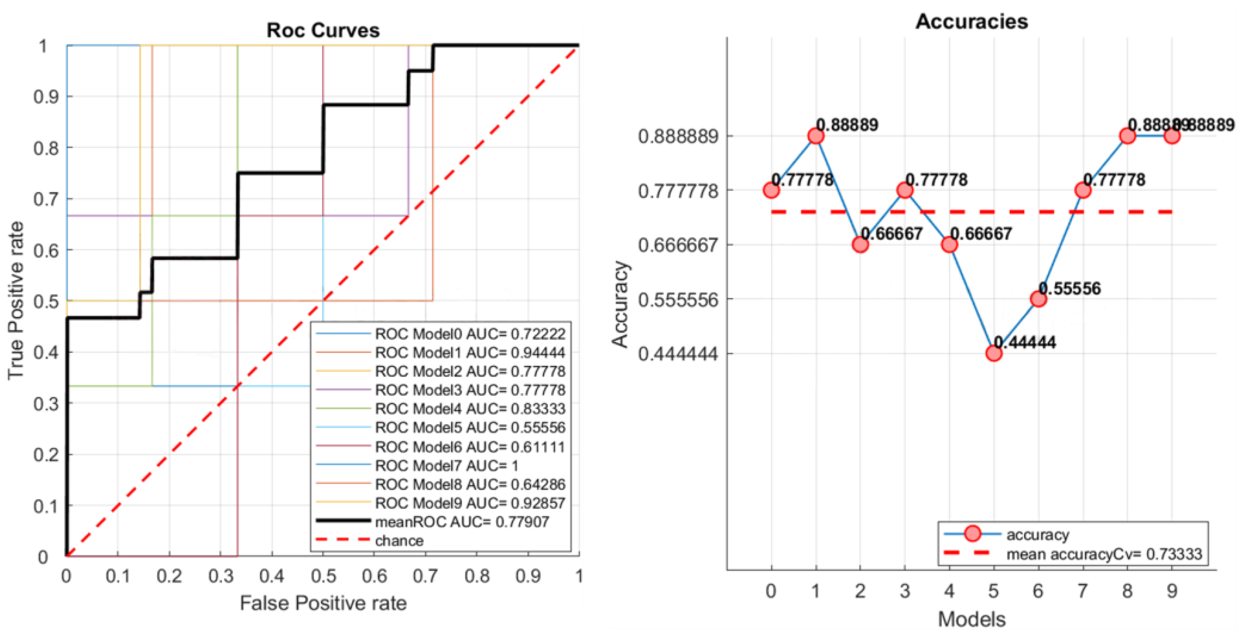
Our approach through matRadiomics: Machine Learning
1
2
3
4
Classifiers:
LDA, KNN, SVM
K-Fold Cross validation:
Stratified, non stratified
Model Saving
Performance Metrics: accuracy, roc, confusion matrix
LDA
KNN
SVM
Selected features
Cross Validated

Slide 14
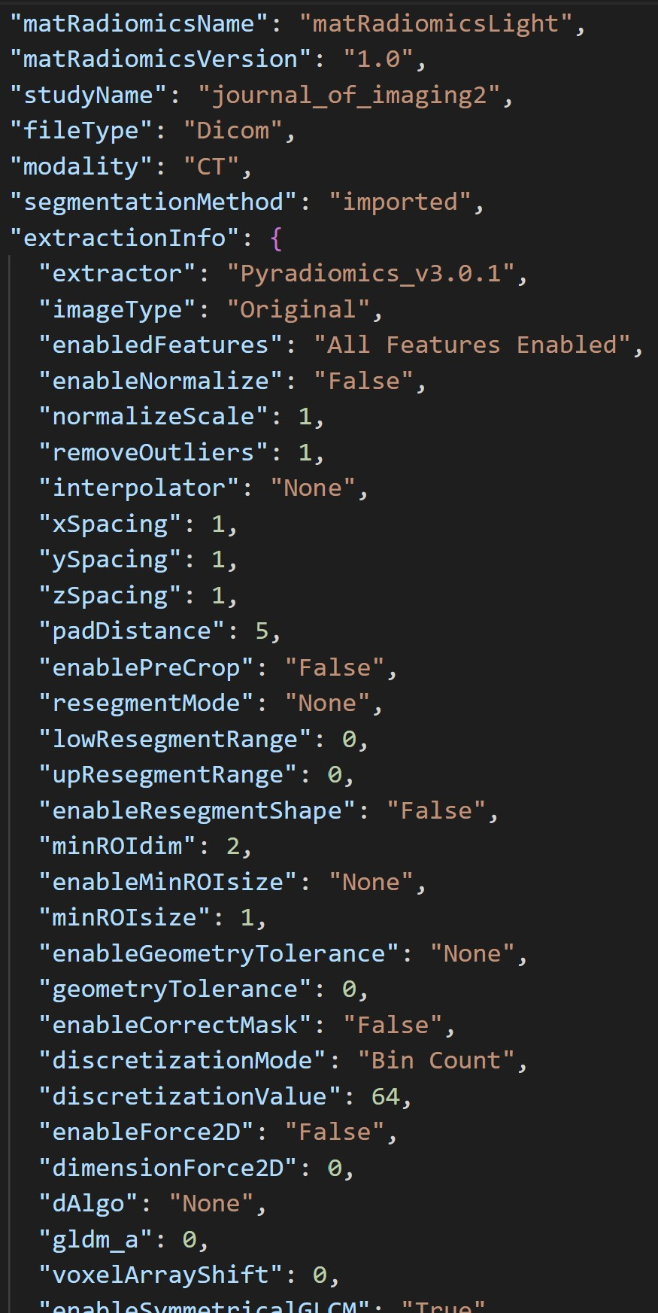
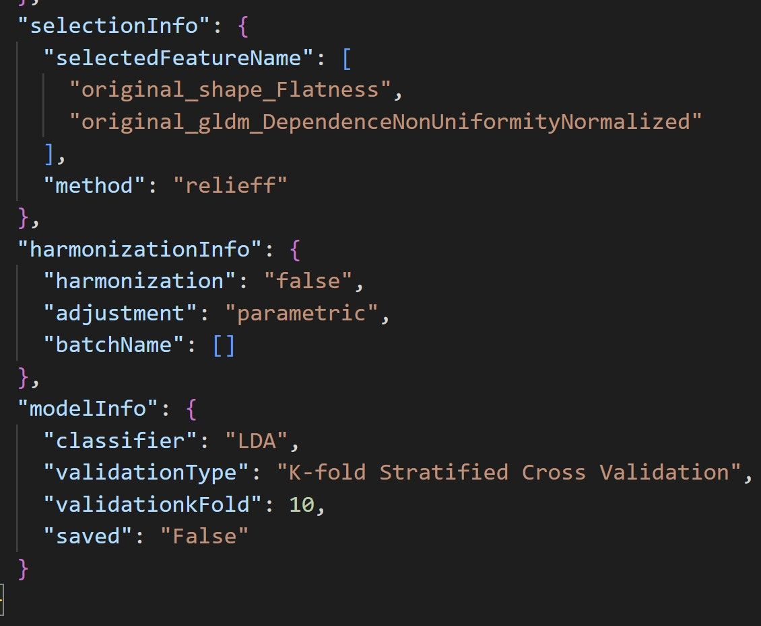
Our approach through matRadiomics: Metadata, Import a Study
Feature Extraction
Feature Selection and ML
Import a Study

Slide 15
Artificial Intelligence in Medicine
High pathological grade prediction in prostate cancer patients undergoing 18F-PSMA PET/CT using matRadiomics
Giovanni Pasini
giovanni.pasini@uniroma1.it

