Slide 1
A software for extracting quantitative metrics and radiomic features in CT images of the lung: development of a practical tool and clinical applications
L’ESPERIENZA DI OSPEDALE NIGUARDA
L. Berta for the Niguarda COVID-19 WG
S.C. Fisica Sanitaria, ASST NIGUARDA (Milano)

Slide 2
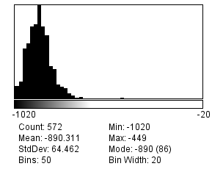
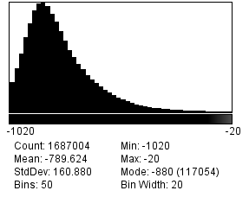
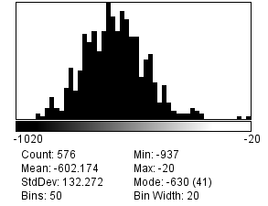
1 slice
Outline
Introduction (MPE, quantitative imaging, Niguarda experience)
Quantitative Metrics in Lung CT
Automatic segmentation
AI models for COVID-19
Deployment in clinical environment
Work in progress
Conclusions
1
1 slice
3D
2
1
3
3
1 slice
#QCT

Slide 3
1 slice
Introduction
1
1 slice
3D
2
1
3
3
1 slice
#QCT

Slide 4
1 slice
Introduction
1
1 slice
3D
2
1
3
3
1 slice
#QCT

Slide 5
1 slice
Introduction
1
1 slice
3D
2
1
3
3
1 slice
#QCT

Slide 6
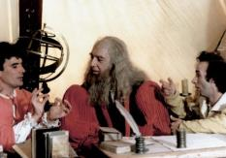
1 slice
The role of Medical Physicist Expert (MPE)
Scientific-Technical Area
Clinical-Medical Area
Techiniques of calculations
Matematicians
1
1 slice
3D
2
1
Hi-Tech Equipment
Medical Doctors
Clinical Staff
Clinical Engineers
MPE
3
3
Image Management and Big-Data
1 slice
Computer/Data Scientists
PATIENTS
Test, Validate, Optimize new technologies (rarely develop)
#QCT

Slide 7
1 slice
Datalake Project: a platform for clinical data collection developed during the first wave of COVID (04/20-04/21)
1
1 slice
3D
2
1
3
3
1 slice
#QCT

Slide 8
1 - CLINICAL task: can we QUANTIFY THE LUNG VOLUME AFFECTED BY THE DISEASE?
#Estimation #QCT

Slide 9
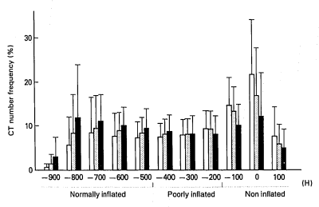
1988
Quantitative analysis based on the frequency distribution of the CT numbers (QCT)
CT numbers represents the linear attenuation coefficient of an x-ray given substance normalized to the linear attenuation coefficient of water
#QCT

Slide 10
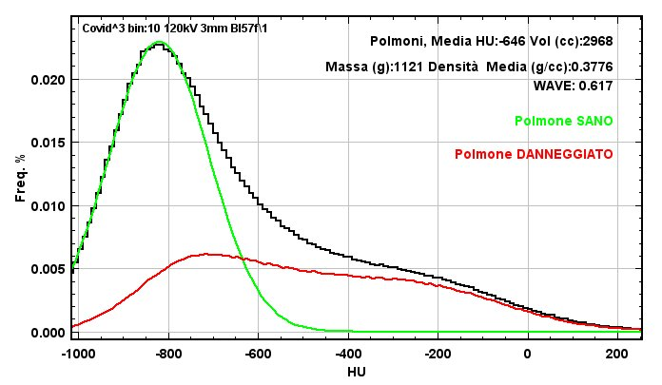
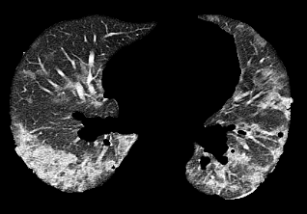
HP
1-Well-Aerated Lung:
Homogenous tissue
Gaussian Distribution
2-Total Lung:
Well-Aerated + Disease +
Vessels
Well-Aerated Lung
Ground-Glass Opacity
Solids or Fluids
#Estimation #QCT

Slide 11
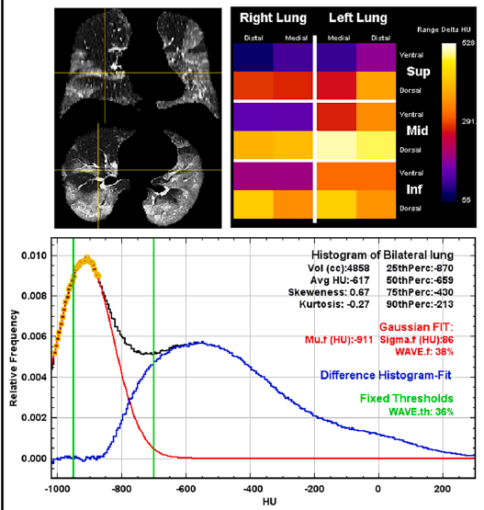
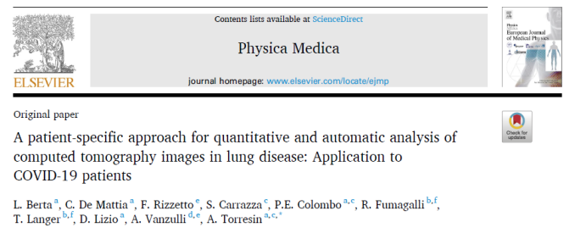
2020
From Histogram data (first-order RF) we can extract more information about WAVE and density distribution of affected lung
WAVE = Well-Aerated Volume Estimation
#Estimation #QCT

Slide 12
2 - Technical & logistic task: can we develop a pipeline starting from automatic segmentation?
#Automatization

Slide 13
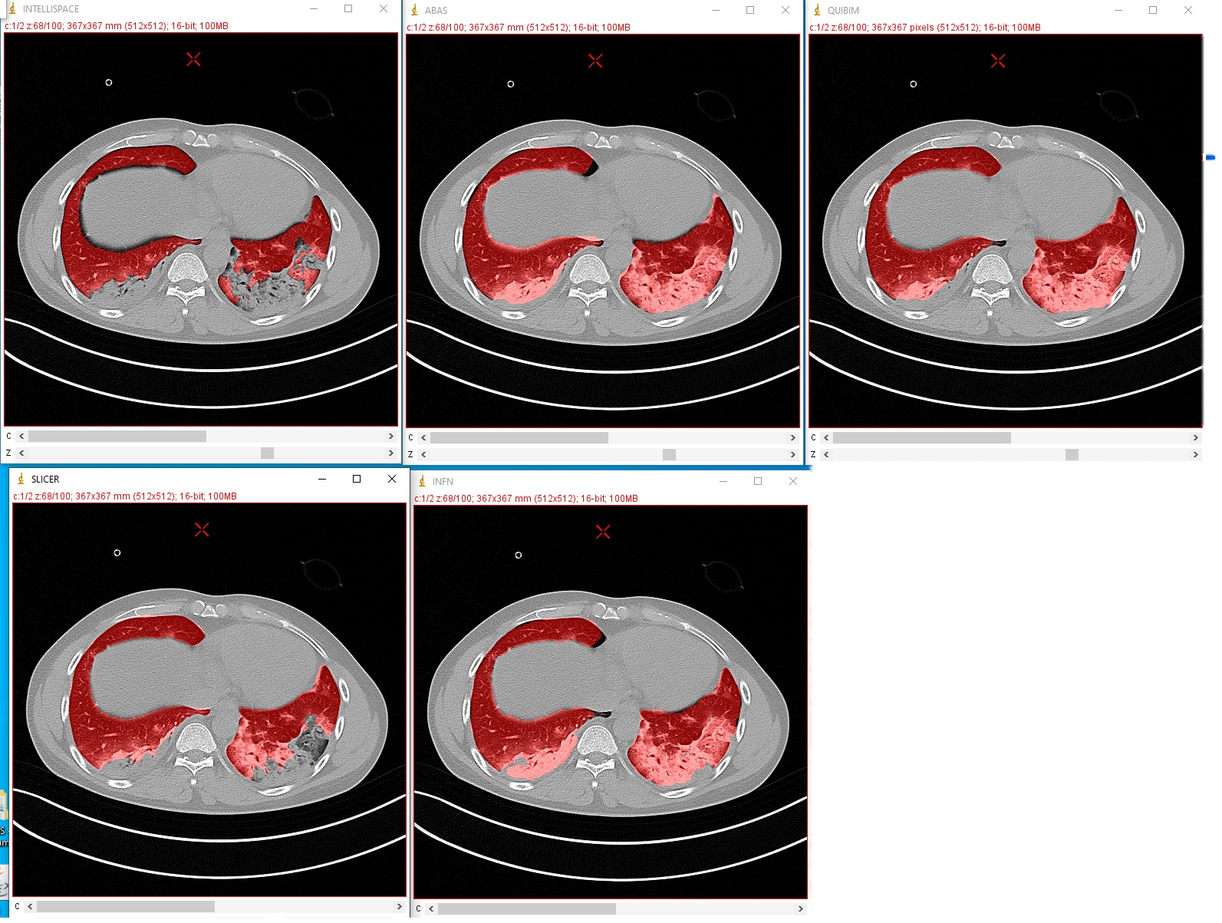
Example of automatic segmentators
ISP
ABAS
QUIBIM
SLICER
INFN
How inaccuracies of automatic segmentations propagate in the calculation of quantitative metrics?
#Automatization

Slide 14
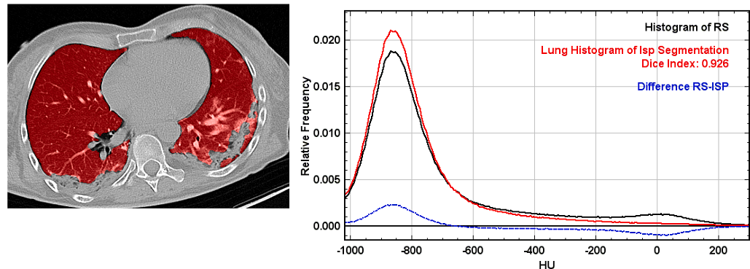
AUTOMATIC SEGMENTATION ASSESSMENT
«Automatic» vs «Gold Standard» segmentations -> QUANTITATIVE
Subjective score (5-points scale) by 4 clinicians –> QUALITATIVE
QCT in automatic & reference segmentation
#QA #Automatization #QCT

Slide 15
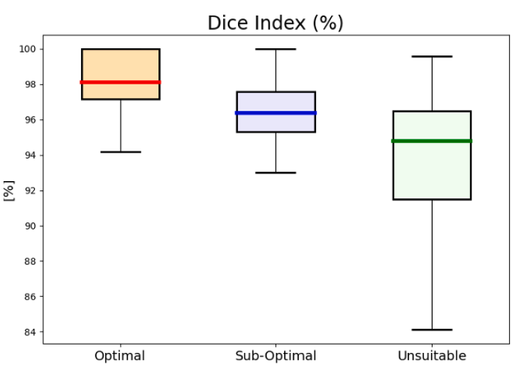
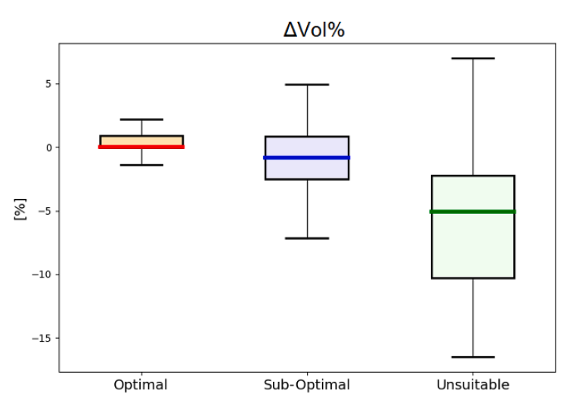
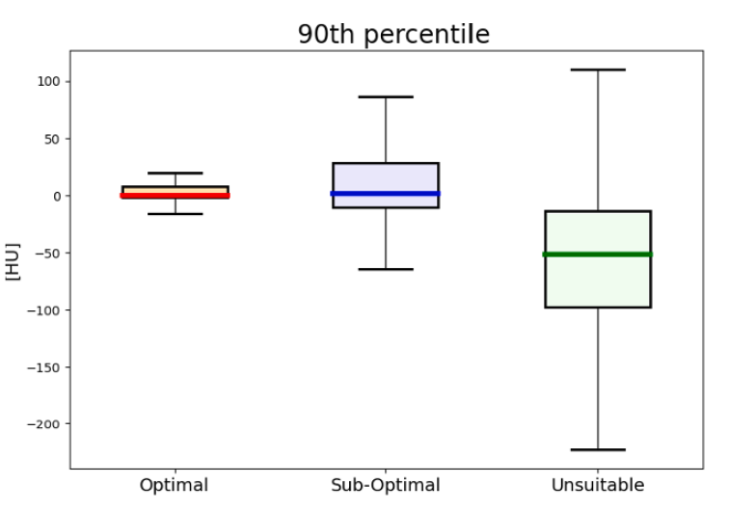
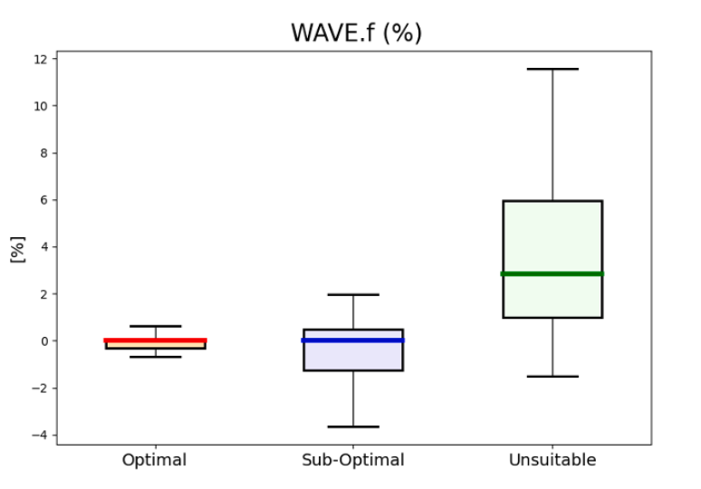
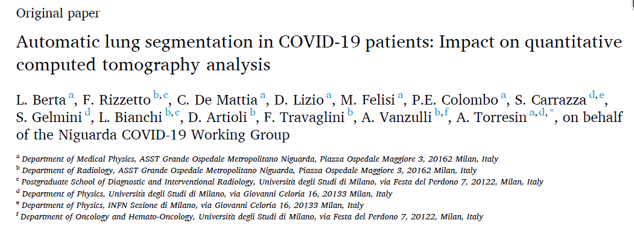
AUTOMATIC SEGMENTATION ASSESSMENT
Qualitative or quantitative approaches provide both good methods for the assessment of Automatic Segmentation
Accuracy of QCT metrics with automatic segmentation
Visual Assessment by Radiologists
(Optimal, Sub-Optimal, Unsuitable)
#QA #Automatization

Slide 16
3 - Clinical task: can we use QCT and radiomics tools to CLASSIFY covid-19 and other viral pneumonia from CT images?
#Classification

Slide 17
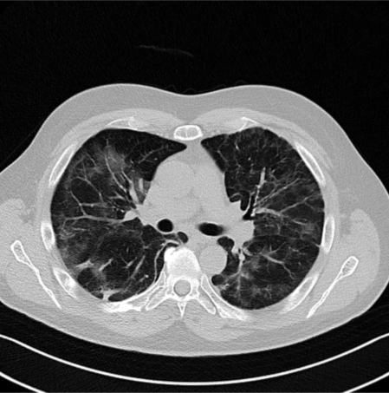
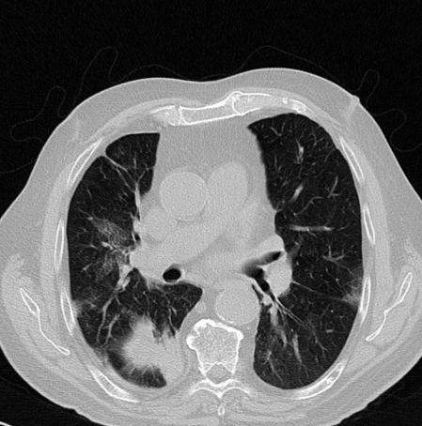
COVID-19 PNEUMONIA
VIRAL PNEUMONIA
VS
#Classification

Slide 18
DATASET (from DATALAKE)
PCR-proven!
647 COVID-19
$\frac{\text{M}}{\text{M}\text{+}\text{F}}$ = 0.71
Median age = 67
Period: 2020 - 2021
1031
PATIENTS WITH VIRAL PNEUMONIA
EVALUATED WITH CT
384 non-COVID-19
$\frac{\text{M}}{\text{M}\text{+}\text{F}}$= 0.62
Median age = 66
Period: 2018 - 2019
#Clinical Data

Slide 19
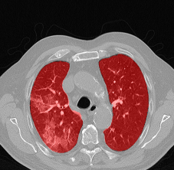
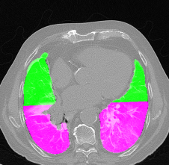
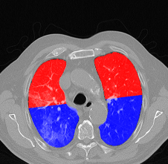
a) QUANTITATIVE METRICS
Whole LUNG
n = 20
QUANTITATIVE METRICS
(1° histogram,
«WAVE Model» )
4 GEOMETRICAL SUBDIVISION
n = 80
#QCT

Slide 20
b) RADIOMIC FEATURES (only whole Lung)
FIRST ORDER FEATURES
RF1 n = 19
e.g. skewness, standard deviation, entropy
GLCM n = 24
e.g. cluster-shade, correlation
GLSZM n = 16
e.g. small area emphasis, zone entropy
SECOND ORDER FEATURES
RF2 n = 40
GLCM = Gray Level Co-occurrence Matrix
GLSZM = Gray Level Size Zone Matrix
#Radiomics

Slide 21
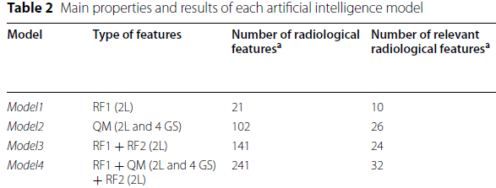
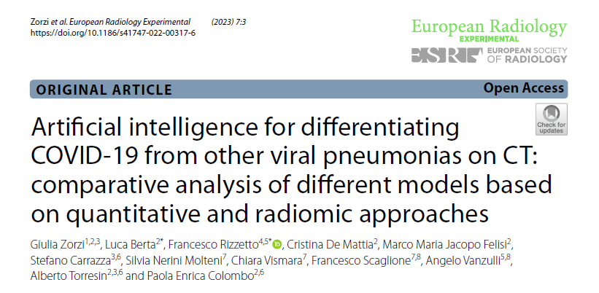
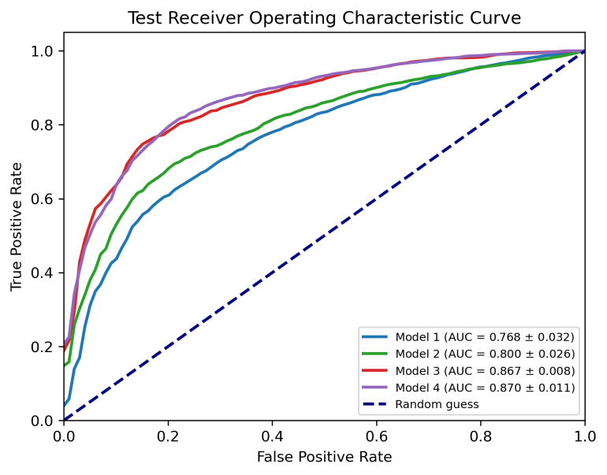
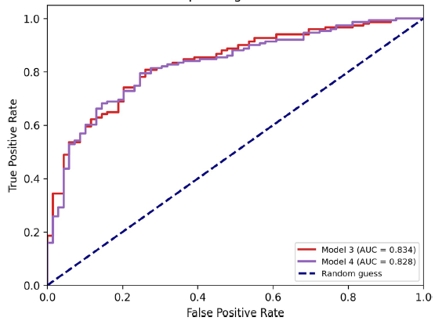
MODELS PERFORMANCE
Training-Test
811 CT images, 4fold-CV
Independent Validation
220 CT images
MODEL 3
AUC-Test = 0.87
AUC-IVS = 0.83
BUILT WITH 1° 2° ORDER RADIOMIC FEATURES on entire lungs
(but NOT QCT…)
#Classification

Slide 22
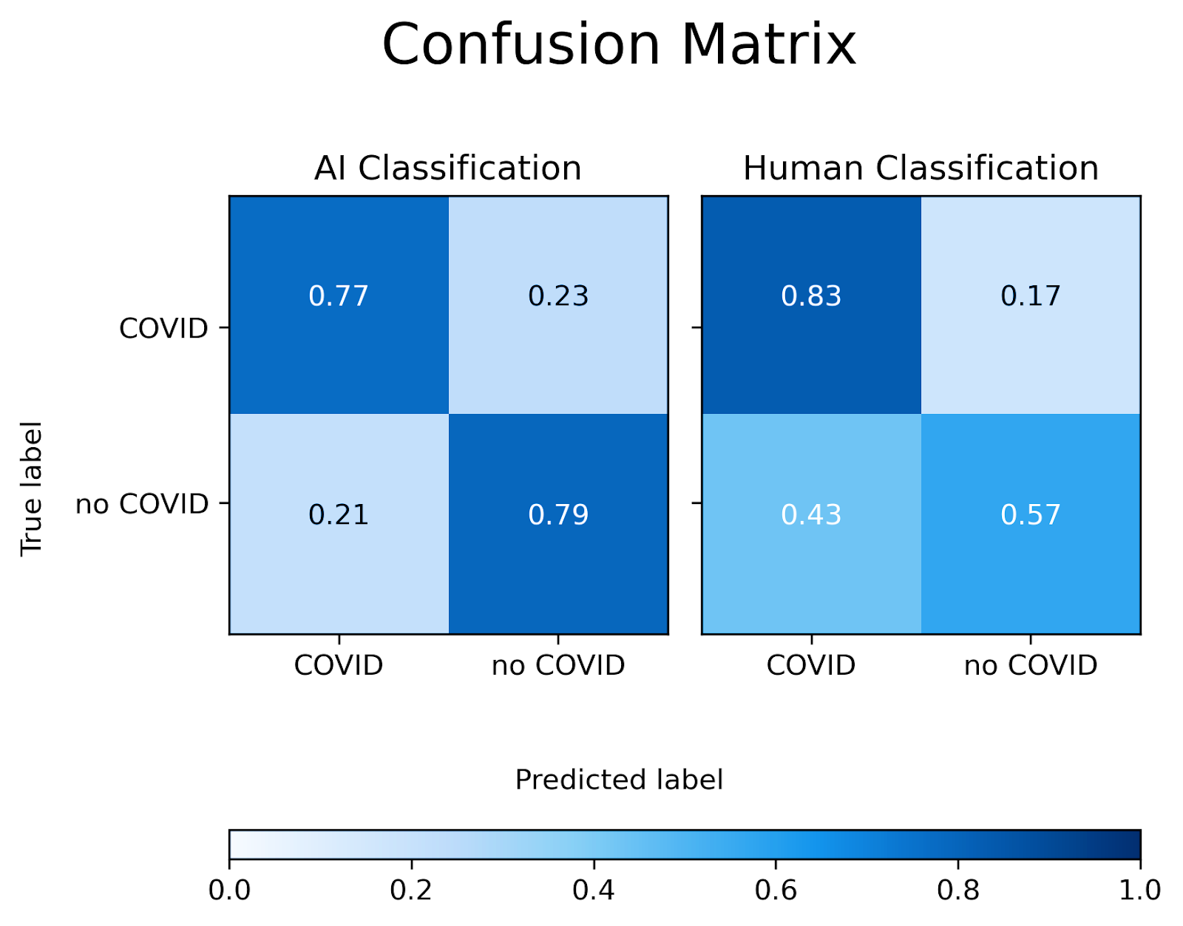
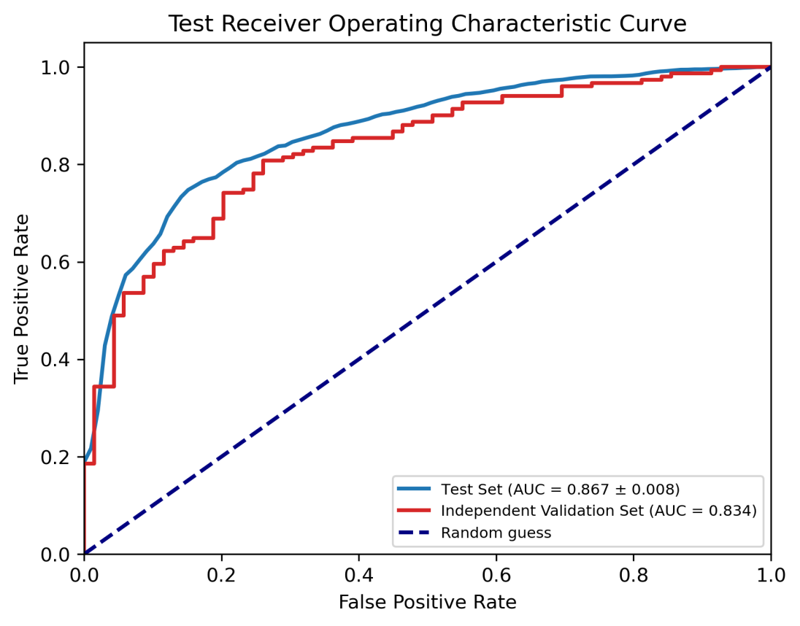
CLASSIFICATION: AI vs RADIOLOGISTS
INDEPENDENT VALIDATION SET
220 PATIENTS
MODEL 3
READERS
3 radiologists: >10-y experience
1 resident: 3-y experience
CO-RADS score:
Score = 1 or 3: non-COVID-19
Score= 3-5: COVID-19
#Classification

Slide 23
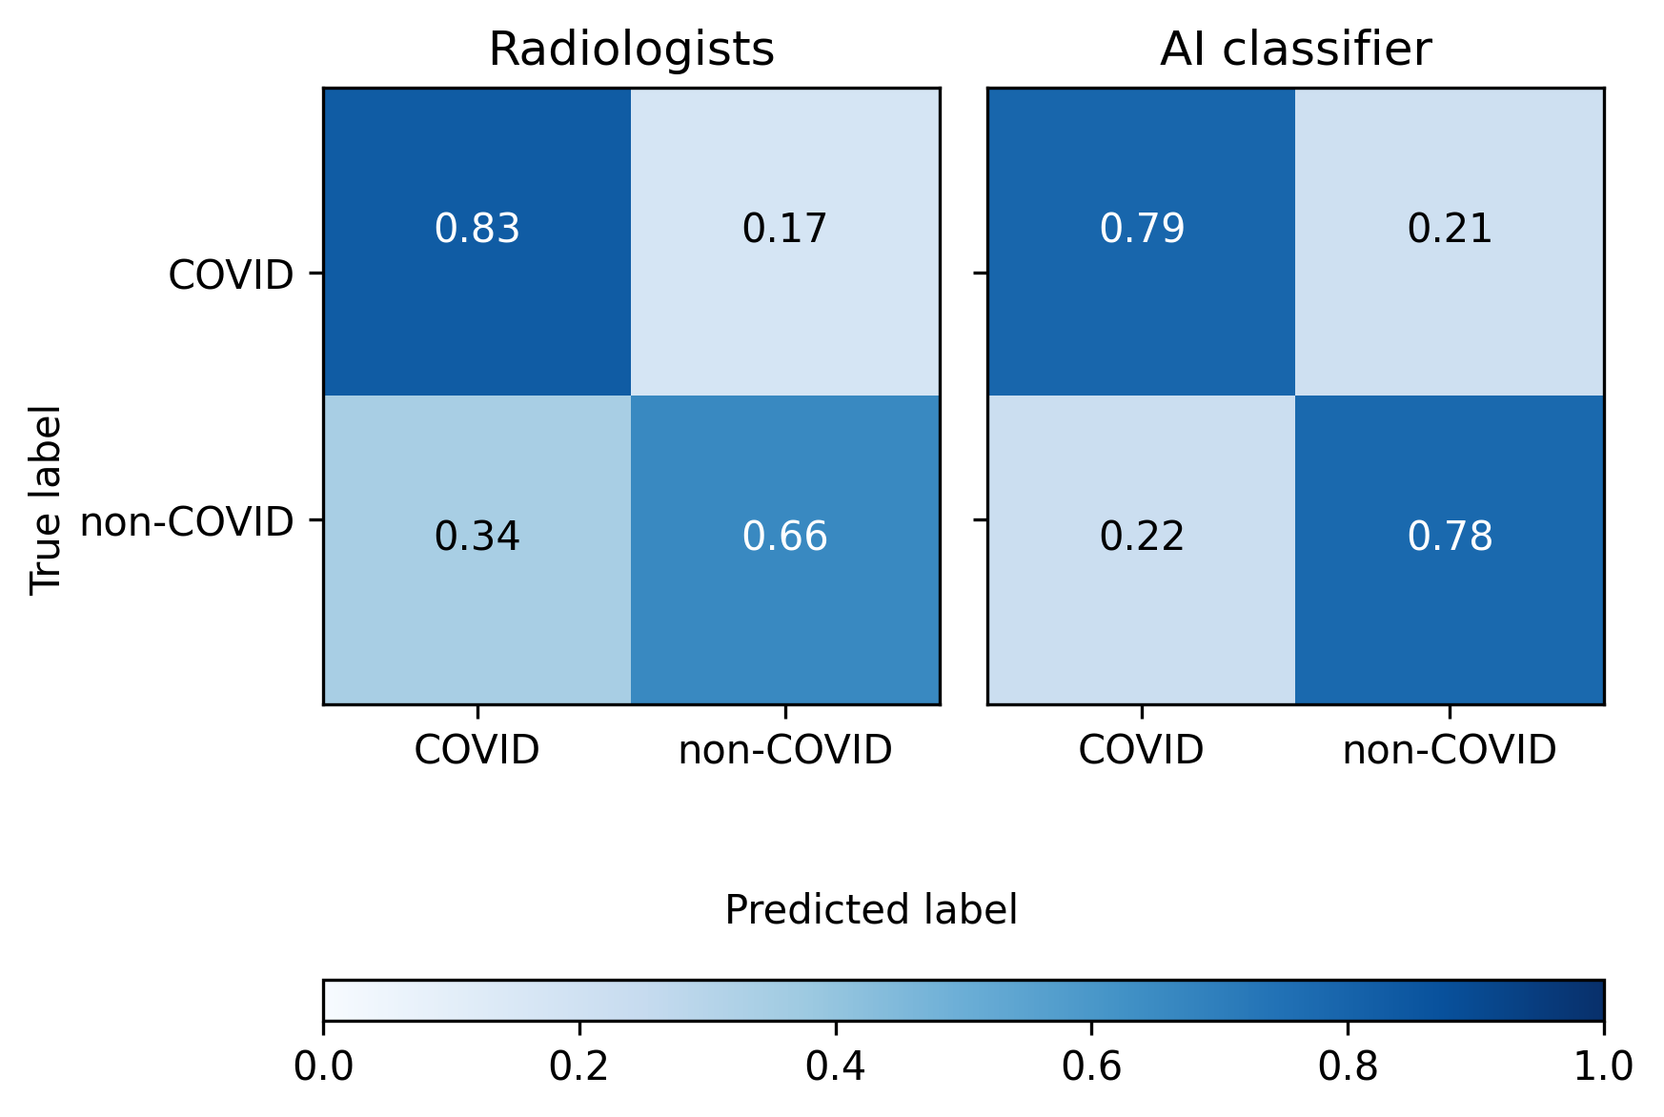
RESULTS
AI = 79%
ACCURACY:
RADIOLOGISTS = 78%
#Classification

Slide 24
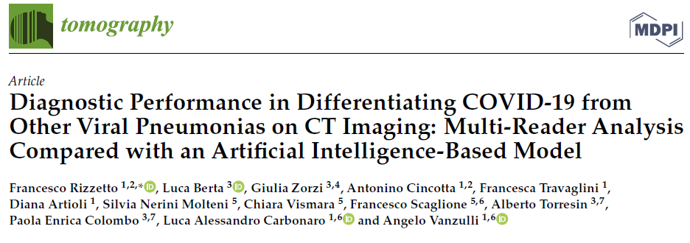
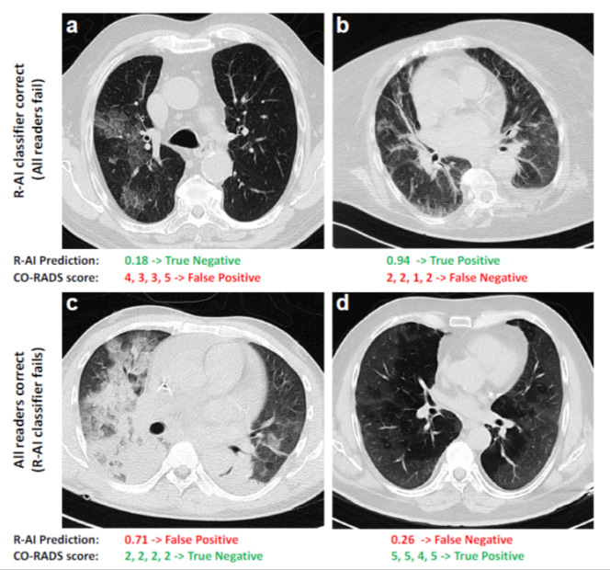
↓↓NON-COVID↓↓
RESULTS
↓↓NON-COVID↓↓
↓↓COVID↓↓
➙AI Correct, all readers fail
➙All readers correct, AI fails
#Classification

Slide 25
CHALLENGING CASES
CO-RADS 3 score assigned by 2 or more radiologists
Difference between CO-RADS score assigned ≥ 3
 | 220 VALIDATION CASES |  | 59 CHALLENGING CASES
 | AI | RADIOLOGISTS | AI | RADIOLOGISTS
Accuracy | 79% | 78% | 75% | 55%
Specificity | 78% | 66% | 78% | 34%
Sensitivity | 79% | 83% | 72% | 69%
#Classification

Slide 26
4 - Technical and logistic task: can we implement this model in the «real» clinical practice?
#Deployment

Slide 27
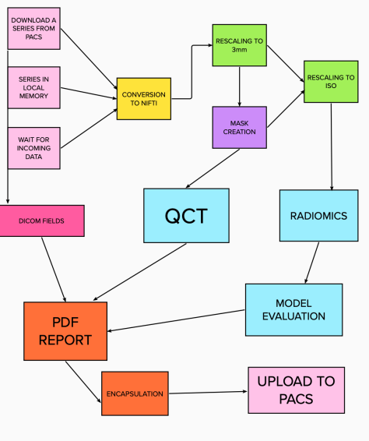
CLEARLUNG
Framework for quantitative analysis and radiomics on lung CT scans
COVID-19 AI diagnosis
Real-time analysis and prediction thanks to PACS connection
#Deployment

Slide 28
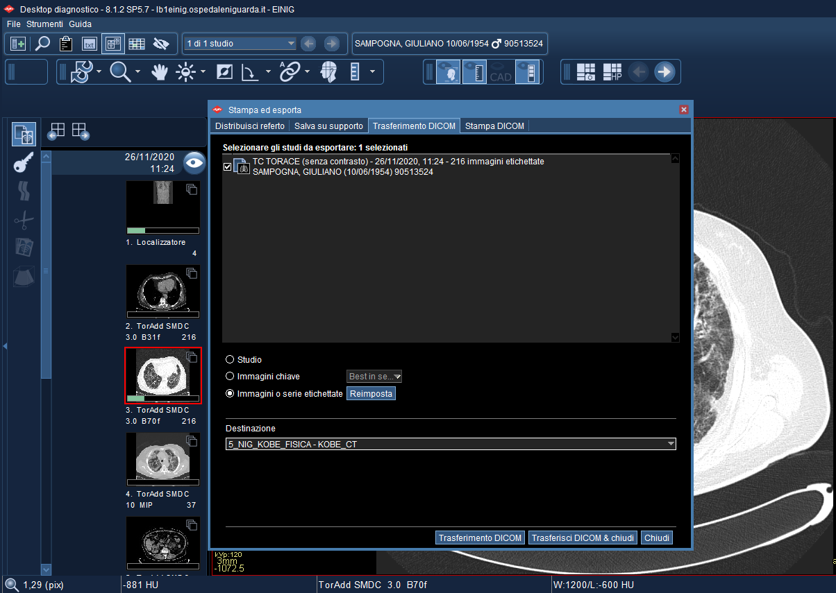
PACS CONNECTION
#Deployment

Slide 29
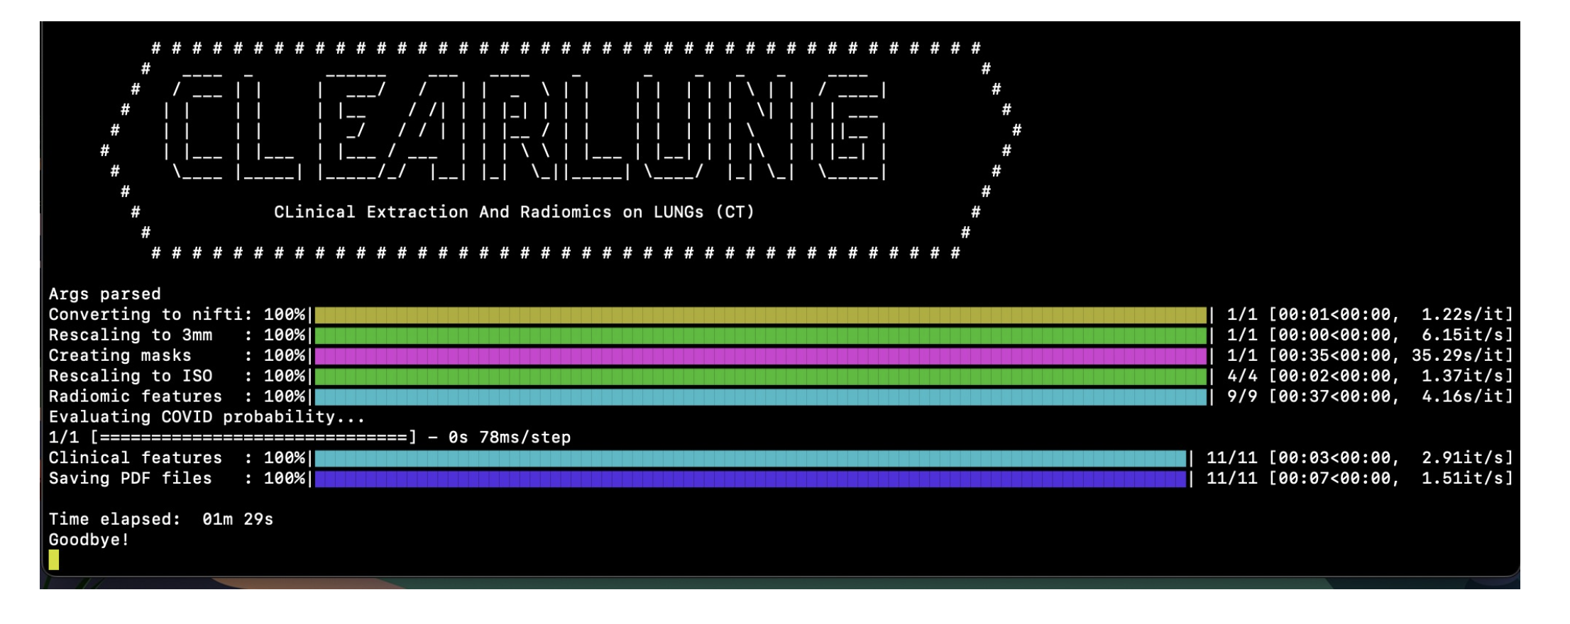
1 minute and 29 seconds!!!
#Deployment

Slide 30
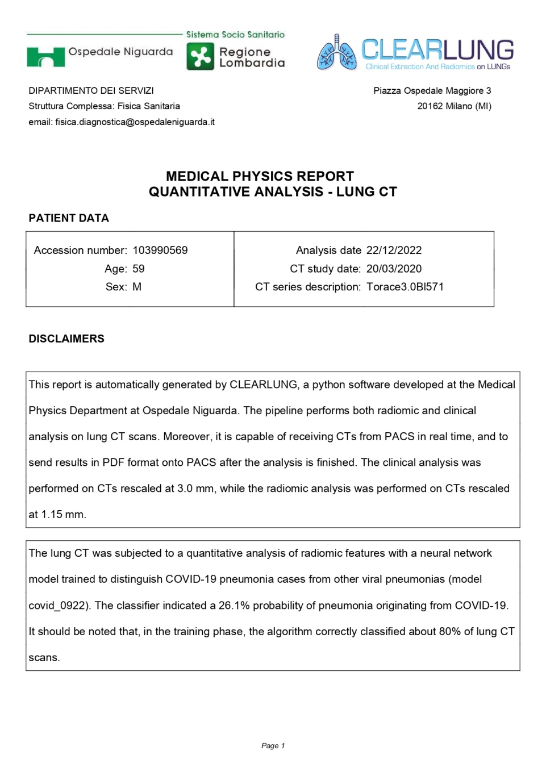
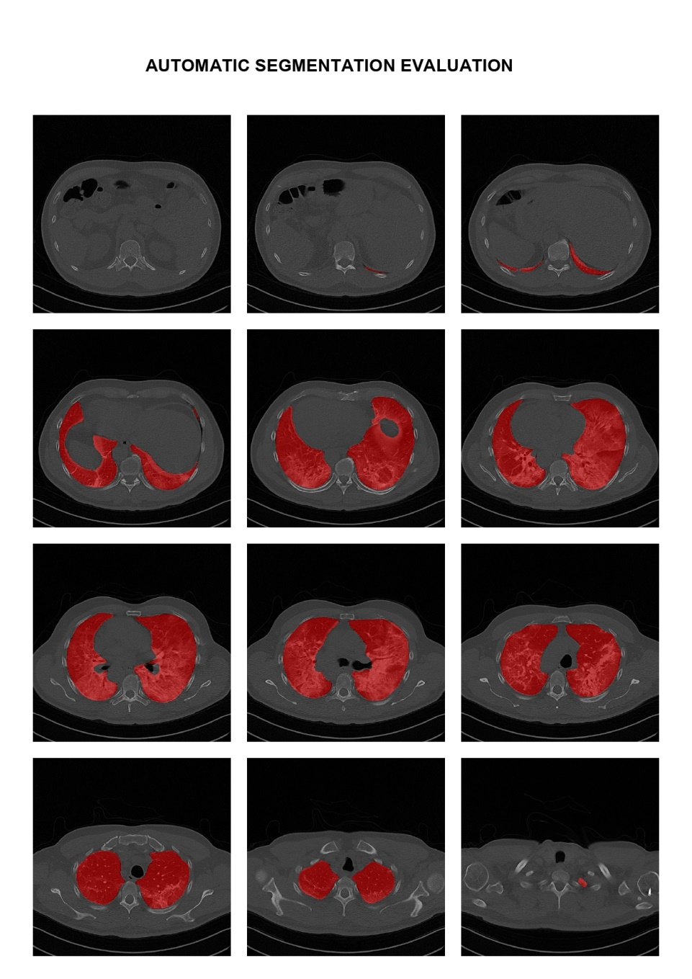
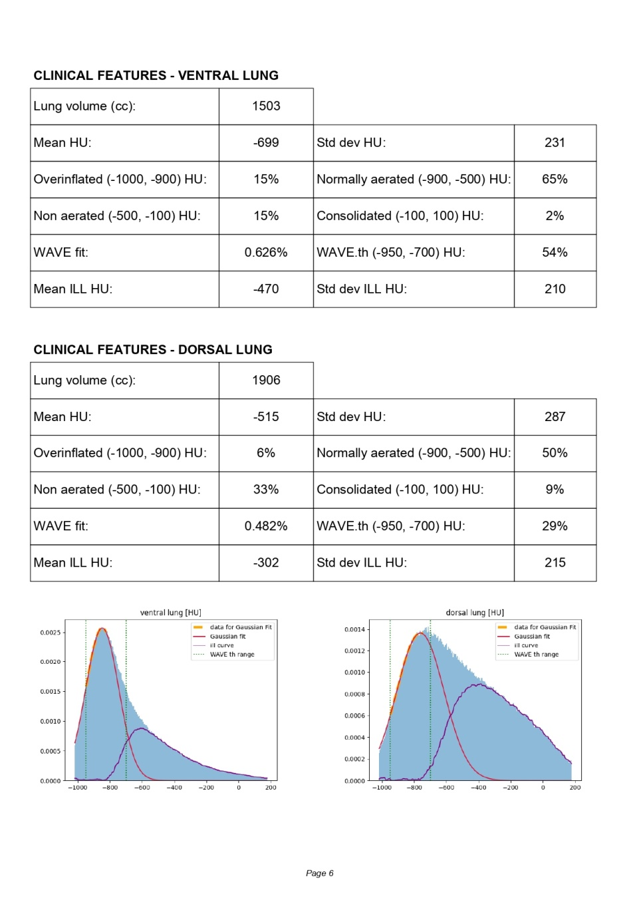
RESULT OF THE AUTOMATIC ANALYSIS
#Report

Slide 31
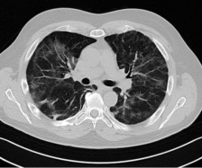
W.I.P. 1: «AI in Clinical Practice»
CORADS = 3
CORADS = 4
AI
Prediction: 0.78
Discuss Δ-Time and Δ-accuracy

Slide 32
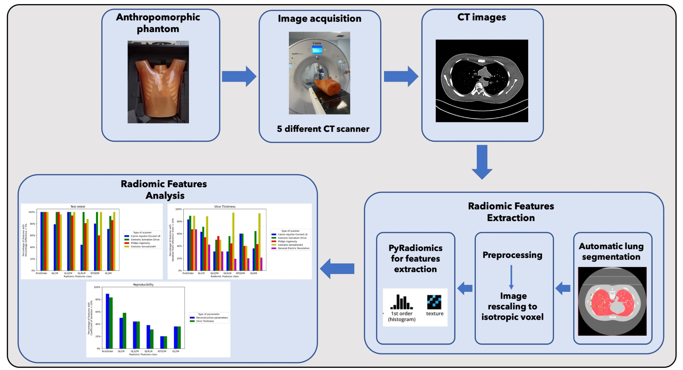
W.I.P. 2: «Antrhopomorphic Phantom»
#Radiomics #QA

Slide 33
CONCLUSIONS
Structured Data and QA is mandatory to develop robust and automatic pipelines: this can be done only by humans
Artificial intelligence modeling is «feasible» in clinical environment
Clinical validation with independent data and medical doctors is mandatory
Interdisciplinary approach leads to results applicable in the clinical setting

Slide 34
Thanks!
Niguarda Team:

