Slide 1
next_AIM
[INFN-CSN5 2022-2024]
Project overview
Alessandra Retico
Istituto Nazionale di Fisica Nucleare
Sezione di Pisa
alessandra.retico@pi.infn.it
next_AIM general meeting meeting - Milano, 13-15 Febbraio 2023

Slide 2
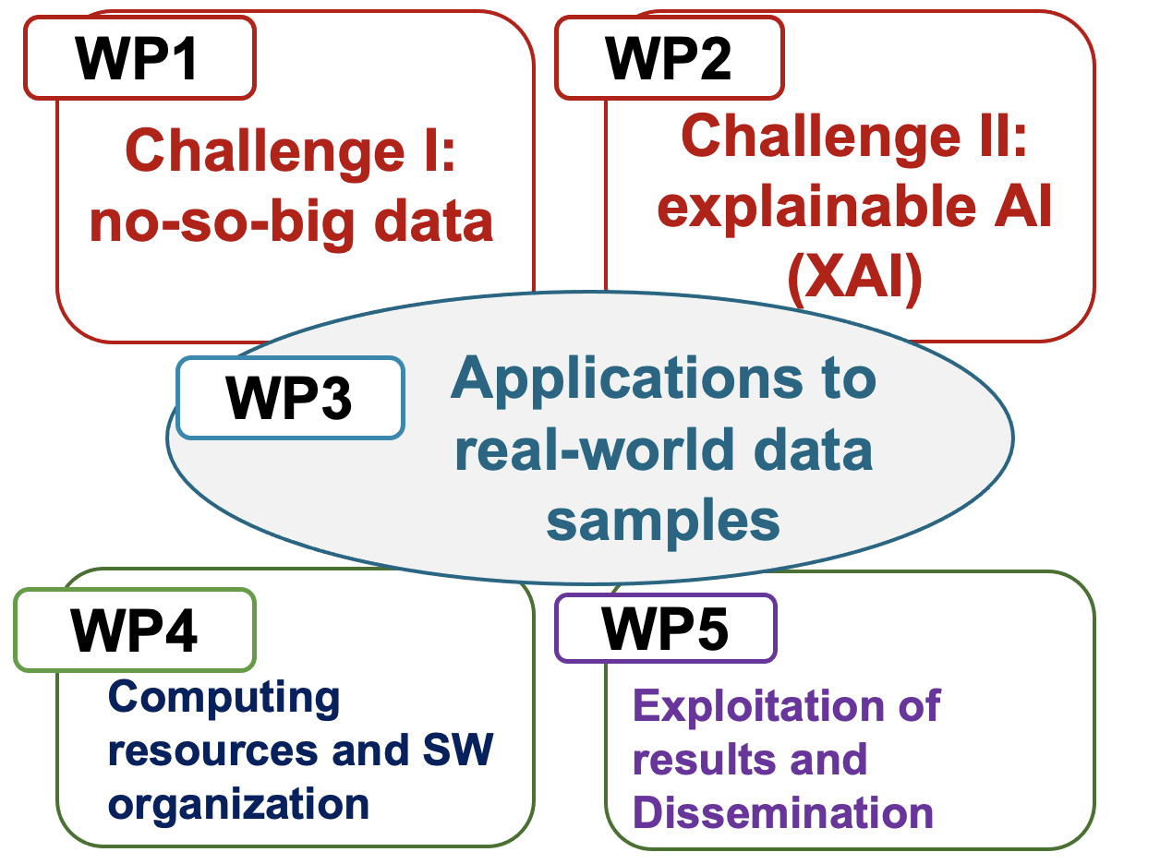
The Artificial Intelligence in Medicine (AIM) INFN Project
Artificial Intelligence to become the next revolution in medical diagnostics and therapy.
New image processing and data analysis strategies, including radiomics approaches, need to be developed and extensively validated.
next
AIM’s objectives
next_AIM’s objectives
[INFN, CSN5, 2019-2021]
AIM1: Multicenter data
harmonization
[INFN, CSN5, 2022-2024]
Principal Invest.: A. Retico
Research Units:
Bari (S. Tangaro) Bologna (D. Remondini) Cagliari (P. Oliva) Catania (M. Marrale) Ferrara (G. Paternò) Firenze (C. Talamonti) Genova (A. Chincarini) Lab. Naz. Sud (G. Russo)
Milano (C. Lenardi)
Napoli (G. Mettivier)
Pavia (A. Lascialfari)
Padova (A. Zucchetta)
Pisa (M.E. Fantacci)
Principal Invest.: A. Retico
Research Units:
Bari (S. Tangaro) Bologna (D. Remondini) Cagliari (P. Oliva) Catania (M. Marrale) Firenze (C. Talamonti) Genova (A. Chincarini) Lab. Naz. Sud (G. Russo)
Milano (C. Lenardi)
Napoli (G. Mettivier)
Pavia (A. Lascialfari)
Pisa (M.E. Fantacci)
AIM2: Quantification
AIM Covid-19 Working Group
AIM3: Predictive models
Long-standing collaboration with Italian centers (hospitals / IRCCS) and with international consortia for data sharing

Slide 3
The Artificial Intelligence in Medicine (AIM) INFN Project
Researchers from INFN divisions and University Departments collaborate closely with Radiologists, Clinicians and Medical Physicists in Clinical Centers to develop innovative solutions based on data mining and AI
Clinical partners
IRCCS S. Martino (GE)
IRCCS Stella Maris (PI)
IRCCS Gaslini (GE)
IRCCS Centro S. G. di Dio (BS)
IRCCS G.Paolo II (BA)
IRCCS Mondino (PV)
IRCCS SDN (NA)
IRCCS IRST Meldola (FC)
IRCCS Bellaria (BO)
IRCCS S. Orsola (BO)
EU / consortia
EADC (EU)
EDLBC (EU)
ADNI (US)
ABIDE (EU/US)
ENIGMA (WW)
Scientific associations
Italian Association of Medical Physics (AIFM)
IMAGO7
Azienda Osp. Univ. Pisana (PI)
Azienda Osp. Univ. Careggi (FI)
Osp. Pediatrico Meyer (FI)
Ospedale Cardarelli (NA)
Azienda Sanitaria Cuneo 1 (CN)
IFO-Ist. Naz. Tumori Regina Elena (RM)
ASST Niguarda (MI)
Policlinico di Bari
Policlinico di Palermo
Policlinico Univ. di Napoli
Policlinico San Matteo (PV)

Slide 4
Project timeline
 |  |  |  |  |  |  |  |  | 2022 |  | 2023 |  | 2024
WP1 | Methodological approaches to handle limited datasets |  | BO |  |  |  | FI
 |  | GE |  |  |  | PD | PI | PV
WP2 | Explainable techniques for biomedical data | BA | BO
 |  |  |  |  |  |  | PI
WP3 | Applications to real data | BA | BO | CA | CT | FE | FI
 |  | GE | LNS | MI | NA | PD | PI | PV
WP4 | Computing resources and SW repository organization | BA | BO
 |  |  |  |  |  |  | PI | PV
WP5 | Exploitation of research results and communication | BA | BO | CA | CT | FE | FI
 |  | GE | LNS | MI | NA | PD | PI | PV
In bold sono indicate le sedi degli attuali conveener dei WP

Slide 5
WP3 tasks
Sedi partecipanti |  |  |  |  |  |  |  |  |  |  |  |  | Task | Topic
 |  |  |  | FE |  |  | LNS |  | NA |  | PI |  | T1 | Radiomics in Digital Breast Tomosynthesis (DBT)
 | BO |  |  | FE |  |  |  |  | NA |  |  |  | T2 | Super-Resolution in DBT
 | BO |  | CT |  |  |  |  |  |  |  |  |  | T3 | Radiomics in prostate cancer
 | BO |  | CT |  |  |  |  |  |  |  |  |  | T4 | Radiomics and DL in tcMRgFUS
 | BO |  |  |  |  | GE | LNS |  |  |  |  |  | T5 | Nuclear NeuroImaging Quantification and Radiomics
BA |  | CA | CT |  |  |  |  |  |  | PD | PI |  | T6 | Connectivity in functional MRI and EEG
 |  | CA | CT | FE | FI | GE |  | MI |  |  | PI | PV | T7 | Radiomics and Deep Learning analysis of CT and patients’ data in COVID-19
 |  |  |  |  |  |  |  |  |  |  | PI | PV | T8 | Radiomics and ML-segmentation on Facio-Scapulo-Humeral dystrophy (FSHD) and lung tumor
BA |  |  |  |  |  |  |  |  |  |  |  | PV | T9 | ML on Imaging data of 10B uptake tracks and dose monitoring by Compton cameras
 |  |  |  |  | FI |  |  |  |  |  | PI |  | T10 | Artificial intelligence for monitoring RT response in soft-tissue sarcomas
 |  |  |  | FE |  |  |  |  |  | PD |  |  | T11 | Machine Learning techniques for cardiological applications
 |  |  |  |  | FI |  |  |  |  | PD | PI |  | T12 | Application of NLP techniques to clinical notes towards the automated reading of instrumental data

Slide 6
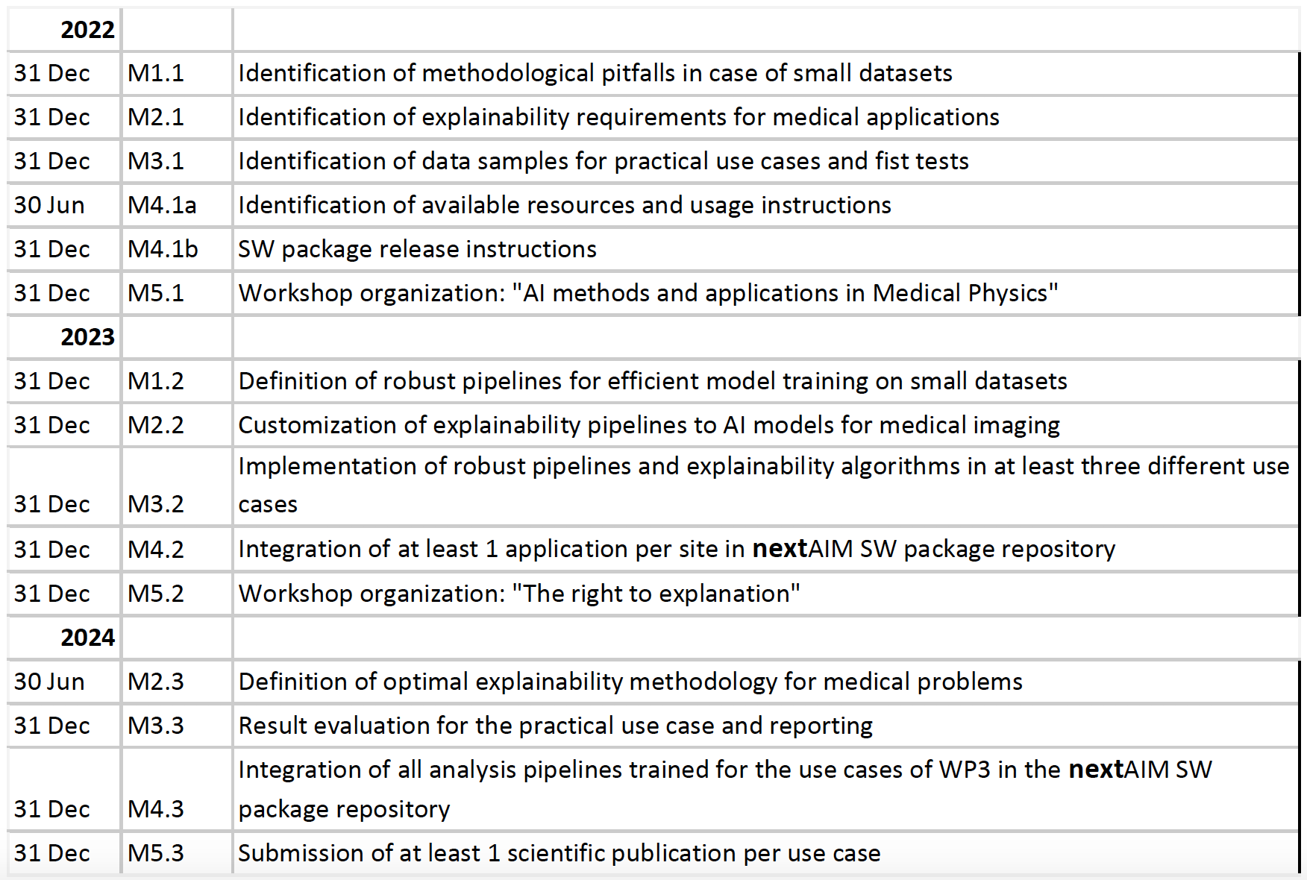
Milestones
WS AI@INFN, Bologna 2-3 Maggio 2022 https://agenda.infn.it/event/29907/
Workshop “AI methods and applications in Medical Physics”
a
31 Dec | M5.3b | Workshop “The right to explaination”

Slide 7
Project status monitoring and reporting
Project meetings:
Kick-off meeting 2022 e general meeting 2023 su https://agenda.infn.it/category/1377/
Meeting mensili (su zoom) tra responsabili locali e conveners dei WP
Minute su drive
Meeting organizzati in autonomia all’interno dei gruppi di lavoro (WP e Task) su piattaforme diverse
Se lo riteniamo utile possiamo riattivare il Gruppo Teams che avevamo creato in precedenza
Project status reporting:
Consuntivi 2022: da completare per inizio aprile
Aggiornamento referee: luglio e settembre 2022, report da preparare in vista dei consuntivi
Aggiornare il sito web https://www.pi.infn.it/aim/
e.g. sezioni “Highlights” e “Publications”

Slide 8
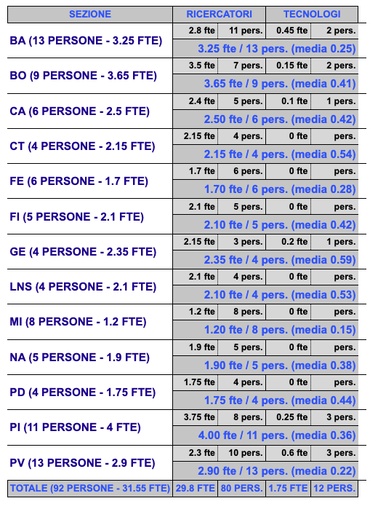
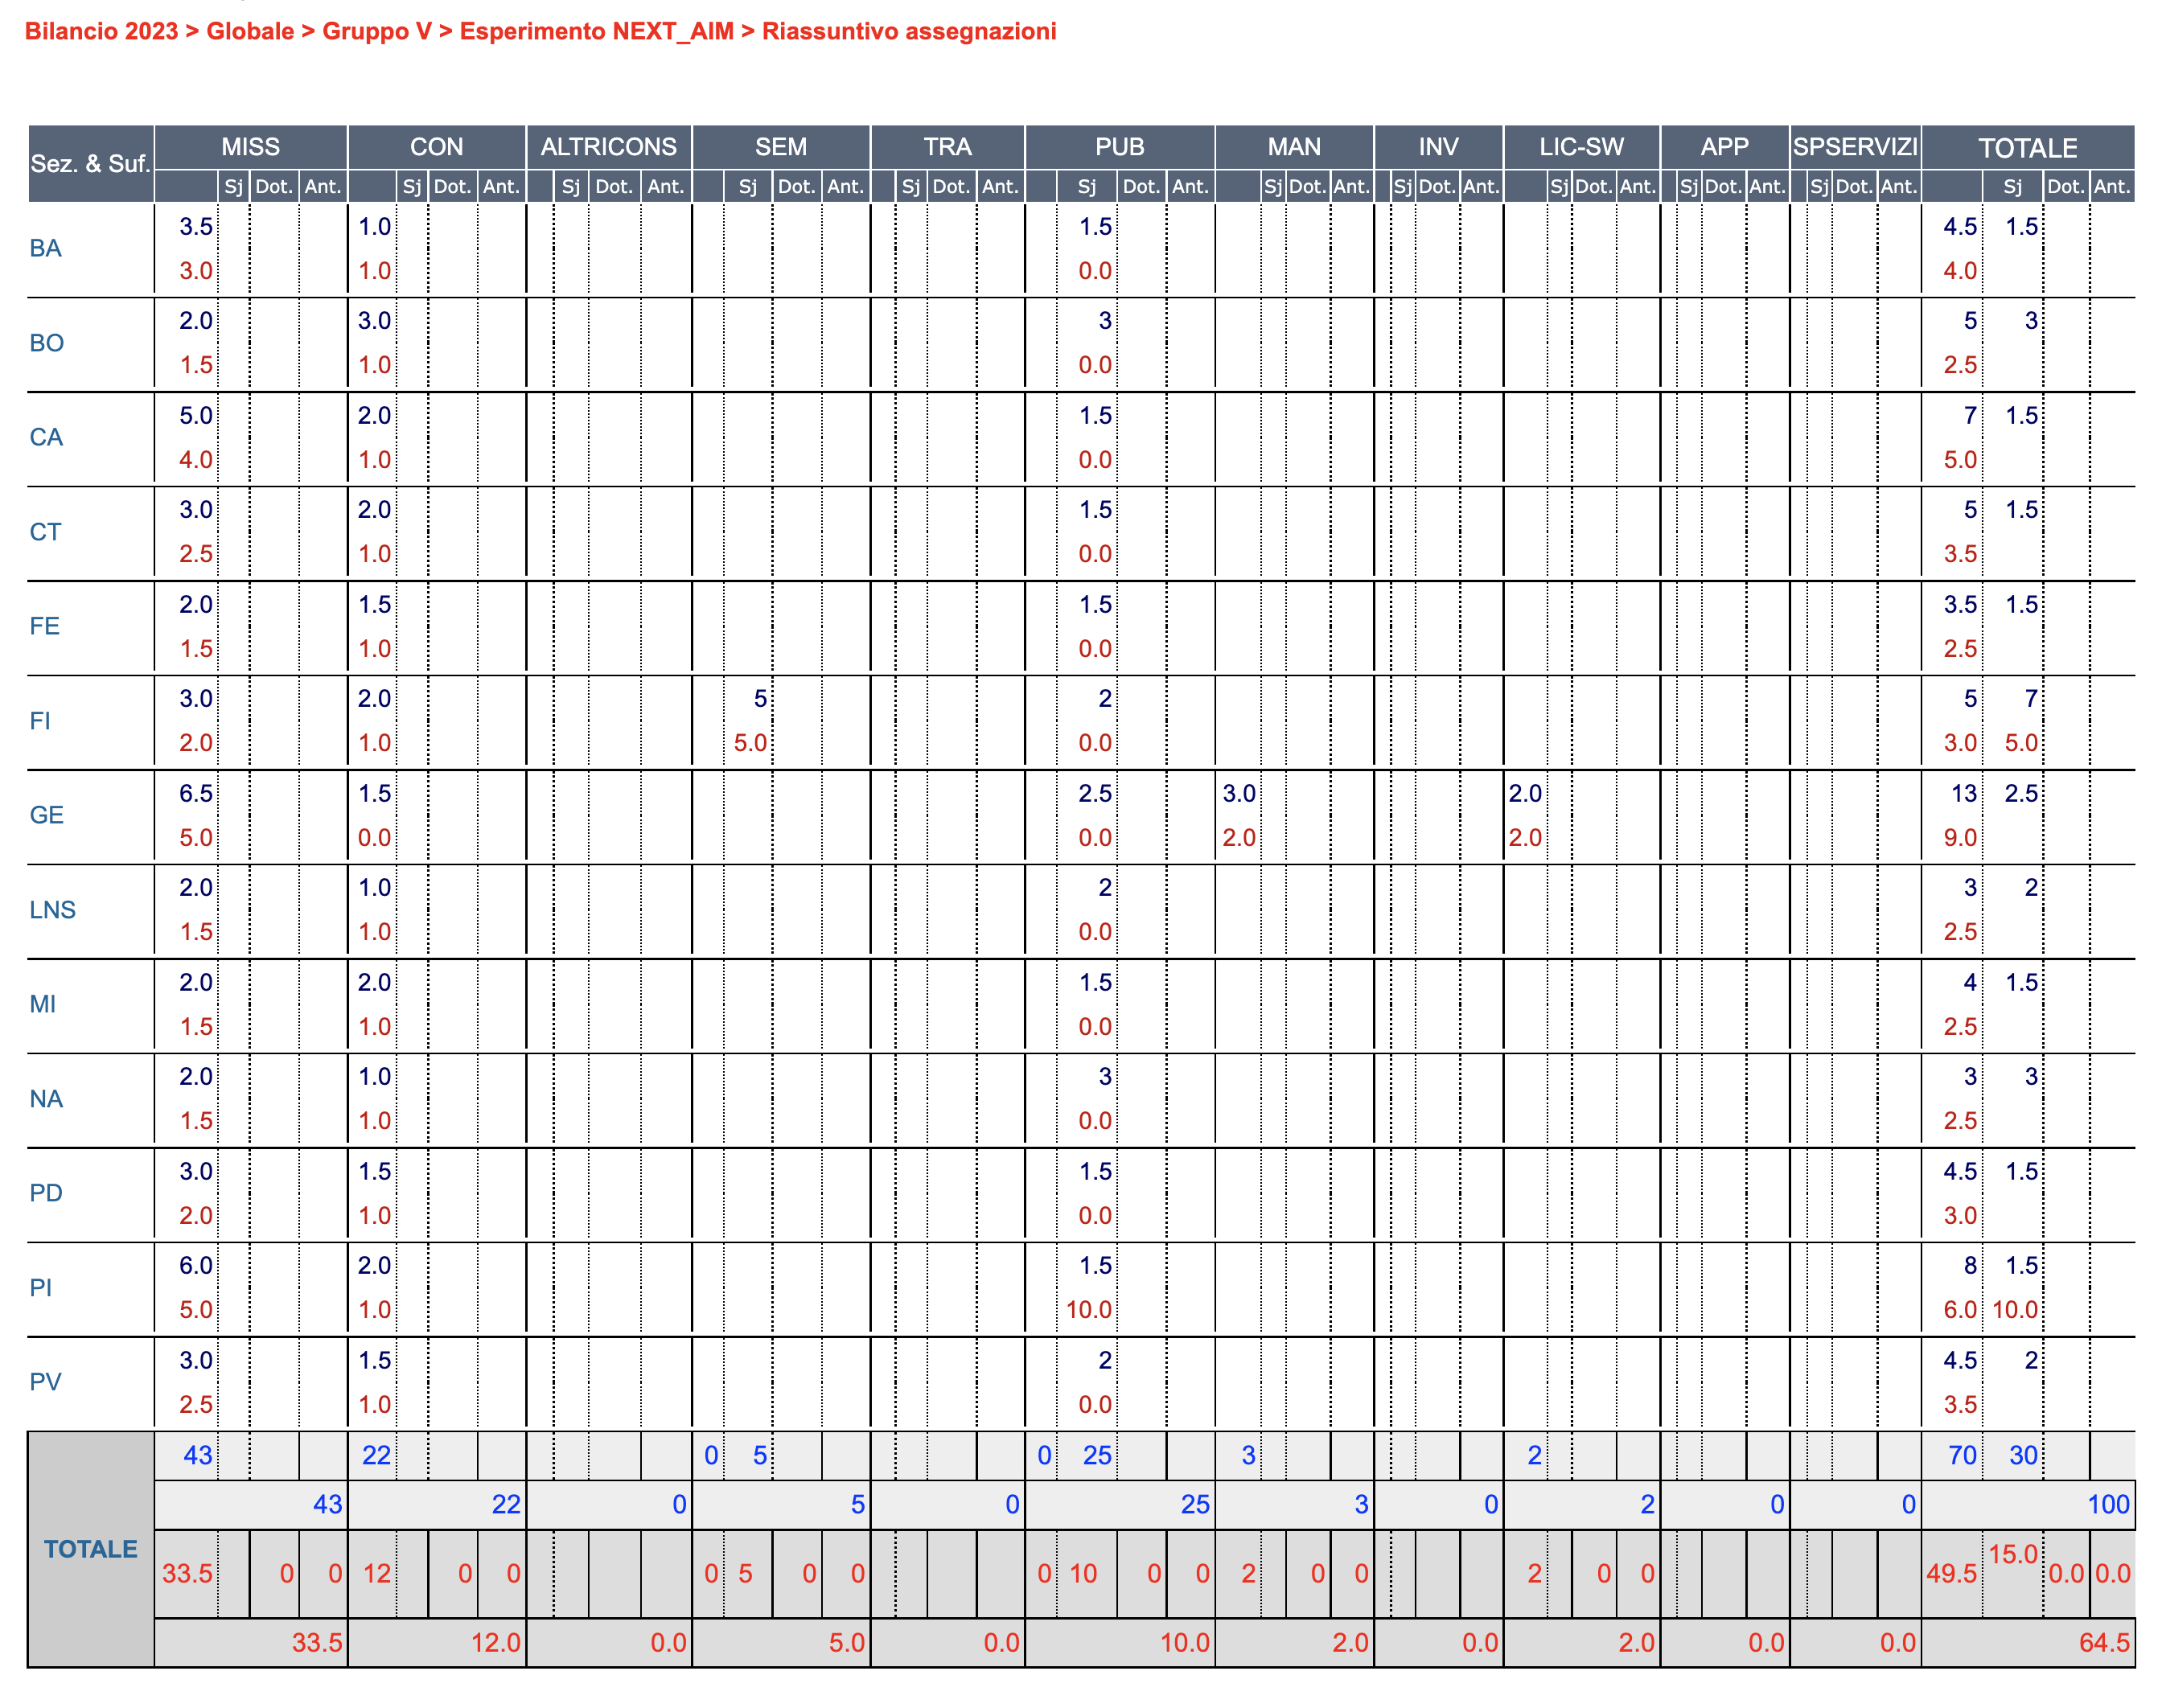
People and budget 2023
64 kE per il 2023
[46 kE nel 2022]
+ access to INFN computing infrastructure [GPU e storage] @ReCaS
92 persone, 31.55 FTE nel 2023
[82 persone, 27.95 FTE nel 2022]

Slide 9
Agenda: 13/02/2023
https://agenda.infn.it/event/34599/

Slide 10
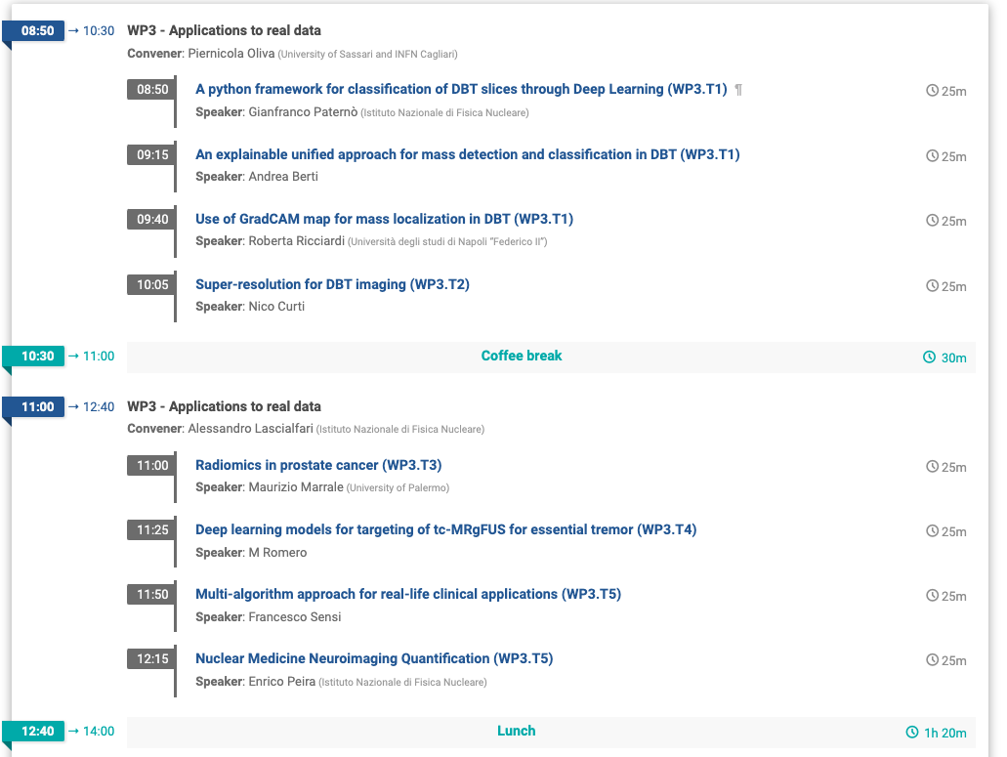
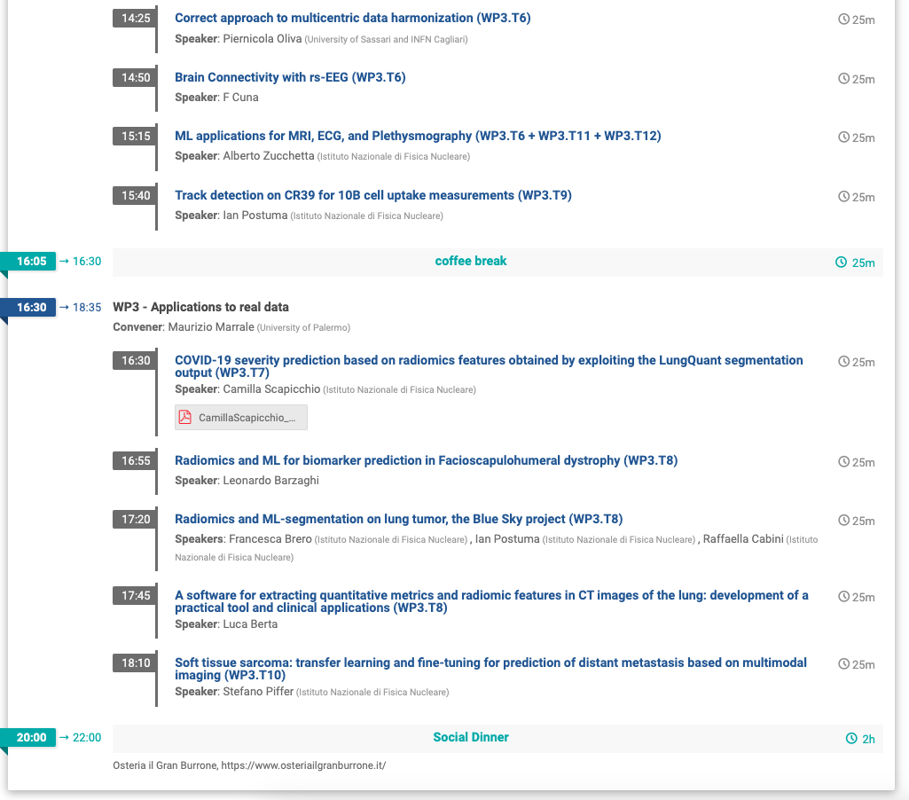
Agenda: 14/02/2023

Slide 11
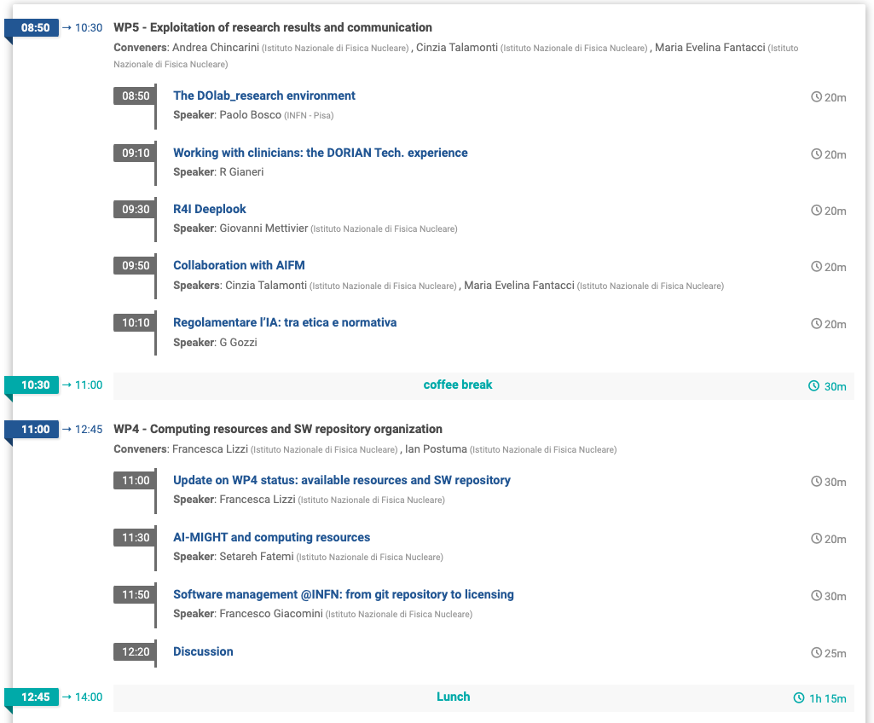
Agenda: 15/02/2023
https://agenda.infn.it/event/34599/
Buon lavoro!

