Slide 1
SiPM Based UV Cameras
Report on WP2 and WP3
Nicolò Tosi – INFN Bologna – 01/03/2023

Slide 2
Work Packages related to this activity
WP2 UV Camera
2.1 Search for commercial SiPM devices for warm-cold demonstrator
2.2 Design and build SIPM and Front-End electronics Printed Circuit Board(s)
2.3 Design and build PCB for a FPGA-based board for the control of Front-End electronics
2.4 Development of the DAQ chain from Front End electronics up to storage disk
WP3 Warm Demonstrator
3.1 Design of the WD
3.2 Construction of the WD
3.3 Interface between WD and UV camera
3.4 Development of a simulation software of the WD
3.5 Development of reconstruction software of the WD

Slide 3
Activities that were carried out
What this talk covers
A 64 ch SiPM camera prototype (warm TRIROC)
A 256 ch SiPM camera demonstrator (cryo ALCOR)
What it does not cover
Warm measurements in GE using a non-SiPM camera in water
Jointly developed simulation and reconstruction

Slide 4
Warm electronics "camera"
TRIROC, 64ch warm readout ASIC (EASYROC family)
Hamamatsu 64 ch 1x1 mm
Kapton flex interconnect
Mosaic Coded aperture, rank 7

Slide 5
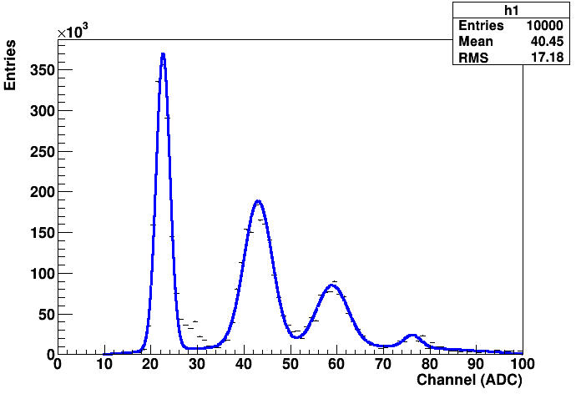
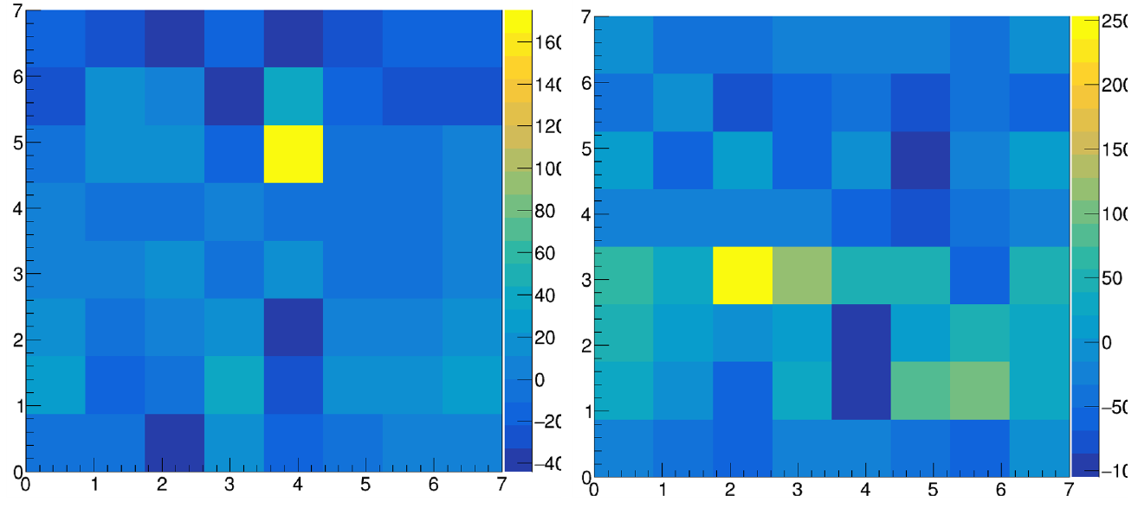
Warm camera
Several Limitations:
The commercial TRIROC board never worked well
The number of pixels was too small for real imaging
The analog signal flex connection was very effective, but not really scalable
Small but significant success:
We reconstructed individual point sources (LED) with deconvolution
Not quite successful with 2 LEDs

Slide 6
Valuable insights from the Warm Demo
We cannot realistically extract analog signals for >> 1k channels
=> We decided to risk switching to the yet unproven ALCOR
The DCR from a SiPM at room temperature is a problem
=> It would not be useful to continue to develop for warm tests
We needed a lot more than 64 pixels
=> Demonstrator unfortunately limited to 256

Slide 7
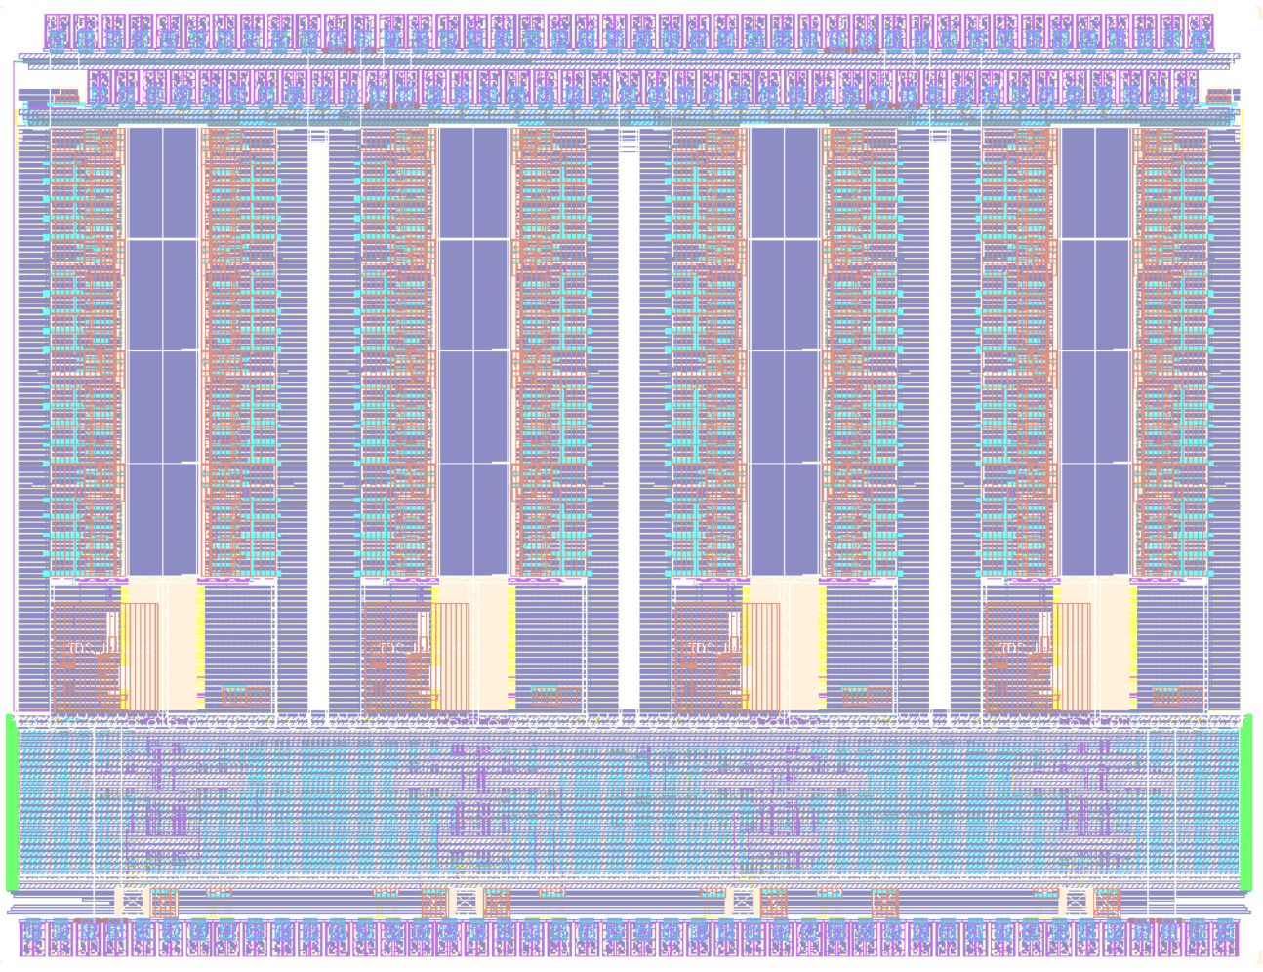
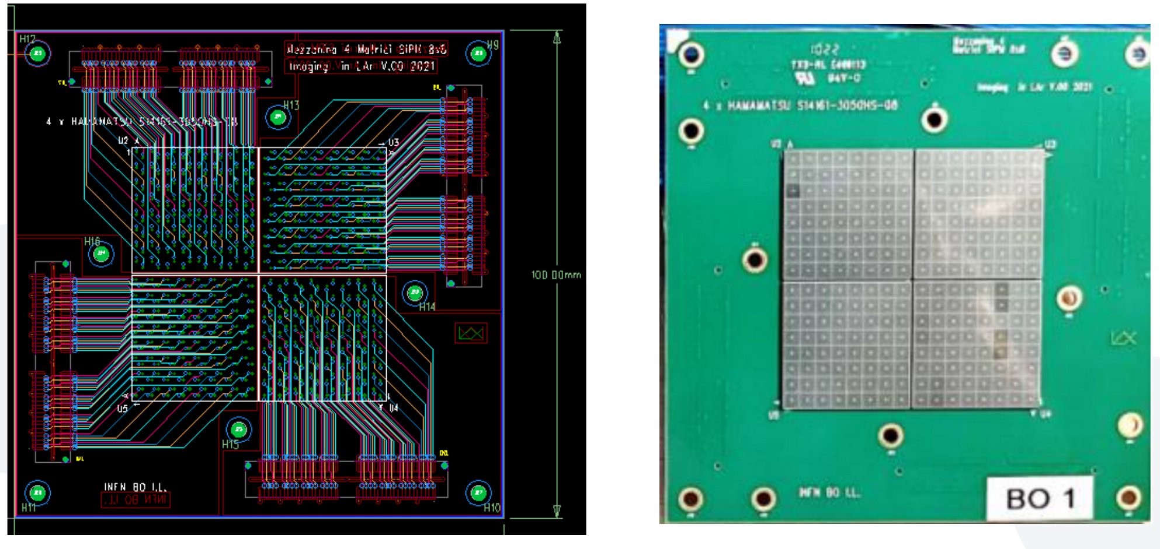
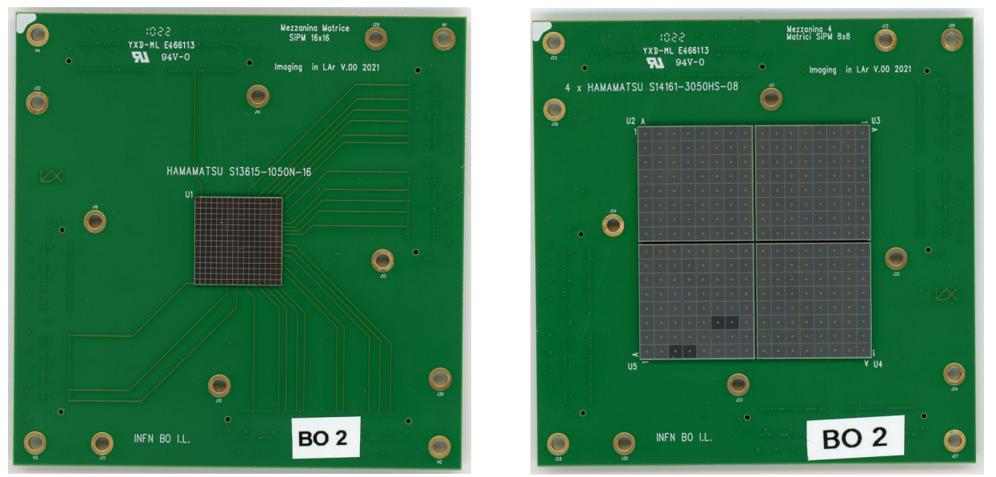
Cold demo requirements and design
Cryo-compatible SiPM ASIC
ALCOR, developed by INFN-TO
32 channel SiPM front end
Support both 1x1 and 3x3 mm sensors
Have enough pixels for imaging

Slide 8
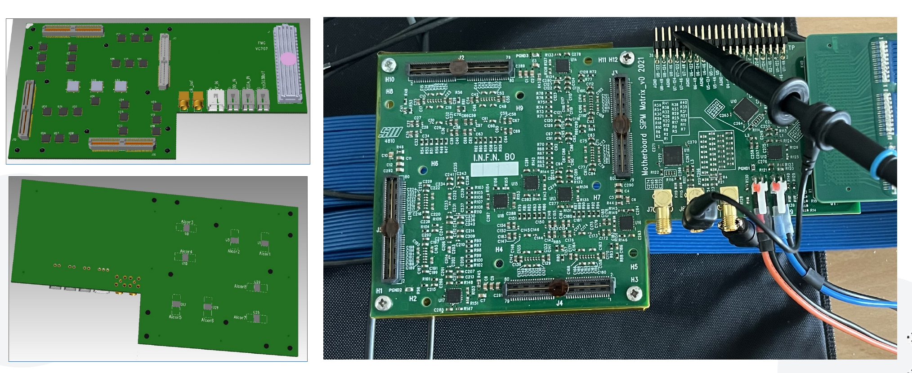
ASIC Board

Slide 9
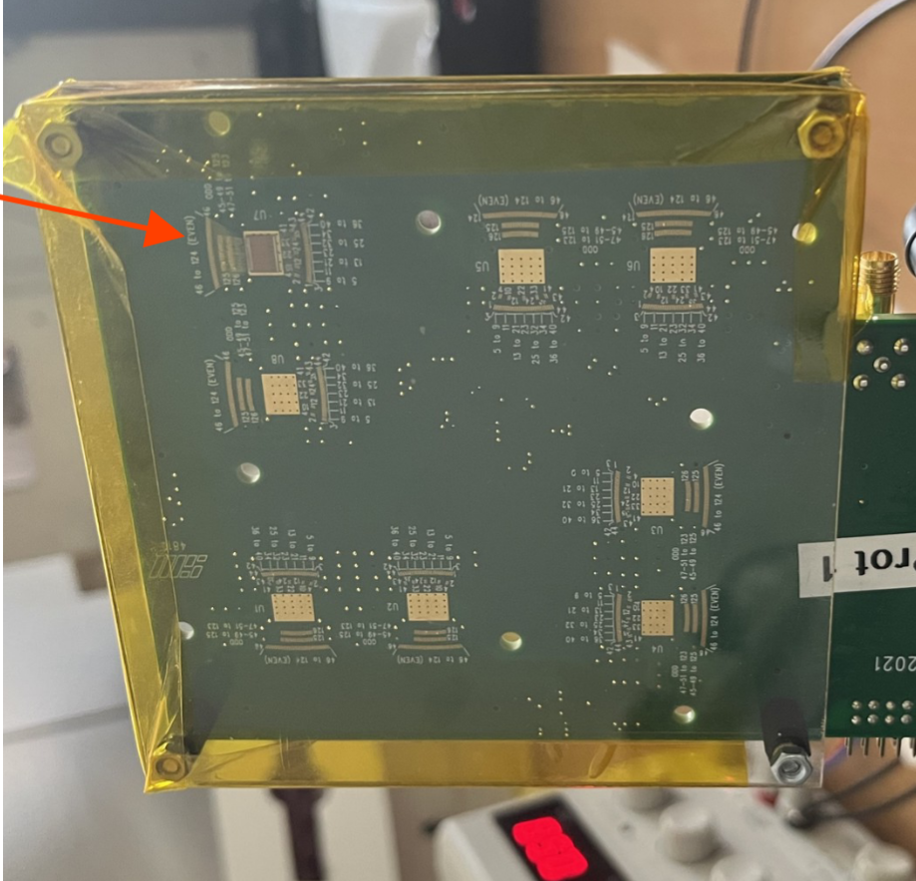
Current Status
All the circuit boards are built and OK
All the SiPM boards (4 1x1 and 4 3x3) are assembled
Two SiPM boards of each time have been coated with PTB
One ASIC board has one ASIC wirebonded
A second one will soon have all ASICs wirebonded
The analog part of the ASIC has been tested extensively
FPGA Firmware can configure the ASICs and dump raw data
Very Basic DAQ software exists to read raw data
Real DAQ Software with GUI, automatic scans, etc... is being written

Slide 10
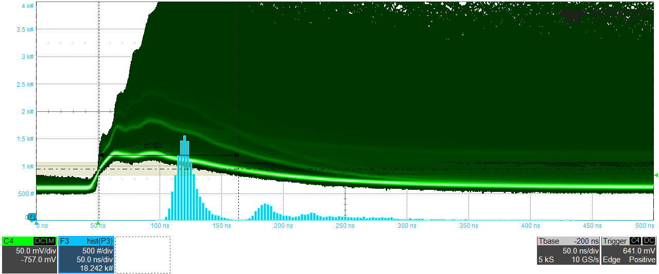
An example waveform with scope ToT

Slide 11
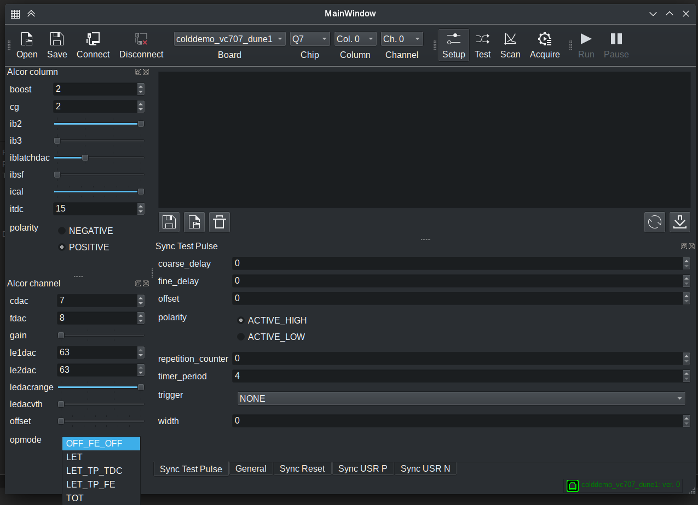
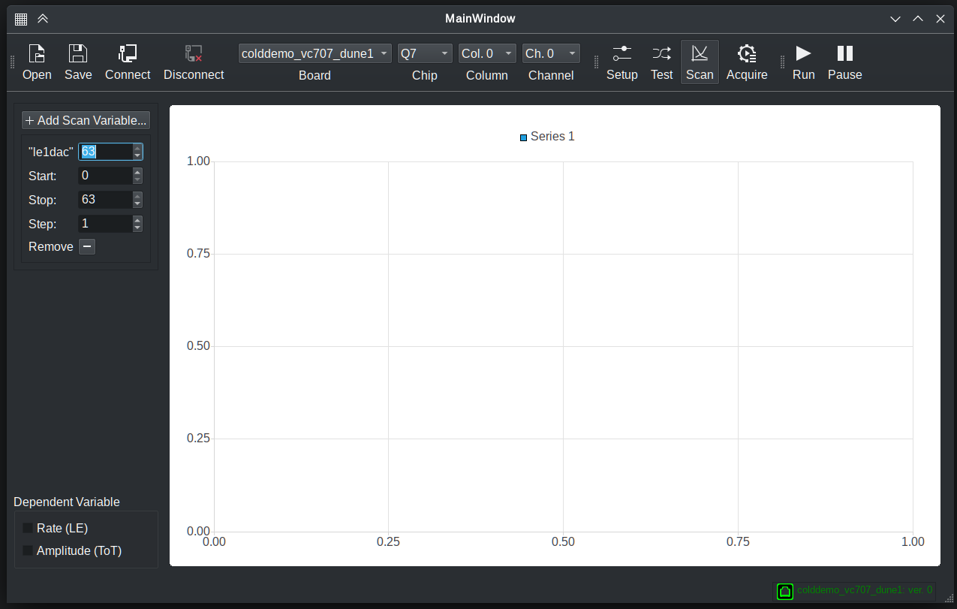
What still needs to be done: software
Complete the DAQ software and documentation
Basic features, configuration file parsing, raw data readout, ... ~75% done
May still need to modify the firmware somewhat
Automatic parameter scan (with fitting, etc...) < 50% done
Data analysis features (ToT to amplitude, ...) 0% done
GUI ~50% done:

Slide 12
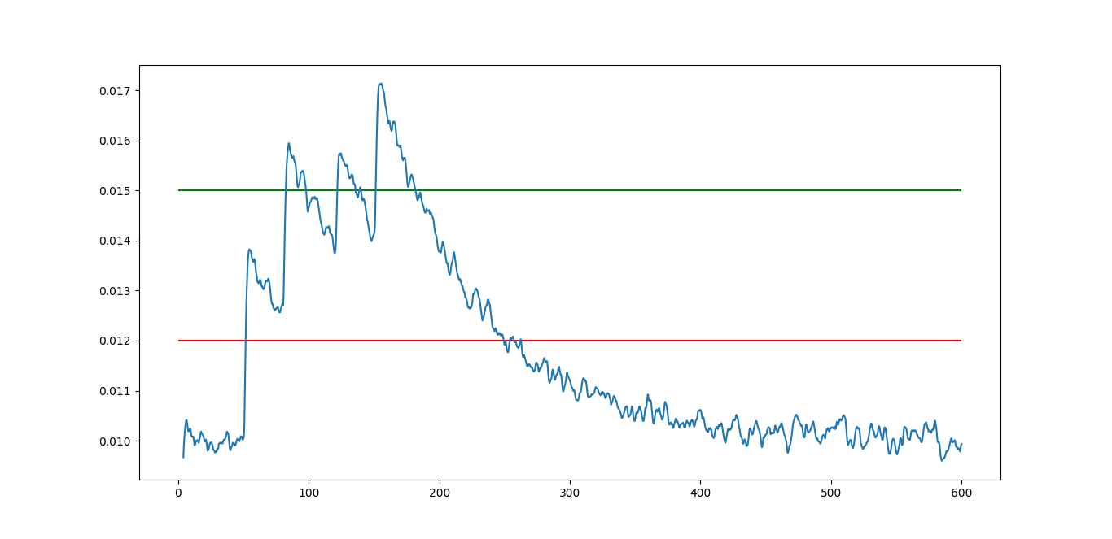
What still needs to be done: hardware
Characterize SiPM matrices at cryo T (IV curve)
All tools are available in principle, but the setup needs to be built and used.
Opportunity to measure some properties of PTB coating
Only test that does not require DAQ
Calibrate ToT with pulsed source
Investigate ToT with "weird" signals
Study optimal thresholds for this type
of event

Slide 13
Future work plan
March:
IV curves
Get software to at least usable state
April:
ToT calibration and studies
Multiple board integration and synchronization
May: contingency

