Slide 1
Pixel Upgrade plan and INFN proposed contributions
G.M. Bilei
Mar. 7 ^{th} 2011

Slide 2
Pixel Upgrade motivations and requirements
The present Pixel detector is working very well and was designed 10 years ago and
built to operate up to a maximum luminosity of ~ 1x10³⁴ cm⁻² s⁻¹
Some limitations (4-5% data losses in inner region) in the Readout Chip will start becoming
evident already at ~ 1x10³⁴ cm⁻² s⁻¹
LHC is planning to increase luminosity in the years 2017-2020 up to 2x10³⁴ cm⁻² s⁻¹
after 1 year shutdown in 2016.
After 1x10³⁴ cm⁻² s⁻¹data losses of the present ROC would deteriorate to un unacceptable level
(~ 15%) at 2x10³⁴cm⁻² s⁻¹ (or 50% !! if the machine will run with 50 ns bunch spacing and higher current /bunch) leading to a major degradation of Tracking performance.
Under these conditions, the ability of CMS to continue to deliver Physics and benefiting of
higher luminosity will be seriously compromised.
The main goal of upgrading the pixel detector in 2016 is thus to maintain high level of
Tracking performances until the end of Phase I e.g. up to 2x10³⁴ cm⁻² s⁻¹
The necessity of replacing the Pixel detector will allow us to design and built a new system
fully benefiting of the technological advances that took place in the past 10 years enabling
the construction of an overall more performing system.

Slide 3
Main features under discussion
New Layout 4 layers / 3 Disks per side
Reduce Read-Out inefficiency of present ROC – that has been designed for L ~ 1x10³⁴ cm⁻² s⁻¹
  New Readout chip to much improve Read-Out efficiency up to 2x10³⁴ cm⁻² s⁻¹
Reduce aggressively (50-60% ) the Material Budget
  - Decrease the amount of multiple scattering, photon conversions and nuclear interactions.
    Improve Impact Parameter Resolution and Tracking efficiency
Add a 4th Layer (radius 160 mm) much closer to the TIB w.r.t. present 3rd Layer (106 mm)
  - Improve track seeding efficiency and hermetic 4 hit coverage
    Improved Tracking and HLT performance (pixel tracks can be found quickly)
    Increase redundancy and robustness of pattern recognition
    Improved Tracking performance in core of high pt jets
    Cope better with possible problems of inner layer of outer Tracker
Reduce Inner Layer Radius from 44 mm to ~ 39 mm (possibly 30mm)
with a new beam pipe 25 mm radius (22.5 mm under consideration)
  - Improve b-jet tagging (aim 20% improvement)
  Reduce dependence on charge sharing and maintain resolution with radiation
  - Improve seed efficiency and quality in very dense environment
    Improved Tracking performance in core of High Pt jets, increased robustness

Slide 4
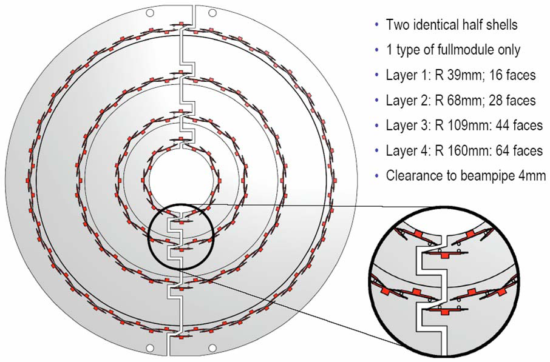
Pixel Upgrade Layout
Total
Number of Pixel modules: 1.888
Number of Pixel:124 M
Sensor Area: 2 m² of Pixel detector

Slide 5
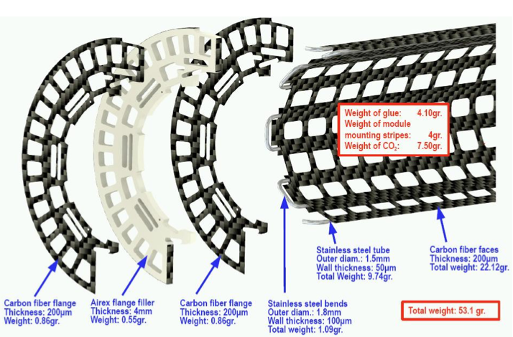
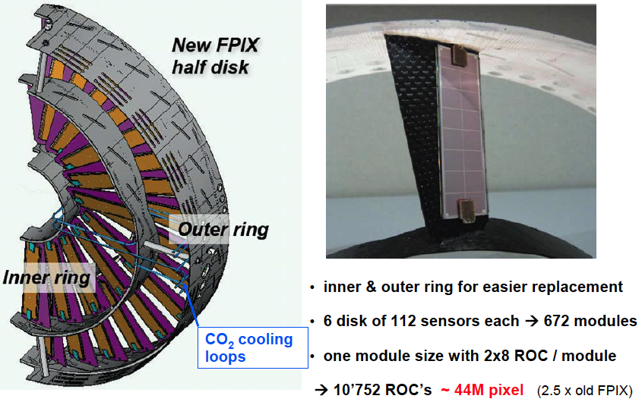
Ultra light mechanics
Forward Pixel Mechanics
Barrel Pixel Mechanics
4 Barrel layers with 1.216 modules
One module 2x8 ROCs
19.456 ROC’s ~ 80M pixel

Slide 6
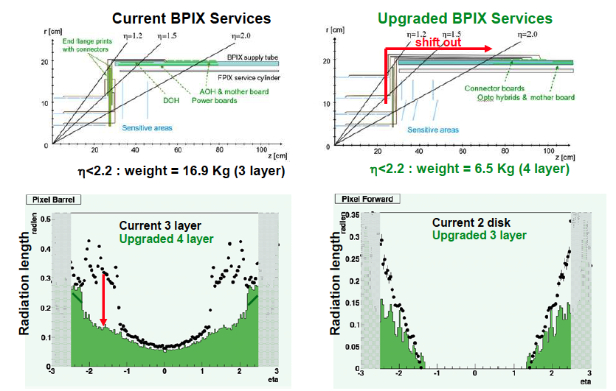
Material Budget
Major reduction ( ~ 50-60%) of Material Budget
G.M. Bilei
6

Slide 7
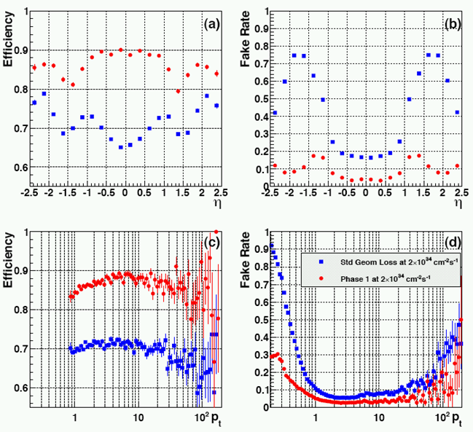
Pixel Track seeding efficiency at 2x10³⁴cm⁻² s⁻¹
upgraded
Phase 1 with data loss
Std Geometry with data loss
current
Present Detector | Radius (cm) | % Data loss at 2×10³⁴
BPIX1 | 4.4 | 16
BPIX2 | 7.3 | 5.8
BPIX3 | 10.2 | 3.0
FPIX1&2 |  | 3.0
upgraded
current
upgraded
Phase 1 Detector | Radius (cm) | % Data loss at 2×10³⁴
BPIX1 | 3.9 | 4.7
BPIX2 | 6.8 | 1.5
BPIX3 | 10.9 | 0.6
BPIX4 | 16.0 | 0.28
FPIX1&2 |  | 0.6
current

Slide 8
Broad brush description Pixel Upgrade - Systems
New PSI46dig ROC:
- Reduce data losses at high luminosity
- Robust digital readout link for higher data rate transmission
- Protection mechanism against large clusters induced by beam background (observed in present Pixel)
New Cooling System: CO₂ Cooling
- Higher refrigeration capability, smaller pipes, lower mass fluid, reduce contribution to MB etc.
New Power System: DC-DC conversion Power System
- Lower currents, lighter internal cables, reduce contribution MB
New Optical Readout link System: 320 MHz digital optical link
- Replace obsolete analog link with more robust digital link, with new lasers,
new opto-hybrids and new opto-receivers
Modified DAQ and Control Systems
- Preserve present TTC, PxFEC
- Modify PxFED to adapt to digital 320 MHz Readout
- Fall forward Inner Layers option must be compatible with these read-out and controls systems

Slide 9
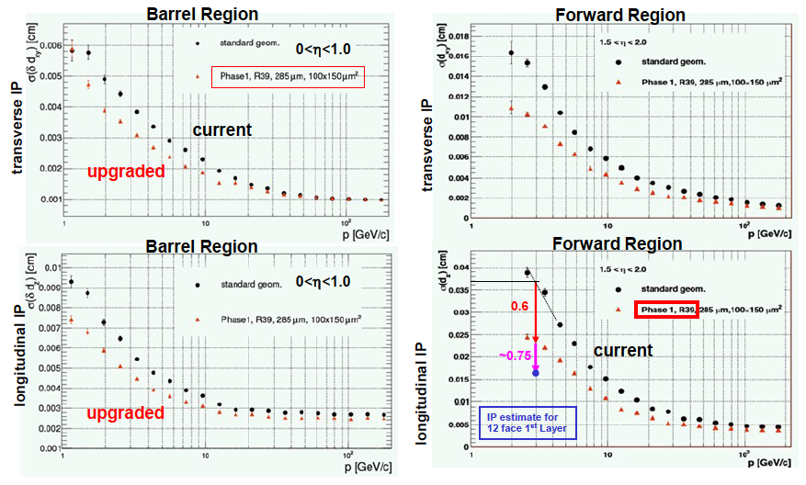
Impact parameter resolution
25-40% improvement in impact parameter resolution in both directions
Direct impact to b-tagging both at HLT and offline!
9

Slide 10
B-tagging performance
+10% efficiency
increase
2x fake tags
reduction
Current
detector
Upgraded
detector
Improved efficiency and fake rate
contributing exponentially
with the number of b-tagged jets
(e.g. Top, Susy, etc.)
QCD 80<pt<120 GeV
Combined Secondary Vertex tagger
10

Slide 11
Preliminary - Area of Interests per Country
Preliminary Draft
Pixel upgrade cost evaluated to be ~ 17.3 MCHF. Sharing among agencies is under discussion

Slide 12
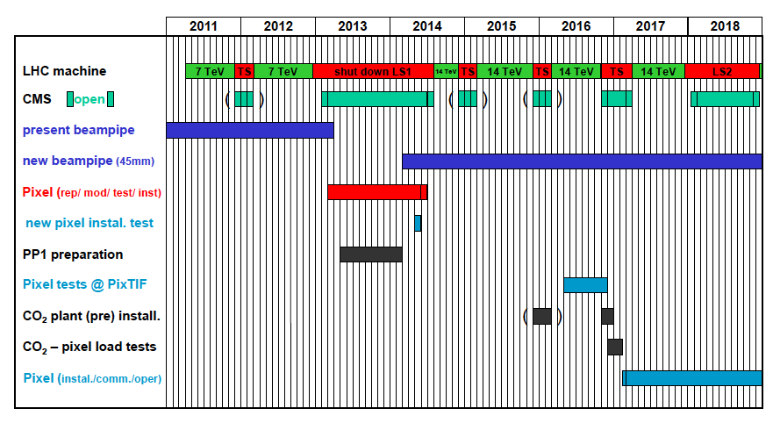
Preliminary Plan – under revision
Technical Proposal
Global plan is presently under
discussion to take into account
Chamonix news.
CERN will publish in ~ July
an update of 10 years plan.

Slide 13
Fall forward option Pixel Upgrade: Inner Layers
- LHC is planning to deliver ~ 500-550 fb⁻¹ by the end of Phase 1.
- The inner layer will have to be replaced once due to radiation damage.
- This replacement presents a further opportunity to improve detector performance
and test newer technologies for later stage (in view of HL LHC era).
- Evaluating Performance, Physics gains in increasing the hit resolution in the
inner layer – ring (reducing the pixel pitch and sensors thickness)
  Sensors design: n-on-n with reduced thickness and 50% pixel area.
  Fall forward line: Develop thinner n-on-n sensors (~ 220 µm thick), ~ 50% smaller pixel area
  (~ 75x100 µm²) and evaluate possible alternatives (diamond).
Improving single hit resolution (gain in term of radiation tolerance and reduction of material)
  Evolve Readout Chip: ROC chip design optimized for lower thresholds and 50% pixel area.
  - Fall forward line: evolve ROC chip, compatible with DAQ and controls.
- Optimized design for lower operational thresholds to ‘extend’ lifetime of the inner layers.
- Reduce readout cell size (~ 75x100 µm²) to match reduced pixel area.
This can be reached thanks to 130 nm (or lower) technologies and to a careful optimization
of the chip layout design.
- Possibly able to digest higher rate with reduced dead time

Slide 14
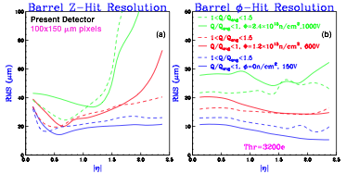
First layer lifetime
Current sensor technology will have sizable resolution deterioration at end of Phase 1 lifetime
  - Radiation fluence expected to exceed 10¹⁵ neq/ cm² in Layer 1
  - Roughly twice as worse resolution and >3% hit inefficiency due to charge trapping
Requires replacement of innermost layer once during Phase 1 (after having integrated
~ 250 fb⁻¹)
14

Slide 15
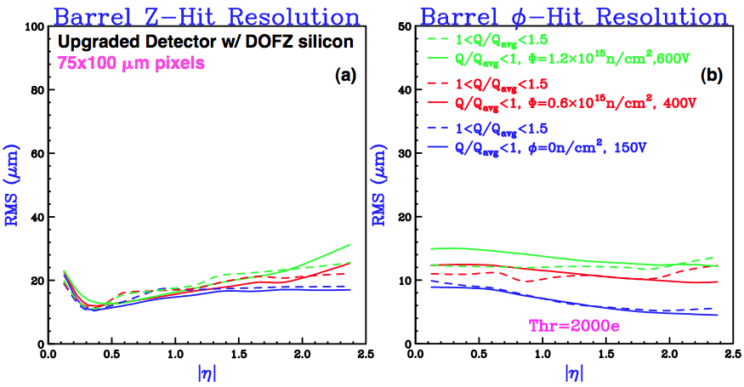
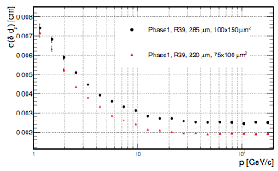
Layer 1 replacement
Replacement of layer 1 opens door for
attractive opportunities
  New chip based on 130nm or smaller
  CMOS technology
  - Can implement smaller pixel cells
  - Aim at lower readout threshold
Longitudinal IP resolution
Smaller pixels with lower readout thresholds
can better preserve position resolution after
irradiation.
Improve impact parameter resolution.
Add resolving power for high pt jets and
boosted objects (b, tau, top).
Better vertex resolution in a high pile-up
environment and improved lifetime measurements
100x150 mm²
~30% improvement
75x100 mm²
15

Slide 16
Possible INFN contributions
INFN past and ongoing major contributions:
- Definition of Layout studies for TP
- Simulation studies for TP and TDR
- Definition of TDR
INFN may take responsibility on:
Set up 1 of the 5 (CH, Germany, CERN, USA) equivalent Module Production Center
- Sensor qualification
- Module bump bonding
- Module assembly and qualification
- Module integration and layer qualification
Participation to common items at CERN
- System studies and test beam
- System Integration and Commissioning
Participation with USA to specific developments for innovative Fall-Forward solution
- Sensor development and qualification
- New readout chip design in 130 nm technology
16
Notes:
16

Slide 17
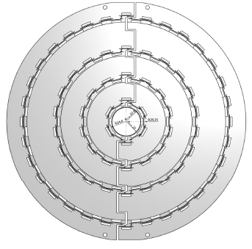
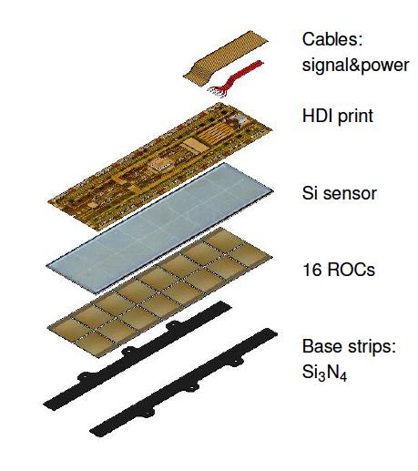
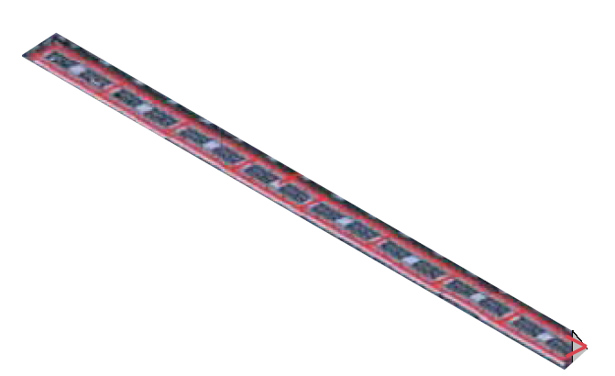
Layer 3
Expressed to the Tracker community our
interest to contribute with a part of BPix layer 3.
Final sharing among countries in discussion and
will be available at the time of TDR
Half Layer 22 faces
8 modules/faces =176 modules
Needs ∼ 250 modules
allowing for 80% yield
and 15% spares
17
Notes:
17

Slide 18
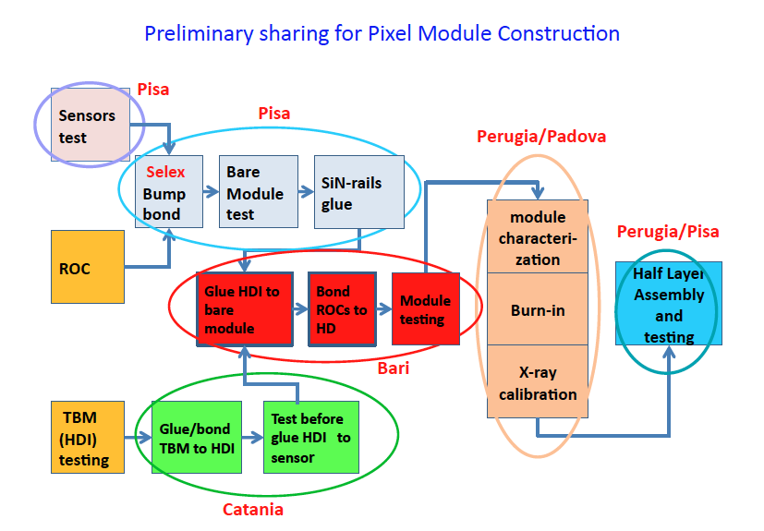
Module construction Flow Chart

Slide 19
Human resources
 | FTE /year | Tecnici FT | Items of interest
Bari | 2,0 | 1,2 | Production, integration + test beam,
Catania | 1,0 | 1,0 | Production, integration + test beam
Firenze * | 0,5
Milano | 0,5 | 0,5 | integration + test beam, Fall Forward
Padova | 1,5 | 2 | Production, integration + test beam, Fall Forward
Perugia | 2 | 1,5 | Production, integration + test beam, Fall Forward
Pisa | 2,5 | tbd | Production, integration + test beam, Fall Forward
Torino | 2 | 1,5 | Integration+ test beam, Fall Forward
* personal partecipation by E. Focardi
All corresponding INFN Directors have been informed about that and we are generally encouraged to go on.
19
Notes:
19

Slide 20
Draft timeline of INFN activities
Develop and produce assembly tools start 2011
Develop assembly and testing procedures start 2011-12
Participate to qualification of ROC chip and TBM 2012
Bump bonding tests and qualification of Selex 2012
Assembly and test procedures established 2012
Full qualification of pre-production modules 2012-13
Module assembly and calibration (~ 12 months construction) 2013-14
Participate to integration at CERN 2015
Participate to commissioning, full system test at CERN 2015
Ready for installation in CMS end 2016

Slide 21
Fall Forward Option development
Design of new readout chip in 130 nm CMOS technology with objectives:
Readout architecture able to sustain very high data flow:
concept: keep data inside the matrix until a request arrives.
“Regional” approach (size 2x2, 2x4..), pixels share memory buffers, logic block and possibly an ADC. Experience exists (ViPix, SuperB..).
2) Pixel size reduction:
improvement in impact parameter resolution, occupancy reduction and sensitivity to radiation damage (sensor leakage current).
Pixel size of 100x75 µm² or even smaller appears feasible.
Experience exists for smaller pixels (ViPix, SuperB..).
3) Increase of clock frequency and output data bit rate:
In 130 nm experience exists (ViPix) with logic blocks operated @~1GHz.
Good safety margin for a digital design at frequencies of few hundreds MHz.
Dead time reduction and readout efficiency optimization.
Logic blocks inside the pixel matrix can operate at lower frequencies.
21
Notes:
21

Slide 22
Possible Work plan
As a first step, these three concepts could be tested in a small-scale device
(just as an example, 32x32 pixels), with a size large enough to give meaningful
results especially for the readout architecture solutions.
• In the preliminary stages of the project, single blocks (e.g. ADC or other critical
analog circuits) could be submitted in a test chip.
• After the basic concepts are proven, a couple of iterations with a full scale device
should lead to the final version of the readout chip, ready for production.
• As usual, an accurate contingency evaluation has to be carried out in terms of both
schedule and funding.

Slide 23
New Pixchip
Project structured in 3 stages (~12-16 months each) total time 4-5 years.
  Design, submission of Test structures (FE, ADC, pixel-level logic), 1 or more chips (estimate cost 250 KCHF)
  Design, submission and test of a small scale version of readout chip (~ 150 KCHF)
  Design, submission and test of a full scale version of the readout chip (~250 KCHF)
  Production run (~ 400 CHF)
Interest and experience in INFN and some other Institutes (FNAL).
INFN : To, Pi, Pg, PD, Fi
- Solid experience in Torino with 250 nm, 130 nm and even 90 nm technologies
(chips FE Alice Si-drift, FE Panda Pixel, Dacel CMS GBIT laser driver).
- Proven experience in Perugia and Pisa Electronics Departments 180, 130, 90 nm
chip design (GR5 activities ->MAPS chips, VPix chip design, TO_asic, FF-LYNX)
- Solid experience in PD for Rad-Hard qualification and SEU measurements
of front-end chips (APV25)
Resources (from INFN):
- 2.5 FTE design
- 2.5 FTE test & characterization
Funding: possible sharing 50-50 INFN - USA (~ 500KCHF each)
23
Notes:
23

Slide 24
Rad hard sensors
Replacement of layer 1 at later stage of Phase 1 provides an opportunity to adopt sensors with greater radiation hardness (diamond could be an option).
Milano group interested to assess possibility of using diamond sensors.
Solid interest and experience and several (past and ongoing R&D) GR5 activities.
- Milano: Diapix
- Catania: RD42
Firenze/Perugia: Rapsodia/Chipsodia
Funding for a batch thin n+on n /diamond sensors with fine pitch 75x100 µm²
possible sharing 50-50 INFN - USA (~ 100 KCHF each)

Slide 25
Summary draft Cost sharing and profile
Item | KCHF
Set ups, jigs and tools | 150
Silicon sensors | 130
FE electronics | 170
Module elect+mecc | 150
Bumpbonding | 400
Fall Forward: sensors | 100
Fall Forward: RO chip | 500
Total | 1600
1.6 MCHF on ~ 17,3MCHF of total cost
2011 : 50 KCHF for start working on instrumenting the labs with
Pixel specific set-ups, probe-cards, tools, jigs etc.
25
Notes:
25

Slide 26
Executive Summary
Technical Proposal for Phase I completed. Discussing timeline for TDR (~ end of 2011)
Present detector was designed to operate up to ~1x10³⁴cm⁻² s⁻¹
Strong evidence that current detector needs to be replaced for running at luminosities above
1x10³⁴cm⁻² s⁻¹
The main goal of upgrading the pixel detector in 2016-17 is to maintain high level of
Tracking performances until the end of Phase I e.g. up to 2x10³⁴ cm⁻² s⁻¹
Radiation effects will grow as luminosity increase requiring once the replacement of inner
layer before the end of phase I
Proposing to contribute to:
1. Development, construction, integration and commissioning of part of Bpix to be installed
in 2016-17.
2. Development of a new Read-out chip with more advance technology employing a
smaller Pixel size.
- This second development has to be seen as important intermediate step toward
identification of new Pixel readout architectures and sensor technology for the Higher Luminosity LHC.
- It will strategically strengthen our INFN community and CMS community
in a critical area as that of readout chip design.

Slide 27
Back up slides

Slide 28
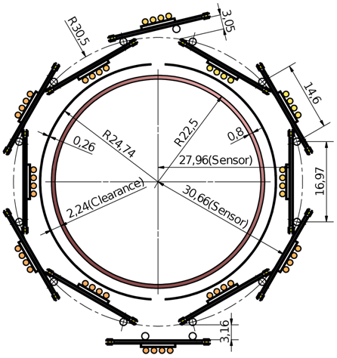
Beam pipe radius
Studies are ongoing to asses safe beam pipe radius.
45 mm diameter seems doable.
Pushing for Beam Pipe installation in LS1 2014
mean 1st layer Si- radius = 29.8 mm from 44
need 2 mm clearance to beam pipe
need adjustable closing mechanism
Beam pipe diameter 45 mm from 58

Slide 29
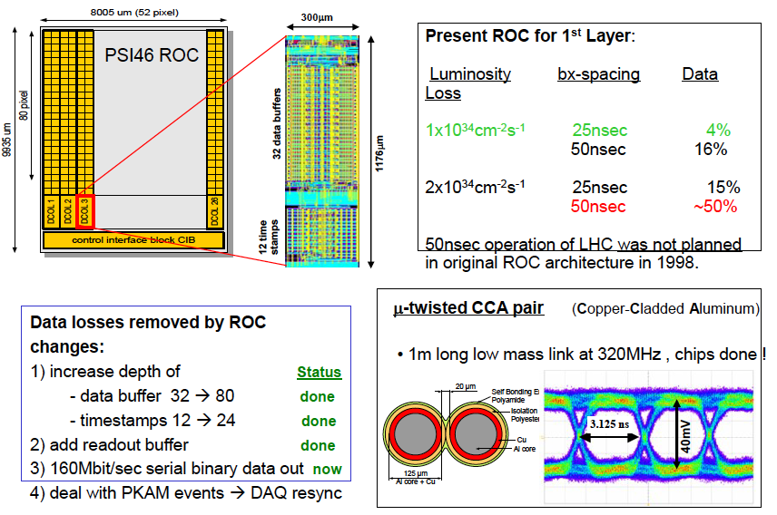
Upgraded PSI ROC Chip

Slide 30
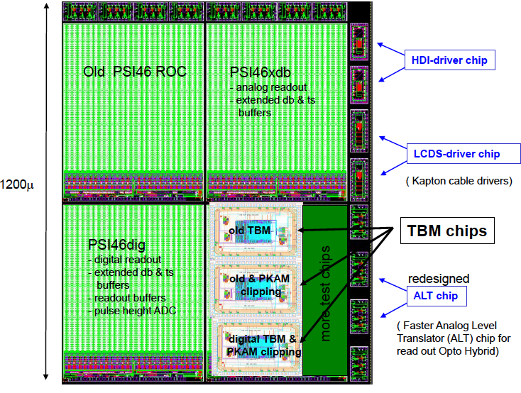
Upgraded PSI ROC Chip
• The current ROC was designed for 1E34cm⁻² s⁻¹
• There is a ~4% dynamic data loss in the innermost BPIX layer at this lumi (readout-related losses 3%, column-drain time 0.8%)
• This increases gradually to ~16% for 2E34 cm⁻² s⁻¹
• For 50 ns bunch spacing at 2E34 cm⁻² s⁻¹, the data loss would be ~50%
• Current ROC needs to be replaced for running above 1E34 cm⁻² s⁻¹
Double buffer space to reduce readout-related dead time
• All digital readout clocked out at 160 MHz from
ROC to new digital Token Bit Manager (TBM).
Multiplex multiple rings with TBM at 320 MHz.
Allows reduction in number of cables
and therefore mass and power.
Submission foreseen for Sep. 2011

Slide 31
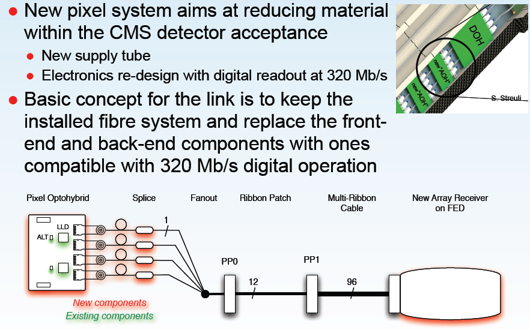
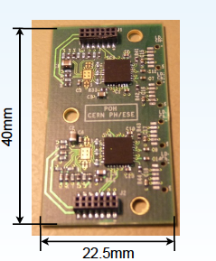
New Optical Link
Activity advancing well at CERN. First Pixel Opto Hybrid (POH) prototypes with new laser
available for evaluation

Slide 32
CO₂ Cooling System
Current cooling system for Tracker uses C6F14, which has density of 1.7 x water
• Biphase CO2 successfully used in HEP, e.g. LHCb “Velo”
• Small channel (~2mm ID) biphase CO2 system would have good
thermodynamic properties (low dT/dP, low mass, low viscosity,
high latent heat, high heat transfer coefficient). Also rad hard
• Factor of ~2 lower density in liquid phase compared to C6F14
• High heat transfer means smaller area of thermal contact.
High latent heat means more heat load per channel.
Smaller pipes, less manifolding and less material.
R&D ongoing and well advanced at CERN/USA since ~ 2 years

Slide 33
DC - DC Power Supply System
• Assume that we will reuse same cable plant (very difficult to change)
• New pixel detector has factor of ~2 more readout chips.
Will need more power To limit resistive losses, propose to bring in high V
along long cables (50m) and use DC-DC switched mode converter (“buck”)
near the detector
• Needs to be rad hard and magnetically tolerant
• R&D ongoing in Germany/CERN since ~ 3 years. Prototypes underway

