Slide 1
mechanical DESIGN OF fcc ir
Stefano Lauciani, Francesco Fransesini
Thanks to Manuela Boscolo, Luigi Pellegrino and Giancarlo Sensolini
This project has received funding from the European Union's Horizon 2020 research and innovation programme under the European Union's Horizon 2020 research and innovation programme under grant agreement No 951754

Slide 2
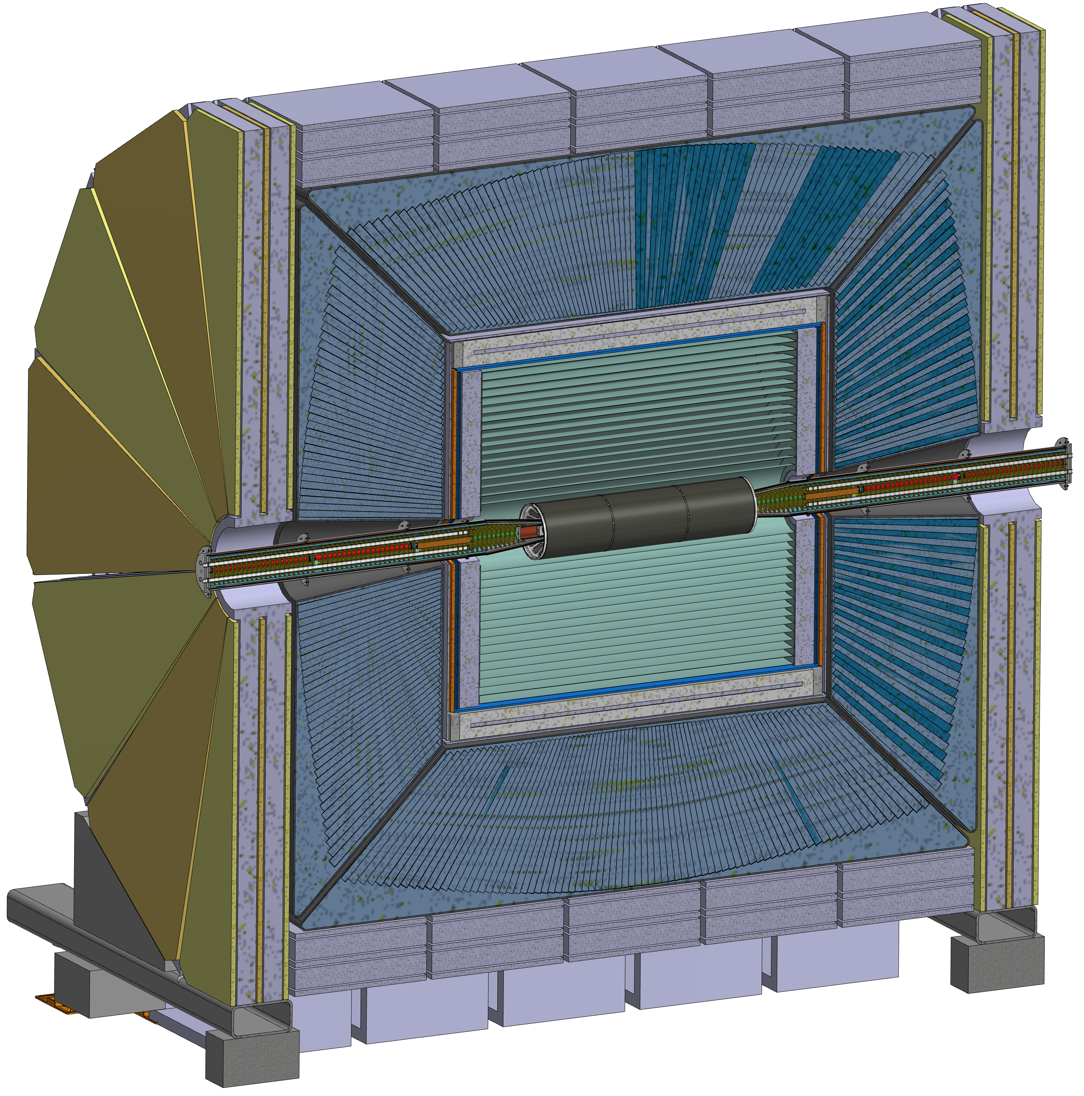
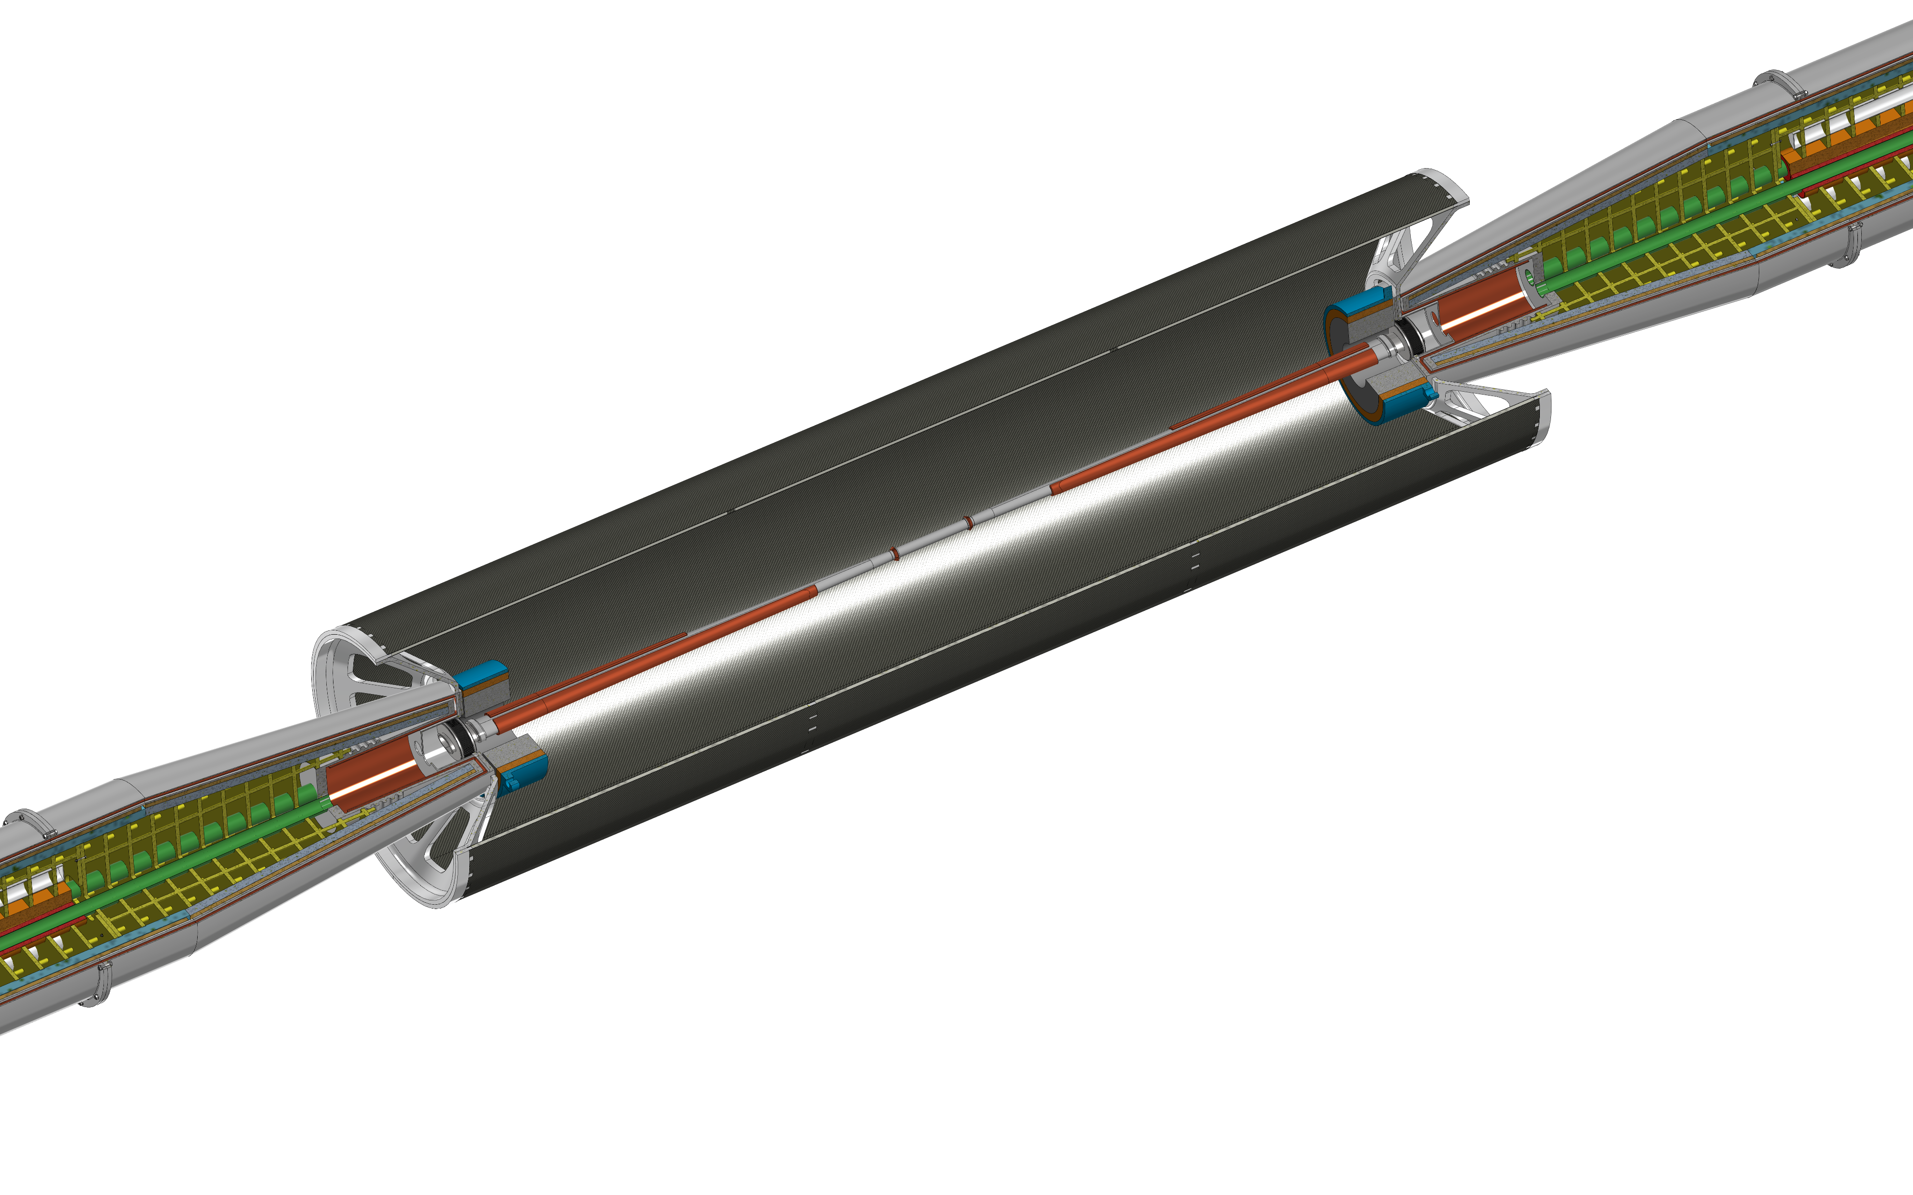
FCC IR region
This design is based on the IDEA detector concept, in fact we are working in close contact with INFN-Pisa integrating their Vertex and Tracker detector design.
Support tube
Cryomagnet
Bellows
Cooling
Central chamber
Trapezoidal chamber
LumiCal
IDEA detector

Slide 3
The most relevant activities made and in progress :
Engineered design of the central chamber
Engineered design or the trapezoidal chamber
Engineered design of the bellows
Engineered design of the support tube
Cad Model + Finite Element Analysis
Cad Model + CST calculation in progress
Cad Model + Finite Element Analysis
Baseline idea for supports of:
Chamber
LumiCal
Bellows
Inner tracker, outer tracker, medium tracker
Each of these elements’ design is in progress, therefore the ideas for support have to follow every step of design refinement
Strategy for an assembly procedure:
Support tube
Disks, medium tracker, outer tracker, inner tracker
IR Chamber
The strategy is in continuum update to follow the modification of the components

Slide 4
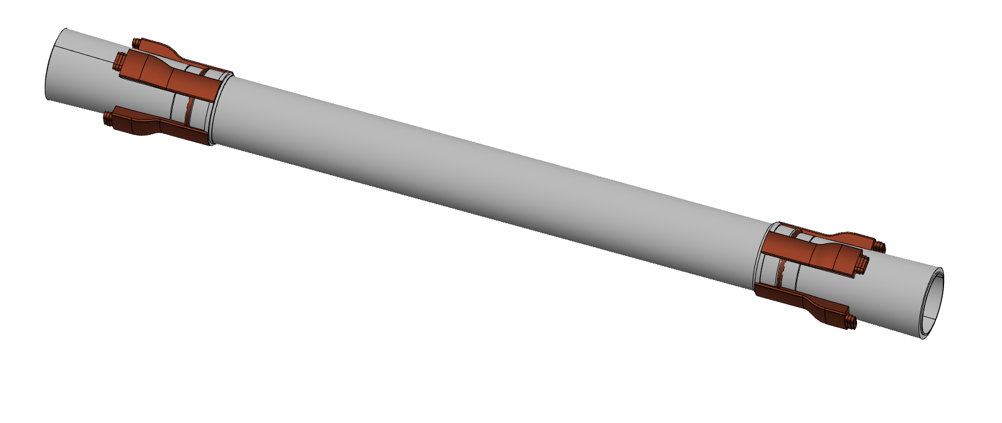
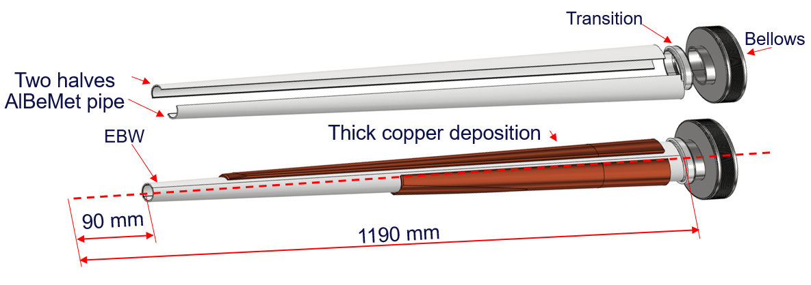
Central chamber
Three layers from 0-90 mm from IP
0.35 mm of AlBeMet162 (62% Be, 38% Al)
1 mm gap for Paraffin
0.35 mm of AlBeMet162
Inlet/outlet for paraffin cooling (copper)
Trapezoidal chamber
Starting from 90 mm to 1190 mm from IP
AlBeMet162 as main material
Chamber in two halves and assembled using electron beam welding (EBW )
Copper cooling system

Slide 5
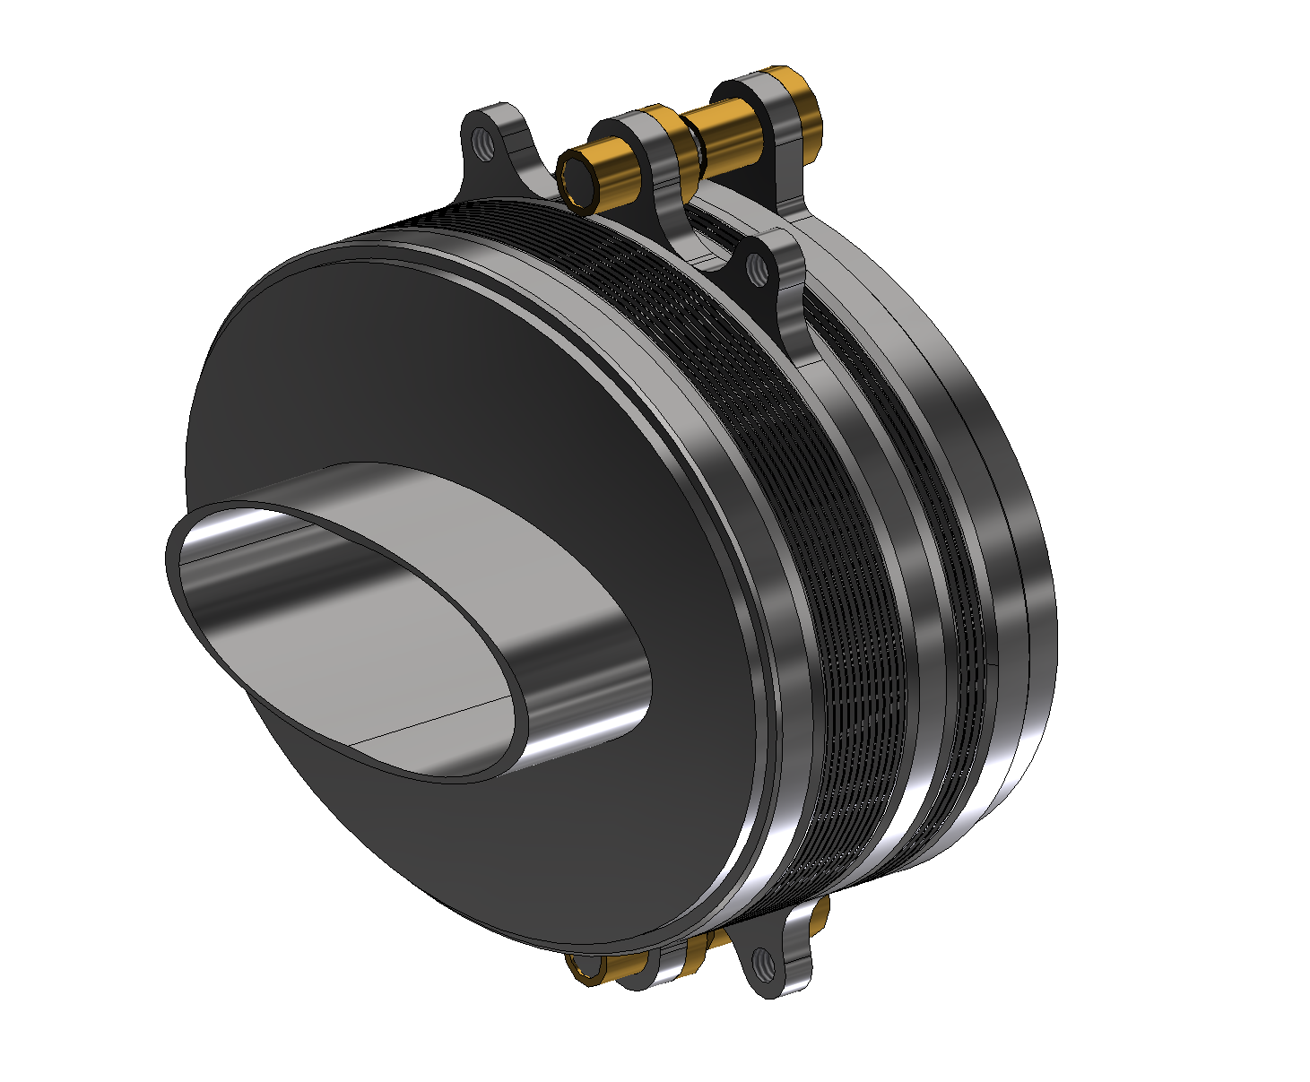
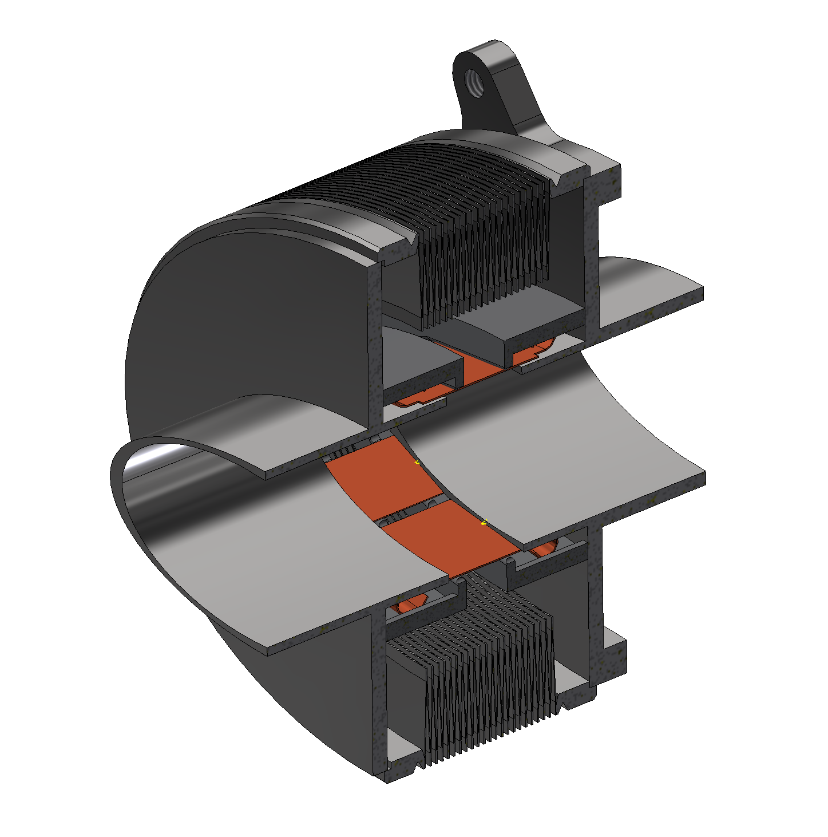
1st Bellows (Single bellows)
2nd Bellows (Double bellows)
Anchoring flange to support tube
Linear bearing system
IP SIDE
IP SIDE
Convolutions to compensate
Cryostat expansion and assembly
CRYOSTAT SIDE
Few convolutions inside support tube for thermal expansion
CRYOSTAT SIDE

Slide 6
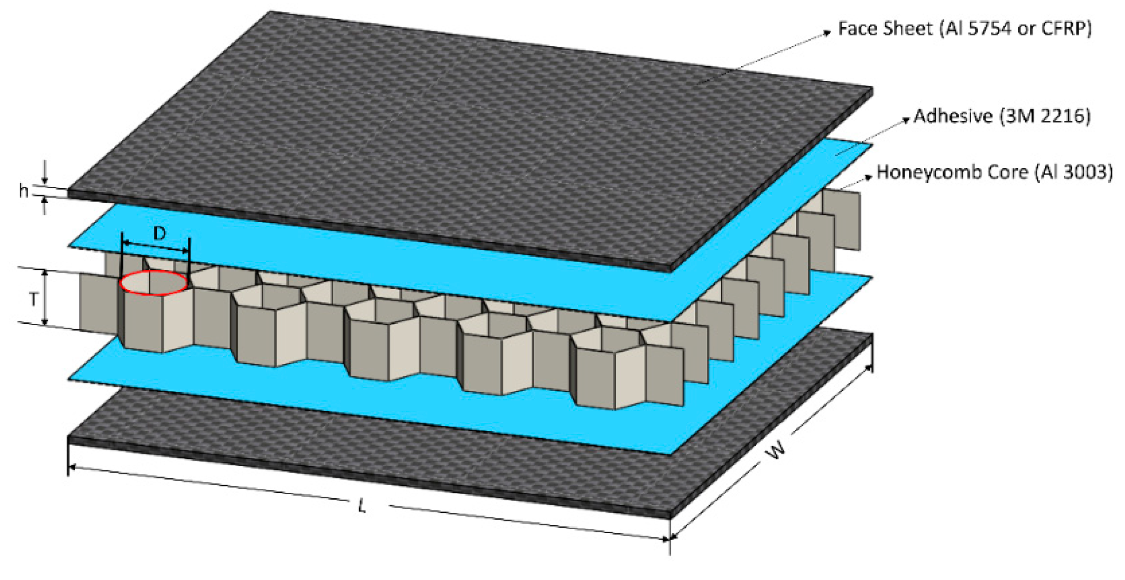
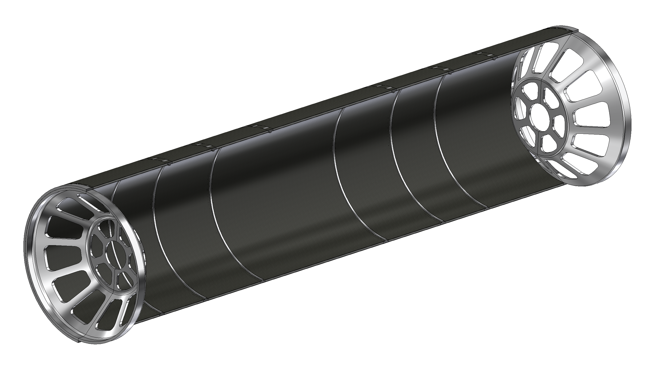
Support tube
The support tube aims to :
Provide a cantilevered support for the pipe
Avoid loads on thin-walled central chamber during assembly or due to its own weight
Support LumiCal
Support the outer and disk tracker
Aluminium endcaps
The structure is made with a multiple layer structure:
1mm CF + 4mm HC + 1mm CF
To allow the support of the disks are necessary 6 reinforcement ribs.
The cylinder is split in two halves to simplify the assembly procedure
The Aluminium endcaps support the LumiCal and the beampipe
Outer and medium tracker
Disk 1, 2 and 3
Aluminium ribs to support:

Slide 7
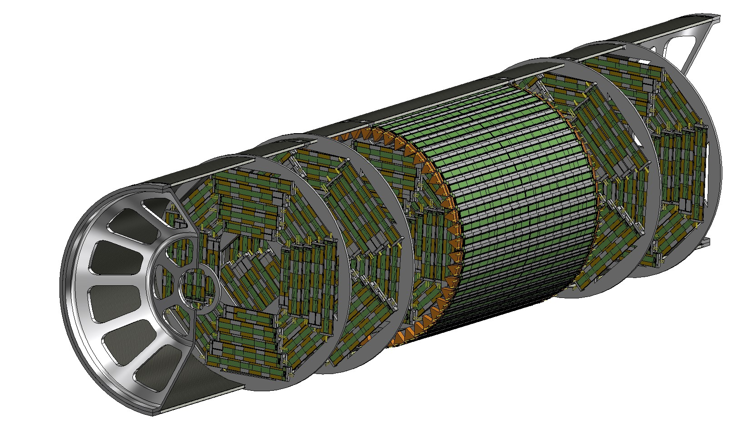
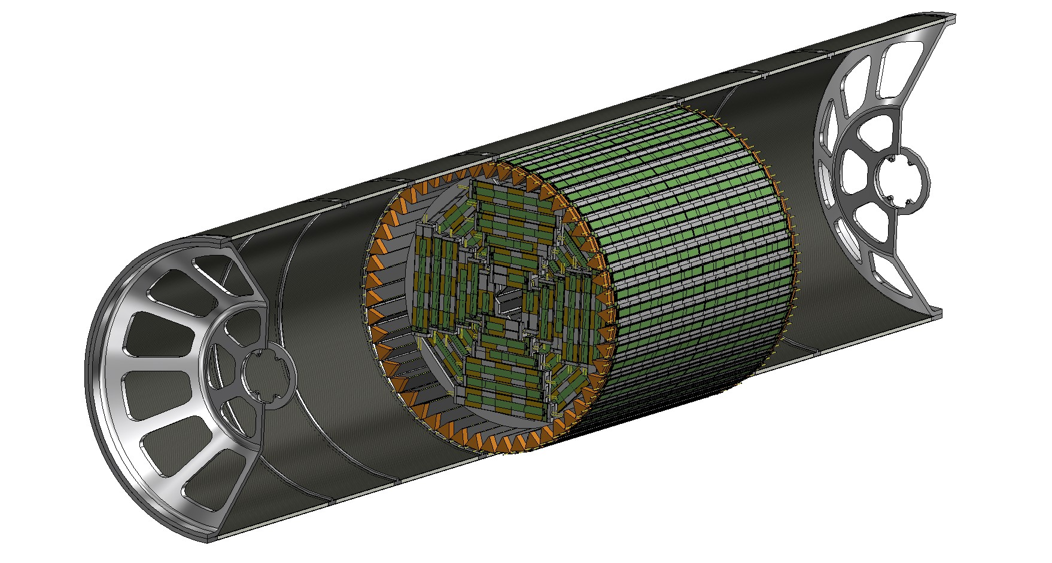
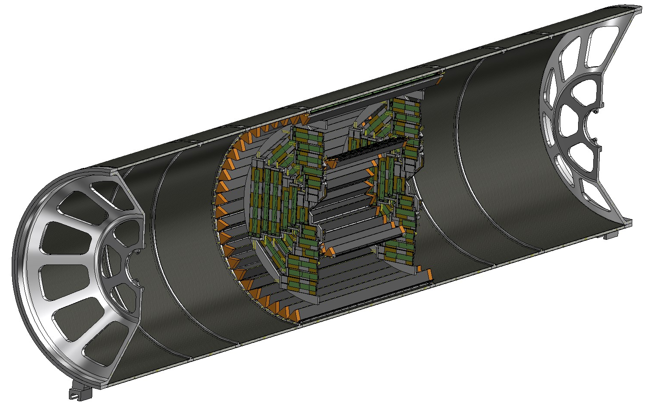
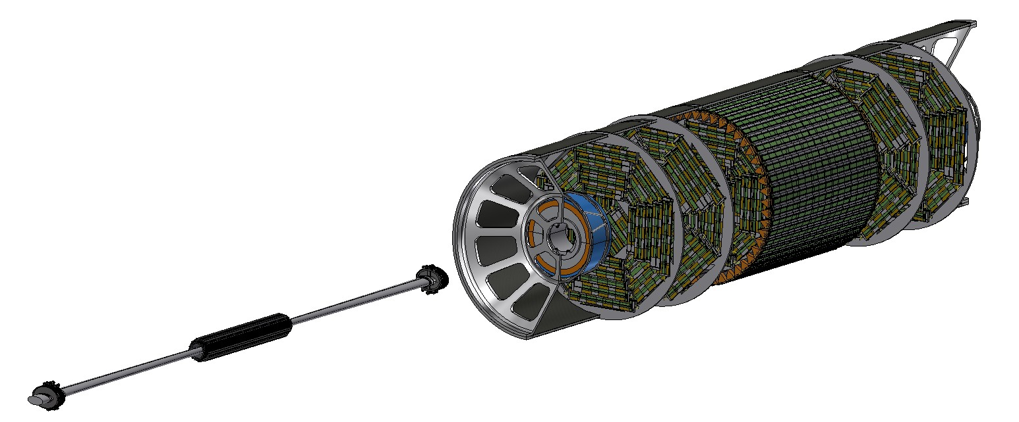
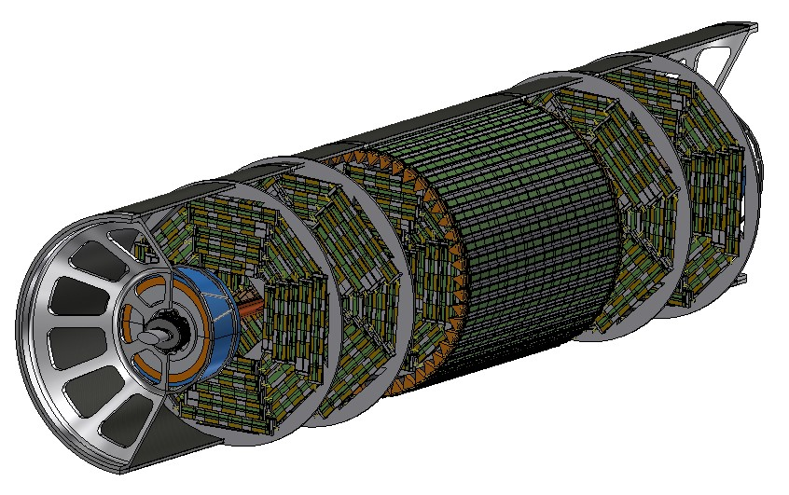
Assembly procedure
Section view
1) Outer tracker, Medium tracker and disks 1 are installed as a rigid structure inside the support tube
2) Disks 2 and 3 are installed inside the support tube
3) LumiCal is installed in centered position, then beam pipe with vertex detector is inserted with a dedicated tool inside disks and outer tracker, then fixed to both endcaps
4) LumiCal can be aligned in the correct position on the outgoing beams
5) Support tube can be closed

Slide 8
Collaboration, workshops and conferences
An effective collaboration has been started with INFN-Pisa on tracker and vertex of IDEA detector, in order to integrate 3D parts inside the IR CAD and study the assembly feasibility
A productive collaboration with Alexander Novokhatski, from SLAC, who is calculating the thermal contribution due to the wake fields.
Vibration mitigation: we are in contact with the LAPP group (Laurent Brunetti, Stanislas Grabon, Eva Montbarbon), to optimize the behaviour of the structure from a vibrational point of view.
CERN people for vacuum, alignment and so on.
Mogens Dam, from Niels Bohr Institute, for LumiCal
Our work has been presented during:
Physics Workshop 2023, “Mechanical model of FCC-ee MDI”, Kracow (01/2023)
FCC-IS 2022 Workshop, “MDI mechanical model and mockup plans”, CERN (12/2022)
Joint FCC-France & Italy Workshop, “Mechanical design of FCC IR”, Lyon (11/2022)
FCC week 2022, “Mechanical design of MDI”, Sorbonne Université, Paris (06/2022)
FCC collaboration week, “Mechanical model of the IR beam pipe”, CERN (12/2021)
FCC week 2021, “Mechanical design of MDI”, CERN (07/2021)
More then 9 MDI meeting at CERN or online

Slide 9
Activity | 05/2021-05/2022 | 05/2022-02/2023 | 02/2023-06/2023 | 06/2023-12/2023 | 12/2023-06/2024
Conceptual design
Central chamber
Trapezoidal chamber
Bellows
Engineered design
Central chamber
Trapezoidal chamber
Bellows
Support tube
Supports design
Chamber
LumiCal
Bellows
Strategy for an assembly procedure
Prototypes (cooling system, manufacturing techniques, resistance)
Additional activity under study
09/02/2023

Slide 12
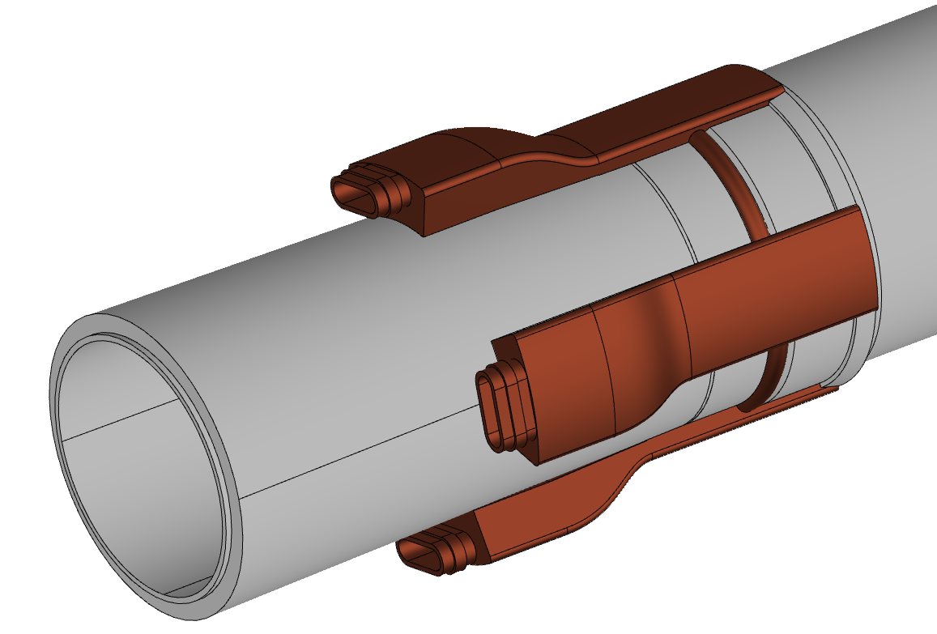
Chamber design – central chamber
The central has the following characteristics:
AlBeMet 162 as main material
Three layers from 0-90 mm from IP
0.35 mm of AlBeMet162 (62% Be, 38% Al)
1 mm gap for Paraffin
0.35 mm of AlBeMet162
Paraffin as coolant
Geometry studied to integrate the central chamber with the vertex detector
Inlet/outlet for paraffin cooling (copper)

Slide 13
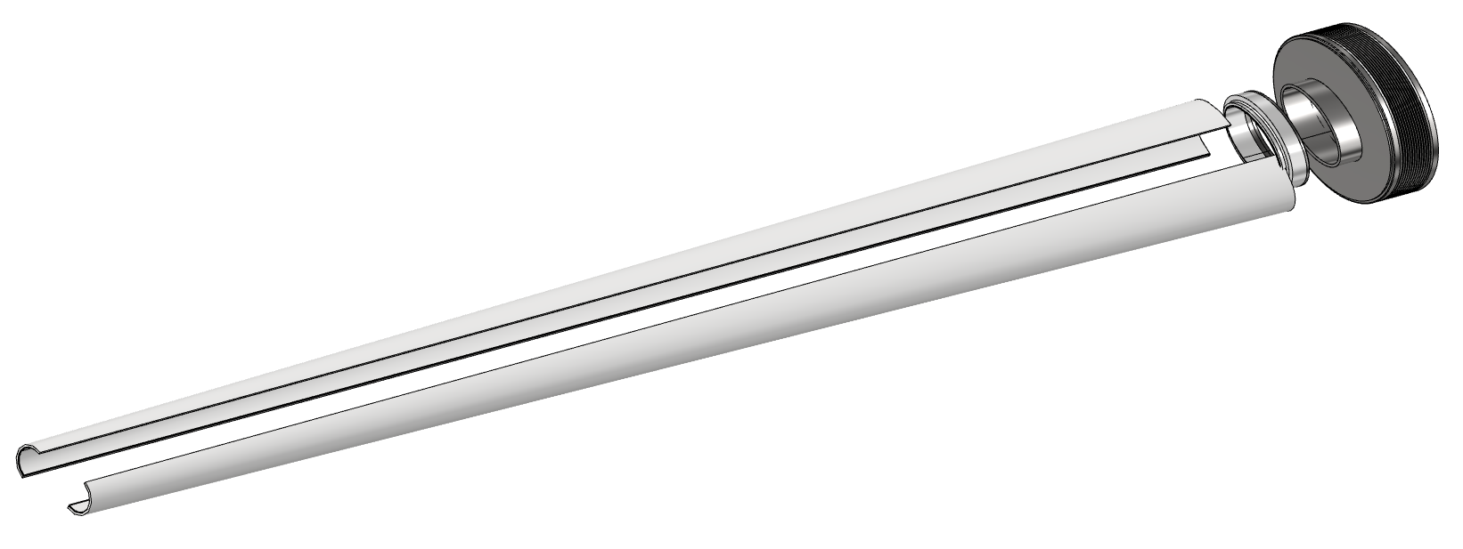
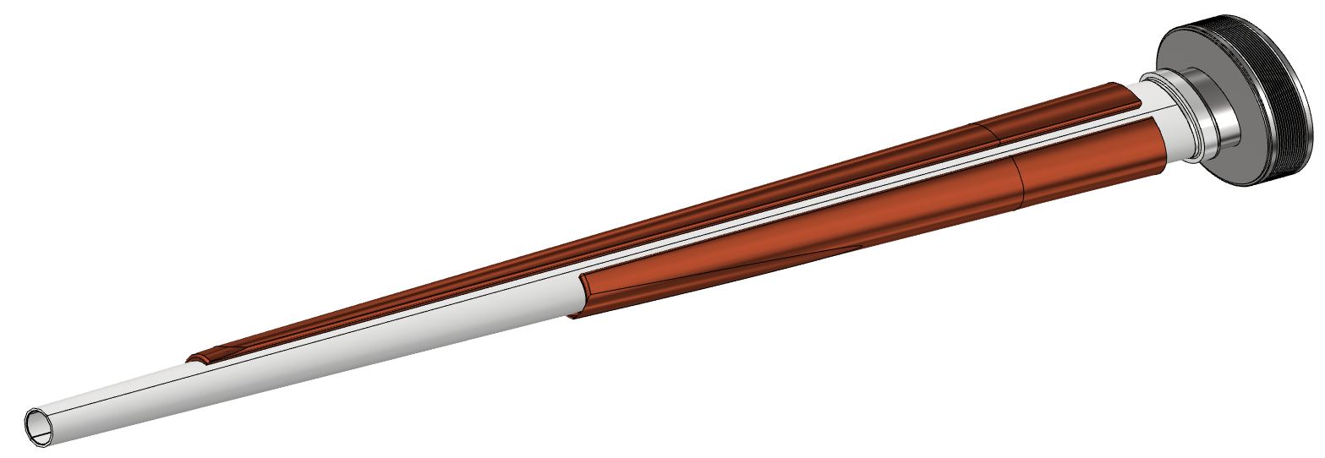
Chamber design – trapezoidal chamber
Main characteristics:
Starting from 90 mm to 1190 mm from IP
AlBeMet162 as main material
Chamber in two halves and assembled using electron beam welding (EBW )
Copper cooling system
Bellows
Transition
Thick copper deposition
Two halves AlBeMet pipe
IP
EBW
90 mm
1190 mm

Slide 14
Structural analysis – central chamber
Loads, constraints, characteristic parameters, design
FEA (Ansys)
Temperature distribution, stress and displacement along the pipe
Paraffin flow (central chamber)
Flow rate: 0,015 kg/s
Section:68,17 mm²
Velocity: 0,3 m/s
Inlet temperature: 18°C
Convective coefficient: 900 W/m²K
Water flow (trapezoidal chamber)
Flow rate: 0,0019 kg/s
Section: 9,62 mm² (20 different channel)
Velocity: 0,2 m/s
Inlet temperature: 18°C
Convective coefficient: 1200 W/m²K
Heat load
54 W central
130 W AlBeMet162 for each part
From CST calculations (Alexander Novokhatski (SLAC))
Weight
chamber
Vertex detector first layer
Constraint
Cantilevered, simply supported configuration
Hypothesis:
Perfect thermal contact between the materials
Chamber design
RESULTS

Slide 15
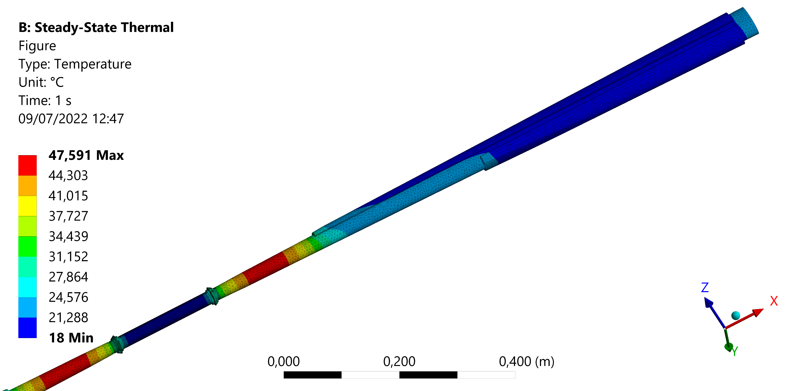
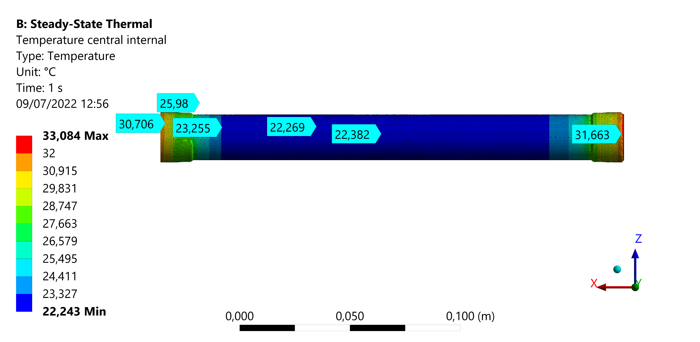
Structural analysis – central chamber- results
 | Trapezoidal chamber | Central chamber
Coolant | Water | Paraffin
Maximum chamber temperature [°C] | 47,6 | 33,1
T_out coolant [°C] | 20,5 | 20,1
Von Mises stress [MPa]
 |  | Trapezoidal SX | Trapezoidal DX | Central IN | Central EX
BEAM | Fixed ends | 22,07 | 21,86 | 46,8 | 38,9
 | Fixed+displ | 14,65 | 10,63 | 9,69 | 17
Maximum displacement [mm]
 |  | X | Y
BEAM | Fixed ends | 0,031 | 0,07
 | Fixed+displ | 0,1 | 0,29

Slide 16
Support tube – Structural analysis
The aim of this analysis is to calculate the stress and displacement in each part of the cylinder (Al reinforcement, carbon fiber, honeycomb).
It is necessary to set:
Chamber | 50 kg
LumiCal | 70 kg + 70 kg
Disk tracker | 6*10 kg
Outer tracker | 15
Medium tracker | 7
First guess loads (overestimated)
Constraint configuration → double fixed ends
Loads configuration
Loads applied to remote point to distribute
Carbon fiber/ honeycomb creation → layered section

Slide 17
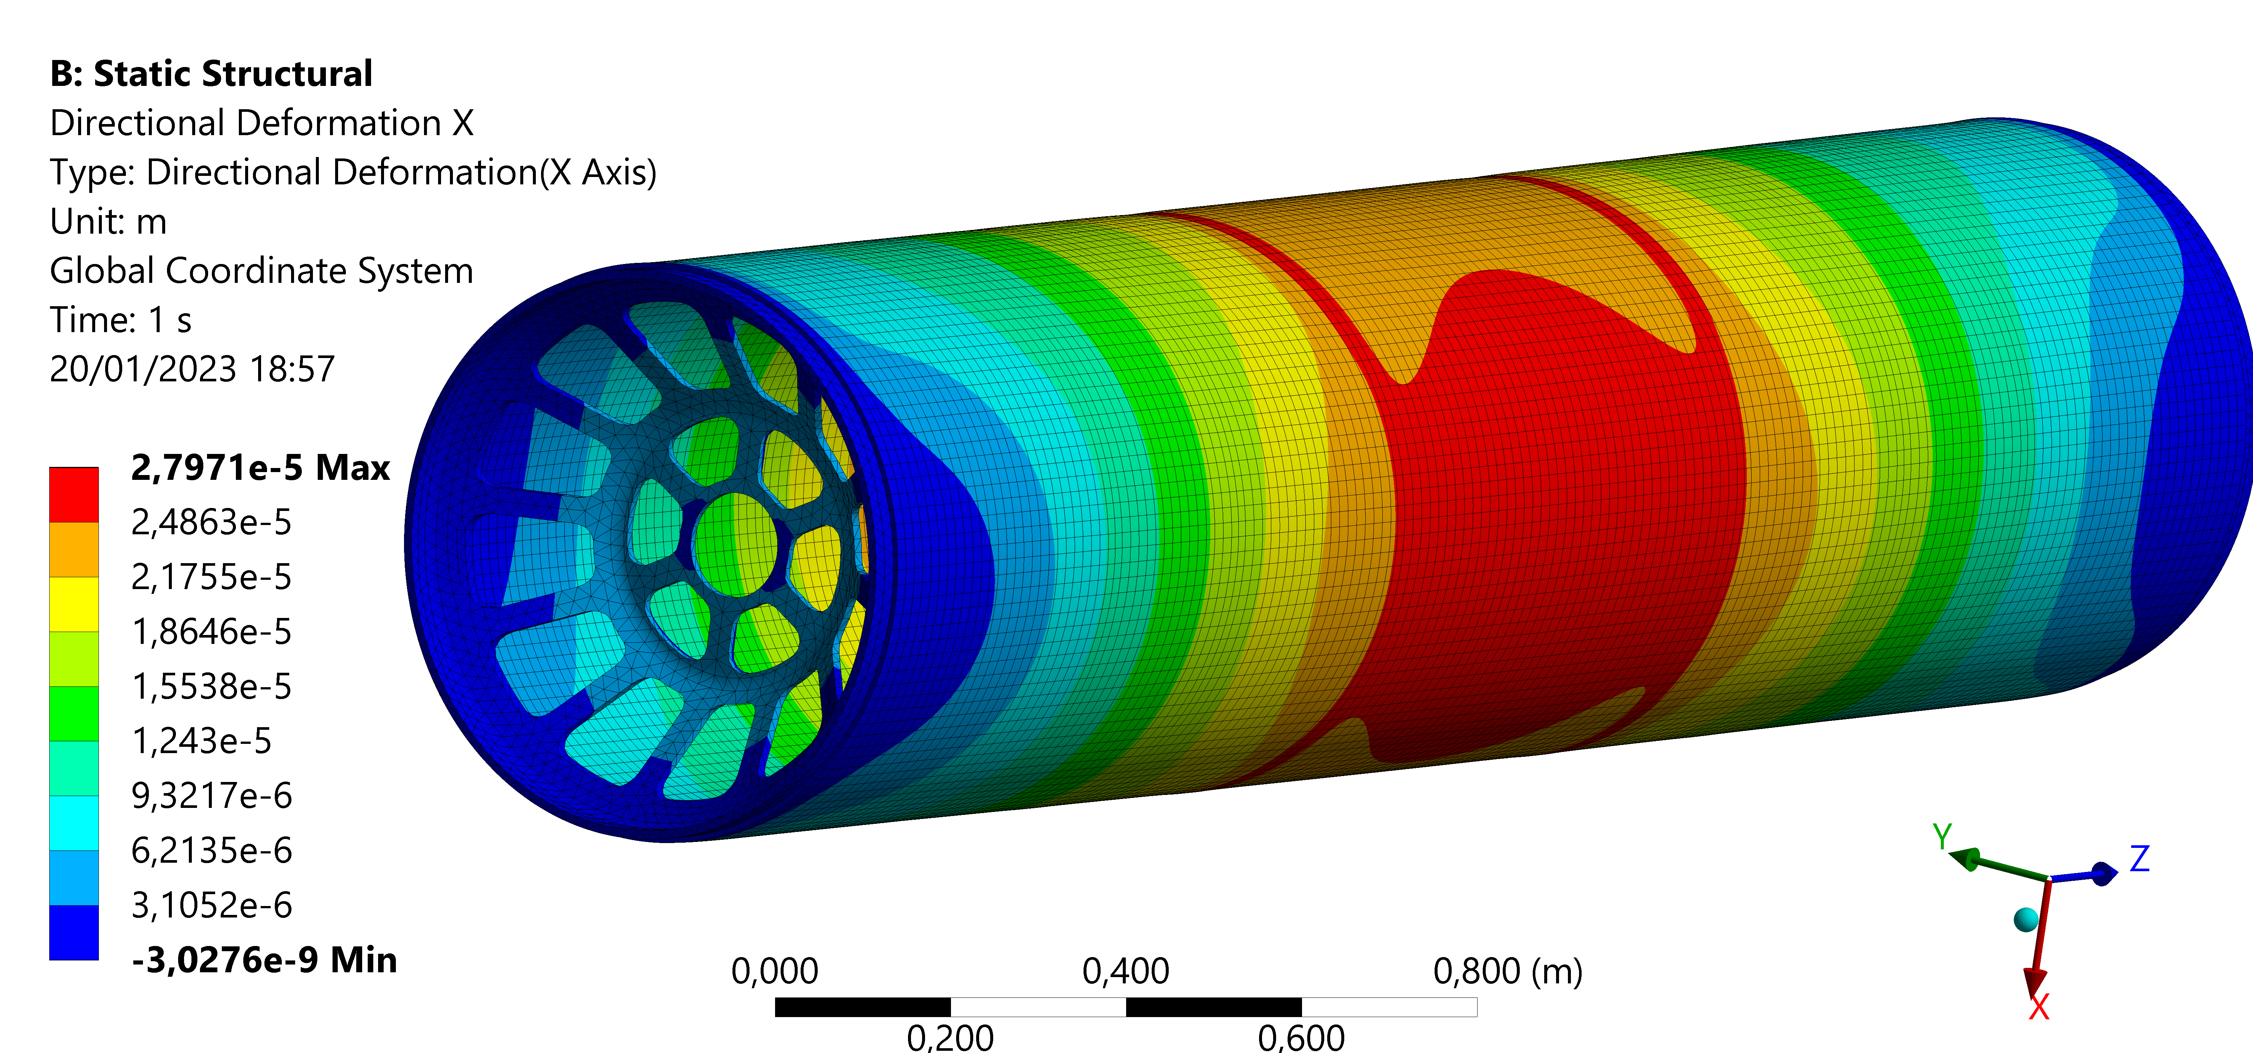
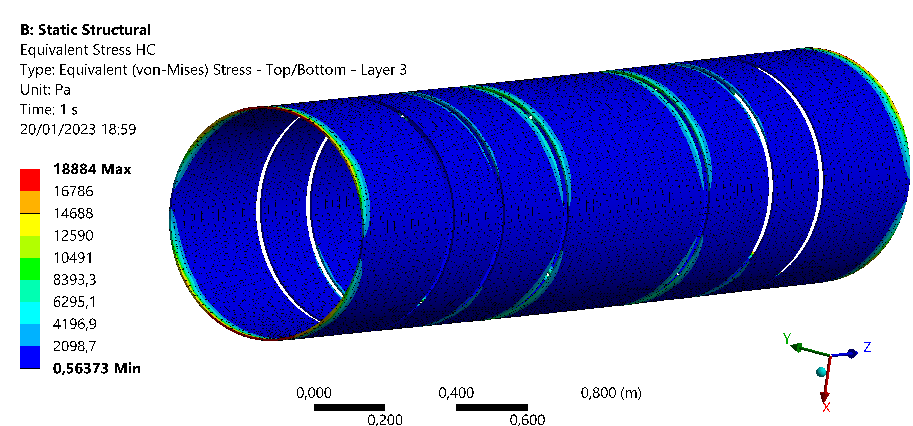
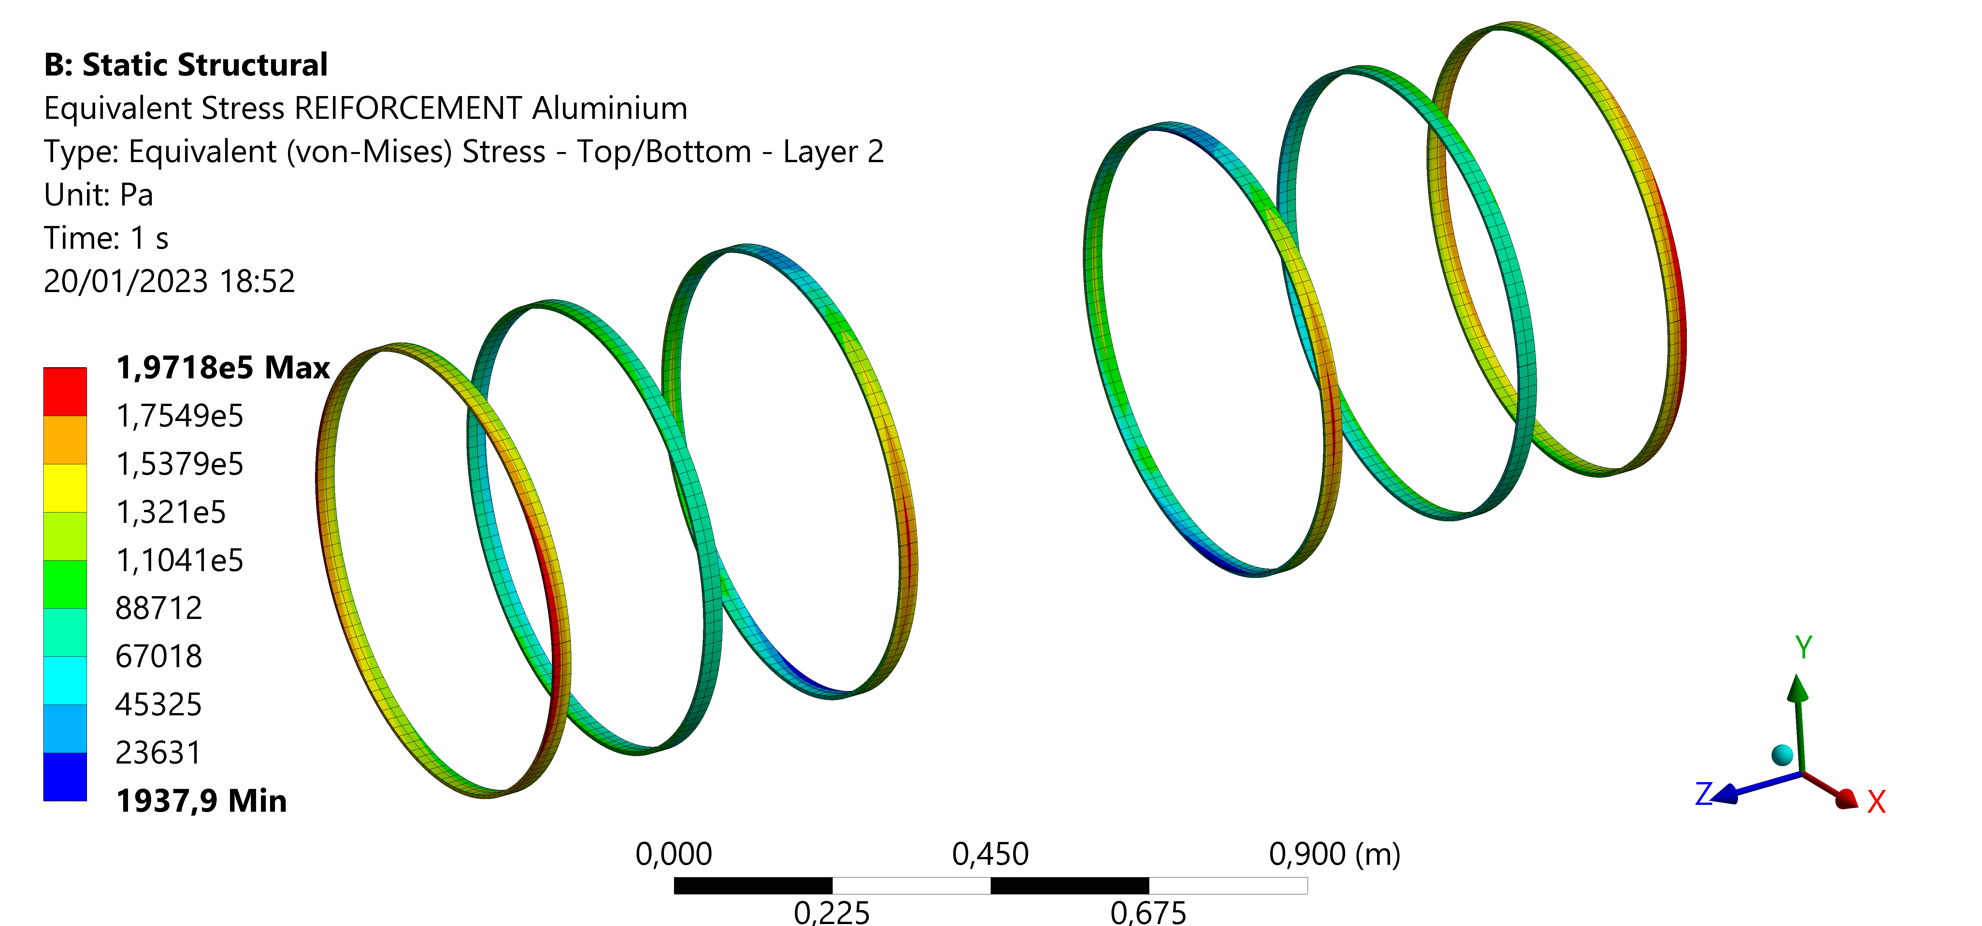
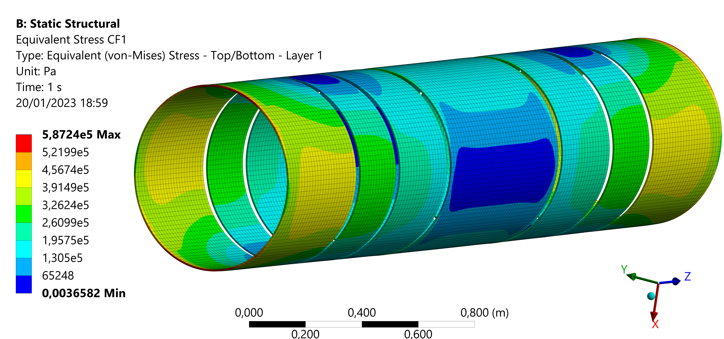
Support tube – Structural analysis – results
 | Maximum stress [MPa]
Aluminium flanges | 2.08
Aluminium ribs | 0.20
Honeycomb | 0.02
Carbon fiber | 0.60
 | Maximum displacement X [mm]
Aluminium flanges | 1.34 e-2
Aluminium ribs | 2.62 e-2
Composite | 2.80 e-2

Slide 18
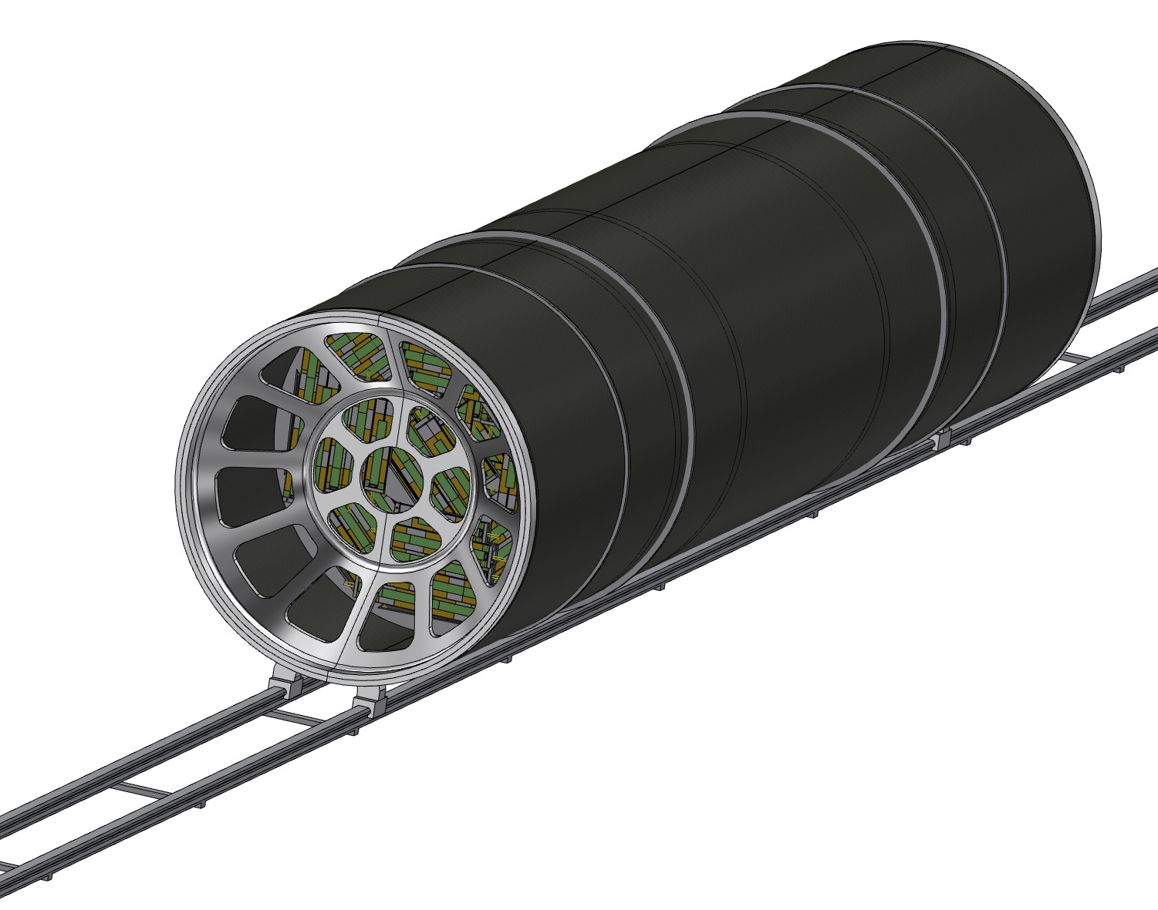
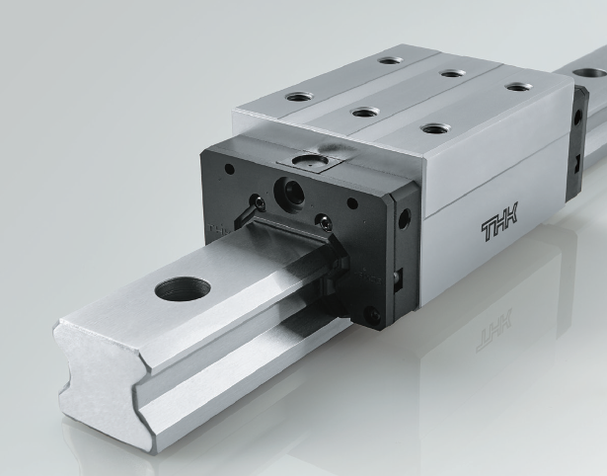
Support tube – Rail
SECTION
The support tube needs to be inserted into the main detector; the idea is to use a rail, starting from the outside of the detector to allow the sliding of the cylinder.
To assure a good precision and appropriate support it is necessary to use the linear bearings; different types are available, the choice has to be made considering:
Required positioning precision
Weight of the whole structure
Necessary degrees of freedom

Slide 19
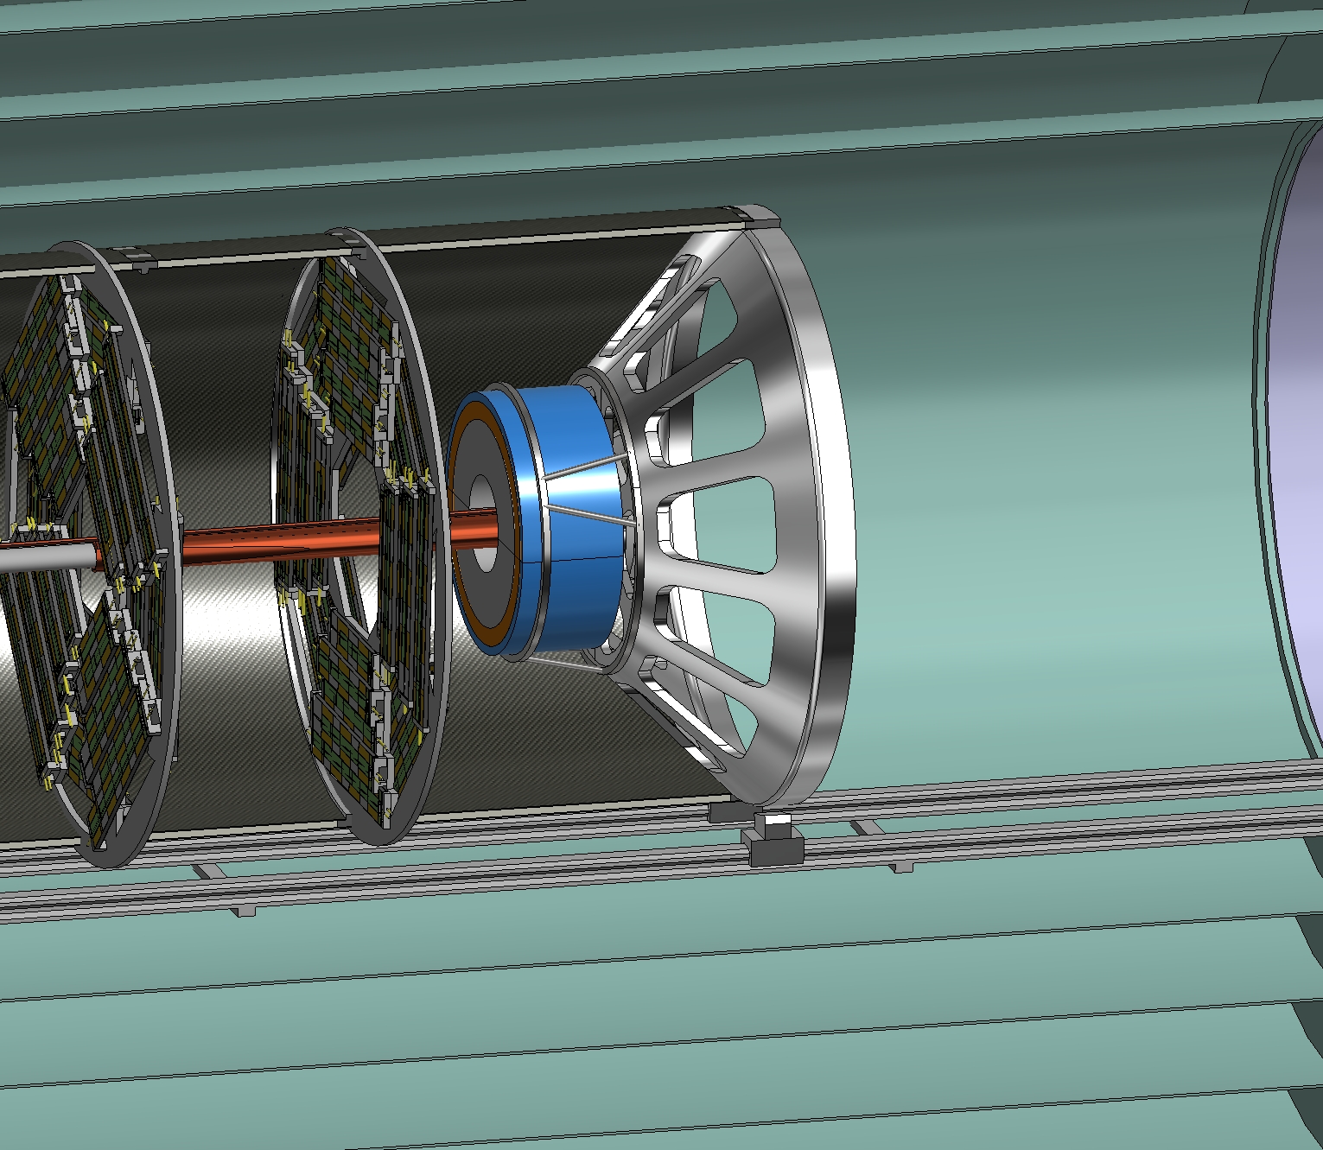
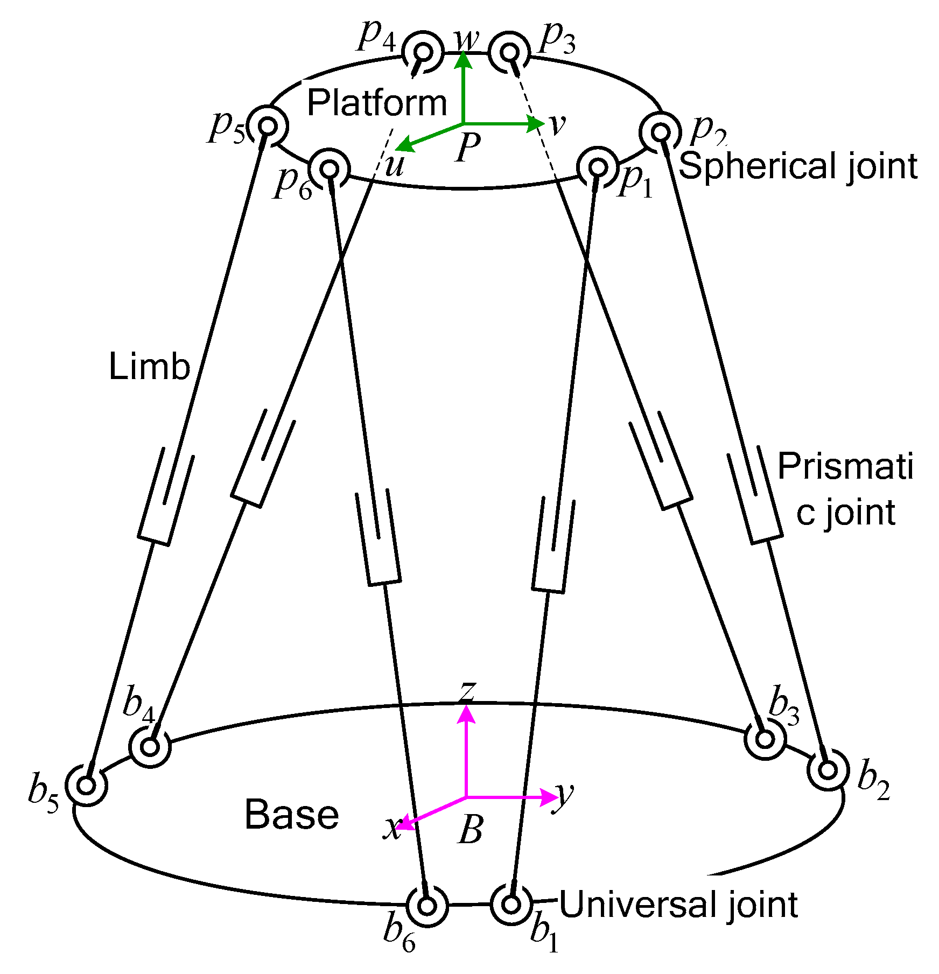
LumiCal – Support proposal
LumiCal are held by the two support tube endcaps.
A hexapod structure allows to limit the axial footprint.
Hexapod positioner has 6 DOF and high-precision positioning.
Actuators could be manual or automatic for a remote positioning.

Slide 20
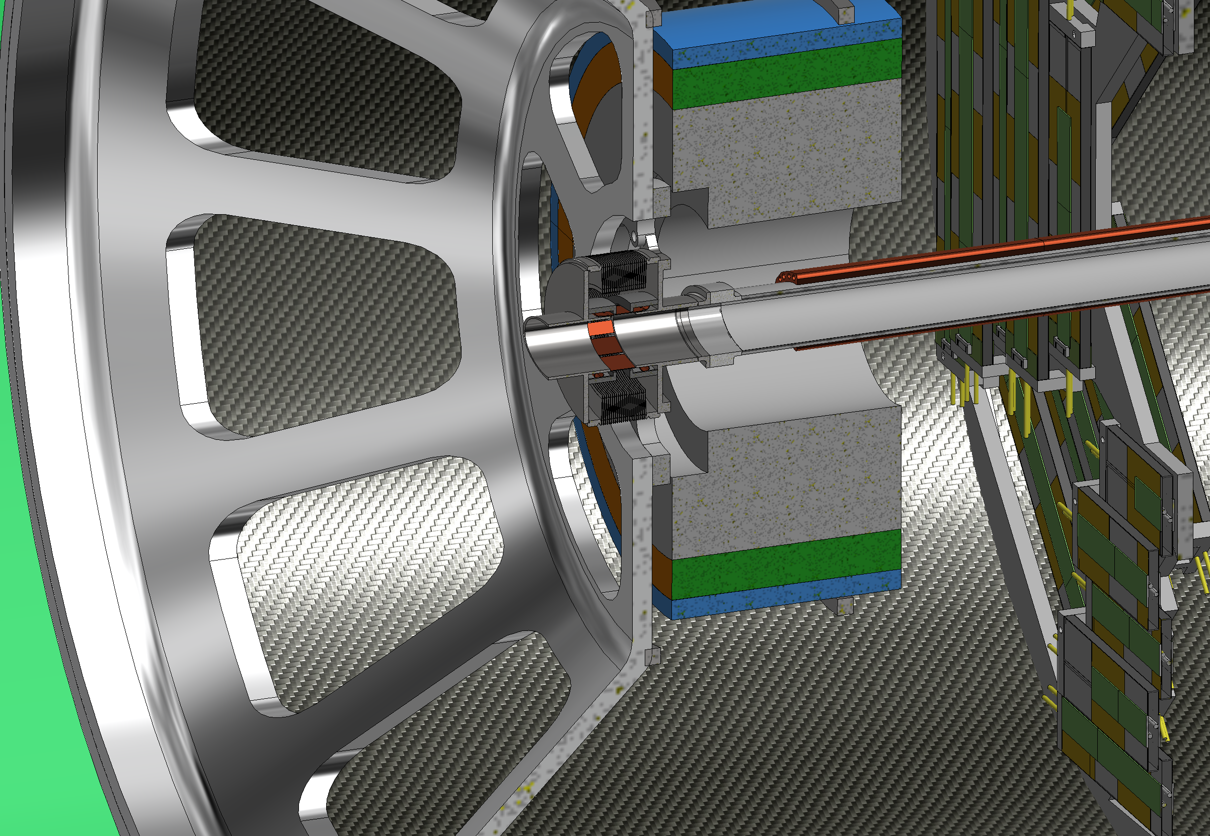
1st Bellows (Single bellows)
Anchoring flange to support tube
IP SIDE
CRYOSTAT SIDE

Slide 21
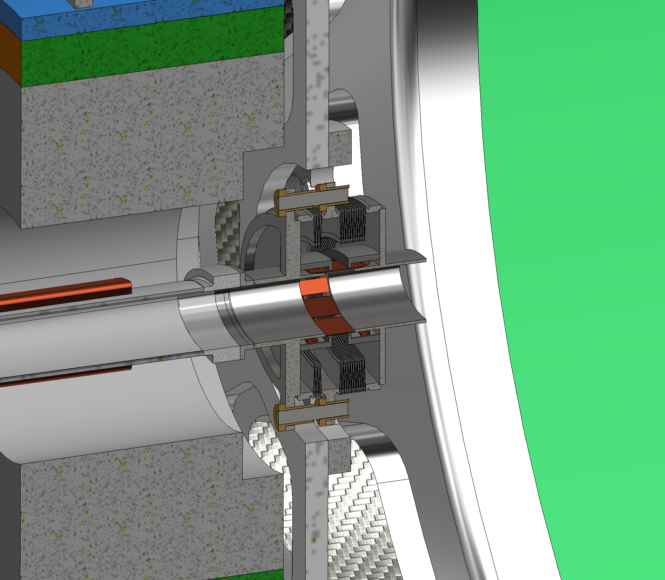
2nd Bellows (Double bellows)
Anchoring flange to support tube
Linear bearing system
Convolutions to compensate
Cryostat expansion and assembly
IP SIDE
CRYOSTAT SIDE
Few convolutions inside support tube for thermal expansion

Slide 22
Bellows – constraint configuration
The use of support tube is designed to avoid overloads on central chamber during assembly and operation (thermal expansion). This solution has been obtained using different kind of bellows for the two side of the support tube.
To understand the constraint configuration, it is useful to create a simplified schema with bellows, support tube and chamber.
Chamber
End cap
End cap
1st Bellows
(named single bellows)
2nd Bellows
(named double bellows)
IP
Support tube
In short, in this way we can:
Protect the central chamber during the assembly procedure
Support properly the chamber bellows-to-bellows, containing the deformation
Allow the thermal deformation without compromising the chamber

