Slide 1
A Computer Vision-based system for virtual dosimetry of workers in Nuclear Medicine Therapy
Giorgia Stendardo,
ISS grant-holder
ML@INFN | SAPIENZA UNIVERSITA’ DI ROMA| 6 MARZO 2023

Slide 2
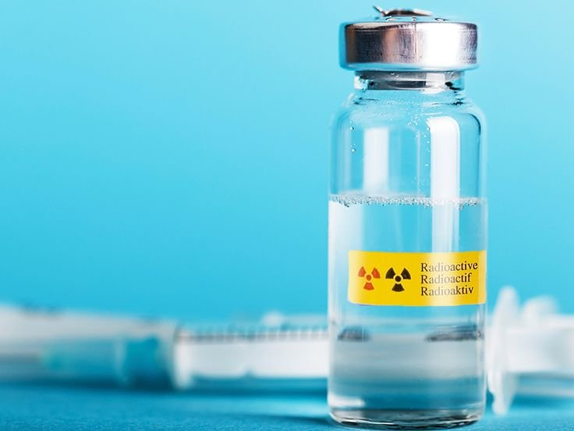
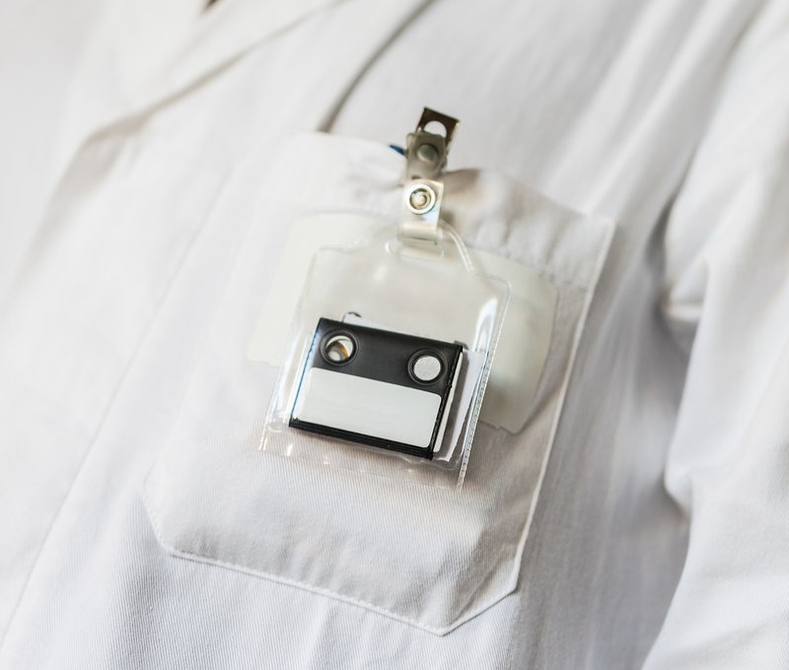
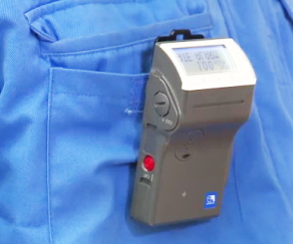
CONTEXT
Incidents and “near misses” in NMT may lead to unintended exposure of workers.
vomiting patient
fall of a radioiodine pill
spill from a syringe
PROBLEM
Personal passive dosimeters
only time-integrated dose!
Active dosimeters
uncomfortable and might be forgotten!

Slide 3
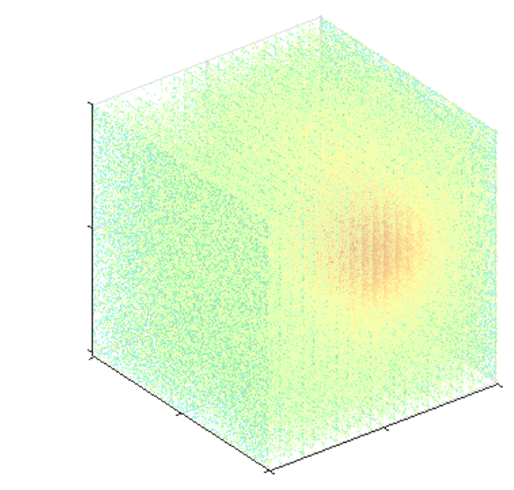
SOLUTION
Real-time tracking
of the body pose of workers with Computer Vision algorithms.
Virtual dosimetry
by integrating tracking and
ambient dosimeters data within
computed radiation field maps.

Slide 4
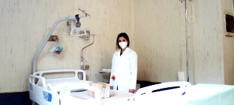
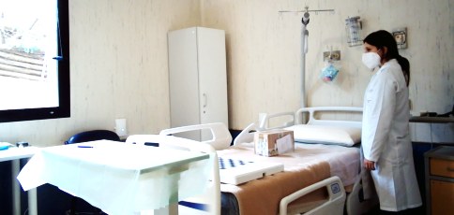
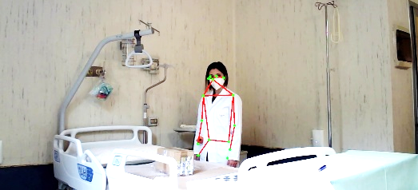
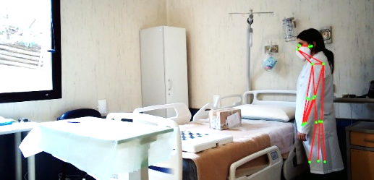
HOW DOES IT WORK?
Video capture from
2 RGB cameras
Detection of the human pose in each frame (2D)
Reconstruction of the 3D coordinates of the pose in the real world

Slide 5
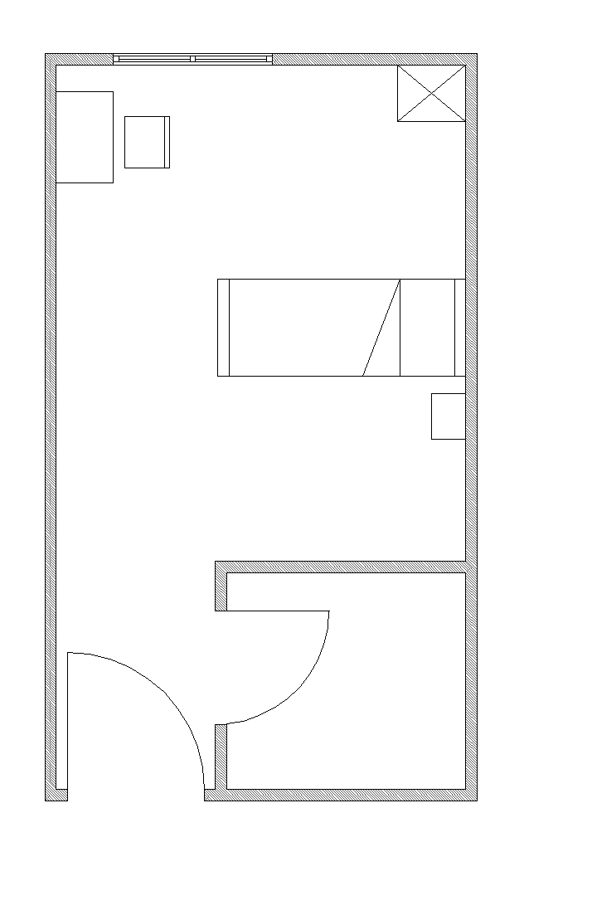
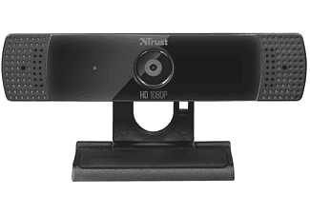
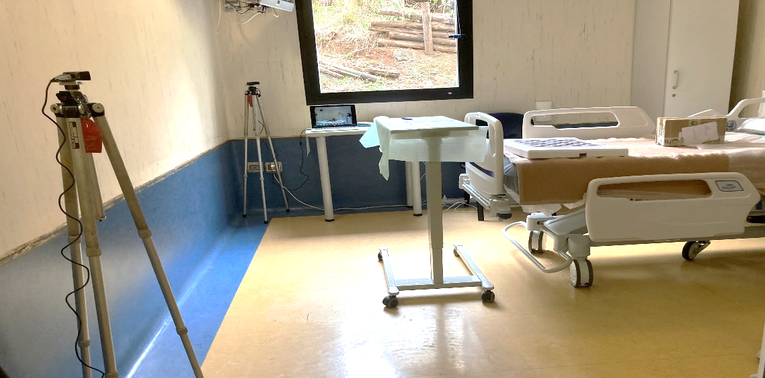
HOW DOES IT WORK?
Video capture from
2 RGB cameras
At least 2 cameras for stereo vision!
Detection of the human pose in each frame (2D)
Reconstruction of the 3D coordinates of the pose in the real world
High-resolution webcam (1080p)
NMT testing room (350x350)

Slide 6
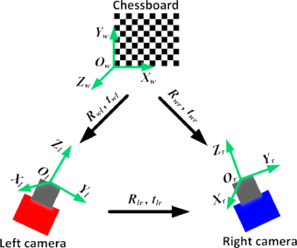
HOW DOES IT WORK?
Video capture from
2 RGB cameras
World coordinates
Camera Calibration &
Stereo Calibration
Detection of the human pose in each frame (2D)
Camera coordinates
Reconstruction of the 3D coordinates of the pose in the real world
Relative orientation

Slide 7
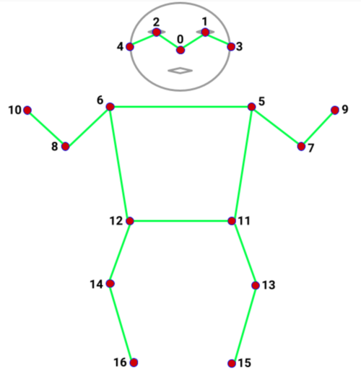
HOW DOES IT WORK?
Human Pose Estimation Algorithm
Video capture from
2 RGB cameras
0 nose
1 left eye
2 right eye
3 left ear
4 right ear
5 left shoulder
6 right shoulder
7 left elbow
8 right elbow
9 left wrist
10 right wrist
11 left hip
12 right hip
13 left knee
14 right knee
15 left ankle
16 right ankle
Google’s pre-trained convolutional neural network model: MoveNet.MultiPose.
Up to 6 people per frame and 17 keypoints per person detected.
Confidence score for each keypoint location (>70% for shoulders and eyes).
Detection of the human pose in each frame (2D)
Reconstruction of the 3D coordinates of the pose in the real world

Slide 8
HOW DOES IT WORK?
Video capture from
2 RGB cameras
Triangulation
using calibration parameters and left camera as world origin
Detection of the human pose in each frame (2D)
Mean position error 5%
Reconstruction of the 3D coordinates of the pose in the real world

Slide 9
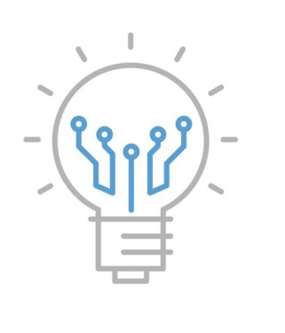
CHALLENGES
Occlusions &
Background objects
Camera position
Multiple people
MoveNet is optimized for:
distances between 2-4 mt from camera.
camera positioned at eye-level and parallel to the floor.
White coats: 10% error and confidence scores < 20% for wrists and knees.
Furniture (e.g. infusion pole) may be confused with a person.
Accuracy of MoveNet in scenes with more than 1 person is under evaluation.
Use of multiple cameras
Fine tuning the model with a training dataset of medical staff images

Slide 10
Tracking operators helps to better reconstruct abnormal events dynamics, by filling the gaps in incident reports of eyewitnesses.
Tracking the pose will enable a non-physical dosimetry, by means of ambient radiation detectors and Monte Carlo simulations of routine and incident scenarios.
TAKE HOME MESSAGE

Slide 11
Thank you!
This system is being developed within the “SIREN” project funded by INAIL (grant BRIC 2019) and is under testing at IFO and Policlinico di Milano.
giorgia.stendardo@iss.it

