Slide 1



An Advanced X-ray Spectromicroscopy of Bi₂Se₃ Ultrathin Films on SiO₂/Si Substrates
M. Azizinia, M. Salvato, M. Amati, L. Gregoratti, R. Parmar, S. J. Rezvani, P. Castrucci and R. Gunnella
High Precision X-Ray Measurements 2023 Conference
19-23 June 2023

Slide 2
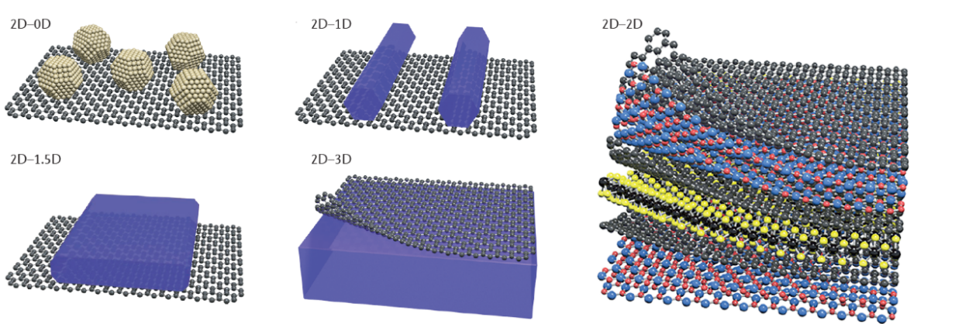
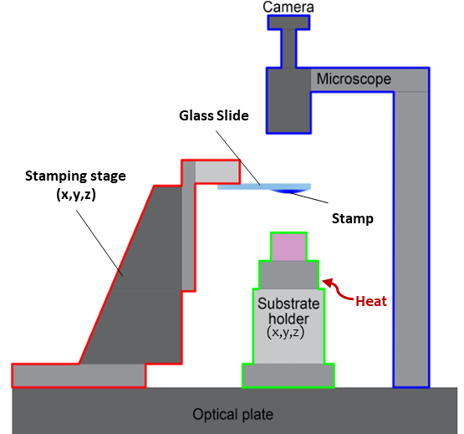
A Brief Introduction
VdW Heterostructures
The use of van der Waals force to assemble low-dimensional materials.
Structures made by stacking different nanomaterials on top of each other (multiple heterojunctions together).
Fabricated by incorporation of (at least) two distinctive nanomaterials.
Possess merged properties superior to those of the individual counterparts.
2D-2D
Heterostructures
Fabrication of heterostructures based on the artificial stacking of 2D materials
PDMS and Pick-up transfer methods
Polydimethylsiloxane (PDMS)
Polypropylene carbonate (PPC)
→ All-dry, since no chemical/water is in contact with the flakes.
Liu, Yuan et al., Nature Reviews Materials 1.9 (2016): 1-17.
Martanov, et al., Nanomaterials 10.11 (2020): 2305.

Slide 3
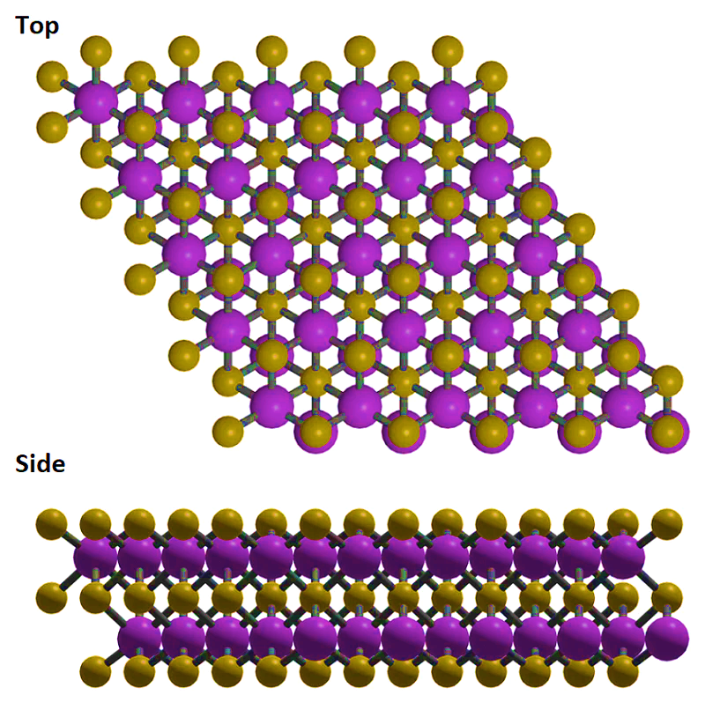
Bismuth Selenide (Bi₂Se₃)
Layered structure (alternating Bi and Se in the sequence of Se-Bi-Se-Bi-Se) in which five atomic layers are covalently bonded → Quintuple (QL).
Van der Waals interactions between QLs.
Bi₂Se₃ is known to be a strong 3D topological insulator:
Se
Bi
Its bulk is insulating
Conducting surface states (symmetry protected)→ Prevented charge backscattering
1QL
Application in optoelectronic and/or opto-spintronic devices based on Si
Broadband photo detection (ultraviolet (UV) to infrared (IR))
Small band gap (ca. 0.3 eV)
Se vacancies are the most abundant intrinsic defects in Bi₂Se₃ → n-type defects → Fermi level crossing the conduction band
Almost in all the cases reposted, the correct stoichiometry is not achieved.
Image taken from: https://www.ossila.com

Slide 4
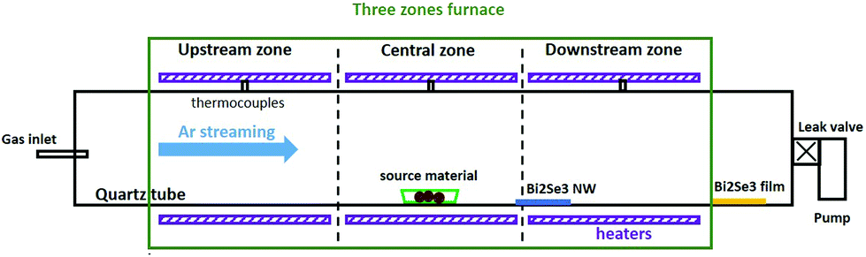
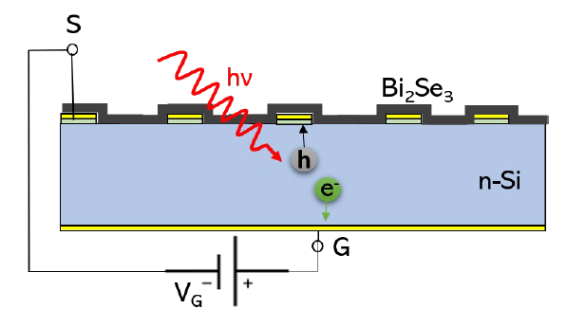
Our Samples
A method by Salvato et al. in 2020.
A two-step physical vapor deposition (PVD) procedure:
1) Deposition of Bi₂Se₃ nanowires/nanobelts inside a quartz tube,
2) re-evaporating the Bi₂Se₃, stuck on the inner surface of the quartz tube (plus some pure Se).
The nanofilms with different thicknesses are deposited on various substrates including glass, Si-Pt and Si-Au substrates (for optoelectronic device applications) and to be specific single photon detectors
It is expected that the samples achieved correct stoichiometry.
SiO₂
Pt
Active window
n-Si
Cr
Far Downstream Region
Salvato, Matteo, et al. Nanoscale 12.23 (2020): 12405-12415.

Slide 5

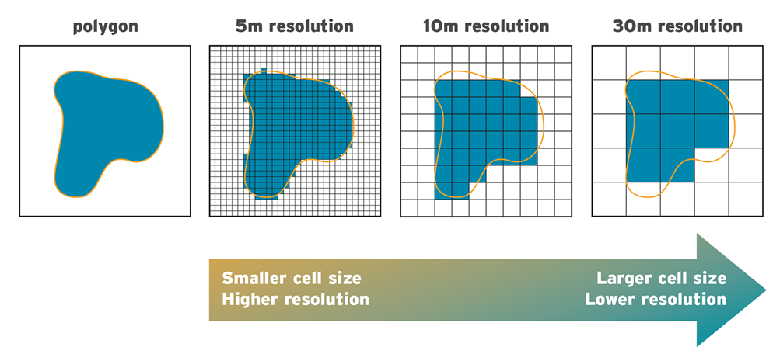
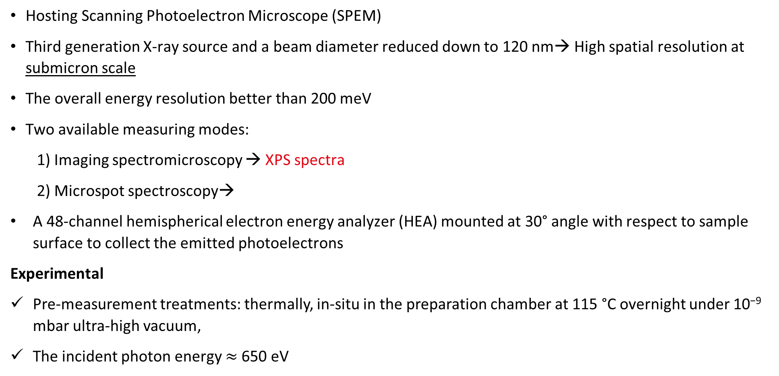
ESCA Microscopy Beamline
Hosting Scanning Photoelectron Microscope (SPEM)
Third generation X-ray source and a beam diameter reduced down to 120 nm→ High spatial resolution at submicron scale
The overall energy resolution better than 200 meV
Two available measuring modes:
1) Imaging spectromicroscopy → XPS spectra
2) Microspot spectroscopy→
A 48-channel hemispherical electron energy analyzer (HEA) mounted at 30° angle with respect to sample surface to collect the emitted photoelectrons
Experimental
Pre-measurement treatments: thermally, in-situ in the preparation chamber at 115 °C overnight under 10⁻⁹ mbar ultra-high vacuum,
The incident photon energy $≈$650 eV
Elemental/or chemical distribution maps of the sample surface
Image taken from: https://www.jbarisk.com

Slide 6
Broad Spectra of the Bi₂Se₃ Films
Presence of Si 2s in sample B, as well as, higher Si 2p and O 1s peak→ The film thickness is different and/or the film on B is not continues
Estimated thickness of the sample A = about 2 nm (i.e. 2QL) due to presence of the Si 2p feature;
Different Bi/Se ratios → Different stoichiometry
Undesired components C 1s and O 1s → due to exposure to air
No other evidence of possible contamination

Slide 7
More Detailed Spectra
Intensity (counts/s)
Binding Energy (eV)
In a general view:
Dissimilarities in Bi 4f core level photoemissions
Resemblance in overall characteristics of the Se 3d core level emissions
A higher intensity of the Bi-O peak in samples A
Larger Si-O component of sample B, indicating a stronger interaction with the Silicon region underneath→ thinner and less uniform nature of the film .

Slide 8
SPEM Images
a) Bi 4f and b) Se 3d SPEM images (peak/background, i.e., Chemical
Mapping) of sample A:
Bi and Se are almost homogeneously distributed on the Si oxide substrate
Se atoms are the first sticking on the Si oxide surface.
c) Bi 4f and d) Se 3d SPEM images of sample B:
Bi atoms are present only in certain areas, while Se atoms are distributed quite homogeneously.

Slide 9
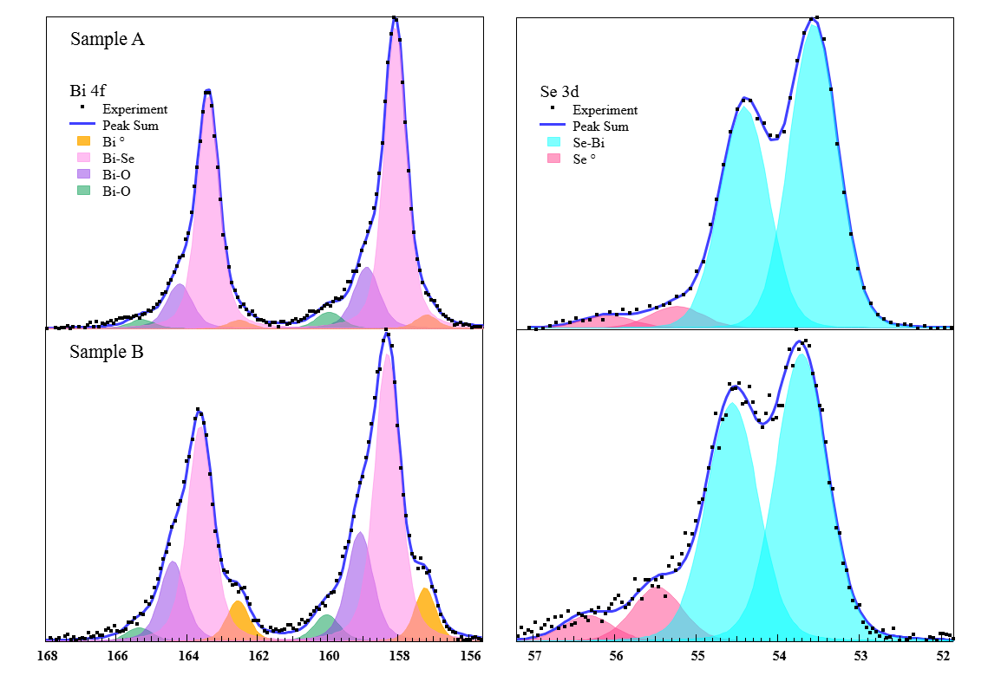
Fitted Peaks and Stoichiometry
Bi 4f 7/2
 | Sample A |  | Sample B
Peak | Center | FWHM | Center | FWHM
Bi ⁰ | 157.21 | 0.73 | 157.23 | 0.72
Bi-Se | 158.09 | 0.75 | 158.30 | 0.75
Bi-O | 158.91 | 0.86 | 159.08 | 0.86
Bi-O | 159.97 | 0.86 | 160.02 | 0.86
Intensity (counts/s)
Se 3d 5/2
 | Sample A |  | Sample B
Peak | Center | FWHM | Center | FWHM
Se-Bi | 157.21 | 0.73 | 157.23 | 0.72
Se ⁰ | 158.09 | 0.75 | 158.30 | 0.75
Stoichiometric Ratios X(Bi)/X(Se)
Sample A | Sample B
0.65 ± 0.02 | 0.54 ± 0.02
Binding Energy (eV)
Sample A: mainly Bi₂Se₃, a small percentage of Bi-O and an extremely low presence of Bi ⁰ and Se ⁰
Sample B: larger percentages of Bi⁰ and Bi oxide and a well higher percentage of Se ⁰
Binding energies are comparable with those reported in literature → no charge transfer at the interface with Si oxide surface, which should have been clearly detected for such an ultrathin Bi₂Se₃ film.

Slide 10
Conclusion
Confirming the ability of this two-step PVD growth technique to produce stoichiometric Bi₂Se₃ films
No serious contamination
No charge transfer has been detected between the substrate surface and the Bi or Se atoms
Note: a small fraction of the bismuth oxide formation is due to the interaction of the Bi₂Se₃ film with environment and substrate
Importance of the position of the substrate inside the quartz tube
Fermi level correctly positioned in the middle of the bulk bandgap as for topological semi conductors
Next…
Building up heterojunctions using Bi₂Se₃ and different 2D materials e.g. graphene
Exploring the interaction between topology and magnetism by Bi₂Se₃/ CrCl₃→ Generation of various novel topological quantum states.
Investigating the interplay between topological insulators and superconductors by Bi₂Se₃/ NbSe₂ junctions

