Slide 1
19/06/2023 : Welcome to LNF and to Frascati

Slide 2
48 participants & 38 contributions
100 participants & 52 contributions
(online)
72 participants & 60 contributions

Slide 3
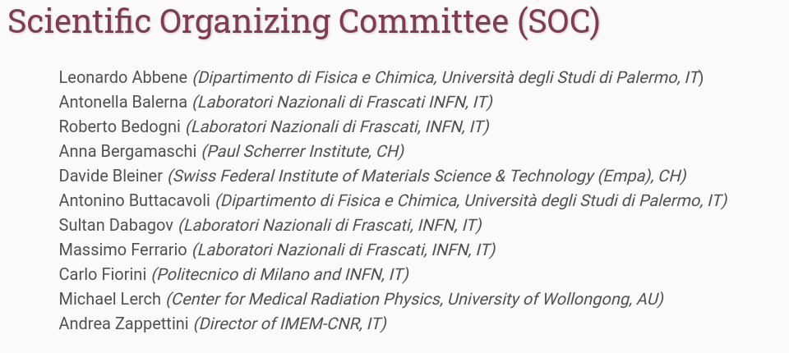
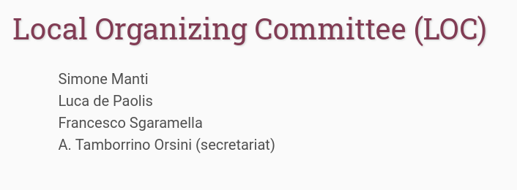

Slide 4
Special thanks to our main and historical sponsors Optigraph
World leaders in HAPG/HOPG production
Posters at coffee break’s desk

Slide 5
Special thanks also to MDPI – Condensed Matter
Full Open Access publication with no Fee & Best Young Researchers’ presentations award

Slide 6
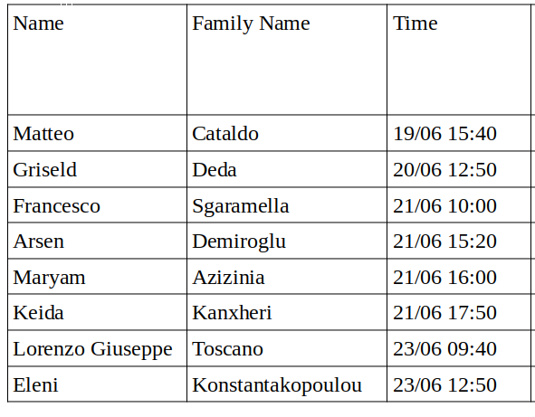
Best Young Researchers’ presentations award
Evaluated on
- quality of the research
- oral presentation
- slides

Slide 7
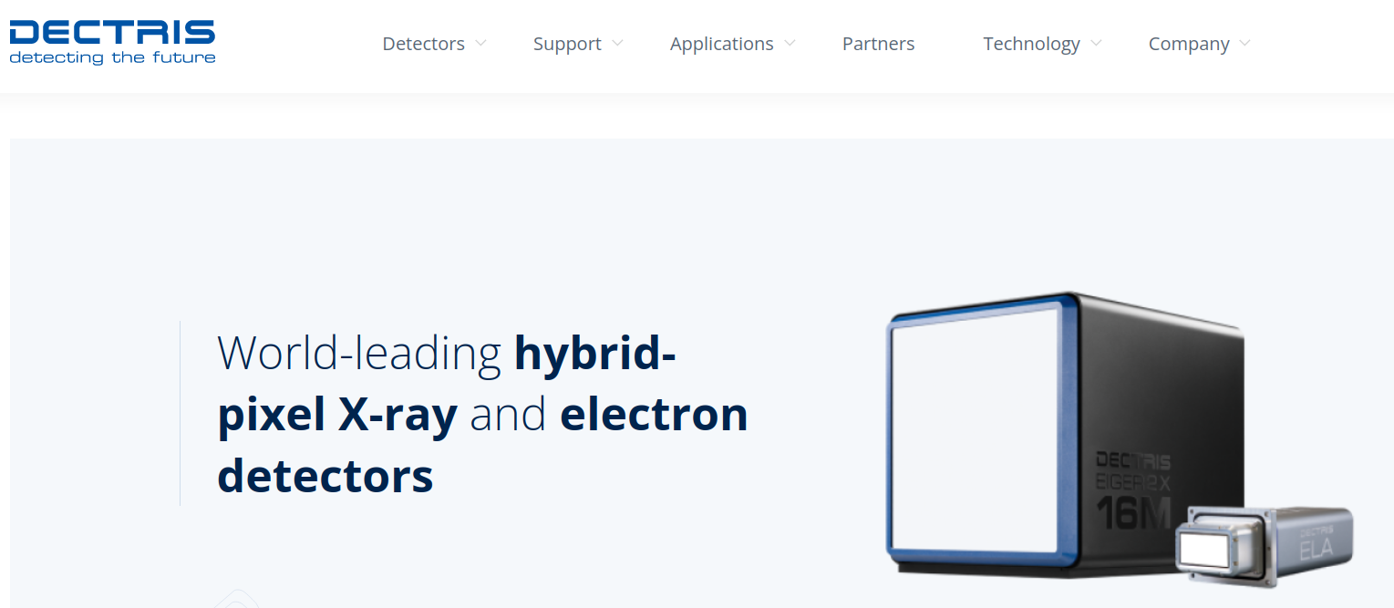
Special thanks the other historical sponsor Dectris
Posters at coffee break’s desk

Slide 8
Special thanks also to CAEN and TESFLUID
Dedicated stands during the conference
Feel free to discuss and interact

Slide 9
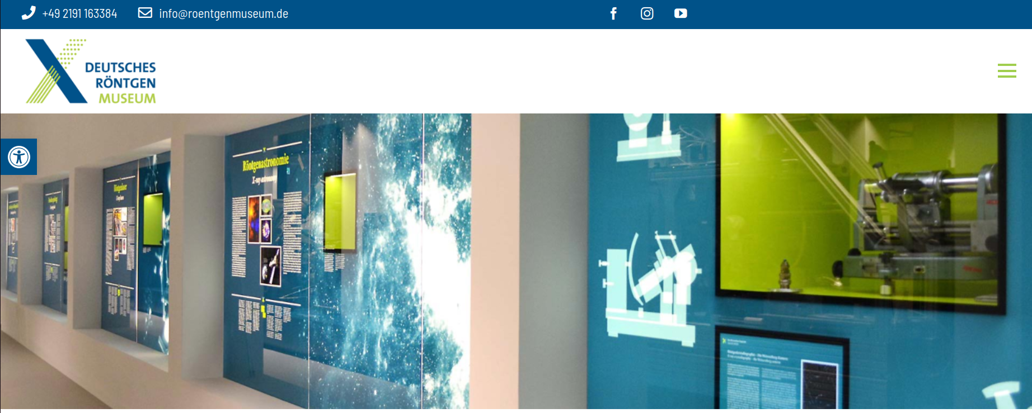
Opening Lectures by Anna-Katharina Kätker (German Röntgen Museum)
19/06/2023, 09:50 - Wilhelm Conrad Roentgen - The discovery of X-rays and the creation of a new medical profession
20/06/2023, 09:30 - Claims of Priority - The scientific path to the discovery of X-rays

Slide 10
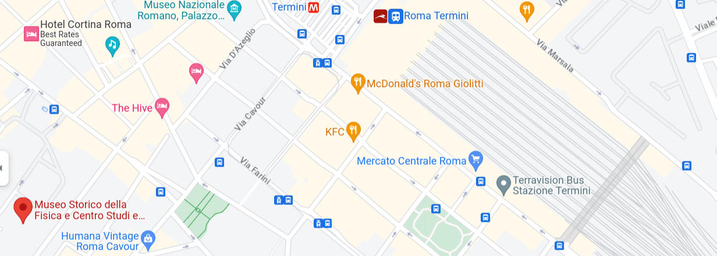
Thursday 22/06/2023
Visit to
Centro Ricerche Enrico Fermi
Starting from LNF @ 15:00
(Train + 15 min. walk)
Visit: 16:30 – 18:00

Slide 11
Visit to EuPRAXIA – related facilities & laboratories
F. Villa (LNF)
20/06/2023 17:45
Visit to DAFNE-Light facilities & laboratories
A. Balerna (LNF)
21/06/2023 18:00

Slide 12
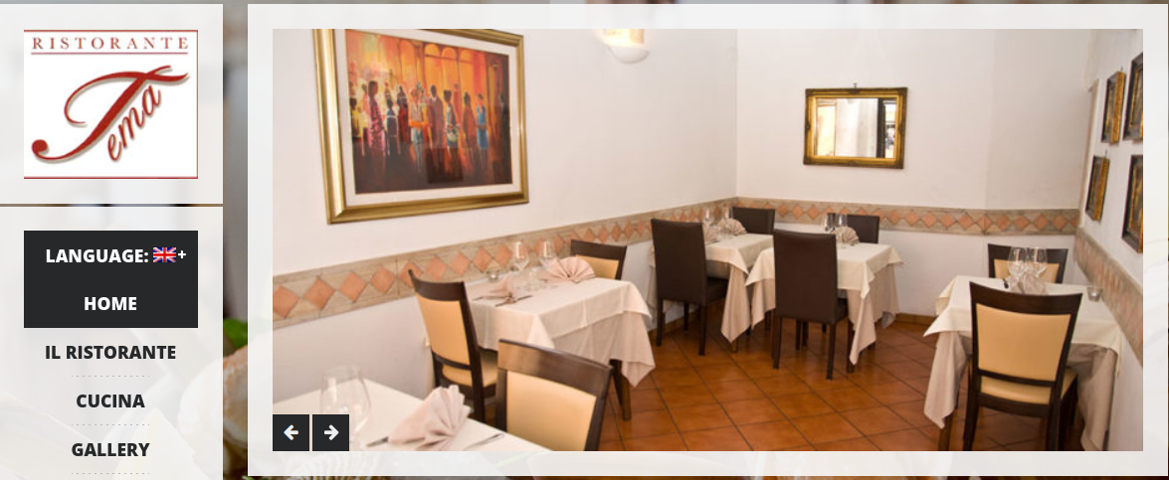
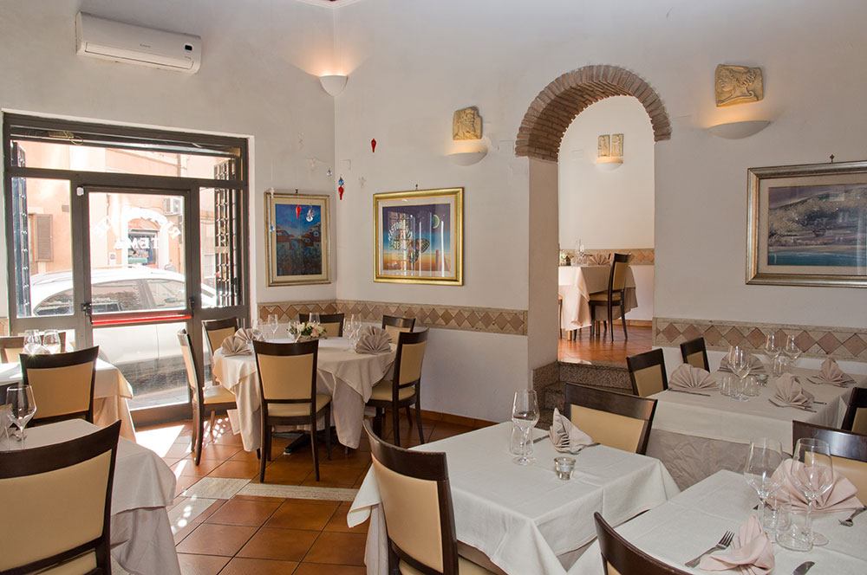
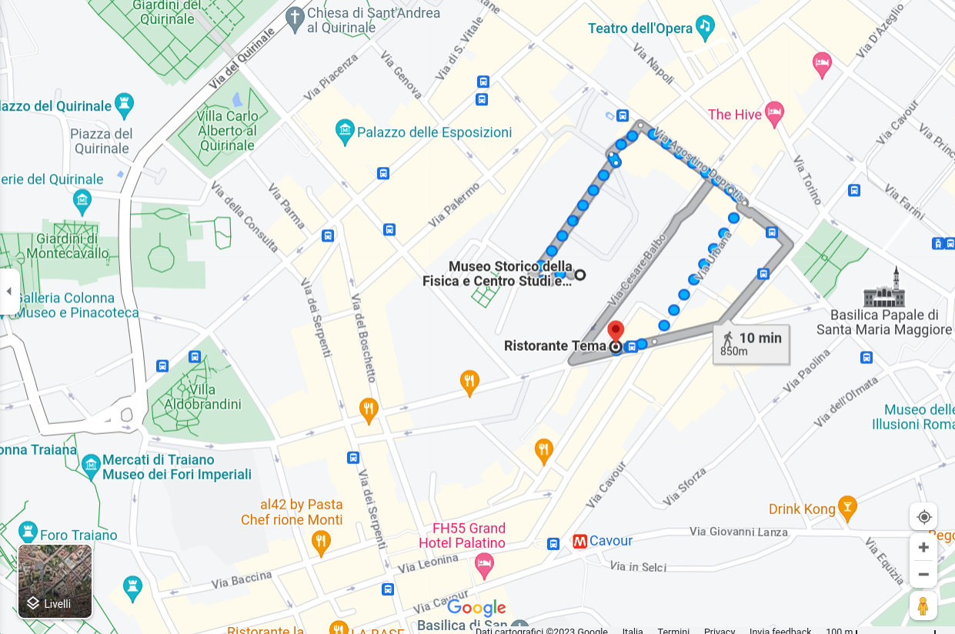
Social dinner will be at Restaurant TEMA
15 min. walking from CREF
Start 19:30
Free time after visit to CREF
A bus will leave at 22:30 to go back to LNF and Frascati

Slide 13
Some logistic information
- Several contributions → Tight schedule → please be in time (chairs...)!!!
- Coffee breaks will be in front of Aula Touschek
- Secondary gate will be open every day based on HPXM2023 program
- Lunches will be at LNF Canteen NOT BEFORE 13:30
- Please put your slides online and on the pc before the starting of your session

Slide 14
Most special thanks
The most special and important thanks are to our colleague Maurizio Chiti
For all his support, help, advice, professionality, and courteousness since my first days at LNF
Without his support, VOXES would not have been successful and HPXM conferences would not exist

Slide 15
Enjoy the conference!!!

