Slide 1
3D CZT spectro-imagers for hard X and soft γ-ray astronomy: development status and preliminary results from a stratospheric balloon flight
Laboratori Nazionali di Frascati 19-23 June 2023 @ Frascati, Italy
S. DEL SORDO, C. Gargano - INAF/IASF Palermo, Italy
E. CAROLI, N. AURICCHIO, J. B. STEPHEN - INAF/OAS Bologna, Italy
A. ZAPPETTINI, M. Bettelli - CNR/IMEM Parma, Italy
L. ABBENE, F. PRINCIPATO, A. Buttacavoli - Dept of Physics and Chemistry, PALERMO University, Italy
G. BENASSI, N. ZAMBELLI, S. ZanettiNI - Due2Lab S.r.l., scandiano, Italy

Slide 2
Topics
The need of a new generation of high performance detectors for the next generation of hard X and soft γ-rays astronomy telescopes
Development of a new 3D CZT spectro-imager detector
Overview of the BADG3R payload for a stratospheric balloon mission
The launch campaign
Summary and future developments

Slide 3
Main drivers for next decades instruments for hard X and soft γ-rays astronomy telescopes
Detectors to cover a large energy band (up to several hundreds of keV) with high performance in term of efficiency, spectroscopy, imaging, timing as well as polarimetry capabilities. Moreover the recent launch of the IXPE satellite makes even more urgent the realization of high energy polarimeters (> 100 keV)
High modularity and compactness to be used in a large variety of satellite class (from medium to micro satellite) in different mission scenarios (e.g. single or cluster type)
To be used in the focal plane of narrow field telescopes implementing new high energy focussing optics (such as broad-band Laue lenses) or to be used for a wide field instrument observing a large fraction of the sky like e.g. Advanced Compton Telescope (ACT)

Slide 4
Spectro-imager sensors requirements
High detection efficiency (>80% at 500 keV) achievable with high Z materials with increased thickness
Fine spectral resolution (1% FWHM at 511 keV) achievable with small volume charge collection
Fine spatial resolution (<0.5 mm) achievable with high segmentation
Fine timing resolution (<1 µs) for pile up and background reduction
Scattering polarimetry capabilities above 80/100 keV
Small size to minimize the environmental and instrumental background
Operating at room temperature

Slide 5
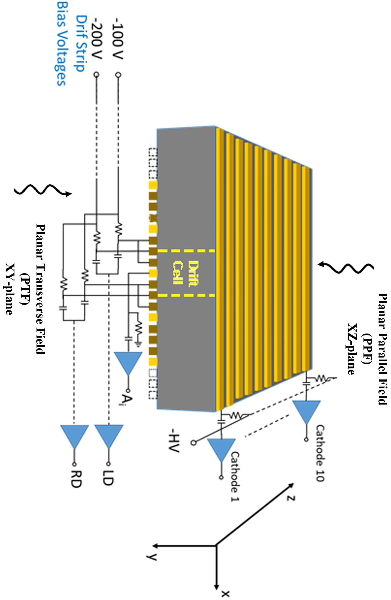
3D CZT PTF basic unit
Planar Transverse Field (PTF) plane
Planar Transverse Field (PTF) irradiation allow to increase the thickness (i.e. efficiency) for photon absorption up to 40 mm
Anode with a drift strip configuration and cathode strips orthogonal to the anodes allow to obtain high spatial resolution with reduced number of readout channels
The drift strips are negatively biased by a voltage divider, whereas the anode strips are held at ground
Digital Pulse Processing (DPP) of readout signals will allow to reconstruct the 3D position of the photon interaction to be used also for energy correction.
A large flexibility to different operative condition without requiring hardware changes

Slide 6
The 3D CZT sensor
Anodes side Cathodes side
The 3D CZT unit mounted on a support with the I/F for the AFEE board
3D CZT detector, realized at IMEM-CNR (Parma, Italy) in collaboration with Due2Lab company (Scandiano, Italy)
Redlen Tech. (BC, Canada) spectroscopic graded CZT crystal: 19.6x19.6x6 mm³
Anode: 48 strips 0.15 mm width and 0.25 mm gap (12 anode strips + 36 drift strip, 3 drift strips between each collecting anode couple)
Cathode: 10 strips 1.9 mm width and 0.1 mm gap
A new passivation method developed by CNR/IMEM (Italy) allows a factor 10 reduction of the leakage currents between anodes and drift strips with respect to other passivation techniques

Slide 7
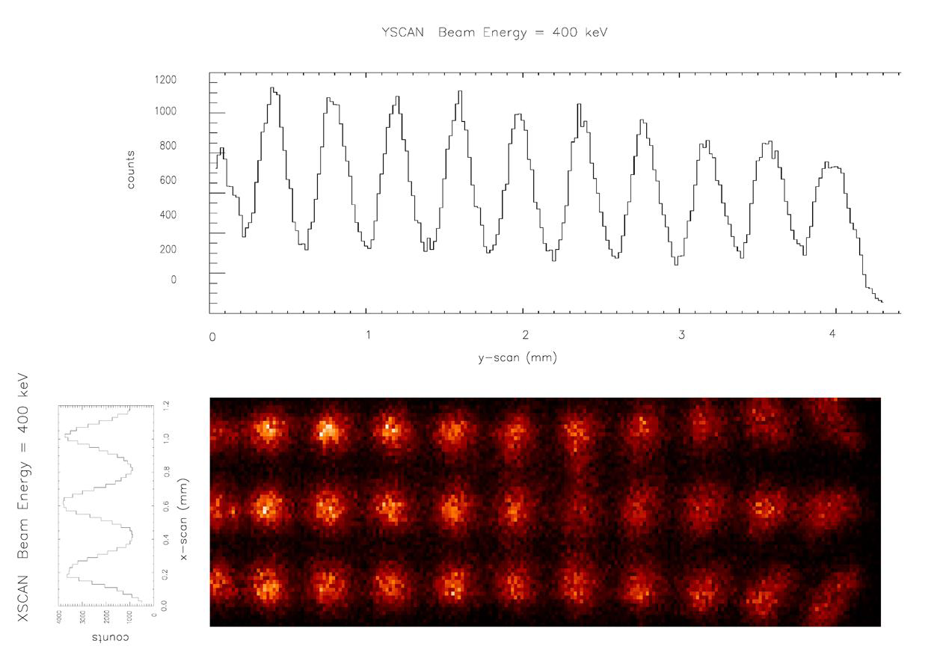
The Digital Pulse Processing
An innovative readout approach: Digital Pulse Processing (DPP)
The detector output signals, after the CSP amplifier are sampled, digitized and processed in real time with custom fully digital algorithms. Original information on the event that generated the signal is preserved, thus allow to discriminate different type of particles from the signal features
This device will be equipped by fast digitizers (125 MHz, 16 bits ADC) and an open FPGA (Xlinx) system able to handle 64 channels with a power consumption of 30 Watt.
The 3D CZT unit: spatial resolution
Tests at laboratory and at the European Synchrotron Radiation Facility (ESRF) demonstrated that a 3D CZT sensor (20x20x5 mm³) can achieve both fine energy resolution and 3D imaging capability. New measurements are foreseen in the next fall.

Slide 8
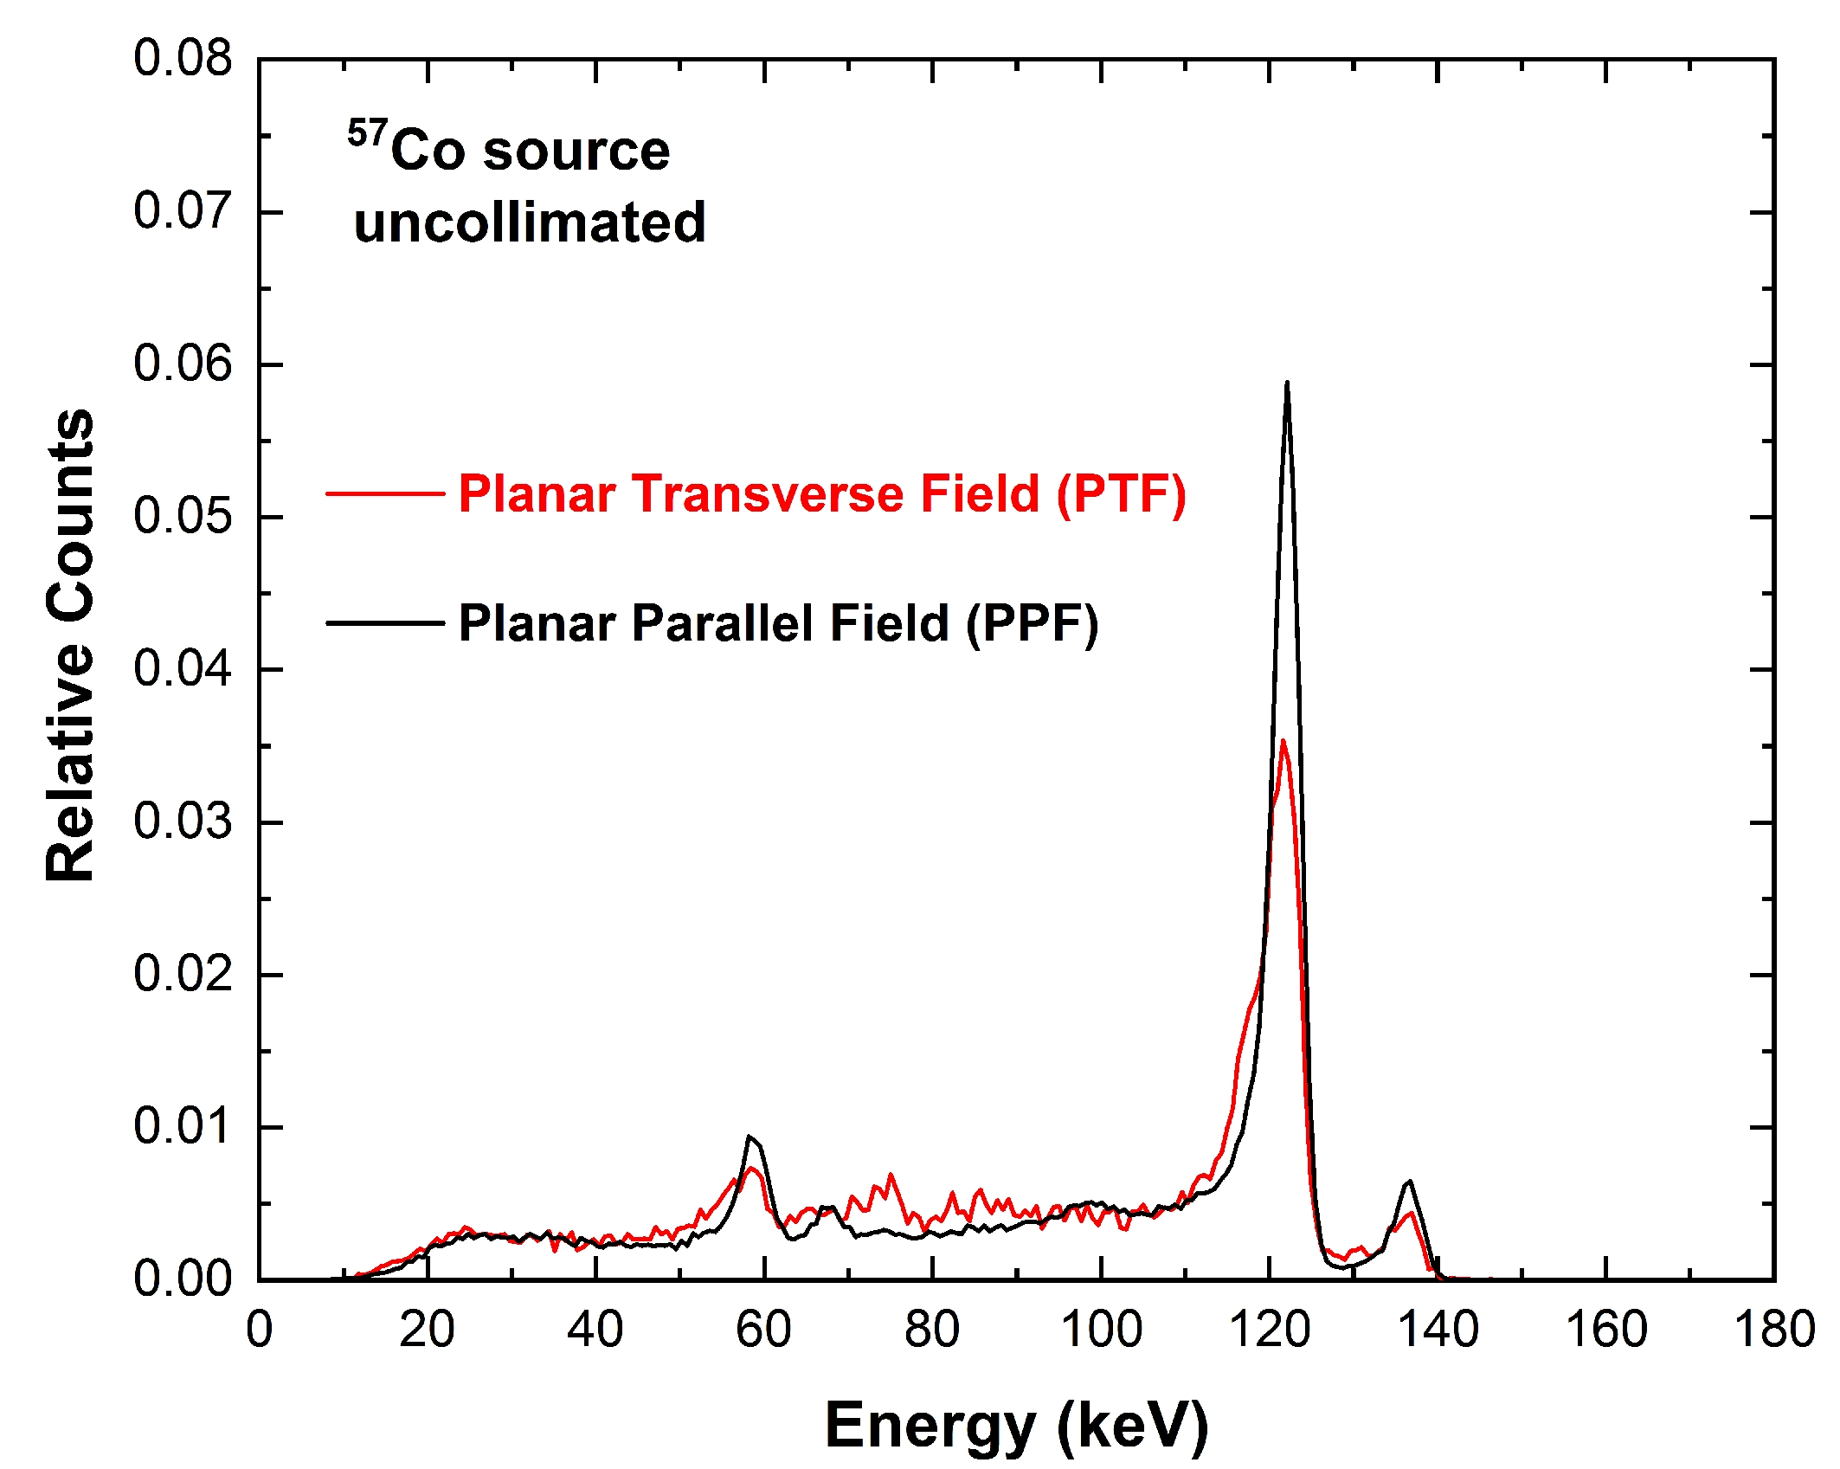
The 3D CZT unit: spectral resolution
Good spectroscopic performance with the digital approach, even without correction by using the 3D position photon interaction knowledge (FWHM): 4.9% at 122keV, 1% at 662 keV

Slide 9
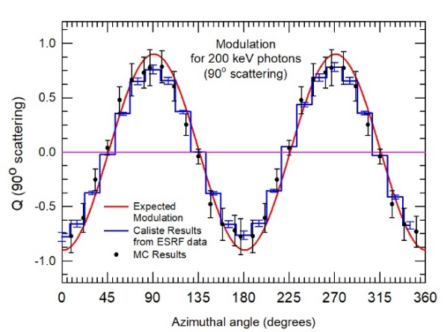
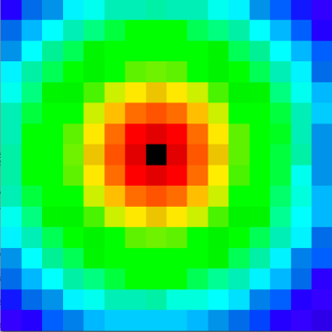
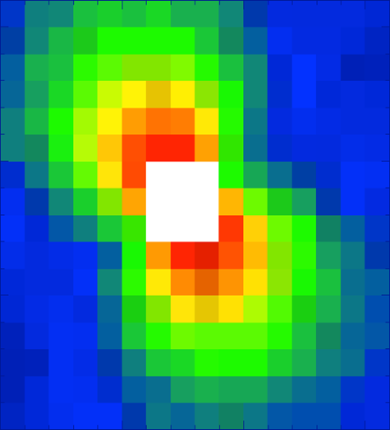
The 3D CZT: high energy polarimetry
Scattering maps at 200 keV with Caliste 256 experiment (16x16 pixels, 0.625 mm pitch)
un-polarized beam 100 % polarized beam
ù
Segmented detectors are able to operate as scattering polarimeter relying on the asymmetry exhibited by the Compton scattering cross-section with respect to the azimuth angle
The typical modulation curve obtained for Compton events with existing pixelated detectors are also achievable with a 3D CZT spectro-imager with much finer spatial resolution

Slide 10
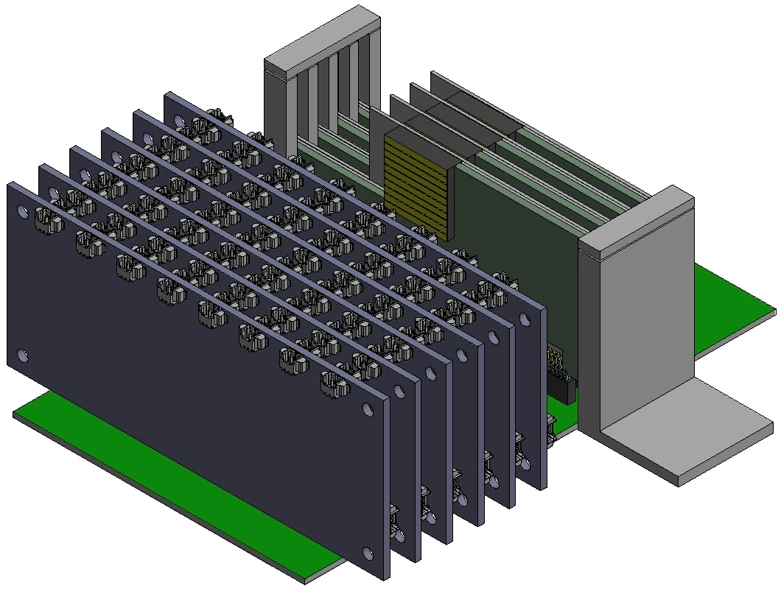
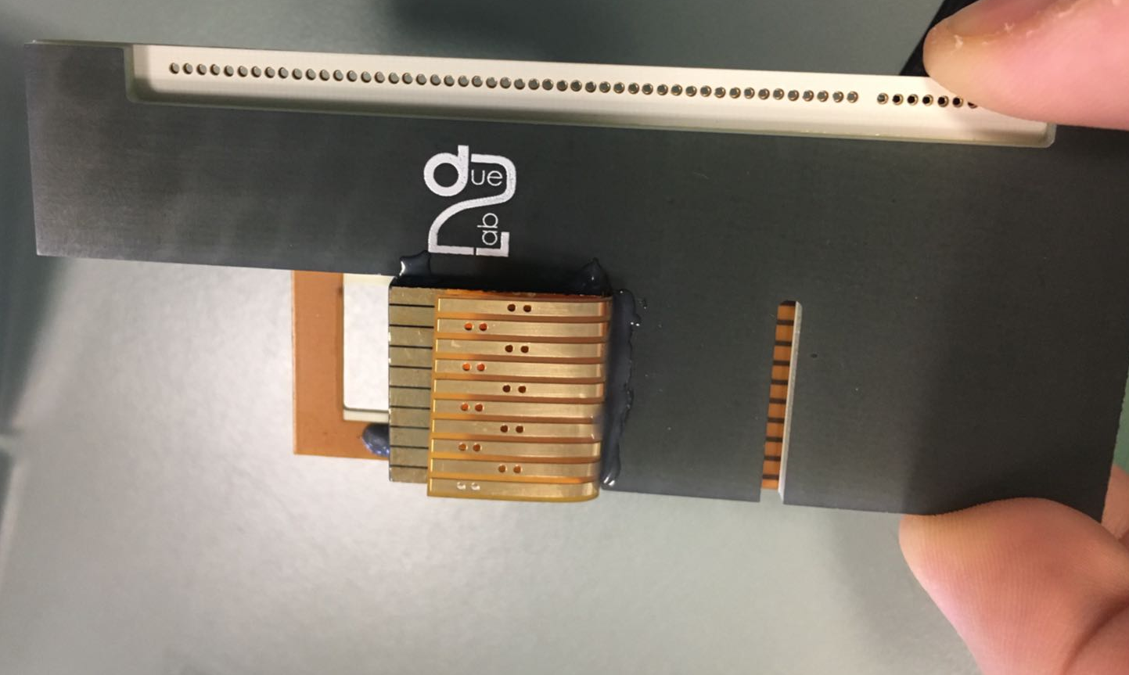
The 3D-CZT Module (3D-CaTM) prototype
Six CSP Boards
Hybrid design, 16 channels
Bias: ± 5 V, Power: 1.4 Watt
Time constant: 250 μs,
Risetime: 0.2 μs
Gain: ∼20
Four 3D CZT units
mounted to the support I/F with the AFEE board
A possible configuration of the 3DCaTM detection module for spectroscopic imaging, timing and polarimetry in hard X-/soft γ-rays satellite mission: four 3D CZT sensors read by six CSP front-end electronics boards

Slide 11
A balloon experiment with a 3D CZT sensor
A balloon flight with a reduced version (only one 3D CZT detector module) is very important to integrate the information obtained at ground facilities like ESRF for photons, INFN/LNL for charge particles and to test the instrument in a pseudo-spatial environment
Verification of the reliability of the 3D CZT sensors passivation, bonding, and packaging, as well as of the custom CSP FEE designed electronics
Measurements of background spectrum, and verify the capability of discriminating different type of particles from the signals features using the full digital approach
Asses the flexibility of the readout digital approach to change the observational mode of the detection system during the flight, uploading different filters and event handling logics in the firmware of the DPP system.

Slide 12
The BADG3R experiment
BADG3R: A BAlloon launched Detector for Gamma-rays with 3 dimension Resolution
In December 2019 we submit the BADG3R payload proposal in the framework of the second call of the H2020/HEMERA program for a ZPB mission
The proposal was accepted for a flight in 2021. Due to the COVID-19 pandemic emergency the flight opportunity has been shifted to 2022
The flight has been carried out at the begin of September 2022, from the SSC ESRANGE base in Kiruna (Sweden)

Slide 13
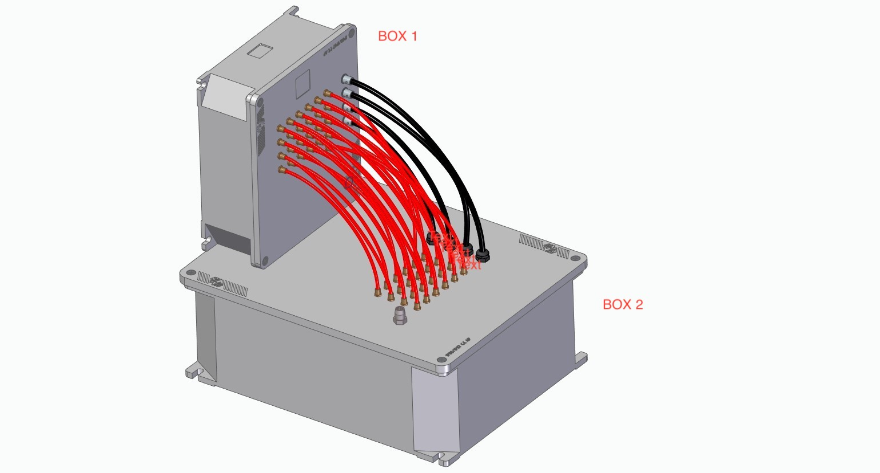
Overview the BADG3R prototype
The two main subsystems of the BADG3R payload are contained in separate aluminum boxes in order to reduce electrical interferences to the FEE
The two containers are connected by 24 cables for the output signals from the Charge-Sensitive Preamplifiers (CSP) and for the power cables (high and low voltages)
The OBDH is connected to the telemetry of the gondola via a LAN port, and receives the voltage from an external dedicated battery pack (24V or 12 V)
OBDH subsystems
3 FPGA boards: 8 ch, 100 MHz, 5W
Microcontroller for voltage control
HV and LW distributor (by using DC-DC converters)
Industrial low power PC (P1101): 10 W, 1.5 kg
On board data storage: two 1 TB SSD
Detector and FEE electronics
HV/LV
OBDH box
CSP Signals

Slide 14
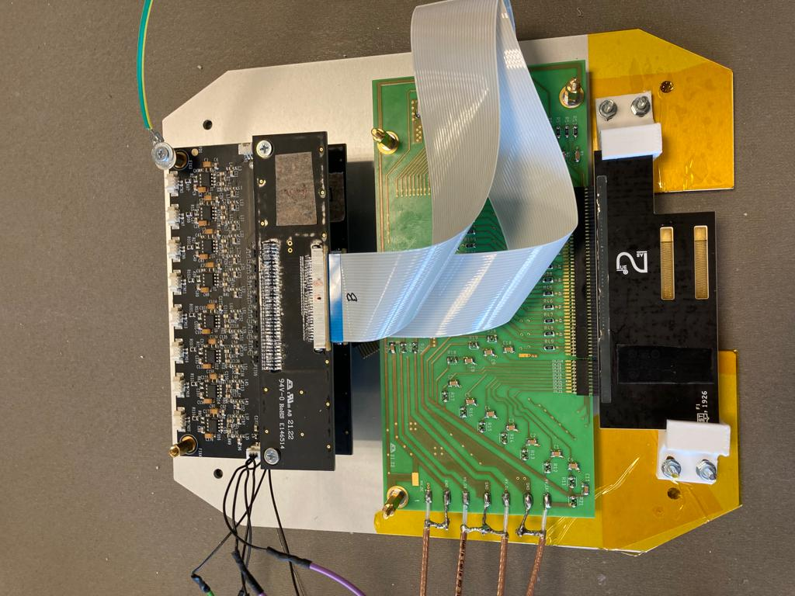
BADG3R: detector system
Two Analog CSP front–end boards
16-channels low noise
Rise time 0.2 μs
Time constant 250 μs
One 3D CZT unit
mounted to the support I/F with the AFEE board
The detector module is one 3D CZT sensor read by two CSP Analog front-end boards
Two small (5x5 cm2 , 2-3 mm thick) heavy metal plates (Pb and Ta) will be installed on the inner walls of the container and will be used as calibrators of the 3DCZT sensor through their fluorescence K-lines during the flight

Slide 15
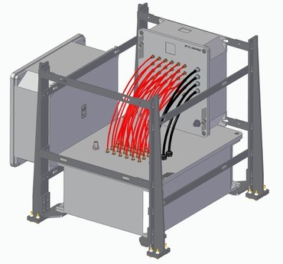
BADG3R prototype: resources
Subsystem | Size (cm) | Weight (kg) | Power (W)
Detector Unit | 20x30x20 | 2.90 | 3.0
OBDH Unit | 40x40x20 | 9.55 | 30.0
Battery Pack |  | 6.75
Structure |  | 8.00
TOTAL |  | 27.20 | 33.0
Data Type | Transmission Type | Expected Bit rate
Housekeepings: Temperature Sensors, Bias (HV, low), FPGA/Digitizer status info’s; Batteries charge status | Downlink/ Continuous | 1 kbits/s
Science: Event in spectroscopic mode. i.e. [time, n. multiplicity, nx(energy, channels)] – Max 120 kb | Downlink/ Burst periodically | 10-50 kbits/s
Telecommands: FPGA params, Bias, Science data downlink type, Safety TLC | Uplink/ Burst | 1 kbits/s
TLM Requirements are evaluated assuming a max rate of 1000 counts/s over the entire volume
Due to limited available telemetry rate, only scientific data after on-board DPP will be downlinked (spectroscopic mode) wile raw waveform snapshots mostly stored on the on-board SSD memory

Slide 16
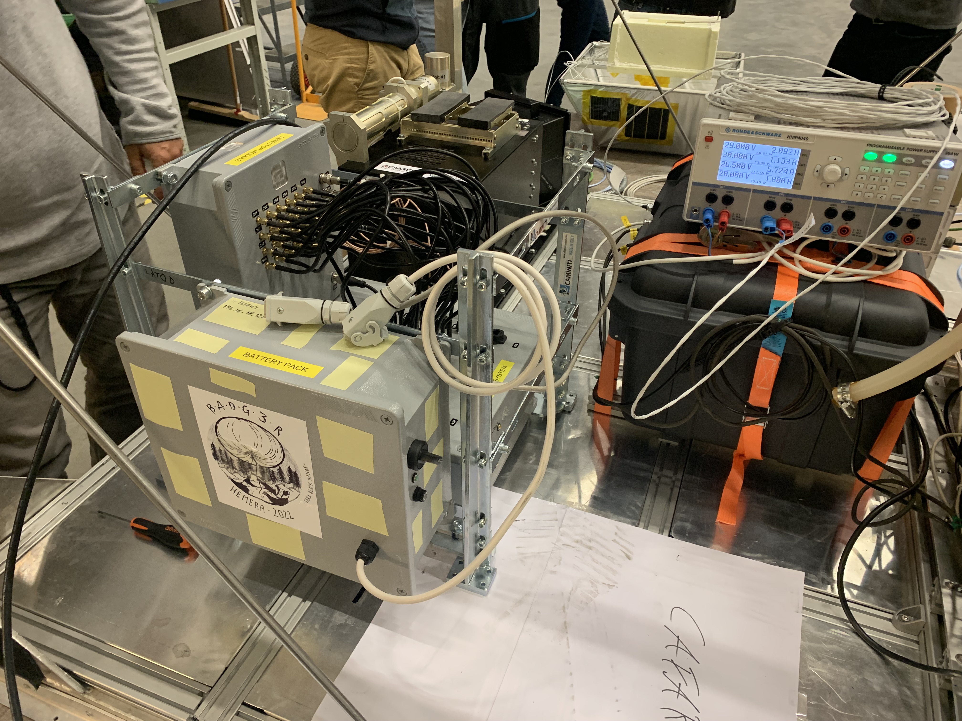
The integration of the payload on the gondola

Slide 17
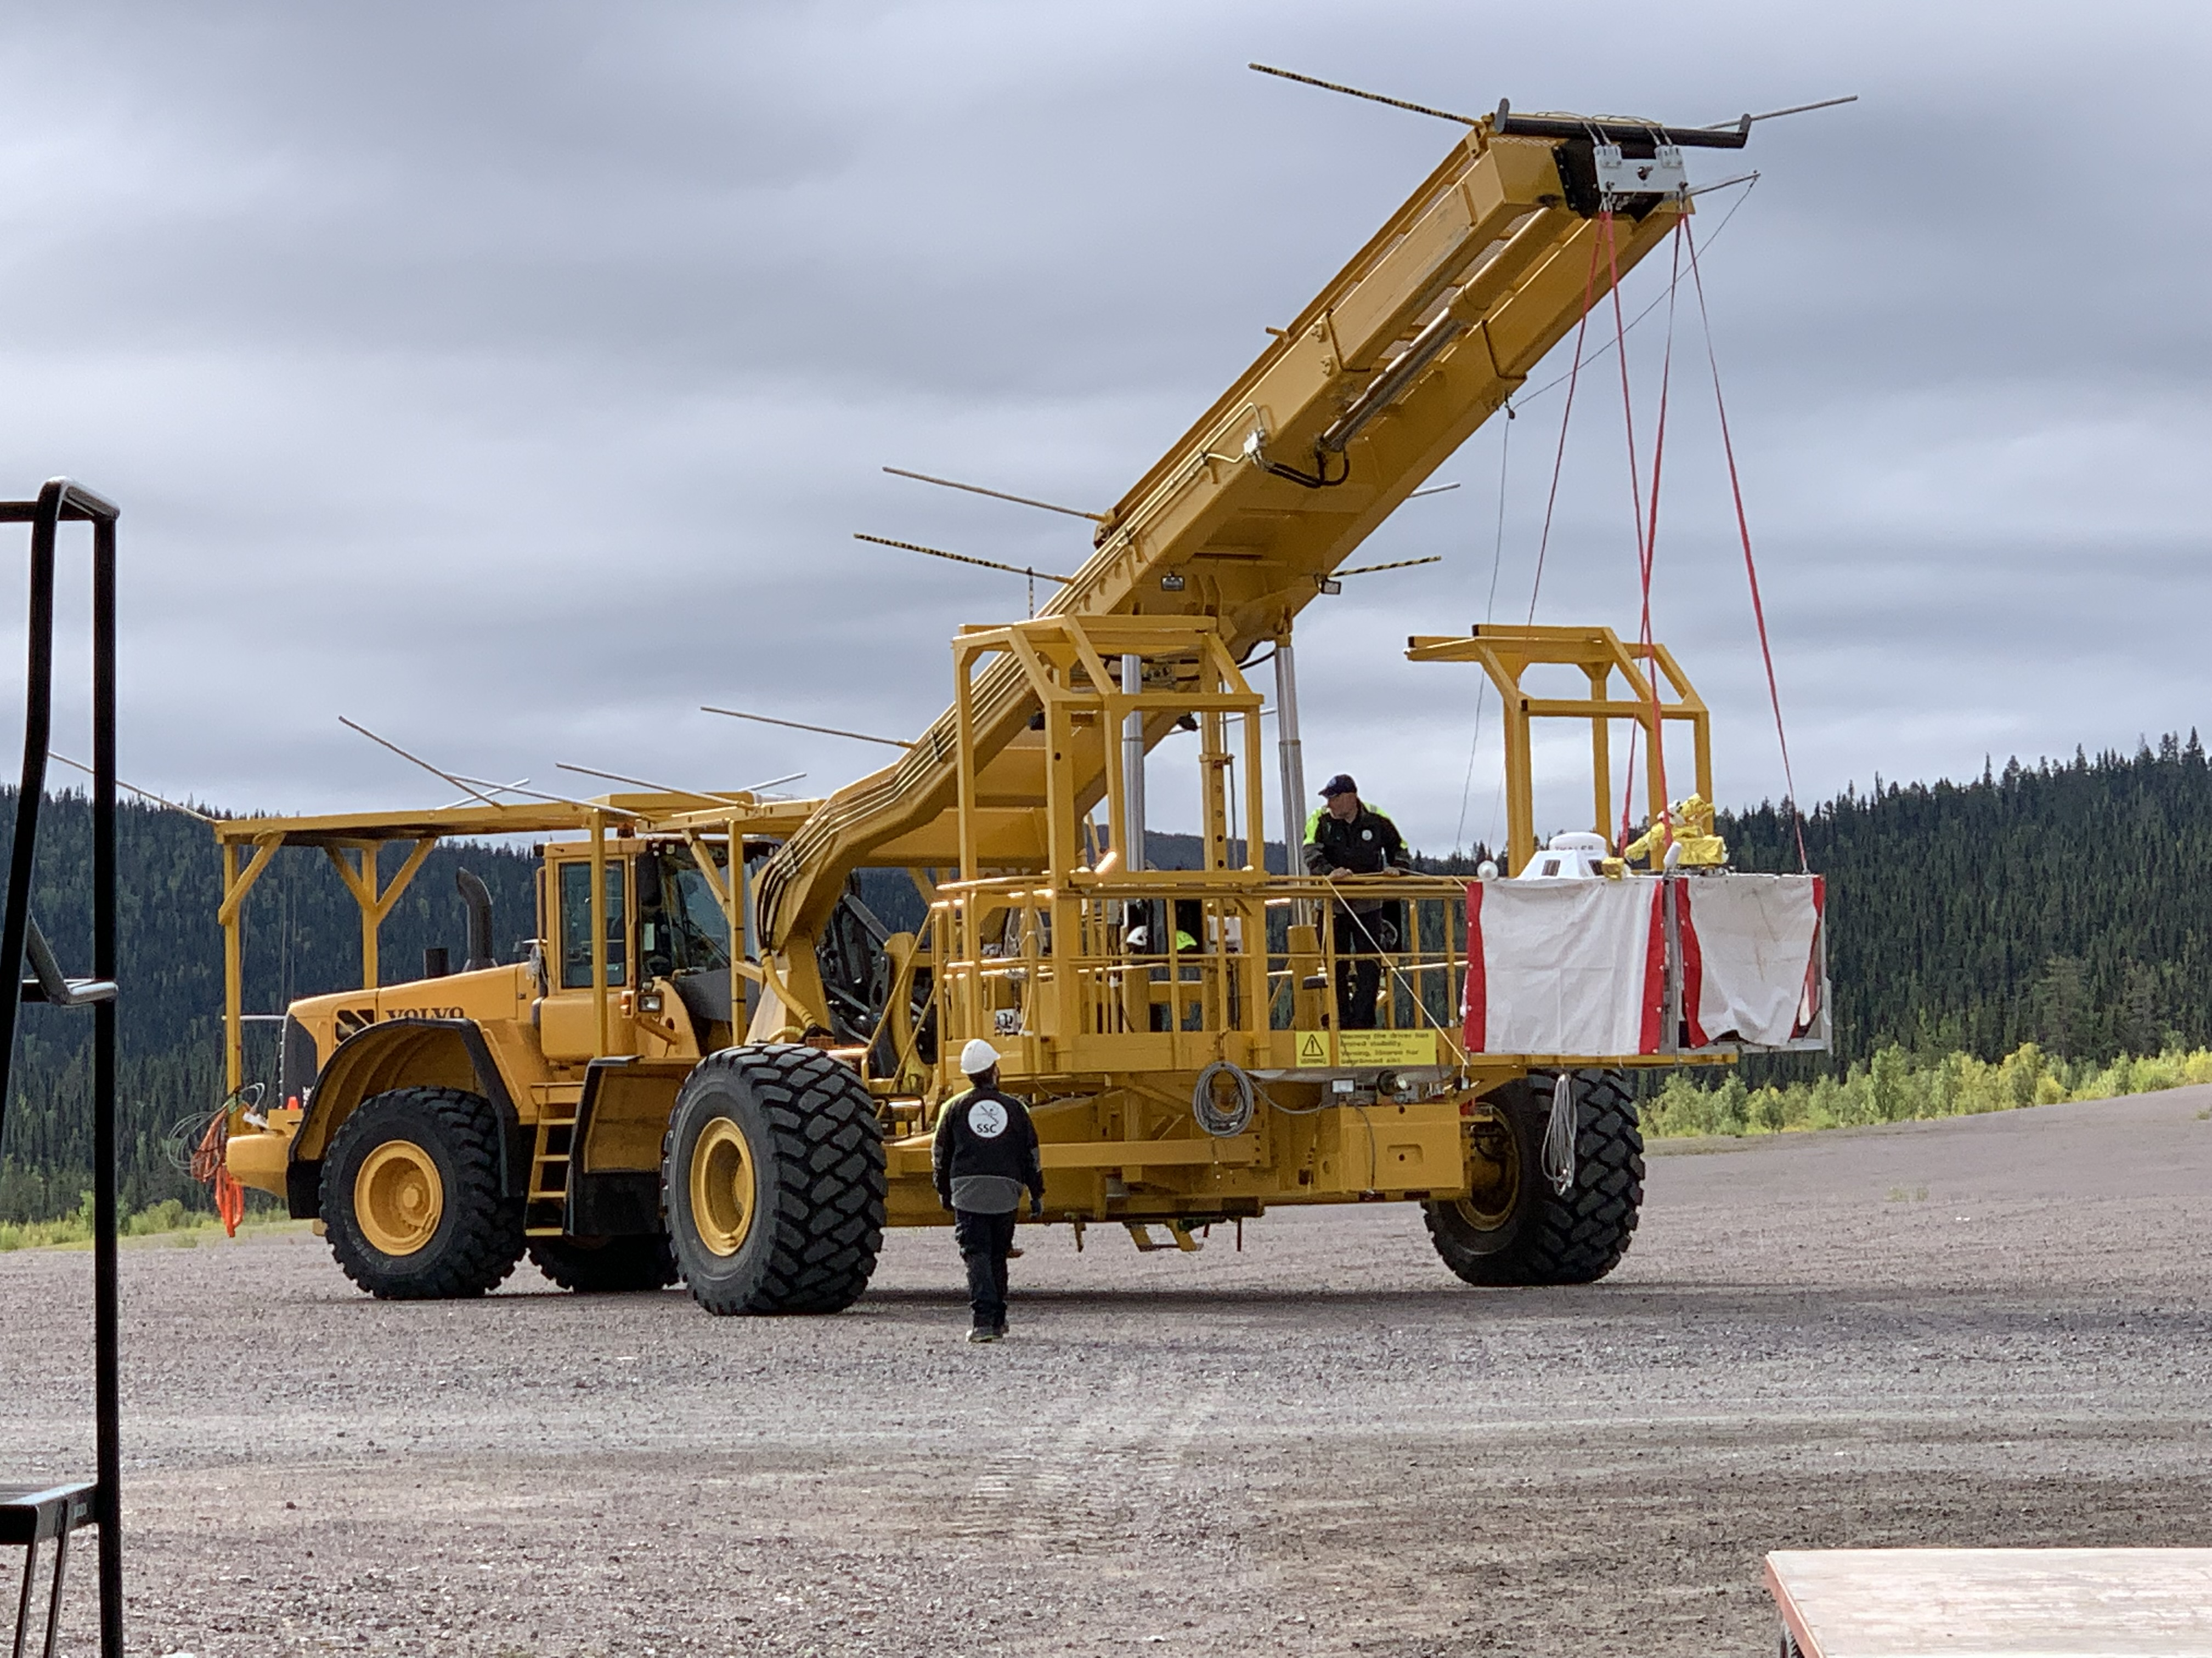
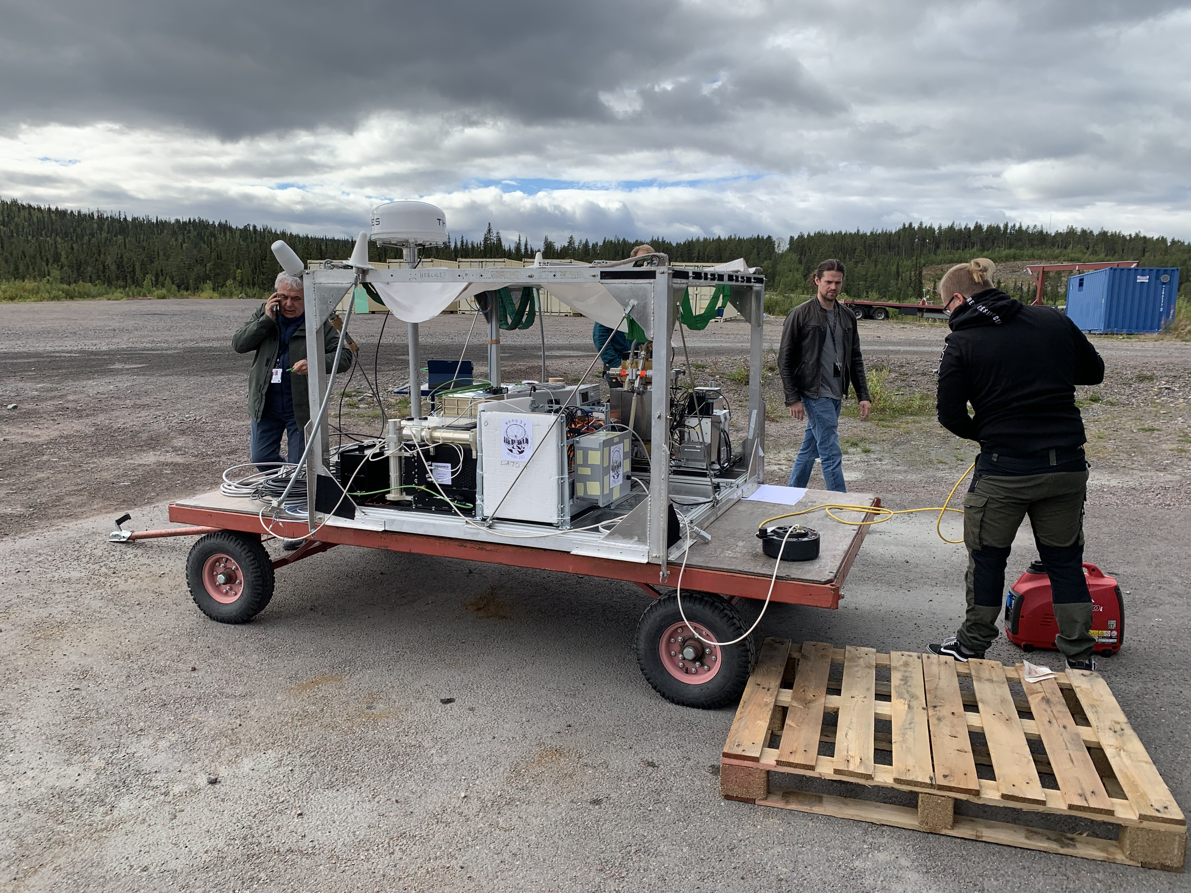
The launch campaign in ESRANGE (SW)

Slide 18
Flight profile and FPGA temperature

Slide 19
Pre and post-flight preamplifiers noise
40 mV of noise are equivalent to a
low energy theshold of about 15 – 20 keV
(depending on gain) This theshold is fine
for a flight at about 32 km

Slide 20
BADG3R schedule and summary
On 7/09, on the third attempt, the balloon was successfully launched
The flight lasted about 12 hours (a bit less than expected) but at two different altitudes (33 and 25 km)
Thanks to the sturdy structure of the payload it was recovered in optimal condition and ready for another flight. A preliminary analysis of the flight data showed also that some improvement must be made to the digital electronics in particular to the FPGAs system
Based on the results of the first BADG3R flight we foresee to ask, for 2024 possibly in the framework of a new HEMERA call or in collaboration with the CNES stratospheric balloon program, and with the support of ASI, for a more sophisticated and longer duration flight (a few days) using the complete and improved version of the 3DCaTM Spectro-imager (4 detectors units, 100 electronic channels, more performant DPP)
On a longer time scale, we plan to realize a small but complete telescope (Laue Lens plus focal plane detector) on a dedicated balloon flight for scientific observations of bright point sources. This experiment could be considered as a pathfinder for a high energy astrophysics satellite mission like ASTENA

