Slide 1
Aristotle University of Thessaloniki
Comparison of different methods for evaluating quantitative XRF data in copper-based artefacts
Eleni Konstantakopoulou, Annalaura Casanova Municchia, Loredana Luvidi, Marco Ferretti
High Precision X-Ray Measurements 19-23 June 2023, Frascati, Italy

Slide 2
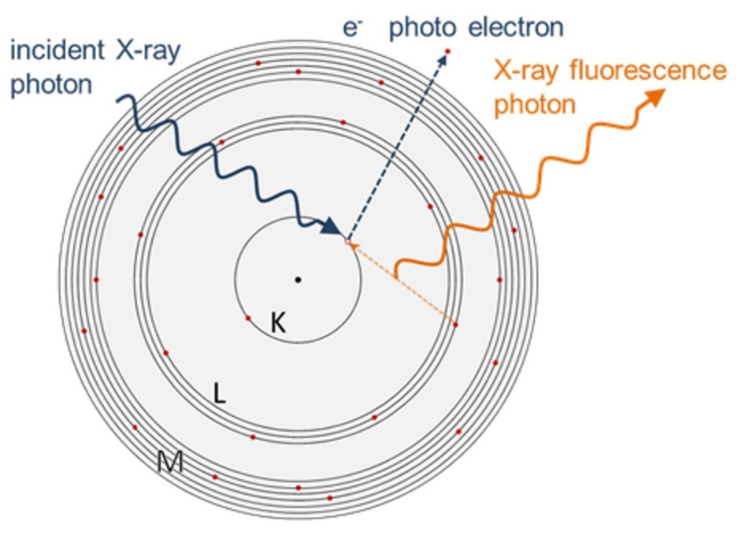
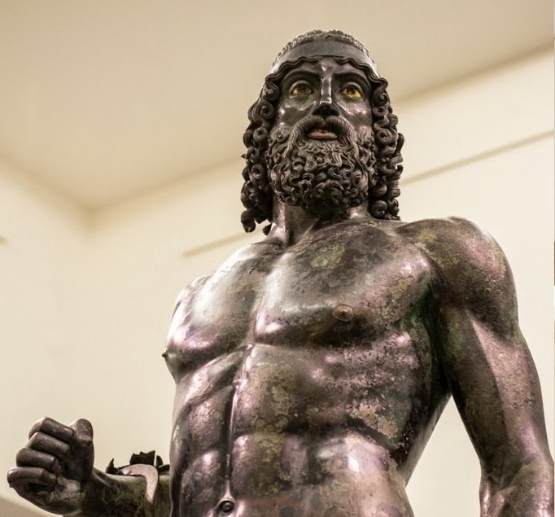
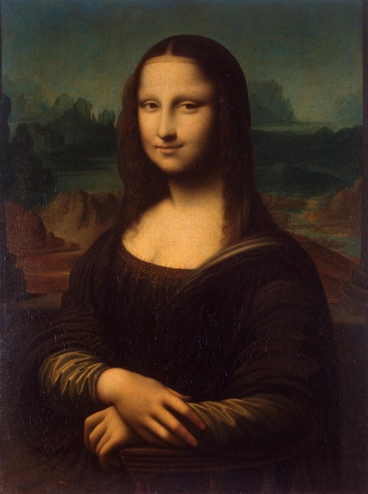
X-Ray Fluorescence Analysis of Heritage Materials
Simultaneous multi elemental analysis
Non-destructive
Portable devices
Application of XRF in Cultural Heritage
Fabrication technology
Authenticity
Provenance of the artefacts

Slide 3
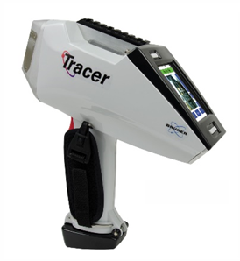
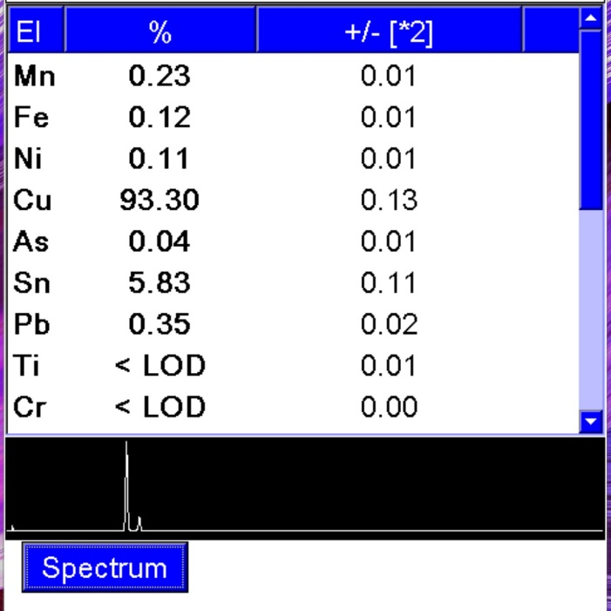
Hand-Held XRF devices
Highly miniaturised hardware
Powerful software which provides quantitative data in real time
Aim of this study is the comparison of the quantitative results of copper-based alloys from a commercial HH-XRF, using 3 different approaches
Built-in manufacturer calibration
Customized manufacturer calibration
Independent external software

Slide 4
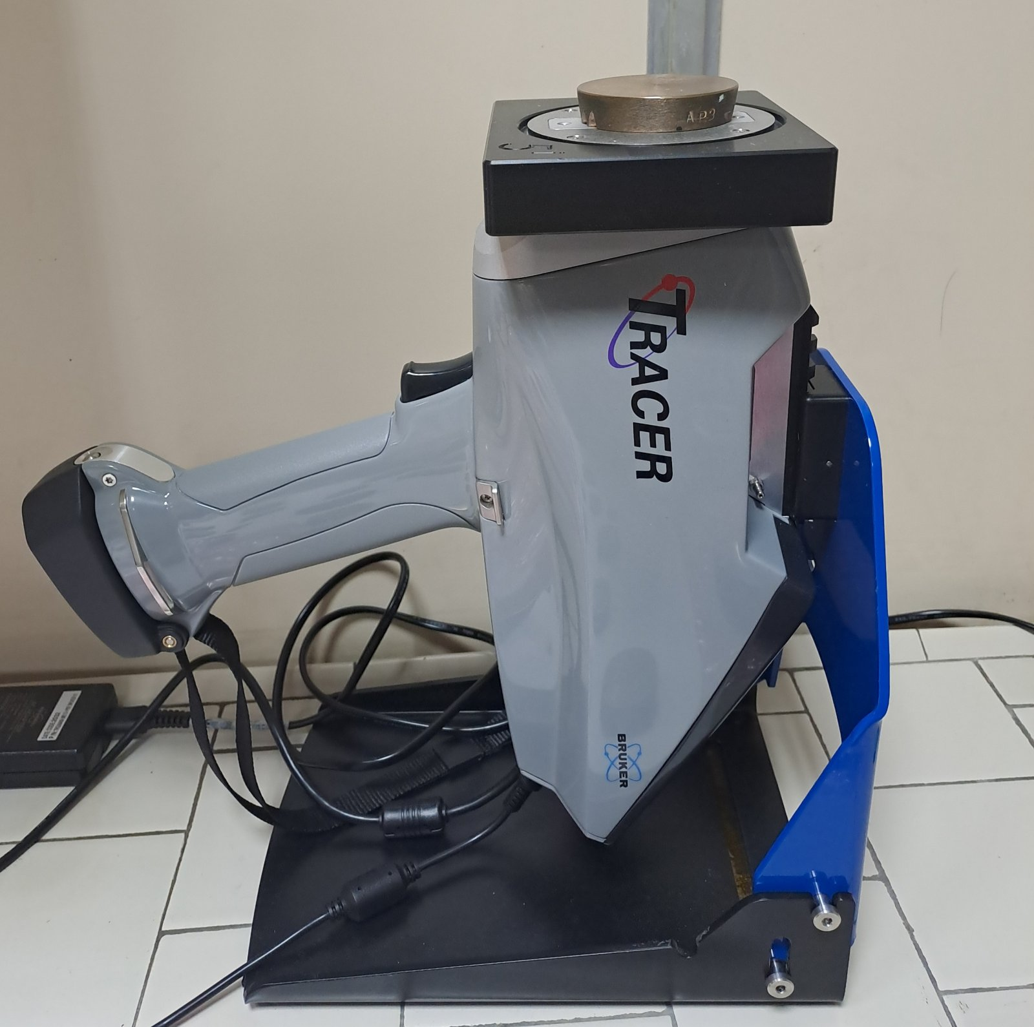
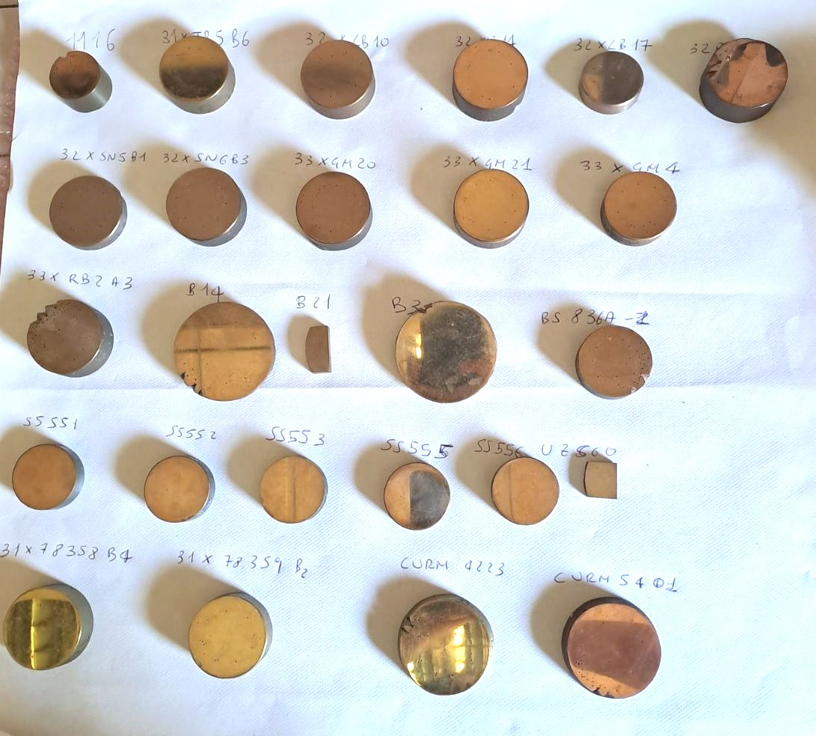
Materials and Methods (1)
Instrument
Reference Materials
Bruker Tracer 5g
26 certified standards compositionally significant of heritage copper-based artefacts
Rh anode X-Ray tube
50 kV max. voltage
195 uΑ max. current
Silicon Drift Detector
Collimators: 3mm, 8mm
5 different filters
ISPC Bruker Tracer 5g
26 Copper - based coupons

Slide 5
Materials and Methods (2)
Experiments
10 series of measurements on 26 standards for each calibration approach by 3mm
 | Built-in Bruker For Cu Alloys | Customized Bruker | Off-Line PyMca
Voltage | 15kV | 49kV | 49kV
Current | 23.2 uA | 39.3uA | 39.3uA
Filter | - | Al(300um) Ti(25um) | Al(300um) Ti(25um)
Meas.Time | 30s | 30s | 30s
Quantification Method | Empirical Coefficients | Empirical Coefficients | Fundamental Parameters

Slide 6
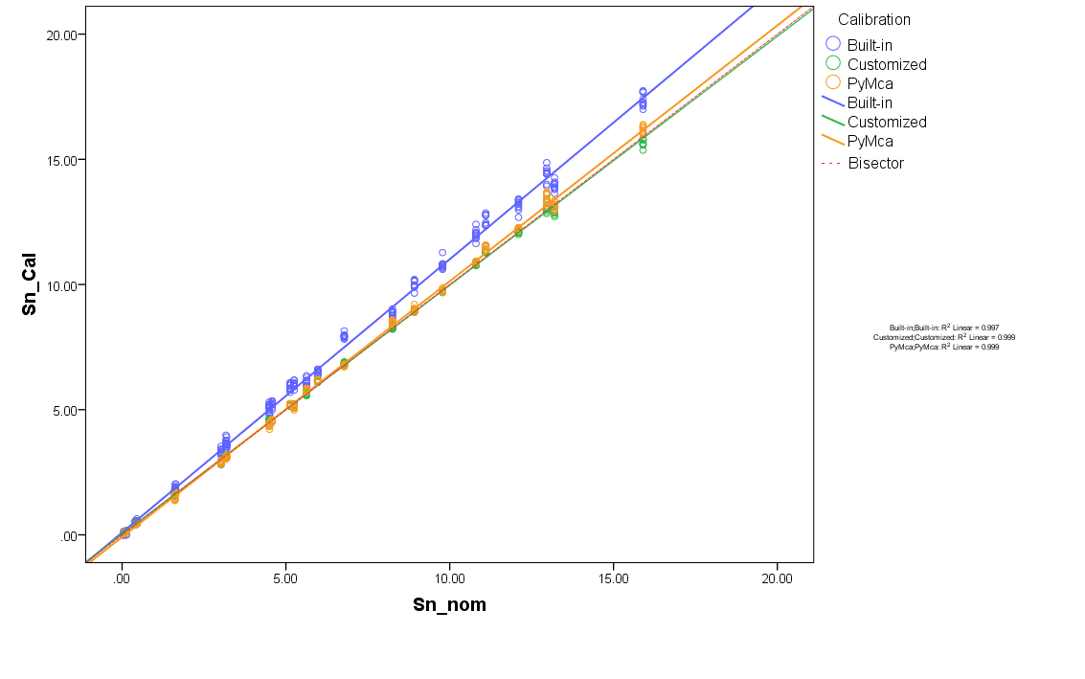
Results – Tin
Calibration | R square | RMSE
Built-in | 0.997 | 0.251
Customized | 0.999 | 0.122
PyMca | 0.999 | 0.145

Slide 7
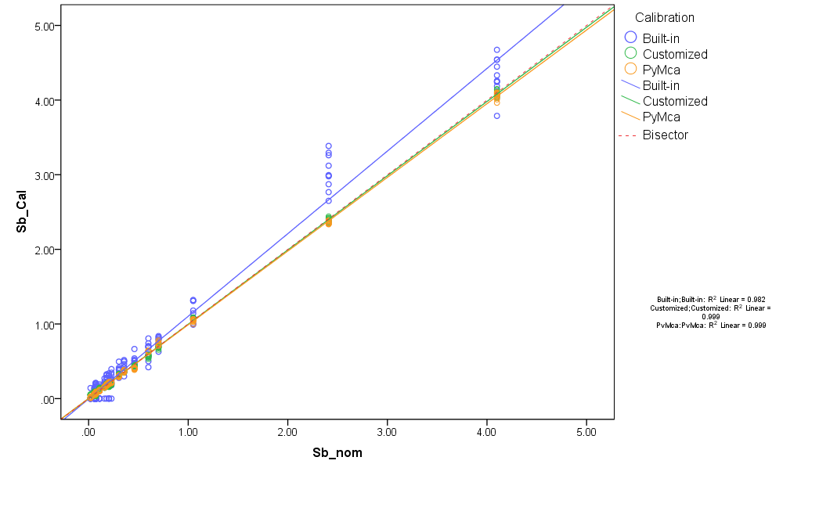
Results – Antimony
Calibration | R square | RMSE
Built-in | 0.982 | 0.149
Customized | 0.999 | 0.025
PyMca | 0.999 | 0.024

Slide 8
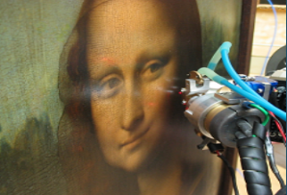
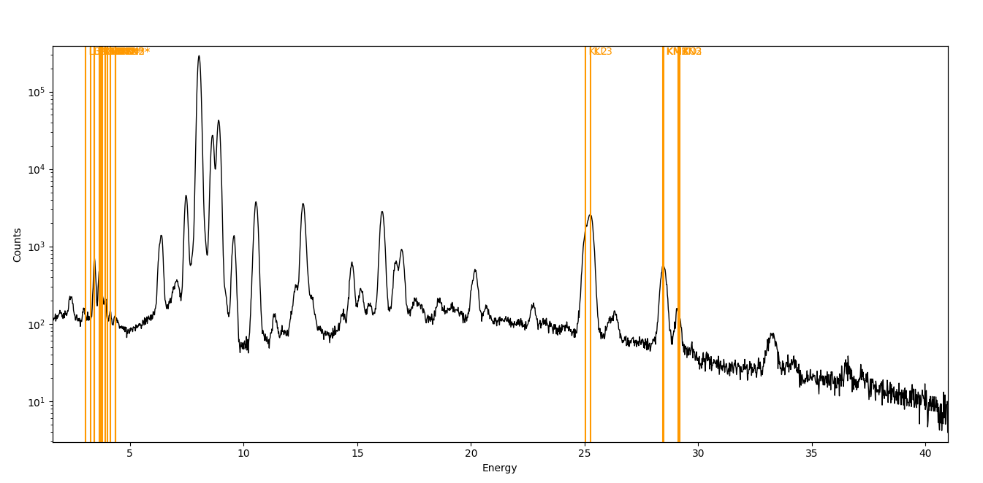
Results – Tin and Antimony
PyMca
K Lines
Sn
Sb
Sb-K Lines
L Lines

Slide 9
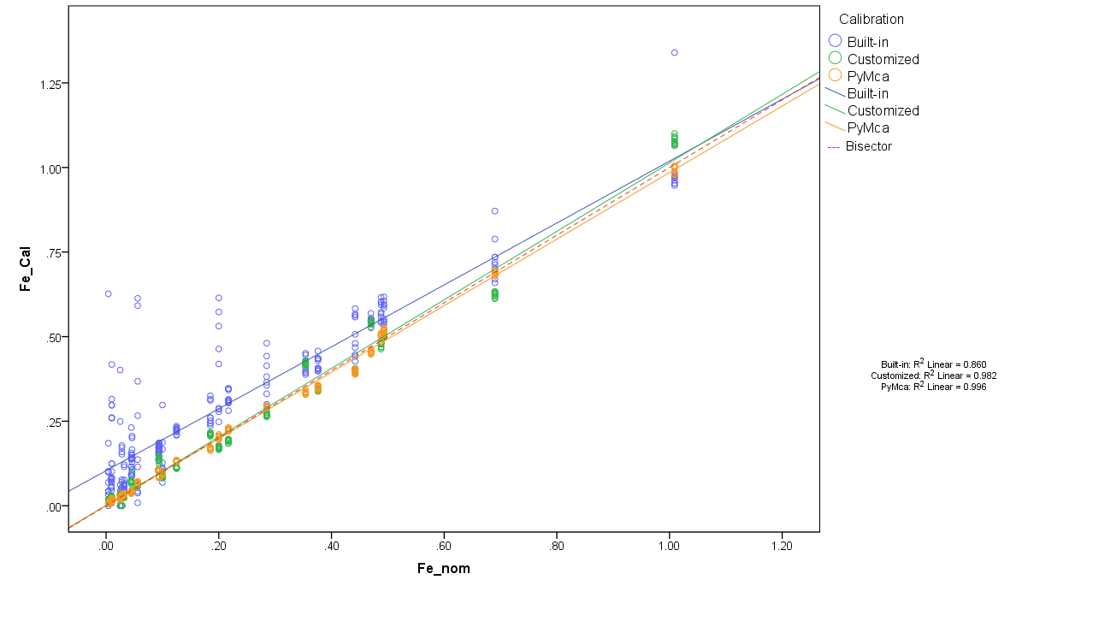
Results - Iron (1)
Calibration | R square | RMSE
Built-in | 0.860 | 0.092
Customized | 0.982 | 0.034
PyMca | 0.996 | 0.015

Slide 10
Results - Iron (2)
Customized Calibration
EasyCal™
Overlap correction

Slide 11
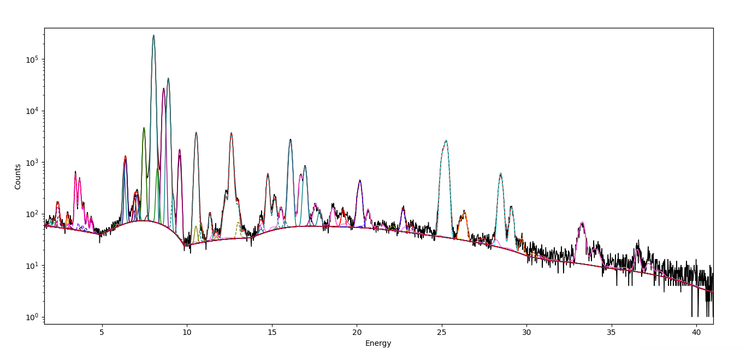
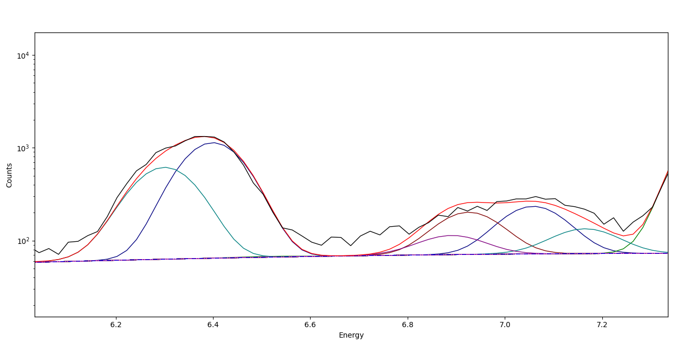
Results - Iron (3)
PyMca Calibration
PyMca
Peaks Spectrum
PyMca
Fe-Kα
Cu-EP
Fe-Kβ
Co-Kβ
Ζn-EP
Cu-EP

Slide 12
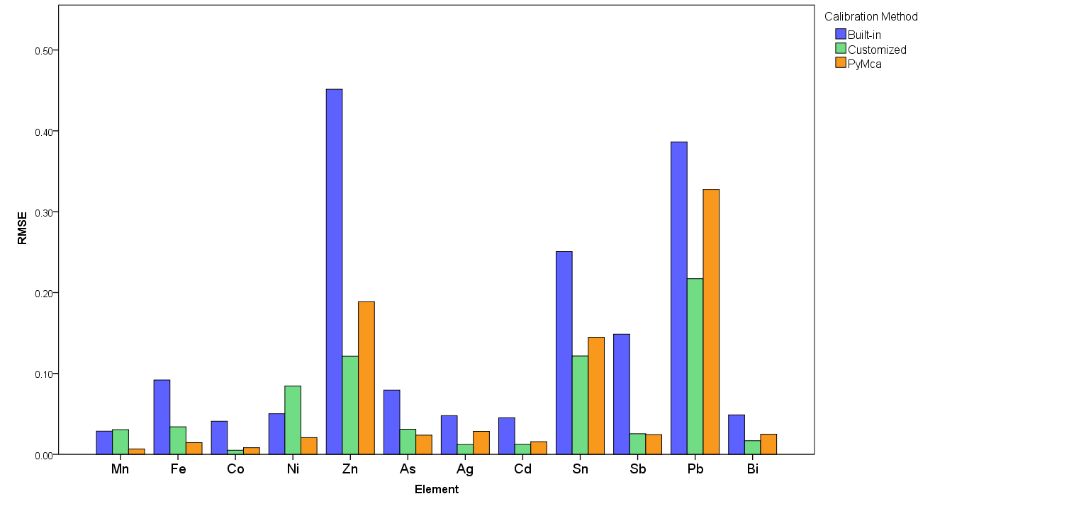
Results – Root Mean Squared Error

Slide 13
Conclusions
Hand-Held XRF devices cannot be considered as black-boxes. The operator must have knowledge of XRF principles
Quantitative data obtained by Built-in Bruker Calibration show the largest deviation from the nominal values
Customized Bruker and PyMca Calibrations provide more accurate results and can be combined for the quantification of copper-based artefacts
Customized Bruker Calibration immediately provides quantitative results and is useful during the field acquisition, while PyMca Calibration can be used for subsequent more detailed spectrum processing

Slide 14
Aristotle University of Thessaloniki
Thank you for your attention

