Slide 1
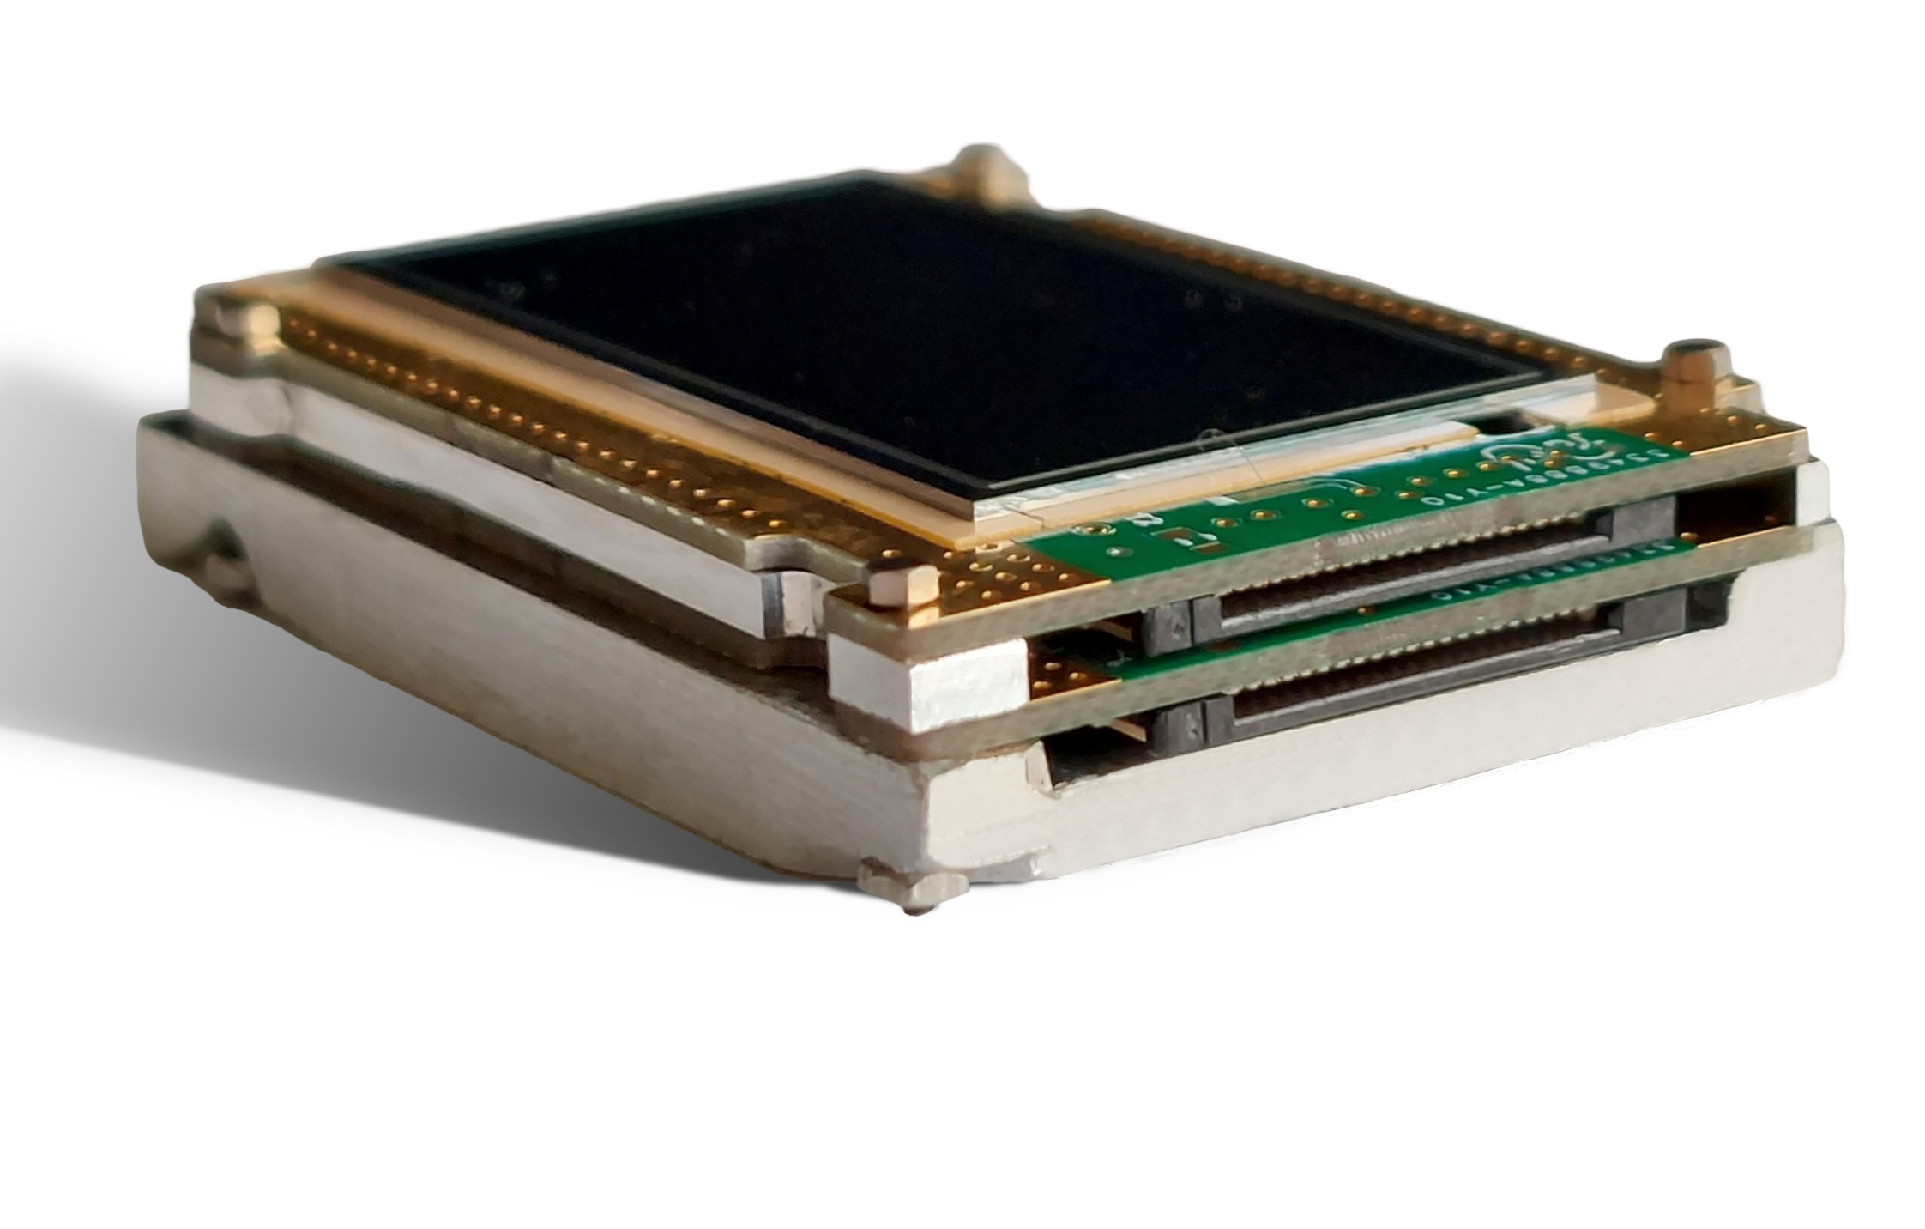
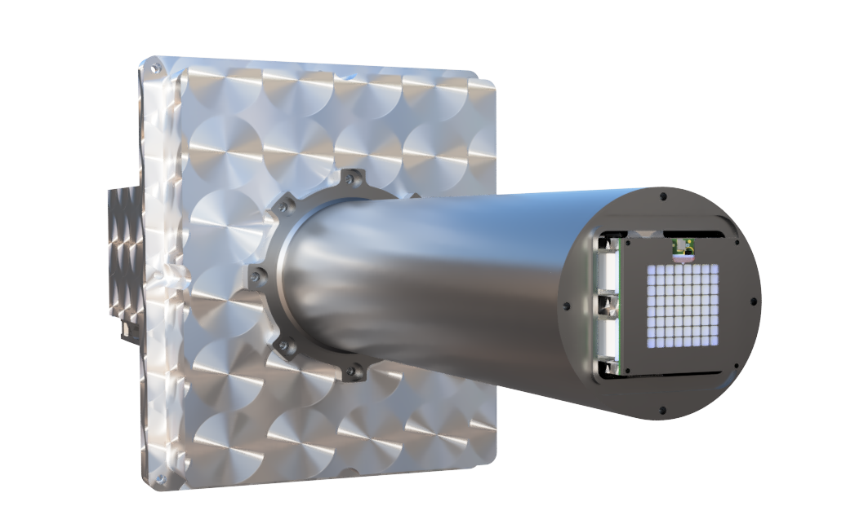
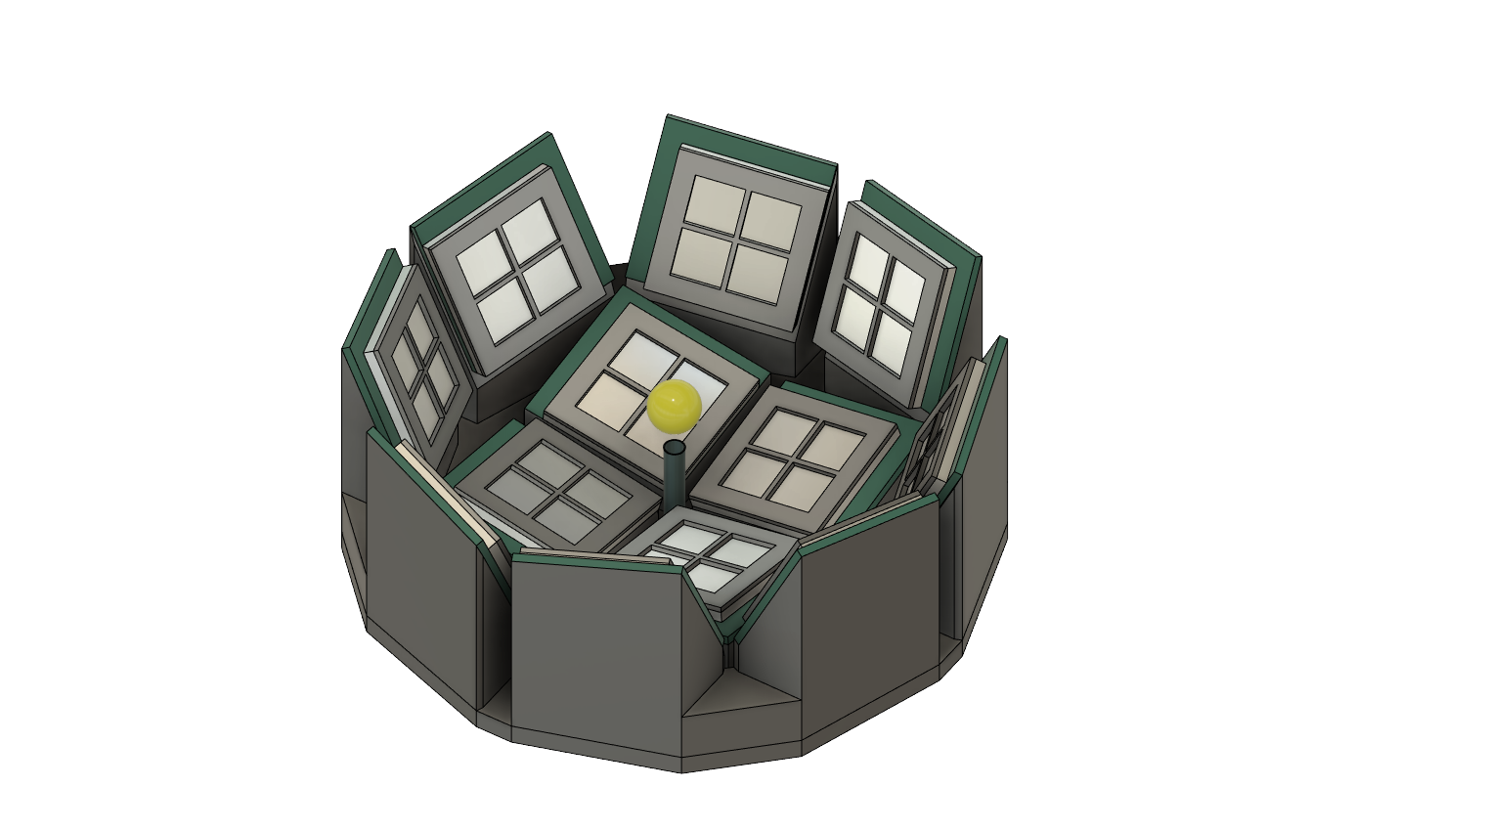
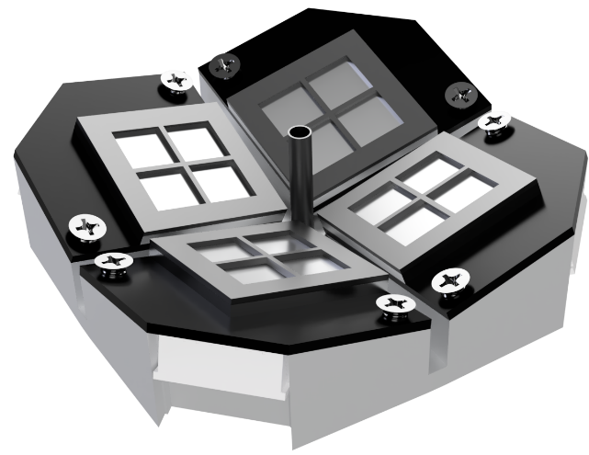
Innovative X-ray detection systems based on monolithic arrays of Silicon Drift Detectors
Griseld Deda^{1,2}, Giacomo Ticchi^{1,2}, Beatrice Pedretti^{1,2}, Davide Di Vita^{1,2}, Giacomo Borghi^{1,2}, Marco Carminati^{1,2}, Nicola Zorzi³ and Carlo Fiorini^{1,2}
Dipartimento di Elettronica, Informazione e Bioingegneria, Politecnico di Milano, Milan, Italy
INFN, Sezione di Milano, Milan, Italy
Fondazione Bruno Kessler, Trento, Italy

Slide 2
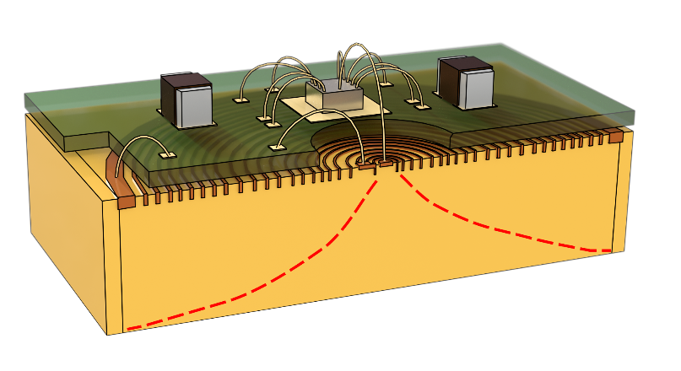
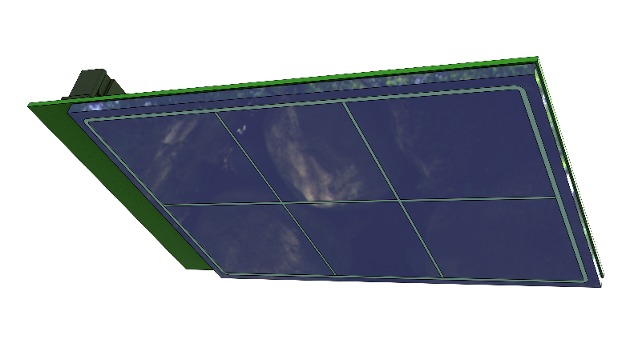
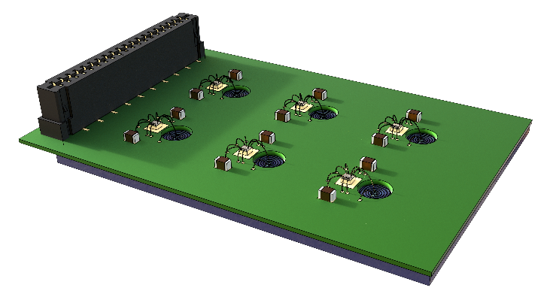
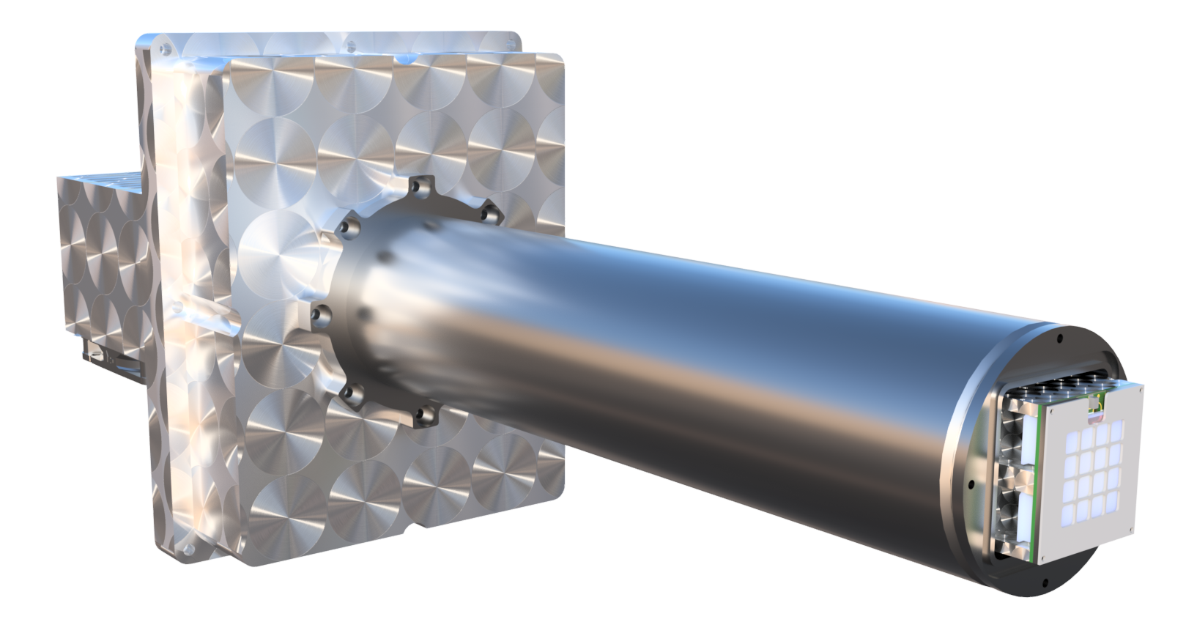

Silicon Drift Detector and CUBE Preamplifier
CUBE
Silicon Drift Detectors provides the best energy resolution (small anode capacitance, independent of detector area)
CUBE Charge Sensitive Amplifier (CSA) with low series noise (high $g_{m}$) is bonded close to SDD anode (minimize parasitics)
SDD+CUBE = versatile solution for high count-rate application (Bombelli et.al.,2012)
Charge Drift
SDD
Charge Generation
Radiation Entrance Window
Goal: adopt SDDs in different configurations to enhance properties like detection efficiency, throughput capability, and compactness, in addition to high-energy resolution.
Example of SDD array mounted on a ceramic
SDD array and CUBE

Slide 3
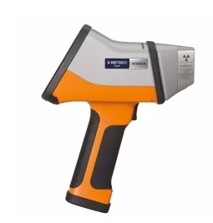
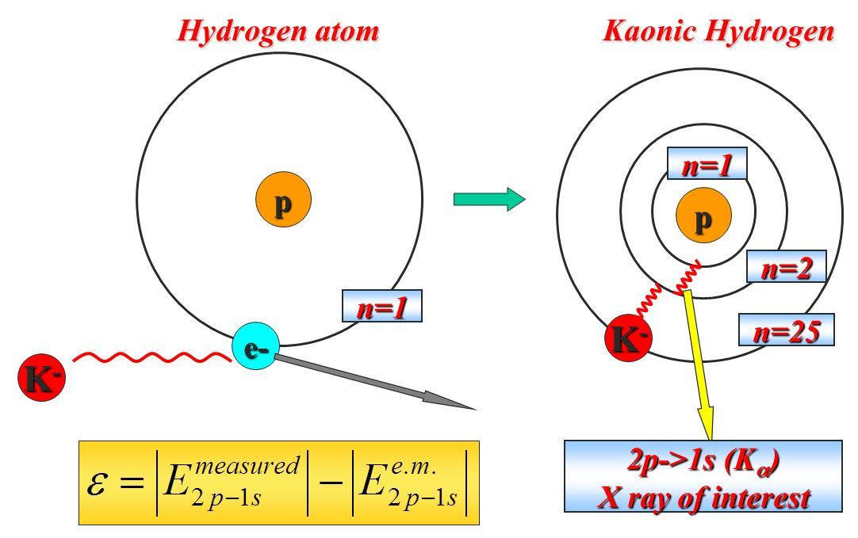
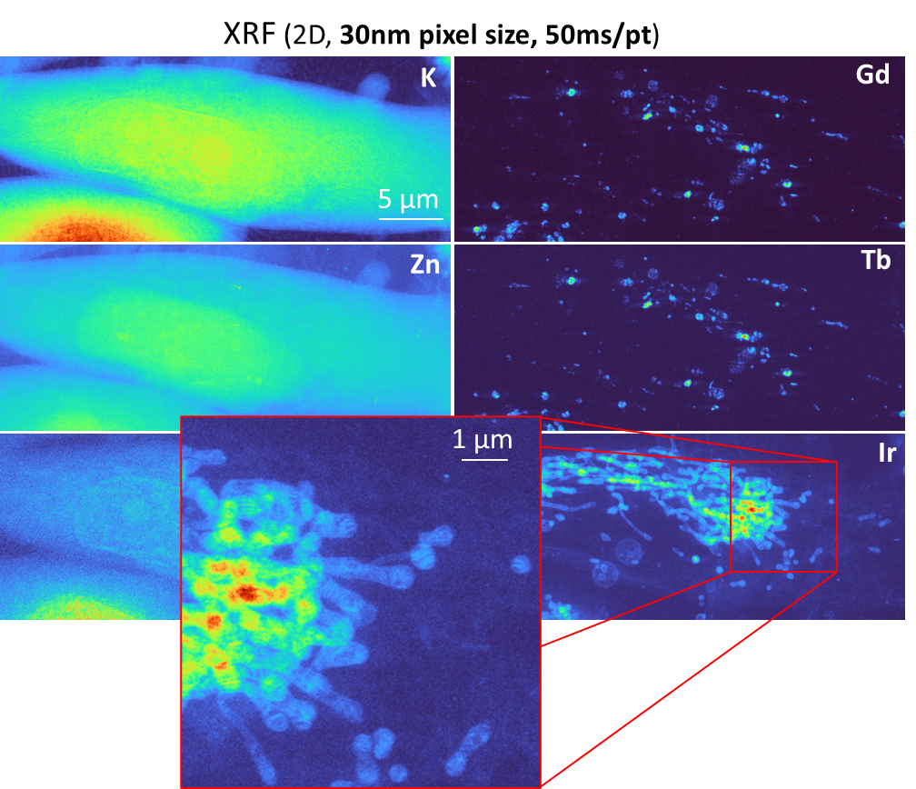
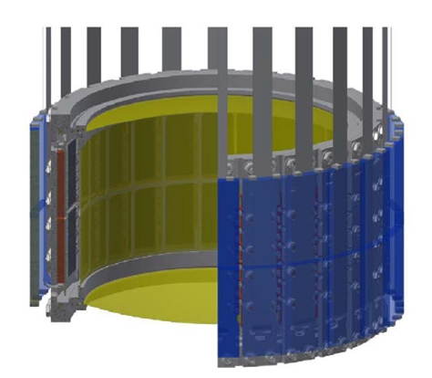
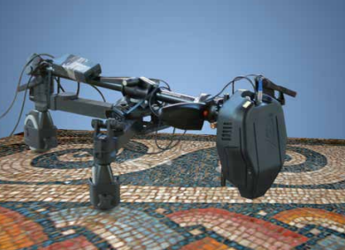
Motivation
High speed mapping in X-ray Fluorescence Microscopy
Nuclear physics experiments
Example: high speed mapping in XFM (X-ray Fluorescence Microscopy)
Industrial bench-top and portable X-ray instruments
High-speed X-ray mapping for cultural heritage applications
SIDDHARTA-2 experiment
Measurement taken at ID16 (ESRF) with ARDESIA detector (courtesy P.Cloetens)

Slide 4
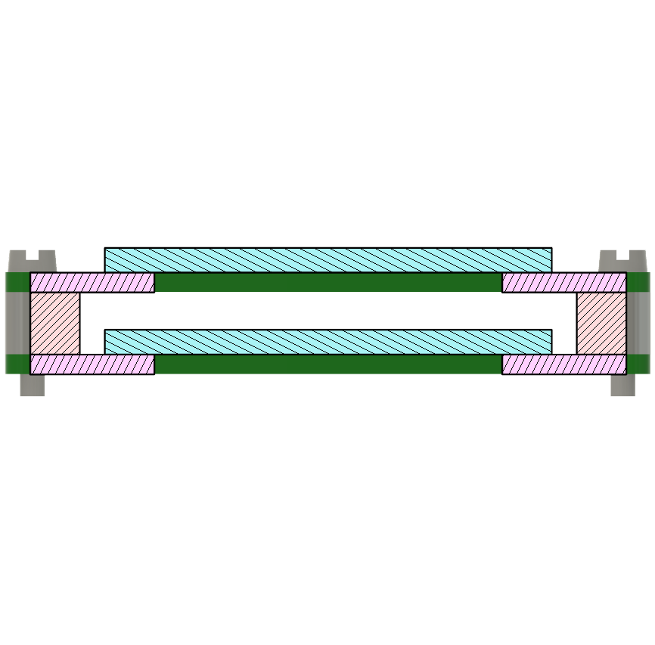




Stacked-SDDs Detection Module
Goal: Development of a new detection module based on 1 mm thick monolithic arrays of Silicon Drift Detector (SDD) coupled with CMOS-based Charge Sensitive Amplifiers (CSA) arranged in a stacked structure to reach 2 mm of effective thickness.
X-Ray source
$$450 μm$$
$$800 μm$$
$$1000 μm$$
$$2000 μm$$
SDDs
Quantum Efficiency
Detection area
Energy (keV)

Slide 5
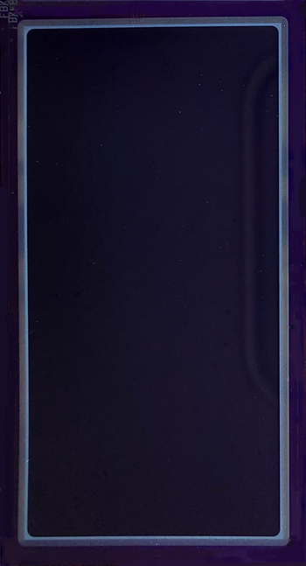
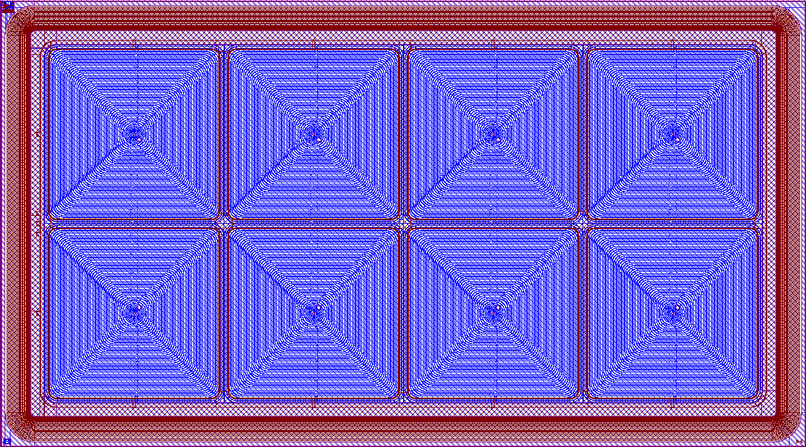
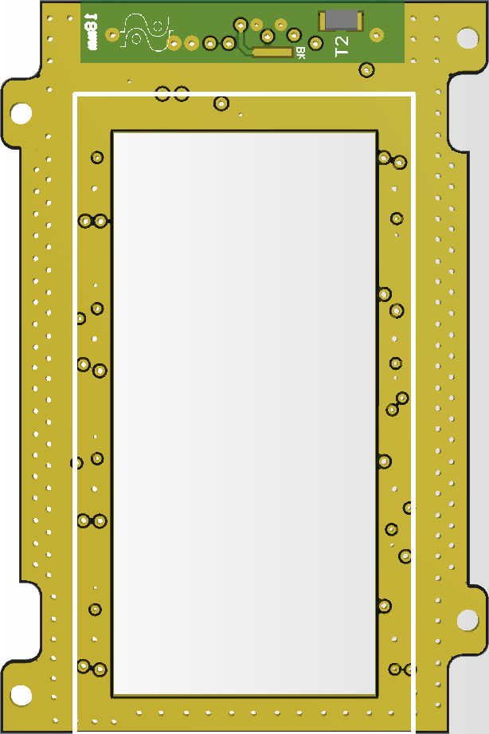
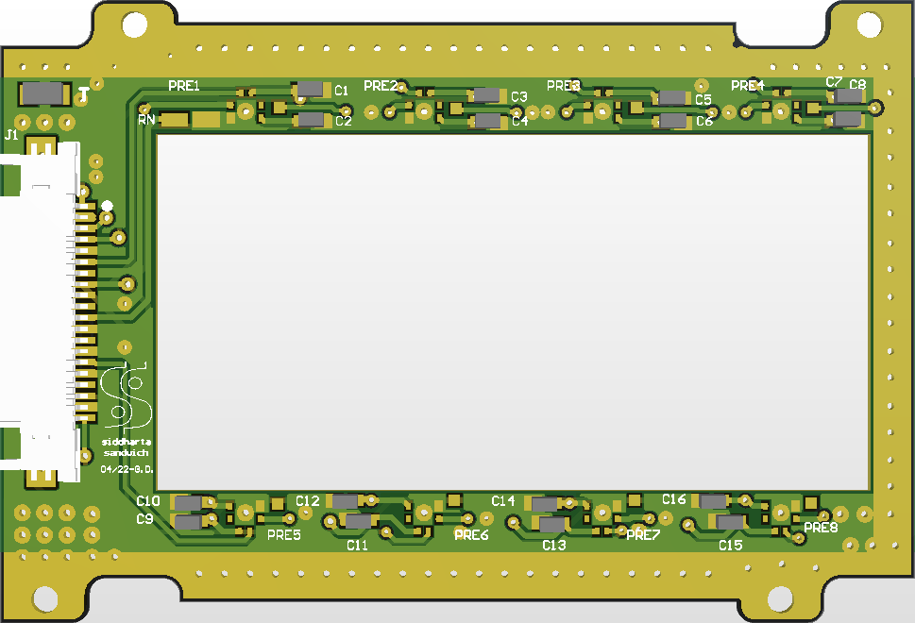
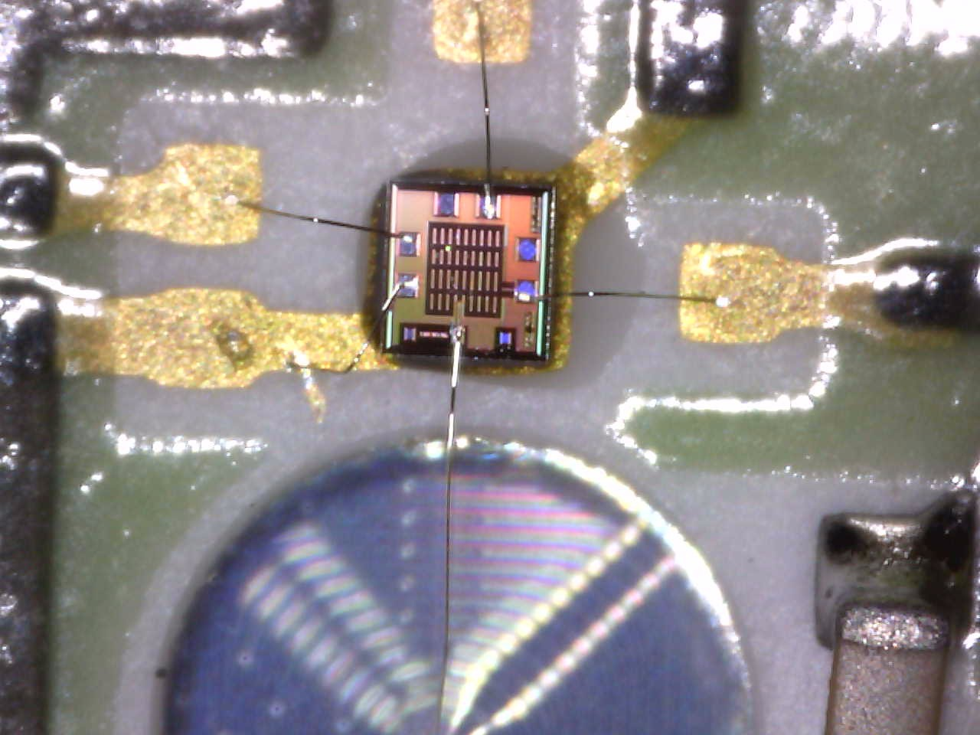
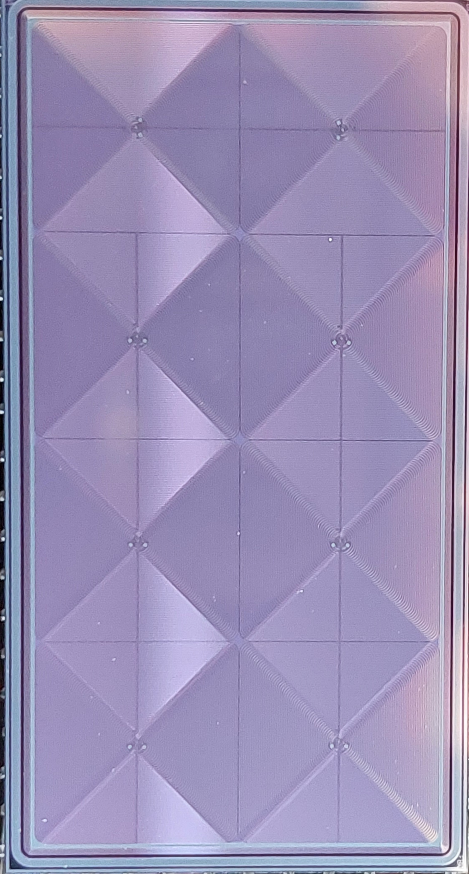
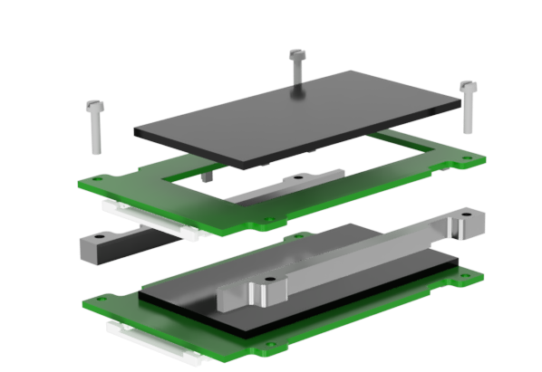
Stacked Structure: SDD and PCB Carrier
TOP side
BOTTOM side
Connector
CSA
1
2
8 mm
41 mm
3
4
20 mm
8 mm
5
6
32 mm
7
8
36 mm
3 mm
16 mm
26 mm
Board cutout
2x4 monolithic array of Silicon Drift Detector
1 mm thick
64 mm² pixel area
36 mm x 20 mm chip dimensions
Produced by Fondazione Bruno Kessler (FBK)
Top SDD
Bottom PCB
Aluminum
spacer

Slide 6
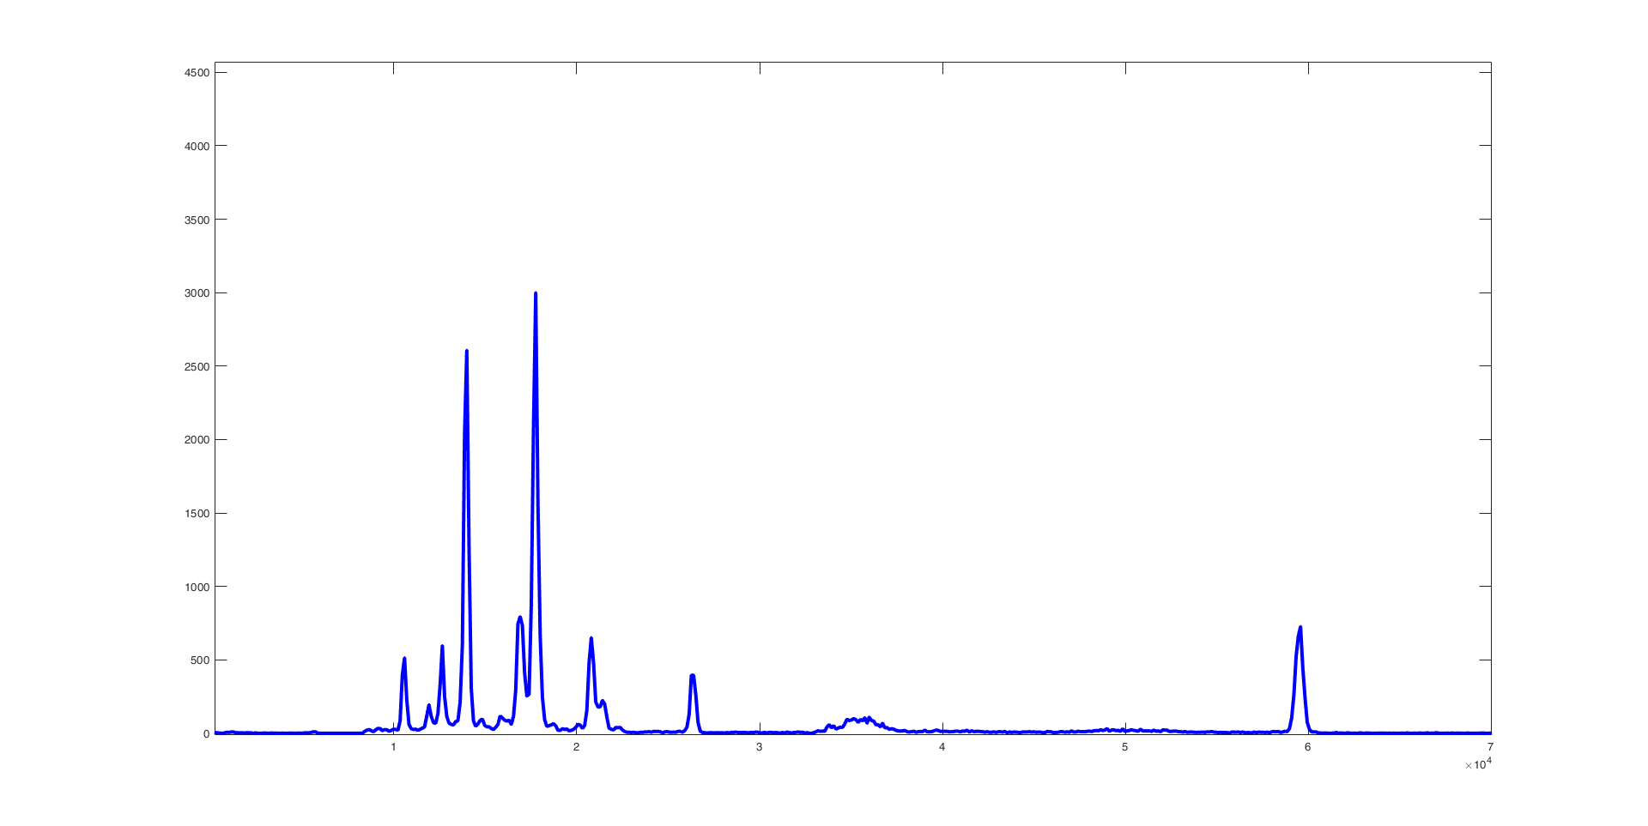
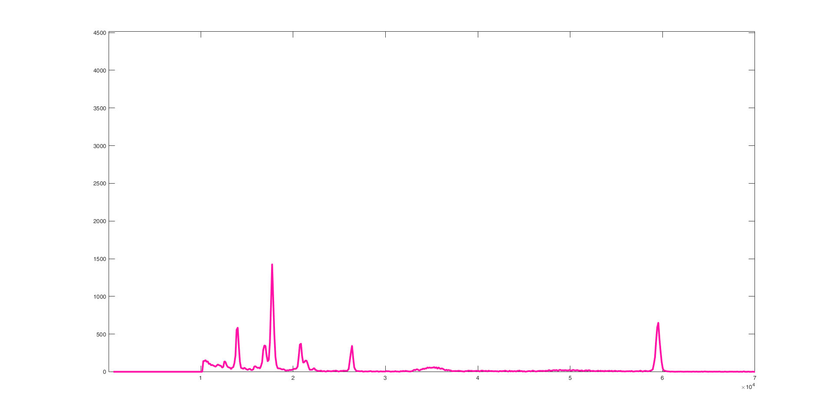
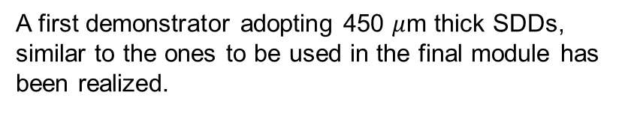
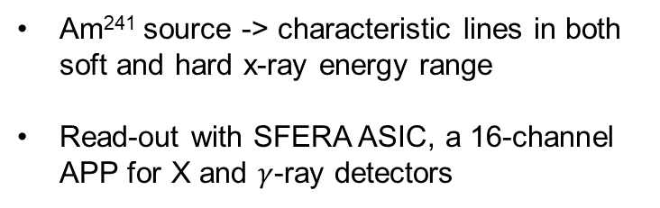
X-ray Spectroscopy Measurements
A first demonstrator adopting 450 $μ$m thick SDDs, similar to the ones to be used in the final module has been realized.
4
Top SDD
13,9keV
17,8keV
3
kCounts
2
20,8keV
26,4keV
59,5keV
1
0
20
0
10
30
40
50
60
70
Energy [keV]
4
Bottom SDD
3
Am²⁴¹ source -> characteristic lines in both soft and hard x-ray energy range
Read-out with SFERA ASIC, a 16-channel APP for X and $γ$-ray detectors
kCounts
2
17,8keV
13,9keV
20,8keV
26,4keV
59,5keV
1
0
20
0
10
30
40
50
60
70
Energy [keV]

Slide 7
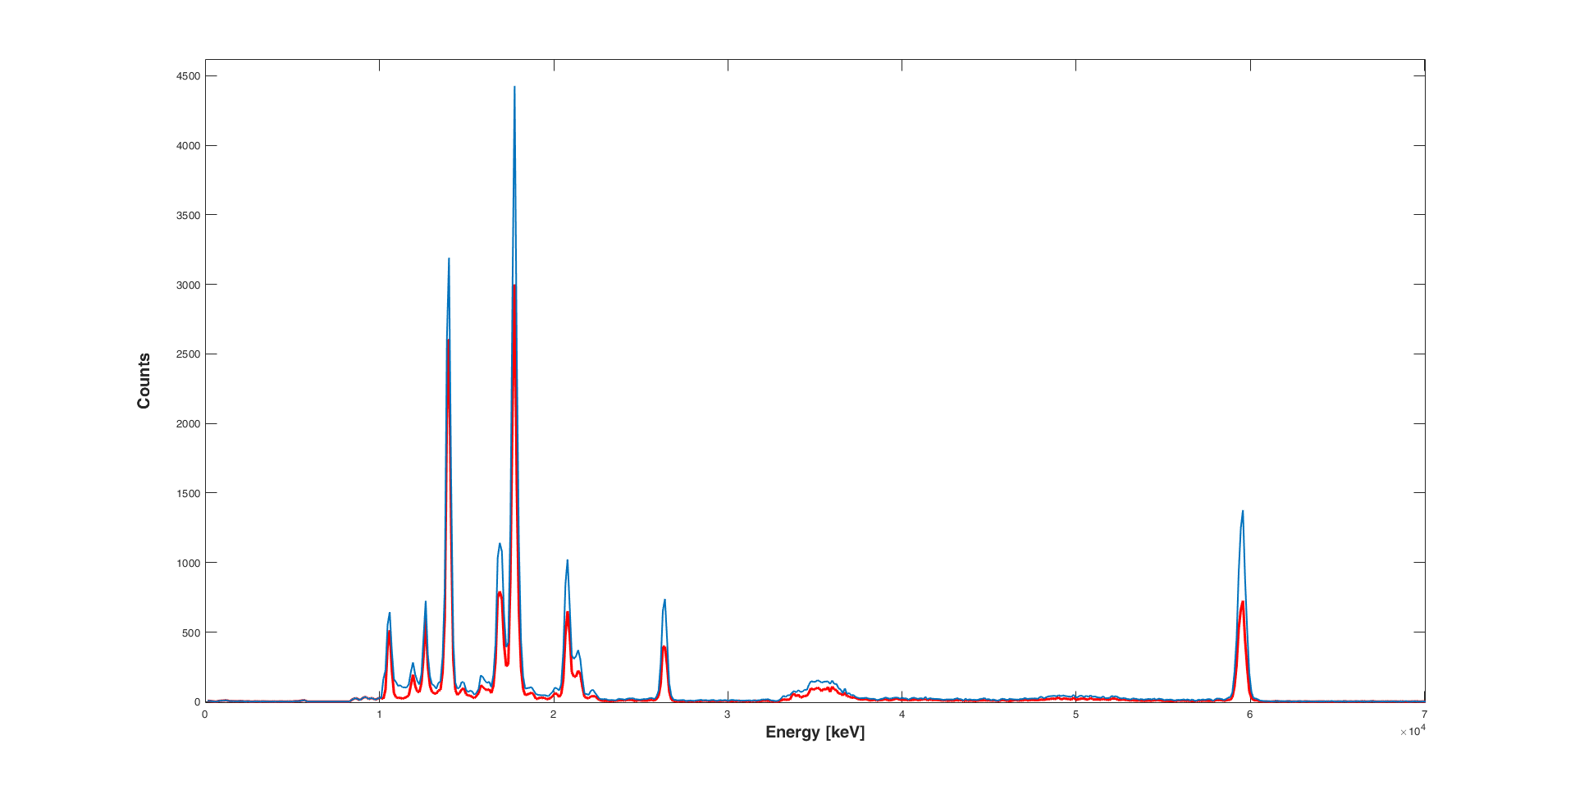
X-ray Spectroscopy Measurements
4
Top SDD
13,9keV
17,8keV
kCounts
3
Total spectrum obtained from the sum
2
20,8keV
26,4keV
59,5keV
17.8keV
Ch3 Top
1
4
13.9keV
Ch3 Top + Ch3 Bottom
0
20
3
0
10
30
40
50
60
70
kCounts
2
20.8keV
59.5keV
26.4keV
4
Bottom SDD
1
3
0
kCounts
0
10
20
30
40
50
60
70
2
17,8keV
Energy [keV]
13,9keV
20,8keV
26,4keV
59,5keV
1
0
20
0
10
30
40
50
60
70
Two-fold increase of the total count rate of the system at the 59.5 keV characteristic line of Am241.
Energy [keV]

Slide 8
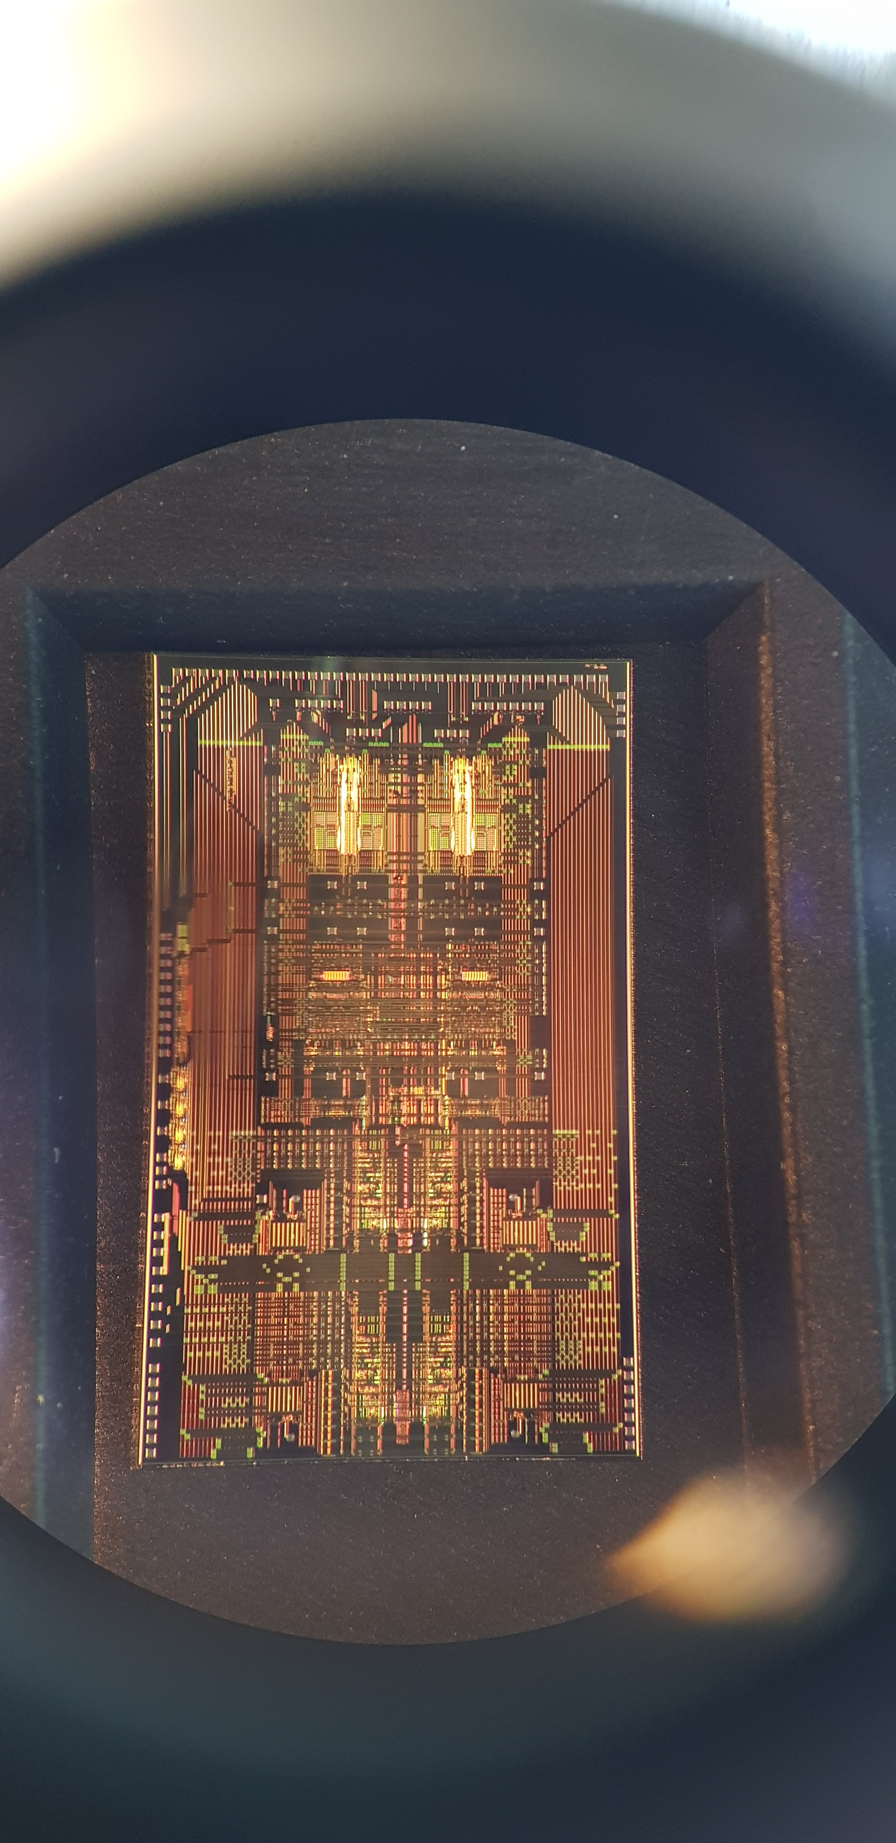
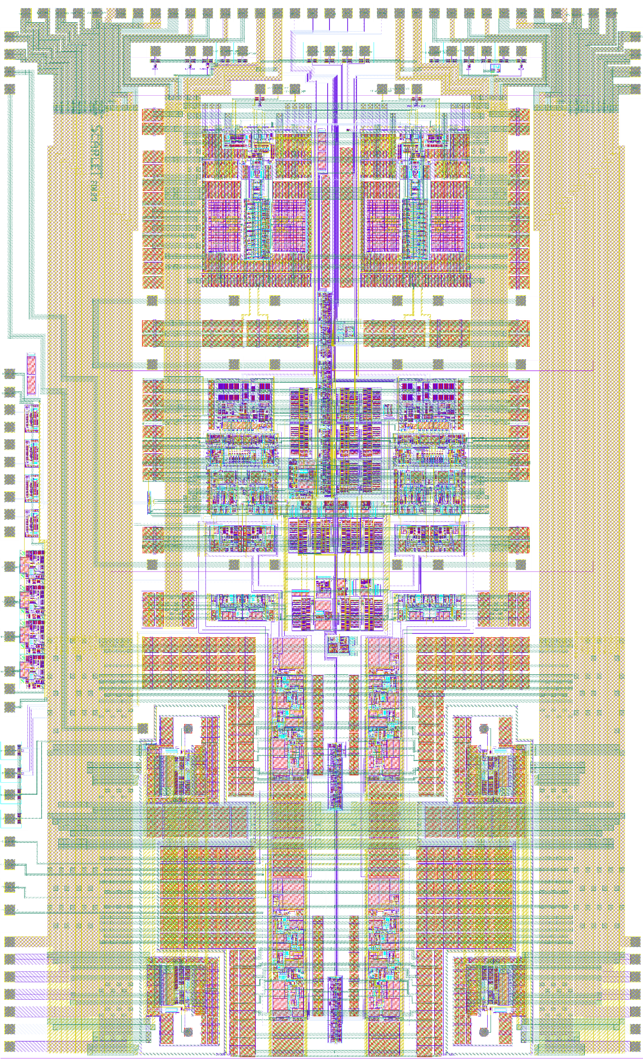
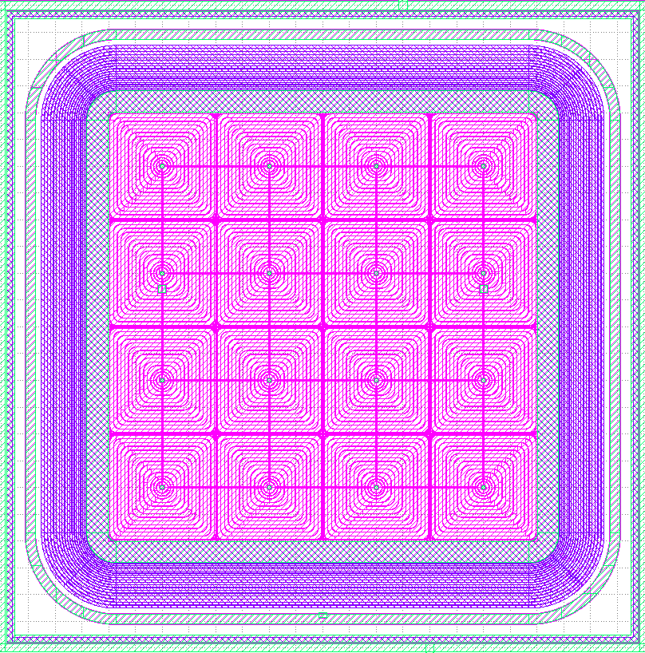
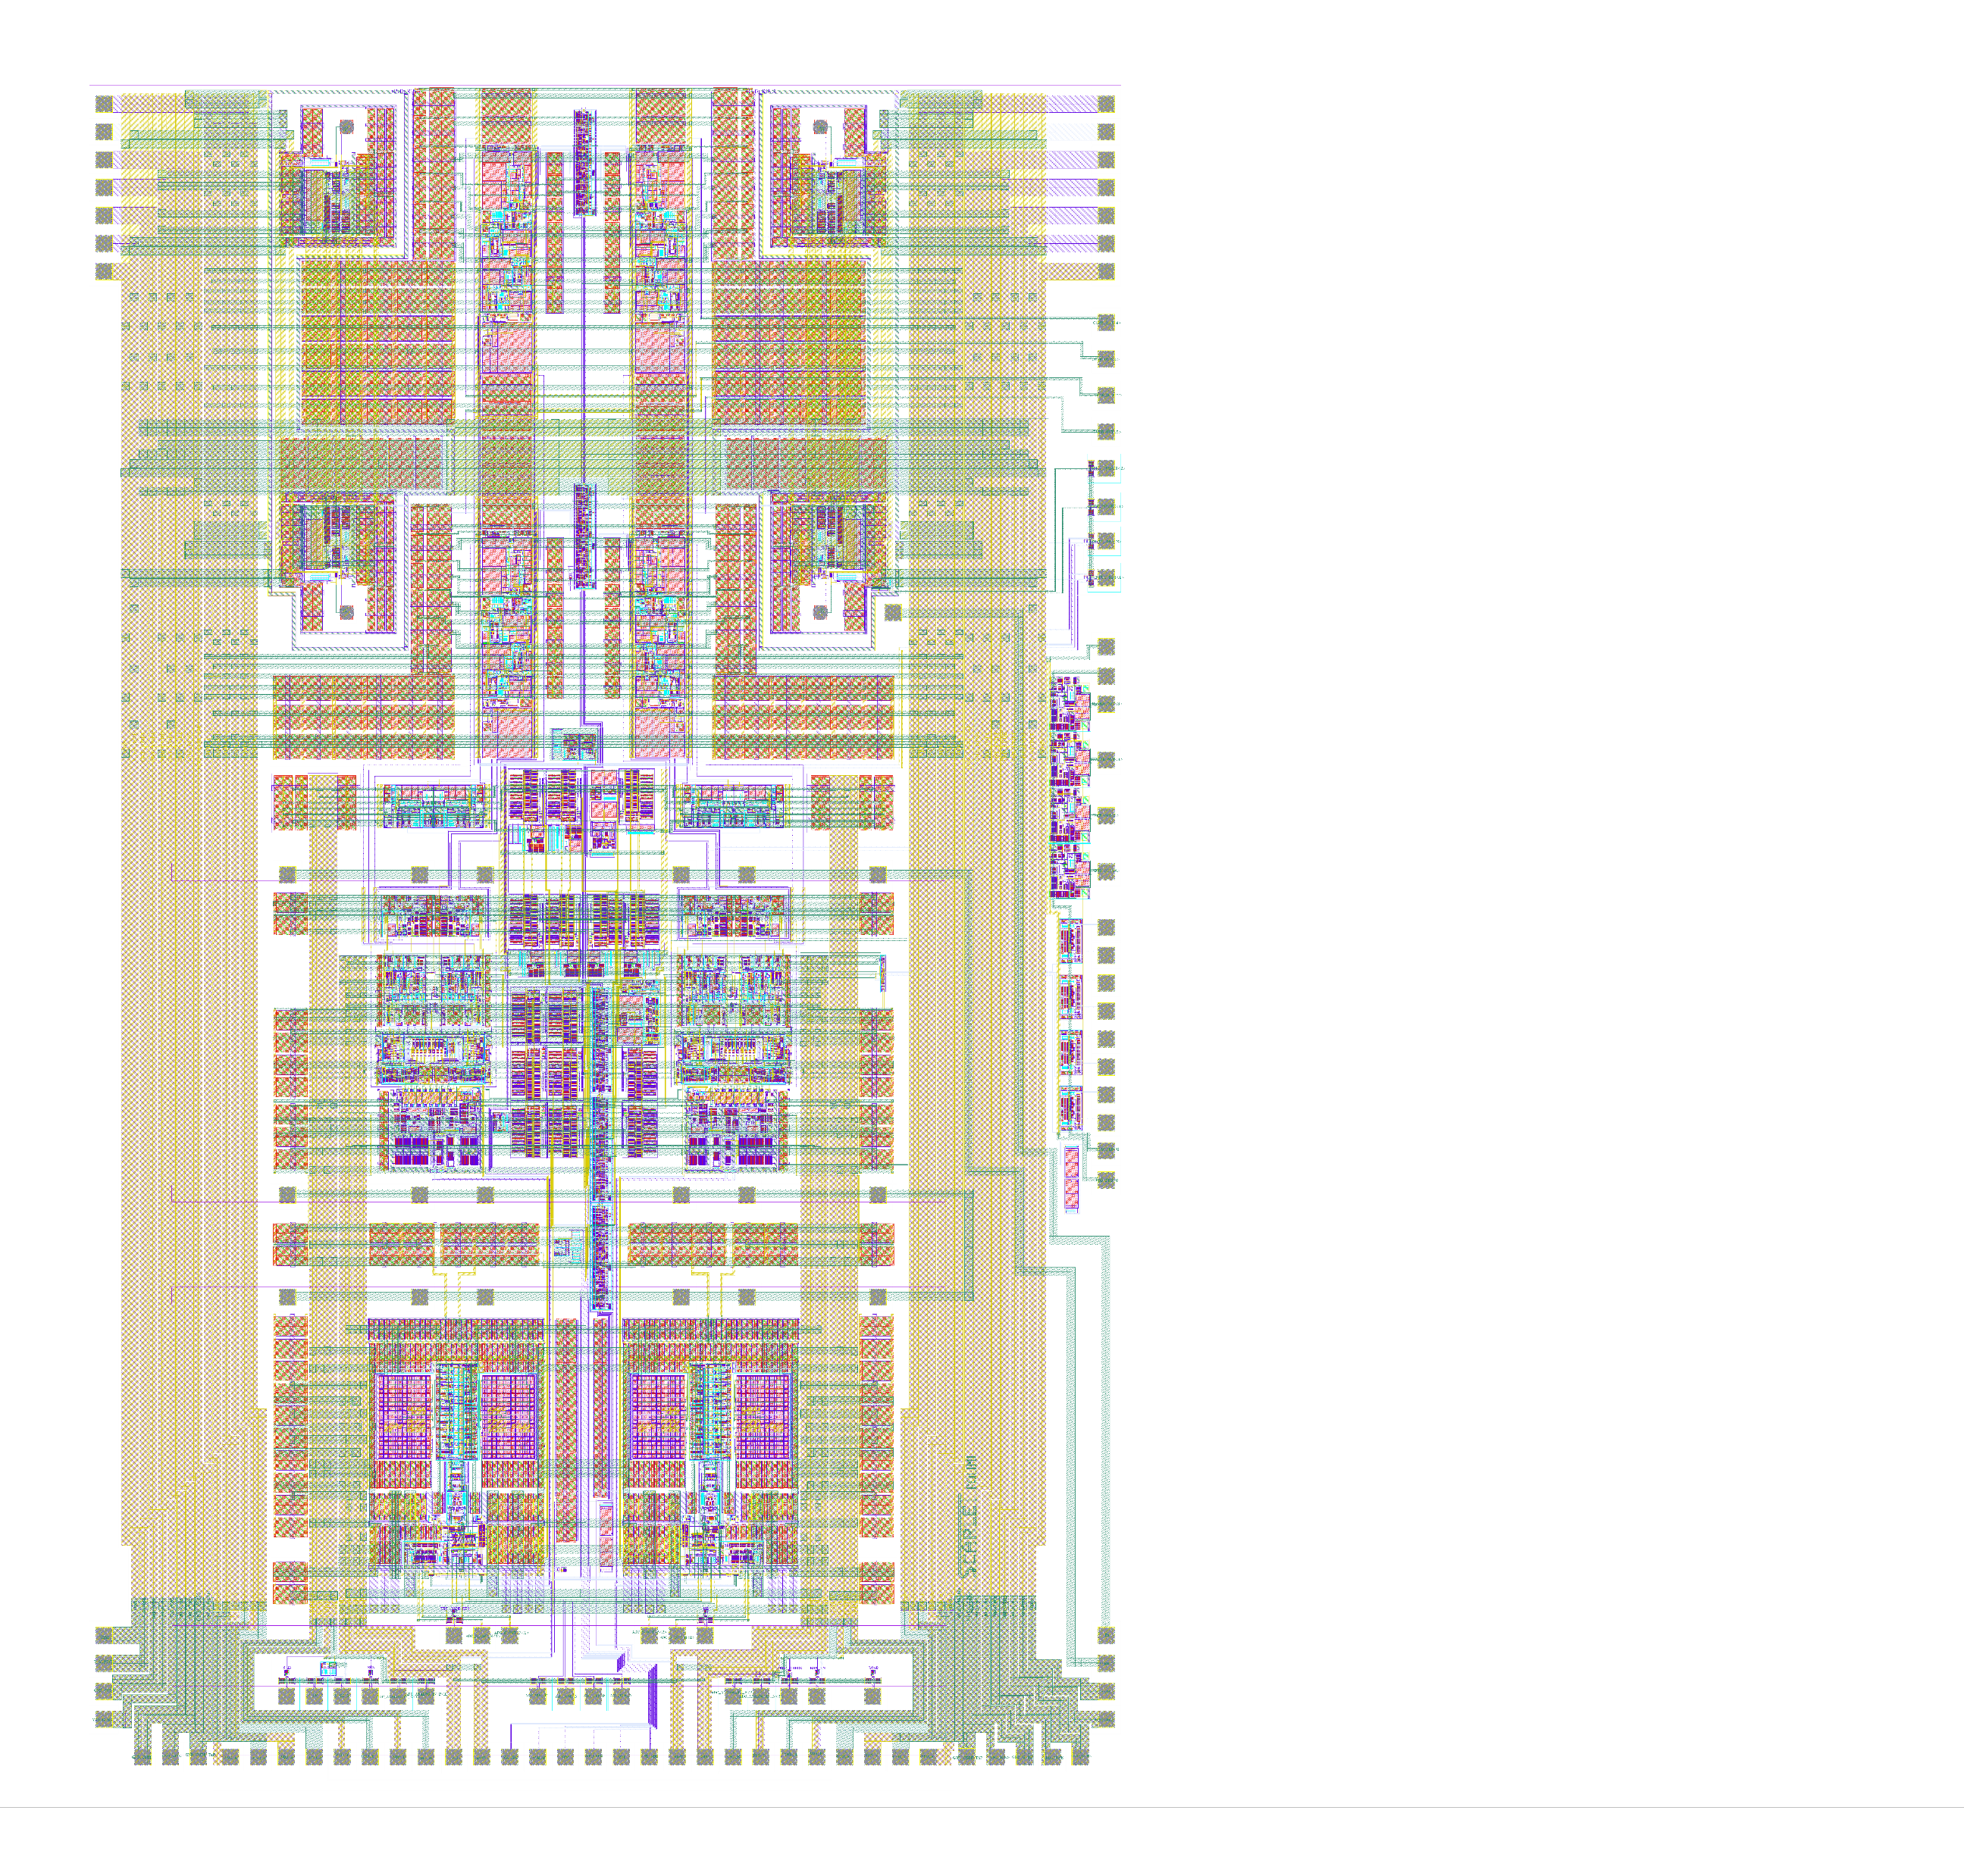
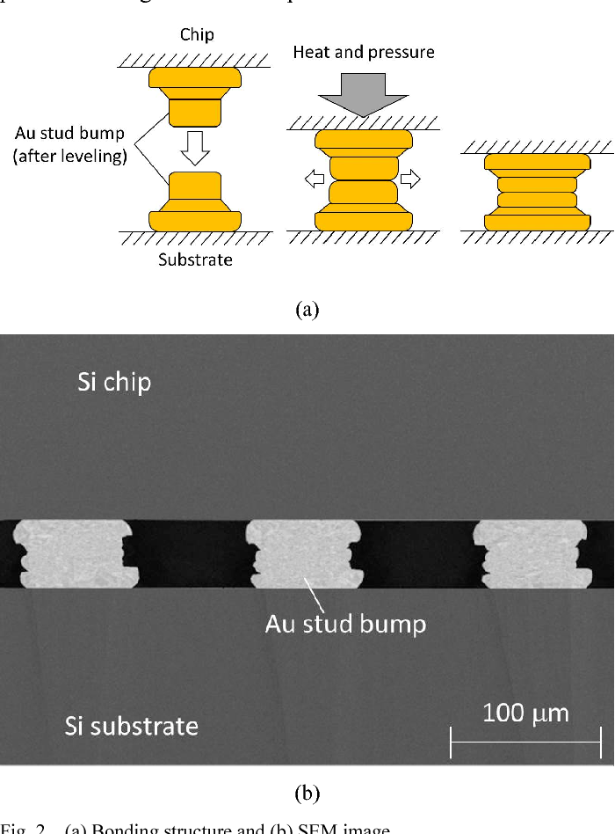
SCARLET Project
Goal of the project: Development of a readout ASIC to be coupled to pixel detectors (focus: monolithic SDDs arrays) for ultra-high rate X-ray spectroscopy.
Mechanical support and thermal sink
Two separated connections, for DAQ and power supply, respectively
Substrate with high thermal conductivity
SDD monolithic array 8x8
Collimator
Excitation beam
(photons or electrons)
ASIC features:
4 readout channels
1Mcps/pixel output count rate
full analog processing in the ASIC pixel
Res. <200eV @200ns pulse width
ADC integrated in the ASIC
4x4 readout ASIC
for each quadrant
X-rays
Sample
Bump bonding
Gold-stud bump-bonding[*]
Future SCARLET 8x8 Illustration
Chip
Heat and pressure
Au stud bump
(after leveling)
Substrate
[*] Caselle et al., J.Inst. 2016

Slide 9
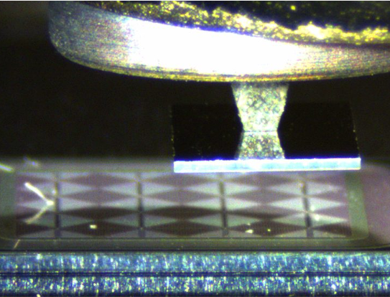
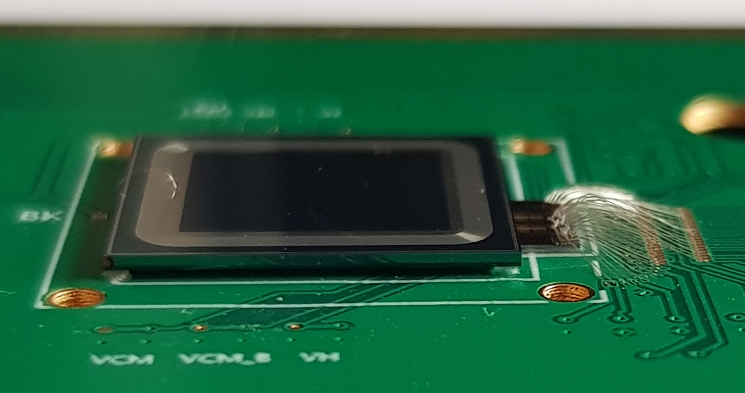
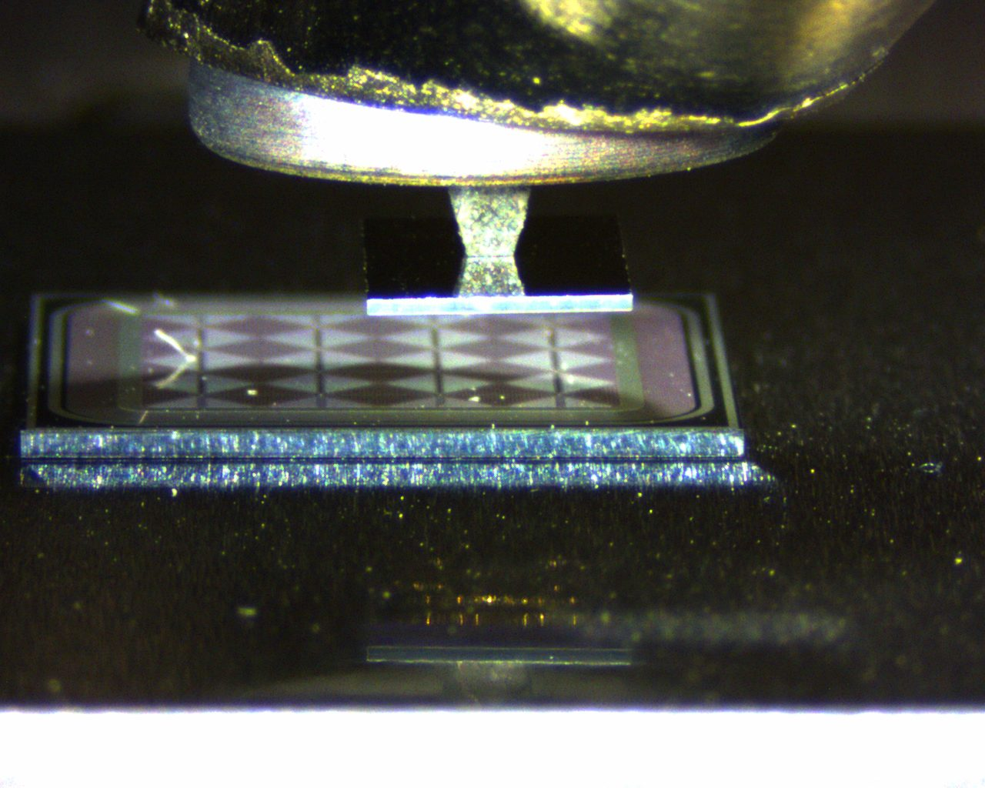
SCARLET Hybrid Detection Module
4x4 monolithic array
4 mm² pixel area
12 mm x 12 mm chip dimensions
450 μm thick; available also 1 mm thick
Produced by Fondazione Bruno Kessler (FBK)
Entrance window
SCARLET
Bump-bonding: SDD bias; anode current signal readout
Wedge-bonding: ASIC power supply; ASIC programming
2 mm
12 mm
Flip-chip assembly

Slide 10
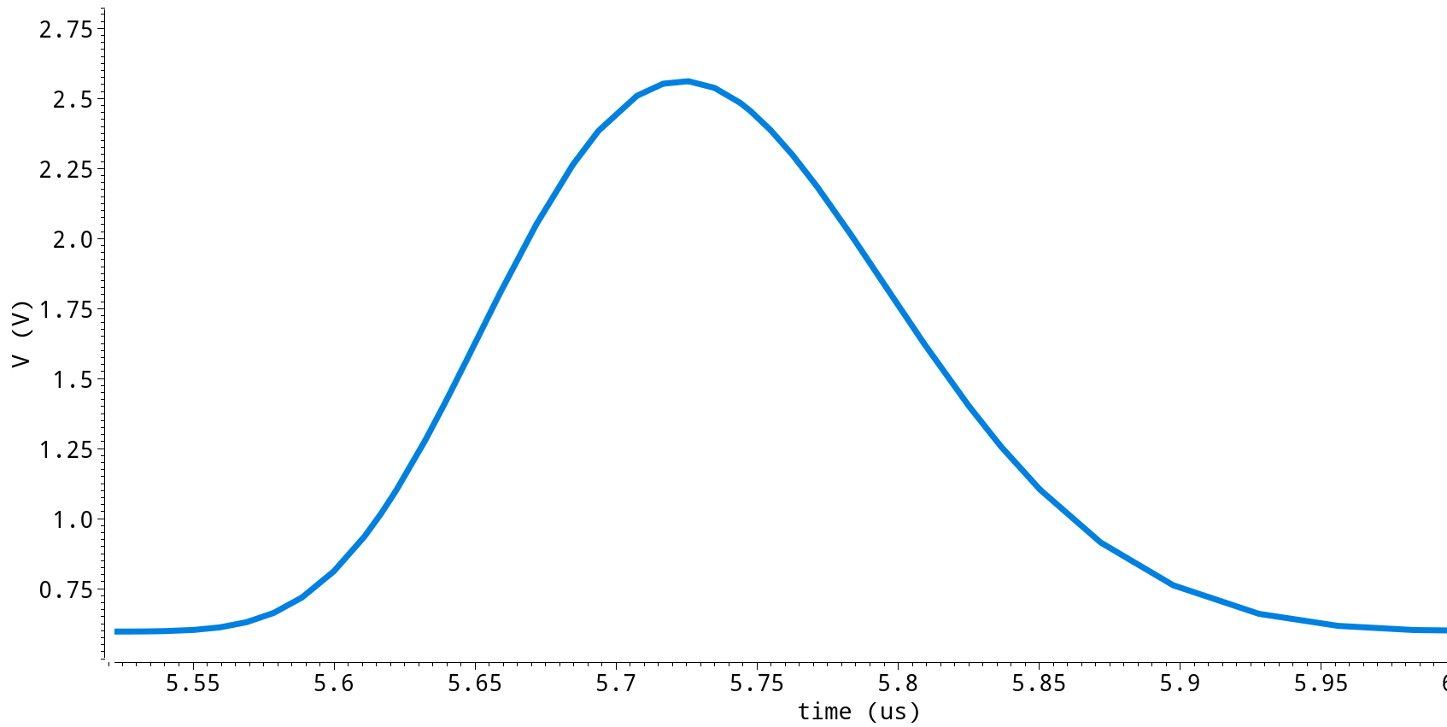
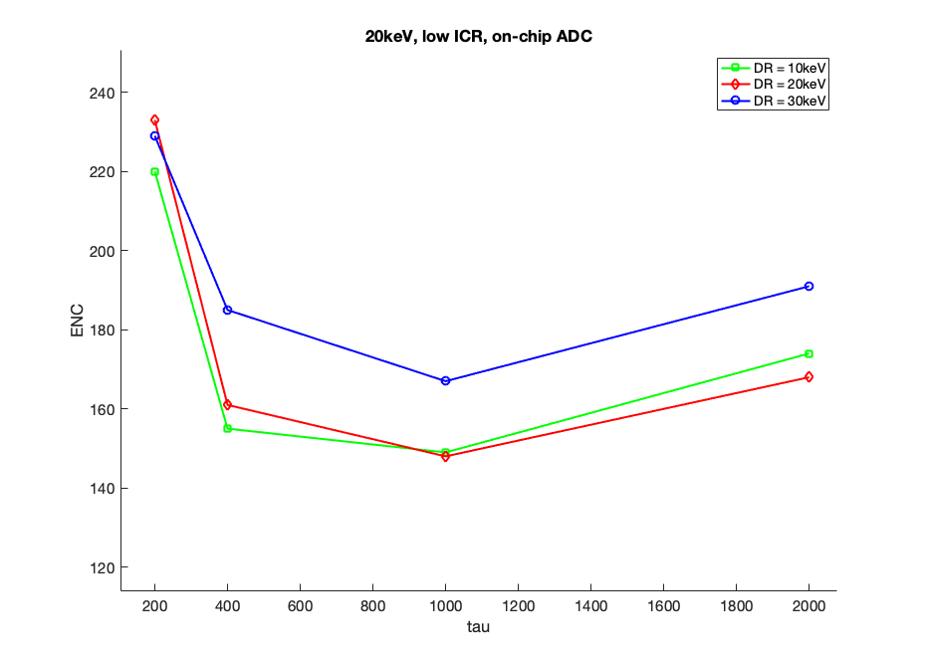
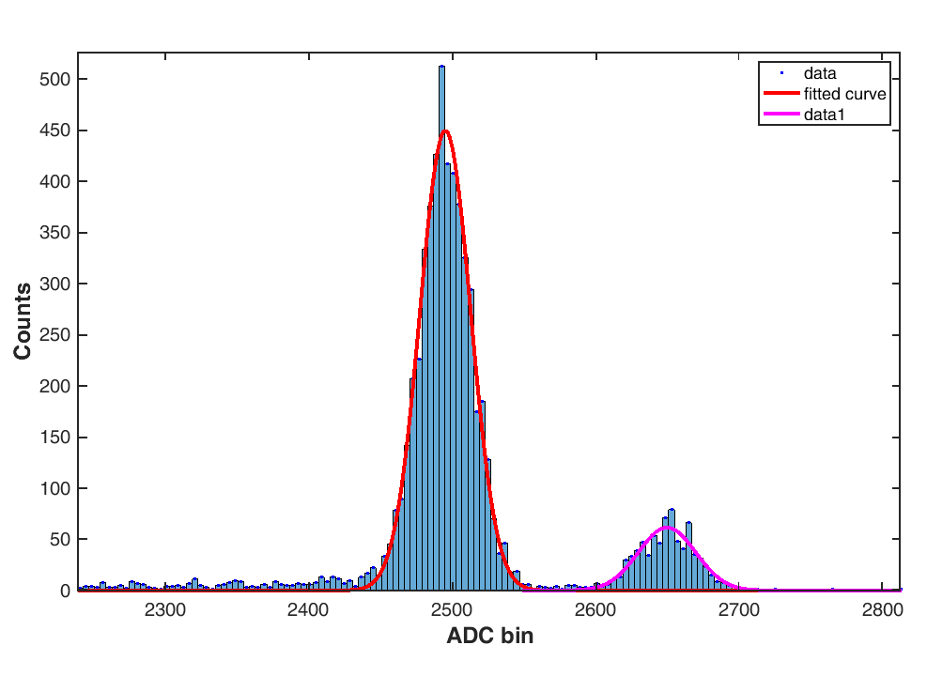


Spectroscopic Experimental Results
Iron-55 X-ray source
Spectra from internal ADC
T ~ 0°C
t_{width}
240
233eV
229eV
Mn-K$α$
5,89keV
220
220eV
200
191eV
FWHM [eV]
185eV
Counts
180
169eV
174eV
148eV FWHM
(10,3 e⁻ rms)
1us pulse width
161eV
149eV
160
168eV
140
155eV
148eV
Mn-K$β$
6,49keV
120
200
400
1000
2000
t_{width} [ns]
ADC bin

Slide 11
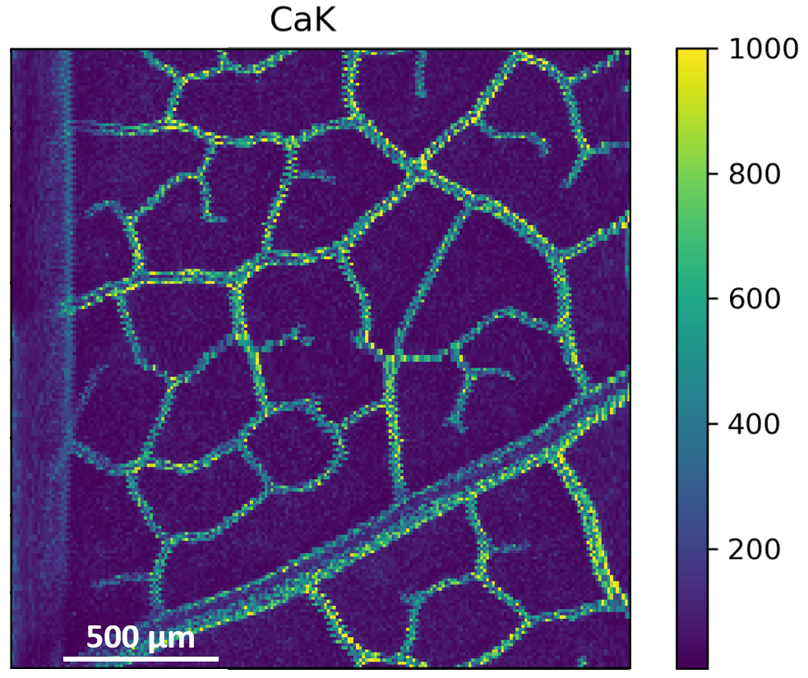

ARDESIA-16 Spectrometer
Synchrotron Radiation Source
140
[All dimensions in mm]
Monochromator
XRF
XAFS
57 ø
Energy Dispersive
Detector
170
255
Focusing
Optic
XFM
Detection Module
Emitted X-ray
Fluorescence
Incident X-rays
Sample

Slide 12
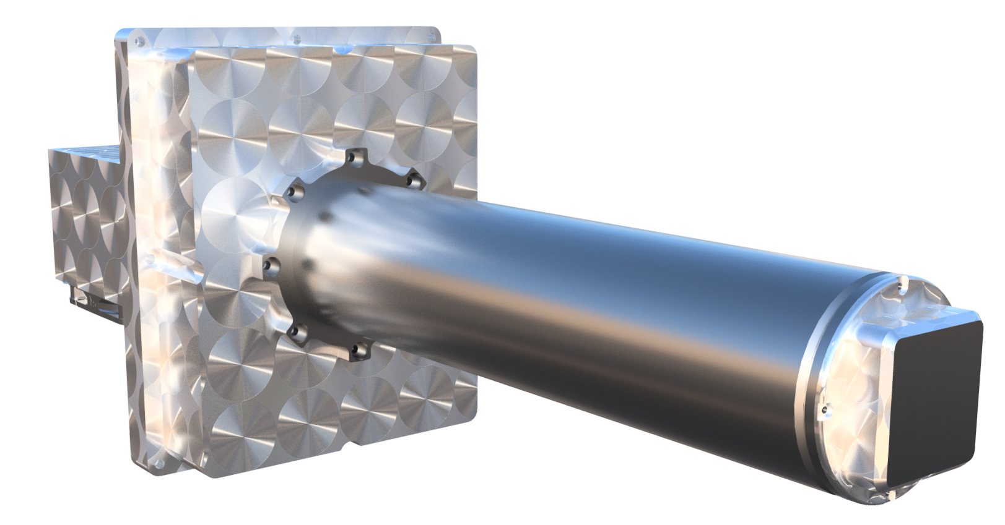
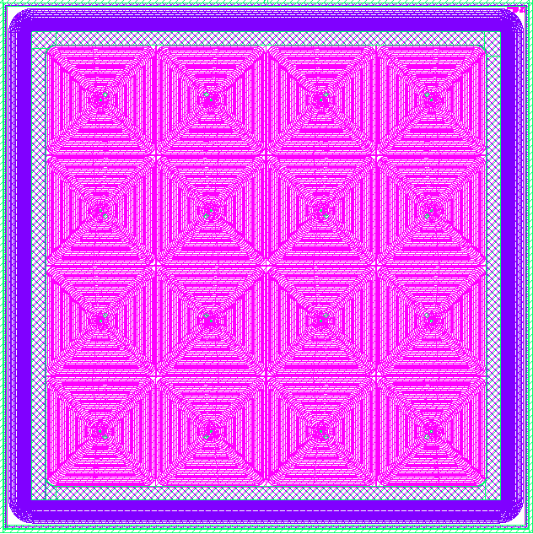
ARDESIA-16 Spectrometer
16 elements monolithic array
140
[All dimensions in mm]
4 × 4 5-mm-side
Detection Module
57 ø
170
255
24 mm
5 mm side for each pixel
Thicknesses from 450 µm to 1 mm
Produced by FBK
[*] Utica, G., et al. "ARDESIA-16: a 16-channel SDD-based spectrometer for energy dispersive X-ray fluorescence spectroscopy." Journal of Instrumentation 16.07 (2021): P07057.

Slide 13
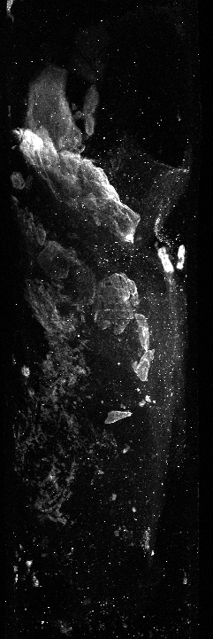
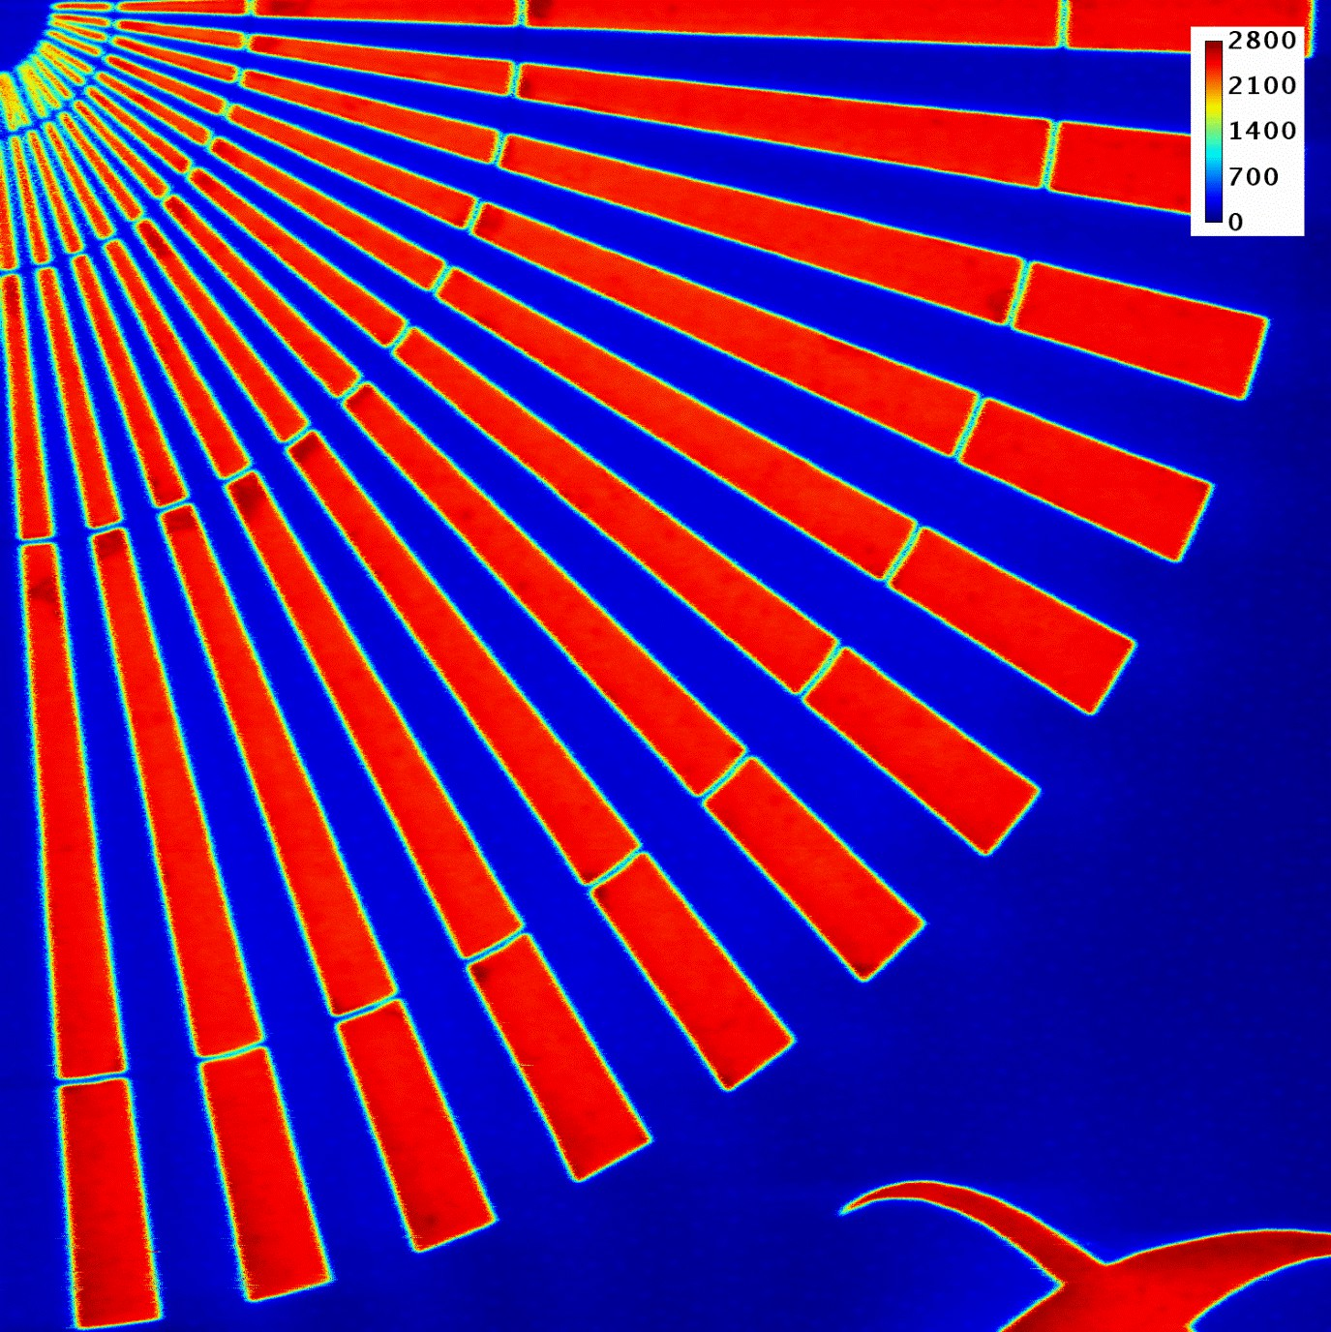
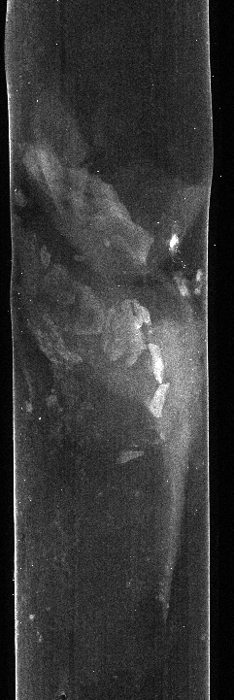
ESRF ID16A – DESY PETRA III P06
High-Definition nano-XRF (Courtesy: Peter Cloetens)
Step size: 10 nm
Dwell time: 15 ms
Atherosclerotic plaques on an arthritic bone
Dwell time: 10 ms
Courtesy: Peter Modregger (Univ. Siegen)
Fe-Kα
Cu-Kα

Slide 14
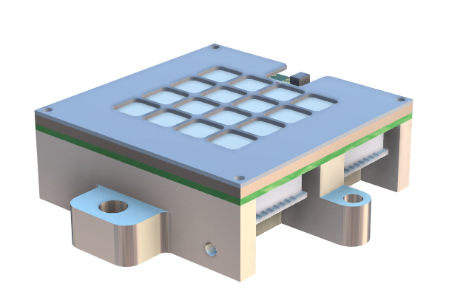
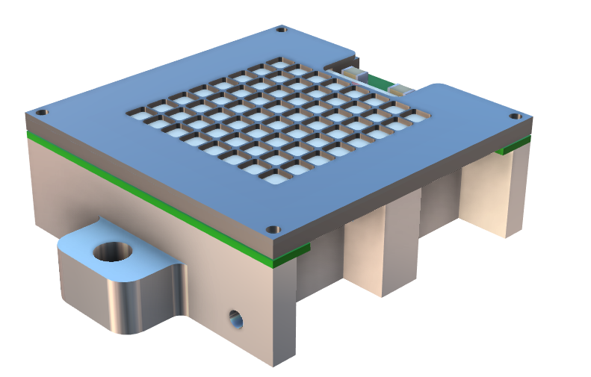

Towards ARDESIA-64
ARDESIA-16
ARDESIA-64
140
Sample
Higher-intensity X-ray beam
Sample
X-ray beam
[All dimensions in mm]
Fluorescence emission
Increased fluorescence emission
Advantages:
Lower experiment time
Higher rate
Increased mapping resolution
57 ø
170
255
17 Mcps
100 Mcps

Slide 15
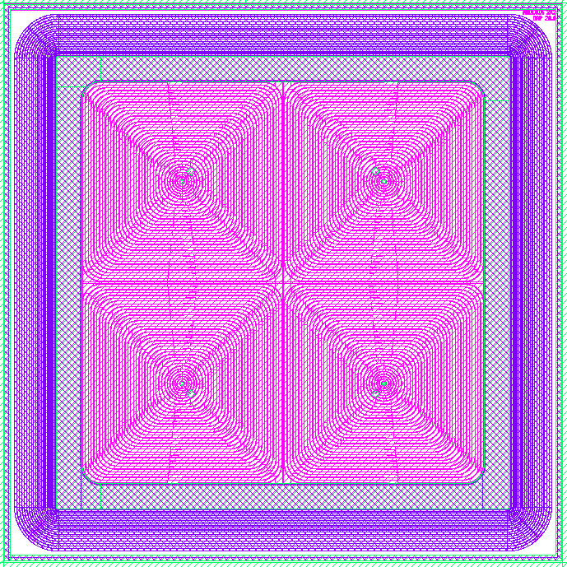
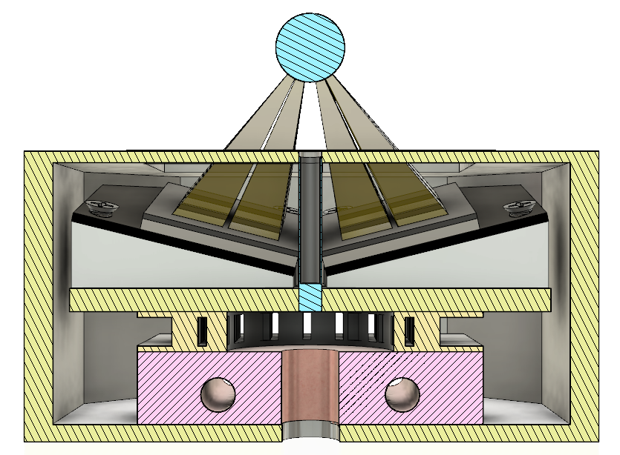
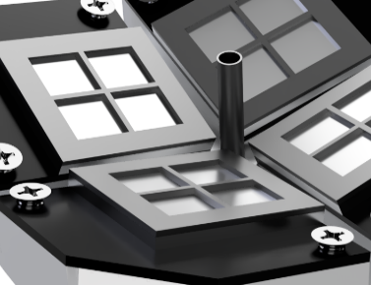
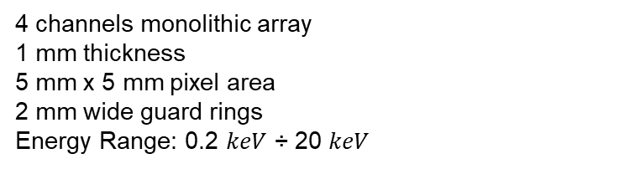

ASCANIO Detection Module
Designed for X-ray fluorescence microscopy (XFM) imaging in synchrotron beamlines
4 channels monolithic array
1 mm thickness
5 mm x 5 mm pixel area
2 mm wide guard rings
Energy Range: 0.2 $keV$ ÷ 20 $keV$
Sample fluorescence light
Sample
Top Beryllium window
14 $mm$
Mo needle
SDDs modules
PCB
Peltier cell
SDD
Copper block
Aluminum enclosure
Bottom
Beryllium window
Mo collimator
X-ray beam

Slide 16

ASCANIO Output Count Rate
Assumption: largest solid angle channels operate at 2 Mcps*
[*] Scoullar P A, McLean C C and Evans R J 2011 Real time pulse pile-up recovery in a high throughput digital pulse processor AIP Conference Proceedings vol 1412 (American Institute of Physics) pp 270–277.

Slide 17
⁵⁵Fe source Spectroscopy Measurements
High energy resolution for high count rate measurements
FWHM = 129 eV
PT = 2 us
FWHM = 175 eV
PT = 32 ns
Measures performed with Dante DPP (XGlab)

Slide 18


Towards a 4π Detection System
Goal: Development of a 4π detection system based on arrays of SDD detectors able to measure directionality of the signal (X-ray emitted by central target)
22,8 mm
57,5 mm
8 mm

Slide 19
Conclusions and Future Work
We presented the adoption of SDDs in different configurations to enhance properties like, detection efficiency, throughput capability and compactness, in addition to high-energy resolution.
Ongoing activities:
Miniaturization of SDD element
Absorption efficiency
Bump-bonding technology
Stacked SDDs
ARDESIA-64
SCARLET project
Solid angle
ASCANIO
4π

Slide 20
Thank you for your attention!
griseld.deda@polimi.it

