Slide 1

Negative muons for cultural heritage: technique overview and developments
Matteo Cataldo
High Precision X-ray Measurement conference, Frascati
19th June 2023

Slide 2
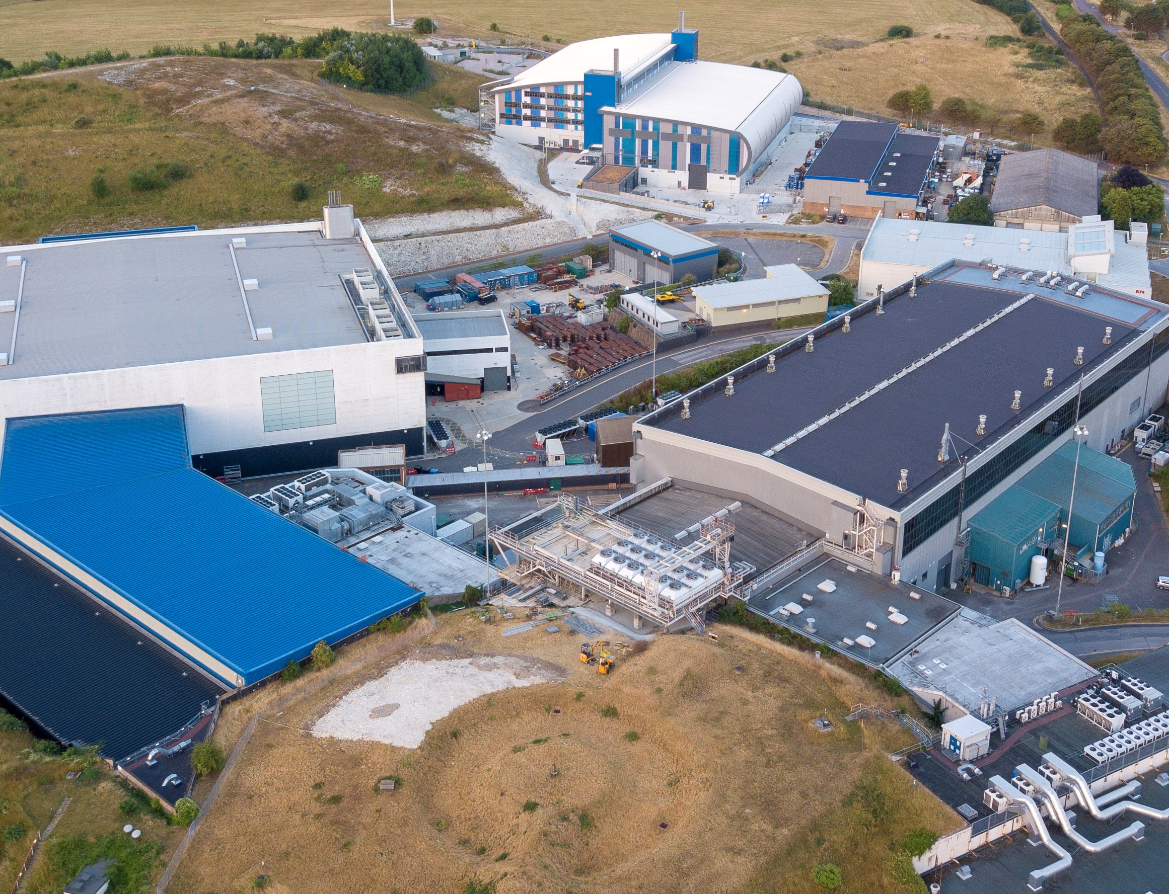
Outline
Scientific Background
Technique development:
  Geant4/Arby validation
  Data analysis with MC simulations
  A case study on Gildings
Final remarks

Slide 3
1. Scientific background
M. Cataldo, HPXM 23, 19th June 2023
When a Negative muon interacts with matter, a “Muonic atom” is formed.
μ
-/+
^{207 times the e-}
µ⁺ 2.2μs
µ⁻ ≤ 2.2μs
The radiation is characteristic of the emitting atom and can be used for material characterization (0.01 – 6 MeV range)[1,2].
As the muon travel towards the nucleus, high energy muonic X-rays are emitted.
[1] Engfer R., Atomic data and nuclear tables,14, 509-597 (1974); [2] Sturniolo, S, Hillier, A. X‐Ray Spectrom. 2020; 1– 17

Slide 4
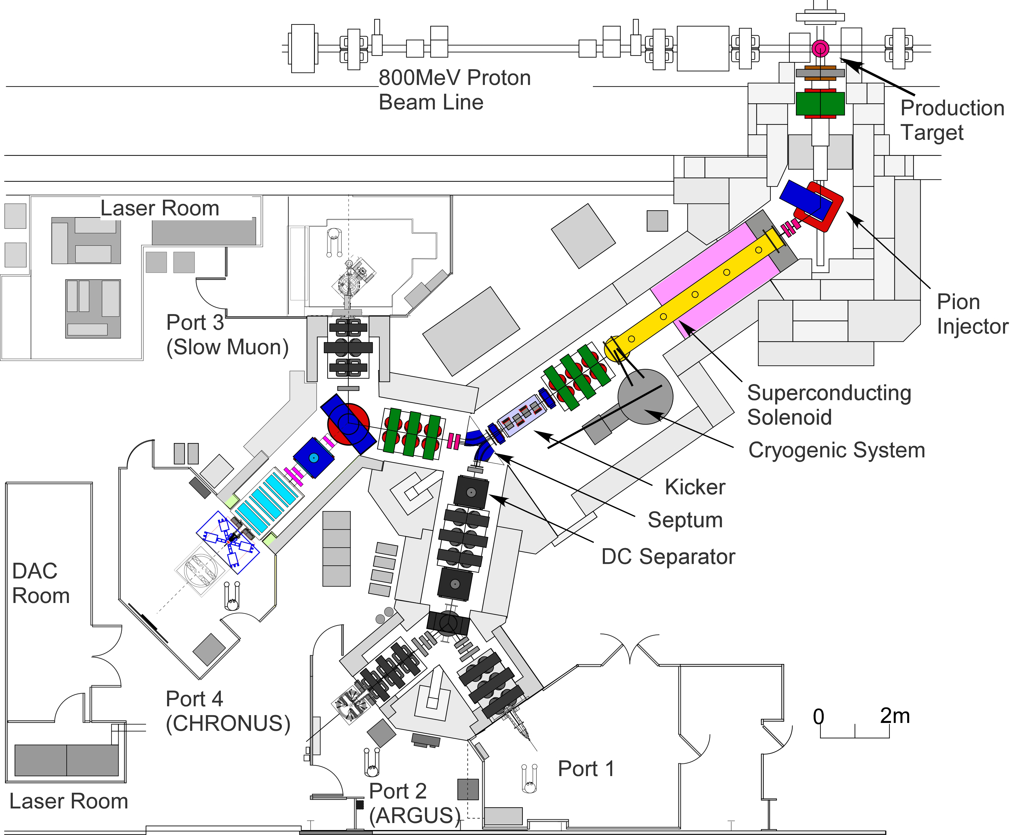
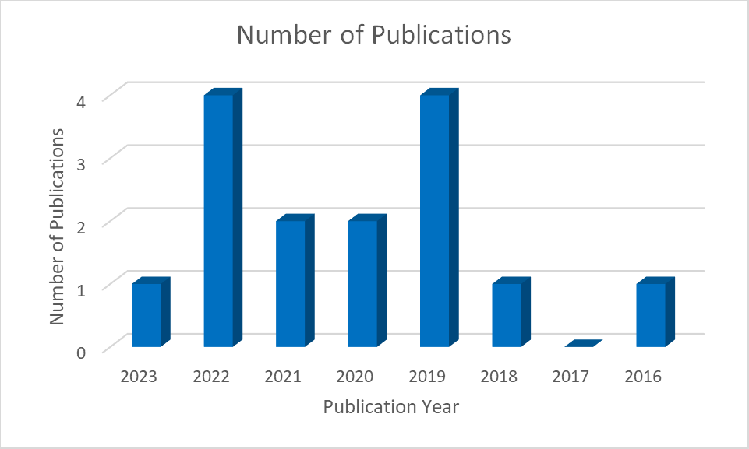

1. Scientific background
M. Cataldo, HPXM 23, 19th June 2023
The technique based on this process is called Muonic atom X-Ray Emission spectroscopy (µ-XES) and is performed at the RIKEN-RAL Facility at the ISIS Neutron and Muon Source (UK).

Slide 5
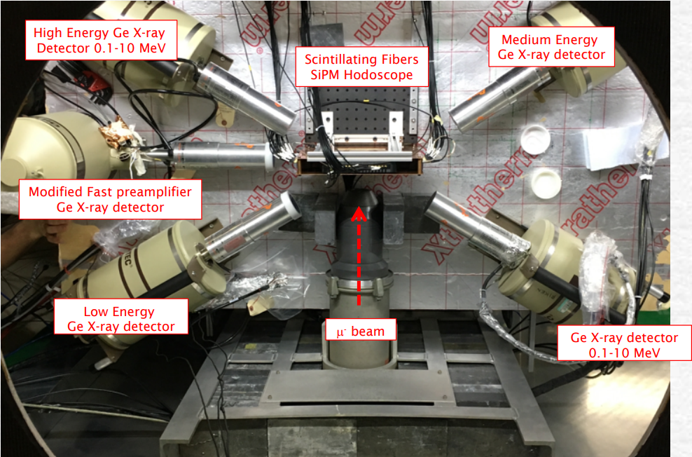
1. Scientific background: the instrument
M. Cataldo, HPXM 23, 19th June 2023
The instrument set up is composed by 4 HPGe detectors that cover a wide energy range

Slide 6
1. Scientific background: Why muons?
M. Cataldo, HPXM 23, 19th June 2023
Multi-elemental
sensitive to almost all elements
Elemental characterization
Penetration depth is remarkable: Momentum & Density dependent: ~ 1cm in metals
Depth Profiling studies
Non-destructive probe
Fundamental for experiment on cultural heritage artefacts
No activation of samples
Self- absorption effect is less significant

Slide 7
1. Scientific background
M. Cataldo, HPXM 23, 19th June 2023
Validating a Monte Carlo simulation software that implements:
the physical processes involved in the muon interaction with matter;
Experimental conditions for better data interpretation;
A new detector set-up.
µ-XES is a very powerful technique
but it still has limitations:
Poor solid angle coverage
Long Measurement time
Low sensitivity
What are we doing to improve?
The software is called «Arby» and it’s a Geant4 based tool

Slide 8
How can we improve data treatment with Monte Carlo simulations?
M. Cataldo, HPXM 23, 19th June 2023
2. Technique development
By reproducing the muon interaction and collecting the emitted X-ray. In This will provide another way to perform quantitative analysis
But
Geant4 is not yet fully reliable: the simulations of many different elements showed some missing information in the simulated spectra
By reproducing a sample and collecting the information of the number of muons stopped in the material, like SRIM-TRIM.
Especially when doing depth profiling, simulation can help in defining the thickness of a layer and give a results that is easy to handle.
This has been done for some sample with interesting results

Slide 9
M. Cataldo, HPXM 23, 19th June 2023
2.1 Geant4/Arby validation
Copper spectra measured at the ISIS Neutron and muon source. Cu is easy identified by a double peak in the low and high energy range

Slide 10
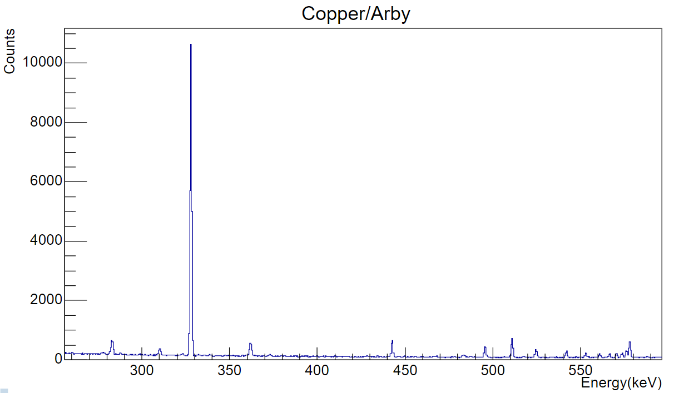
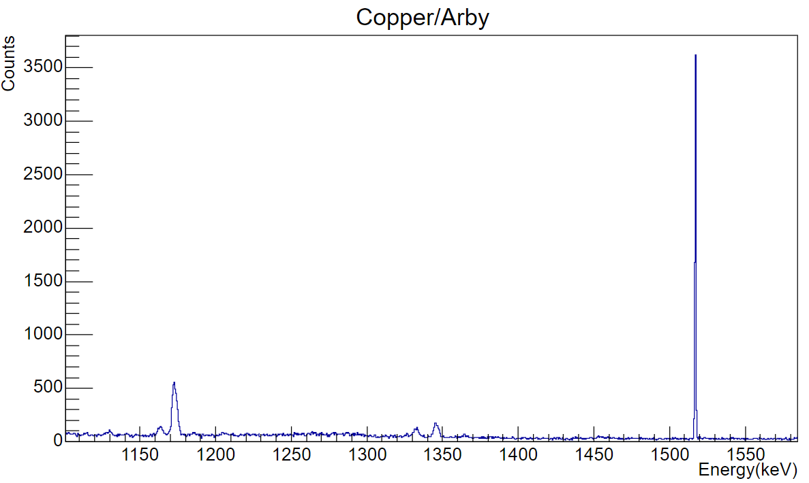
M. Cataldo, HPXM 23, 19th June 2023
2.1 Geant4/Arby validation
Copper spectra simulated with Geant4. The Cu double peaks are missing
(Simulation performed with a HPGe crystal)
330
1507

Slide 11
M. Cataldo, HPXM 23, 19th June 2023
2.1 Geant4/Arby validation
The genat4 classes responsible of the process of muonic atoms formation and radiative deexcitation are:
G4MuonMinusCapture
G4EmCaptureCascade
The cascade class was developed years ago and very small modifications have been made since then.
The main problem is the incorrect x-ray emission lines for high Z atoms, especially in the high energy range (K-shell transitions). This was evaluated for a bunch of elements. For Z ≤ the software works ok.
A solution can be provided by MuDirac, a software that calculates muonic transition energies [2]
The idea is to create a database of energies from which Geant4 can draw when simulating
[2] Sturniolo, S, Hillier, A. X‐Ray Spectrom. 2020; 1– 17

Slide 12
M. Cataldo, HPXM 23, 19th June 2023
2.1 Geant4/Arby validation
Simulated copper spectra with MuDirac. Cu double peaks are present.

Slide 13
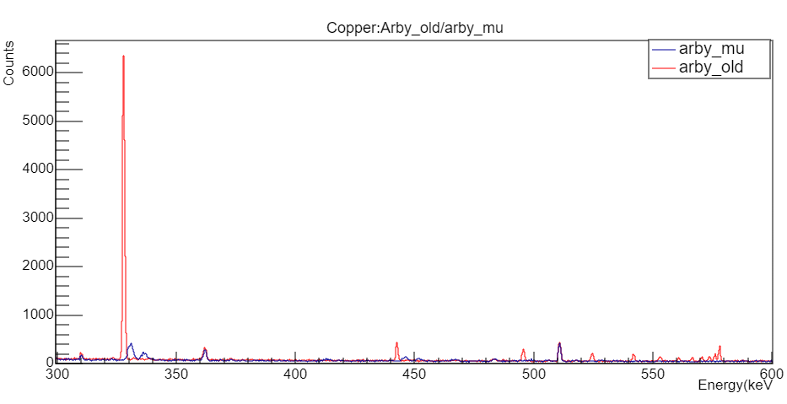
M. Cataldo, HPXM 23, 19th June 2023
2.1 Geant4/Arby validation
MuDirac has been implemented in Geant4/ARBY. The blue spectra is the updated version, while the red one the old. Double peaks are now present, but some information is missing at the higher energies.

Slide 14
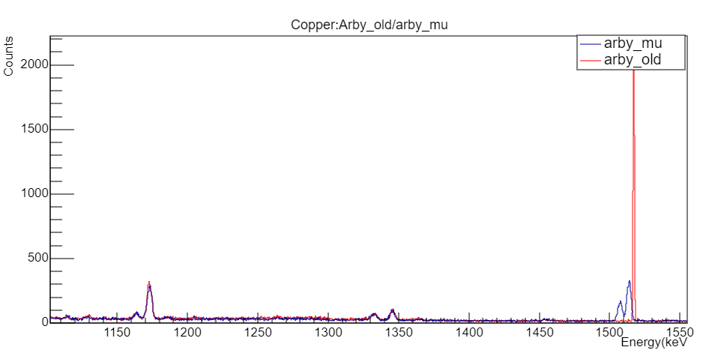
M. Cataldo, HPXM 23, 19th June 2023
2.1 Geant4/Arby validation

Slide 15
M. Cataldo, HPXM 23, 19th June 2023
2.1 Geant4/Arby validation
The approach provided by Mudirac has produced some interesting results.
However, it has some drawbacks:
The intensities of Mudirac simulated spectra are not correct (as Geant4 presumably)
When using Mudirac, the information about the cascade process is lost, since the software is using a single energy value.
How can this be improved?
MuDirac 2.0 is being developed, with the aim of resolving the intensities issues
Comparison of measurements of real standards with the simulations, to evaluate Geant4 intensities
Use real measurements to scale Mudirac intensities
Find a compromise between the two software

Slide 16
How can we improve data treatment with Monte Carlo simulations?
M. Cataldo, HPXM 23, 19th June 2023
3. Data analysis: developments
By reproducing the muon interaction and collecting the emitted X-ray. In This will provide another way to perform quantitative analysis
But
Geant4 is not yet fully reliable: the simulations of many different elements showed some missing information in the simulated spectra
By reproducing a sample and collecting the information of the number of muons stopped in the material, like SRIM-TRIM.
Especially when doing depth profiling, simulation can help in defining the thickness of a layer and give a results that is easy to handle.
This has been done for some sample with interesting results

Slide 17
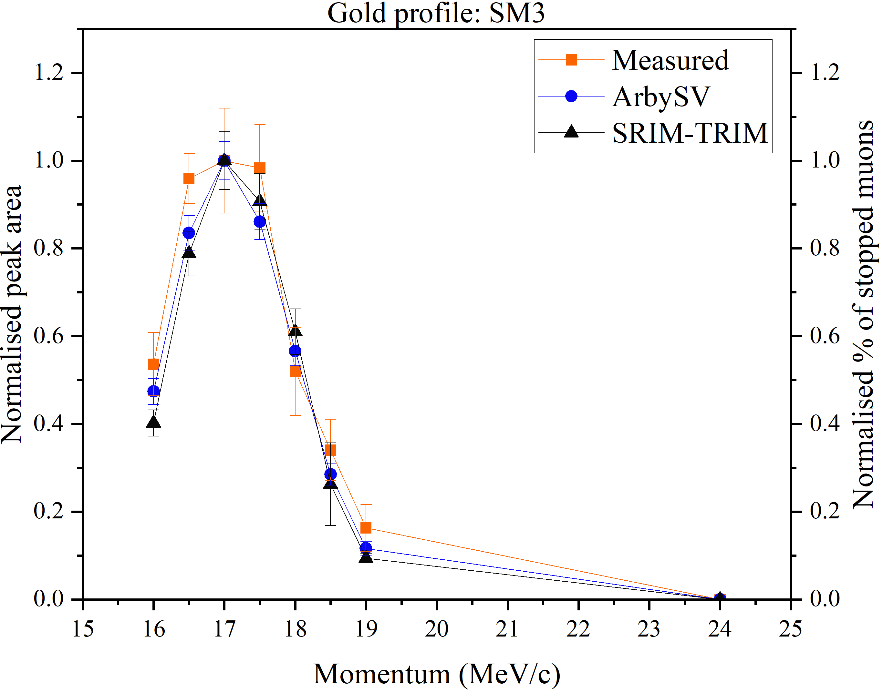
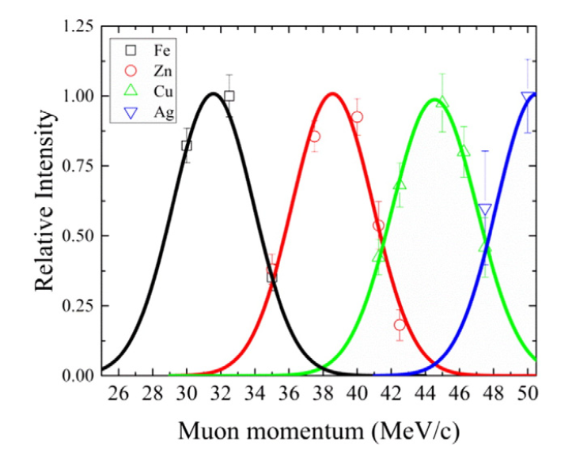
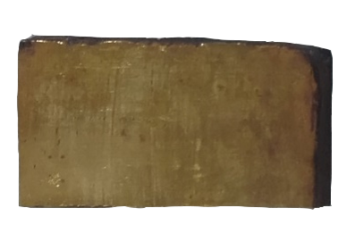
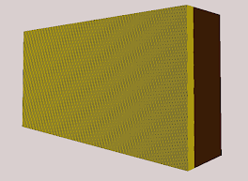
2.2. Data analysis with MC simulations
M. Cataldo, HPXM 23, 19th June 2023
Muon momentum can be tuned so that the muons are stopped in different layers
A real sample (gilded), with two layer is reproduced in the MC software and muon interaction is simulated
The results of the simulation are compared with experimental results. Here, we compared SRIM-TRIM and Geant4 with simulations to get a 11 um thickness of the gold layer.

Slide 18
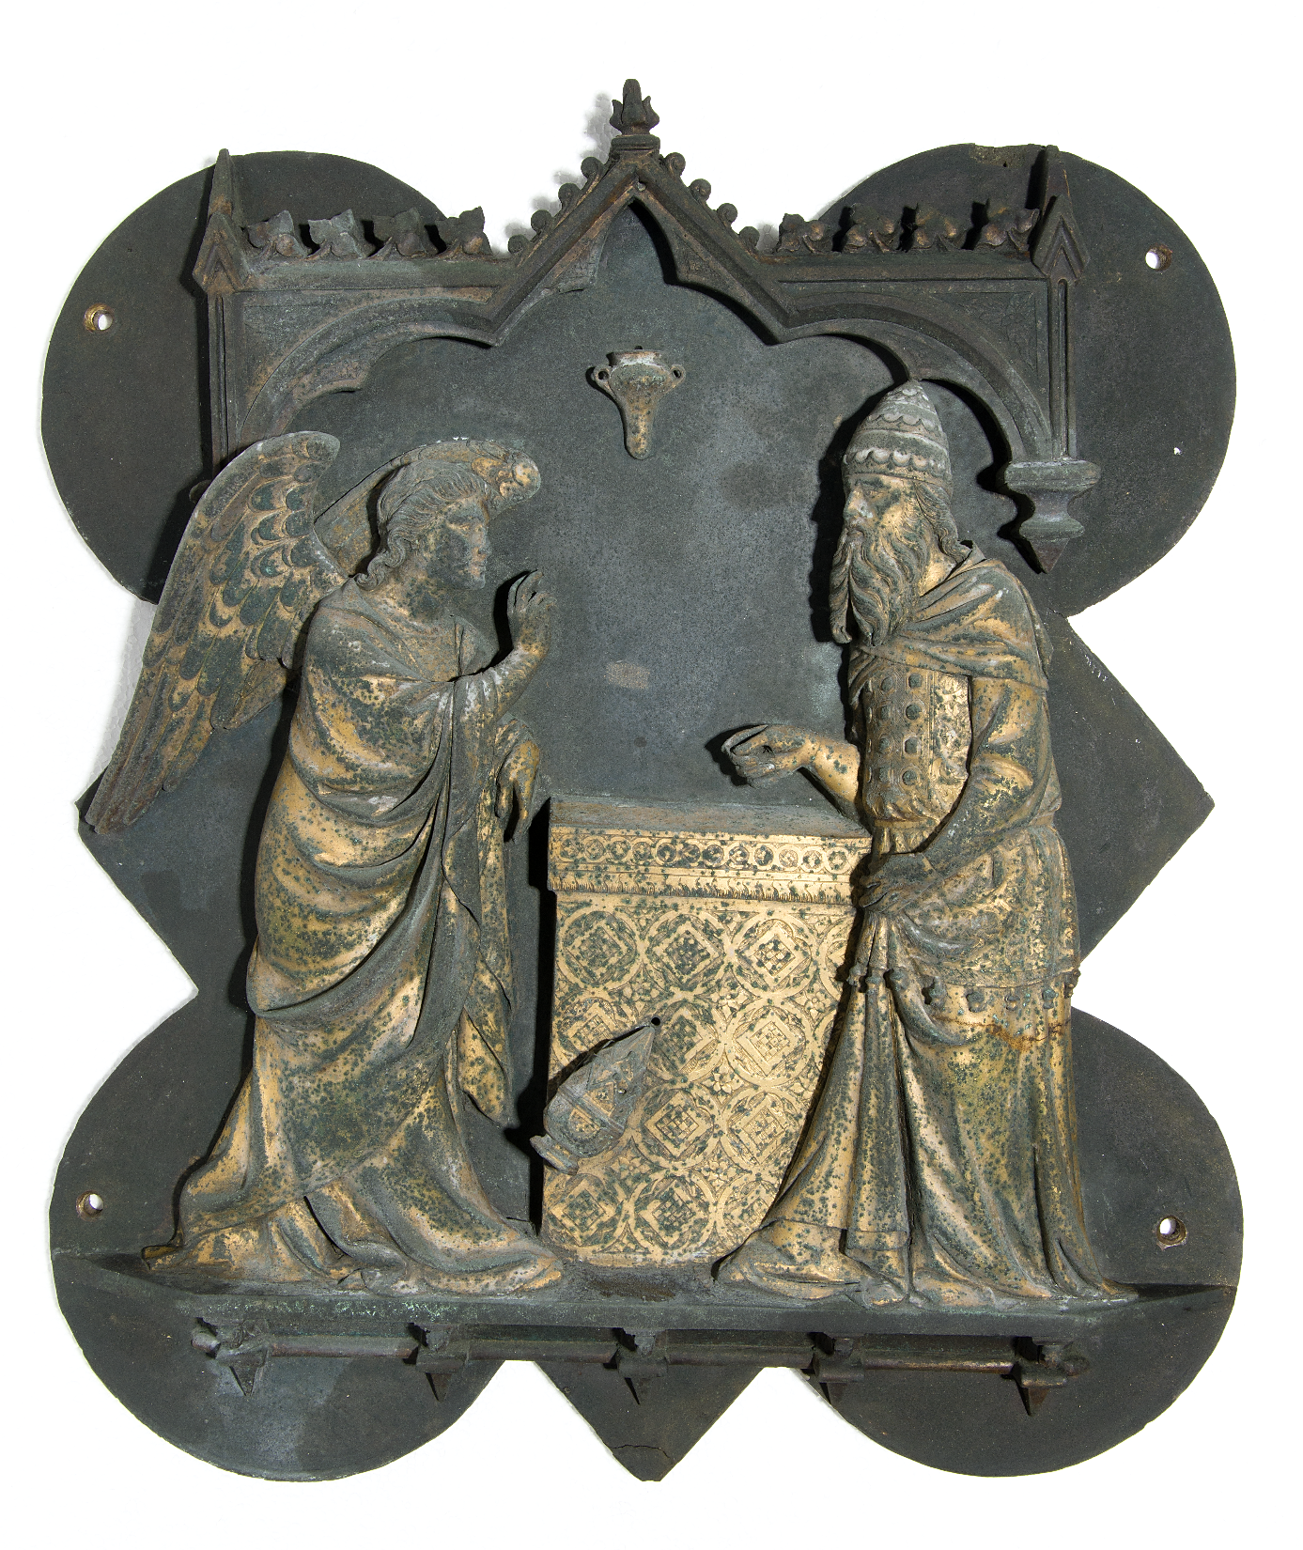
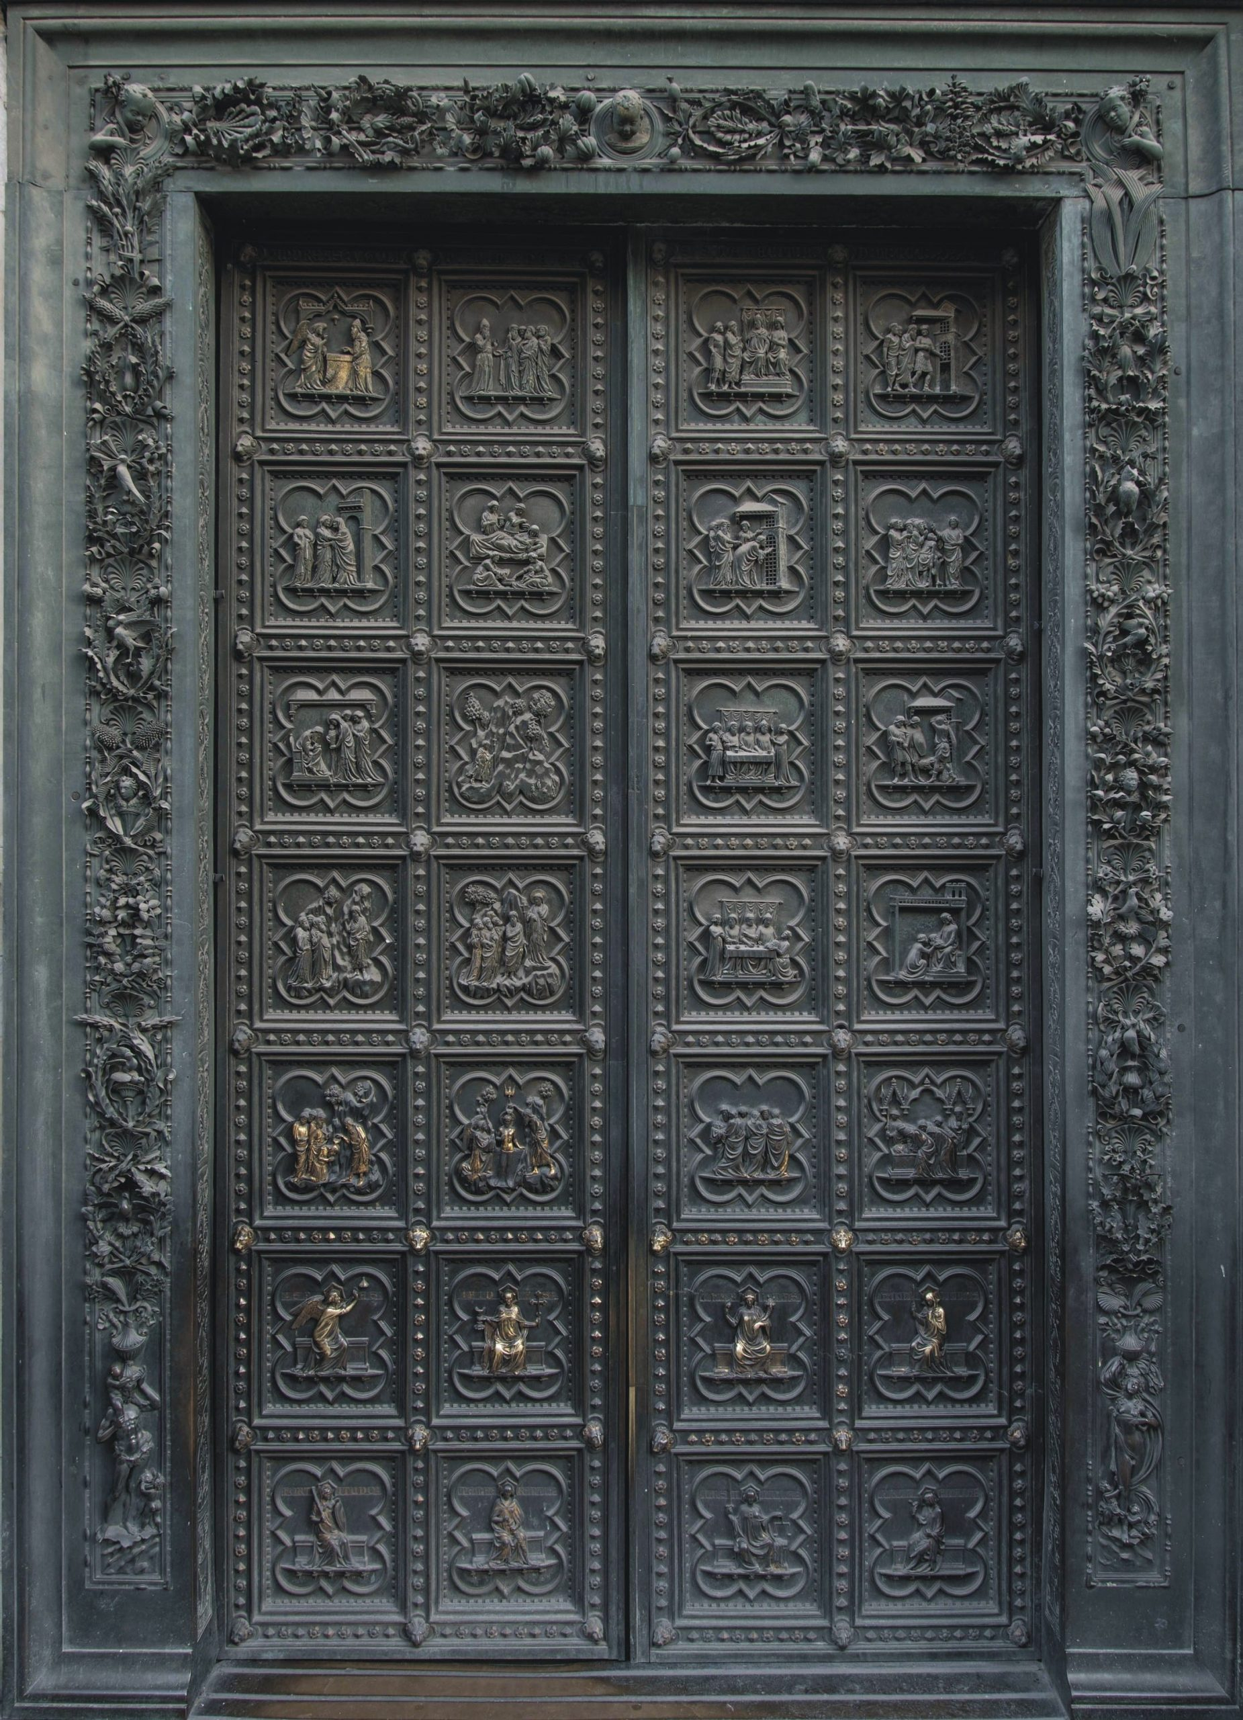
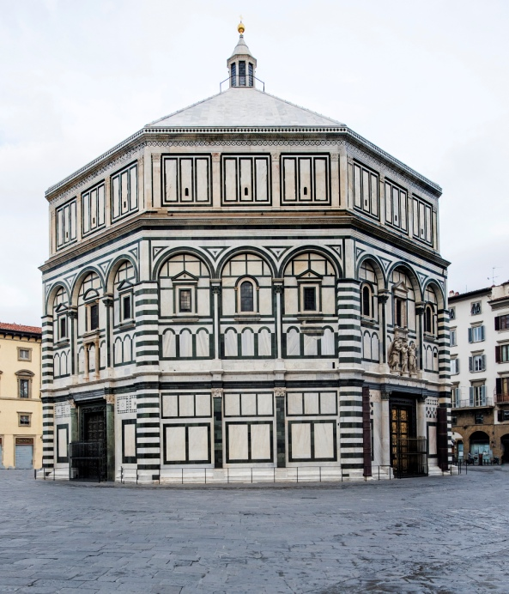
2.3 A case study on gilded bronze
M. Cataldo, HPXM 23, 19th June 2023
Baptistery gate of Florence: “formella” of the Annunciation to Zachary.
Florence Baptistery
South Baptistery Door by Andrea Pisano, Leonardo D'Avanzo e bottega (1329 -1336)

Slide 19
2.3 A case study on gilded bronze
M. Cataldo, HPXM 23, 19th June 2023
Set up of the simulations in the following slides (momentum scaling p = 1.03):
Air|Gold|Cu_based layers
Momentum scan: 16/17.5/18/19 MeV/c
Here, the best fit of the simulation for the gold layer is reached at gold thickness of 16 µm, with an acceptable agreement between the simulated data and the measurements.

Slide 20
2.3 A case study on gilded bronze
M. Cataldo, HPXM 23, 19th June 2023
(Momentum scan:16/16.5/18/20/22/24/26 MeV/c)
Here, simulations with a fixed layer don’t describe fully the experimental measurement.
The layer seems to be quite uneven, but thick, since the gold can be seen at high momenta.
So, how to simulate this?

Slide 21
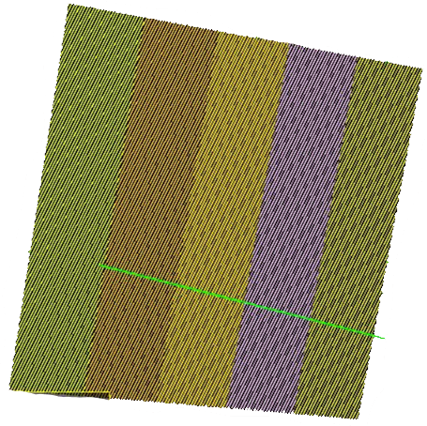

2.3 A case study on gilded bronze
M. Cataldo, HPXM 23, 19th June 2023
With a multi-layered structure:
Simulation with different layers (5/10) with varied thickness, from 1 um up to 50 um
The sample generally used for the simulations (5x6 cm) is dived in 5 smaller layers of 1 cm or 10 layers of 0.5 cm each
In this way it is possible to replicate an uneven surface and try to replicate the experimental sample
The investigated area has the diameter of the collimated beam spot (blue circle, 30 mm)
Front and lateral view

Slide 22
2.3 A case study on gilded bronze
M. Cataldo, RAL, 13th June 2023
In red, five layers of thickness (µm): |10 | 30 | 50 | 40 | 20| (average: 30 µm)
In blue, ten layers of thickness (µm):
| 1 | 20 | 15 | 20 | 50 | 40 | 10 | 25 | 5 | 15 (average (20 µm)
Here, it was more complicated to get a good agreement between simulation and real measurement. Anyway, given the complicated structure of the layer, results are quite satisfactory.

Slide 23
2.3 A case study on gilded bronze
M. Cataldo, RAL, 13th June 2023
Measured Area | Simulated Gold thickeness
Altar | Uneven – between 1µm amd 50µm
Zachary body | 15 ± 0.5 µm
Angel Body | 16 ± 0.5 µm
Angel wing | Not observed
Lion cheek | 15 ± 0.5 µm
Chiselled surface that probably required a thick layer of gold.
Very similar values means good control of the process gilding process, probably done with the same amalgam or in the same moment

Slide 24
Final remarks
M. Cataldo, HPXM 23, 19th June 2023
µXES is becoming well-established non-destructive, depth selective and sensitive to almost all elements.
This project aims to bring improvement to the technique with the use of Monte Carlo based software. This will improve not only the instrument but also the data analysis for material characterization. Simulations have already been used for detector development and data interpretation with promising results. Still, further improvements are required, especially for the Geant4 process that handles muon interaction with matter.

Slide 25
Thanks for the attention!
Acknowledgements
Adrian D. Hillier
ISIS Neutron and Muon Source, RAL, Didcot, UK
Massimiliano Clemenza
INFN Sezione Milano Bicocca, Milan, Italy
Oliviero Cremonesi
INFN Sezione Milano Bicocca, Milan, Italy
Stefano Pozzi
INFN Sezione Milano Bicocca, Milan, Italy
Katsu Ishida
RIKEN, Japan
Francesco Grazzi
CNR-IFAC, Sesto Fiorentino, Italy
Simone Porcinai
Opificio delle Pietre dure, Firenze, Italy
Antonella Scherillo
ISIS Neutron and Muon Source, RAL, Didcot, UK

