Slide 1
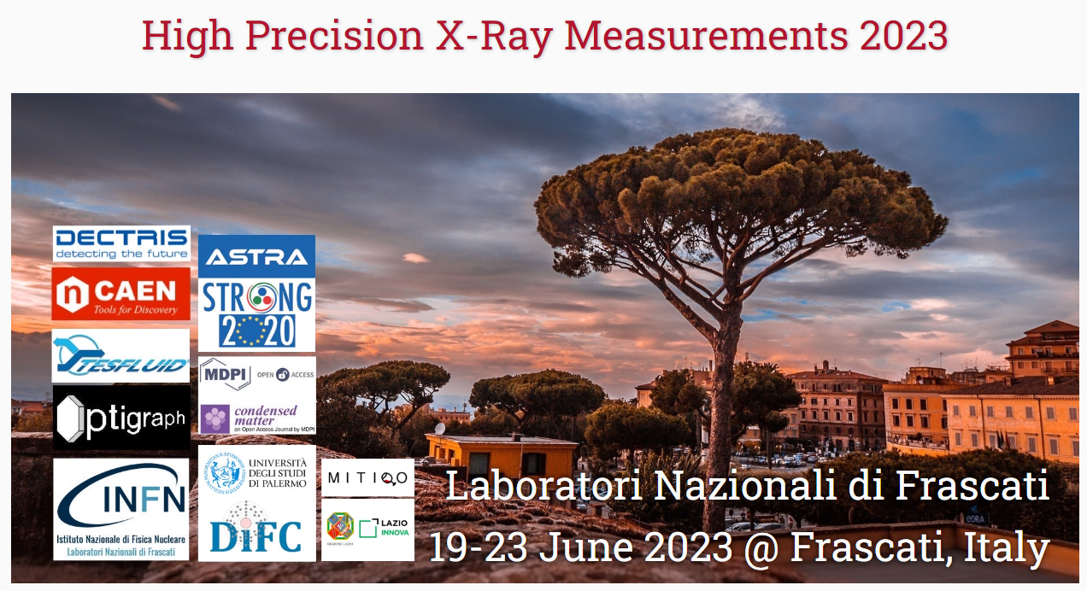
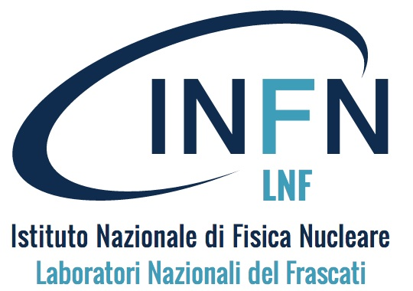
Recent trends of X-ray dosimetry with thermoluminescent detectors
Dr. Abner Iván Castro Campoy
ivan.castro@lnf.infn.it
Frascati (RM) Italy June 2023

Slide 2
1
Introduction

Slide 3
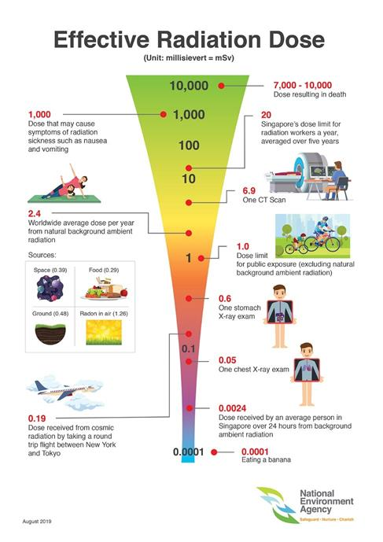
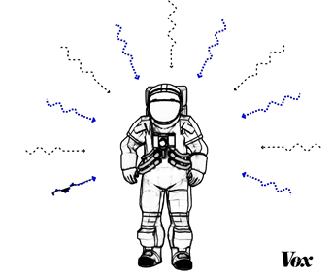
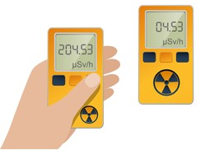
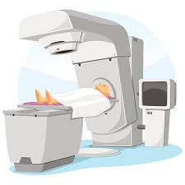
  20 mSv per year.
  80 % natural sources.
  20 % artificial sources.

Slide 4
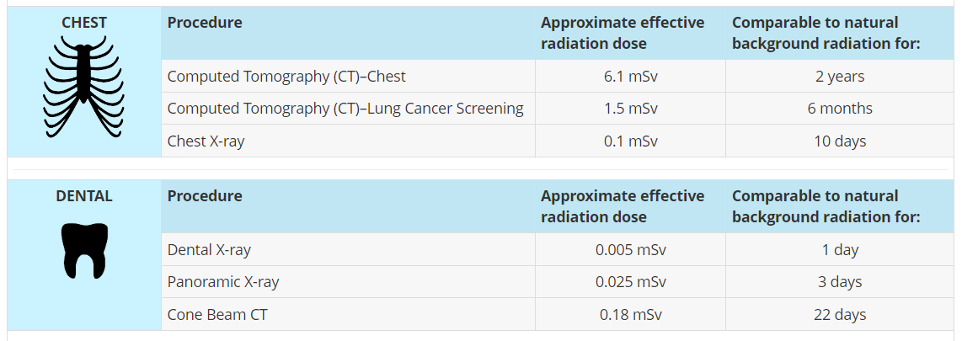
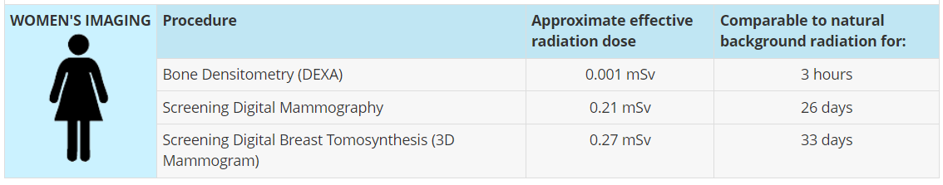
Common x-ray procedures
  Source: Health Physics Society - Doses from Medical X‐Ray Procedures

Slide 5
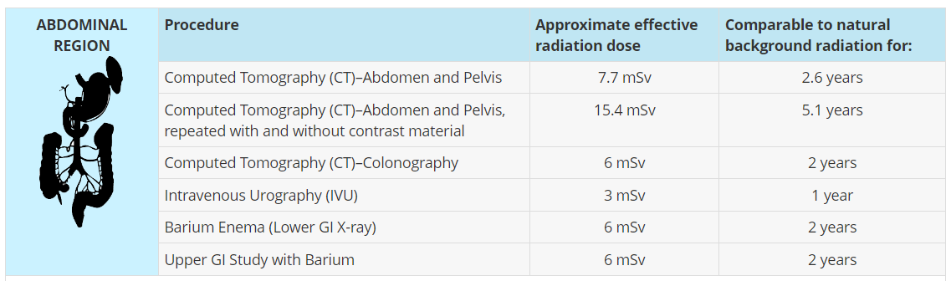
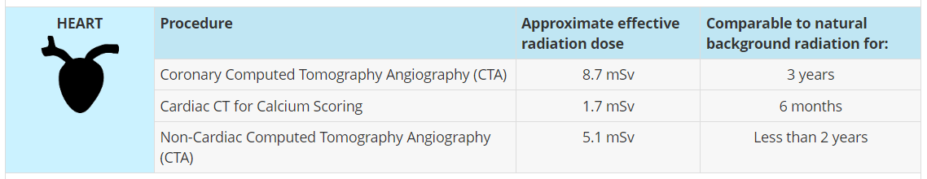
Common x-ray procedures
  Source: Health Physics Society - Doses from Medical X‐Ray Procedures

Slide 6
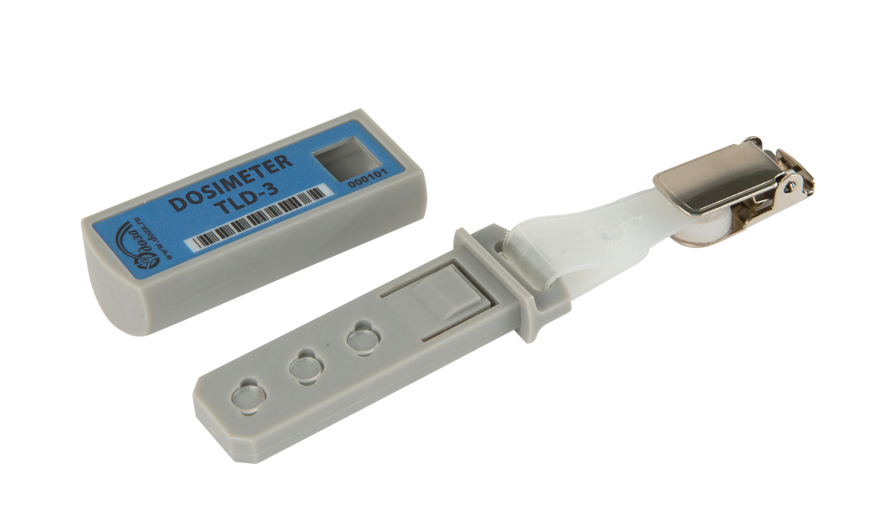
Thermoluminescence detectors
Desired features:
Reusability.
Wide range of dose response linearity.
High sensibility.
Simple glow curve.
Chemically inert.
Mechanically strong.
Simple and cheap synthesis method.
Enviromentally friendly.
  Source: Stephen W. S. Mckeever – Thermoluminescence of Solids

Slide 7
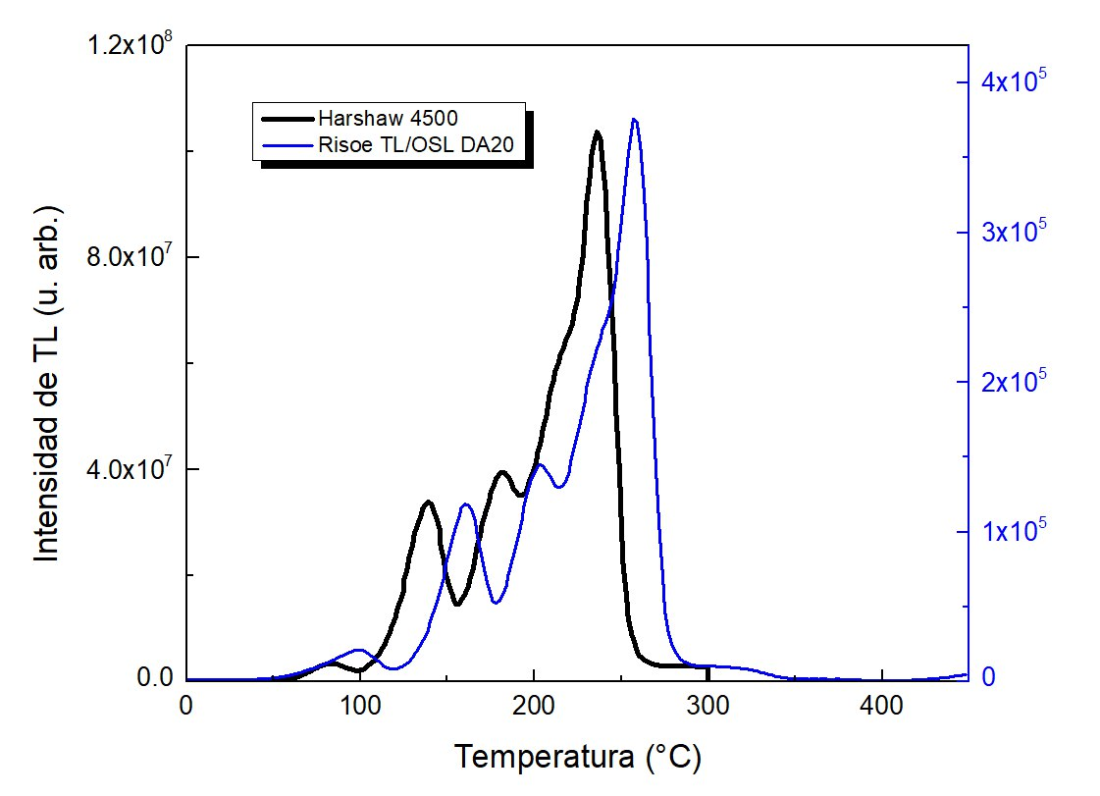
What is Thermoluminescence?

Slide 8
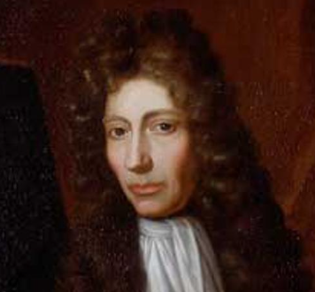
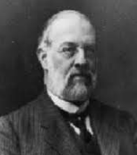
A short history of thermoluminescence
“Twelfthly, To satisfi my self, whether the Motion introduc’d into the Stone did generate the Light upon the account of its producing heat there, I held it near the Flame of a Candle, till it was qualify’d to shine pretty well in the Dark . . . .” – Robert Boyle, 1664
“I have ventured to employ the term luminescence for all those phenomena of light which are more intense than corresponds to the actual temperature” - Eilhardt Wiedemann, 1889.
  Source: Eduardo G. Yukihara & Stephen W. S. Mckeever - Optically Stimulated Luminescence: Fundamentals And Applications

Slide 9
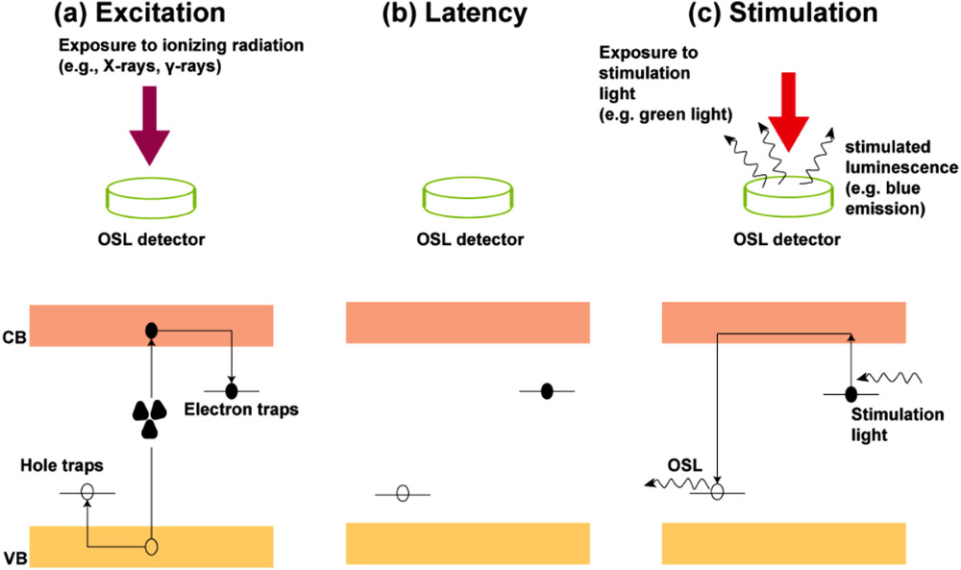
Stimulated Luminescence Mechanism
  Thermoluminescence (TL)
  Optically Stimulated Luminescence (OSL)
  Persistent Luminescence or Afterglow (AG)
  Source: Eduardo G. Yukihara & Stephen W. S. Mckeever - Optically Stimulated Luminescence: Fundamentals And Applications

Slide 10
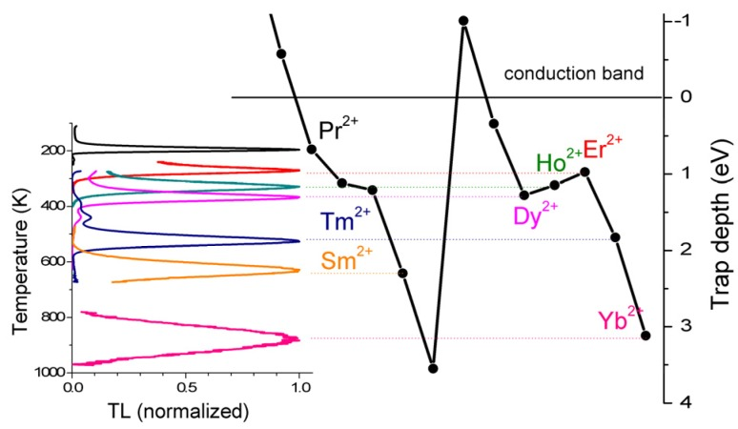
Applications of TL
  Source: Adrie J. J. Bos - Thermoluminescence as a Research Tool to Investigate Luminescence Mechanisms

Slide 11
2
Recent trends

Slide 12
In the past
  KBr, KBr:Cu
  NaCl
  CaS:Ce
  Al₂O₃
  TLD-100 and its variants
  Some sulfates
  Complex glowcurve
  Complex synthesis method
  Low dose range

Slide 13
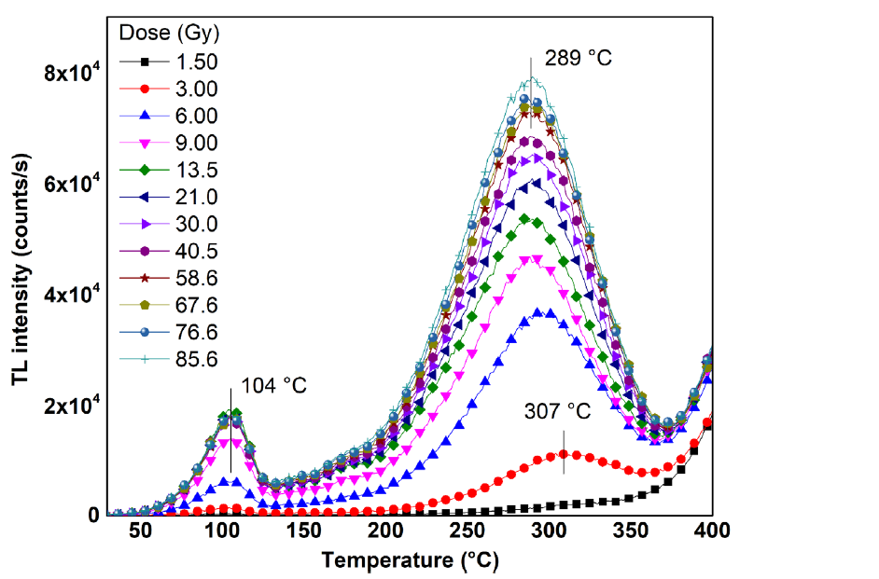
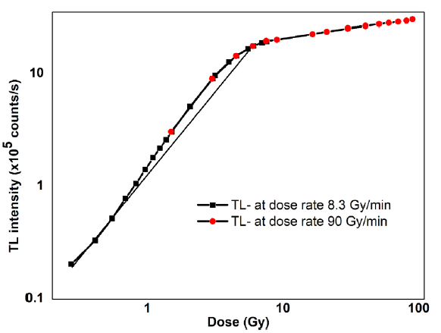
Nowadays
  Source: Gil-Tolano, et al., 2018 - X-Ray Thermoluminescence Dosimetry Characterization of Commercially Available CVD Diamond

Slide 14
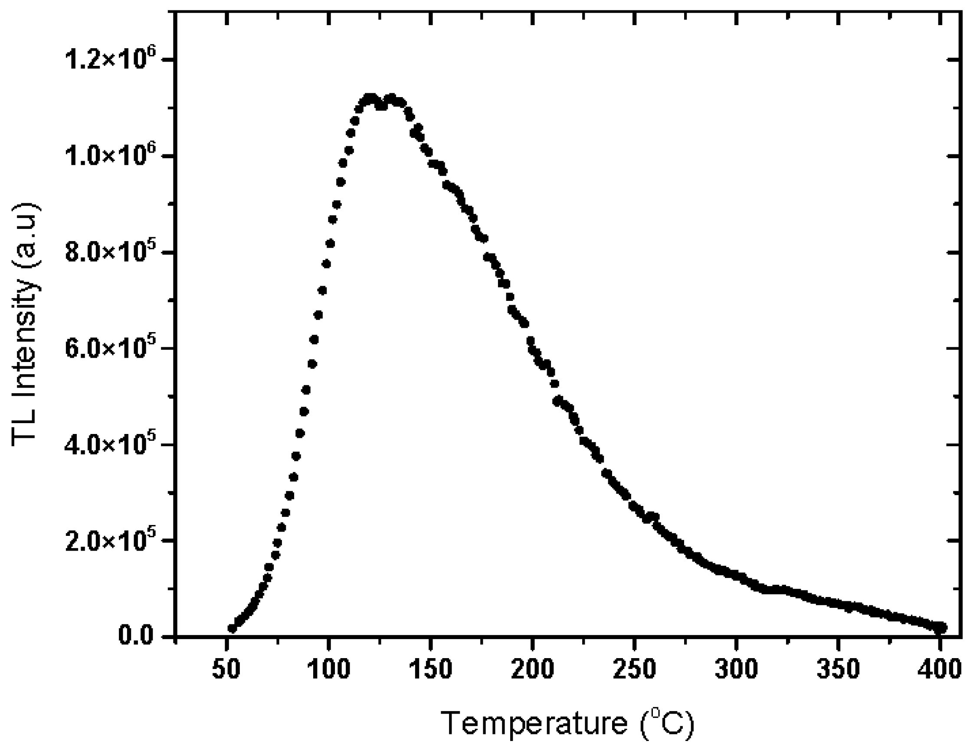
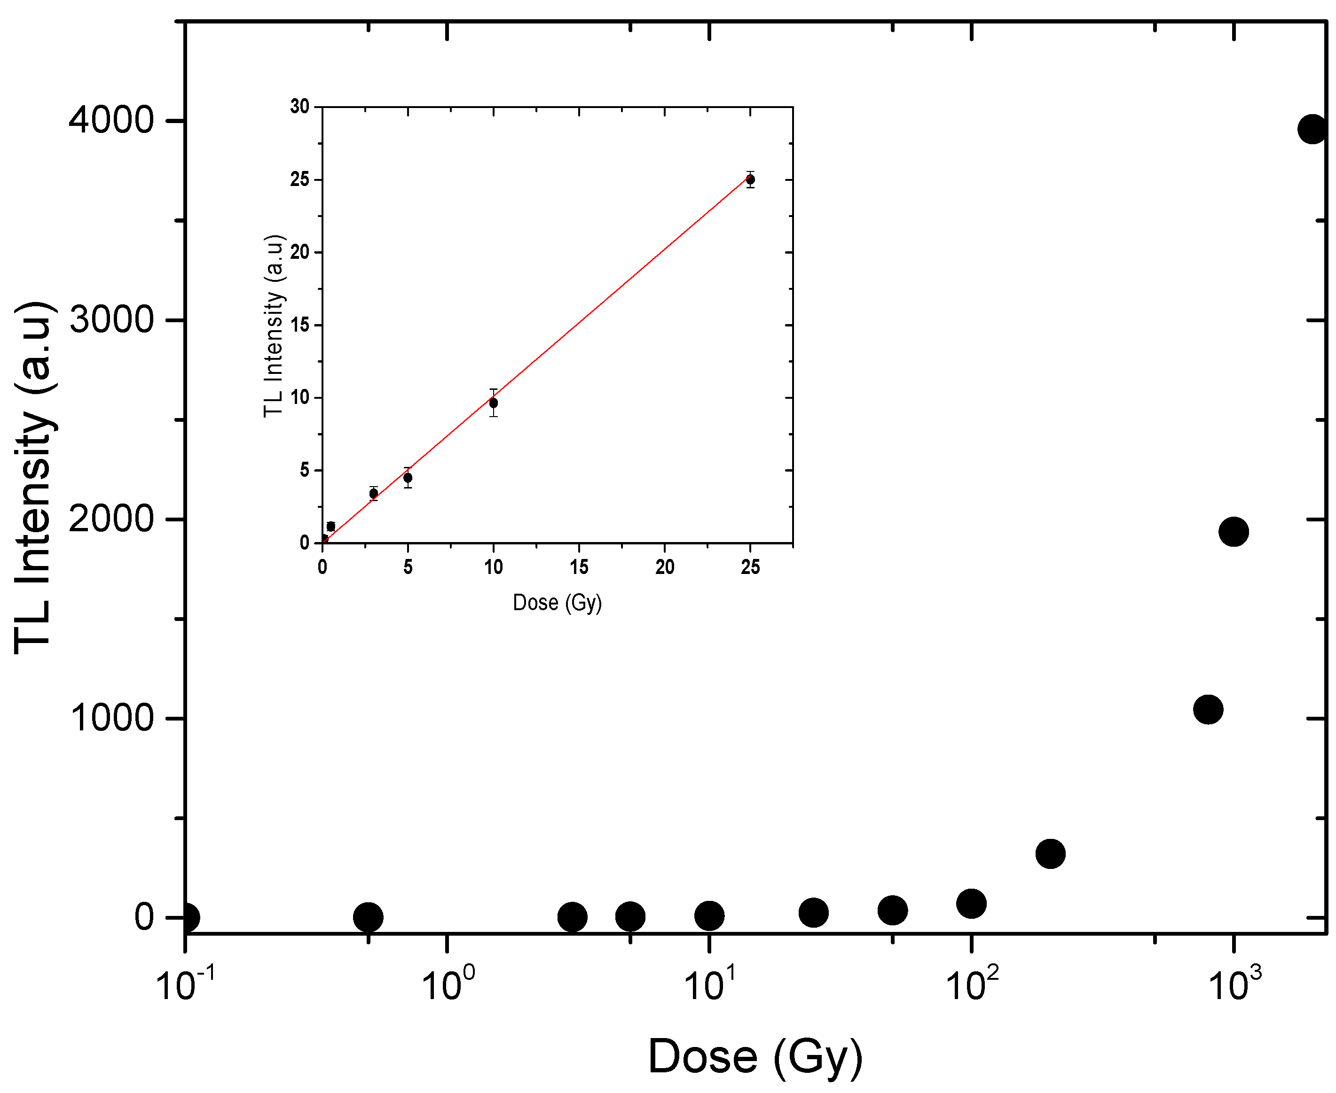
Nowadays
  Source: E. Salama, et al., 2022 -Rhyolite as a Naturally Sustainable Thermoluminescence Material for Dose Assessment Applications

Slide 15
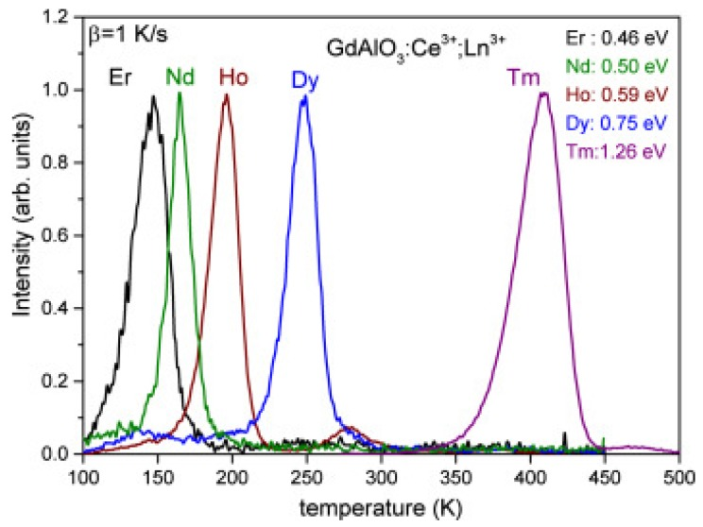
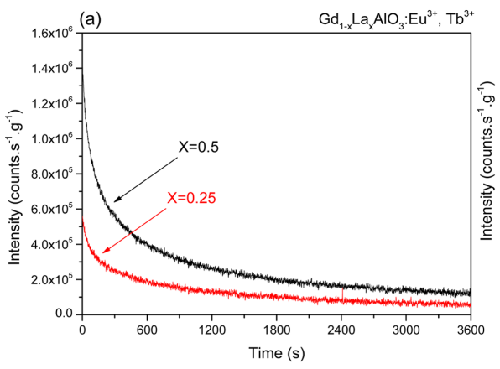
Nowadays
  Source: H. Luo, et al., 2017 -Controlled Electron−Hole Trapping and Detrapping Process in GdAlO3 by Valence Band Engineering

Slide 16
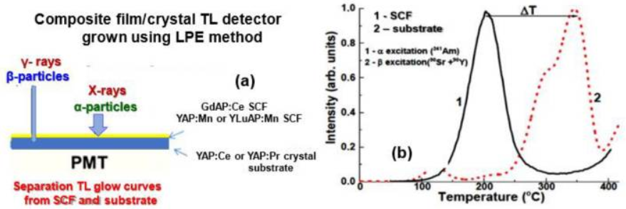
Nowadays
  Source: S. Witkiewicz-Lukaszek, et al., 2022 - Development of the Composite Thermoluminescent Detectors Based on the Single Crystalline Films and Crystals of Perovskite Compounds

Slide 17
Nowadays
  Source: Work in progress at LEMRAP

Slide 18
3
Conclusions

Slide 19
Due to the growing interest in radiation dosimetry in environmental, clinical, and personal areas, great efforts are currently being made globally to produce new high-performance dosimetric materials.
Thermoluminescence is a powerful tool in radiation dosimetry and has established itself as the most widely used technique for such applications today.
Most of the widely used materials consist of alkaline earth metal salts or oxides, activated by rare earth ions or metal ion impurities, generally synthesized by elaborated and costly methods.
There is no ideal dosimeter, so there is a large area of opportunity for the investigation of new materials for the detection and dosimetry of ionizing radiation.

Slide 20
Thank you for your attention

