Slide 1
Tests of QED by precision spectroscopy of highly-charged ions and exotic atoms
Paul Indelicato
High Precision X-Ray Measurements
June 19-23, 2023, INFN, Frascati

Slide 2
Outline
Introduction: QED contributions for atoms
Tests of QED with HCI: exemple of He-like ions
Tests of QED in muonic and antiprotonic atoms: more sensitive to the vacuum structure
QED with muonic atoms: the HEATES experiment at J-PARC
set-up
microcalorimeter
results on muonic Ne
Future experiments: PaX and QUARTET
Conclusion
HPXRM 2023

Slide 3
one electron QED at order α
Self Energy
Vacuum Polarization
H-like “One Photon” order (α/π)
Many calculations, very accurate down to Z=1
HPXRM 2023

Slide 4
one electron QED at order α²
H-like “Two Photon” order (α/π)²
HPXRM 2023

Slide 5
Closed fermion loops 2nd order diagrams
10 diagrams with ± signs
so compensation
next order?
SE-VP
Uelhing
in Dirac Eq.
Källén & Sabri potential
S(VP)E
VP-VP
Yerokhin, V. A., P. Indelicato and V. M. Shabaev (2008), Phys. Rev. A 77 (6): 062510 (062512).
Lindgren, et al. (1993), J. Phys. B: 26: L503-L509.
Mitrushenkov, A., L. Labzowsky, I. Lindgren, H. Persson and S. Salomonson (1995). Phys. Lett. A 200: 51-55.
HPXRM 2023

Slide 6
Two-loop Self-energy
Direct calculations:
1s: Z10≤Z≤100
2s: ≈30≤Z≤100
2p1/2: 30≤Z≤100
2p3/2: 60≤Z≤100
also for Li-like ions fine structure
V. A. Yerokhin, Phys. Rev. A 97, 052509 (2018).
V. A. Yerokhin, Eur. a. J D 58, 57 (2010).
V. A. Yerokhin, Phys. Rev. A 80, 040501 (R) (2009).
V. A. Yerokhin, P. Indelicato, and V. M. Shabaev, Phys. Rev. A 77 062510 (12) (2008).
V. A. Yerokhin, P. Indelicato, and V. M. Shabaev, JETP 101, 280 (2005).
V. A. Yerokhin, P. Indelicato, and V. M. Shabaev, Phys. Rev. A 71, 040101(R) (2005).
V. A. Yerokhin, P. Indelicato, and V. M. Shabaev, Eur. Phys. J D 25, 203 (2003).
V. A. Yerokhin, P. Indelicato, and V. M. Shabaev, Phys. Rev. Lett. 91, 073001 (2003).
V. A. Yerokhin and V. M. Shabaev, Phys. Rev. A 64, 062507 (13) (2001).
HPXRM 2023

Slide 7
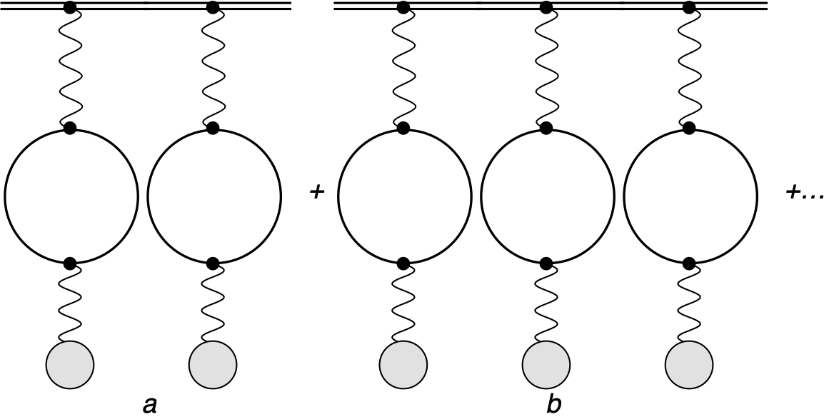
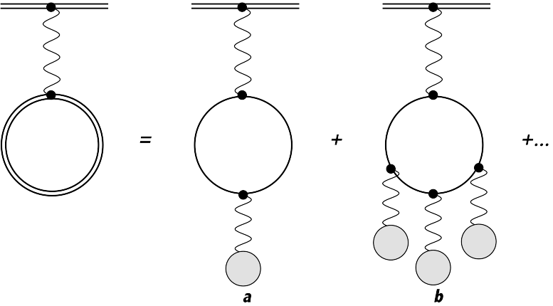
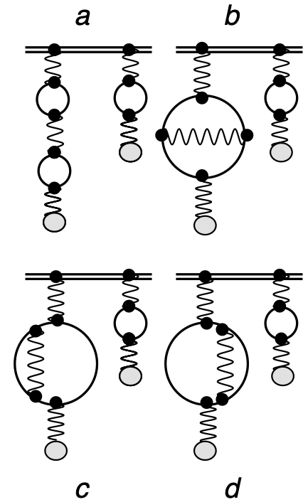
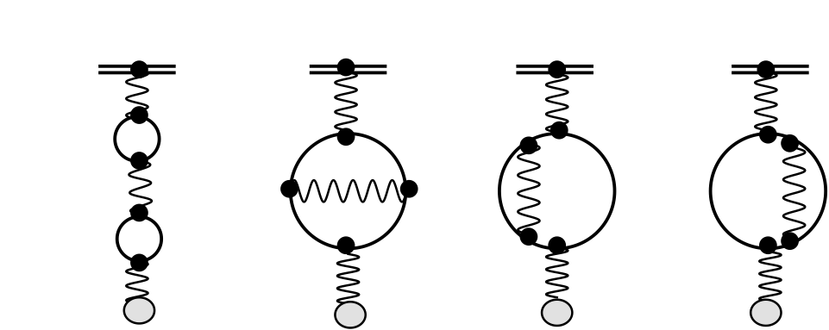
Contributions included to all-order
All-order: the charge distribution is included exactly in the wavefunction and in the operator, when relevant. Higher order Vacuum Polarization contribution included by numerical solution of the Dirac equation
P. Indelicato. Phys. Rev. A 87, 022501 (2013).
HPXRM 2023

Slide 8
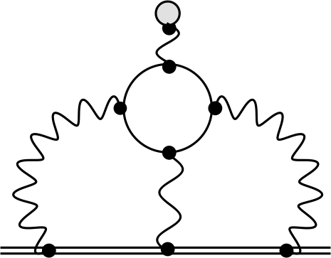
Light by light scattering in muonic atoms
Diagrams with 4 vertex with external lines in an electron-positron loop
Wichman & Kroll V13(r)~ α(Zα)³
approx. to V15(r)~ α(Zα)⁵ and V17(r)~ α(Zα)⁷ also included
Uehling V11(r)~ α(Zα)
a is a renormalization term: no contribution
b1 and b2: virtual Delbrück scattering V22(r)~ α²(Zα)²
(part of the expansion of S(VP)E)
3rd order V31(r)~ α³(Zα)~V13(r)/Z²
E. Borie and G. A. Rinker, Rev. Mod. Phys. 54, 67 (1982).
E. Y. Korzinin, V. A. Shelyuto, V. G. Ivanov, R. Szafron, and S. G. Karshenboim, Phys. Rev. A 98, 062519 (2018).
HPXRM 2023

Slide 9
tests with Hydrogenlike ions
QED, nuclear size corrections…
HPXRM 2023

Slide 10
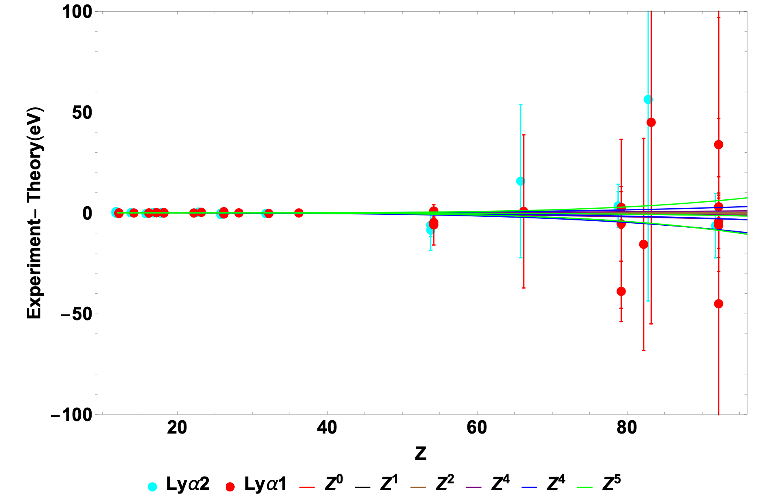
Comparison theory-experiment fr H-like ions
P. Indelicato, Topical Review: QED tests with highly-charged ions, Journal of Physics B 52 (2019) 232001.
HPXRM 2023

Slide 11
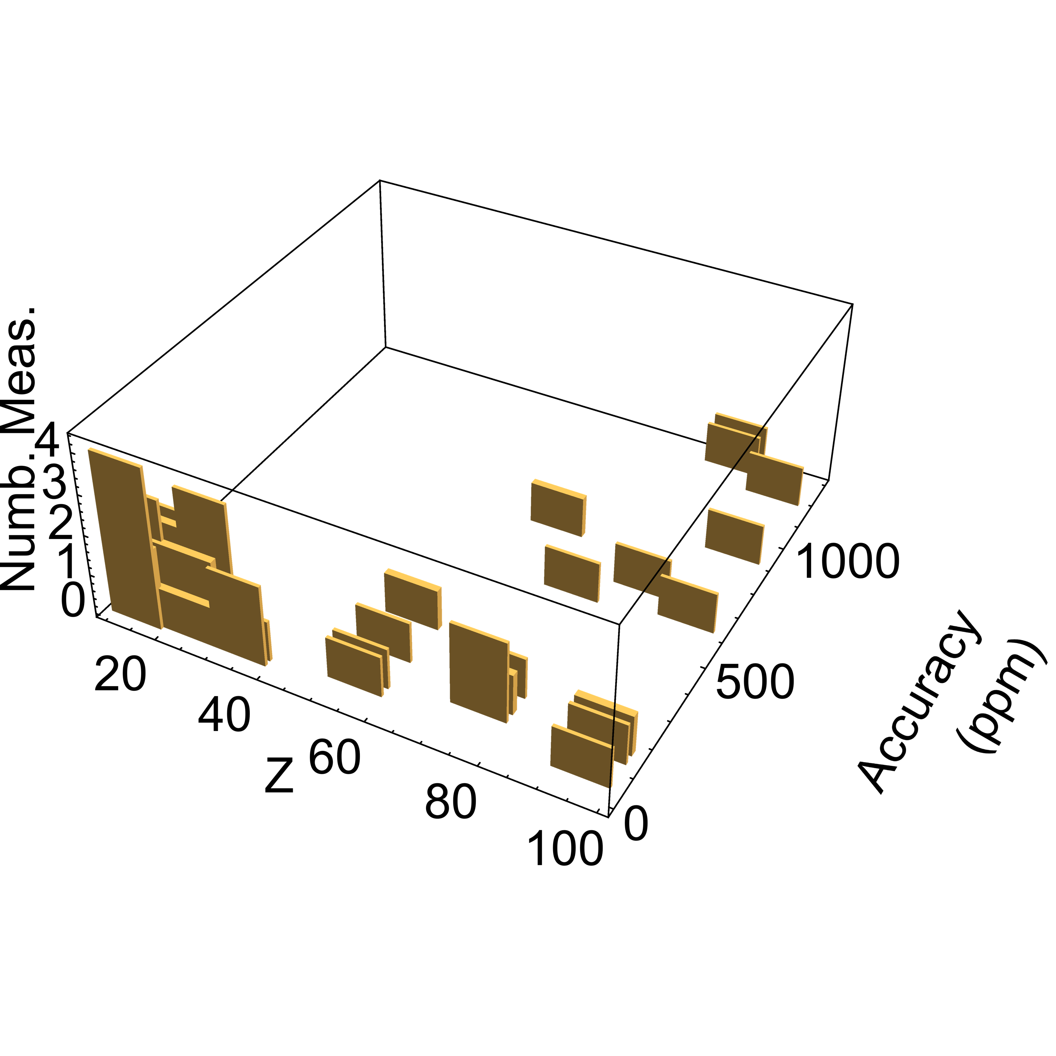
Quality of the measurements: H-like 2→1 transitions
33 values for Lyα1
21 values for Lyα2
HPXRM 2023

Slide 12
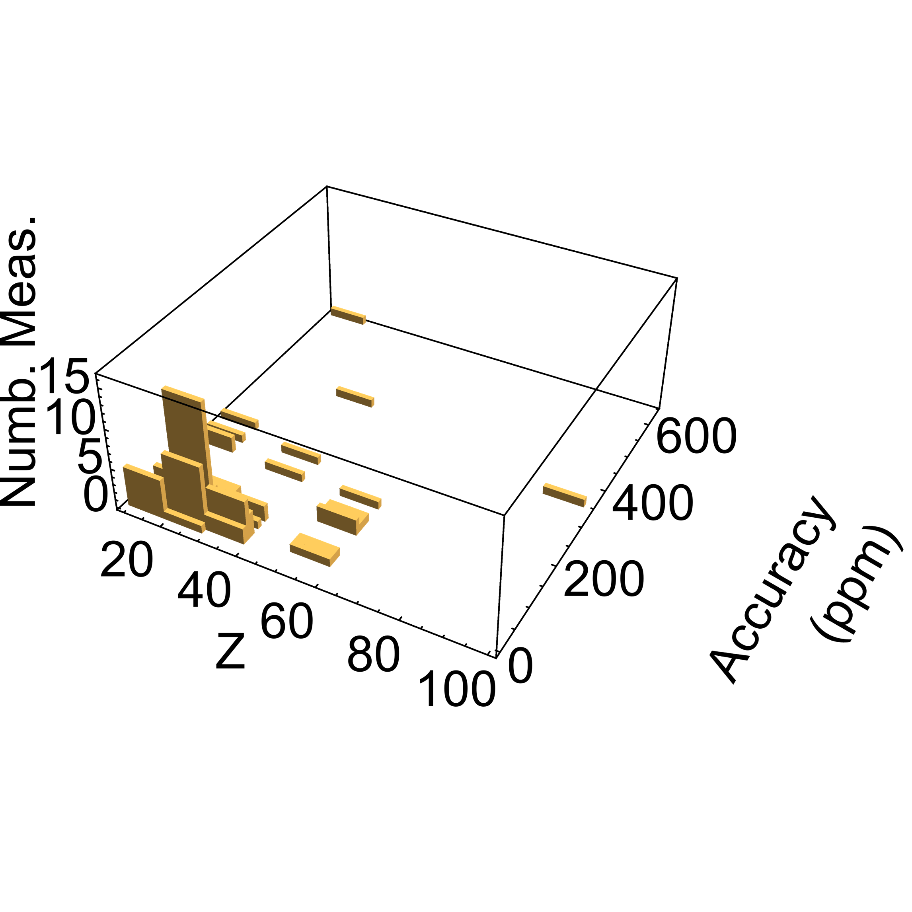
Quality of the measurements: He-like 2→1 transitions
Lack of high-accuracy measurements for high-Z
Few below 10 ppm, even at low-Z
HPXRM 2023

Slide 13
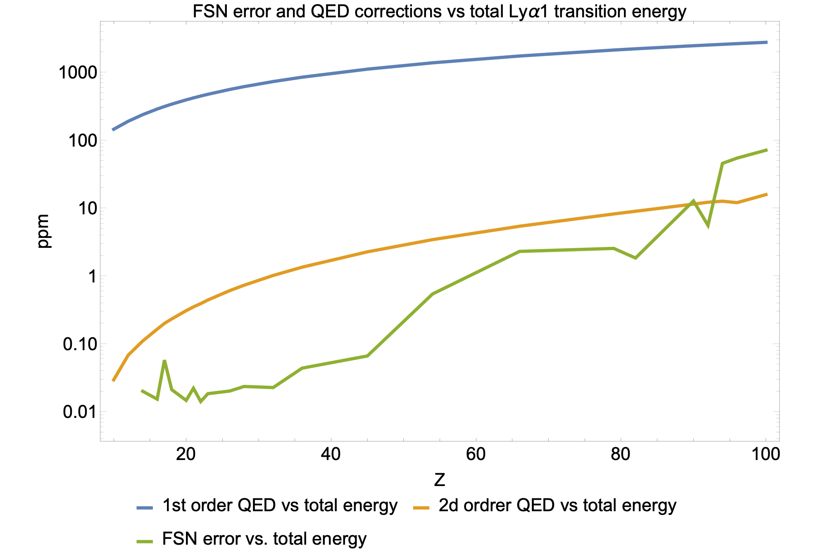
Is there an optimal Z to avoid nuclear uncertainties?
FNS
3 ppm measurement accuracy
²³⁸U
FNS
HPXRM 2023

Slide 14
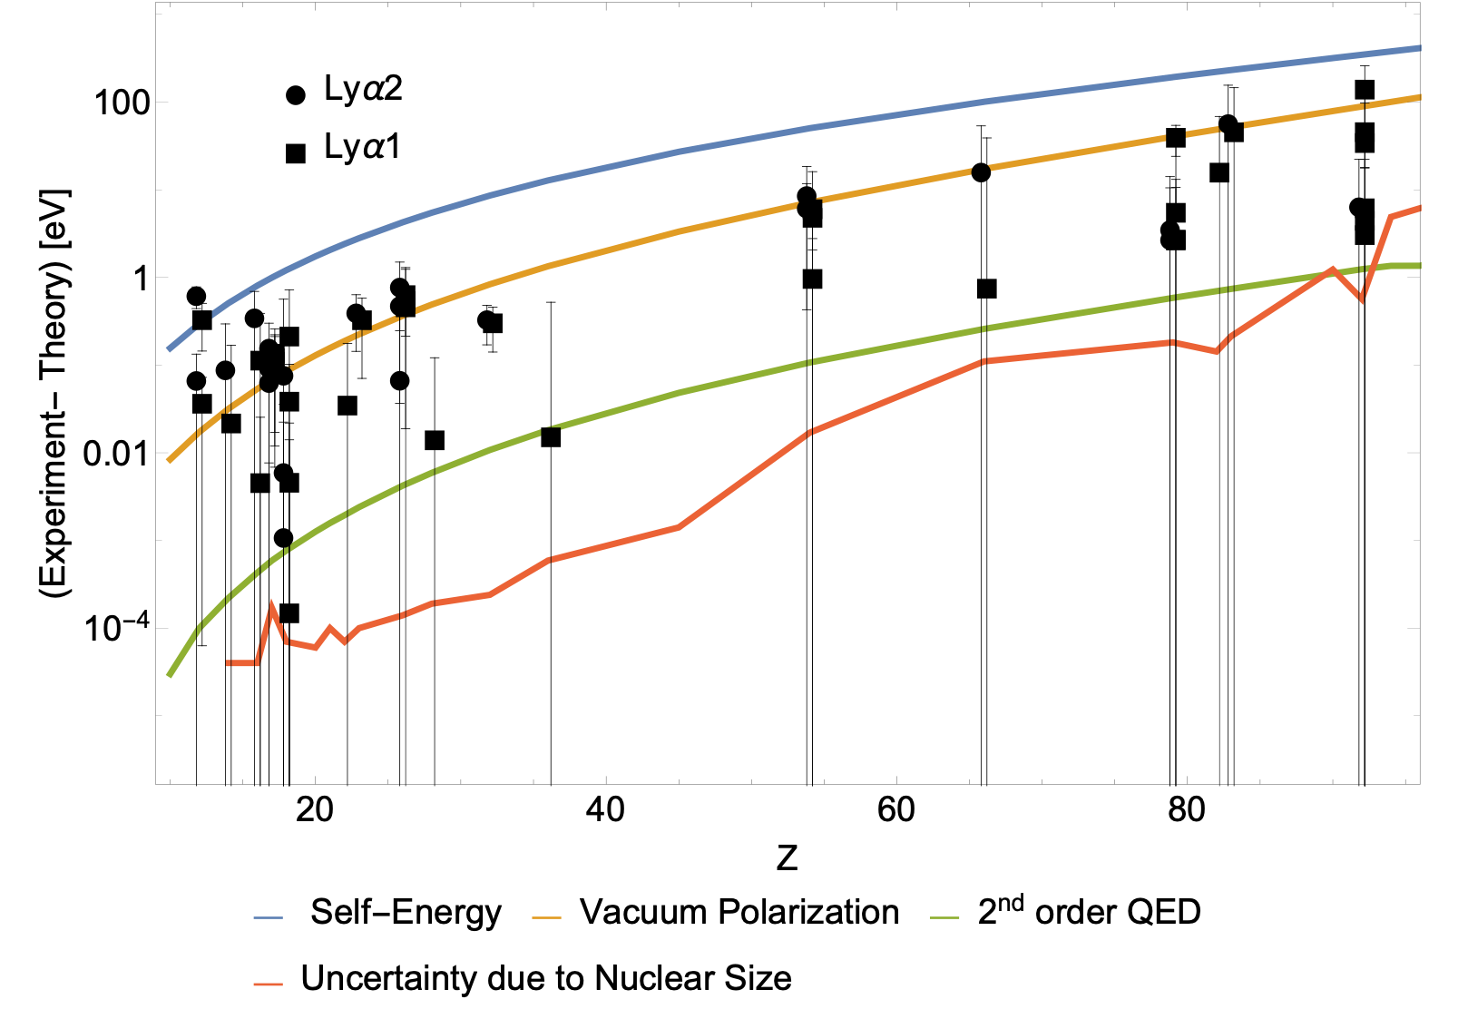
Effect on energy
HPXRM 2023

Slide 15
High-precision measurements medium-Z HCI
Crystal spectroscopy of highly charged ions
HPXRM 2023

Slide 16
Best He-like measurements n=2→n=1 transitions Z≥12
Mg (Z=12) w-line Aglitskii (1974!) 1352.329 (15) ~10.9 ppm
S (Z=16): w-line Heidelberg EBIT/single crystal (2014) 2460.630 (21) ~8.7 ppm
S (Z=16): z-line LKB: (2023) 2430.3685(97) ~4 ppm
Ar (Z=18): w-line LKB: Machado et al (2018) 3139.5927(80) ~2.5 ppm
Ar (Z=18): w-line Heidelberg EBIT(2014) 3139.5810 (92) ~2.9 ppm
Ar (Z=18): z-line LKB: Amaro et al (2012) 3104.1605 (77) ~2.5 ppm
Fe (Z=26): w-line Heidelberg EBIT (2014) 6700.441 (49) ~7.3 ppm
Kr (Z=36): w-line Heidelberg+XFEL (2014) 13114.47 (14) ~10.7 ppm
Kr (Z=36): x-line Heidelberg+XFEL(2014) 13026.15 (14) ~10.7 ppm
U (Z=92): new measurement spring 2022 CRYRING@FAIR+micro-calorimeter analysis not finished
Other measurements on Li-like and Be-like S and Ar, B-like being analyzed.
HPXRM 2023

Slide 17
Principle of a Double flat crystal spectrometer
Precise X-ray energy measurements without calibration lines
dispersive mode (2 θ_{Bragg})
Correction: index of refraction
counts
Histogram = Line shape × spectrometer response
Δθ
Source
counts
> < 10 ⁻⁴ rad
Non-dispersive mode (0)
Δθ
In this mode, regardless of the energy, X-ray pass through when the crystals are almost parallel: spectrometer response function: Crystal×2^{1/2} (Compton, 1917)
HPXRM 2023

Slide 18
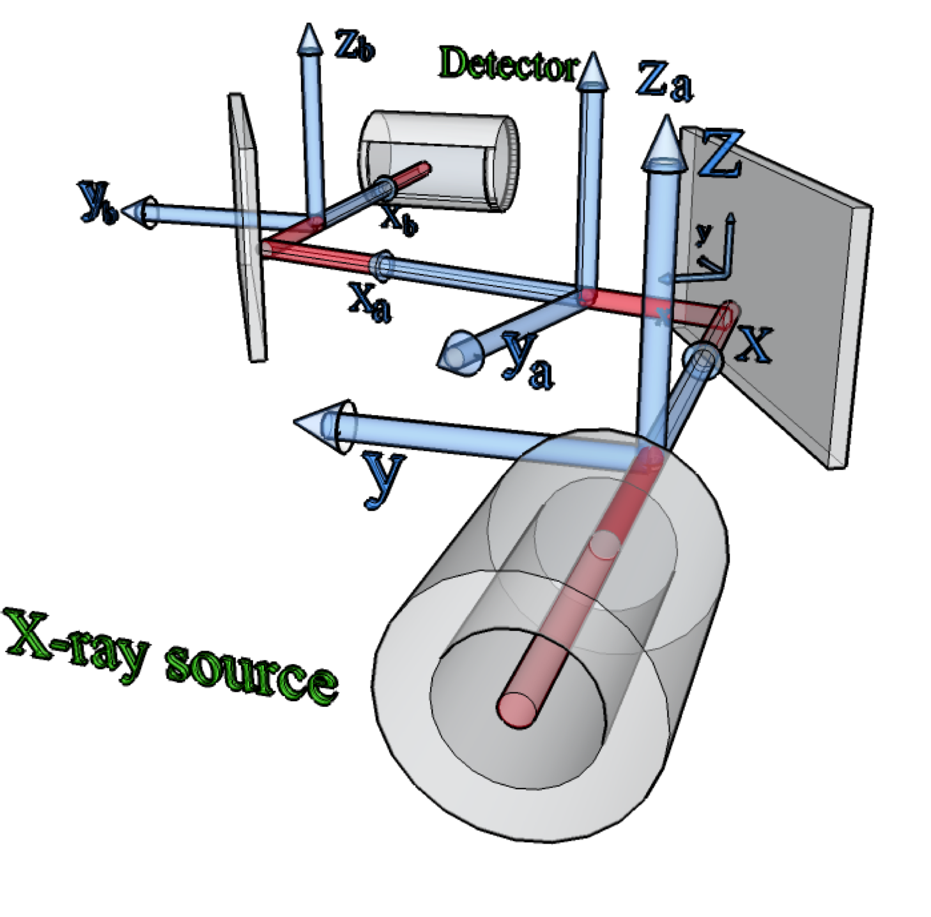
Principle of a Double flat crystal spectrometer
P. Amaro et al., Radiation Physics and Chemistry 98, 132 (2014).
HPXRM 2023

Slide 19
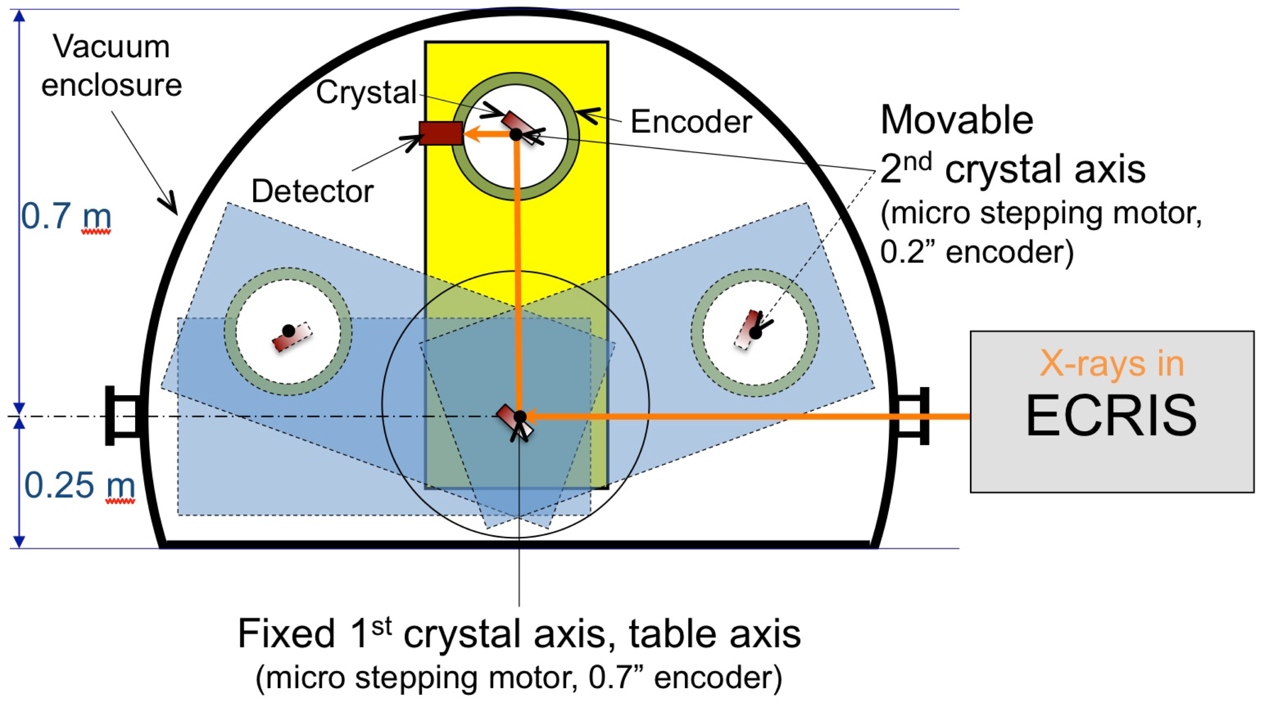
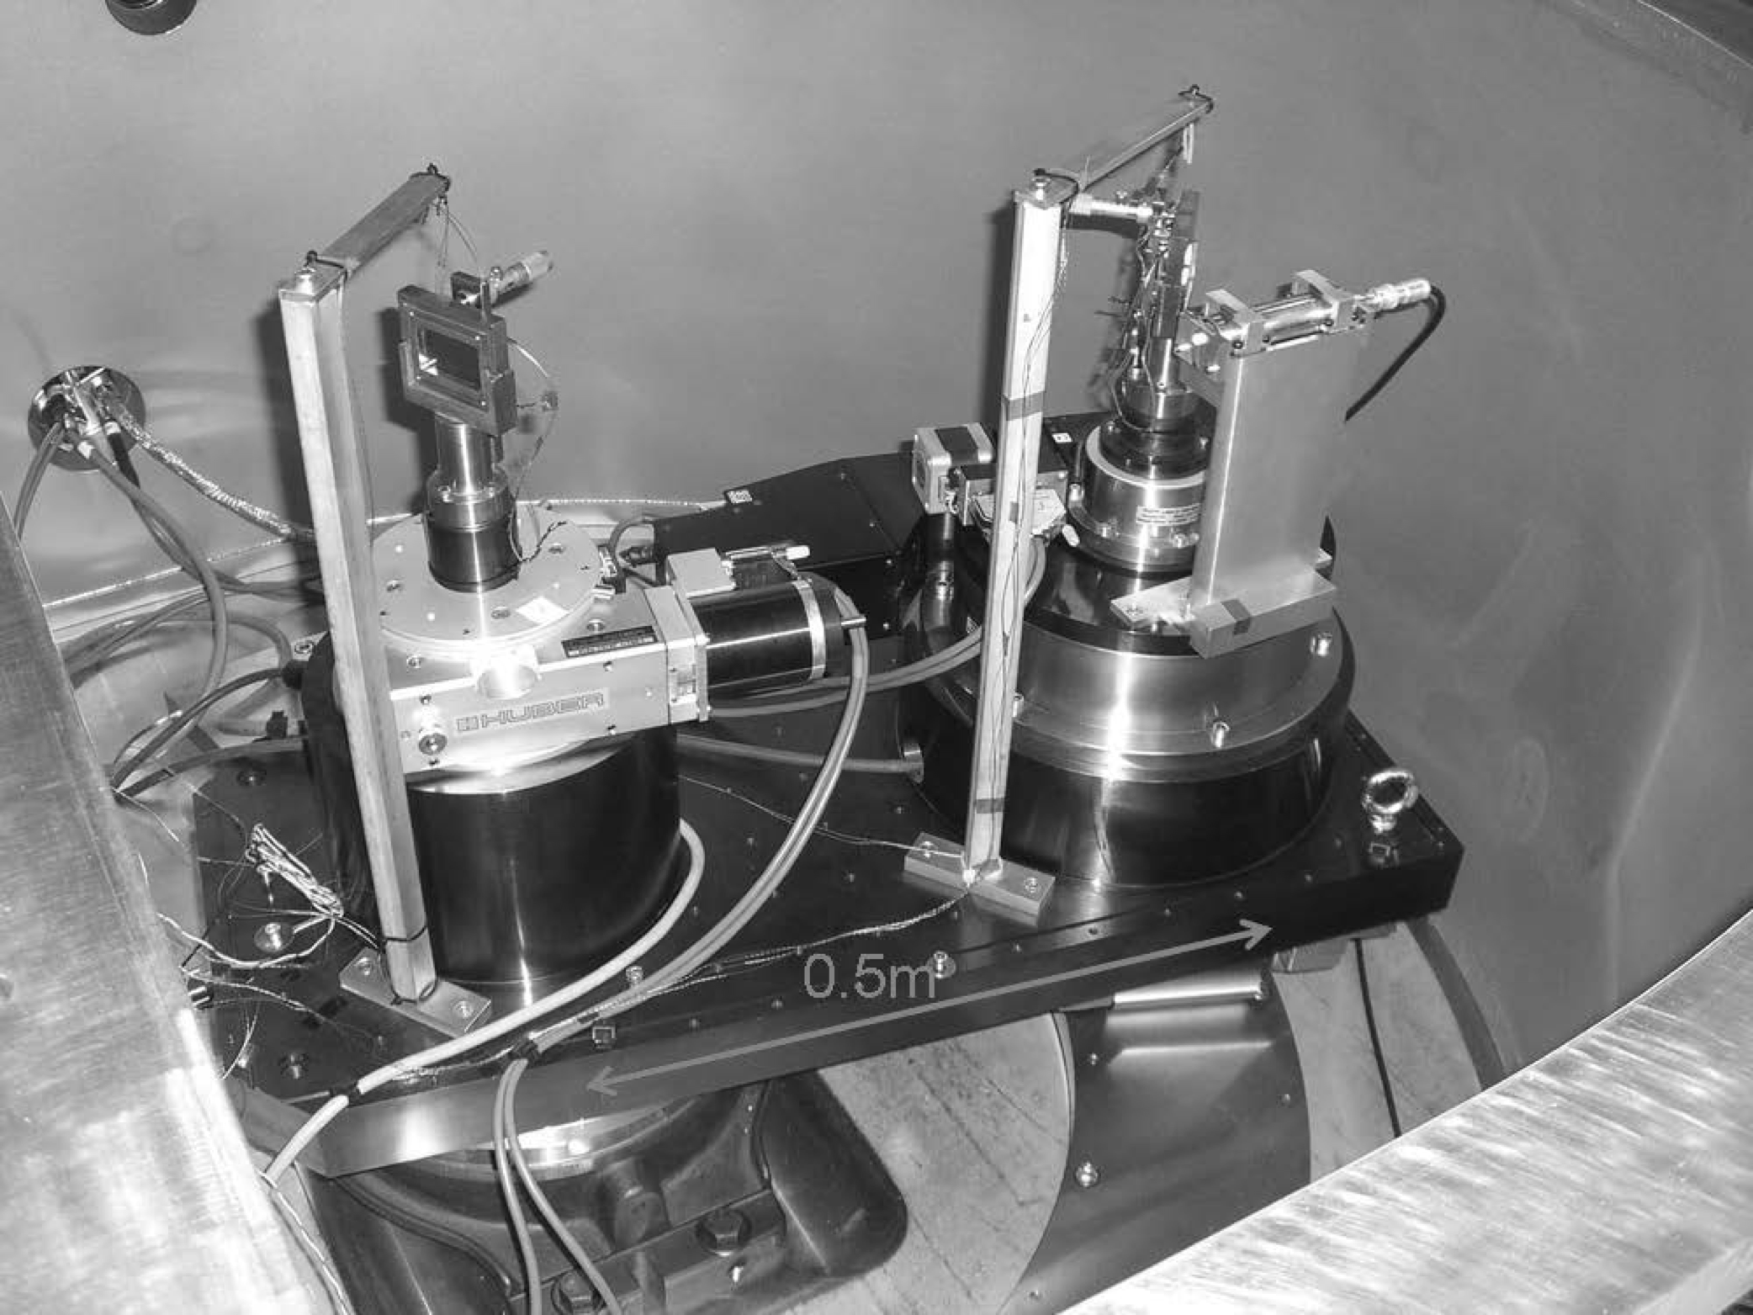
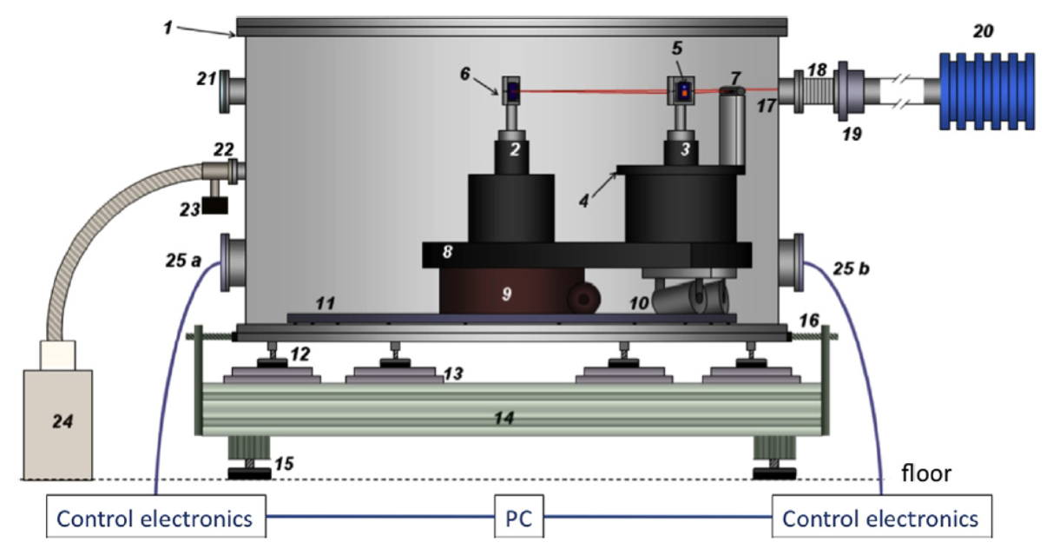
The LKB highly-charged ions double crystal spectrometer
HPXRM 2023

Slide 20
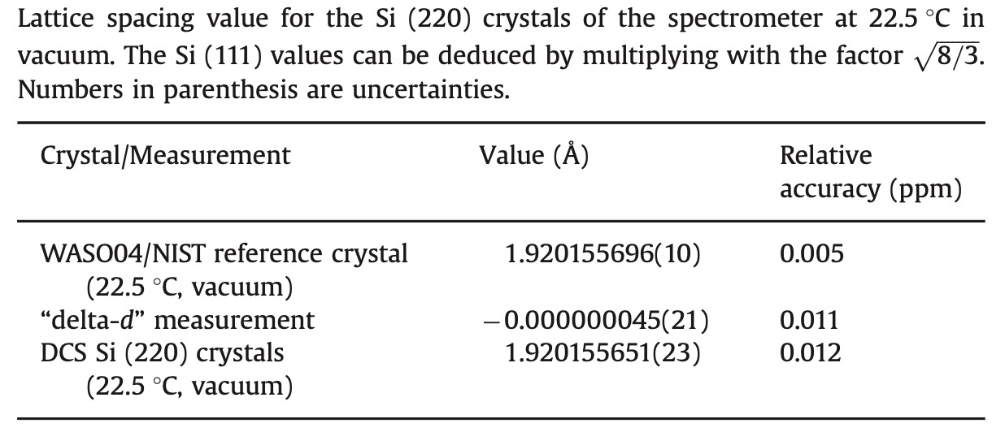
The LKB highly-charged ions double crystal spectrometer
Angular encoders accuracy:
1st crystal: 0.5” of arc
2nd crystal: 0.2” of arc
HPXRM 2023

Slide 21
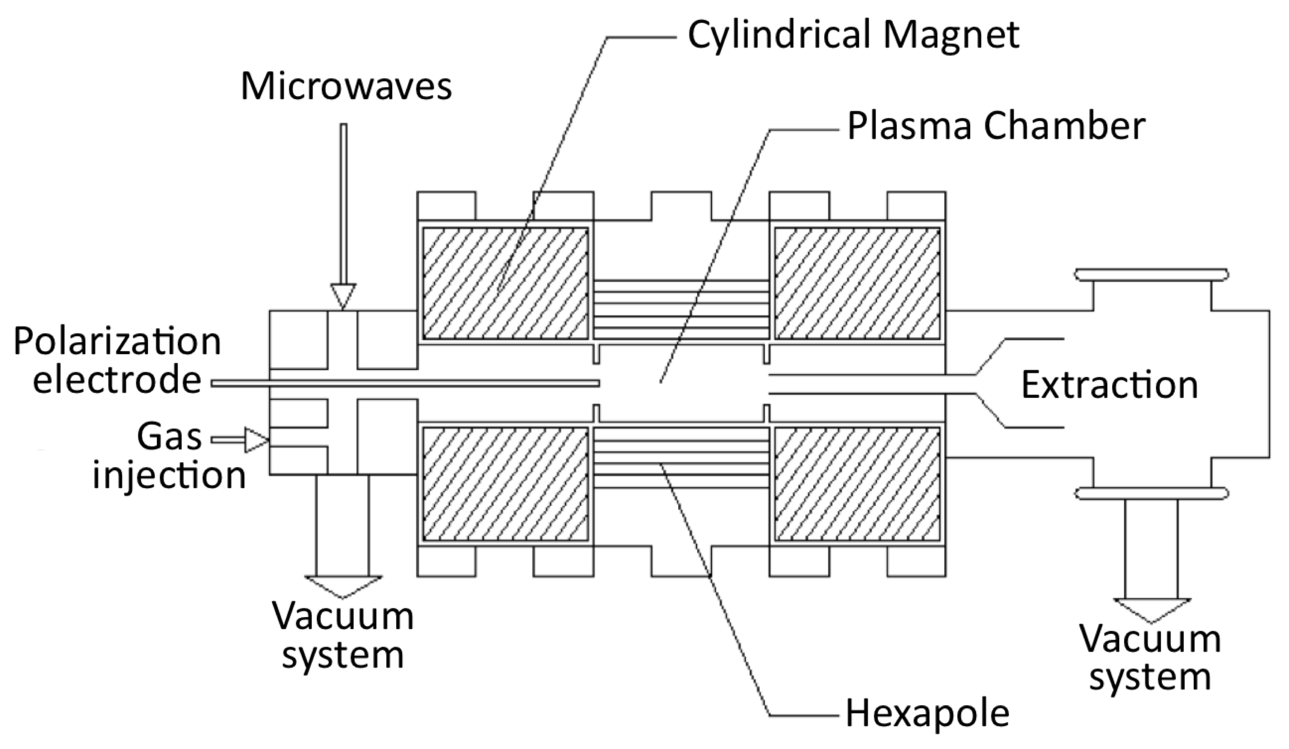
SIMPA Electron-Cyclotron Ion source
HPXRM 2023

Slide 22
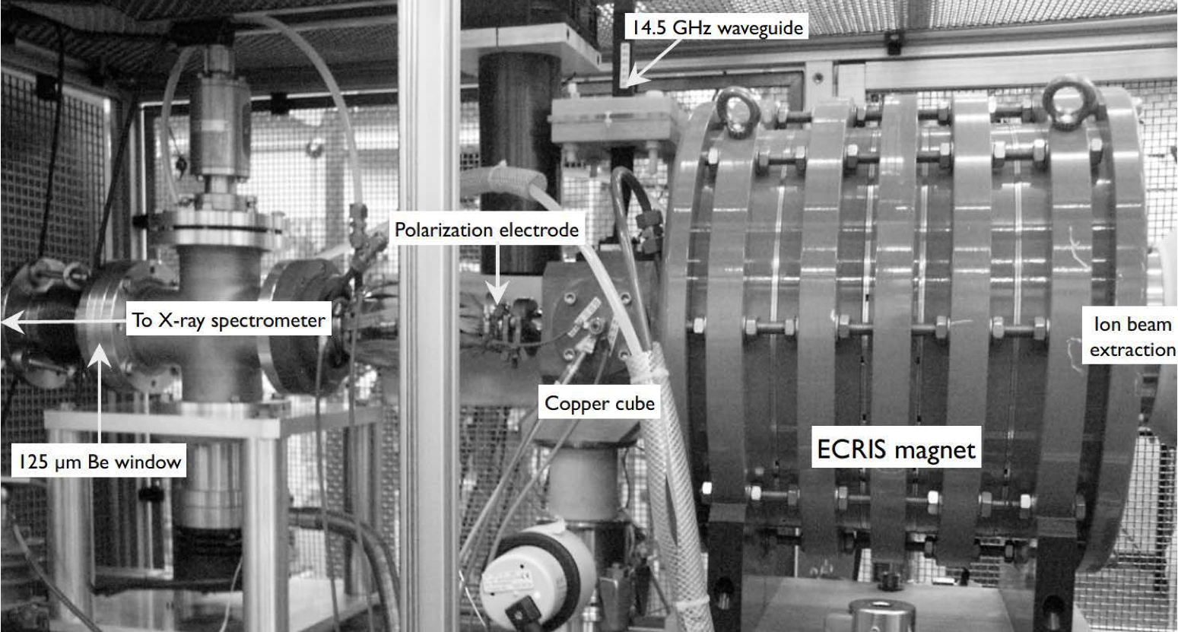
SIMPA Electron-Cyclotron Ion source
HPXRM 2023

Slide 23
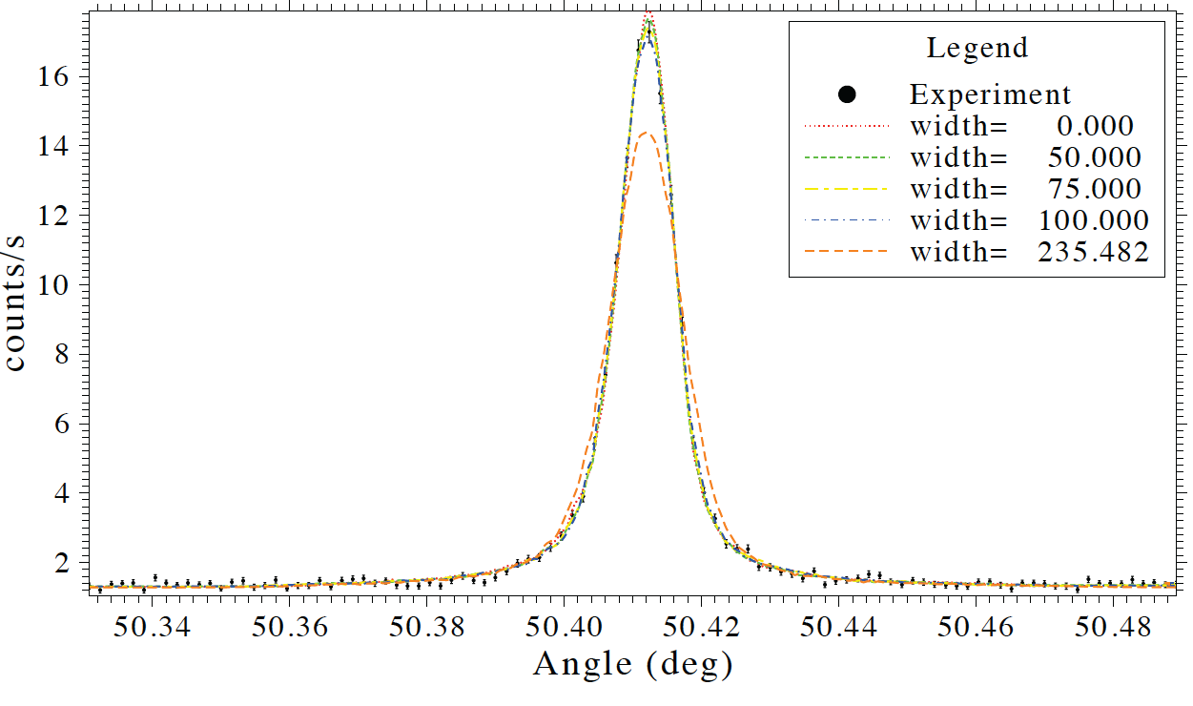
He argon M1: 1s2s ³S1-1s² ¹S0
P. Amaro, et al., Phys. Rev. Lett. 109 (4), 043005 (2012).
Very narrow, width only due to Doppler effect in a 1 eV/q space-charge potential
HPXRM 2023

Slide 24
Determining the width of the 1s2p ¹P1-1s² ¹S0 line in Ar
J. Machado,et al., Phys. Rev. A 97 (3), 032517 (2018).
HPXRM 2023

Slide 25
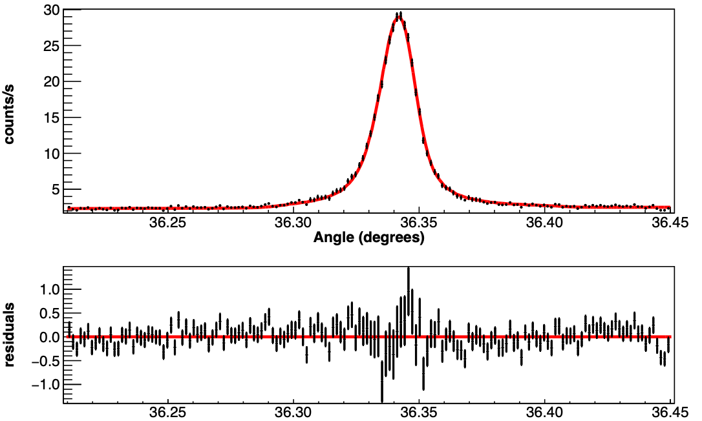
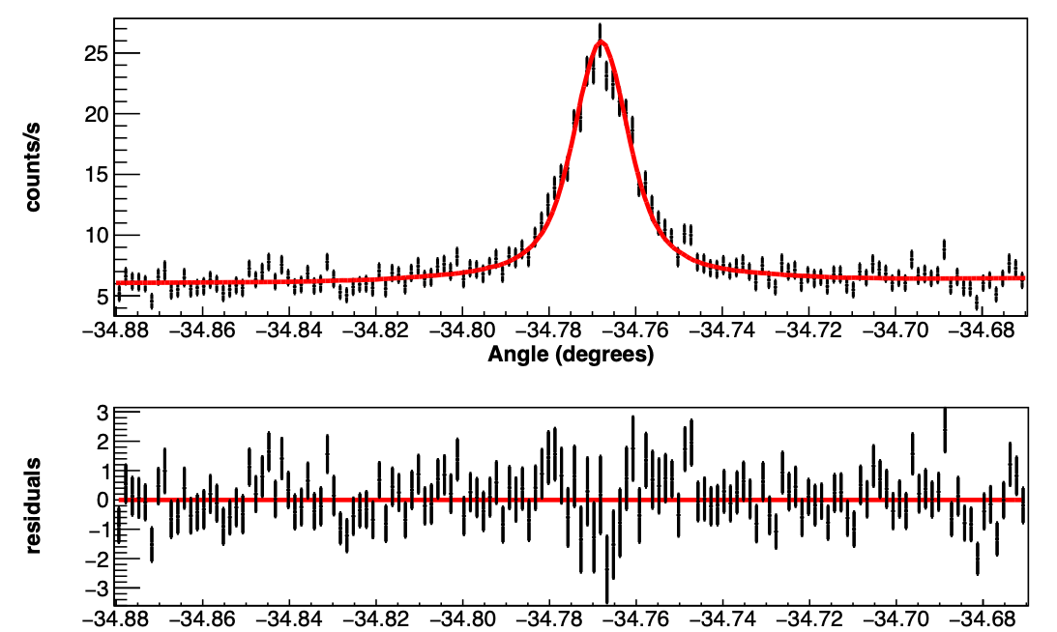
He-like sulfur M1: 1s2s ³S1-1s² ¹S0
only 17 in Ar (counts/seconds)
J. Machado et al, Phys. Rev. A 107, 032821 (2023).
HPXRM 2023

Slide 26
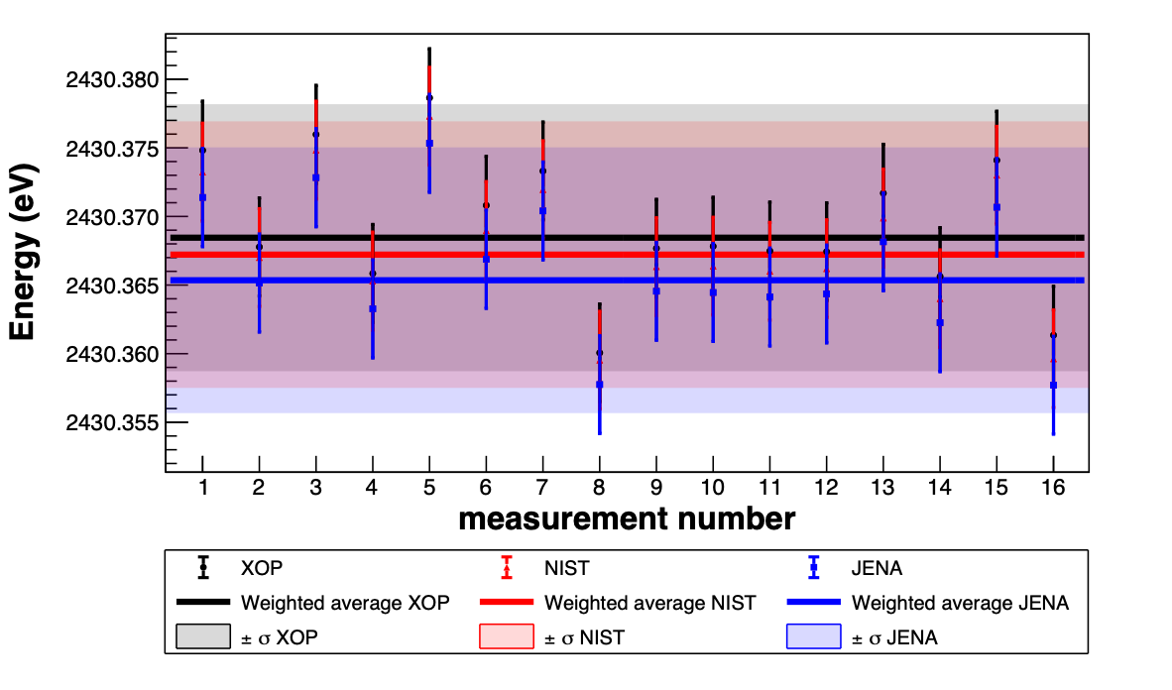
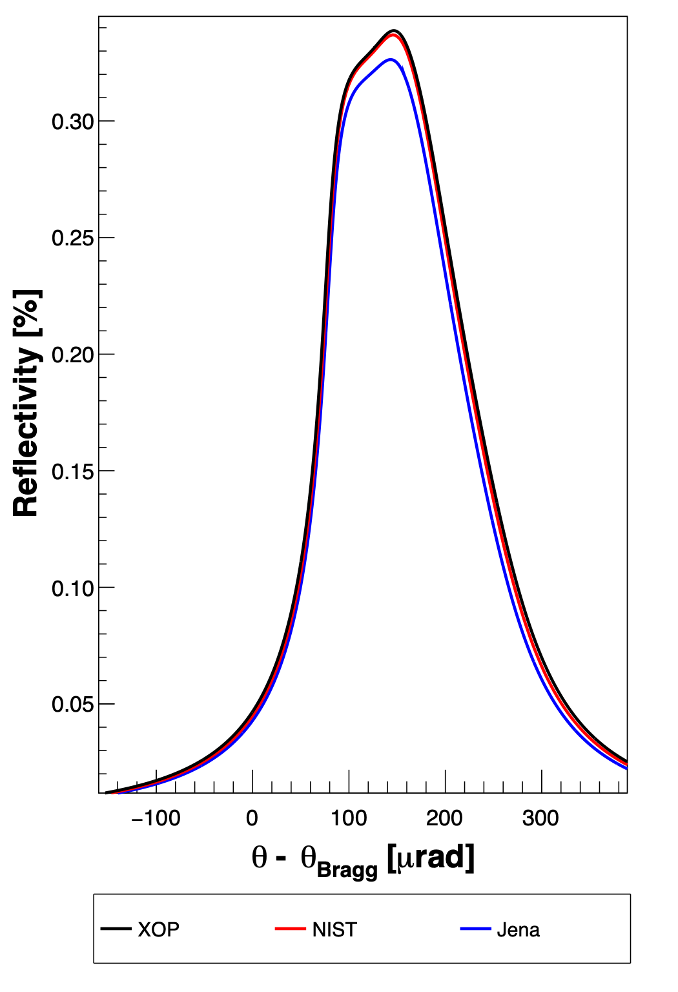
Sensitivity to crystal parameters
Sensitivity to the interaction of the crystal atoms to x-rays
not quite enough to choose between models (all based on theoretical calculations)
changes in rocking curves
HPXRM 2023

Slide 27
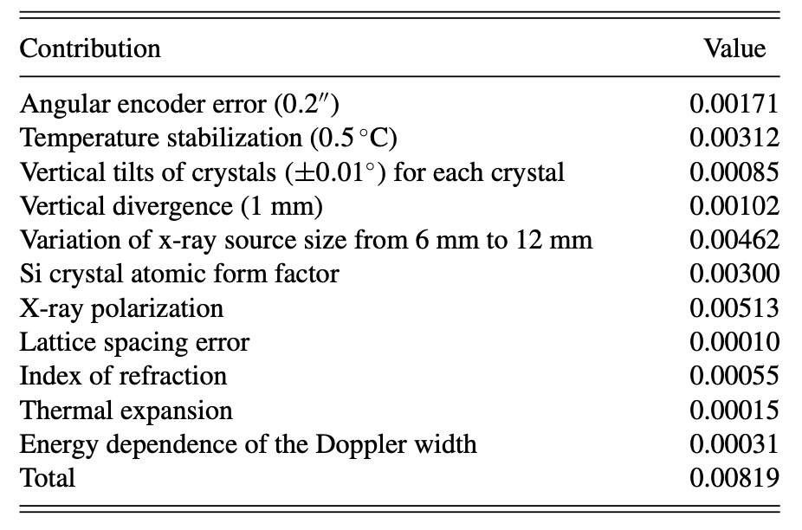
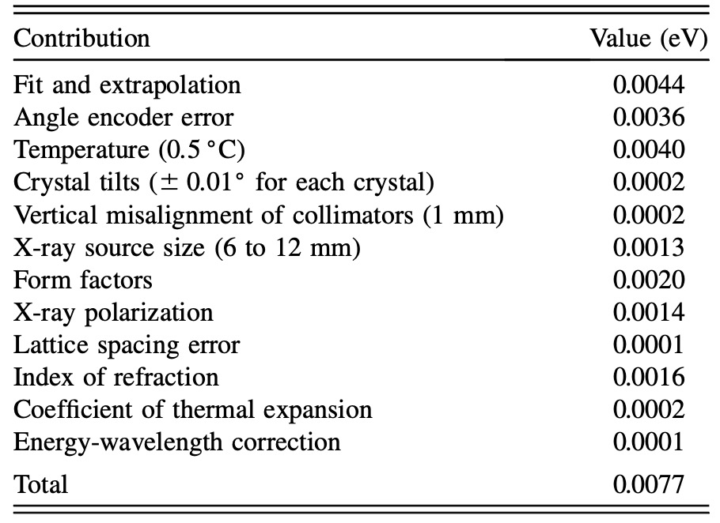
Error comparison
Sulfur M1
Argon M1
HPXRM 2023

Slide 28
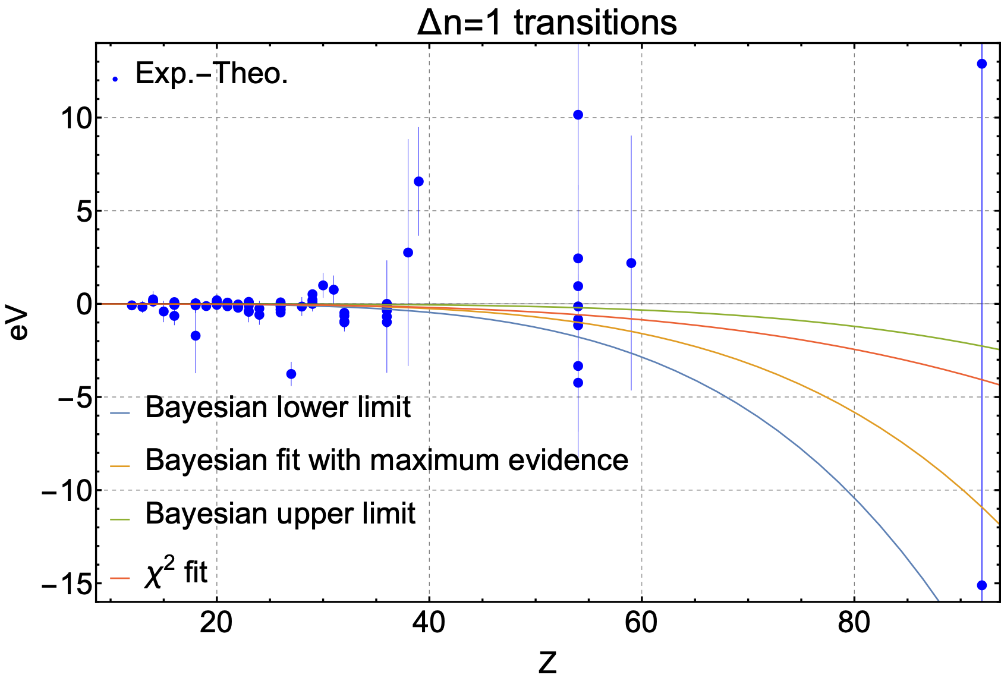
Comparison with theory
2.7x10⁻⁷ Z^{3.6}
3.3x10⁻⁹ Z^{4.5}
Theory: Artemyev et al. (2005) and Yerokhin et al. (2022)
C. Godinho, J. Machado, M. Guerra, M. Trassinelli, N. Paul, P.I.
HPXRM 2023

Slide 29
Exotic atoms and QED
Nuclear effects and QED contributions
HPXRM 2023

Slide 30
D. A. Bennett, W. B. Dories, M. S. Durkin, J. W. Fowler, G. C. Hilton, J. D. Gard, K.S. Morgan, G. C. O’Neil, C. D. Reintsema, D. R. Schmidt, D. S. Swetz, U. Ullom
P. Indelicato, N. Paul
T. Azuma, T. Okumura,
Y. Ueno, T. Isobe, S. Kanda
T. Takahasi, P. Caradonna, M. Katsuragawa, T. Minami, K. Mine, S. Nagasawa, S. Takeda, Y. Tsuzuki, G. Yabu
N. Kawamura, Y. Miyake, K. Shimomura, P. Strasser, S. Tampo, B. S. Takeshita, G. Yoshida
Y. Ichinohe. S. Yamada
S. Okada
T. Hashimoto ,T. U. Ito,
T. Osawa
R. Hayakawa,
H. Suda,
H. Tatusno
A. Taniguchi
K. Ninoyima, I. Chiu, M. Kasino, H. Noda, K. Terada
Y. Kino, T. Nakamura. T. Okutsu
I. Umegaki
S. Wantanabe
K. Kubo
HPXRM 2023

Slide 31
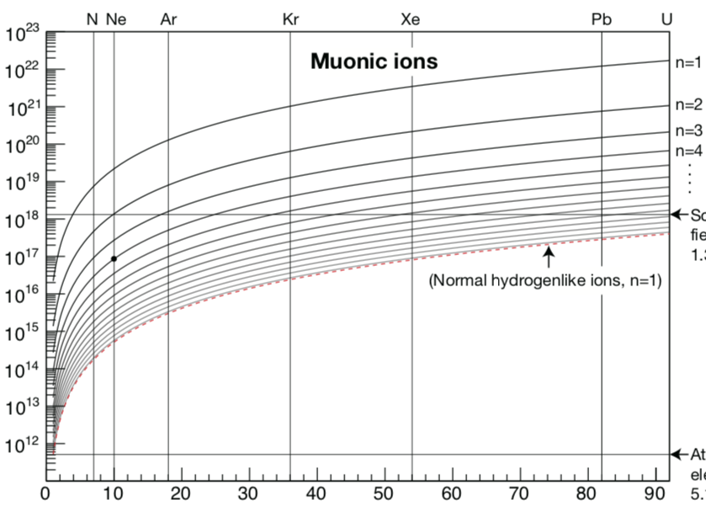
Strong-field QED with muonic atoms
}
muon
.
.
.
n=10
Energy levels in muonic ions
Schwinger
Limit
}
Electric field [V/m]
GSI
H-like HCI, n=1
Energy levels in HCI
First experiments
@ JPARC
Equivalent field!
Atomic unit of electric field
electron
Atomic number [Z]
n=1
Exotic atoms:
(strong field) x (Rydberg states)
Vanishing nuclear uncertainties!
N. Paul et al, « Testing Quantum Electrodynamics with Exotic Atoms » PRL 126, 173001 (2021)
HPXRM 2023
Notes:
On peut se concentrer sur les transitions entre les états de Rydberg circulaire avec très peu de recouvrement avec le noyau. Donc on garde des transitions en champ fort, mais on se débarrasse des incertitude nucléaires. Ceci est un nouveau paradigme dans les tests de la QED, dont notre groupe est à l’origine, et que j’aimerai developper par la suite.
Pendant mon postdoc j’ai analysé les résultats des calculs QED pour articuler ce nouveau concept dans un article qui vient d’être accepté au PRL.

Slide 32
could one get precise QED tests with exotic atoms?
Look at Rydberg states
Use circular Rydberg states (no interaction with the nucleus)
Yrast transitions (highest l for a given n)
Check ratio of first and second order QED correction to finite nuclear size as a function of n
Such systems enable to explore beyond the Schwinger limit
N. Paul, G. Bian, T. Azuma, S. Okada, and P. Indelicato, Phys. Rev. Lett. 126, 173001 (2021).
HPXRM 2023

Slide 33
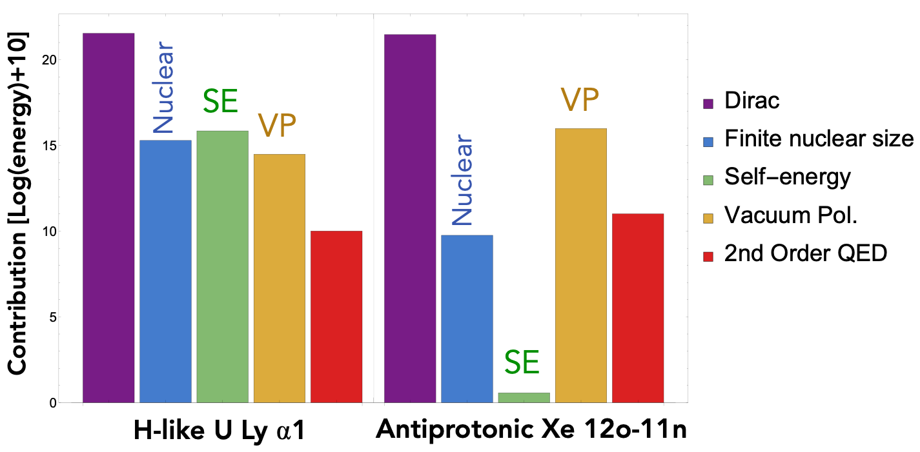
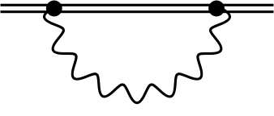
HCI and Exotic Atoms: a complementary pair
Self energy (SE)
Vacuum pol. (VP)
Highly charged ion: SE>VP
Exotic atom: VP>SE
Self-energy is dominant in HCI, vacuum polarization is dominant in exotic atoms
Unique probe of vacuum polarization, « one of the most interesting phenomena predicted by contemporary quantum electrodynamics » (Foldy and Eriksen, Physical Review (1954))
Complementary to vacuum studies with high-intensity lasers
HPXRM 2023

Slide 34
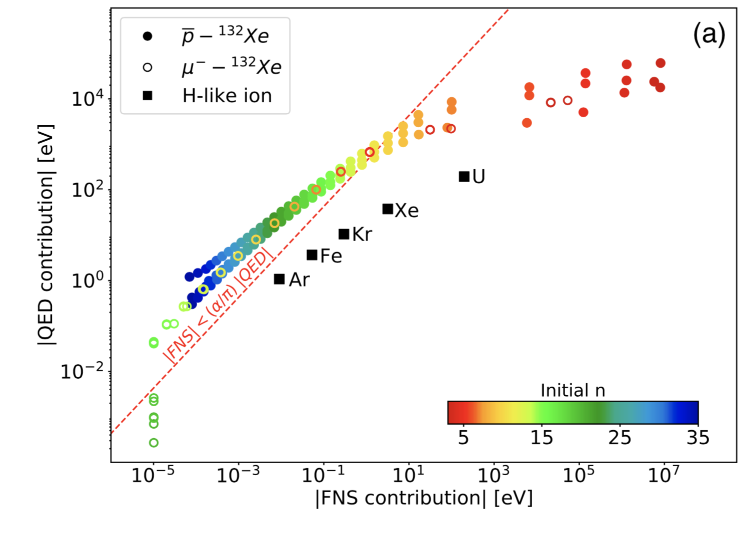
QED vs Finite Nuclear Size
QED theory calculations
Precision QED calculations performed for radiative cascade in muonic atoms from H →U
Multiconfiguration Dirac Fock code (MCDFGME, P. Indelicato, J.P. Desclaux)
One order of magnitude gain in sensitivity compared to normal H-like ions, by avoiding nuclear physics uncertainties
HPXRM 2023

Slide 35
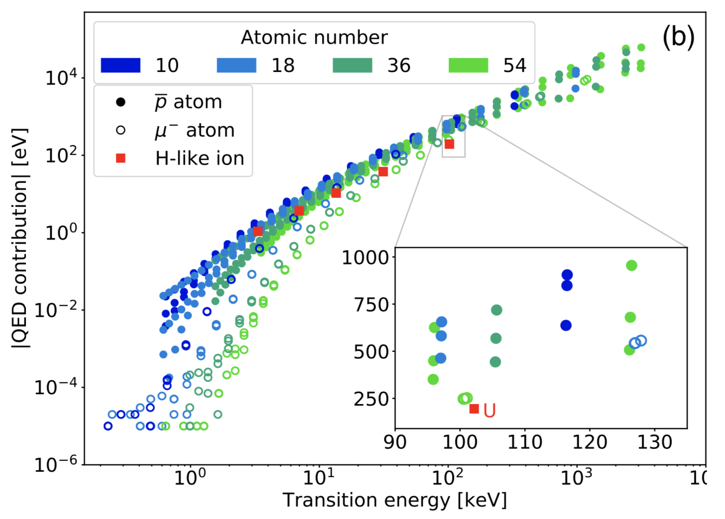
QED vs Transition Energy
Ge detection range
p
Larger QED contributions to transition energies, accessible for lower-Z ions
Factor of 2-10 gain in QED enhancement for a given detection range
QED effects in exotic atoms are larger for a given Z, thus easier to measure
HPXRM 2023

Slide 36
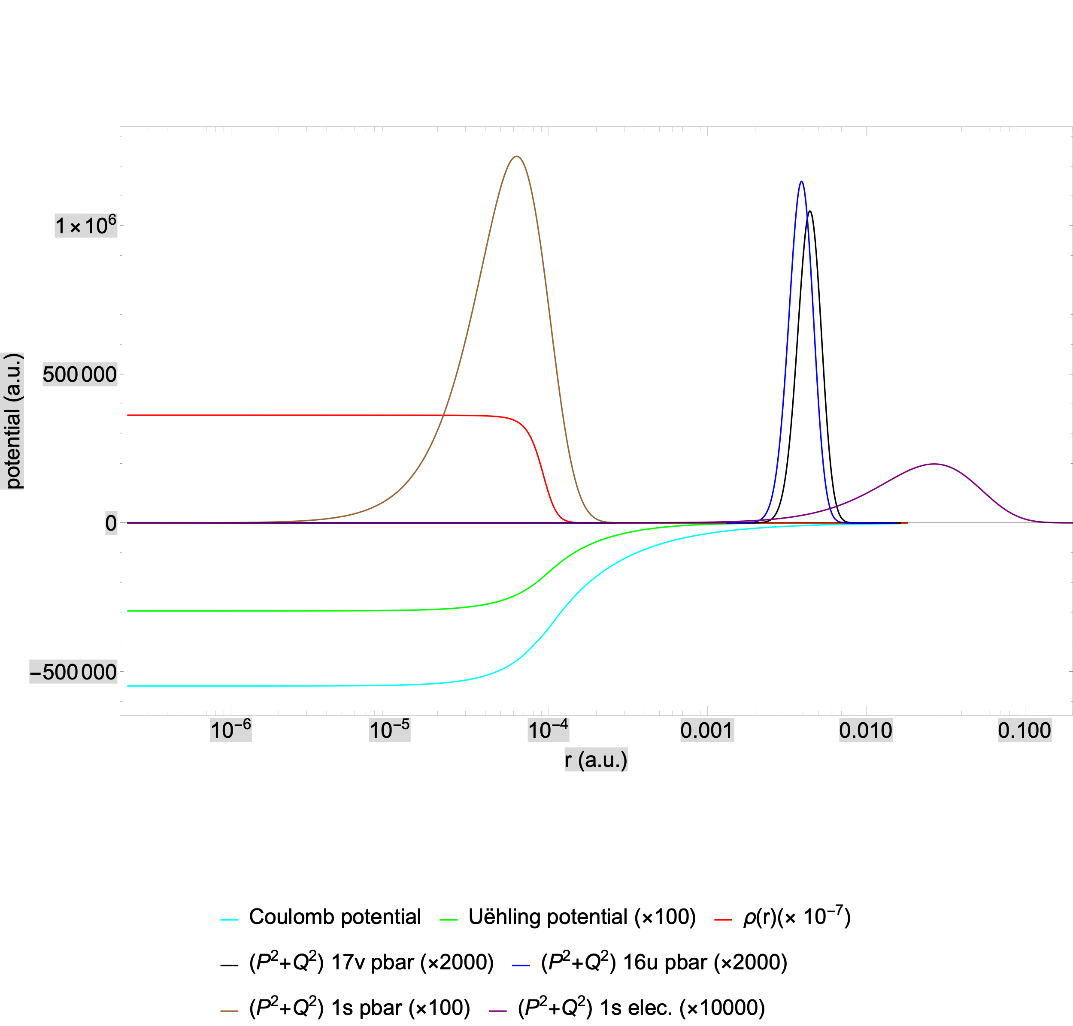
Wavefunctions and potentials
HPXRM 2023

Slide 37
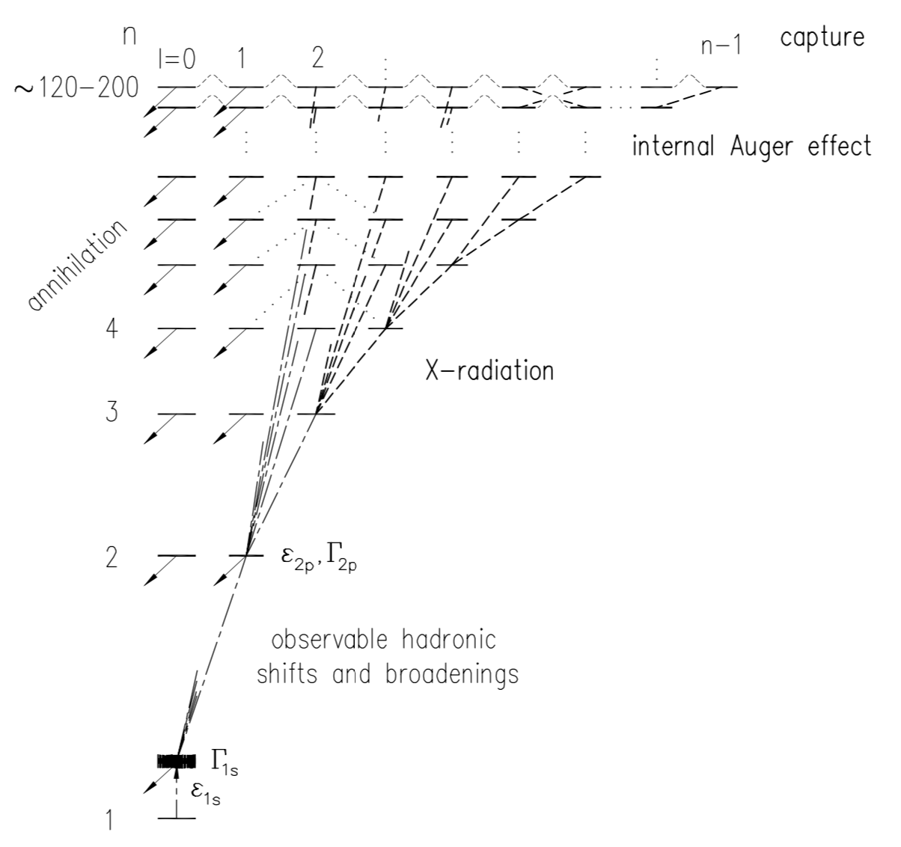
The exotic atom cascade
Antiprotonic atom cascade
Auger electron
Exotic particle
}
QED
Z
Exotic atom x-rays
}
Nuclear properties
$$n_{exotic}≈n_{e^{-}}\sqrt{m_{exotic}/m_{e^{-}}}$$
The exotic particle captures onto high-n orbitals
Decays via Auger electrons and radiatively (X-rays)
Eventually is either captured by nucleus (muons), or annihilates (antiprotons)
HPXRM 2023

Slide 38
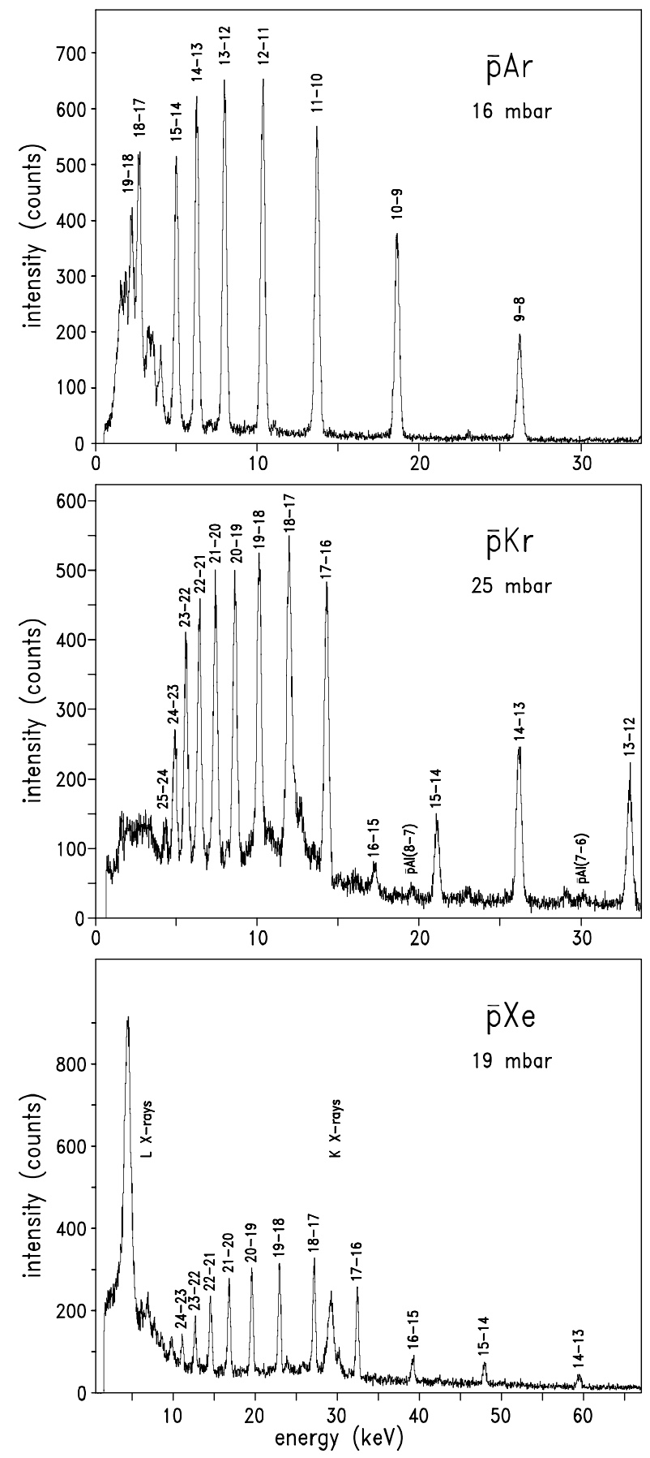
Cascade in antiprotonic atoms
High-n Rydberg-state Yrast transitions
observed with a gard-ring Si(Li) detector at the “Low Energy Antiproton Ring” (LEAR) at CERN
D. Gotta, K. Rashid, B. Fricke, P. Indelicato, and L. M. Simons, Eur. Phys. J D 47, 11 (2008).
HPXRM 2023

Slide 39
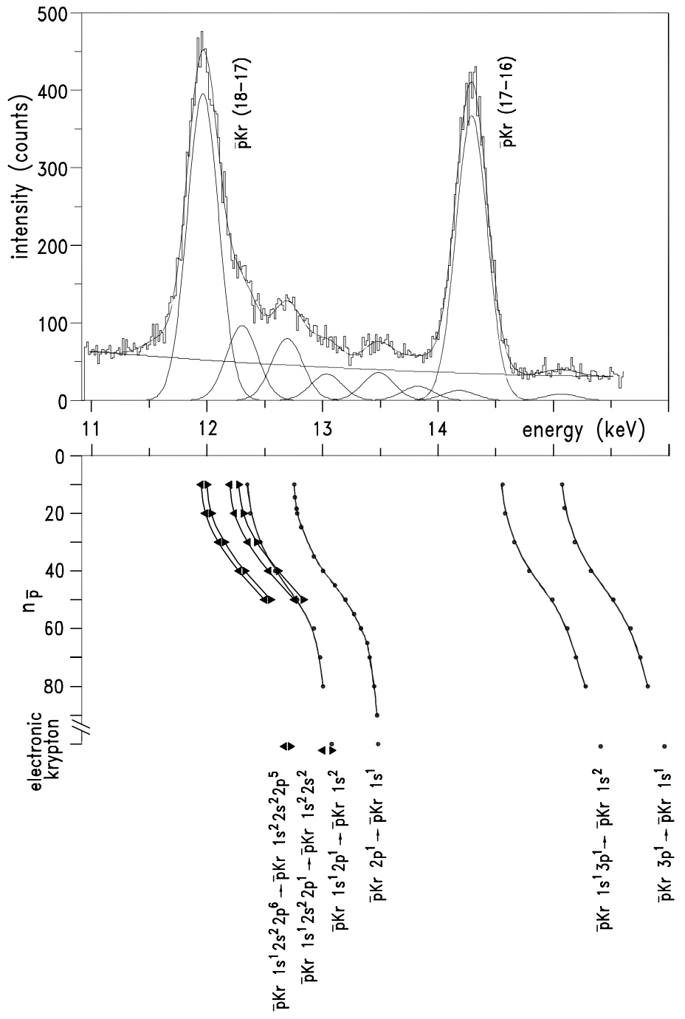
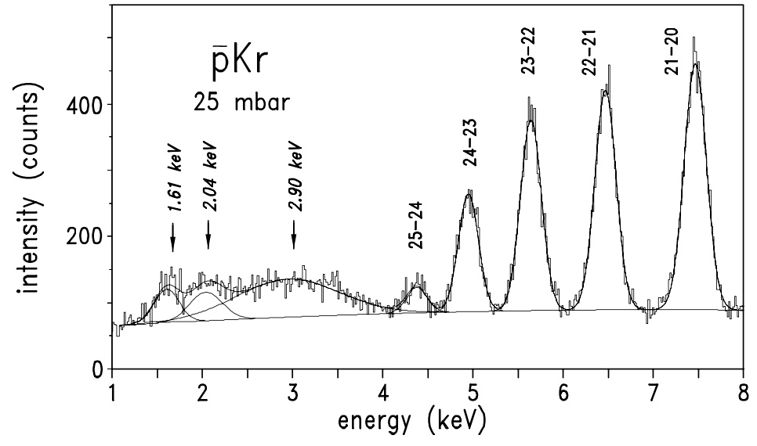
Determining the number of remaining electrons
D. Gotta, K. Rashid, B. Fricke, P. Indelicato, and L. M. Simons, Eur. Phys. J D 47, 11 (2008).
HPXRM 2023

Slide 40
First example: µNe
QED tests and µCalorimeter
HPXRM 2023

Slide 41
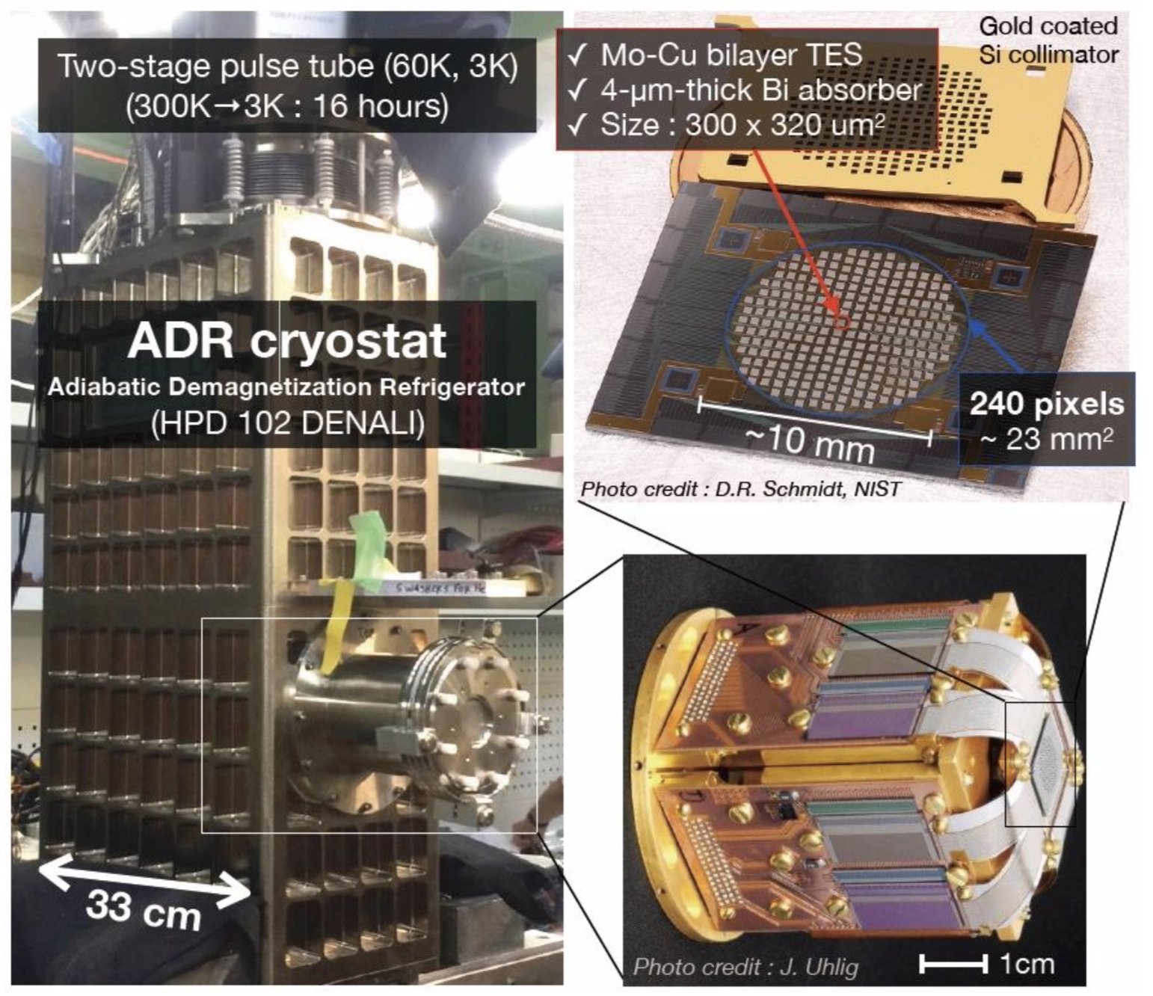
Key technology : NIST Transition Edge Sensing detector
HPXRM 2023
Notes:
But as we have seen, it is exotic atoms that may offer a promising alternative to precision QED tests, and thus we have a 5 year accepted campaign at JPARC in Japan to perform precision x-ray spectroscopy of Rydberg states in muonic atoms. The key to these experiments is a new type of quantum sensor technology developed by our collaborators at NIST, a transition edge sensing microcalorimeter detector. These detectors are unique because they combine high resolution, so a few eV for a 6 keV transition, here you can see the comparison between a TES and a normal solid-state detector that we use for in-beam spectroscopy. At the same time they have high quantum efficiency, which is essential for doing physics with exotic beams. We were there for three weeks in Jan 2020 as you can see here.

Slide 42
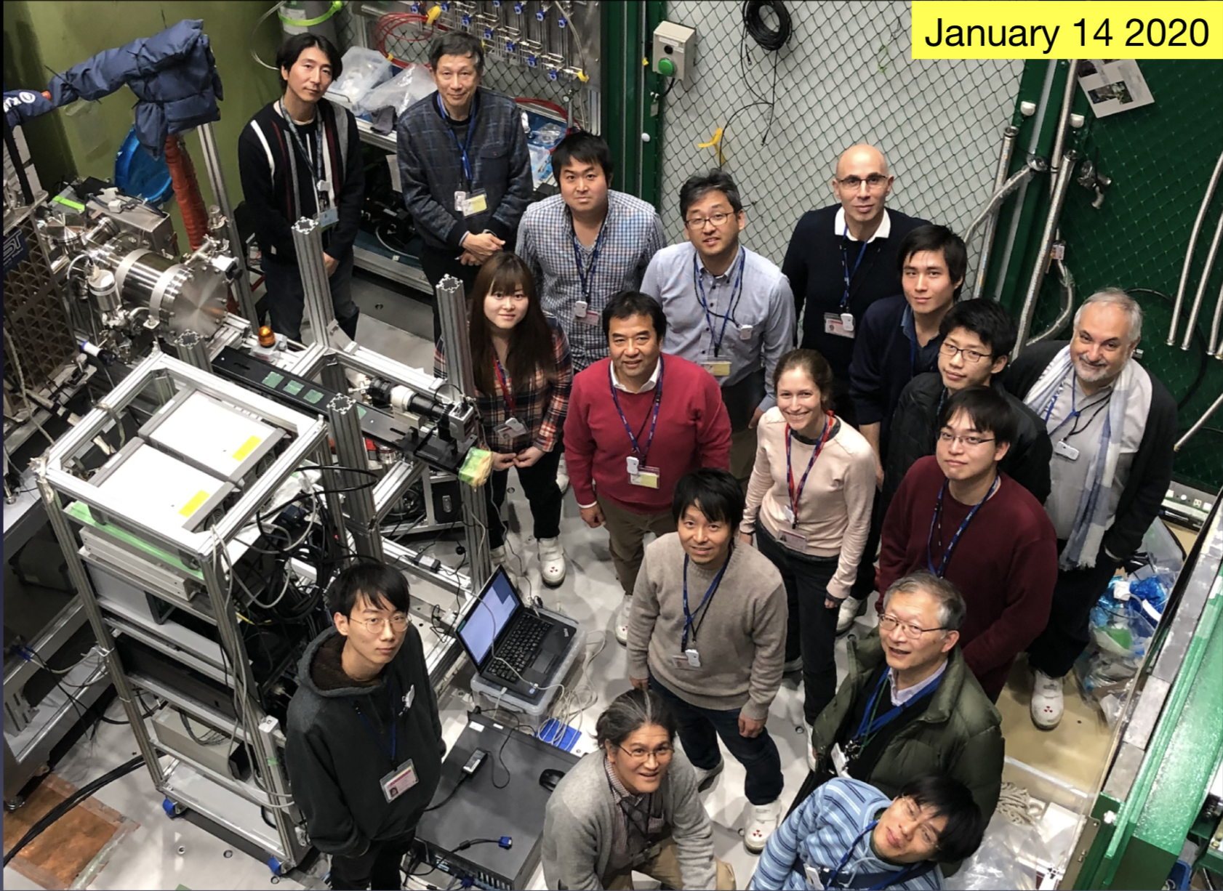
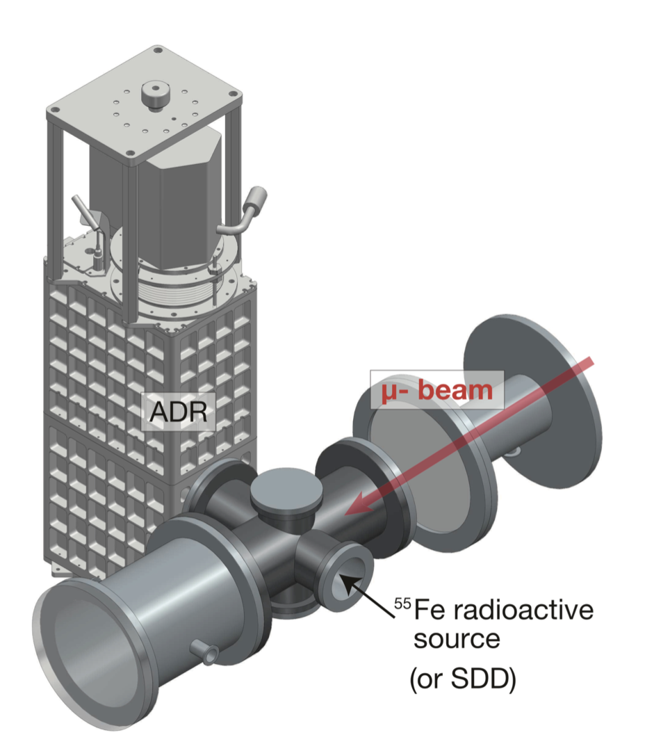
First experiments with muonic atoms at J-PARC
5-year accepted scientific program at J-PARC muon facility in Japan (2020-2025)
QED tests=precision x-ray spectroscopy of Rydberg states in muonic atoms
LKB @ JPARC—Jan 14, 2020
Collaboration: RIKEN, JAEA, JAXA, KEK, Osaka University, Rikkyo University, Tohoku University, Tokyo Metrolopolitan University, NIST, LKB
X-ray tube
HPXRM 2023
Notes:
But as we have seen, it is exotic atoms that may offer a promising alternative to precision QED tests, and thus we have a 5 year accepted campaign at JPARC in Japan to perform precision x-ray spectroscopy of Rydberg states in muonic atoms. The key to these experiments is a new type of quantum sensor technology developed by our collaborators at NIST, a transition edge sensing microcalorimeter detector. These detectors are unique because they combine high resolution, so a few eV for a 6 keV transition, here you can see the comparison between a TES and a normal solid-state detector that we use for in-beam spectroscopy. At the same time they have high quantum efficiency, which is essential for doing physics with exotic beams. We were there for three weeks in Jan 2020 as you can see here.

Slide 43
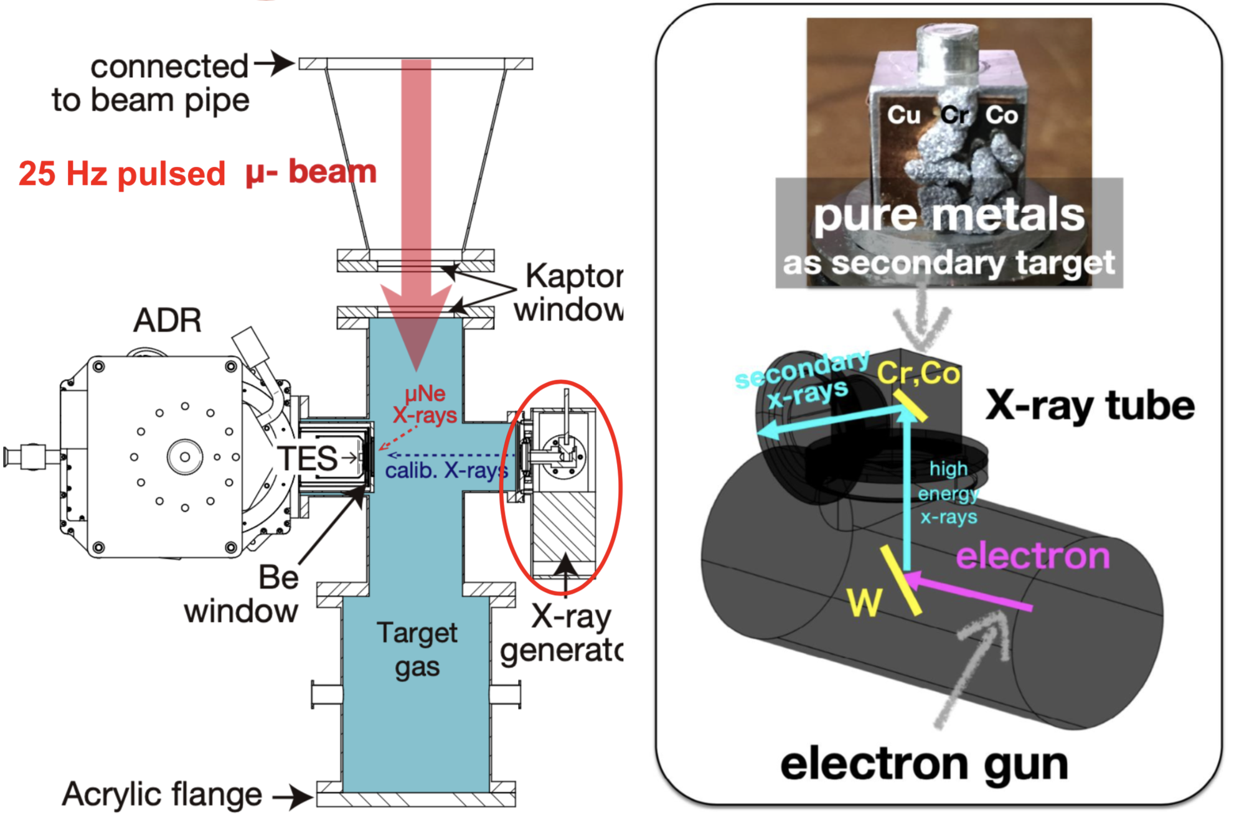
Experimental setup—details
HPXRM 2023
Notes:
But as we have seen, it is exotic atoms that may offer a promising alternative to precision QED tests, and thus we have a 5 year accepted campaign at JPARC in Japan to perform precision x-ray spectroscopy of Rydberg states in muonic atoms. The key to these experiments is a new type of quantum sensor technology developed by our collaborators at NIST, a transition edge sensing microcalorimeter detector. These detectors are unique because they combine high resolution, so a few eV for a 6 keV transition, here you can see the comparison between a TES and a normal solid-state detector that we use for in-beam spectroscopy. At the same time they have high quantum efficiency, which is essential for doing physics with exotic beams. We were there for three weeks in Jan 2020 as you can see here.

Slide 44
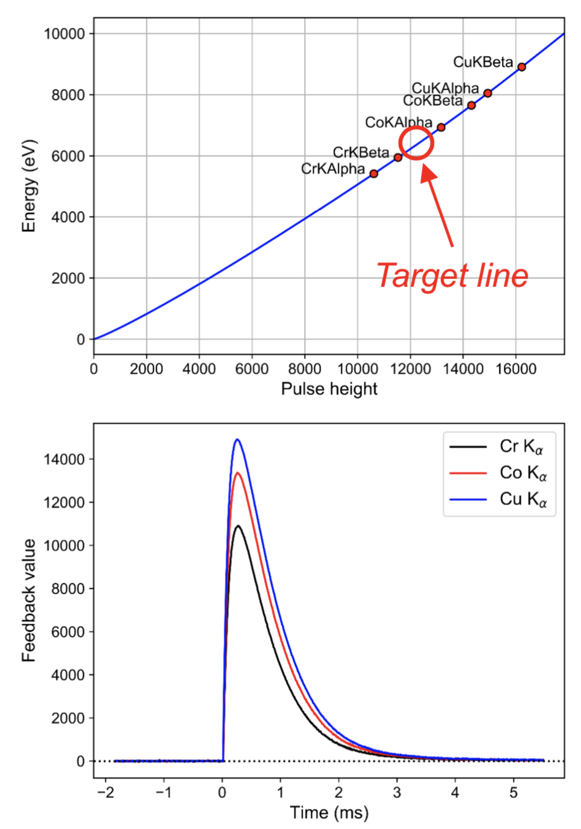
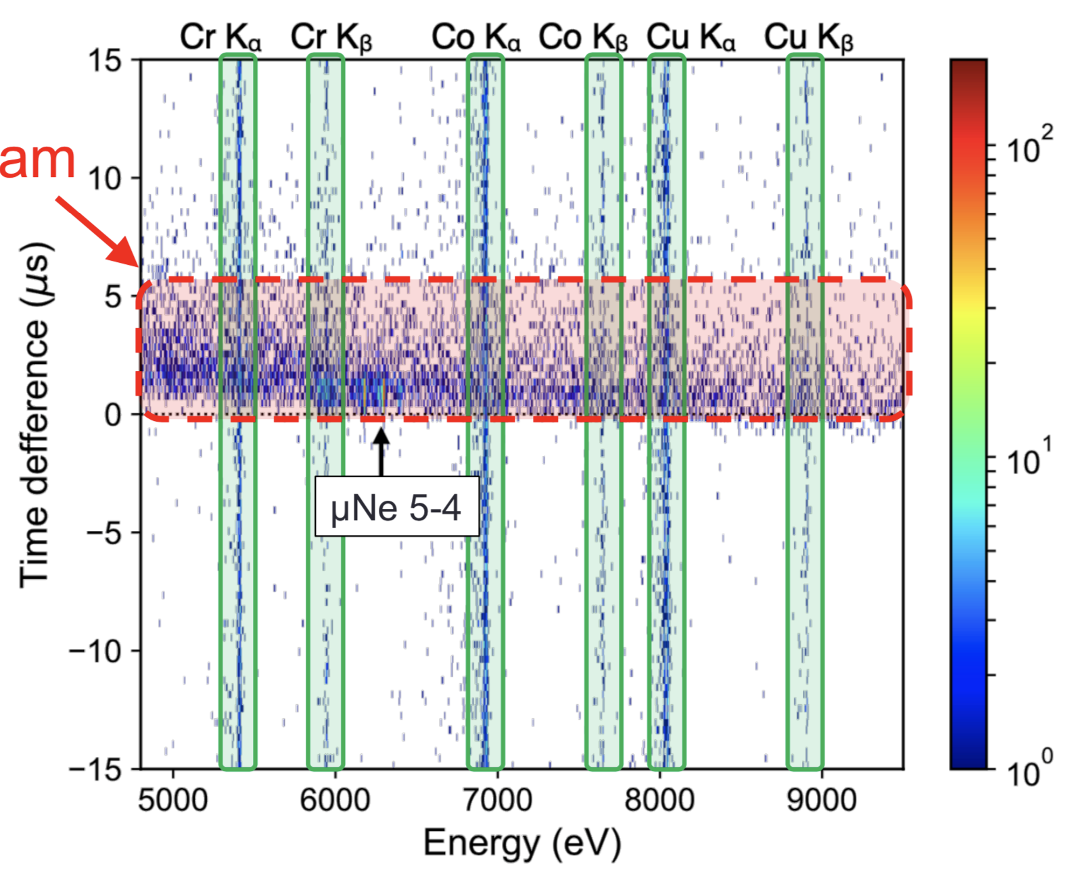
TES calibration
Counts
Muon beam
Pixel-by-pixel energy calibration
Continuous calibration lines from x-ray gun
HPXRM 2023
Notes:
But as we have seen, it is exotic atoms that may offer a promising alternative to precision QED tests, and thus we have a 5 year accepted campaign at JPARC in Japan to perform precision x-ray spectroscopy of Rydberg states in muonic atoms. The key to these experiments is a new type of quantum sensor technology developed by our collaborators at NIST, a transition edge sensing microcalorimeter detector. These detectors are unique because they combine high resolution, so a few eV for a 6 keV transition, here you can see the comparison between a TES and a normal solid-state detector that we use for in-beam spectroscopy. At the same time they have high quantum efficiency, which is essential for doing physics with exotic beams. We were there for three weeks in Jan 2020 as you can see here.

Slide 45
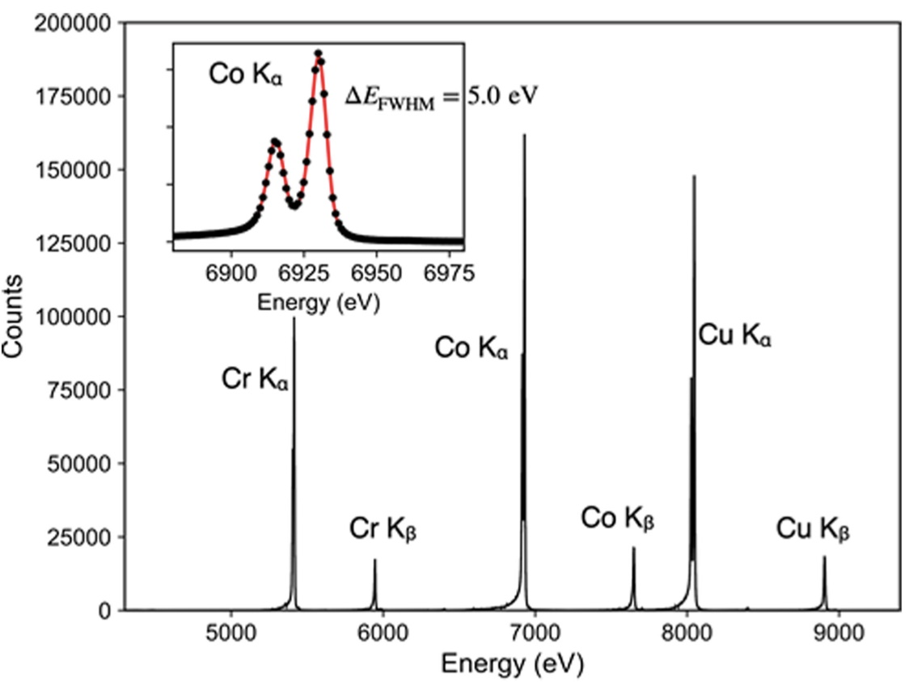
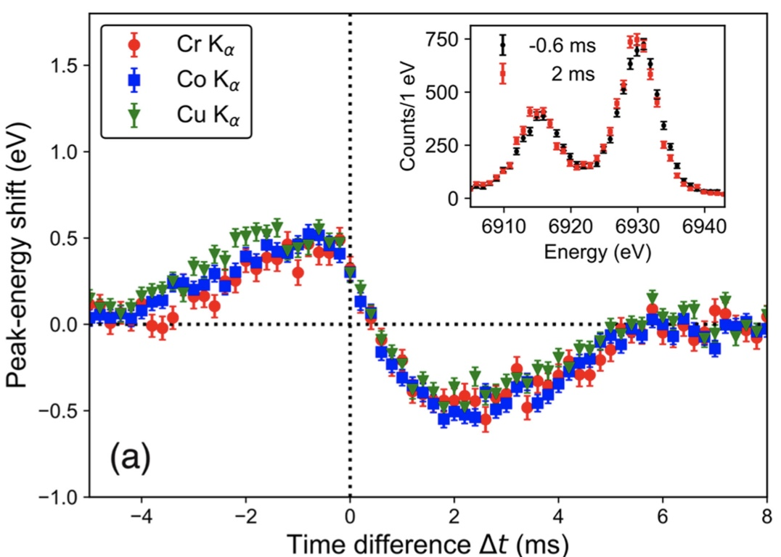
TES calibration
muon beam
Co Kα
µ Ne 5g-4f
Total calibration spectrum at 0.1 atm
Energy shift (tmuon-tx-ray)
Dynamical Response of Transition-Edge Sensor Microcalorimeters to a Pulsed Charged-Particle Beam, T. Okumura, T. Azuma, D.A. Bennett, P. Caradonna, I.H. Chiu, W.B. Doriese, M.S. Durkin, J.W. Fowler, J.D. Gard, T. Hashimoto, R. Hayakawa, G.C. Hilton, Y. Ichinohe, P. Indelicato, T. Isobe, S. Kanda, M. Katsuragawa, N. Kawamura, Y. Kino, K. Mine, Y. Miyake, K.M. Morgan, K. Ninomiya, H. Noda, G.C.O. Neil, S. Okada, K. Okutsu, T. Osawa, N. Paul, C.D. Reintsema, D.R. Schmidt, K. Shimomura, P. Strasser, H. Suda, D.S. Swetz, T. Takahashi, S. Takeda, S. Takeshita, H. Tatsuno, Y. Ueno, J.N. Ullom, S. Watanabe and S. Yamada. IEEE Transactions on Applied Superconductivity 31, 1-4 (2021).
HPXRM 2023
Notes:
But as we have seen, it is exotic atoms that may offer a promising alternative to precision QED tests, and thus we have a 5 year accepted campaign at JPARC in Japan to perform precision x-ray spectroscopy of Rydberg states in muonic atoms. The key to these experiments is a new type of quantum sensor technology developed by our collaborators at NIST, a transition edge sensing microcalorimeter detector. These detectors are unique because they combine high resolution, so a few eV for a 6 keV transition, here you can see the comparison between a TES and a normal solid-state detector that we use for in-beam spectroscopy. At the same time they have high quantum efficiency, which is essential for doing physics with exotic beams. We were there for three weeks in Jan 2020 as you can see here.

Slide 46
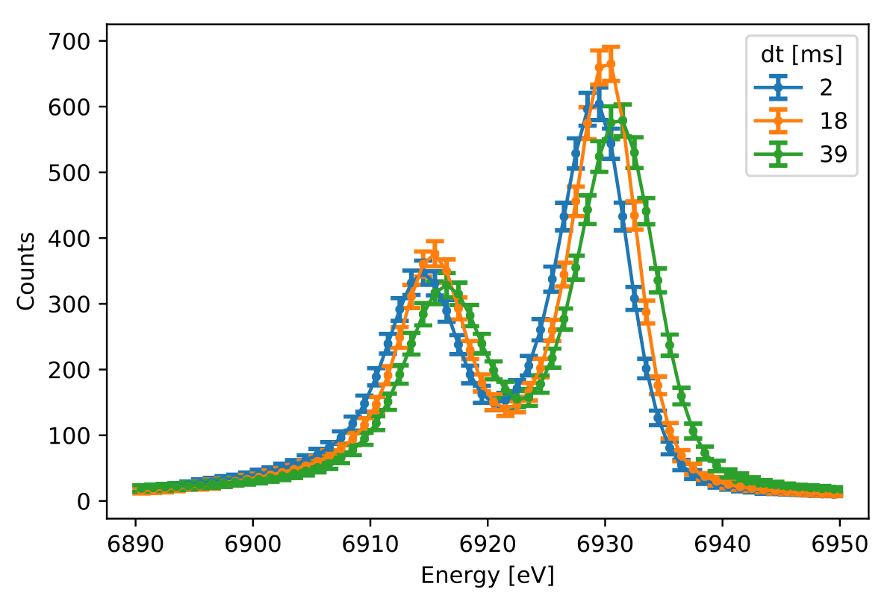
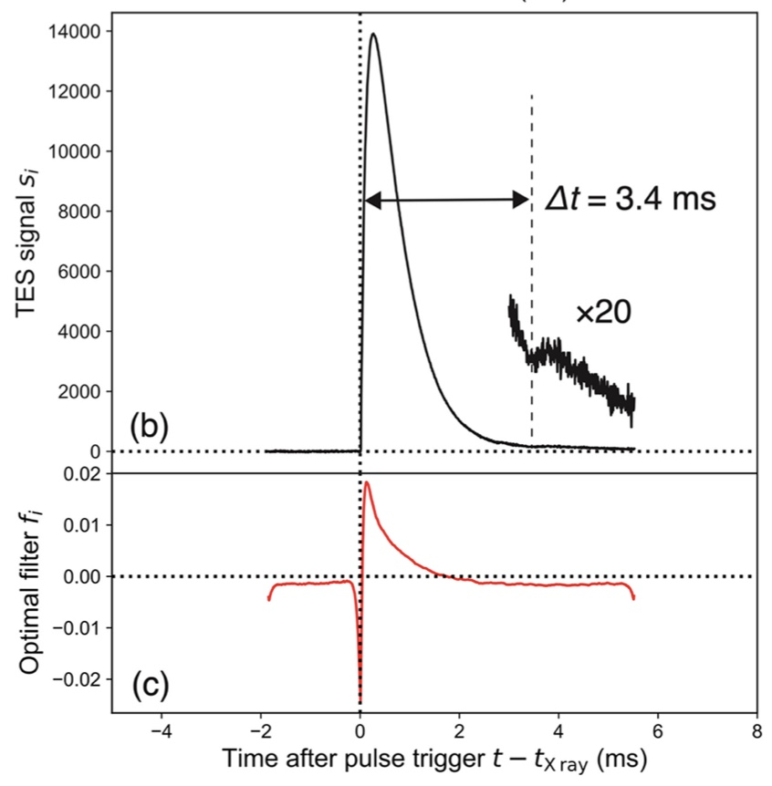
TES calibration
Co Kα at 0.4 atm
Co Kα 3.4 ms before µ pulse
muon beam at 0 ms
Energy shift (tmuon-tx-ray)
time-dependent optimal filter to evaluate the pulse energy
Dynamical Response of Transition-Edge Sensor Microcalorimeters to a Pulsed Charged-Particle Beam, T. Okumura, T. Azuma, D.A. Bennett, P. Caradonna, I.H. Chiu, W.B. Doriese, M.S. Durkin, J.W. Fowler, J.D. Gard, T. Hashimoto, R. Hayakawa, G.C. Hilton, Y. Ichinohe, P. Indelicato, T. Isobe, S. Kanda, M. Katsuragawa, N. Kawamura, Y. Kino, K. Mine, Y. Miyake, K.M. Morgan, K. Ninomiya, H. Noda, G.C.O. Neil, S. Okada, K. Okutsu, T. Osawa, N. Paul, C.D. Reintsema, D.R. Schmidt, K. Shimomura, P. Strasser, H. Suda, D.S. Swetz, T. Takahashi, S. Takeda, S. Takeshita, H. Tatsuno, Y. Ueno, J.N. Ullom, S. Watanabe and S. Yamada. IEEE Transactions on Applied Superconductivity 31, 1-4 (2021).
HPXRM 2023
Notes:
But as we have seen, it is exotic atoms that may offer a promising alternative to precision QED tests, and thus we have a 5 year accepted campaign at JPARC in Japan to perform precision x-ray spectroscopy of Rydberg states in muonic atoms. The key to these experiments is a new type of quantum sensor technology developed by our collaborators at NIST, a transition edge sensing microcalorimeter detector. These detectors are unique because they combine high resolution, so a few eV for a 6 keV transition, here you can see the comparison between a TES and a normal solid-state detector that we use for in-beam spectroscopy. At the same time they have high quantum efficiency, which is essential for doing physics with exotic beams. We were there for three weeks in Jan 2020 as you can see here.

Slide 47
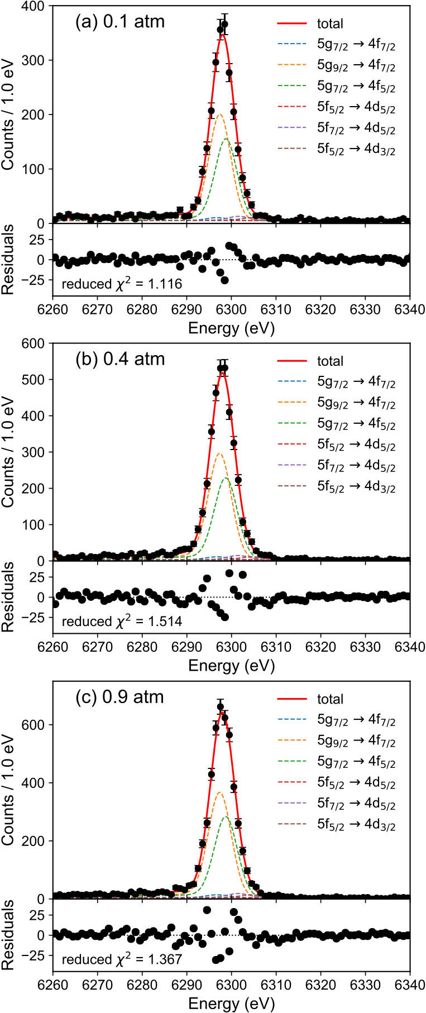
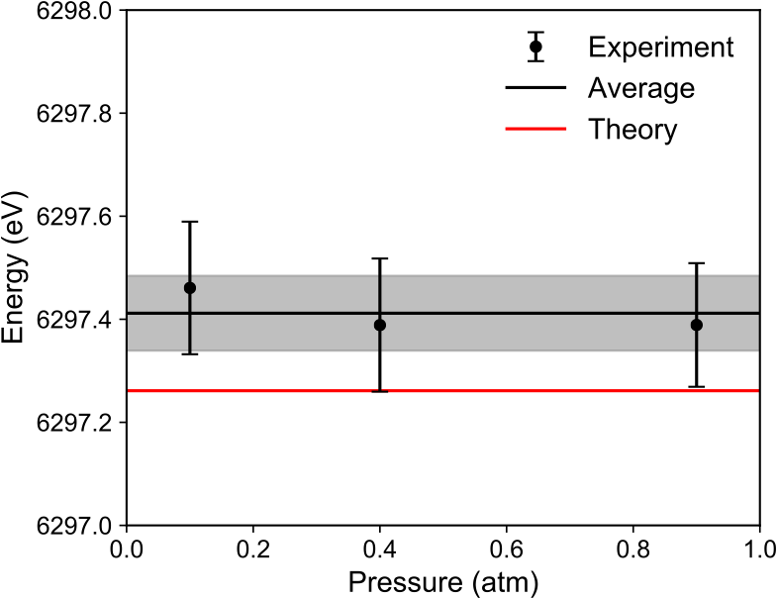
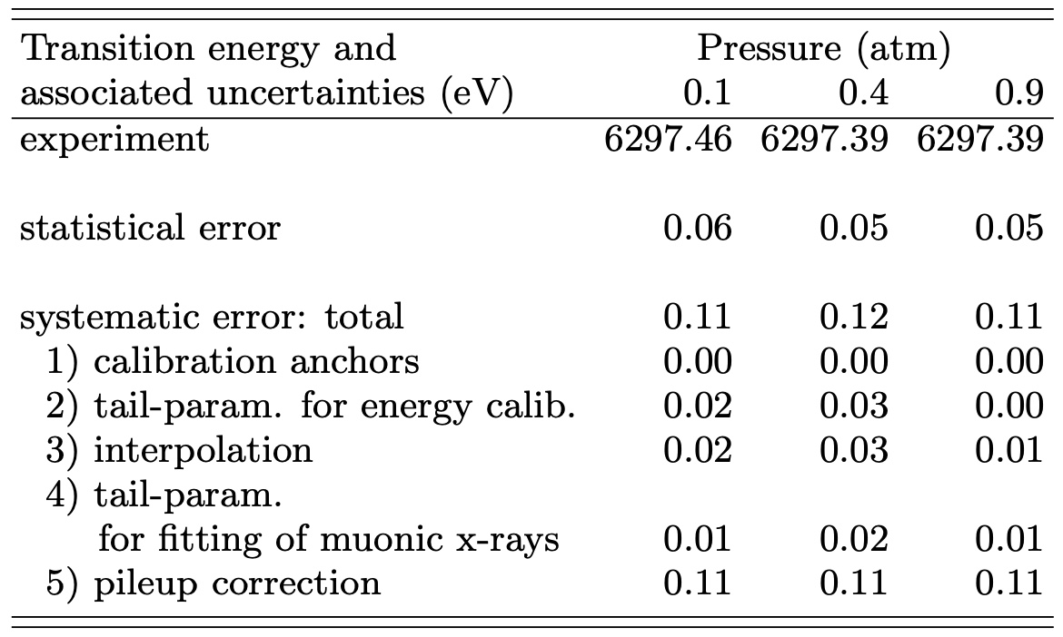
Experimental spectra and pressure dependence
shift due to presence of 1 electron: -1.25 eV
HPXRM 2023

Slide 48
Experimental spectra and pressure dependence
intensity ratio as free parameter
n=20 I=0.025
n=15 I=0.038
n=10 l=0.066
n=8 l=0.086
n=6 I=0.117
I5f-4f
Itotal
statistical population in
HPXRM 2023

Slide 49
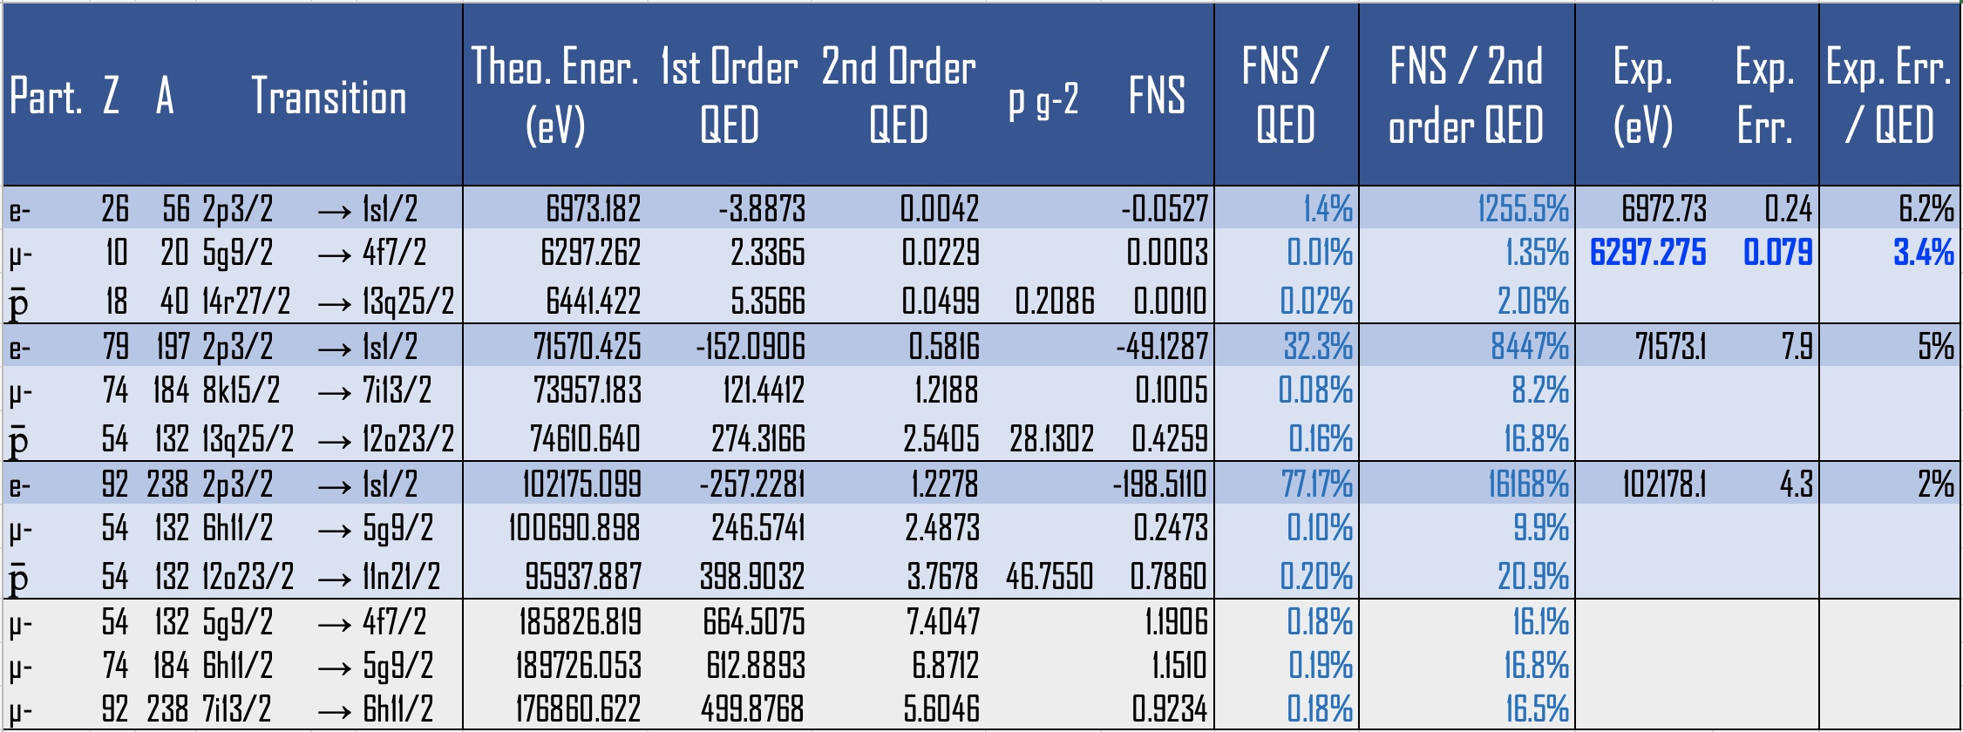
Comparison with µNe
J-PARC
Theory-Exp.: 0.013±0.079 eV
T. Okumura, T. Azuma, D.A. Bennett, P. Caradonna, I. Chiu, W.B. Doriese, M.S. Durkin, J.W. Fowler, J.D. Gard, T. Hashimoto, R. Hayakawa, G.C. Hilton, Y. Ichinohe, P. Indelicato, T. Isobe, S. Kanda, M. Katsuragawa, N. Kawamura, Y. Kino, K. Mine, Y. Miyake, K.M. Morgan, K. Ninomiya, H. Noda, G.C. O'Neil, S. Okada, K. Okutsu, N. Paul, C.D. Reintsema, D.R. Schmidt, K. Shimomura, P. Strasser, H. Suda, D.S. Swetz, T. Takahashi, S. Takeda, S. Takeshita, M. Tampo, H. Tatsuno, Y. Ueno, J.N. Ullom, S. Watanabe, S. Yamada, Testing Quantum Electrodynamics: High Precision X-ray Spectroscopy of Muonic Neon Atoms, Phys. Rev. Lett. 130, 173001 (2023).
HPXRM 2023

Slide 50
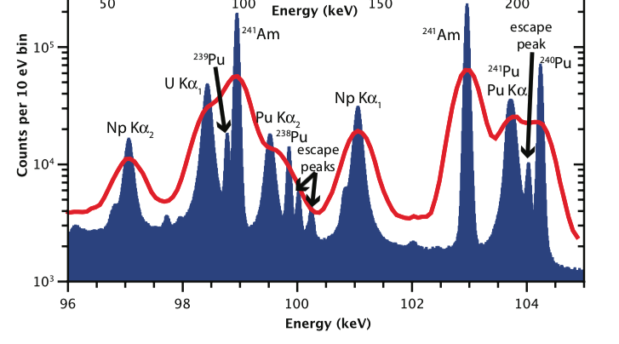
Next step: high-energy TES
Key technology
High energy resolution (ΔE/E ~10⁻⁴)
High efficiency (~10⁻⁴)
Transition Edge Sensing (TES) μcalorimeter (NIST)
Ge detector
TES μcalorimeter
X-ray tube
Rev. Sci. Instrum. 83, 093113 (2012)
enable to do up to muonic Xe or W (using WF6 gas)
should be ready and first experiment planned for march 2023
HPXRM 2023
Notes:
Ce détecteur est un Transition Edge Sensing microcalorimètre, qui a à la fois une haute efficacité et une haute resolution en énergie, jamais disponible auparavant dans la gamme des rayons-X. Pour démontrer le gain qu’on a pour la physique avec ce detecteur, ici vous avez un comparison entre un détecteur de germanium standard pour ce type de mesure, et ce détecteur TES. Cette bonne resolution en energie nous permet de tester la QED avec des atomes exotiques.

Slide 51
Future experiments: PAX
antiprotonic atoms
HPXRM 2023

Slide 52
Progress with detectors: µcalorimeter vs Si(Li)
HPXRM 2023

Slide 53
Slow antiprotons now available at CERN (again)!
ELENA:
« Extra Low ENergy Antiprotons »
First beams of decelerated antiprotons obtained now (5 keV on GBAR line)
HPXRM 2023
Notes:
Les antiprotons froids sont just maintenant disponible au CERN dans le nouveau anneau ELENA, et l’équipe de métrologie est déjà sur place dans le collaboration GBAR.

Slide 54
Future experiments: QUARTET
(re)measuring light-elements (Z>2) nuclear radius with muonic atoms
HPXRM 2023

Slide 55
QUARTET
QUARTET: QUAntum inteRacTions with Exotic aToms
Use micro-calorimeter (magnetic version from KIP Heidelberg University)
replacement for crystal spectrometers
Test experiment next November (background, calibration…)
Collaboration:
LKB
Technion
PSI
KIP
Mainz Univ.
KU Leuven
ETHZ
Nova Univ. Lisbon
HPXRM 2023

Slide 56
Crystal spectrometry of muonic atoms
Experiments performed at the Paul Scherrer institute with solid targets and transmission crystal spectrometer to measure nuclear radii
— require intense beams of muons
— strong electron recapture during the cascade (solid), giving shifts
— lower n=1, 2, 3, 4 levels used as the aim was to measure precisely nuclear size
The shift due to uncertainty in the number of electron recaptures in pionic magnesium lead to the error in the pion mass determination
HPXRM 2023

Slide 57
muonic ⁶Li
2p3/2
F=5/2
0.011 eV
F=3/2
-0.008 eV
F=1/2
-0.019 eV
Electric Q-pole negligible
18671.579 eV, EM width=0.007 eV
F=3/2
0.440 eV
1s
1.346 eV
F=1/2
-0.880 eV
⁶Li nuclear spin I=1 µ=0.8220473 µN Q=-0.000808 barns
Quartet 27/3/2023
N.J. Stone. Atomic Data and Nuclear Data Tables 90, 75-176 (2005)

Slide 58
muonic ¹⁰B
0.883 eV
F=9/2
0.123 eV
0.368 eV
2p3/2
F=7/2
0.000 eV
F=5/2
-0.096 eV
-0.221 eV
F=3/2
-0.164 eV
-0.736 eV
52223.187 eV, EM width=0.053 eV
Electric Q-pole
F=7/2
4.360 eV
1s
10.493 eV
F=5/2
-5.813 eV
¹⁰B nuclear spin I=3 µ=1.80064478µN Q=0.0847 barns
Quartet 27/3/2023

Slide 59
New results: all-order self-energy with finite size
Indelicato and Mohr (2023)
HPXRM 2023

Slide 60
New results: all-order self-energy with finite size
SE with FNS: Indelicato and Mohr (2023)
Nuclear Polarization: Oreshkina (2022)
HPXRM 2023

Slide 61
Conclusion
He-like ions:
There are now a few measurements of He-like n=2-n=1 transitions in medium-Z elements
Accuracies are of a few ppm demonstrated by two methods
Agreement with theory is good (less than 1.5 σ)
Muonic atoms
new high-precision measurements made possible without the issue of low efficiency of crystal spectrometers
high-precision tests of QED without influence of nuclear size uncertainties
Micro-calorimeters works well in harsh accelerator conditions
New projects:
New project (PaX) to extend to antiprotonic atoms
Ne project (QUARTET) to measure nuclear properties of light elements. First test next October…
Well tested mdfgme code allows to calculate accurately exotic atoms energies, with more QED corrections, transitions rates…, with or without electrons present
HPXRM 2023

Slide 62
Comparison with theory
HPXRM 2023

