Slide 1
Silicon Drift Detector technologies for high-throughput spectral-timing
X-ray space astronomy
Francesco Ceraudo (francesco.ceraudo@inaf.it)
On behalf of the eXTP/LAD, PixDD and HERMES collaborations

Slide 2
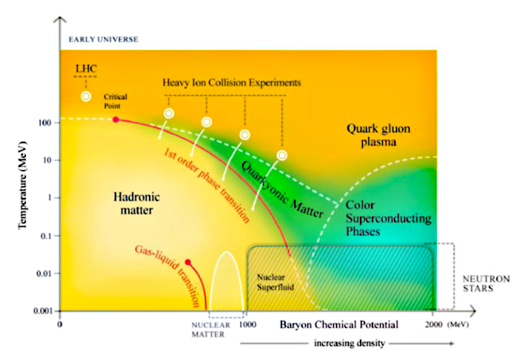
INTRODUCTION
Open questions in astrophysics
Open questions of modern physics:
  How does matter behave in strong gravitational fields?
  What are the properties of matter at higher density than the nucleus?
Those conditions do not occur on Earth but are typical of Neutron Stars and Black Holes
Spectral-timing: Spectral evolution of radiation from compact objects gives information on Equation of State of NS, Strong-field General Relativity…

Slide 3
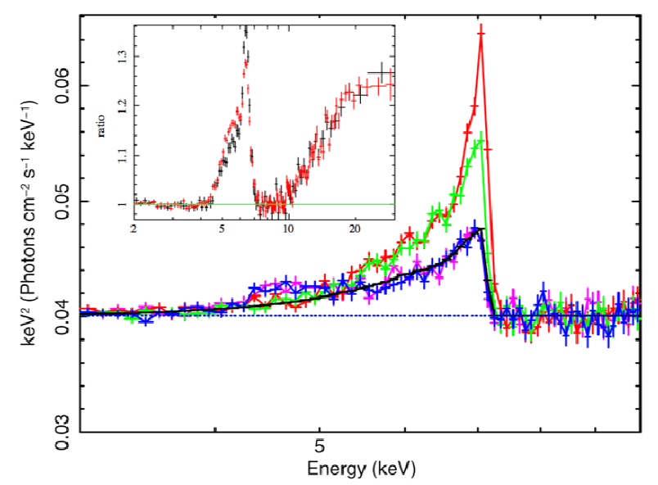
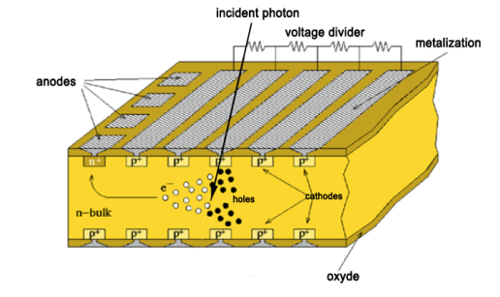
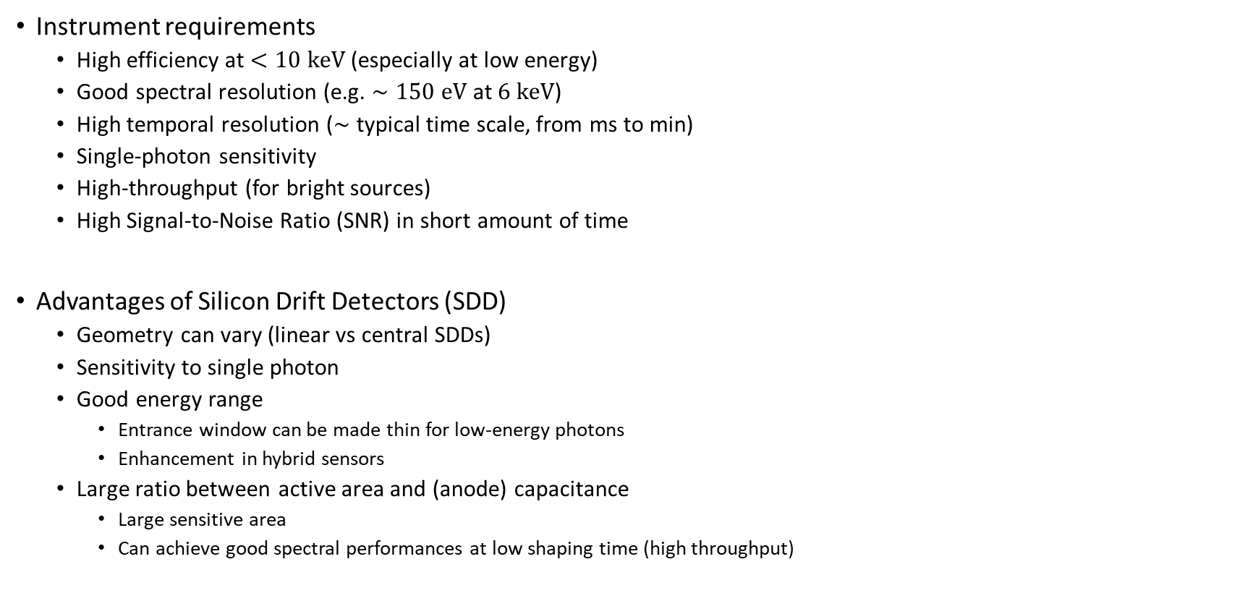
Introduction
Instrument requirements
Instrument requirements
  High efficiency at $<10 keV$ (especially at low energy)
  Good spectral resolution (e.g. $∼150 eV$ at $6 keV$)
  High temporal resolution ($∼$ typical time scale, from ms to min)
  Single-photon sensitivity
  High-throughput (for bright sources)
  High Signal-to-Noise Ratio (SNR) in short amount of time
Advantages of Silicon Drift Detectors (SDD)
  Geometry can vary (linear vs central SDDs)
  Sensitivity to single photon
  Good energy range
    Entrance window can be made thin for low-energy photons
    Enhancement in hybrid sensors
  Large ratio between active area and (anode) capacitance
    Large sensitive area
    Can achieve good spectral performances at low shaping time (high throughput)

Slide 4
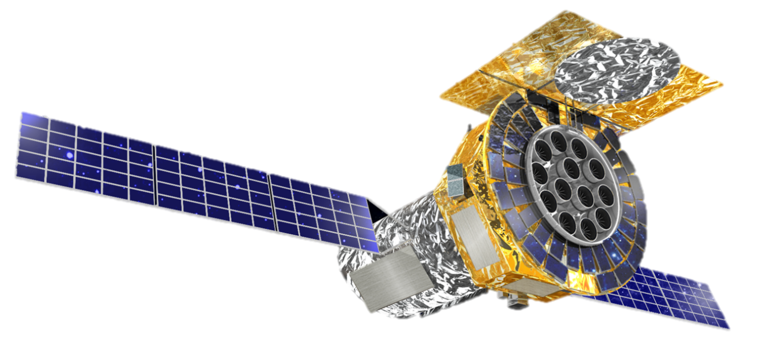
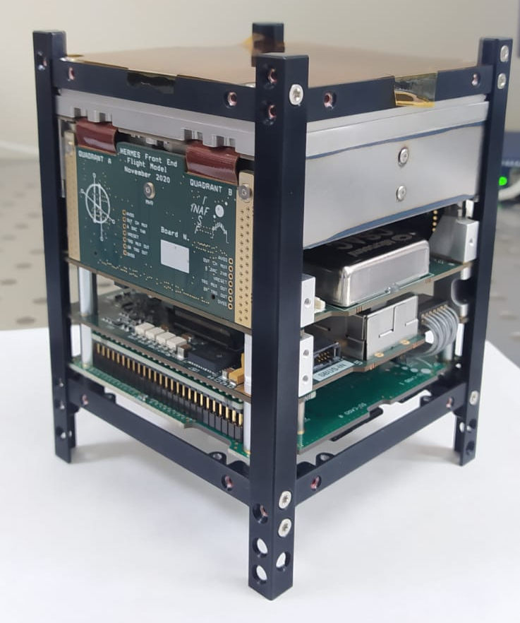
Introduction
Sample applications
Astrophysical applications of SDDs
  Large sensor area, non-focusing optics
    Large collecting area from replicating detectors
    Large FOV, high background
  Small sensor area, small-focal length telescopes
    Increase collecting area by replicating full telescopes
    Small FOV, low background (but high complexity)
  Lobster-eye optics (micro-channel optics)
    Large FOV, large detector area
    Low background
  Broad-band detectors
    Hybrid architecture to extend energy range
    Compact instrument
eXTP/LAD
PixDD
HERMES

Slide 5
















Large Area Detector

Slide 6


Large Area Detector
Overview
Large Area Detector
  Onboard the Chinese-European enhanced X-ray Timing and Polarimetry (eXTP) mission
  Large-area instrument for high-throughput photon-by-photon time-resolved spectroscopy of astrophysical X-ray sources
LAD main design and performance parameters
Parameter | Value
Energy Range | 2-30 keV nominal 2-80 keV extended
Effective Area | ≥1.3 m² @ 2 keV ≥3 m² @ 8 keV ≥1.5 m² @ 30 keV
Energy Resolution | ≤260 eV FWHM @ 6 keV (all events)
Field of View | <65 arcmin FWHM
Time Resolution | 10 µs
Absolute Time Accuracy | 2 µs
Dead Time | ≤1% @1Crab
Maximum Flux (sustained) | ≥1 Crab
Maximum Flux (time-limited) | >15 Crab (300 minutes)
Total Mass | 579 kg CBE+DMM
Total Power | 769 W CBE+DMM
Telemetry | 0.2 Mbps (typical, for a 1 Crab source)
Number of modules | 40
SFA & PFA
LAD
WFM

Slide 7
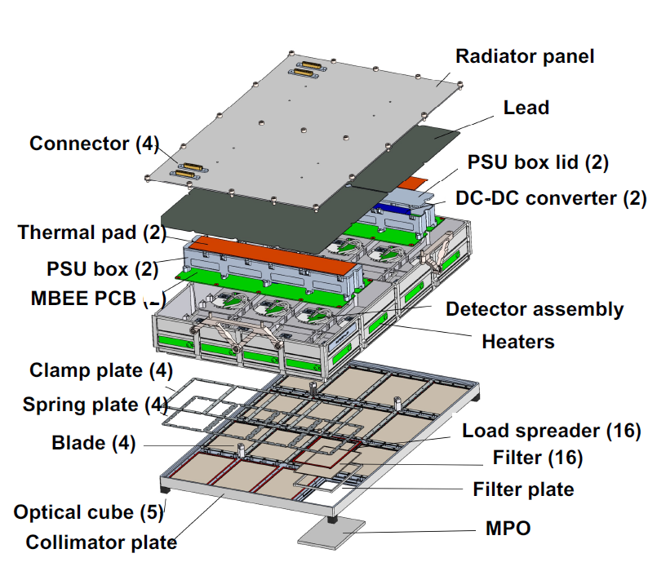
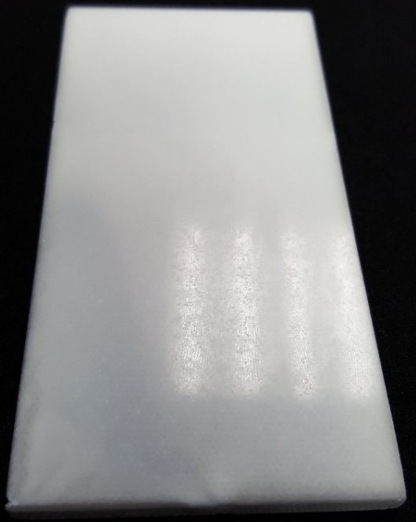
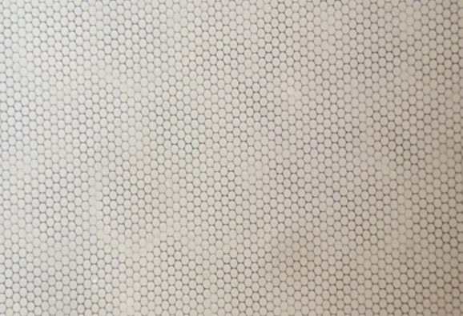
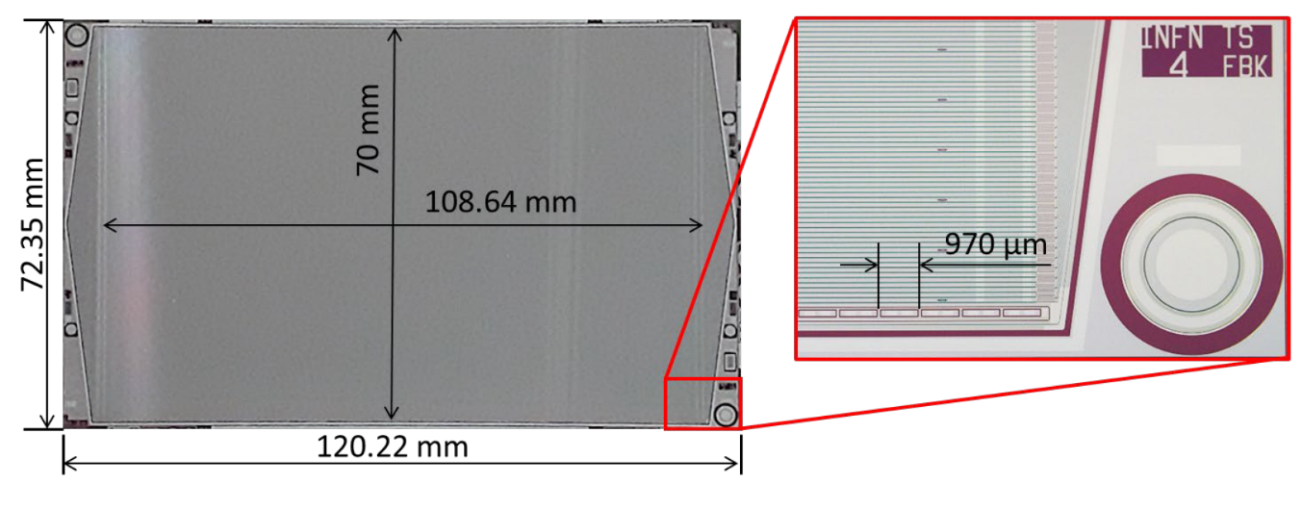
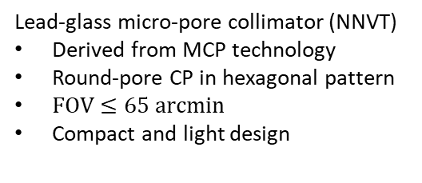
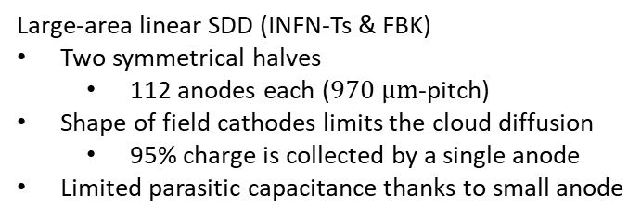
Large Area Detector
Core components
Lead-glass micro-pore collimator (NNVT)
Derived from MCP technology
Round-pore CP in hexagonal pattern
$FOV≤65 arcmin$
Compact and light design
Confining cathodes
Drifting charge
cloud
Large-area linear SDD (INFN-Ts & FBK)
Two symmetrical halves
  112 anodes each ($970 μm$-pitch)
Shape of field cathodes limits the cloud diffusion
  95% charge is collected by a single anode
Limited parasitic capacitance thanks to small anode
Small anodes
Ref: M. Feroci et al. The large area detector onboard the eXTP mission, ProcSPIE, 2022, 121811X. DOI: 10.1117/12.2628814.

Slide 8
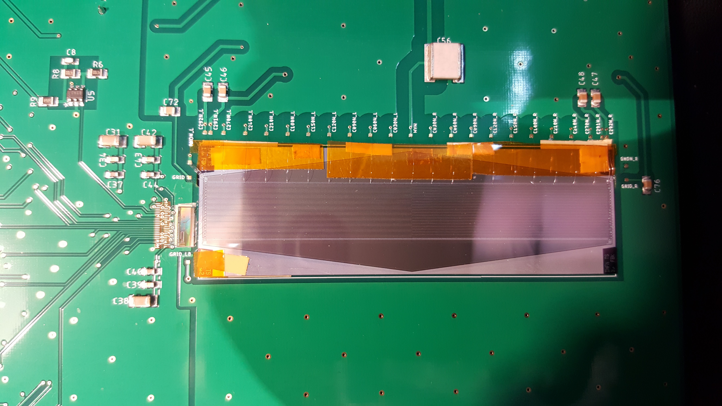
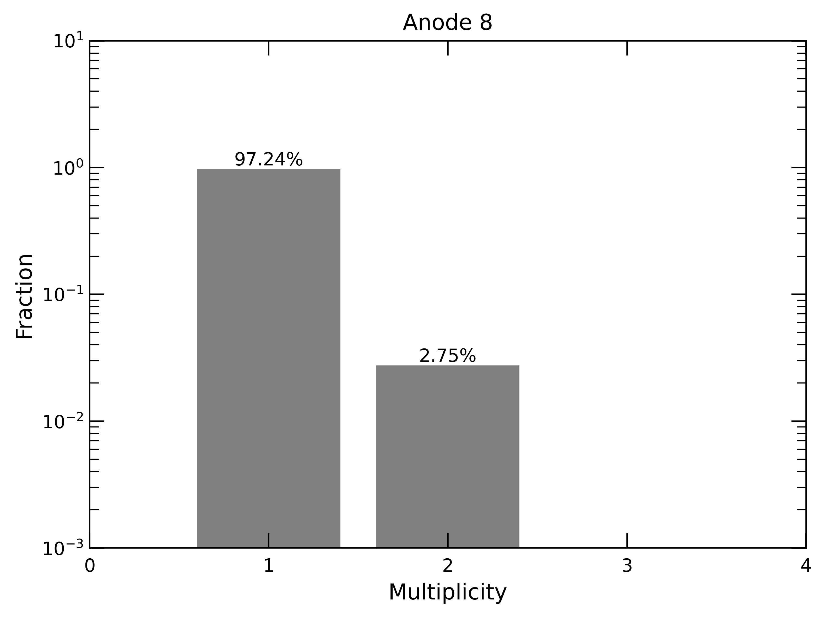

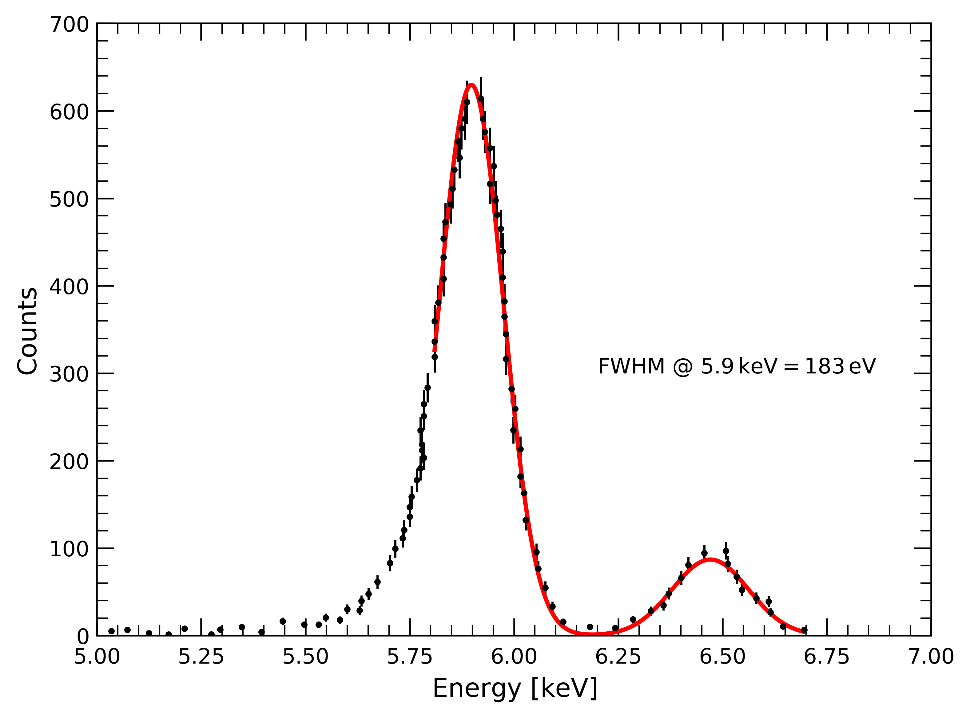
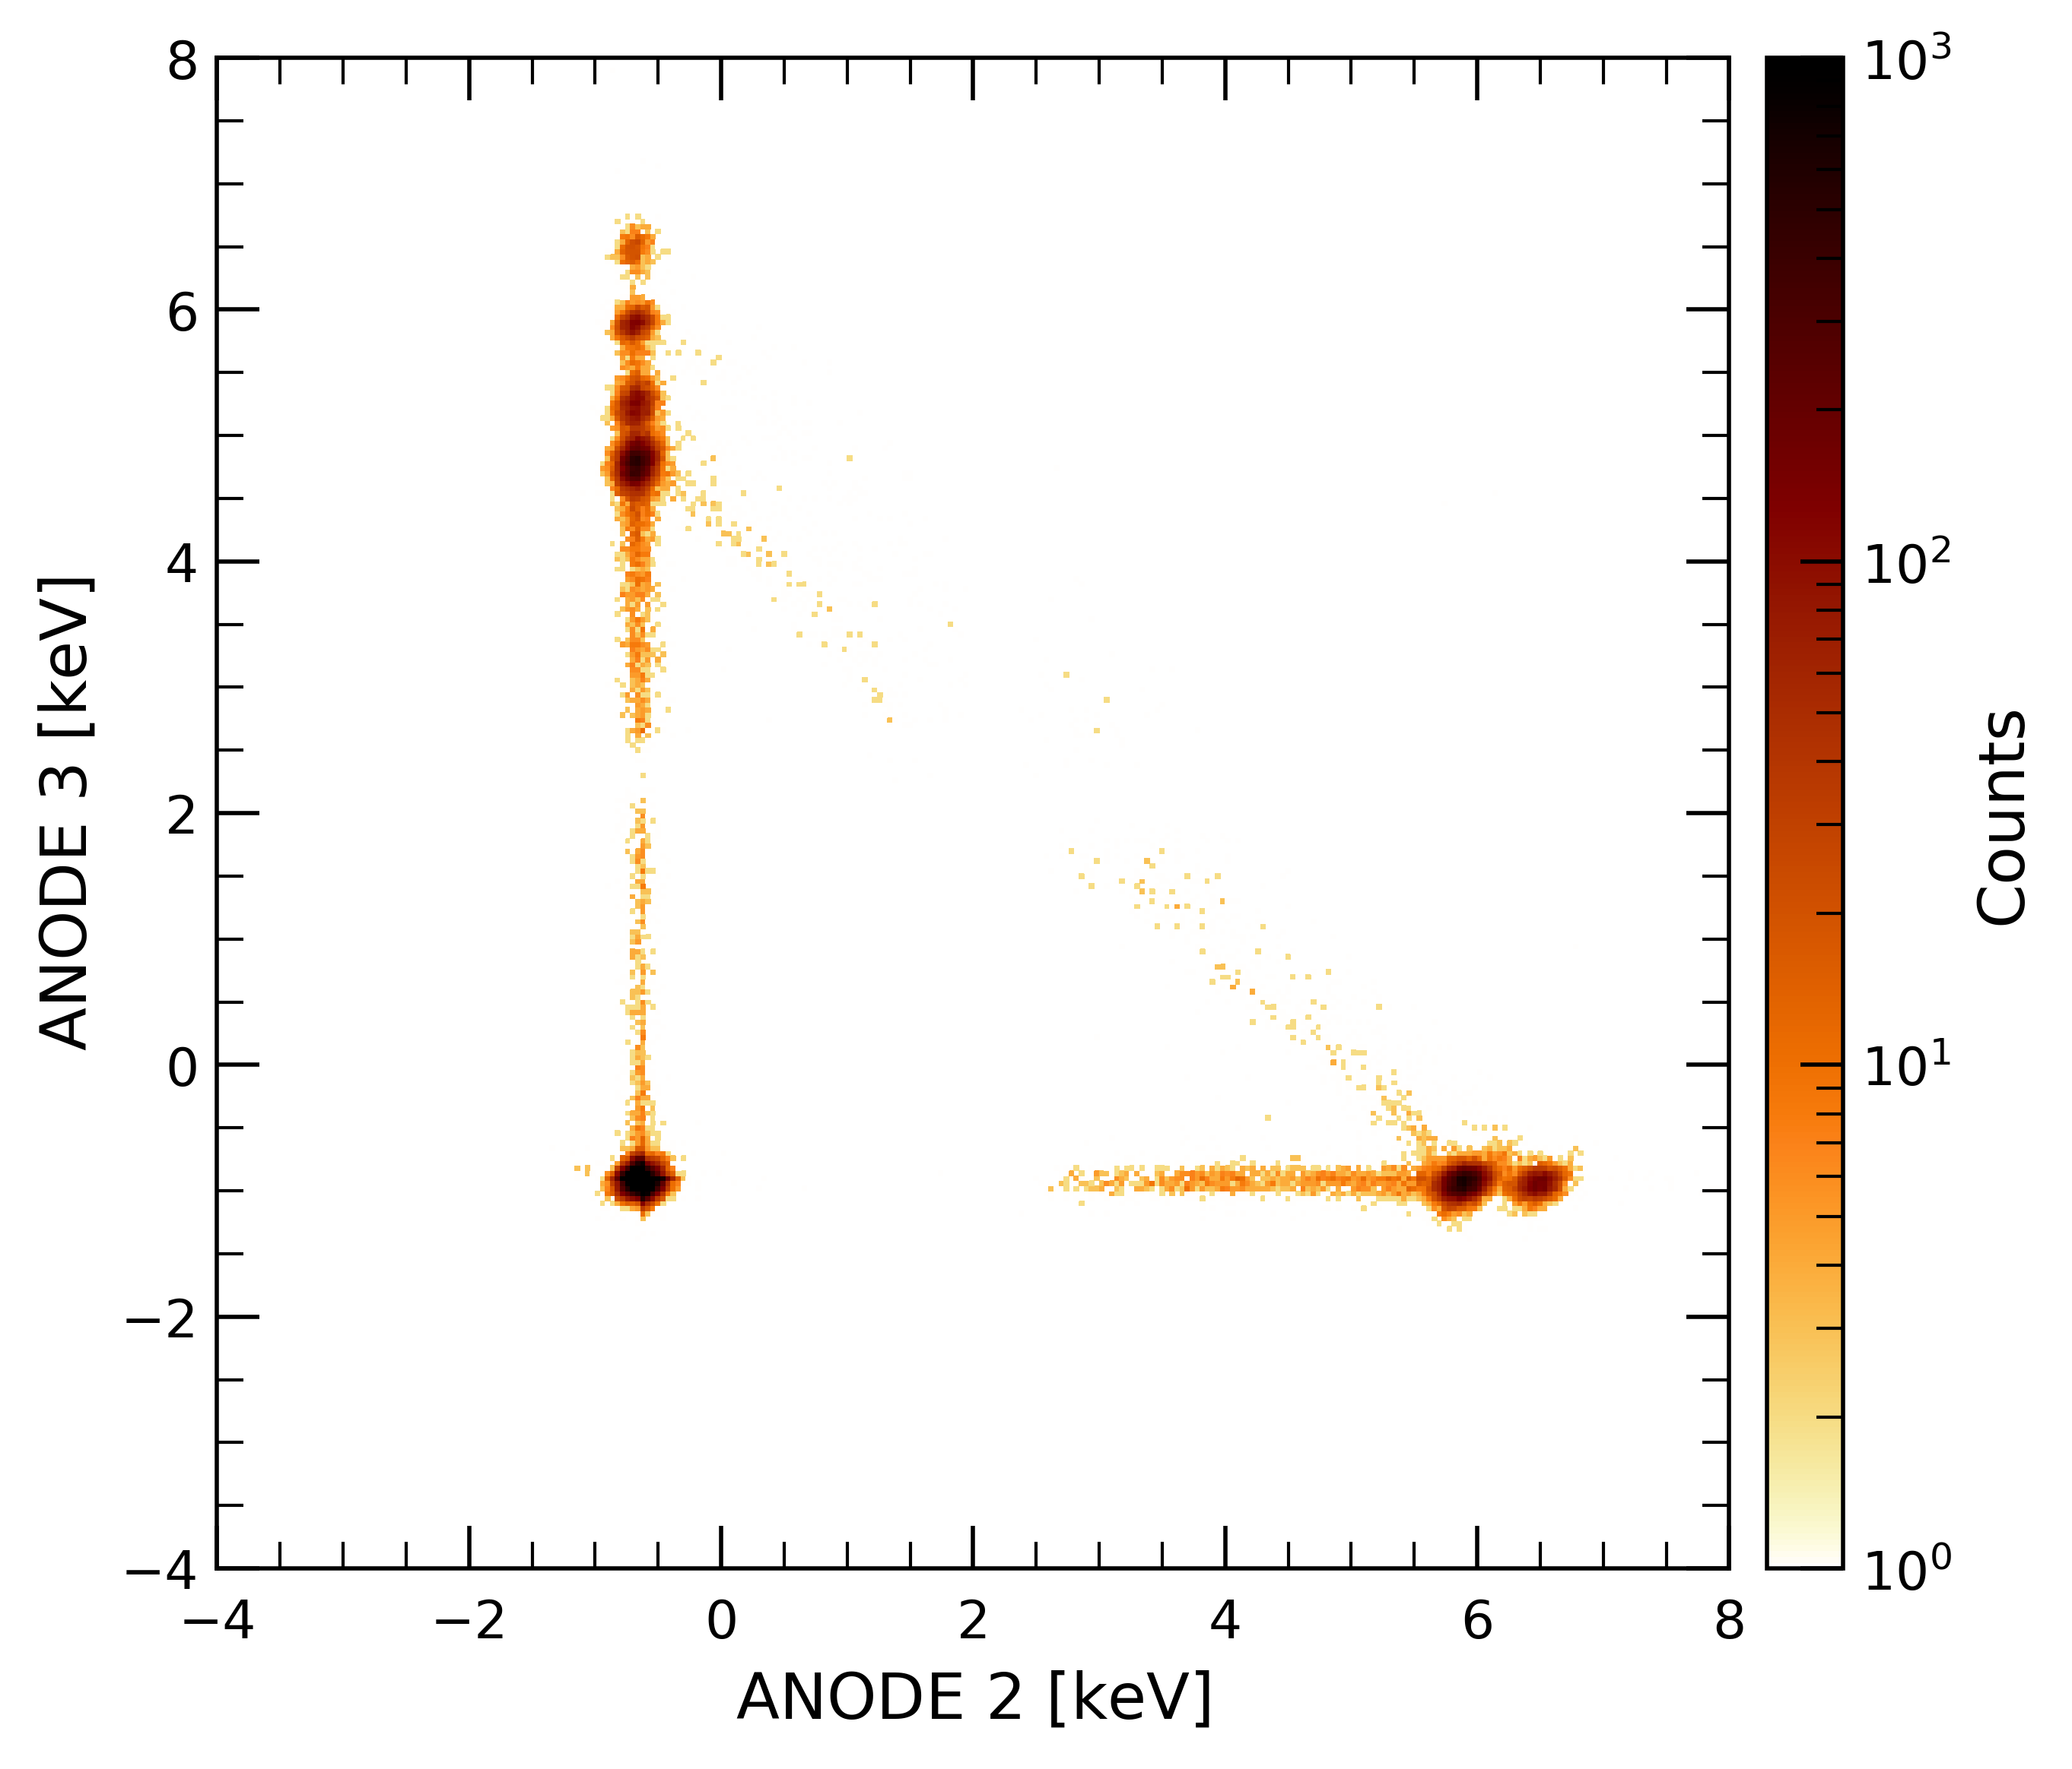

Large Area Detector
Performance of prototype
Spectral performance tested at INAF/IAPS
  Small-scale prototype (same drift length but 10 anodes)
  Readout by VEGA ASIC
Charge confinement verified
  $≥97\%$ singles, $≤3\%$ doubles, no events with multiplicity > 2
Achieved resolution (one channel, single events)
  $FWHM\left(5.9 keV\right)≈183 eV$ at $T={−20}^{∘}C$
SDD
VEGA ASIC

Slide 9







The PixDD project

Slide 10
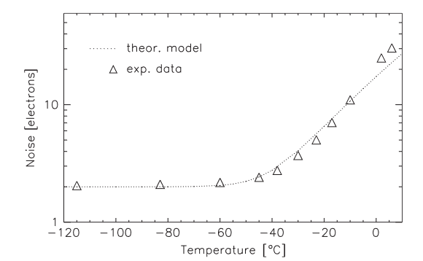
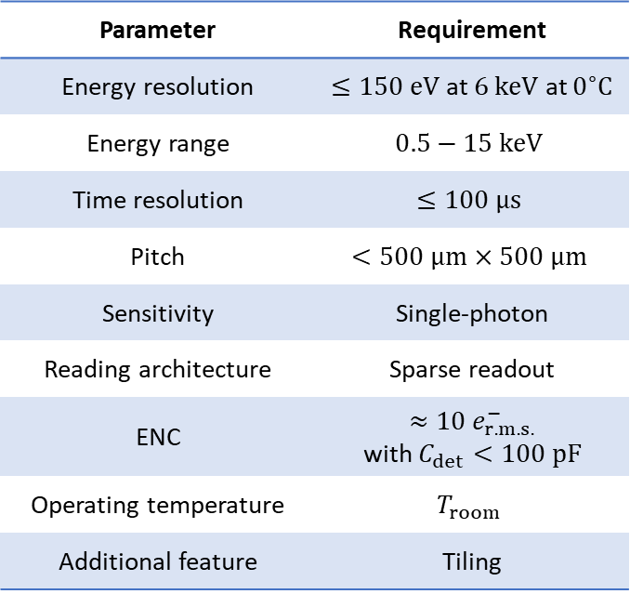
Pixelated Silicon Drift Detector
Overview
Pixelated Silicon Drift Detector
  R&D project funded by the Italian Space Agency
  SDD-based system for high-throughput spectral-timing studies
To be used at focal plane of large Field of View optics (e.g. lobster-eye) and concentrators
Goal of solving limitations of current X-ray detectors
  CCDs: Pile-up, limited time resolution, low-temperature
  DePFETs: low-temperature, fast readout with high power
Parameter | Requirement
Energy resolution | $≤150 eV$ at $6 keV$ at $0^{∘}C$
Energy range | $$0.5−15 keV$$
Time resolution | $$≤100 μs$$
Pitch | $$<500 μm×500 μm$$
Sensitivity | Single-photon
Reading architecture | Sparse readout
ENC | $$≈10 e_{r.m.s.}^{−}$$ with $C_{det}<100 pF$
Operating temperature | $$T_{room}$$
Additional feature | Tiling
E.g. pn-CCD

Slide 11
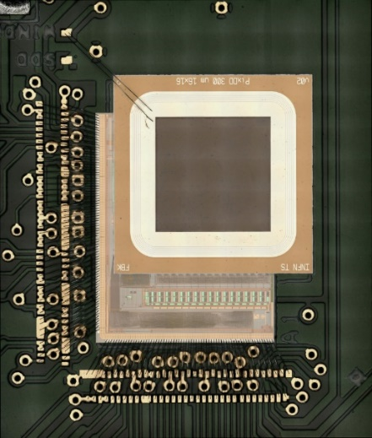
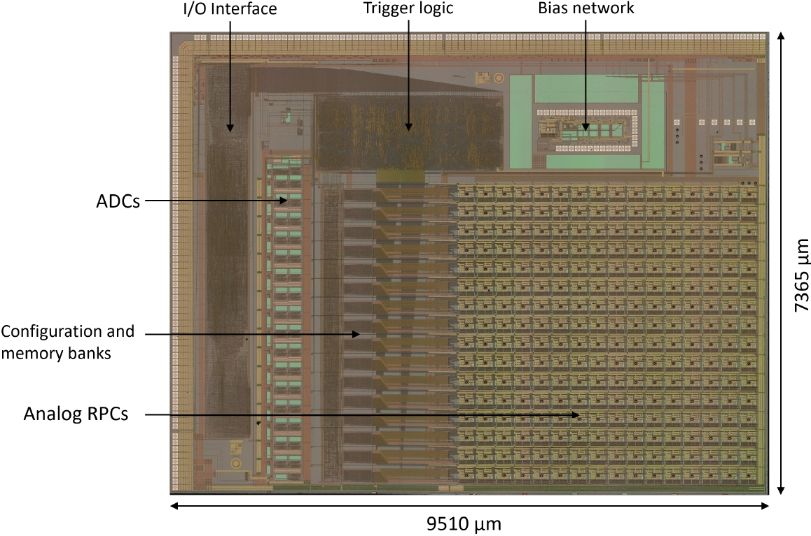
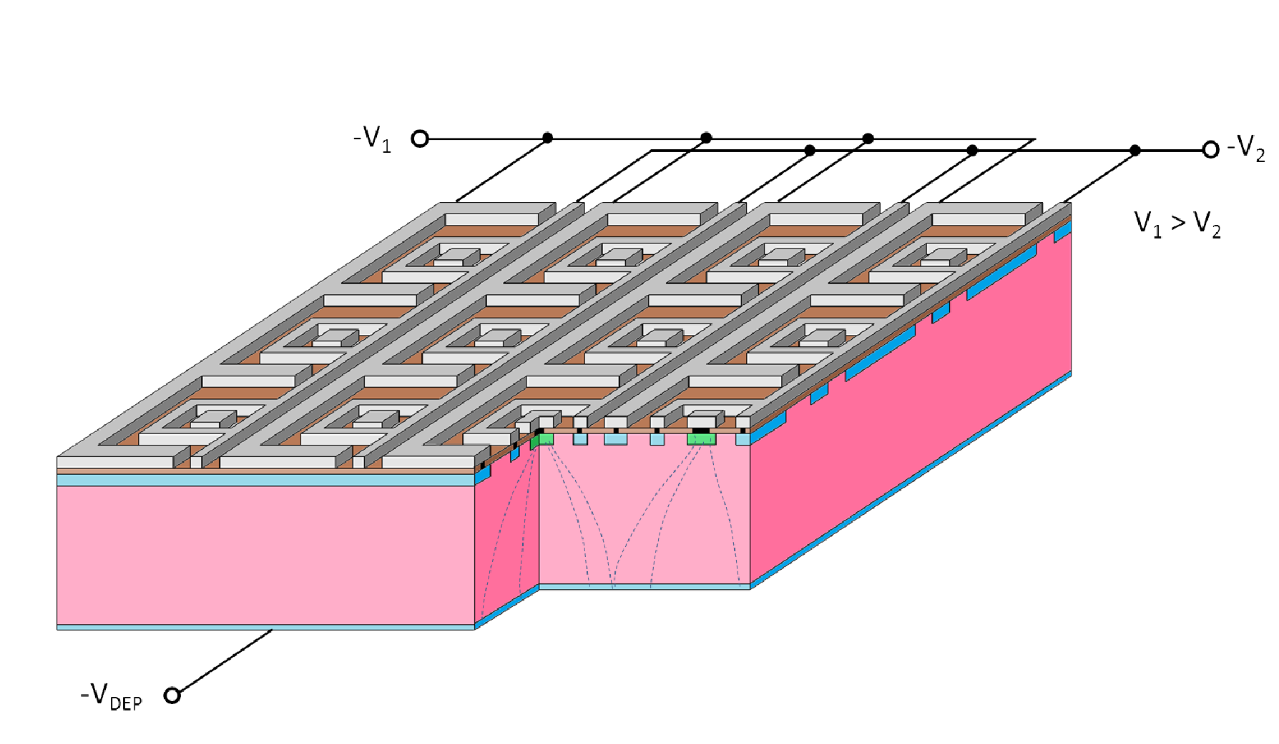

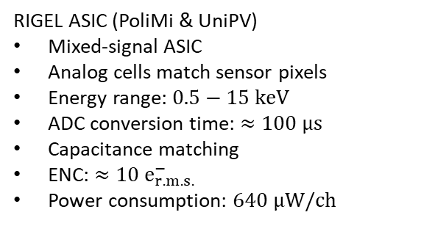







Pixelated Silicon Drift Detector
Sensor and ASIC
$$C_{anode}≤35 fF$$
$$300 μm$$
$$−39 V$$
$$−32 V$$
$$450 μm$$
$$300 μm$$
$$−70 V$$
Shallow entrance window
$$I_{leak}≲{10}^{2} pA {cm}^{−2}$$
$$I_{anode}≲1 pA$$
SDD matrix (INFN-Ts & FBK)
Fully-depleted back-illuminated 16×16 SDD matrix
Low-leakage current process
Small anode capacitance
Optimized for low energy
Capable of Fano-limited spectroscopy at T_{room}
RIGEL ASIC (PoliMi & UniPV)
Mixed-signal ASIC
Analog cells match sensor pixels
Energy range: $0.5−15 keV$
ADC conversion time: $≈100 μs$
Capacitance matching
ENC: $≈10 e_{r.m.s.}^{−}$
Power consumption: $640 μW/ch$

Slide 12
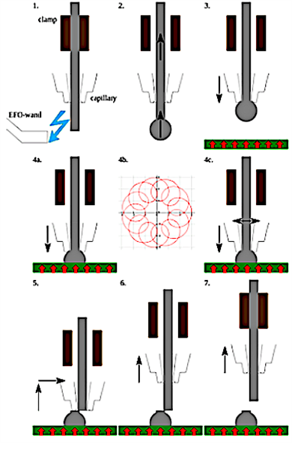
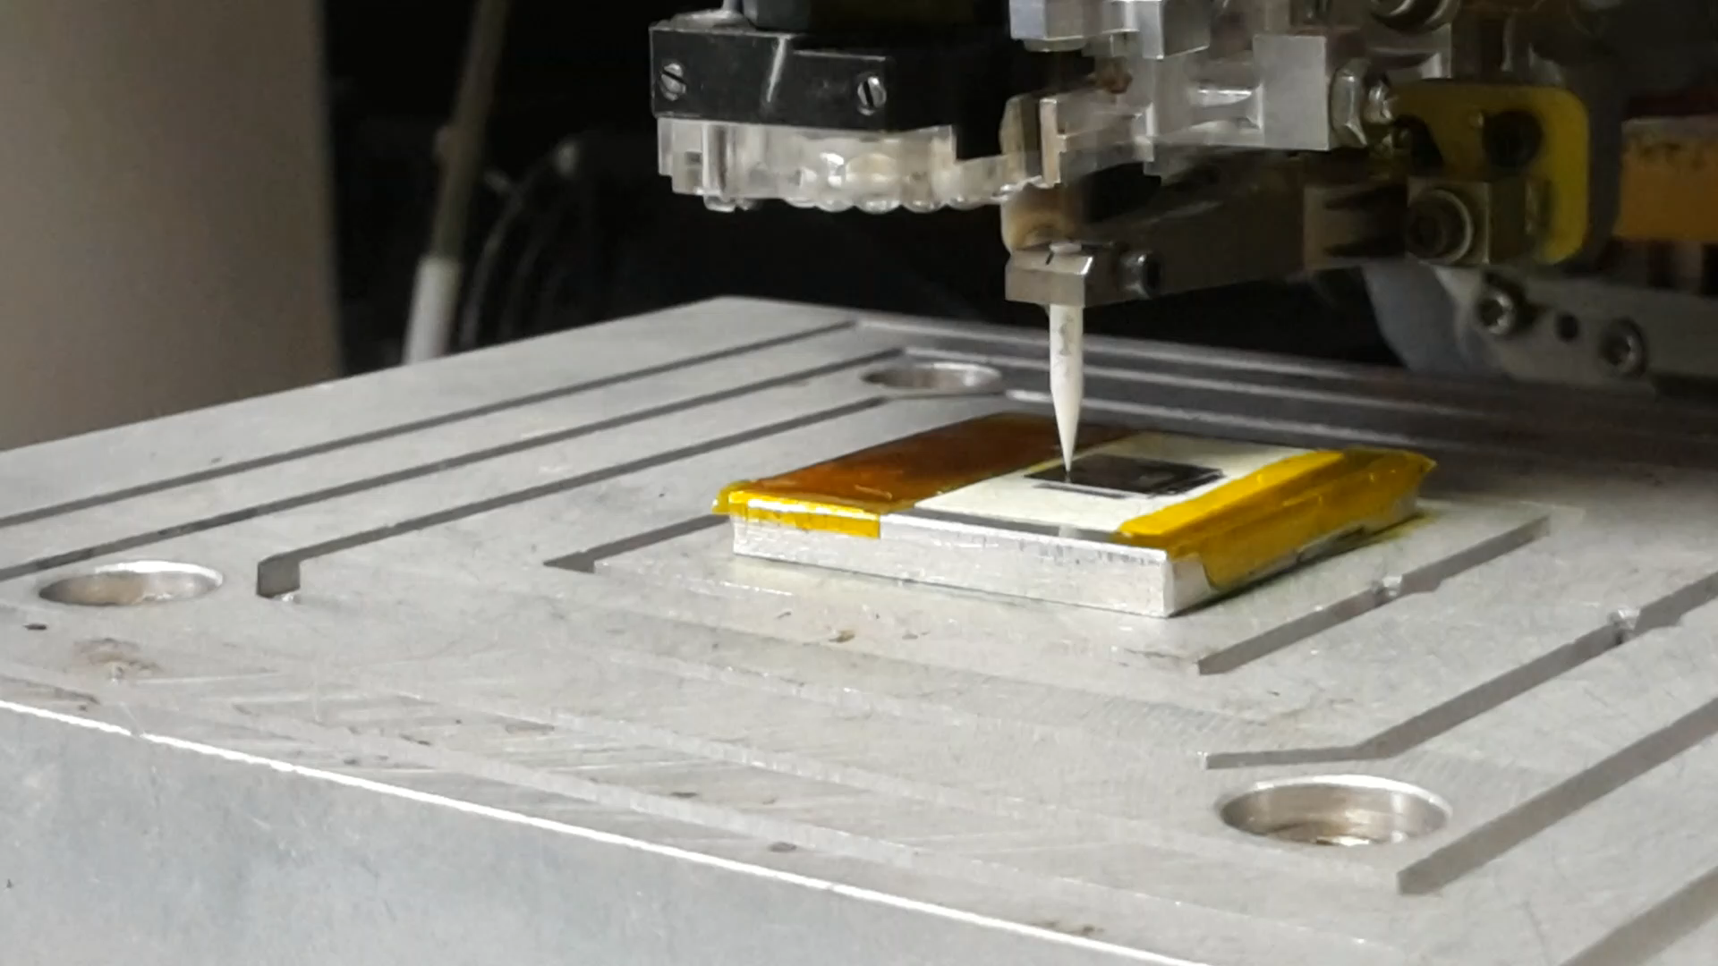
Pixelated Silicon Drift Detector
Gold-stud bump bonding
Bump-bonding decreases parasitic capacitance of wires and increases fill factor
Traditional bump-bonding requires photolithography (expensive)
Novel die-level process developed at KIT originally for CMS

Slide 13
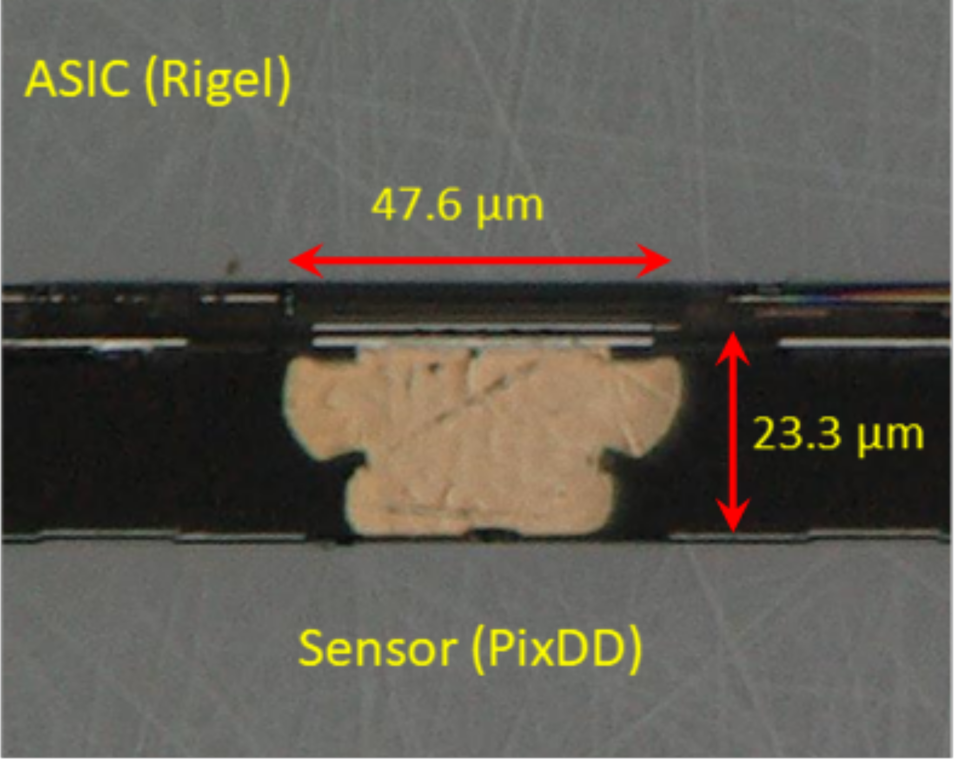
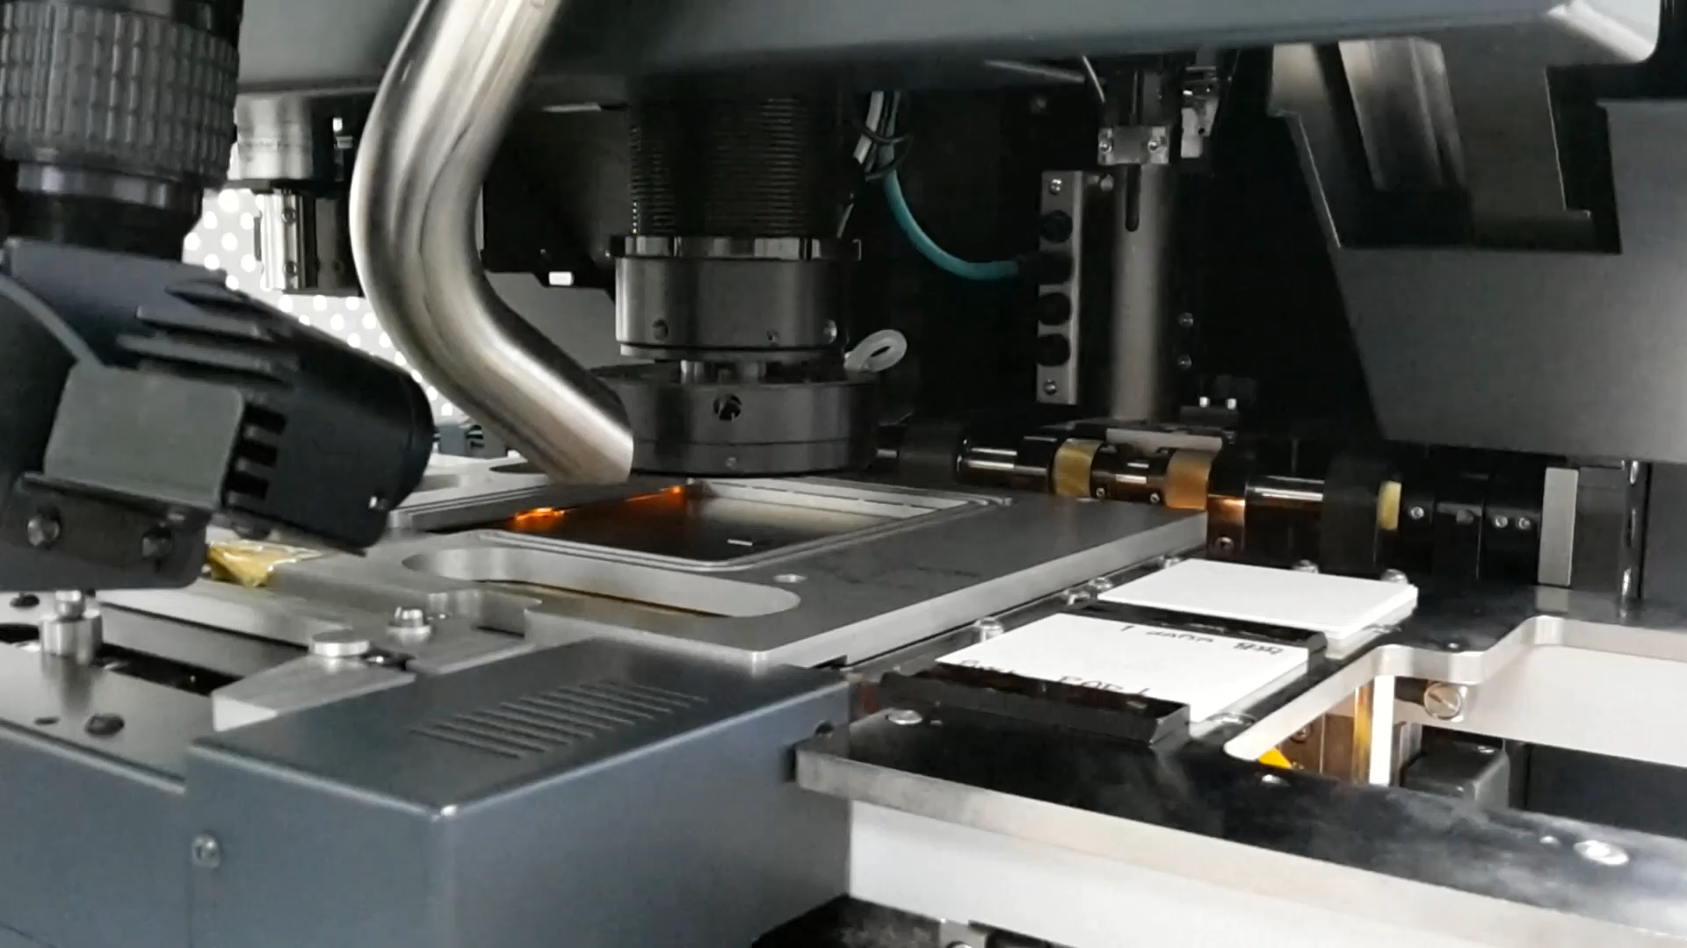
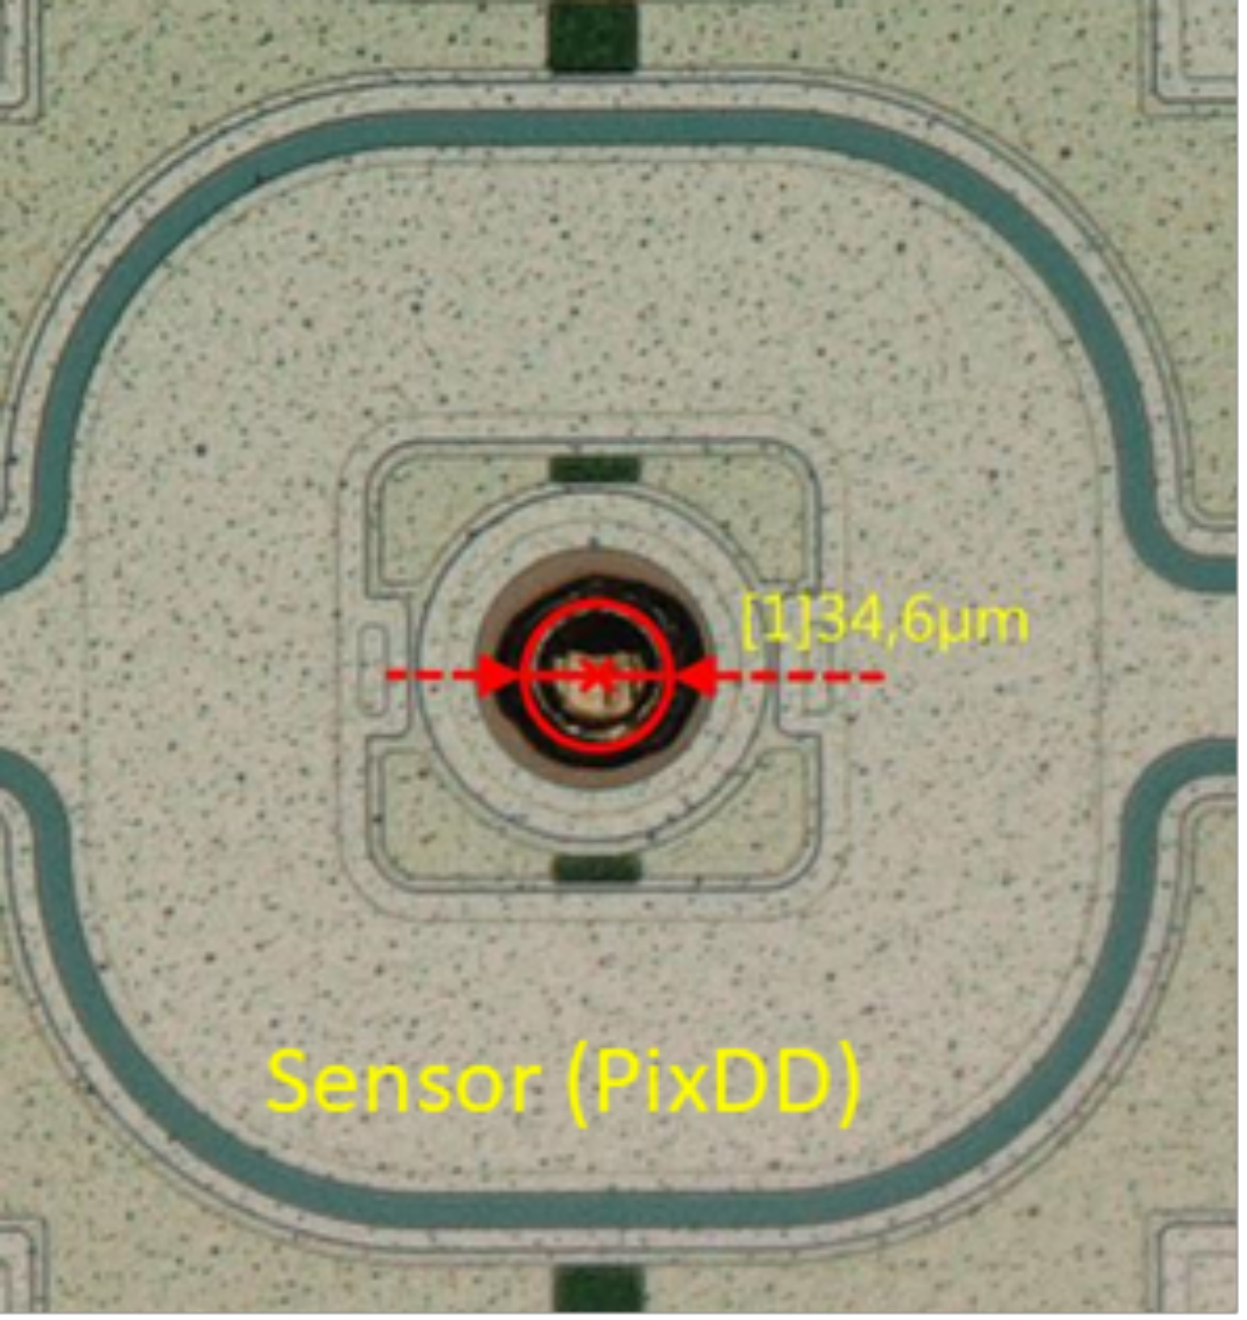
Pixelated Silicon Drift Detector
Gold-stud bump bonding
Bump-bonding decreases parasitic capacitance of wires and increases fill factor
Traditional bump-bonding requires photolithography (expensive)
Novel die-level process developed at KIT originally for CMS

Slide 14
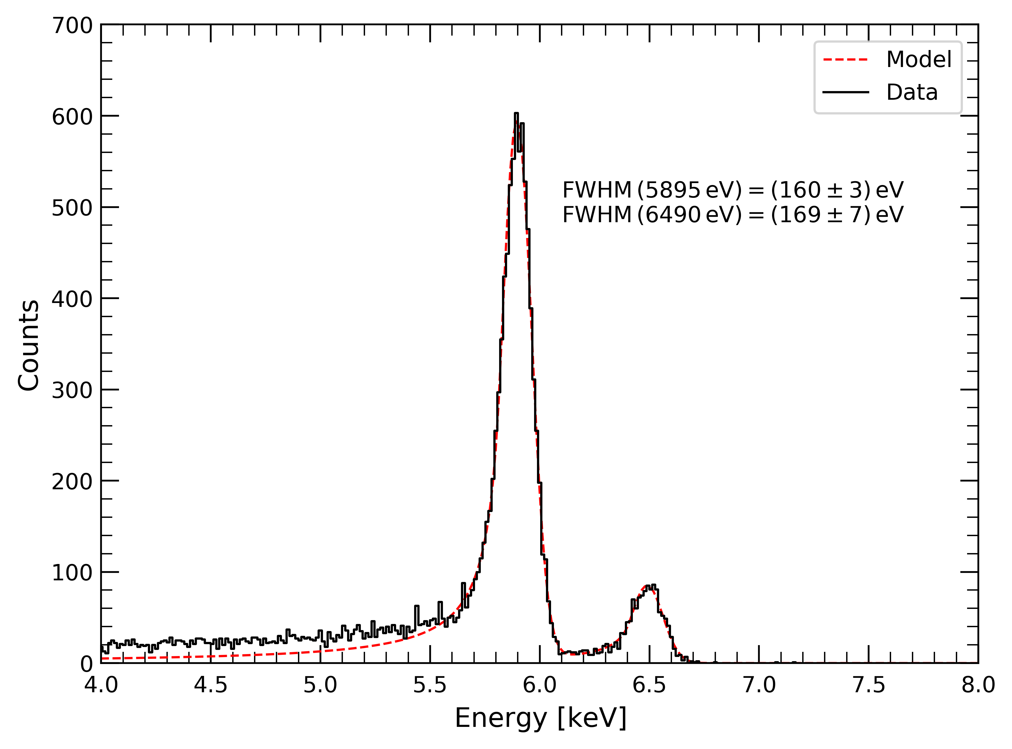
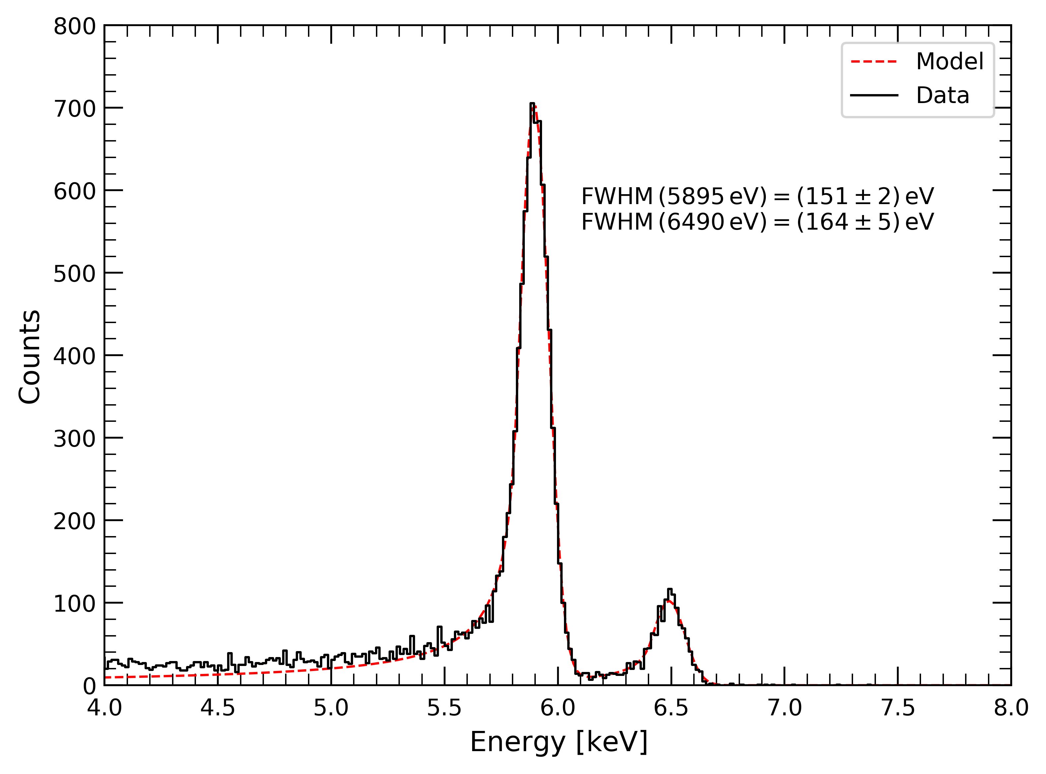
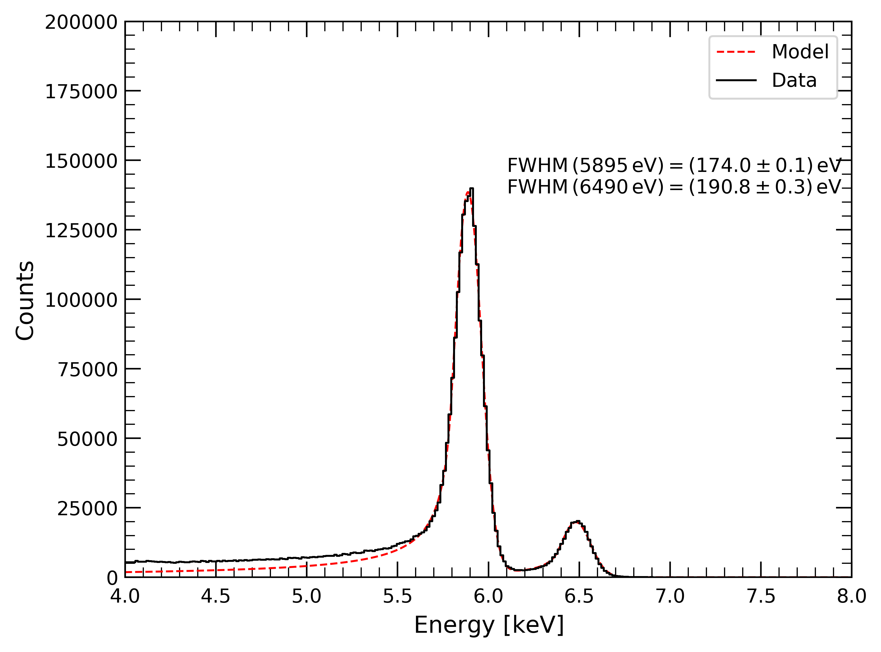
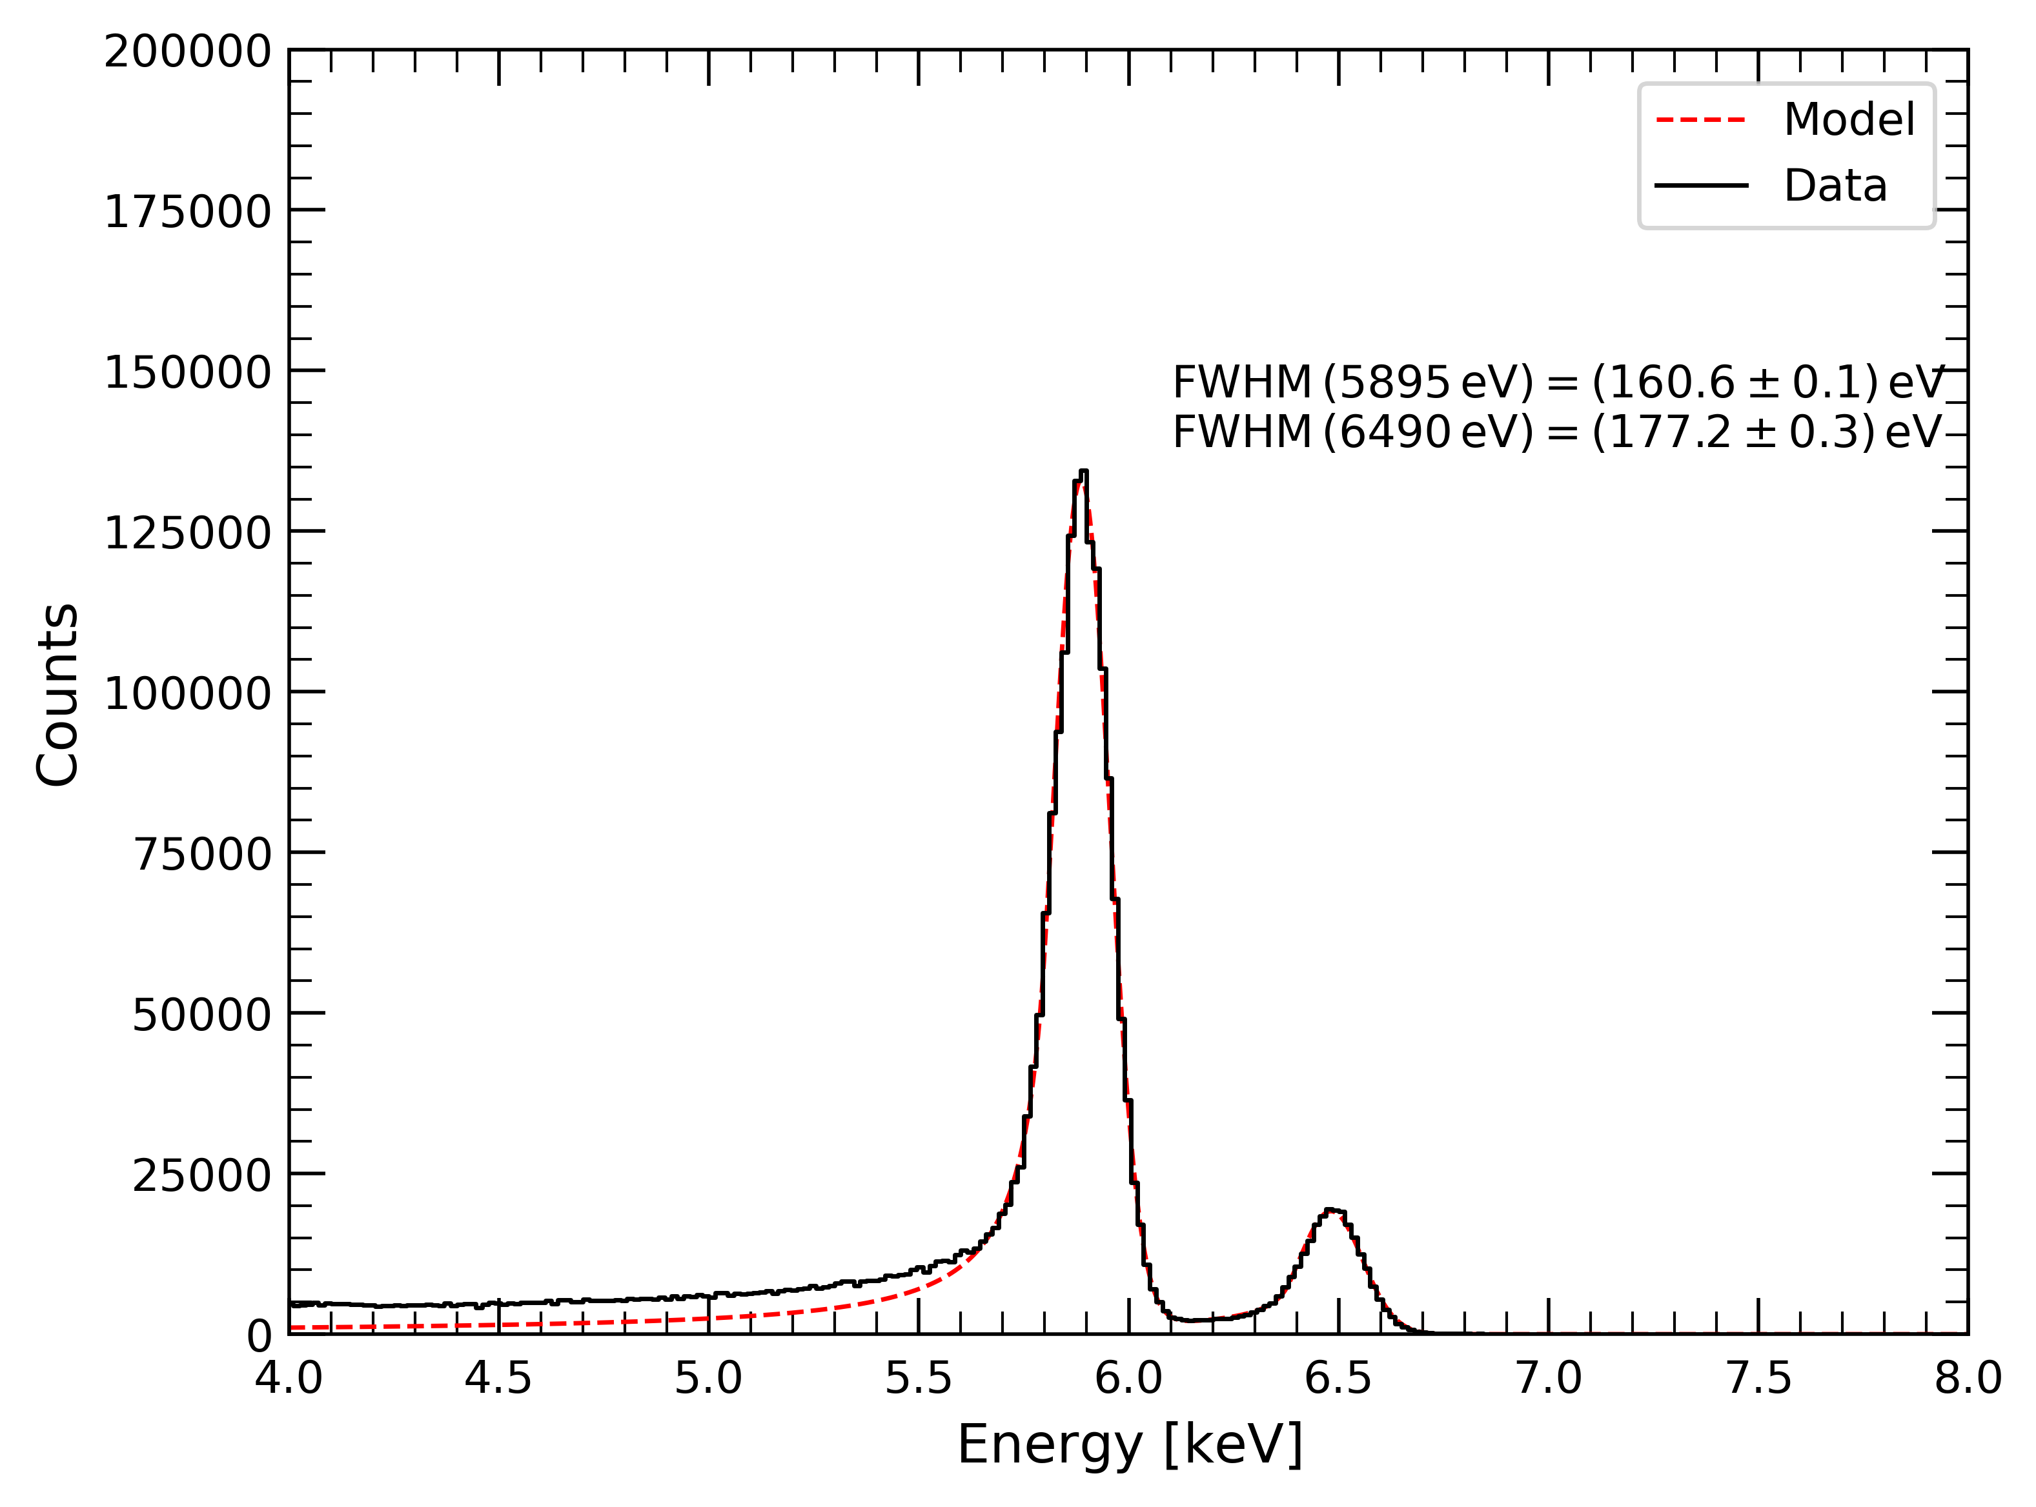
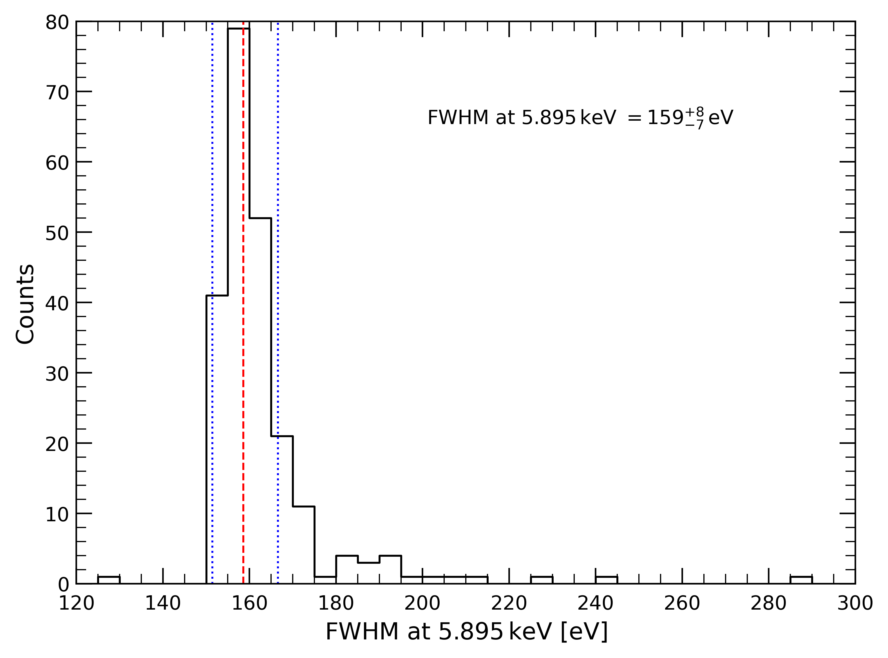




Pixelated Silicon Drift Detector
Spectral performance
$$T={20}^{∘}C$$
$$T=0^{∘}C$$
Performance tested at INAF/IAPS
Achieved resolution (single pixel)
  $FWHM\left(5.9 keV\right)≈160 eV$ at $T={20}^{∘}C$
  $FWHM\left(5.9 keV\right)≈150 eV$ at $T=0^{∘}C$
Very low detector leakage current
Uniform response
Single pixel
Single pixel
Charge sharing
Charge sharing
Pixel resolution at 5.9 keV at $T=0^{∘}C$
Sum spectrum
(pixels w/ FWHM < 300 eV)
Sum spectrum
(pixels w/ FWHM < 300 eV)
Charge sharing
Charge sharing
Ref: F. Ceraudo et al. PixDD: a multi-pixel silicon drift detector for high-throughput spectral-timing studies, ProcSPIE, 2022, 1219116. DOI: 10.1117/12.2630450.

Slide 15
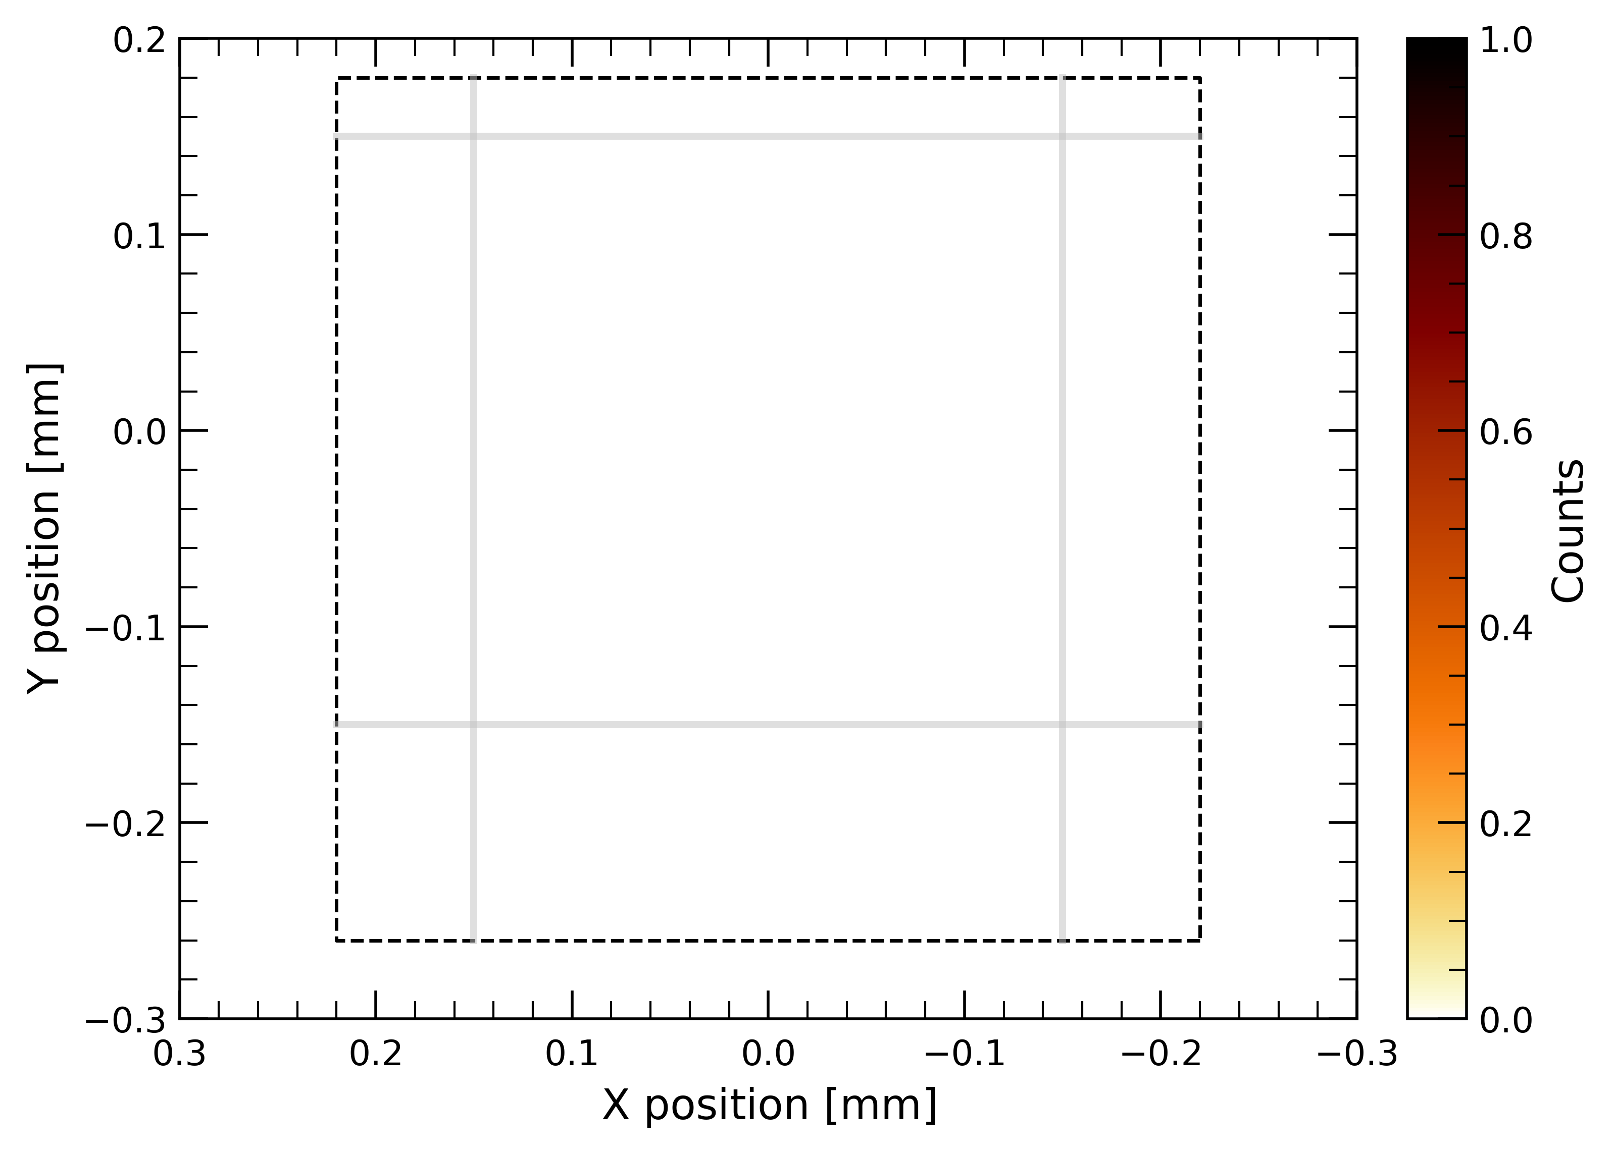
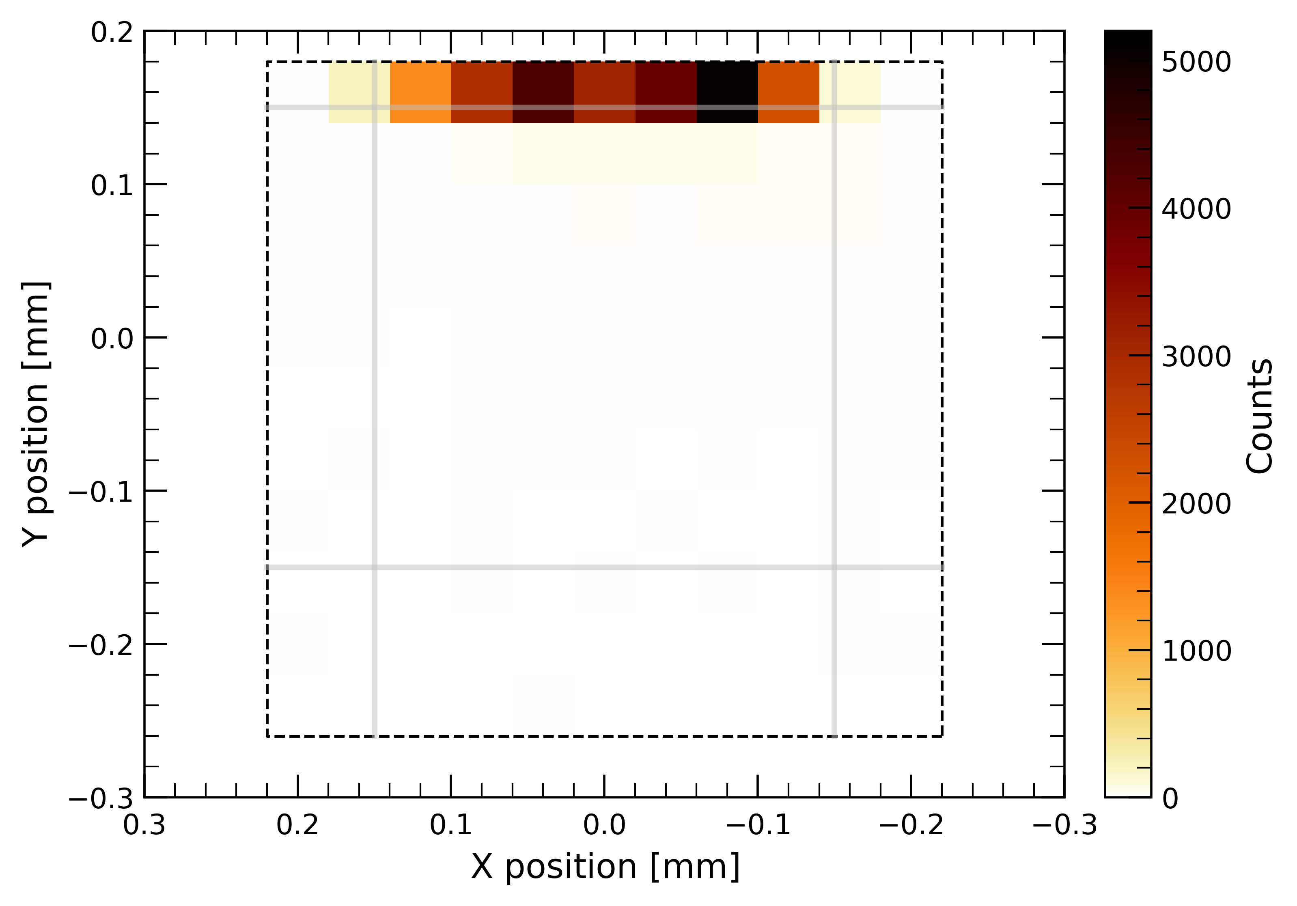
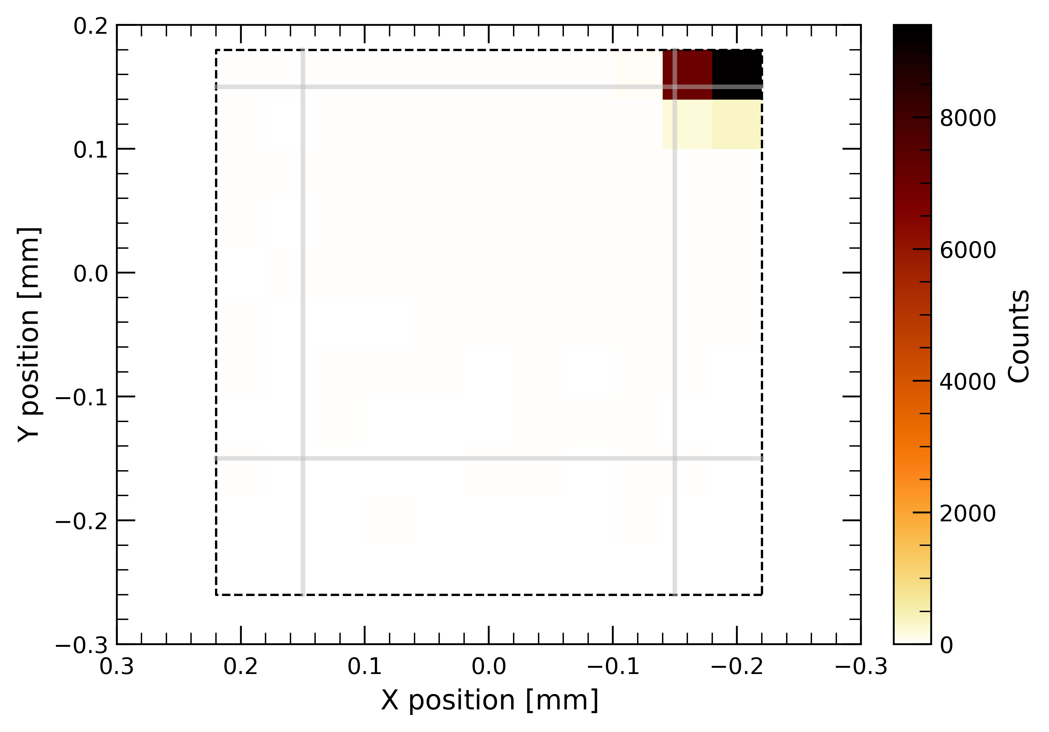
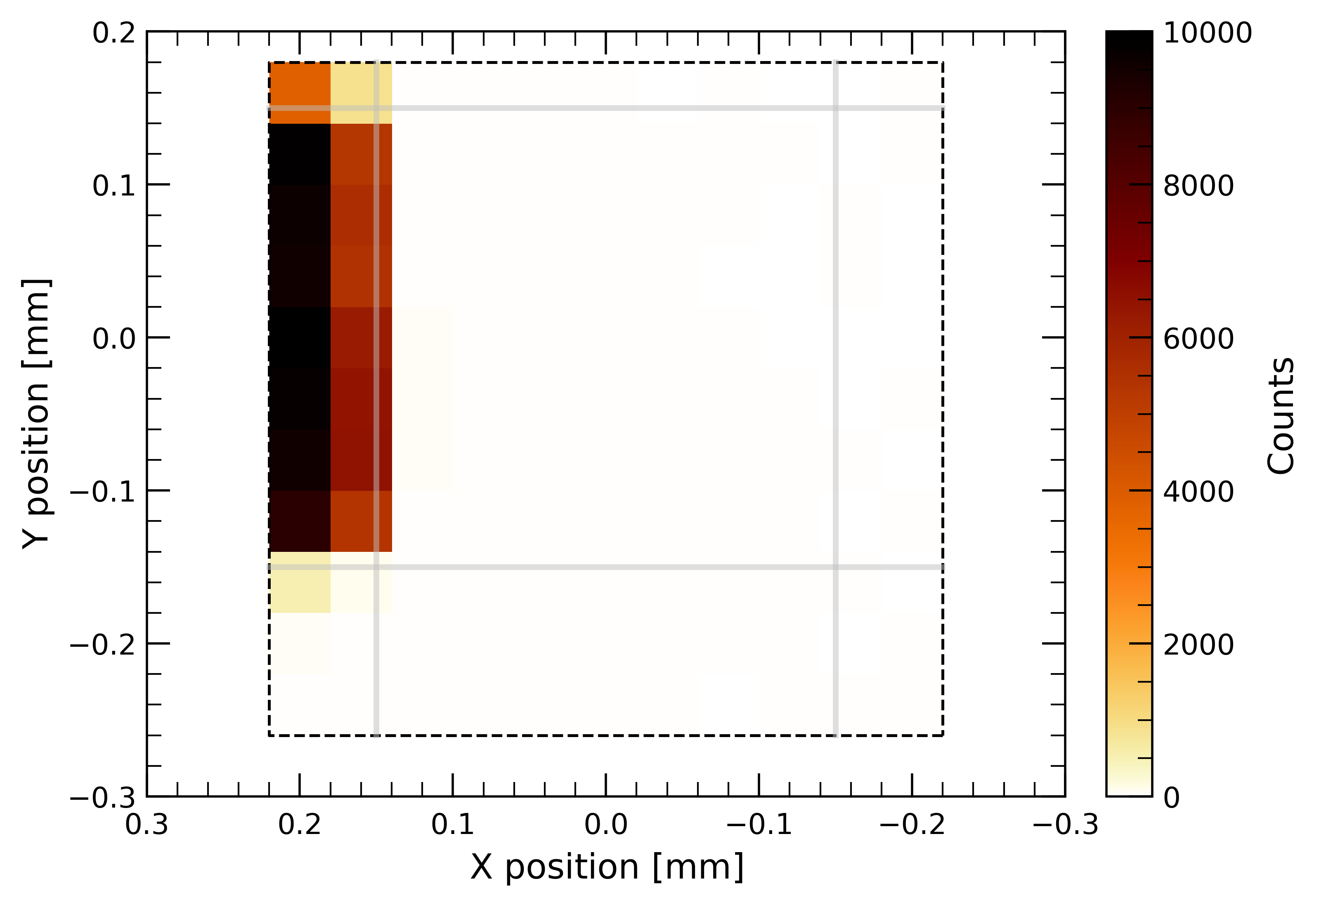
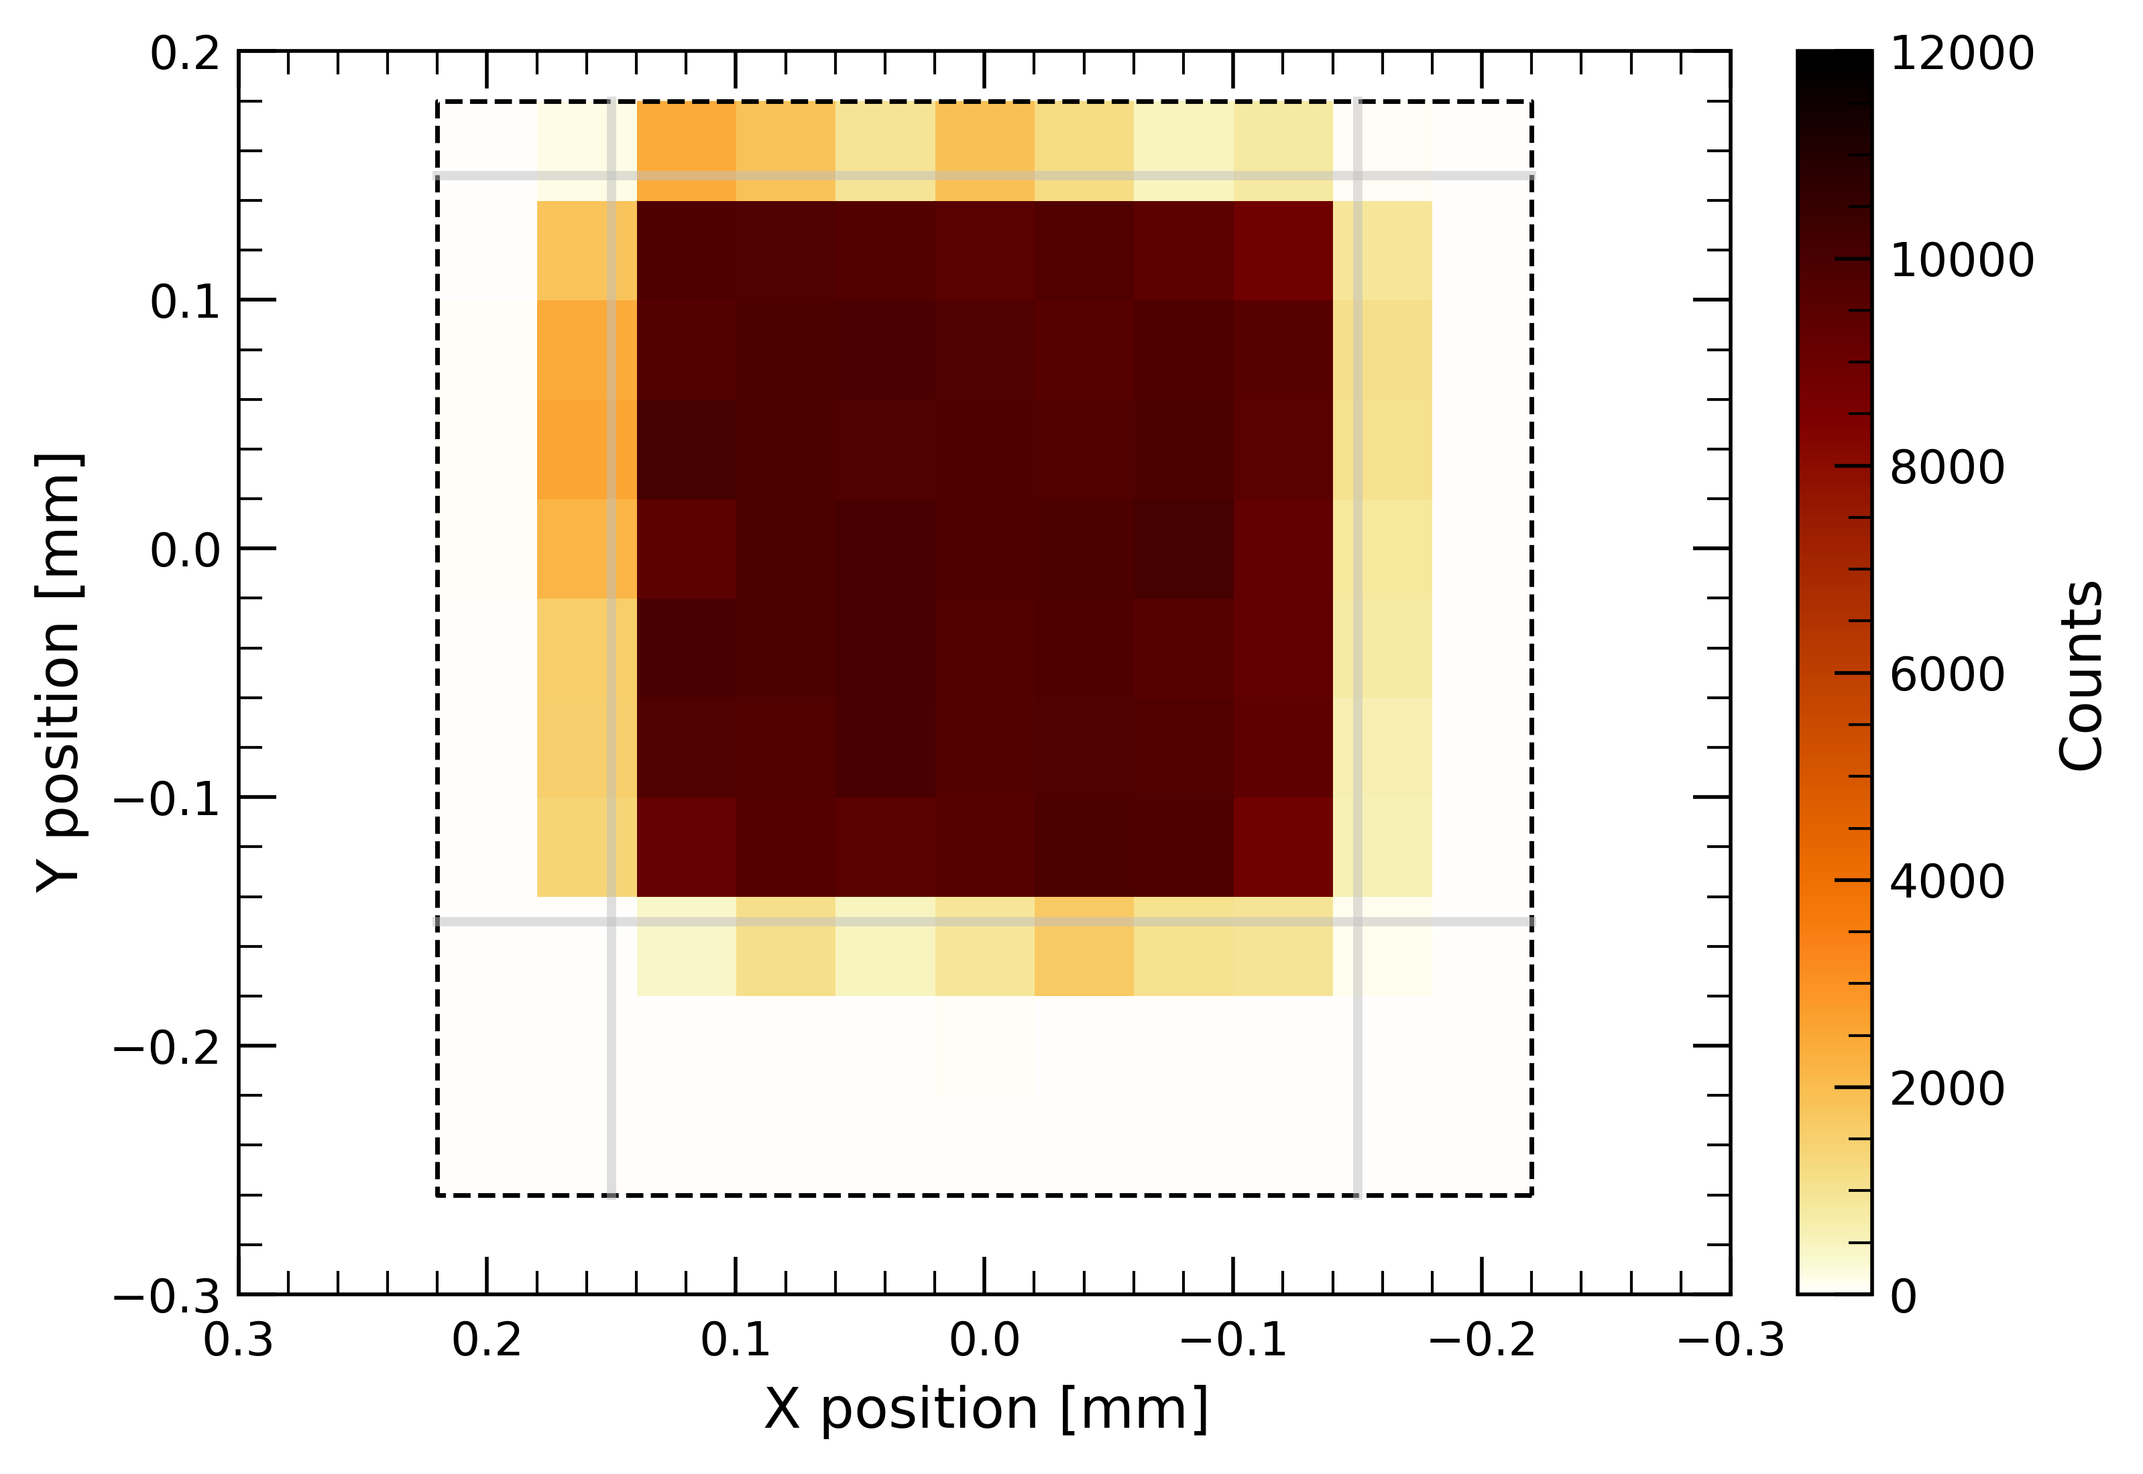
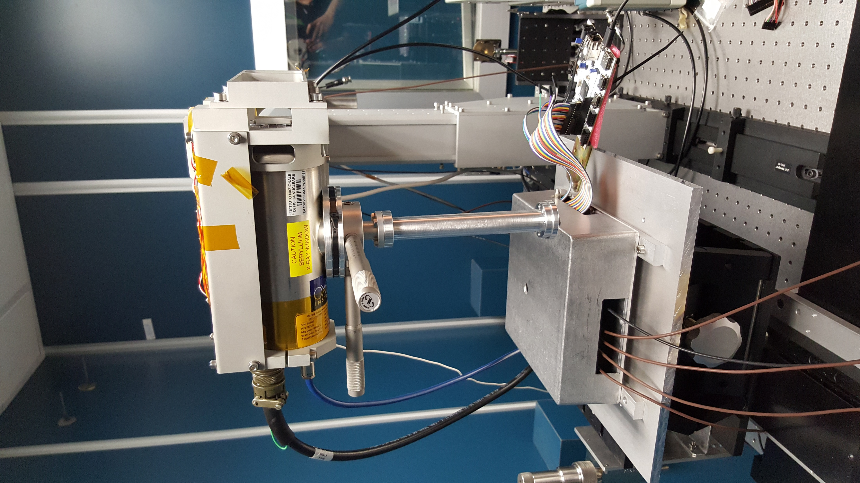
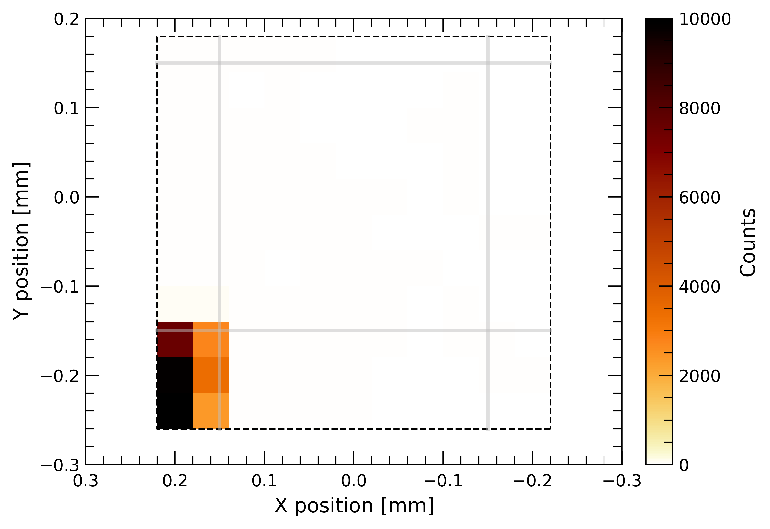
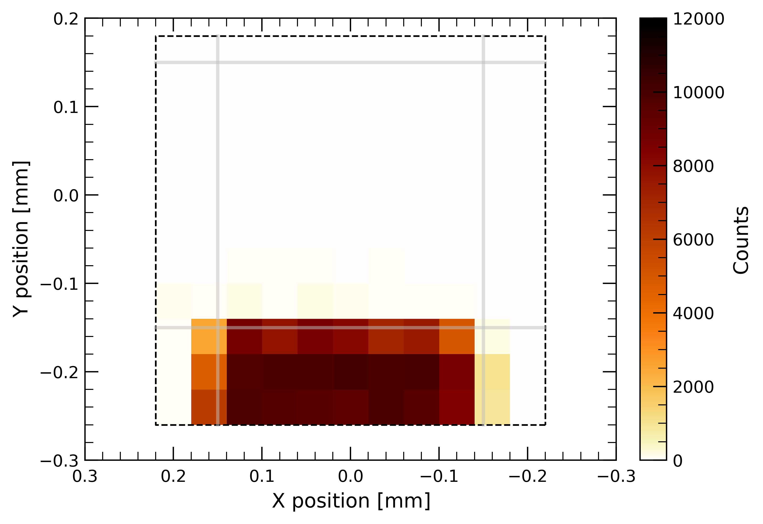
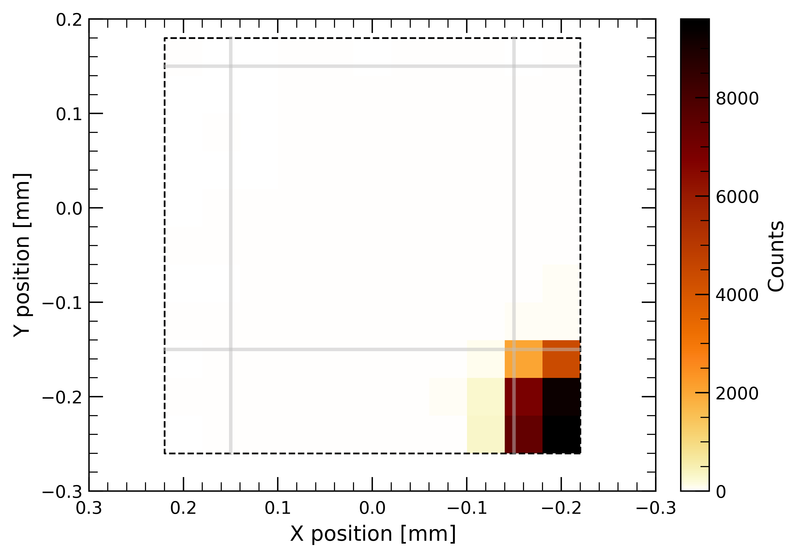




Pixelated Silicon Drift Detector
Sub-pixel response
Single counts
Uniform region with no charge sharing:
  $280 μm×280 μm$
Boundary region with charge sharing:
  $40 μm$
Triple and quadruple counts occur at the corners (not shown)
Setup at IAPS X-ray facility
Fe-anode
X-ray tube
$100 μm$ diaphragm
2D micrometric stages
(diaphragm alignment)
$25 μm$ diaphragm
Detector box
3D micrometric stages
(detector position)
$20 μm$-FWHM beam

Slide 16
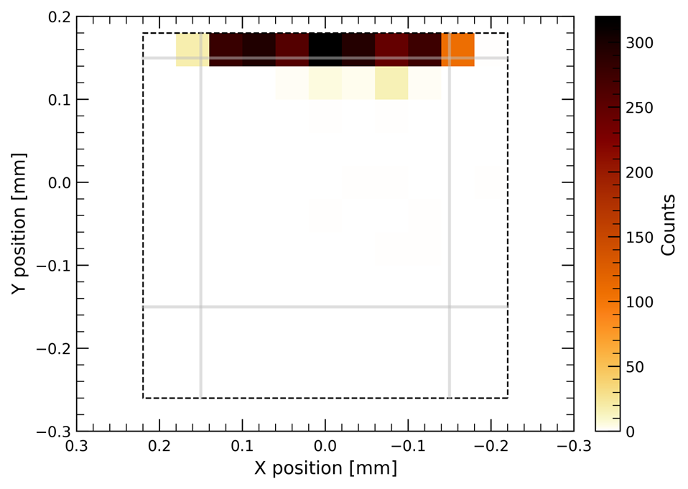
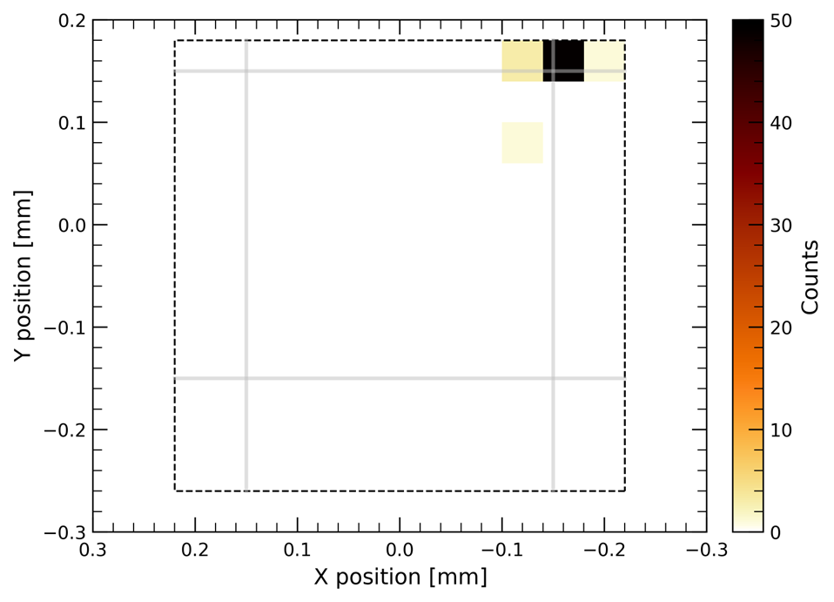
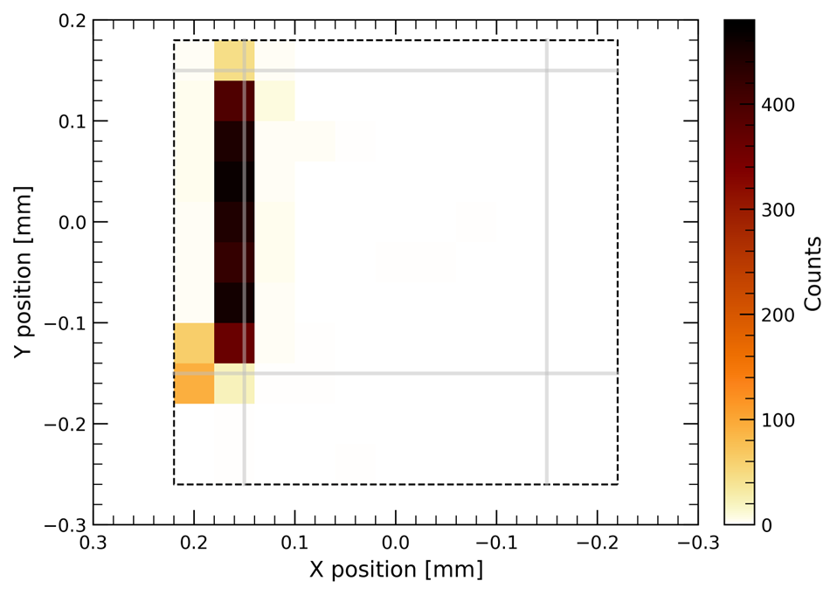
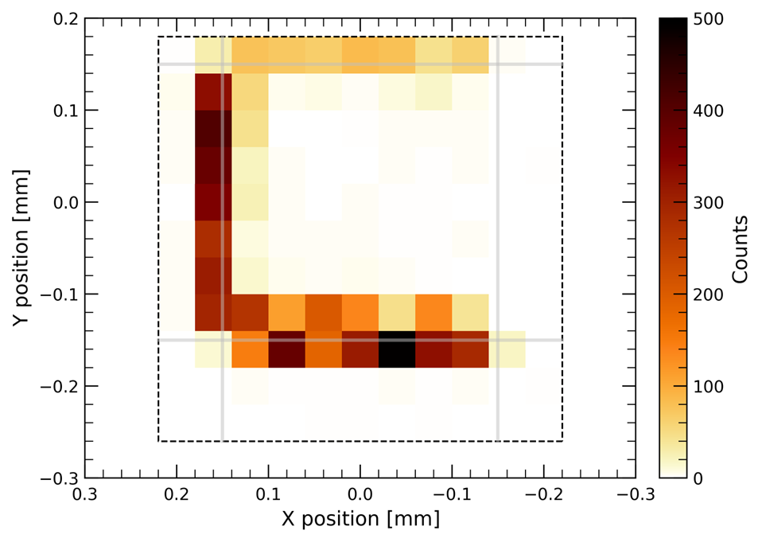
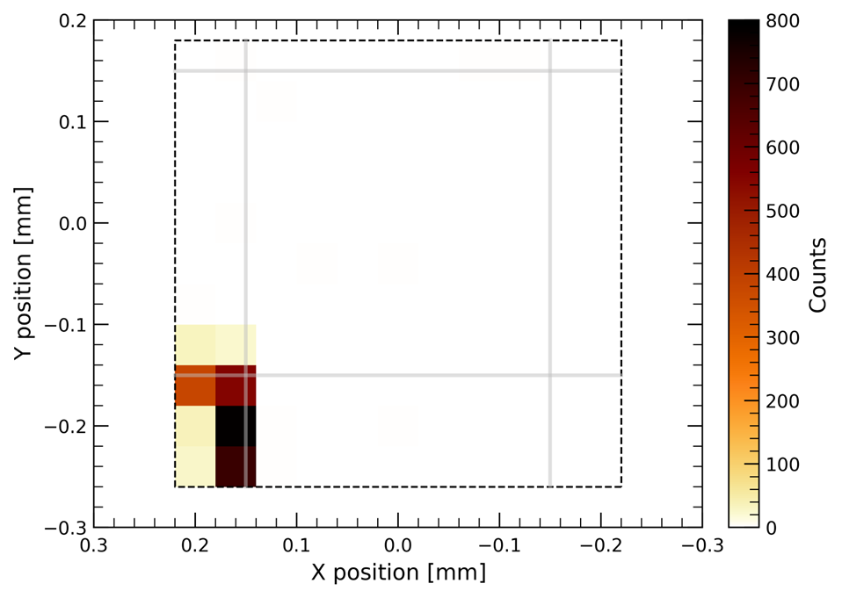
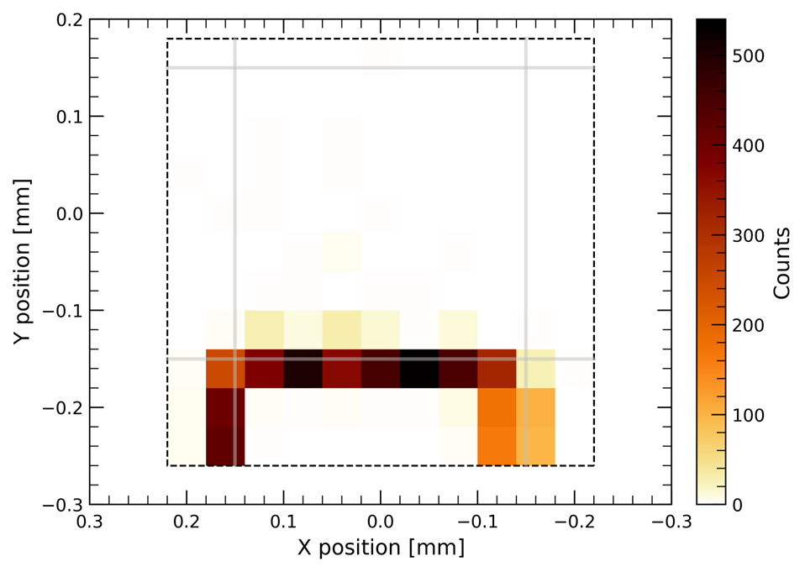

Pixelated Silicon Drift Detector
Sub-pixel response
Double counts
Uniform region with no charge sharing:
  $280 μm×280 μm$
Boundary region with charge sharing:
  $40 μm$
Triple and quadruple counts occur at the corners (not shown)
Setup at IAPS X-ray facility
Fe-anode
X-ray tube
$100 μm$ diaphragm
2D micrometric stages
(diaphragm alignment)
$25 μm$ diaphragm
Detector box
3D micrometric stages
(detector position)
$20 μm$-FWHM beam

Slide 17











The HERMES constellation

Slide 18




HERMES
Overview
$γ−$rays
High Energy Rapid Modular Ensemble of Satellites
  First Italy-led constellation of 6× 3U CubeSats (1U = 10×10×10 cm³)
  For localization of Gamma-Ray Bursts and other transients via triangulation
HERMES Pathfinder
  Funding: ASI, H2020-Space
  Consortium: >20 institutions, PMI and > 100 scientist worldwide
  Scientific payload: INAF
  S/C: PoliMi
  Launch date: 2024
  Orbit: LEO Equatorial/SSO
SpIRIT
  Funding: ASA, UoM, ASI participation, MoU with HSP
  Scientific payload: provided by INAF ($∼$ identical to HSP)
  S/C: Inovor/Sitael-AU
  Launch date: late 2023
  Orbit: SSO

Slide 19


HERMES
Overview
SENSITIVITY → better than 2 ph/cm²/s
EFFECTIVE AREA → ≥ 50 cm²
ENERGY BAND → E_{low} ≤ 5 keV & E_{high} ≥ 2 MeV
ENERGY RESOLUTION → 1 keV (soft X) and 5 keV (hard X) EOL
TIME RESOLUTION → ≤ 400 ns
TIME ACCURACY → ≤ 200 ns
FOV → ≥ 3 sr FHWM
BACKGROUND → lower than 25 counts/cm²/s for E<20 keV
VOLUME → 1U
MASS → lower than 1.8 kg
POWER → lower than 5 W
RADIATIVE ENV → LEO (EQ or SSO)
THERMAL CONTROL → passive (EQ), active (SSO)
COMPONENTS → COTS (mainly)
RELIABILITY → higher than standard CubeSats
REDUNDANCY → segmented detector
OTHER → “mass” production

Slide 20

HERMES
Detector principle
Siswich concept
  Silicon Drift Detector and Ce:GAGG scintillator crystals sandwich
    Two SDDs per GAGG crystal
  X-mode: Direct detection of X-rays via SDDs (single events)
  S-mode: Indirect detection of Gamma-rays via scintillators and SDDs (double events in SDD pairs)
Broad-band energy response
Very compact (96×96×30 mm³) and light-weight instrument
SDD
GAGG

Slide 21






HERMES
Core components
FEE (IASF-Mi) designed to provide:
Low noise/cross-talk
High detector density
Efficient thermal I/Fs
Compact design
LYRA-FE & LYRA-BE (PoliMi & UniPavia) ASIC designed for:
Noise performance (also leakage & C matching)
E range: 0-33000 e⁻ (0÷120 keV Si, 0÷2.5 MeV GAGG)
Low power: < 1mW/channel
Signal routing and low cross-talk (I-based el. IFs, separation in LYRA-FE and LYRA-BE)
2×5 SDD (INFN & FBK) with design/process optimized for:
Energy resolution and noise (threshold), optical QE
Modularity (redundancy)
FEE PCB complexity and integration
Time resolution
X/gamma discrimination (via multiplicity)

Slide 22







HERMES
On-ground calibration campaign
$$T={−10}^{∘}C$$
P/L calibration performed at INAF/IAPS
  X-ray sources: ⁵⁵Fe (X), ¹⁰⁹Cd (X) and ¹³⁷Cs ($γ$)
  Typical pixel resolution at 5.9 keV: $≈300 eV$ at $−{10 }^{∘}C$
  Typical pixel resolution at 662 keV: $≈80 keV$ at $−{10 }^{∘}C$
$$T={−10}^{∘}C$$
Ref: R. Campana et al. Calibration of the first detector flight models for the HERMES constellation and the SpIRIT mission, ProcSPIE, 2022, 121815K. DOI: 10.1117/12.2629031.

Slide 23

HERMES
Current status
All 6 HERMES P/L have been fully characterized
  S/C integration is about to take place
SpIRIT P/L delivered in in 2022
PFM and FM6 not shown in the photo

Slide 24
Conclusions

Slide 25

Conclusions
Summary
SDDs make excellent sensors for spectral-timing X-ray astronomy
Large Area Detector onboard eXTP
  Collimated instrument based on linear SDD
  Huge effective area: ≥3 m² @ 8 keV
  Spectral performance of the prototype sensor:
    $FWHM\left(5.9 keV\right)≈183 eV$ at $T={−20}^{∘}C$
    > 97% single events
Pixelated Silicon Drift Detector
  Pixelated SDD to be placed at focal plane of X-ray optics
  First spectral characterization of 256-pixel detector
    $FWHM\left(5.9 keV\right)≈150 eV$ at $T=0^{∘}C$ (single pixel)
    $FWHM\left(5.9 keV\right)≈160 eV$ at $T=0^{∘}C$ (pixel sum)
HERMES constellation
  CubeSat constellation based on SDD+scintillators for the localization of transients
  Large energy range: 5 keV – 2 MeV
  On-ground calibrations completed for all P/L
Confining cathodes
Drifting charge
cloud
Small anodes

Slide 26
Conclusions
References
S. Zhang et al. The enhanced X-ray Timing and Polarimetry mission — eXTP. In: Science China Physics, Mechanics, and Astronomy 62.2, 29502 (feb. 2019), p. 29502. DOI: 10.1007/s11433-018-9309-2. arXiv: 1812.04020 [astro-ph.IM].
R. Campana et al. Calibration of the first detector flight models for the HERMES constellation and the SpIRIT mission. In: Space Telescopes and Instrumentation 2022: Ultraviolet to Gamma Ray. Vol. 12181. Society of Photo-Optical Instrumentation Engineers (SPIE) Conference Series. Ago. 2022, 121815K, 121815K. DOI: 10.1117/12.2629031. arXiv: 2210.13860 [astro-ph.IM].
F. Ceraudo et al. PixDD: a multi-pixel silicon drift detector for high-throughput spectral-timing studies. In: X-Ray, Optical, and Infrared Detectors for Astronomy X. Vol. 12191. Society of Photo-Optical Instrumentation Engineers (SPIE) Conference Series. Ago. 2022, 1219116, p. 1219116. DOI: 10.1117/12.2630450.
Y. Evangelista et al. Design, integration, and test of the scientific payloads on-board the HERMES constellation and the SpIRIT mission. In: Space Telescopes and Instrumentation 2022: Ultraviolet to Gamma Ray. Vol. 12181. Society of Photo-Optical Instrumentation Engineers (SPIE) Conference Series. Ago. 2022, 121811G, 121811G. DOI: 10.1117/12.2628978. arXiv: 2210.13866 [astro-ph.IM].
M. Feroci et al. The large area detector onboard the eXTP mission. In: Society of Photo-Optical Instrumentation Engineers (SPIE) Conference Series. Vol. 12181. Society of Photo-Optical Instrumentation Engineers (SPIE) Conference Series. Ago. 2022, 121811X, p. 121811X. DOI: 10.1117/12.2628814.

