Slide 1
MITIQO project n. A0375-2020-36647
High Precision X-Ray Measurements 2023
June 19–23, 2023 - Laboratori Nazionali di Frascati INFN
Investigating Metals’ Content and Oxidation States
in Edible Liquids using XRF Analysis
with VOXES X-ray Spectrometer
Simone Manti, Marco Miliucci, Alessandro Scordo, Roberto Bedogni, Alberto Clozza, Gabriel Moskal, Kristian Piscicchia, Alessio Porcelli, Diana Sirghi and Catalina Curceanu
In situ Monitoring of Toxicity, geographical Indication, and Quality of Olive oil, wine, and other edible liquids
Notes:
-Title 32 Text 22

Slide 2
Outline
The VOXES X-ray Spectrometer
XES spectra with VOXES
Applications: content and oxidation states of metal

Slide 3
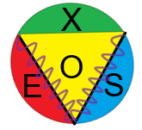
High resolution von-Hamos X-Ray spectrometer using
HAPG for Extended Sources in a broad energy range
VOXES is an high resolution and high efficiency X-ray spectrometer in the range of energies 2 - 20 keV using Highly Annealed Pyrolytic Graphite (HAPG) bent crystals able to work with ‘extended’ sources
To be used in (for example):
Kaonic atoms experiments
(kaon mass, isotopic shift, etc..)
Elemental mapping
XRF of trace metals
Food control
Medical applications
Others.

Slide 4
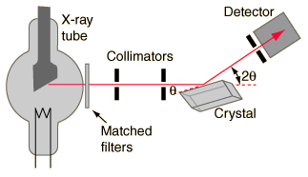
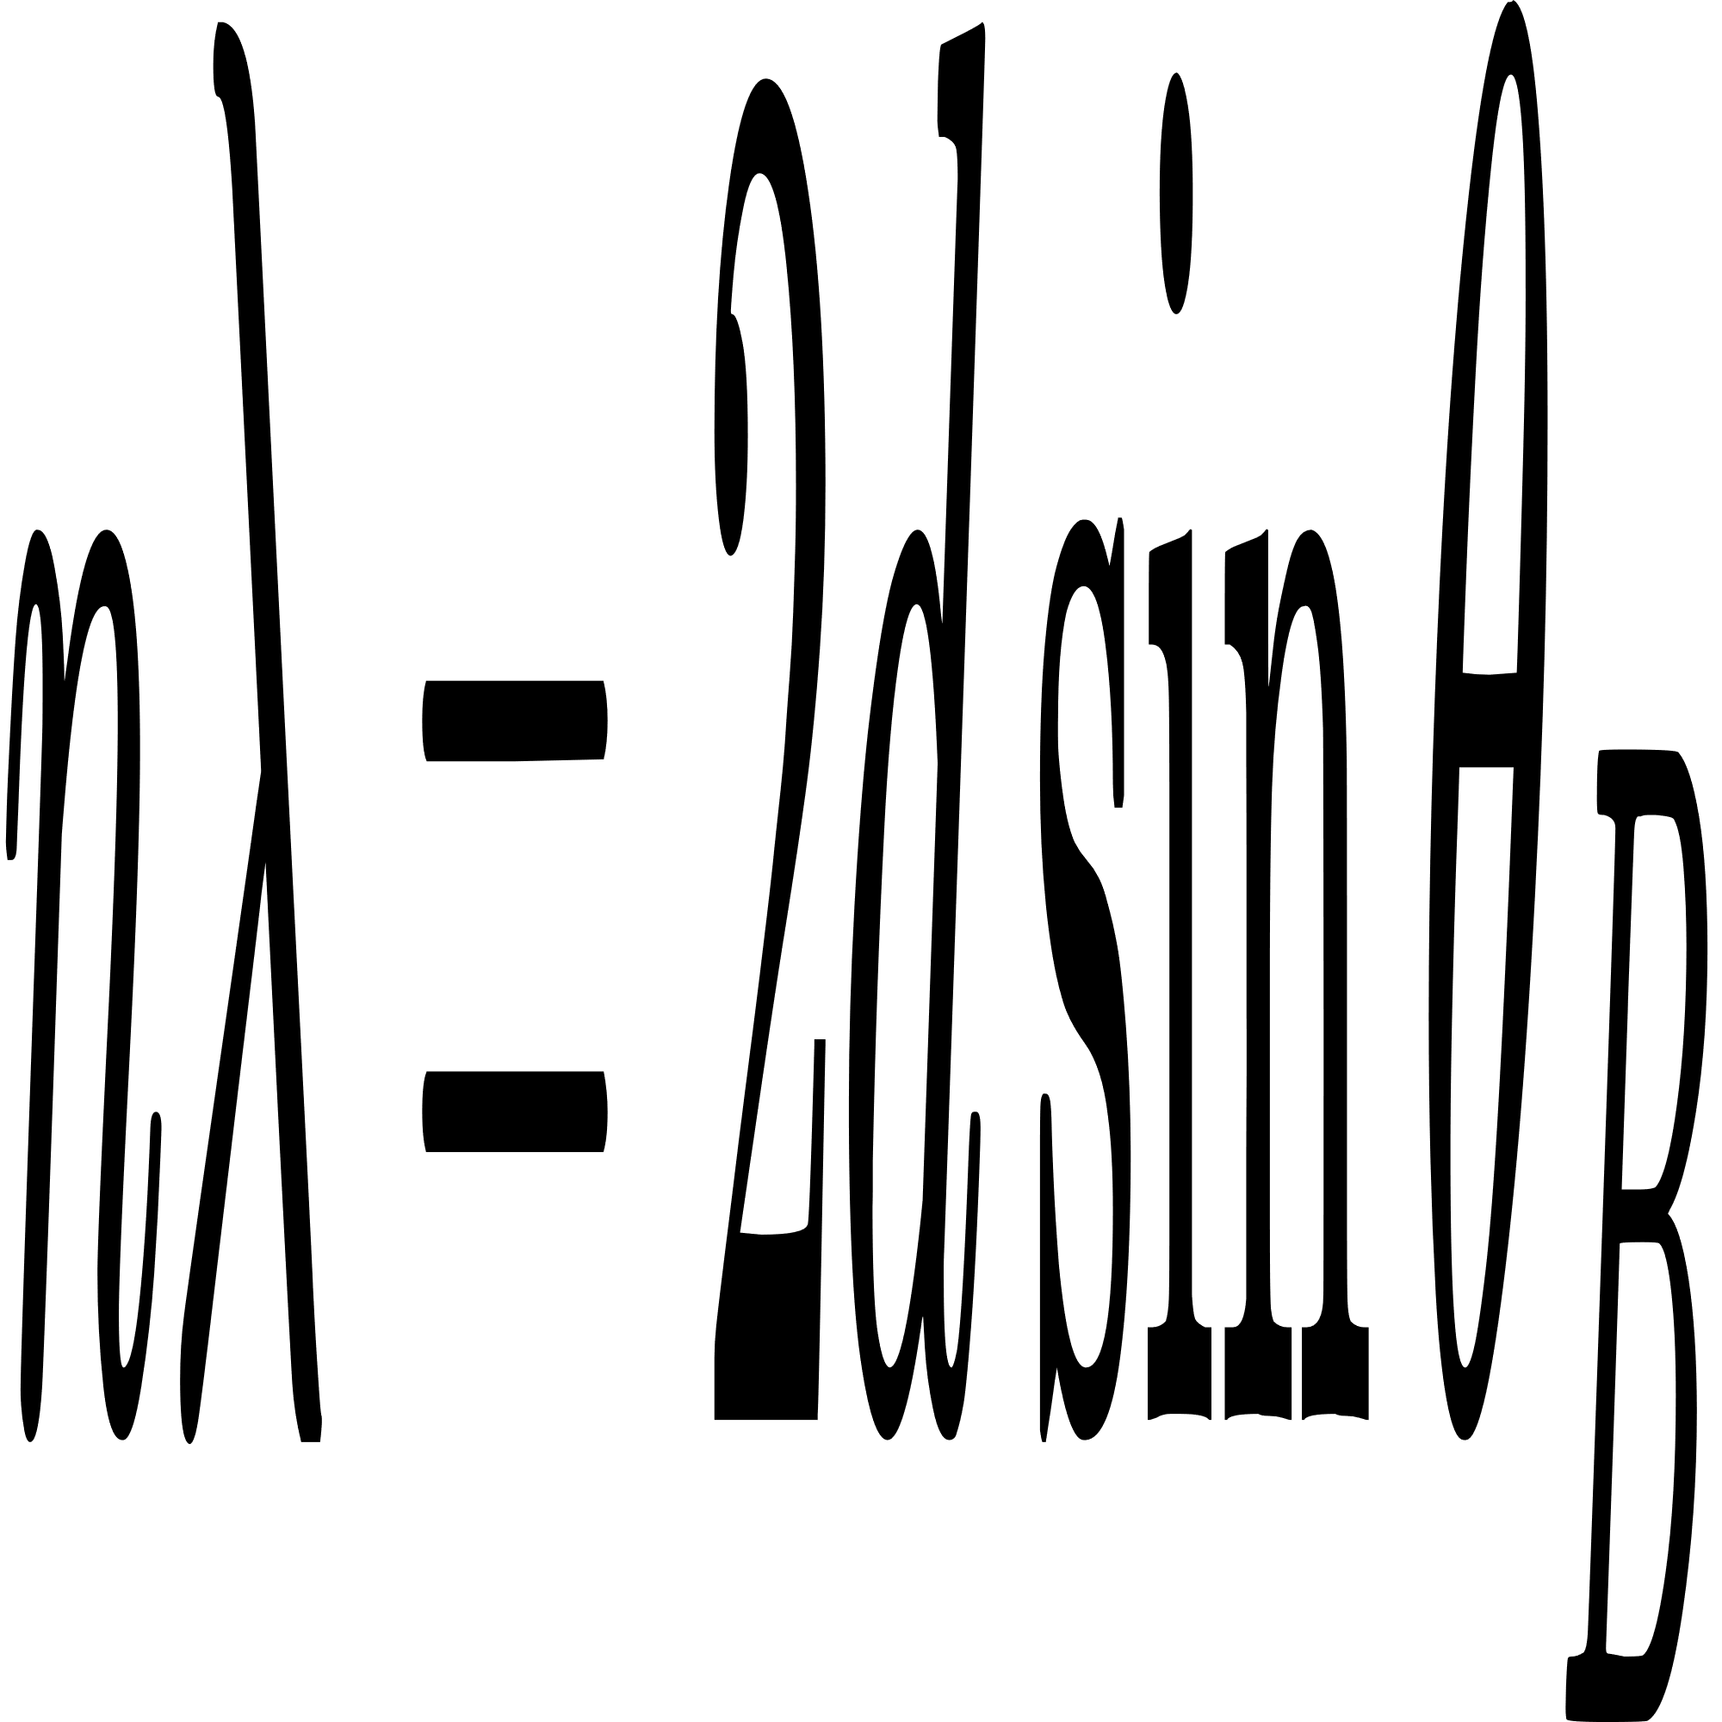
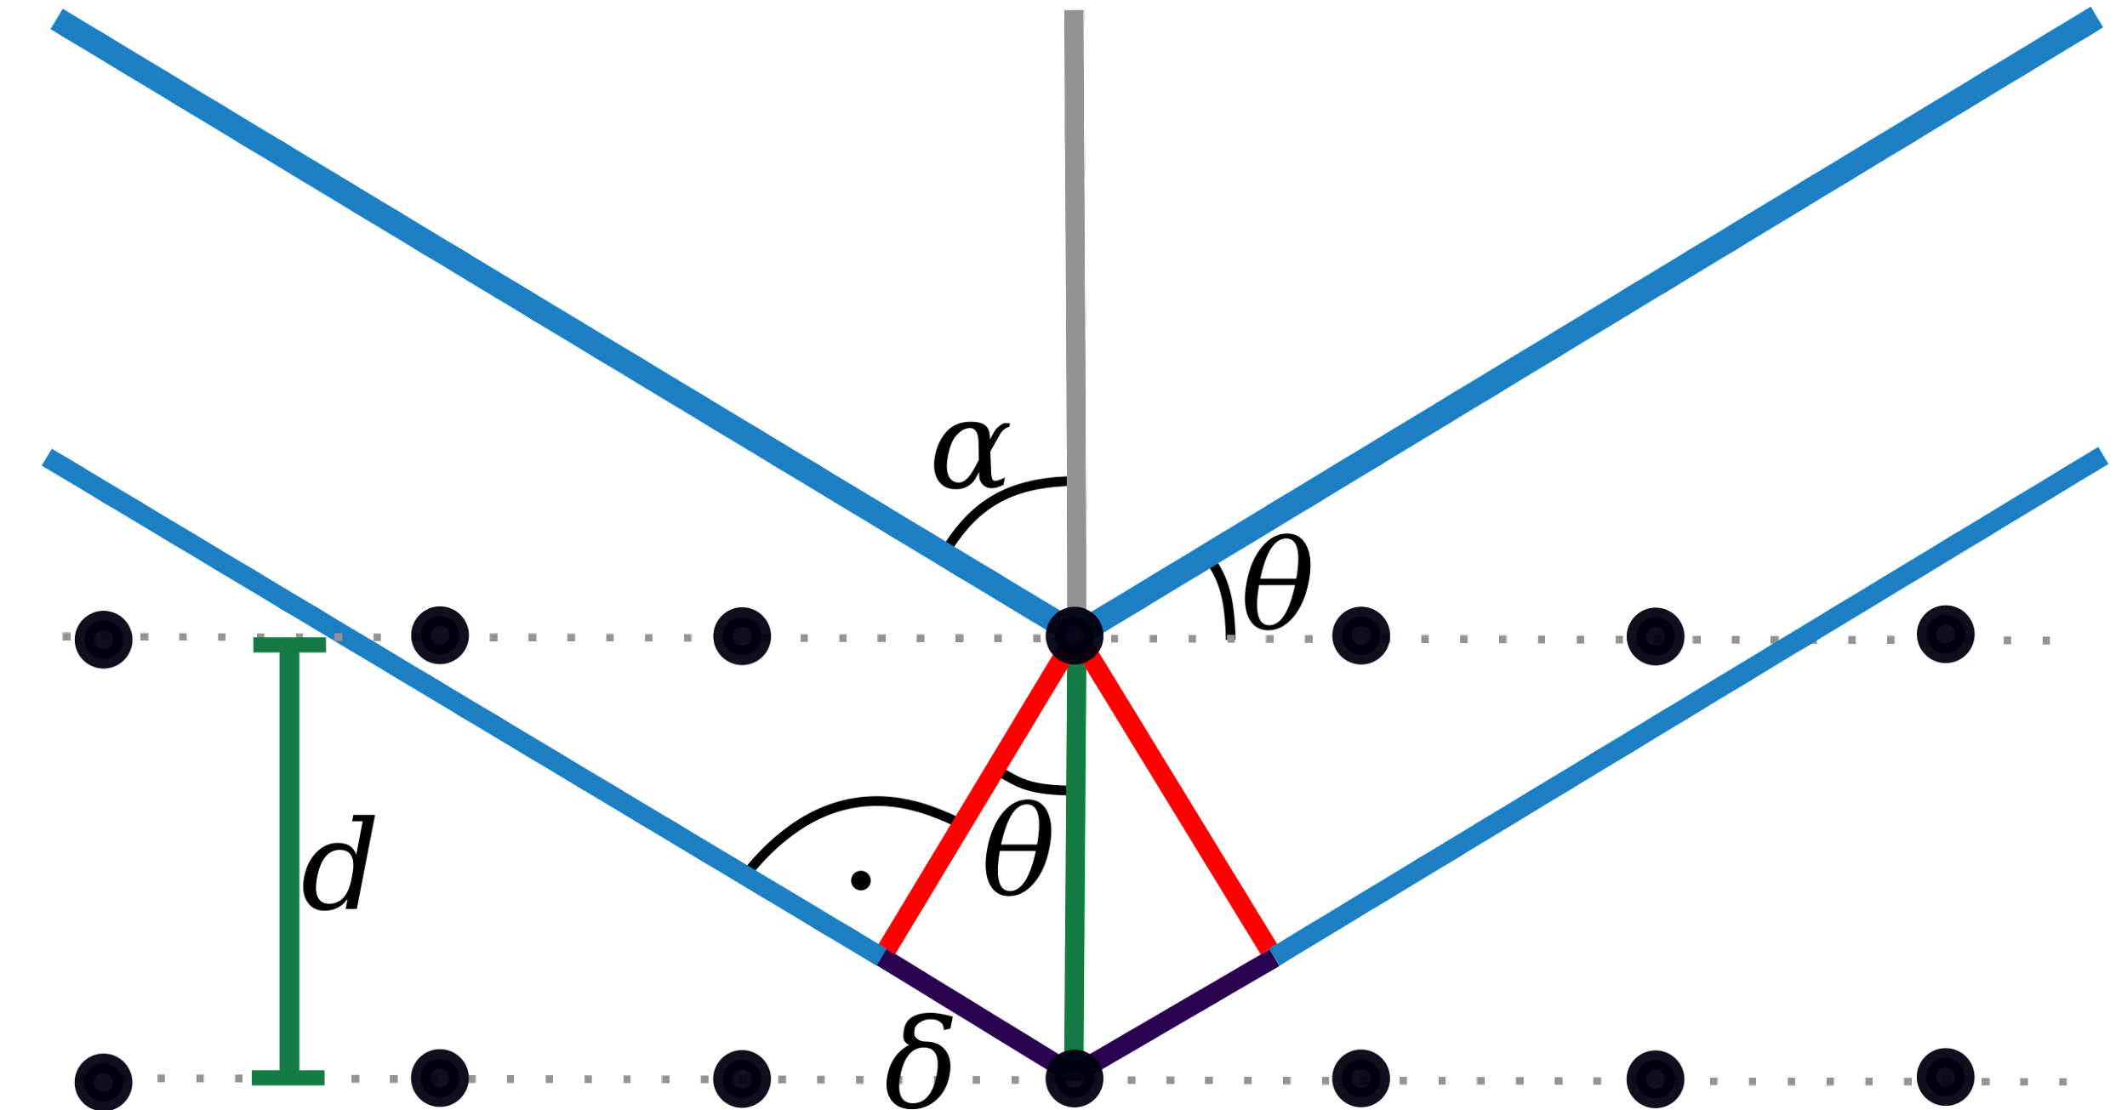
X-Ray Emission Spectroscopy (XES) with crystals
But….
- Small solid angles can be covered
- Typical efficiencies : 10⁻⁵ – 10⁻⁸
- Typical d (Si) ≈ 5.5 Å (good for E < 6 keV)
- Typical source size 10-100 mm
FWHM ~ 1-10 eV can be achieved depending on the quality of the crystal and the dimensions of the detectors

Slide 5
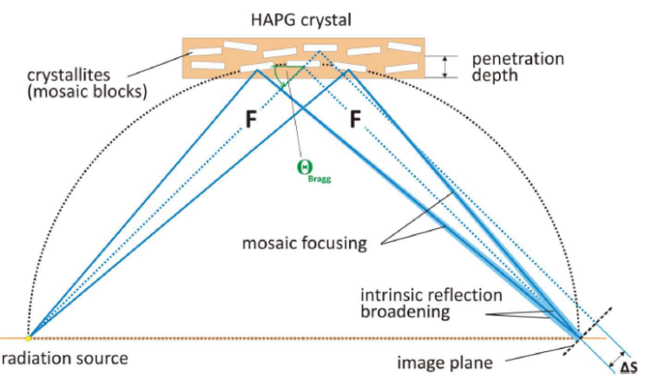
HAPG mosaic crystals improve the efficiency
Mosaic crystal consist in a large number of nearly perfect small crystallites.
Mosaicity makes it possible that even for a fixed incidence angle on the crystal surface, an energetic distribution of photons can be reflected
Pyrolitic Graphite mosaic crystals (d = 3.354 Å):
Bending does not influence resolution and intensity
Mosaic spread down to 0.05 degree
Integral reflectivity ~ 10² higher than for other crystals
Variable thickness (efficiency)
Excellent thermal and radiation stability
Increase of efficiency
(focusing) ~ 50
Loss in resolution

Slide 6
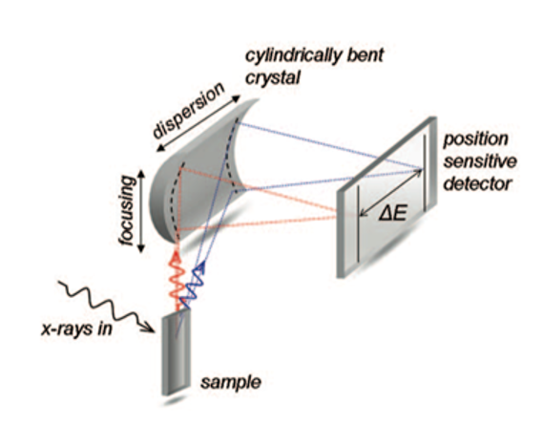
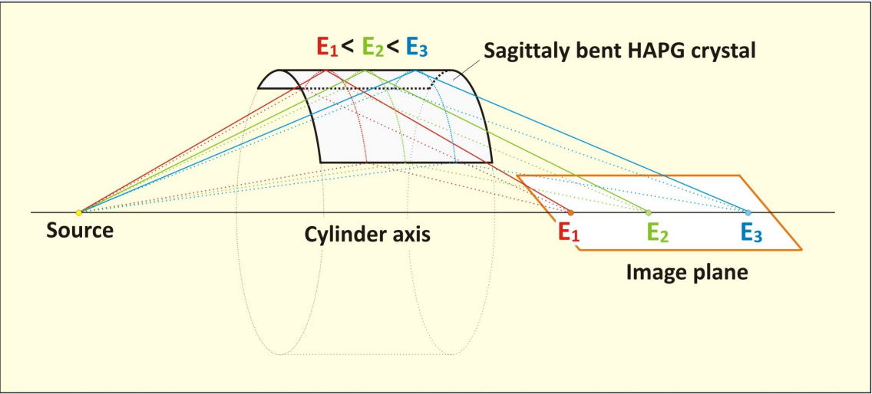
Improving the solid angle with Von Hamos configuration
Von Hamos configuration can further improve the signal collection efficiency.
In this configuration, also the vertical dimension of the X-ray source can be exploited

Slide 7
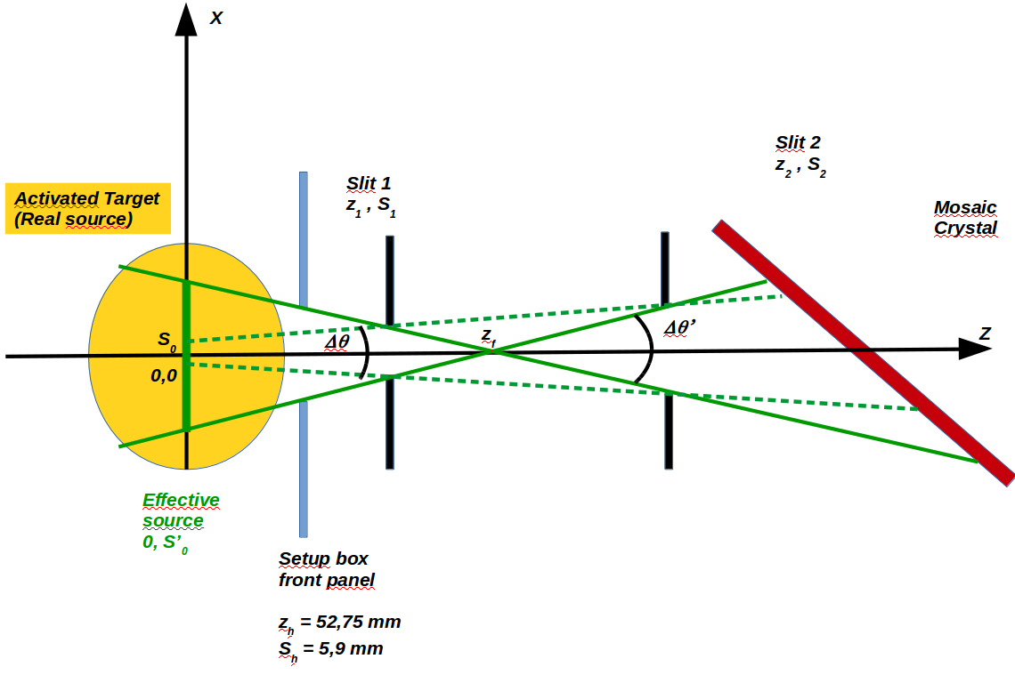
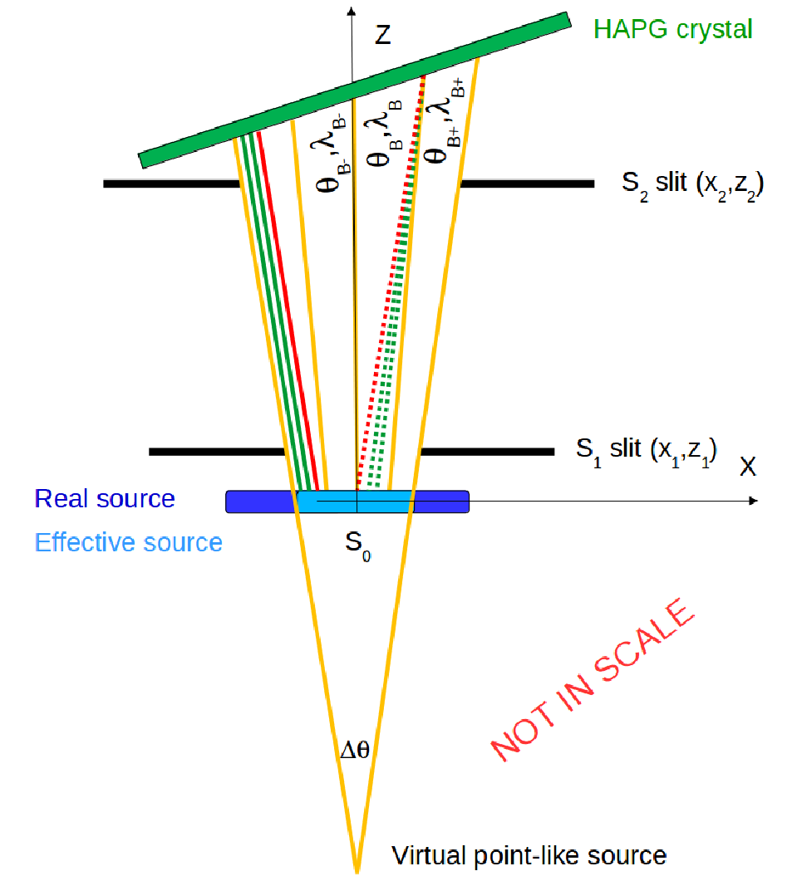
VOXES: enlarging the source size with two slits
The shape of the “signal” beam can be optimized to increase the effective source size
On the other hand, this may lead to a worsening of the resolution

Slide 8
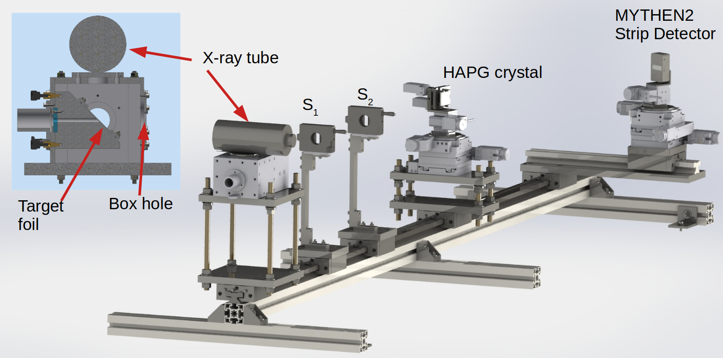
The VOXES setup
32 x 8 mm surface
640 channels, 50 μm resolution
4-40 keV range
Working @ room temperature
0-10 mm opening
26 mm circular frame
< 1 μm sensitivity
Slits (STANDA 10MAOS10-1)

Slide 9
Outline
The VOXES X-ray Spectrometer
XES spectra with VOXES
Applications: content and oxidation states of metal

Slide 10
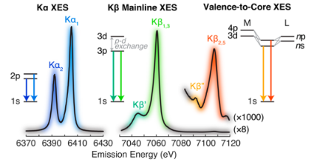
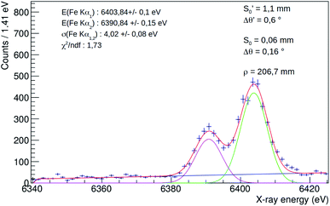
X-ray Emission Spectroscopy (XES) with VOXES
Nicole Lee, Taras Petrenko, Uwe Bergmann, Frank Neese, and Serena DeBeer, Journal of the American Chemical Society 2010 132 (28), 9715-9727 DOI: 10.1021/ja101281e

Slide 11
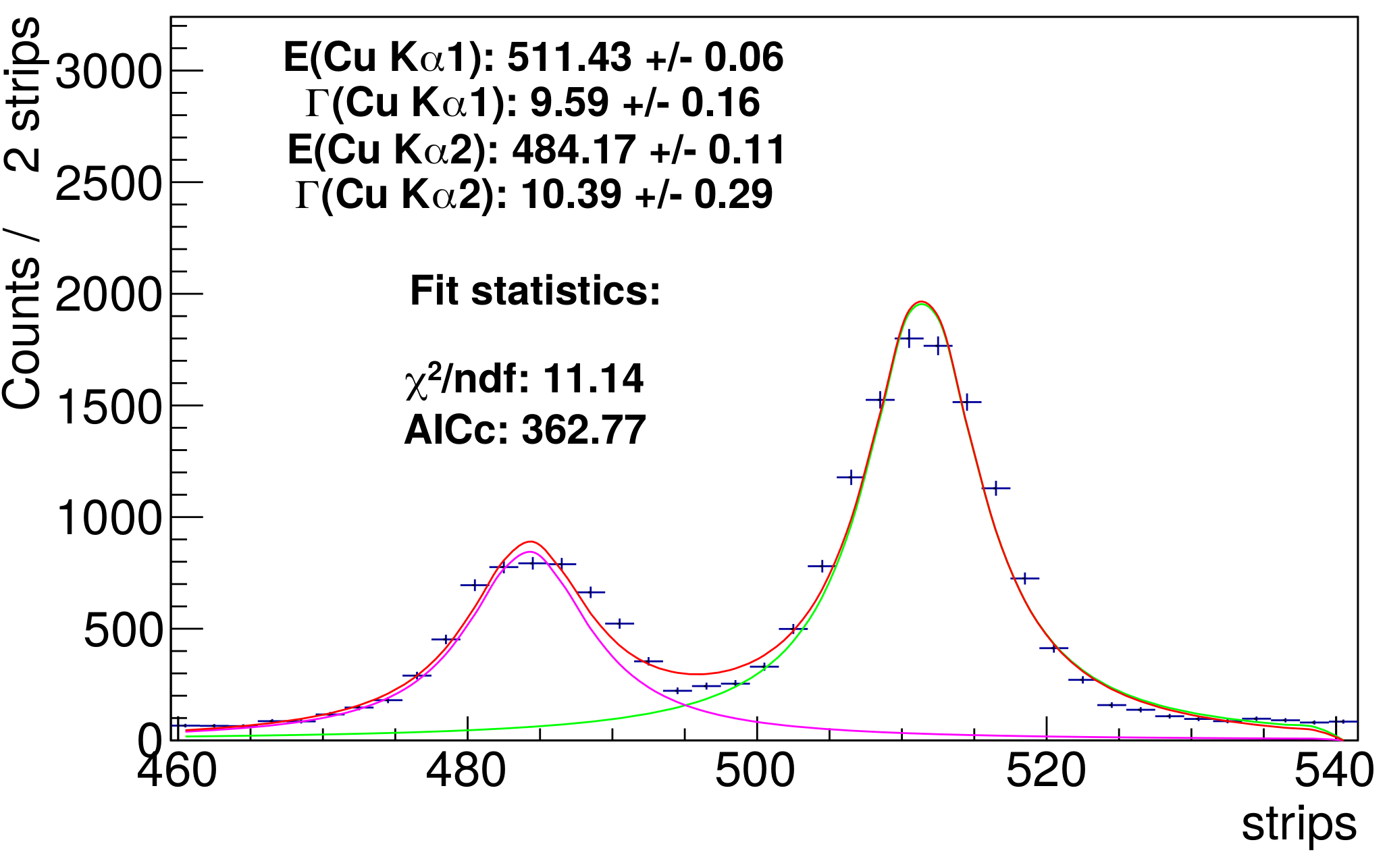
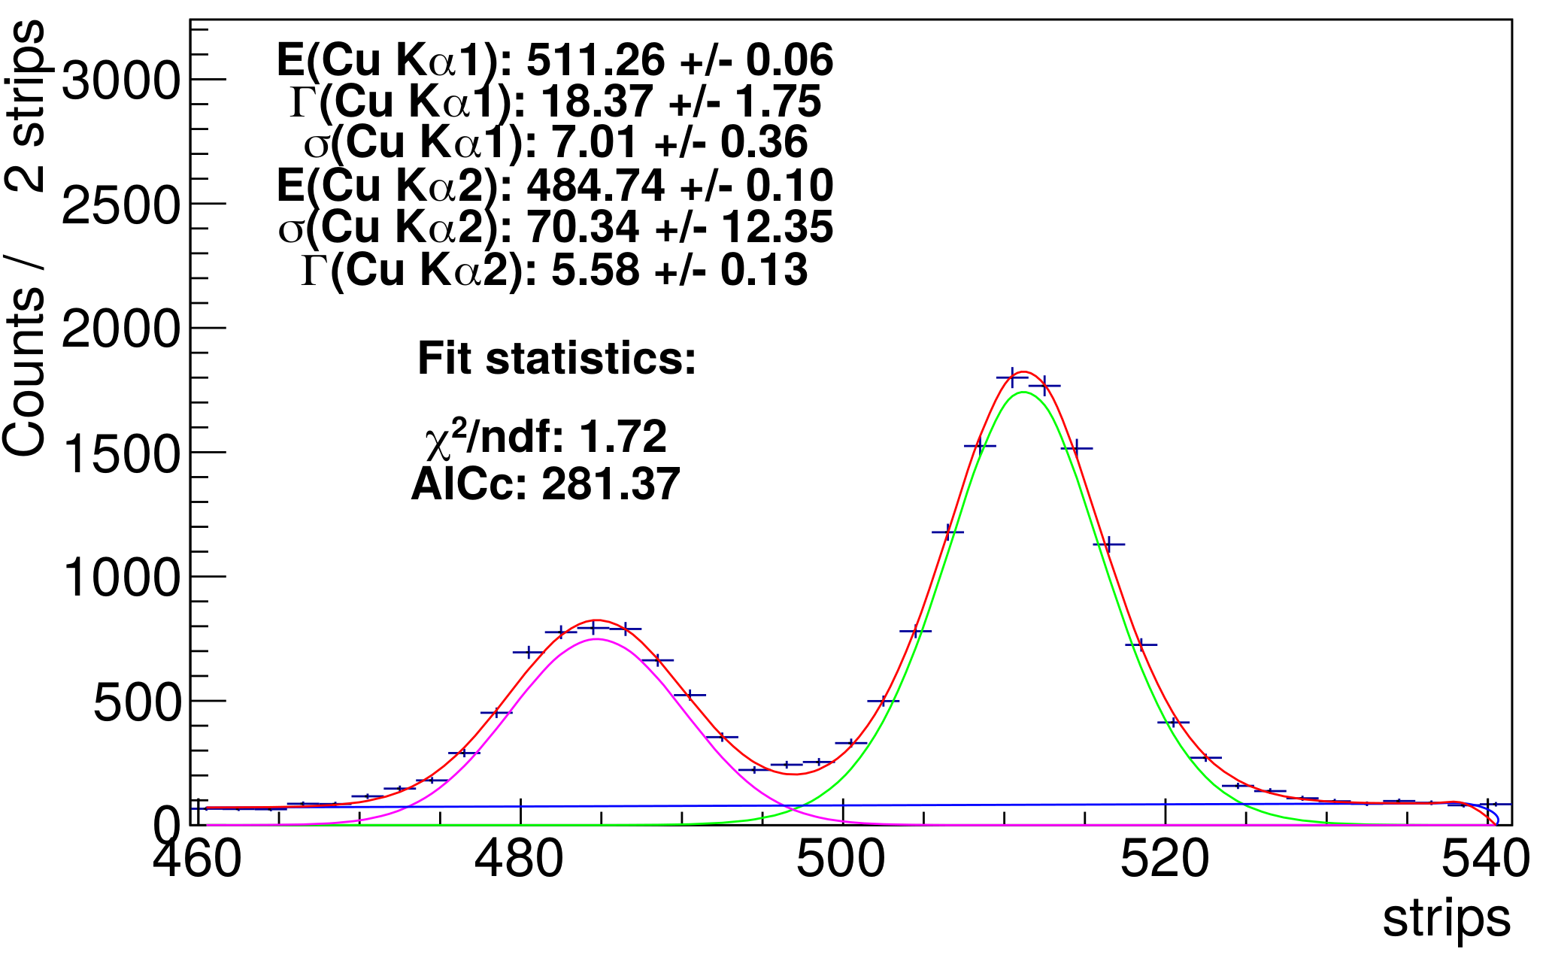
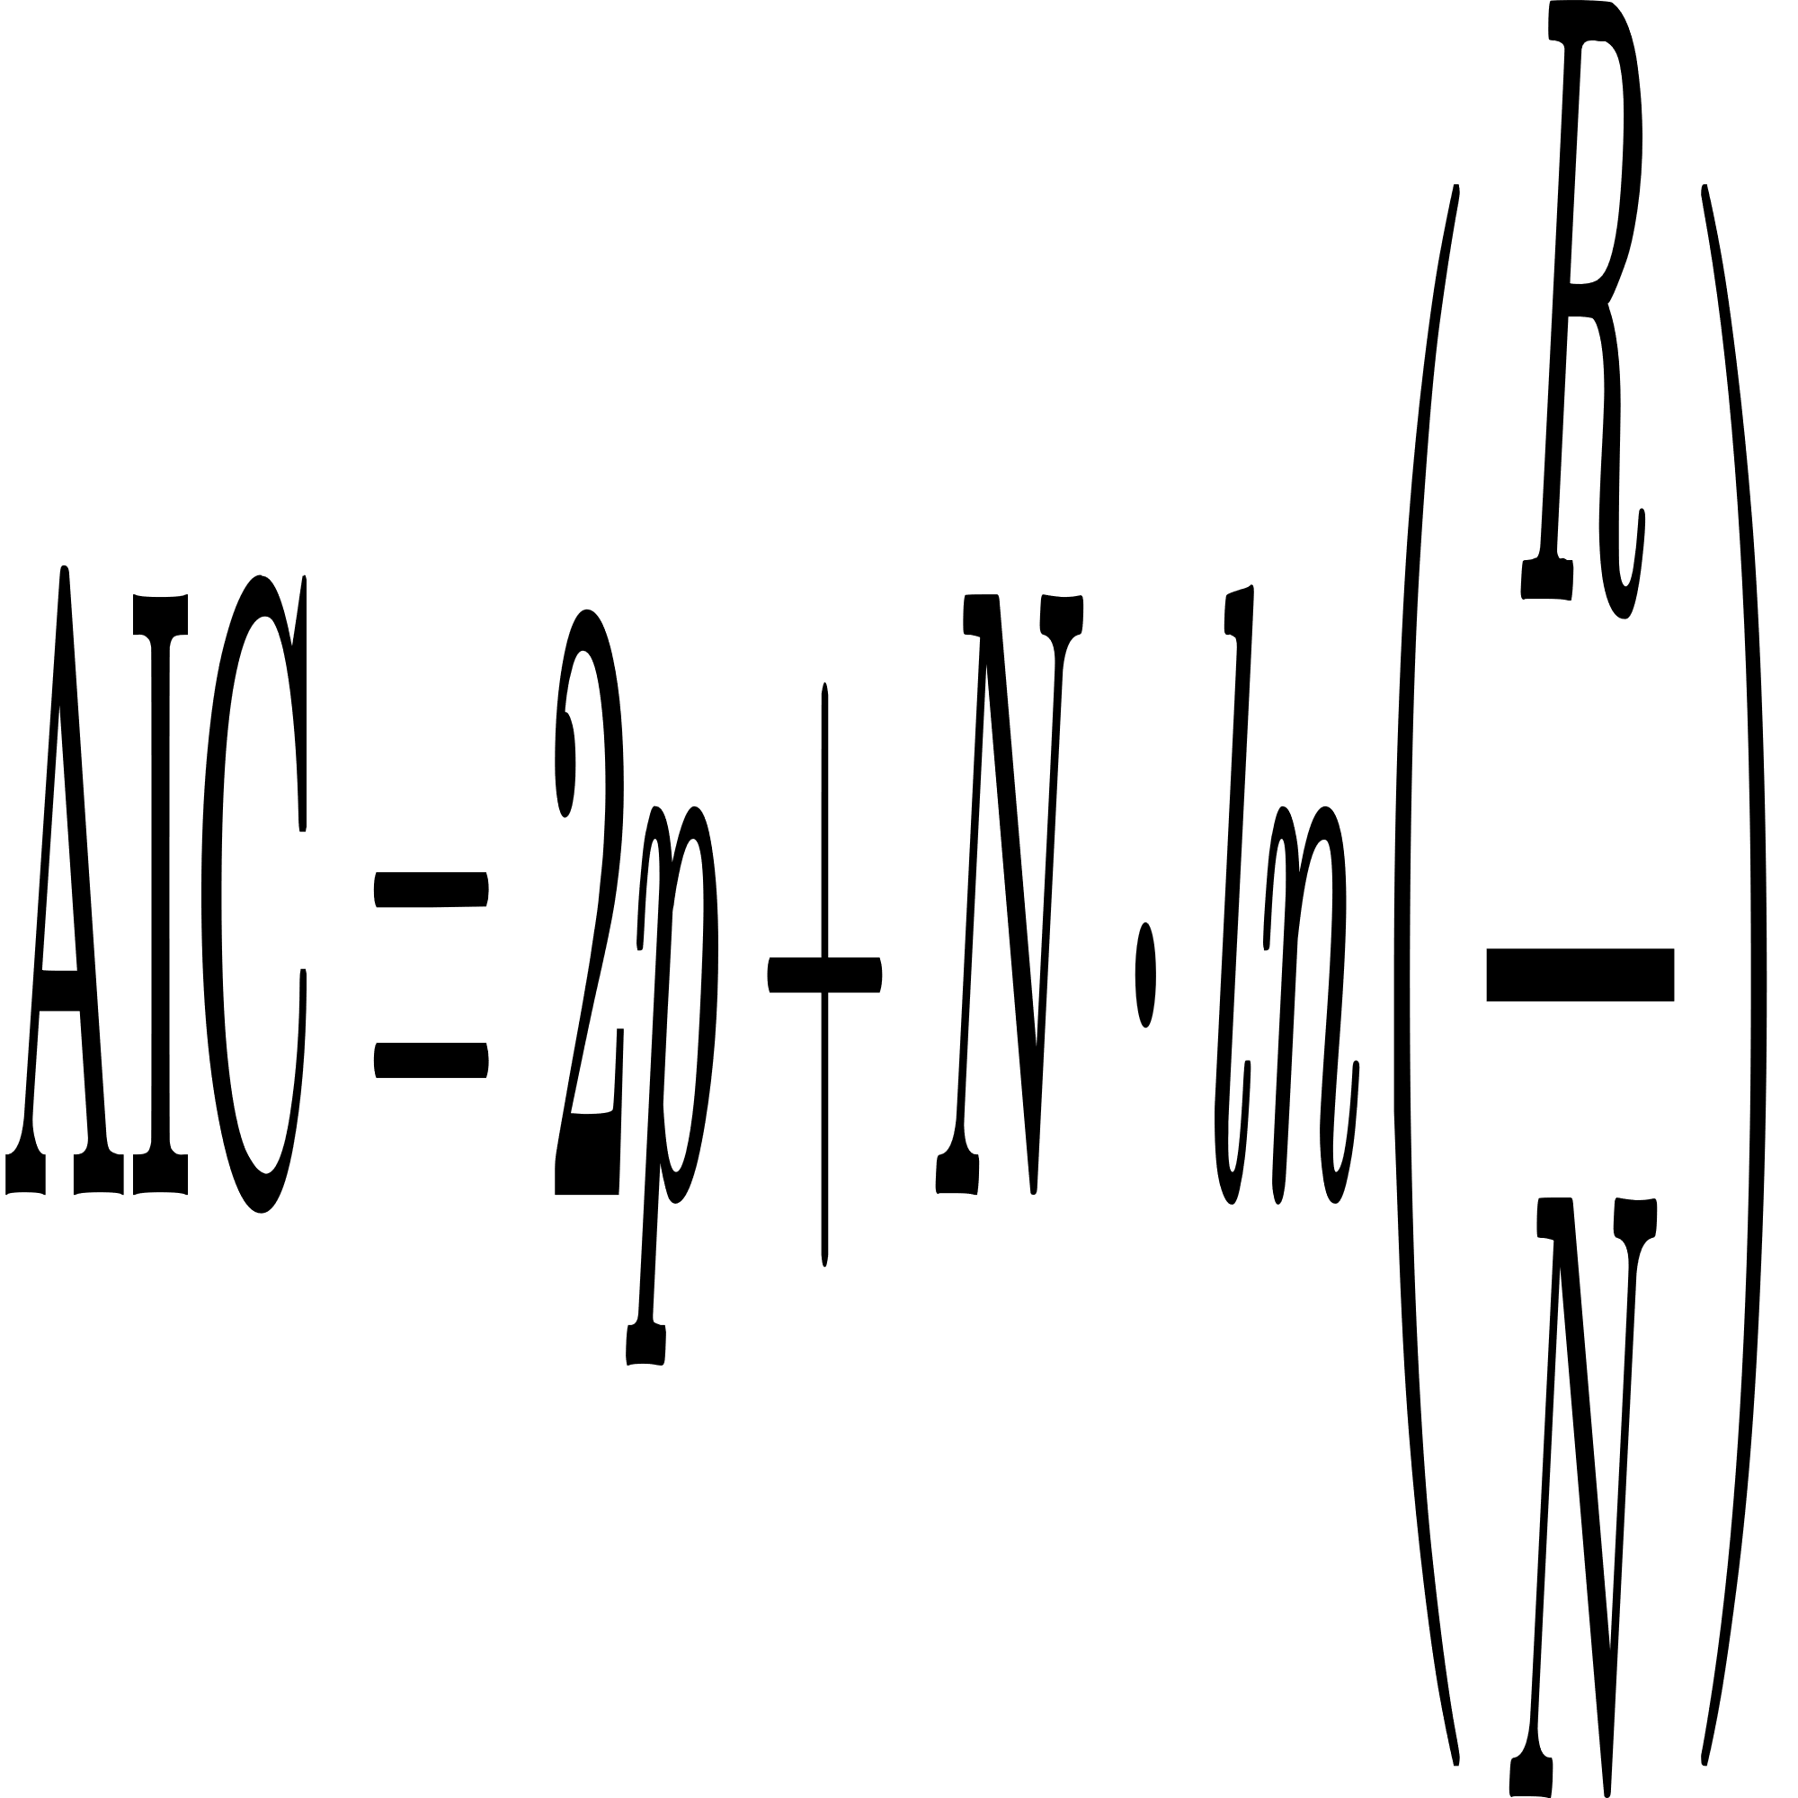
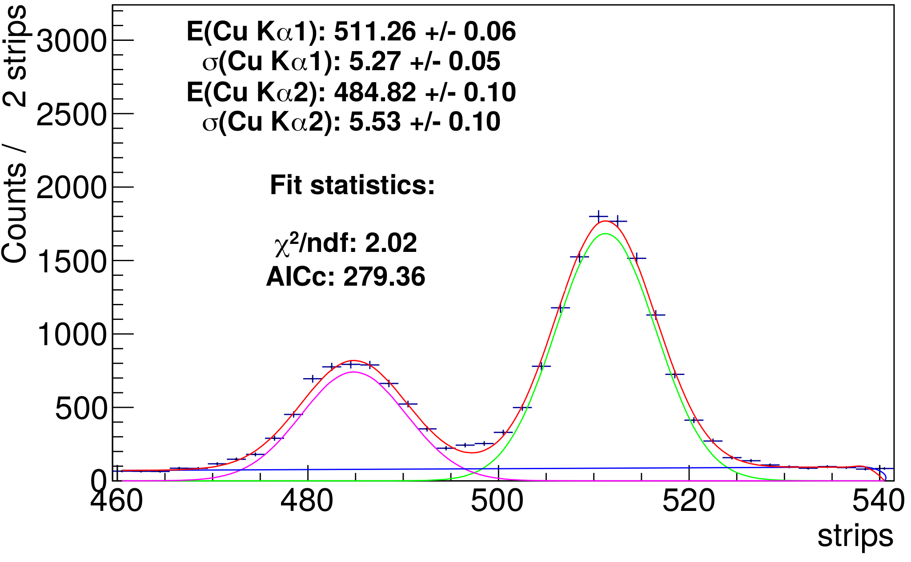
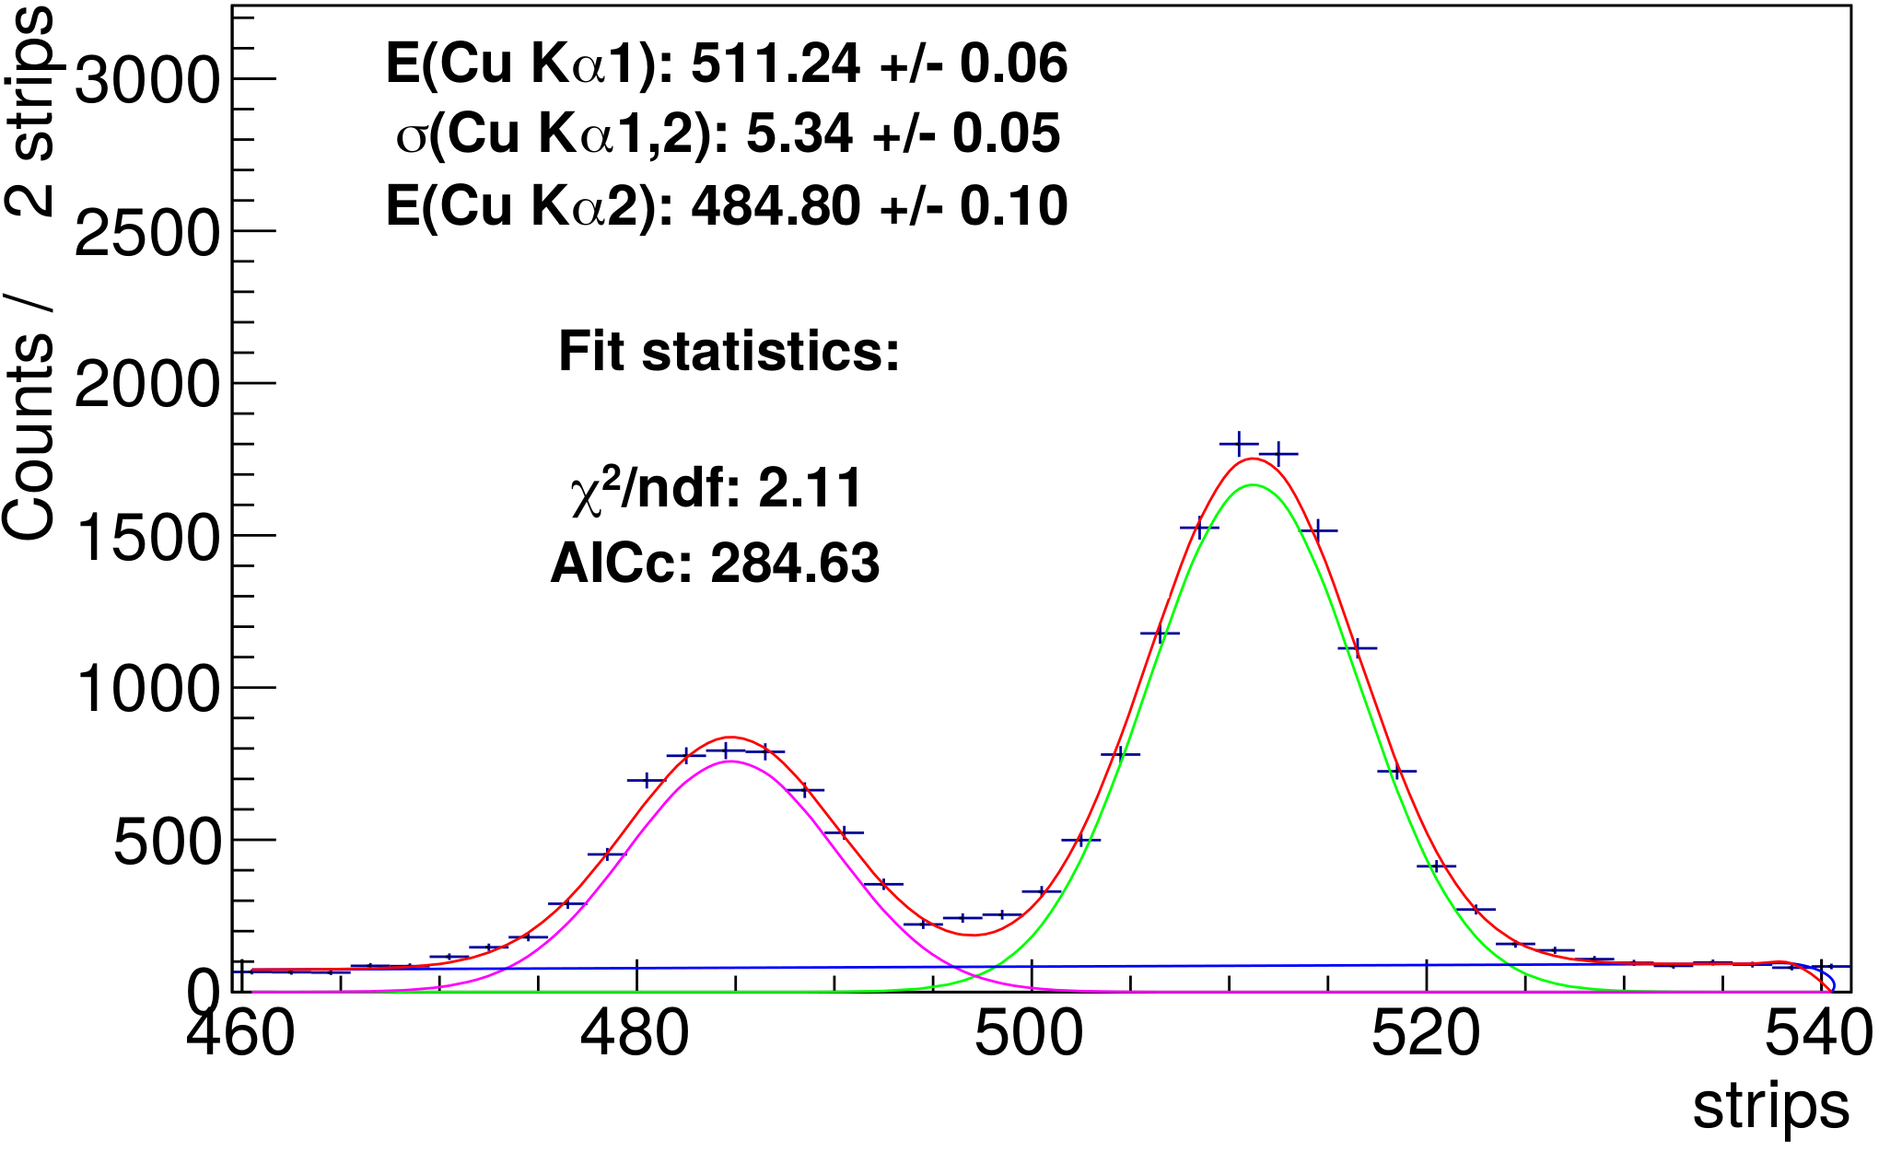
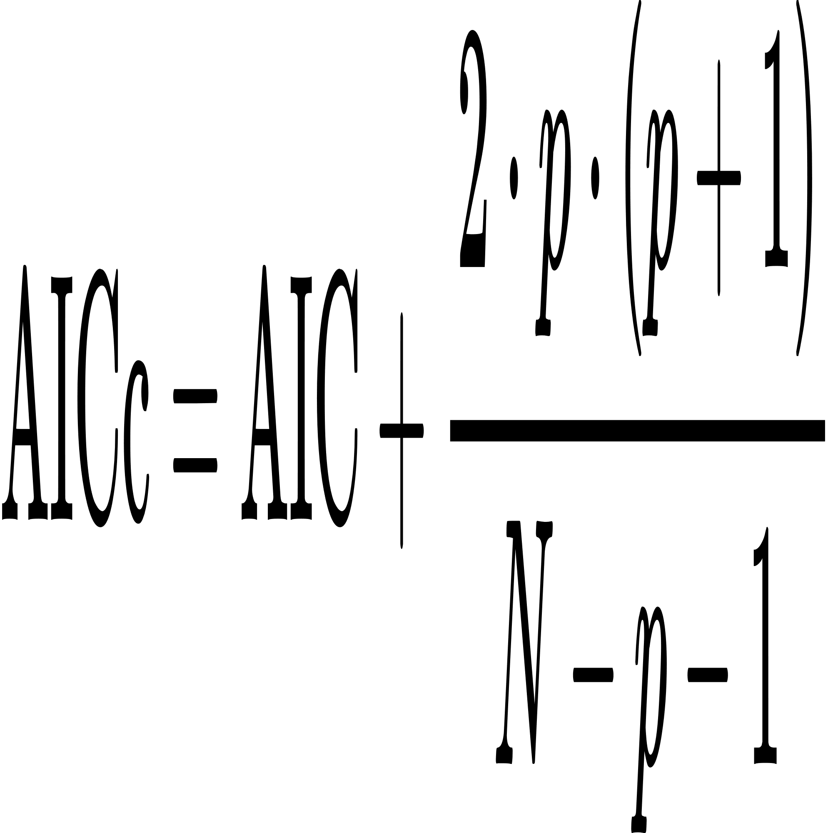
Which is the correct shape to be used for peak fitting?
Natural linewidths are Lorentzian but….
Is Voigt really better?
Lorentzian
fit
Voigt fit
Akaike Information Criteria:
N = num of fitted points
p = num of fit parameters
Gauss
fit
Common σ
Gauss fit
(for N/p < 40)
Not much information loss using gaussian shape

Slide 12
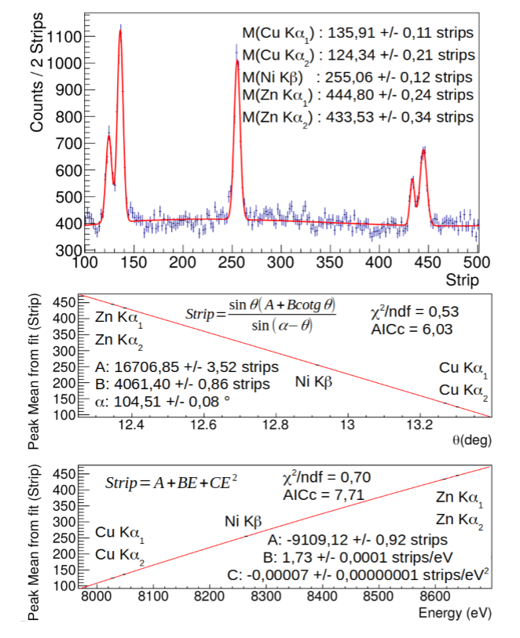
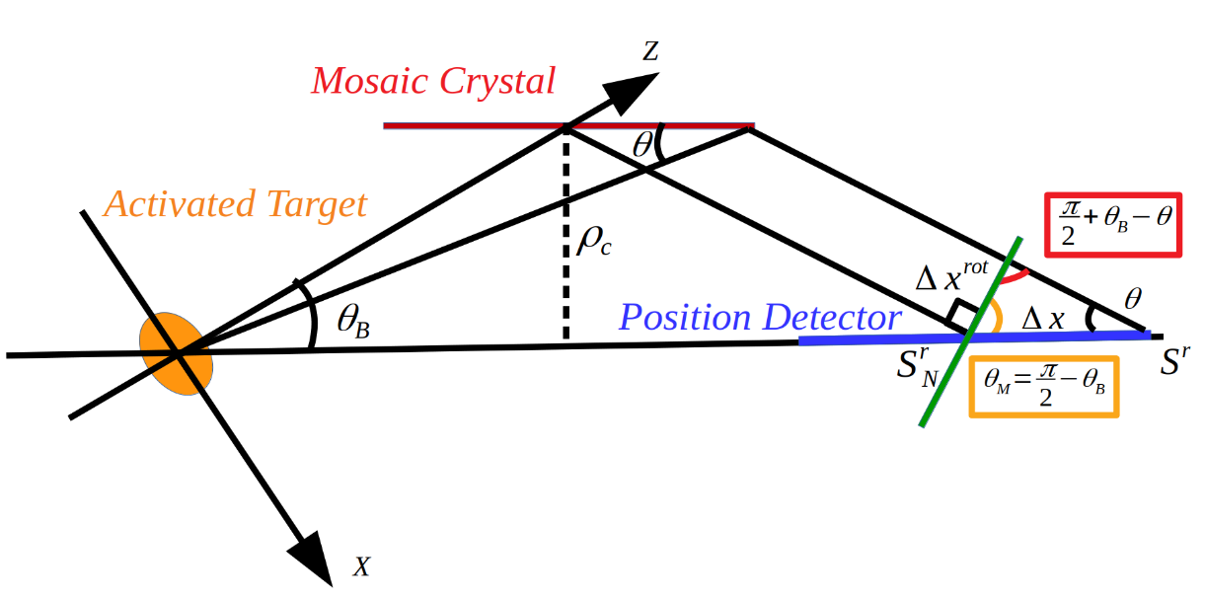
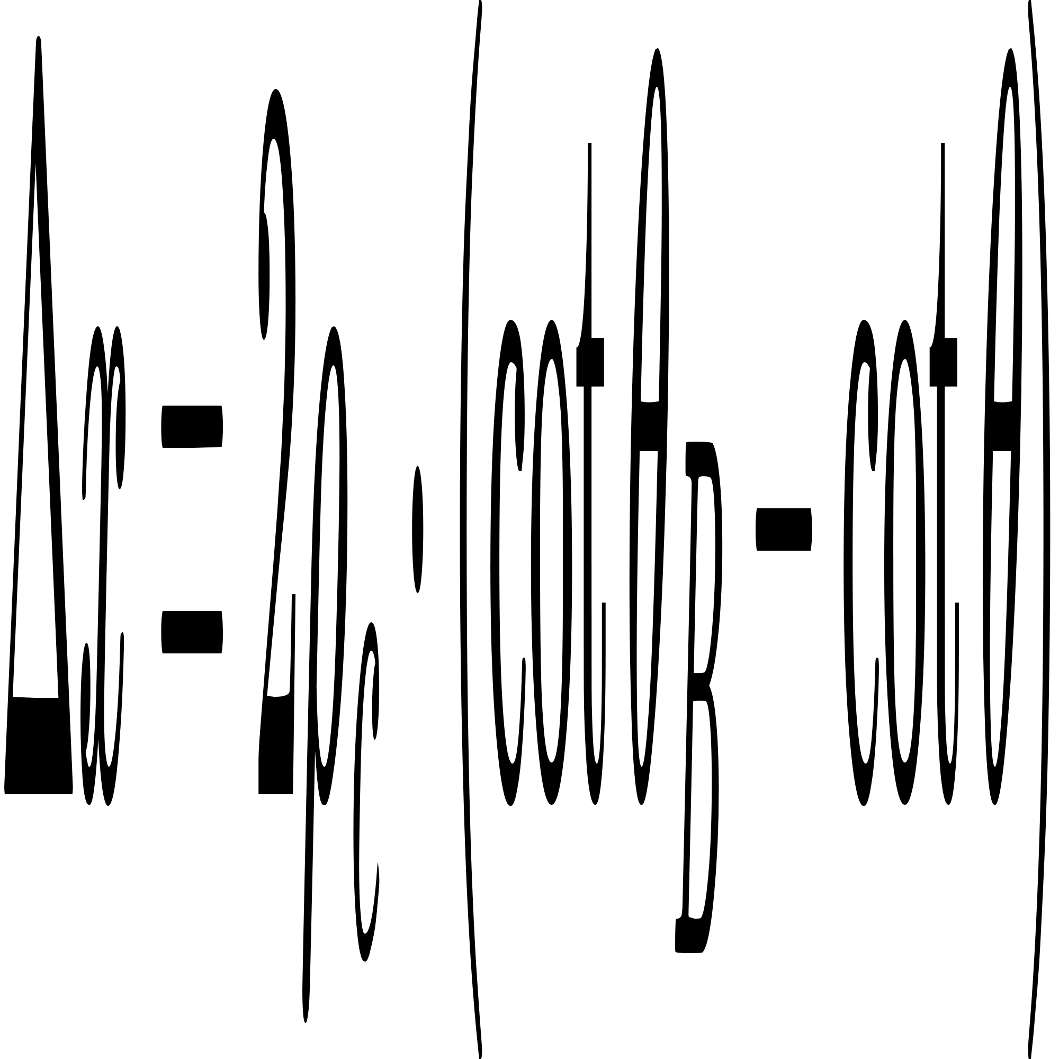
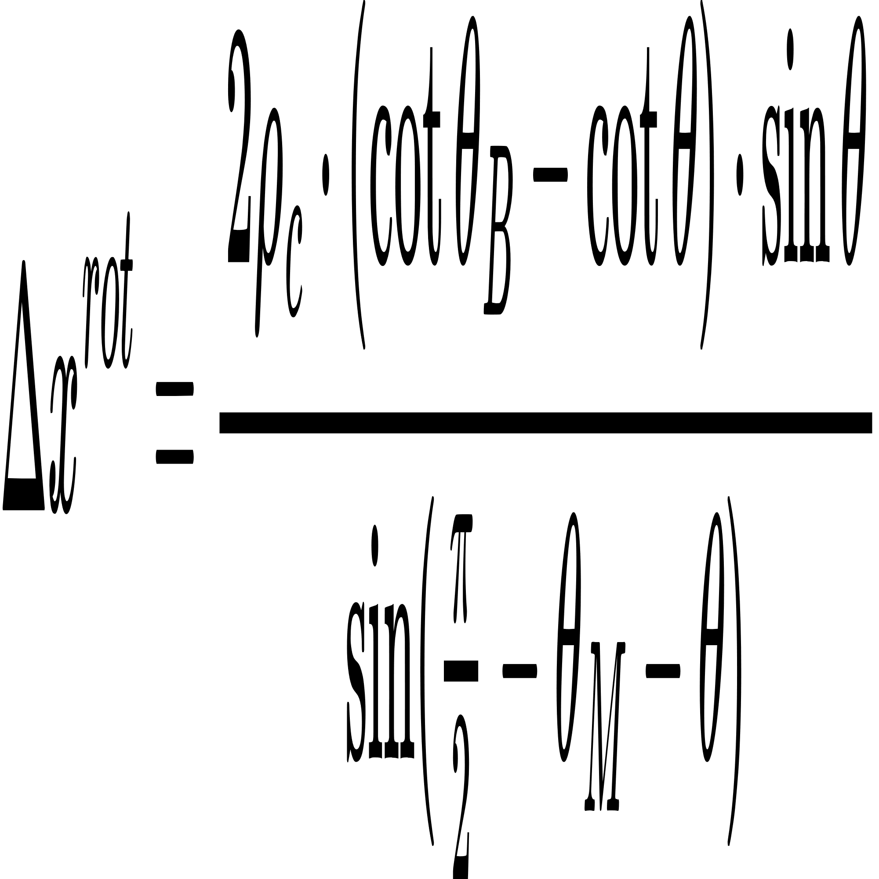
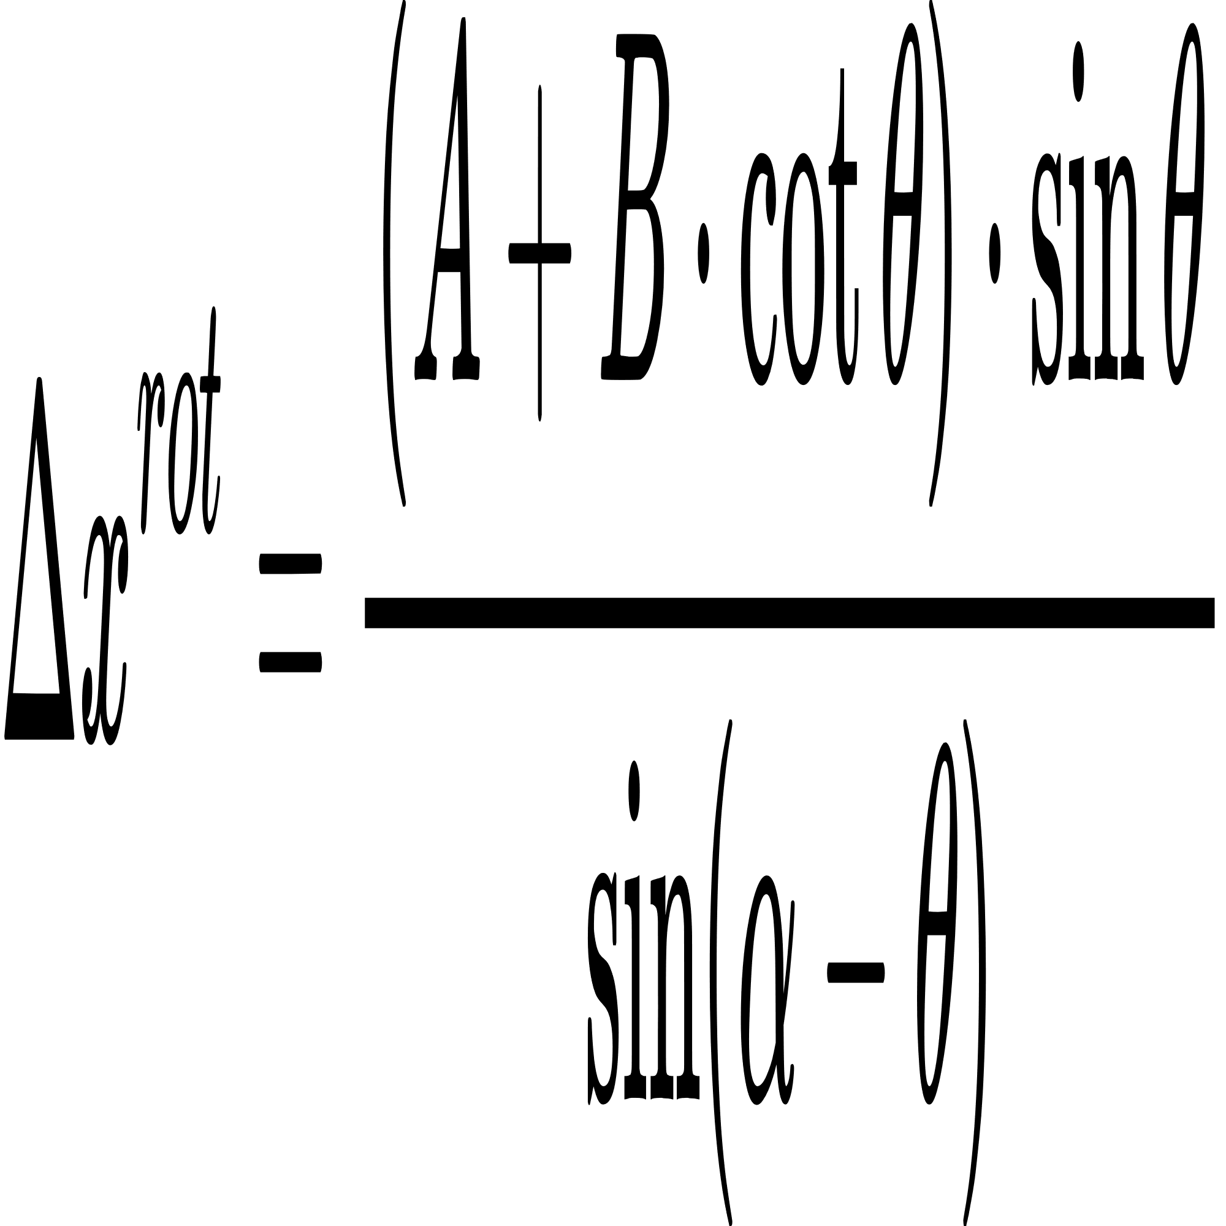
Energy calibration with Bragg spectroscopy
Standard VH calibration:
Semi VH calibration:
Parametric form:
Given the small q values (sinq ≈ q), is it also possible to calibrate with a polynomial?
Information loss???

Slide 13
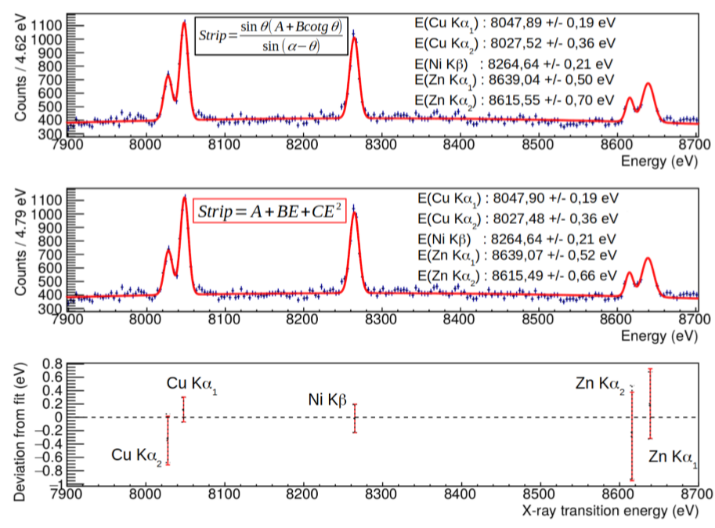
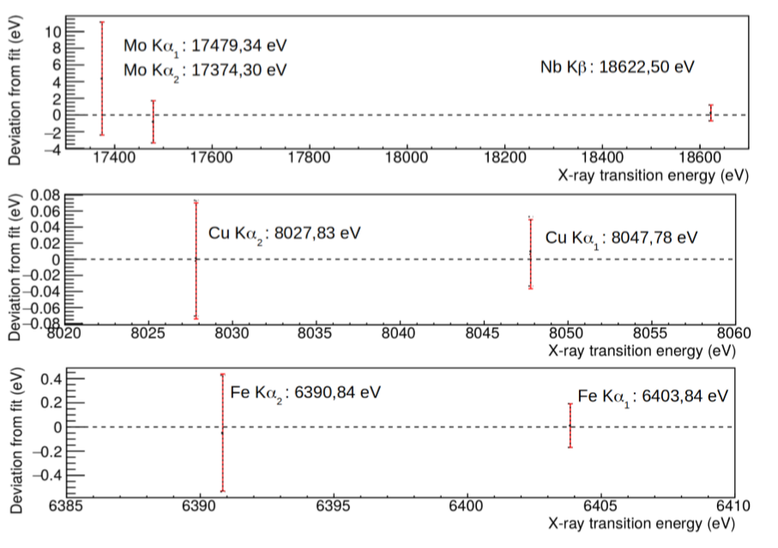
Energy calibration with Bragg spectroscopy
The (small) information loss is not influencing the peak positions
Also valid for higher and wider energy ranges (and higher θ, Δθ values)

Slide 14
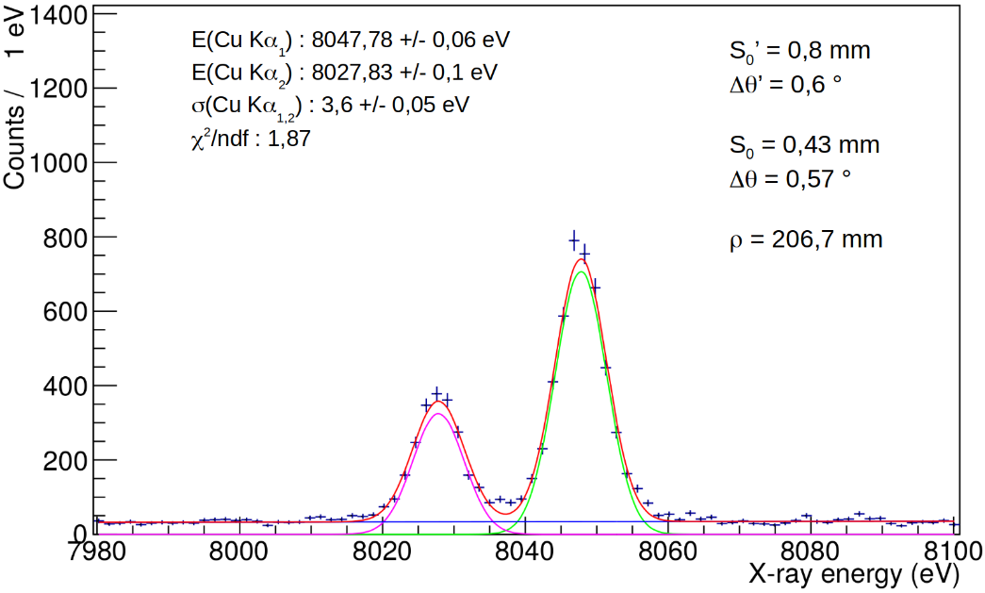
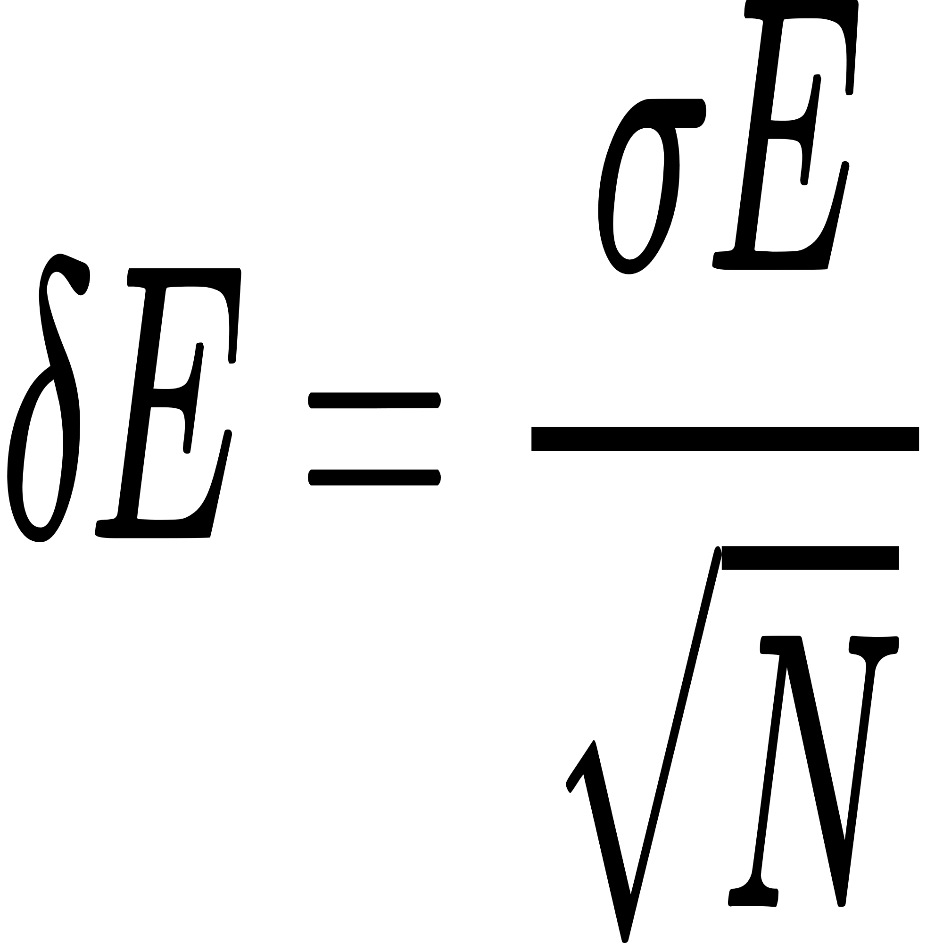
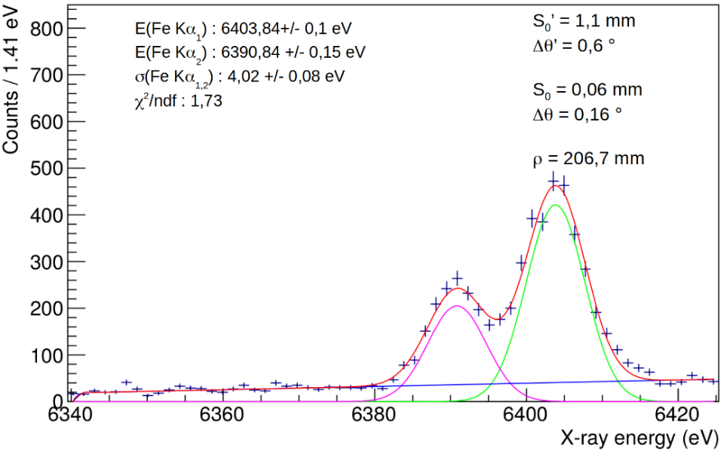
Finding the best S₀’ and Δθ’ for XES spectra
In the limit of a background free pure gaussian peak, the precision is related to the resolution via:
Given the energy and r_{c} it is alwasy possible to find the optimal configuration to obtain the best peak position precision
Valid for all energies
(tested for 6-20 keV)

Slide 15
Outline
The VOXES X-ray Spectrometer
XES spectra with VOXES
Applications: content and oxidation states of metal

Slide 16
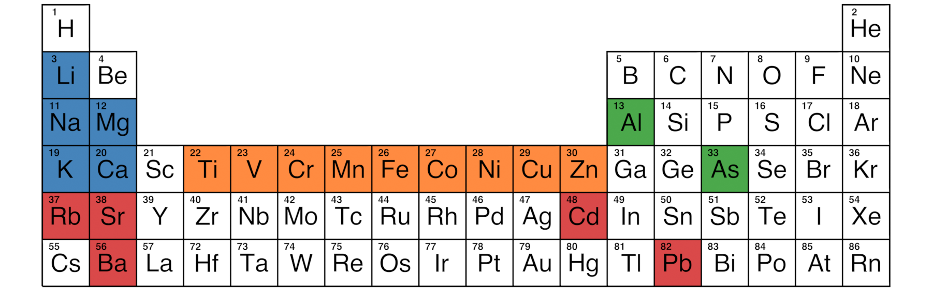
What metals are present in wine?
Tariba, B. Metals in Wine—Impact on Wine Quality and Health Outcomes. Biol Trace Elem Res 144, 143–156 (2011)

Slide 17
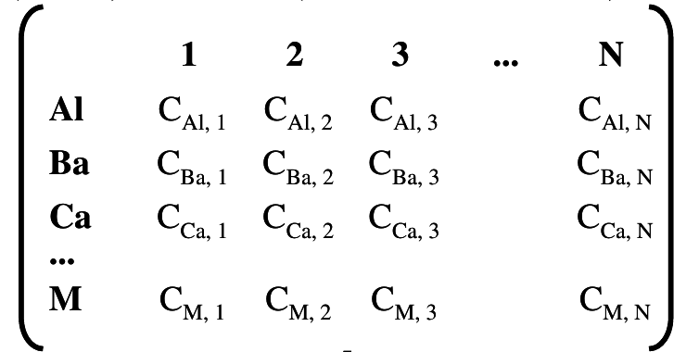
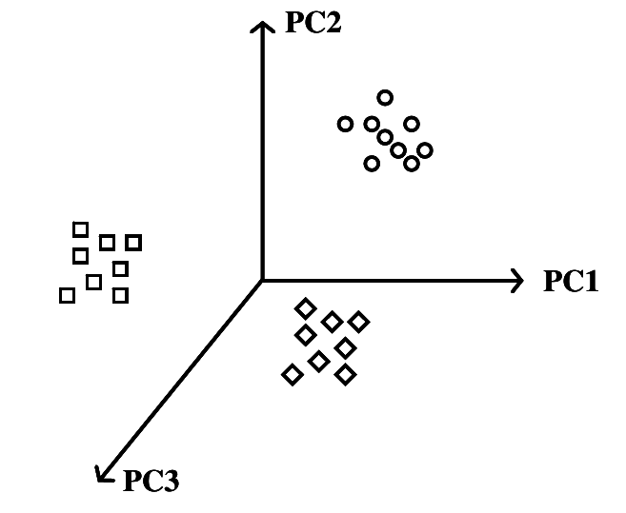
Metals as a fingerprint for geographical origin of wine
Huang, Xian-Yong & Jiang, Zi-Tao & Tan, Jin & Li,. 2017. 1-7. 10.1155/2017/2038073.

Slide 18
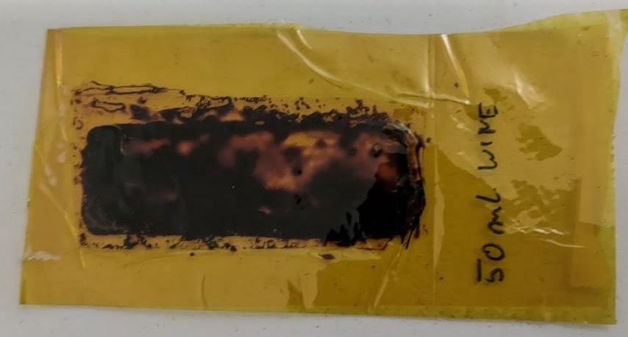
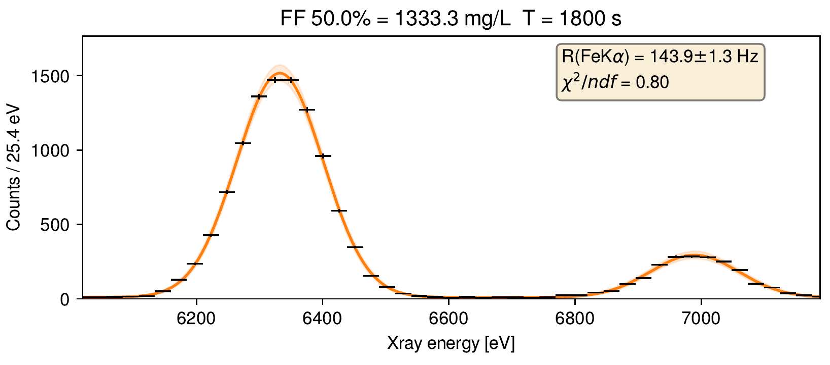
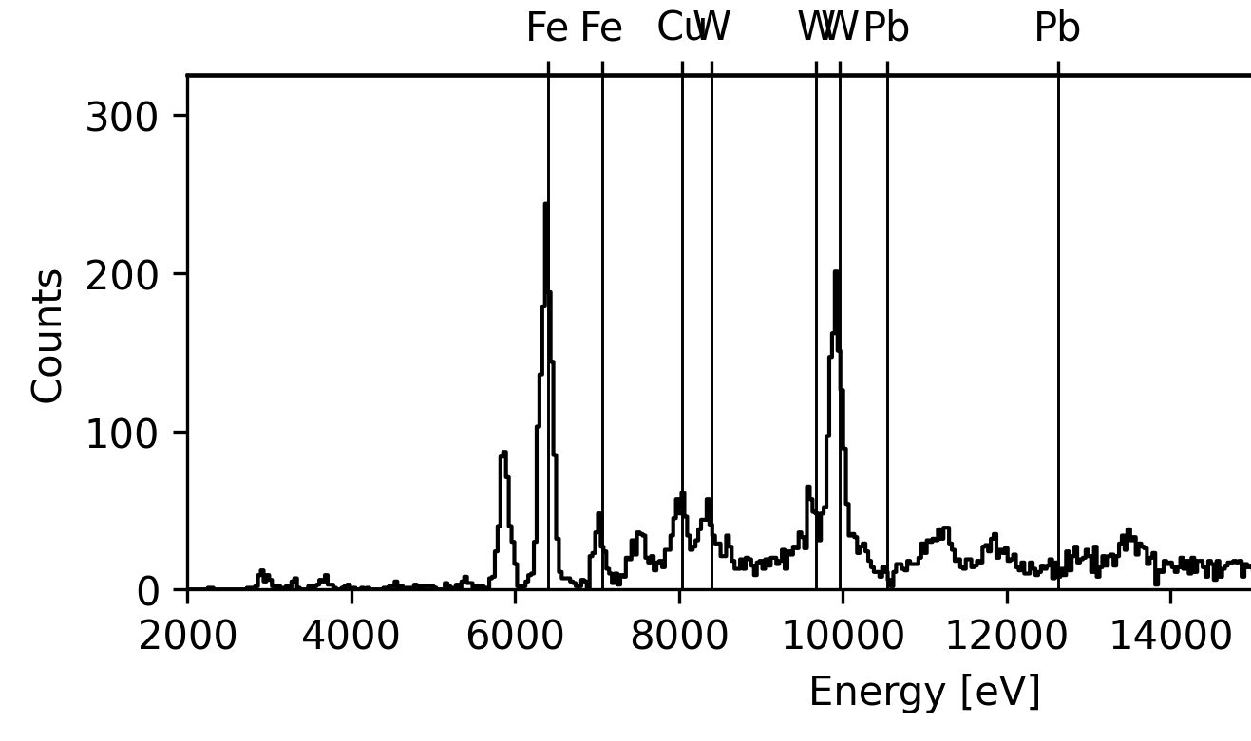
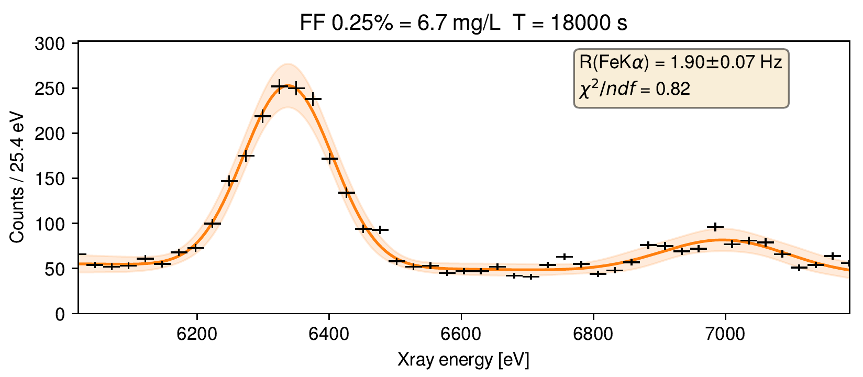
Metal content with the pindiode: dry and liquid samples
FerroFolin diluition
2666 mg/L of Fe

Slide 19
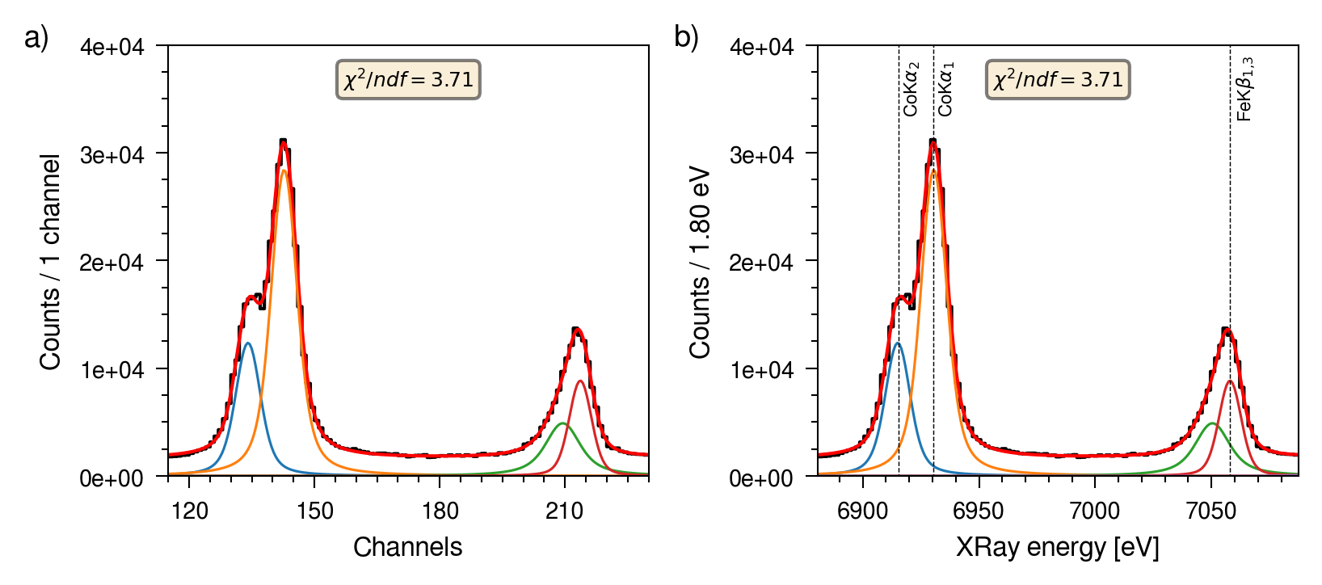
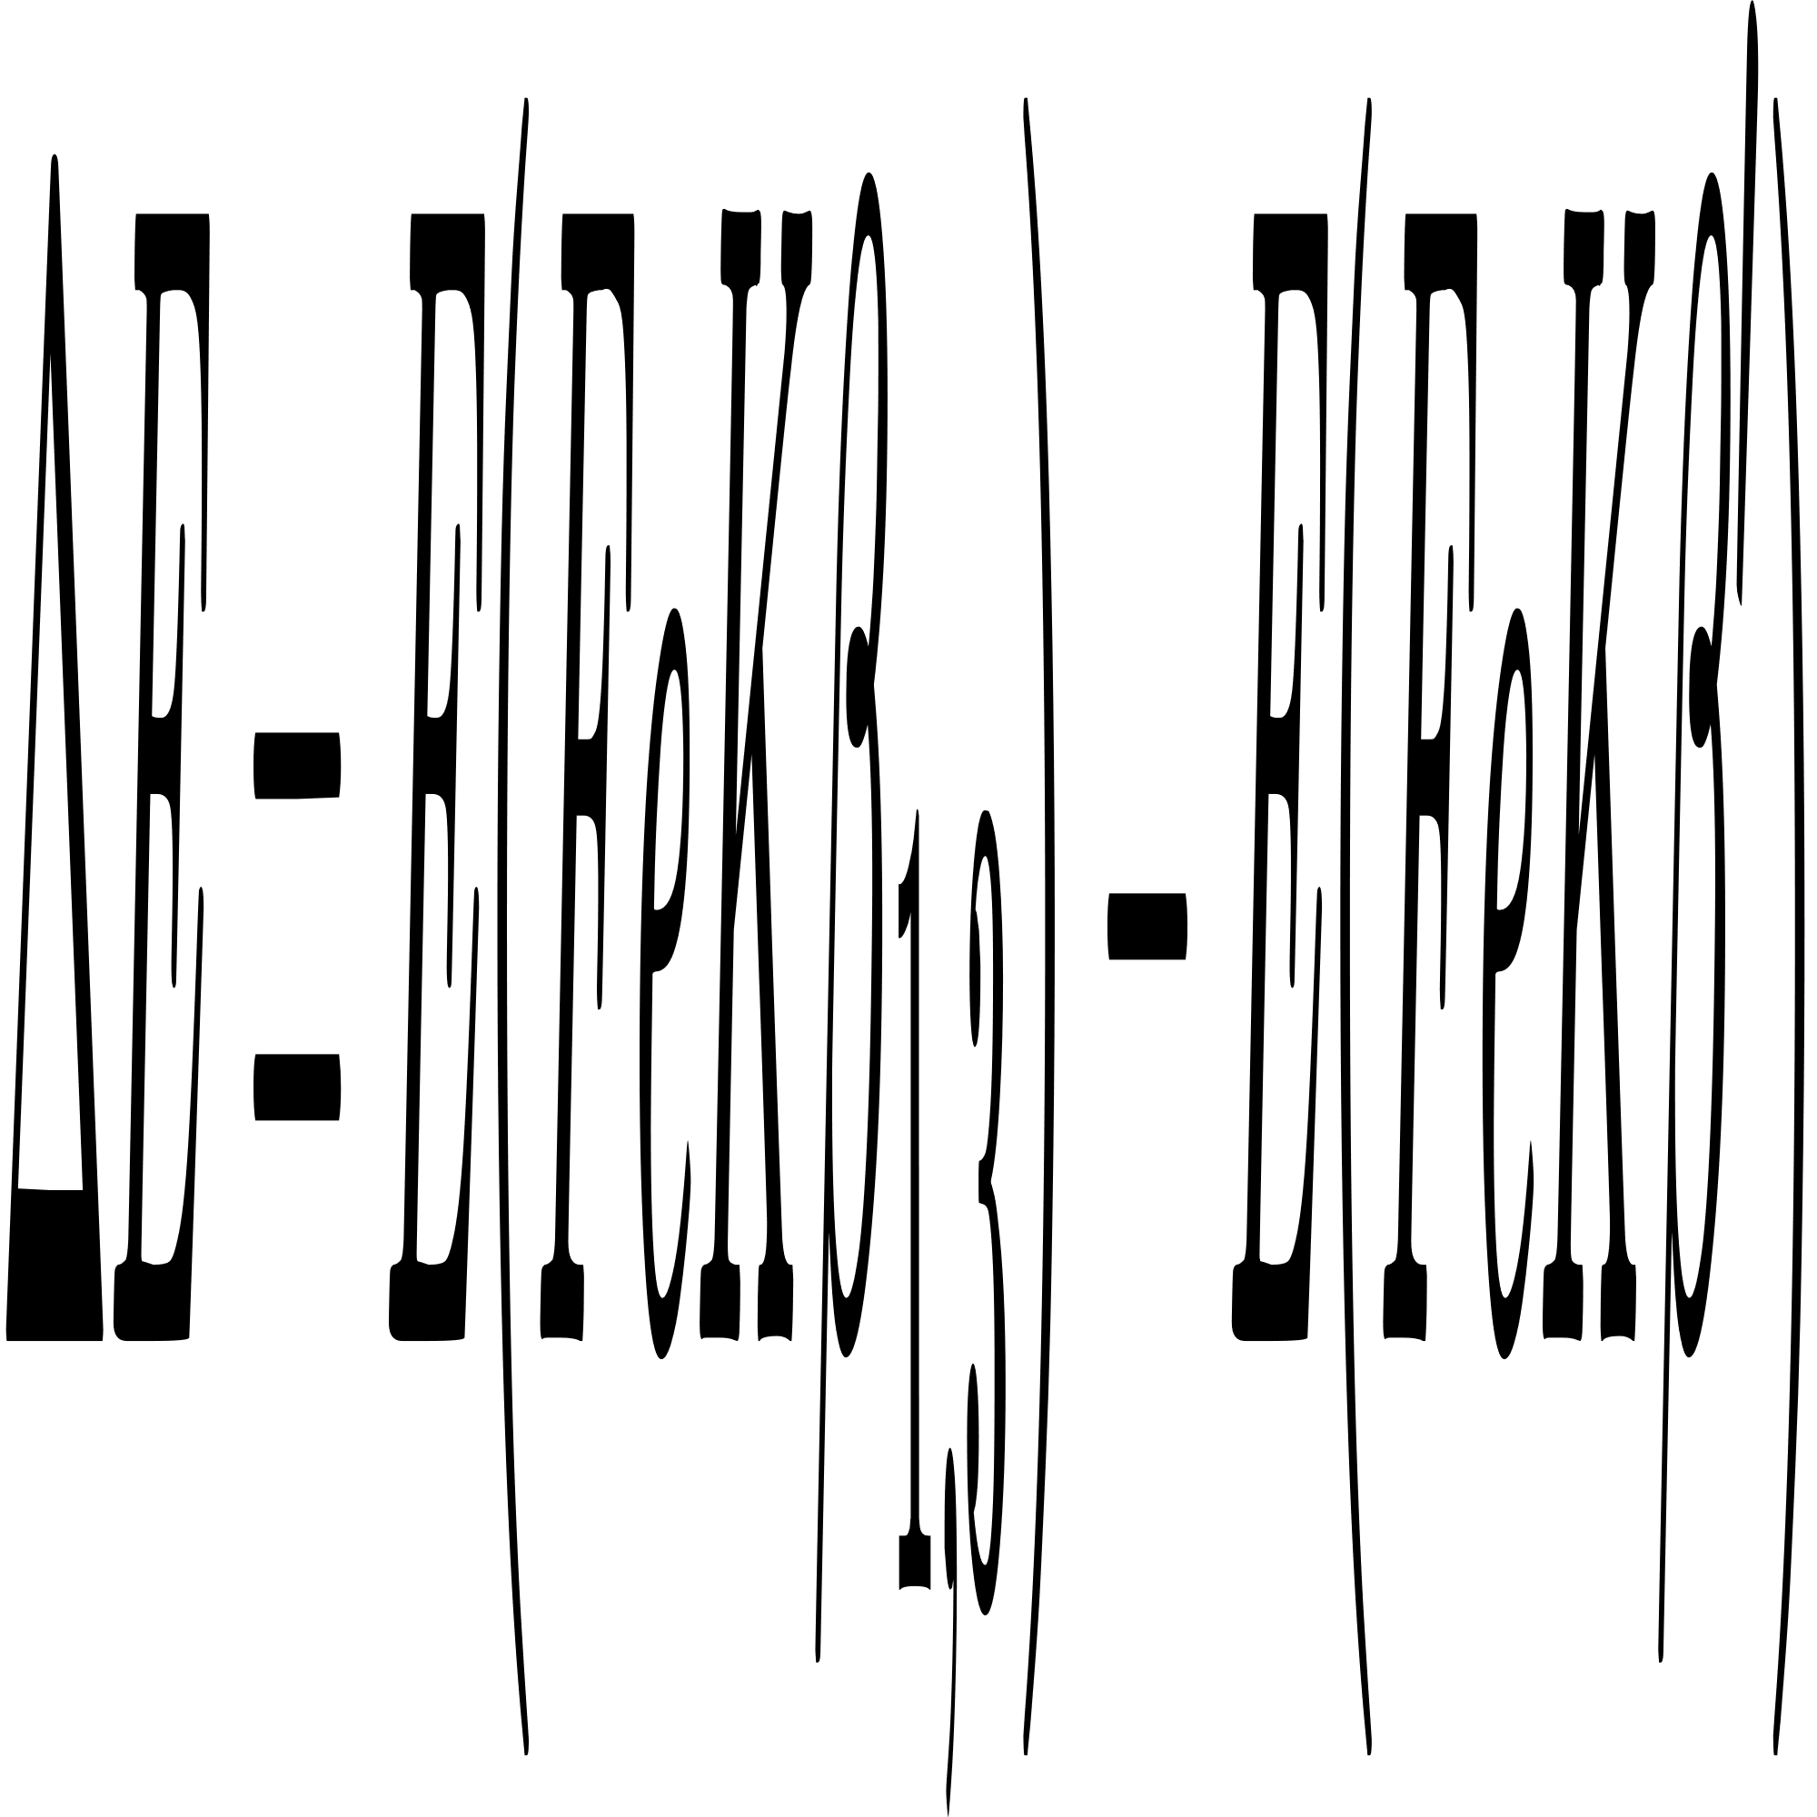
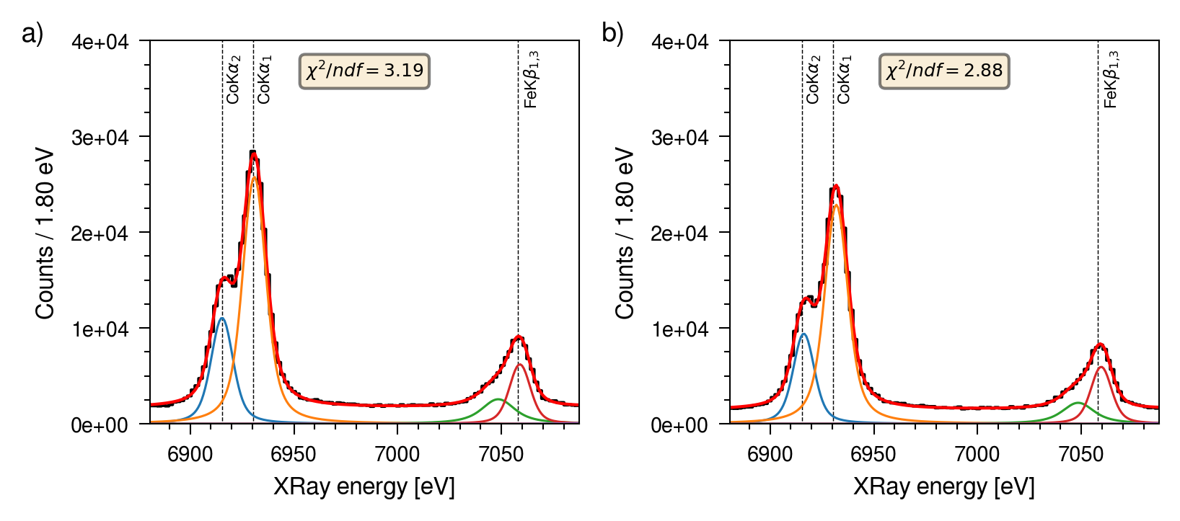
Detecting Iron oxidation state in solids and liquids
Fe⁰
Fe⁰
Fe⁺²
Fe⁺³

Slide 20
Conclusion
The VOXES X-ray Spectrometer
XES spectra with VOXES
Applications: content and oxidation states of metal
Thanks for your attention!

