Slide 1
X-ray detectors at the European XFEL: user operation and optimization
Olivier Meyer for the European XFEL Detector Group
Detector Support Coordinator
High Precision X-Ray Measurements 2023
Laboratori Nazionali di Frascati, 19-23 June 2023 @ Frascati, Italy

Slide 2
Outline
Overview of the European XFEL user facility
  The company
  Beam
  Science
Detectors setups
  Challenges
  Technologies (existing and specific developments)
  Data correction
Support to user experiments
  Preparation to the beamtime
  Support during the beamtime
  Optimization following user feedback
Next developments, conclusion

Slide 3
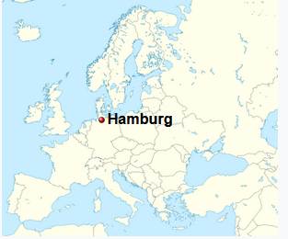

The European XFEL User facility
International company, 12 shareholders countries
Missions
  Design, construction, commissioning
  Offer optimal research opportunities to academic and industrial users
    Support user access and operation
    Build & maintain state-of-the-art instrumentation and run necessary R&D program
  Training and educational role in Free Electron Laser (FEL) science
Key dates
  Start of construction in 2009
  Start of user operation in September 2017

Slide 4
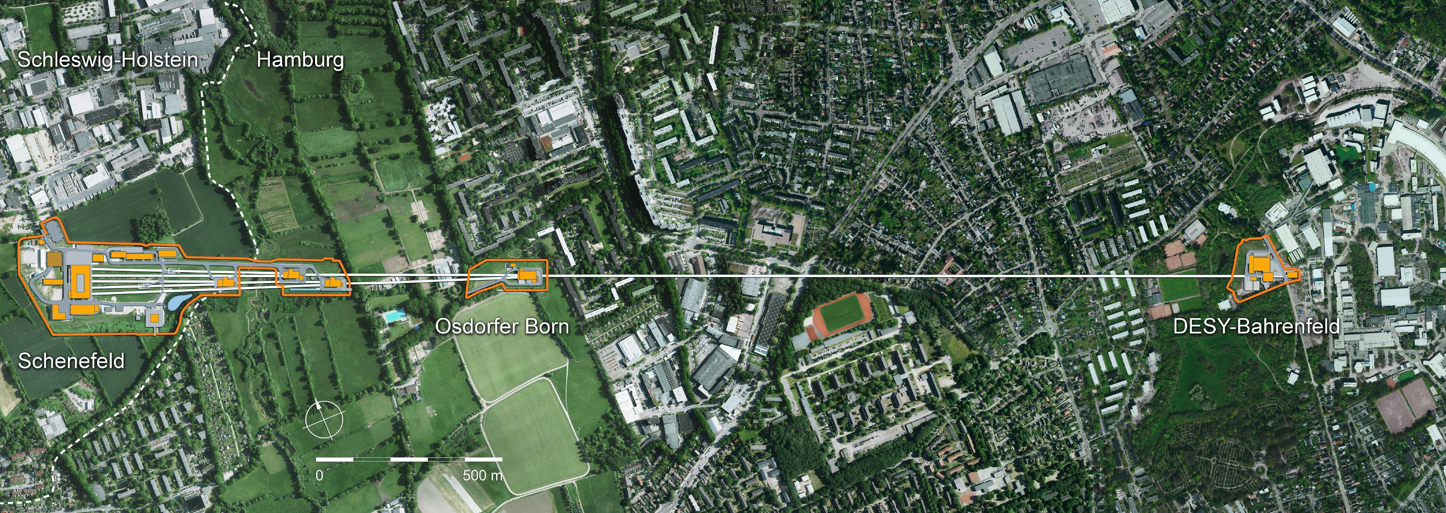

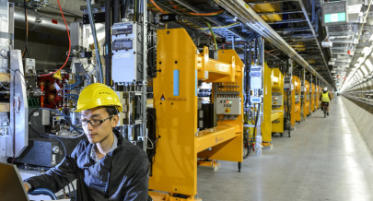
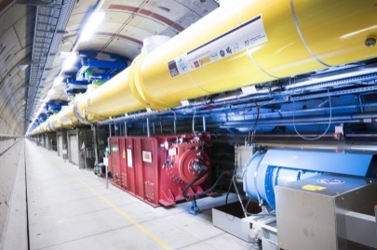
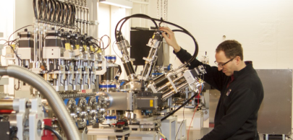
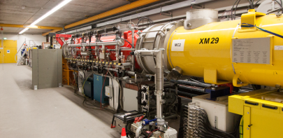
XFEL Beam: 3.4 km of underground facility
Total length: 3.4 km
Undulator systems
Superconducting linear accelerator
Electron injector
DESY campus
Scientific instrument
Notes:
Tunnel is between 6 and almost 40 metres deep underground.

Slide 5
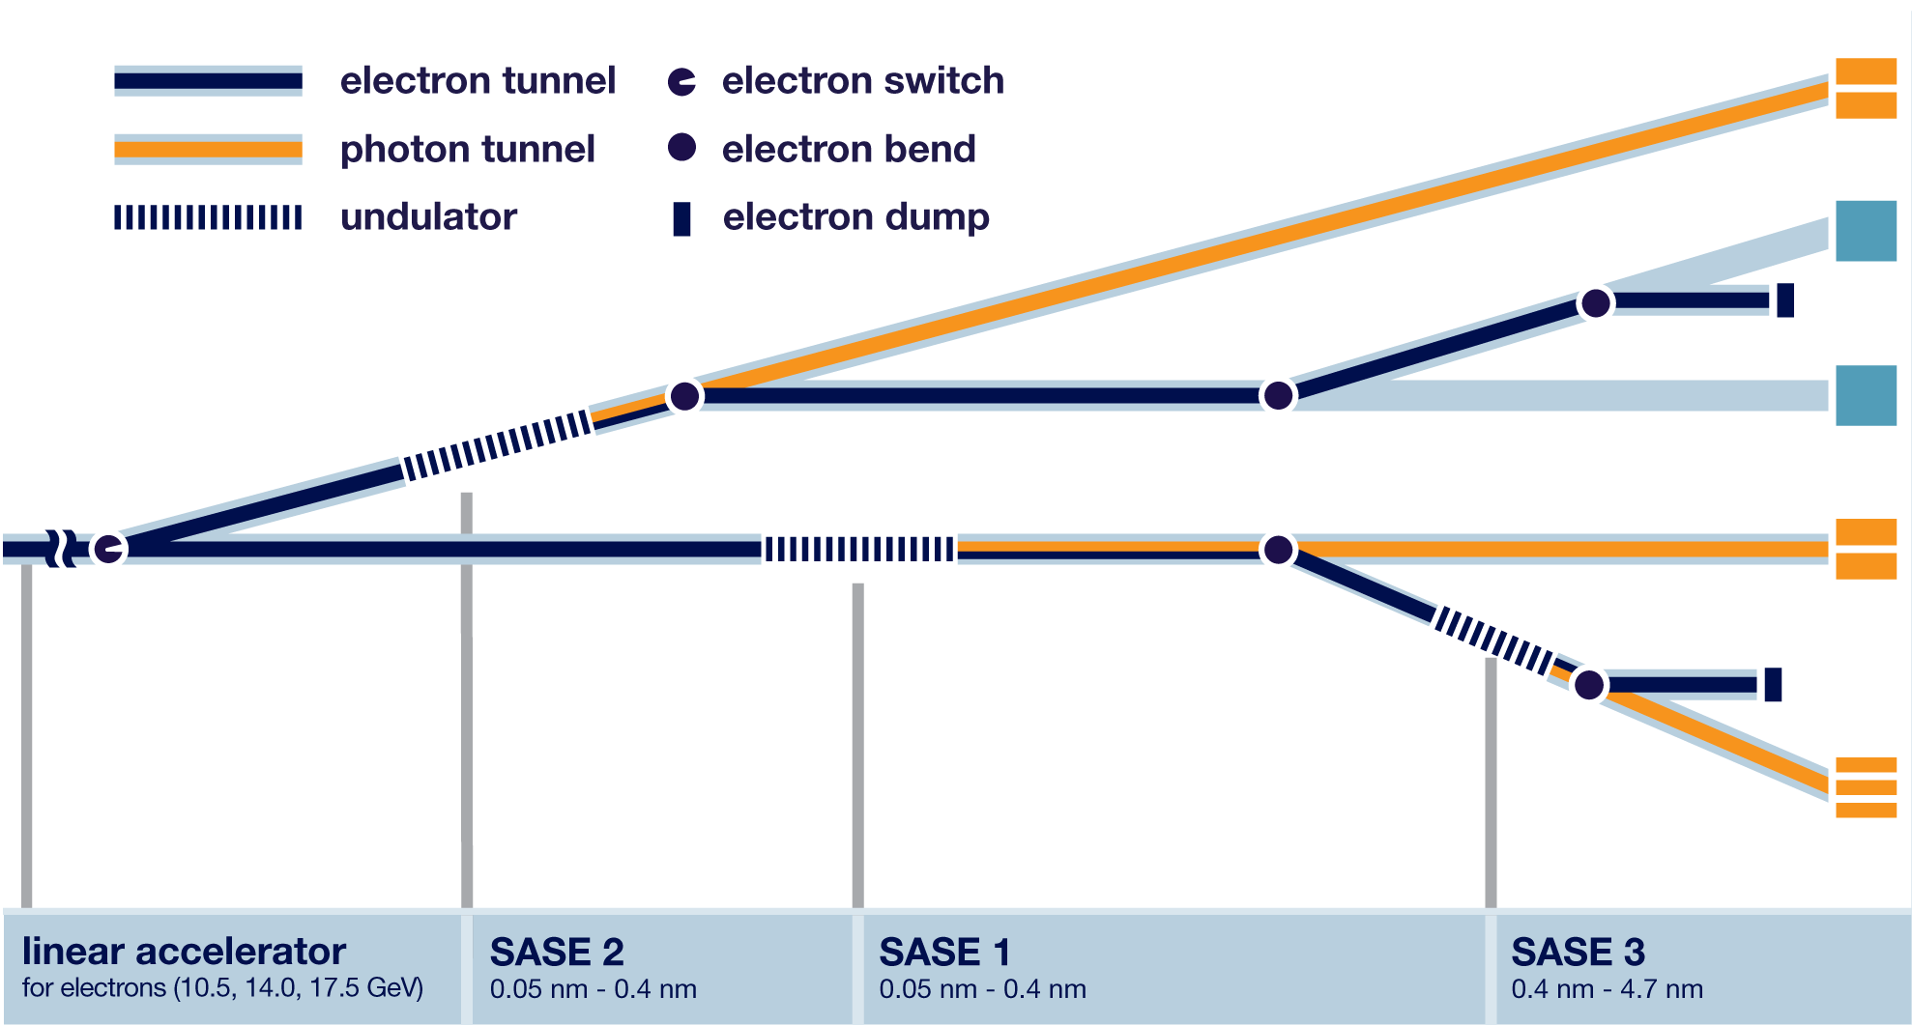
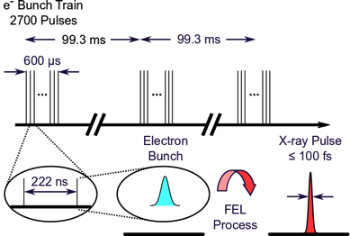
XFEL Beam: 3 beamlines, 7 Instruments
XFEL beam facility
XFEL time structure: Burst Mode
HED
MID
Future
Beamlines
10 Hz
FXE
SPB/ SFX
SXP
SQS
SCS
Linear accelerator
10.5,14,17.5 GeV
SASE* 2
Hard X-Rays
6 – 25 keV
SASE 1
Hard X-Rays
6 – 25 keV
SASE 3
Soft X-Rays
0.2 – 3 keV
4.5 MHz
*Self-Amplified Spontaneous Emission
Key points
  FEL radiation: coherence, short pulse duration, high intensity
    High peak intensity up to 10¹² photons/pulse
  Repetition rate up to 4.5 MHz (lower rate also available)
  Pulse pattern flexible: 1 to n pulses per train (up to 2700)
→ Main challenges for detectors:
  Burst mode operation at 4.5 MHz
  High dynamic range

Slide 6
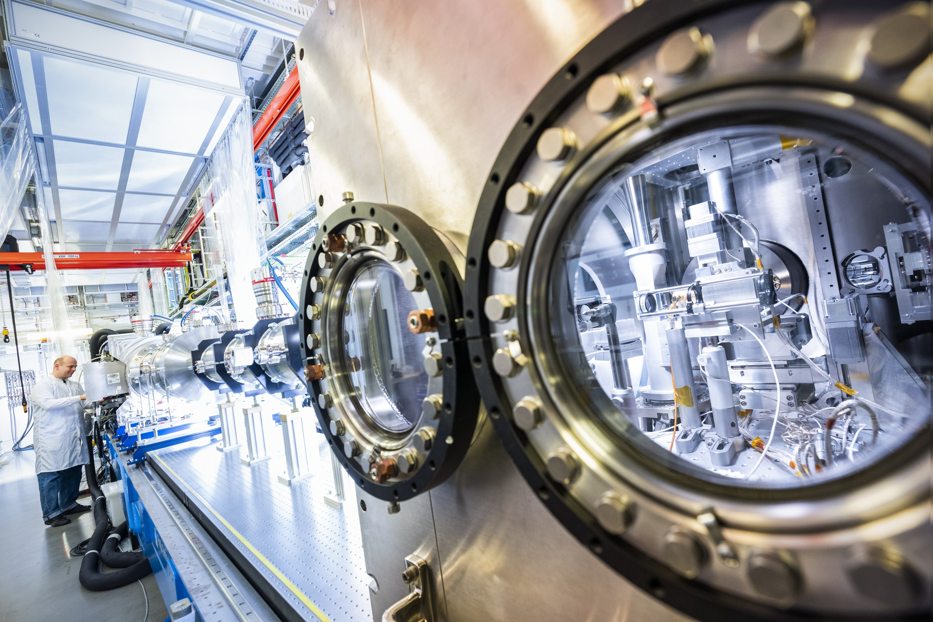
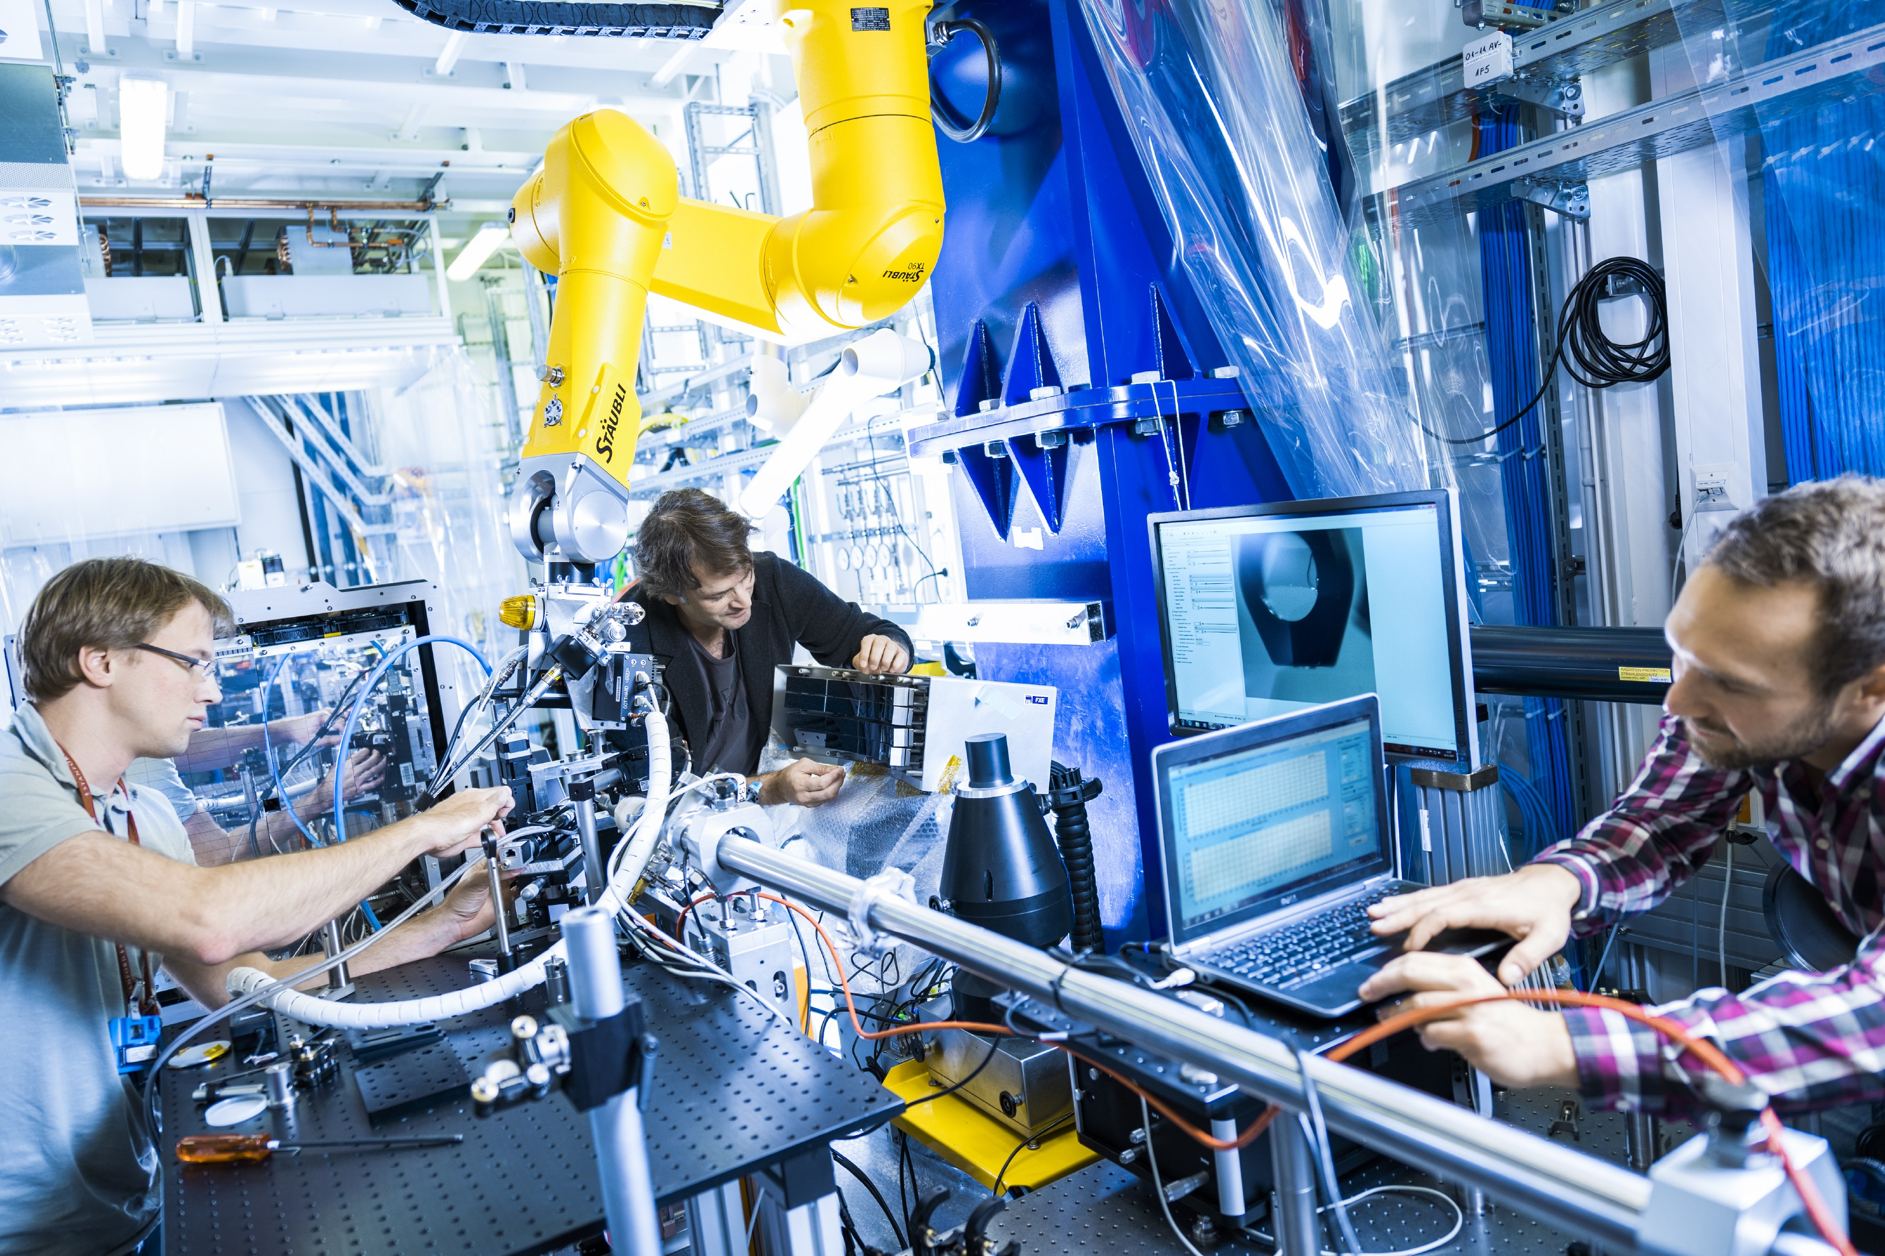
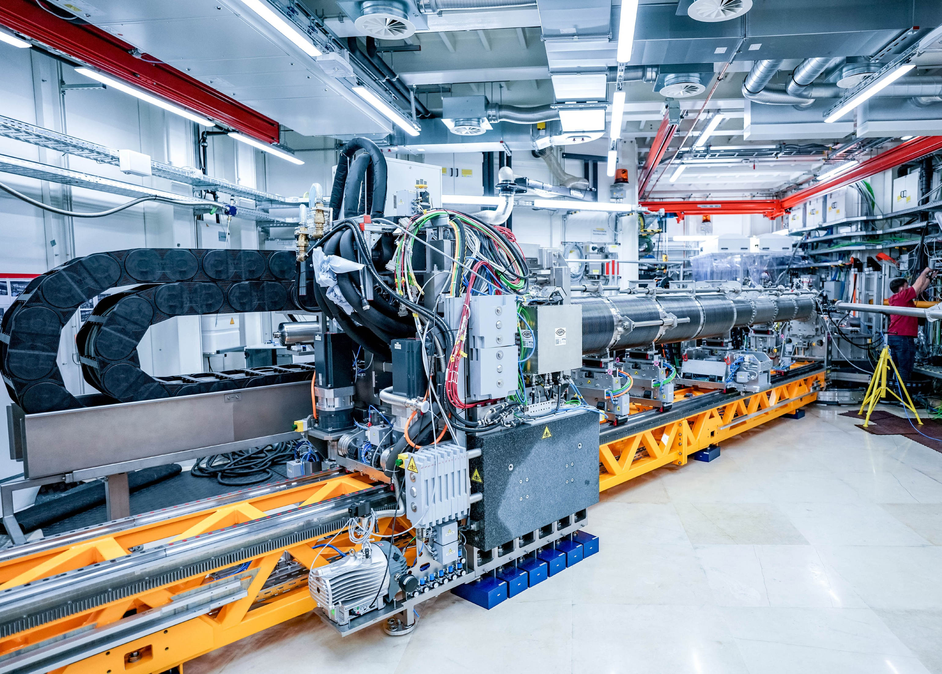
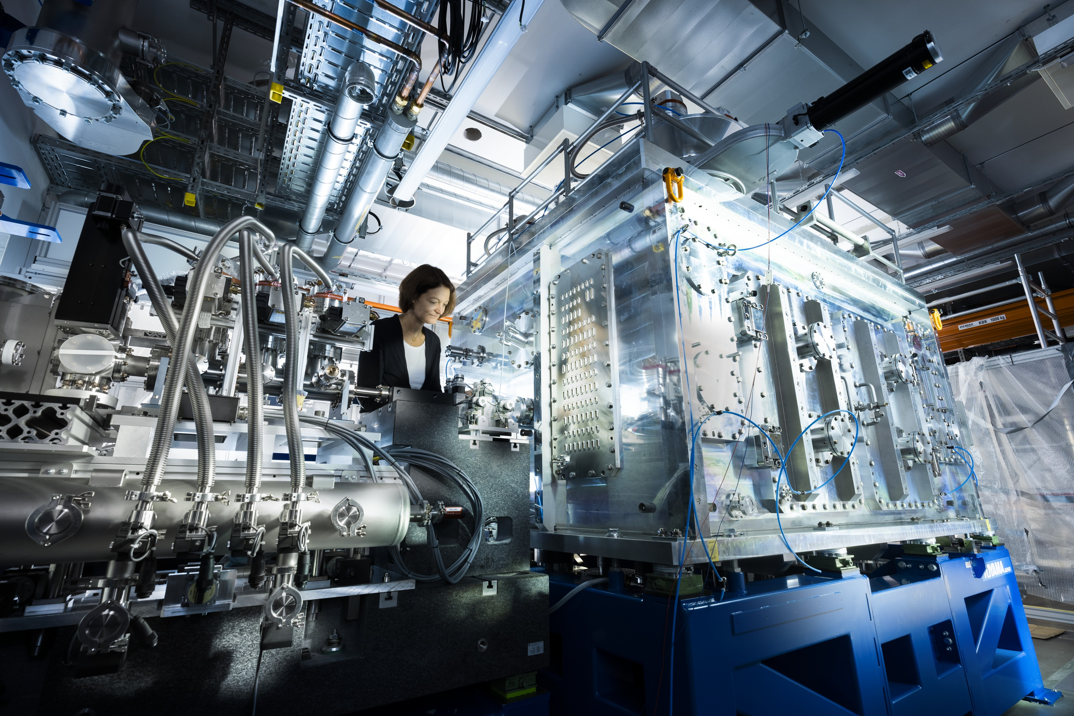
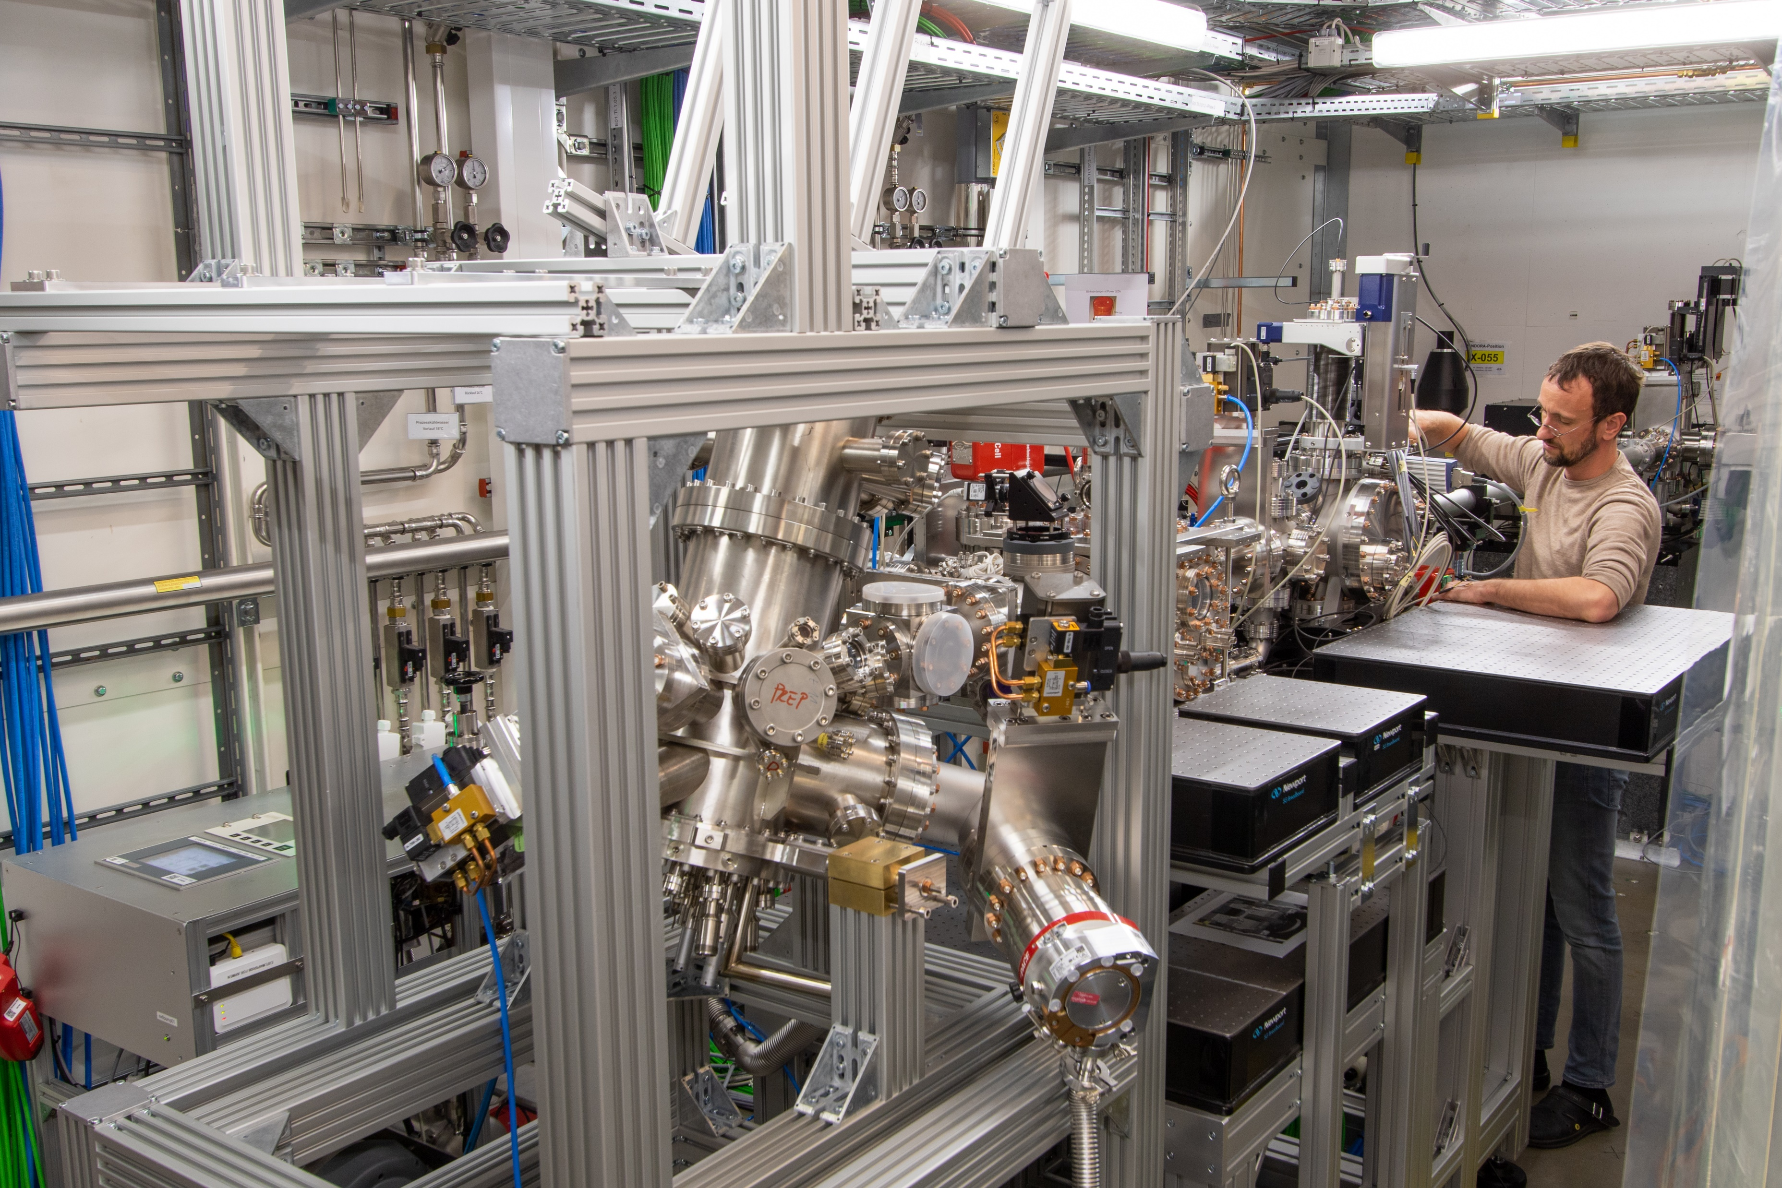
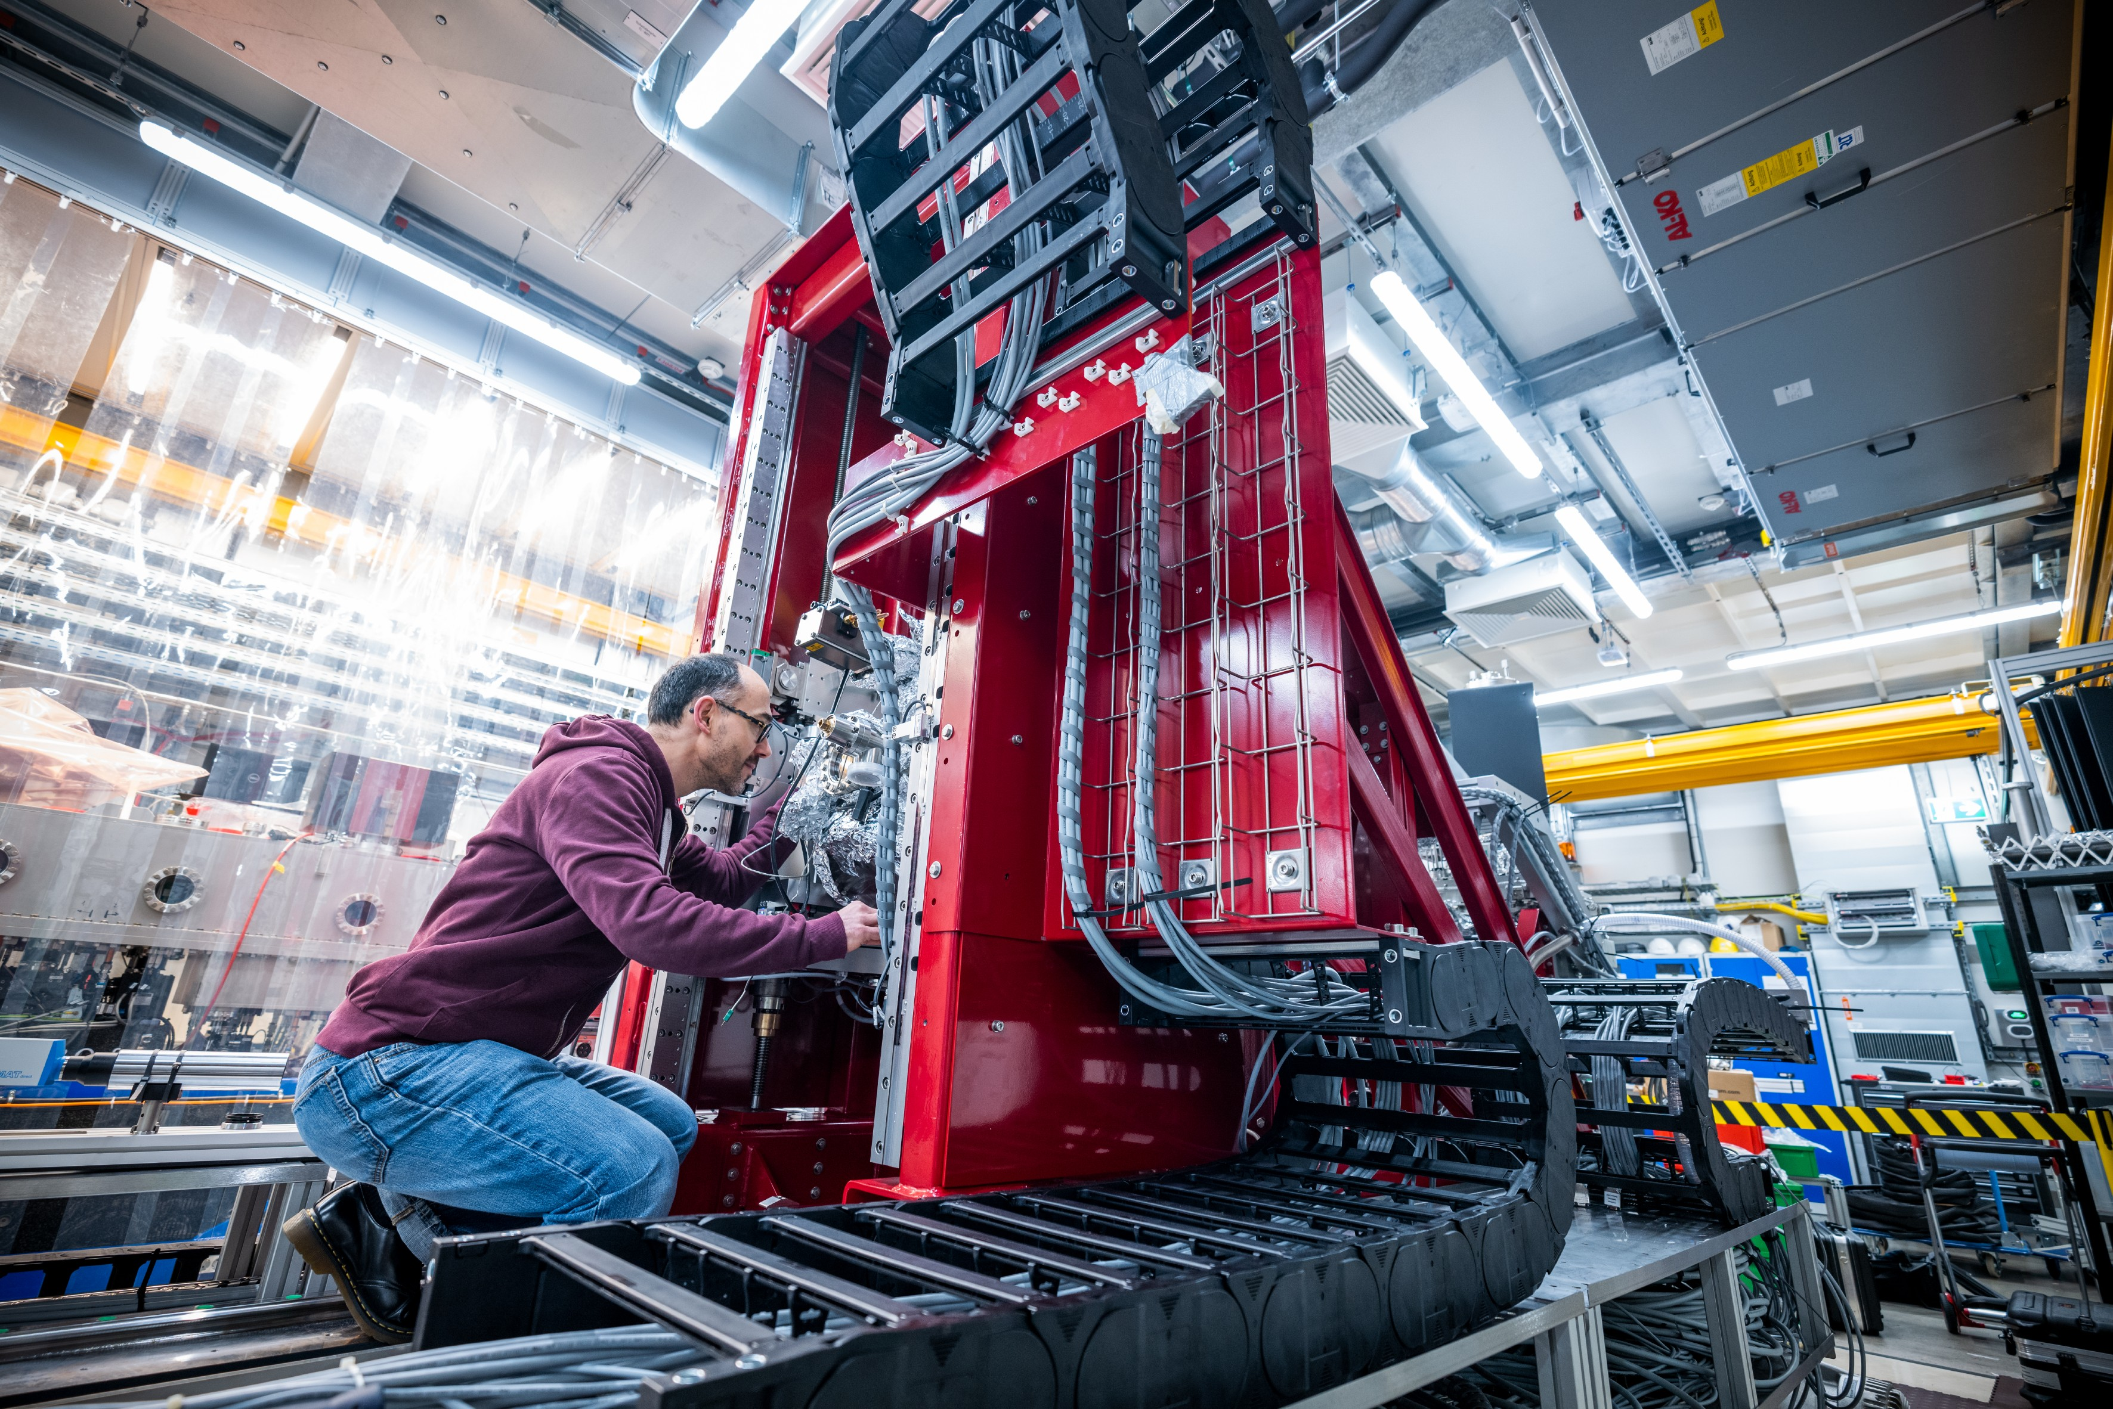
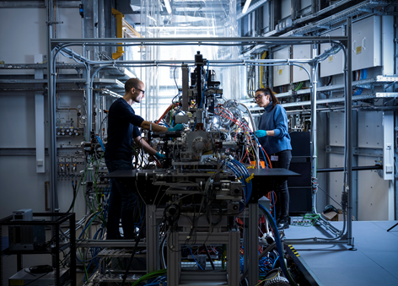
XFEL Science: 7 Instruments
SASE 1 (Hard X-Rays)
SASE 2 (Hard X-Rays)
SPB/SFX (start Sep 2017)
Single Particles, Clusters and
Biomolecules /
Serial Femtosecond Crystallography
FXE (start Sep 2017)
Femtosecond X-Ray Experiment
MID (start Apr 2019)
Materials Imaging & Dynamics
HED (start May 2019)
High Energy Density Matter
SASE 3 (Soft X-Rays)
  Main Technics:
  Single Particle Imaging (SPI)
  X-ray scattering (WAXS/ SAXS)
  Serial Femtosecond Crystallography (SFX)
  X-ray Spectroscopies (XES/ XAS)
  Resonant Inelastic X-ray Scattering (RIXS)
  ….
  → More constraints on detectors
SXP (start summer 2023)
Soft Xray Port
SCS (start Nov 2018)
Soft X-Ray Coherent Scattering /
Spectroscopy
SQS (start Nov 2018)
Small Quantum Systems

Slide 7
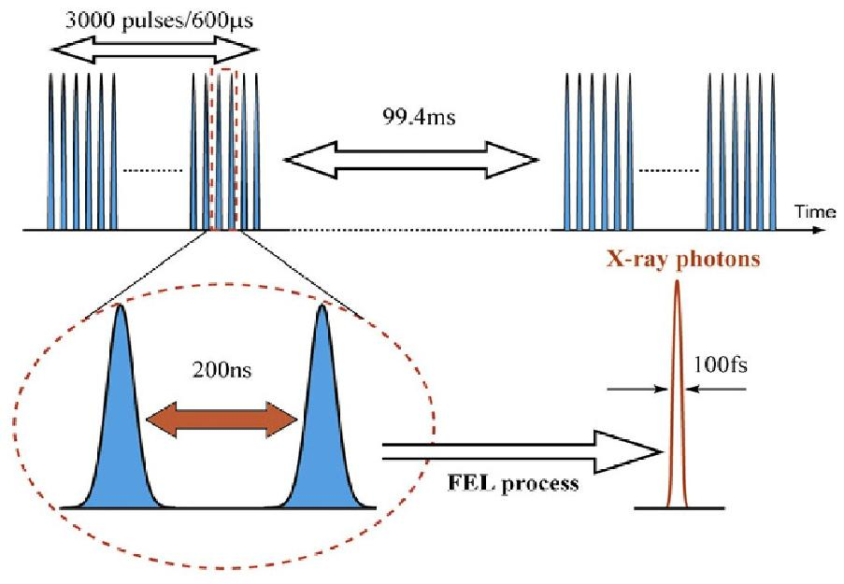
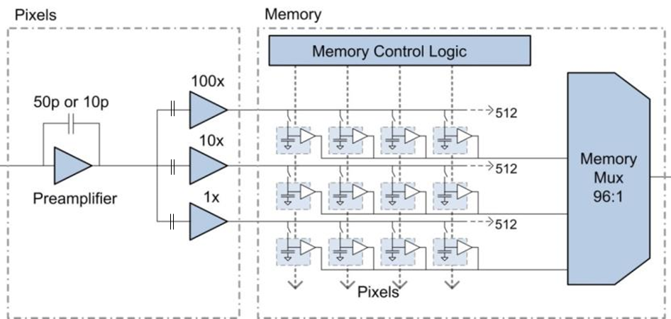
Detector setups: challenge 1, matching the specific EuXFEL time structure
Challenges for detectors design
  Data readout and on chip image storage < 220 ns
  Data transfer during bunch train gap of 99.3 ms
  → On sensor image storage capability
Electron Bunch Train
2700 bunches 600 µs
Data transfer
Processing
Data Storage
3000 Pulses/666 μs
99.3 ms
Charge collection
Amplification
Image storage
222 ns
LPD mem cells matrix (RAL)
→ Dedicated development was needed to cope with
the unique time structure

Slide 8
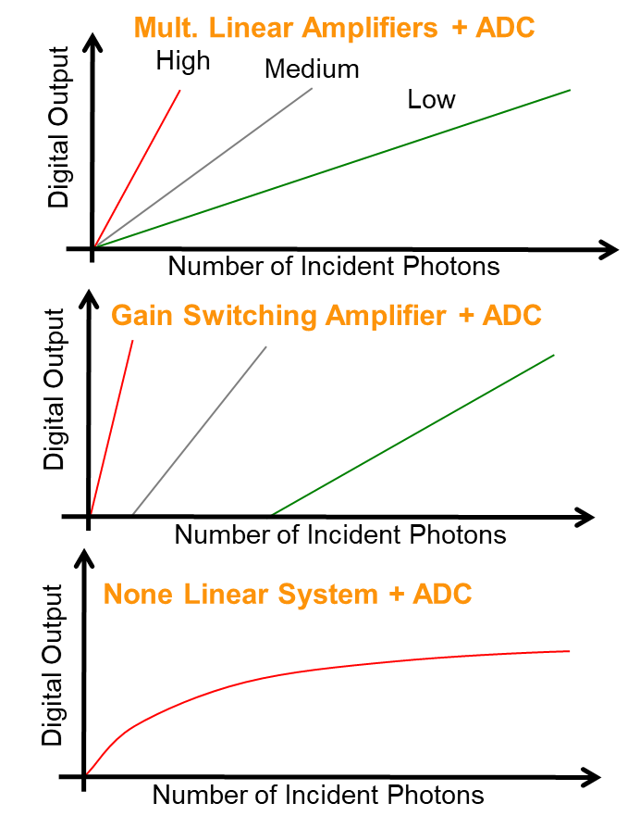
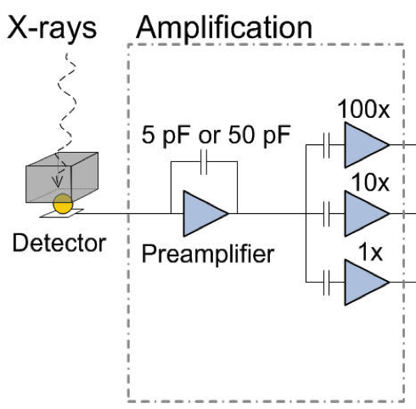
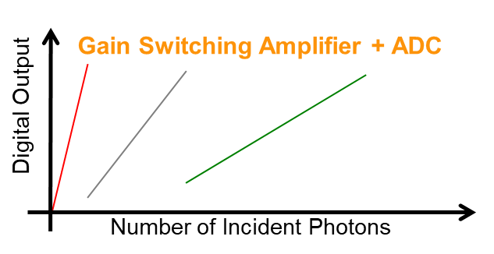
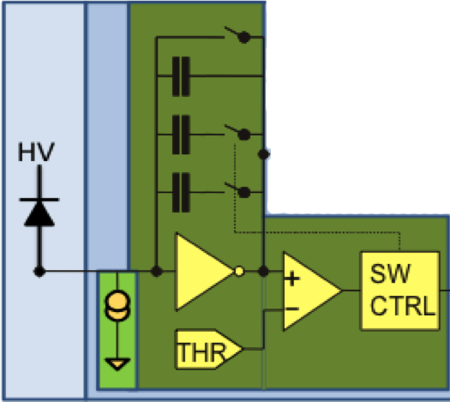
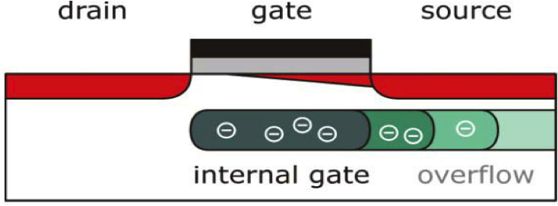
Detector setups: challenge 2, matching the high dynamics range → 3 projects
  LPD operated at FXE (2017)
  - 3 images generated in parallel, all data available
  - ~ 30 Gb/sec → 1 gain stage selected per pixel
  - 10⁵ dynamic range (12 keV), 512 images on pixel
  AGIPD operated at SPB, MID (2017) & HED (2020)
  - Gain switched at the preamplifier level
  - Automatic switching gain
  - Gain switching region needed specific attention
  - 10⁴ dynamic range (12 keV), 352 images on pixel
  DSSC-DEPFET commissioning on going
  - Signal compression at the sensor level
  - One amplification circuit for he whole range
  - Non linear response requires accurate calibration
  DSSC-miniSDD operated SQS/ SCS (2019)
  - Lower dynamics range 8 bits (linear detector response)
  - Fine gain tuning capability
  - 800 images on pixel (digital)

Slide 9
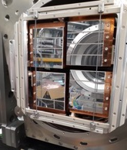
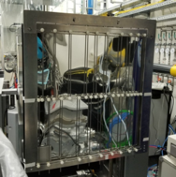
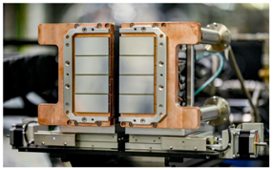
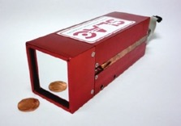




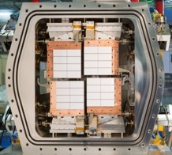
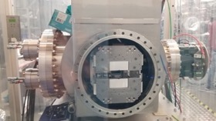

2D Detectors operated at EuXFEL
AGIPD (SPB/SFX, MID, HED)
LPD (FXE)
X-ray
energy
Jungfrau (all hard X-ray inst.)
EuXFEL
bespoke
EuXFEL
bespoke
ePix100 (MID, HED)
Hard
X-rays
6-25 keV
Noise: 350 e- (HG)
Dyn range: 10⁴ 12 keV ph
1M 200 x 200 μm pix
Noise: 2010 e- (HG)
Dyn range: 10⁵ 12 keV ph
1M, 500 x 500 μm
Noise: 50 e- (HG)
Dyn range: 100 8 keV ph
0.5 M, 50 x 50 μm pix
Noise: 80 e- (HG)
Dyn range: 10⁴ 12 keV ph
16 memcells / 150 kHz (fixed gain)
0.5 M, 75 x 75 μm pix
DSSC (SCS, SQS)
pnCCD (SQS)
EuXFEL
bespoke
Noise: 60 e-
Dyn range:
N x 256 ph @ 4.5 Mhz –
N x 512 @ f≤2.2 MHz
N ≤ 1 for single ph sens
1M 204 x 236 μm hex pix
Soft
X-rays
0.5-3 keV
Noise: 3 e-
Dyn range: 1500-3000 1 keV ph
75 x 75 μm pix
10 Hz
4.5 MHz
Rate

Slide 10
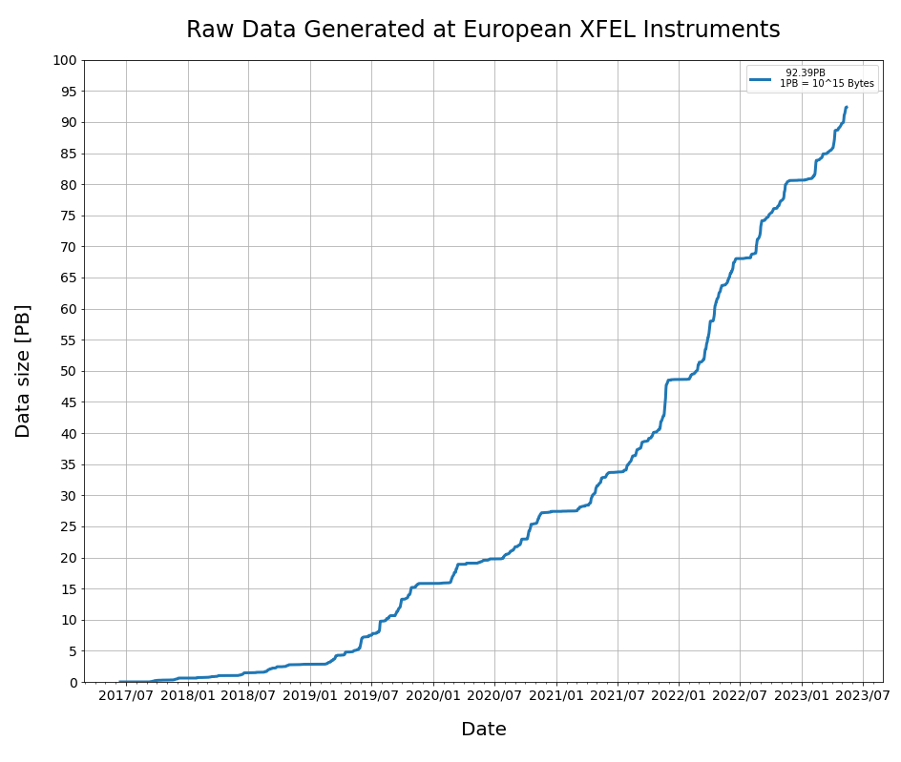




Detectors setups: data correction
Corrected data proposed for each detector
100 PB
Data storage constraint
Offset Correction
Gain corrections
Bad Pixel Maps
….
Raw data
Corrected data
Online/ off line correction process
07/2017
07/2023
Experiment tuning !!
1 trains/ 5 (2 Hz)
Corrected data
Online cluster
Users on line display
Cal. constants
Sample of corrected data
Train gap
data transfer
Files
Raw data
PC-layer
Calibration database
All trains
Corrected data
Offline cluster
User data
Full corrected data set

Slide 11
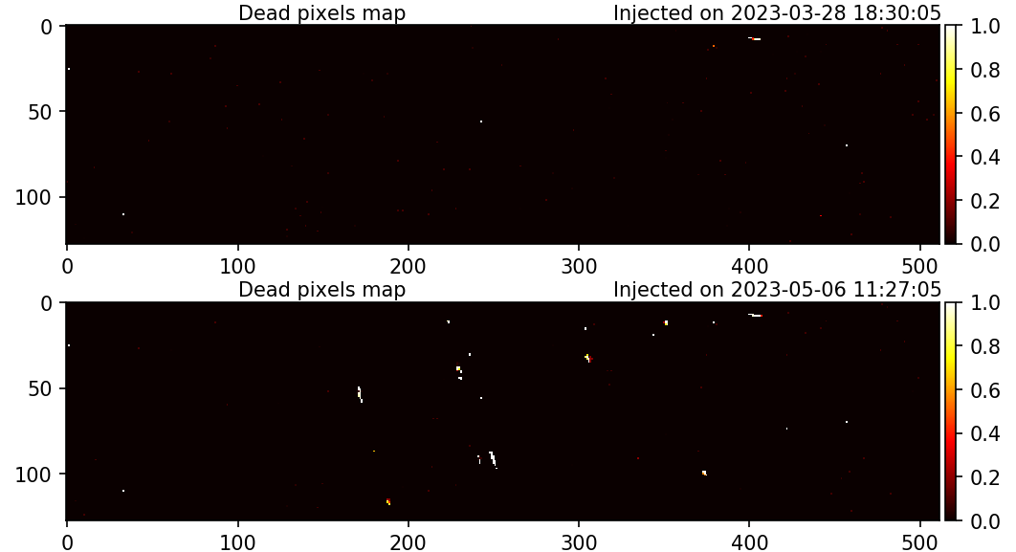
Support to User experiments
Beamtime preparation
Support during experiment
Optimization based on users feedback
Maintenance periods (2x6 weeks per year)
  Detector firmware/ software updates
  Modules replacement (damages/ failure)
  Overall tests at each instruments (end of maintenance periods)
Operation modes are defined with the instrument scientists
Detector calibration: 2 examples
  AGIPD1M
  DSSC-miniSDD
AGIPD1M@MID
- dead pixels from the most affected module
Before incident
After incident
Main beam scattering on the Al sample holder
< 0.1% pixels damaged

Slide 12
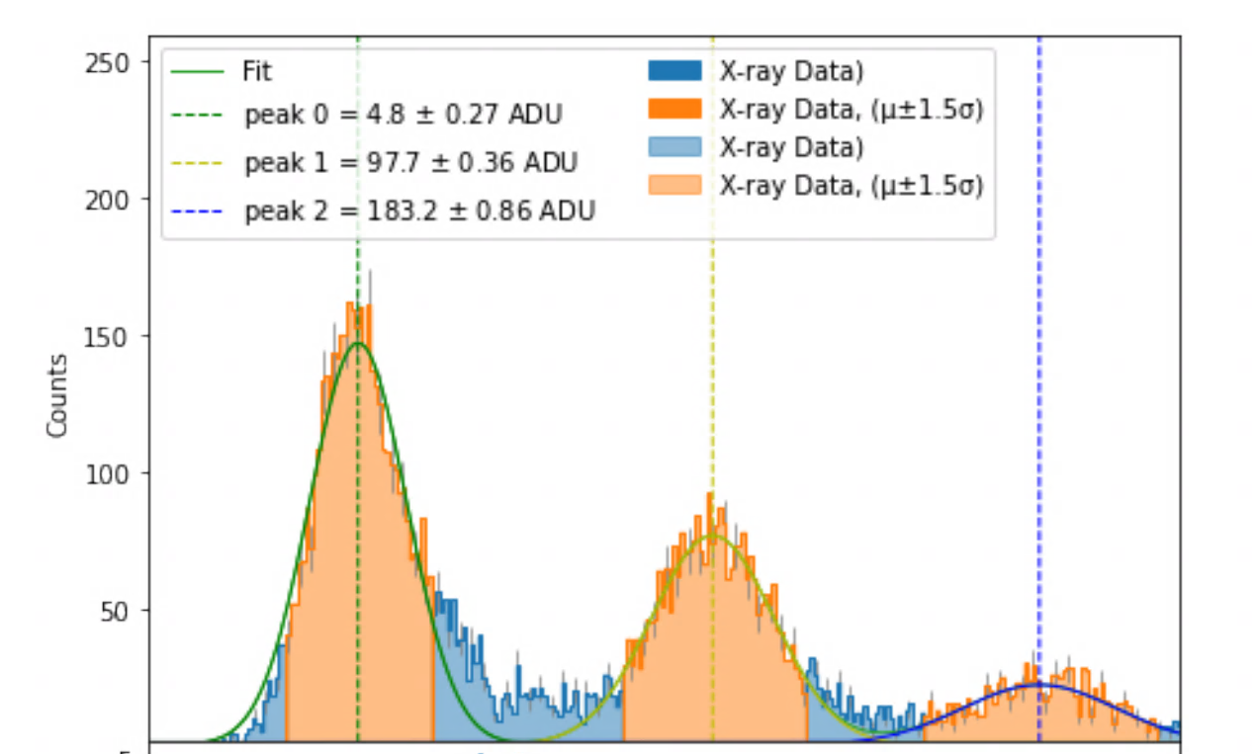
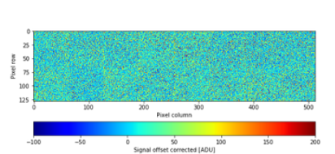
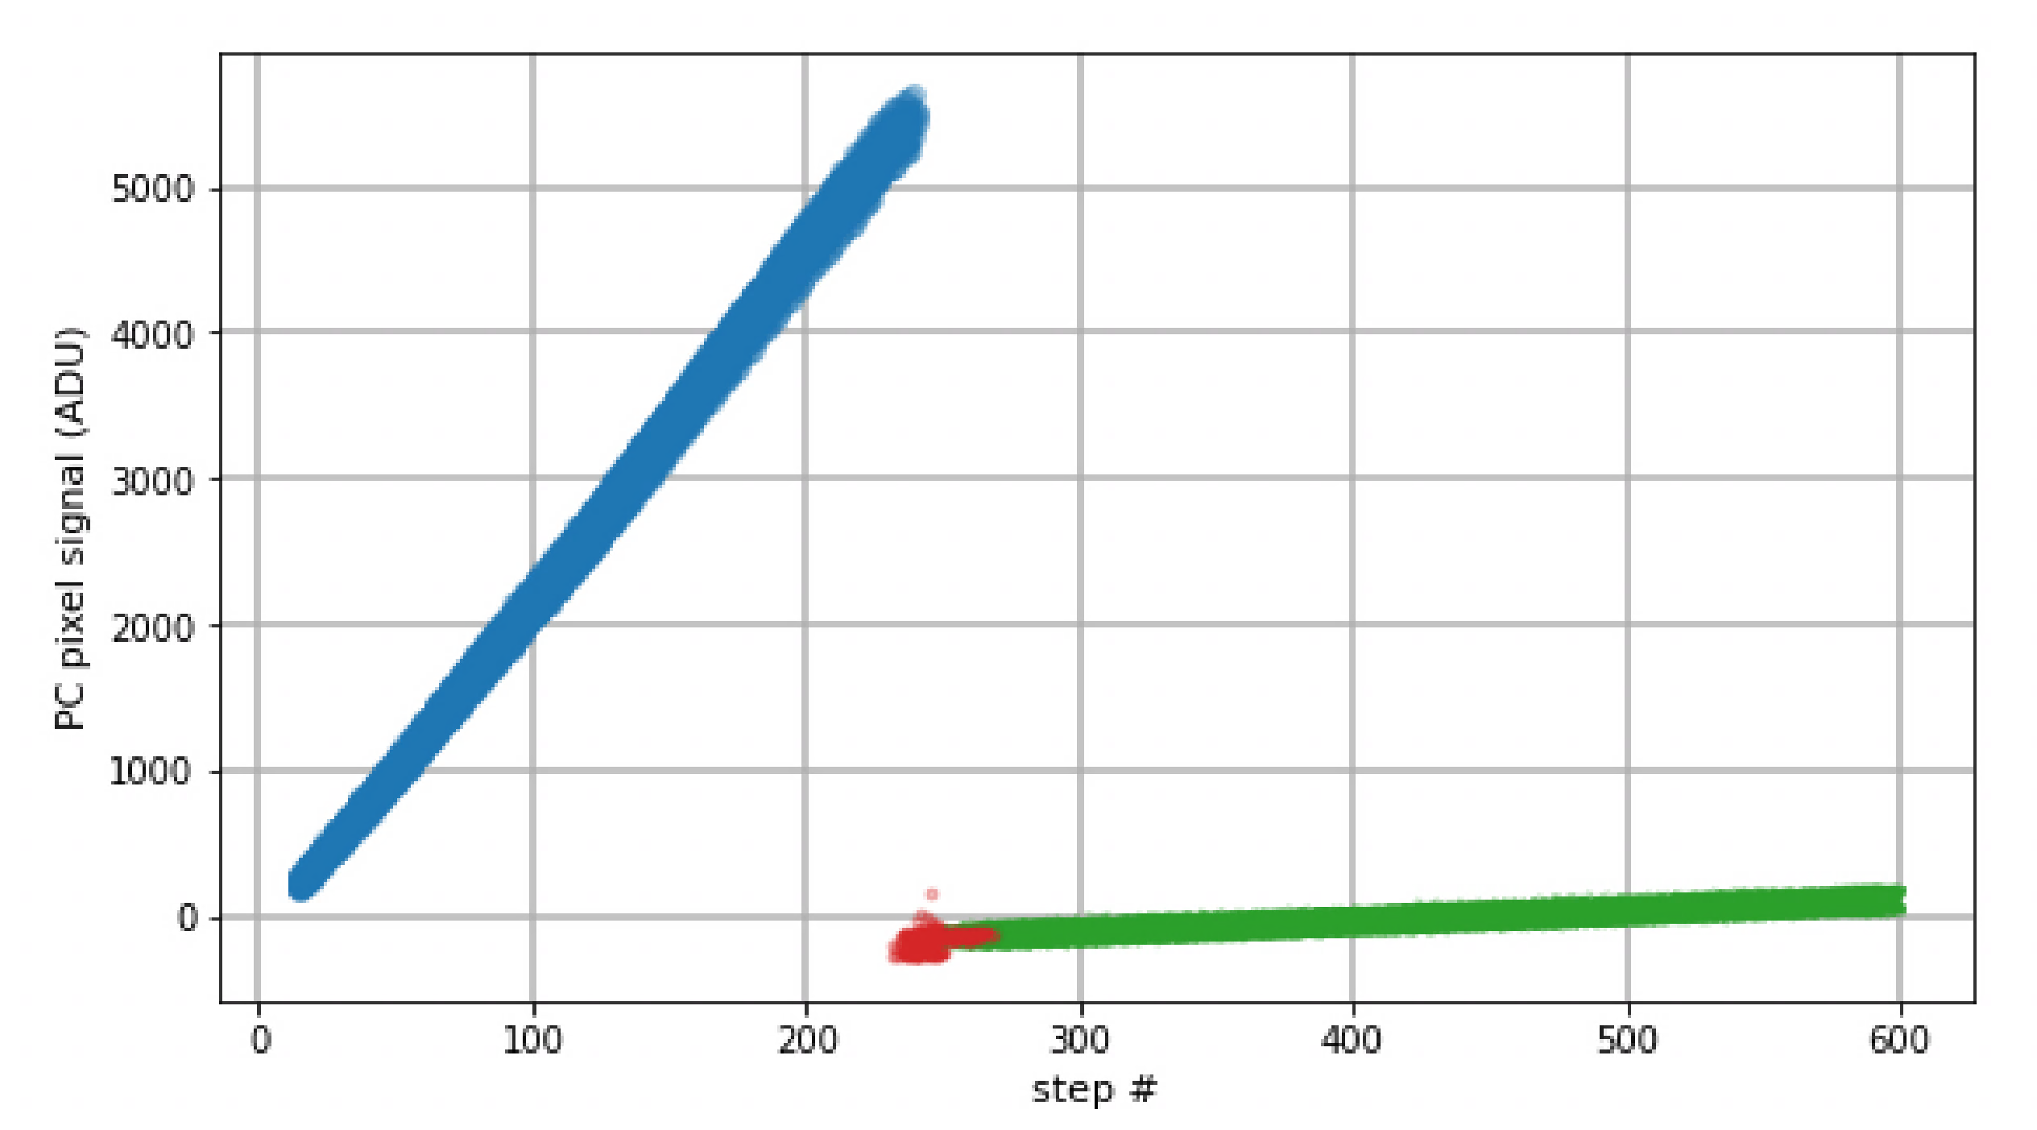
Support to User experiments
Beamtime preparation
Support during experiment
Optimization based on users feedback
(1) AGIPD gain calibration (per pixel, per mem cells, per acquisition rates (4.5, 2.2, … MHz)
  2 steps process, once per year (if no major changes)
(1) Flat Field with Cu foil (8.05 keV)
Saturation
8.05 keV
Medium gain
MG
Low gain
LG
High gain
HG
ADU
→ Conversion Gain [ADU/keV]
ADU
(2) Internal charge injection
High Gain
Transition
region
Gain stage
High Gain
Medium Gain
Low Gain
Image data
Medium gain
N of photons (Energy)
Charges (AU)
→ Relative Gain factor (HG/ MG)

Slide 13
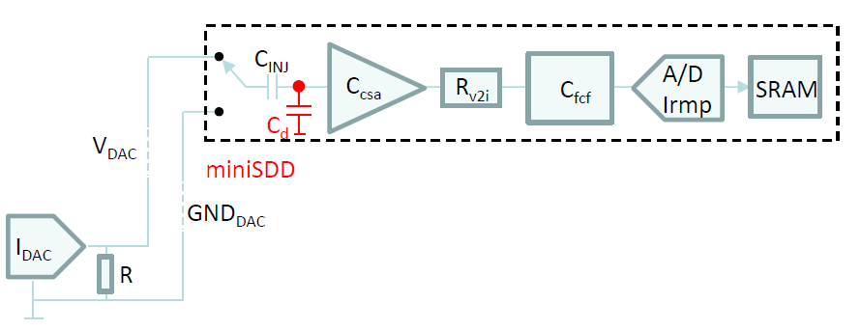
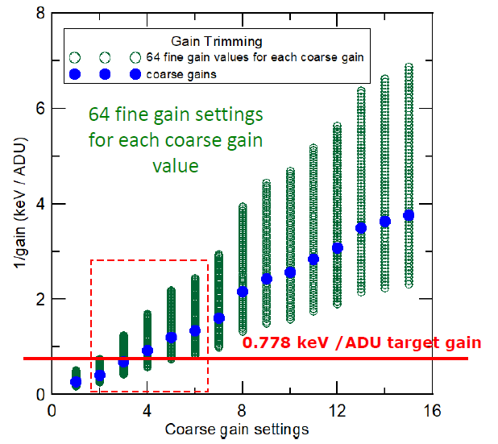
Support to User experiments
Beamtime preparation
Support during experiment
Optimization based on users feedback
(2) DSSC-MiniSSD calibration and gain setting
  → Gain setting optimization for each experiment (compensate the low dynamics range)
→ Gain tuning feature of the readout channel
- Coarse gain tuning from the analog part
- Fine gain tuning from the ADC settings
- Internal calibrated injection circuit
Several combinations
(C_{csa}, R_{v21}, C_{fcf})
Offset
V/ADU
Calibrations process:
1 Calibration with X-rays (1 energy) → conversion gain + the internal injection circuit
2 Gain setting (eV/ADU value) for each pixel:
- Identification of the closest coarse gain
- Iteration of the fine gain using the calibrated injection circuit to set the target eV/ADU value
3 Based on this → a lookup table (LUT) lists the gain values corresponding to all settings combinations
Gain setting process:
The LUT is used to finely set up the eV/ADU value for each experiment
→ For any arbitrary energy (from 0.5 to10 keV) → 0.5 to 10 Ph/ ADU can be set

Slide 14





Support to User experiments
Beamtime preparation
Support during experiment
Optimization based on users feedback
Each week: 3 instruments run Tuesday-Sunday 24h/day
  Data Operation Center (DOC): single contact point for support
7 Instruments
IT Expert
DOC crew
- 2 Colleagues on shifts (7h00 – 23h00)
- 1 Data Run Coordinator (24/7 On Call Duty)
Timing Expert
24/7 OCD Support
Detector Expert
Monitoring tools
Incident sources
Controls Expert
Data Analysis Expert
Documentation

Slide 15
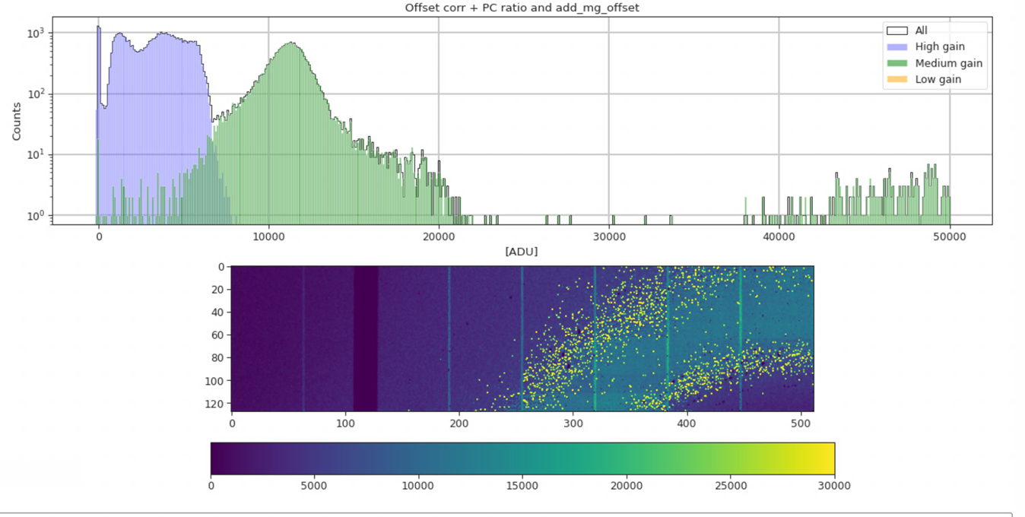
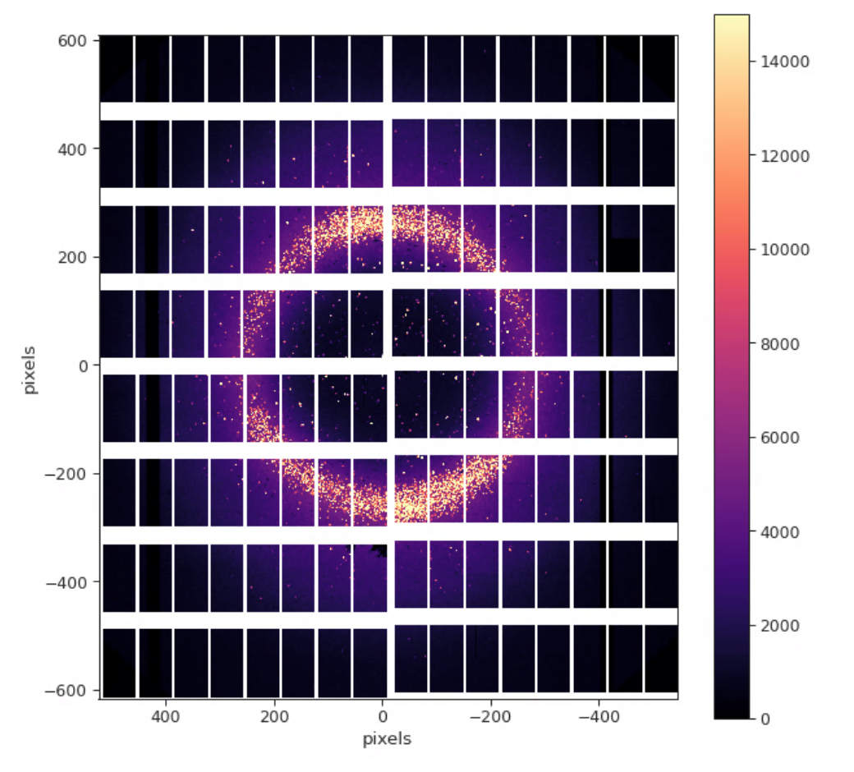
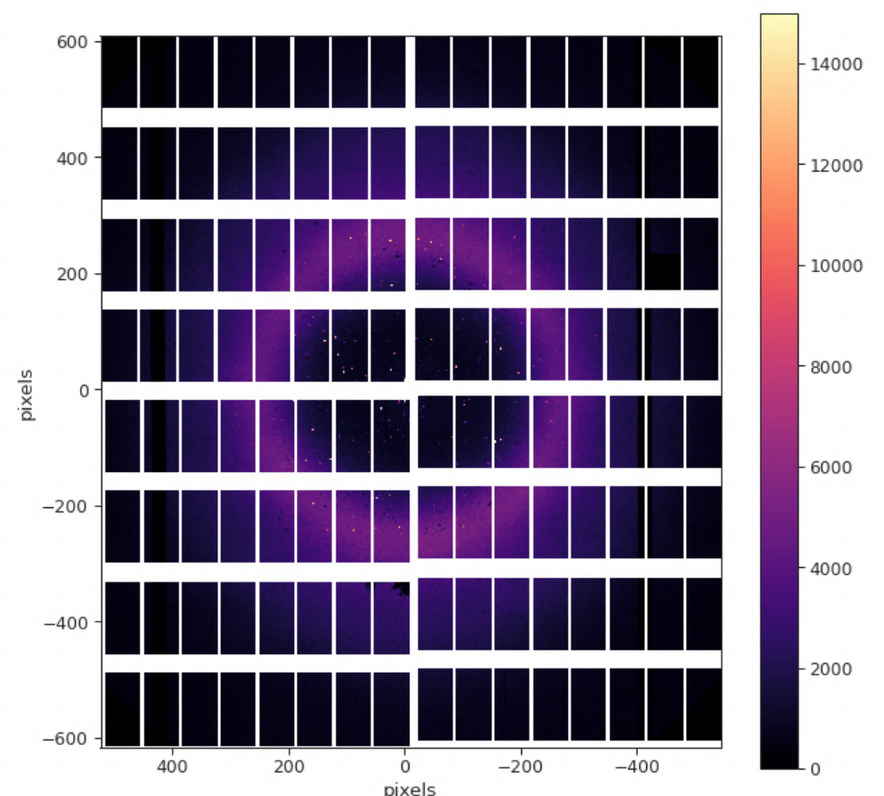
Support to User experiments
Beamtime preparation
Support during experiment
Optimization based on users feedback
(1) AGIPD: elimination of the “snowy pixels”
  The “Snowy pixels” effect is a HG-MG transition region artefact
  The problem: those snowy pixels wrongly detected as Bragg peak events
  The cause: late switching gain at the preamplifier stage level
120 ns
200 ns
  Solutions proposed
    Fixed Medium Gain Operation mode was first proposed to user
      Some experiments were successfully conducted
    Longer Integration time (I_{t}) is the most efficient solution
      I_{t} increased from 120 ns to 200 ns
      → snowy pixels decreased by 3 order of Magnitude
        Rates < 4.5 MHz only
        Not recommended for low intensity data (higher noise)
Lysozyme data taken in August 2021 at SPB
(2) DSSC-miniSDD: Higher performance proposed for acq. rate < 4.5 MHz → 9 bits ADC conversion available (8 bits)
  Dynamics range increased by a factor 2: 511 Ph achieved instead of 255 (1 Ph/ ADU sensitivity)
  Readout noise decreased by 33 %: 40 ENC RMS achieved instead of 60 ENC

Slide 16
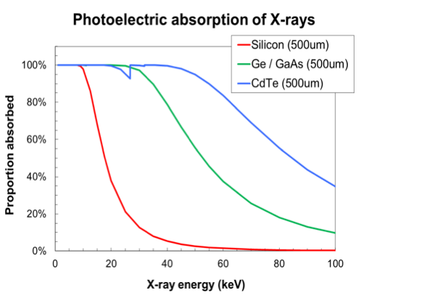
Next developments: on going work
New detectors expected for 2030+
  To move to the new technologies (current technologies will be obsolete soon)
  To meet users’ expectations
  Take opportunity
    to standardize the detector setups
    to reduce the number of technologies supported
Constraints & requests
  Feedback from instruments
    All instruments: smaller pixel size ~100 𝜇m pitch (200 – 500 𝜇m)
    → front electronics space constraint
    For some instruments: move to higher Energies (23 keV already conducted)
      Poor absorption of Si → less statistics for data but also damages
  Higher duty cycle of the accelerator → more pulses per train
    More images storing capabilities → new challenges
    Larger data output → data reduction become mandatory

Slide 17
Conclusion
European XFEL propose unique X-ray FEL beam delivery since 2017
  Many outcomes of experiments from the six instruments already published
  3 development projects were conducted with consortiums:
    AGIPD and LPD → successfully in operation since 2017 (Hard X rays)
    DSSC - MiniSDD → successfully in operation since 2019 (soft X rays)
    DSSC - DEPFET is in the commissioning phase and will be operated in 2024
The support to the user experiments is a constant and demanding effort
  Detector calibration and maintenance
  24/7 support during the experiment
  Optimization of the detector based on the users feedback
    Important role of our detector experts
Work in progress on the next generation of detectors (2030 +)
  Smaller pixels
  Higher energies
  More images storing capabilities

Slide 18


Thank You for listening ! olivier.meyer@xfel.eu https://www.xfel.eu/
Acknowledgment

Slide 19
Additional slides

Slide 20
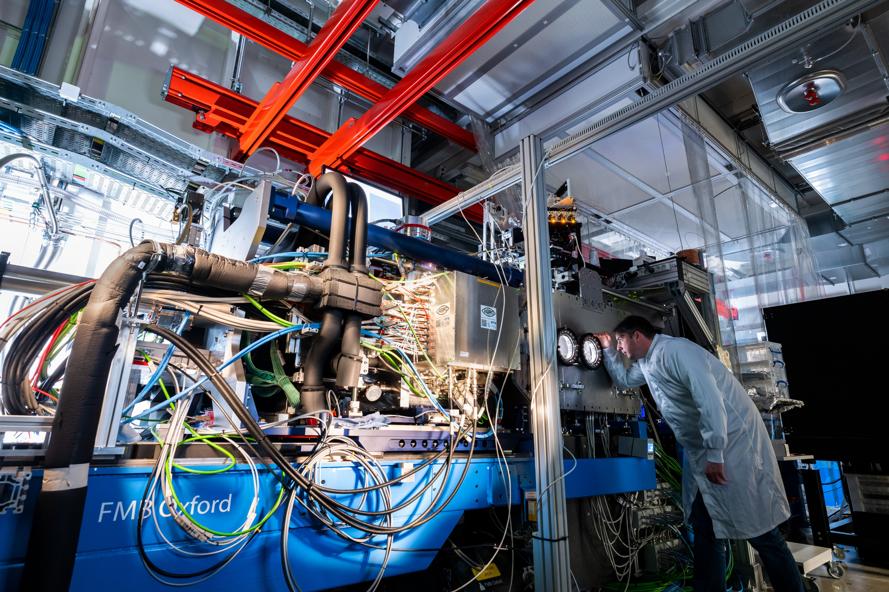
XFEL Scientific instrument: SASE 1
FXE (Femtosecond X-Ray Experiments: investigate chemical reactions at the atomic scale in short time scales molecular movies)
  Main technics
    X-ray scattering (XRS)
    X-ray spectroscopies (XES/ XAS)
  Detectors:
    High dynamics, MHz, large detectors
    Low noise high resolution small area detectors for spectroscopy
SPB/ SFX (Single Particles, Clusters and Biomolecules and Serial Femtosecond Crystallography): determine the structure of single particles, such as atomic clusters, viruses and biomolecules
  Main Technics
    Coherent Single Particle Imaging (SPI)
    Time Resolved Serial Femtosecond crystallography (TR-SFX)
  Detectors:
    High dynamics, MHz, large detectors
Hard X-Rays

Slide 21
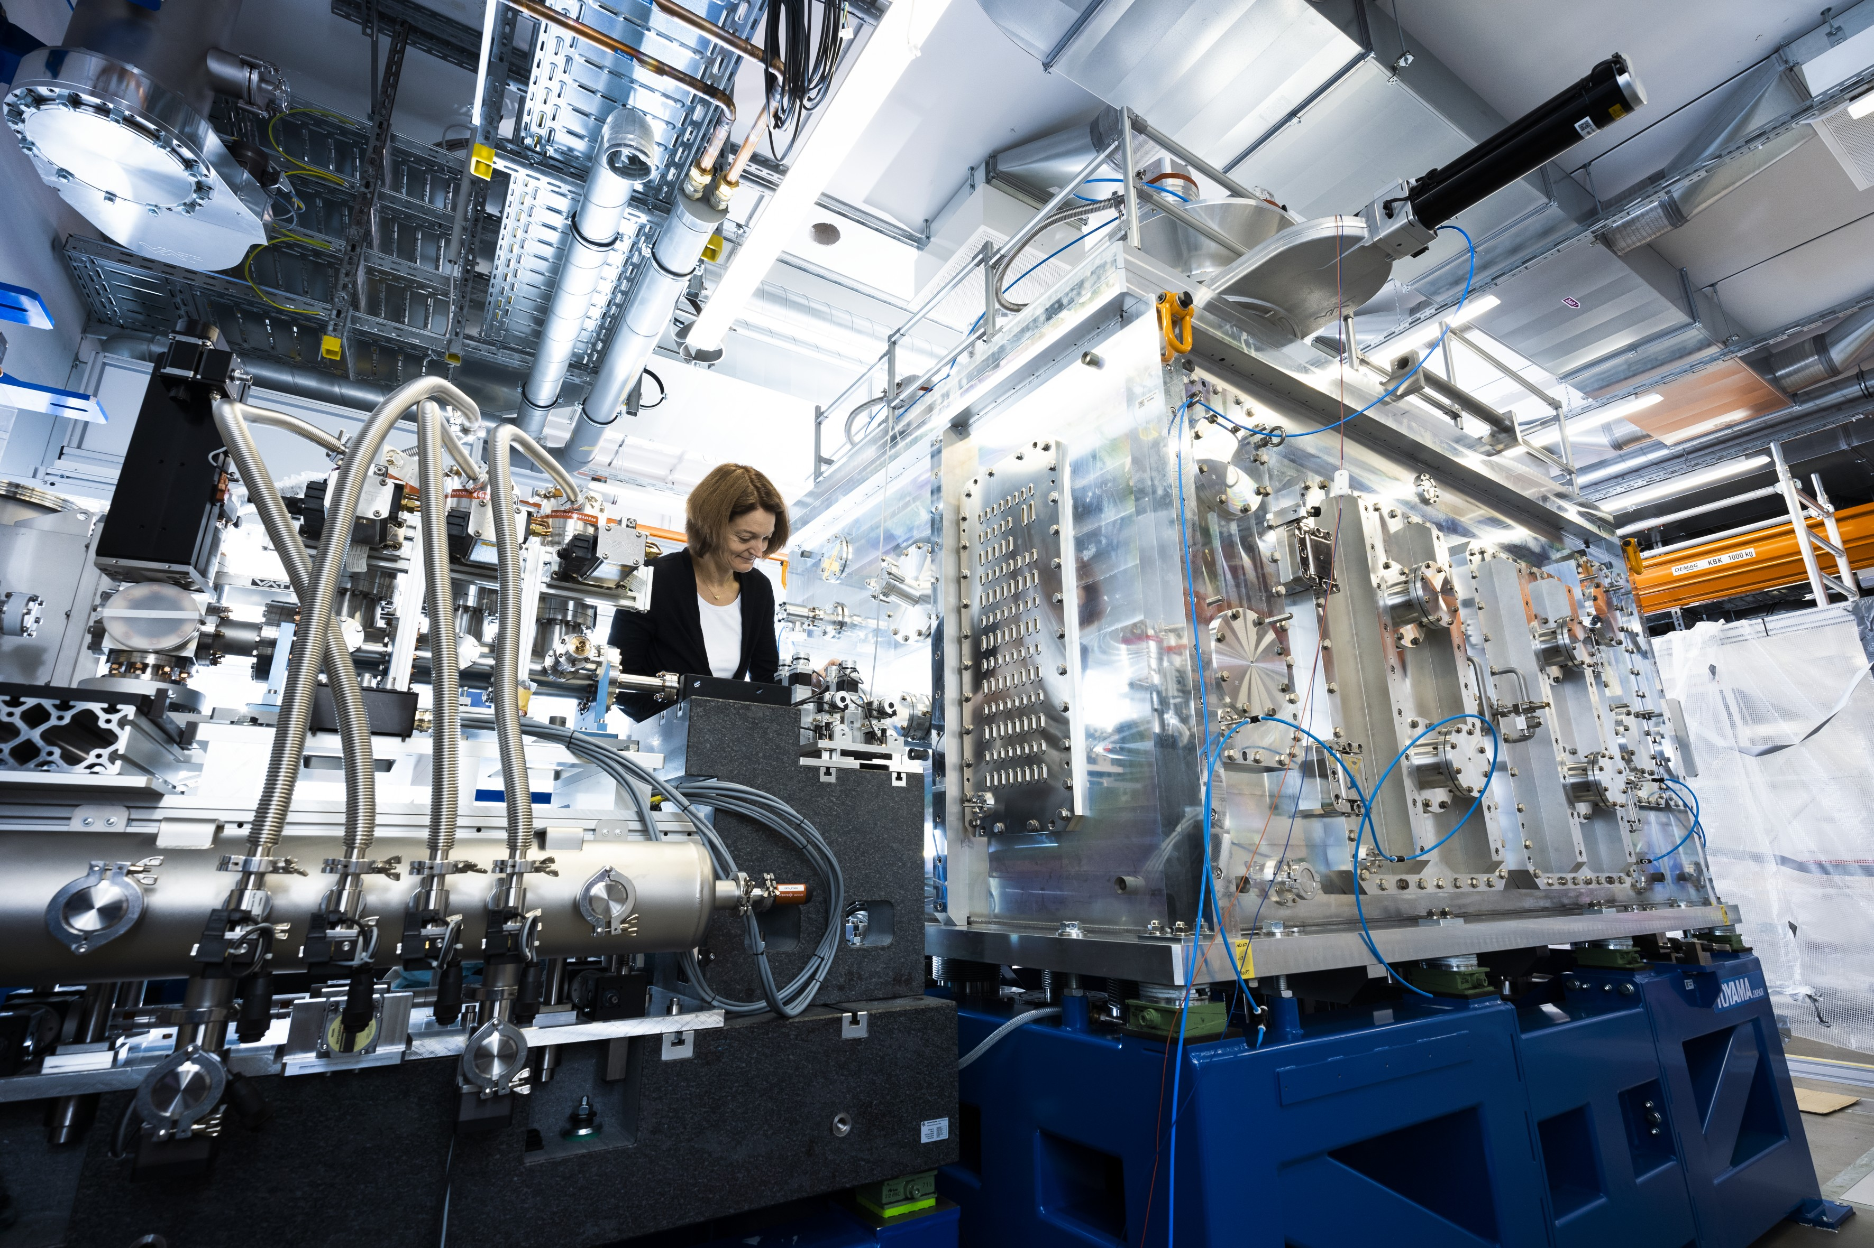
XFEL Scientific instrument: SASE 2
MID Materials Imaging & Dynamics: image and analyse nano-sized devices and materials used in engineering
  Main Technics
    Time resolved X-ray scattering (WAXS/ SAXS)
    Coherent Diffraction Imaging (CDI)
    X-ray photon correlation Spectroscopy (XPCS)
  Detectors:
    Low noise, MHz, large detectors
    Low noise high resolution small area detectors for spectroscopy
HED High Energy Density Matter: look into some of the most extreme states of matter in the universe
  Main Technics
    X-ray diffraction (XRD)
    X-ray scattering (SAXS, IXS)
    X-ray self emission (XES)
  Detectors
    High dynamics, MHz, large detectors
    Low noise high resolution small area detectors
Hard X-Rays

Slide 22
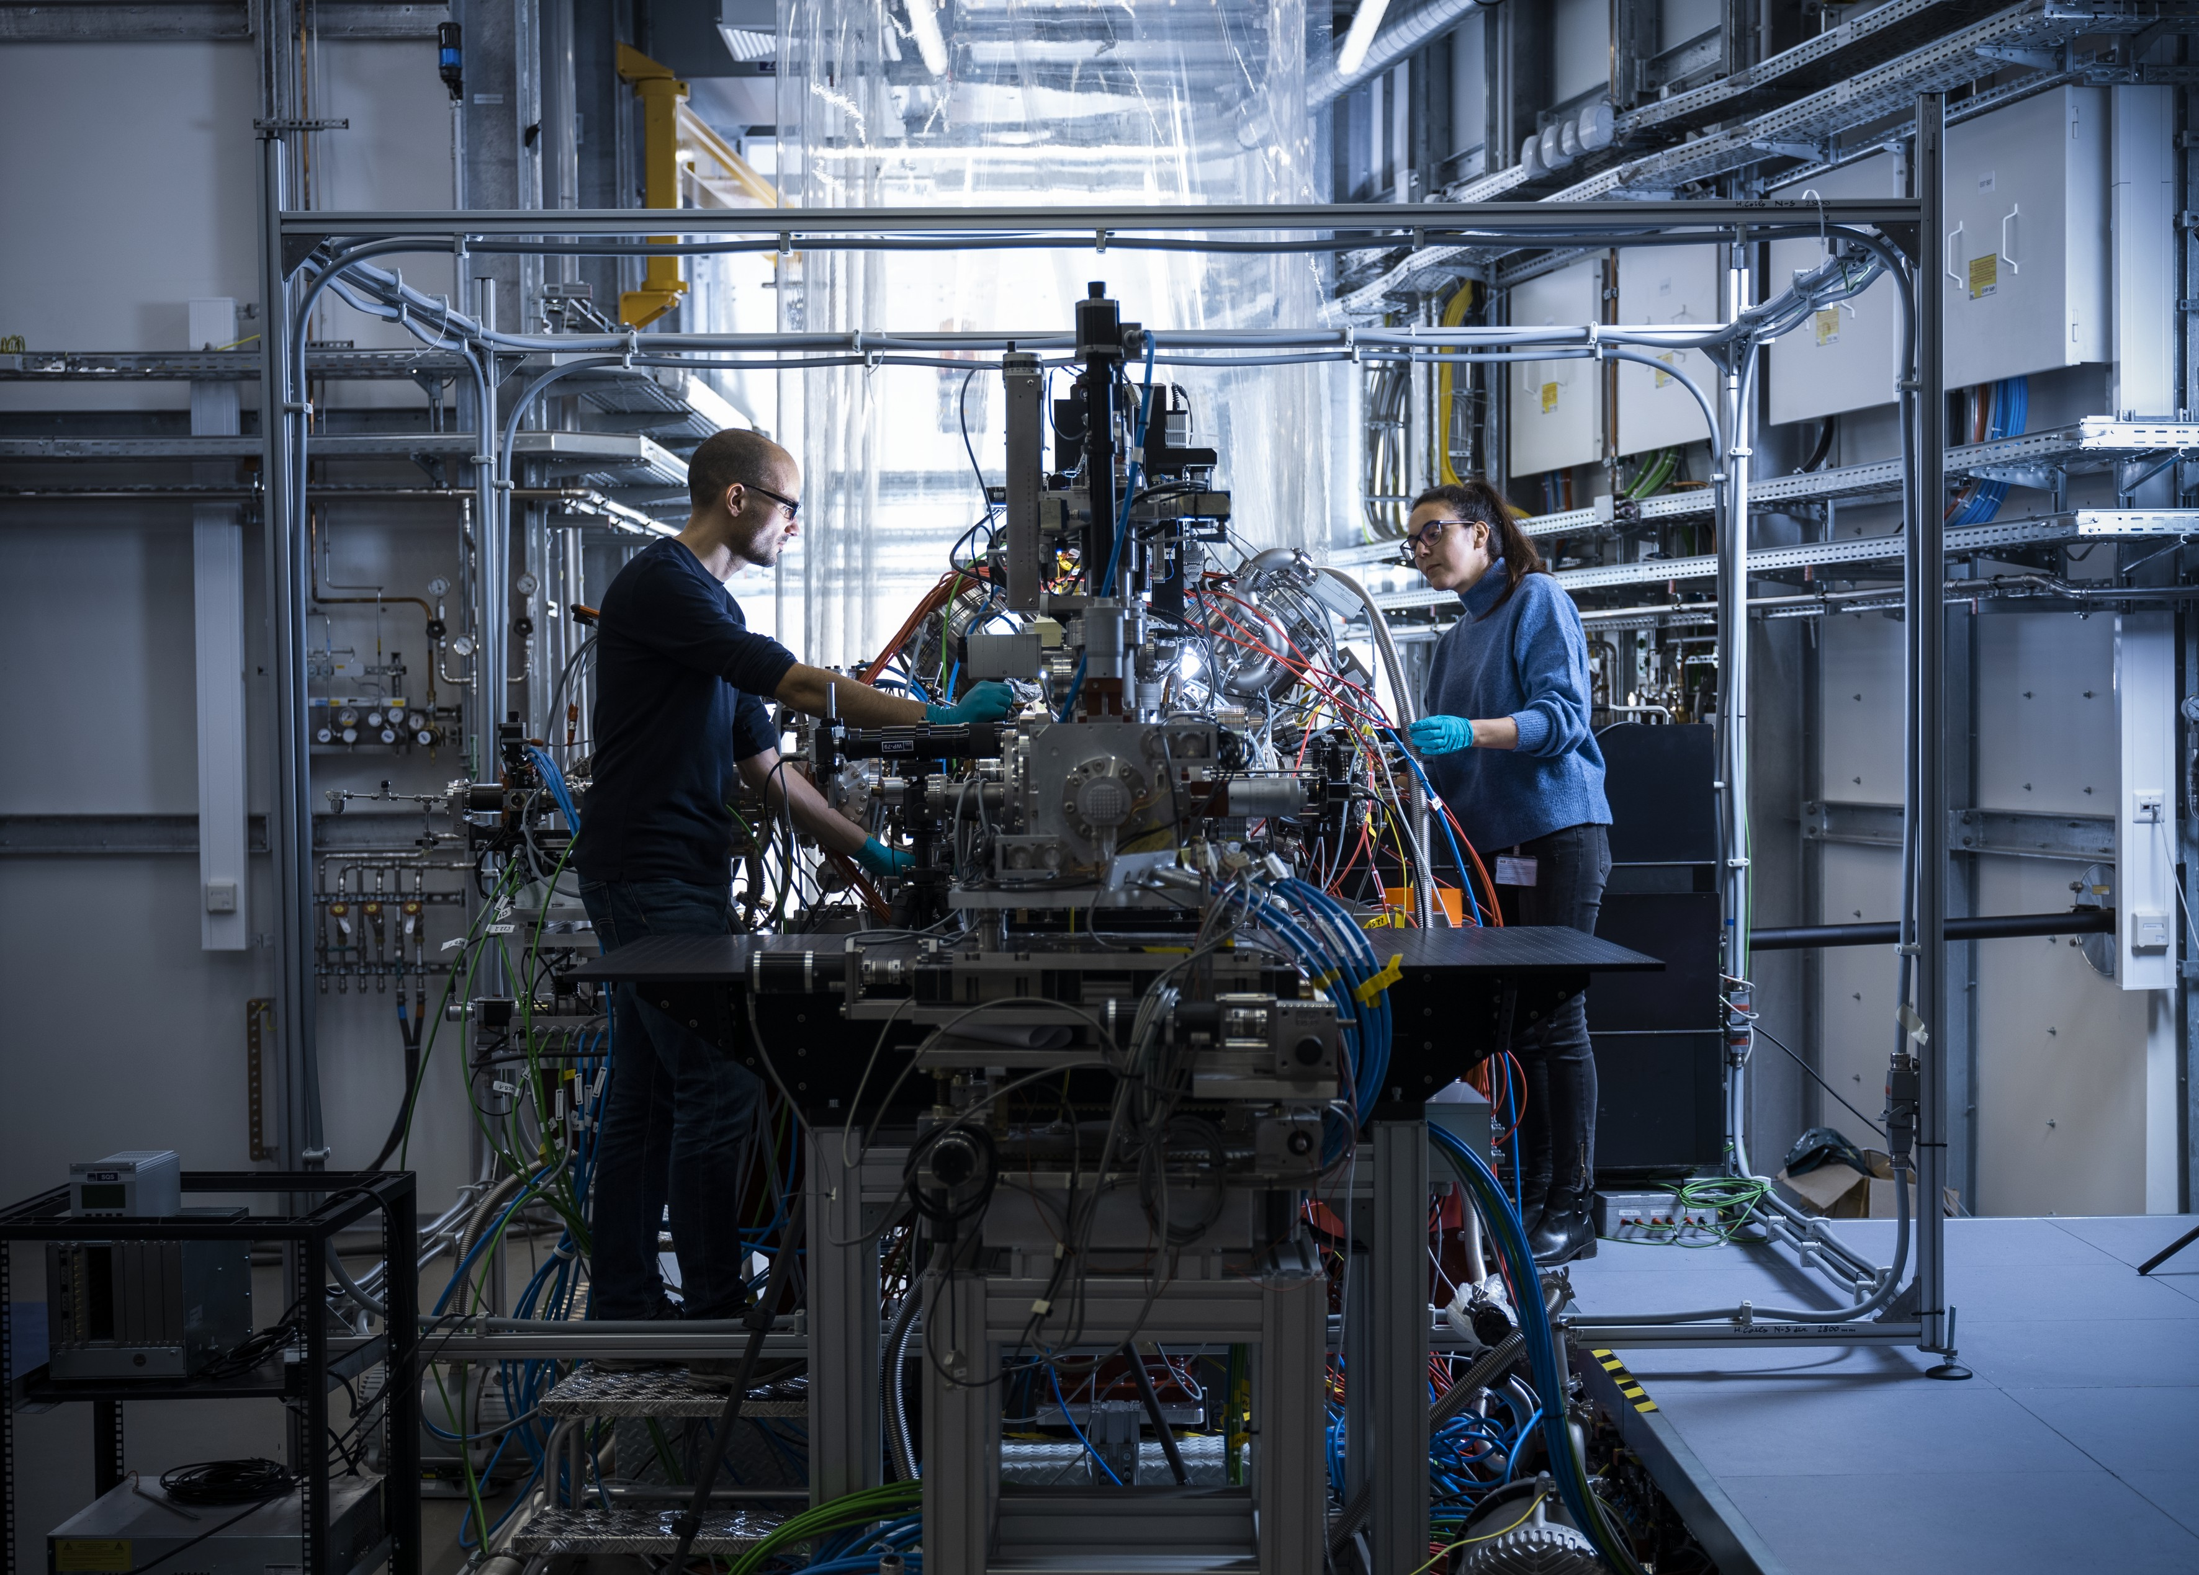
XFEL Scientific instrument: SASE 3
Soft X-Rays
SCS (Soft X-Ray Coherent Scattering /Spectroscopy): determine the structure and properties of large, complex molecules and nano-sized structures
  Main Technics
    Coherent X-ray diffraction (XRD)
    Resonant Inelastic X-ray Scattering (RIXS)
    X-ray spectroscopies (XAS/ XES)
  Detectors:
    Low noise, MHz, large detectors
    Low noise high resolution small area detectors for spectroscopy
SQS Small Quantum Systems: examine the quantum mechanical properties of atoms and molecules
  Main Technics
    Electron Time-Of-Flight (eTOF)
    Velocity Map Imaging (VMI)
    Resonant Inelastic X-ray Scattering (RIXS)
    Coherent Single Particle Imaging (SPI)
  Detectors:
    Low noise, MHz, large detectors
    Low noise high resolution small area detectors for spectroscopy

Slide 23
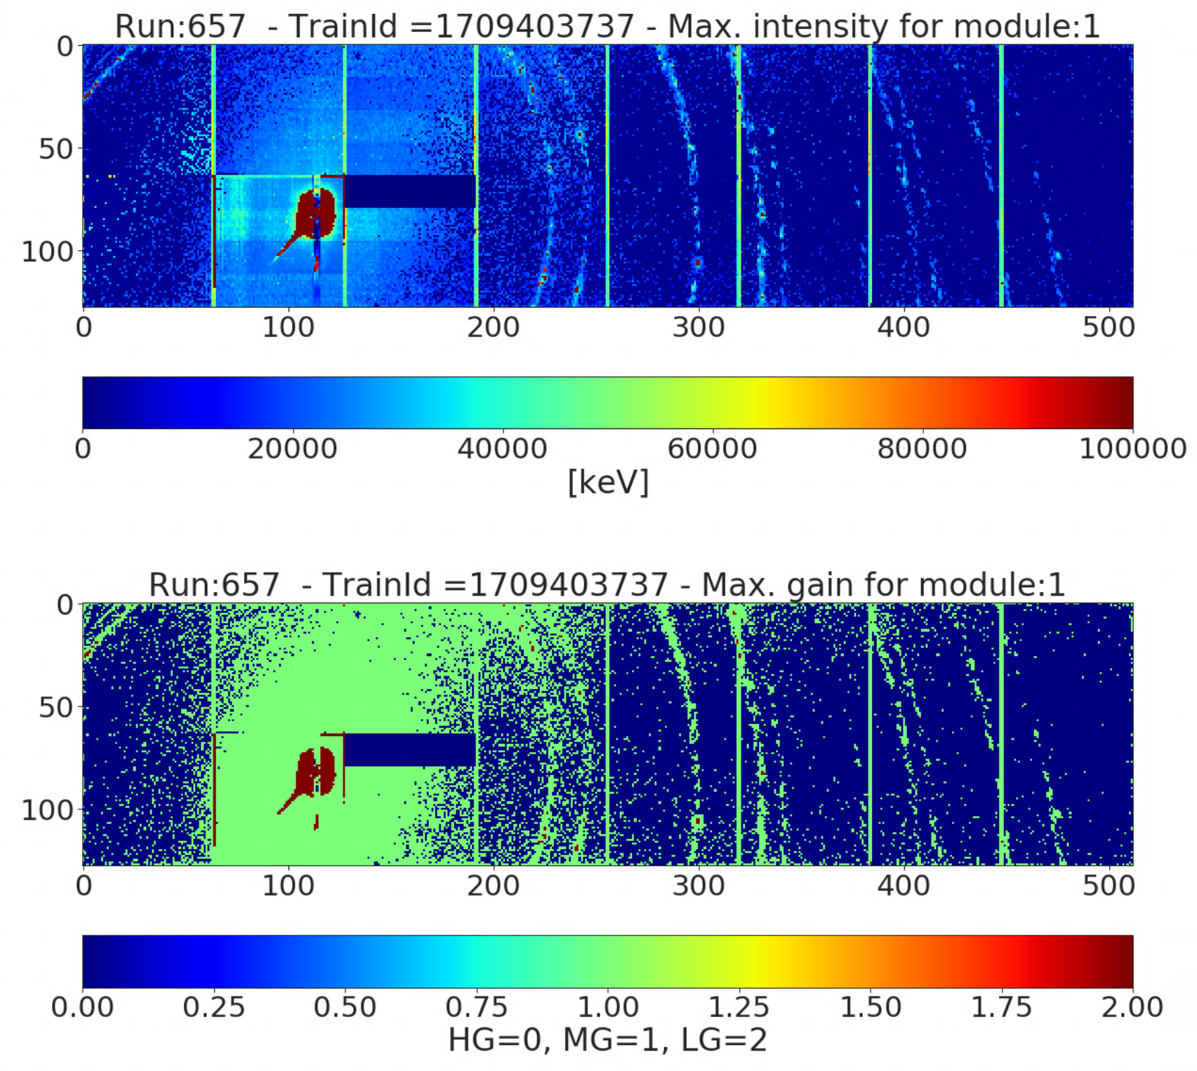
DET Highlights of the last month(s)
AGIPDs user operation with photon energy above 20 keV – radiation damage
  1M AGIPD at MID: radiation damage due to the detector’s exposure to the signal created by the scattering of the primary beam on the Al sample holder ( several modules were affected, < 0.1% pixels damaged )
  AGIPD500K at HED: one module was lost as a result of the detector being exposed to the signal created by diffraction of the primary beam on the diamond cell
AGIPD1M@MID
- dead pixels from the most affected module
AGIPD500K@HED
- „deadly signal“ on the detector
Before incident
After incident

