Slide 1

High Precision X-Ray Measurements 2023
Laboratori Nazionali di Frascati, 19-23 June 2023
The Cryogenic Anticoincidence detector for the newAthena
X-IFU instrument: a program overview.
C. Macculi
on behalf of the X-IFU CryoAC team
L. Piro, A. Argan, M. D’Andrea, S. Lotti, G. Minervini, F. Gatti, C. Boragno, E. Celasco,
L. Ferrari Barusso, G. Gallucci, D. Grosso, M. Rigano, M. Fiorini, M. Uslenghi,
G. Torrioli, F. Chiarello, D. Brienza, E. Cavazzuti, S. Puccetti, A. Volpe

Slide 2
Outline
NXB assessment at the X-IFU FPA and its impact on the CryoAC design
CryoAC Design concept
CryoAC functional block diagram
From the DM to a new prototype concept
Production and Genova Lab/facility status
Conclusions
For info:
https://www.the-athena-x-ray-observatory.eu/
http://x-ifu.irap.omp.eu/
X-IFU movie:
https://www.youtube.com/watch?v=mOf6WIDmi30

Slide 3
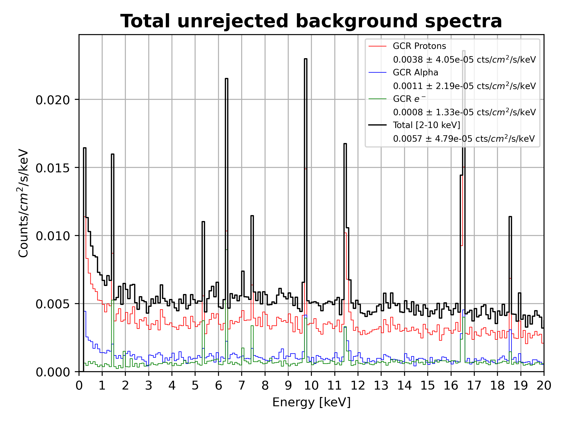
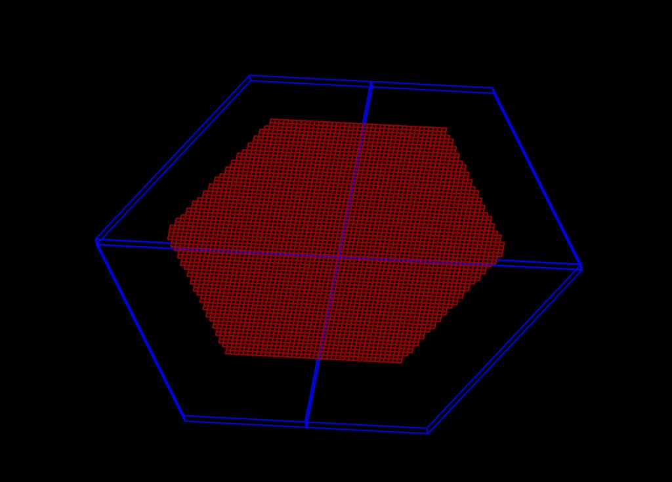
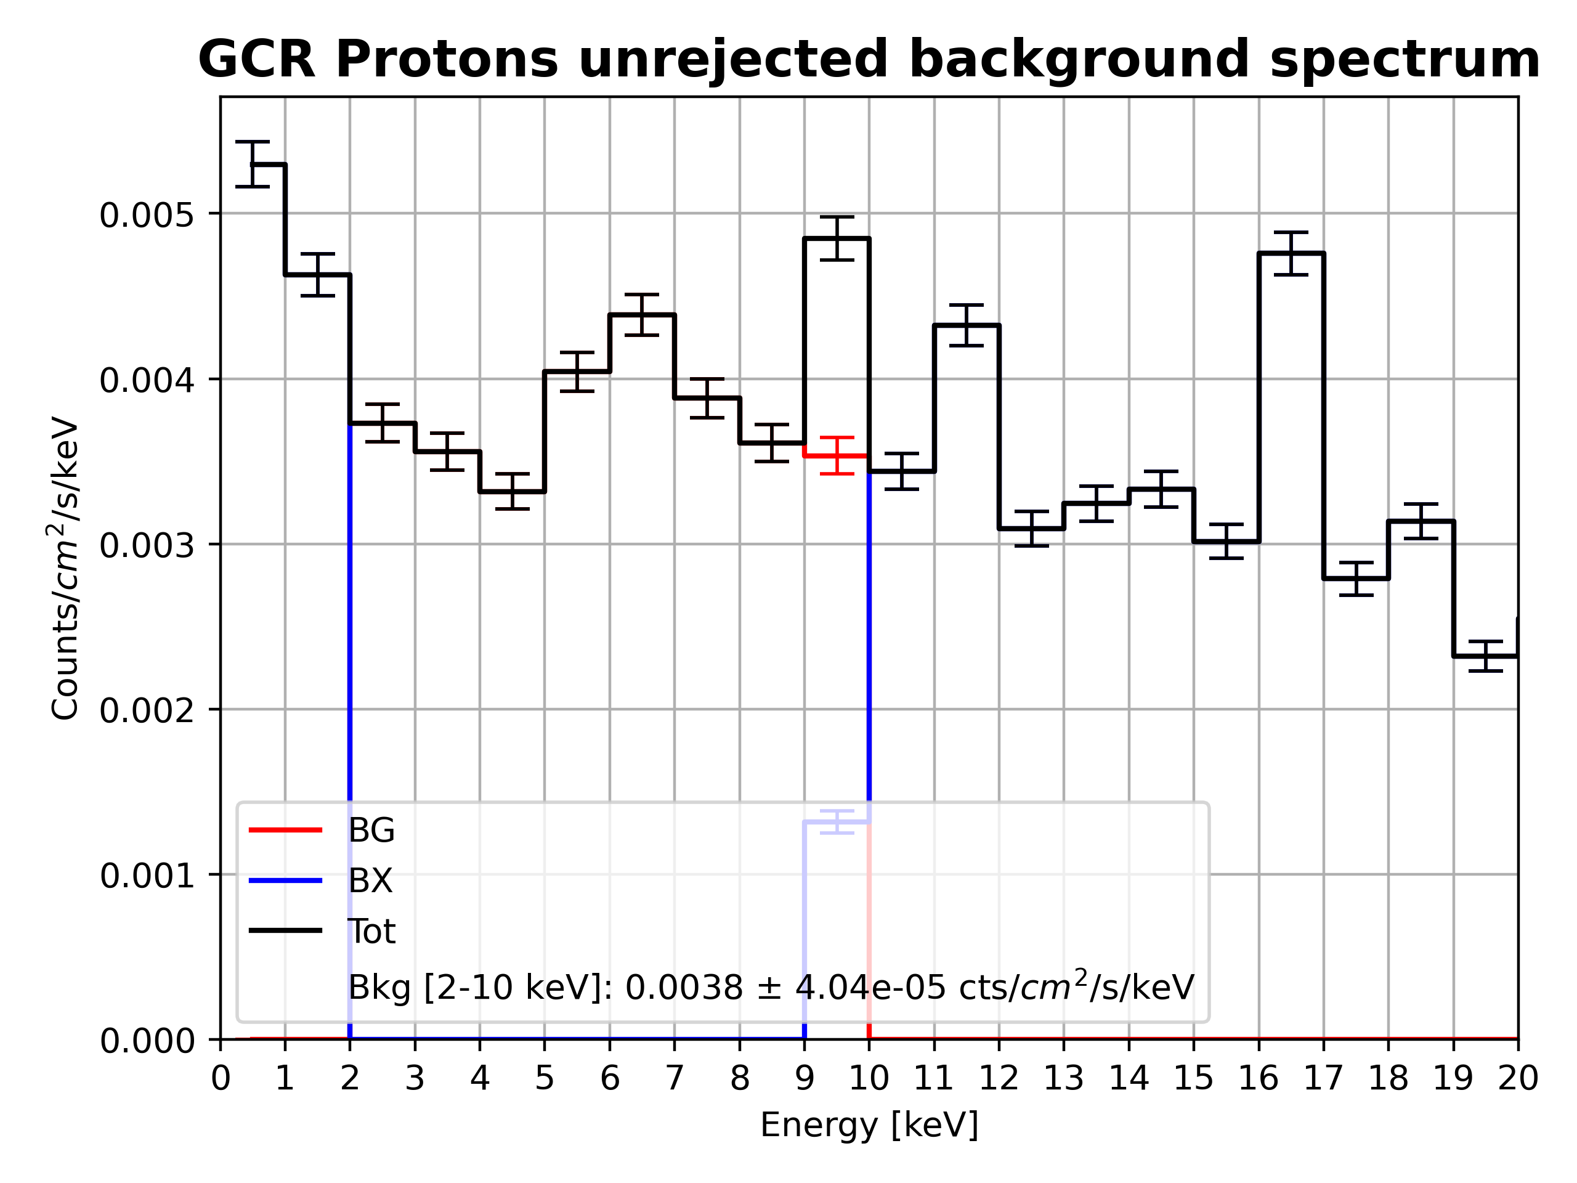
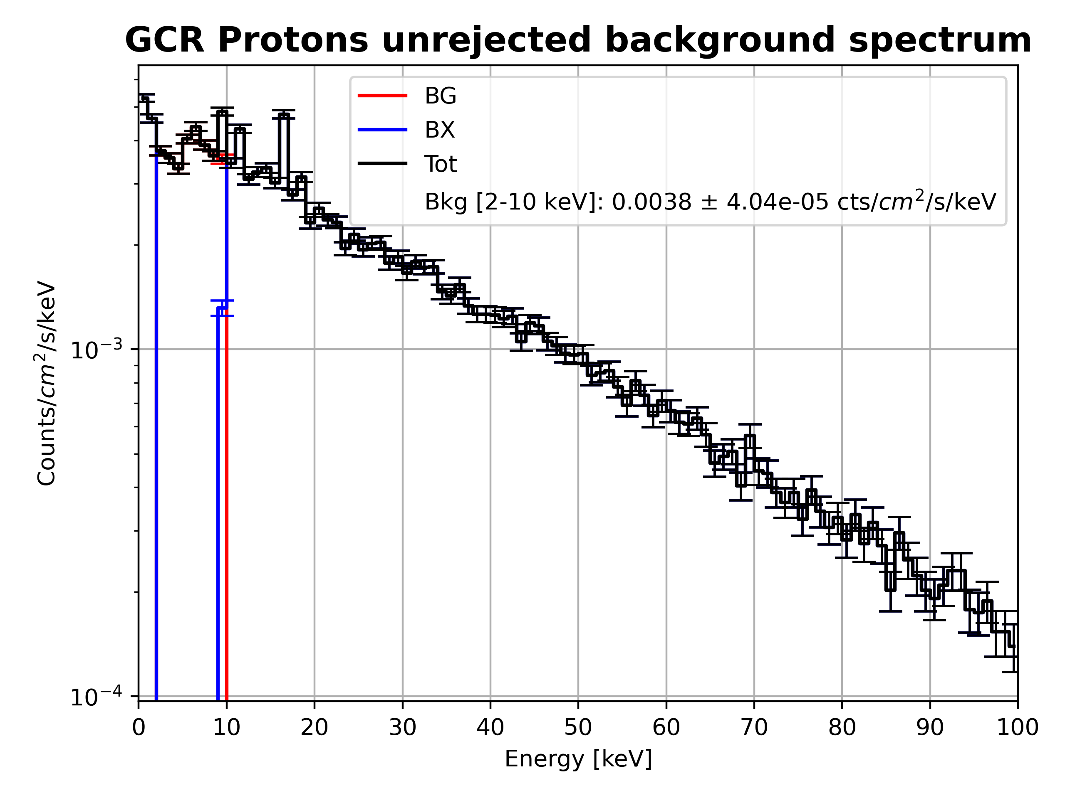
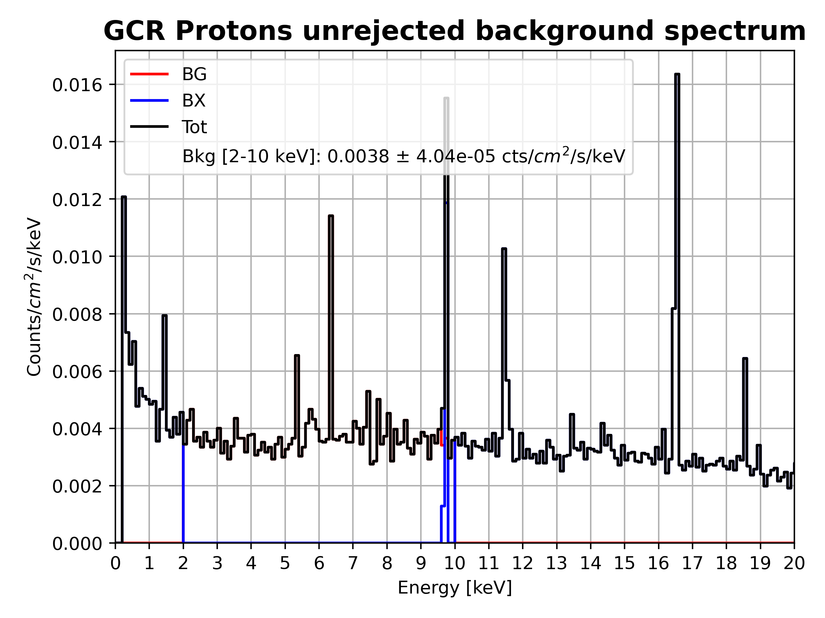
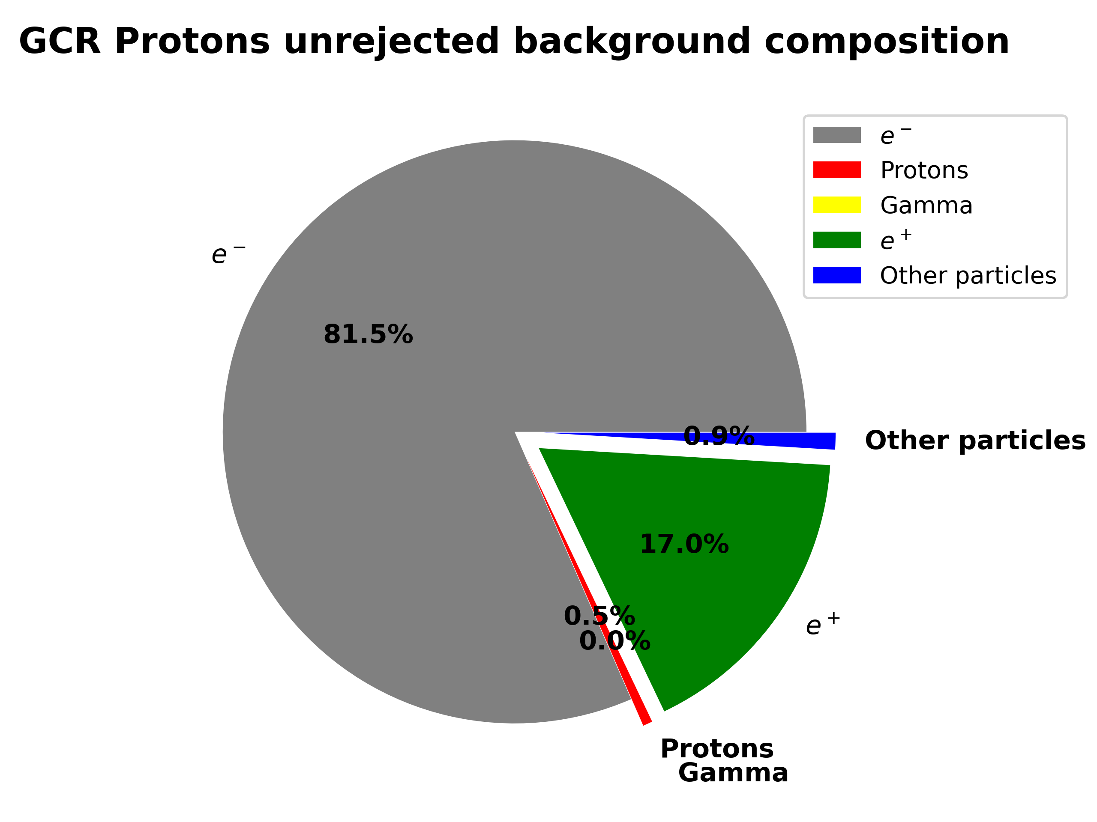
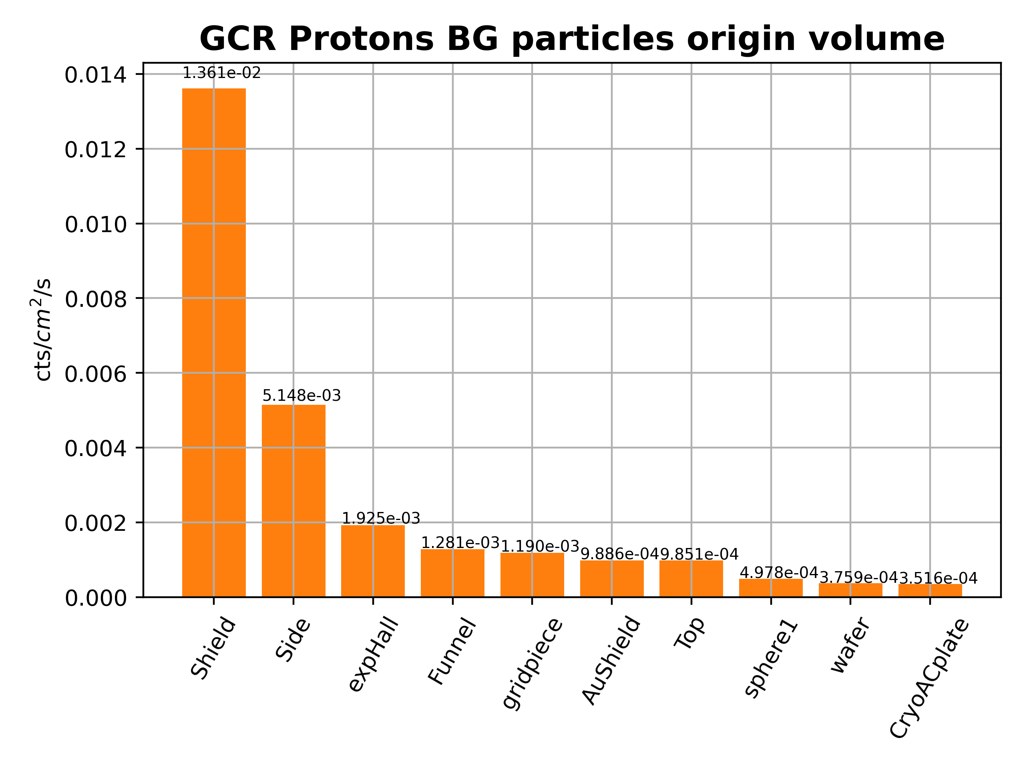
Geant4 simulations for X-IFU
Geant4 has been extensively used for background estimates for X-IFU
  Geant4 10.4
  Current mass model (2017), new one under construction due to newAthena
  Worst-case input spectra for GCR protons, α particles, e⁻
  Dedicated physics list developed (Space Physics List)
    Created and validated against experimental results (AREMBES, ESA CTP)
    Validated with new experimental data (EXACRAD ESA CTP, AHEAD2020 EU-H2020)
    Included in the next Geant4 release
  Dedicated analysis framework developed
  Requirements (2-10 keV energy bandwidth): 5× 10⁻³ 𝑐𝑡𝑠 𝑐𝑚⁻² 𝑠⁻¹ 𝑘𝑒𝑉⁻¹
  Without any reduction techniques the NXB is ~ 30x req.
  Expected background level (5.7 ± 0.05) × 10⁻³ 𝑐𝑡𝑠 𝑐𝑚⁻² 𝑠⁻¹ 𝑘𝑒𝑉⁻¹
Several modifications tested for:
  CryoAC design guidance and performance improvement
  Design and optimization of passive shielding
  FPA optimization
  Main array absorbers layout and materials

Slide 4
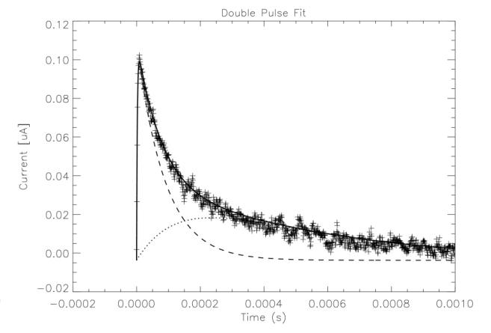
CryoAC Design concept: a detector aimed at reducing the particle bkg
The athermal signal is the first phonon-bunch produced in silicon crystal at sub-K temperature as sson as energy is deposited by the particle. The thermal signal rises once the athermal one decay.
If the mean-free path of the athermal is higher than the distance between the hitting point and the TES, then the athermal can release energy into the TES quickly heating its electron gas thus generating the electric pulse.
Our idea has been so far to use the athermal, producing a fast signal, as trigger to veto the particles hitting the TES array.
The challenge has been up to now to wallpaper one absorber surface of TESes to efficiently collect such athermal bunches thus shaping well the produced pulse.
Requirement and System constraint | Value
Geometrical rejection efficiency | 98.5%
Detection efficiency | 99.98%
Trigger efficiency | 99.999%
Allocated power dissipation (50 mK) | < 40 nW (CBE)
Time tagging accuracy | ≤ 10 µs (at 3 sigma)
Intrinsic Deadtime | 1%
Thermal bath | 50 mK
4 bridged-suspended Si absorbers to have a well controlled G
Ir/Au TESes on each absorber surface
Distance from TES array < 1 mm
Pt Heaters deposited onto the absorber to increase its temperature
  to decrease bias currents thus limiting both power dissipation, and magnetic coupling effects to the TES main detector array (trade-off wrt Rshunt)
  Detector diagnostics; energy calibration
Parameter | Value
Number of Pixels | 4
Pixel size | 1.23 cm² (TBC due to newAthena)
Absorber thickness | 500 μm
Distance from X-IFU | < 1 mm
Detector Dynamic Energy range | 6 keV – 950 keV (TBC)
Rise Time | < 15 μs (TBC)
Effective Fall time constant | 250 μs (TBC)
Thermal time constant | 2.5 ms (TBC)
TES Material | Ir/Au
Absorber Material | Silicon
Transition temperature | 100 mK (TBC)
But…
Few months ago we have produced a prototype having 1 only wideTES, instead of our usual network, deposited on 1 cm^2 Si and hit it by photons very far and very close to the TES thus probing the detector response in quite opposite working condition.

Slide 5
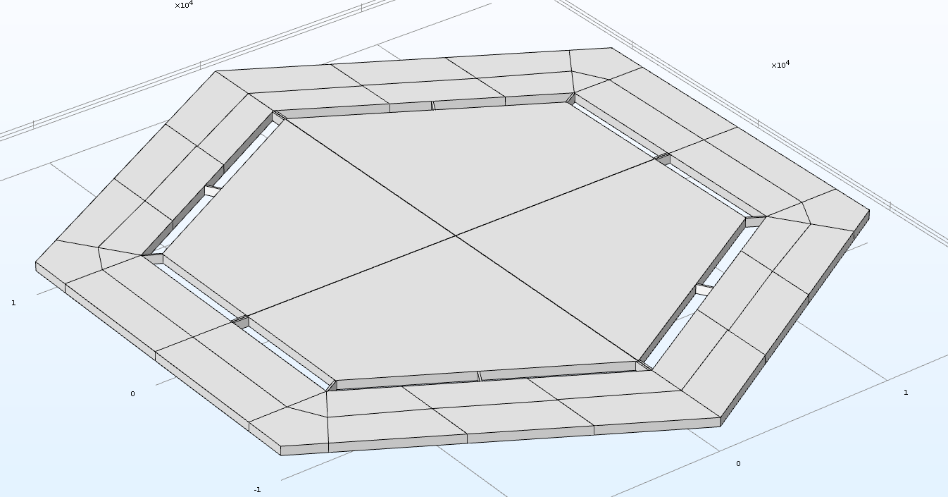
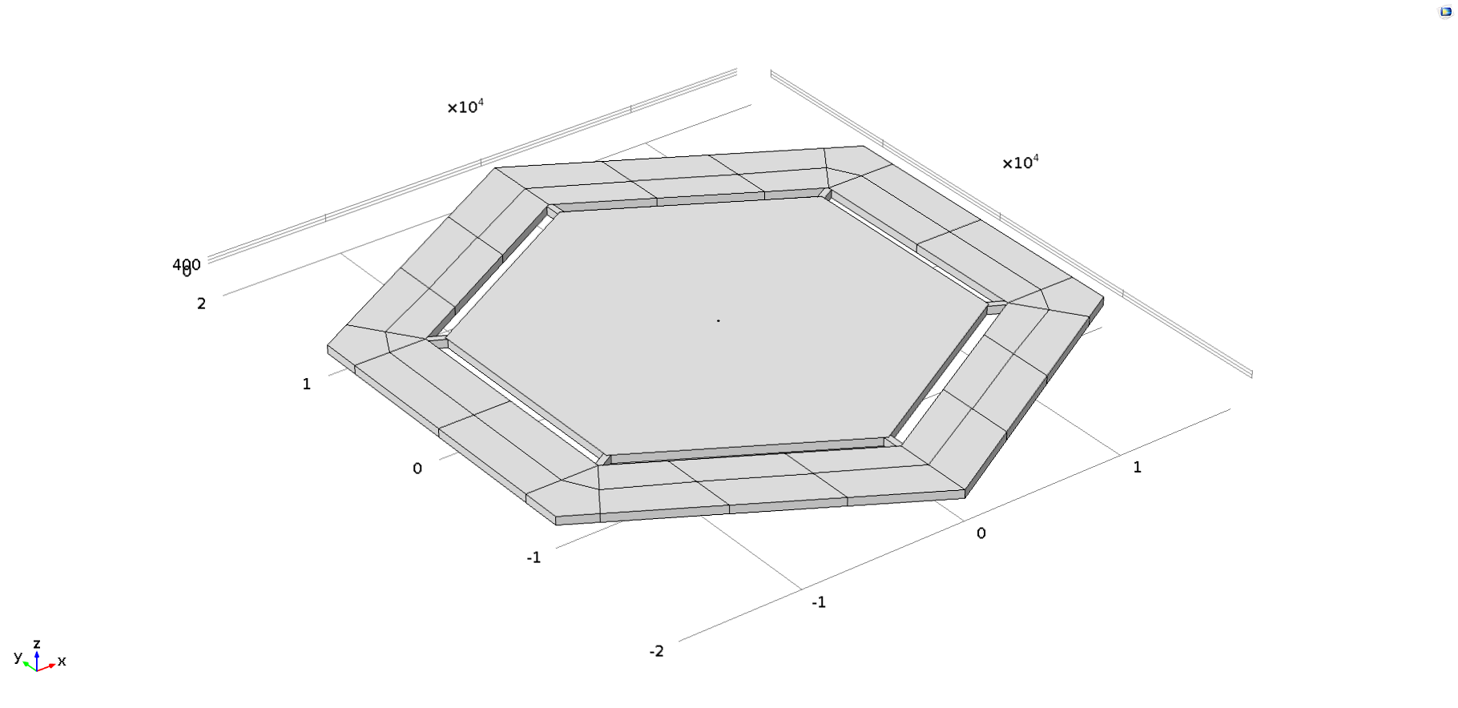
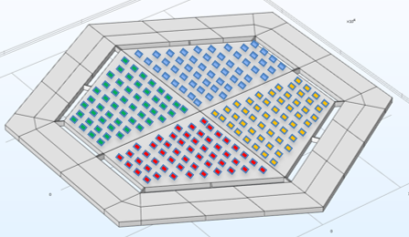
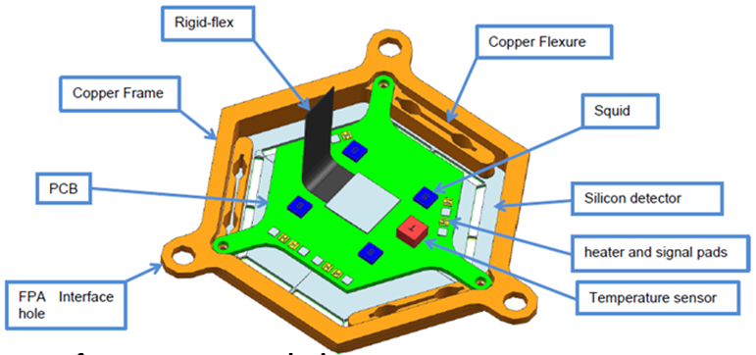
The CryoAC will have an hexagonal shape, and given the above requirements and specifications, the present design assumes that the CryoAC detector assembly is built as 4 identical trapezoidal pixels, each one connected to the silicon rim by 4 bridges per pixel in order to realize the thermal conductance to the thermal bath,
but there is on-going a study to trade-off this baseline wrt a monolithic geometry to see pro and cons in terms of detector responsivity, rejection efficiency, deadtime, robustness.
Baseline: segmented to be trade-off with monolithic
Previous TES distribution vs new one to be studied (few per pixel)
CryoAC 50 mK assembly

Slide 6
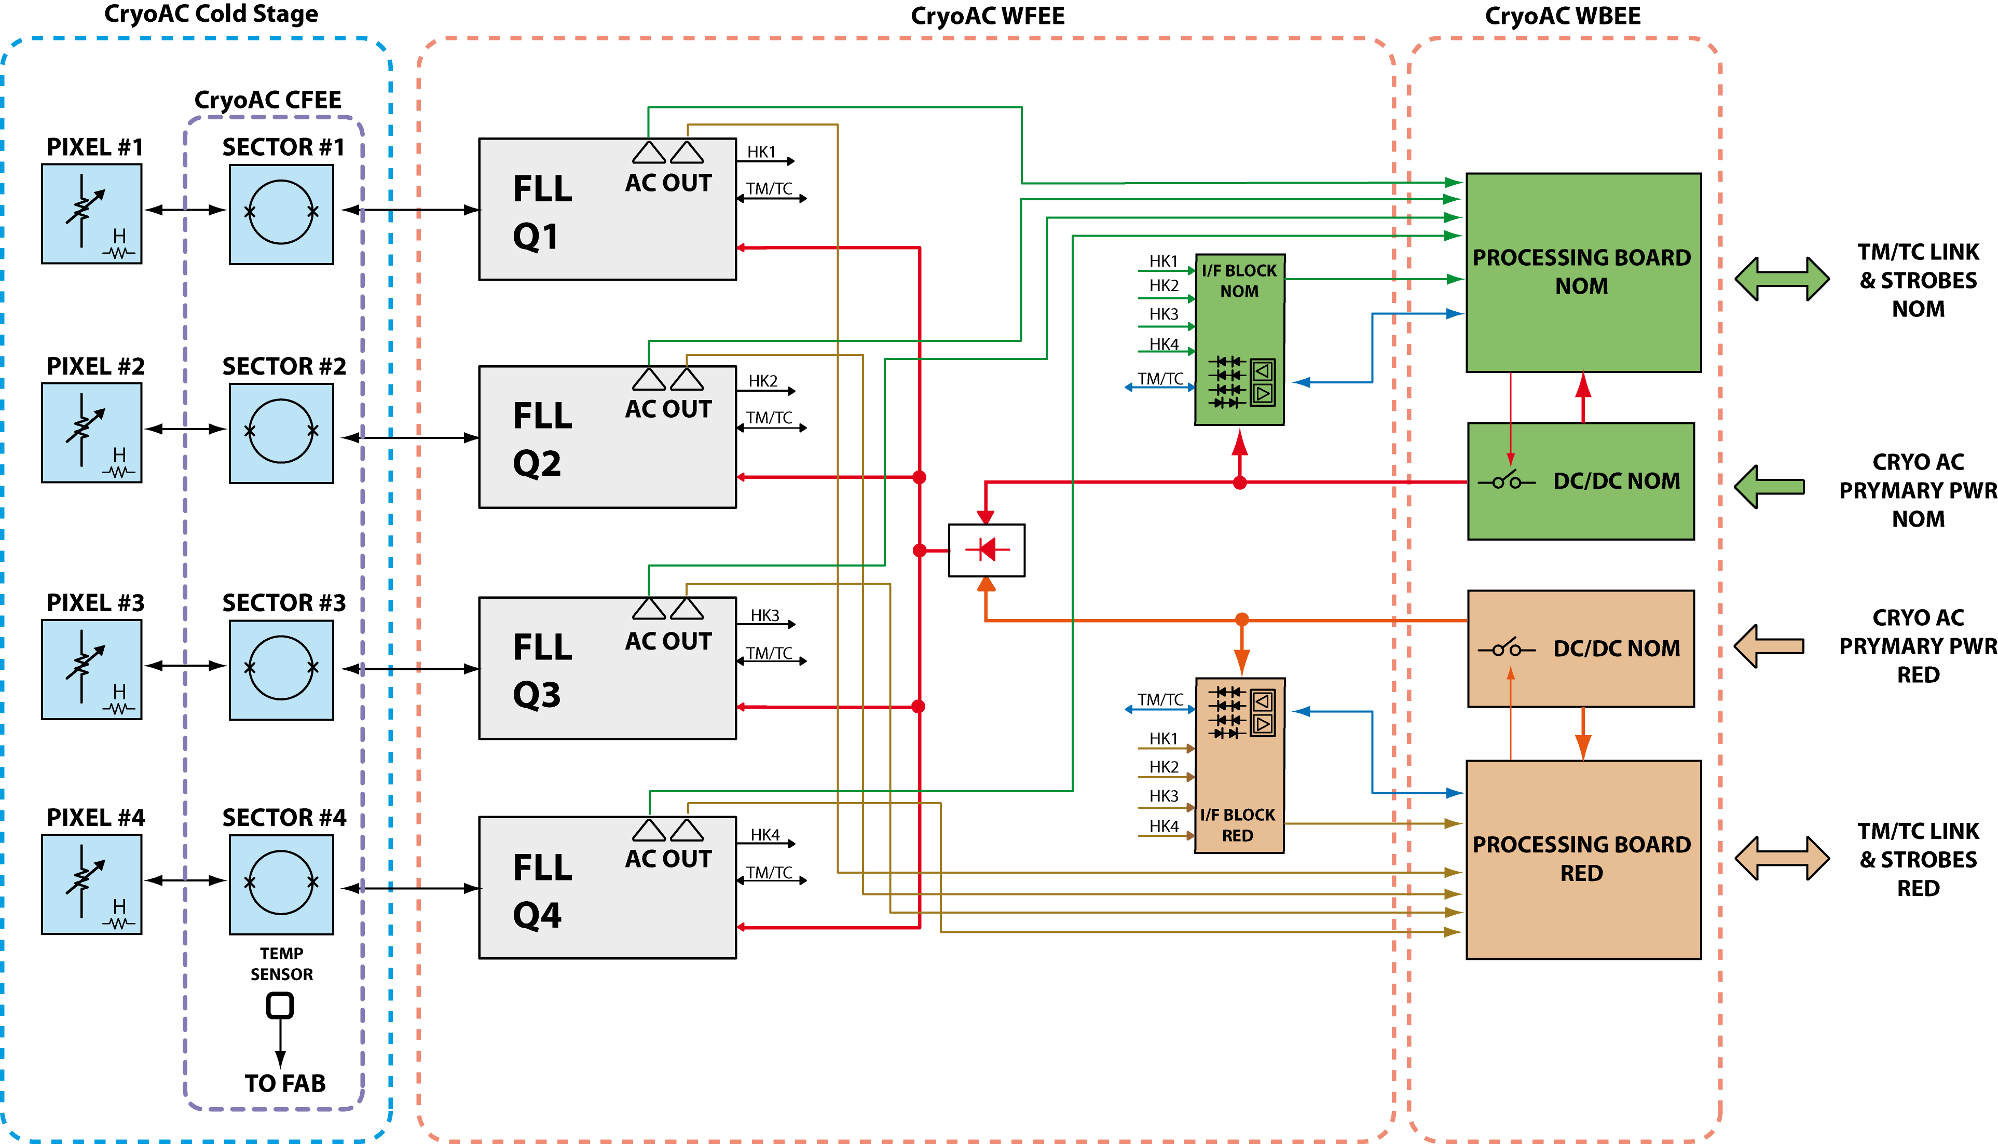
CryoAC functional block diagram
Cold stage: 4 TESes pixels + CFEE composed by 4 SQUID to readout each TES
WFEE divided in 4 quadrants: each one provides bias to TES and SQUID single pixel and produces the analogic scientific signal (AC OUT) and the FLL HouseKeepings → Standard FLL readout (no multiplexing)
WBEE in Nominal and Redundant boards: each one processes and digites the signal from the WFEE, packets the data to be sent to the Instrument Control Unit. Veto operation will be performed on ground, given the expected modest TM rate.

Slide 7
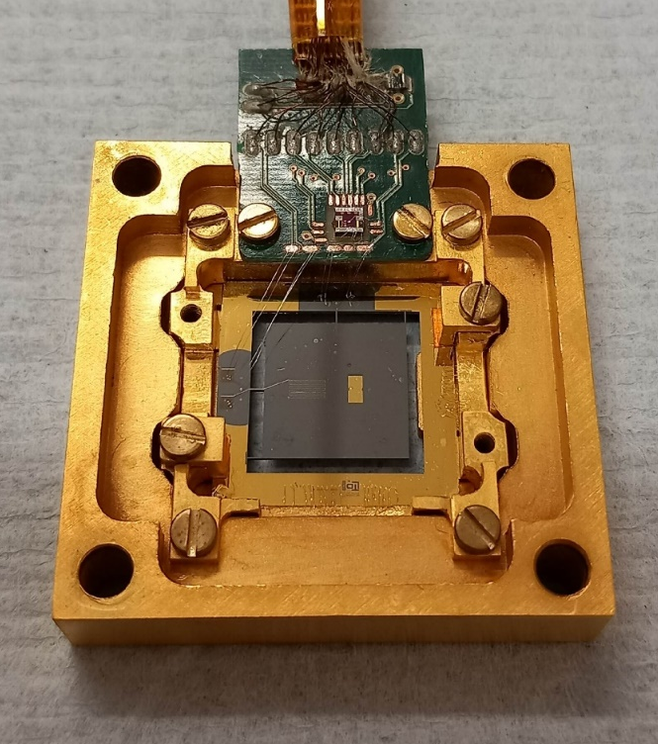
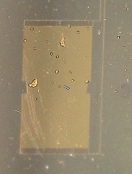
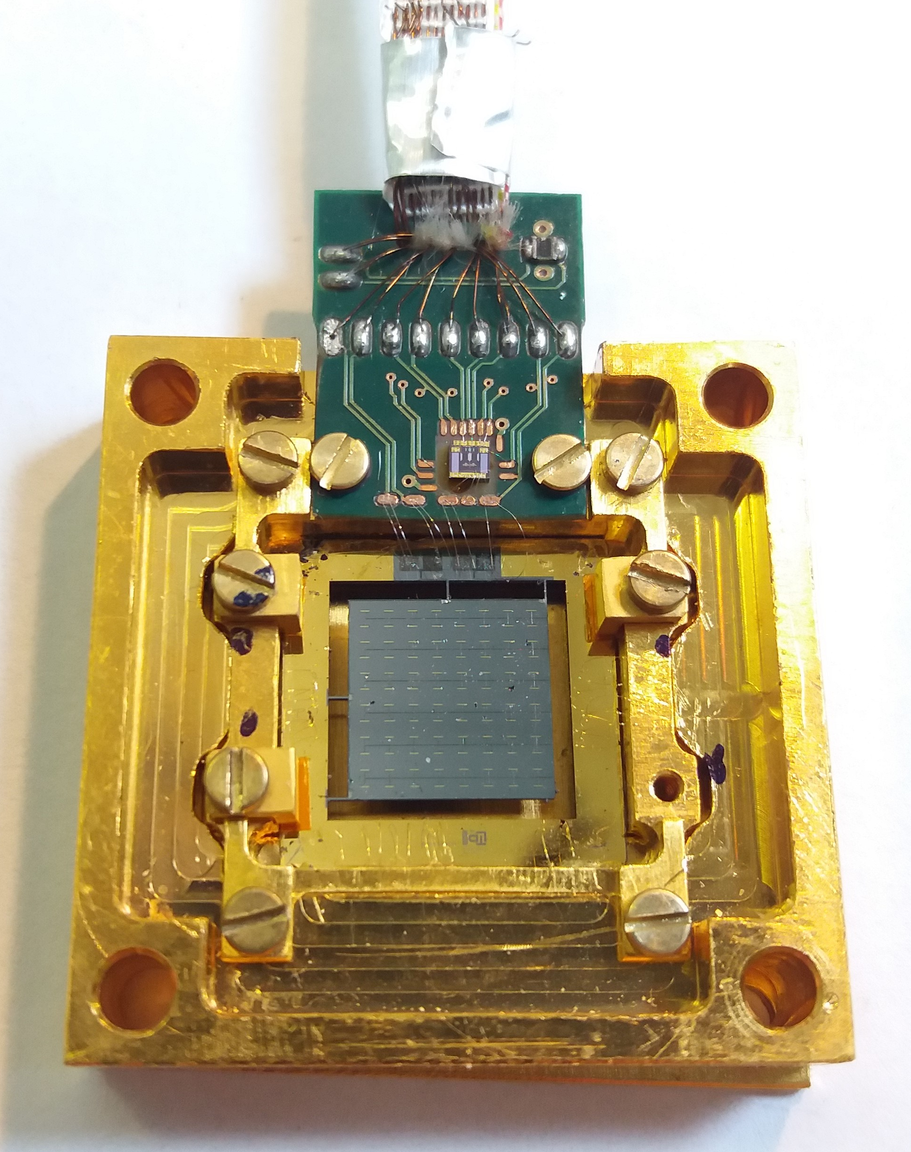
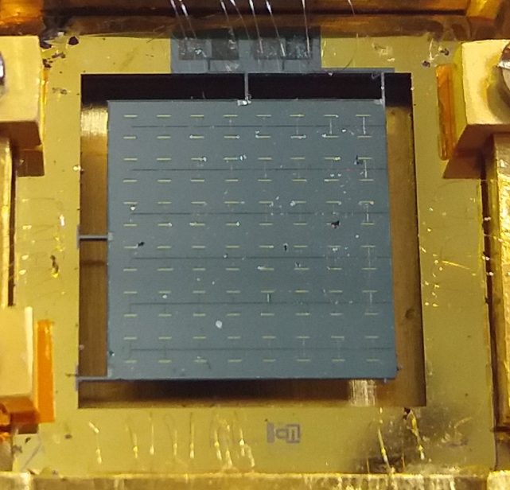
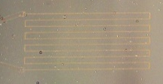
DM (AC-S10) for Concept vs DM #127 for Thermal Validation
So far, the CryoAC peculiar features have been (DM AC-S10 below just as example):
Thin Si absorber
~ 100 TES per cm² area
On-absorber deposited heater
Several chips have been designed produced and tested in the last ~ 10 years
What I’ll report later are results from last sample DM#127 that are simplifying our view of the CryoAC design concept about the TES number to be deposited.
DM (AC-S10)
DM #127
Ir/Au TES
2 mm x 1 mm
(Ir/Au: 185/41 nm)
Au Heater
394 Ω at cold
Absorber
Si 500 μm thick

Slide 8
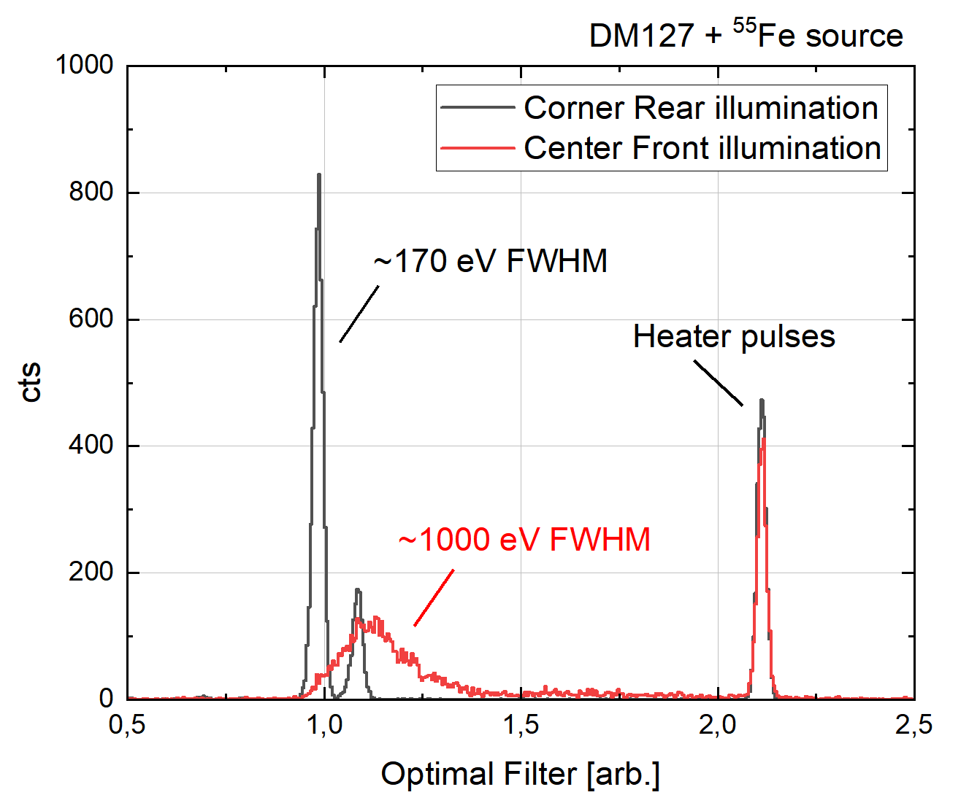
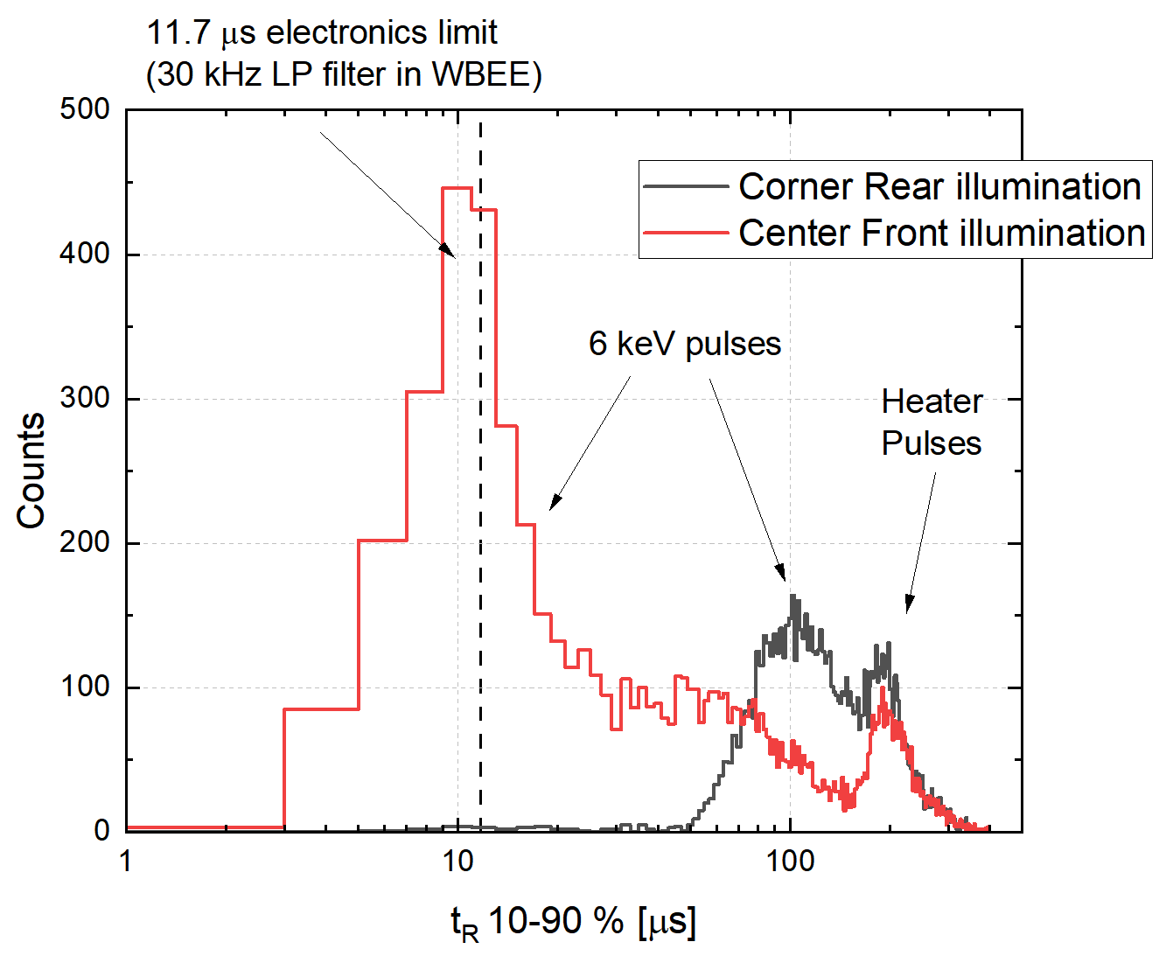
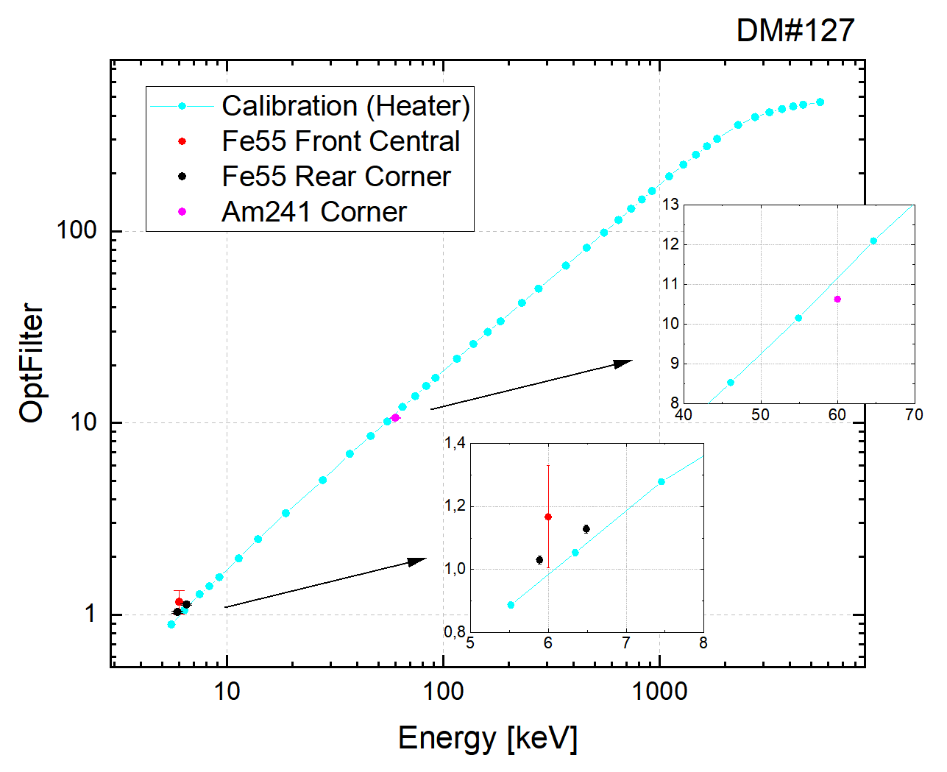
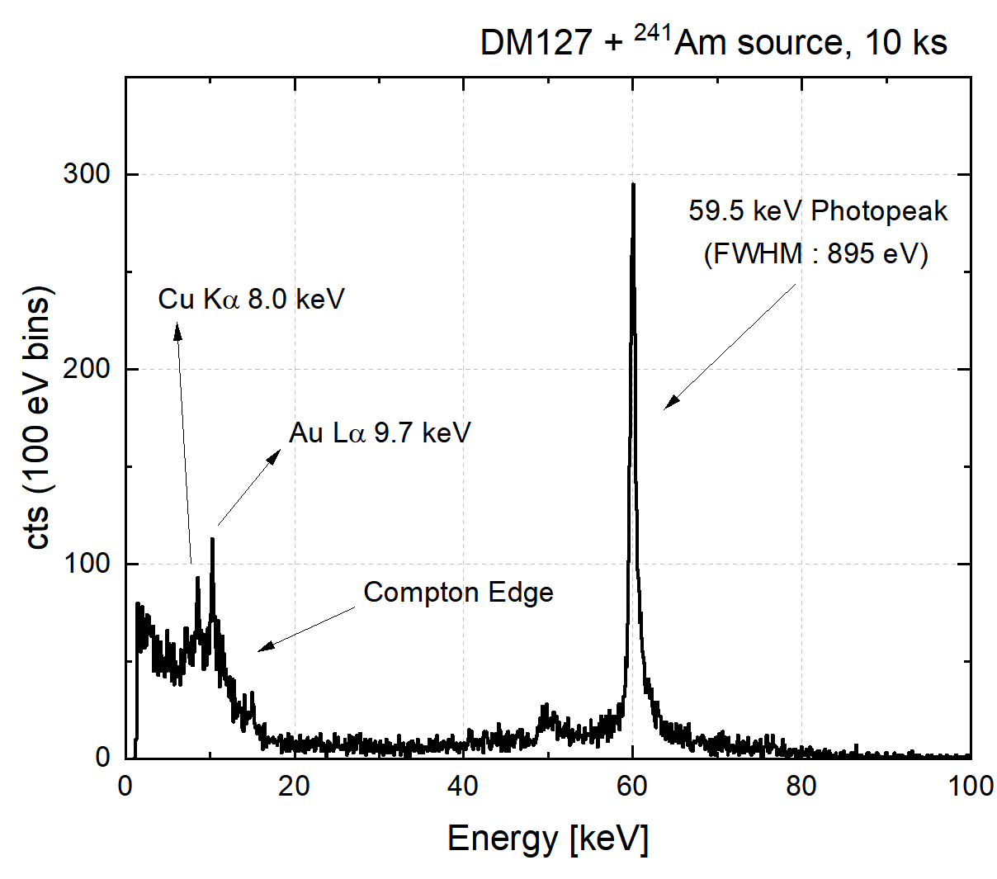
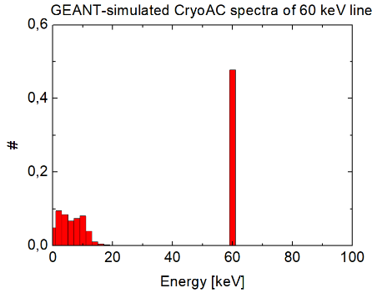
Illumination by 6 keV photons (⁵⁵Fe) and 60 keV photons (shielded ²⁴¹Am)
Center front
TES
Si absorber
Corner rear
With athermals worst energy resolution but faster pulses rise.
Thermal design is conservative for both energy threshold and dead-time (both the ⁵⁵Fe spectra start at the same point)
Validation of the energy calibration by the on-chip heater (0.5 keV accuracy up to 60 keV) against 6 keV photons (⁵⁵Fe) and 60 keV photons (²⁴¹Am)
→ we can calibrate the CryoAC by using its heater
Geant4 simulation
60 keV photons on 500 µm Si

Slide 9
DM#127 – Summary
Parameter | DM#127 (P heater = 0 nW) | CryoAC DM (P heater = 0 nW) | CryoAC requirement | Note
Low Energy Threshold | 1.4 keV | ~ 3 keV | < 6 keV
Bias current | 1 mA | 8 mA |  | < ~ 3mA requested by FPA
Power dissipation @ 50 mK | 9 nW | 30 nW | < 10 nW / pixel | Possible reduction by using heater and/or different shunt resistor
Rise Time | 25 µs | 15 µs | < 15 µs | Compliant with time-tagging accuracy requirement if < 30 µs: First direct evidence of a fast thermal Pulse extraction performed thanx to the WBEE trigger logic algorithm
ETF decay time | 1.3 ms | 700 µs | < 250 µs | Achievable with higher α and higher silicon legs aspect ratio
Thermal decay time | 2.4 ms | ~ 3 ms | < 2.5 ms
ΔE_{FWHM} @ 6 keV | 170 eV | 1300 eV | < 2500 eV
We are achieving good results by working with a pure thermal detector which translate into:
  simplified TES network, thus also mitigating failure during production process
  lower bias current and thermal dissipation
In the newATHENA context, this detector simplification can provide a more robust design going towards the requested new thermal dissipation, bias currents, etc…

Slide 10
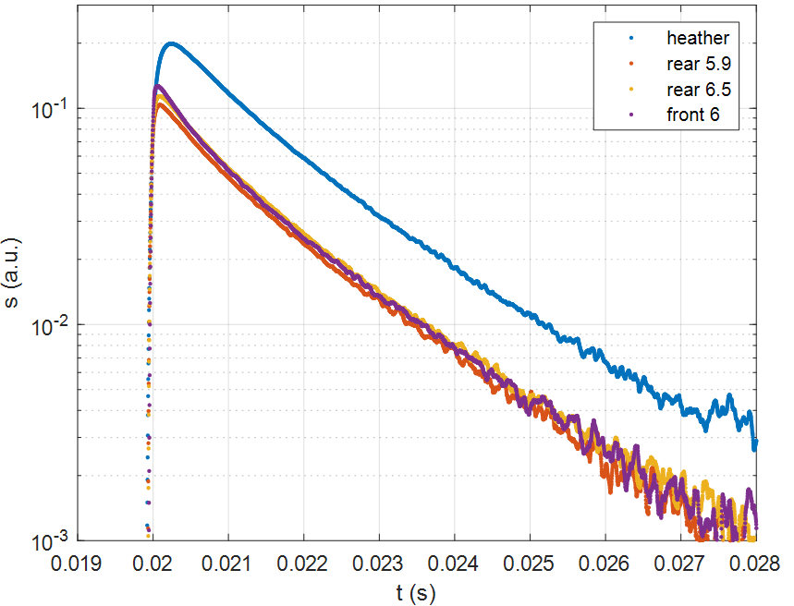
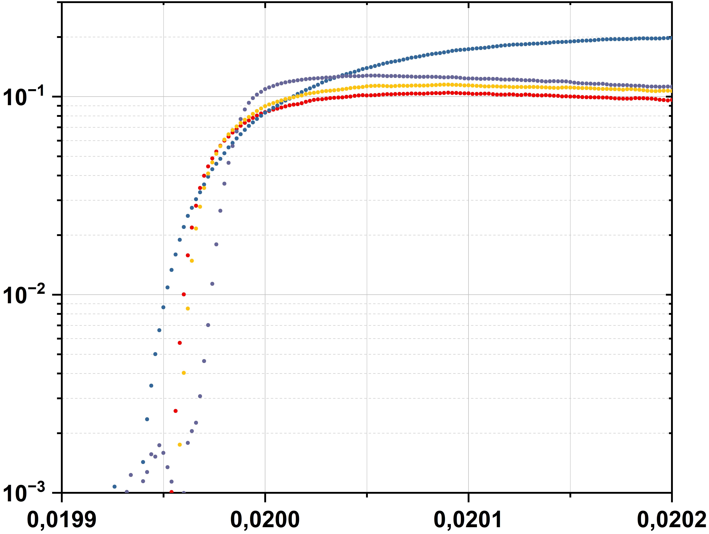
Phonon physics investigation: Genova simulation of athermal phonons (Si slab 1 cm² x 500 µm)
z
y
x
Signals on DM#127
z
Hz
Hz
Hz
Pure thermal pulse
(by heater)
z
x
y
The athermal phonon simulation gives us as result that after 10 μs the phonon distribution is uniform with energy equivalent to a Planckian at 10 K (still athermal, but uniformly distributed in the absorber volume → less TES needed, not necessary to wallpaper)
Semilog scale of measured signals with DM#127 show a thermal decay preceded by a peak formed by the combination of the thermal and a-thermal part of the signal. (This is more evident when the signal source is near to the TES)
These evidences plus the detector performances summarized in the previous Table allow us a fine tuning of the thermal and a-thermal signal parts exploitation to make the CryoAC with few TES per cm² without affecting the anticoincidence capability and gaining in spectroscopic capability. From the production point of view few TESes simplify a lot the design (wiring, …)

Slide 11
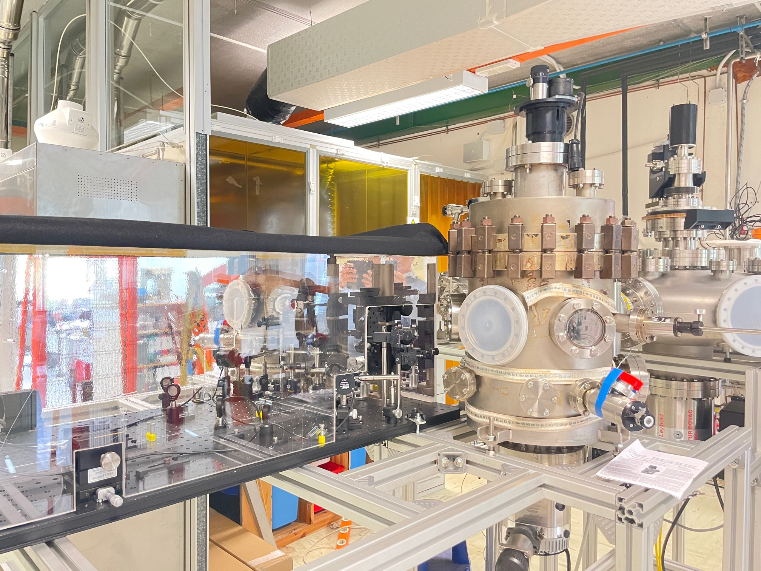
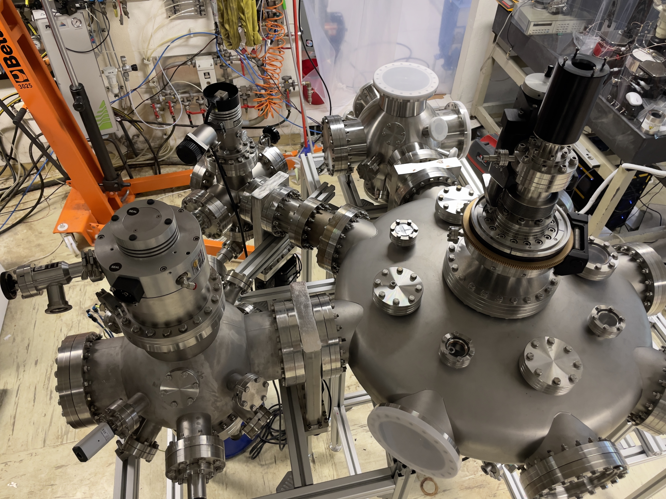
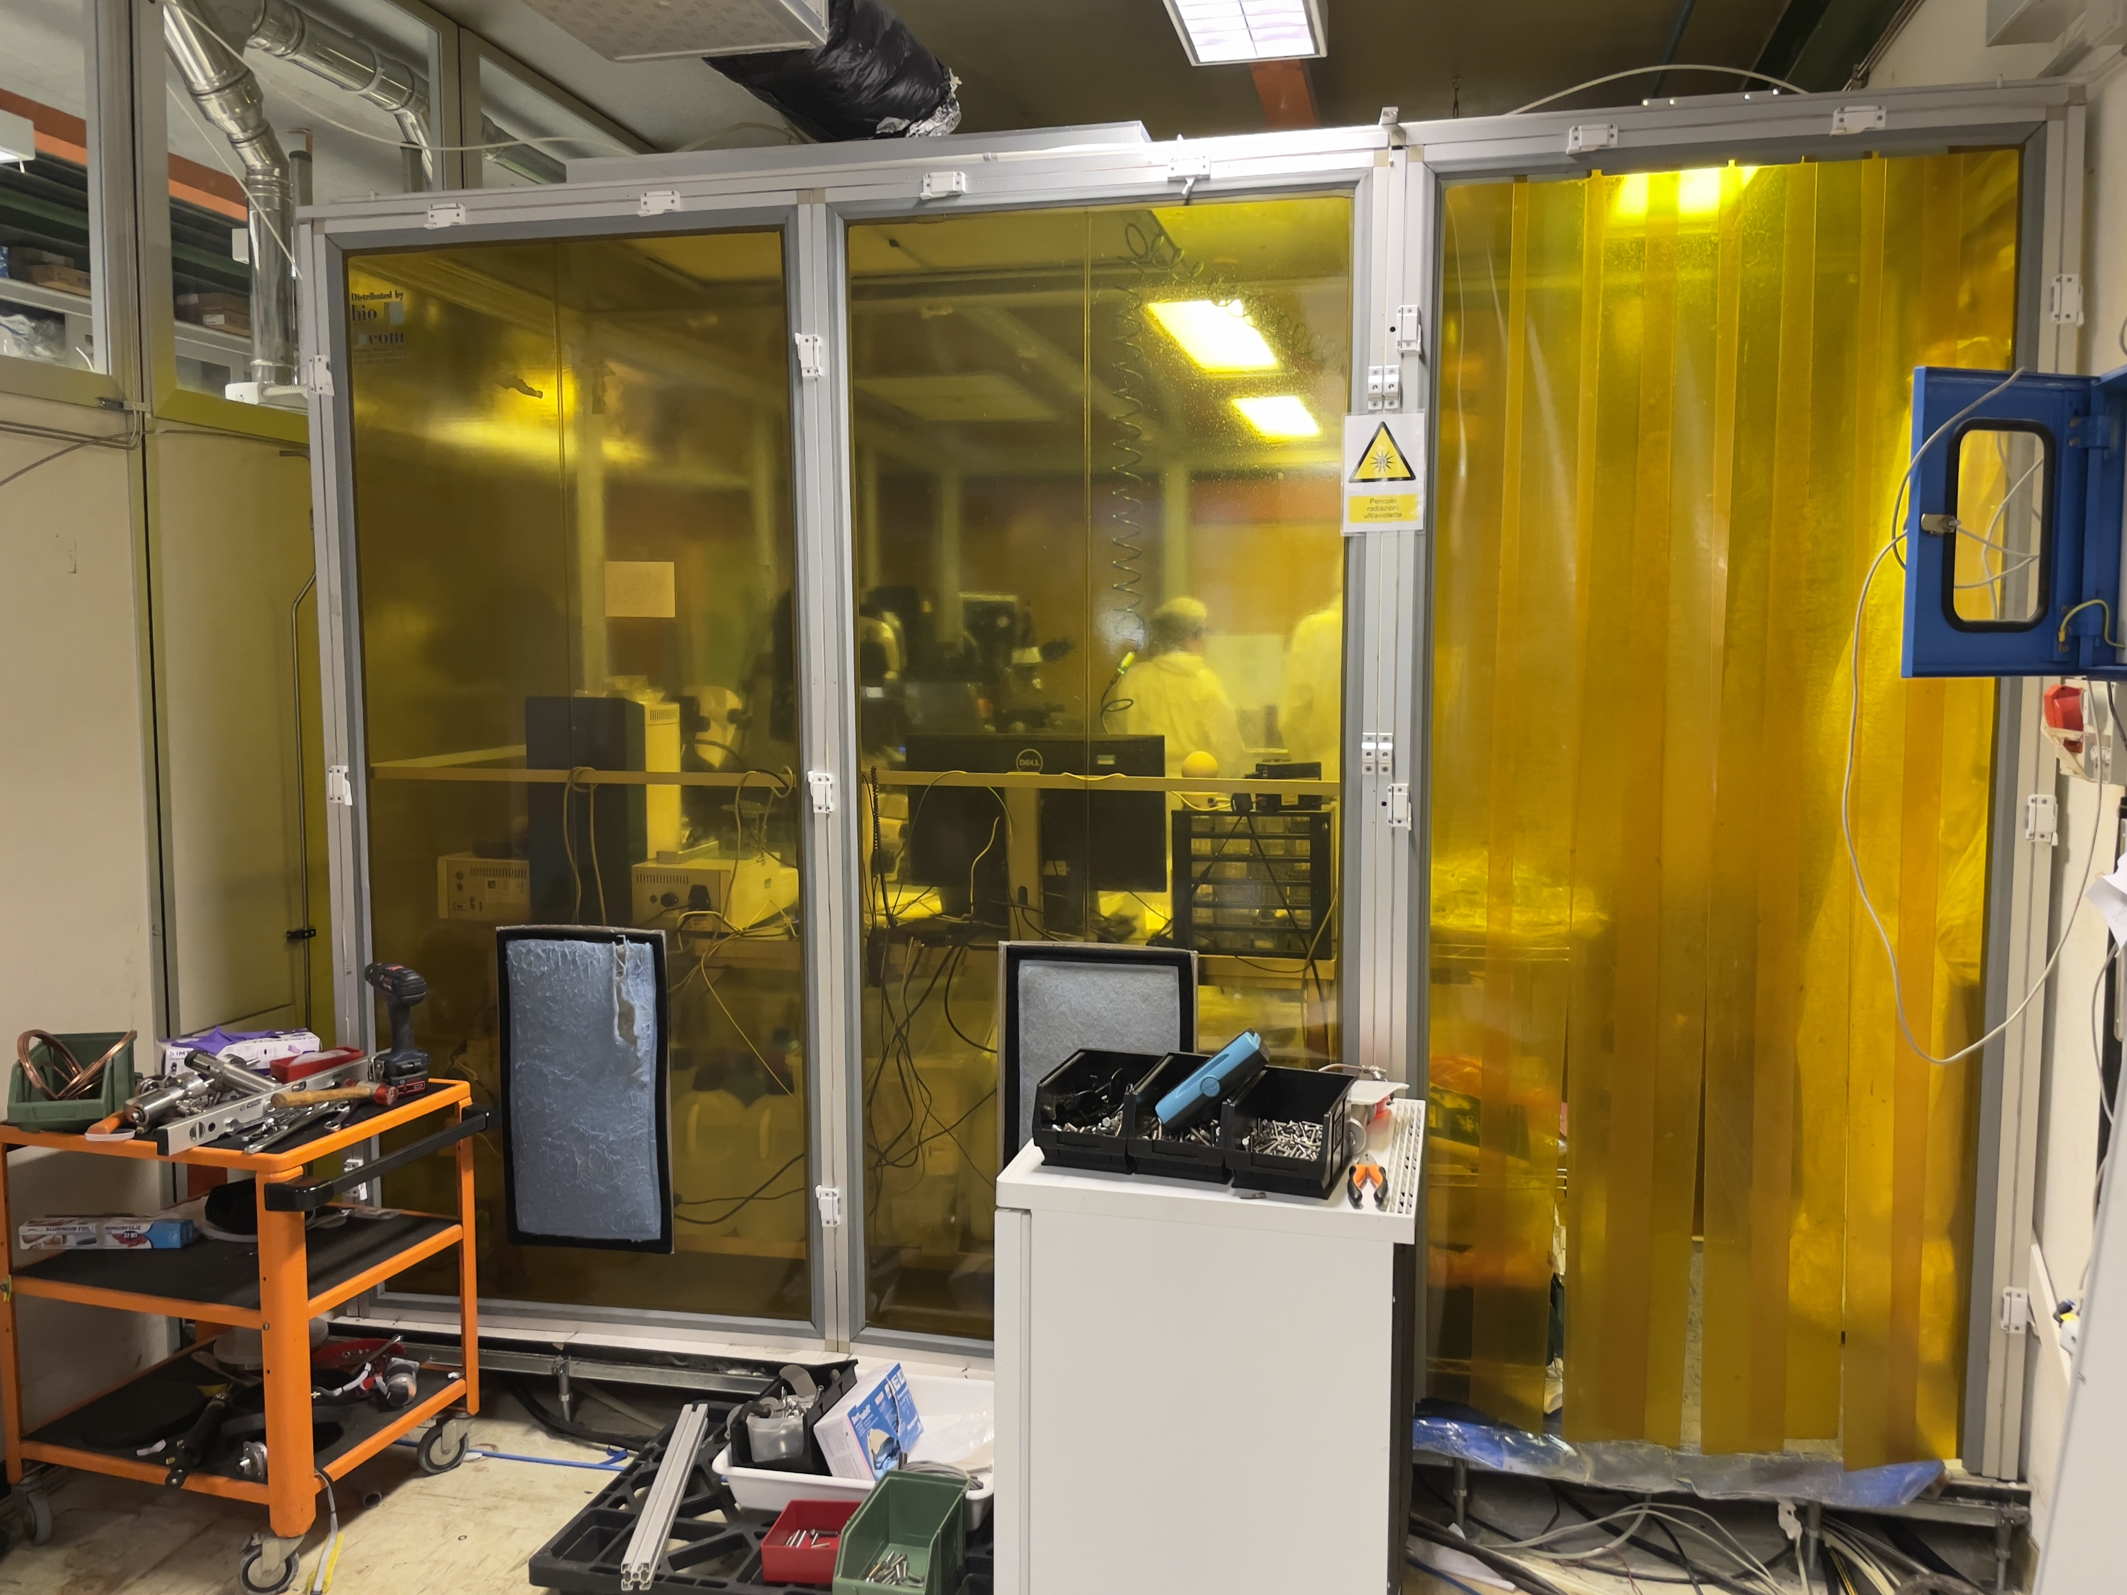
Critical technologies: the steps to enable CryoAC production
→ Production and Genova Lab/facility status ←
The several produced samples and relative studies against the CryoAC requirements have highlighted the necessity of major upgrades of laboratory in terms of production instrumentation (cannot be overcome by temporary actions), and because we faced instability in the sample results linked to lack of or limitations in monitoring
Solution: lab facilities upgrade → instrumentations and CleanRoom
Main lines for fabrication facility upgrade
  Chip/Film Processes (Etching, Ir/Au TES, Nb/SiO2/Nb stripline)
  Film growth (Ir uniformity and on site quality monitoring, Nb and Au cross interference, SiO₂ isolation
  Environmental particulate contamination (CR over the film growth & test area, Connection to Lithography CR)
At present our goal is to restart the production process by September having the full facility in working configuration
30 m^2
15 m^2

Slide 12
Conclusion
our effort by 2024 will be focused on the fabrication process procedure validation and sample test
Lab and fab facilities upgrade at Genova to be closed in September
Present DM-like detector (thermal sample) nearly compliant with CryoAC requirements → Just a scaling of the Si-legs aspect ratio to be fully compliant, but weend of a new chip to be tested to confirm our view
How many TES to deposit per pixel? We have to produce chip to better understand the behaviour but from Genova simulation on phonon physics we have a guide
All in all, at present our CryoAC concept is a segmented device having full active area reduced to ~ 4’ FoV (from ~ 5 to ~ 3 cm^2 active area) based on 4 pixels and 4 readout chain as the old baseline, but each pixel having on-board 1 or few TES (probably with bias line not superimposed deposited but in parallel on the absorber plane: Ibias ~ 1/Ntes)
2023 tentative planning:
  Single process procedure consolidation (bi-layer deposition, TES RIE, Si DRIE) Jan/2024 → validation by 2024
  Closure of the thermal and athermal validation Dec/2023
  CryoAC rejection efficiency measurement at a beam test facility (in touch with BTF@Frascati) by Dec/2023
  SM1 activity (vibration of exhagonal assembly having not representative I/F, already done SM0 chip)

