Slide 1
High Precision X-Ray Measurements 2023
19 – 23 June 2023, Laboratori Nazionali di Frascati, Italy
Development of energy-resolved X-ray scanners for contaminant detection: results from the AVATAR X project
A. Buttacavoli¹*, F. Principato¹, G. Gerardi¹, D. Cascio¹, G. Raso¹, V. Taormina¹, M. Bettelli², A. Zappettini², S. Zanettini³, G. Bertuccio⁴, F. Mele⁴, J. Quercia⁴ and L. Abbene¹
¹Department of Physics and Chemistry-E. Segrè, University of Palermo, Italy
²IMEM/CNR, Parma, Italy
³due2lab s.r.l, Reggio Emilia, Italy
⁴Politecnico di Milano, Como, Italy
*corresponding author: antonino.buttacavoli@unipa.it

Slide 2
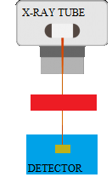
Motivations
Goal: Development of room temperature spectroscopic imagers for X-ray imaging up to 150 keV.
AVATAR X Project (MUR)
Energy-resolved X-ray scanners
for food inspections
Department of Physics and Chemistry (DiFC),
University of Palermo (Italy) (L. Abbene)
IMEM-CNR, Parma (Italy) (A. Zappettini)
Politecnico di Milano, (G. Bertuccio)
Due2lab company, Italy (N. Zambelli)
Collaboration

Slide 3
Proposed Detection Systems
Front-end electronics with
the preamplifier (CSP) stage
Digital Readout Electronics for Pulse Shape and
Height Analysis
(PSHA)
CZT linear array detectors
Requirements
Room temperature operation
Energy resolution < 3 keV at FWHM at 60 keV
Sub-millimetre spatial resolution (< 0.5 mm)

Slide 4
DETECTORS AND ELECTRONICS

Slide 5
The Detectors
Detectors are fabricated at IMEM-CNR (Parma, Italy) and by due2lab s.r.l (Reggio Emilia, Italy).
CZT crystals (10.4 x 3 x 1 mm³) grown by using the Boron Oxide Encapsulated Vertical Bridgman (B-VB) growth technique and gold electroless contacts.
Linear arrays with pixel pitch of 225 µm.
Inter-pixel gap of 25 µm.
Intermediate guard-ring to minimize charge sharing.
A. Zappettini et al., J. Cryst. Growth 307 (2007) 283

Slide 6
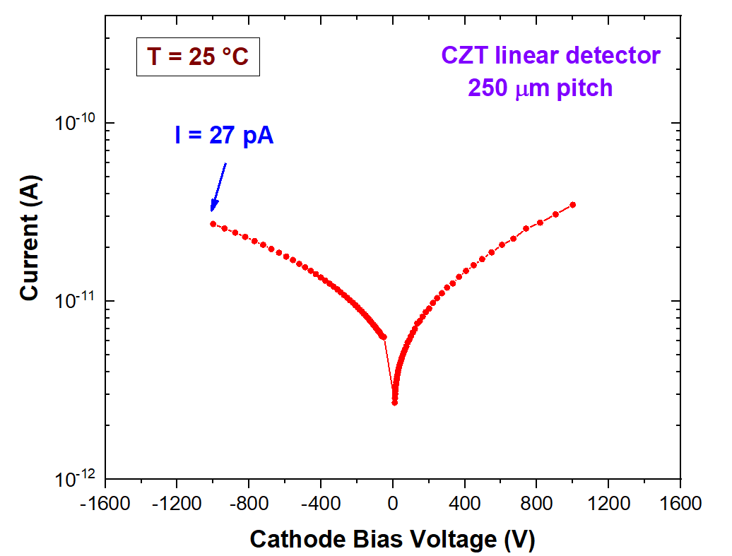
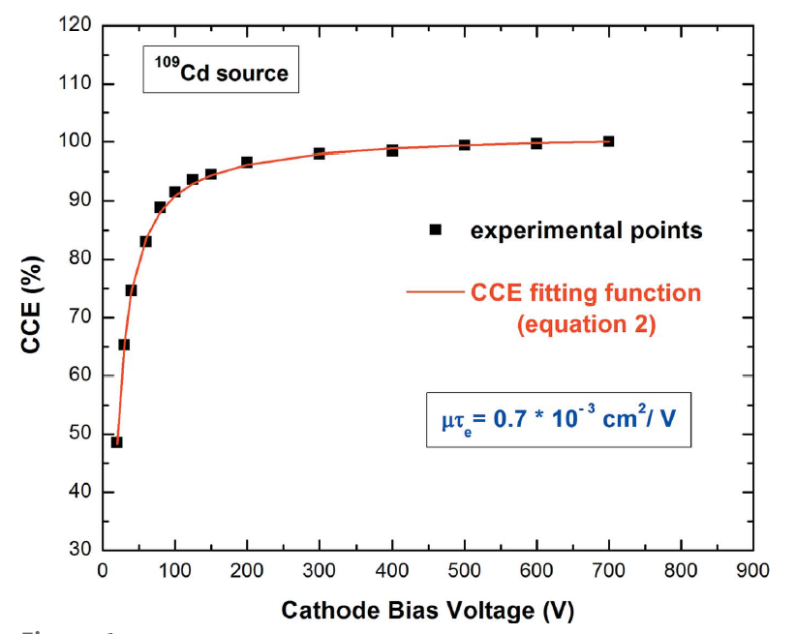
B-VB CZT Detectors
Physical properties of B-VB CZT detectors
Low leakage currents
High bias voltage operation (> 7000 V/cm)
Good electron charge transport properties
L. Abbene, et al. J. Synchrotron Rad. (2020) 27 (2), 319.

Slide 7
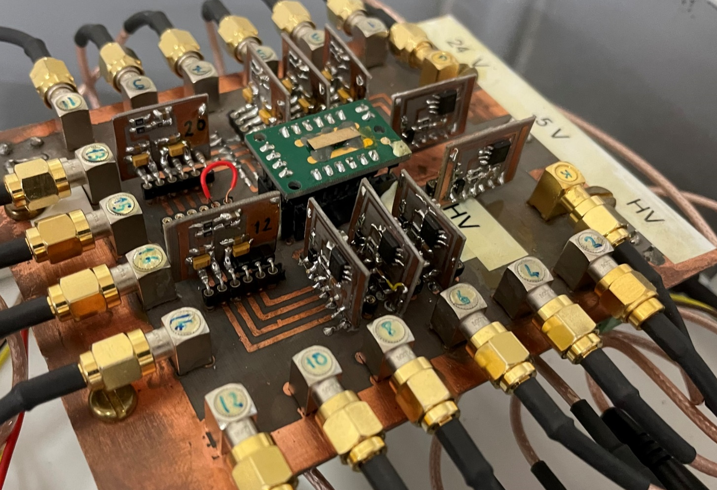
Front-end Electronics
Hybrid charge sensitive preamplifiers developed at University of Palermo
Front-end electronics with preamplifier stage (no analog pulse shaping).
ENC < 100 electrons.
Resistive-feedback circuit with a decay time of 20 us.

Slide 8
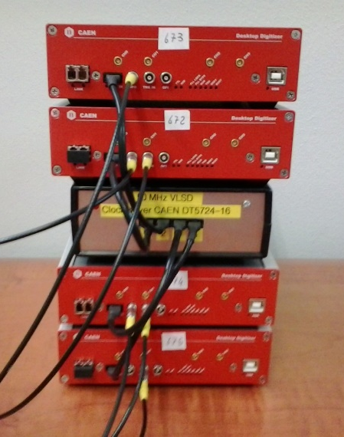
Digital Electronics
Digital Pulse Processing (DPP) electronics.
8 digitizers (100 MHz) with 32 channels
(modified version of CAEN DT5724, CAEN S.p.A., Italy).
Custom Firmware based on a DPP strategy developed at DiFC (University of Palermo).
L. Abbene, et al. J. Synchrotron Rad. (2018) 25 (1), 257.

Slide 9
Digital Pulse Processing
Digital Real-Time Pulse Shaping by using the Single Delay Line (SDL) and Trapezoidal filtering.
Outputs
the arrival time
the pulse height (energy)
the pulse time width and the peaking time (shape)
The system also allows the acquisition of the CSP waveforms for quick look or off-line analysis.

Slide 10
SPECTROSCOPIC RESULTS

Slide 11
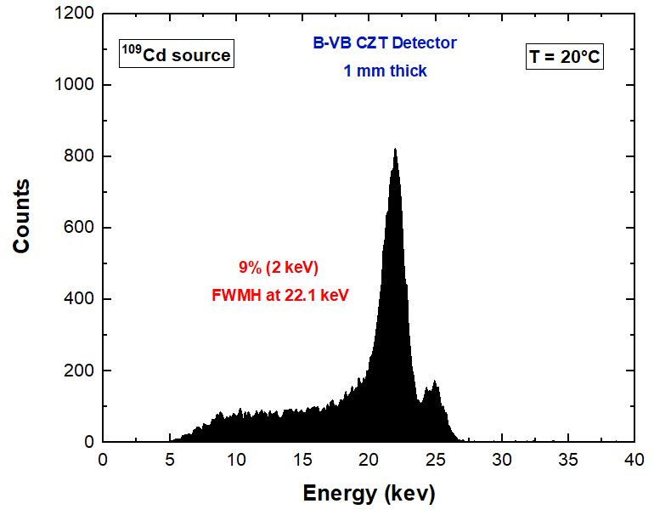
Energy Spectra from Anode Pixels
- 700 V

Slide 12
Energy Spectra from internal guard-ring

Slide 13
Energy Spectra from Cathode

Slide 14
Spectroscopic Correction with Cathode/Anode Pulses

Slide 15
PRELIMINARY RESULTS WITH A NEW ASIC

Slide 16
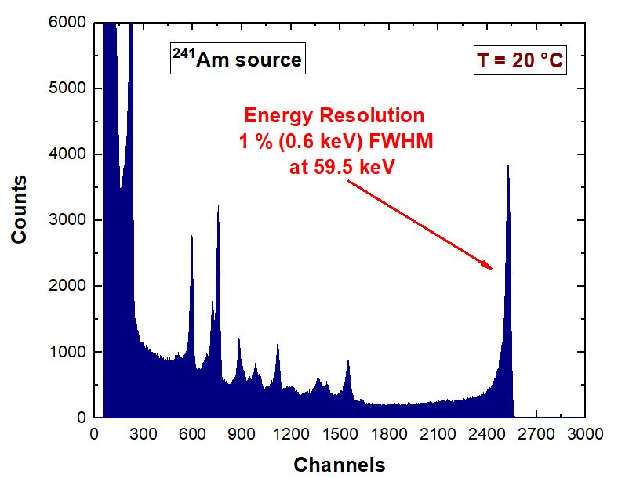
Spectroscopic Performance with a new ASIC
SIRIO ASIC
Preamplifier Stage
Technology: CMOS 0.35 µm
Conversion gain: 40 mV/fC
ENC (without detector) 3.2 el. r.m.s.
Rise-time (without detector): <10 ns
F. Mele, et al. IEEE TNS (2021) 68, 379-383.
Ultra-high resolution at room temperature… very close to the Fano Noise (0.4 keV at 60 keV)!

Slide 17
CHARGE SHARING MEASUREMENTS

Slide 18
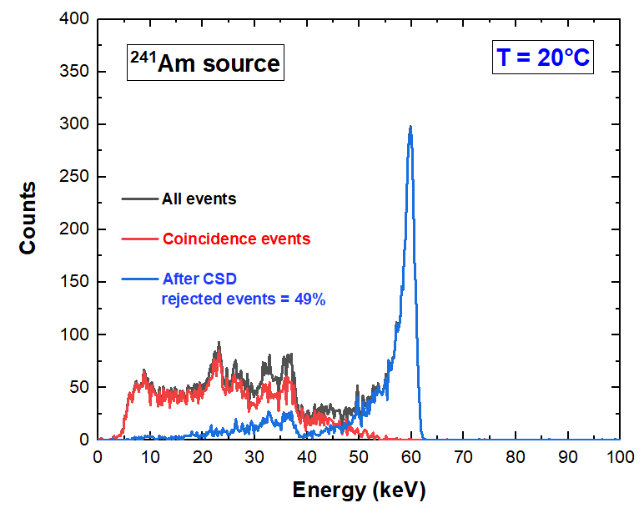
Charge Sharing Results
Time coincidence events between a pixel with all adjacent pixels and guard-ring (simulating a pixel layout)
Shared events of 49 % with inter-pixel gap of 25 µm.
For comparison, shared events of 60 % with inter-pixel of 50 µm.

Slide 19
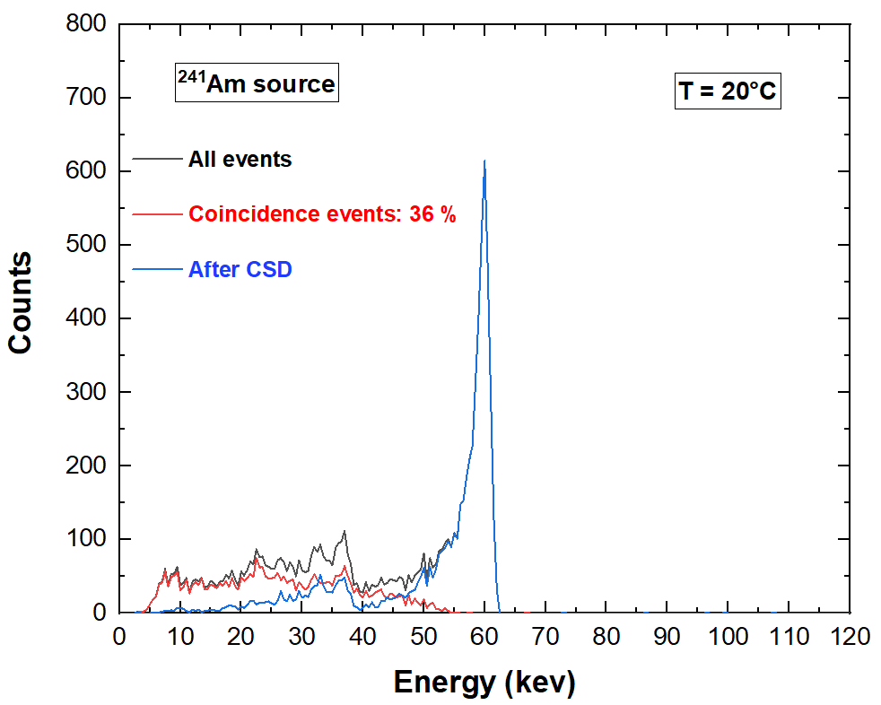
Charge Sharing Results
Time coincidence events between a pixel with the two adjacent pixels (linear array approach)
Shared events of 36 % with collimator and guard-ring (linear array approach).

Slide 20
Charge Sharing Results
Time coincidence events between a pixel with the two adjacent pixels (linear array approach)

Slide 21
RESULTS FROM ENERGY-RESOLVED IMAGES

Slide 22
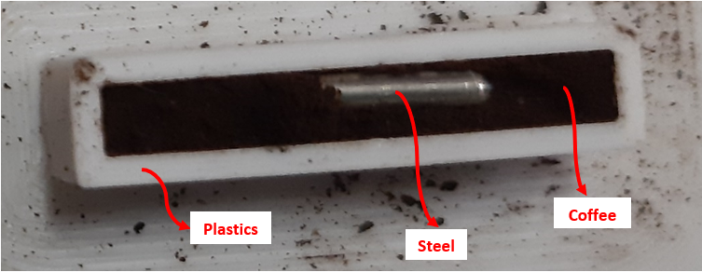
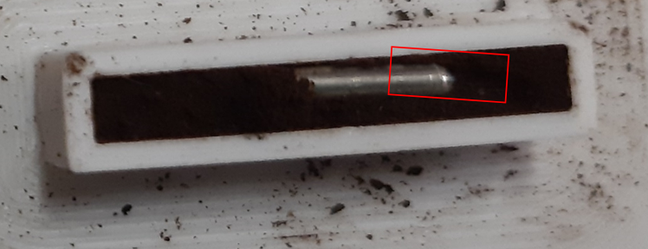
The Phantom
X-ray scanning with Ag-target X-ray tube (50 kV)
Scanned area
$${CNR}_{C}=\frac{\left|I_{C}−I_{B} \right|}{σ_{B}}= \frac{C_{c}}{σ_{B}}$$

Slide 23
Photon Counting Images and Charge Sharing
X-ray scanning with Ag-target X-ray tube (50 kV)
Raw Image (with charge sharing)
CNR_{steel} = 6 CNR_{plastics} = 1
G-CSD Image (after CSD with the internal guard-ring)
CNR_{steel} = 11 CNR_{plastics} = 5
CSD Image (after CSD)
CNR_{steel} = 11 CNR_{plastics} = 6

Slide 24
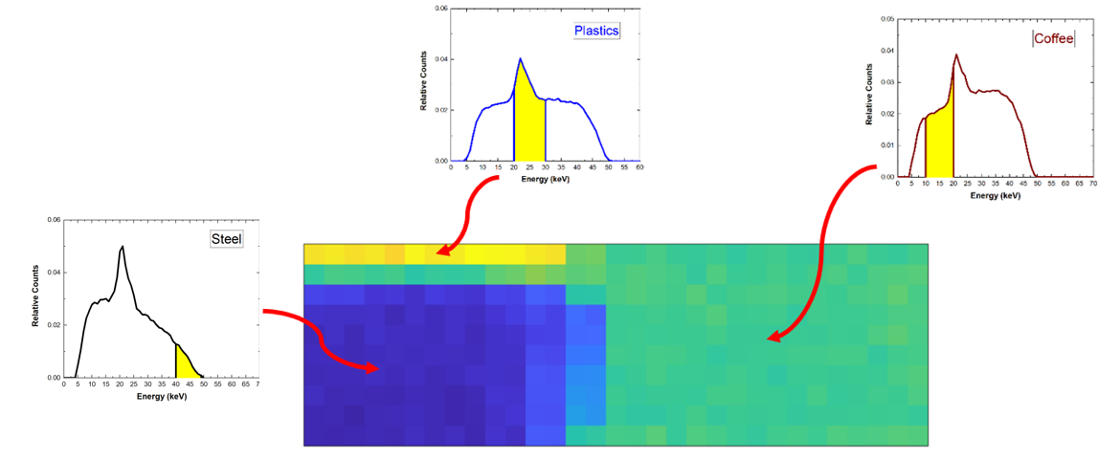
Energy-Resolved X-ray Images
New Technique: Window-Based Energy Selecting X-ray Imaging
Taormina et al.
21 June 2023 5:10 pm
Session: X-ray detectors 3
This conference
A. Buttacavoli et al., Sensors Vol 23, Issue 6 (2023) 3196

Slide 25
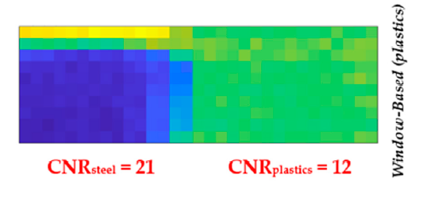
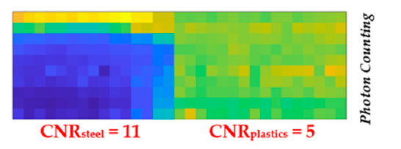
Energy-Resolved X-ray Images
New Technique: Window-Based Energy Selecting X-ray Imaging
Taormina et al.
21 June 2023 5:10 pm
Session: X-ray detectors 3
This conference
A. Buttacavoli et al., Sensors Vol 23, Issue 6 (2023) 3196

Slide 26
Conclusions and Ongoing Activities
B-VB CZT linear array detectors with good room temperature performance (FWHM < 3 keV at 60 keV) are developed.
Inter-pixel gap of 25 µm allows the reduction of charge sharing and charge losses.
Ultra-high energy resolution (0.6 keV FWHM at 60 keV) was obtained with a new ASIC, opening exciting activities for spectroscopic and imaging enhancements.
A new energy-resolved approach, termed window-based energy selecting, was developed and excellent CNR enhancements in X-ray images were obtained, if compared with photon counting and other energy-resolved techniques;
20

Slide 27
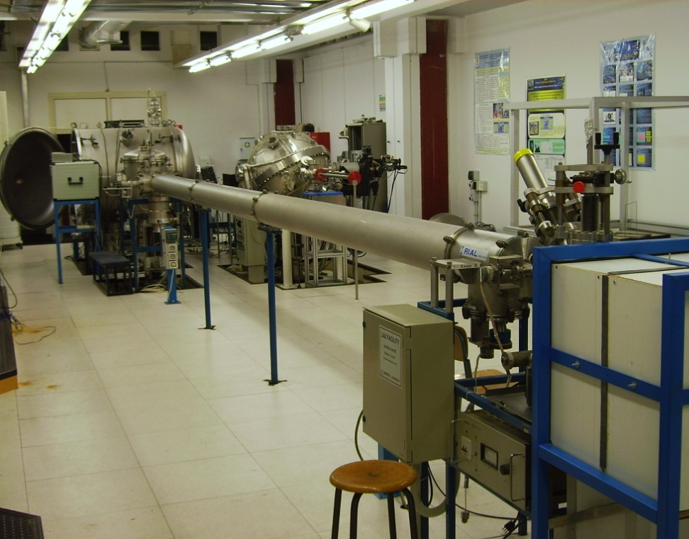
THANK YOU FOR YOUR KIND ATTENTION

