Slide 1
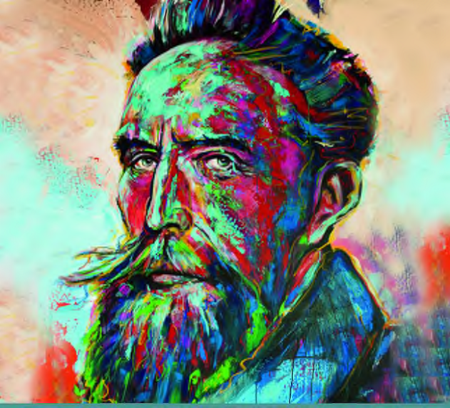
Wilhelm Conrad Röntgen The discovery of X-rays and the creation of a new medical profession Anna-Katharina Kätker HPXM Conference 2023 Laboratori Nazionali di Frascati 19-23 June 2023
© Deutsches Röntgen-Museum
Notes:
invitation
special year
100th anniversary of Röntgen's death on February 10, 1923, -a fitting occasion

Slide 2
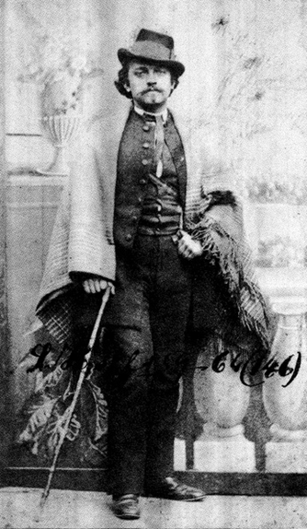
Prologue – Stuttgart 1892
"Oh, if only there was a way to make man transparent like a jellyfish!"
Philander. Electra - A medical fairy tale, 1892
Ludwig Hopf alias Philander (1838-1924),
German physician and writer
HPXM Conference I 19-23 June 2023
© Deutsches Röntgen-Museum
Notes:
Ludwig Hopf , German physician and writer - Philander.
Three years before the discovery
Wrote about a young country doctor in his fairy tale “Electra” - spirit of the twentieth century
box with a special light
became reality. WCR discovered a new kind of light that was able to pass through matter.

Slide 3
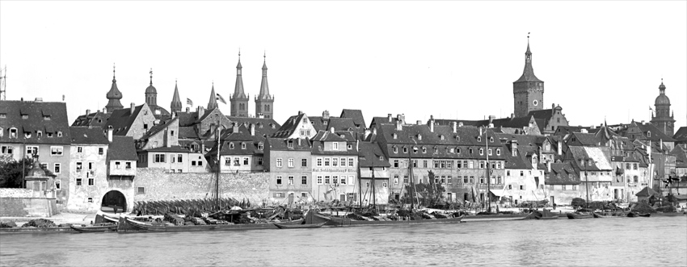
Würzburg 1895
View over the river to Würzburg W.C. Roentgen,1890
HPXM Conference I 19-23 June 2023
© Deutsches Röntgen-Museum
Notes:
discovery - Bavarian town Würzburg, around 1890.
Here in 1889,
young and ambitious scientist WCR had been appointed Professor for physics
successor of the very famous German physicist Friedrich Kohlrausch.
enthusiastic amateur photographer

Slide 4
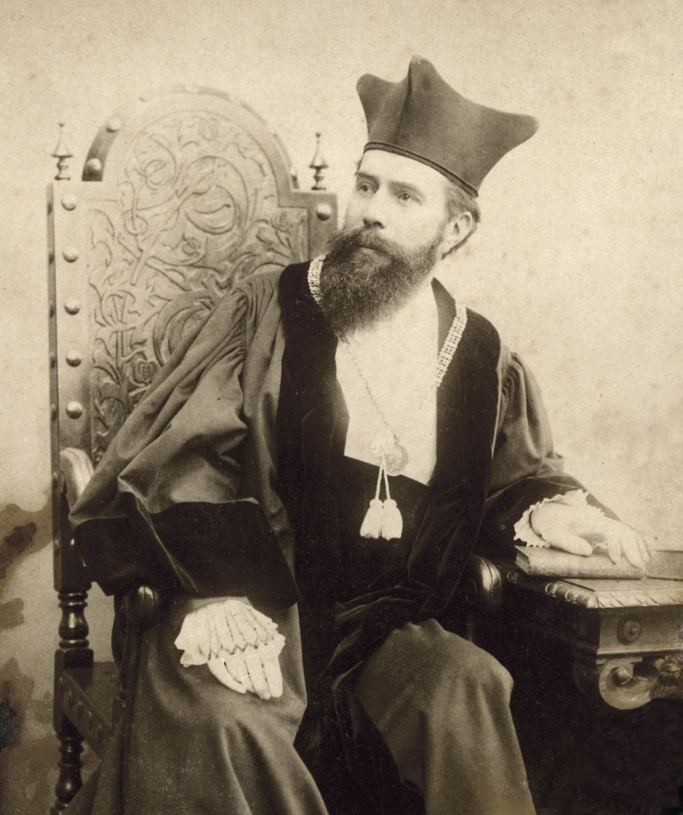
Brief biography of Röntgen
NAME Wilhelm Conrad Röntgen
OCCUPATION Physicist
DATE OF BIRTH March 27, 1845
PLACE OF BIRTH: Remscheid, Germany
EDUCATION Mechanical engineering
at Polytechnic (Zurich)
PhD in physics at
University of Zurich
PROFESSIONAL Strassburg, Hohenheim,
STATIONS Giessen, Wuerzburg,
Munich
DATE OF DEATH February 10, 1923
PLACE OF DEATH: Munich, Germany
W.C. Roentgen,1894 (Archive University of Wuerzburg)
HPXM Conference I 19-23 June 2023
© Deutsches Röntgen-Museum
Notes:
Quick overview biography
born in 1845 in Lennep, Rheinland.
parents - cloth merchands.
school in in Apeldorn and Utrecht, in the Netherlands.
no highschool diploma - he wasn’t allowed to study at a German university
mechanical engineering at Polytechnicum Zurich.
After his PhD with August Kundt,
proceeded as Professor for Physics in Strassburg, Hohenheim, Giessen, Würzburg, Munich.

Slide 5
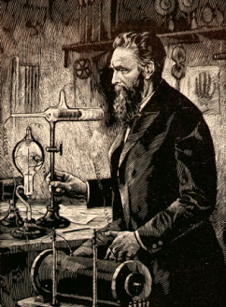
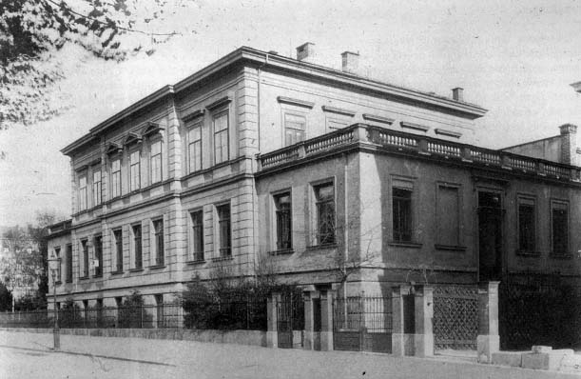
Physical Institute, University of Würzburg
"I have been for a long time interested in the problem of the cathode rays from a vacuum tube as studied by Hertz and Lenard. I had followed theirs and other researches with great interest, and determined, as soon as I had the time, to make some researches of my own. This time I found at the close of last October (1895). I had been at work for some days when I discovered something new."
W. C. Roentgen: Interview mit H.J. Dam Mc Clure’s Magazin, April 1896
HPXM Conference I 19-23 June 2023
© Deutsches Röntgen-Museum
Notes:
spring of 1894
cathode rays - popular topic
Studied electric currents flowing through evacuated glass tubes
beam of electrons traveling from the negatively charged electrode (cathode)…
excite the glass wall or gas atoms - luminous colour effects.
not yet known, confirmed only in 1897 by Joseph John Thomson.
Two years earlier - Heinrich Hertz - rays passed through gold and aluminum foils inside the tube.
assistant Philip Lenard, special tube with a thin aluminum window –
permitted the cathode rays to pass out of the vacuum tube into the air.
From October 1895 Röntgen started with his own experiments on cathode rays by first repeating Lenards experiments, later on he changed the e-set-up
building which contained his lab in Würzburg.

Slide 6
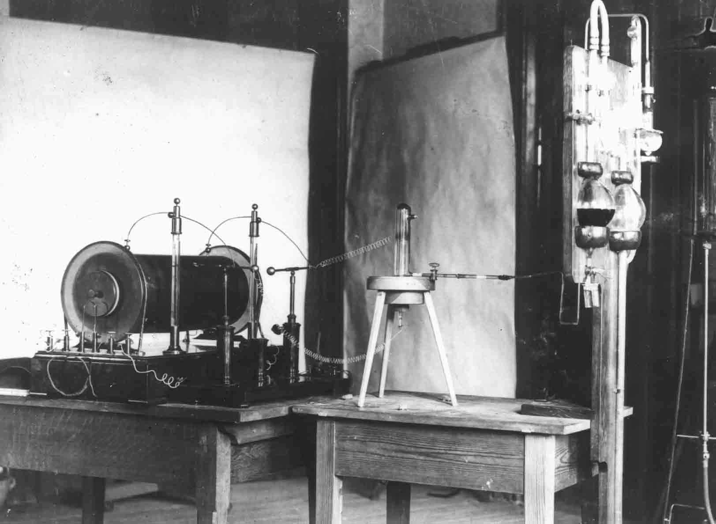
The experiment – „I did not think; I investigated.“
“A discharge from a large induction coil is passed through a Hittorf’s vacuum tube, or through a well-exhausted Crookes’ or Lenard’s tube. The tube is surrounded by a fairly close-fitting shield of black paper; it is then possible to see, in a completely darkened room, that paper covered on one side with barium platino-cyanide lights up with brilliant fluorescence when brought into the neighborhood of the tube, whether
the painted side or the other be turned towards the tube. The fluorescence is still visible at two meters distance. It is easy to show that the origin of the fluorescence lies within the vacuum tube.“
Roentgen WC. On a new kind of rays. Nature 53, 274, §1. 1896
HPXM Conference I 19-23 June 2023
© Deutsches Röntgen-Museum
Notes:
Friday, November 8, 1895 something new!
used Crookes and Hittorf ionising tubes, with heavier walls and without aluminium windows - connected to a special vacuum pump.
high voltage of about 60.000 Volt - Ruehmkorff induction coil.
By accident, fluorescent crystals, lying nearby began to glow.
sure that the blue and visible light from the tube - by fluorescence.
To verify this hypothesis R covered the tube with a black cardboard.
crystals were still glowing.
could not be described with the then existing knowledge of physics.
R. concluded that a new invisible and penetrating light
X-rays.

Slide 7
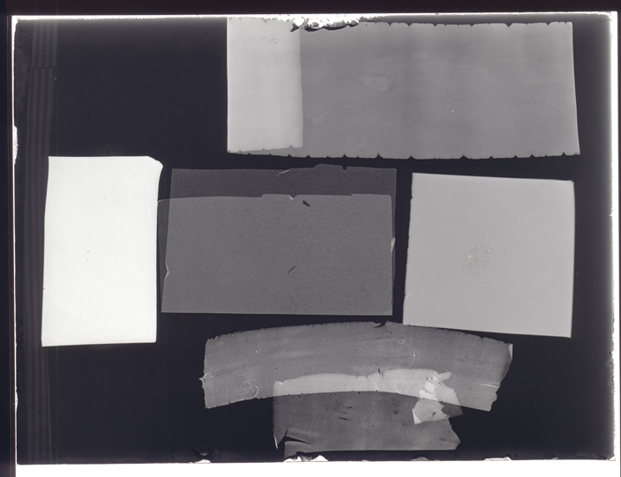
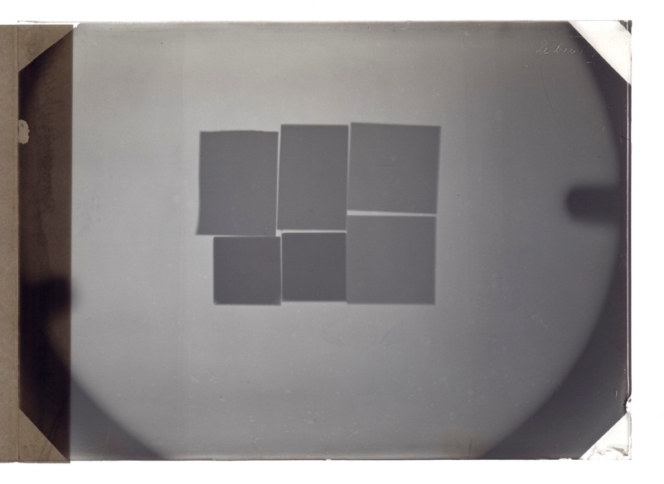
Experiments on x-rays - Absorption
“Increasing thickness increases the hindrance offered to the rays by all bodies. A picture has been impressed on a photographic plate of a number of superposed layers of tinfoil, like steps, presenting thus a regularly increasing thickness. This is to be submitted to photometric processes when a suitable instrument is available.”
“Pieces of platinum, lead, zinc, and aluminum foil were so arranged as to produce the same weakening of the effect.”
Roentgen WC. On a new kind of rays. Nature 53, 274, §3. 1896
HPXM Conference I 19-23 June 2023
© Deutsches Röntgen-Museum
Notes:
Following his first observation - seven weeks in his laboratory.
ambitious amateur photographer - new radiation was able to expose photographic plates.
practical tool to record.
to learn more about the physical nature - particles like the cathode rays or electromagnetic waves like the visible light?
started a series of experiments to analyse characteristic - absorption, propagation, reflexion, diffraction, deflection…
different material can absorb the radiation in different ways and he found out that absorption depends on the material and its thickness.

Slide 8
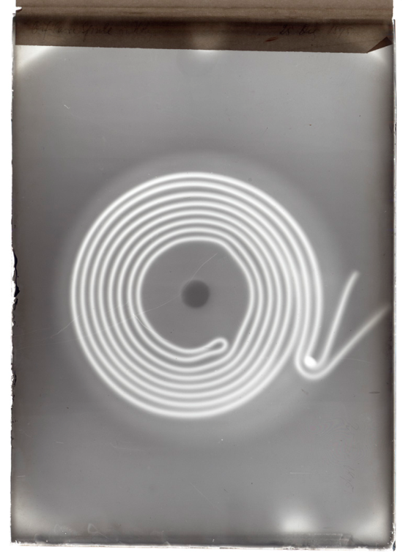
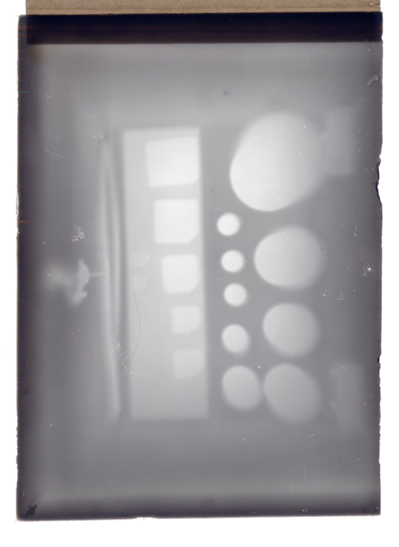
Experiments on x-rays – Spiral in a wooden box
“The justification of the term “rays,” applied to the phenomena, lies partly in the regular shadow pictures produced by the interposition of a more or less permeable body between the source and a photographic plate or fluorescent screen. (…) Thus, I have an outline of part of a door covered with lead paint; the image was produced by placing the discharge-tube on one side of the door, and the sensitive plate on the other. I have also a shadow of the bones of the hand, of a wire wound upon a bobbin, of a set of weights in a box…”
Roentgen WC. On a new kind of rays. Nature 53, 274, §14. 1896
HPXM Conference I 19-23 June 2023
© Deutsches Röntgen-Museum
Notes:
enthusiastic photographer
taking photographs of different objects:
laboratory door, painted with lead colour
a metal spiral in a wooden box
and a set of weights.

Slide 9
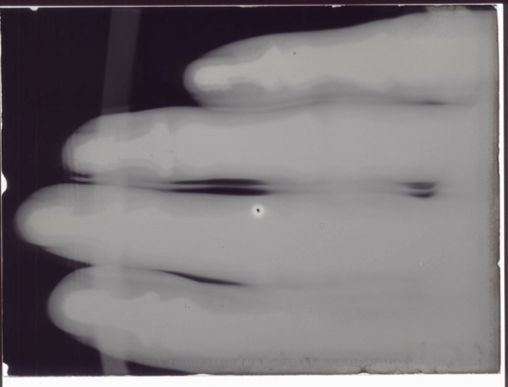
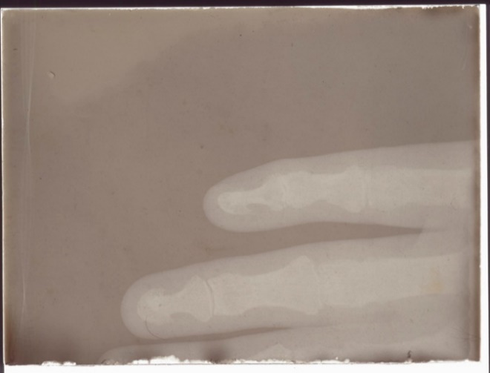
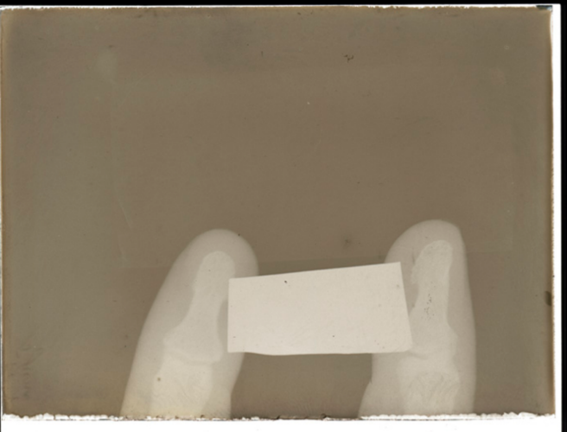
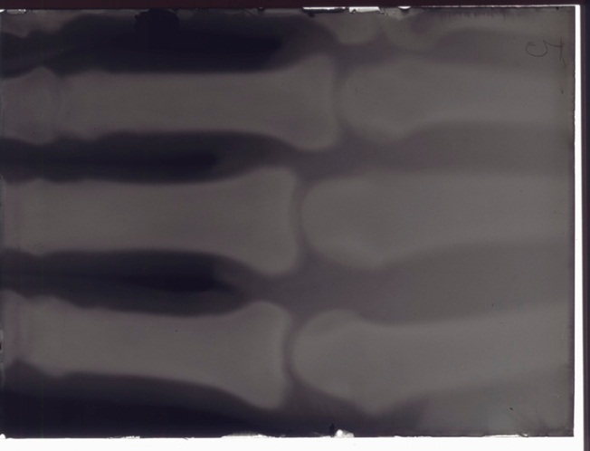
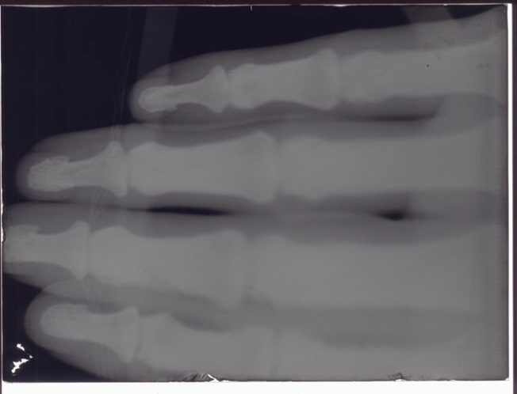
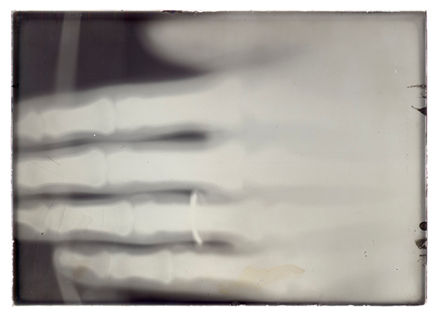
Experiments on x-rays – Röntgen‘s own hand
“If the hand be held before the fluorescent screen, the shadow shows the bones clearly with only faint outlines of the surrounding tissues.”
Roentgen WC. On a new kind of rays. Nature 53, 274, §2. 1896
HPXM Conference I 19-23 June 2023
© Deutsches Röntgen-Museum
Notes:
first to see the bones of a living human beeing
series of radiographs he documented parts of his own hand in April 1896.

Slide 10
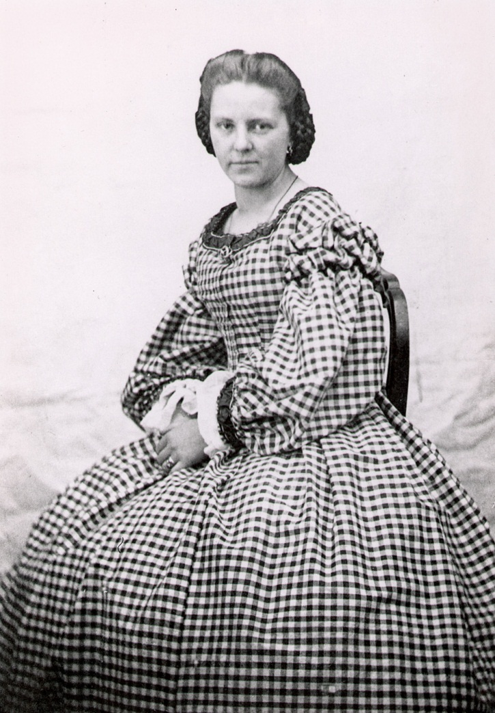
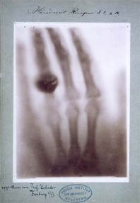
A vision of modern diagnostics
Anna Bertha Roentgen, nèe Ludwig (1839-1919)
Radiograph of Anna‘s hand taken on December 22nd, 1895
HPXM Conference I 19-23 June 2023
© Deutsches Röntgen-Museum
Notes:
world-famous became the radiograph of his wifes’ hand.
made the greatest impression upon the public.
On the photographic plate the bones of her hand and two rings can be seen distinctively.
historic document and December 22nd, 1895
became the true birthday of radiology as a medical field of work.
Wasn’t quite comfortable, commented the photo with: “I have seen my death”

Slide 11
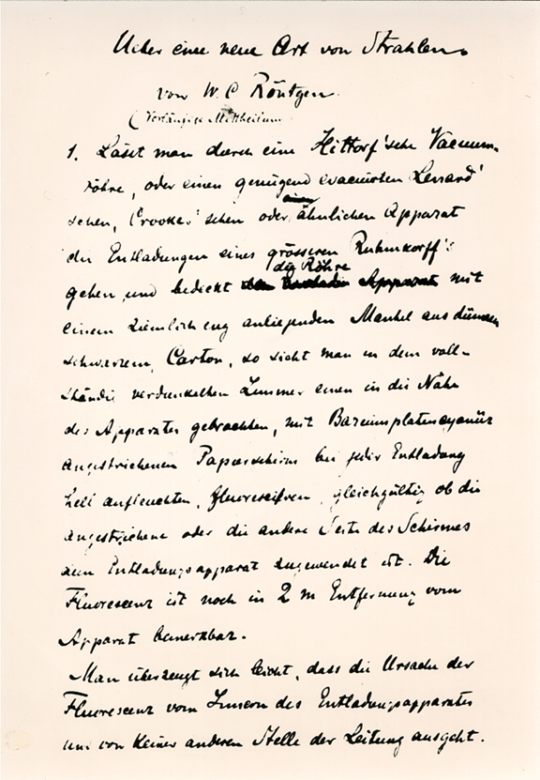
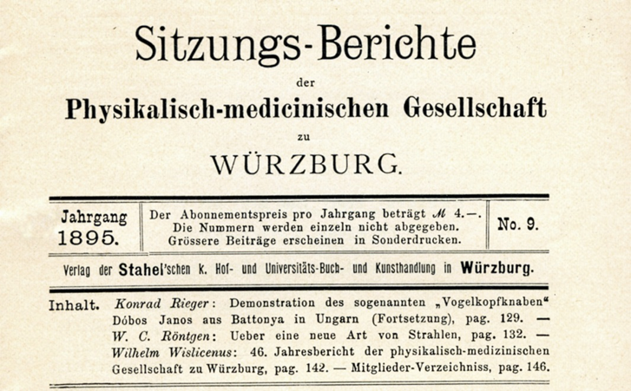
Manuscript of the first page, preliminary communication
HPXM Conference I 19-23 June 2023
© Deutsches Röntgen-Museum
Notes:
On December 28th, 1895 Roentgen submitted the manuscript of his results “Ueber eine neue Art von Strahlen (Vorläufige Mittheilung) to the
secretary of the Physical-Medical Society of Würzburg
for publication in the official organ of the society

Slide 12
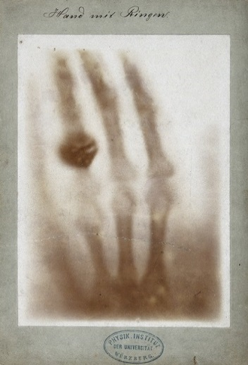
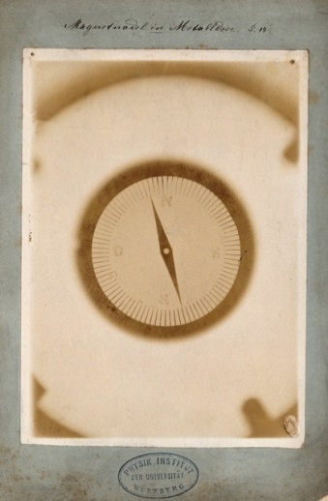
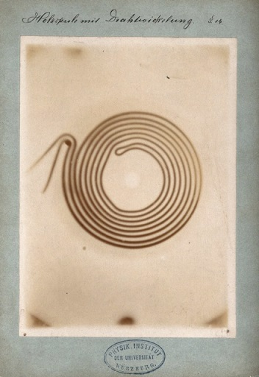
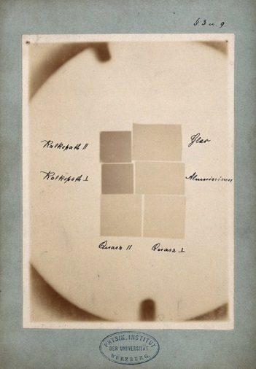
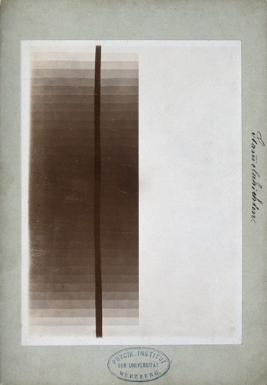
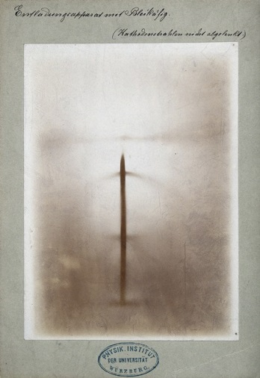
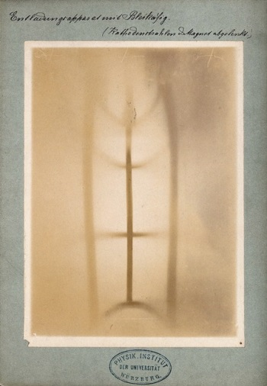
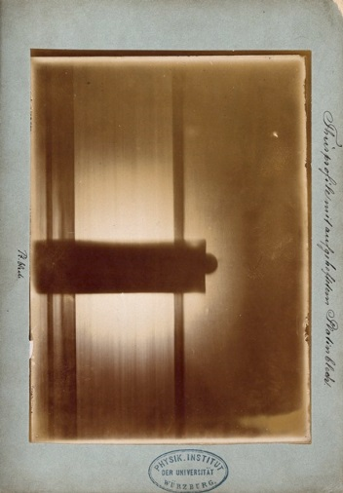
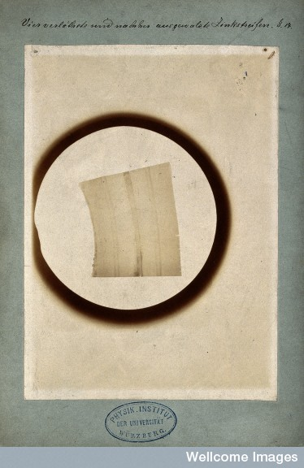
First reactions from scientists
HPXM Conference I 19-23 June 2023
© Deutsches Röntgen-Museum
Notes:
R. sure of the fundamental significance of his paper.
printed in the first week of 1896 and sent with nine pictures to important European scientists.
Among them F. Exner (Vienna), A. Voller (Hamburg) E. Warburg (Berlin), O. Lummer (Berlin), L. Zehnder (Freiburg), F. Kohlrausch (Strassburg), H.A. Loretz (Leiden),
Lord Kelvin (Glasgow),
Schuster (Manchester),
H. Poincaré (Paris) and others.

Slide 13
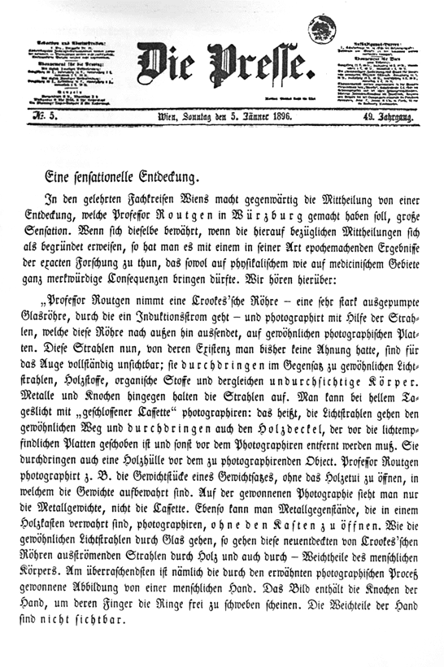
A message went around the world
“Wiener Presse“ (5.1.1896)
“Frankfurter Zeitung” (7. und 8.1.1896)
“The Electrical Engineer” New York (8.1.1896)
“Würzburger Anzeiger“ (9.1.1896)
“The Electrician” London (10.1.1896)
“Lancet” 11.1.1896
“British Medical Journal“ (11.1.1896)
“Le Matin“ Paris (13.1.1896)
“Nature” London 16.11896
„Times“ New York (16.1.1896)
„Science“ New York (24.1.1896)
„La Settimana“ Florence (25.1.1896)
HPXM Conference I 19-23 June 2023
© Deutsches Röntgen-Museum
Notes:
news - with unbelievable rapidity throughout the world.
mayor newspapers had picked up upon the story.
“Wiener Presse” on January 5th, 1896, as a direct consequence
Konrad Zacharias Lecher, the publisher - sensed the importance of Röntgen’s work
wrote an enthusiastic and appreciative article.
The Frankfurter Zeitung and the London Standard reprinted the news on January 6th and 7th,
from London, cabled to all countries all over the world, original paper was translated into many languages.

Slide 14
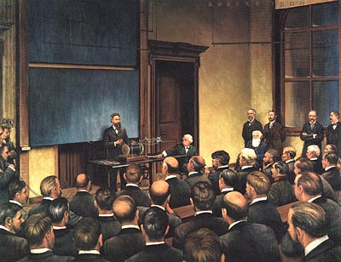
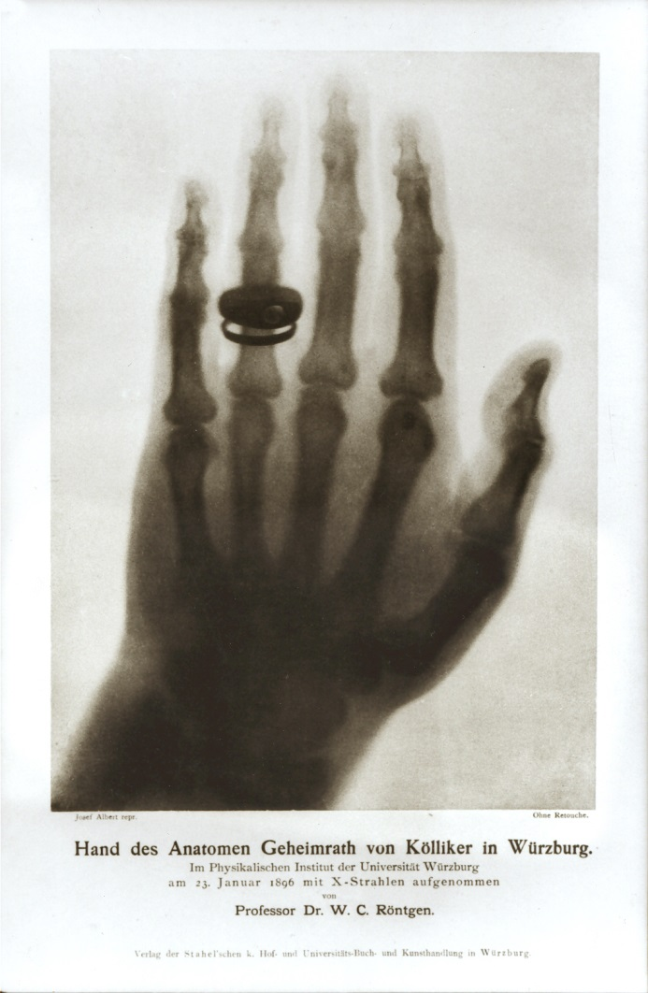
Public lecture
Physical-Medical Society University of Würzburg
Special Meeting on January 23rd, 1896
Alan Thom (1915-1979) painting in: Bender GA. Great Moments in Medicine. Parke, Davis Company, Northwood, Institute Press, Detroit 1966.
HPXM Conference I 19-23 June 2023
© Deutsches Röntgen-Museum
Notes:
Public demonstrations and lectures, widespread throughout 1896.
R. himself just gave one public presentation: On January 23rd, 1896
special meeting of the Physico-Medical Society of Würzburg .
made the radiograph of the hand of the famous German anatomist Prof. Albrecht Koelliker
exposure time 30 minutes.
Audience gave R. standing ovations
von Kölliker suggested to call the new rays henceforth "Röntgen rays".

Slide 15
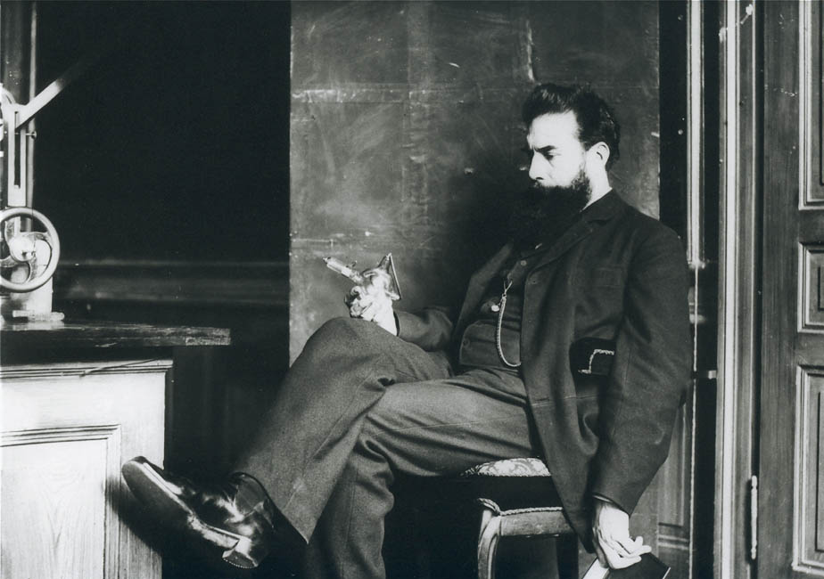
Röntgen - Scientist and man
“According to the good tradition of German university professors, I believe their discoveries and inventions belong to humanity, and should not be hampered by patents, licenses, contracts, nor controlled by any group.”
Röntgen in a letter to Max Levy, engineer at A.E.G.
HPXM Conference I 19-23 June 2023
© Deutsches Röntgen-Museum
Notes:
very modest man.
detested the excessive publicity and also disliked the fame and attention his discovery brought him as person
.
Röntgen declined to take out a patent on the X-rays
preferring to make it available to the medical and scientific communities for use of improvement and further research.
In 1901, he was given the first ever awarded Nobel Prize in Physics and
donated the Nobel Prize money
refused the title of nobility.

Slide 16
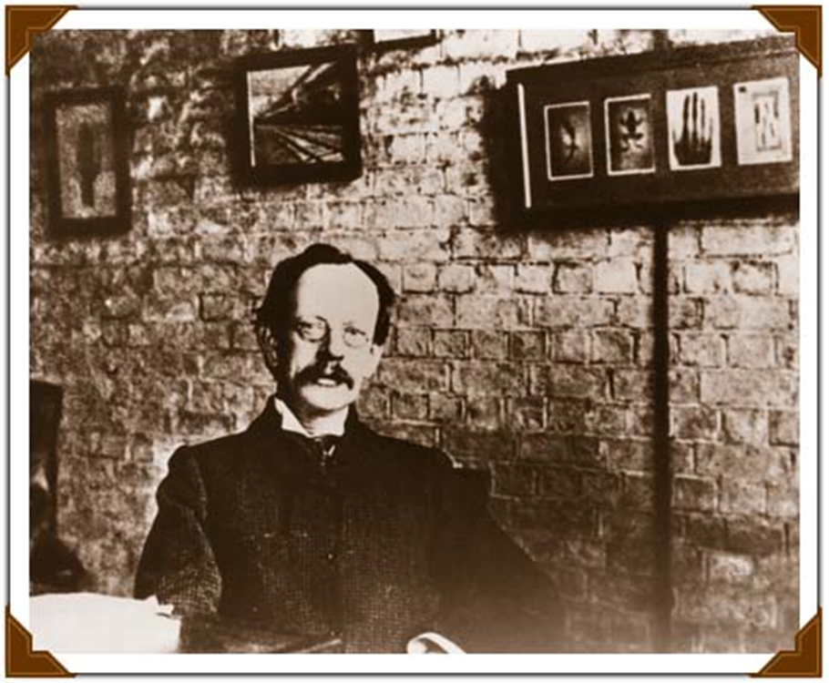
Enthusiastic scientists
Radiographs!
Joseph J. Thomson (1856-1940) Cavendish-Laboratory, Cambridge, UK
HPXM Conference I 19-23 June 2023
© Deutsches Röntgen-Museum
Notes:
Scientists were thrilled about the new light. No one could escape from the new x-rays.
JJ. Thomson in his lab in Cambridge,UK with radiographs hanging on the wall.
Experiments soon were repeated in many laboratories around the world,
Following exp. By Hittorf and Crookes on cathode rays - tubes and high-voltage apparatus had been installed practically in all physical laboratories.
whole generation of physicists started to analyse the nature of x-rays.

Slide 17
First national X-ray activities
Country | Date | City | Photographer
Germany | 06.01.1896 | Berlin | Moritz Jastrowitz
Poland | 08.01.1896 | Krakow | Karol Olszewski
France | 10.01.1896 | Paris | Paul Odin / Toussaint Barthélemy
The Netherlands | 10.01.1896 | Amsterdam | Ernst Julius Cohen
Hungary | 11.01.1896 | Budapest | Jenö Klupathy
Austria | 12.01.1896 | Vienna | Franz Exner / Eduard Haschek
UK | 13.01.1896 | Edinburgh | Alan A. Campbell Swinton
Russia | 16.01.1896 | Petrograd | Nikolai G. Egorov
Italy | 25.01.1896 | Pisa | Angelo Battelli
USA | 27.01.1896 | New Haven | Arthur W. Wright
Belgium | 29.01.1896 | Antwerpen | Henry van Heurck
Swiss | 30.01.1896 | Bern | Emil Theodor Kocher
Portugal | 03.02.1896 | Coimbra | Henrique Teixeira Bastos
HPXM Conference I 19-23 June 2023
© Deutsches Röntgen-Museum
Notes:
Discovery on the 8th November, publication on December 28th, 1895…
As early as January 1896, numerous experiments with X-rays began in various countries.

Slide 18
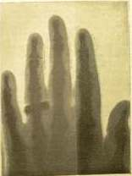
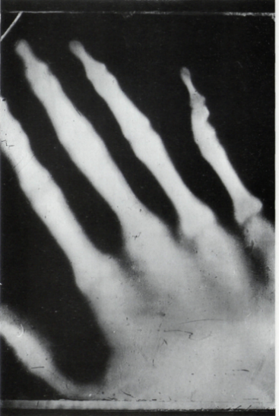
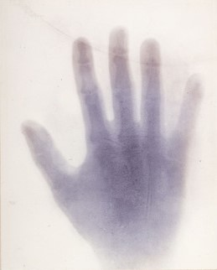
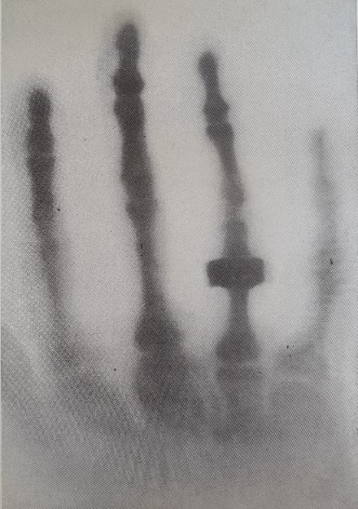
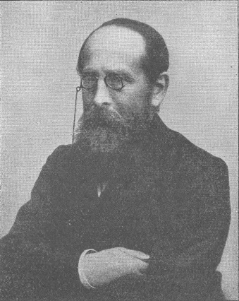
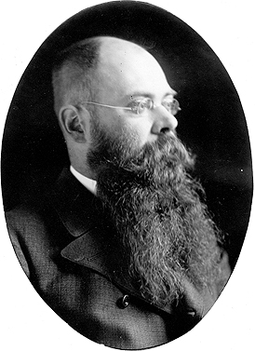
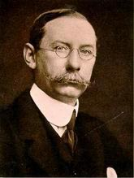
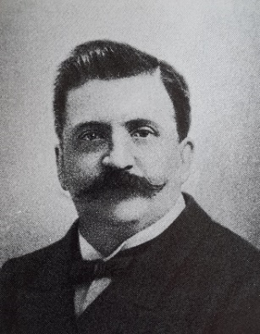
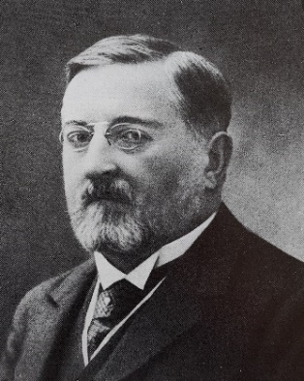
First national radiographs
Jastrowitz, Berlin (Jan 6,1896)
Haschek , Vienna
(Jan 12, 1896)
Campbell Swinton,
Edinburgh (Jan 13,1896)
Toussaint Barthélémy and Paul Oudin, Paris (20 January 1896)
HPXM Conference I 19-23 June 2023
© Deutsches Röntgen-Museum
Notes:
some of the pioneers and their results.
Mainly radiographs of hands

Slide 19
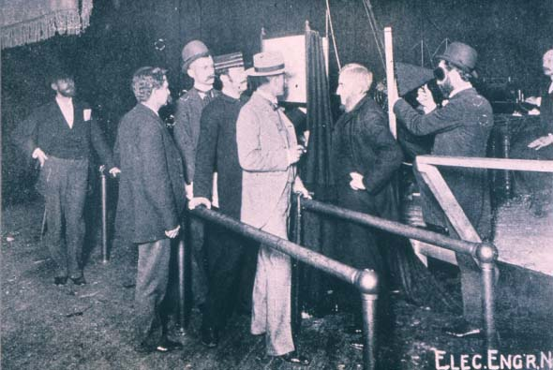
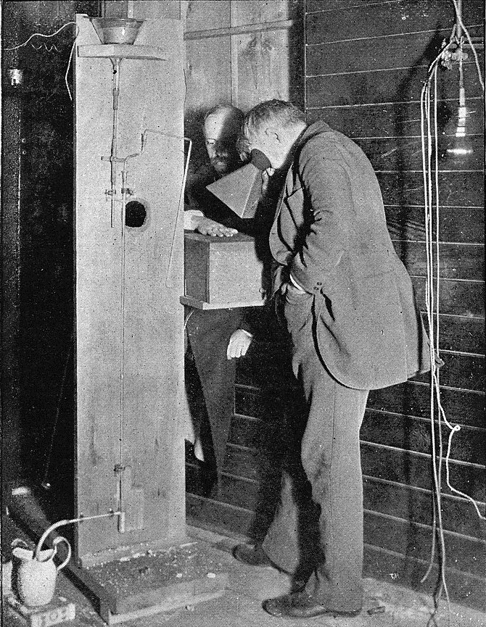
Roentgenmania
The public lines up for Thomas Edison's public demonstration of x-rays at the Electric Light Exposition in New York City, May 1896
Thomas Edison examines Clarence Dally’s hand through a fluoroscope of his own design
HPXM Conference I 19-23 June 2023
© Deutsches Röntgen-Museum
Notes:
enthusiasm - opened the doors to applications popular and lucrative.
With fluoroscopy laypersons could observe the powers of X-rays.
Cryptoscopes, looking much like field glasses from the outside, were light-proof observation devices with luminous crystals on the inside.
possible to observe the X-rays even under daylight conditions.
pioneers of fluoroscopy in the U.S.A. was Thomas A. Edison - turned Röntgen’s scientific findings into a market success.
In May of 1896 Edison staged at the Electric Light Exposition in New York City, a special show on the Röntgen rays.
generated a wave of interest - both at exhibitions and even at carnivals and side shows – the X-ray devices sought to attract public attention.
Röntgen fever spread around the world.
commercial use of X-ray technology turned science into something of a show - no sense of any need to deal with the hazardous radiation sensibly.
Edison terminated his Röntgen shows in 1904 after his chief assistant, Clarence Dally, died of burns caused by X-rays.

Slide 20
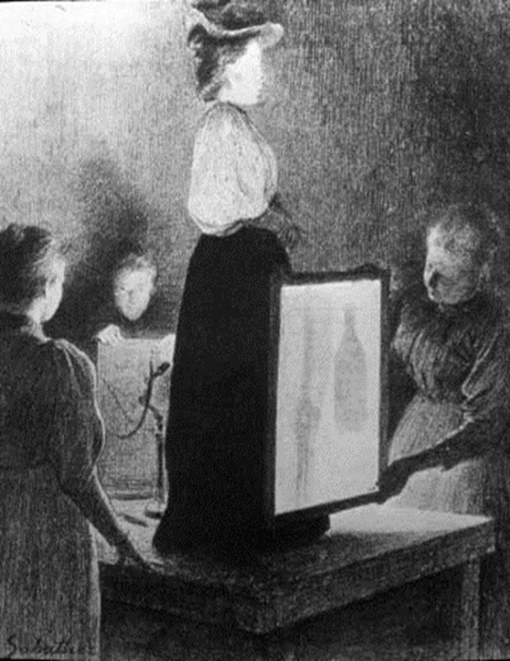
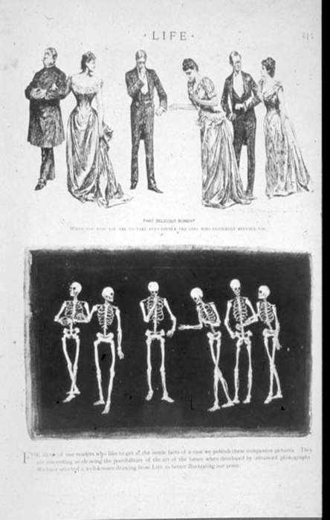
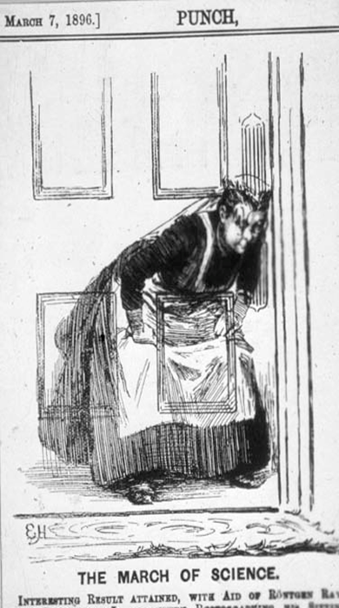
Public interest
HPXM Conference I 19-23 June 2023
© Deutsches Röntgen-Museum
Notes:
Boulevard newspapers and gazettes were full of ideas about the new opportunities:
Unmask thieves,
the naked high society
expose secret listeners at the door.

Slide 21
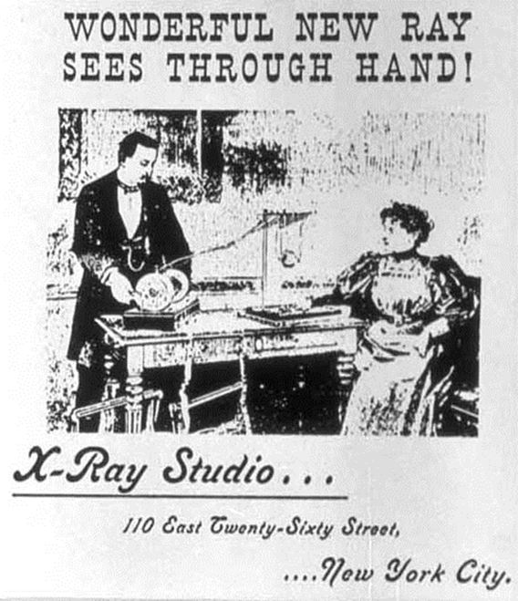
Public x-ray studios
HPXM Conference I 19-23 June 2023
© Deutsches Röntgen-Museum
Notes:
physical fundamentals and the biological effects were largely unknown at the end of the 19th century.
Different scientific cultures – medicine, physics and engineering – came together at this new interface.
pioneers, exploring new terrain.
purchased X-ray equipment at their own expense or experimented in university laboratories.
pioneering radiologists converted basement rooms and pantries in hospitals to create modest X-ray examining rooms or “studios”.
seeds for the X-ray departments and later entire institutes.

Slide 22
Early professional X-ray institutes
Roentgen institute of Heinrich Albers-Schönberg in Hamburg 1896
HPXM Conference I 19-23 June 2023
© Deutsches Röntgen-Museum
Notes:
X-ray cabinet of the German X-ray pioneer Heinrich Albers-Schönberg in Hamburg 1896.
like a museum with a lot of radiograph on the walls.
Albers-Schönberg was appointed the first chair for radiology at the university of Hamburg in 1919.

Slide 23
Spread experience - First radiological journal
Sidney D. Rowland (1871-1917)
Rowland, S. (Ed). Archives of clinical Skiagraphy, London, Vol 1, May 1896
HPXM Conference I 19-23 June 2023
© Deutsches Röntgen-Museum
Notes:
In order to spread the individual experiences - the first radiological journal "Archive of the Clinical Skiagraphy"
by Sidney Rowland, published in May 1896.
More and more professional societies emerged over the time.
The first such association was founded as “The Röntgen Society” on March 3, 1897, in Great Britain. (DRG 1905)

Slide 24
Radiological examination techniques
Morton, WJ., Hammer EW. The X-Ray: or, photography of the invisible and its value in surgery. New York 1896
HPXM Conference I 19-23 June 2023
© Deutsches Röntgen-Museum
Notes:
Two techniques were used in parallel for practical handling:
Fluoroscopy and photographic recording,
here demonstrated by Dr. William Morton and Edward Hammer in early 1896 in New York.
Due to the long exposure times of minutes to one hour, the focus was on fluoroscopy.

Slide 25
Quality of the X-ray images
Soft tube: low vacuum
Hard tube: high vacuum
I A very soft tube shows the shadow of the hand solid, the bones are hardly visible.
II The penetration increases with the hardness of the tube. The rays make a distinction between soft tissue, bone and metal. Images of the upper extremity up to the shoulder joint are possible.
III If the skin between the fingers is almost radiated through, the internal structure of the bones emerges. Now the tube has a degree of hardness that is suitable for both fluoroscopy and imaging.
IV With even greater hardness, differentiation decreases as penetration increases. Flesh and bones are now radiated almost completely and almost equally well. Only for very dense body parts and the direct observation at the lampshade such hard tubes are necessary.
HPXM Conference I 19-23 June 2023
© Deutsches Röntgen-Museum
Notes:
The degree of hardness of the X-rays was determined by the degree of evacuation of the tube.
well evacuated tube generated hard X-rays
degree of hardness of the tube determines the quality of the X-ray images:
I A very soft tube shows the shadow of the hand, but the bones are hardly visible.
IV Flesh and bones are now radiated almost completely

Slide 26
Sensitive X-ray tubes
Iconic R.G.S. Normal tube with capacitor regeneration
(1910-1912), length 52cm
Amputated and preserved Hand of Dr. Paul Krause
Dr. Paul Krause, Radiologist (1871-1934)
HPXM Conference I 19-23 June 2023
© Deutsches Röntgen-Museum
Notes:
best result is somewhere in the middle,
doctors tried from day to day to achieve the optimal conditions for their image by first x-raying their own hand…with serious consequences.
Early on they noticed the harmful effects of the rays, - xray sunburn developed on their hands – initially only as reddening of the skin, later with severe longterm damage such as severe pain and tumours.
until William David Coolidge 1913
special exhibit in our museum
hand of Dr. Paul Krause. He was one of the foremost radiologists and president of the German Radiological Society.
initiated the founding of the German Röntgen-Museum.
After his suicide, he bequeathed his left hand, which was severely damaged by X-ray burns, to the Röntgen Museum.
It serves as a memorial to the fact that X-rays open up new possibilities in medicine, but also pose severe health risks

Slide 27
Roentgenology 1896 – Angiography
17.01.1896
First experimental radiograph of a post mortem hand filled with Teichmann‘s mixture (Calcium carbonate, cinnebar, paraffin). Exposure time 57 min.
Eduard Haschek (1875-1947) Physicist. Physical Institute University of Vienna, Austria
Otto Lindenthal (1872-1947) Physician. Anatomical Institute University of Vienna, Austria
HPXM Conference I 19-23 June 2023
© Deutsches Röntgen-Museum
Notes:
the year 1896 plays an outstanding role in the discoveries and inventions in diagnostic radiology and the first steps of radiotherapy.
a total of 49 books and brochures and almost a thousand essays were written on the scientific aspects and possible applications
Mostly dealing with the possible applications in medicine.
17th of January, the anatomist Tandler in Vienna provided the assistants Eduard Haschek (1875-1947) and Otto Lindenthal (1872-1947) at the Institute of Physics with the amputated hand of a corpse.
arterial vessels were filled in with the Teichmann’s solution, a mixture of chalk, cinnabar and paraffin.
exposure time of 57 minutes, - first angiogram was created.

Slide 28
Roentgenology 1896 – Dental
January 20, 1896
First intra-oral dental radiograph
Self experiment with an improvised x-ray device. Exposure: 25 minutes
Friedrich Otto Walkhoff (1860-1934) Dentist, Braunschweig, Germany
Friedrich Giesel (1852-1927) Chemist, Braunschweig, Germany
HPXM Conference I 19-23 June 2023
© Deutsches Röntgen-Museum
Notes:
first dental radiograph introduced by the attempts of the German dentist Otto Walkhoff (1860-1934).
In the middle of January,
Walkhoff asked the chemist, Professor Giesel in Braunschweig, to take an X-ray of his back teeth.
Small pieces were cut from the commercial plates and again wrapped light-proof.
This first intraoral X-ray was taken after an exposure time of some 25 minutes.

Slide 29
Roentgenology 1896 – Intensifying screens
February/March 1896
First radiographs taken with intensifying screens
C.H. Henry (Paris) reported on 10.2.1896 about the intensifying effect of zinc sulphide
Michael Pupin (New York) presented on 2.3.1896 a radiograph of a hand, with a barium platinum cyanuric intensifying film
Thomas A. Edison (Schenectady) recognized on 12.3.1896 the suitability of calcium tungstate (CaWO4) for the effective amplification of X-rays.
Michael Pupin (1858-1935) Physicist, New York, USA
Thomas A. Edison (1847-1931) Inventor, Menlo Park, USA
HPXM Conference I 19-23 June 2023
© Deutsches Röntgen-Museum
Notes:
Michael Pupin, first to follow Röntgen's experiments in the US.
In early 1896 he invented the method of placing a sheet of paper coated with fluorescent substances next to the photographic plate
reduced the exposure time from over an hour to a few seconds.
Edison was the first to use calcium tungstate for image intensifying screens.

Slide 30
Roentgenology 1896 – Whole body
March 1896
First whole body radiograph
9-part first composite full-body radiograph in original size (1.84 m). Exposure times: head 60 min, chest 6 min, knee joints 50 min, pelvis 60 min, feet/ arms/ hands each 15 min.
Ludwig Zehnder (1854-1949) Physicist, University of Fribourg, Germany
HPXM Conference I 19-23 June 2023
© Deutsches Röntgen-Museum
Notes:
First whole body radiograph in 9 parts,
taken in March 1896 by Ludwig Zehnder.
Some parts of the body depends on two wounded soldiers.
The head depends on the photographer (exposure time app. 60 minutes)

Slide 31
Roentgenology 1896 - Thorax
April 1896
First thorax radiograph
Exposure: 60 minutes
Francis Henry Williams (1852-1936) Physician, Cambridge, USA
HPXM Conference I 19-23 June 2023
© Deutsches Röntgen-Museum
Notes:
The Us-American Pioneer Francis Henry Williams (MIT)
took the first radiograph of the thorax in April 1896.
The exposure time was about 60 minutes.
You all know how to take a lung x-ray: Take a deep breath, hold it ….

Slide 32
Roentgenology 1896 - Therapy
Autumn 1896
First fractional radiotherapy of a hairy mole.
Leopold Freund (1868-1943) Dermatologist, University Hospital of Vienna, Austria
HPXM Conference I 19-23 June 2023
© Deutsches Röntgen-Museum
Notes:
The dermatologist Leopold Freund from Vienna established radiation therapy as a new scientific field.
In autumn 1896 he irradiated a five-year-old girl whose entire back was densely hairy,
exposed her to X-rays for two hours a day - thus achieving hair loss.
During the treatment, the girl suffered from radiation ulcers in the lumbar region, which could be corrected surgically.

Slide 33
New medical professions
1896-1900
Radiologist as solo worker: was physician and assistant and at the same time photographer and mechanic, archivist and registrar.
After 1900
Different professions:
the radiologist as a medical specialist
the X-ray nurse, the X-ray photographer the X-ray technician.
Röntgen examination, circa 1900
HPXM Conference I 19-23 June 2023
© Deutsches Röntgen-Museum
Notes:
triumphal advance of radiology as a diagnostic tool was followed by the creation of an independent professional specialty with its own defined requirements.
At the outset the radiologist fulfilled various roles:
physician
and at the same time photographer
technician
and archivist.
After 1900, these diverse tasks gave rise to a number of different professions:
the radiologist as a medical specialist, the X-ray nurse, the X-ray photographer and the X-ray technician.

Slide 34
Radiologist
Radiology was recognized as an independent medical speciality after the end of WW I when the first chairs were established at the universities.
HPXM Conference I 19-23 June 2023
© Deutsches Röntgen-Museum
Notes:
Radiology was recognized as an independent medical specialty after the end of World War I.
The first chairs were established at the universities.
In Germany the first chair for radiology was established in 1919.

Slide 35
Radiographer and X-ray technician
The pioneering work of woman in all fields of radiology is still undervalued, even today.
Archiv Leonie Moser, Winterthur
HPXM Conference I 19-23 June 2023
© Deutsches Röntgen-Museum
Notes:
For a long time science and technology were the domain of men.
Only a very few women worked in research or in a management position in hospitals. Their pioneering work in all fields of radiology is still undervalued, even today.
Only gradually did women move into this new profession –
as X-ray assistants
Or X-ray nurses.
Knowledge about technology and physics was just as necessary as learning about x-ray photography.
In WW1 Marie Curie offered her services to develop Frances medical x-ray fascilities.
With provided funds, she equipped the first radiological car with a mobile unit containing a radiographic apparatus and a dynamo.
“little Curies”.
She taught herself the skills of radiography, driving and even auto mechanics.

Slide 36
Röntgen-Museum in Remscheid
Established 1932
2.500 sqm exhibition area
160.000 Exhibits
Archive documents, photographs, radiographs
Special library with 15.000 books
HPXM Conference I 19-23 June 2023
© Deutsches Röntgen-Museum
Notes:
Last but not least please allow me to give you a short introduction in our museum.
founded in 1932.
It was the German Roentgen Society who decided already in 1906 to have a special education center for young radiologists.
asked their members to collect machicnes, radiograph, reports.
The idea was to build a huge museum in berlin or Munich.
Because of the first Wolrd War theses plans were destroyed.
A past president of the German Roentgen Society had the idea to build a monument and a museum at Roentgens Birthplace. Today we do have a exhibition area of 2.500 sqm. We are describing the history of x-rays and their applications from the micro- to the macro cosmos. A lot of the original ideas were realised...

Slide 37
Student‘s Lab RöLab
HPXM Conference I 19-23 June 2023
© Deutsches Röntgen-Museum

Slide 38
Röntgen‘s Birthplace in Remscheid-Lennep
Built arround 1760
Bought by Roentgen‘s father 1812
Sold in 1846 to a butcher
Re-opened March 2019
© Fotos: Deutsche Röntgen-Gesellschaft
HPXM Conference I 19-23 June 2023
© Deutsches Röntgen-Museum
Notes:
Close to the museum you can find Roentgen‘s birthplace.
Under the direction of the German Roentgen-Society the house was broadly restored
meeting place for scientists from all over the world.
Contains small exhibition of Röntgens life and original documents.
I am looking forward to see you all there some day. Thank you very much for your attention.

Slide 39
Acknowledgements and sources
Archiv Deutsches Röntgen-Museum, Remscheid
Archiv Leonie Moser Winterthur
Wellcome Collection
Wikimedia commons
Archive University Wuerzburg
Dr. Leo Rigler in Brecher, Ruth & Edward M. Brecher (1969) The Rays: A History of Radiology in the United States and Canada ( Baltimore, MD: Williams and Wilkins)
Kienböck R, Holzknecht G: Röntgenologie. Eine Revision ihrer technischen Einrichtungen und praktische Methoden. Urban & Schwarzenberg, Berlin/ Wien 1918–1924.
Morton WJ, Hammer EW. The X-ray ; or, Photography of the invisible and its value in surgery New York : American Technical Book Co., 1896. (https://archive.org/details/xrayorphotograp01hammgoog)
Grigg ERN The trail of the invisible light. Charles C. Thomas Publisher, Springfield, USA 1965
Department of Radiology at the University of Maastricht, NL
Alan Thom (1915-1979) painting in: Bender GA. Great Moments in Medicine. Parke, Davis Company, Northwood, Institute Press, Detroit 1966.
HPXM Conference I 19-23 June 2023
© Deutsches Röntgen-Museum

