Slide 1
X-ray imaging using compact light sources Silvia Cipiccia
Department of medical PHYSICS and biomedical engineering

Slide 2
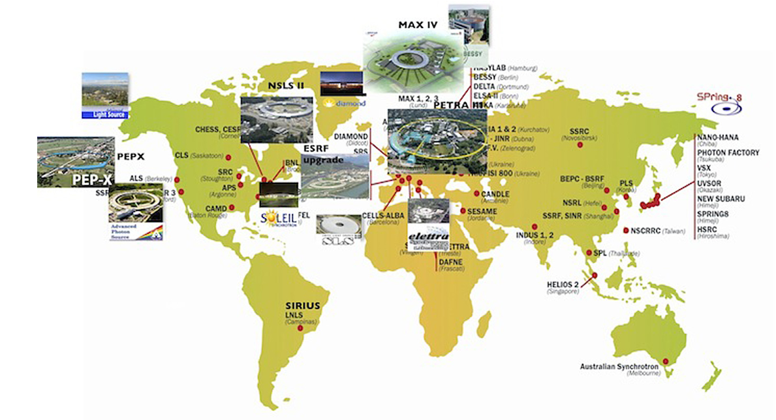
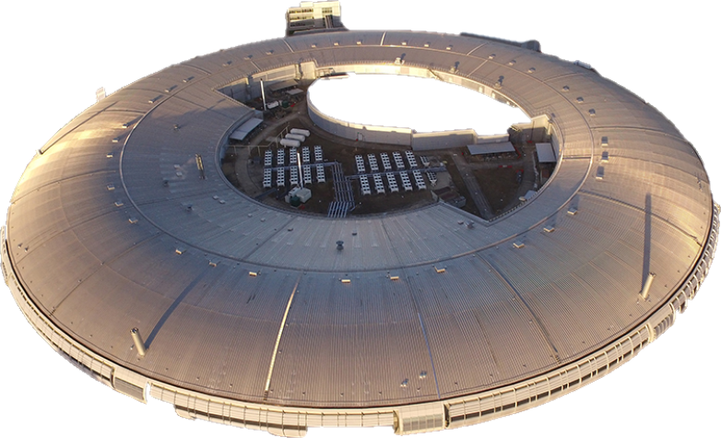
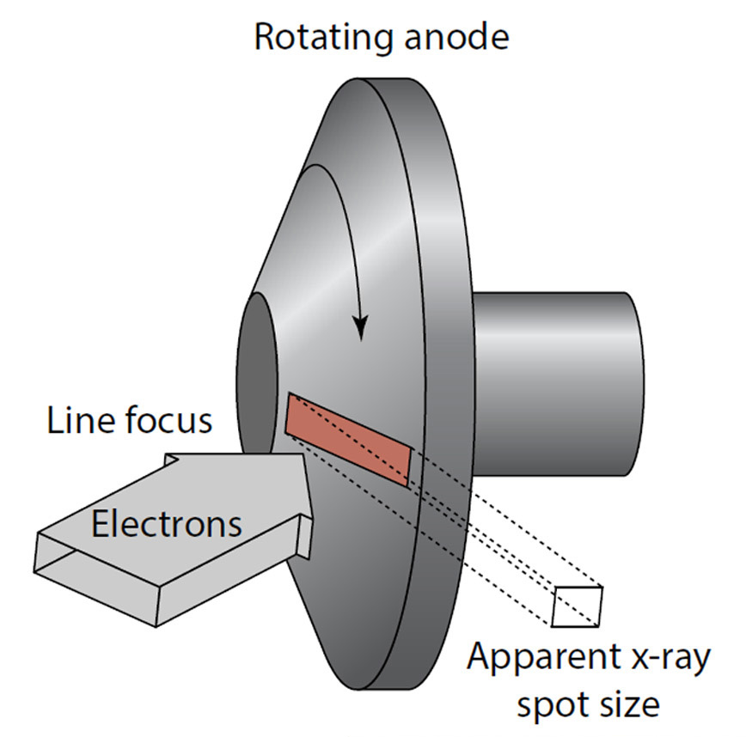
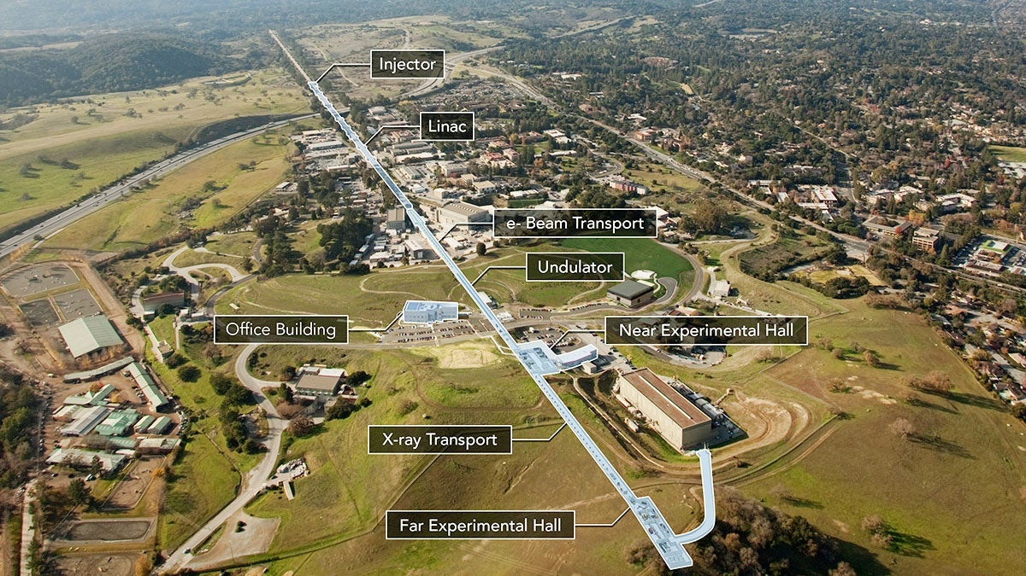
X-ray imaging
M.E. Couprie
Journal of Electron Spectroscopy and Related Phenomena 196 (2014) 3–13
Novel sources
Liquid metal-jet
Inverse Compton Scattering
Laser-driven sources
Laboratory sources
SYNCHROTRON
XFEL

Slide 3
- Each source has different specific features - Not a solution fits all
Coherent diffraction imaging
Multimodal imaging at the femtosecond

Slide 4
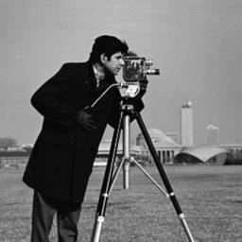
Coherent diffraction imaging
Conventional Microscopy
Radiation is scattered from a sample and is focussed through a lens into an image plane
The detector is placed in the image plane and captures the intensity image (lost phase information)
The image is limited in resolution by the quality of the lens profile to the high scatter angles

Slide 5
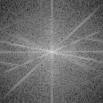
Coherent diffraction imaging
Replace the function of the lens with a computational reconstruction
Allows to recover both the modulus and phase components of the wave
Is not limited by the quality of the optical components (perfect transfer function)
Recover the relative phase

Slide 6
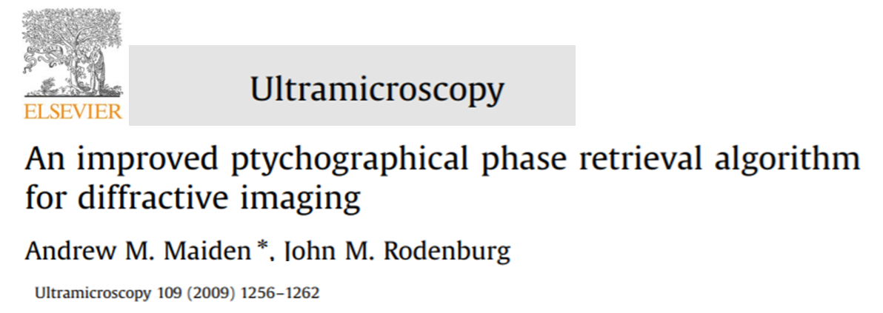
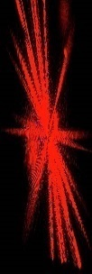
Ptychography: Scanning Coherent Diffraction Imaging
Extends the coherence by scanning
Does not require pre-knowledge of the illumination
D2 (far field)
FZP
Source
L_{sc}
Coherent
X-ray beam
d
XPCD
D1
pinhole
Sample raster scanned

Slide 7
X-ray ptychography
Nanoscale resolution
Sensitive to small changes in electron density
Quantitative
Requires high quality beam:
high coherence

Slide 8
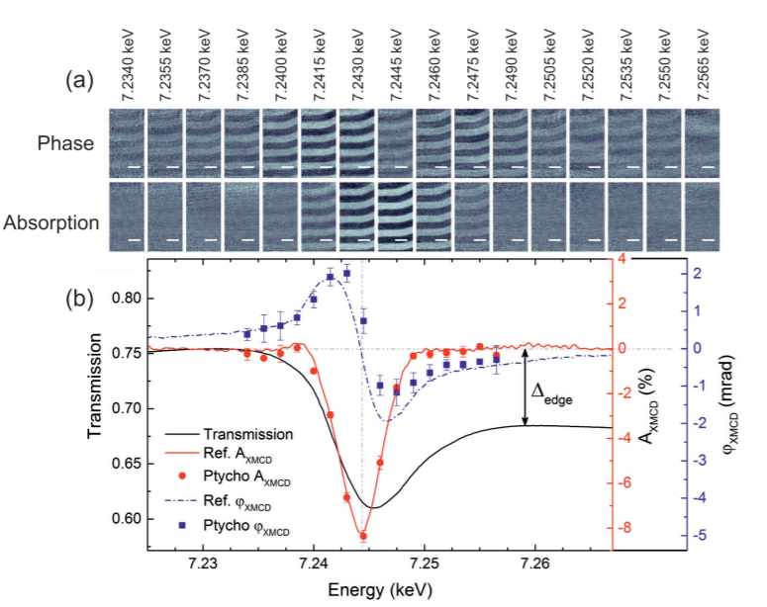
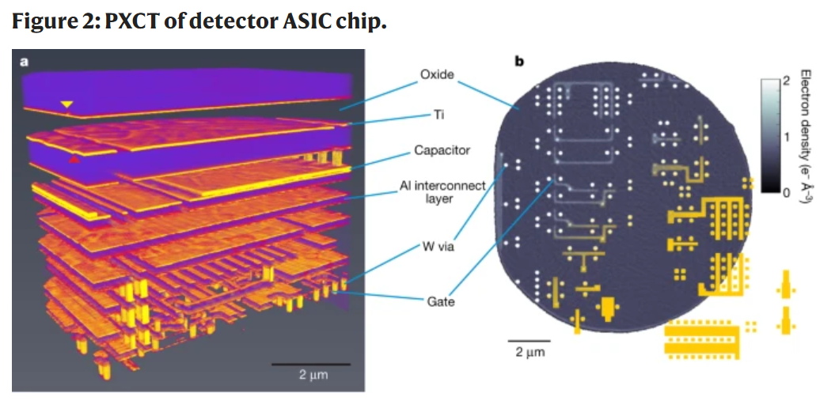
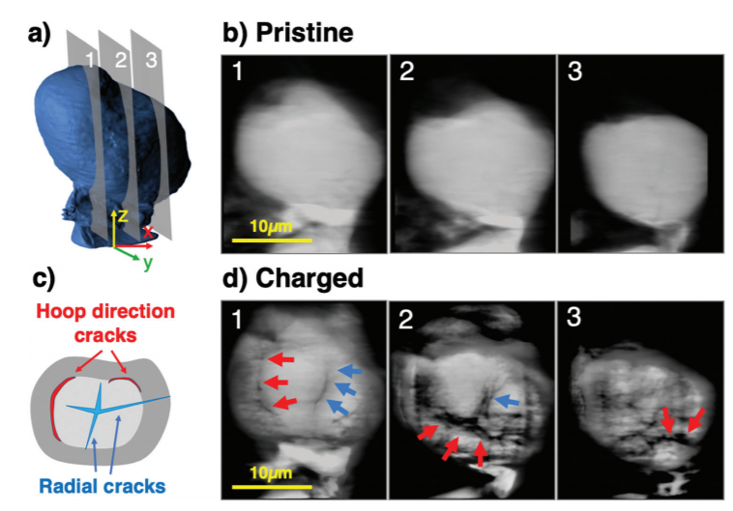
X-ray ptychography
Magnetic domain imaging
Electronic science
Batteries

Slide 9
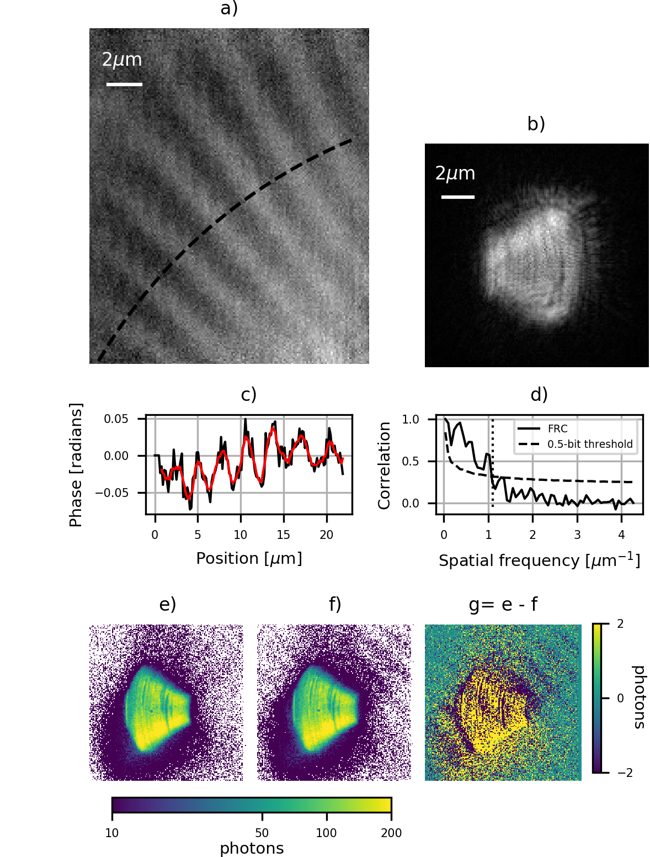
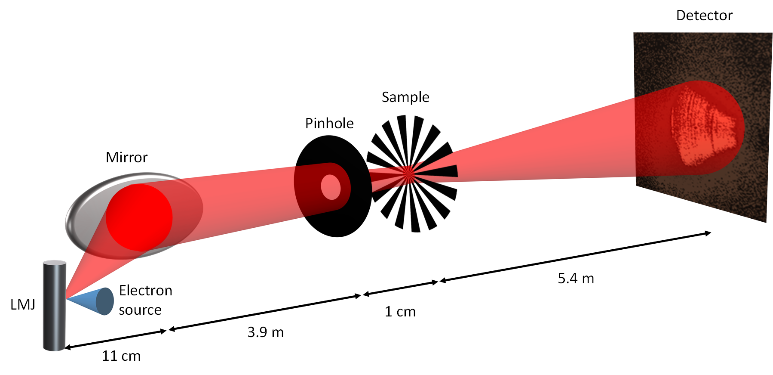
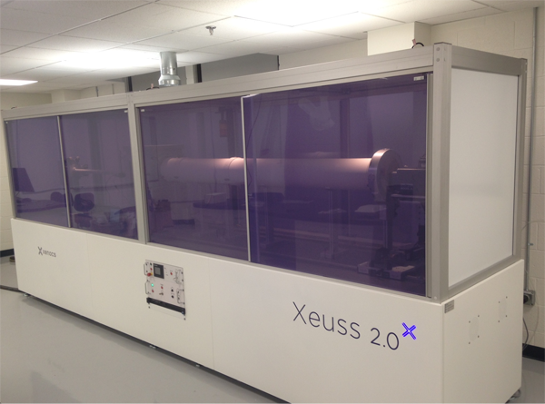
Coherent diffraction imaging with an LMJ
Can be performed outside a synchrotron?
YES
SMALL laboratory Sheffield: Sasha Mykhaylyk
Brilliance 10¹¹ photons/(0.1%BW s mrad² mm²)

Slide 10
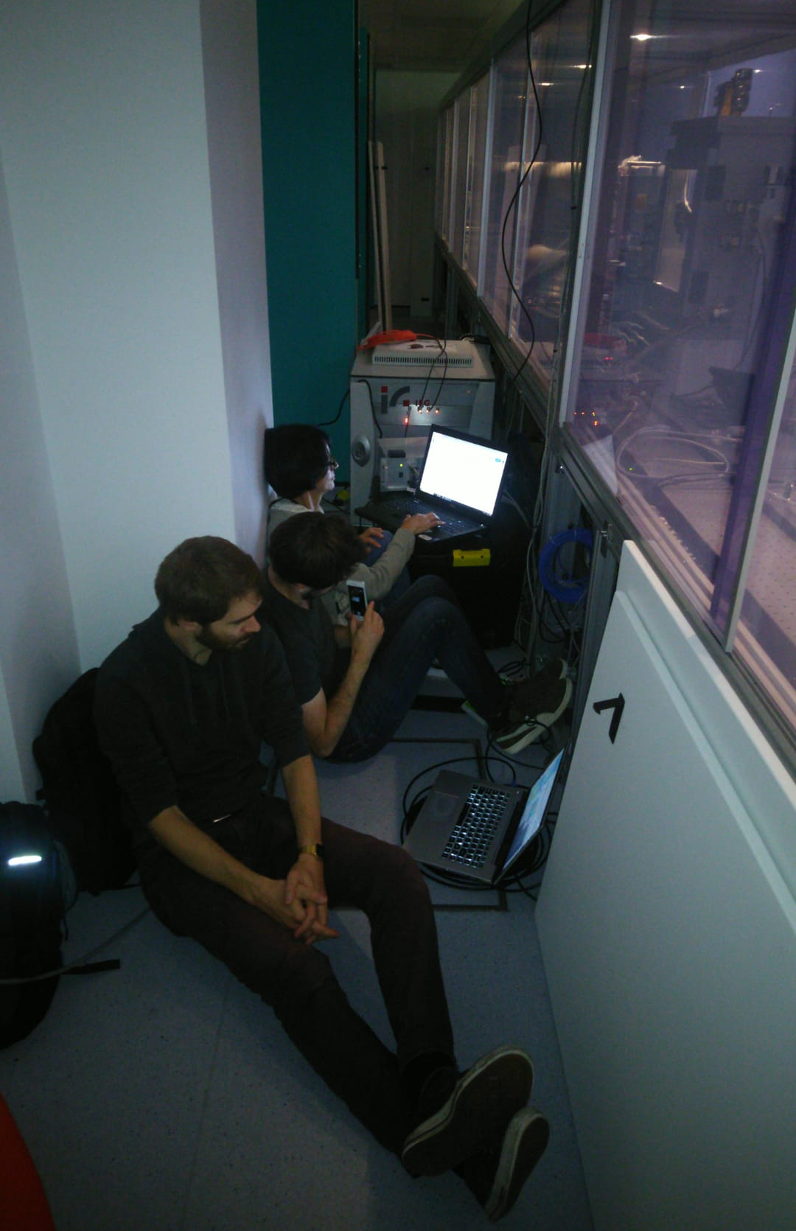
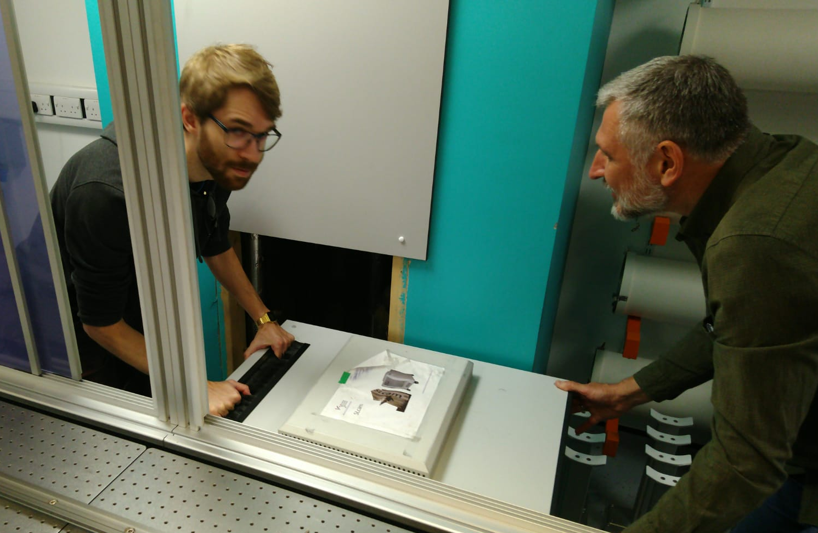
Coherent diffraction imaging with an LMJ
Long acquisition
Source instability
Main Challenge
Dedicated setup
Next steps
Increase usable flux
Broadband
Hyperspectral detector
Algorithm

Slide 11
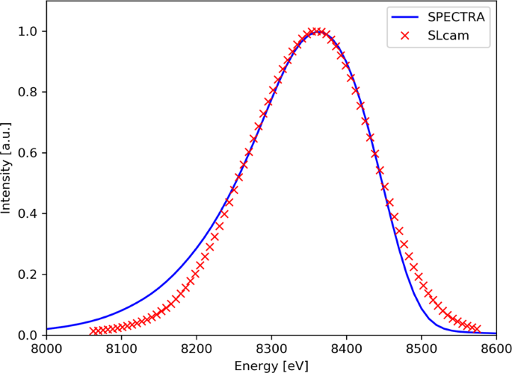
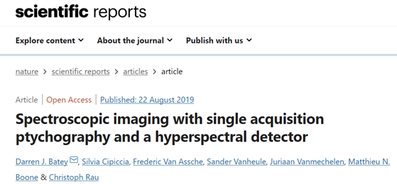
Broadband ptychography
Detector as monochromator
Hyperspectral detectors (e.g. Hexitec, SLcam)
Scanning Ni edge in a single acquisition
Edge subtraction
Limitation:
Not compatible with high flux
Resolution limited by the detector bandwidth

Slide 12
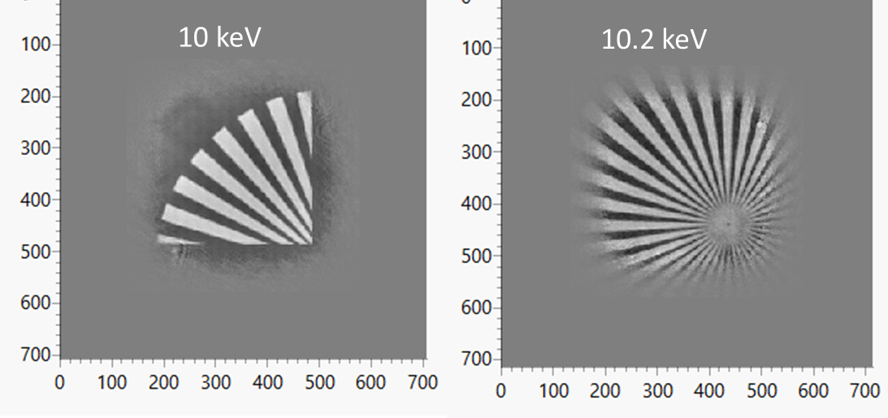
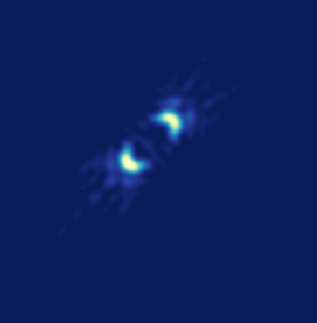
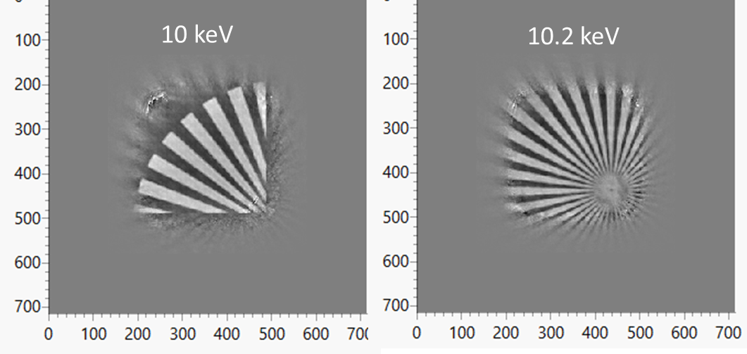
Broadband ptychography
Algorithm as monochromator
Multiple illuminations (one per energy)
Modify standard algorithm
Multiple objects (one per energy)
Initial guess
Probe
Probes_E
Object
Objects_E
Transport to far field (FFT)
Simulated objects
Individual FFT
Retrieved objects
Calculated intensity
Measured
intensity
Add modulus

Slide 13
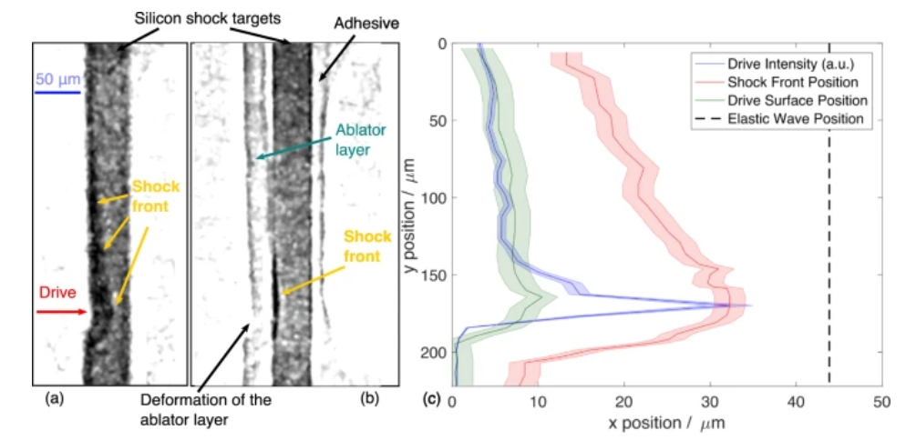
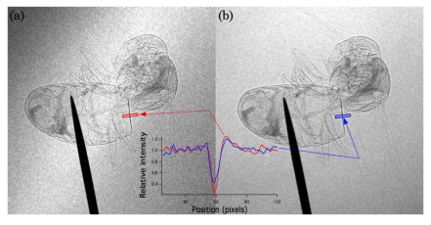
Laser-driven x-ray sources
Ultra-fast imaging
Unique Features
Compact
Femtosecond pulse duration
Small source size → high spatial coherence
To exploit at the best:
Single-shot: to make sue of the femtosecond time resolution
Multimodal: access multiple information in one acquisition
Phase Contrast

Slide 14
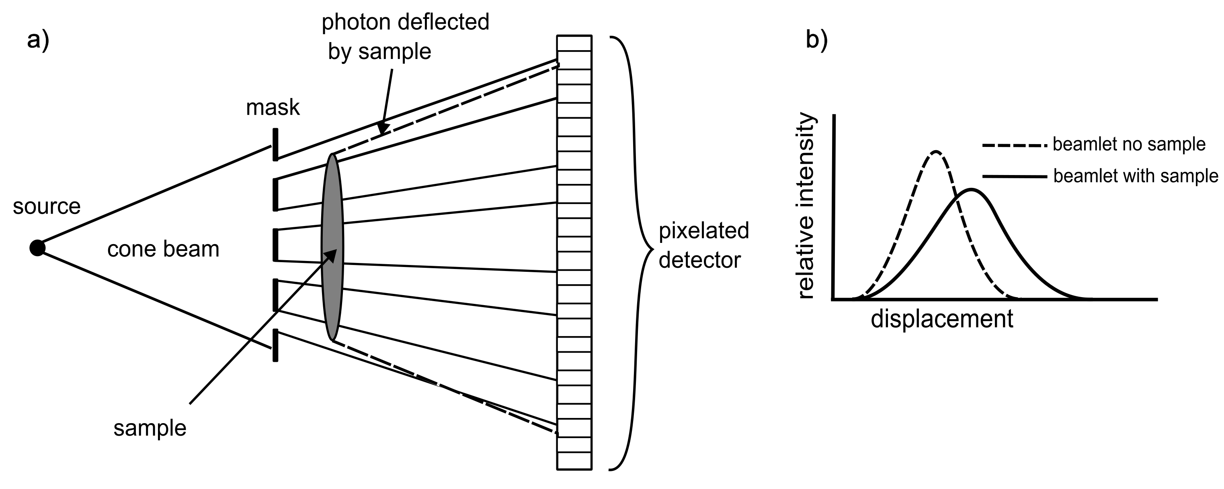
Edge Illumination-Beam Tracking
Robust
Polychromatic sources
Low spatial coherence (large source size)
a)
b)
c)
absorption
phase
scattering

Slide 15
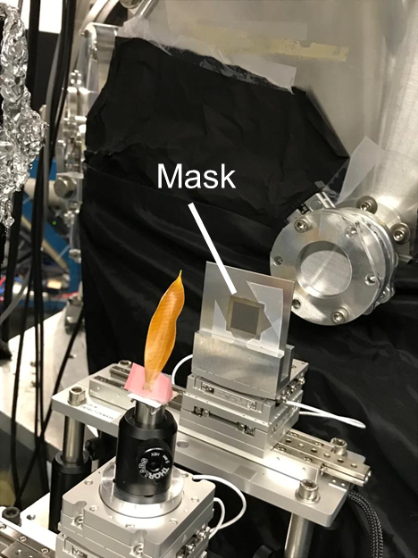
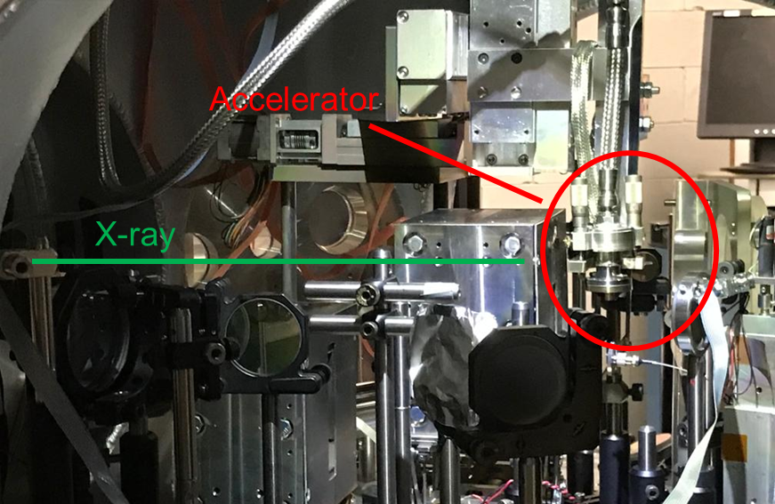
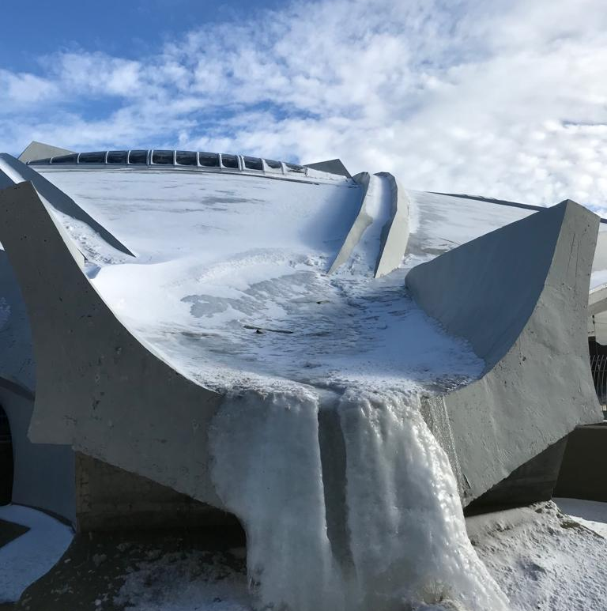
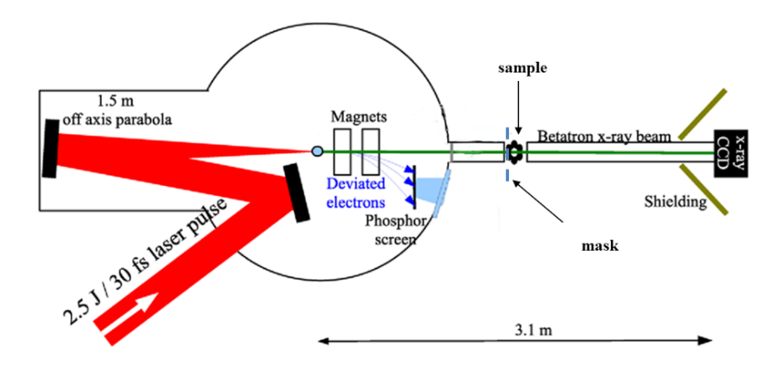
Beam Tracking with a laser-driven source

Slide 16
Beam Tracking with a laser-driven source
Detector
Andor Ikon L
1024x1024 pixels, 13 um pixel size
Tungsten mask: 12 um aperture, 39 um period. Laser micromachined by Scitech Precision
Resolution
Single shot: mask period
Dithering: mask aperture
Bridges to reinforce the self-standing structure

Slide 17
Source characterization
Energy Spectrum
Source pointing
A. Doherty et al. ‘Femtosecond multimodal imaging with a laser-driven x-ray source’.
Comm. Physics, in review

Slide 18
Dithering acquisition
Parameters
4 dithering steps
Pixel size 10.7x30 um
Sample orange peel
100 cumulated shots per dithering step
Transmission
Refraction
Scattering
1 mm
Transmission
A. Doherty et al. ‘Femtosecond multimodal imaging with a laser-driven x-ray source’.
Comm. Physics, in review

Slide 19
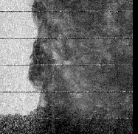
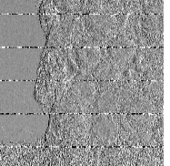
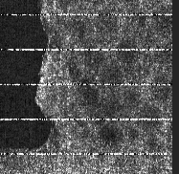
No dithering
Binning 2: Pixel size 39x30 um
Parameters
50 shots
Scaling
Tailored plasma: up to factor 100
More efficient detector
Laser power: 145 TW 750W, factor 3
Resolution
Masks: 2 um aperture, 7 um period
Similar statistics
Higher resolution
1 mm
Factor 12 in statistics
Transmission
Refraction
Scattering
Single shot
Parameters
Binning 8: Pixel size 39x120 um
A. Doherty et al. ‘Femtosecond multimodal imaging with a laser-driven x-ray source’.
Comm. Physics, in review

Slide 20
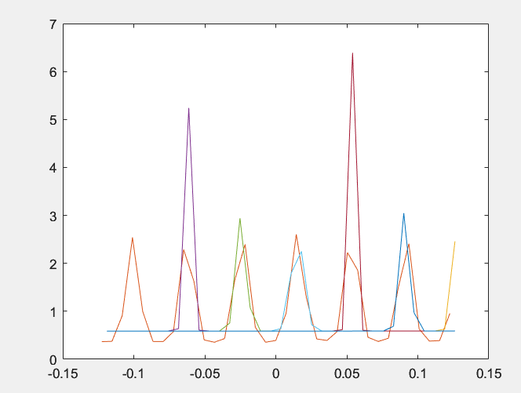
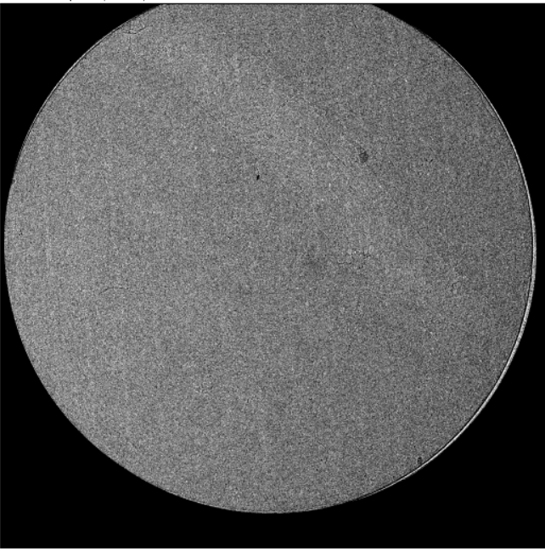
Challenges:
Flat battery cell 8 mm diameter
Free space propagation
Fitting issues
BT- transmission
Spectral variations
Main Challenge
More robust fitting
transmission
refraction
scattering

Slide 21
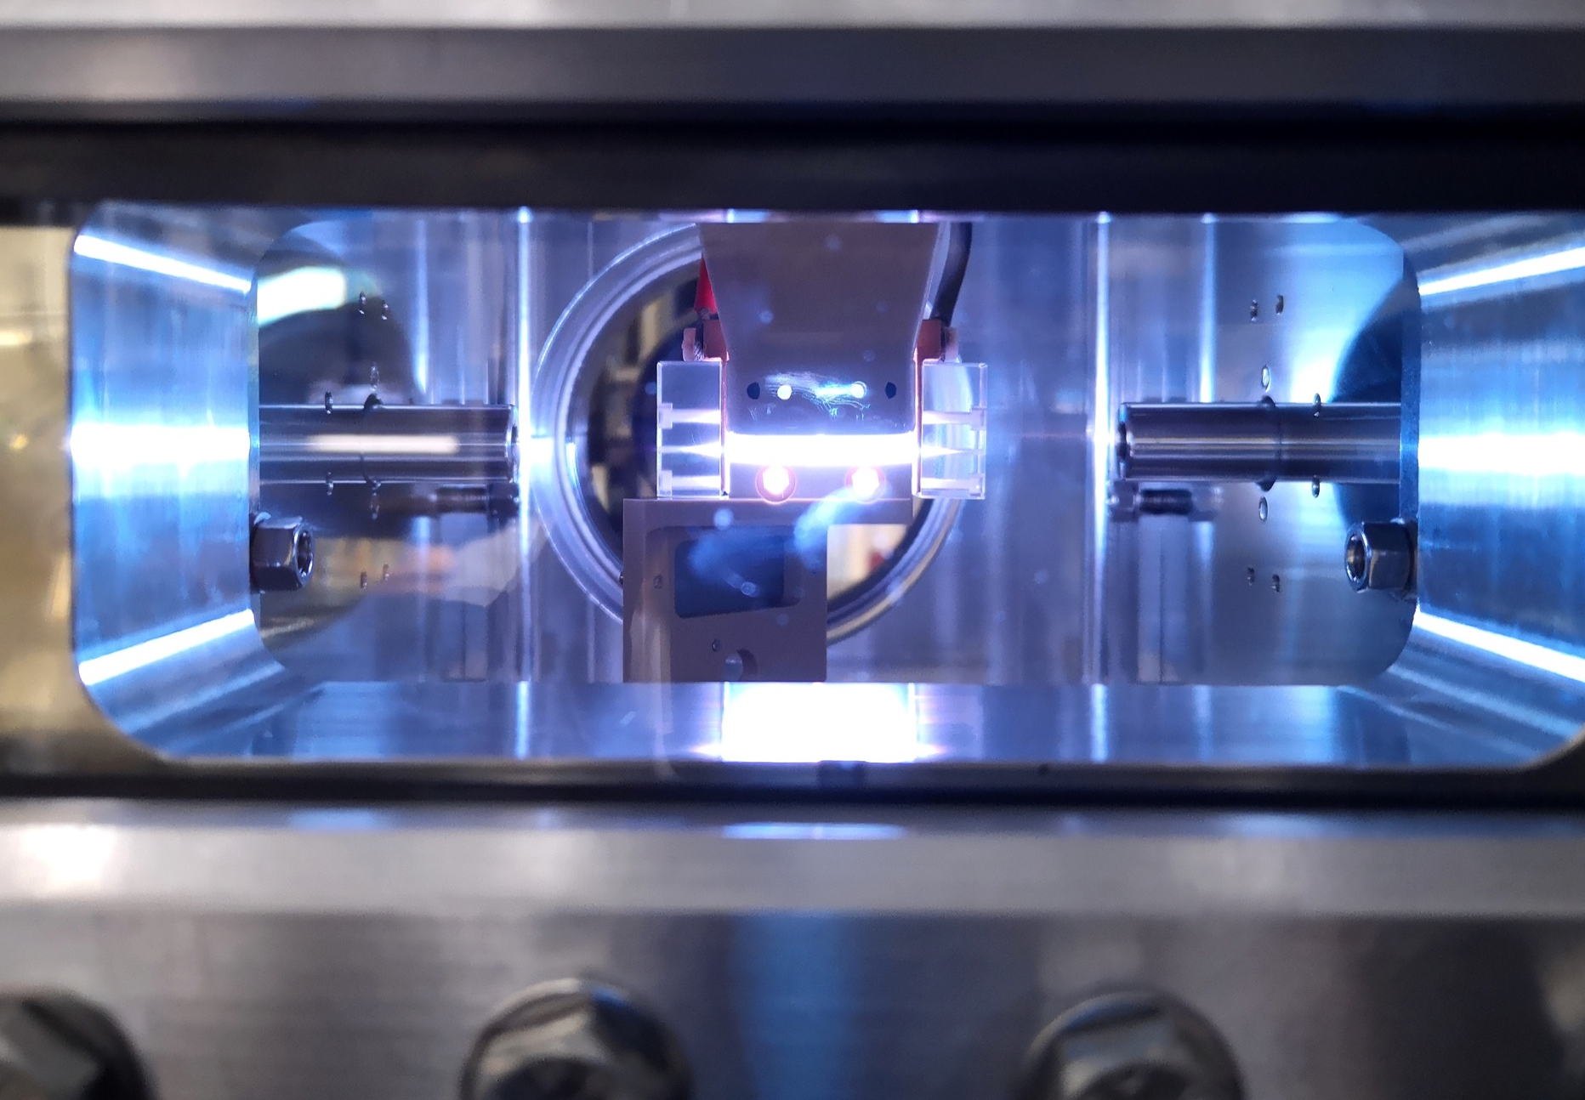
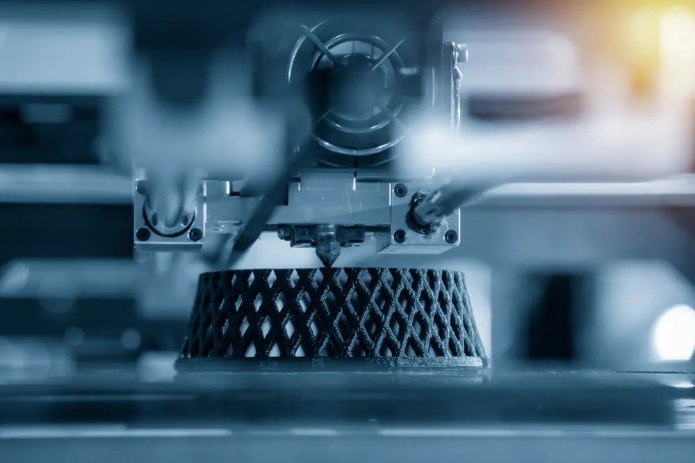
Enabling science
Novel Sources
Imaging techniques
Applications
s.cipiccia@ucl.ac.uk

Slide 22
Thank you!

