Slide 1
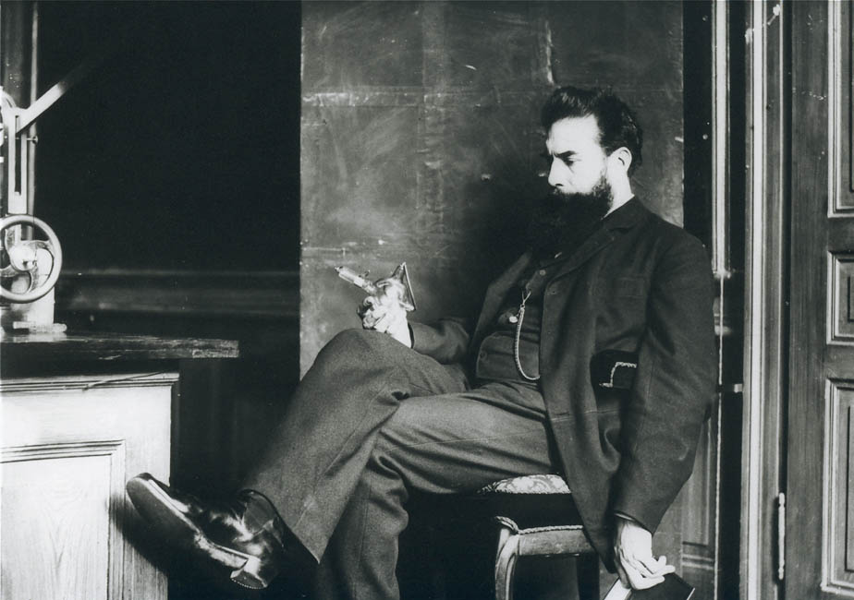
Claims of Priority The scientific path to the discovery of X-rays Anna-Katharina Kätker HPXM Conference 2023 Laboratori Nazionali di Frascati 19-23 June 2023
© Deutsches Röntgen-Museum
Notes:
invitation
special year
100th anniversary of Röntgen's death on February 10, 1923, -a fitting occasion

Slide 2
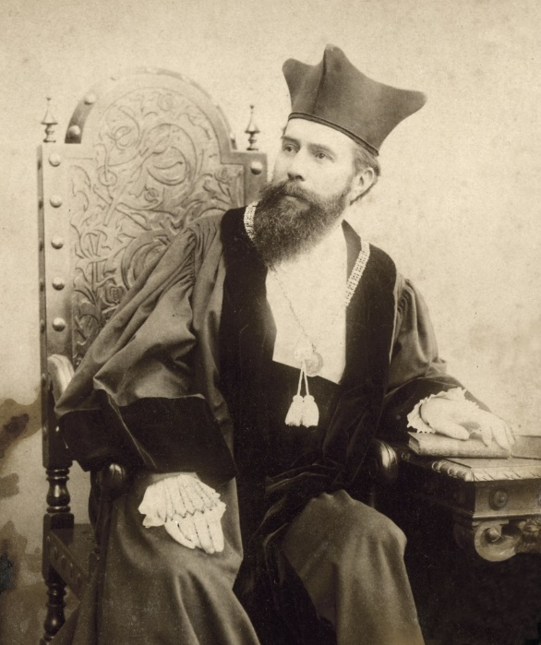
Wilhelm Conrad Röntgen – The man behind the discovery
NAME Wilhelm Conrad Röntgen
DATE OF BIRTH March 27, 1845
in Remscheid, Germany
EDUCATION Mechanical engineering at Polytechnic (Zurich)
PhD in physics at University of Zurich
PROFESSIONAL Strassburg, Hohenheim, Giessen, Wuerzburg,
STATIONS Munich
DATE OF DEATH February 10, 1923 in Munich
W.C. Roentgen, 1894
(Archive University of Wuerzburg)
“According to the good tradition of German university professors, I believe their discoveries and inventions belong to humanity, and should not be hampered by patents, licenses, contracts, nor controlled by any group.”
Röntgen in a letter to Max Levy, engineer at A.E.G.
HPXM Conference I 19-23 June 2023
© Deutsches Röntgen-Museum
Notes:
Let us first have a quick look on Röntgen‘s biography and on what kind of man he was
born in 1845 in Lennep, Rheinland.
parents - cloth merchands.
school in in Apeldorn and Utrecht, in the Netherlands.
no highschool diploma - he wasn’t allowed to study at a German university
mechanical engineering at Polytechnicum Zurich.
After his PhD with August Kundt,
proceeded as Professor for Physics in Strassburg, Hohenheim, Giessen, Würzburg, Munich.
very modest man.
detested the excessive publicity and also disliked the fame and attention his discovery brought him as person
.
Röntgen declined to take out a patent on the X-rays , preferring to make it available to the medical and scientific communities for use of improvement and further research.
In 1901, he was given the first ever awarded Nobel Prize in Physics and
donated the Nobel Prize money
refused the title of nobility.

Slide 3
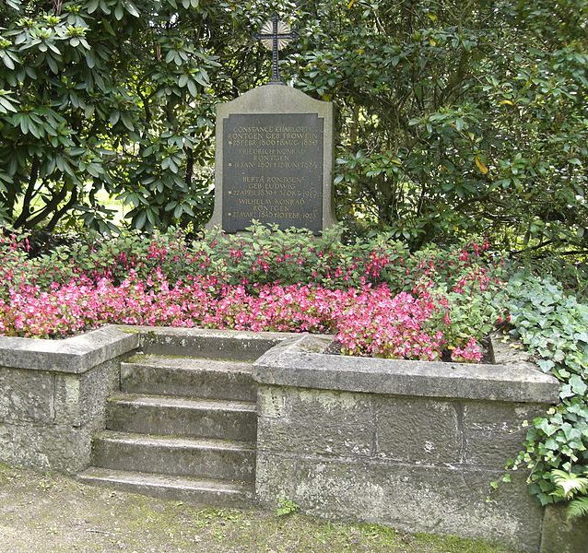
February 10, 1923 - Röntgen‘s death
February 10, 1923
Röntgen dies of intestinal cancer
(Age 77)
In his last will and testament, he stipulated that a large part of the letters addressed to him and unpublished scientific records were to be destroyed.
Why?
Grave of the Röntgen Family at the Old Cemetery Gießen
HPXM Conference I 19-23 June 2023
© Deutsches Röntgen-Museum
Notes:
On February 10, 1923, WCR died of intestinal cancer, age of almost 78.
In accordance with Röntgen's testamentary wishes, his ashes were buried in the Old Cemetery in Gießen,
In his last will and testament, he stipulated that a large part of the letters addressed to him and unpublished scientific records were to be destroyed.
already begun burning the mail addressed to him, some of which had been stored for years.
special cabinet in his Munich apartment and always kept them locked and even sealed when he was away.
Later, he asked his friends to burn the letters - Not all of them complied with this request.
emotional state. The war had been lost , 1919, Röntgen's wife, lived in a dangerous post-war political turmoil, Large parts of his considerable fortune were unfortunately lost due to inflation
Another reason could be that Röntgen certainly also wanted to avoid his documents falling into the hands of colleagues and envious people who could use them against him. For early on, there were rumours that Röntgen was not the first discoverer of the rays.
This is the subject of a discussion that continues to this day about the priority claims of the "true discoverers" of X-rays.

Slide 4
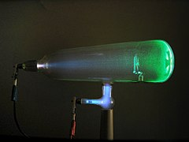
Research on gas discharges in the 19th century
Crooke‘s tube.
(Source: D-Kuru from Wikimedia Commons)
HPXM Conference I 19-23 June 2023
© Deutsches Röntgen-Museum
Notes:
The history and the claims about the discovery of X-rays are a history of research on gas discharges in the 19th century.
popular attraction in fairgrounds in the last decades of the 19th century - mysterious luminous phenomena.
contained various fluorescent crystals arranged in flower bouquets.
But in the second half of the nineteenth century, gas discharge became increasingly a subject of science as well.

Slide 5
Milestones on the way to the discovery
1654 Otto v. Guericke
1705 Francis Hauksbee
1746 Abbé Nollet
1785 William Morgan
Important milestones before the 19th century :
1834 Michael Faraday
1865 Plücker und Geissler
1867 J. W. Hittorf
1876 Eugen Goldstein
1879 William Crookes
1881 Johann Puluj
1890 Goodspeed and Jennings
1894 Nikola Tesla
1894 Philip Lenard
1895 Wilhelm Hallwachs
1895 Wilhelm Conrad Röntgen
19th century:
HPXM Conference I 19-23 June 2023
© Deutsches Röntgen-Museum
Notes:
So a new field of research emerged – with many famous names involved, as you can see here.
Was steadily expanded by numerous innovative technical developments and skills.
These technical innovations included, from the 1859s onward, powerful high-voltage supplies, further development of the art of glass blowing.
The development of modern mercury air-pumps made it possible to create the high vacuums in the tubes required for the experiments and the scientific analysis of the glow phenomena.
Before Röntgen started working on cathode rays, many scientists had already done research in that field, aimed to fathom the physical nature of the observable phenomena of luminosity.
Until Röntgen’s research in 1895 and two years later, however, the nature of cathode rays remained unclear.
This motivated Röntgen
But up to two centuries earlier, important milestones in science had already been achieved, which ultimately contributed to the research of discharge tubes and to Röntgen being able to make his discovery.
And in the following, some of the important researchers and their contributions to the scientific path that led to the discovery of X-rays and in some cases their possible priority claims for the discovery are presented.

Slide 6
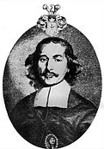
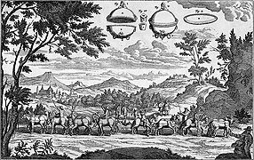
Otto von Guericke 1654
Otto von Guericke (1602-86)
The Magdeburg hemispheres – the experiment was performed before the Imperial Court at Ratisbon in 1654.
HPXM Conference I 19-23 June 2023
© Deutsches Röntgen-Museum
Notes:
The first milestone was the discovery of the vacuum in the middle of the 17th century.
Otto von Guericke, the mayor (town council) of the citiy of Magdeburg, is considered the father of the air pump.
To demonstrate the great pressure of the ambient air he constructed a huge copper sphere in two halves – the so-called Magdeburger hemispheres, fitted air-tight and the air was pumped out
In front of the Imperial Court, more than 24 horses, noise like a canonball was heard. Yet, when the vacuum was abolished by opening the cock of the air-pump and admitting the air, the hemispheres fell apart on their own.
Robert Boyle, Francis Hauksbee, Abbé Nollet and others further improved the air pump in the following years.
Röntgen‘s discovery and the research on gas discharges in general would not have been possible without von Guerickes air pump.

Slide 7
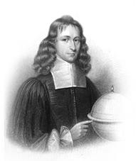
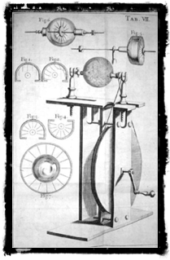
Hauksbee – London 1705
Achieved an electrical discharge within a vacuum
Francis Hauksbee (1660 – 1713) Physico-Mechanical Experiments, London 1709
Hauksbee Generator
HPXM Conference I 19-23 June 2023
© Deutsches Röntgen-Museum
Notes:
The next milestone was achieved by Francis Hauksbee in 1705 by producing an electrical discharge within a vacuum.
that mecury when agitated within an evacuated flask produced a luminosity of its glass walls and little electrical sparks –
exhausted much larger tubes and bell jars, air pump of his own design.
big mashines for the rapid rotation of vacuum bulbs and found that the friction of his dry hand on the outside of these bulbs gave a purple glow
extensive set of experiments and was the first to excite a vacuum tube, the ancestor of all x-ray tubes, by an electrical machine.
obtained sparks larger than had ever been seen in a laboratory.

Slide 8
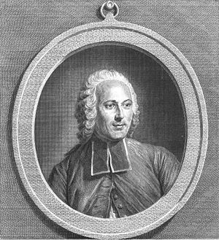
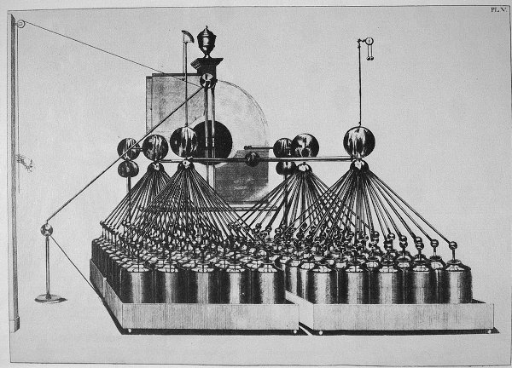
Abbé Nollet and the „electrical egg“, Paris 1746
Jean Antoine (Abbé) Nollet (1700-1770)
Battery of Leyden Jars, 1795
HPXM Conference I 19-23 June 2023
© Deutsches Röntgen-Museum
Notes:
Let's take a step further in the development history towards modern x-ray tubes.
Jean-Antoine Nollet, particularly interested in the ‘new science of electricity’.
reputed to have given the name to the Leyden jar, the first capacitor, after it was invented by Pieter van Musschenbroek in 1746.
The Leyden jar, which ‘stores’ static electricity, is shown in the above illustration.
Unlike Hauksbee, who placed the high voltage electricity within an evacuated tube, Nollet placed it outside.
led the voltage to the glass vessel by means of iron chains sealed into the vessel wall - “electrical egg,
contained the essentials for the production of x-rays – a vacuum tube and an outside source of high voltage electricity.
If he could have achieved a higher vacuum and would have sealed another wire on the opposite end of the electrical egg, Nollet would have been the first to generate x-rays.
However, even if he had succeeded in generating them, he would not have known cause he had no tool to detect them. The photographic plate was invented not before 90 years later, no fluorescent screen

Slide 9
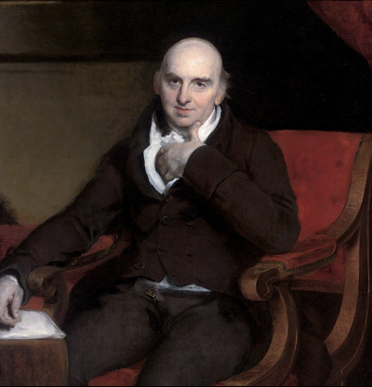
William Morgan, London 1785
First to unknowingly produce X-rays
→ in his experiments, he wanted to ascertain „the non-conducting power of a perfect vacuum“
→ By boiling mercury, he obtained a very high vacuum
→ glass tube cracked, admitted slowly air and he observed a continuing succession of beautiful colours
William Morgan (by Thomas Lawrence), on view at the Institute of Actuaries, Staple Inn Hall, London
HPXM Conference I 19-23 June 2023
© Deutsches Röntgen-Museum
Notes:
However, some 40 years later a welsh apothecary named William Morgan would succeed in producing x-rays. That was 1785, did this unknowingly
He used evacuated glass tubes with a piece of tinfoil fastened at the closed end as a terminal.
By boiling mercury, he obtained so high a vacuum that an electrical discharge was unable to overcome the high resistance of the tube.
And that was exactly what he intended to show: „the non-conducting power of a perfect vacuum“.
glass tube cracked and admitted slowly air - observed a continuing succession of beautiful colours, beginning with yellowish-green and passing through blue and purple to red.
might be possible to estimate the degree of a vacuum by determining the resulting colour of the electrical discharge.
what precise potential difference Morgan’s static machine was able to produce
And the high vacuum Morgan achieved in his tubes was comparable to that of the later x-ray-tubes.
After Röntgen’s discovery, the identification of the yellow-green shade with x-rays made it clear that Morgan was very likely the first to produce them.

Slide 10
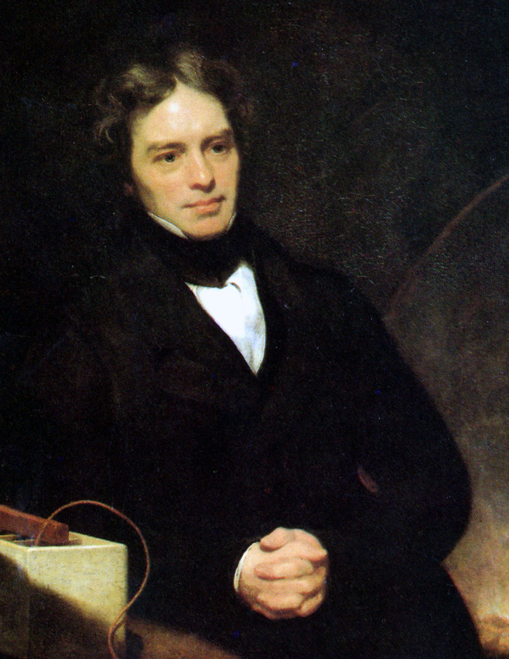
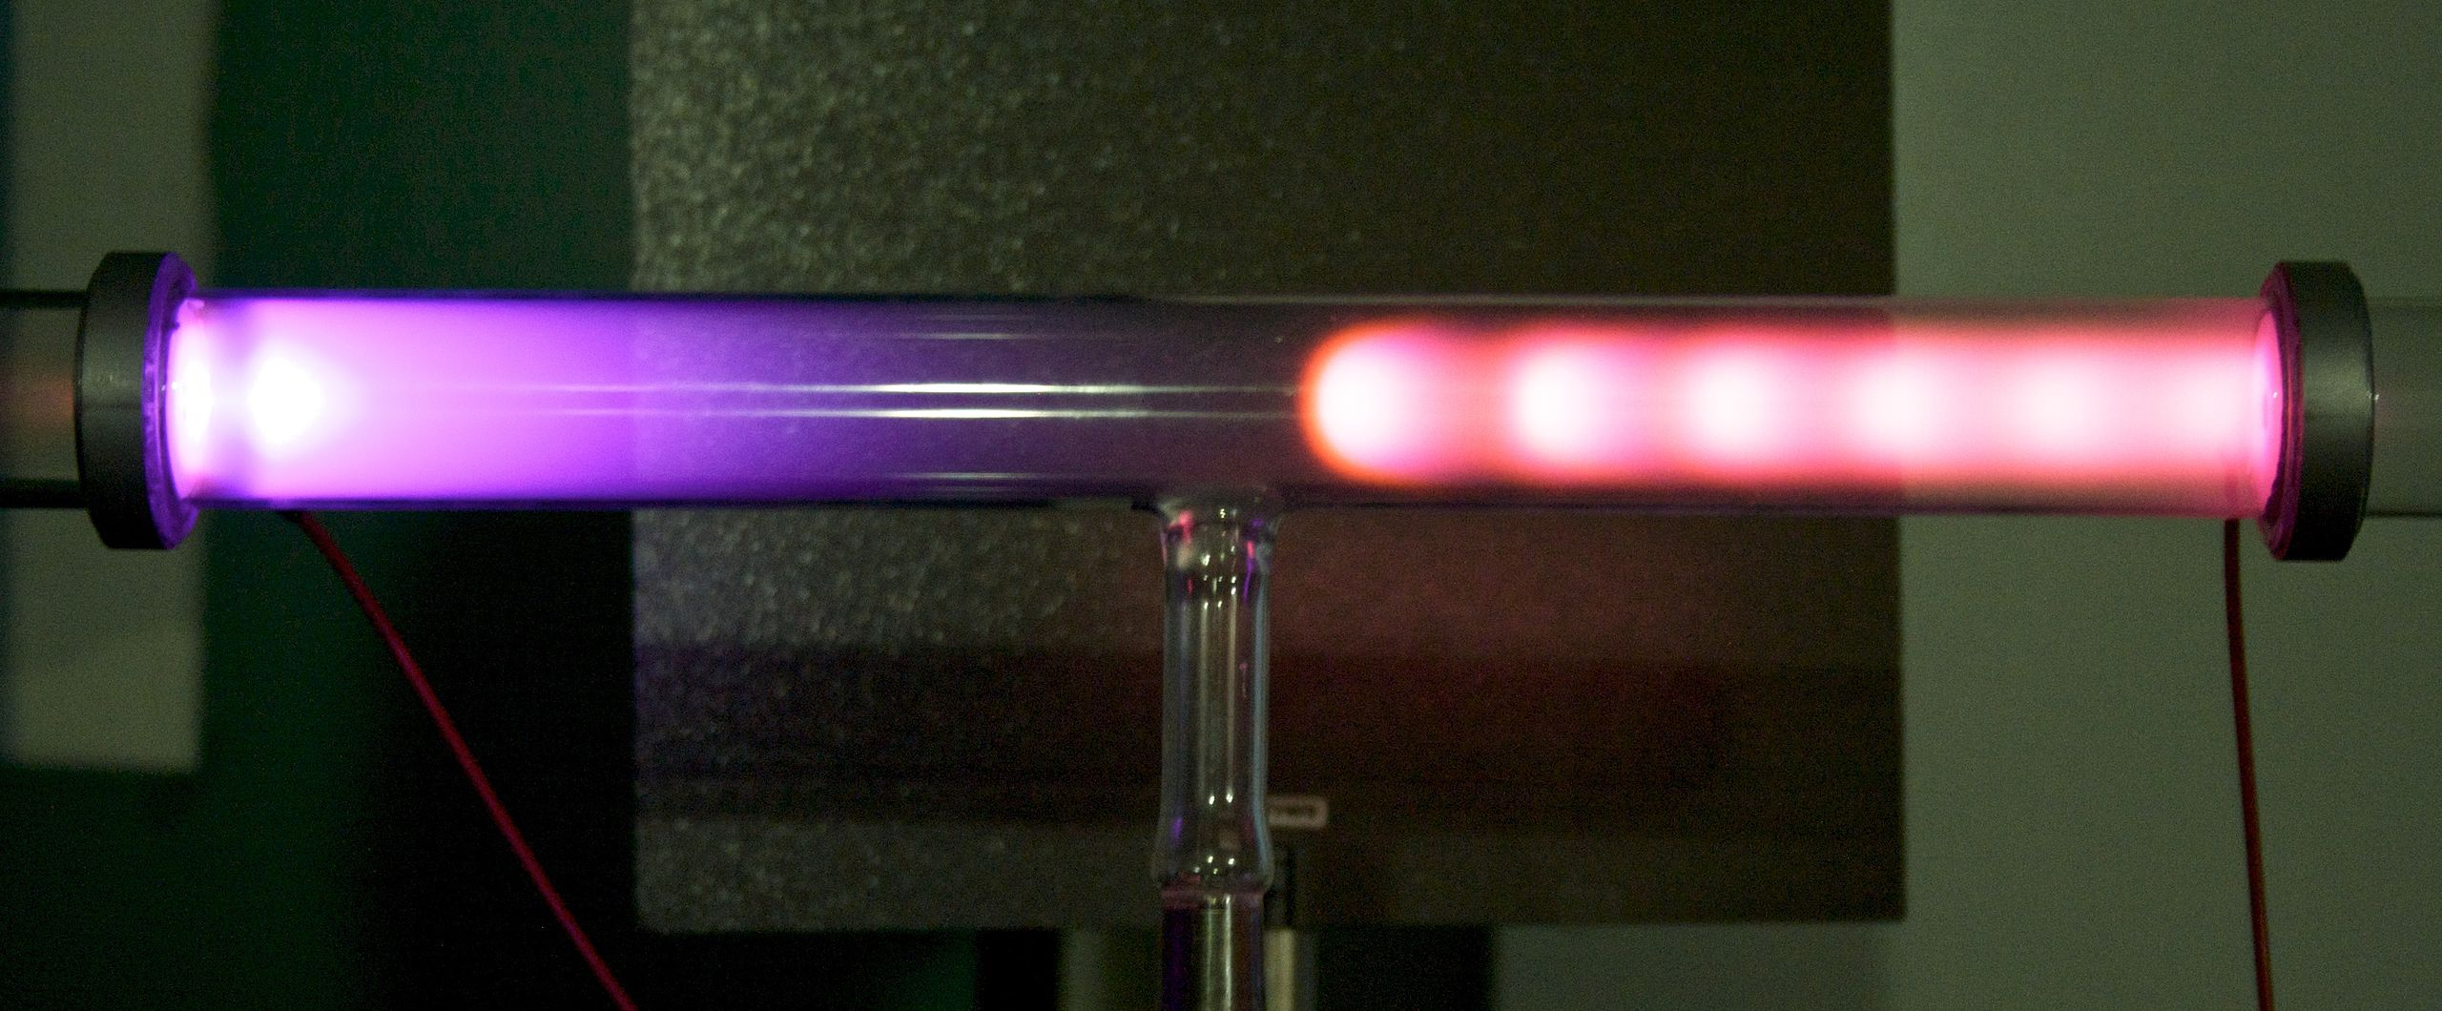
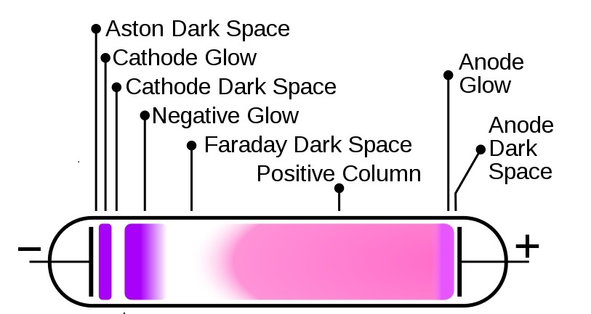
Faraday – London 1834
Michael Faraday (1791-1867) Painting by Thomas Phillips oil on canvas, 1841-1842
Glow Discharge © L.B. Loeb
HPXM Conference I 19-23 June 2023
© Deutsches Röntgen-Museum
Notes:
We are now entering the 19th century, in which research on discharge tubes made particular progress – one important role plays Michael Faraday:
Besides his discoveries of the electromagnetic induction (1831) – induction coil and transformer - , he investigated the electric current in thinned gases 1830s, first systematic experiments.
Using glass tubes into which two electrodes had been sealed –coined the words anode and cathode - he had discovered that the sparks observed under atmospheric pressure change to a glow when the tube is evacuated.
Using different gases, noticed glow discharges with its beginning at the cathode and its end at the anode. As he lowered the gas pressure, he noticed a dark spot occurring near the cathode, also known as the “Faraday dark space”.
awakened a renewed interest in the study of electrical discharges from evacuated tubes.
Difficulties - quality of the glass tubes and the inefficient methods of producing high vacuums.

Slide 11
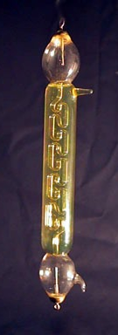
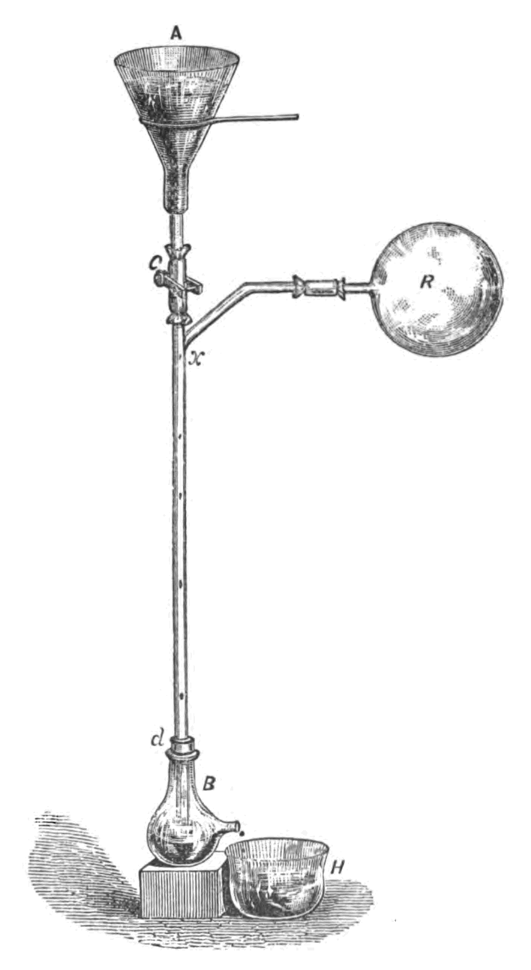
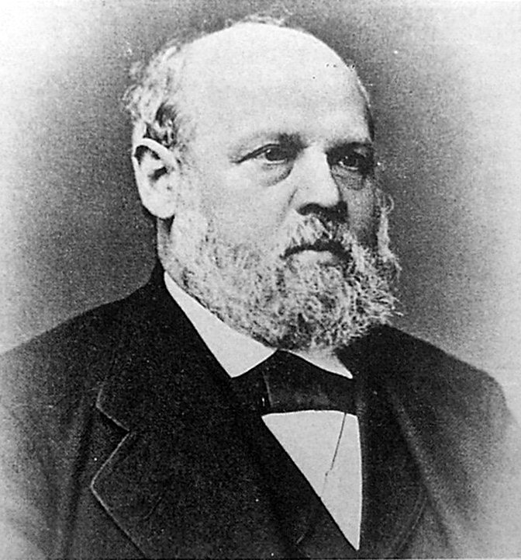
Geissler and Plücker - Bonn 1865
Johann Heinrich Geissler (1814-1879)
Geissler tube
Sprengel air evacuation pump
HPXM Conference I 19-23 June 2023
© Deutsches Röntgen-Museum
Notes:
The beginning of a systematic exploration of low pressure gas discharges, Julius Plücker and the glassblower Heinrich Geißler
latter has mainly provided solutions to the two problems previously mentioned.
skilled glass-blower - Low-vacuum tubes came to be called Geissler tubes.
also responsible for a second major necessary improvement –advanced form of the mercury air pump invented by Hermann Sprengel in 1865. With this new pump a relatively high vacuum up to 1 × 10 ^{–3} atm could be achieved.
Geissler also fused platinum wire electrode terminals into both ends of the tube.
By applying high voltages from a Ruhmkorff induction coil (invented in the 1830s), admitting small quantities of various gases - able to produce luminous colour effects of great brilliance and beauty.

Slide 12
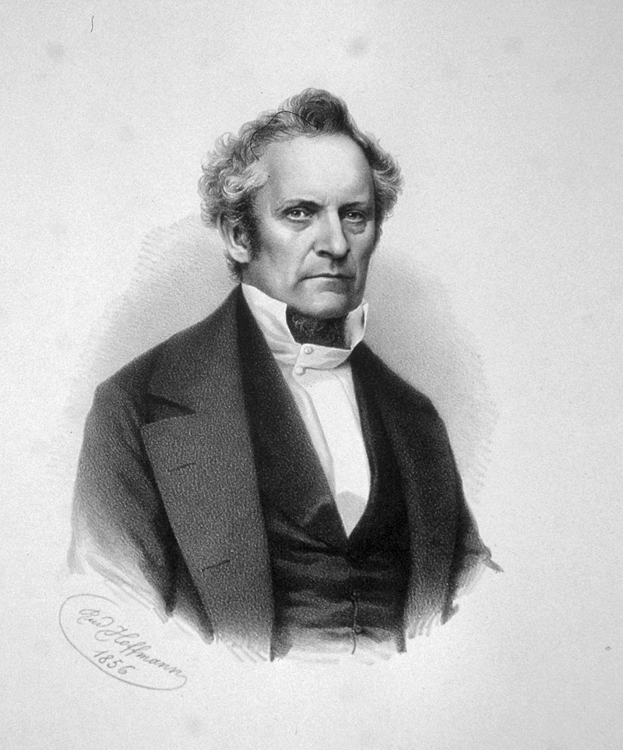
Plücker and Hittorf - Bonn 1865
Plücker’s and Hittorf’s investigations showed
→ each gas, when a certain voltage was applied, could be made to discharge with a specific spectrum of light.
→ Hittorf discovered the cathode rays shortly after Plücker's death in 1869
Julius Plücker (1801-1868)
HPXM Conference I 19-23 June 2023
© Deutsches Röntgen-Museum
Notes:
These achievements of Geissler contributed decisively to the success of the experiments of Julius Plücker.
Plücker and his doctoral student Johann Wilhelm Hittorf experimented with gas discharge tubes, which ultimately led to the discovery of element-specific line spectra and cathode rays.
These investigations showed that each gas, when a certain voltage was applied, could be made to discharge, each with a specific spectrum of light.
first to observe glass fluorescence (green in glass of British manufacturers and blue in German glass) opposite one of the electrodes.
this light emanating from the cathode could be concentrated with the use of a magnet.
Hittorf discovered the cathode rays shortly after Plücker's death in 1869, which represented an important step towards the discovery of X-rays.

Slide 13
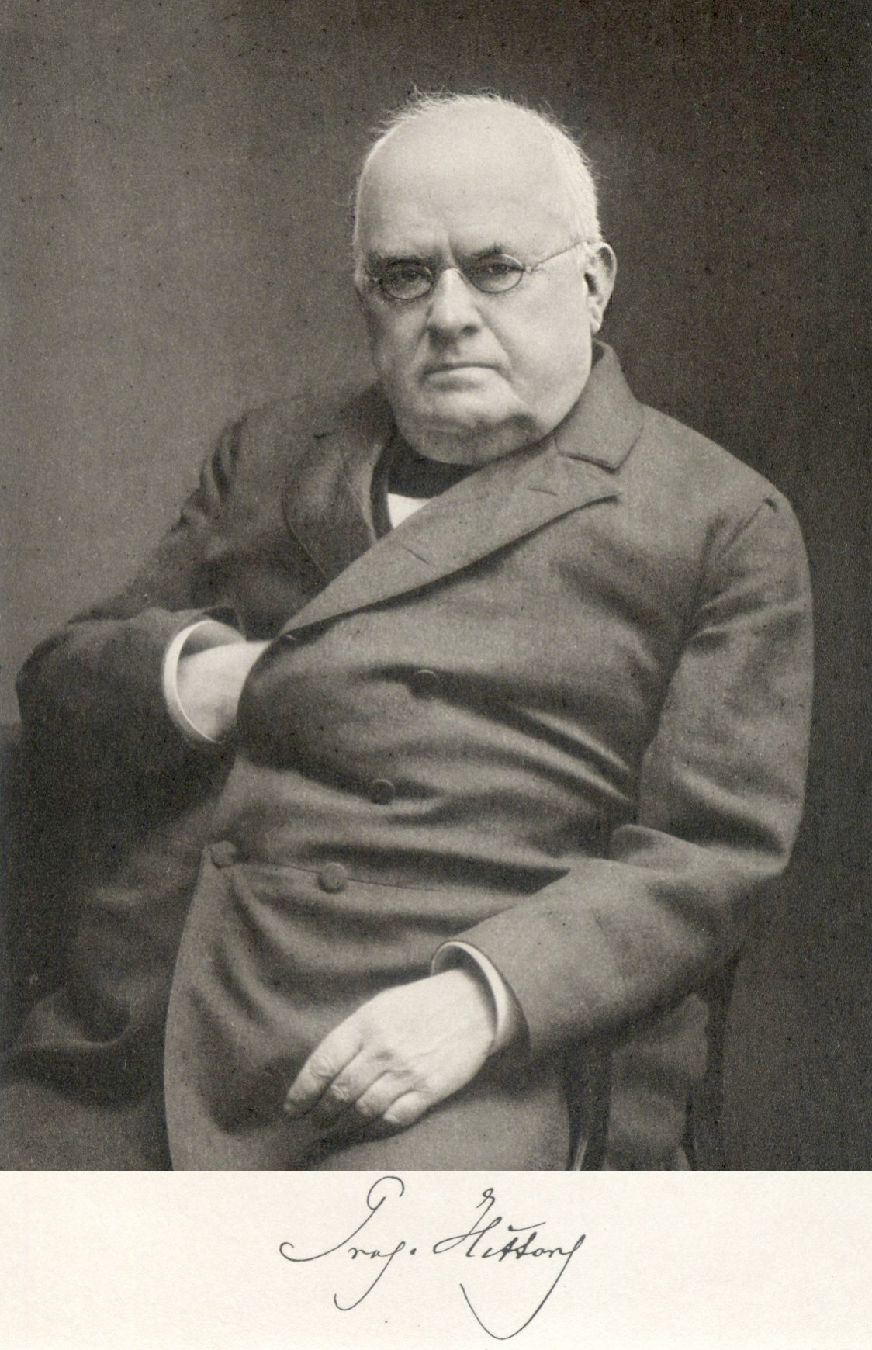
Hittorf - Münster 1867
“The glowing appears to be the process by which the transfer of current from the particles of the gaseous medium to those of the [...] cathode is mediated."
Johann Wilhelm Hittorf (1824-1914)
HPXM Conference I 19-23 June 2023
© Deutsches Röntgen-Museum
Notes:
For further investigations Hittorf improved his apparatus.
he acquired the spark inductor invented by Daniel Rühmkorff, He then set about improving the vacuum.
succeeded in researching the main properties of the cathode rays (so named 10 years later by Eugen Goldstein in 1876).
built tubes with much higher vacuum and in an L-shaped form - He noted that the electrical discharge always occurred in the arm with the negative electrode (thus the cathode). Identified the cathode as the source of the phenomenon
propagate in a straight line, produce fluorescence when they strike the glass wall, metal foil in the path of the rays casts shadows.
He explained the rays coming from the cathode as a simple (negative) current - Plücker had already demonstrated that they were deflected in the magnetic field.
Hittorf must have produced X.-rays as well.

Slide 14
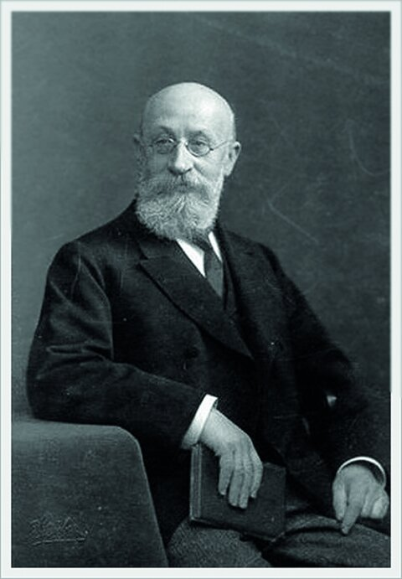
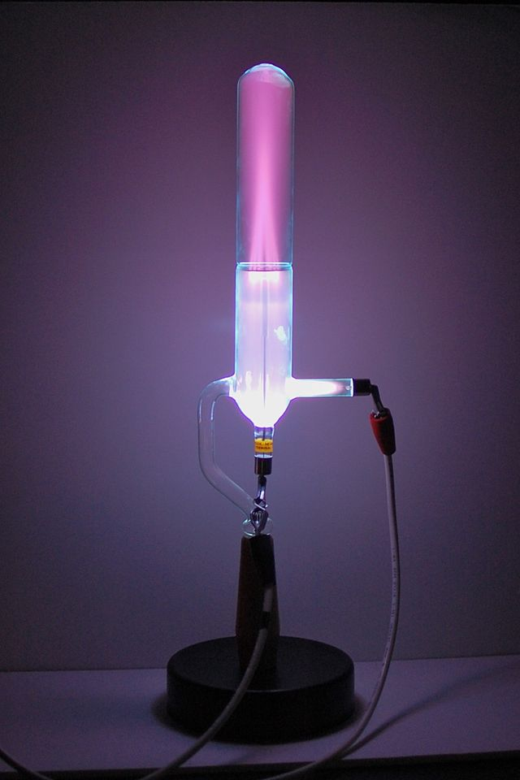
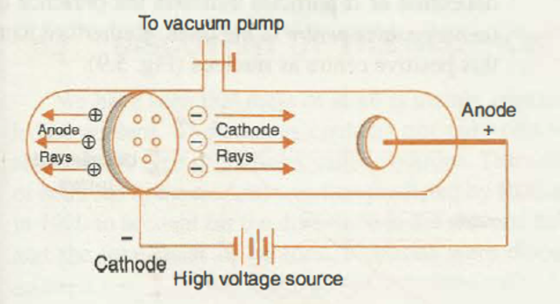
Goldstein - Berlin 1886
Eugen Goldstein (1850-1930)
HPXM Conference I 19-23 June 2023
© Deutsches Röntgen-Museum
Notes:
Building on the work of Plücker and Hittorf, Eugen Goldstein from Berlin conducted extensive gas discharge experiments
1876, rays were emitted vertical to the cathode surface - he therefore coined the term cathode rays/stream.
In 1886 Goldstein discovered the anode rays - produced by positively charged ions after impact ionization, accelerated towards the cathode, pass – if the cathode is provided with holes – through these holes ("channels") due to their inertia and can be detected behind the cathode by their luminous phenomena.
“canal rays” (German “Kanalstrahlen”), speculated that these rays consisted of positively charged particles.

Slide 15
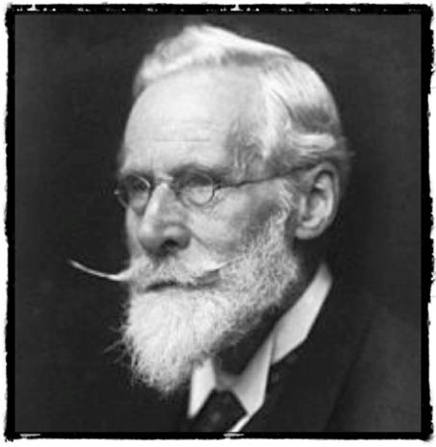
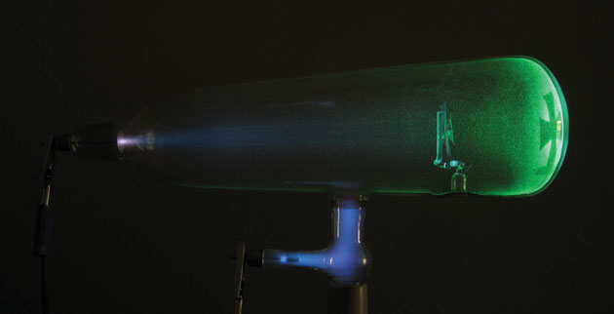
Crookes – London 1879
“… the walls of tube emit blue lights and the photo-graphic plates show ‘foggy’ shadows…”
Annual Meeting of the British Association for the Advancement of Science in Sheffield on 22 August 1879
Sir William Crookes (1832-1919)
HPXM Conference I 19-23 June 2023
© Deutsches Röntgen-Museum
Notes:
Besides Hittorf, Sir William Crookes also dealt with cathode rays.
In 1879 he could prove with the maltese cross tube, that the cathode rays beam spreads out lineary from the cathode to the anode.
The high-vacuum tubes (10-6atm), his own design and later used by Röntgen.
He predicted, that the cathode rays must be an amount of negative charged particles, his theory has been approved.
After increasing the gas pressure he noticed a glowing discharge. Crookes believed to observe shining atoms or matter in a special state. In his lecture “On Radiant Matter” Crookes pronounced the hypothesis of a fourth state of aggregation of matter to explain phenomena in highly evacuated cathode tubes.
that his photographic plates were strangely fogged and often blackend, complained about the faulty photo plates to the manufacturer.
In his writings he gave a perfect description of an x-ray tube in full action, of all the phenomena occurring within it. But he appeared to ignore what was happening outside it, he did not recognize the correlation of the assumed “faulty plates” and his experiments.
He definitely generated X-rays.
But no one, during 20 years of experimentation with high-vacuum tubes, which became known as Crookes tubes, at schools and universities around the world, seemed to notice – until Röntgen in 1895.

Slide 16
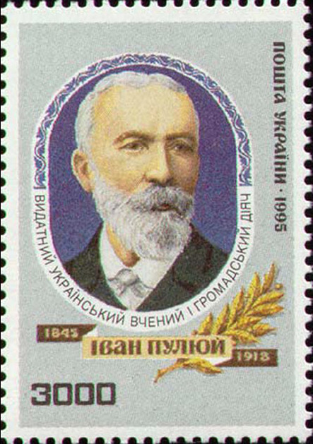
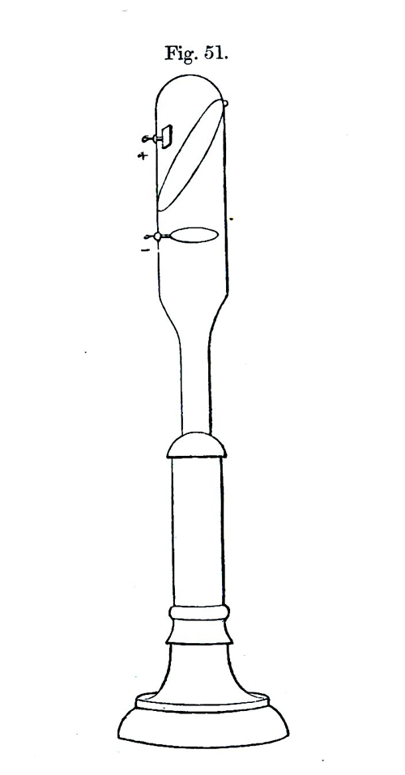
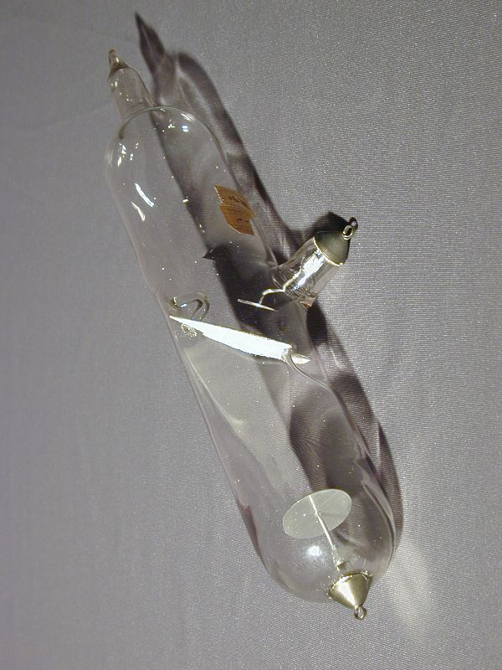
Puluj – Vienna 1881
Johann Puluj (1845-1918) (Ukrainian stamp, 1995)
The Puluj phosphorescent lamp (© Museum Experimentalphysik Innsbruck)
HPXM Conference I 19-23 June 2023
© Deutsches Röntgen-Museum
Notes:
Ukrainian physicist and electrical engineer Johann Puluj.
he offered an explanation to the nature of cathode rays: Physical particles were mechanically released from the electrodes that are charged with negative electricity, moving in a straight line at high speed, and together with the residual molecules of the gas mediating the conduction of electricity between the electrodes of the discharge tube.
In the course of his research, Puluj developed luminescent lamps in 1881, which were later called Puluj lamps - The phenomena he described in his publications were probably indeed X-rays and his lamp was in principle a prototype of an X-ray tube.
However, Puluj did not resume his research until after the publication of Röntgen's first treatise on the new rays in January 1896, first physicists to recognise the potential of X-rays for medical diagnostics and produced numerous X-ray images.
With his research, Puluj certainly laid an important foundation for Röntgen's discovery of X-rays. That is why some journalists called him the discoverer of X-rays. Puluj himself acknowledged Röntgen's priority.

Slide 17
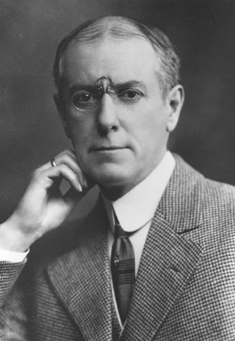
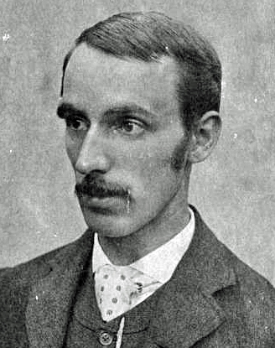
Goodspeed – Pennsylvania 1890
First "radiation accident" in history
22nd February 1890
A.W. Goodspeed (1860- 1943) and William Jennings (1860-1945)
HPXM Conference I 19-23 June 2023
© Deutsches Röntgen-Museum
Notes:
Let me now tell you about an event, that was called “The first radiation accident in history” – though it happened 5 years before Röntgens discovery
evening of 22 February 1890, the American physicist Arthur Goodspeed (1860-1943) and the photographer William. N. Jennings (1860-1946) were once again experimenting with high-voltage discharges in the physics laboratory of the University of Pennsylvania.
were to photograph lightning and brush discharges produced by spark inducers.
After they had finished their experiments, there were still some unexposed photographic plates in appropriate photocassettes on their experimental table. Some coins were lying on top of them.
Goodspeed fetched from his collection some of the Crook's discharge tubes there, connected them, and showed Jennings the fascinating luminous phenomena in the tubes.
A few days later, Jennings reported that while developing all the photographic plates, even those that were not directly exposed, he had noticed something strange. On one plate, there were circular structures overlaid with traces of sparks. Neither the photographer nor the physicist could explain this curious effect.
Was it a manufacturing defect?

Slide 18
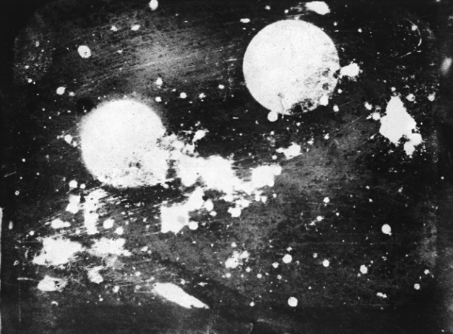
Goodspeed – Pennsylvania 1890
"Now, gentlemen, we wish it clearly understood that we claim no credit whatever for what seems to have been a most interesting accident, yet the evidence seems quite convincing that the first Roentgen shadow picture was really produced almost exactly six years ago tonight, in the physical lecture room of the University of Pennsylvania.“
Goodspeed at a meeting of the American Philosophical Society, 21st February 1896
Radiograph of two American coins 22.02.1890
HPXM Conference I 19-23 June 2023
© Deutsches Röntgen-Museum
Notes:
G put the negative aside - In the course of time, no one thought of it again.
Six years later, Arthur Goodspeed also learned of the discovery, remembered the plate that had been put aside and studied it again.
The logical explanation could only be that he and Jennings had unknowingly taken the first X-ray picture of coins on 22 February 1890.
Goodspeed then repeated his experiments under the same conditions, with the same apparatus and tubes, and he obtained comparable results.
At the meeting of the American Philosophical Society on 21 February 1896, Goodspeed gave a remarkable experimental lecture on X-rays, recounting the events of this first "radiation accident" in history, almost exactly six years ago. At the conclusion of his lecture, Goodspeed said: (…)

Slide 19
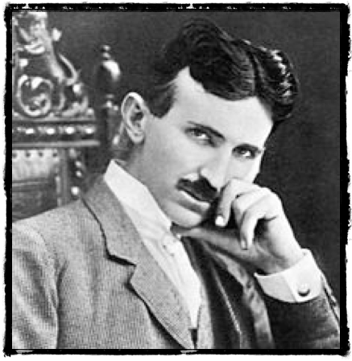
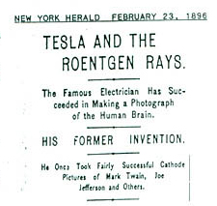
Tesla – New York 1894
Nikola Tesla (1856 – 1943)
HPXM Conference I 19-23 June 2023
© Deutsches Röntgen-Museum
Notes:
There is a large fan community of Nikola Tesla on the internet, who repeatedly post the claim that Tesla was the true discoverer of X-rays.
Unfortunately, they also have to admit that there are no documents or records of this. In a fire in Tesla's laboratory, however, all the evidence is said to have been burnt.
Whoever would like to believe this…

Slide 20
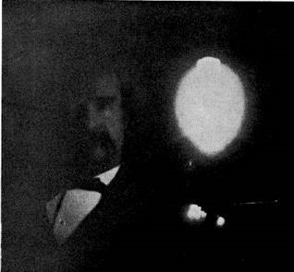
Tesla – New York 1894
HPXM Conference I 19-23 June 2023
© Deutsches Röntgen-Museum
Notes:
Around 1894 Tesla developed a unipolar gas discharge tube and made experiments with phophorescent lamps in January 1894.
By taking a photograph of Marc Twain he saw on the photographic plate something strange. It seemed to him as if a screw inside his camera being shown on the picture.
However, it was only after Röntgen's announcement that he became intensively involved with X-rays. He contacted Roentgen and sent him some of his radiographs.

Slide 21
Lenard – Bonn 1894
„I am the mother of X-rays.
Just as the mid-wife is not responsible for the mechanism of birth, so was Roentgen not responsible for the discovery of X-rays since all the groundwork had been prepared by me. Without me, the name of Roentgen would be unknown today.”
Lenard, P. (1936) Deutsche Physik. J. F. Lehmann, Munich. vol. 1
HPXM Conference I 19-23 June 2023
© Deutsches Röntgen-Museum
Notes:
Let us start the discussion on the next scientist with with a quotation:
„I am the mother of X-rays.
Just as the mid-wife is not responsible for the mechanism of birth, so was Roentgen not responsible for the discovery of X-rays since all the groundwork had been prepared by me. Without me, the name of Roentgen would be unknown today.”
After Röntgen had learned of Lenard's experiments, he asked his colleague for information for his own experiments. So what was Lenard's part in the discovery of x-rays. Was he right?

Slide 22
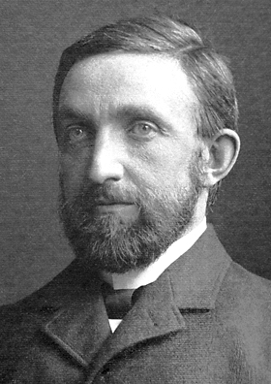
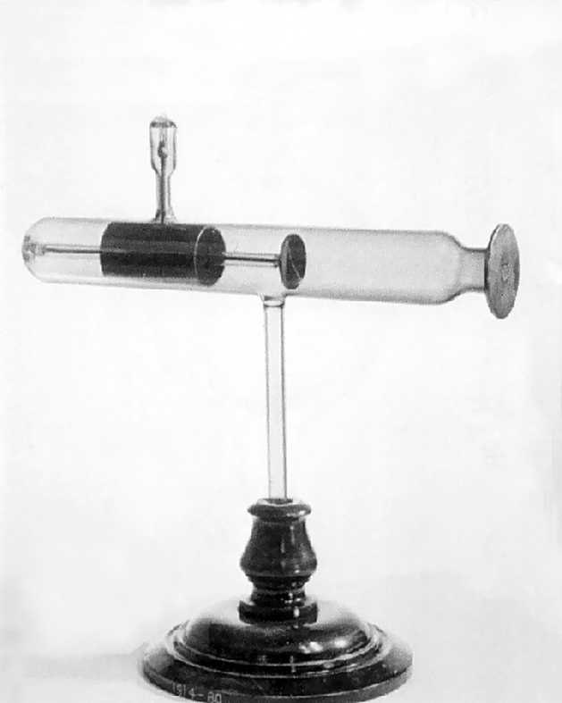
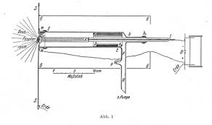
Lenard – Bonn 1894
“…But what would happen if the wall were made permeable to the cathode rays?...”
Lenard 1894
Philipp Lenard (1862-1947)
HPXM Conference I 19-23 June 2023
© Deutsches Röntgen-Museum
Notes:
Let us have a closer look on the research work of Philipp Lenard.
Lenard was particularly interested in researching the passage of cathode rays through thin layers of material. As early as 1892, Hertz had discovered that a thin metal sheet transmitted cathode rays.
This prompted Lenard to build a thin aluminum window, vacuum tight, which permitted the cathode rays to pass out of the vacuum of the tube into the air.
Lenard must have produced x-rays in the course of these experiments, noticed some of their properties along with those of the cathode rays.
cathode rays not only penetrated through the window but also travelled several cms in the free air – their effects could be studied with fluorescing substances (phosphates), able to blacken a photographic plate.
But in the end, Lenard did not identify X-rays and failed to establish that x-rays were a different form of radiation from cathode rays.
contributed to further research into the physical nature of cathode rays, using his research results, Joseph John Thomson succeeded in 1897 in proving that cathode rays are made of electrons.
In 1905, Nobel Prize in Physics - Despite this award, Lenard was very bitter about the fact that Röntgen alone was awarded the first Nobel Prize in physics in 1901, that he himself was passed over in the process. Since then, he has referred to himself as the true discoverer and downplayed Röntgen's role.

Slide 23
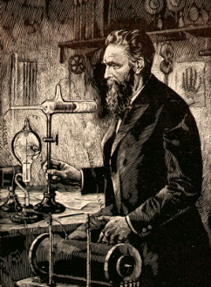
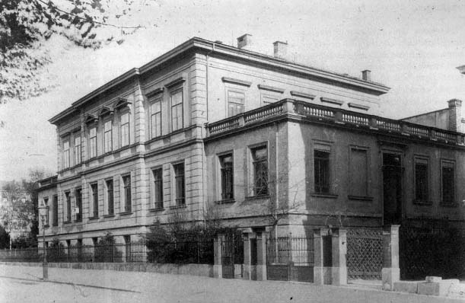
Röntgen – Wuerzburg 1895
"I have been for a long time interested in the problem of the cathode rays from a vacuum tube as studied by Hertz and Lenard. I had followed theirs and other researches with great interest, and determined, as soon as I had the time, to make some researches of my own. This time I found at the close of last October (1895). I had been at work for some days when I discovered something new."
W. C. Roentgen: Interview mit H.J. Dam Mc Clure’s Magazin, April 1896
HPXM Conference I 19-23 June 2023
© Deutsches Röntgen-Museum
Notes:
Then, probably in spring of 1894 Roentgen became interested in the work of Philip Lenard on cathode rays.
In the course of the summer of 1895 Röntgen had assembled equipment, such as a fairly large induction coil and suitable discharge tubes
From Hertz’s and Lenard’s work it was known that these rays are absorbed in air, gases, and in thin metal foils roughly according to the total mass of the matter traversed.
It was also known that the rays excited fluorescencein different crystals like fluorite and barium platino cyanide.
Röntgen later never divulged what measurements he intended to make. In an interview wit the American reporter H. J. Dam from McClure’s magazine he said: Quote”…."

Slide 24
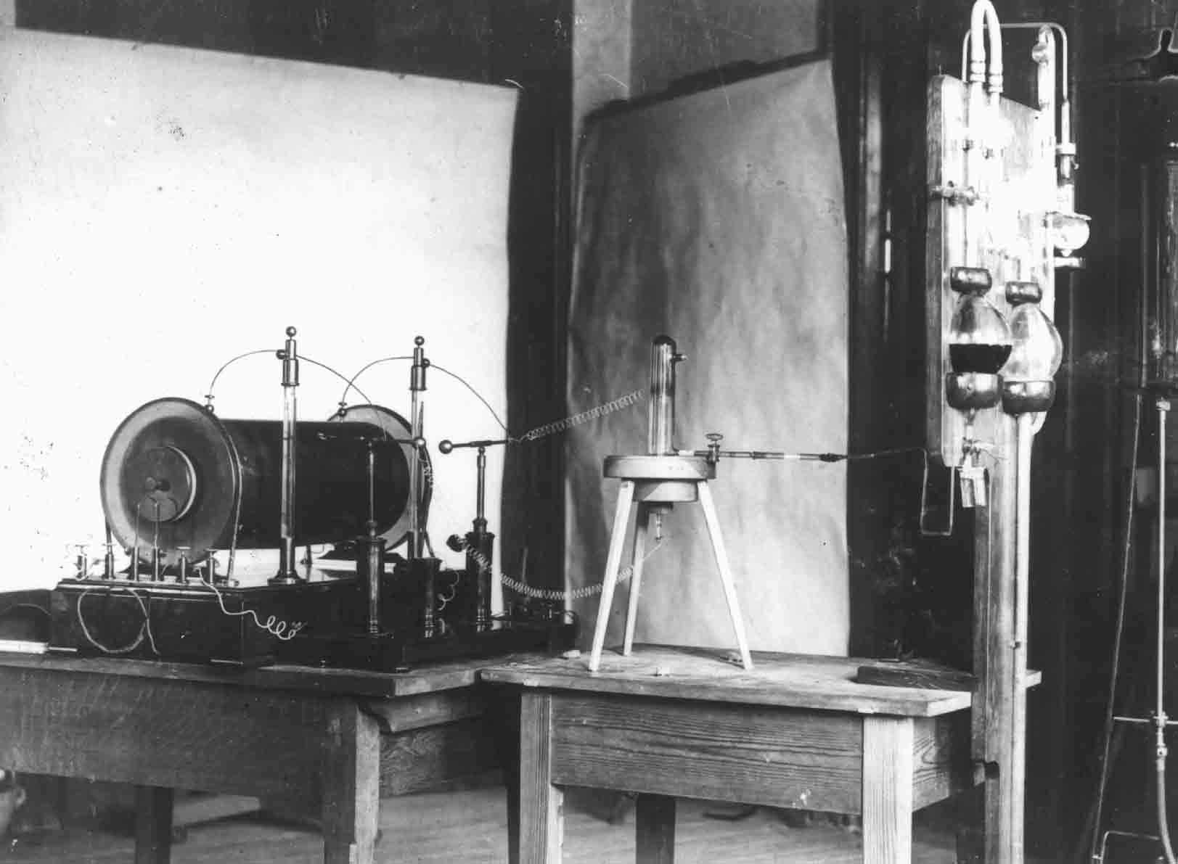
The experiment – „I did not think; I investigated.“
“A discharge from a large induction coil is passed through a Hittorf’s vacuum tube, or through a well-exhausted Crookes’ or Lenard’s tube. The tube is surrounded by a fairly close-fitting shield of black paper; it is then possible to see, in a completely darkened room, that paper covered on one side with barium platino-cyanide lights up with brilliant fluorescence when brought into the neighborhood of the tube, whether
the painted side or the other be turned towards the tube. The fluorescence is still visible at two meters distance. It is easy to show that the origin of the fluorescence lies within the vacuum tube.“
Roentgen WC. On a new kind of rays. Nature 53, 274, §1. 1896
HPXM Conference I 19-23 June 2023
© Deutsches Röntgen-Museum
Notes:
Friday, November 8, 1895 something new!
used Crookes and Hittorf ionising tubes, with heavier walls and without aluminium windows - connected to a special vacuum pump.
high voltage of about 60.000 Volt - Ruehmkorff induction coil.
By accident, fluorescent crystals, lying nearby began to glow.
sure that the blue and visible light from the tube - by fluorescence.
To verify this hypothesis R covered the tube with a black cardboard.
crystals were still glowing.
could not be described with the then existing knowledge of physics.
R. concluded that a new invisible and penetrating light
X-rays.

Slide 25
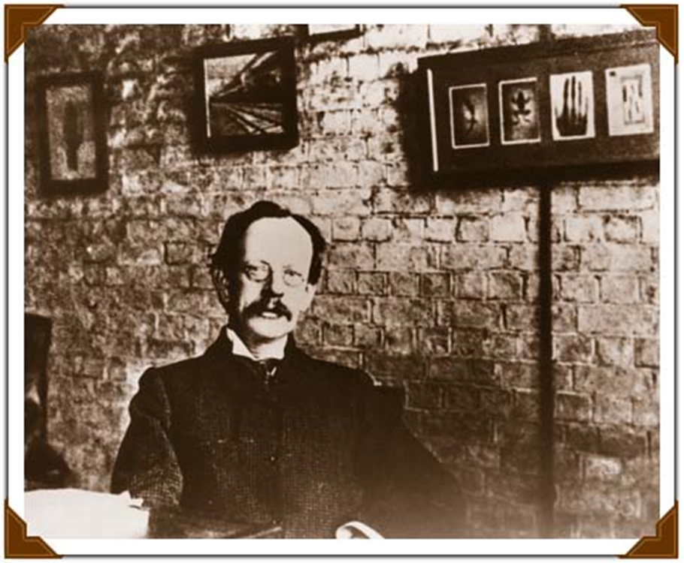
Thomson - Cambridge 1896
Radiographs!
Joseph J. Thomson (1856-1940) Cavendish-Laboratory, Cambridge, UK
HPXM Conference I 19-23 June 2023
© Deutsches Röntgen-Museum
Notes:
The provisional conclusion of the history of cathode ray research was made by Sir Joseph John Thomson.
He succeeded in studying the nature of the cathode rays by conducting different experiments.
He got clear about the fact, that the cathode rays were charged particles or as he called them “corpuscles”.
To determine the mass-to-charge-ratio of these particles he equaled the magnetic deflection with the electrical one. He obtained that each of the particles had the same small mass, about ~ 1/2000 (a two-thousandth) of the hydrogen atom. This way he had discovered the negative charged electrons.

Slide 26
Conclusion
The study of gas discharge and the clarification of the physical nature of cathode rays was an important field of research in the 19th century.
Despite numerous observations on the existence of a radiation penetrating matter, no questions or not the right questions were asked to clarify the phenomena.
Röntgen was not the first to generate and observe X-rays.
Röntgen was the first to clearly identify the new phenomenon and to describe its properties precisely in the course of his meticulous research.
After numerous speculations JJ Thomson's research on the specific charge of cathode rays, proved that they were electrons.
HPXM Conference I 19-23 June 2023
© Deutsches Röntgen-Museum
Notes:
Despite numerous observations no questions or not the right questions were asked to clarify the observed phenomena. This was not done until Wilhelm Conrad Röntgen.
It is true that Röntgen was not the first to generate and observe X-rays.
But Röntgen was the first to clearly identify the new phenomenon and to describe its properties precisely in the course of his intense research. It took almost 2 decades for decisive new insights in x-ray properties to be gained.
It was JJ Thomsson who clearified the physical nature of cathode rays.

Slide 27
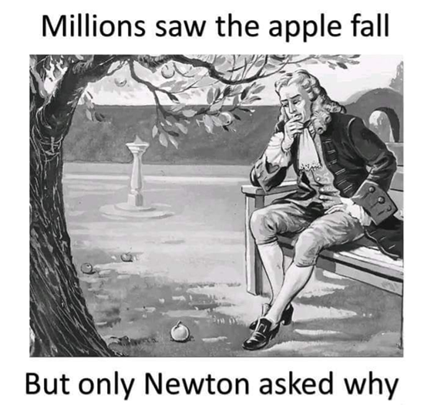
Conclusion
Serendipity
HPXM Conference I 19-23 June 2023
© Deutsches Röntgen-Museum
Notes:
this illustration sums it up
Serendipity means: allowing for chance finds, and accepting that what is found is not necessarily what was being looked for –
„I did not think; I investigated.“

Slide 28
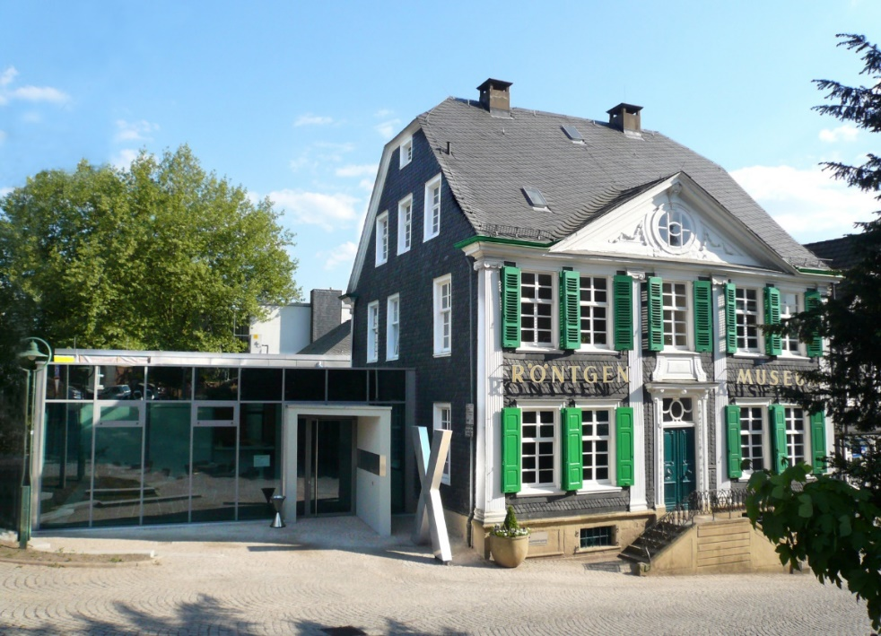
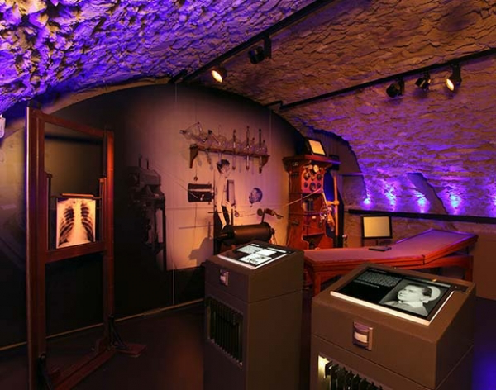
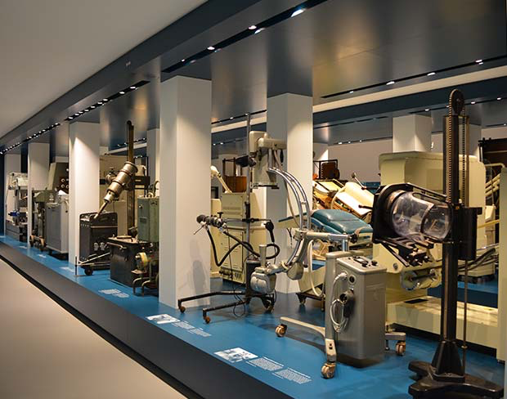
Röntgen-Museum in Remscheid
Established 1932
2.500 sqm exhibition area
160.000 Exhibits
Archive documents, photographs, radiographs
Special library with 15.000 books
Apothecaries’ history fellows I 21st March 2023
© Deutsches Röntgen-Museum
Notes:
Last but not least please allow me to give you a short introduction in our museum.
founded in 1932.
It was the German Roentgen Society who decided already in 1906 to have a special education center for young radiologists.
asked their members to collect machicnes, radiograph, reports.
The idea was to build a huge museum in berlin or Munich.
Because of the first Wolrd War theses plans were destroyed.
A past president of the German Roentgen Society had the idea to build a monument and a museum at Roentgens Birthplace. Today we do have a exhibition area of 2.500 sqm. We are describing the history of x-rays and their applications from the micro- to the macro cosmos. A lot of the original ideas were realised...

Slide 29
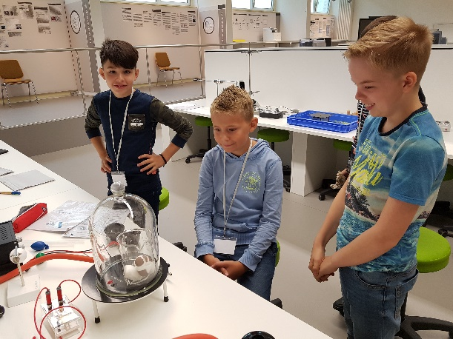
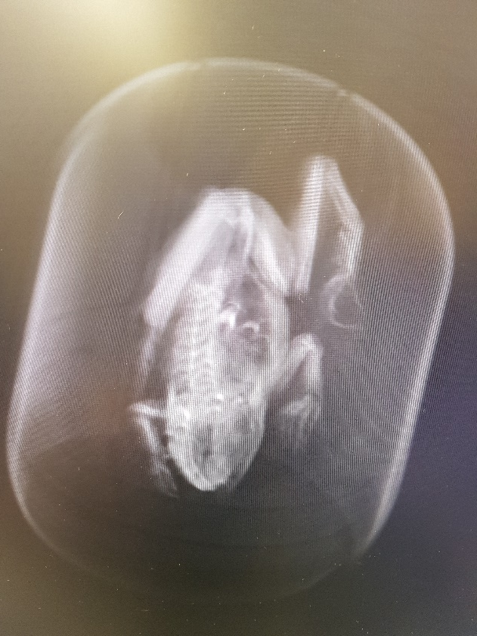
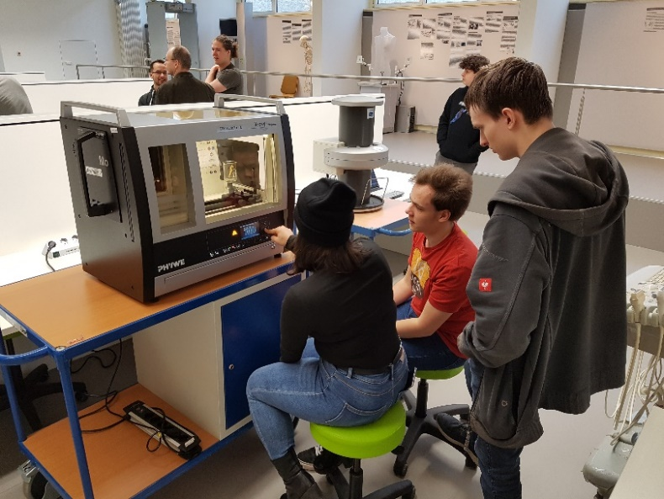
Student‘s Lab RöLab
Apothecaries’ history fellows I 21st March 2023
© Deutsches Röntgen-Museum

Slide 30
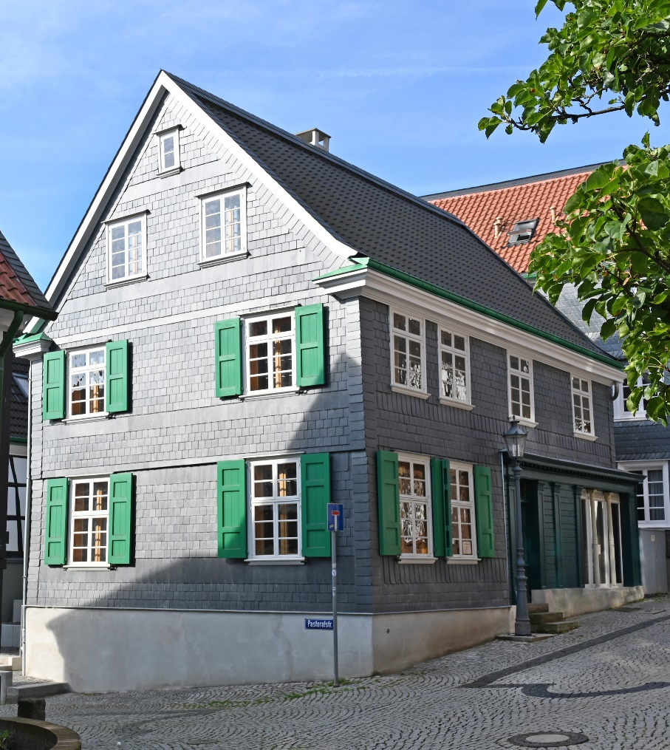
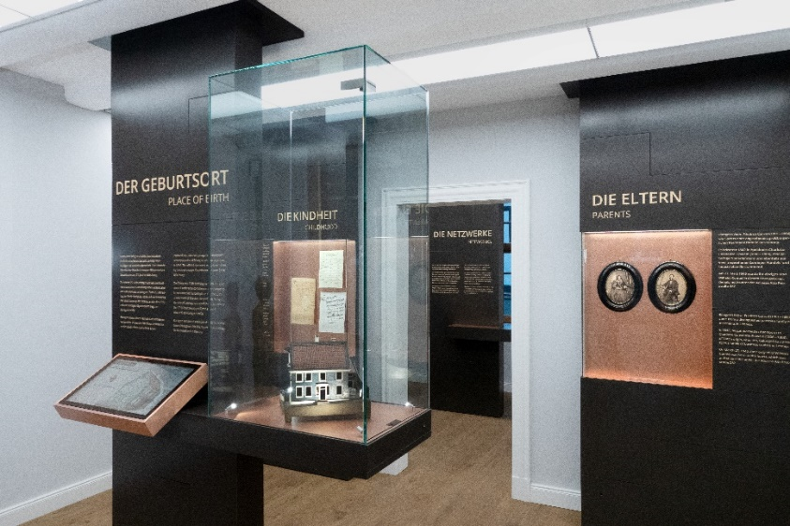
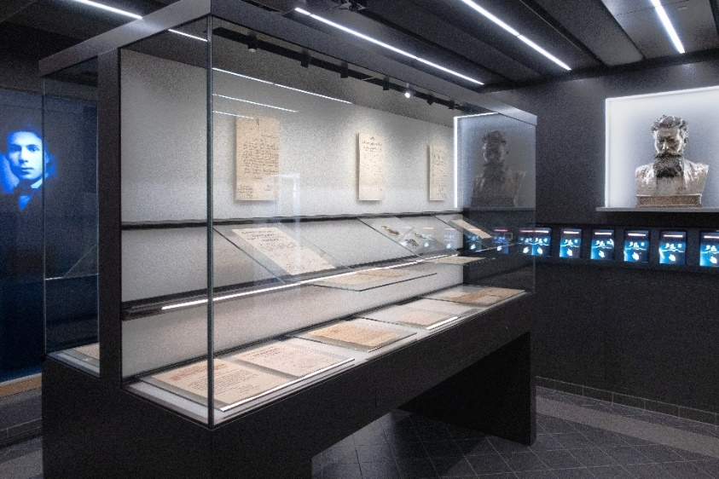
Röntgen‘s Birthplace in Remscheid-Lennep
Built arround 1760
Bought by Roentgen‘s father 1812
Sold in 1846 to a butcher
Re-opened March 2019
© Fotos: Deutsche Röntgen-Gesellschaft
Apothecaries’ history fellows I 21st March 2023
© Deutsches Röntgen-Museum
Notes:
Close to the museum you can find Roentgen‘s birthplace.
Under the direction of the German Roentgen-Society the house was broadly restored
meeting place for scientists from all over the world.
Contains small exhibition of Röntgens life and original documents.
I am looking forward to see you all there some day. Thank you very much for your attention.

Slide 31
Acknowledgements and sources
Archiv Deutsches Röntgen-Museum, Remscheid
Wikimedia commons
Hallwachs, Wilhelm: Über den Einfluß des Lichtes auf electrostatisch geladene Körper. In: Annalen der Physik, Bd. 33, 1888, S. 301–312.
Lenard, Philipp. “Ueber die electrostatischen Eigenschaften der Kathodenstrahlen.” Annalen der Physik 300: 279-289.
Lenard, Philipp: Ueber Katodenstrahlen in Gasen von atmosphärischem Druck und im äussersten Vacuum; Annalen der Physik und Chemie, Bd. 51, Heft 2, S. 225 – 267, Joh. Ambrosius Barth, Leipzig 1894
Museum Experimentalphysik Innsbruck
www.iucr.org/news/newsletter/volume-28/number-2/physicist-and-electrician-of-ukrainian-roots-johann-puluj-18451918-his-professional-career-and-the-invisible-cathode-rays
www.tubecollection.de
Glas Museum, Gehlberg
http://www.stamp.kiev.ua/ukr/stamp/?p=1&amp;fi=1&amp;rubrID=12http://www.stamp.kiev.ua/eng/news/
(IUCr) Johann Puluj (1845–1918): his career and the “invisible cathode rays”
Apothecaries’ history fellows I 21st March 2023
© Deutsches Röntgen-Museum

