Slide 1



The EuAPS betatron photon beam: ultra-bright light pulses for imaging and spectroscopy
High Precision X-ray Measurements 2023
June 22nd, 2023
Francesco Stellato
University of Rome «Tor Vergata» & INFN
on behalf of the EuPRAXIA collaboration

Slide 2
Summary
The EuAPS project
  EuPRAXIA & EuAPS
Plasma acceleration & Betatron emission @ EuPRAXIA
Betatron X-ray source figures
Photon science plan:
  Imaging
  Spectroscopy
  … and beyond
Outlook

Slide 3
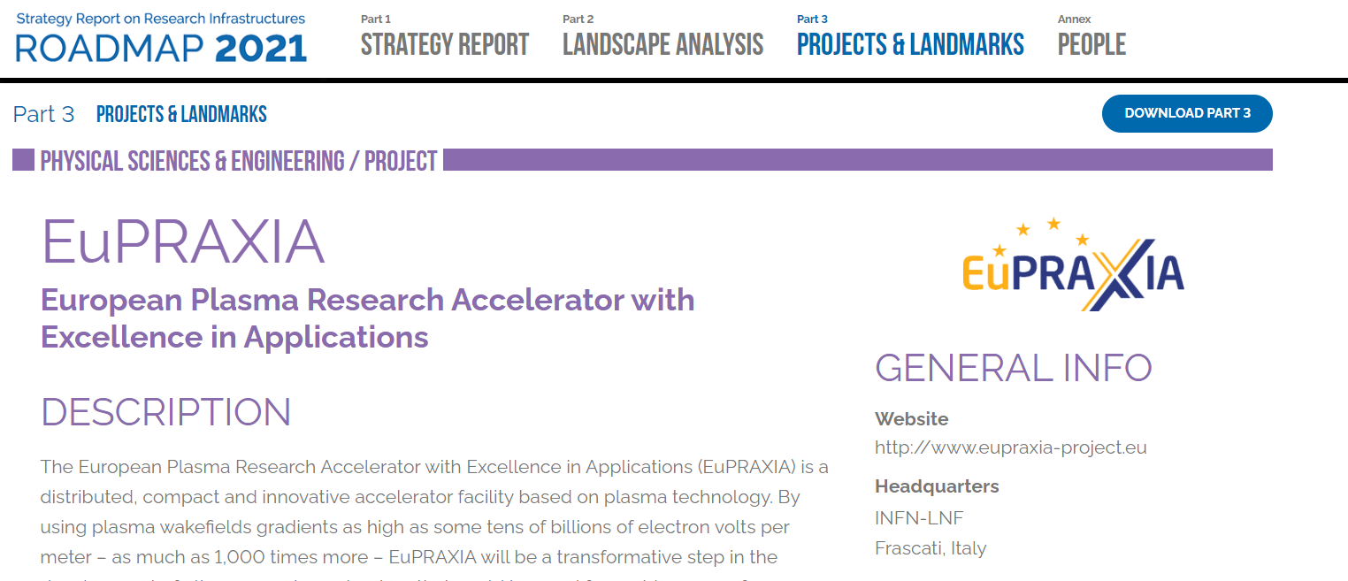

The EuPRAXIA project
Facility with very high field plasma accelerators, driven by lasers or beams
1 – 100 GV/m accelerating field
Shrink down the facility size
1
Producing particle and photon pulses to support several urgent and timely science cases
Enable frontier science in new regions and parameter regimes
2
https://www.eupraxia-facility.org/
Courtesy M. Ferrario

Slide 4
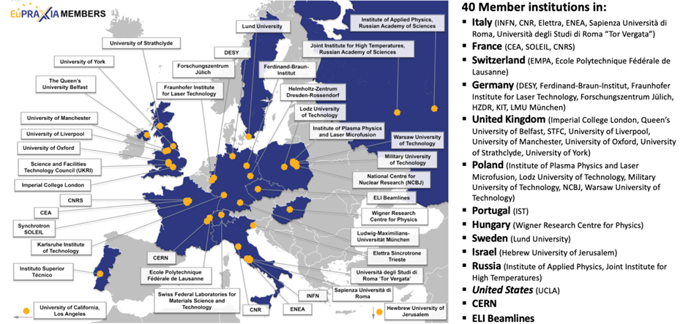
The EuPRAXIA project
Courtesy M. Ferrario

Slide 5
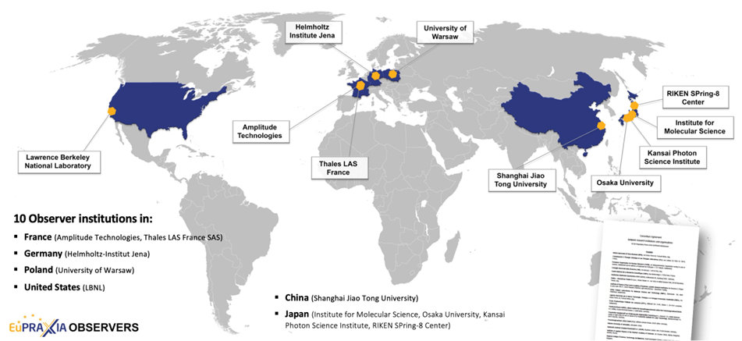
The EuPRAXIA project
Courtesy M. Ferrario

Slide 6
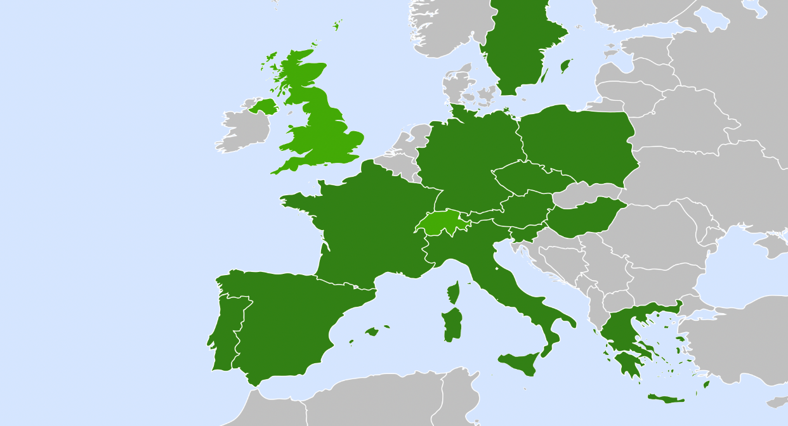


The EuPRAXIA project
European Distributed Facility
5 excellence centers
2 construction sites
Beam-driven plasma user facility
EuPRAXIA Headquarter
Laser-driven plasma user facility: candidates
Excellence Center
Advanced Applications Beamlines (UK)
Plasma Acc. & High Rep. Rate Dev. (D)
2
2
3
4
Technology Incubator (CZ - ELI)
2
5
2
User Data Center (H)
Laser-Plasma Acc. & 1 GeV FEL (F)
6
2
Beam-driven plasma user facility
EuPRAXIA Headquarter
1
Theory & simulations (P)
Horizon Europe
Courtesy M. Ferrario

Slide 7

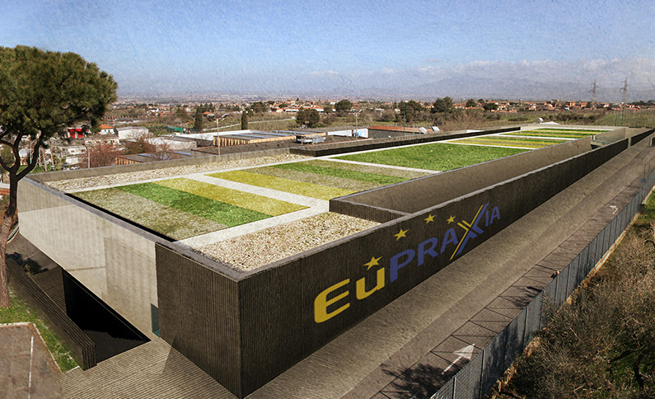
The EuPRAXIA project
In order to produce compact accelerators, new schemes are being developed
EuPRAXIA is the first ever design of a plasma accelerator facility
Assman et al. Eur. Phys. J. (2020)

Slide 8
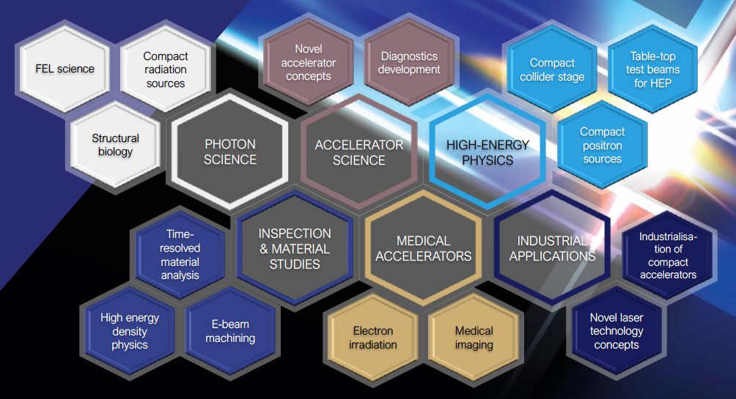
The EuPRAXIA project
Electrons
(0.1-5 GeV, 30 pC)
Positrons
(0.5-10 MeV, 10⁶)
Positrons (GeV source)
Lasers
(100 J, 50 fs, 10-100 Hz)
X-band RF Linac
(60 MV/m , up to 400 Hz)
Plasma Targets
Betatron X rays
(1-10 keV, 10¹⁰)
FEL light
(0.2-36 → 200 nm, 10⁹-10¹³)
Courtesy M. Ferrario

Slide 9

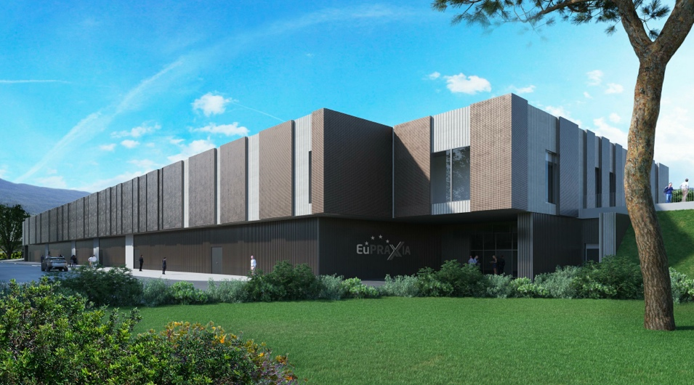
EuPRAXIA@SPARC_LAB
SITE 1: LNF-INFN
> 108 M€ invest funding
Beam-driven plasma accelerator
Europe`s most compact and most southern FEL
The world`s most compact RF accelerator (X band with CERN)
Courtesy A. Cianchi

Slide 10
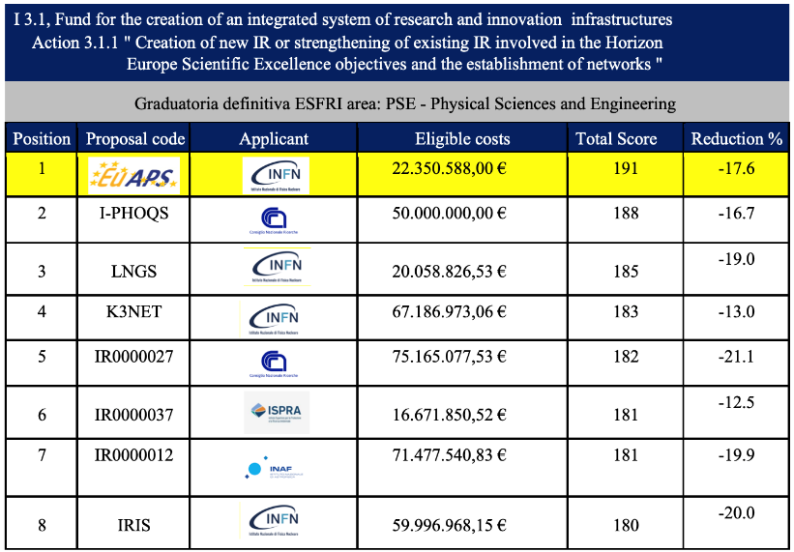



EuAPS – EuPRAXIA advanced photon sources
Next Generation EU
Research Infrastructures
Scientific Quality: 50/50;
Impact: 47/50;
Implementation: 94/100
Courtesy A. Cianchi

Slide 11
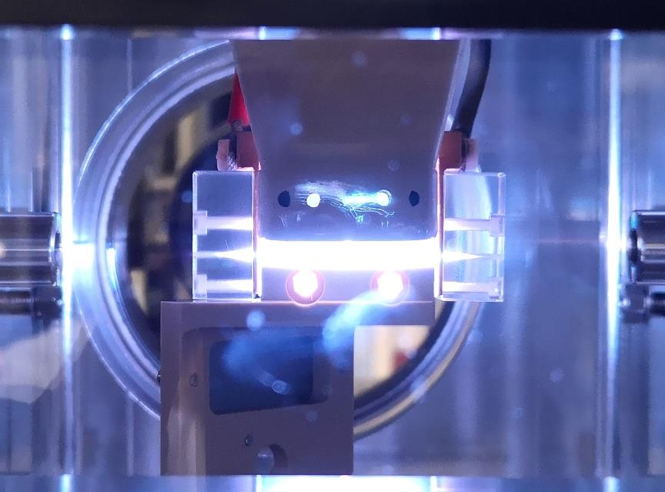
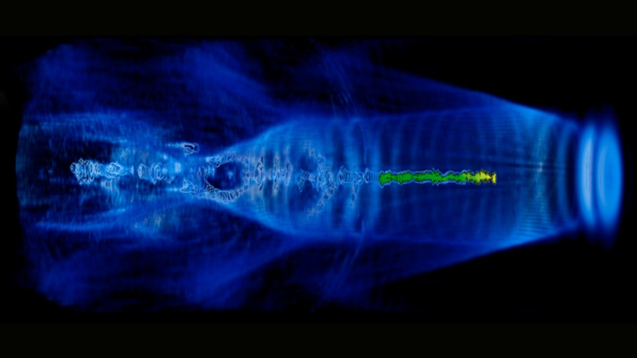
Plasma acceleration @ EuPRAXIA
Particle accelerators produce photons by making electrons bunches move on curved trajectories.
In plasma acceleration, a driver pulse (laser or electron) creates a wakefield in a plasma
The plasma wakefield accelerates a witness electron bunch injected behind the driver pulse. The electrons wiggle in the plasma wakefield and get accelerated

Slide 12
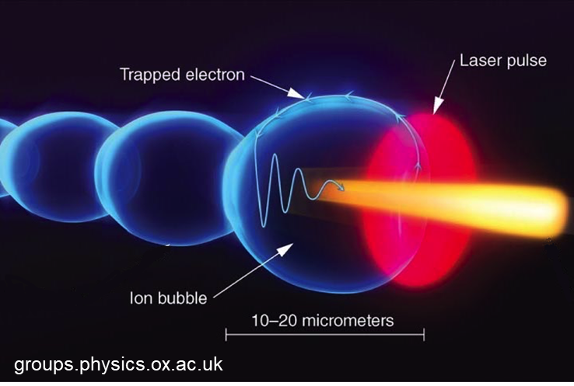
Betatron radiation @ EuPRAXIA → EuAPS
The accelerated electron can be used to run a Free Electron Laser → EuPRAXIA
At the same time, the electrons, as a «byproduct» of their movement on a curved trajectory, emit photons in the X-ray region.
This phenomenon is referred to as betatron emission.
Albert et al. PPCF 56 (2014)

Slide 13
Betatron radiation @ EuPRAXIA → EuAPS
Betatron X-ray radiation with a certain degree of coherence is emitted with a synchrotron-like (wiggler) process within a narrow cone.
Betatron radiation has been measured and characterized at the FLAME laser facility of the INFN-LNF
Paroli & Potenza Adv Phys X 2017
Curcio et al. Phys. Rev. Accel. Beams 2017; Curcio et al. NIM 2017

Slide 14
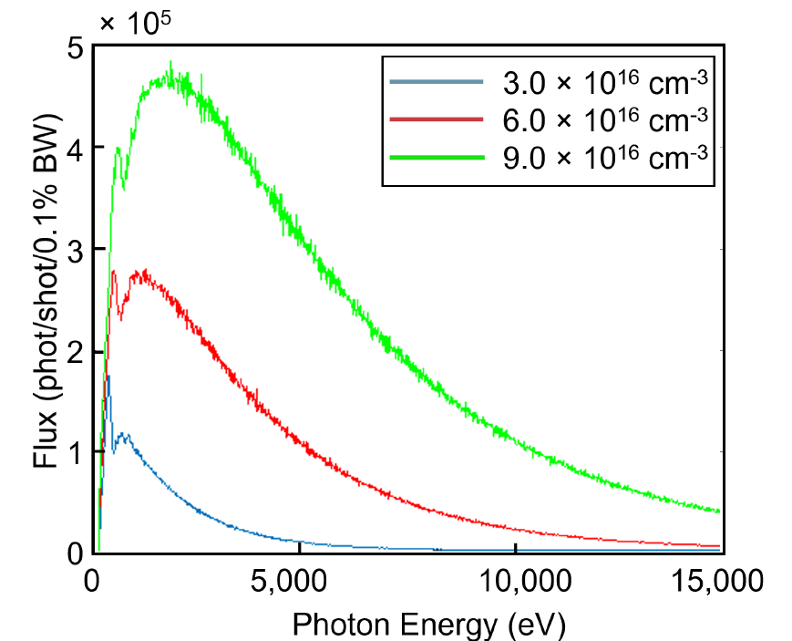
Betatron radiation @ EuPRAXIA → EuAPS
Betatron radiation covers the hard X-rays region and has a good spatial coherence. The brightness can be comparable with that of third-generation synchrotrons.
Curcio et al. NIM 2017
Paroli et al. NIM 2015
Preliminary simulations of the EuPRAXIA betatron spectrum (for maximized brilliance exploiting high plasma density)
Stellato et al. Cond. Matt. 2022

Slide 15
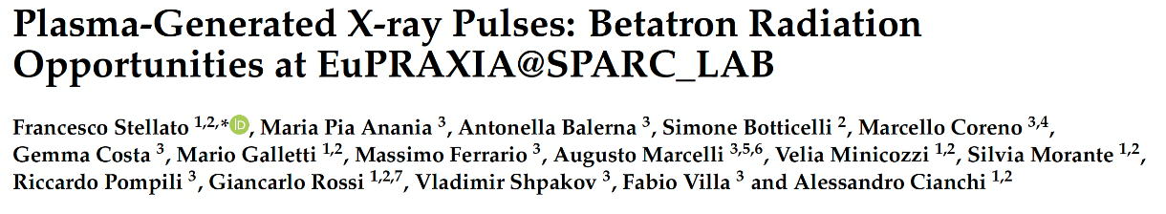
Betatron radiation @ EuPRAXIA → EuAPS
Parameter | Value
Photon energy | 2-10 keV
Photons/pulse | 10⁷ - 10⁹
Pulse duration | 10-50 fs
Repetition rate | 1 Hz
Expected parameters of the EuAPS betatron radiation source
Photon science case

Slide 16
Betatron radiation @ EuPRAXIA → EuAPS
What are betatron pulses good for?
Betatron radiation covers a broad energy range
Spectroscopic techniques
Betatron pulses are short (femtoseconds)
Pump-probe, time-resolved experiments
Betatron radiation is partially (spatially) coherent
Phase-contrast imaging

Slide 17
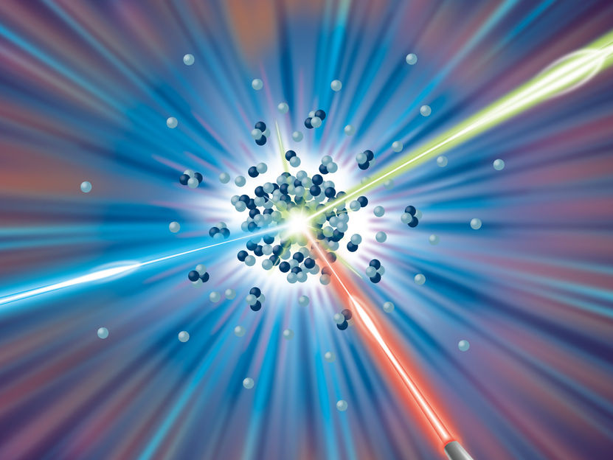
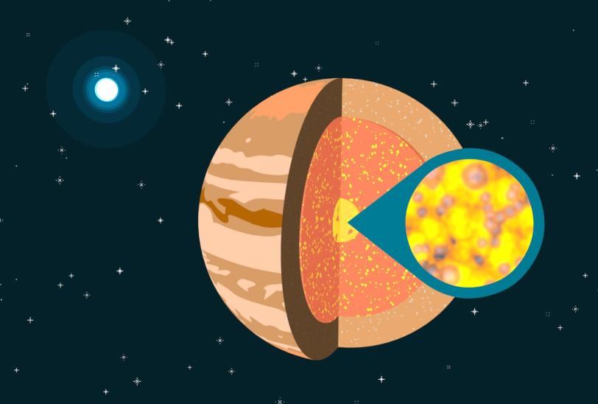
Photon Science @ EuAPS in a nutshell
Ultra-fast, pump-probe
time-resolved X-ray Spectroscopy
Imaging
at a small-scale source
Physics of warm-dense matter
Femtochemistry of organometallic complexes
Tissues
Plants
Cultural Heritage

Slide 18
Photon Science @ EuAPS
Ultra-fast, (partially) coherent photon pulses
1- Static imaging ​
  2- Static X-ray absorption (and emission) spectroscopy​
    3- Time-resolved pump-probe absorption (and emission) spectroscopy
      4- Time resolved imaging (ultrafast dynamics)
        … and beyond (wide-angle X-ray scattering, diffraction, …)

Slide 19
Photon Science @ EuAPS- Timeline
Imaging of biological (and cultural heritage) samples
  Exploits the brilliance and coherence of betatron radiation,
  requires small divergence and good focusing
Static X-ray Spectroscopy
  Relatively easy, but does not exploit the radiation time structure
Ultra-fast X-ray spectroscopies exploiting ultra-short betatron pulses
  More complicated, requires timing between pump and probe pulses, but fully exploits the fs pulse duration
Time-resolved diffraction
  Depending on the samples, requires monochromatic beams with high flux

Slide 20
Photon Science @ EuAPS - Timeline
The betatron X-ray source will be developed @ FLAME (200 TW, 35 fs) to optimize:
  Laser parameters
  Plasma source devices
  Electron diagnostics
  X-ray spectrum
  Photon flux
In early 2024 → moved to the SPARC bunker, installation of a new compressor and refurbishing of the old one.
The advanced photon diagnostics and the user end station will be tested and installed during/after the commissioning of the source

Slide 21
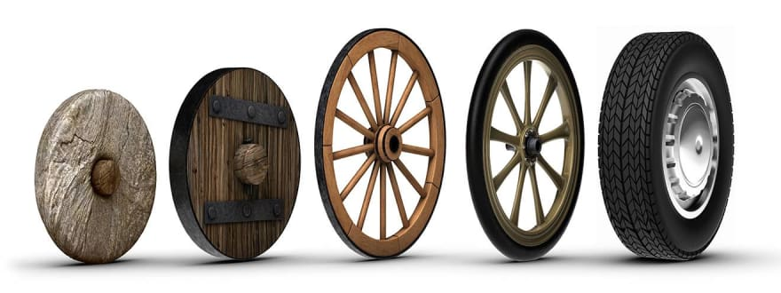
Where are we?
Betatron science has already allowed performing X-ray measurements
We are not aiming at reinventing the wheel, but we can build up and improve moving from the wheels that have already been invented.

Slide 22
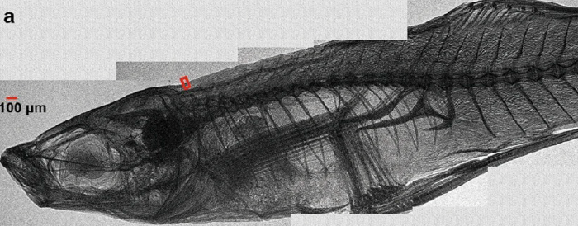
Biological imaging
Betatron sources can fill the gap between synchrotrons and X-ray tubes for imaging and Computer Tomography (CT)
Pulsed X-ray source (duration <30 fs)
>10¹⁰ photons/pulse
Small diameter <1 m
Critical energy of some keV
Low repetition rate: 0.05 Hz
→ Total acquisition time: 2 h
Guo et al. Scientific Reports 2019

Slide 23
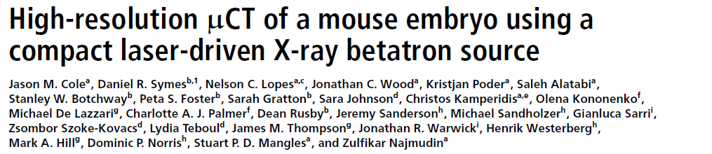
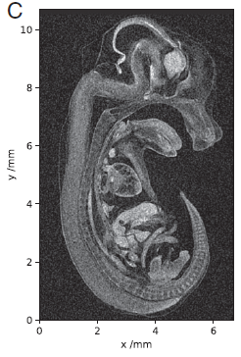
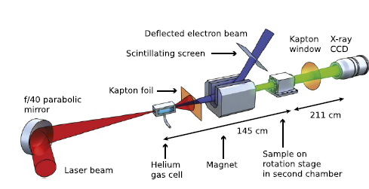
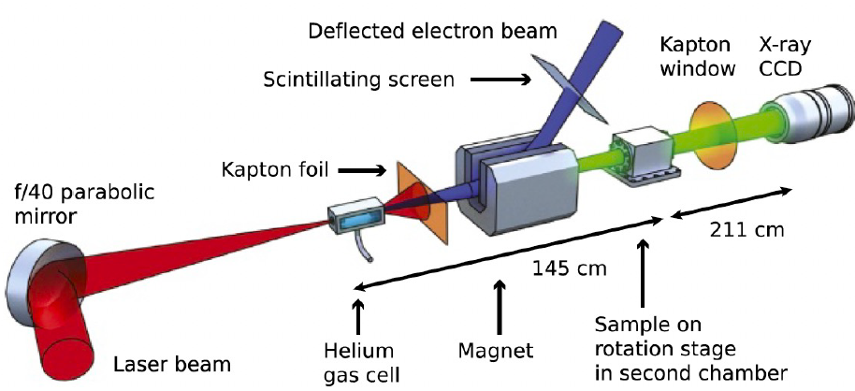
Computer Tomography (CT)
Cole et al. PNAS 2018

Slide 24
Phase-contrast imaging
Betatron sources have a spatial coherence that allows performing Phase Contrast Imaging (PCI).
In PCI, one measures the difference in wavefront, while in “traditional” imaging one measures the difference in the X-ray absorption coefficient between different “objects”
PCI provides better contrast than radiography, especially when dealing with biological samples.
PCI has been shown to work pretty well for thin samples exploiting a betatron source
Wenz et al. Nature communications 2015

Slide 25
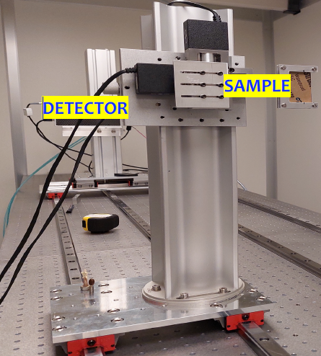
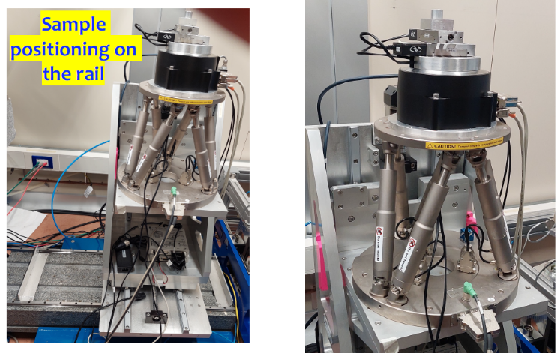
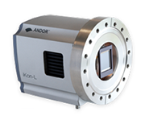
Imaging – Experimental setup
Variable sample-detector distance
Accurate sample positioning and rotation
Small pixel, 2D X-ray detector
CCD or CMOS
Courtesy A. Balerna

Slide 26
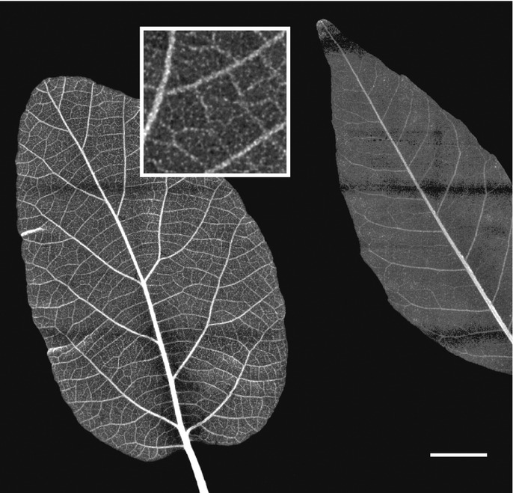
Imaging – The pilot experiment
Green science
X-ray imaging of leaves (and wood)
aiming at the (tens of) microns resolution
Experiments performed with the broad radiation spectrum filtered by different materials to obtain difference maps emphasizing the presence of heavy metal contaminants → pollution control
Reale et al. - MIDIX Soft X-rays microradiography

Slide 27
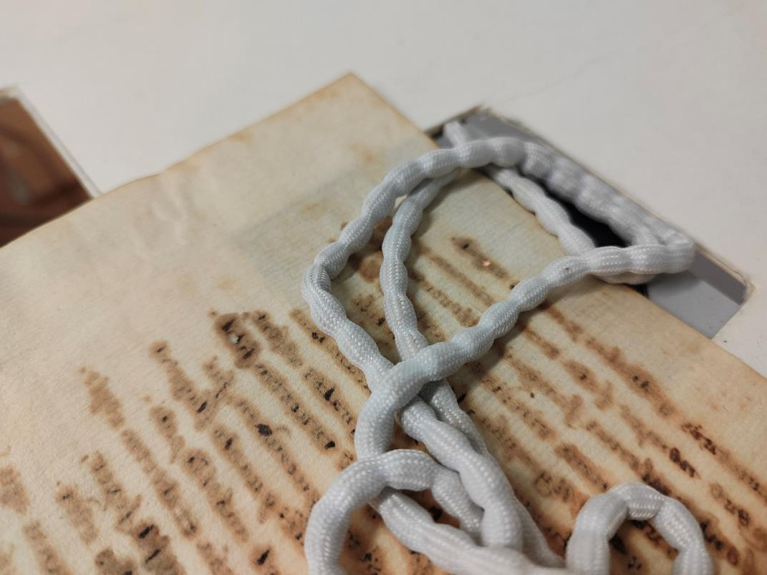
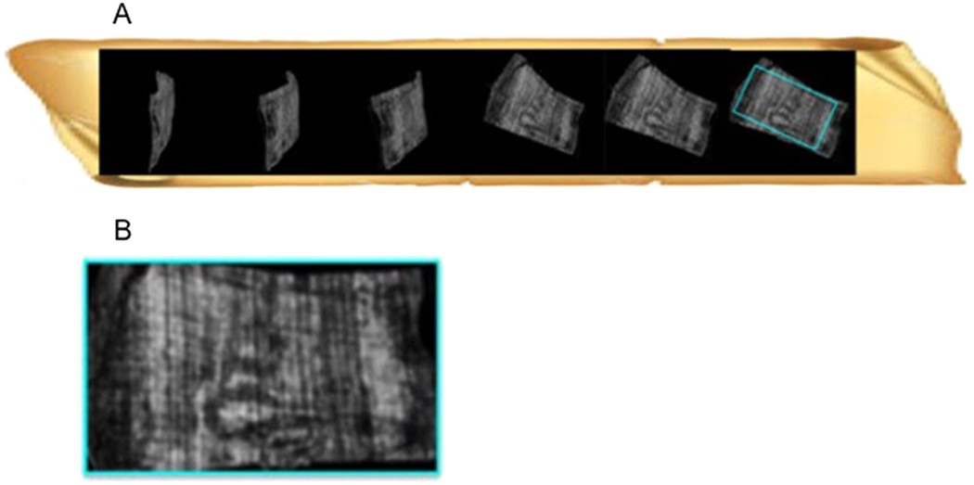
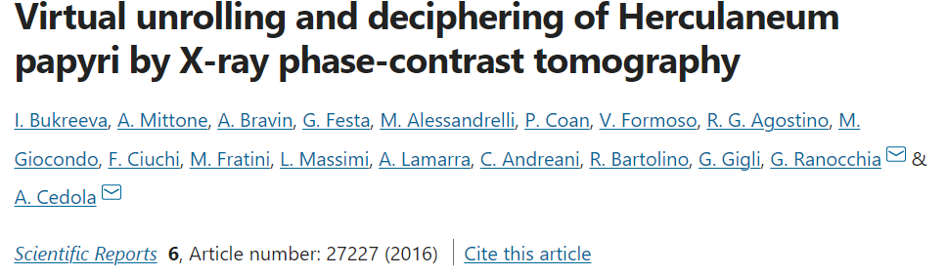
Imaging – Cultural Heritage
Imaging of ancient paper documents
Characterization of inks
(chemical sensitivity thanks to filters)
with Dr. Giulia Festa, Centro Studi e Ricerche Enrico Fermi

Slide 28
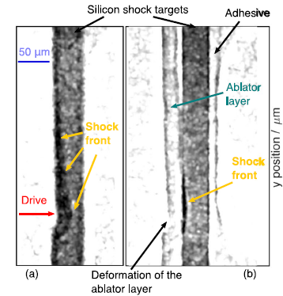
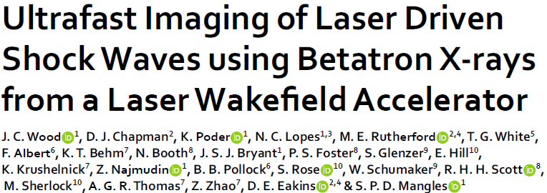
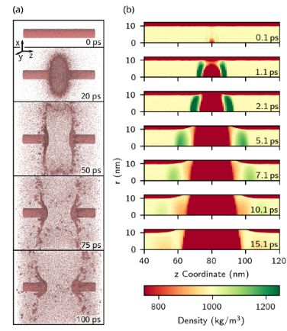
Time-resolved imaging
Nanoparticles dynamics
                Shock-waves in materials
Liquid jet explosion
under X-ray beams

Slide 29
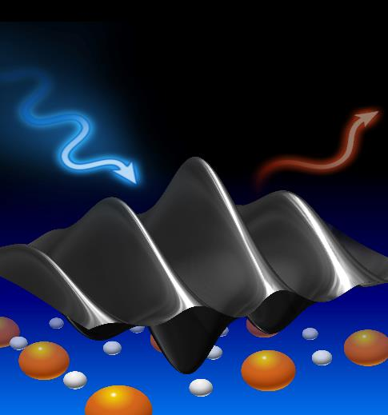
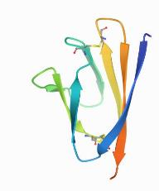
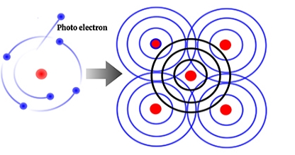
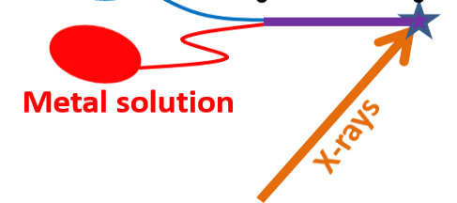


Absorption Spectroscopy
Like synchrotron wigglers, betatron sources have a broad energy spectrum (1-10 keV)
Unlike synchrotrons, betatron emit very short pulses (10-50 fs)
They are therefore ideal sources to perform time-resolved spectroscopic experiments
X-ray Absorption Spectroscopy
Measures the X-ray absorption coefficient and acts as a local probe (∼5 Å) around metals
Proteins
$$μ(ℏω)=\text{4}{\text{π}}^{2}\text{α} ℏω\left|\left\langle Ψ_{i}\right|\right.\hat{ε}⋅\vec{r}{\left.\left|Ψ_{f}\right\rangle \right|}^{2}ρ(E_{f})$$
Metal ions

Slide 30


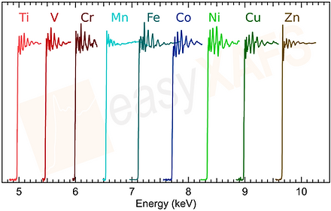
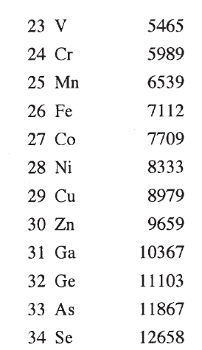
Absorption Spectroscopy
Interaction of biomolecules (at high concentration) with transition metal ions.
Time-resolved studies of metallic materials and warm-dense matter.

Slide 31
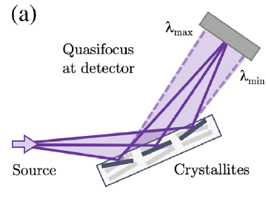
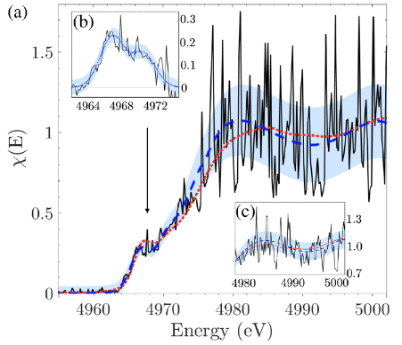
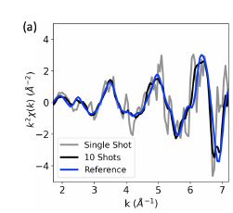
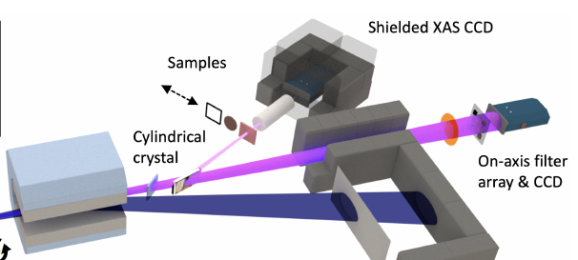
Absorption Spectroscopy
Single-shot XANES spectrum at the Ti K-edge
Kettle et al. Phys. Rev. Lett. 2021
Single-shot EXAFS spectrum at the Cu K-edge
Kettle et al. arxiv 2023
Cylindrical crystal
Mosaic crystal analyzer

Slide 32
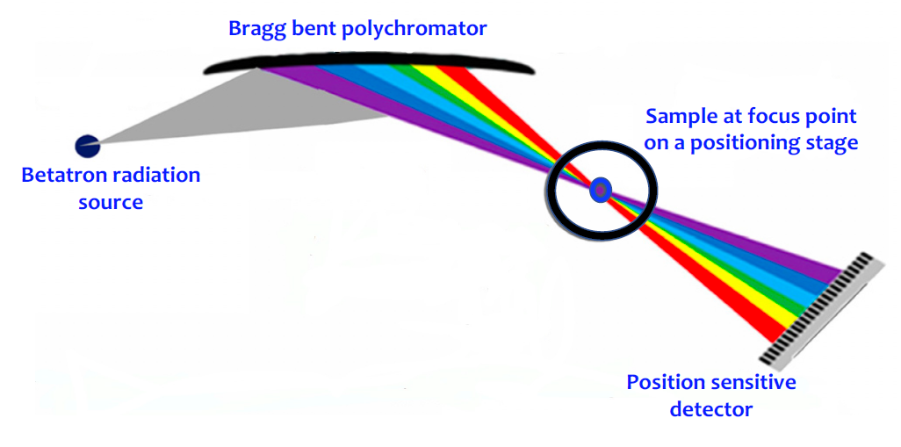
Absorption Spectroscopy – Experimental setup
X-ray Absorption Spectroscopy
in dispersive mode
Curved or mosaic crystal analyzers
+
Position sensitive detector
+
High-power femtosecond laser for pump-probe measurements
No monochromator to maximize the photon flux on the sample

Slide 33
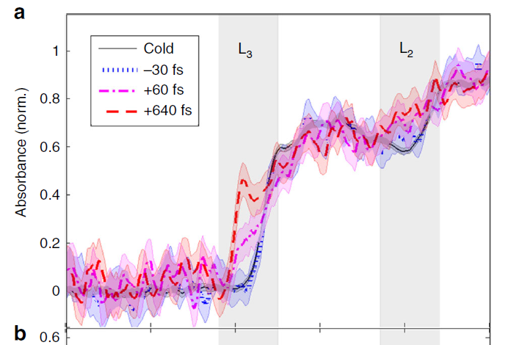
Ultra-fast Spectroscopies
Optical laser pump / betatron probe experiments can follow the non-equilibrium dynamics of the copper heating process via XAS on fs timescale
Mahieu et al. Nature Comm 2015
Measurements of Ionization States in Warm Dense Aluminum with Betatron Radiation
Mo et al. 2017

Slide 34
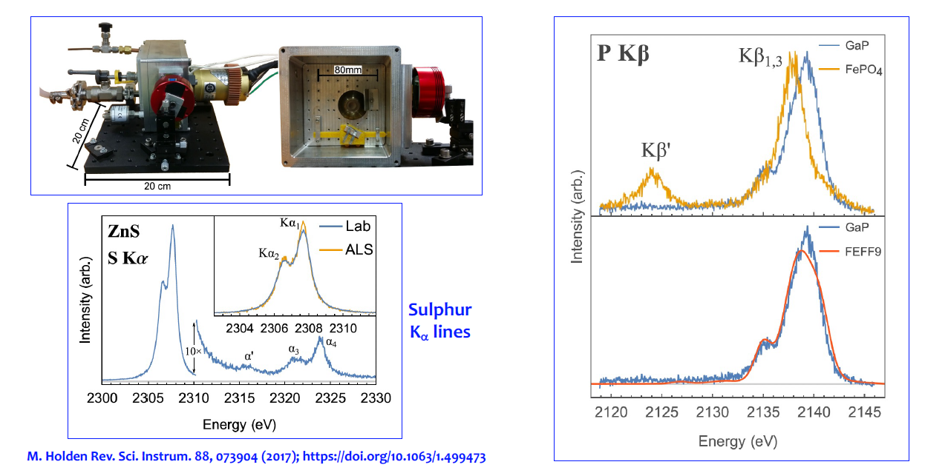
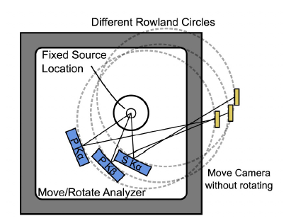
Emission Spectroscopy
Design and performance of a compact x-ray emission spectrometer having a dispersive refocusing Rowland (DRR) circle geometry → high energy resolution even for UNFOCUSED x-ray sources
Courtesy A. Balerna

Slide 35
Outlook
Imaging
  A source itself, but contributing to technology development of betatron sources to obtain synchrotron-level images at small-scale facilities
X-ray spectroscopy
Ultra-fast experiments exploiting ultra-short betatron pulses
Synergy with the EuPRAXIA@SPARC_LAB Free Electron Laser beamlines
(same location, same pulse-length, although different wavelength and brilliance)
EuPRAXIA’s goal: novel technologies for (science at) compact accelerators

Slide 36



Acknowledgements
People
Balerna
L. Brombal
F. Brun
A. Cianchi
A. Curcio
M. Coreno
S. Donato
Z. Ebrahimpour
F. Galdenzi
M. Galletti
M. Ferrario
A. Marcelli
V. Minicozzi
S. Morante
R. Pompili
V. Shpakov
F. Villa
@
You all for the kind attention

