Slide 2
Gamma ray all-sky map
Image credit: Fermi LAT/NASA

Slide 3
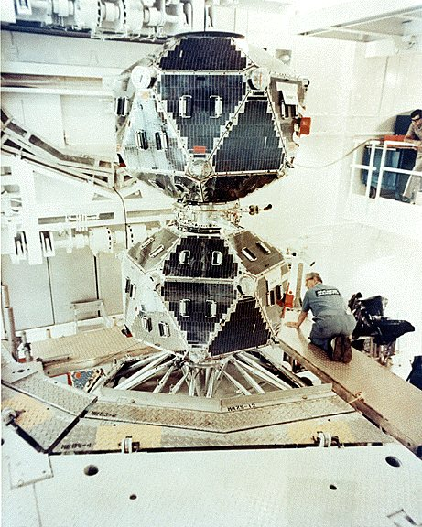
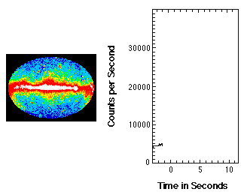
In 1963 the «Vela» satellites, were realized to monitor the application of the Nuclear Test Ban Treaty…
…and recorded 73 gamma-ray bursts (GRBs)!
Image credit: NASA

Slide 4
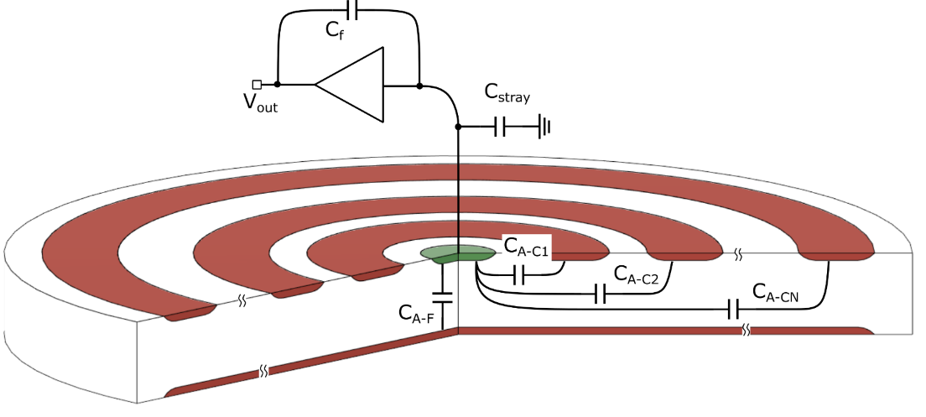
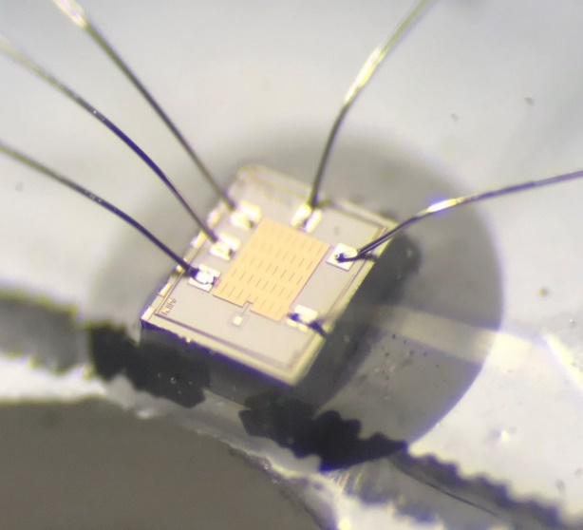
Overview
Silicon drift detectors (SDD) for x/gamma-ray science in astrophysics
High energy resolution in the 0.1 - 20 keV range
Excellent scaling with respect to the area
Capable of room-temperature operation
Suitable for imaging applications
Application Specific Integrated Circuits:
Hybrid detectors: RIGEL for the ADAM project
Linear detectors: VEGA for wide-field monitor applications
SiSwich detectors: LYRA and ORION for the HERMES and THESEUS mission concepts

Slide 5
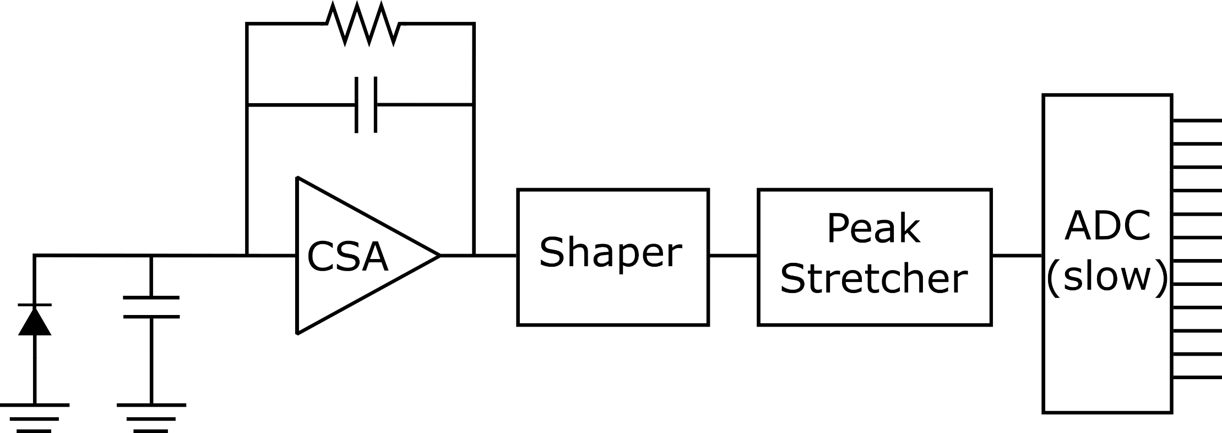
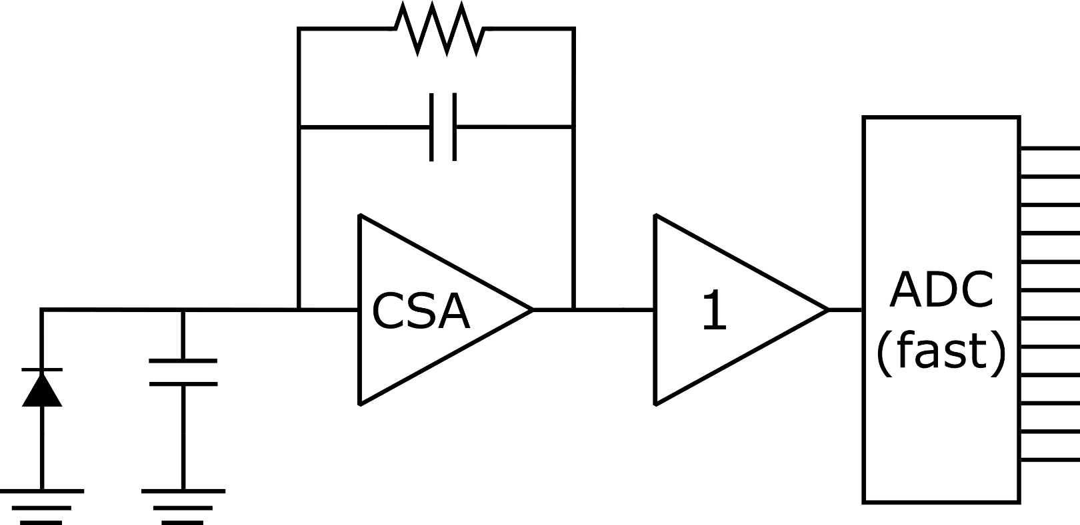
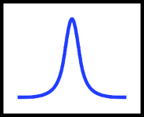
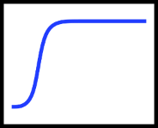
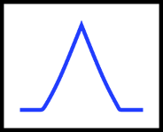
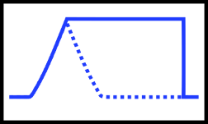
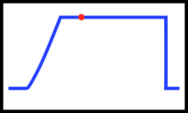
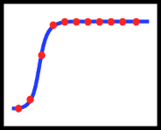
Charge pulse processing schemes
Low-power consumption is possible
Lower risk of Mixed/Signal design issues
Scales well with the number of channels
Complex pile-up strategies are harder to implement
More sensitive to PVT (process/voltage/temperature) variations
Highly flexible and configurable
Best pile-up rejection algorithms
Early digitalization (the earlier, the better!)
High-frequency clock and digitally intensive
High power consumption per channel

Slide 6
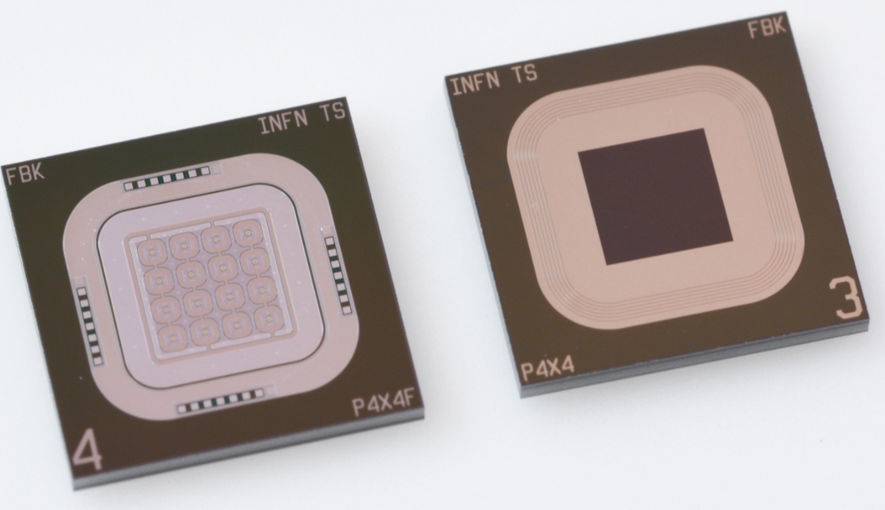
Hybrid detectors - The PixDD detector and the RIGEL ASIC
Part of the Advanced Detector for x-ray Astronomy Missions (ADAM) project.
Development of redout system to be placed at the focal plane of X-ray optics.
Science drivers:
Study matter under extreme conditions, low flux compact cosmic sources.
Key features:
Hybrid detector architecture (PixDD + Rigel ASIC)
References: Y. Evangelista (2018), M. Gandola (2022)

Slide 7
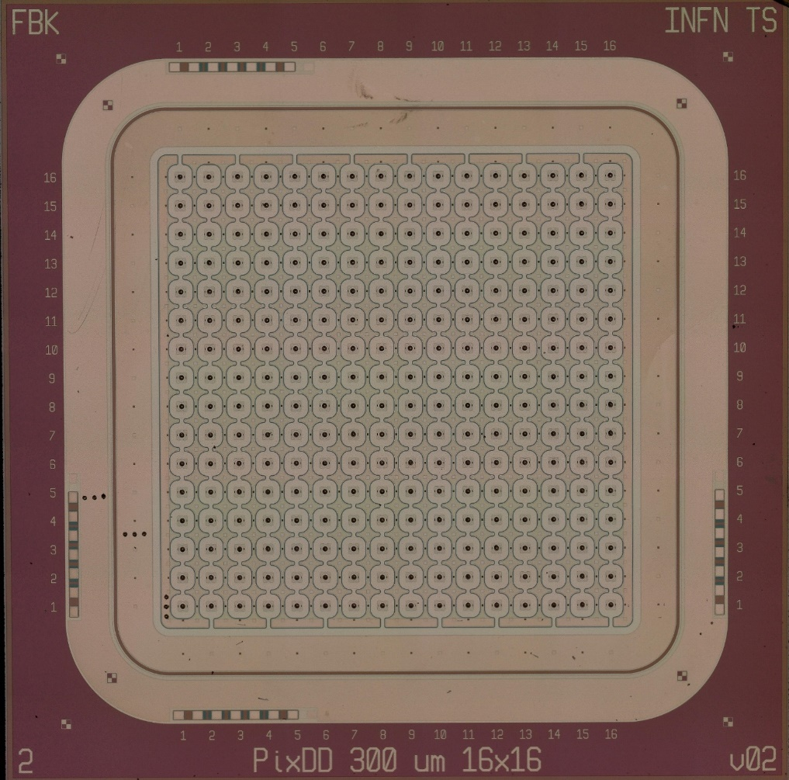
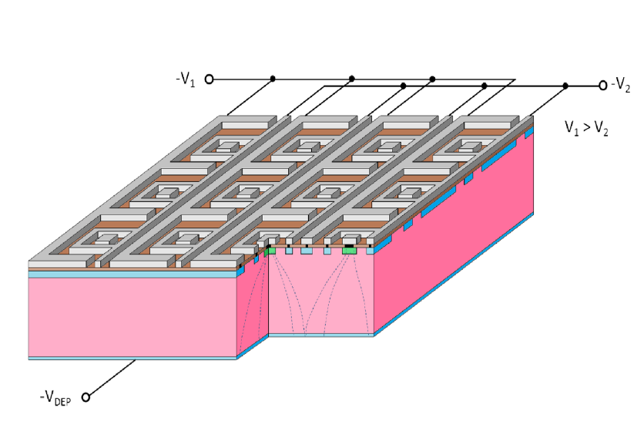
The Pixel Silicon Drift Detector
$$300 μm$$
$$−39 V$$
$$−32 V$$
300 μm
$$450 μm$$
$$300 μm$$
$$−70 V$$
$$I_{leak}≲{10}^{2} pA {cm}^{−2}$$
$$I_{anode}≲1 pA$$
300 μm

Slide 8
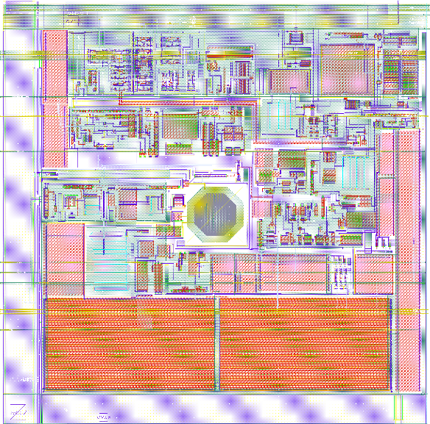
RIGEL Architecture
300 μm
300 μm
Specification | Requirements
Energy range | 8400 el. (30 keV)
ENC (intrinsinc) | ≃10 e⁻ rms
Shaping time | 0.5–5.0 μs
FWHM @5.9 keV | < 150 eV @ 0°C
Energy threshold | 0.5-3 keV
ADC resolution (Wilkinson) | 10 bit
Power consumption | < 1 mW/channel
Readout Pixel Cell (RPC)

Slide 9
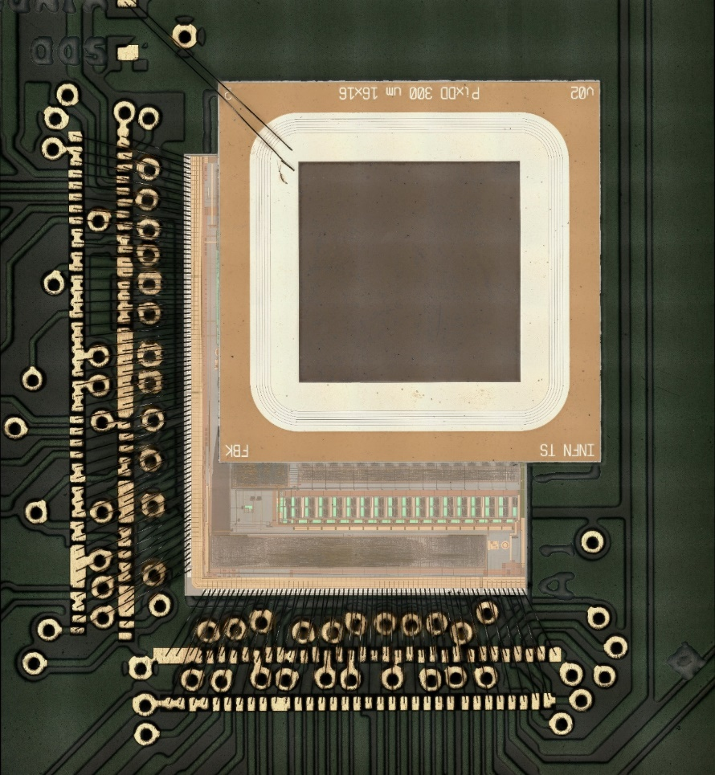
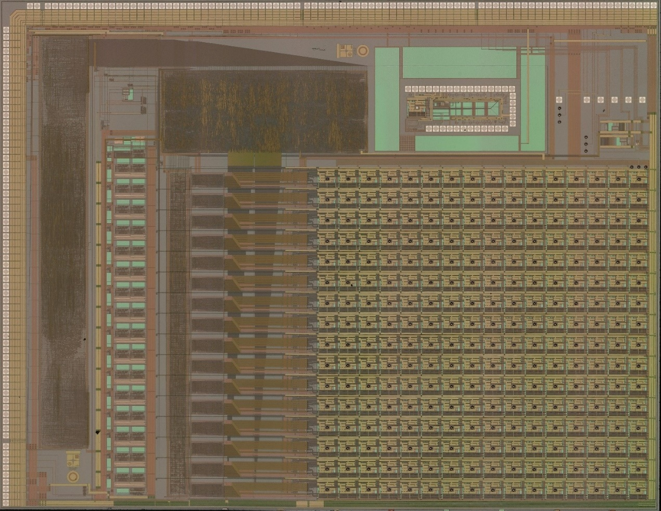
The hybrid RIGEL/PixDD detector
Technology:
AustriaMicroSystem CMOS 0.35 µm
Assembled RIGEL/PixDD detector
RIGEL full 16x16 ASIC micrograph
Trigger
Logic
I/O Interface
7365 µm
16 A/D Converters
16x16 RPC
Configuration
Readout chip (Rigel)
Bump-bonding connection
23 µm
Sensor (PixDD)
PixDD cross-section
47 µm
9510 µm

Slide 10
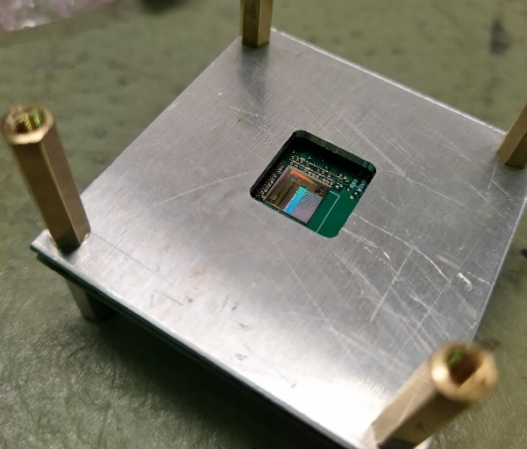
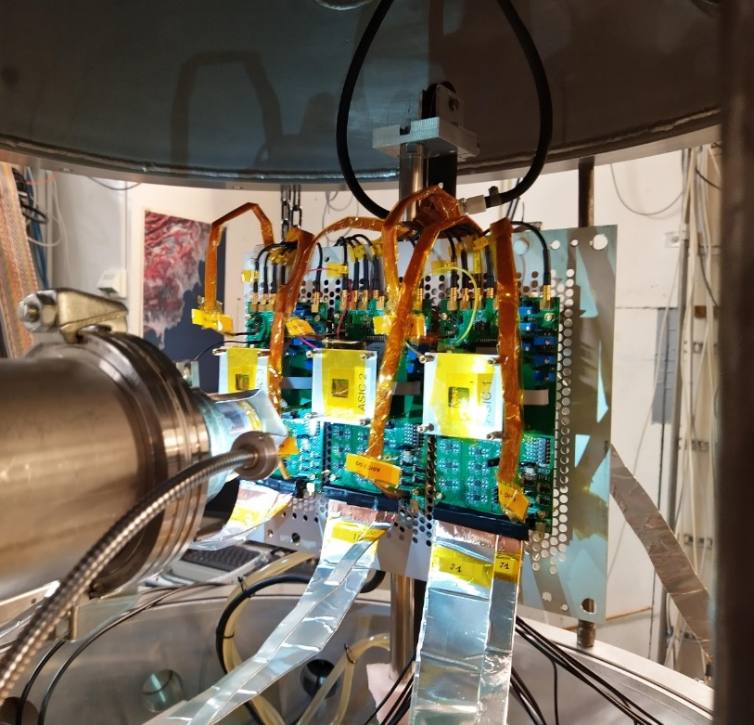
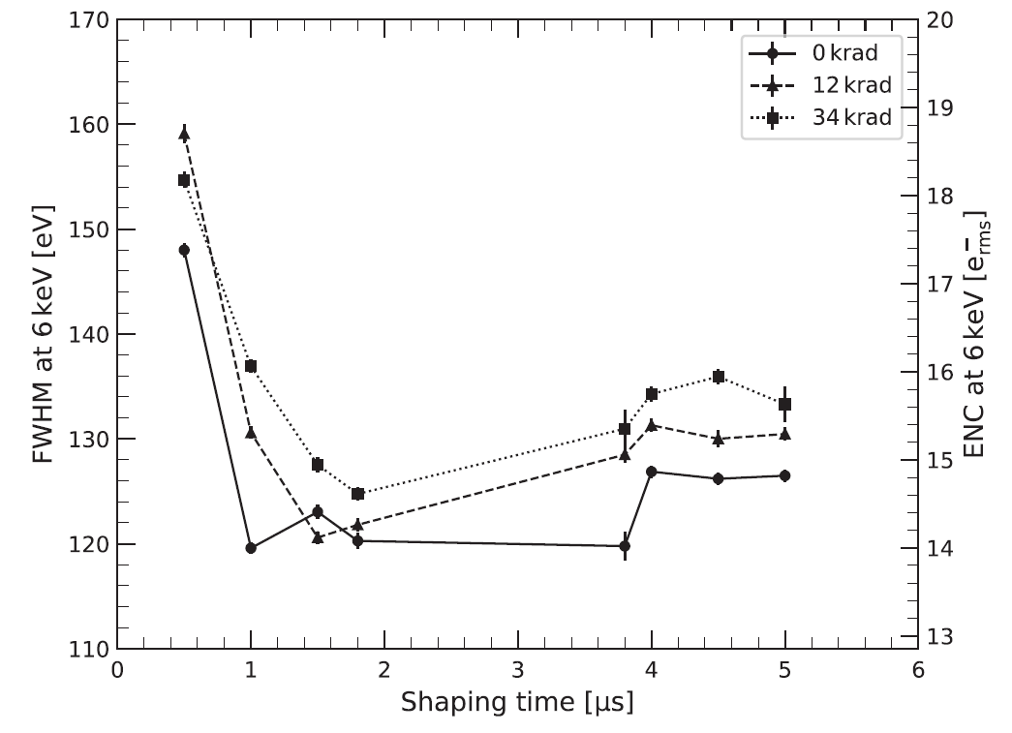
Main RIGEL experimental results
Mean ENC @ 20°C:
11.6 el. r.m.s. (RIGEL intrinsic)
19.2 el. r.ms. (PixDD/RIGEL)
Channel gain dispersion: 13%
Low sensitivitiy to small TID levels
ASIC samples

Slide 11
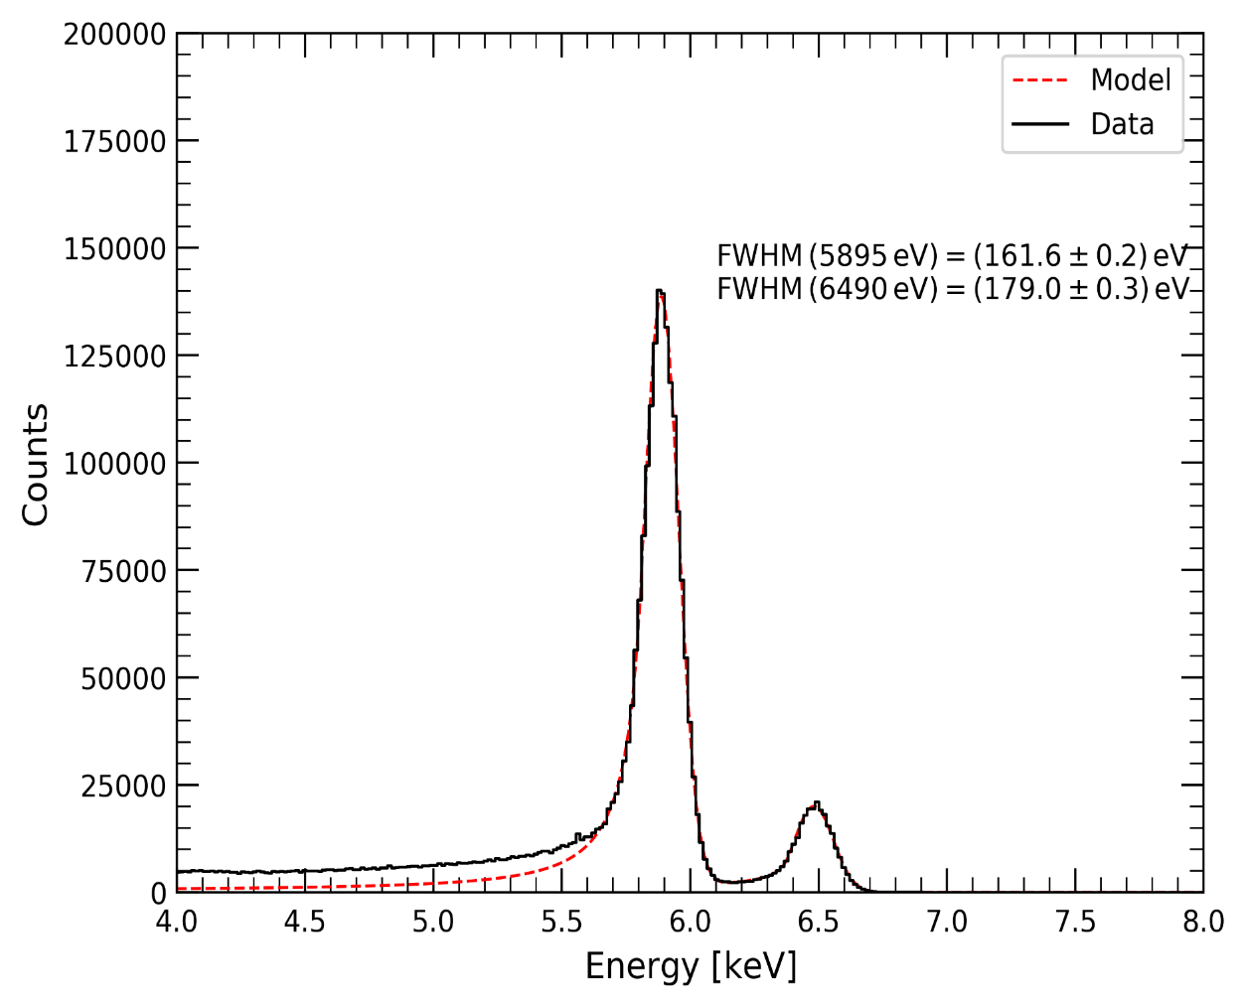
Main experimental results
Summed Spectrum
All pixels with FWHM (5.9 keV) < 300 eV
Mean ENC @ 20°C:
11.6 el. r.m.s. (RIGEL stand-alone)
19.2 el. r.ms. (PixDD/RIGEL)
Channel gain dispersion: 13%
Low sensitivity to small TID levels
Mean FWHM @ 0°C:
162 eV on ⁵⁵Fe 5.9 keV line
Power consumption 640 µW/channel
T = 0°C
FWHM=162± 0.2 eV
Low-leakage, high-resolution detector
Simple readout/postprocessing architecture
SDD operates with relatively low-voltages (<100 V)
Larger area require 4-sides buttable ASIC/SDD
ASIC cost rise 1-to-1 with detector area (independent from the n. of channels)

Slide 12
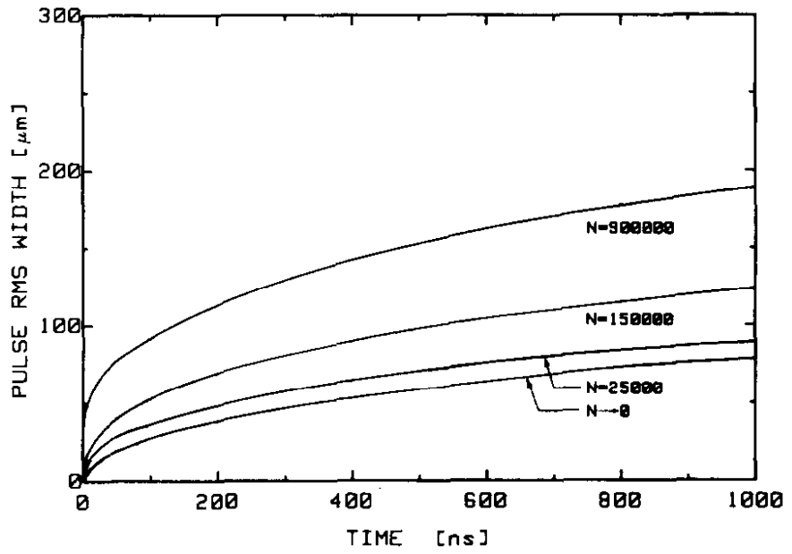
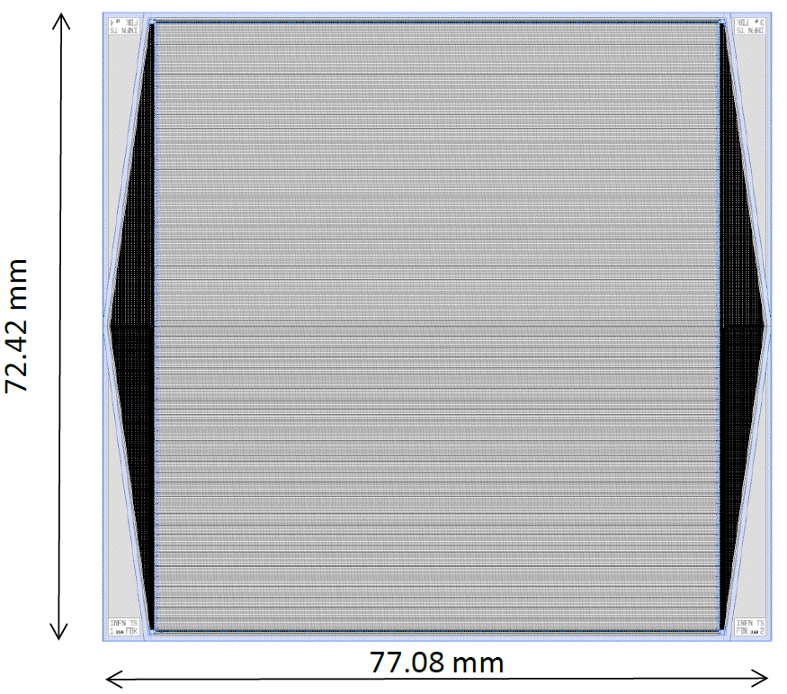
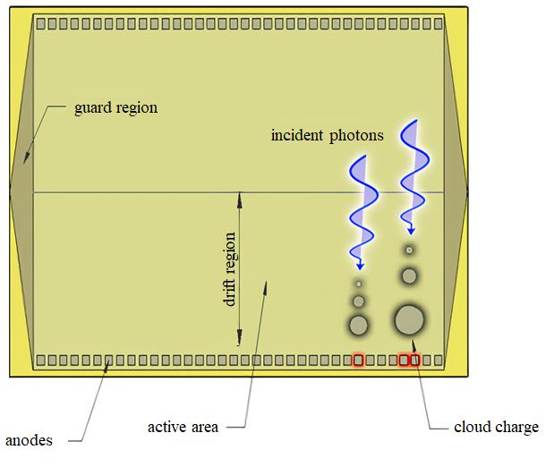
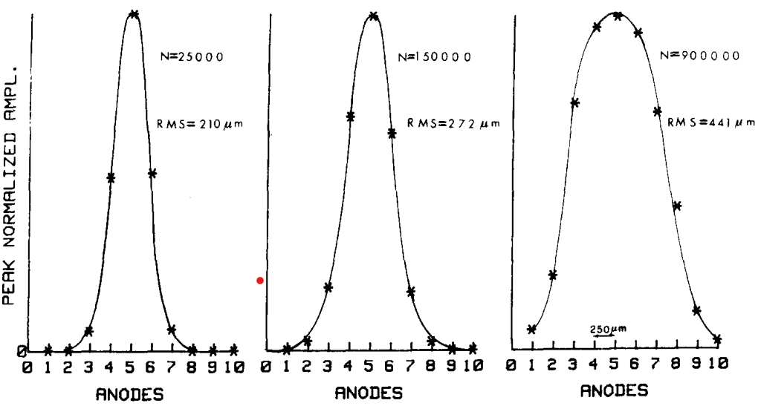
Imaging with linear silicon drift detectors
Wide Field Monitor (WFM)
References: E. Gatti (1987)

Slide 13
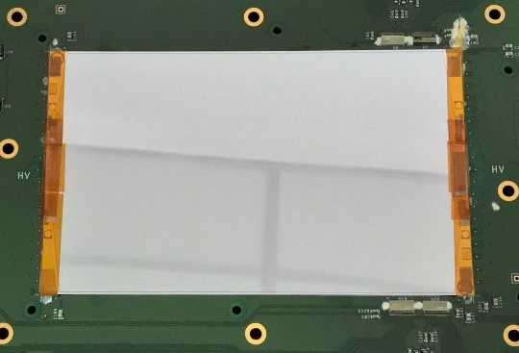
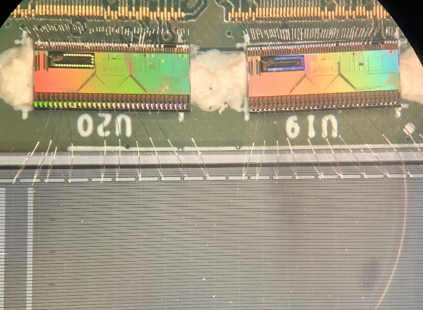
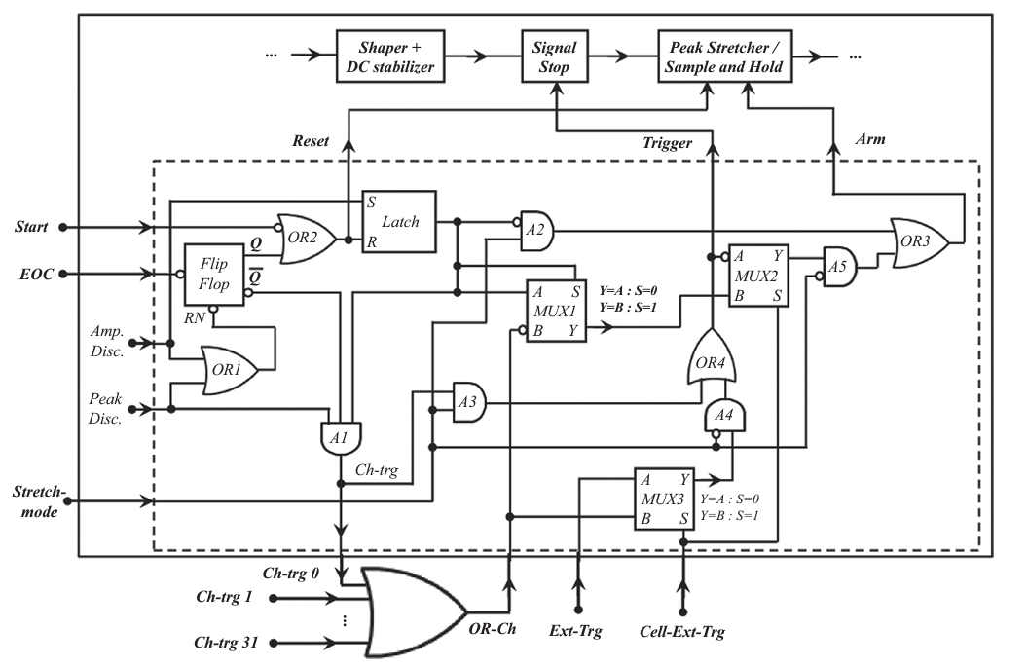
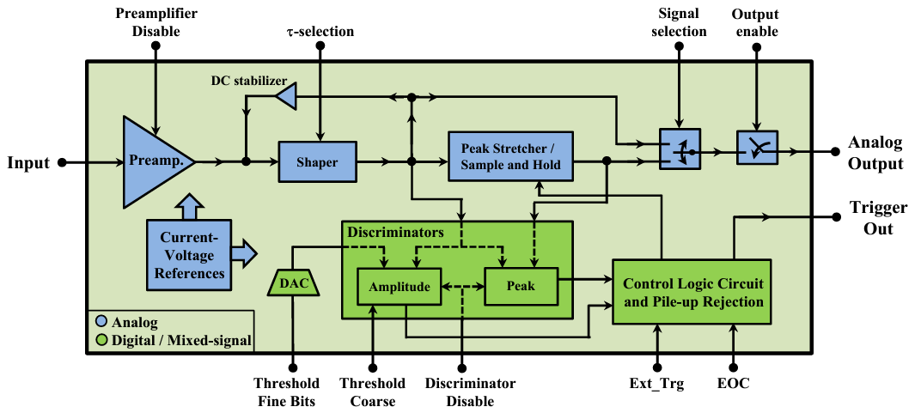
Readout of a linear SDD - the VEGA ASIC
Must be capable of triggering also small charge fractions (for better charge cloud shape reconstruction)
Synchronized readout between channels and adjacent chips
References: R. Campana (2014), M. Ahangarianabhari (2015)

Slide 14
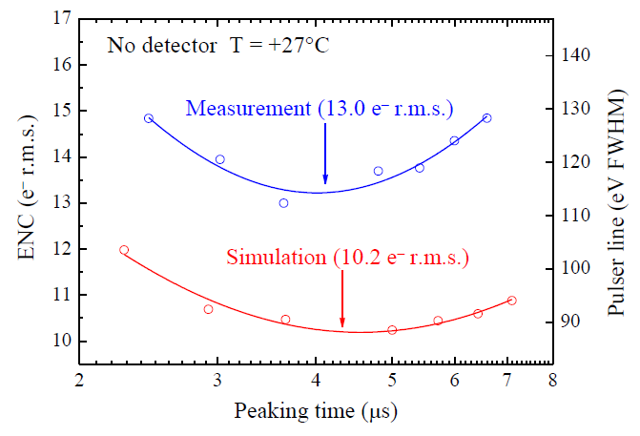
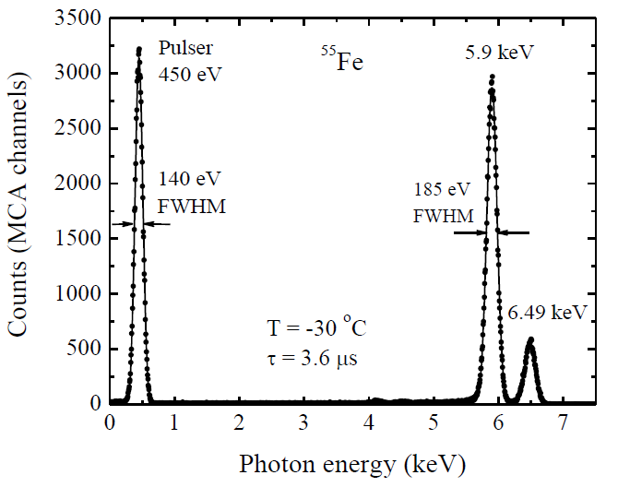
Main VEGA experimental results
Intrinsic ENC @ 27°C: 13.0 el. r.m.s.
Opt. FWHM @ -30°C: 185 eV on ⁵⁵Fe 5.9 keV line (hexagonal det.)
Power consumption 0.4 mW/channel
Reduced number of channels
Reduced constraints in terms of area occupation
Sensitivity to production defects in the detector is increased
Requires large drift voltages (1300V)
High channel occupancy for each event
… how can we increase the energy range?

Slide 15
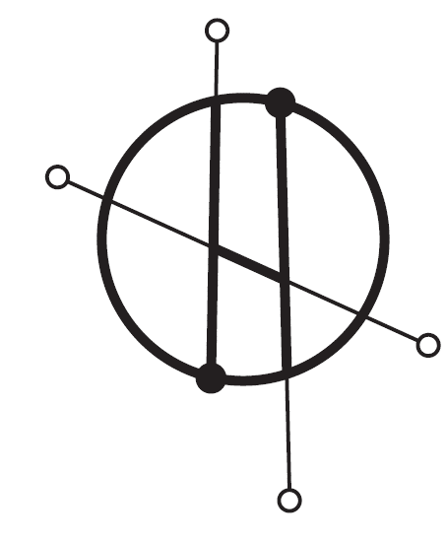
SiSwich detectors and distributed readout with LYRA and ORION ASICs
Science drivers:
Detection and localization of Gamma-Ray Burst, triggering observation by other ground/spaceborne instruments (THESEUS/HERMES)
HERMES key features:
Based on large constellation of nano-satellites
Inexpansive, fast and modular approach
THESEUS key features:
Medium class satellite, with several onboard instruments for GRB follow-up
X-Gamma/Ray Spectrometer (XGIS) with large detection plane (50x50 cm²)
Common key features
SiSwich detector (SDDs are illuminated from both sides)
THESEUS References : L. Amati (2017), G. Stratta (2017)
HERMES References: F. Fiore (2020), Y. Evangelista (2020)

Slide 16
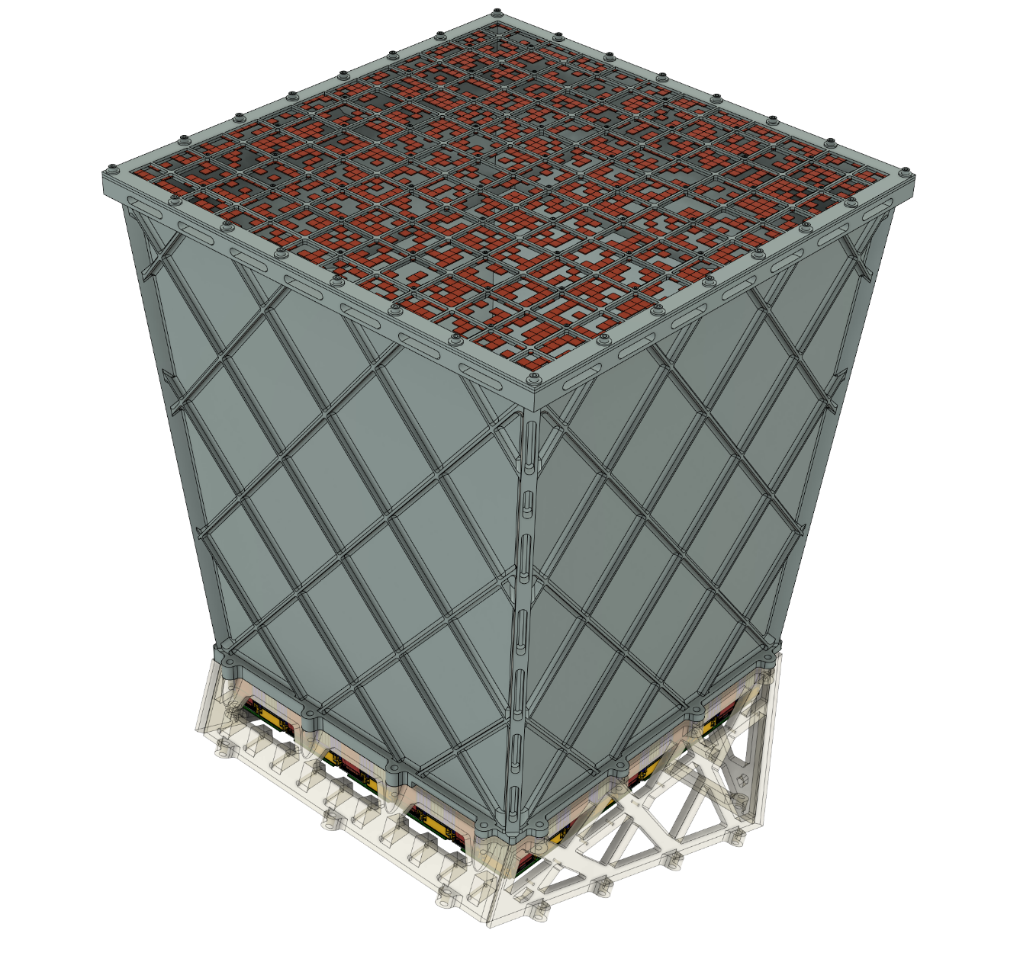
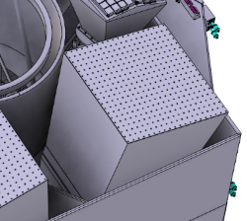
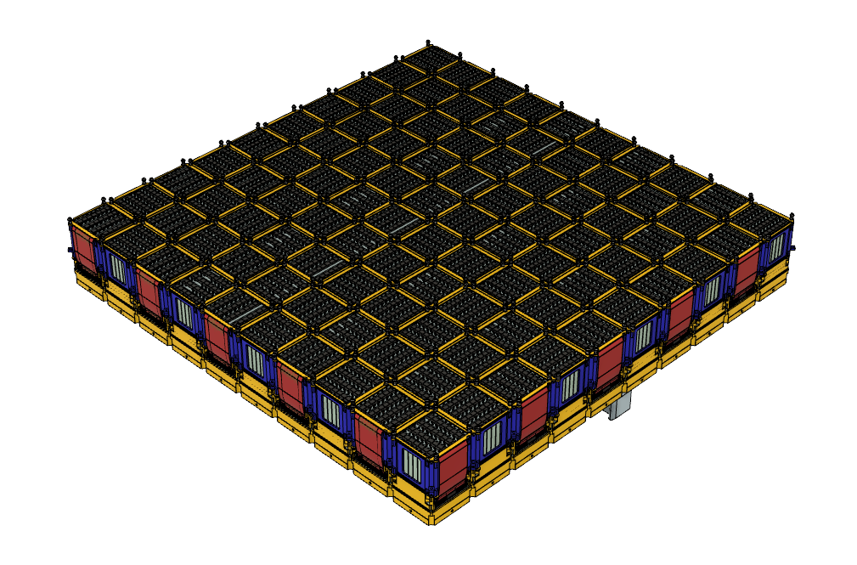
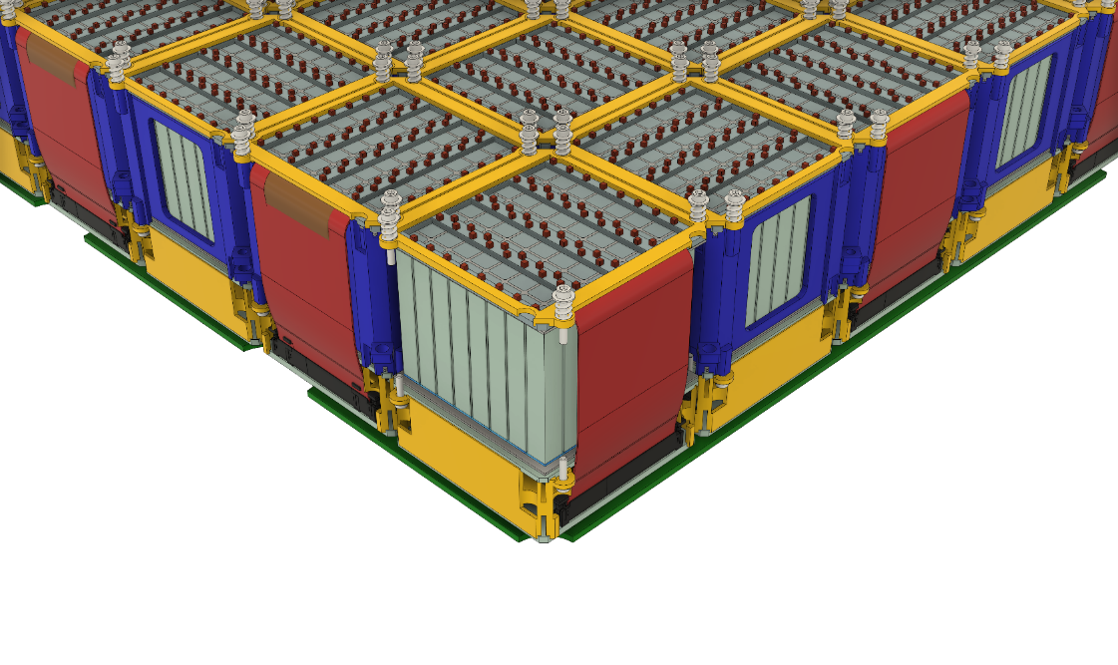
THESEUS and the X-Gamma Imaging Spectrometer - Overview
Coded Aperture Mask (60x60 cm²)
1-150 keV
energy range
XGIS (80 kg per camera):
Wide Energy Range: 2 keV – 20 MeV
Imaging capability
Spectroscopy grade energy resolution
Collimator Assembly
Field of View ≈ 77°
Matrix of 10x10 Detection Modules
Detection Plane (50x50 cm²)

Slide 17
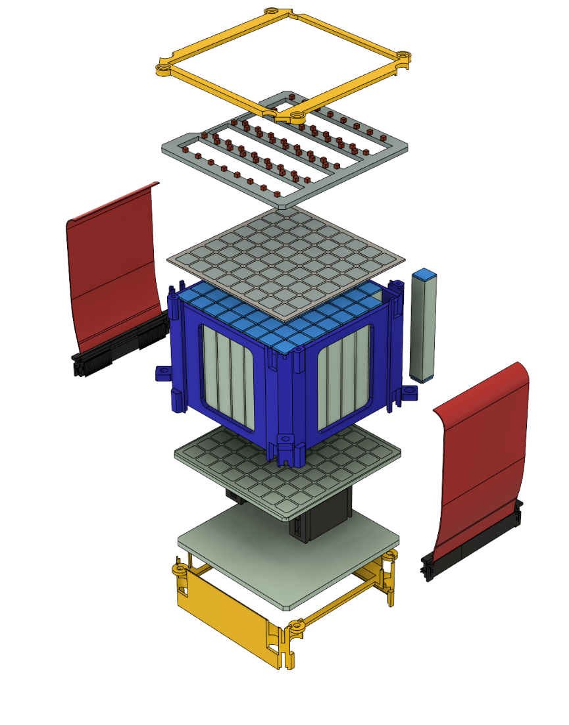
X-Gamma Imaging Spectrometer - Detection module
~4.5 cm
Top Front-End (FE) PCB
64x ORION-FE
128x per module
8x8 monolithic top-SDD matrix
12 800x FE per camera
X-Ray detection (2-20 keV)
64x CsI(Tl) scintillators
Gamma-Ray detection (20 keV – 5 MeV)
Rigiflex connectors
8x8 monolithic
bot-SDD matrix
Back-End (BE) PCB
Scintillation light readout for energy and position reconstruction
8x ORION-BE
per module
800x ORION-BE per camera
Bottom FE-PCB

Slide 18
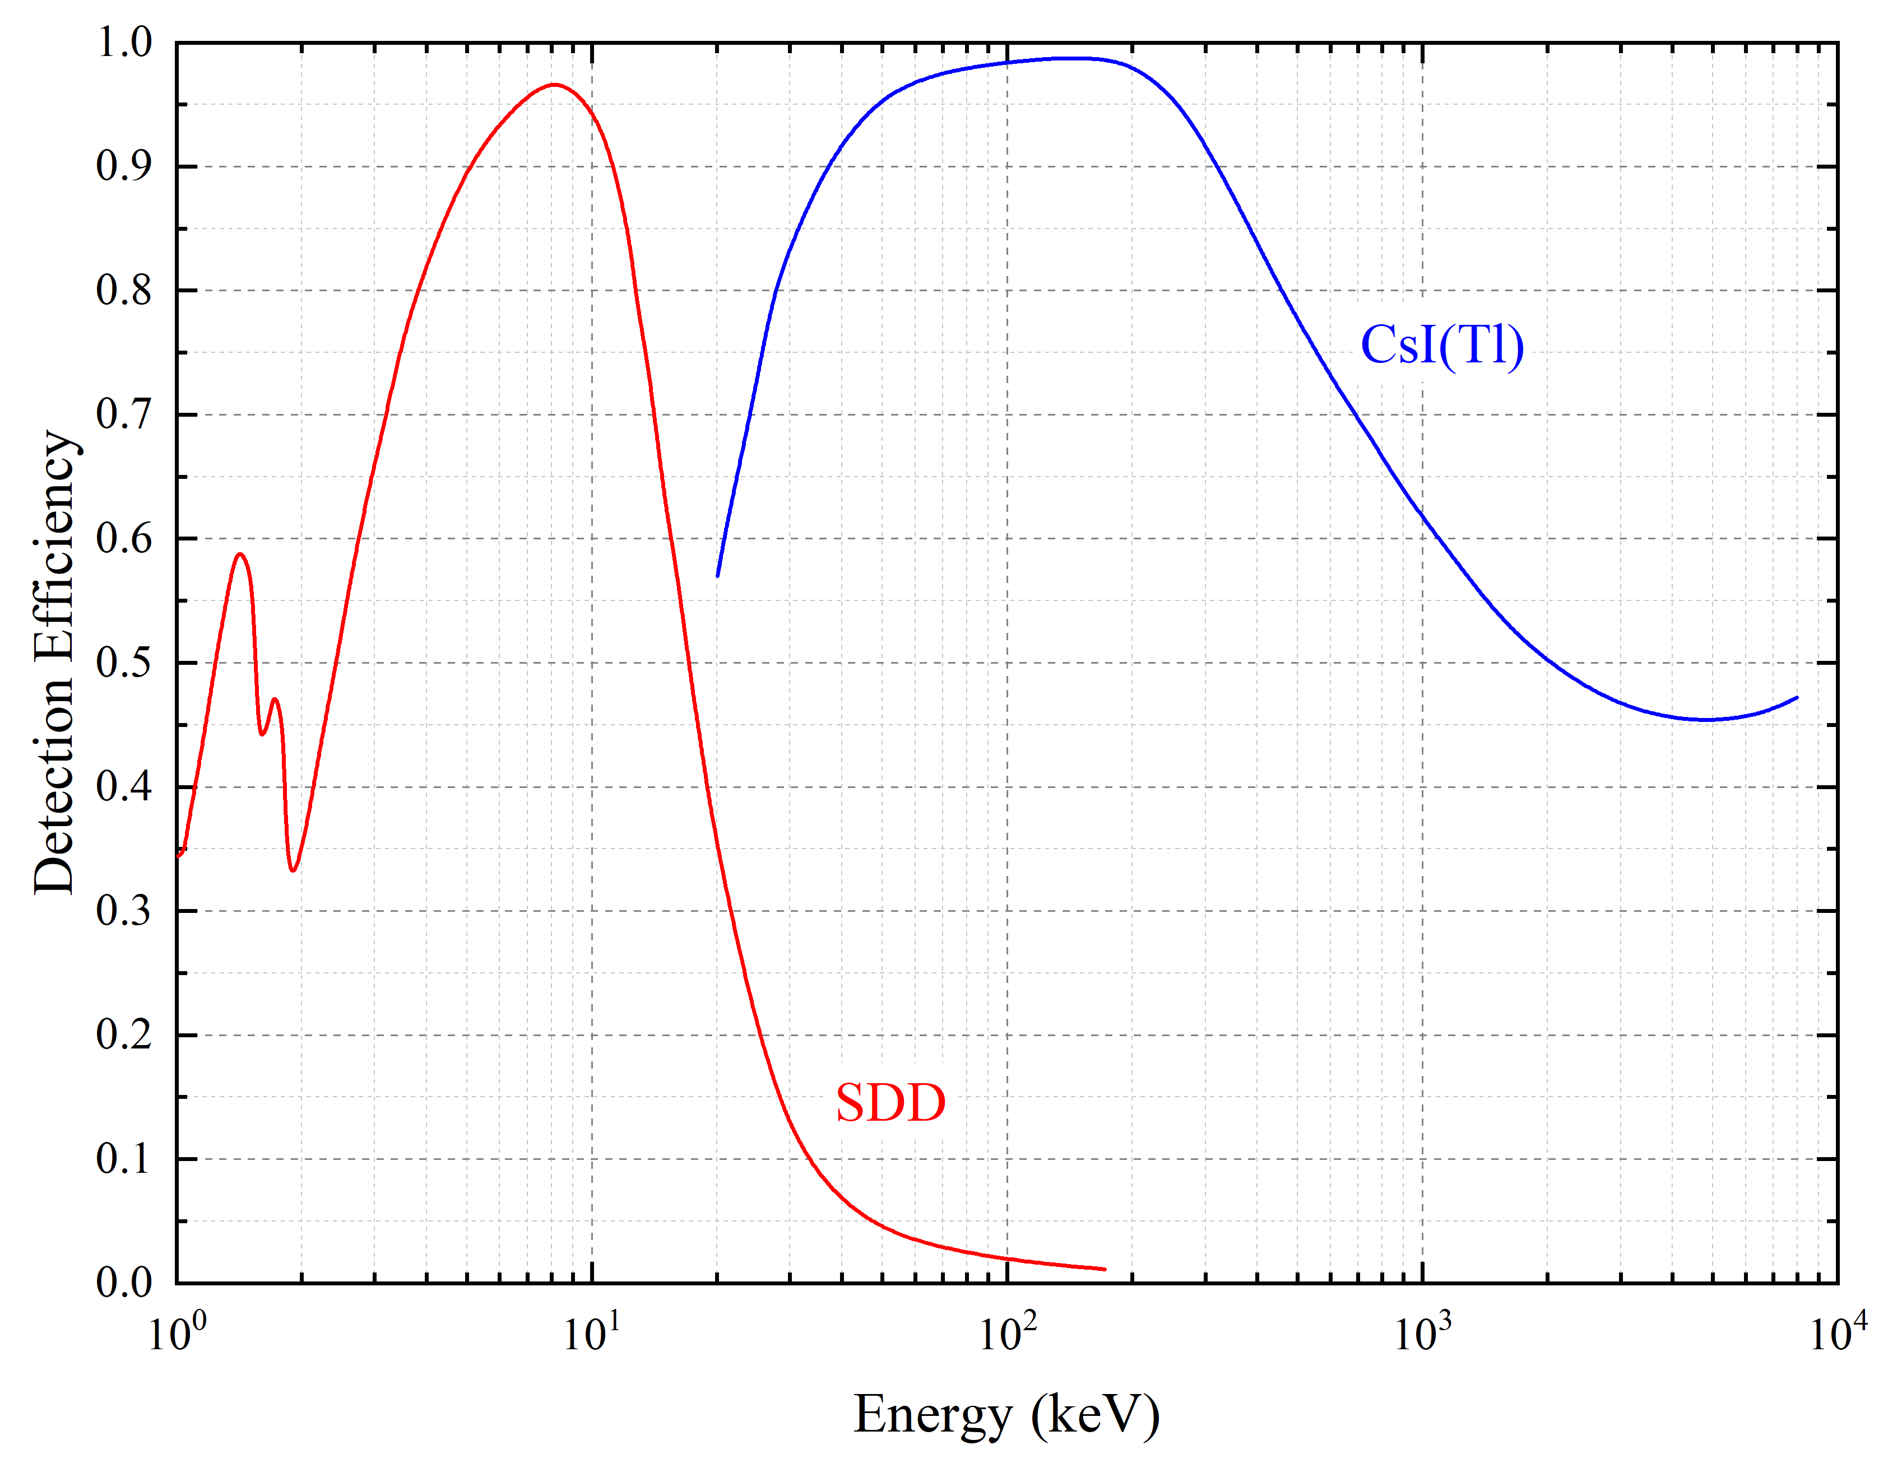
The ORION chipset - Pixel readout: double detection architecture (SiSwich)
X-Ray
ORION Front-End (Top)
SDD-Top pixel
X-Event!
ORION Back-End
Scintillator
SDD-Bottom pixel
ORION Front-End (Bot)

Slide 19
The ORION chipset - Pixel readout: double detection architecture (SiSwich)
Gamma-Ray
ORION Front-End (Top)
SDD-Top pixel
Gamma-Event!
ORION Back-End
Scintillator
SDD-Bottom pixel
ORION Front-End (Bot)
The energy and the position of interaction within the crystal can be inferred by comparing the top and bottom signals!

Slide 20
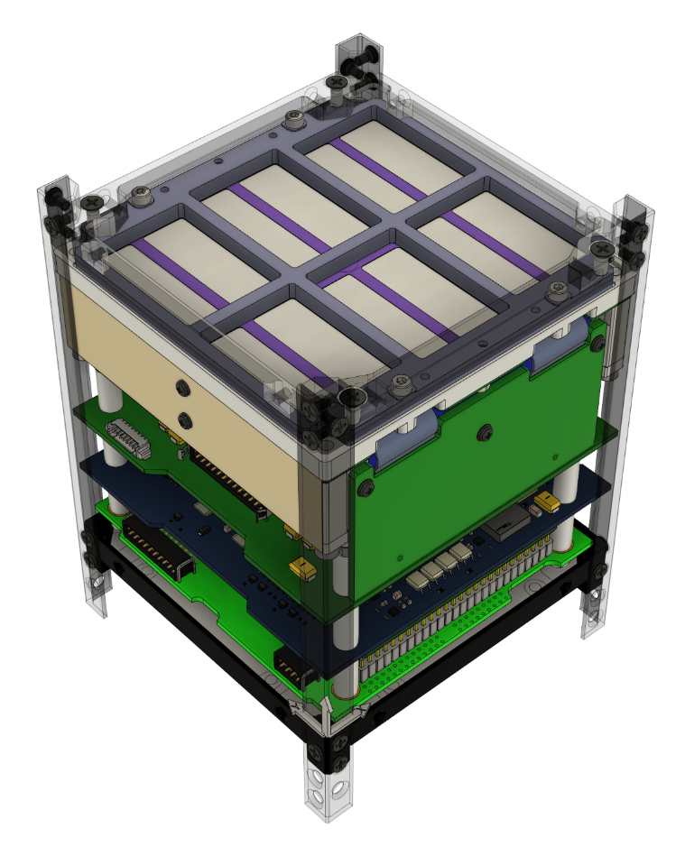
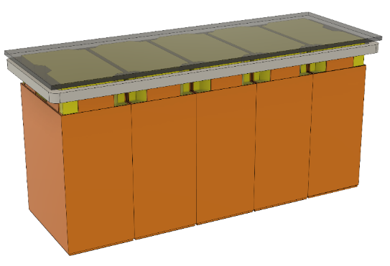
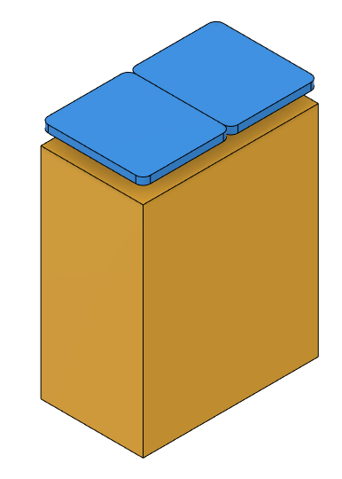
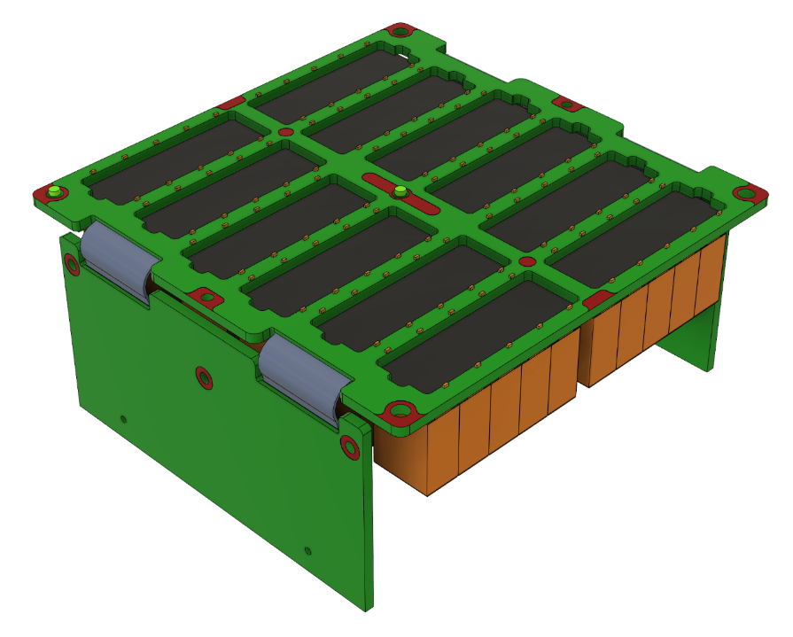
The HERMES cubesat
γ-ray
SDD pixel-1
X-ray
SDD pixel-2
GAGG Scintillator
10 cm
10 cm
We can reconstruct the gamma event when both SDD trigger, but can’t reconstruct the depth of interaction

Slide 21
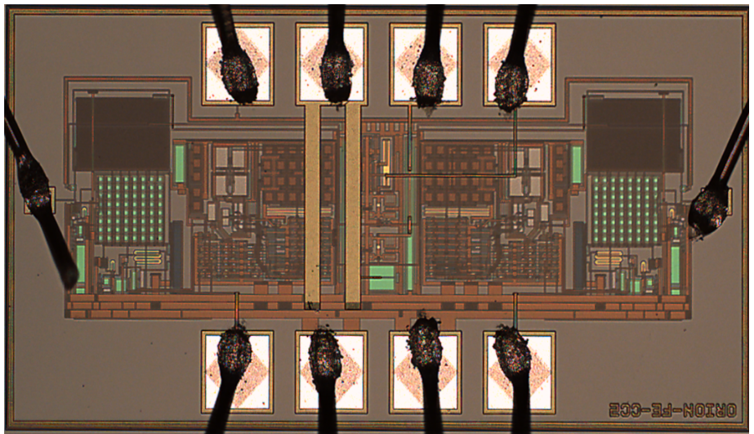
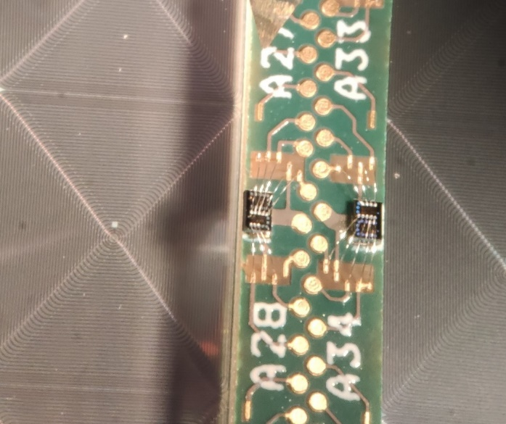
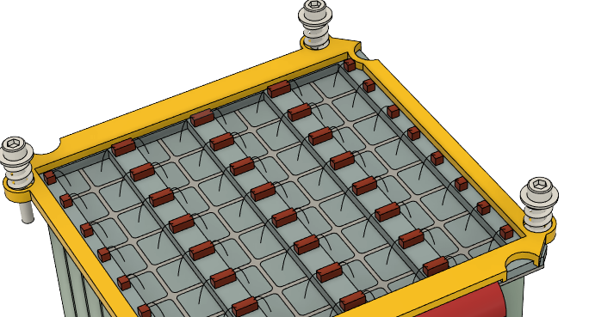
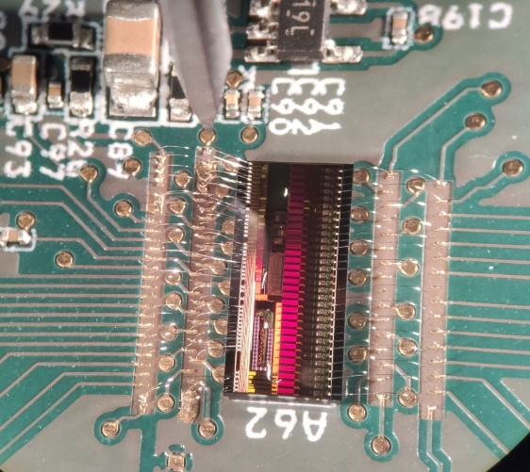
Distributed readout electronics: the ASIC “constellation”
ORION-FE micrograph
FE-1
FE-2
490 µm
990 µm
3 mm

Slide 22
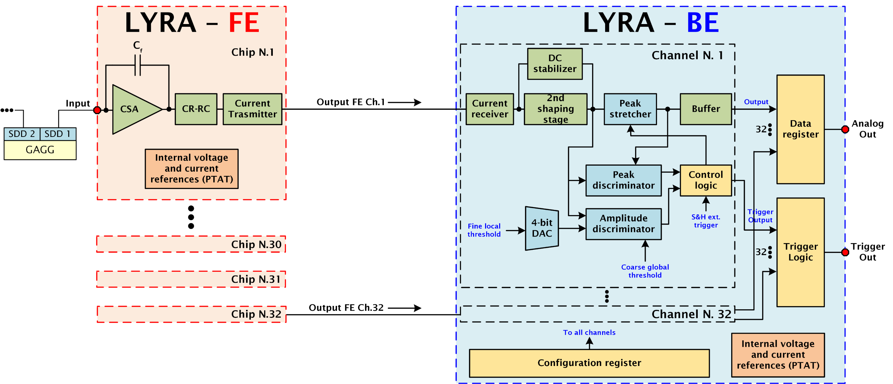
LYRA ASIC architecture
LYRA-FEs closely connected to the SDDs
LYRA-BE placed on the BE PCB

Slide 23
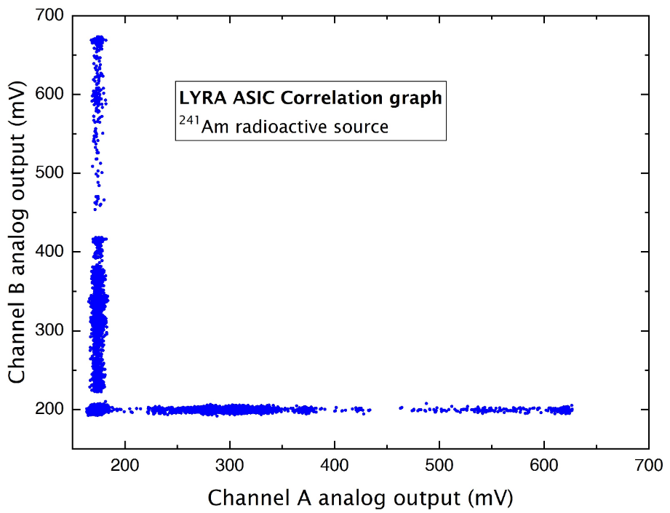
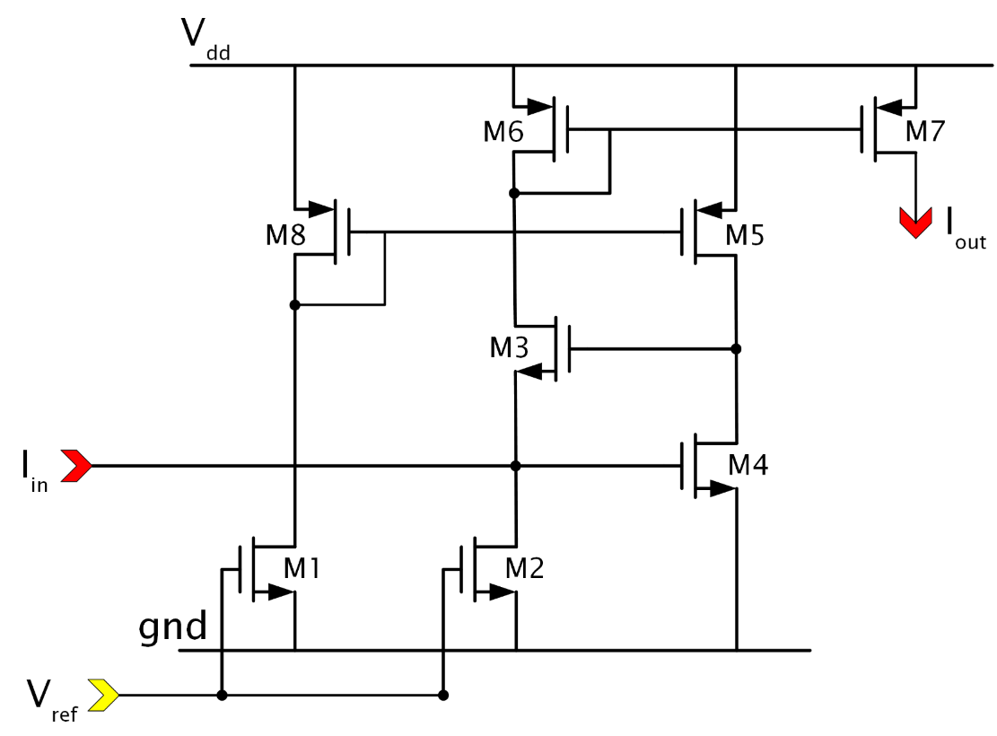
LYRA Current mode transimssion

Slide 24
The ORION ASIC architecture
ORION-FEs closely connected to the SDDs
ORION-BE placed on the BE PCB

Slide 25
The ORION ASIC architecture
High risk of charge injection toward anode bond-wires!
Current mode transmission minimizes the charge injection

Slide 26
The ORION ASIC - X ray processing
High gain output
1 us peaking time
X-Ray
No trigger on the Gamma processor

Slide 27
The ORION ASIC - Gamma ray processing
Trigger on the X-Processor is discarded
Gamma-Ray
Low Gain output
3 us shaping time (meet collection time of scintillation light)

Slide 28
Test PCB for analog characterization
SDD
2x2 SDD (Backside)
ORION-FE (dual channel)
ORION-BE
(analog only)
Design and manufacturing by
25 mm² per pixel ~80 pA/cm² anode current

Slide 29
Experimental Equivalent Noise Charge vs. Temperature
39.6 el. rms
(3.7 keV FWHM on CsI(Tl))
24.3 el. rms
(212 eV FWHM on Si)

Slide 30
XGIS Demonstration Model
Top FE-PCB
Back End-PCB
XGIS module Frame + bottom SDD (8x8)
XGIS module «deploied»
XGIS module assembled!
Bot FE-PCB
Courtesy of OHB Italy s.p.a.

Slide 31
Acknowledgments
Technological Aims:
Development of large area Silicon Drift Detectors
Development of dedicated readout electronics
Target Applications:
High-energy resolution & high-rate for soft X-ray detectors in advanced light sources
Low-power & high-energy resolution detectors for X-/Gamma-ray astrophysics

Slide 32
Other ASIC collaborations going on at SDIC-Lab
Fast, room temperature X-ray inspection systems for food safety, material recycling and control with CZT/CdTe detectors
2D high repetition-rate x-ray cameras for Linac Coherent Light Source (LCLS-II) at the Stanford Linear Accelerator Center (SLAC)
…and always open for more! Thank you!

